Slide 1
TTUHSC Webraider Portal
Office of the Registrar
phone 806-743-2300 | fax 806.743-3027 | registrar@ttuhsc.edu
www.ttuhsc.edu/registrar

Slide 2
webraider.ttuhsc.edu
Update
Phone & Address

Slide 3
HSC MYTECH Tab - Registration

Slide 4
Payment Agreement Screen
Check the box and click “I Agree” to proceed to registration

Slide 5
The School will email you the list of courses to add before registration opens, Direct any questions on Courses to your School
If you are a Dual Degree student you may need to contact the HSC Registrar’s office to update your curriculum, if you are coming from a different program. Otherwise, you will not be able to complete your registration.

Slide 6
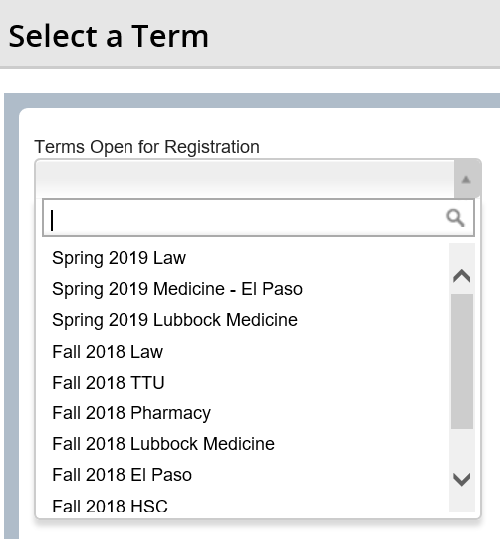
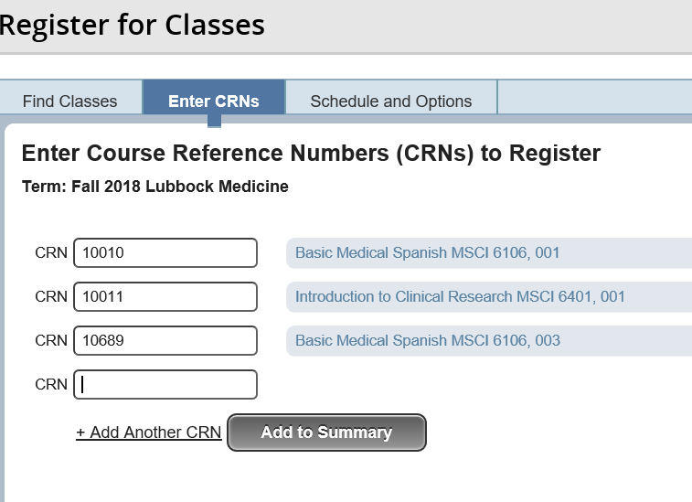
Select the Term provided by your School
Once you’ve added the Correct CRN’s you can select Add to Summary
Repeat the process if you are registering for multiple terms

Slide 7
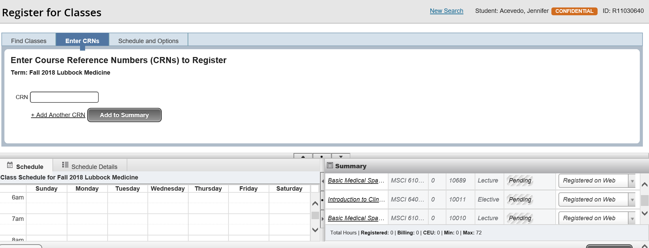
You will be able to see your registered courses here
This will reflect Pending until you click submit

Slide 8
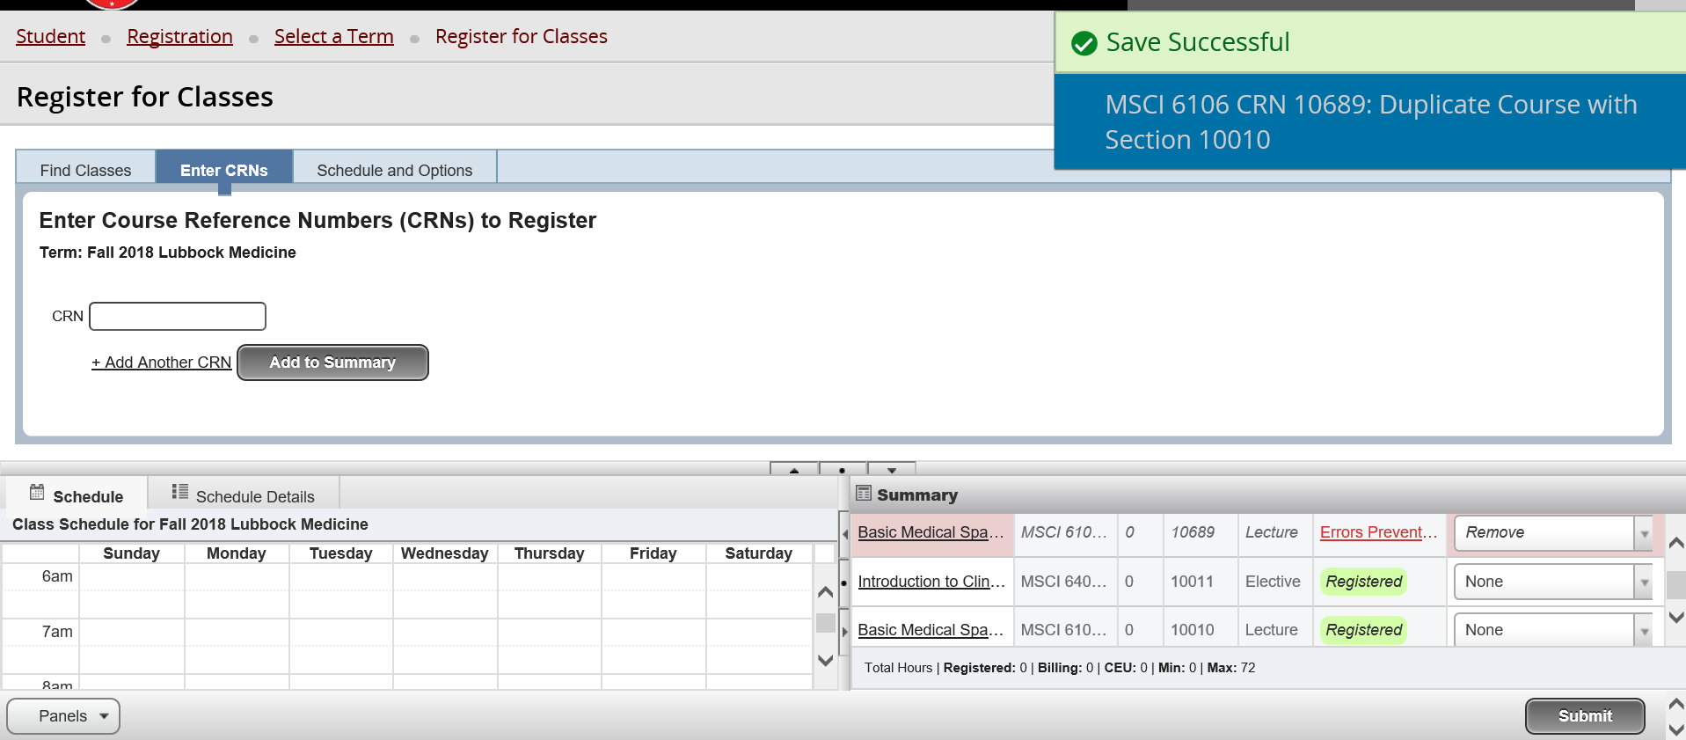
Once you click submit it will reflect “Registered”
If you receive Errors, you will need to contact the Registrar’s Office to research those errors.

Slide 9
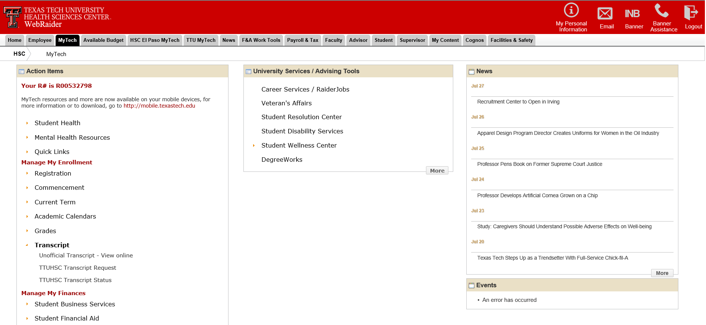
Transcript Ordering & Online Viewing

Slide 10
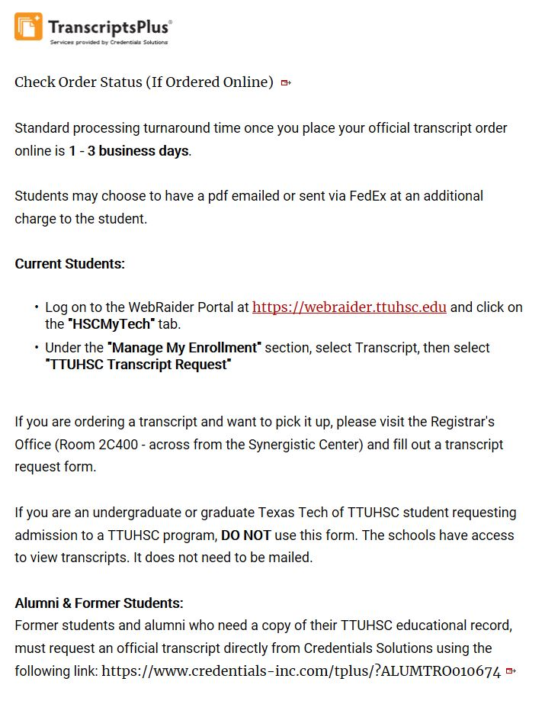
TTUHSC Transcripts are supplied through Credentials, Inc. Electronic PDF Transcripts & Expedited Shipping available for an additional fee or For Pick Up Transcripts come by 2c400 and complete a quick form and we will print while you wait! *Please note TTU also uses credentials but TTUHSC has a different link and we are only able to provide HSC Transcripts. You will need to contact TTU for their Credentials link

Slide 11
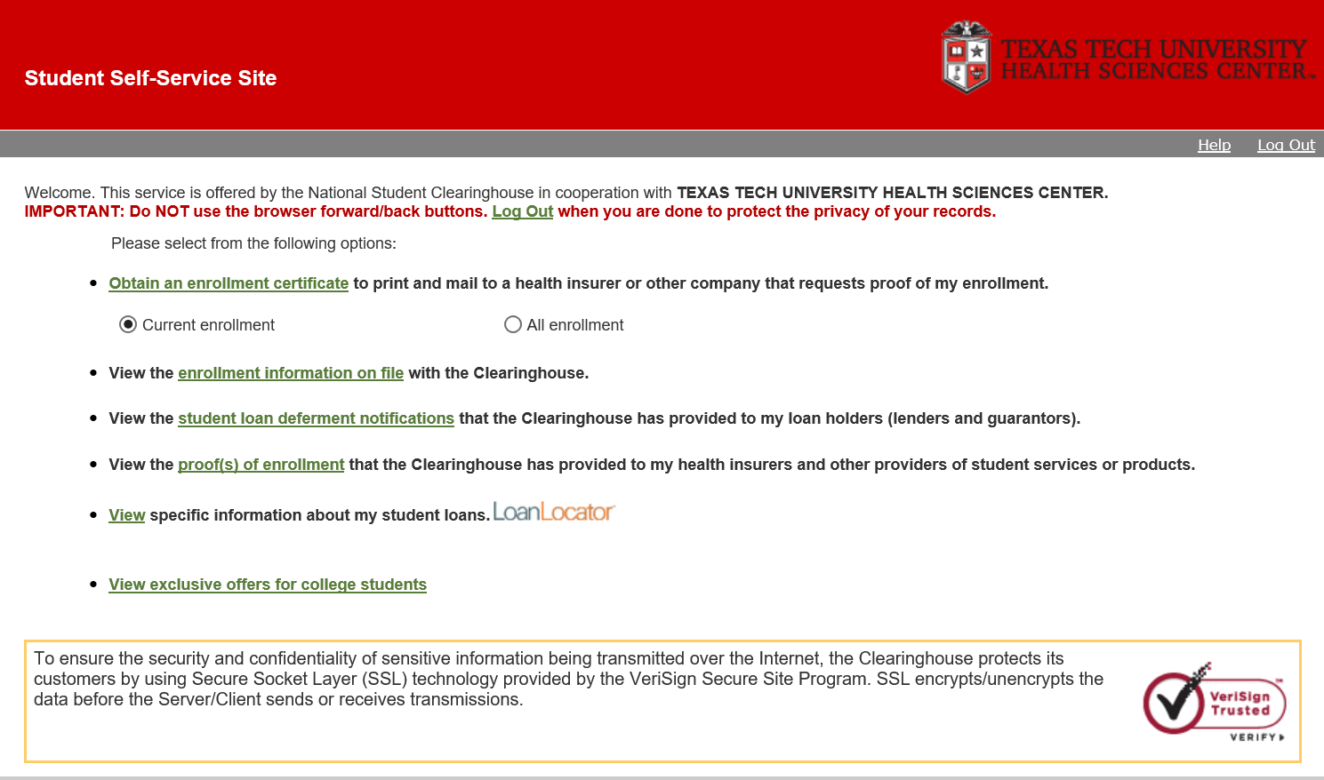
Request Enrollment Verifications Available AFTER the 12th class day of each term
You MUST click the Green link to generate your PDF Enrollment Certificate

Slide 12
FERPA Family Educational Rights and Privacy Act

Slide 13
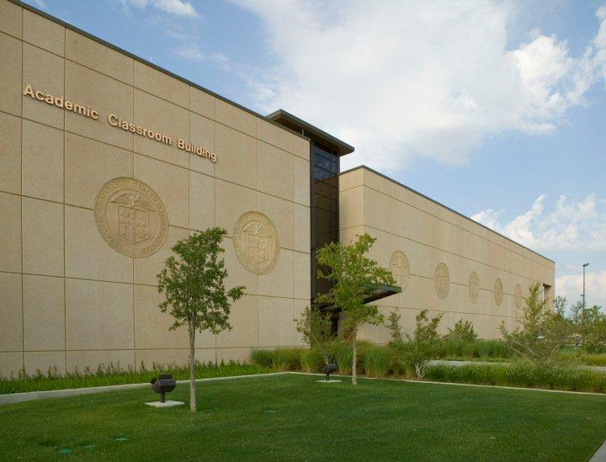
For more info please see the FERPA powerpoint presentation available on our Registrar website:
www.ttuhsc.edu/registrar

Slide 14
Directory Info is considered Public and we CAN release the following info unless you request Confidentiality
(you can update your records to reflect “Confidential” through your WebRaider Portal under My Personal Information)

Slide 15
To release Non Directory Information to a specific party, please complete a Consent form to Release your Educational records
(Available on our Registrar home page under Student Forms)

Slide 16
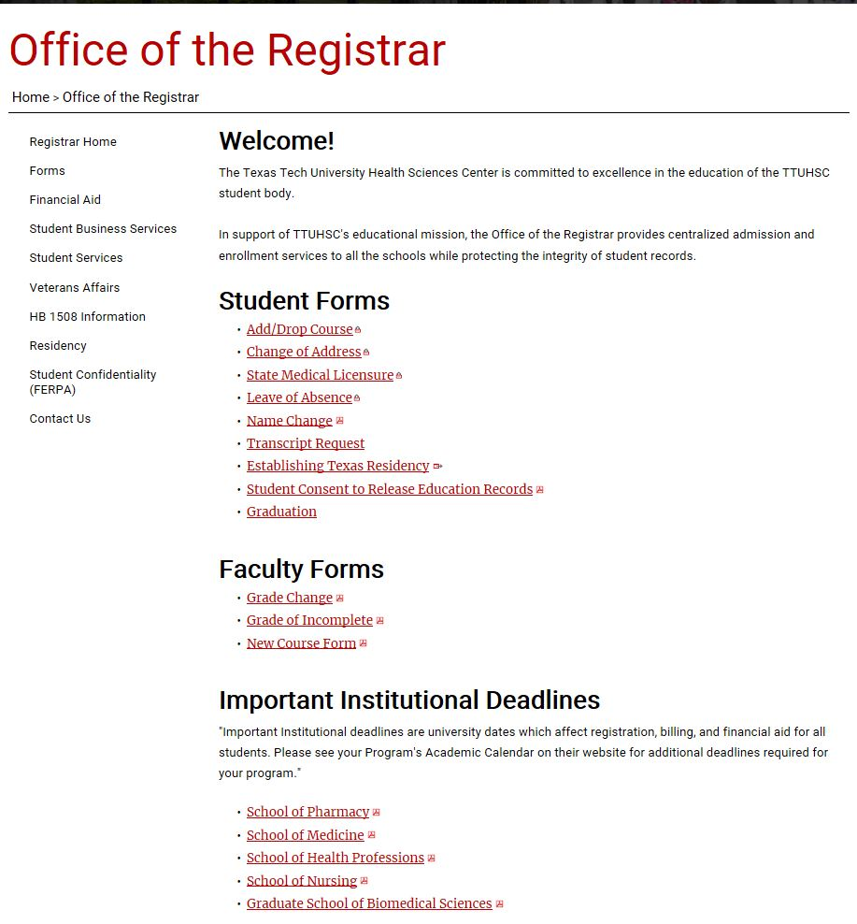
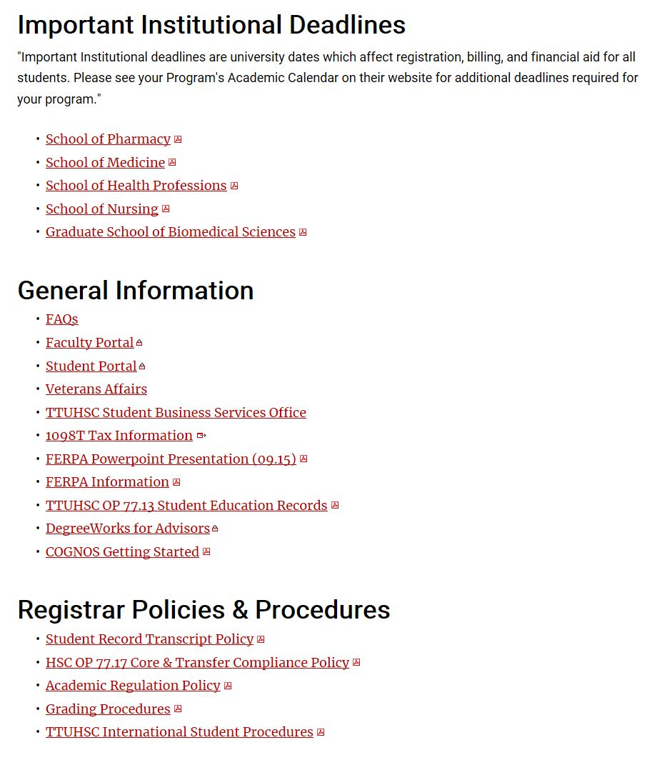
www.ttuhsc.edu/registrar

Slide 17
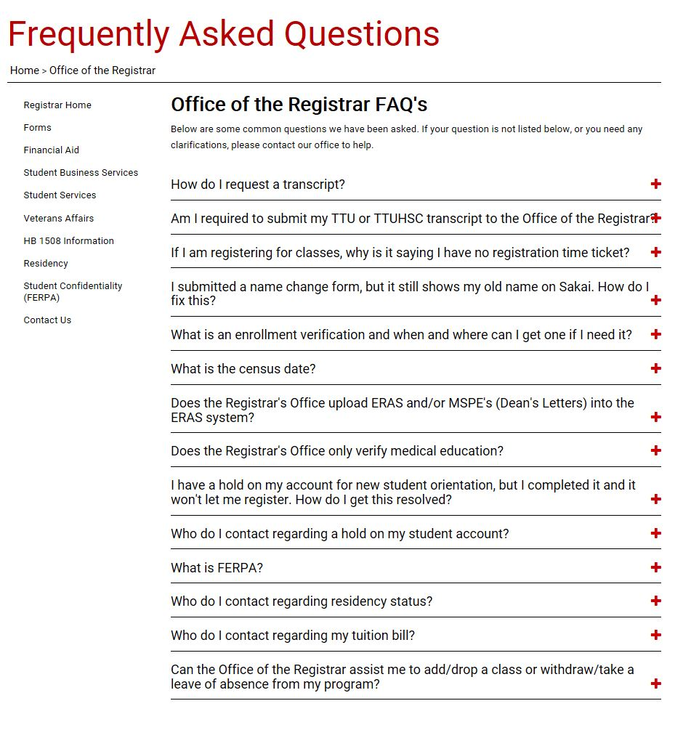
FAQ’s
If you have any questions, contact our office and we will be happy to assist.
Office hours are
Monday –Friday 8:00 am - 5:00 pm
Call us at 806-743-2300 Email us at registrar@ttuhsc.edu
Please include your R# in all correspondence

Slide 18
Office of the Registrar
3601 4th Street, MS 8310 |Lubbock, TX 79430-8310
Phone: 806-743-2300 | Fax: 806-743-3027
www.ttuhsc.edu/registrar
Located across from the Synergistic Center in the Academic Classroom Building
Room 2C400 - Student Services
Questions? Email us at registrar@ttuhsc.edu
Services Available through your Webraider Portal:
Registration Changes (Through the first class day, after that please contact your advisor)
Address & Phone Number Changes
Order Transcripts (TTUHSC transcripts only)
Enrollment Verifications (after 12th Class Day)
Contact our office for Legal Name Changes and Social Security Number Updates
When contacting us please be prepared to provide your R number or Social Security Number

