Slide 1
Getting Ready for the SACSCOC On-Site Visit
March 18-21, 2019

Slide 2
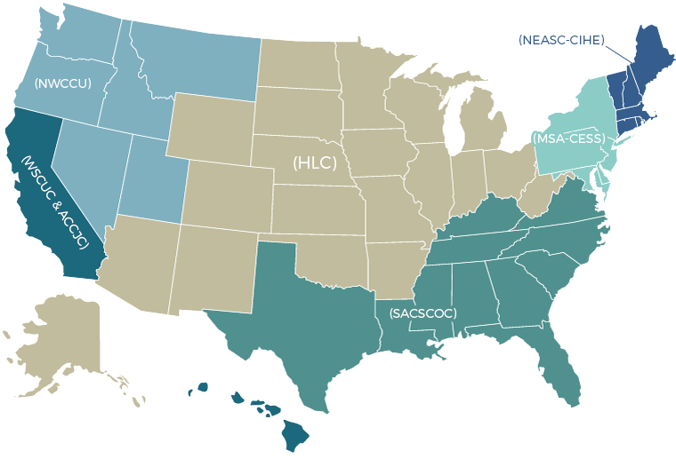
What is SACSCOC?
(Southern Association of Colleges and Schools Commission on Colleges)

Slide 3
Why is regional accreditation important?
Quality assurance
Eligibility for federal financial aid
Prerequisite for many program accrediting bodies

Slide 4
Timeline of SACSCOC Accreditation
Sept. 2018
Submission of Compliance Certification Report
2004 Separate accreditation from TTU
2015
Submission of Fifth-Year Interim Report
Feb. 2019
Submission of Focused Report/QEP
Dec. 2019
Anticipated reaffirmation of accreditation
2009
Last reaffirmation of accreditation
June 2018
Separate accreditation of TTUHSC El Paso
March 2019
On-site
Review

Slide 5
Overview of On-site Review
March 18-21, 2019
Monday, March 18: Reviewers will spend approximately two hours at each site before traveling to Lubbock to join the rest of the review team.
Tuesday, March 19: Reviewers will spend all day at the Lubbock campus.
Wednesday, March 20: Reviewers will spend all day at the Lubbock campus.
Thursday, March 21: The review team will conduct an exit interview with Chancellor Mitchell and selected leaders before leaving Lubbock.

Slide 6
Comments/Questions about SACSCOC

Slide 7

Quality Enhancement Plan (QEP)

Slide 8
What is the QEP?
The Quality Enhancement Plan (QEP) is a specific requirement of our accreditation through SACSCOC.
It is a five-year project that reflects our commitment to enhance overall institutional quality and effectiveness by focusing on an issue that TTUHSC considers important in improving student learning and/or student success across all schools and campuses.

Slide 9
Identification of the Topic
Student Satisfaction Survey
Faculty Survey
Council of Deans
Program of Assistance for Students
TTUHSC Strategic Planning Efforts
QEP Development Taskforce
Student Focus Groups

Slide 10

Well Beyond Initiative
Focus on student wellness with a specific emphasis on emotional intelligence
8 Dimensions of Wellness
  Emotional
  Environmental
  Financial
  Intellectual
  Occupational
  Physical
  Social
  Spiritual

Slide 11
Emotional Intelligence
The Mixed Model of Emotional Intelligence is based on the premise that cognitive intelligence (IQ), personality, and emotional intelligence (EQ) collectively influence how individuals think and act (Bradberry and Greaves, 2009).
PERSONAL COMPETENCE |  |  | SOCIAL COMPETENCE
SELF AWARENESS | SELF MANAGEMENT |  | SOCIAL AWARENESS | RELATIONSHIP MANAGEMENT

Slide 12
Student Learning Outcomes
Students will be able to differentiate eight dimensions of wellness and identify potential strategies to enhance wellness within each dimension.
Students will be able to distinguish the four domains of emotional intelligence and categorize the skills associated with each domain.
Students will be able to apply appropriate strategies for enhancing emotional intelligence.
Students will be able to demonstrate resilience in response to stress and/or trauma in their lives.

Slide 13
Strategies for Implementation
Online Module: Students will complete an online module that describes the eight dimensions of wellness, provides strategies for enhancing wellness, and introduces the mixed model of emotional intelligence.
Emotional Intelligence 2.0: TTUHSC faculty will incorporate Emotional Intelligence 2.0 into selected courses. This book describes strategies to increase emotional intelligence and gives students the opportunity to take the online Emotional Intelligence Appraisal®

Slide 14
Strategies for Implementation (cont.)
3. Educational Programming: Optional events presented by both external speakers and TTUHSC faculty and staff will be offered at least once per quarter. Topics will be aligned with various aspects of emotional wellness.
4. Wellness Website: TTUHSC will develop a website to focus primarily on emotional wellness, and eventually include all eight dimensions. The website will include strategies for improvement and related student resources.

Slide 15
Strategies for Implementation (cont.)
5. Internal Grants: The Well Beyond initiative seeks to support any efforts of TTUHSC schools and will award grants to support school or institutional activities that seek to promote the emotional wellness of TTUHSC students.

Slide 16
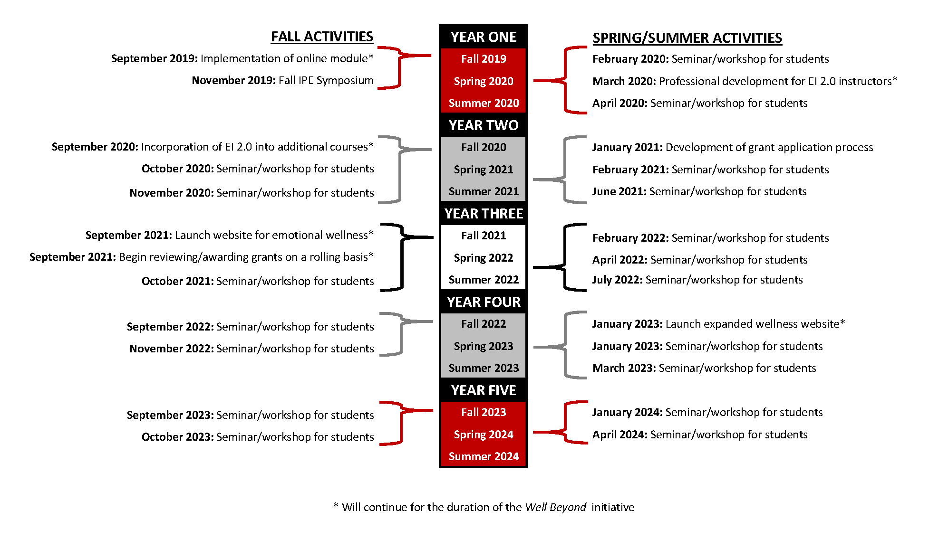
Projected Timeline

Slide 17
QEP Co-directors
Leslie Collins, JD
Senior Director, Academic Affairs
Alan Korinek, PhD
Managing Director of TTUHSC Counseling Center, Program of Assistance for Students, and Employee Assistance Program

Slide 18
Comments/Questions about QEP

