Slide 1
How to Write an Abstract for an
Award Winning
Poster Presentation
Dr. Susan Bergeson
Associate Dean, GSBS

Slide 2


Tackling Your Abstract Submission:
Student Research Week URL:
https://www.ttuhsc.edu/biomedical-sciences/student-research-week/

Slide 3


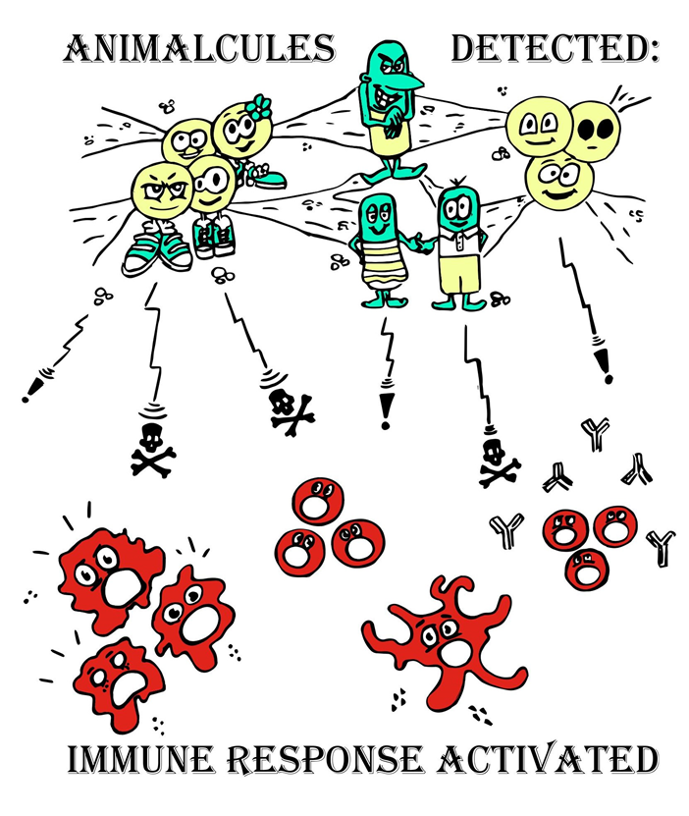
Read the Directions :
Deadlines:
2/4 and 2/18
Abstract Limitation:
2000 characters
Poster Limitation:
10 min, +2 for Qs
March 19th-22nd
https://student.ttuhsc.edu/biomedical-sciences/student-research-week/posters.aspx

Slide 4
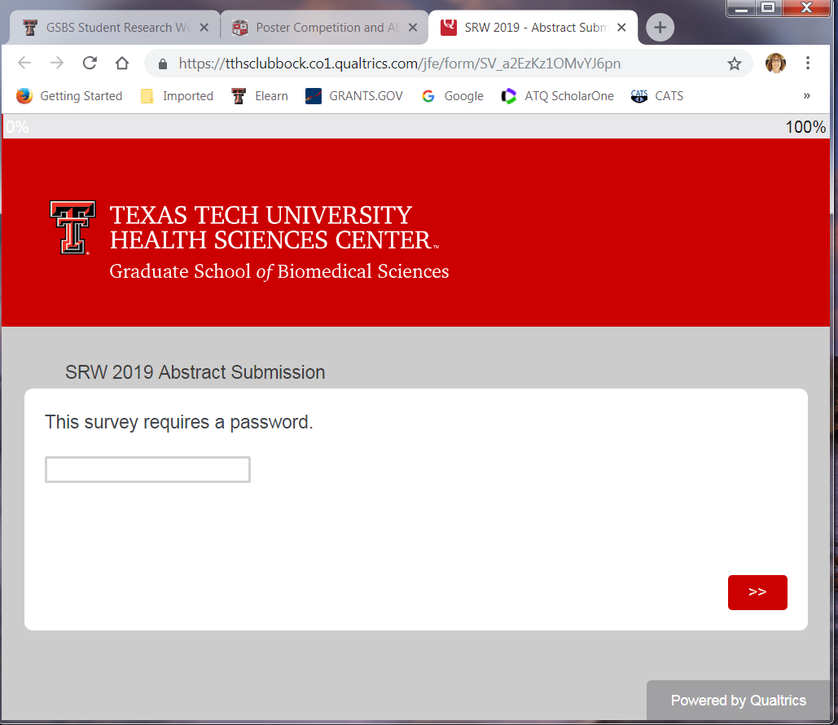
Poster Submission
SRW 2019 - Abstract Submission
  Survey Password: antibodies
For questions, please contact the SRW Committee
By submitting you agree to the aforementioned criteria.

Slide 5
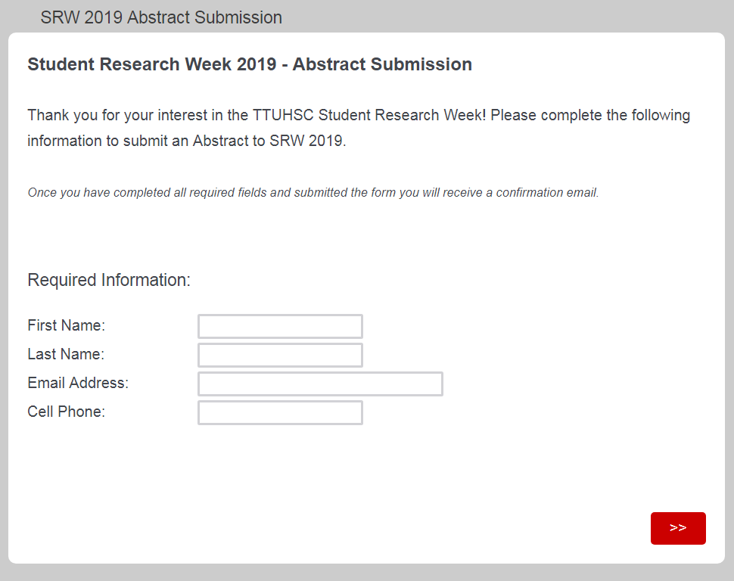
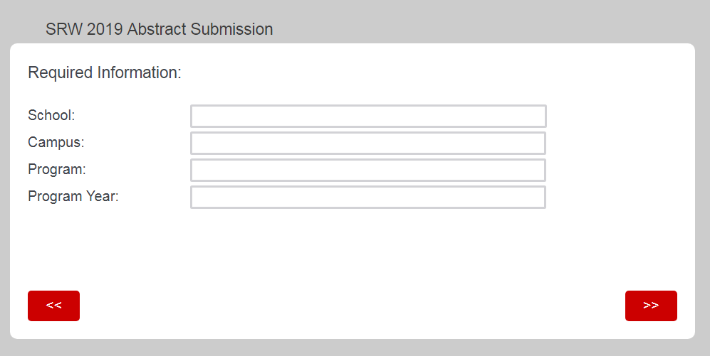
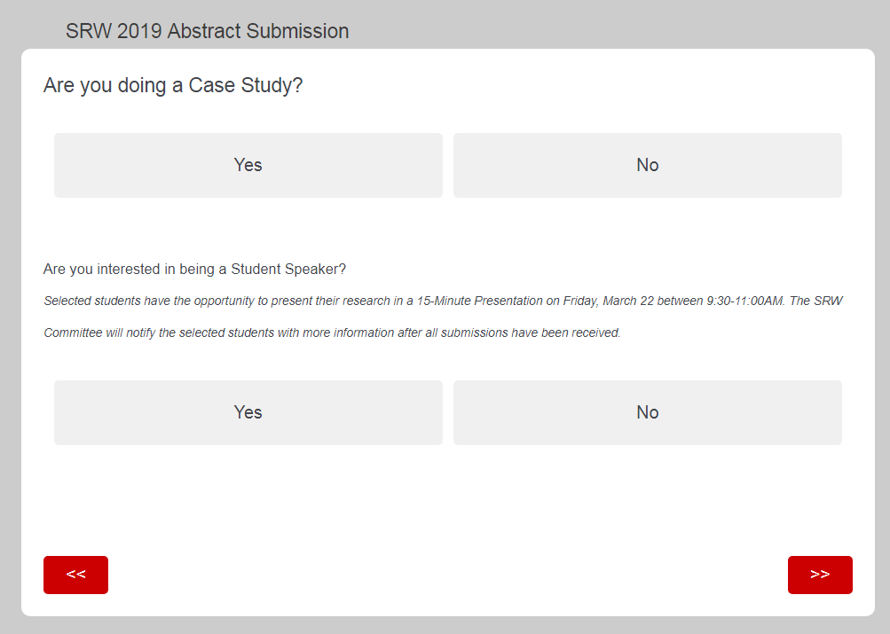
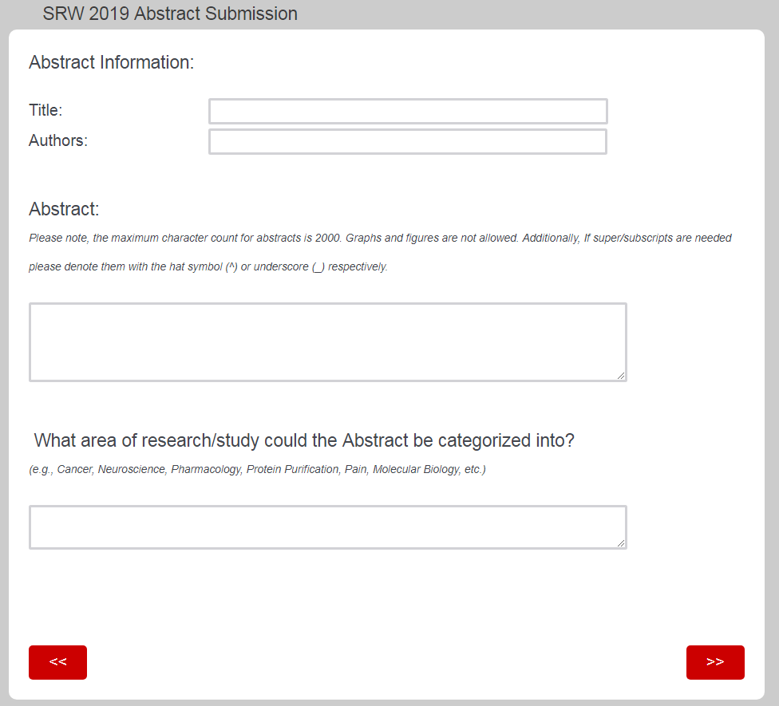

Slide 6
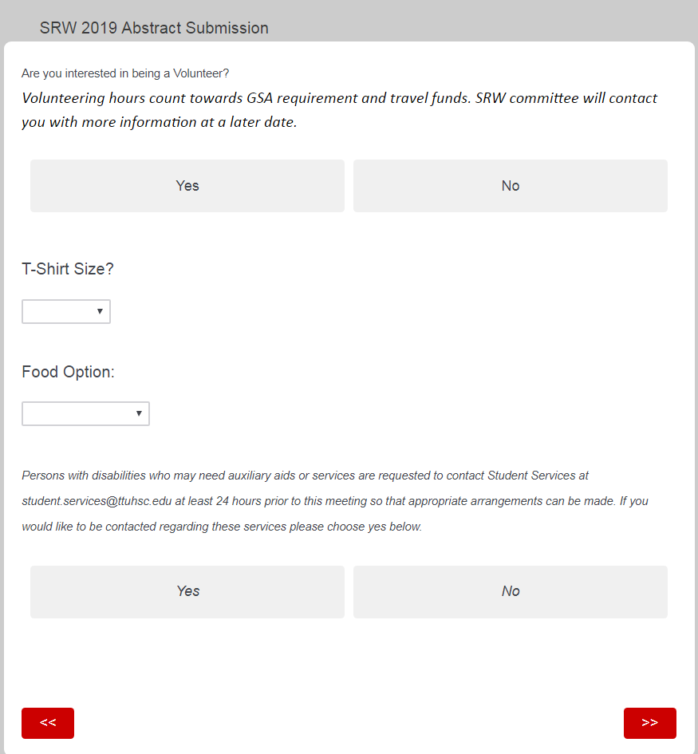

Slide 7

Who will judge you?
How will you be judged?
The judges will use criteria when reviewing posters:
  Judging Criteria for Scientific Research
  Judging Criteria for Case Presentations

Slide 8

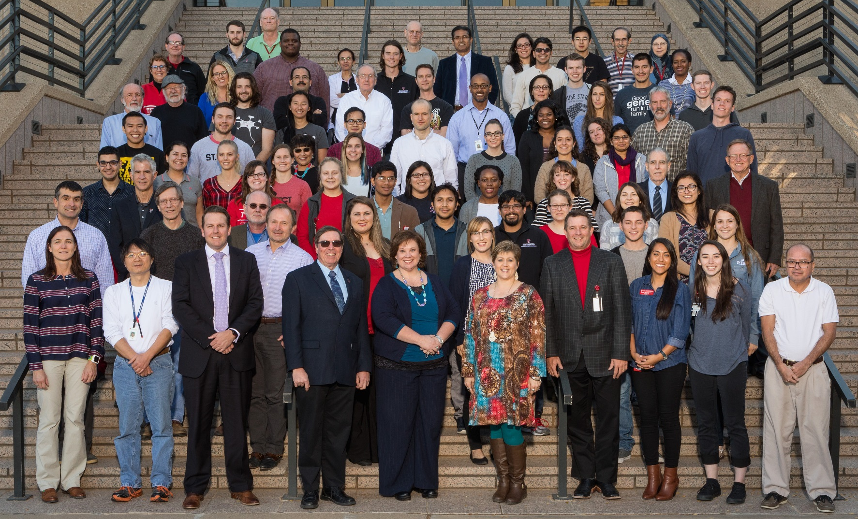
Q. Who are your reviewers and how will they judge you?
A.
Physicians and scientists who are not experts in your area.

Slide 10
Judging Criteria for Case Presentations
Significance / Introduction:
Case history is clearly defined.
Sufficient patient background and literature is presented for understanding the medical problem.
Significance of the problem under investigation and rationale for reporting the case is clearly indicated. Uniqueness of the case study is clearly explained.
Methods:
Clinical test used are clearly explained. Any unusual test performed include the laboratory's ranges of normal values.
Approach to the problem presented by this patient is appropriate. Though process of determining appropriate diagnosis, including differential diagnoses, is explained.
Results:
Patient clinical results presented are pertinent and clearly presented.
Diagnosis presented is sufficiently addressed by results/future clinical work.
Conclusions/Discussion:
Conclusions are clearly described.
Conclusions are supported by observations and literature background.
Recommended treatment and outcome of treatment are discussed (if applicable.
Directions for future investigation or management of similar cases are indicated.
Presentation / Response to Questions:
Overall style of the presentation is effective (delivery/eye contact).
Presenter uses time effectively
Presenter answers questions in an organized, concise, and accurate fashion.
Presenter offers additional insight to discussion.

Slide 11
Judging Criteria for Scientific Research
Significance / Introduction:
1. Current hypothesis is clearly defined.
2. Sufficient background is presented for understanding of the study.
3. Significance of the problem under investigation is clearly indicated.
4. Hypothesis is clearly stated.
Methods:
1. Methods utilized are clearly explained.
Experimental design is valid for question addressed. (Are there any methods that would be better utilized?)
Results:
1. Results are clearly stated.
2. Controls are addressed and appropriate.
3. Figures/tables clearly convey intended information.
4. Presented hypothesis has been sufficiently addressed by results and/or future experiments. (All needed experiments have been mentioned.)
Conclusions/Discussion:
1. Conclusions are clearly described.
2. Conclusions are supported by observations and literature background.
3. Directions for future investigation or management of similar cases are indicated/discussed.
Presentation / Response to Questions:
1. Overall style of the presentation is effective (delivery/eye contact).
2. Presenter uses time effectively
3. Presenter answers questions in an organized, concise, and accurate fashion.
4. Presenter offers additional insight to discussion.

Slide 12
Title: ~10 words describing the work (take home message)
Authors and Affiliations: use general authorship rules
Focus on the title - that might be all people read!
A positive first impression for the judges is good too….

Slide 13

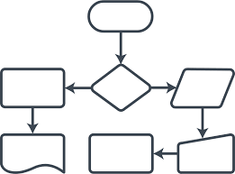
Title of Project
Author List √
Dept., Institution, City, State
Abstract
Take Home Message Graphic
Hypothesis / Case
Conclusions
1
2
3
**
Acknowledgements

Slide 14
Abstract: Write a single paragraph to your audience!
  Background
Statement of the Problem / Gap in knowledge
    What work is needed and why?
Hypothesis to be tested
    What question is being asked and how do you expect it to be answered?
Aims of the Project (may have sub-hypotheses)
Methods
Results
Conclusions and Implications
Use past tense; you usually do not include work to be done.
CASE STUDY DETAILS

Slide 15
Words of Wisdom
Identify gap in knowledge, major objectives, results and conclusions
Include minimal information needed to create understanding
and excitement
Avoid jargon specific to a given field
Set up proper expectations, which varies by field and expertise
Be clear, concise and accurate
    Omit unnecessary background
    Remove extra words and phrases
    Don’t forget the HYPOTHESIS!!!
    Abstracts from your mentor or national meeting publications can be useful in your forming a style you like
    Avoid use of non-descript pronouns (this, that, these, it…)

Slide 16
Poster Award Categories
GSBS students years 1-2 (including Biotechnology)
GSBS students years 3+
Health Professions
Medical students years 1-2, GMS and MPH
Medical students years 3-4
Residents and Clinical Fellows
School of Pharmacy and Pharmaceutical Sciences
Undergraduates (All undergraduate participants are in this category, regardless of subject)

Slide 17

“NO ONE LOOKS STUPID WHEN THEY’RE HAVING
FUN”
HAVE FUN!

