Slide 1
Managing Stress
The importance of self care and how it affects your mental health
Kristie Collins, LPC, LMFT
Associate Director for the Counseling Center @TTUHSC
Employee Assistance Program
Notes:
Question: What is self care and how does it impact your mental health?

Slide 2
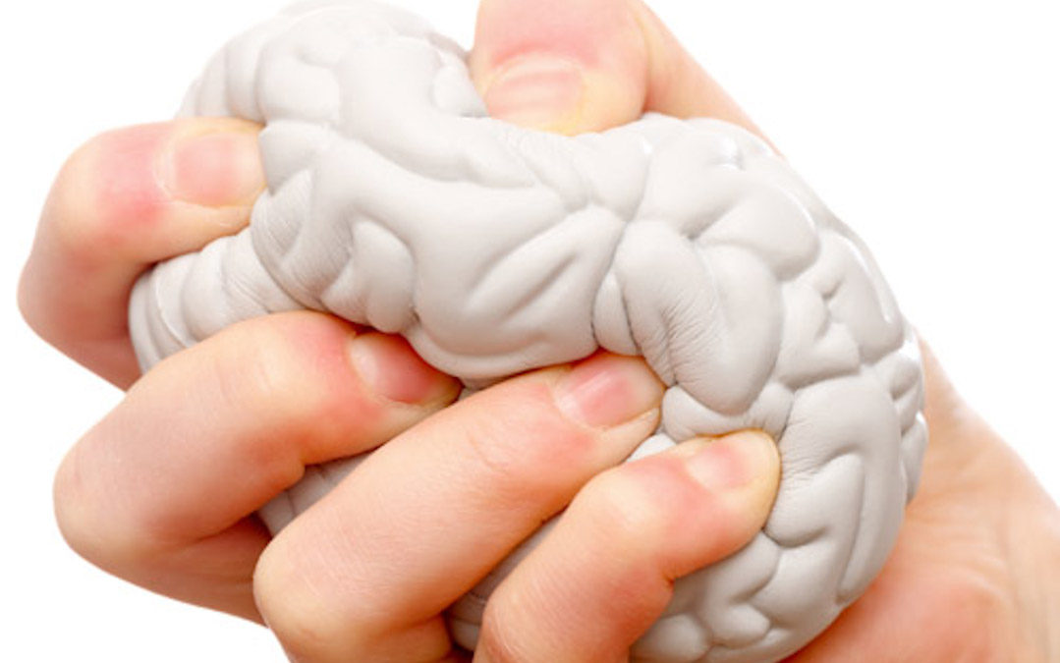
Unmanaged
Stress
Unmanaged
Anxiety
Depression
Learn to manage your stress!
It’s not simple or easy but
it is possible.
Notes:
Before we talk about self care, lets take a look at the relationship between stress, anxiety, and depression. This model looks a little like a continuum where normal stress in on one end and depression is on the other.
–Dr. Curt Thompson, a neuro-psychiatrist says depression becomes a symptom of the anxiety I can not manage.

Slide 3
Anxiety is a physiological response
Performance
Beneficial
Resource
Blessing
Harmful
Liability
Curse
Anxiety
Notes:
If we are going to learn to manage anxiety, it is helpful to understand it. Anxiety, like food, is not something you can simply get rid of. As you can see, anxiety increases performance, and so, it is needed. However, if we are performing at an optimal level, we are very close to crossing the line were it then begins to cause negative symptoms.

Slide 4
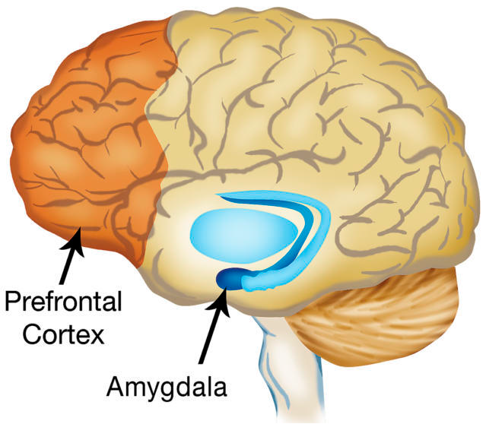
Anxiety is a physical response
Prefrontal Cortex: part of “higher” functioning, meaning it is used to:
Define
Create
Respond
Plan
Reason
Judge
Amygdala: involved in processing emotions, and fear-learning. It links areas of the prefrontal cortex to the brainstem systems.
Smoke detector
Fight/Flight or Freeze response
Thalmus
Notes:
Higher brain/lower brain, human/animal, rider/horse
When faced with a threatening situation, our thalamus, which receives incoming stimuli, sends signals to both the amygdala and the cortex.
If the amygdala senses danger, it makes a split second decision and begins the fight-or-flight response before the cortex has time to overrule it.
This cascade of events triggers the release of adrenaline (epinephrine), which leads to increased heart rate, blood pressure, and breathing. You may experience a racing heart, shaking, sweating, and nausea as this happens.
In this way, the amygdala triggers a sudden and intense unconscious emotional response that shuts off the cortex, making it hard for you to think clearly about the situation. As your brain triggers the release of stress hormones such as cortisol, you find it increasingly hard to problem solve and concentrate. This whole process takes a toll, and you may not recover to your original level of functioning for several hours.

Slide 5

Notes:
The amygdala is very similar to mall cop, Paul Blart and his response in this scene.

Slide 6
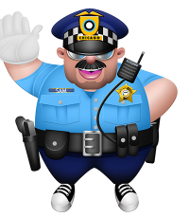
Amygdala acts as our smoke alarm
Search
Alert
Mobilize
Notes:
Analogy: smoke detector in the home I grew up in going off every time my mother cooked
The term "amygdala hijack" was coined by psychologist Daniel Goleman in his 1995 book, Emotional Intelligence: Why It Can Matter More Than IQ. Goleman used the term to recognize that although we have evolved as humans, we retain an ancient structure in our brain that is designed to respond swiftly to a threat. While at one time this was designed to protect us, it can interfere with our functioning in the modern world where threats are often more subtle in nature.

Slide 7
Notes:
We can not change life events. However, we can work to widen our window of tolerance.

Slide 8
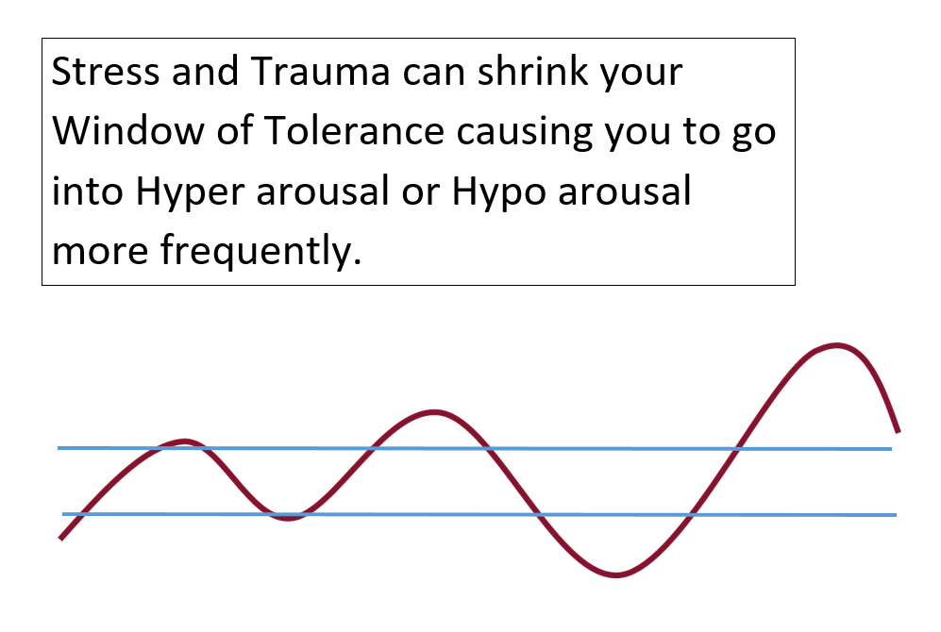

Slide 9
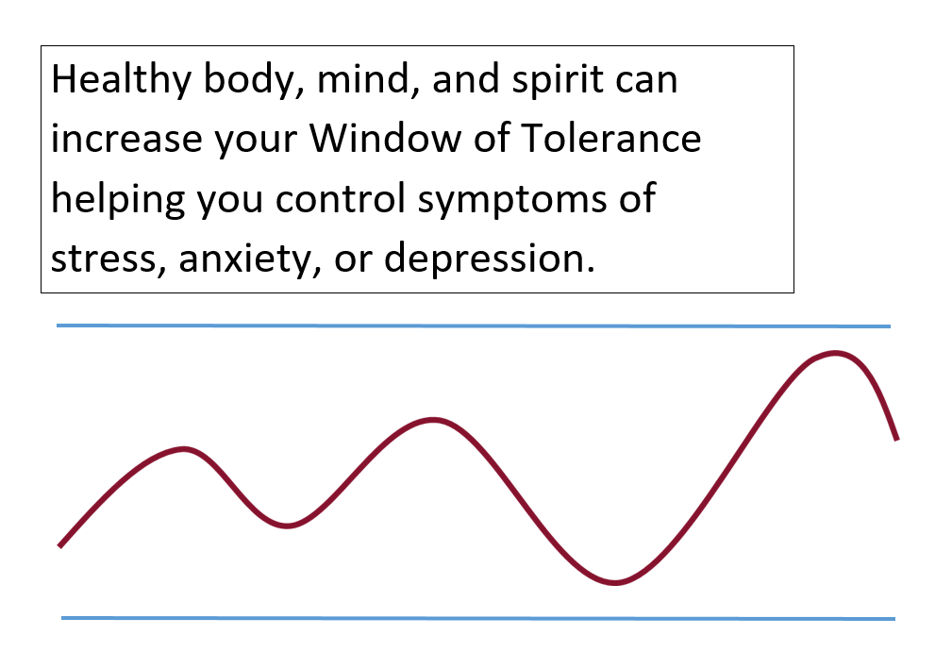

Slide 10
https://www.ttuhsc.edu/centers-institutes/counseling/resouces.aspx
Self
talk
Self
care
Aerobic exercise
Positive, Negative, Neutral
The inner dialogue we have going in our head every waking moment
Proper sleep
Mindfulness practices
Connected relationships
Humor
Gratitude
Talk to yourself the way you talk to someone you love
Spiritual practices and disciplines
What you tell yourself becomes your reality
Intentionality
Notes:
These are the things we can focus on to widen our window of tolerance.

Slide 11

Conscious vs. subconscious Mind
Conscious Mind - 5 to 7 thoughts every second
Subconscious Mind – 2 million bits of info every second
Problem: Much of our negative thinking happens in the subconscious mind while we are unaware
Notes:
An explanation of why self talk gets out of control so easily.

Slide 12
Anxiety-Igniting Thought | Coping Thoughts
It's no use trying. Things will never work out for me. | I'm going to try, because then there's at least a chance that I'll accomplish something.
Something's going to go wrong. I can feel it. | I don't know what's going to happen. These kinds of feelings have been wrong before.
I need to focus on this thought, doubt, or concern. | Cortex, you've spent too much time on this and need to move on.
I must be competent and excel at everything I do. | No one is perfect, I'm human and expect I'll make mistakes at times.
Everyone should like me. | No one is liked by everyone, so I'll encounter people who don't like me.
Notes:
Here are a few examples of anxiety-igniting thoughts vs. coping thoughts.

Slide 13




Mindfulness
Definition of mindfulness: maintaining a moment-by-moment awareness of our thoughts, feelings, bodily sensations, and surrounding environment.
Tip: Pay attention to what you pay attention to!
Resources:
Moodfit
Notes:
Anxiety is caused by the past and all the things we can’t change and the future and all the things we can not predict or control.
Mindfulness is being in the here and now which is much less stressful.

Slide 14
You can learn to manage anxiety
We have to take personal responsibility for the way we think, speak, and act. We need to stop being victims of our biology, of what happens to us and start being victors. -Dr. Caroline Leaf

Slide 15
Books
Switch on Your Brain by Caroline Leaf
Rewire Your Anxious Brain by Pittman and Karle
Get Out of Your Head by Jennie Allen

Slide 16
Video Resources
The Mind Explained: Anxiety and Mindfulness on Netflex https://www.netflix.com/title/81098586
90:10 The Single Most Important Thing You Can Do For Your Stress https://youtu.be/I6402QJp52M

Slide 17
What is Available Through the Counseling Center?
Counseling Sessions (individual, couple, family)
  6/8 (depending on contract) free sessions per employee per fiscal year
  Assessment, treatment and/or referral for a broad range of presenting problem
  Daytime Hours - Monday thru Friday
  Evening Hours - Monday thru Thursday
24-hour Crisis Line
*Due to the COVID-19 virus, The Counseling Center at TTUHSC is moving to telehealth counseling, using a HIPPA-compliant Zoom platform.

Slide 18
Location and Contact Information
Location of the Counseling Center at TTUHSC
  RM 1A300
    Off 4th Street, between Indiana Ave and Texas Tech Parkway
  See our website for directions
Numbers to Call for an Appointment
  743-1327 or 1-800-327-0328
  Call the Counseling Center directly; no referral is needed
  www.ttuhsc.edu/counseling

