Slide 2
Financial Aid For Future Health Care Providers
How Can I Pay for School?
Nikki Sosa
Student Financial Aid

Slide 3
How Much Will it Cost?
Estimated Financial Aid Student Budgets – “Sticker Shock”
 | 1st yr (10 mo) | 1st yr (9 mo) | 1st yr (9 mo) | 1st yr (9 mo) | 1st yr (12 mo) | 1st yr (9 mo)
 | Medicine | Pharmacy | Trad. UG Nurs | Undergrad HP | Grad HP | GSBS/MPH
Tuition | 15,616 | 13,794 | 6,400 | 5,600 | 10,000 | 3,042
Fees | 3,192 | 2,768 | 4,666 | 2,244 | 2,826 | 3,206
Bks/Supplies | 1,800 | 1,900 | 1,600 | 1,400 | 2,000 | 900
Housing/food | 15,000 | 12,798 | 10,400 | 11,050 | 17,065 | 12,088
Transportation | 5,000 | 4,500 | 4,000 | 4,250 | 6,000 | 4,250
Personal/Misc. | 6,000 | 7,146 | 6,352 | 6,750 | 9,529 | 6,750
Est. Total Budget | 46,608 | 42,906 | 33,418 | 31,294 | 47,420 | 29,336

Slide 4
How Much Will it Cost?
Estimated total for the entire programs:
Program | Total Estimated Cost | 17-18 Average Student Loan Debt
Medicine – 4 years | $199,852 | $150,266
Pharmacy – 4 years | $185,423 | $120,498
Trad. UG Nursing – 2 years (1 year for RN to BSN and Accelerated Nursing programs) | $66,522 | $9,842 to $25,392
Grad Nursing – 2 to 4 years depending on pace | $118,392 (3 years) | $47,474
UG Health Professions – 2 years | $72,210 | $19,041
Grad Health Professions – 2 to 3 years depending on program | $132,432 (3 years) | $57,113 to $90,983
GSBS/MPH – 2 to 6 years depending on program | $82,161 (3 years) | $38,654

Slide 5
Cost of Attendance Federal Regulations
Items that may be covered by financial aid
Tuition & fees
Books & supplies (including lab equipment)
Computer (budget adjustment form and proof of expense required; may only be submitted once)
Housing & food (rent, utilities, groceries)
Transportation (car insurance, maintenance, gas)
Personal/Miscellaneous
Health insurance, medical & dental expenses, clothing, cleaning, entertainment, etc.
Transportation costs for residency interviews (Med/Pharm)
State professional license exam (only if incurred during final year of study)

Slide 6
Cost of Attendance Federal Regulations – Continued
Items that Cannot be included in the financial aid budget
Automobile payments
Consumer debt (credit cards, loan payments, etc.)
Review courses
Spouse’s expenses (such as medical expenses or insurance)

Slide 7
How Do I Pay For School?
Savings – live frugally now and while in school
Family – use cash gifts from family and friends for school costs
Scholarships – School, outside organizations,
web searches
Financial aid – Apply every year. Financial
aid awards vary from grants, scholarships
to student loans

Slide 8
What Is Financial Aid?
Financial aid is defined as assistance to pay for your cost of attendance. Any assistance is considered “financial aid” regardless of the source. These sources include:
Grants – Funds from federal and state sources that do not require repayment
Scholarships – State, institutional, organizational funds that do not require repayment
Loan Programs – Funds that must be repaid. May consist of federal and private loans
Federal Direct Loans - Subsidized, Unsubsidized, Parent Plus, & Graduate Plus
State Loan – College Access Loan, Be-On-Time Loan
Veteran’s Benefits – Such as Hazelwood, GI Bill and Ch. 33 benefits.
Contact the TTUHSC VA Coordinator at 806-743-7549

Slide 9
How Do I Apply For Financial Aid
Complete a Free Application for Federal Student Aid (FAFSA) for the appropriate aid year. For example, the 19-20 FAFSA would be used if you would be attending TTUHSC summer 2019, fall 2019 and/or spring 2020.
Go to https://fafsa.ed.gov. TTUHSC FAFSA school code is 016024
You will need:
Household Size/Number in College
Income & Tax Information
Parent Information
Until student is 24 years old, married, has a dependent, or is in a graduate program

Slide 10
Why Should I Use The FAFSA?
FAFSA application is used to determine federal and state grant eligibility
Institutional scholarship applications require a completed FAFSA on file
Access to federal and state loan programs, that offer certain benefits
Fixed interest rate
Payment deferment and grace period
Flexible repayment options
Federal Loan Consolidation
Public Service Loan Forgiveness Program for federal loans
Disability and death benefits – loan cancellation

Slide 11
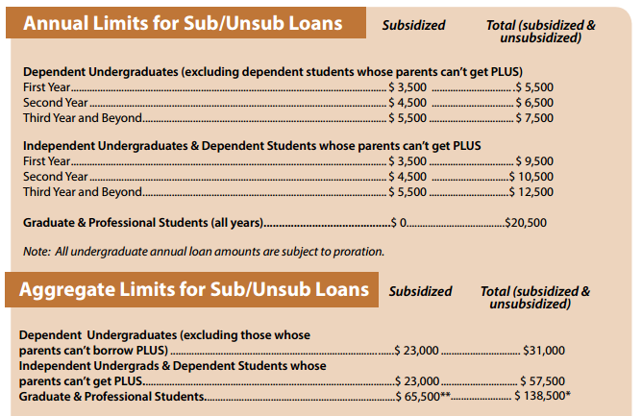
Federal Grant & Loan Limits
Pell Grant Awards for 19-20 – The maximum Pell Grant award is $6195. (Only for eligible undergraduates)
Undergraduate and Graduate Nursing, Health Professions, and GSBS/MPH Loan Limits:

Slide 12
Financial Aid Annual Process
October 1st of each year; new year’s FAFSA becomes available
Student completes Free Application for Federal Student Aid (FAFSA) https://fafsa.ed.gov
TTUHSC receives FAFSA data from the Federal processor electronically.
March: TTUHSC begins sending missing information emails to the student if additional documents are needed. Student returns those necessary documents to complete the financial aid file.
May: TTUHSC emails award notice to the student. The award offer outlines the programs and funding the student is eligible to receive for the school year.
Student completes the Federal Direct Loan Application process for the year. (only for students borrowing Federal Direct Loans).
Student completes Grad Plus/Alternative loan application (only for students borrowing one of these loans)
10 days prior to the start of each semester:
SBS Tuition Due date—ONLY for students not receiving Financial Aid
10 days prior to the start of each semester:
Federal Direct Loan processing service electronically sends loan funds to the school
Financial aid funds (loans, grants, & scholarships) are posted towards student’s tuition accounts
The week before the start of each semester:
TTUHSC SBS Office sends any refunds to student based on student’s refund preference.

Slide 13
Student Business Services
Please contact Student Business Services (SBS) at (806) 743-7867 for questions regarding:
Tuition and fee information, tuition payment options, and payment plans
How refunds are processed or how to set up direct deposit information
How to submit 3rd party payments, such as Texas Tomorrow Fund

Slide 14
Other Types of Financial Assistance
Armed Forces
Air Force
www.airforce.com/education/ongoing-education
Army
www.goarmy.com/amedd/hpsp.jsp
Navy
www.navy.com/careers/healthcare/physicians
Rural Health
National Health Service Corps
https://.nhsc.hrsa.gov/scholarships/index.html
Rural Health Information Hub
www.ruralhealthinfo.org/funding

Slide 15
Web Resources
TTUHSC Financial Aid www.ttuhsc.edu/financial-aid
US Department of Education www.studentaid.ed.gov
Federal Student Aid www.studentloans.gov
FinAid-Student Guide to Financial Aid
www.finaid.org
National Student Nurses’ Association www.nsna.org
National Student Loan Data System
www.nslds.ed.gov
American Association of Colleges of Pharmacy www.aacp.org
National Association of Advisors for the Health Professions, Inc. www.naahp.org
Association of American Medical Colleges www.aamc.org
FastWeb Scholarship Search www.fastweb.com
American Public Health Association www.apha.org
CollegeBoard www.collegeboard.org
Texas Financial Aid Information www.collegeforalltexans.com
APhA Academy of Student Pharmacists www.pharmacist.com/apha-asp

Slide 16
Financial Aid Questions
TTUHSC Financial Aid Office
3601 4th Street, MS 8310
Lubbock, TX 79430
806.743.3025
website:
www.ttuhsc.edu/financial-aid
Email:
financial.aid@ttuhsc.edu

Slide 17
Thank you

