Slide 1


Slide 2
Financial Aid For Future School of Medicine Students
How Can I Pay for a Health Professions Degree?
Mia Myers
Student Financial Aid

Slide 3

How Much Will it Cost?
Estimated Financial Aid Student Budgets – “Sticker Shock”
 | 1st yr (10 mo) | 1st yr (9 mo) | 1st yr (12 mo) | 1st yr (9 mo) | 1st yr (12 mo) | 1st yr (12mo)
 | Medicine | Pharmacy | Trad. UG Nurs | Undergrad HP | Grad HP | GSBS/MPH
Tuition | 17,700 | 14,820 | 10,560 | 7,680 | 9,180 | 5,064
Fees | 4,376 | 4,348 | 8,862 | 3,710 | 4,087 | 3,070
Bks/Supplies | 1,734 | 1,900 | 2,400 | 1,800 | 1,700 | 1,200
Housing/food | 14,220 | 12,798 | 17,064 | 14,789 | 17,064 | 17,064
Transportation | 5,000 | 4,500 | 6,000 | 5,200 | 6,000 | 6,000
Personal/Misc. | 8,500 | 7,650 | 10,201 | 8,841 | 10,201 | 10,201
Est. Total Budget | 51,530 | 46,016 | 55,087 | 42,020 | 48,232 | 42,599

Slide 4
How Much Will it Cost?
Estimated total for the entire programs:
Program | Total Estimated Cost | 21-22 Average Student Loan Debt
Medicine – 4 years | $193,702 | $108,878
Pharmacy – 4 years | $185,567 | $107,503
Trad. UG Nursing – 2 years (1 year for RN to BSN and Accelerated Nursing programs) | $66,906 | $9,415 to $18,870
Grad Nursing – 2 to 4 years depending on pace | $135,216 (3 years) | $38,187
UG Health Professions – 2 years | $65,712 | $10,141
Grad Health Professions – 2 to 3 years depending on program and pace | $144,015 (3 years) | $21,246 to $73,685
GSBS/MPH – 2 to 6 years depending on program and pace | $88,008 (3 years) | $20,428

Slide 5

Cost of Attendance Federal Regulations
Items that may be covered by financial aid
  Tuition & fees
  Books & supplies (including lab equipment)
  Computer (budget adjustment form and proof of expense required; may only be submitted once)
  Housing & food (rent, utilities, groceries)
  Transportation (car insurance, maintenance, gas)
  Personal/Miscellaneous
    Health insurance, medical & dental expenses, clothing, cleaning, entertainment, etc.
  Transportation costs for residency interviews (Med/Pharm)
  State professional license exam (only if incurred during final year of study)

Slide 6

Cost of Attendance Federal Regulations – Continued
Items that Cannot be included in the financial aid budget
  Automobile payments
  Consumer debt (credit cards, loan payments, etc.)
  Review courses
  Spouse’s expenses (such as medical expenses or insurance)

Slide 7

How Do I Pay For School?
  Savings – live frugally now and while in school
  Family – use cash gifts from family and friends for school costs
  Scholarships – School, outside organizations,
  web searches
  Financial aid – Apply every year. Financial
  aid awards vary from grants, scholarships
  to student loans

Slide 8
What Is Financial Aid?
Financial aid is defined as assistance to pay for your cost of attendance. Any assistance is considered “financial aid” regardless of the source. These sources include:
  Grants – Funds from federal and state sources that do not require repayment
  Scholarships – State, institutional, organizational funds that do not require repayment
  Loan Programs – Funds that must be repaid. May consist of federal and private loans
    Federal Direct Loans - Subsidized, Unsubsidized, Parent Plus, & Graduate Plus
    State Loan – College Access Loan, Be-On-Time Loan
  Veteran’s Benefits – Such as Hazelwood, GI Bill and Ch. 33 benefits.
    Contact the TTUHSC VA Coordinator at 806-743-7549

Slide 9
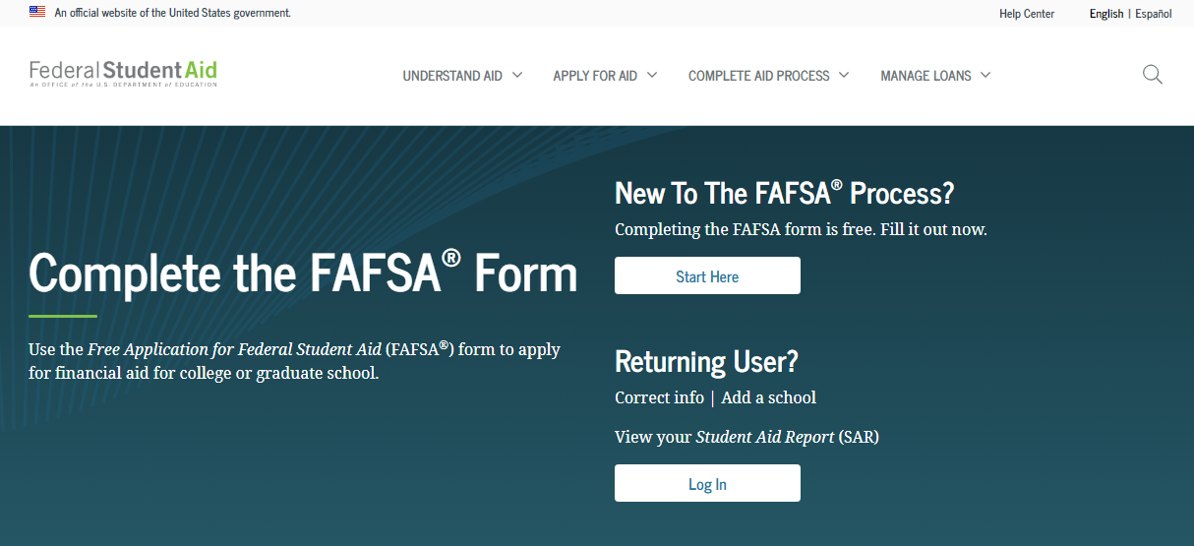
How Do I Apply For Financial Aid
Complete a Free Application for Federal Student Aid (FAFSA) for the appropriate aid year. For example, the 2023-2024 FAFSA would be used if you would be attending TTUHSC summer 2023, fall 2023 and/or spring 2024.
Go to https://studentaid.gov/h/apply-for-aid/fafsa. TTUHSC FAFSA school code is 016024
You will need:
Household Size/Number in College
Income & Tax Information
Parent Information
Until student is 24 years old, married, has a dependent, or is in a graduate program

Slide 10
Why Should I Use The FAFSA?
  FAFSA application is used to determine federal and state grant eligibility
  Institutional scholarship applications require a completed FAFSA
  Access to federal and state loan programs, that offer certain benefits
    Fixed interest rate
    Payment deferment and grace period
    Flexible repayment options
    Federal Loan Consolidation
    Public Service Loan Forgiveness Program for federal loans
    Disability and death benefits – loan cancellation
    For more information, visit https://studentaid.gov.

Slide 11
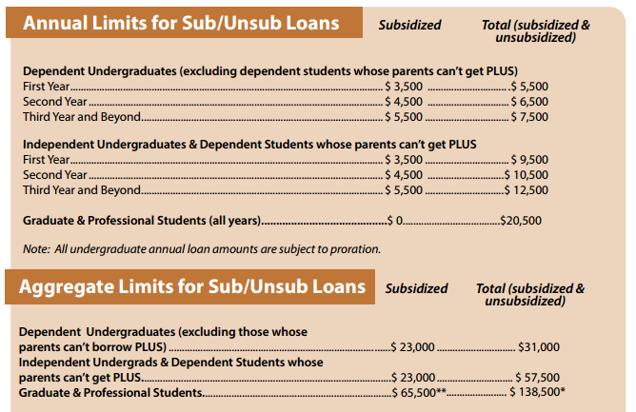
Federal Grant & Loan Limits
Pell Grant Awards for 23-24 – The maximum Pell Grant award is $7395. (Only for eligible undergraduates)
Undergraduate and Graduate Nursing, Health Professions, and GSBS/MPH Loan Limits:

Slide 12
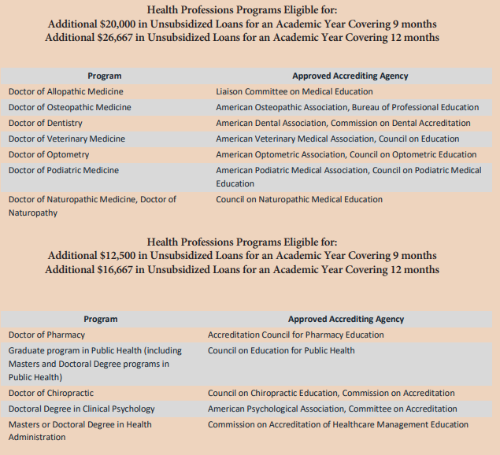
Federal Grant & Loan Limits- continued
There are higher unsubsidized loan limits for certain health professions programs such as School of Medicine:

Slide 13
Financial Aid Annual Process
October 1st of each year; new year’s FAFSA becomes available (will be Dec. 1st this year)
Student completes Free Application for Federal Student Aid (FAFSA) https://studentaid.gov/h/apply-for-aid
TTUHSC receives FAFSA data from the Federal processor electronically.
March: TTUHSC begins sending missing information emails to the student if additional documents are needed. Student returns those necessary documents to complete the financial aid file.
May: TTUHSC emails award notice to the student. The award offer outlines the programs and funding the student is eligible to receive for the school year.
Student completes the Federal Direct Loan Application process for the year. (only for students borrowing Federal Direct Loans).
Student completes Grad Plus/Alternative loan application (only for students borrowing one of these loans)
10 days prior to the start of each semester:
SBS Tuition Due date—ONLY for students not receiving Financial Aid
10 days prior to the start of each semester:
Federal Direct Loan processing service electronically sends loan funds to the school
Financial aid funds (loans, grants, & scholarships) are posted towards student’s tuition accounts
The week before the start of each semester:
TTUHSC SBS Office sends any refunds to student based on student’s refund preference.

Slide 14

Student Business Services
Please contact Student Business Services (SBS) at (806) 743-7867, option #1 or sbs1@ttuhsc.edu for questions regarding:
Tuition and fee information, tuition payment options, and payment plans
How refunds are processed or how to set up direct deposit information
How to submit 3rd party payments, such as Texas Tomorrow Fund
Tuition Estimates - http://www.fiscal.ttuhsc.edu/studentbusserv/tuitionestimates.aspx
Exemptions and Waivers - http://www.fiscal.ttuhsc.edu/studentbusserv/exemptionsandwaivers.aspx
For more information - http://www.fiscal.ttuhsc.edu/studentbusserv/

Slide 15

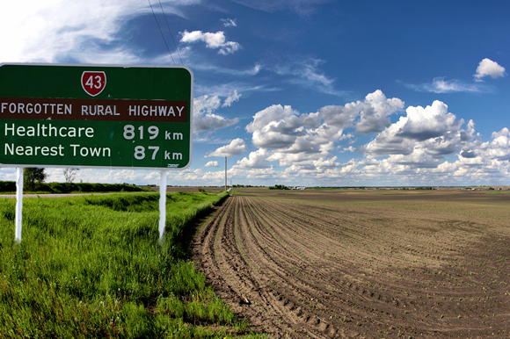
Other Types of Financial Assistance
Armed Forces
Air Force
  www.airforce.com/education/ongoing-education
Army
  www.goarmy.com/amedd/hpsp.jsp
Navy
  https://www.med.navy.mil/Accessions
Rural Health
National Health Service Corps
  https://nhsc.hrsa.gov/scholarships/index.html
Rural Health Information Hub
  www.ruralhealthinfo.org/funding

Slide 16

Web Resources
TTUHSC Financial Aid www.ttuhsc.edu/financial-aid
US Department of Education www.studentaid.ed.gov
Texas Medical Association https://www.texmed.org/MSS/
FinAid-Student Guide to Financial Aid
www.finaid.org
CollegeBoard www.collegeboard.org
American Association of Colleges of Pharmacy www.aacp.org
National Student Nurses’ Association https://www.nsna.org
National Association of Advisors for the Health Professions, Inc. www.naahp.org
Association of American Medical Colleges https://students-residents.aamc.org/
American Public Health Association www.apha.org
APhA Academy of Student Pharmacists www.pharmacist.com/apha-asp
FastWeb Scholarship Search www.fastweb.com
Texas Financial Aid Information www.collegeforalltexans.com

Slide 17

Financial Aid Questions
TTUHSC Financial Aid Office
3601 4th Street, MS 8310
Lubbock, TX 79430
806.743.3025
website:
www.ttuhsc.edu/financial-aid
Email:
financial.aid@ttuhsc.edu

Slide 18

Thank you

