Slide 1


Slide 2
Financial Aid For Future Health Care Providers
How Can I Pay for School?
Mia Myers, M.Ed.
Senior Financial Aid Advisor

Slide 3

How Much Will it Cost?
Estimated Financial Aid Student Budgets – “Sticker Shock”
 | 1st yr (10 mo) | 1st yr (9 mo) | 1st yr (9 mo) | 1st yr (9 mo) | 1st yr (12 mo) | 1st yr (9 mo)
 | Medicine | Pharmacy | Trad. UG Nurs | Trad. UG HP | Trad GR HP | GSBS/MPH
Tuition | 15,016 | 13,262 | 4,560 | 5,700 | 9,840 | 3,654
Fees | 2,909 | 2,620 | 3,992 | 2,968 | 3,660 | 1,978
Bks/Supplies | 1,835 | 1,900 | 1,200 | 1,500 | 2,050 | 900
Housing/food | 15,290 | 13,500 | 8,302 | 9,964 | 14,976 | 11,232
Transportation | 5,090 | 4,500 | 3,022 | 3,628 | 5,472 | 4,104
Personal/Misc. | 5,650 | 6,688 | 5,932 | 7,120 | 8,461 | 6,346
Est. Total Budget | 45,790 | 42,470 | 27,008 | 30,880 | 44,459 | 28,214

Slide 4
How Much Will it Cost?
Estimated total for the entire programs:
Program | Total Estimated Cost | 15-16 Average Student Loan Debt
Medicine – 4 years | $194,566 | $130,266
Pharmacy – 4 years | $183,521 | $120,498
Trad. UG Nursing – 2 years (1 year for RN to BSN and Accelerated Nursing programs) | $66,522 | $9,842 to $25,392
Grad Nursing – 2 to 4 years depending on pace | $118,392 (3 years) | $47,474
UG Health Professions – 2 years | $72,210 | $19,041
Grad Health Professions – 2 to 3 years depending on program | $132,432 (3 years) | $57,113 to $90,983
GSBS/MPH – 2 to 6 years depending on program | $82,161 (3 years) | $38,654

Slide 5

Cost of Attendance Federal Regulations
Items that may be covered by financial aid
  Tuition & fees
  Books & supplies (including lab equipment)
  Computer (budget adjustment form and proof of expense required; may only be submitted once)
  Housing & food (rent, utilities, groceries)
  Transportation (car insurance, maintenance, gas)
  Personal/Miscellaneous
    Health insurance, medical & dental expenses, clothing, cleaning, entertainment, etc.
  Transportation costs for residency interviews (Med/Pharm)
  State professional license exam (only if incurred during final year of study)

Slide 6

Cost of Attendance Federal Regulations – Continued
Items that Cannot be included in the financial aid budget
  Automobile payments
  Consumer debt (credit cards, loan payments, etc.)
  Review courses
  Spouse’s expenses (such as medical expenses or insurance)

Slide 7

How Do I Pay For School?
  Savings – live frugally now and while in school
  Family – use cash gifts from family and friends for school costs
  Scholarships – School, outside organizations,
  web searches
  Financial aid – Apply every year. Financial
  aid awards vary from grants, scholarships
  to student loans

Slide 8
What Is Financial Aid?
Financial aid is defined as assistance to pay for your cost of attendance. Any assistance is considered “financial aid” regardless of the source. These sources include:
  Grants – Funds from federal and state sources that do not require repayment
  Scholarships – State, institutional, organizational funds that do not require repayment
  Loan Programs – Funds that must be repaid. May consist of federal and private loans
    Federal Direct Loans - Subsidized, Unsubsidized, Parent Plus, & Graduate Plus
    State Loan – College Access Loan, Be-On-Time Loan
  Veteran’s Benefits – Such as Hazelwood, GI Bill and Ch. 33 benefits.
    Contact the TTUHSC VA Coordinator at 806-743-7549

Slide 9
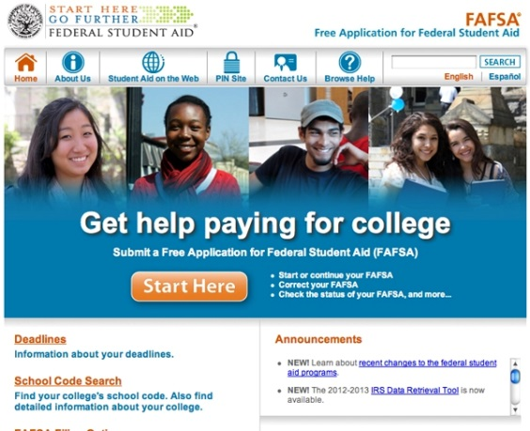
How Do I Apply For Financial Aid
Complete a Free Application for Federal Student Aid (FAFSA) for the appropriate aid year. For example, the 17-18 FAFSA would be used if you would be attending TTUHSC summer 2017, fall 2017 and/or spring 2018.
Go to https://fafsa.ed.gov. TTUHSC FAFSA school code is 016024
You will need:
Household Size/Number in College
Income & Tax Information
Parent Information
Until student is 24 years old, married, has a dependent, or is in a graduate program

Slide 10
Why Should I Use The FAFSA?
  FAFSA application is used to determine federal and state grant eligibility
  Institutional scholarship applications require a completed FAFSA on file
  Access to federal and state loan programs, that offer certain benefits
    Fixed interest rate
    Payment deferment and grace period
    Flexible repayment options
    Federal Loan Consolidation
    Public Service Loan Forgiveness Program for federal loans
    Disability and death benefits – loan cancellation

Slide 11
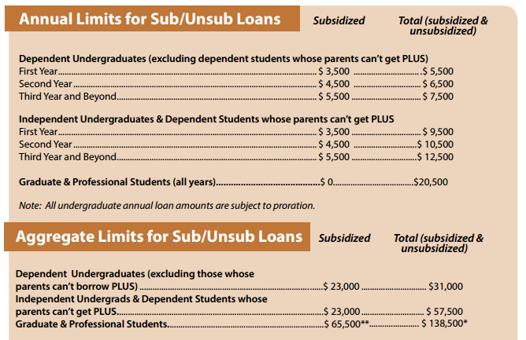
Federal Grant & Loan Limits
Pell Grant Awards for 16-17 – The maximum Pell Grant award is $5815. (Only for eligible undergraduates)
Undergraduate and Graduate Nursing, Health Professions, and GSBS/MPH Loan Limits:

Slide 12
Financial Aid Annual Process
October 1st of each year; new year’s FAFSA becomes available
Student completes Free Application for Federal Student Aid (FAFSA) https://fafsa.ed.gov
TTUHSC receives FAFSA data from the Federal processor electronically.
March: TTUHSC begins sending missing information emails to the student if additional documents are needed. Student returns those necessary documents to complete the financial aid file.
May: TTUHSC emails award notice to the student. The award offer outlines the programs and funding the student is eligible to receive for the school year.
Student completes the Federal Direct Loan Application process for the year. (only for students borrowing Federal Direct Loans).
Student completes Grad Plus/Alternative loan application (only for students borrowing one of these loans)
15 days prior to the start of each semester:
SBS Tuition Due date—ONLY for students not receiving Financial Aid
10 days prior to the start of each semester:
Federal Direct Loan processing service electronically sends loan funds to the school
Financial aid funds (loans, grants, & scholarships) are posted towards student’s tuition accounts
The week before the start of each semester:
TTUHSC SBS Office sends any refunds to student based on student’s refund preference.

Slide 13

Student Business Services
Please contact Student Business Services (SBS) at (806) 743-7867 for questions regarding:
Tuition and fee information, tuition payment options, and payment plans
How refunds are processed or how to set up direct deposit information
How to submit 3rd party payments, such as Texas Tomorrow Fund

Slide 14


Other Types of Financial Assistance
Armed Forces
Air Force
  www.airforce.com/education/ongoing-education
Army
  www.goarmy.com/amedd/hpsp.jsp
Navy
  www.navy.com/careers/healthcare/physicians
Rural Health
National Health Service Corps
  http://www.nhsc.hrsa.gov/scholarships/index.htm
Rural Health Information Hub
  www.ruralhealthinfor.org/topics/scholarships-loans-loanrepayment

Slide 15

Web Resources
TTUHSC Financial Aid www.ttuhsc.edu/financial-aid
US Department of Education www.studentaid.ed.gov
Federal Student Aid www.studentloans.gov
FinAid-Student Guide to Financial Aid
www.finaid.org
National Student Nurses’ Association www.nsna.org
National Student Loan Data System
www.nslds.ed.gov
American Association of Colleges of Pharmacy www.aacp.org
National Association of Advisors for the Health Professions, Inc. www.naahp.org
Association of American Medical Colleges www.aamc.org
FastWeb Scholarship Search www.fastweb.com
Texas Financial Aid Information www.collegeforalltexans.com
American Public Health Association www.apha.org
CollegeBoard www.bigfuture.collegeboard.org

Slide 16

Financial Aid Questions

Slide 17

Thank you

