Slide 1

SHP UG/GR Orientation
Financial Aid

Slide 2

What is Financial Aid
FINANCIAL AID is defined as assistance to pay for your educational expenses. These expenses include tuition, fees, books, supplies, instruments and living expenses while in school. Any assistance is considered “financial aid” regardless of the source. These sources include:
Grants—Funds from Federal and State sources that do NOT require repayment
Scholarships—State, Institutional, Organizational funds that do NOT require repayment
Loan Programs—Money that must be paid back. May consist of Federal and Private loans
Ex. Federal Direct Unsubsidized Loan, Federal Direct Graduate Plus Loan
Departmental Payments/Waivers – Assistance with tuition/fees while in school; ex. Non-resident tuition waivers
Veteran’s Benefits – Hazelwood, Ch. 33, etc. Please contact the TTUHSC VA Coordinator at 806-743-7549 for more details.

Slide 3
Items Covered By Financial Aid
Tuition & Fees
Books & Supplies (including lab equipment)
Housing and food (rent, utilities, phone, groceries)
Transportation (insurance, maintenance, gasoline)
Health Insurance
Personal and miscellaneous (medical, dental, clothing, cleaning, etc.)
Travel and living expenses for away rotations (budget adjustment form and proof of expenses required)
Computer (budget adjustment form and proof of expense required; may only be submitted once during degree plan)

Slide 4
Items NOT Covered by Financial Aid
Automobile payments
Consumer debt (credit cards, loan payments)
Review courses
Spouse’s expenses (such as medical expenses or insurance)
Student association costs (such as conference trips)

Slide 5

Applying For Financial Aid
Complete a 2017-2018 FAFSA (Free Application for Federal Student Aid)
Go to: www.fafsa.ed.gov Follow the instructions as directed. Our FAFSA school code is: 016024.
If you need a FSA ID # go to https://studentaid.ed.gov/sa/fafsa/filling-out/fsaid.
As a graduate Health Professions student, you are now considered an independent student on the FAFSA. This means you are no longer required to provide parent information on your FAFSA, nor does TTUHSC require you to provide your parental information on your FAFSA.
Your FAFSA data will be sent to our office once it has been processed. Please allow 5 business days for the data to be reviewed and processed.
You will receive an email from the Student Financial Aid Office if we need any additional information to finish processing your file.
All Student Financial Aid emails are sent to your TTUHSC Student Email Account.
Please be sure to check this account for correspondence from our office.
Students who are ineligible to complete the FAFSA are ineligible to apply for Federal Student loans. These students may still apply for alternative student loans. For an inclusive list of alternative student loan lenders, please visit www.finaid.org. Please note, many lenders require a US cosigner in order to apply for their alternative loans.

Slide 6

Applying For School of School of Health Professions Scholarships
The School of Health Professions has scholarships dedicated to currently enrolled students. In addition, there are general scholarships funded by private foundations and organizations. Scholarships are administered by the School of Health Professions Office of Admissions and Student Affairs. Scholarships given to incoming students will be based on the admissions application including all information that is provided by that application and the application process (e.g. grade point average, GRE scores (if applicable), interview, written essay, extracurricular/volunteer activities.)
SHP Scholarship
Please monitor your email and social media for SHP Scholarship opportunities. https://student.ttuhsc.edu/health-professions/current/scholarships.aspx

Slide 7
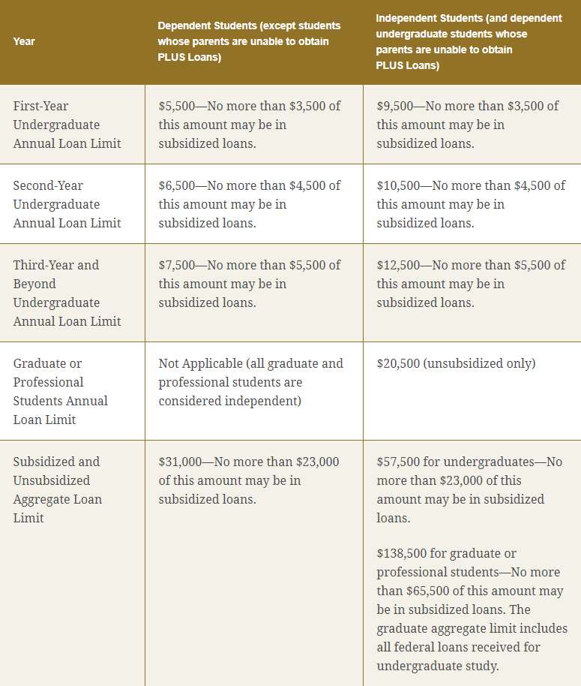
Federal Student Loans

Slide 8
Federal Student Loan Interest rates for July 1, 2017 through June 30, 2018
Undergraduate Student
Subsidized Loan: 4.45% Unsubsidized Loan: 4:45%
Graduate Student
Unsubsidized Loan: 6.00% Grad Plus Loan: 7.00%
Private Student Loan rates vary between lenders and student credit rating
(please note, grad plus loans and private student loans require credit approval)

Slide 9
Need More Money?
To request any previously declined loans, logon to WebRaider and access your financial aid awards. On the Accept Award Offer tab, enter your request in the comment box at the bottom of the screen. Please be sure to request a specific amount for the semester or year.
Budget revision requests are also available to help students with unexpected expenses or increased living costs. Contact the financial aid office for more information on revision requests.

Slide 10

Federal Loan Information
You can locate loan servicer information and current federal loan totals on the National Student Loan Database System website.
You will need your FSA ID and password to access the information.

Slide 11
Financial Aid Annual Process
October 1st of each year, new year’s FAFSA becomes available
Student completes Free Application for Federal Student Aid (FAFSA) www.fafsa.ed.gov
TTUHSC receives FAFSA data from the Federal processor electronically.
March: TTUHSC begins sending missing information emails to the student if additional documents are needed. Student returns those necessary documents to complete the financial aid file.
May: TTUHSC emails award notice to the student. The award offer outlines the programs and funding the student is eligible to receive for the school year.
Student completes the Federal Direct Loan Application process for the year. (only for students borrowing Federal Direct Loans).
Student completes Grad Plus/Alternative loan application (only for students borrowing one of these loans)
15 days prior to the start of each semester:
SBS Tuition Due date—ONLY for students not receiving Financial Aid
10 days prior to the start of each semester:
Federal Direct Loan processing service electronically sends loan funds to the school
Financial aid funds (loans, grants, & scholarships) are posted towards student’s tuition accounts
The week before the start of each semester:
TTUHSC SBS Office sends any refunds to student based on student’s refund preference.

Slide 12
Emergency Tuition & Short Term Loans
Emergency Tuition Loans are available at 5% interest for currently enrolled TTUHSC students.
Short Term Loan for up to $500 is also available to currently enrolled students for other types of emergencies. This loan has an interest rate of 5%.
Both types of loans must be repaid within 90 days.
www.ttuhsc.edu/financial-aid

Slide 13
Student Business Services
Please contact Student Business Services (SBS) at (806) 743-7867 or at SBS@ttuhsc.edu for questions regarding:
Tuition and fee information, tuition payment options, and payment plans
How refunds are processed or how to set up direct deposit information
How to submit 3rd party payment information

Slide 14
Office of Financial Aid
Academic Classroom Building Room 2C400
TTUHSC Office of Financial Aid
3601 4th Street MS8310
Lubbock, TX 79430-8310
(806) 743.3025 phone (806) 743.2304 fax
financial.aid@ttuhsc.edu
Mia.C.Myers@ttuhsc.edu
www.ttuhsc.edu/financial-aid
Office hours:
Monday-Friday 8am-5pm
No appointment needed to see an advisor

