Slide 1
Speech Pathology Orientation
Part I
Micah Walsleben, MLS
October 25, 2016
Notes:
Welcome to the first of three library sessions for Speech Pathology! In this first part, I will give a tour of the library website and introduce a few sites where you can find systematic reviews. Let’s begin!

Slide 2



Lubbock Reference Librarians
Available on 2nd floor of library, across from the Learning Resource Center and public computers
8am–5pm
Monday–Friday
Jennifer Yack
Peggy Edwards
Micah Walsleben
Margaret Vugrin
Notes:
These are the Reference Librarians at the Lubbock campus. Our office hours are Monday – Friday 8:00am – 5:00pm Central Time. Feel free to give us a call or send us an e-mail! We will be happy to help you.

Slide 3
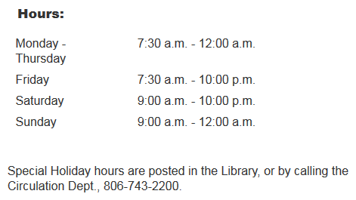
Library Hours
Phone: 806-743-2200
Holiday hours and early closings are also posted as announcements in your e-Raider portal.
Notes:
Here are the normal hours of operation for the HSC library. Any special holiday hours or early closing announcements are posted within the library itself and in the announcement section of your eRaider portal. Of course, you can always call the library at the number shown on this slide.

Slide 4
Preferred Internet Browsers
Firefox
Chrome
Safari
Notes:
Before we navigate to the library website, here are the three preferred browsers for accessing it. We’ve encountered a few problems with Internet Explorer not supporting all of the technology on the library website. If you’re accessing the website from a personal computer, etc., please use one of these browsers instead.

Slide 5
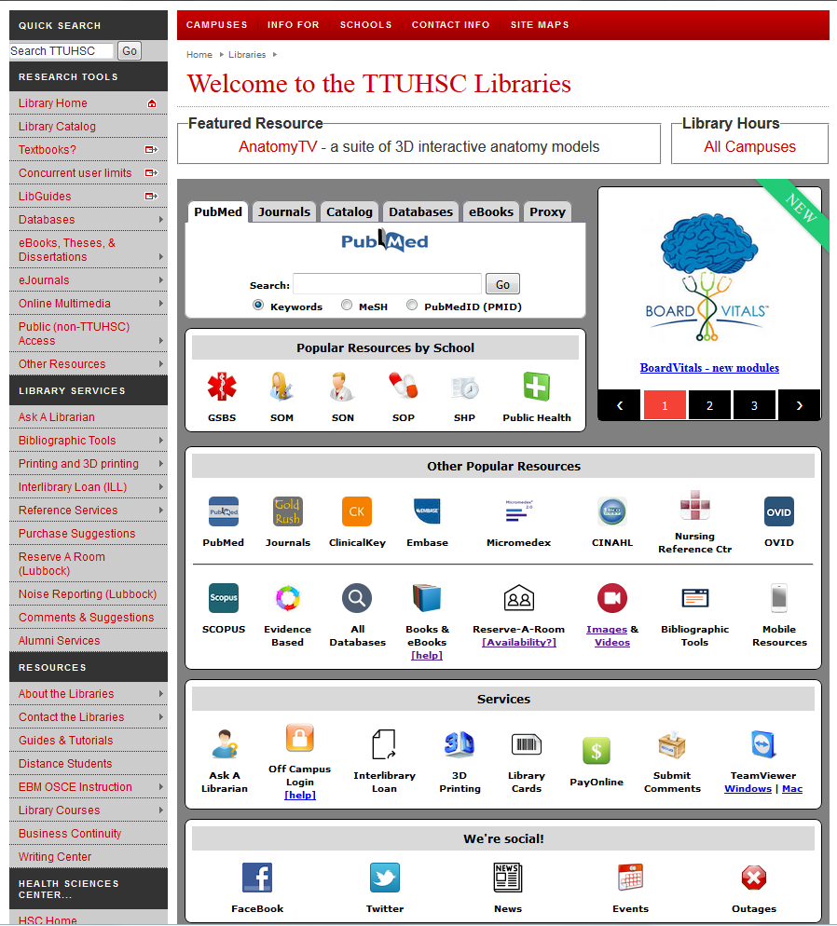
TTUHSC Libraries’ Website
www.ttuhsc.edu/libraries
Notes:
This is the library website, along with the URL address. I recommend bookmarking this page to help you access our resources quickly and easily. Because our resources require you to log in from off campus, it’s best to bookmark the main page rather than any specific resource.

Slide 6
Library Catalog
Notes:
From the library website, select “Catalog” from the column on the left side of the page, under “Research Tools”.

Slide 7
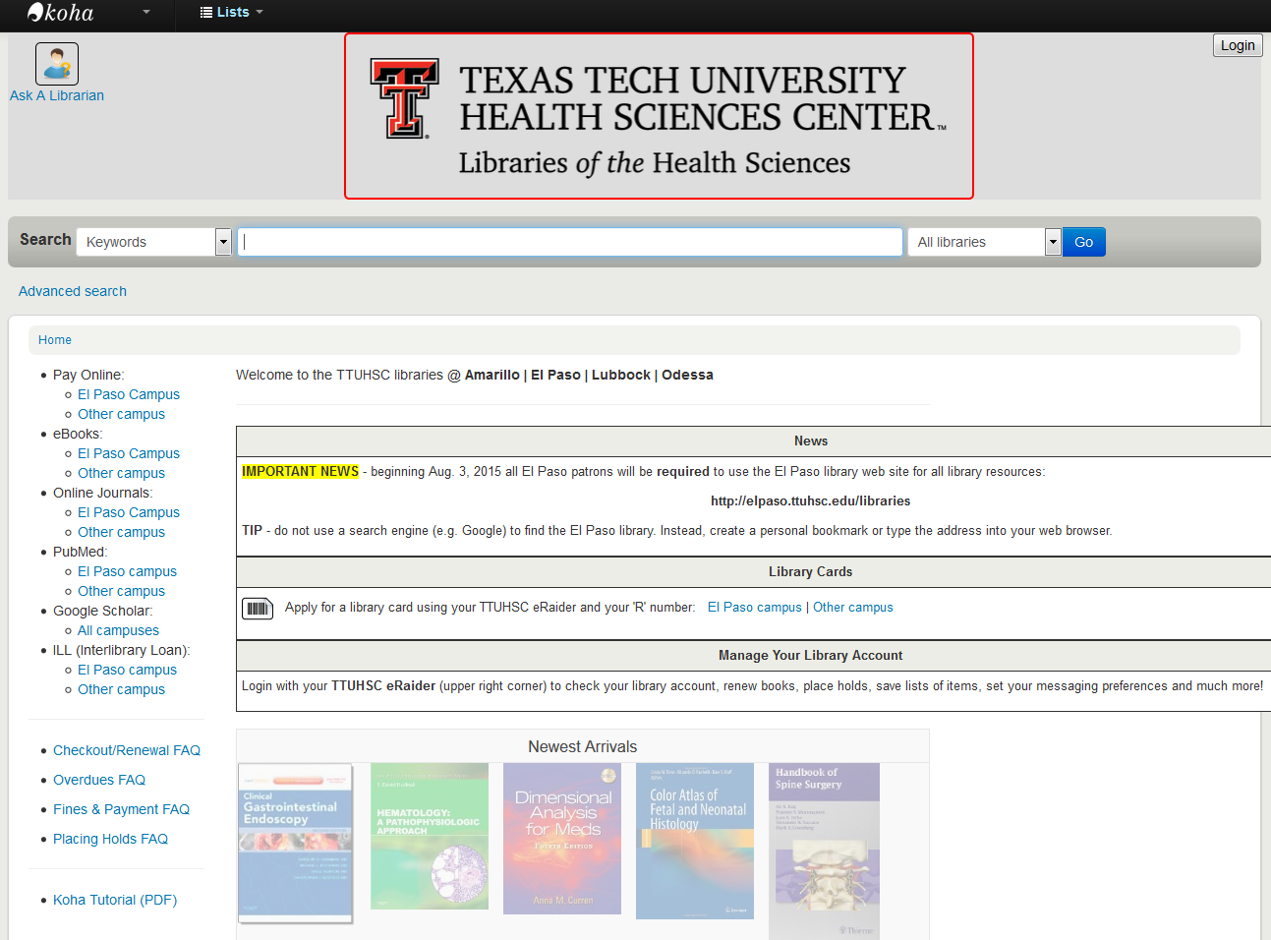
Sign in for your account information
Notes:
The is the main catalog page. From here, you can search the libraries at all our branches for the book that you need. We have also added all of our e-books to the catalog to make it the main searching tool for all books. If you come across an e-book, the words “online access” will be highlighted next to a link you can click to go to the book. In the upper right of the screen is a login button. Click and sign in with your eRaider username and password to access your library account. You can see when your materials are due, if you have any fines, and even renew the materials you have checked out.

Slide 8
Borrowing Policies and Fines
Books/Audiovisuals/Journals:
Checkout period for books is two weeks, audiovisuals for 10 days. Journals in the print collection cannot be checked out.
May renew items twice in person, over the phone, or via the eRaider sign in within the library catalog.
Fines for overdue items:
50 cents per day per item
Library privileges are lost until fines are paid
Notes:
Here are the library’s borrowing policies and fine system. You can check the status of your account at any time through the eRaider sign in within the library catalog, or by calling the main number.

Slide 9
Guides and Tutorials
Online
step-by-step
guides
Notes:
Another place I’d like to point out is our “Guides and Tutorials” page. It’s located in the lower left corner of the library web site in the section labeled “Resources”.

Slide 10
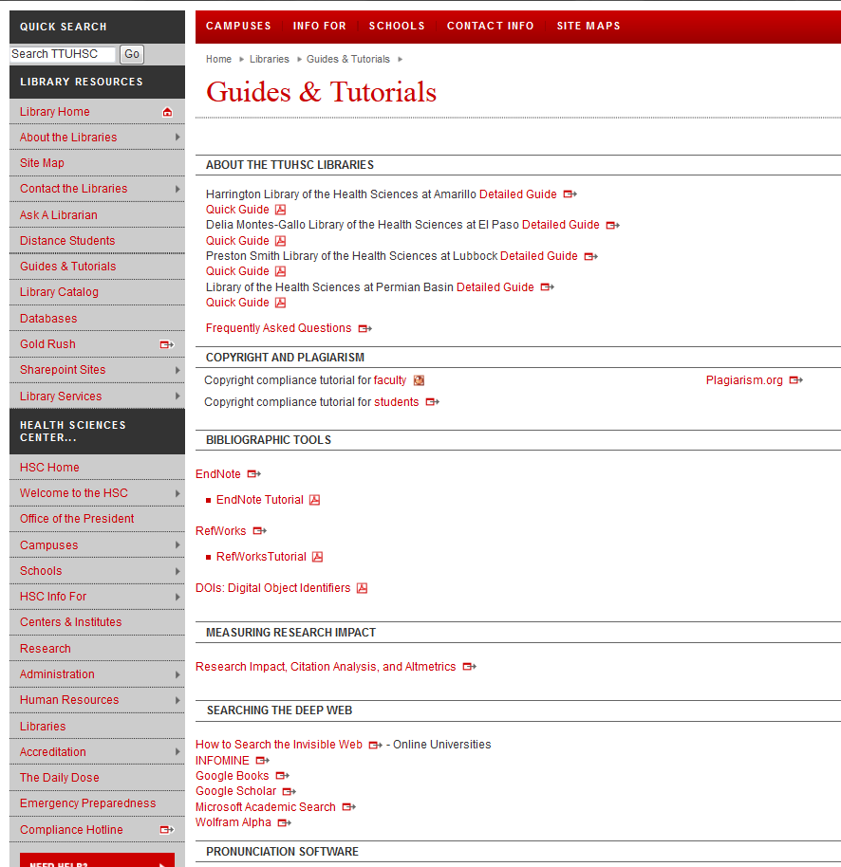
Scroll down to see additional tutorials
Notes:
Here is the “Guides and Tutorials” page. You’ll notice we have guides to all the branch libraries. Scrolling down the page will take you to helpful tutorials on our more popular databases and online resources.

Slide 11
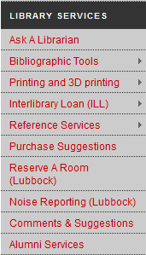
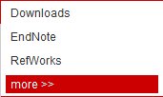
APA Help
Notes:
Are you writing a paper and need help with APA format? We can’t tell you exactly how to cite your paper, but we do have a compilation of tools and websites to help you. In the middle of the left column of the library web site, labeled “Library Services”, mouse over “Bibliographic Tools”, then click on “More”.

Slide 12
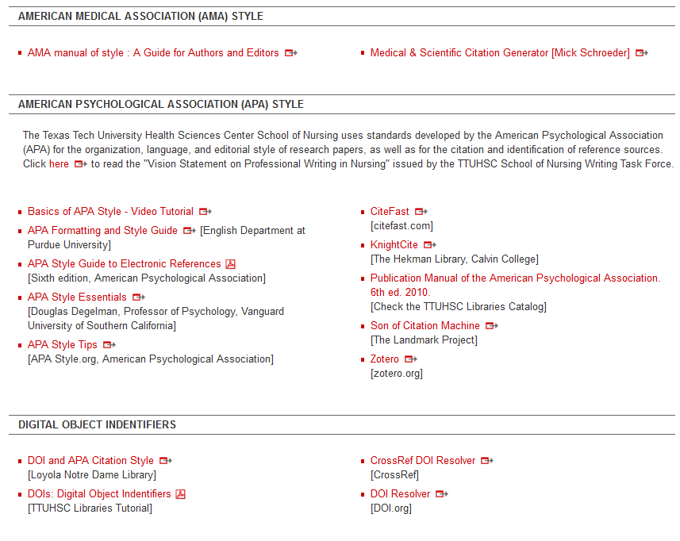
Notes:
Towards the middle of the “Bibliographic Tools” page is this information regarding APA. Here, we have online style manuals, various guides and tutorials, and a few online citation generator tools to help you format your citations. Remember, always double-check citations that are generated for you to make sure that they are what your professor requires for the assignment.

Slide 13
Online Writing Center!
Notes:
TTUHSC now has an online writing center! It’s located under “Resources” at the lower left of the web site. You can submit your papers for review and feedback. The online Writing Center follows the academic calendar for TTU, however, so make sure they are accepting papers before you submit yours.

Slide 14
Mobile Resources
Notes:
The link to our mobile resources is located in the middle section of the library web site, under “Other Popular Resources”.

Slide 15
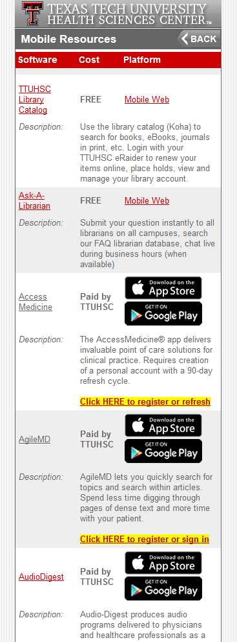
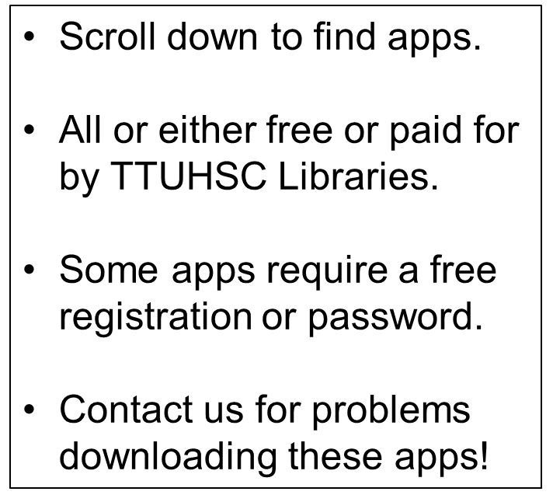
Notes:
The page that the link brings you to is a list of mobile apps and resources that are available to you either for free or as a result of an existing subscription through the library. Either way, as a student, you don’t have to pay for any app on this list! Some of these apps require that you register; this is free, and you may use any username and password you want. A few of these apps require a password; these are provided for you in the instructions. If you have any problems downloading these apps, please call the library for assistance.

Slide 16
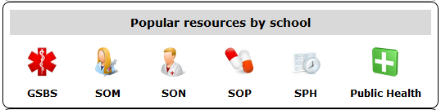
Resources just for you!
Notes:
The library has resources just for you! Starting at the library web site, find the tab in the upper middle of the page labeled “Popular resources by school”. From there, click on the icon labeled “SPH”.

Slide 17
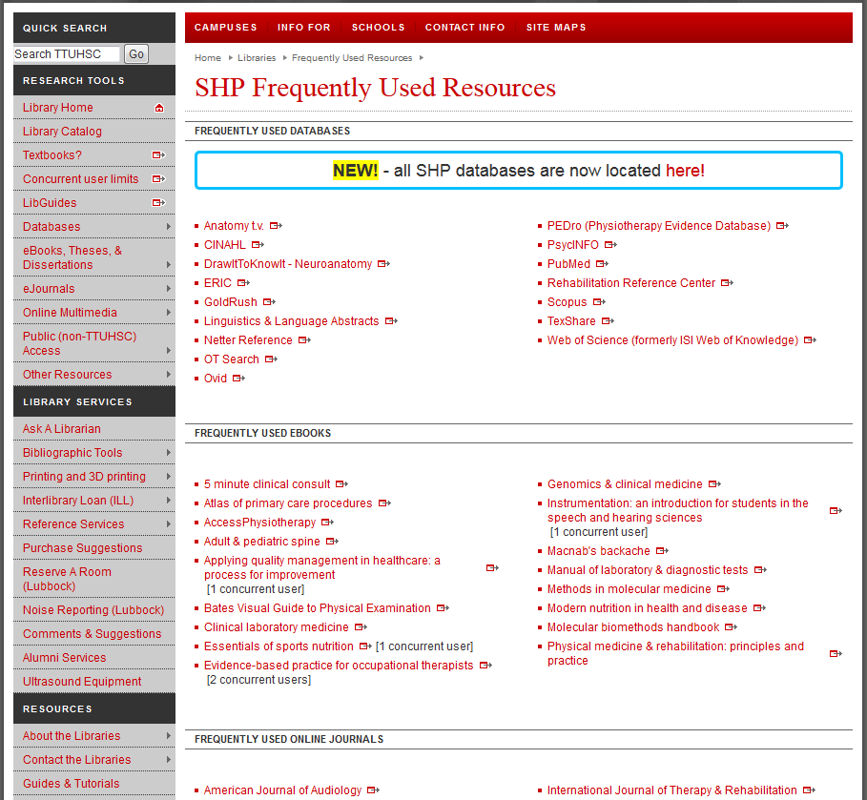
Notes:
Here are a list of databases, eBooks, etc. that will be helpful to you. While this is not the full extent of the resources available to you, this is a great place to start when you’re working on an assignment or project.

Slide 18
(ILL) Interlibrary Loan
Read all about it here!
Notes:
If you need a book or article that is not available at the library, you have the option of ordering it through our Interlibrary Loan system. It’s found on the left side of the library website under “Library Services”.

Slide 19
Basic ILL Information
Online ordering form makes submitting requests quick and easy
Response time for requests is anywhere from 2 – 5 business days, depending on location of the item
Books from any TTUHSC branch library are free, all others are $4.00
Journal articles are charged per page, but fees will not exceed $4.00
There is a rush option available, but at a higher fee rate
Notes:
Here is some basic information about our Interlibrary Loan system that will be useful for you to know. If you need a book from any TTUHSC branch library, we will ship it to you for free. There is also an online ordering form grouped with the other Interlibrary Loan information on the library website for your convenience.

Slide 20
Ask A Librarian
Notes:
If you have any questions or need assistance with research or an assignment, please don’t hesitate to contact us through our “Ask A Librarian” service. The best way to access this is through the Ask A Librarian logo, located under “Services”.

Slide 21
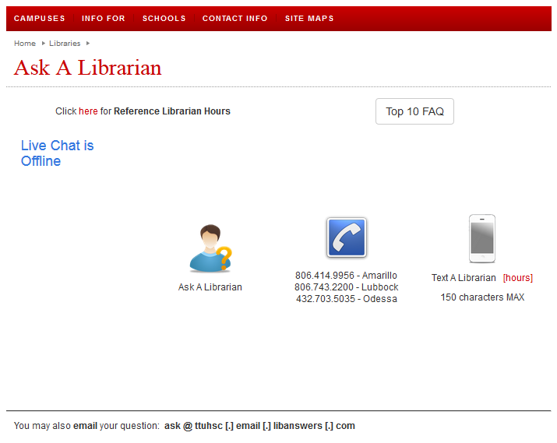
Notes:
From here, there are several ways to contact us. You can submit your question through our Ask A Librarian e-mail form (the person with a question mark), call the library nearest you, or chat online with a librarian (when the service is available). You also have the option of texting your question and receiving a text in response. Both the e-mails and texts received are sent to each librarian in all branches of the Health Sciences Center, so you can be assured that your question will be answered in a timely manner.

Slide 22
Team Viewer
Notes:
Another option for receiving additional help from the library is through Team Viewer. Team Viewer is a program that allows the librarian to view your computer desktop remotely in order to help you with your research and other questions in real time. This program is located on the library web site under “Services”. Download options are available for both Windows and Mac systems.

Slide 23
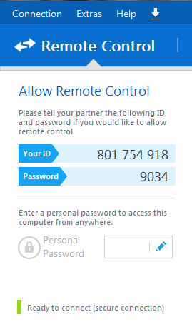
Give your ID and password to a librarian on the phone
We will be able to remotely control your desktop—we will see what you see as well as move your mouse, etc.
Please make an appointment in order to ensure plenty of time to work on your problem!
Notes:
When you download Team Viewer, you’ll see something like this, with an I.D. and a password. Once you have this, call a librarian. Relay the I.D. and password over the phone, and the librarian will be able to see what’s on your computer screen and control the mouse! The librarian will stay on the phone with you and walk you through your research question in real time. You can call and start a Team Viewer session immediately, or if you have a major project/assignment coming up, you can schedule an appointment as well. A key feature about Team Viewer that I’d like to point out is that the password changes each time you close the program. That way, anyone who was able to access your desktop once would not be able to do so again once you close out Team Viewer.

Slide 24
Helpful Databases
Find Systematic Reviews quickly and easily!
Notes:
Now that you’ve been introduced to the library, it’s time to delve into some helpful databases where you can find systematic reviews!

Slide 25
Today’s Databases
Campbell Collaboration
National Guideline Clearinghouse
Linguistics & Language Behavior Abstracts
PubMed Clinical Queries

Slide 26
The Campbell Collaboration
Let’s explore…

Slide 27
Go to this website!
http://www.campbellcollaboration.org

Slide 28
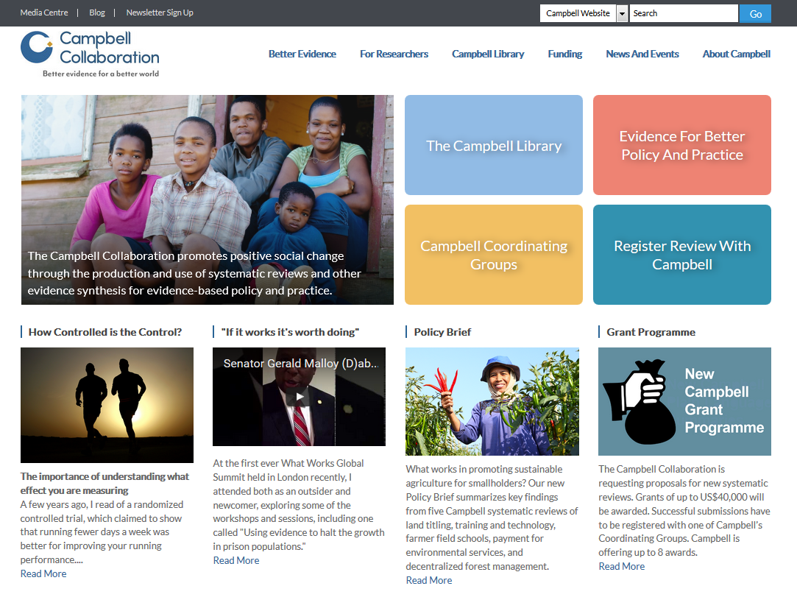
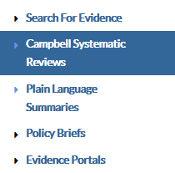

Slide 29
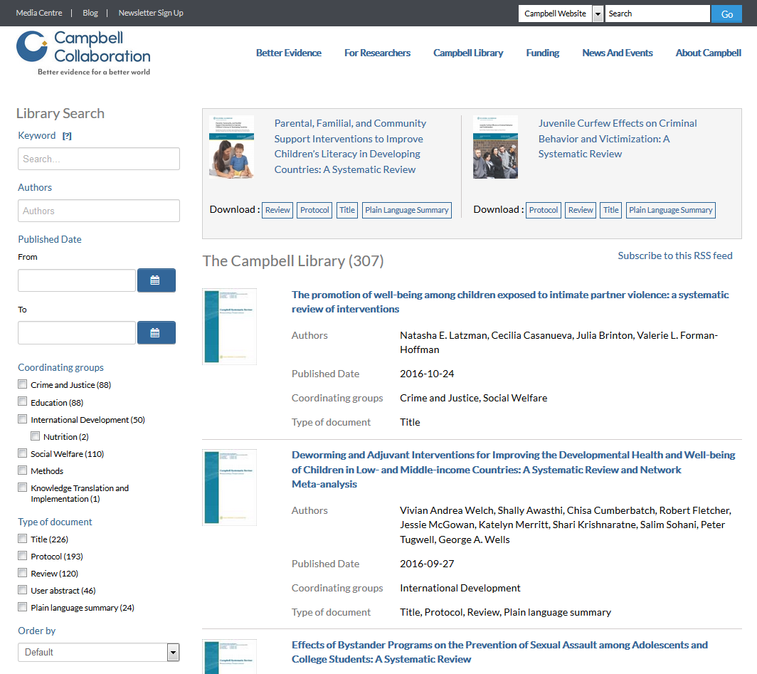
language delay

Slide 30
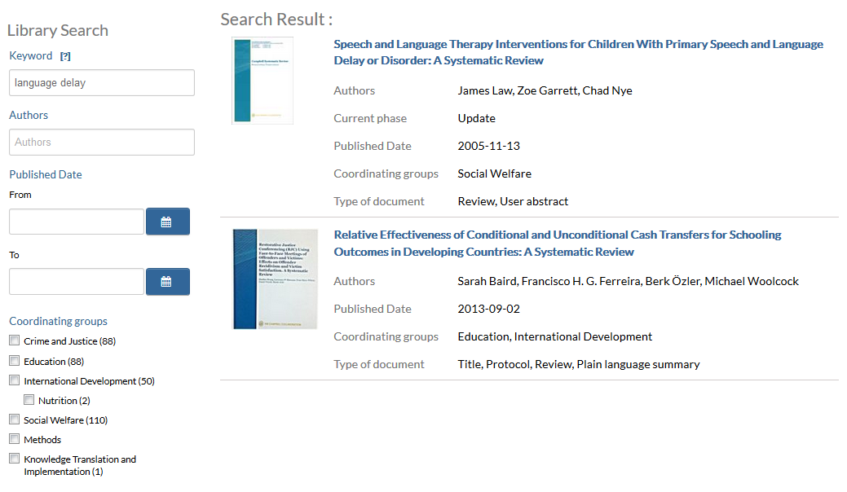

Slide 31
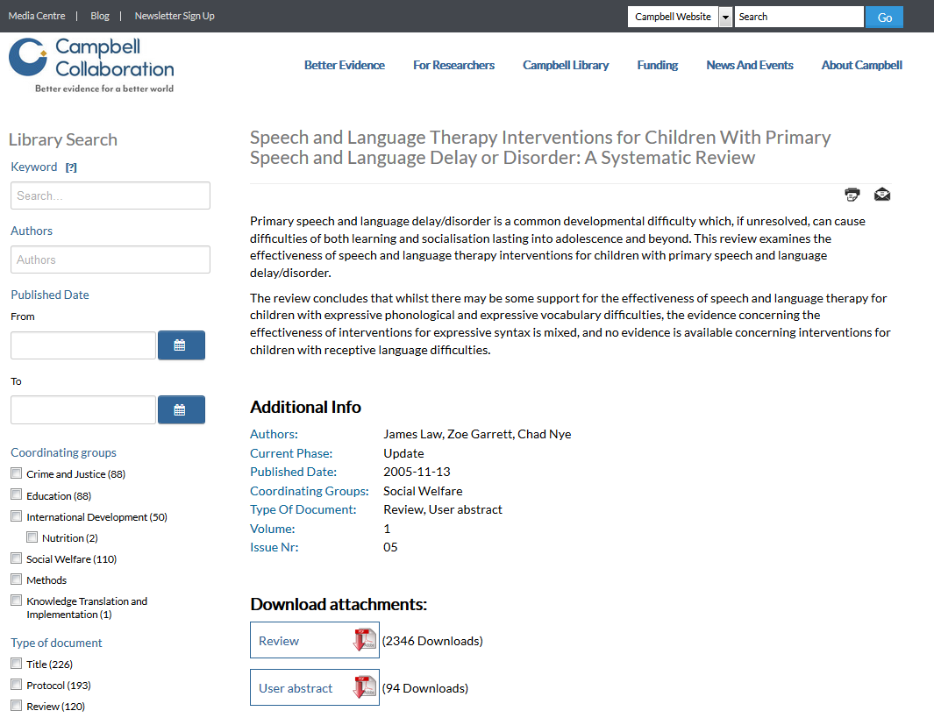
Notes:
Here is the article page in the Campbell Collaboration. This provides the abstract, as well as the option to download the pdf of the article, and option to share/export the reference.

Slide 32
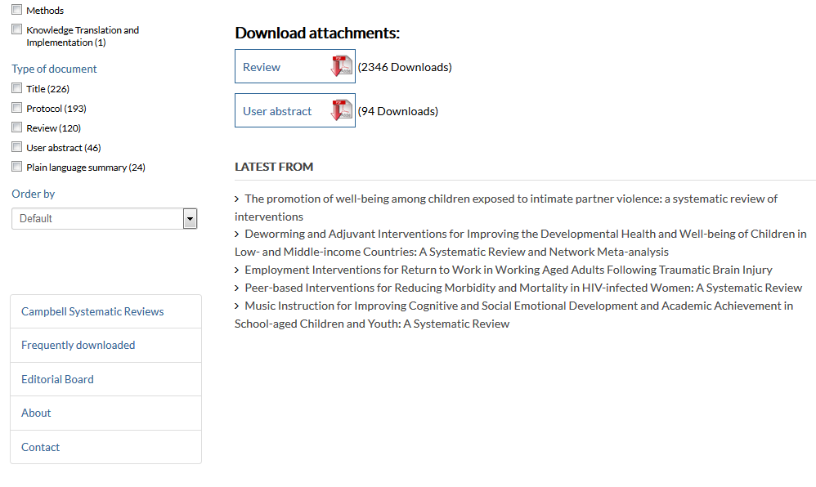

Slide 33
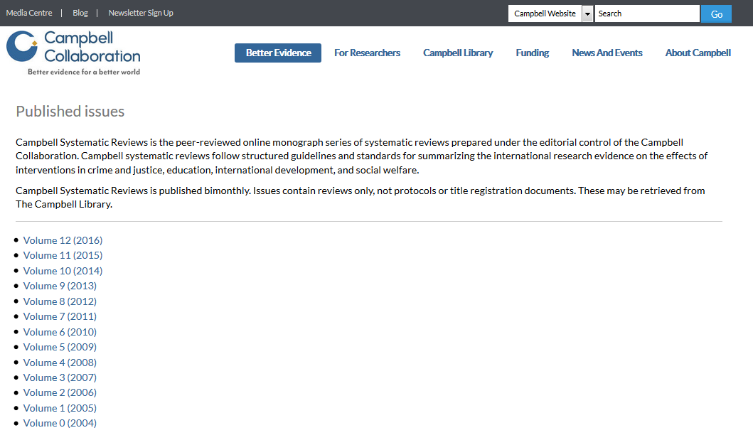

Slide 34
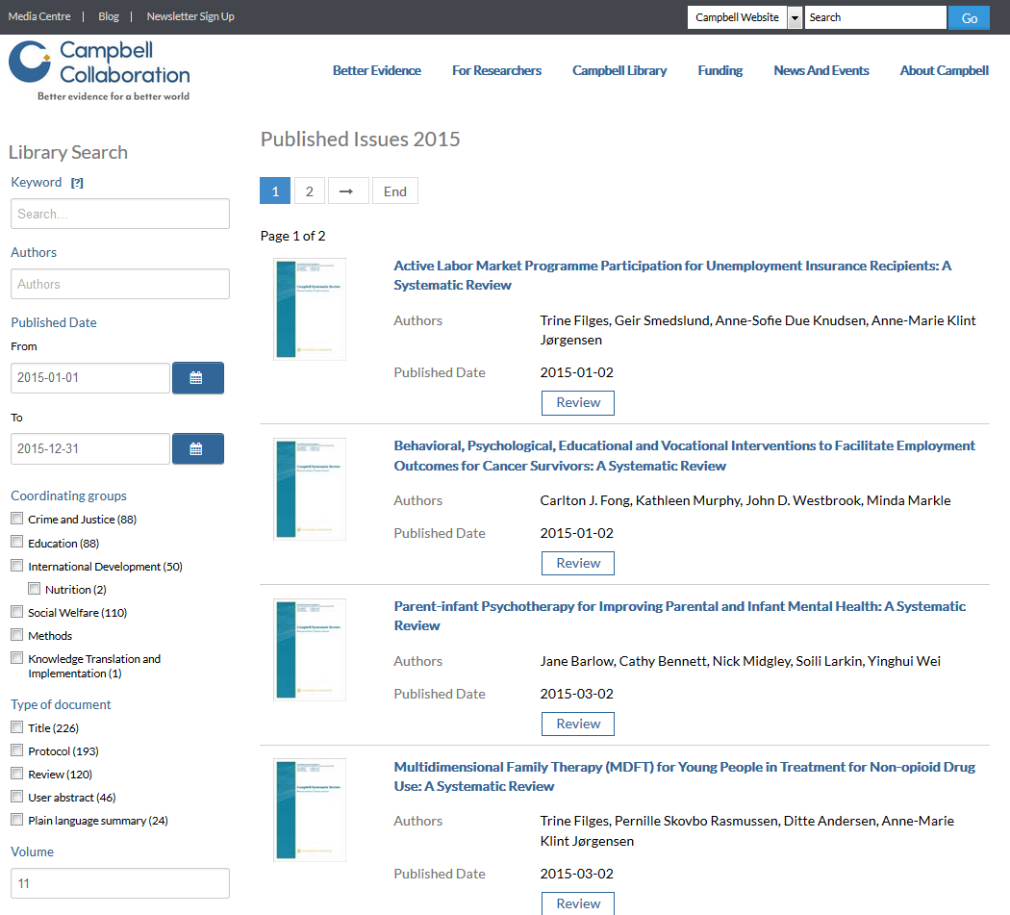
Notes:
Here are all the systematic reviews published by the Campbell Collaboration in 2015. You can browse through and view any of these.

Slide 35
National Guideline Clearinghouse(NGC)
Let’s explore…

Slide 36
Start at the library website!
http://www.ttuhsc.edu/libraries

Slide 37
Notes:
From the library web site, select “Evidence Based”.

Slide 38
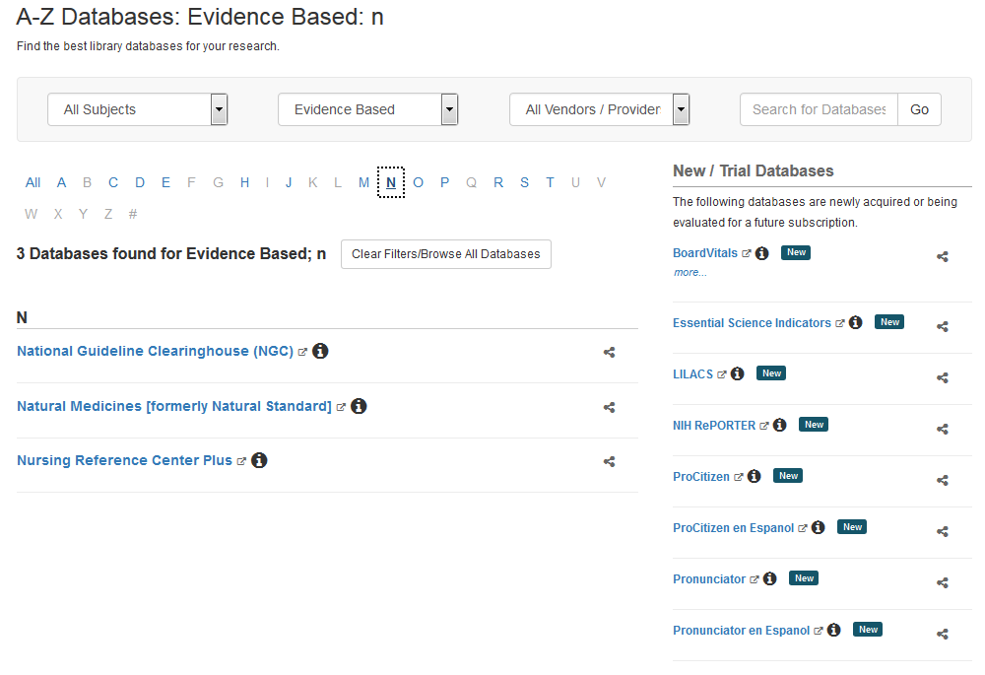

Slide 39
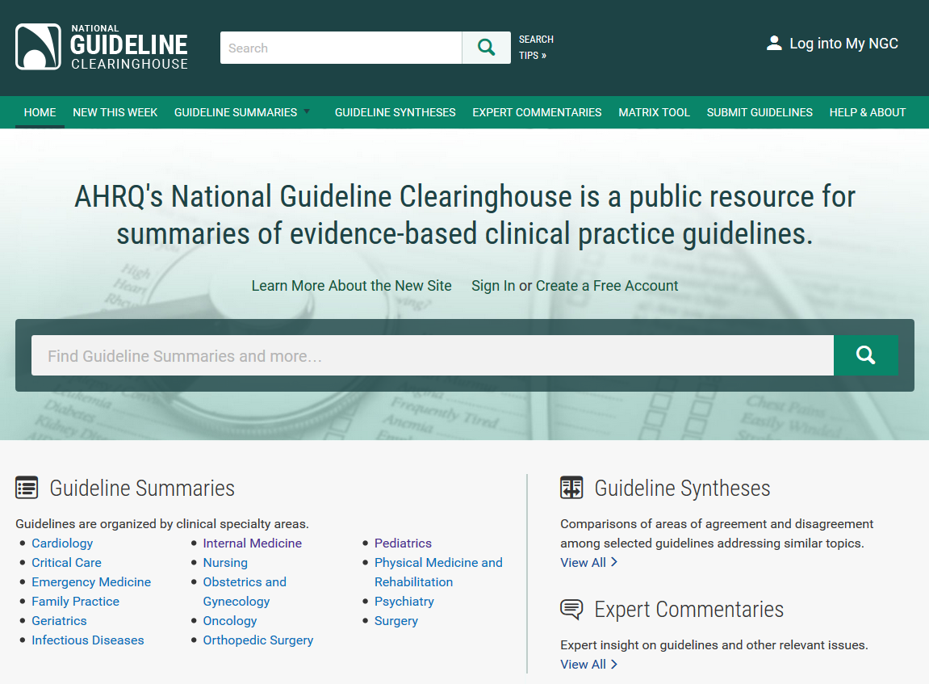
language delay

Slide 40
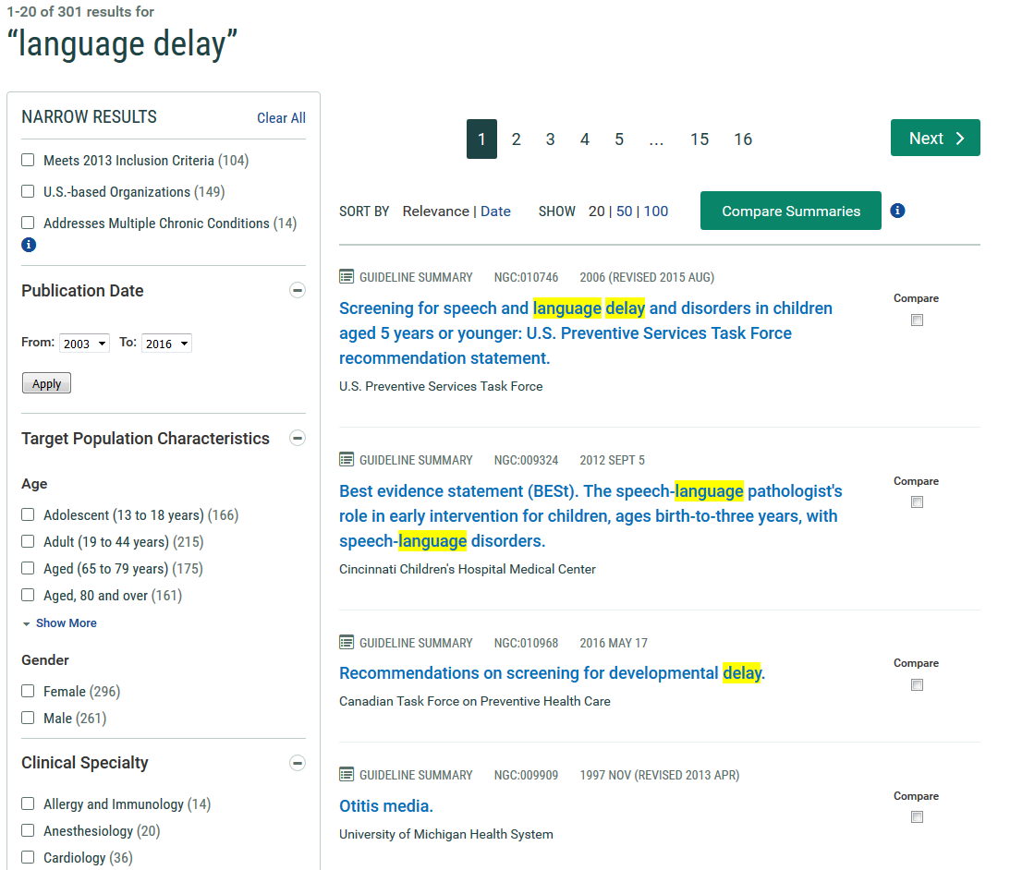
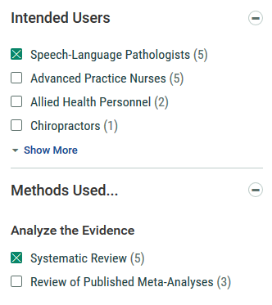

Slide 41
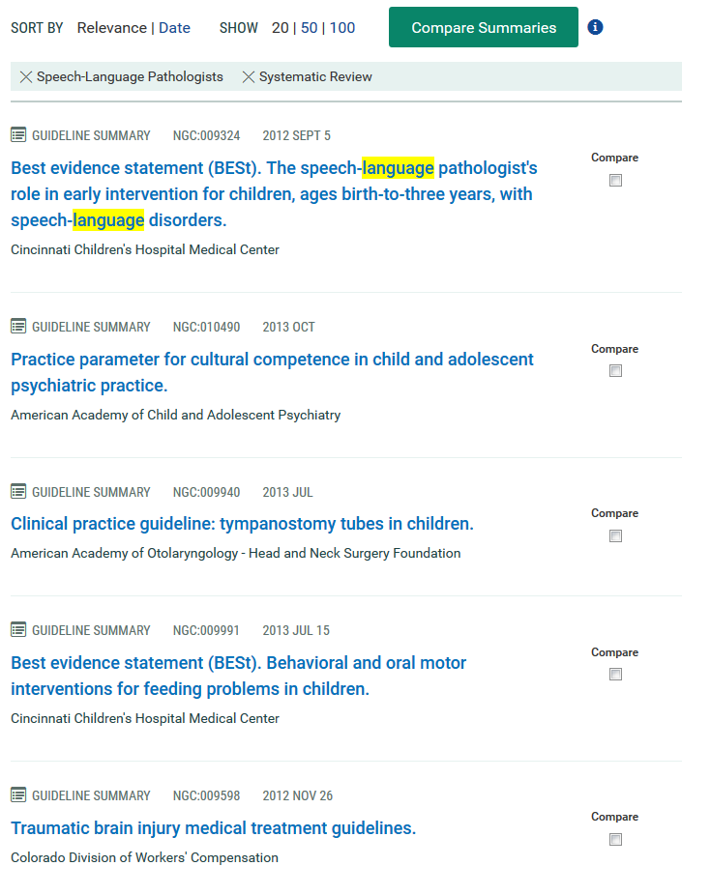

Slide 42
PubMed Clinical Queries
Find Systematic Reviews fast!

Slide 44
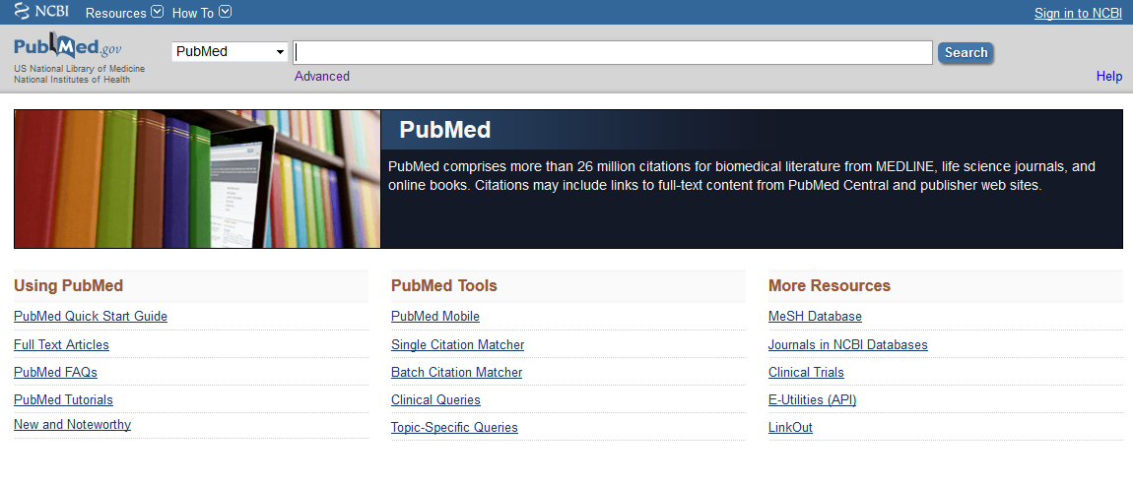
Notes:
Clinical Queries is located under “PubMed Tools”.

Slide 45
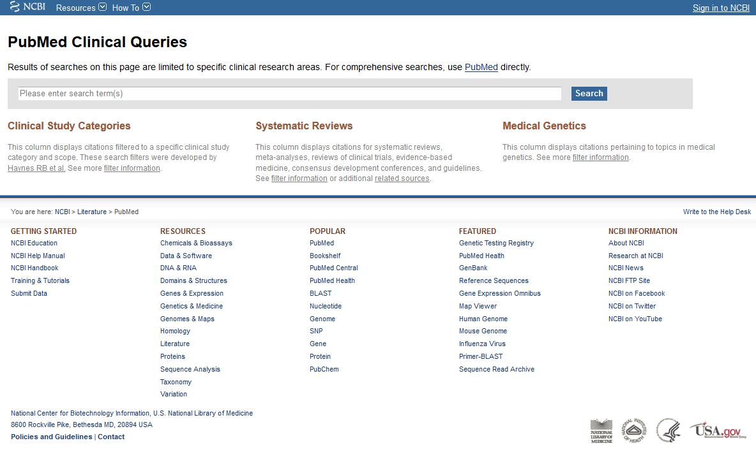
language delay speech pathology
Notes:
PubMed Clinical Queries is an excellent way to search PubMed without going through the controlled thesaurus, or “MeSH”. Here, all you need to do is enter your terms, and the database will do the rest! To show you how this works, I’m going to search for “language delay speech pathology”.

Slide 46
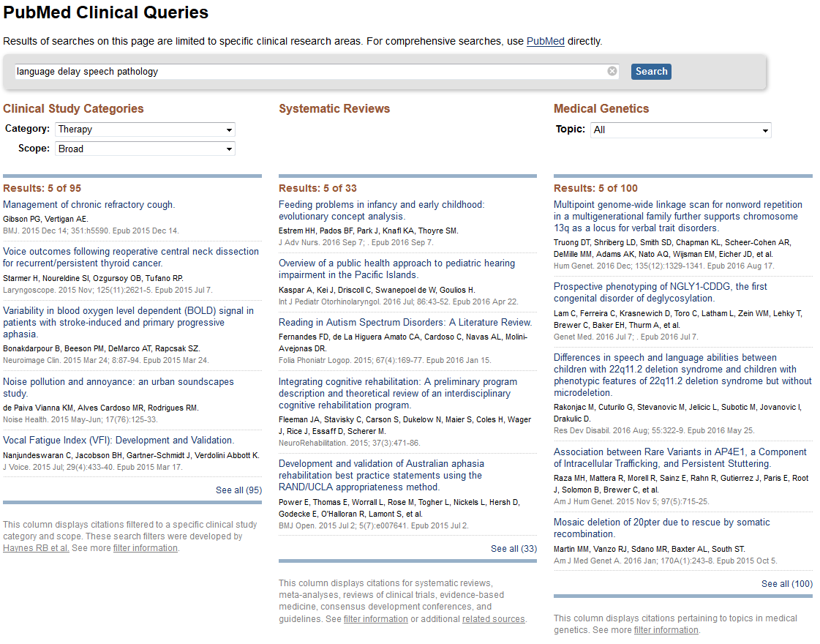
Notes:
Here are the results! They are split into three categories: Clinical Study, Systematic Reviews, and Medical Genetics. In the third column, PubMed has sifted through the articles on our topic and pulled out all the systematic reviews. To see all 33, click “See all” at the bottom of the list.

Slide 47
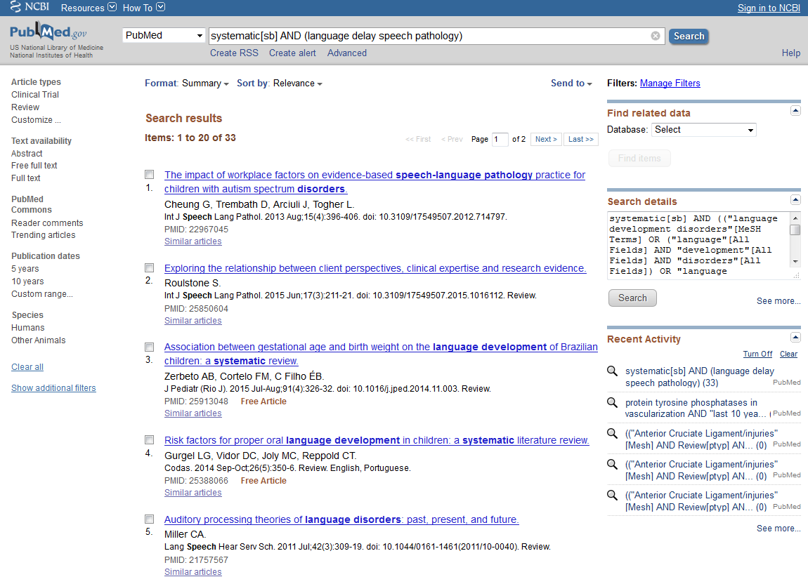
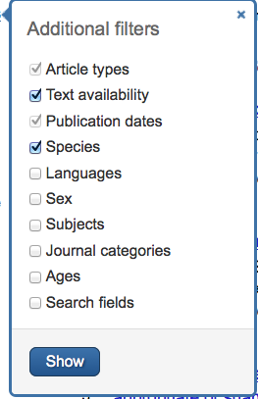
Notes:
Here, you can see all the systematic reviews PubMed found. To the left of the citations is a filter bar. Here, you can limit the results according to age group, gender, publication date, and more!

Slide 48
Linguistics and Language Abstracts

Slide 50
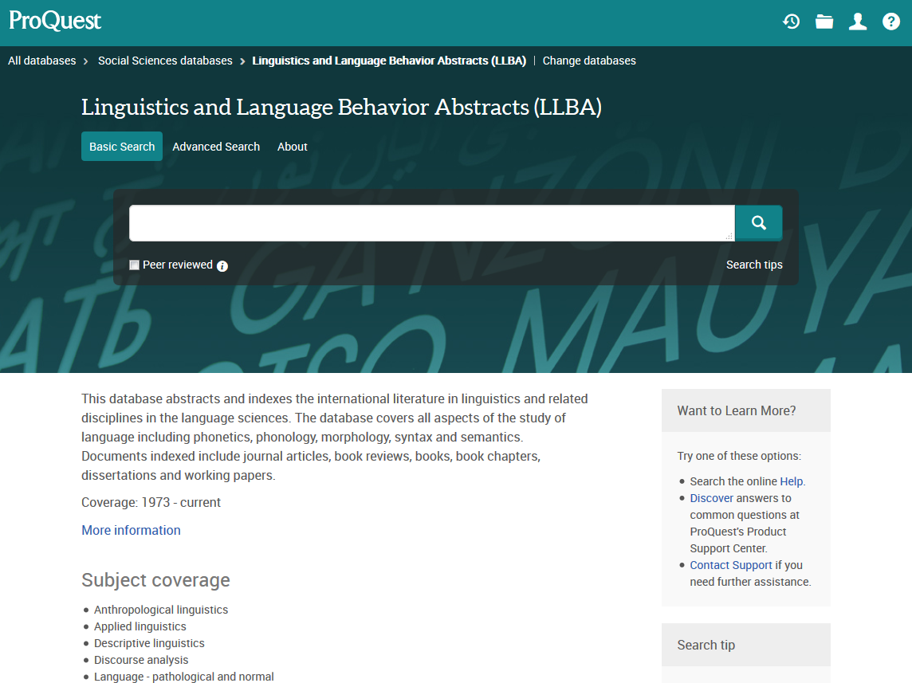
Notes:
Once you’re at the start page of Linguistics and Language Abstracts, click on “Advanced Search”, located above the search bar.

Slide 51
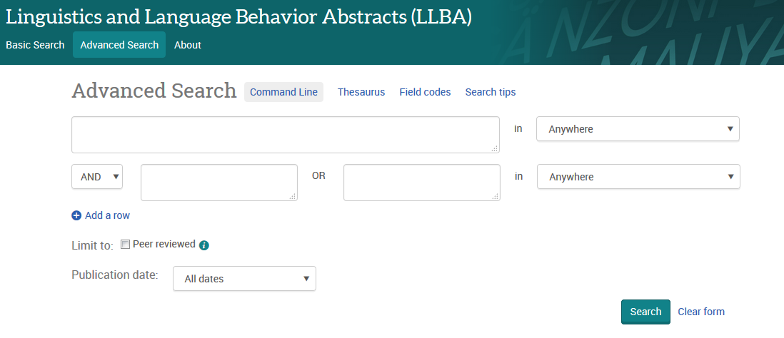
language delay
systematic review
Notes:
Here, you can better structure your search. Because this database does not have a specific filter that would let you limit results to only systematic reviews, you will need to include it in the search. Let’s do a sample search of “language delay” AND “systematic review”.

Slide 52
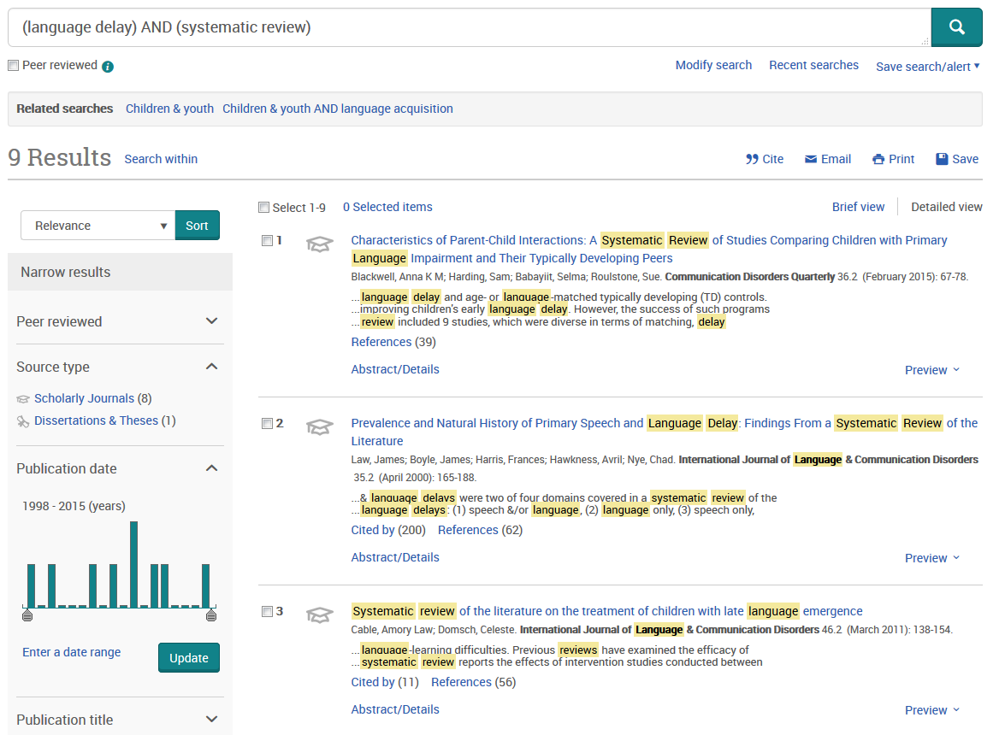
Notes:
We have 9 results! To see an example, click on the title of the first result.

Slide 53
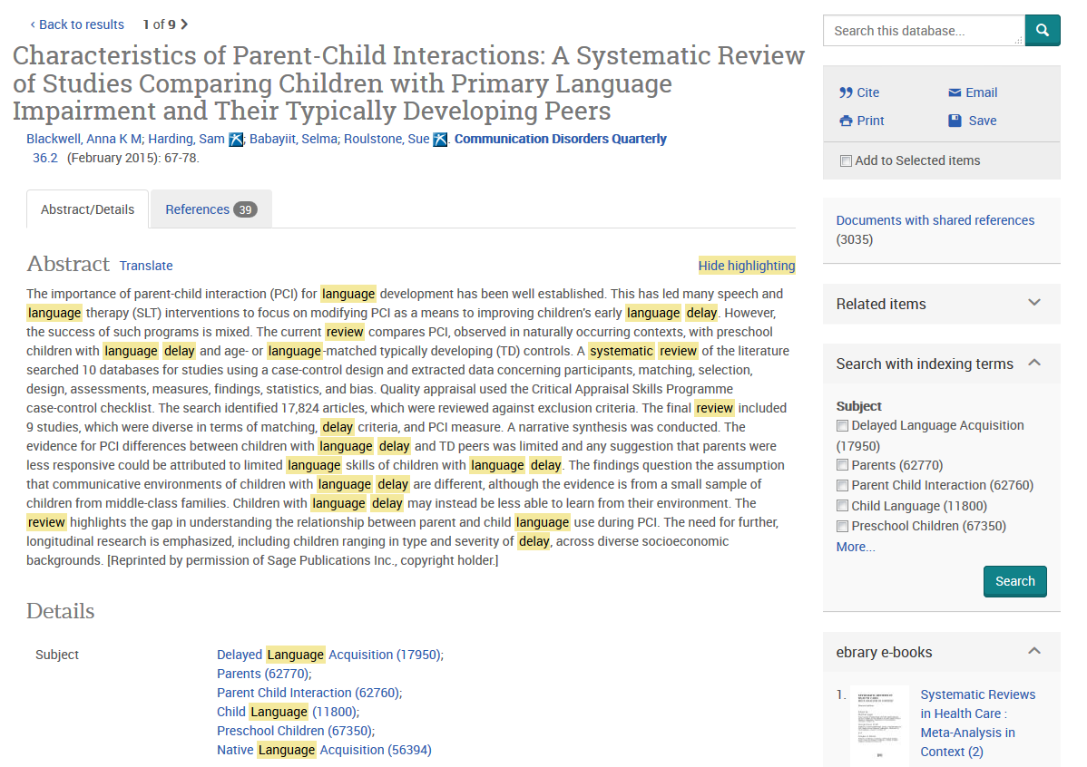
Scroll down for article information, then check Gold Rush.
Notes:
Here is the abstract for the article, as well as other information. Linguistics and Language Abstracts unfortunately does not support any link outs to Gold Rush. In order to determine if this article is available in our holdings, you’ll have to glean the citation information from this page, then search Gold Rush on your own.

Slide 54
Gold Rush
Notes:
If you have a citation for a journal article and need to see if it’s in the library’s collection (perhaps you found an article with a full text link that didn’t work properly or didn’t have a link at all, and you would like to double check to see if we have it), Gold Rush is the place to go. It’s located either under “Other Popular Resources” or in the “Journals” tab towards the top of the page.

Slide 55
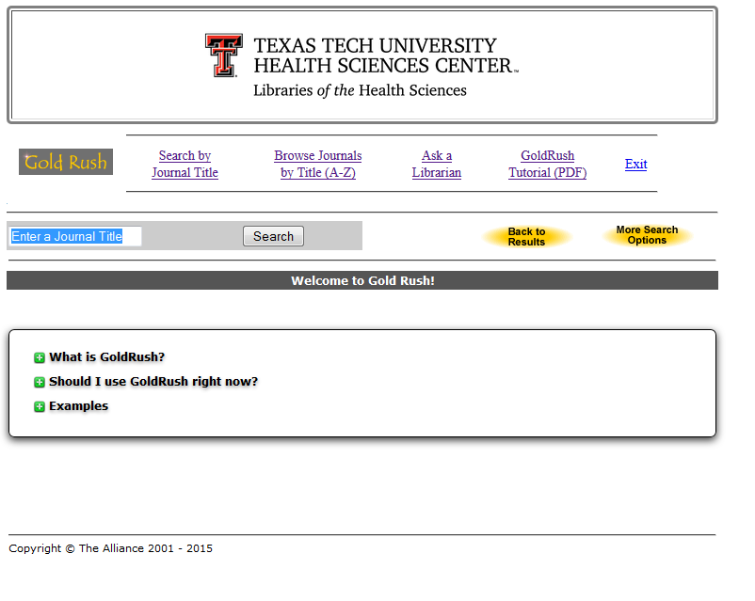
communication disorders
Notes:
This is the main Gold Rush page. It includes some additional information about this tool as well as links to tutorials and other helpful resources, including an “Ask A Librarian” link if you need help. To give you an idea of what searching for a journal looks like in Gold Rush, let’s do a search for a journal. You can enter the full title, or just the words you remember. As an example, search for “communication disorders”.

Slide 56
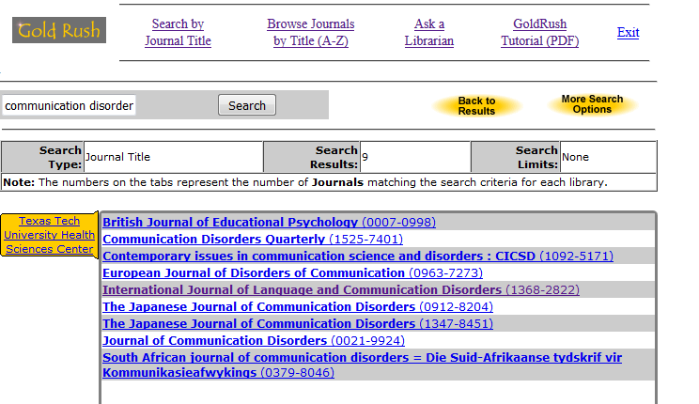
Notes:
This is the list of all the journals we have that have the words “communication disorders” in them. From the list, choose the exact title you want.

Slide 57
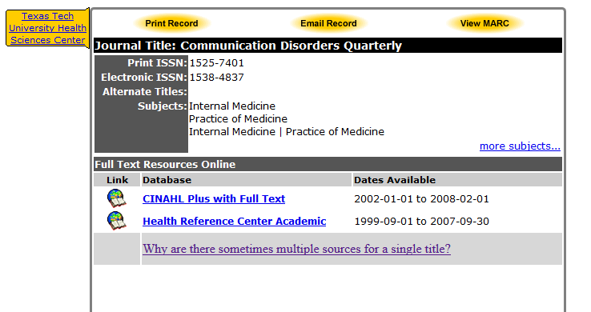
Notes:
The site will then direct you to a page that has some information about the journal, a link to search for it in our print collection, and links to the full text online (when applicable). Notice that this journal has four online options. Some journals have only one and some you encounter might have this many or more. How then do you choose which online option to click? The best way is to look at the “Dates Available” information to the right of the online links. Look at the year in which your article was published, then look at the dates available and find one that has the year you need. When you click on an online link, you will then need to find the year, volume, and issue of the journal, then scroll until you find your article. There should be a full text option from there.

