Slide 1
TTUHSC Preston Smith Library
presents
Pharmacy
Information Resources
Rev. 08//12

Slide 2


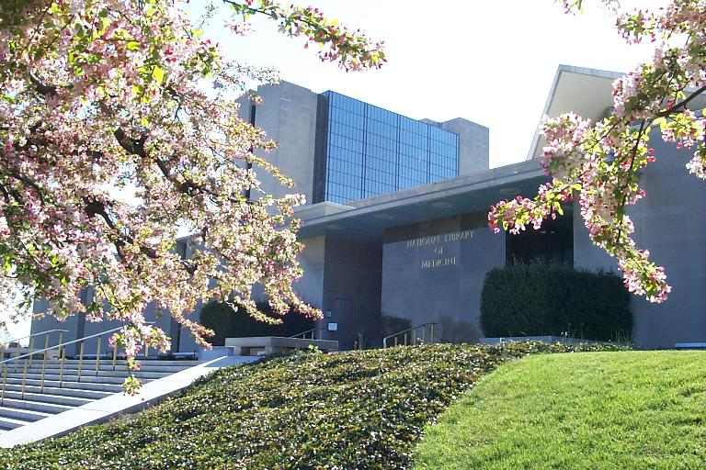
PubMed Database
Biomedical journal literature
International scope
Published by:
The National Library of Medicine

Slide 3

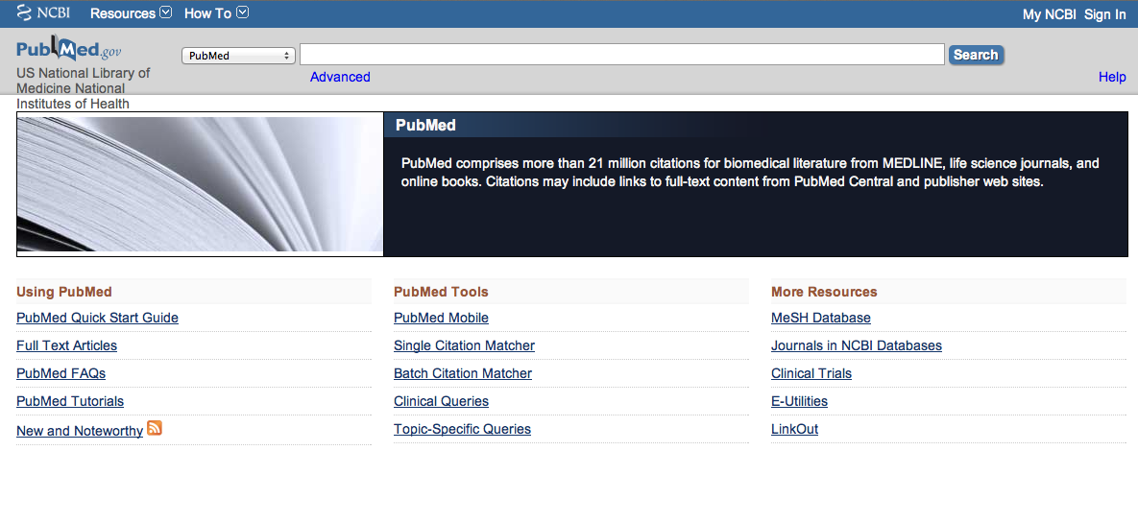
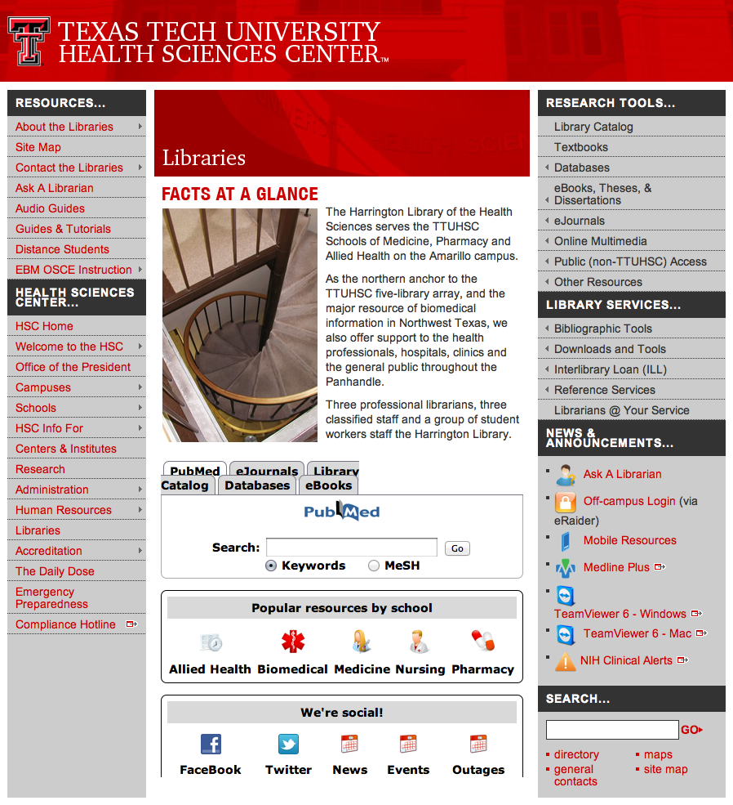
Accessing PubMed
Freely available over the Internet
@ www.pubmed.gov
Also through library’s home page

Slide 4


Evidence-Based Practice is guided by thoughtful integration
of the best available scientific knowledge with clinical expertise.

Slide 5
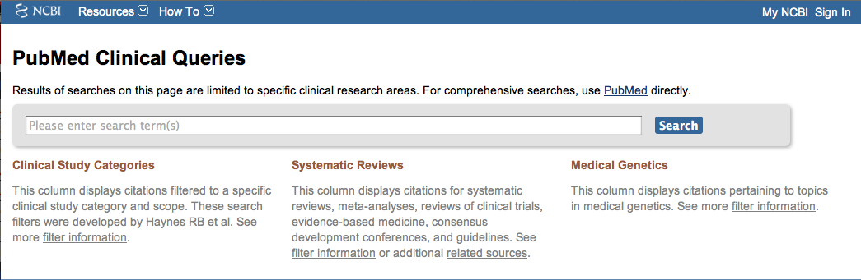
PubMed’s Clinical Queries
tool that searches for evidence-based literature

Slide 6

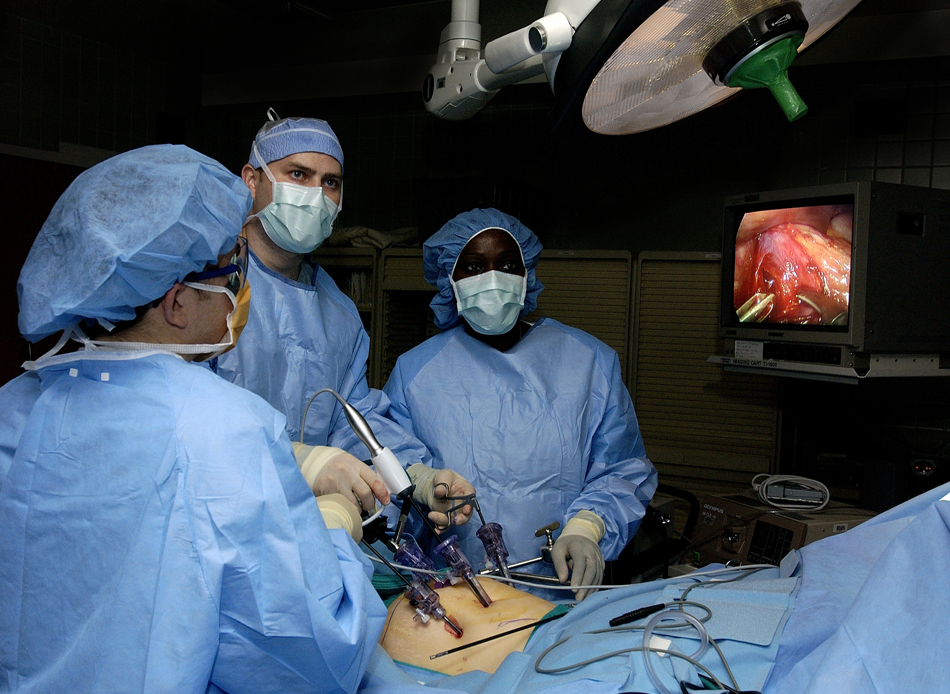
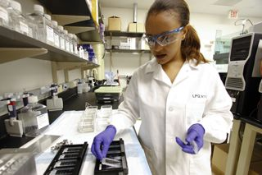
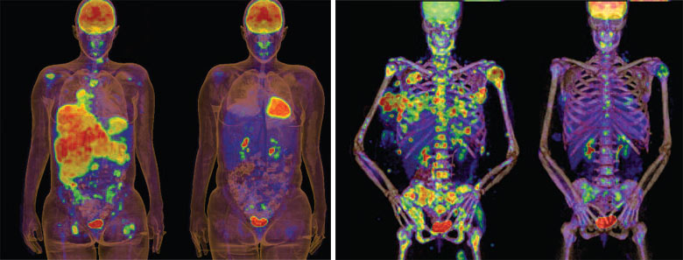
Clinical Queries Searchable by:
Diagnosis
Therapy
Prognosis (prediction of probable outcome)
Etiology (cause)

Slide 7
Clinical Queries Searchable by:
Diagnosis
Therapy
Prognosis (prediction of probable outcome)
Etiology (cause)

Slide 8
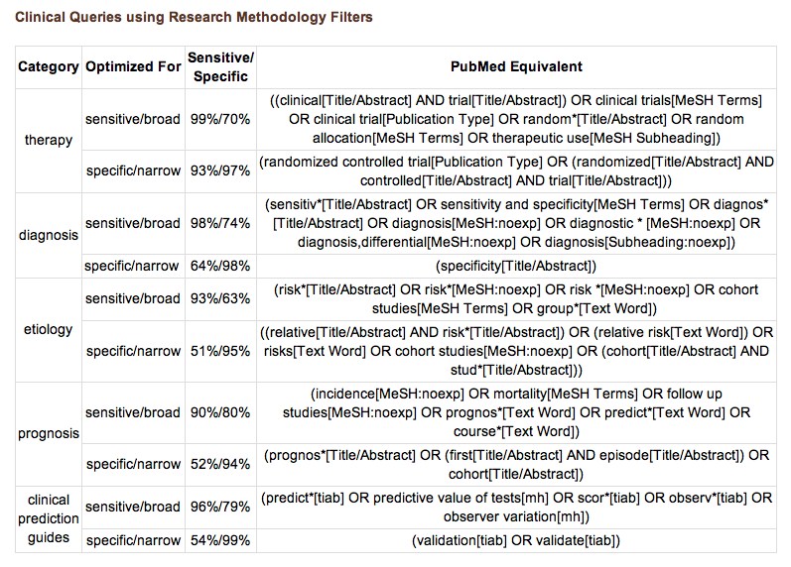
PubMed’s Clinical Queries
uses pre-formulated search strategies with a keyword search

Slide 9
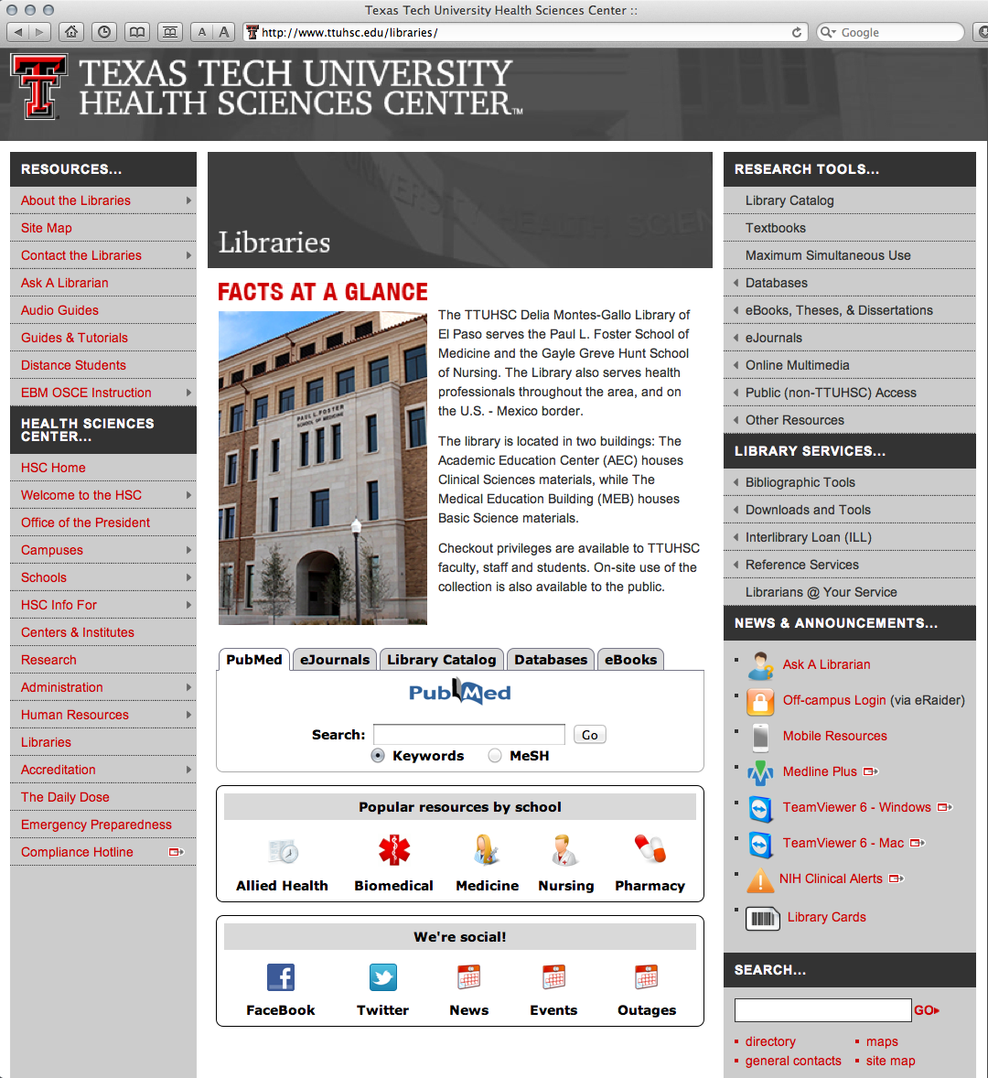
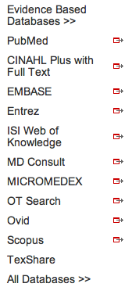
www.ttuhsc.edu/libraries
Mouse over Databases
Click PubMed

Slide 10
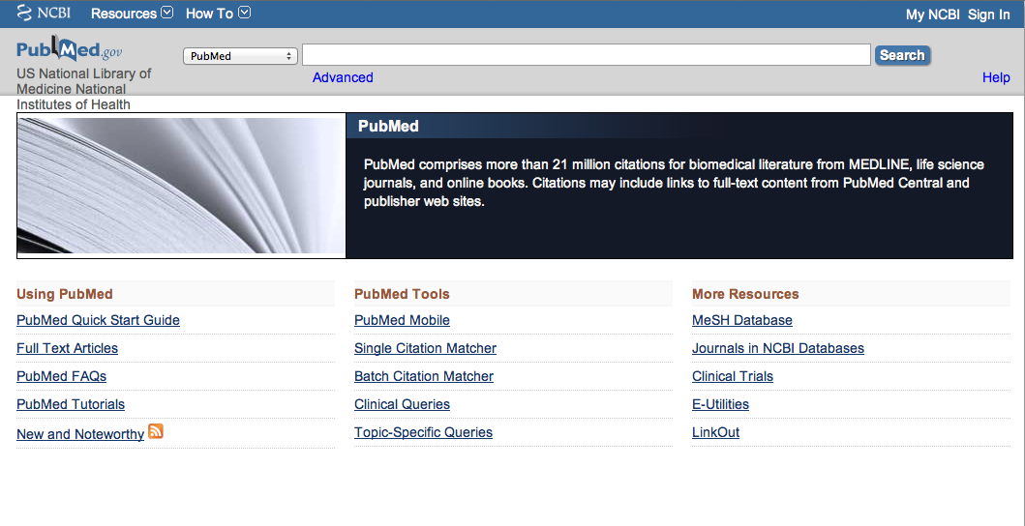
Click Clinical Queries

Slide 11
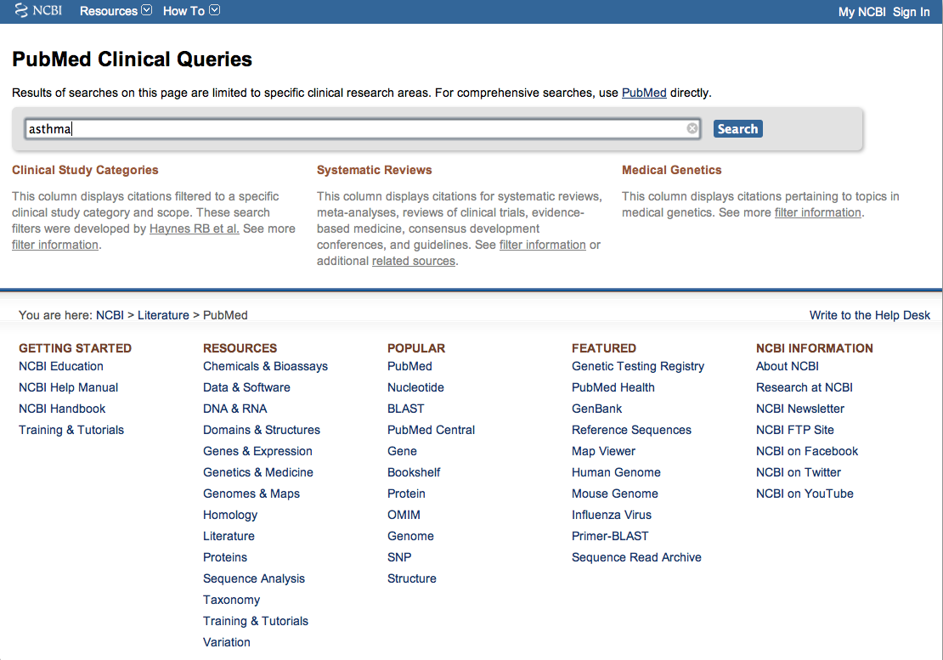
Enter asthma
Click
Search

Slide 12
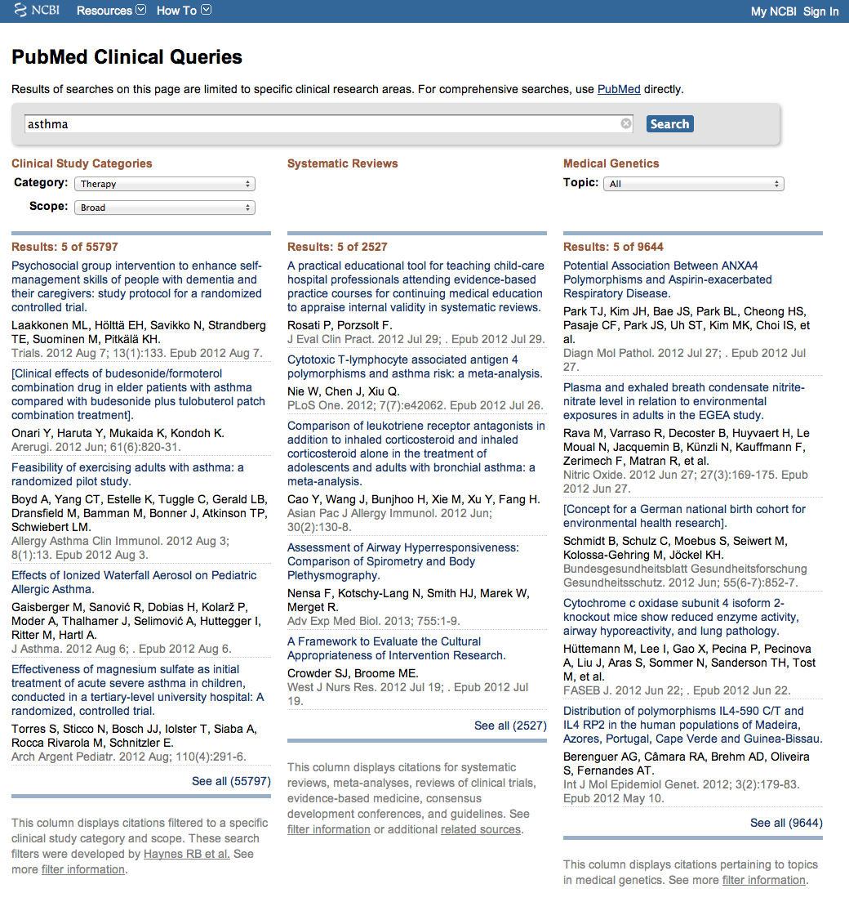
Results for Therapy and
Broad Scope
Change to Narrow Scope

Slide 13
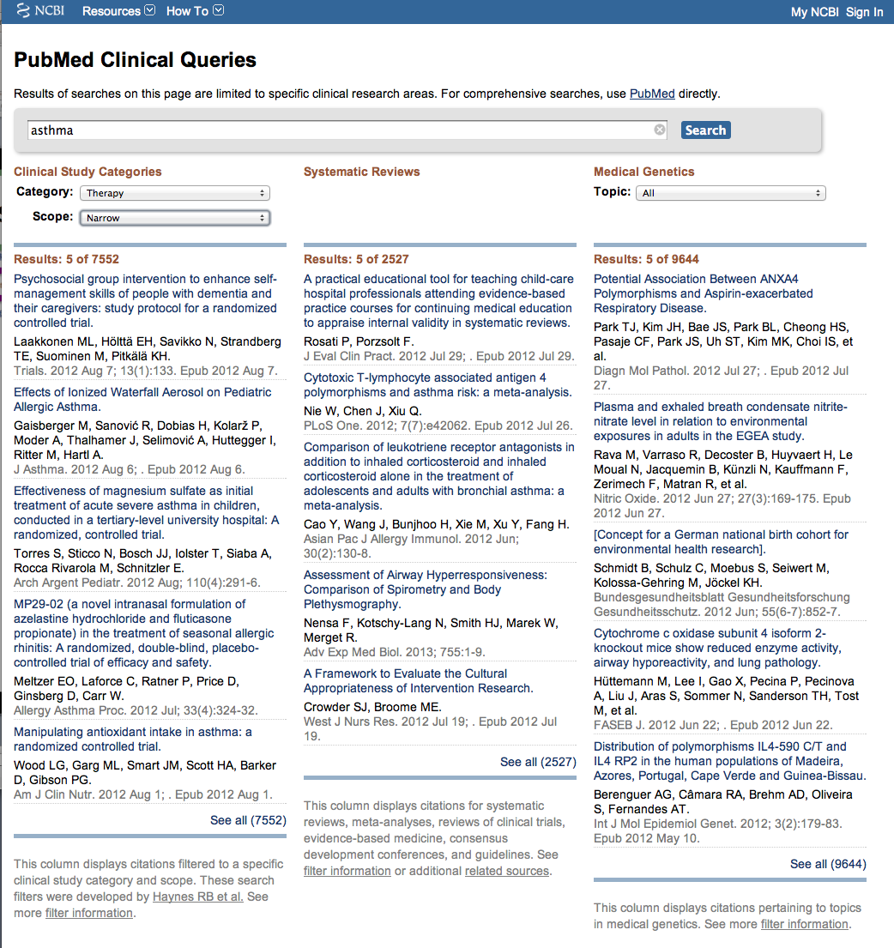
Results for Therapy and
Narrow Scope
Click See all (7552)

Slide 14
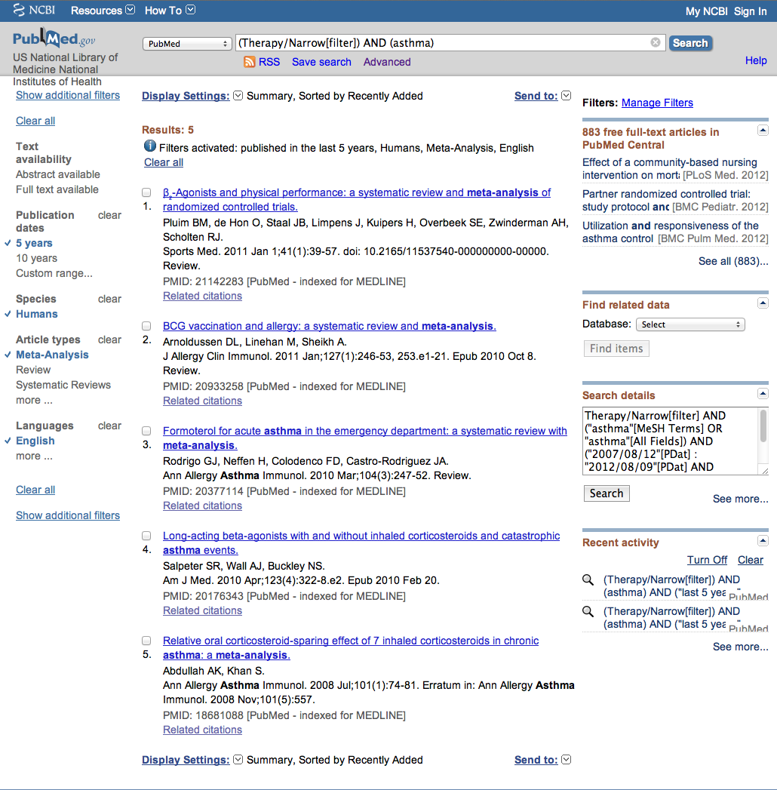
Click Limits

Slide 15
Click on the article title you wish to read

Slide 16
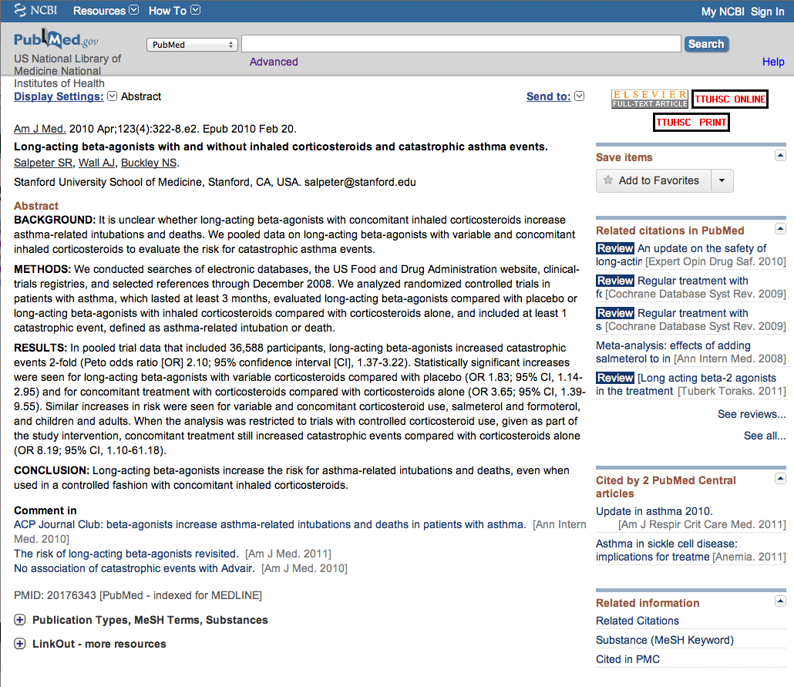
Click for Free Full Text
TTUHSC ONLINE

Slide 17
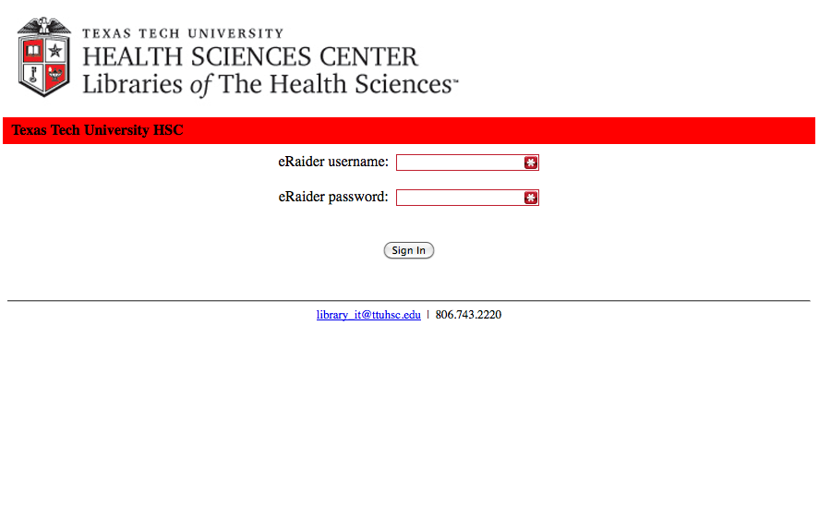
TTUHSC Libraries - Proxy Server
When Searching from Off Campus:
Enter the
Eraider username and password
assigned to you
by Information Services.
A
Problems with eRaider call: 806-743-2870 or 806-743-2875
a

Slide 18

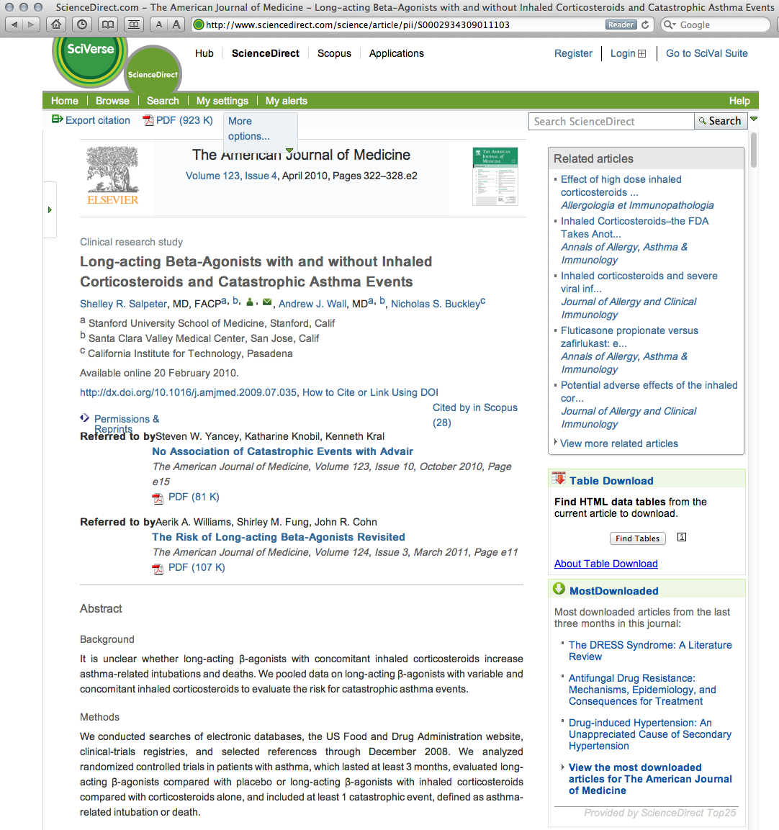
Click

Slide 19
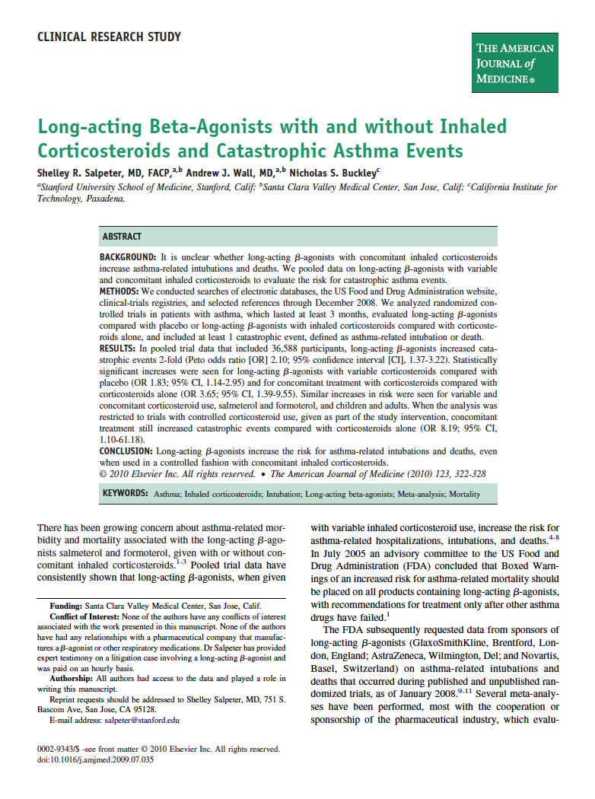
Full Text

Slide 20
EMBASE
* Major strength is drug-related information
* Biomedical & pharmaceutical research literature
* Contains article citations; over 80% include abstracts
* International in scope; covers @5,000 journals
* Compared to PubMed, 2,000 journals are unique
* Updated daily

Slide 21
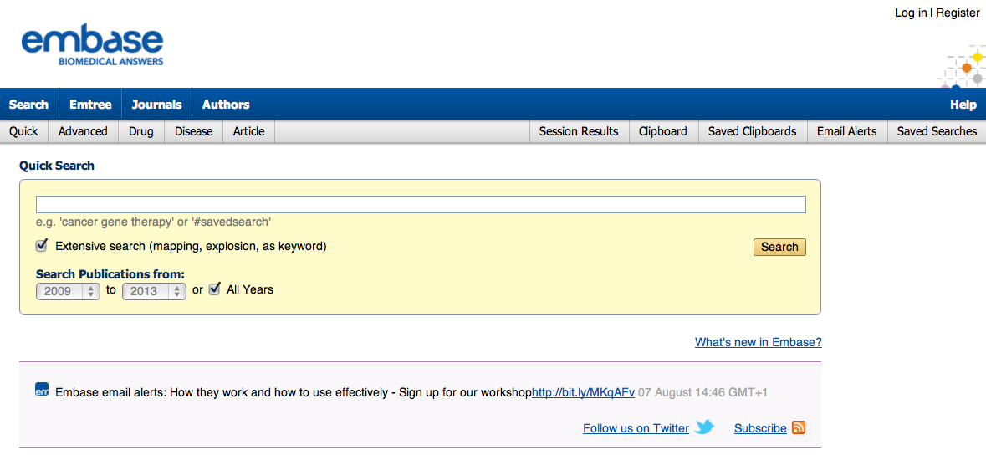
Main Search Page

Slide 22
Click EMTREE Tool

Slide 23
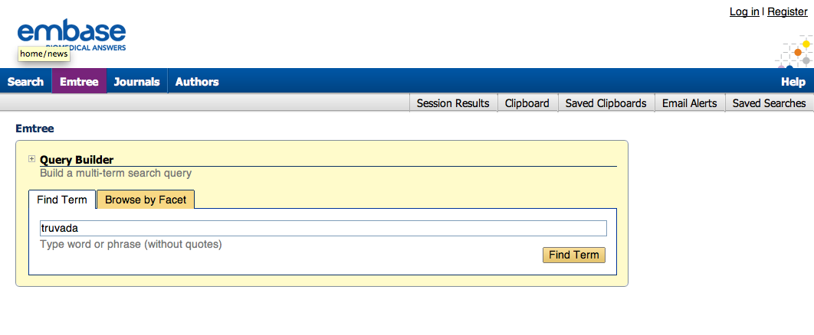
Click Find Term
Enter
truvada

Slide 24
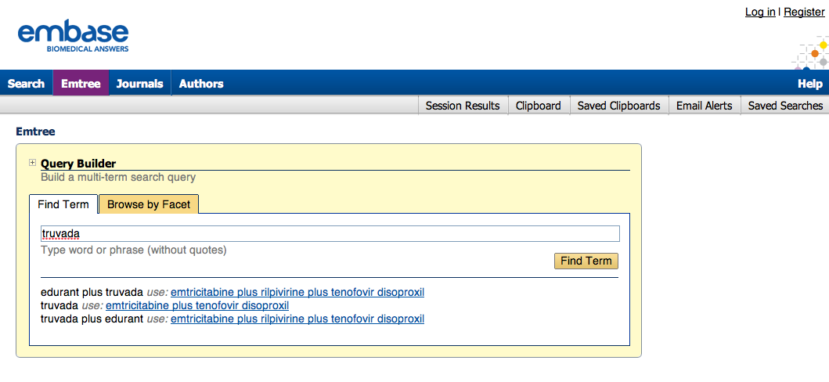
Expanded term list

Slide 25
Click term

Slide 26
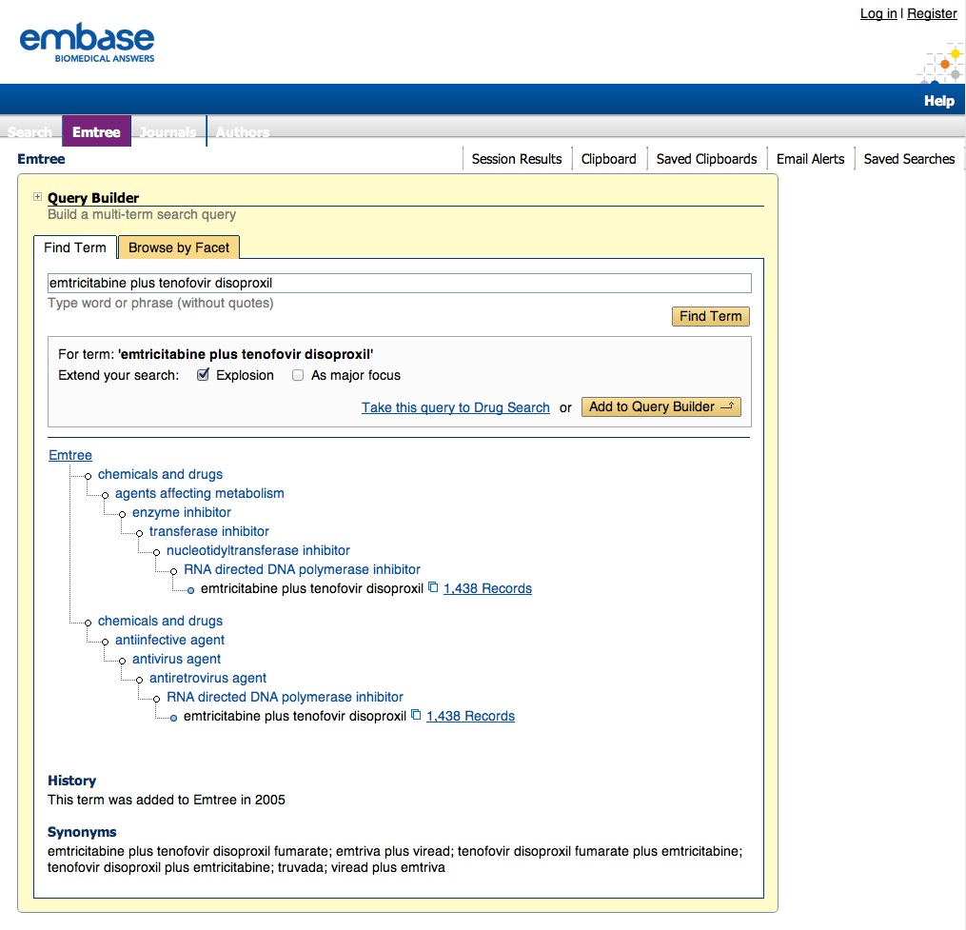
EMTREE hierarchy

Slide 27
Click Add to Query Builder

Slide 28
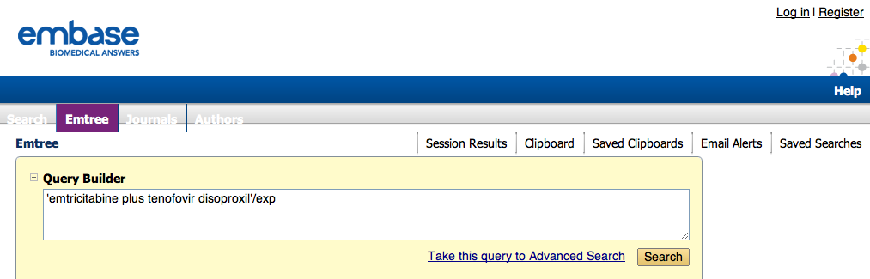
Click Search

Slide 29
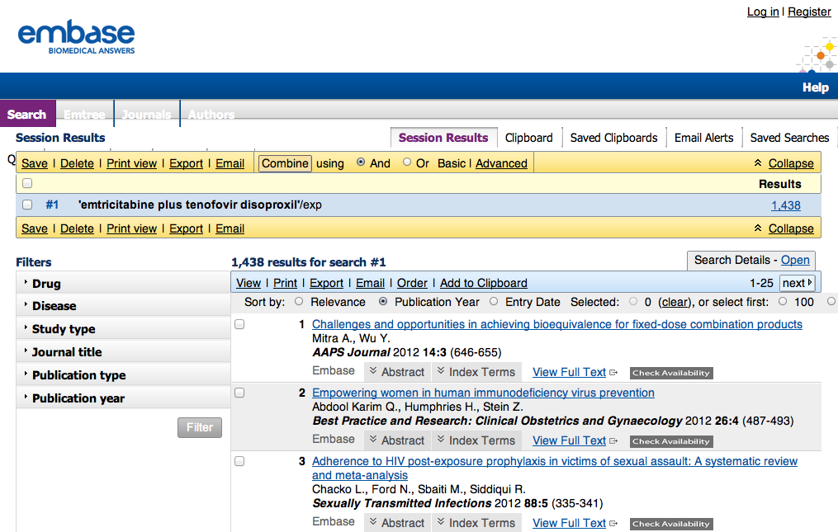
Click Study type

Slide 30
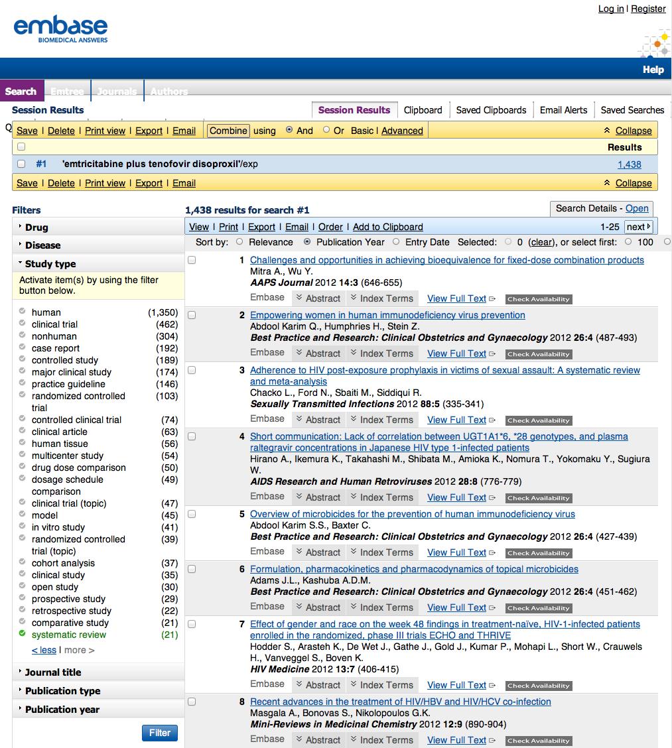
Select systematic review

Slide 31
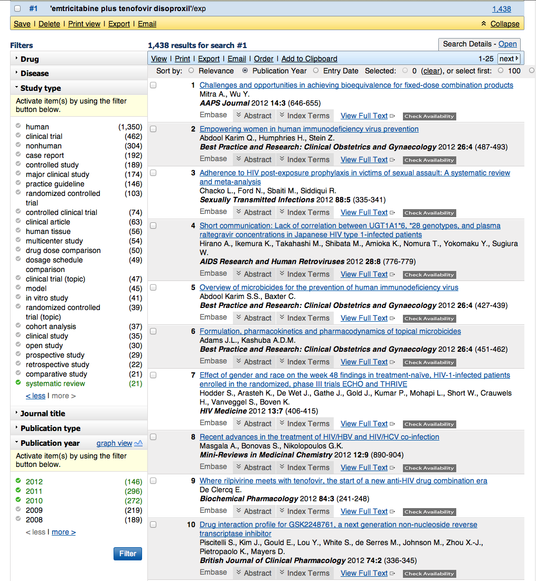
Select to 2008 – 2012
Click Filter

Slide 32
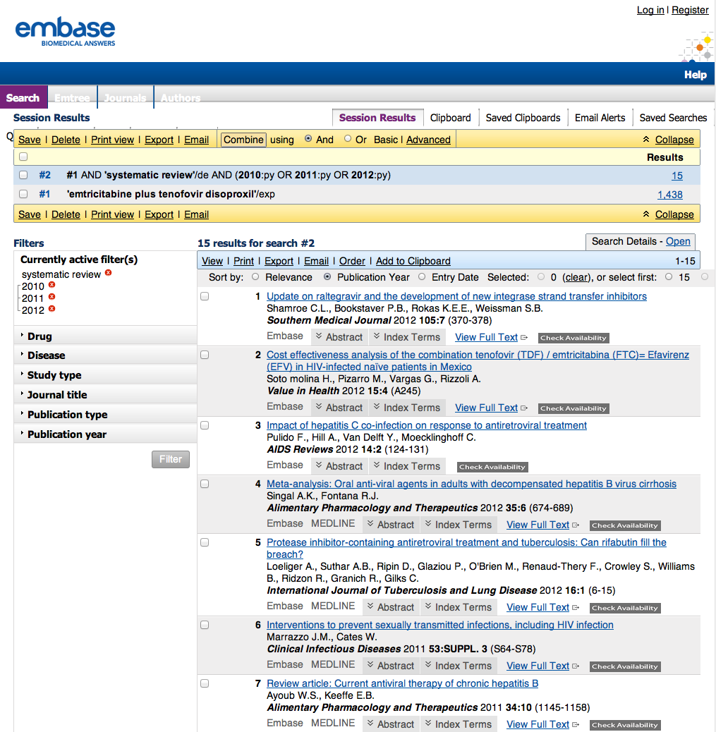
15 Results
Click View Full Text

Slide 33
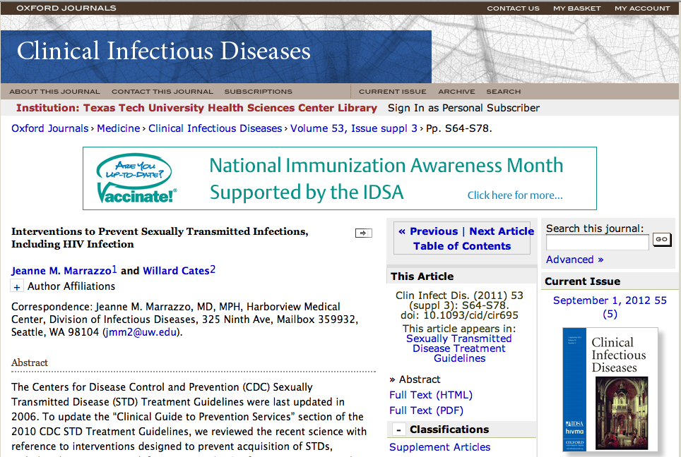
1
Click PDF

Slide 34
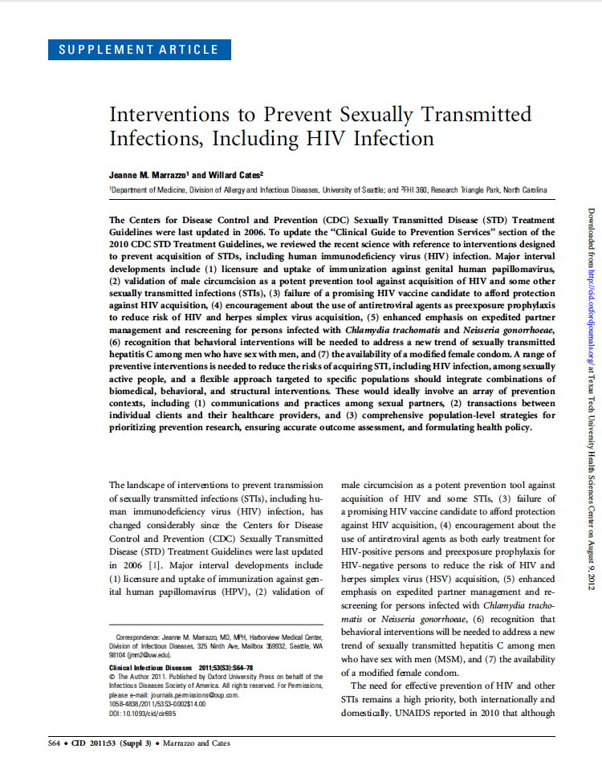
Full Text Article

Slide 35
Gold Rush
Access to library subscribed e-journals
Search by journal title
*
*

Slide 36

www.ttuhsc.edu/libraries
Mouse over eJournals
Click Gold Rush

Slide 37
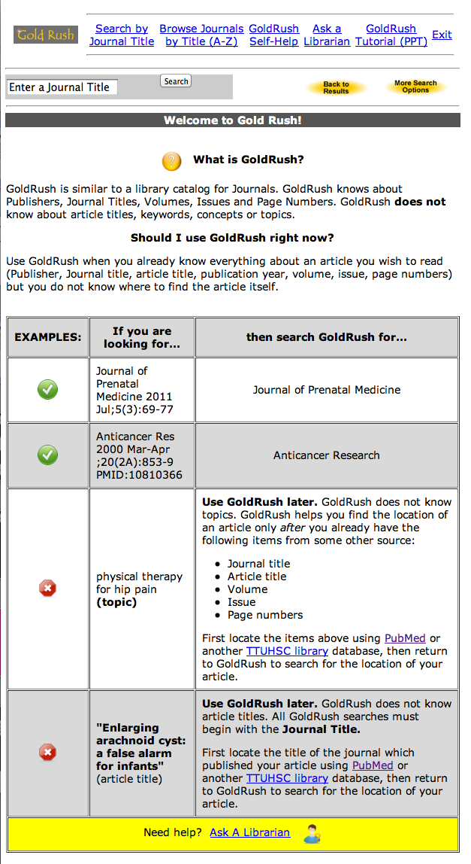
Instructions for using

Slide 38
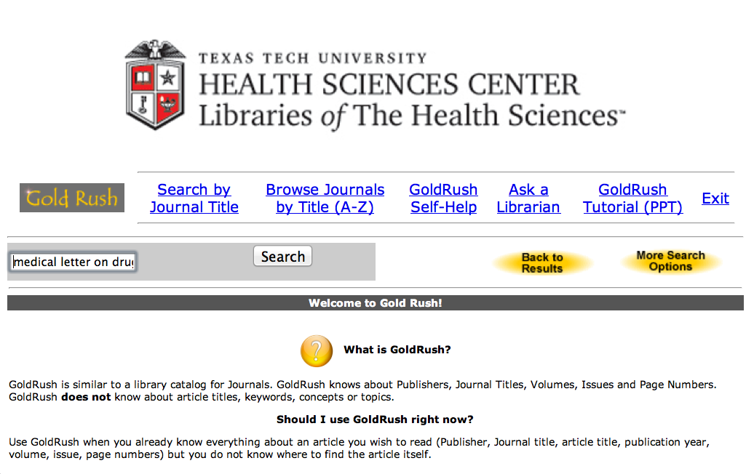
Enter
medical letter on drugs and therapeutics
Click
Search

Slide 39
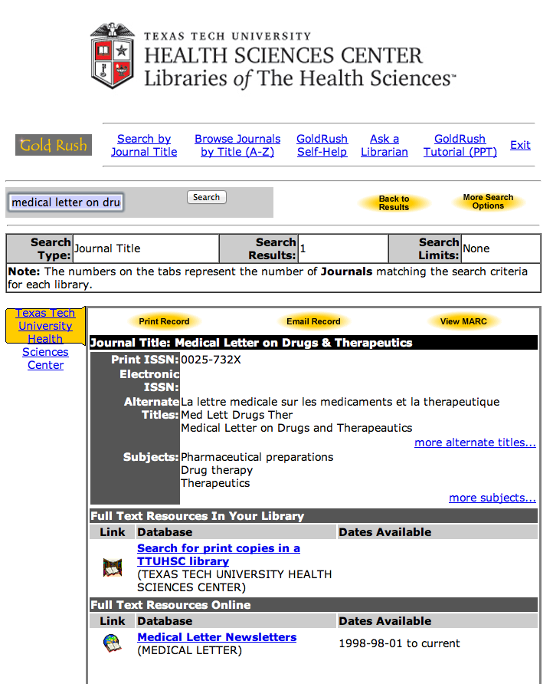
1) Check Dates Available
2) Click Publisher

Slide 40
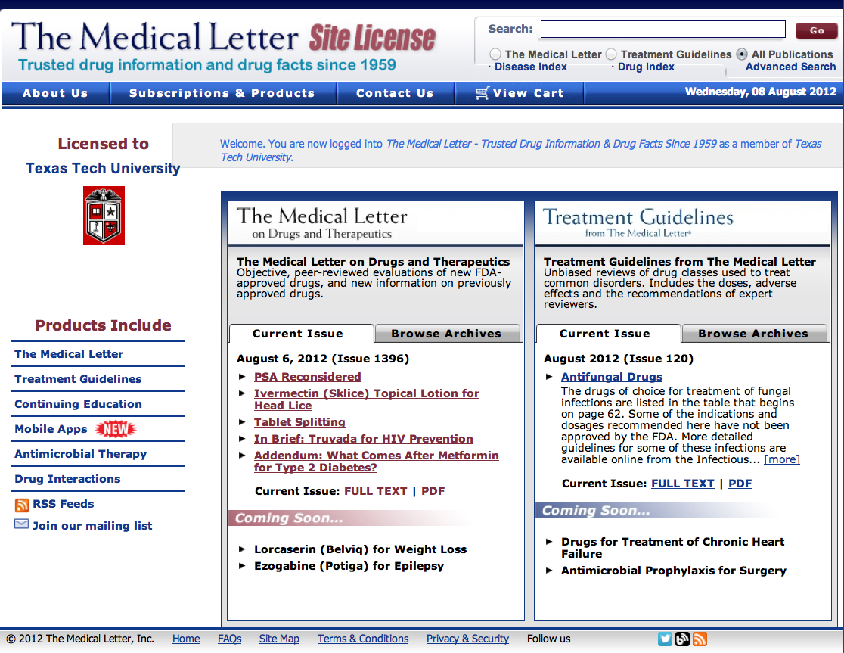

Slide 41
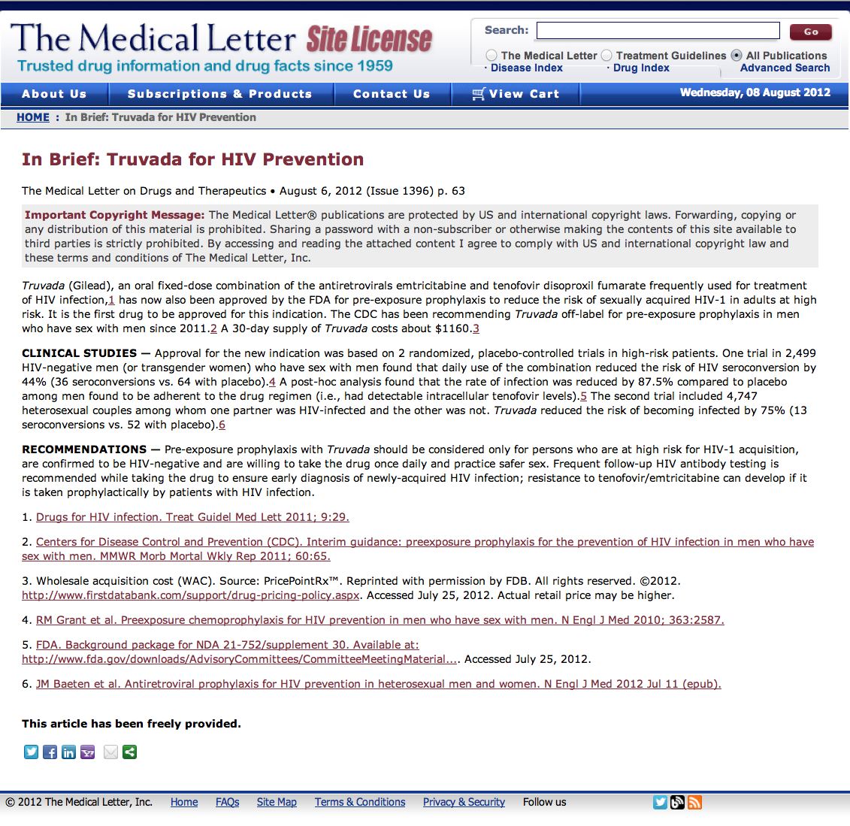
Full Text

Slide 43
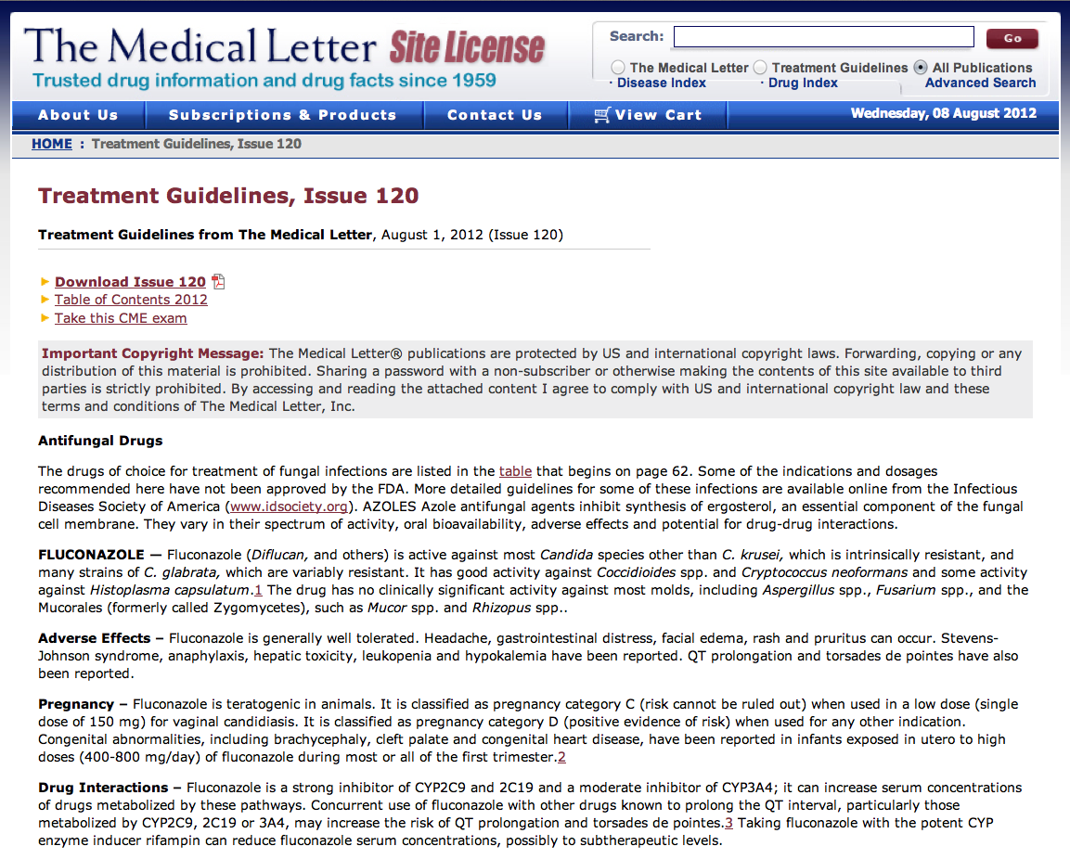
Full Text

Slide 45
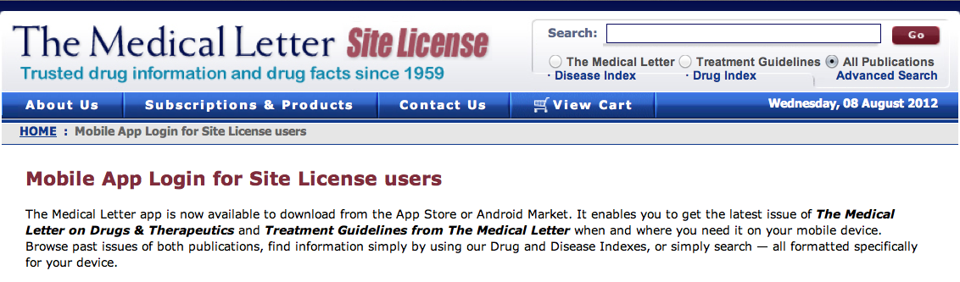
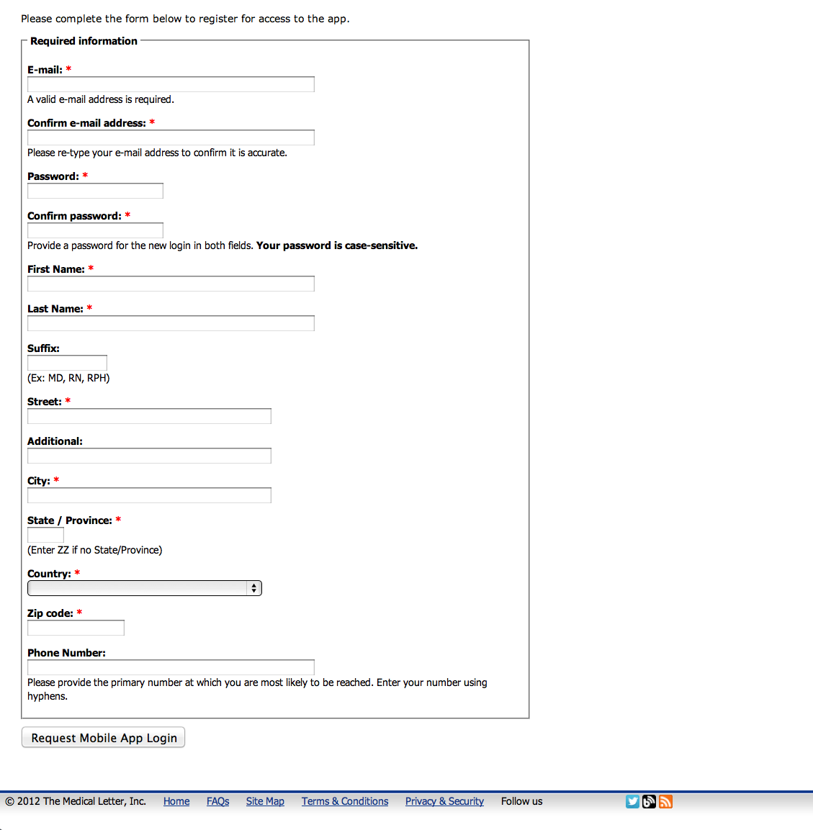
Fill out application

Slide 46
Other NLM Databases

Slide 47
www.ttuhsc.edu/libraries
Click Databases

Slide 48
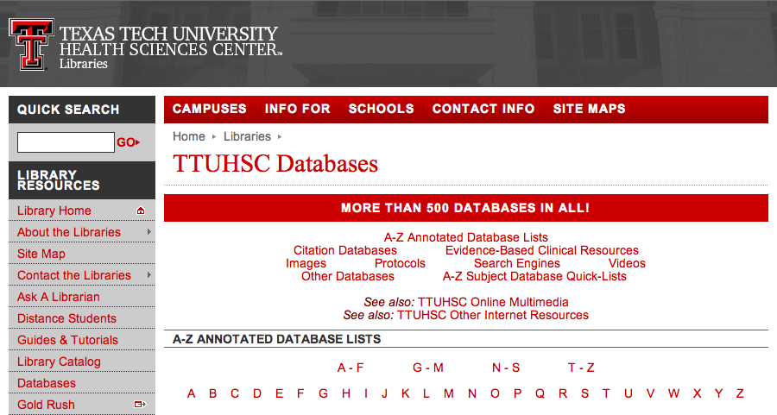
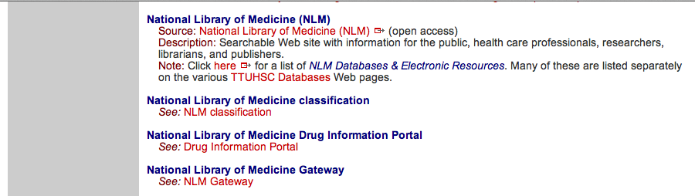
Click “N”
Scroll and click National Library of Medicine

Slide 49
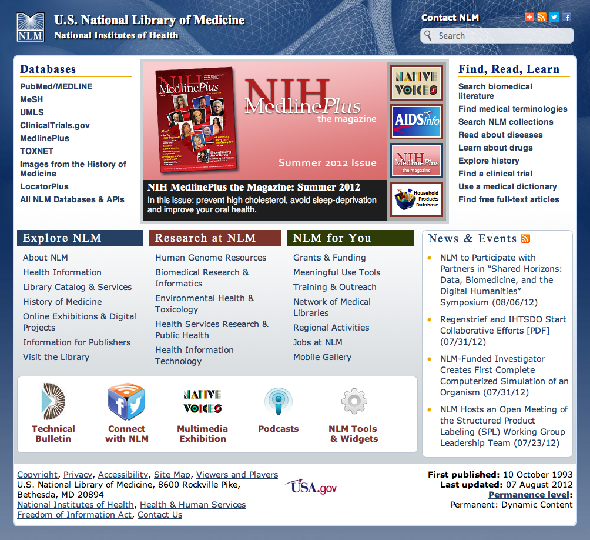
Click All NLM Databases & API’s

Slide 50
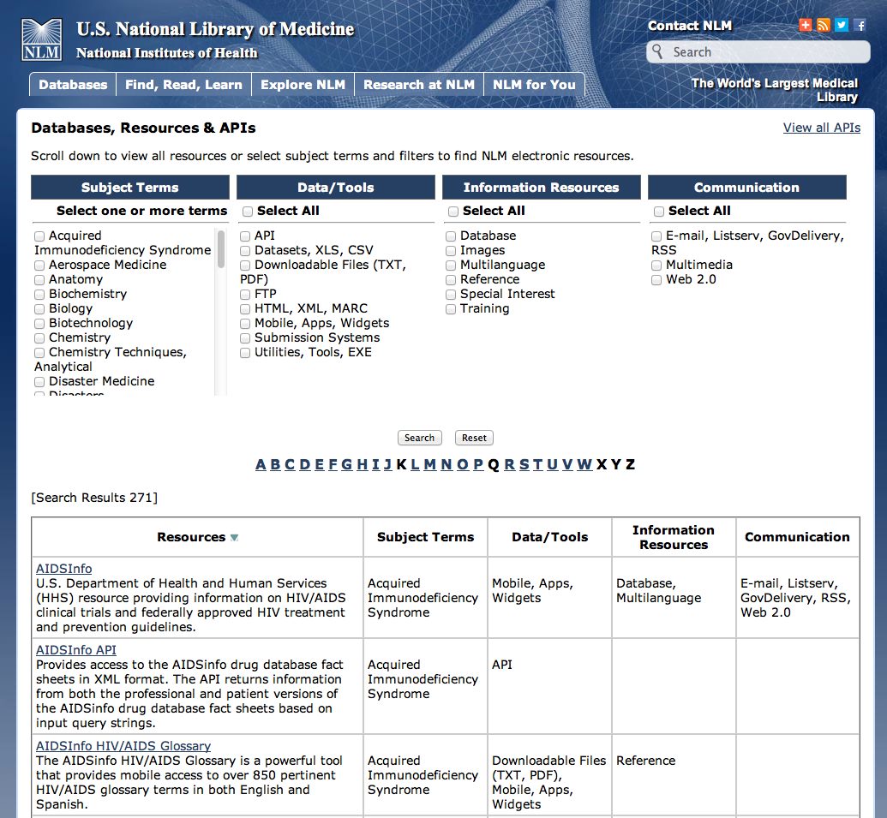
Locate and Click Database Name

Slide 51
ChemIDplus

Slide 52
ChemIDplus
online dictionary
chemicals, including names, synonyms, and chemical structures
ChemIDplus Lite searches name or registry number
Advanced ChemIDplus provides chemical structure, property, and toxicity searching

Slide 53
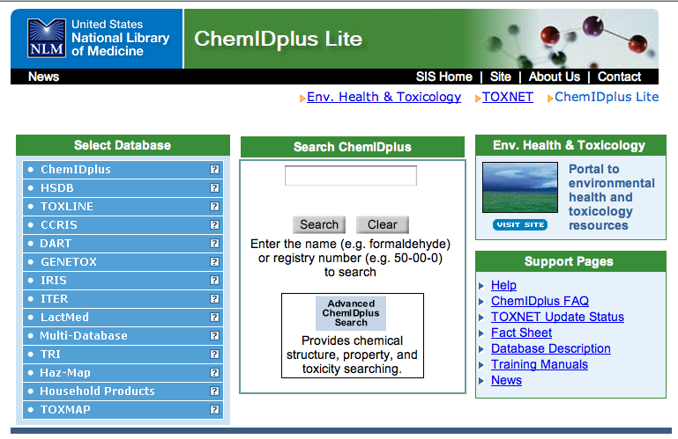
Enter aspirin and click search

Slide 54
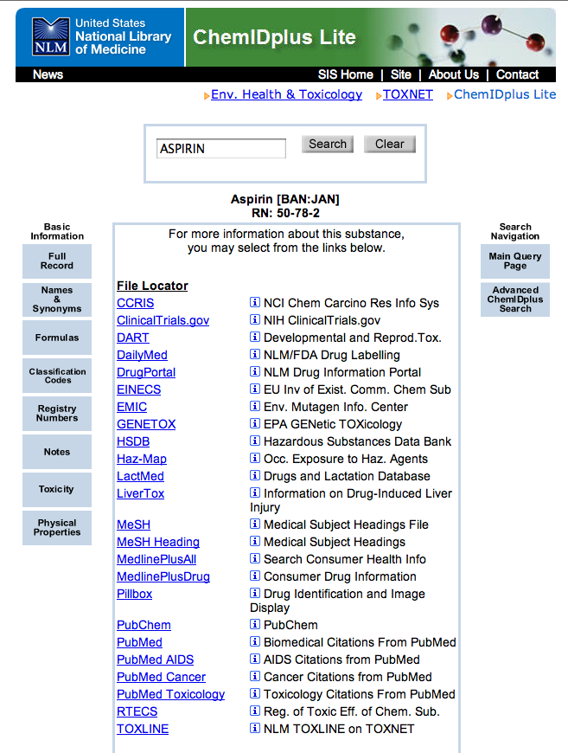
Click Advanced ChemIDplus Search

Slide 55
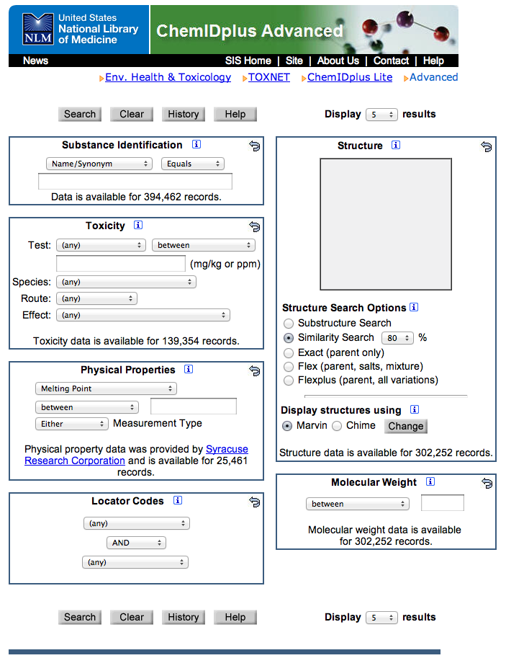
Search Options

Slide 56
Clinical Trials.gov

Slide 57
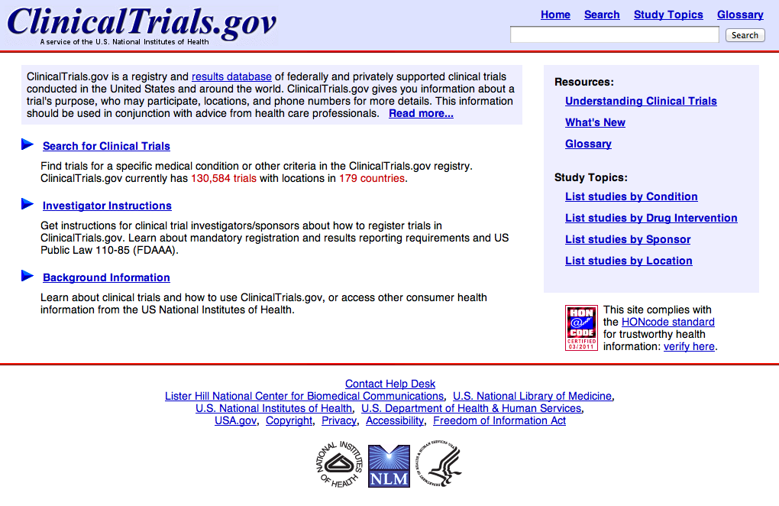

Slide 58
DailyMed

Slide 59
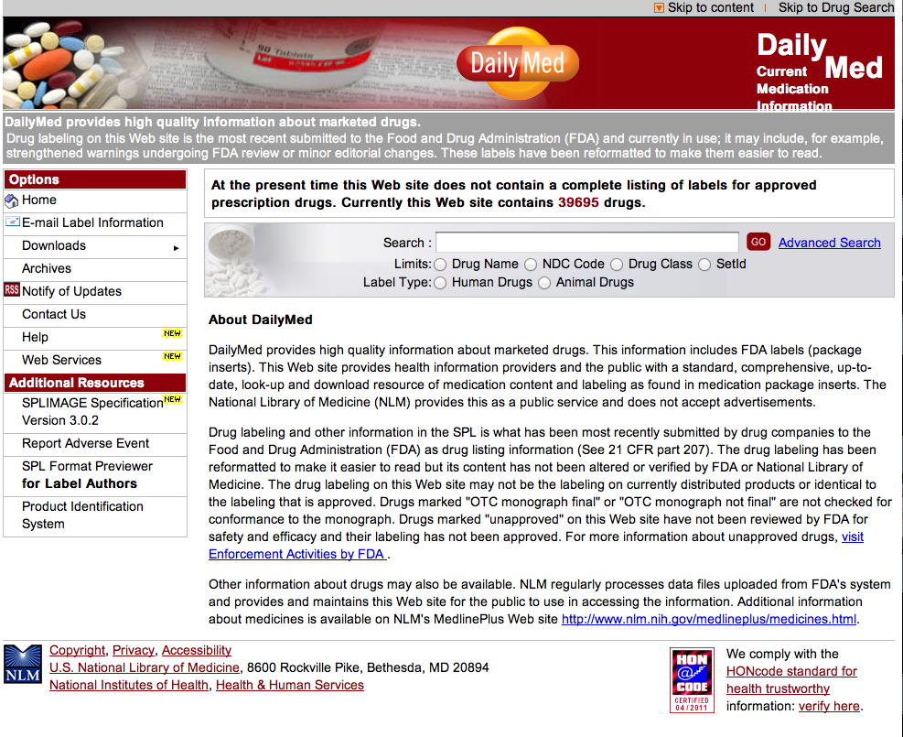

Slide 60
Dietary Supplements
Labels Database

Slide 61
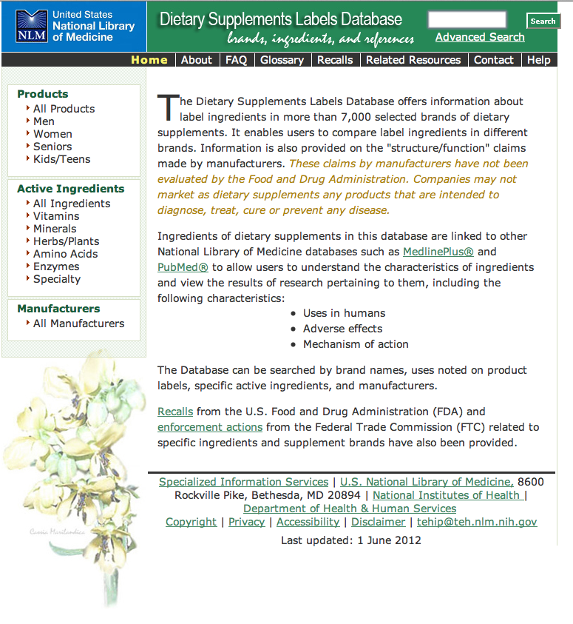

Slide 62
Drug Information

Slide 63
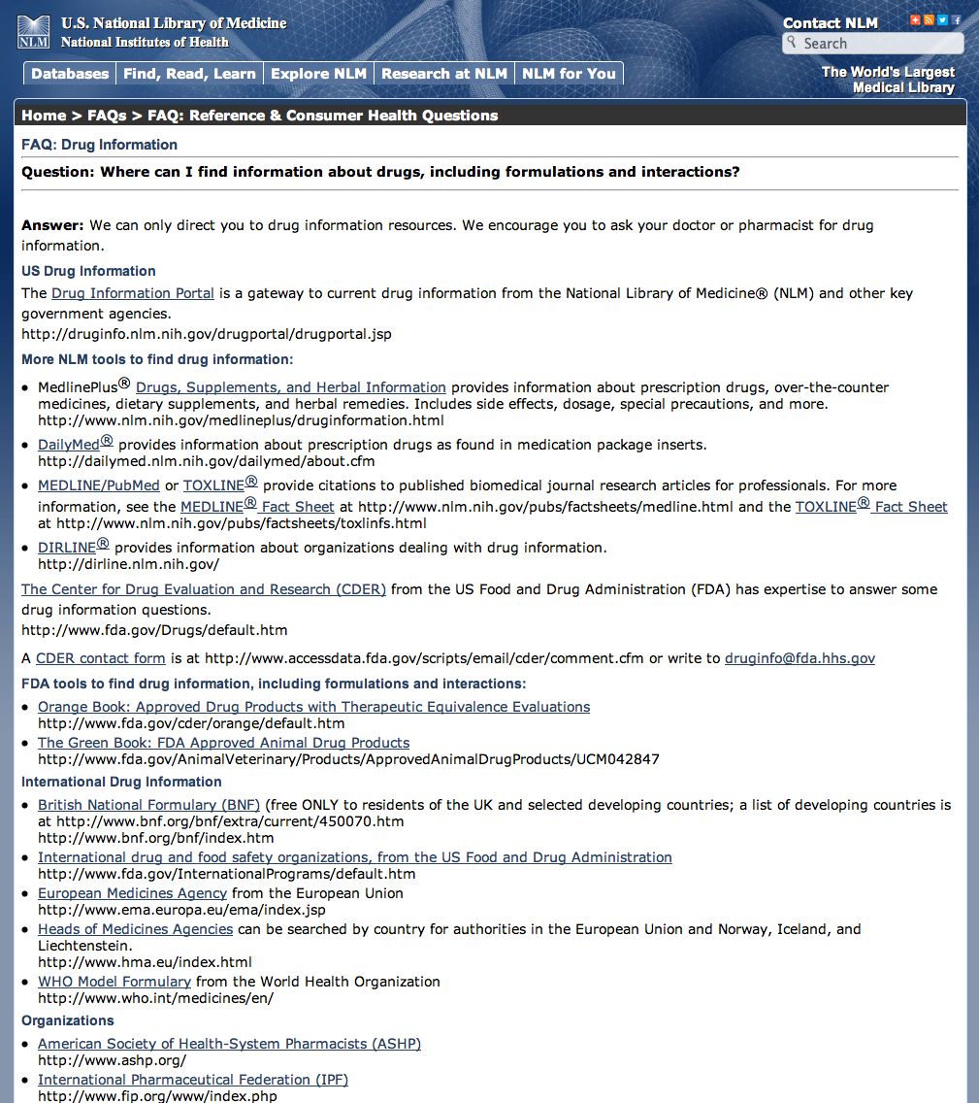
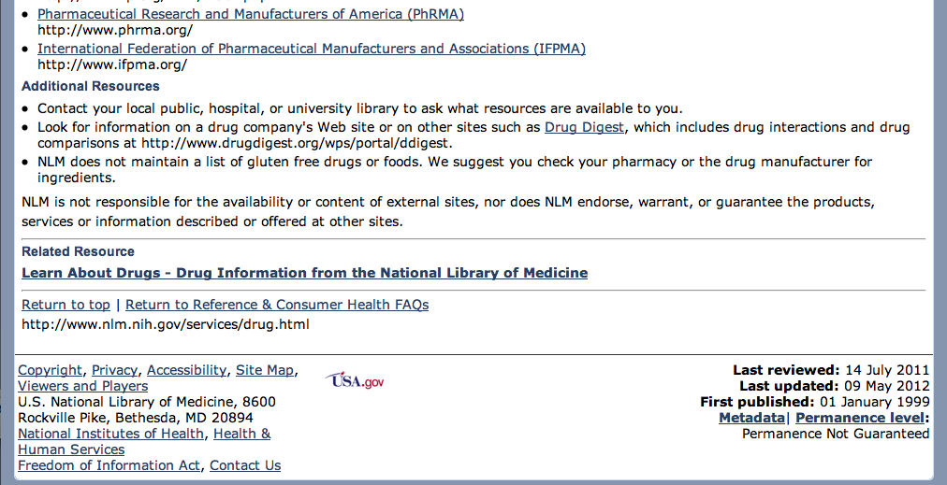

Slide 64
Drug Information Portal

Slide 65
Drug Information Portal
gateway
current, accurate drug information
33,368 drugs
NLM and other key government agencies
Mobile site

Slide 66


Slide 67
Household
Products Database

Slide 68

Product Menu

Slide 69


Slide 70



Slide 71
MedlinePlus

Slide 72

authoritative information for patients

Slide 73

Click Drugs & Supplements

Slide 74
My Medication List

Slide 75

App to help users manage their medications

Slide 76


Slide 77
Pillbox Beta

Slide 78


Slide 79
PubChem

Slide 80


Slide 81
Toxicology
Data
Network

Slide 82


Slide 83


Slide 84
LactMed

Slide 85


Slide 86


Slide 87
NCBI

Slide 88


Slide 89
Plagiarism Resources

Slide 90
www.ttuhsc.edu/libraries
Click Guides &
Tutorials

Slide 91


Slide 92

or contact us at:
Lubbock
(806) 743-2200
Amarillo
(806) 354-5448
El Paso
(915) 545-6652
Odessa
(432) 335-5171

Slide 93
Electronic Evaluations

Slide 94
The End

