Slide 1
Access Products
a collection of information resources and tools

Slide 2
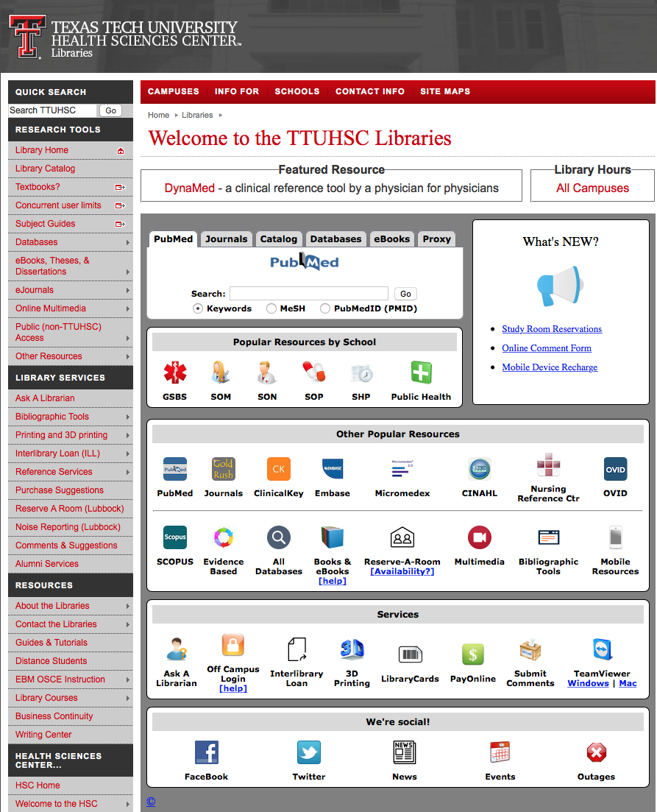
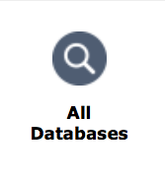
www.ttuhsc.edu/libraries
Click

Slide 3
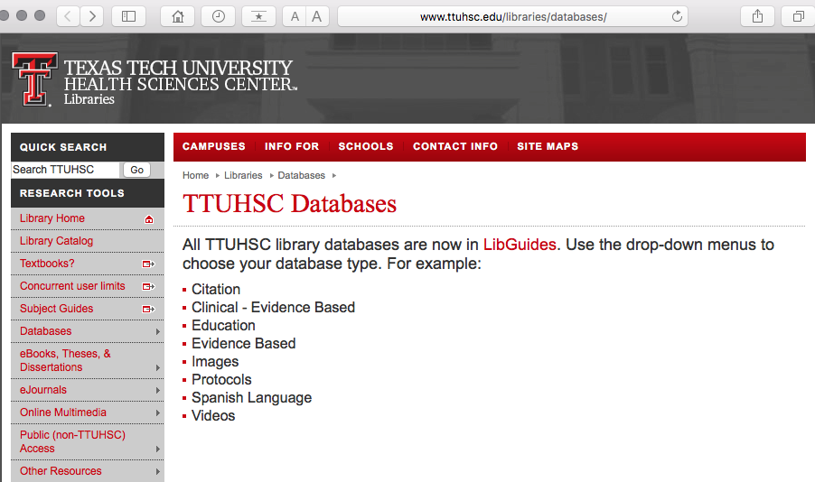
Click LibGuides

Slide 4
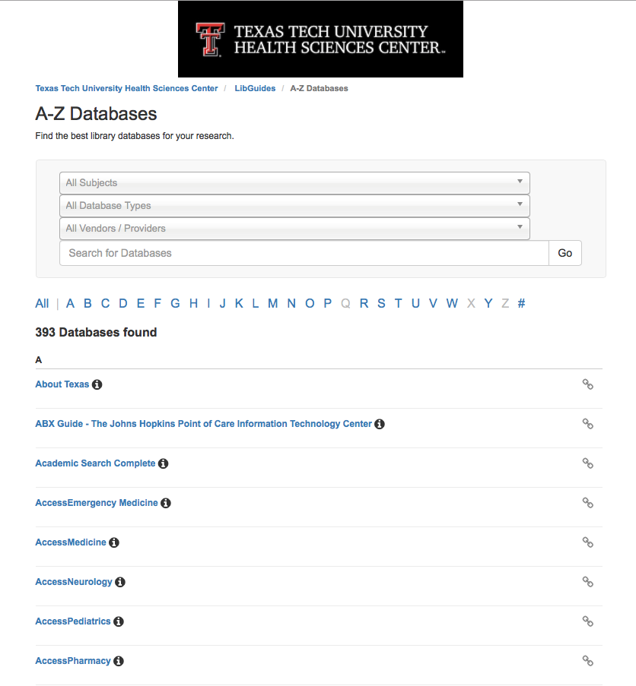
Click appropriate tool

Slide 5
Create a My Access
Account

Slide 6
Click Access Medicine

Slide 7
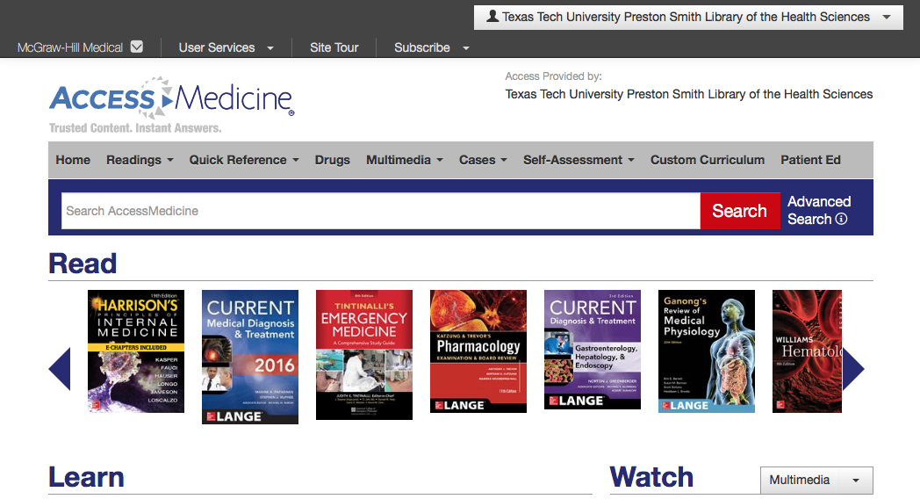
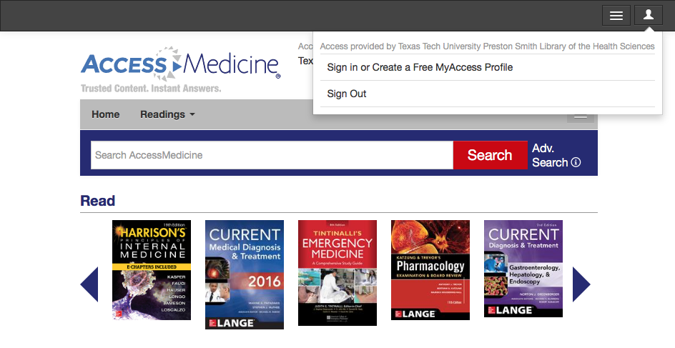
Click the drop down menu

Slide 8
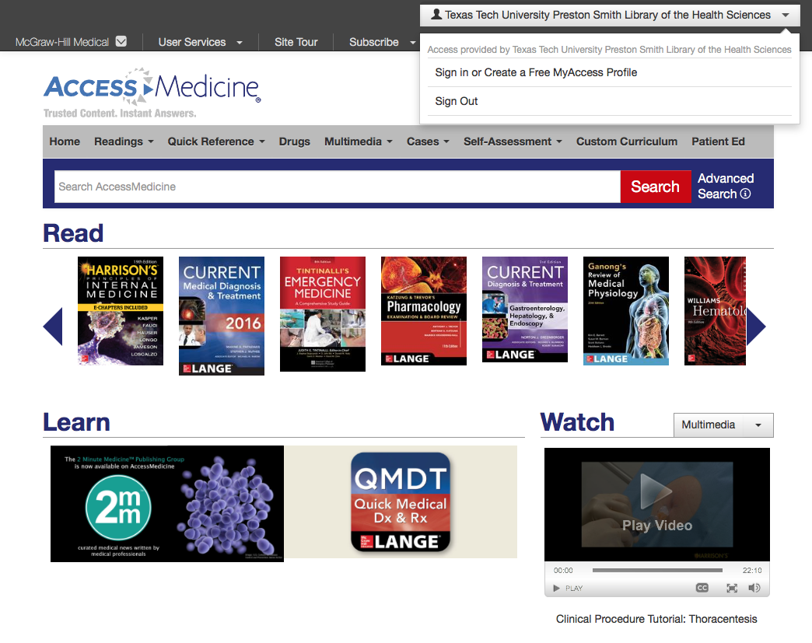
Click Create a Free MyAccess Profile

Slide 9
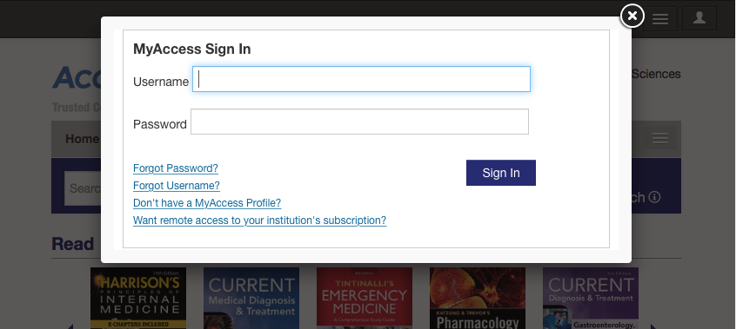
Click Don’t have a MyAccess Profile?

Slide 10
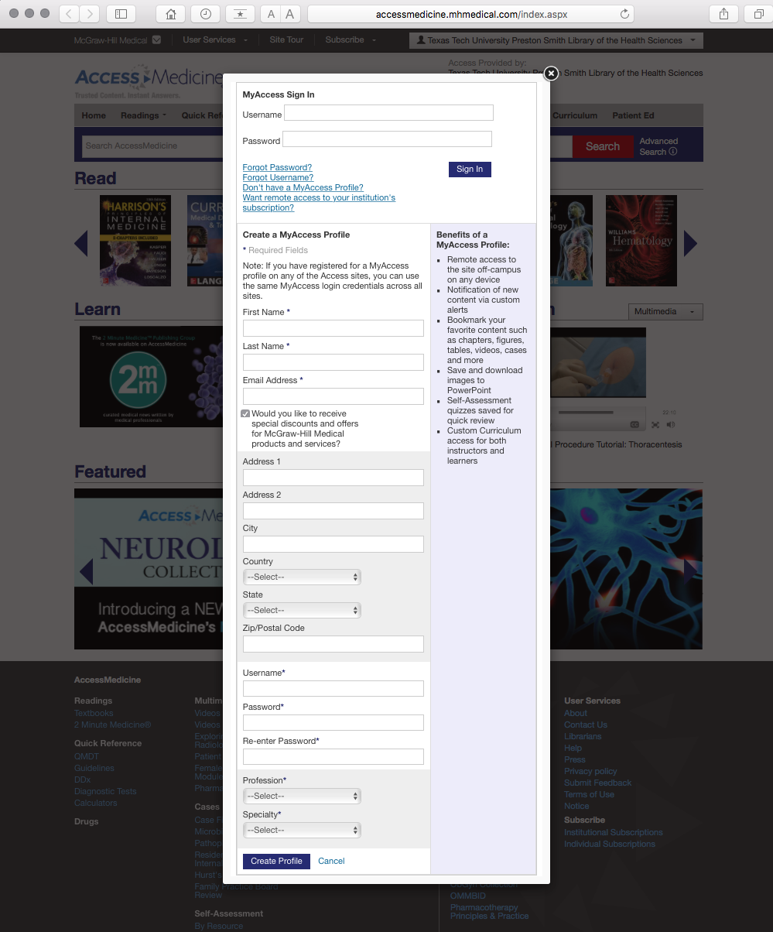
Complete the form

Slide 11
Login to your personal account

Slide 12
Access Medicine

Slide 13
Major Medical Electronic Textbooks – free access!

Slide 14
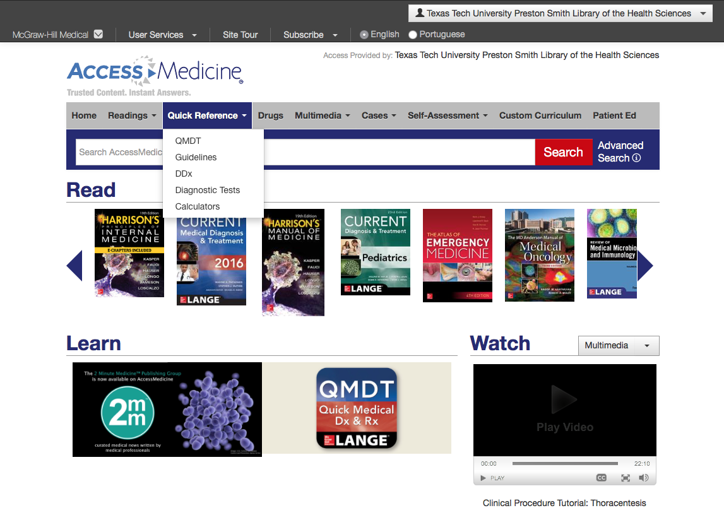
Click Quick Reference

Slide 15
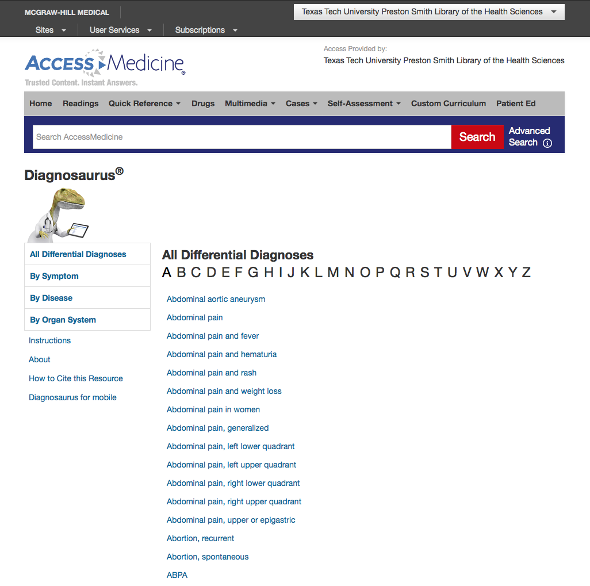

Slide 16
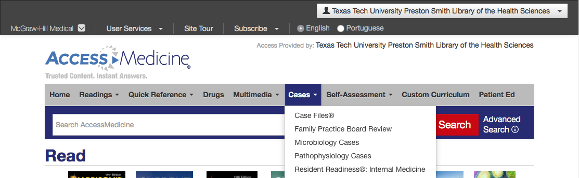

Slide 17
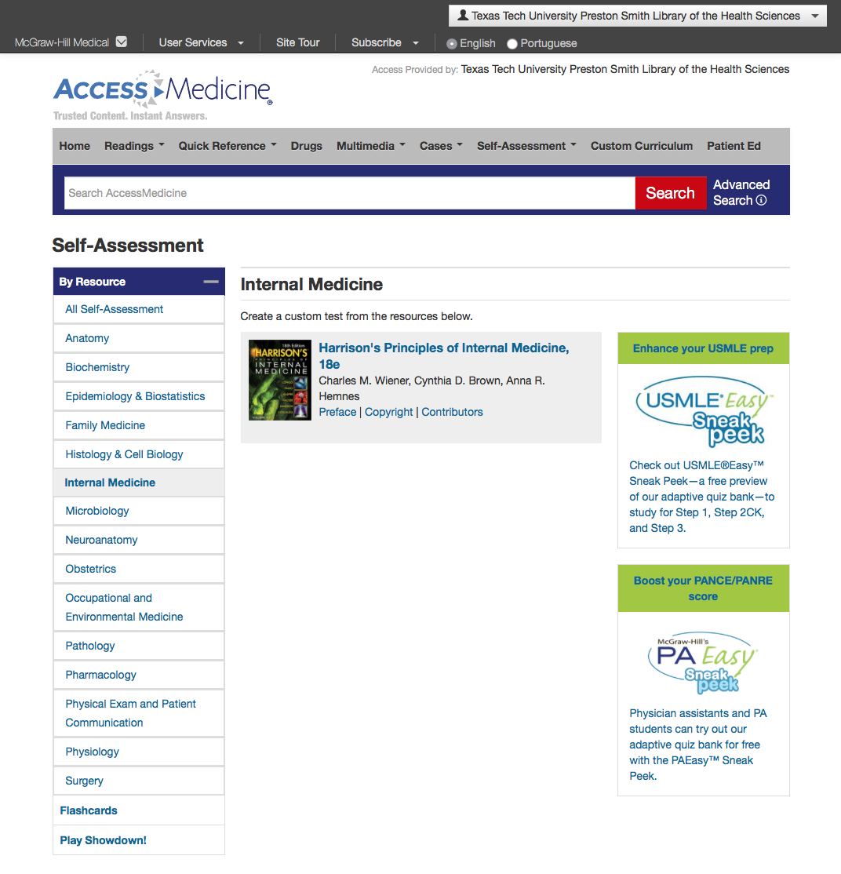
Play Showdown!

Slide 18
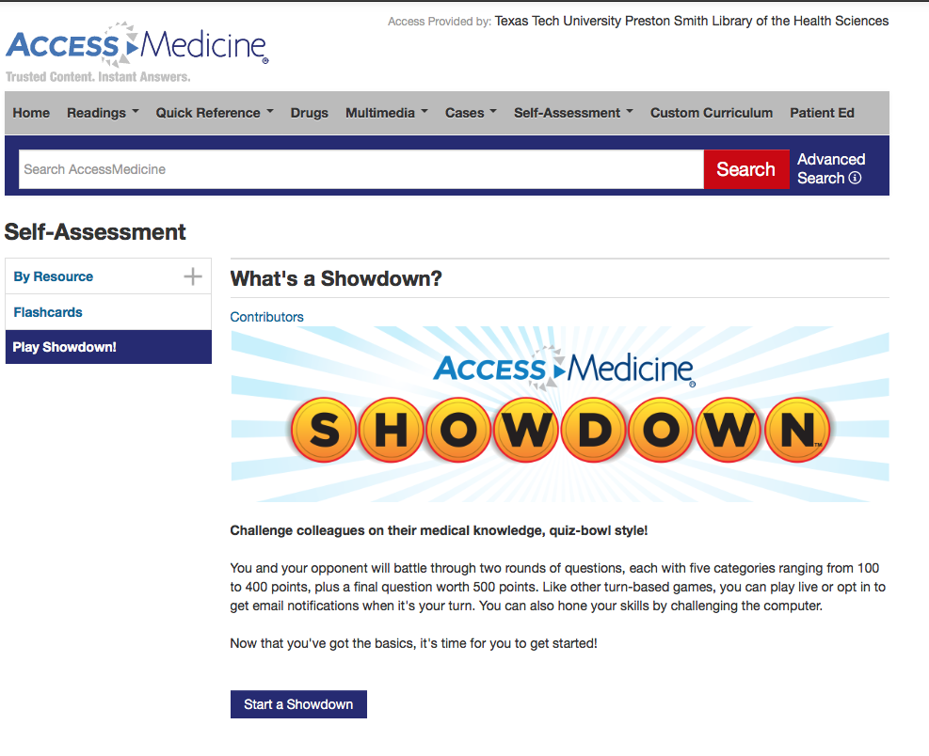

Slide 19
Access Emergency Medicine

Slide 20
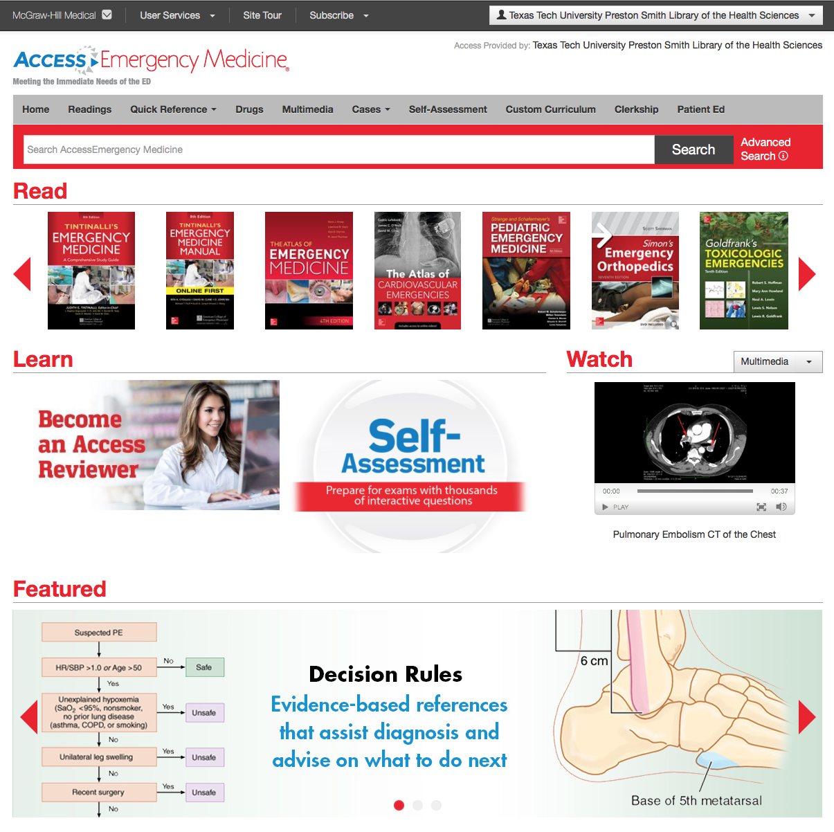
Major Electronic Textbooks – free access!

Slide 21
Access Pediatrics

Slide 22
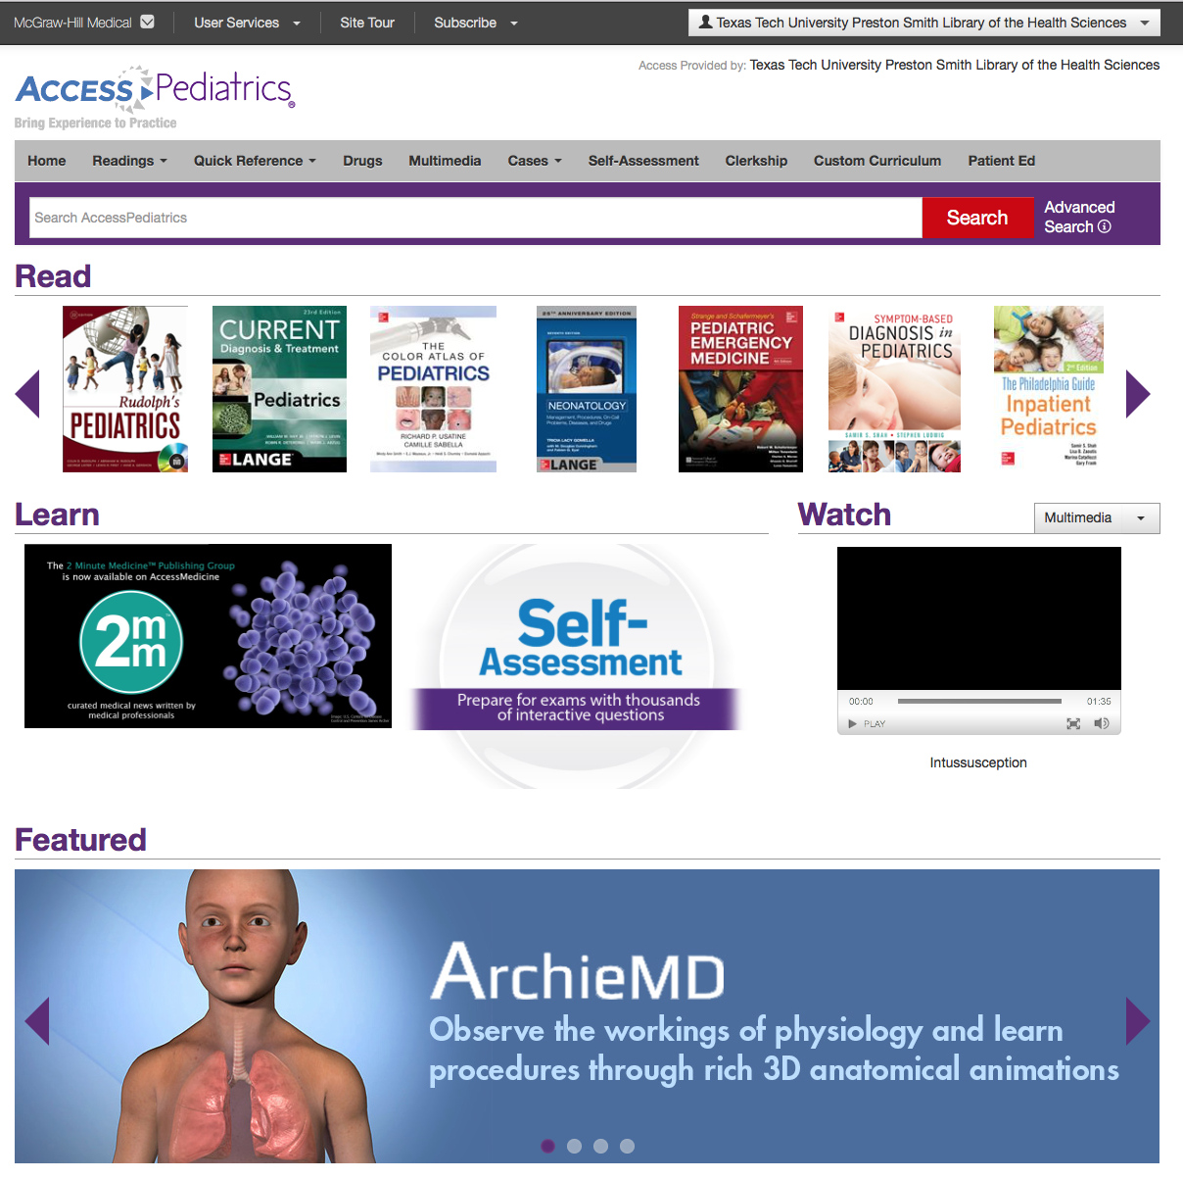
Major Electronic Textbooks – free access!

Slide 23
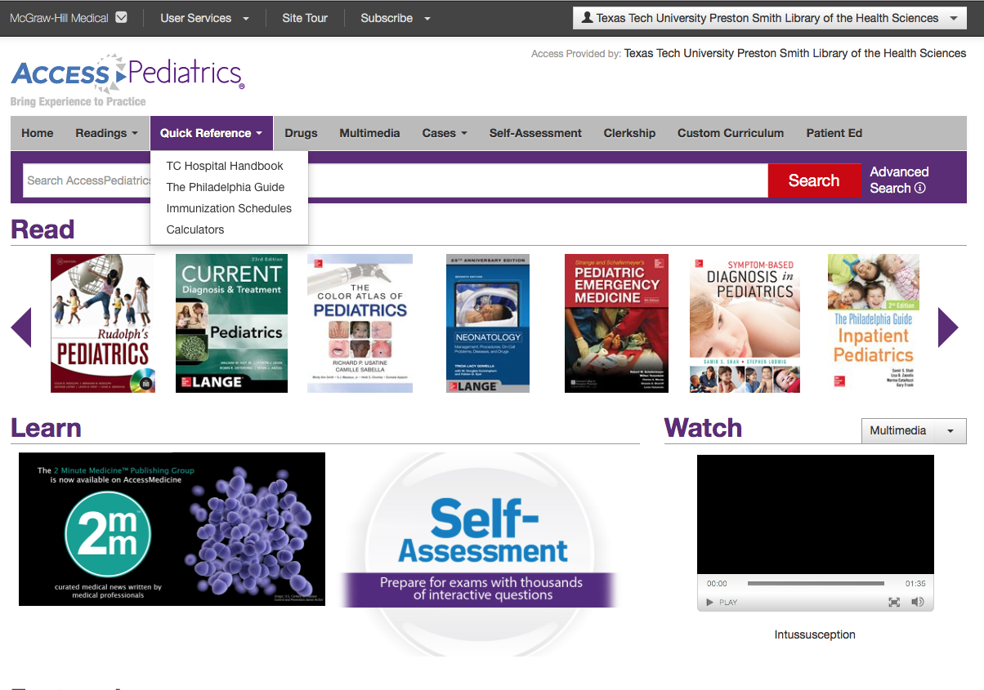
Click Quick Reference

Slide 24
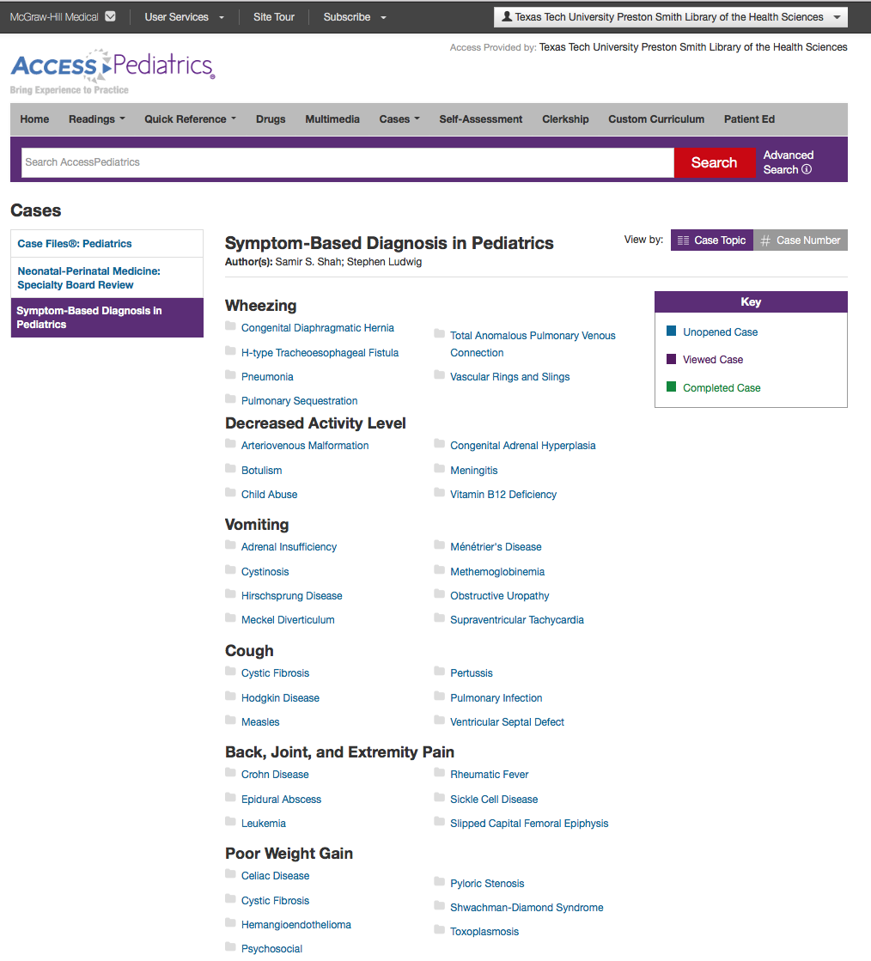

Slide 25
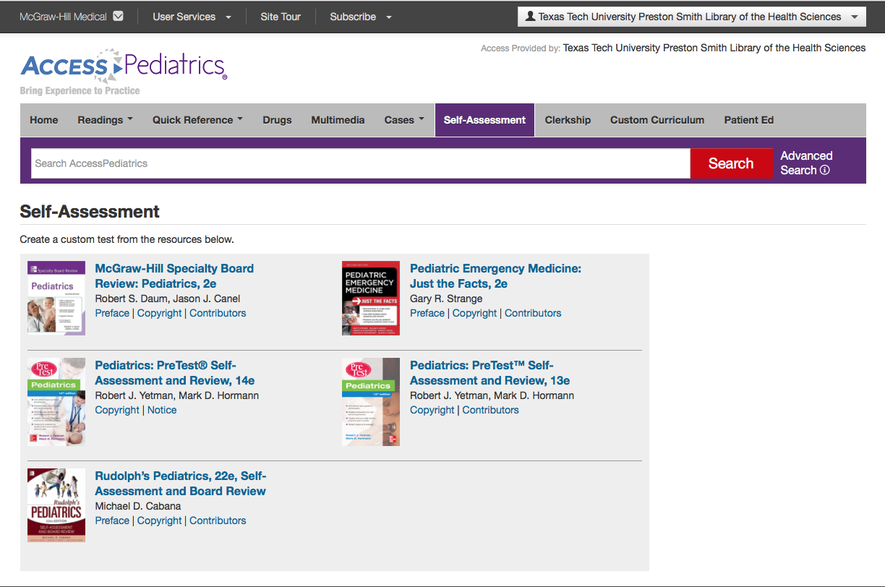

Slide 26
Access Pharmacy

Slide 27
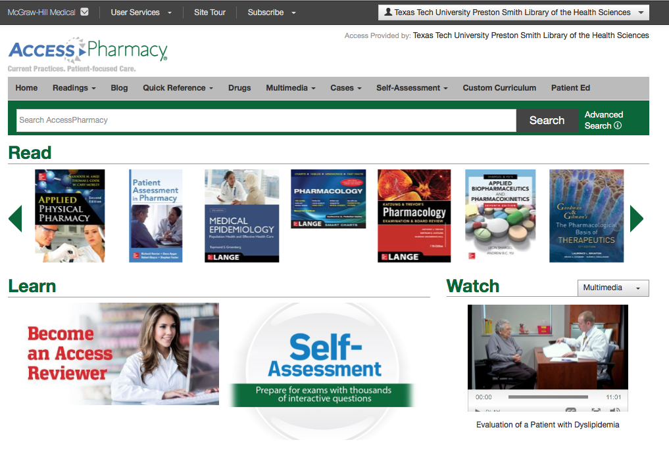
Major Electronic Textbooks – free access!

Slide 28
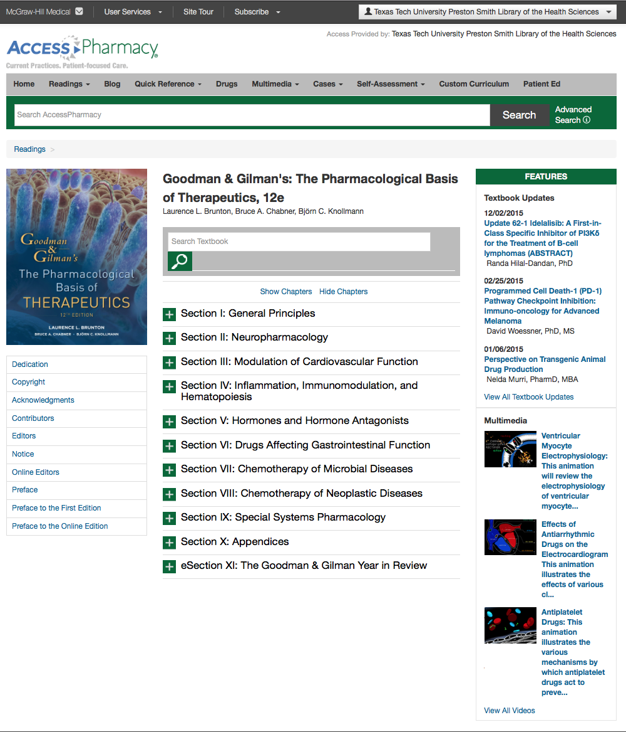

Slide 29
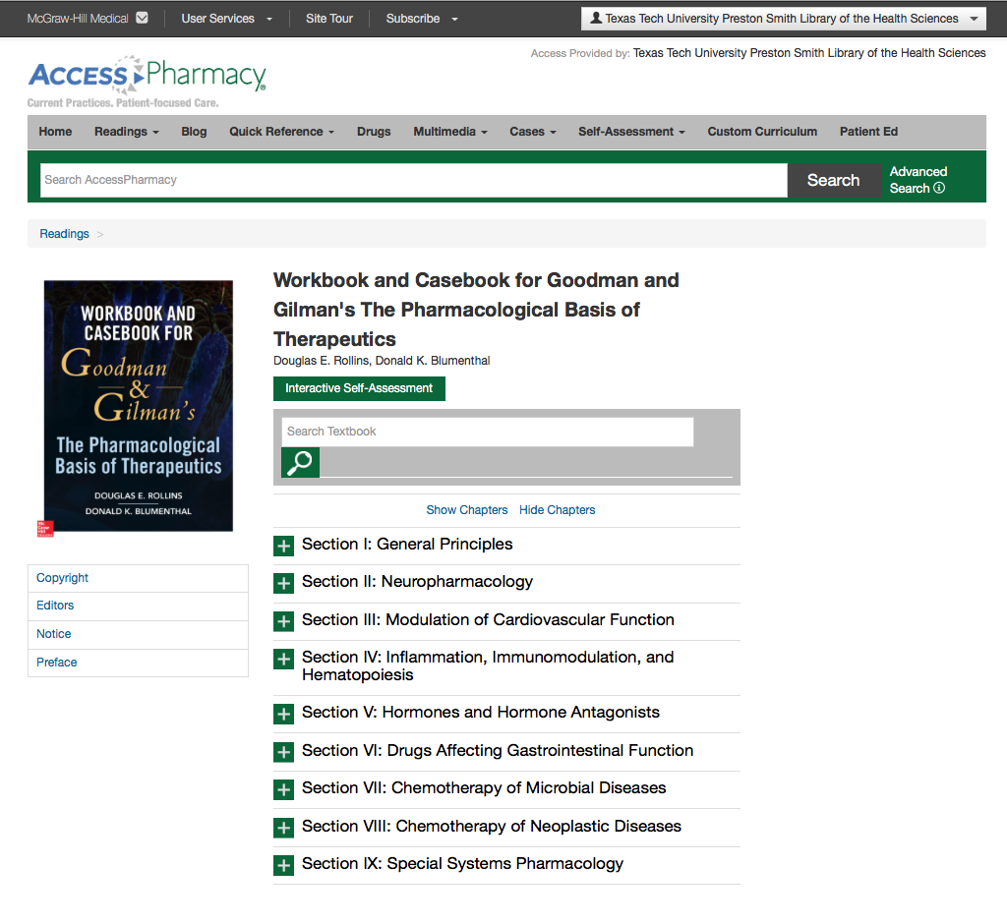

Slide 30
Access Surgery

Slide 31

Major Electronic Textbooks – free access!

Slide 32
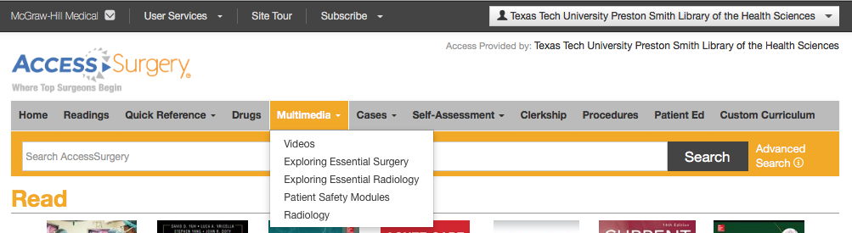

Slide 33
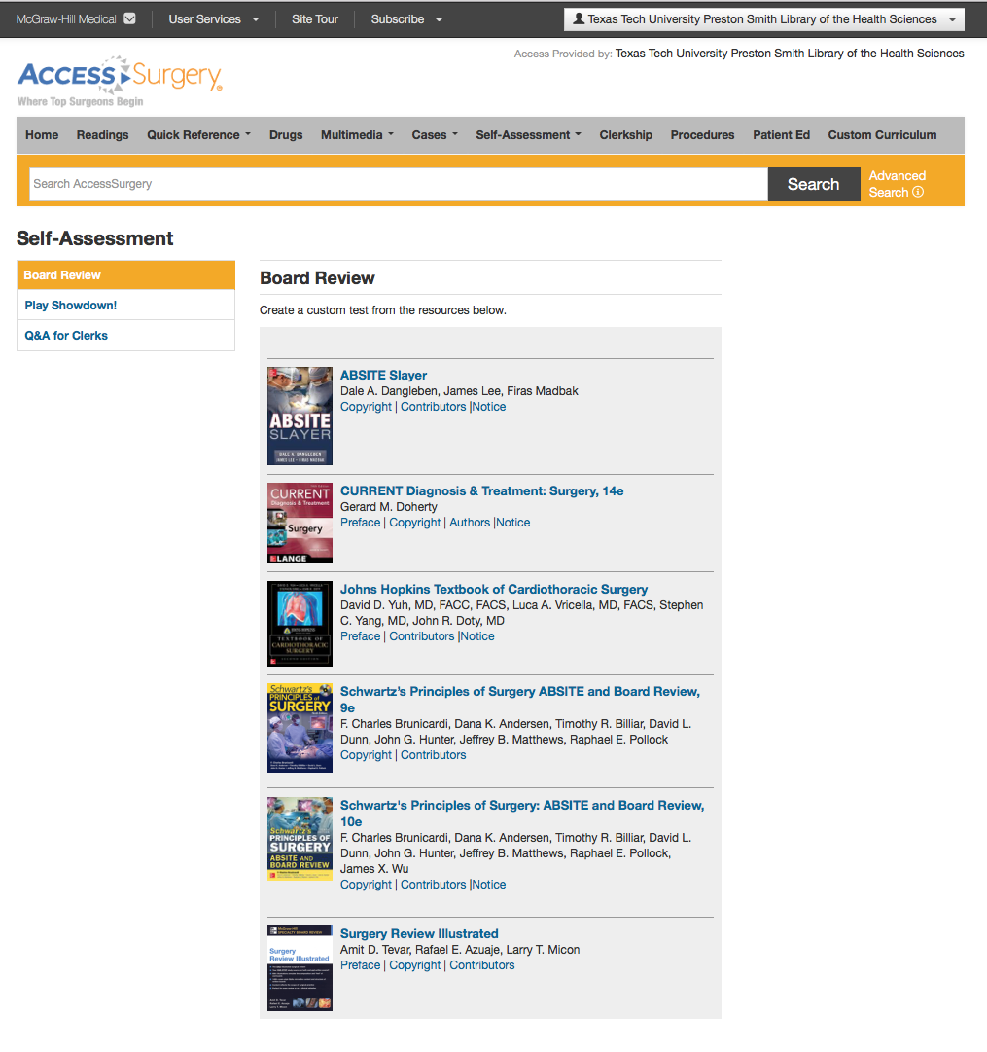

Slide 34
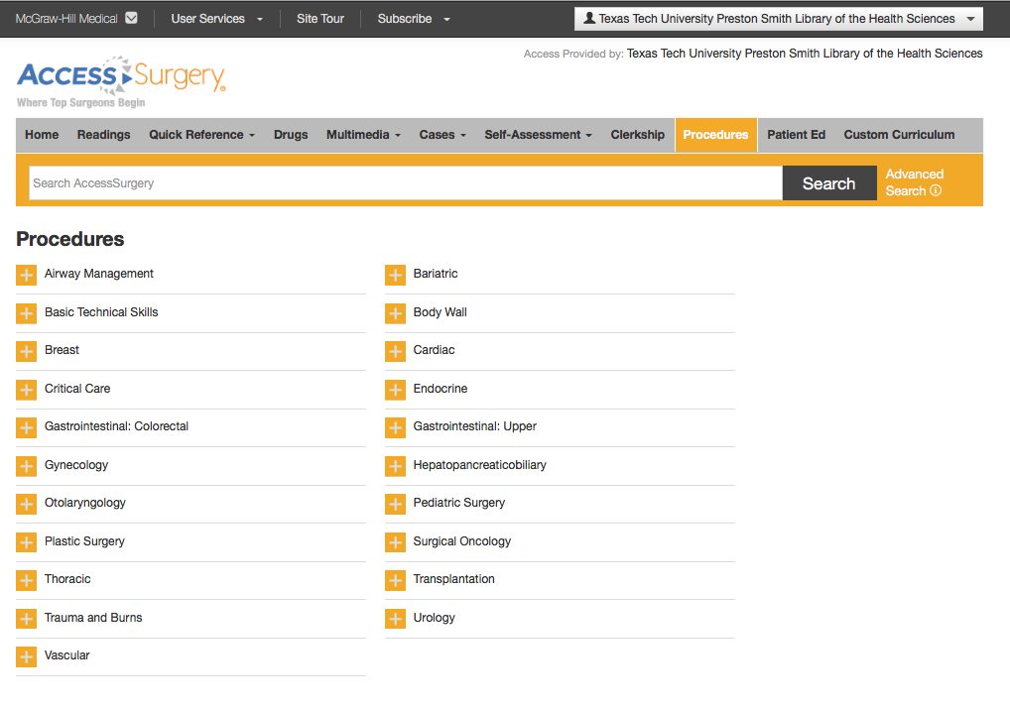

Slide 35
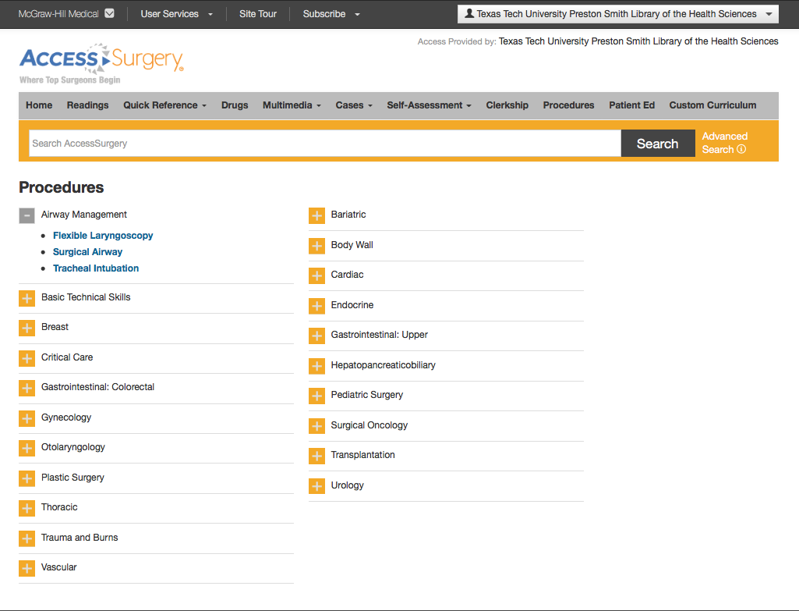

Slide 36
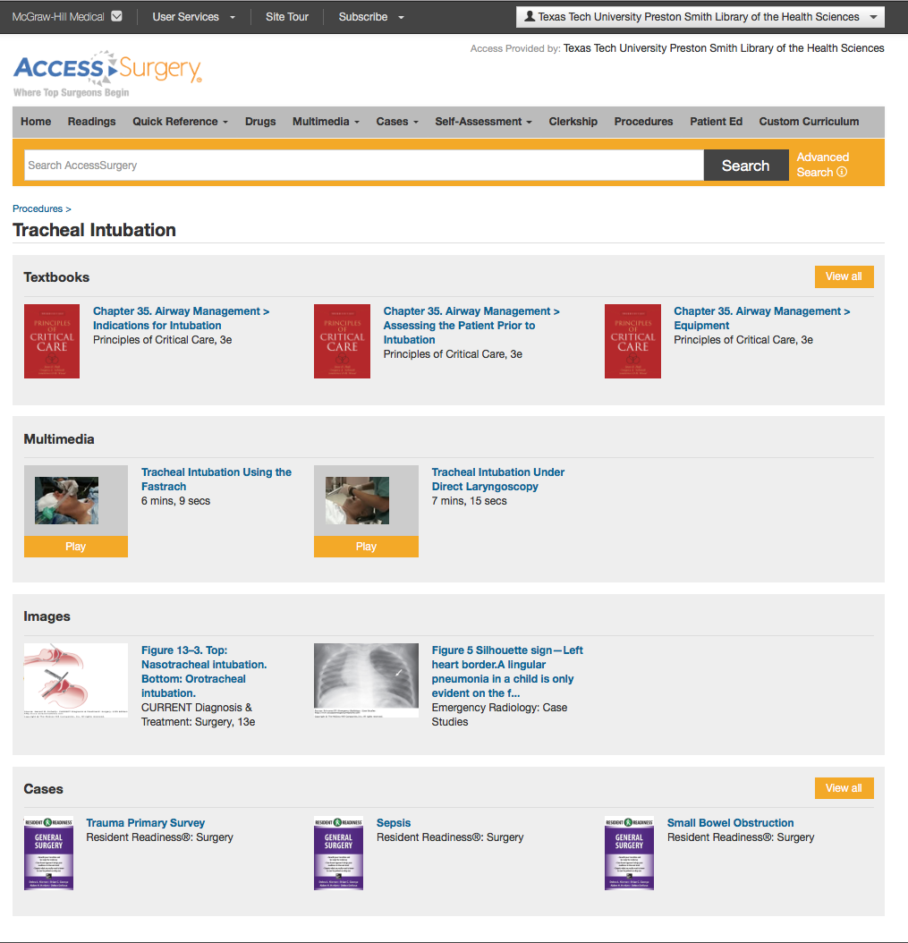

Slide 37
Neurology Collection

Slide 38

Major Electronic Textbooks – free access!

Slide 39
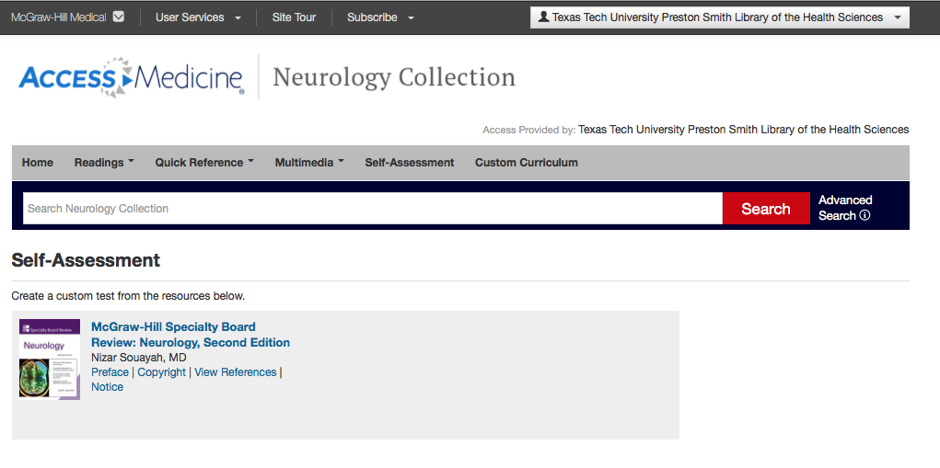

Slide 40
McGraw-Hill
Umbrella Index

Slide 41
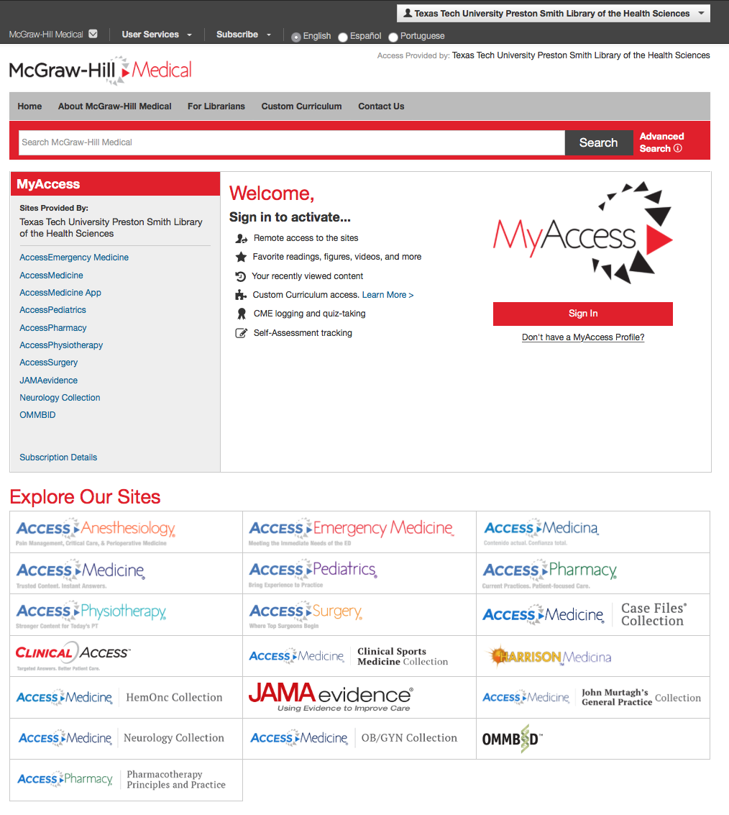
Cross search all of the collections at one time!

Slide 42
Mobile App

Slide 43
Login to your personal account

