Slide 1
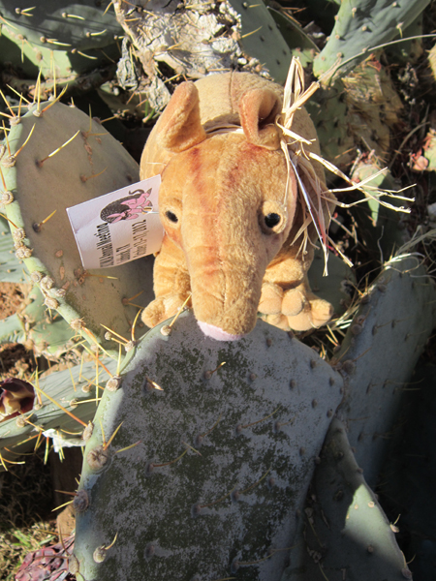

Amador’s
Adventures
Design by Dawn Kruse Field 6/2012

Slide 2
The
five states
of the
South Central Chapter/
Medical Library Association

Slide 3
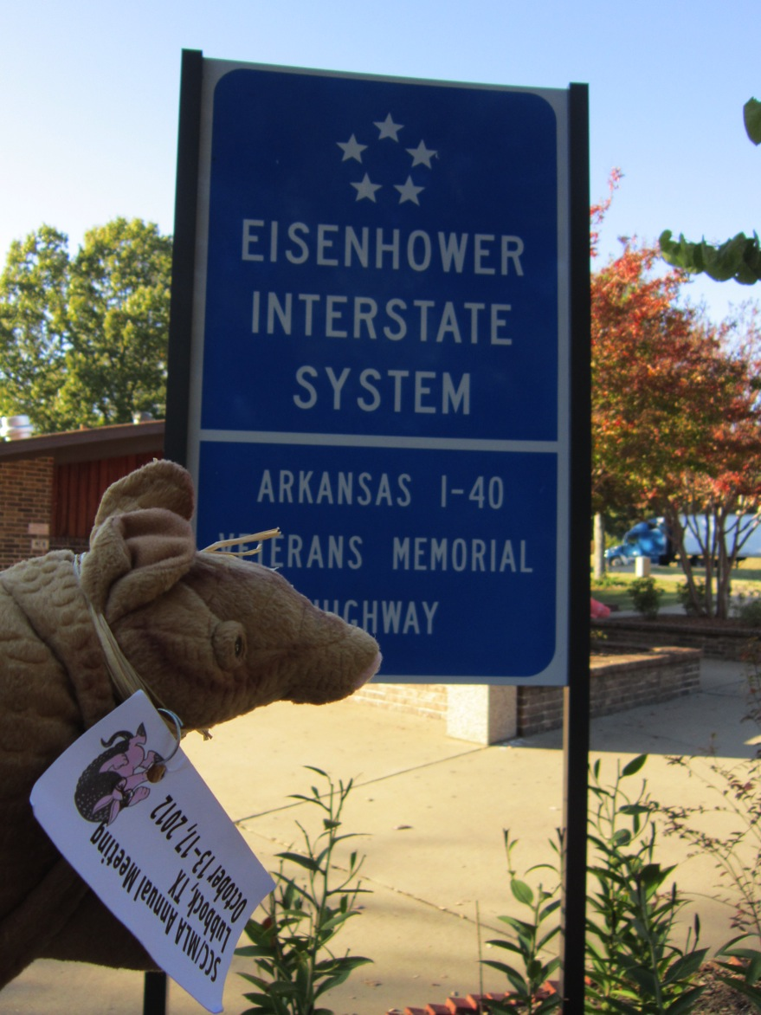

Slide 4
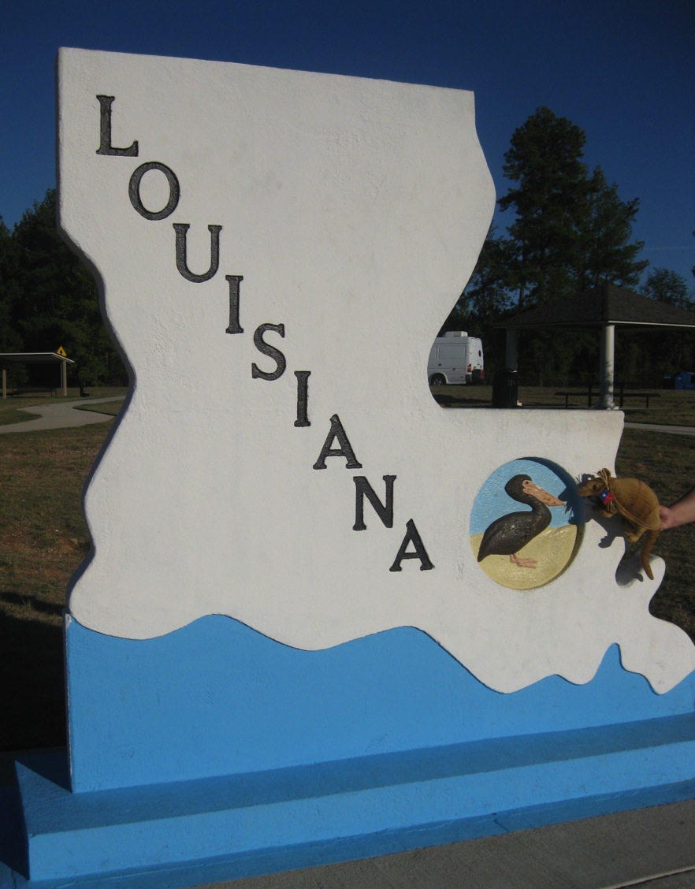

Slide 5
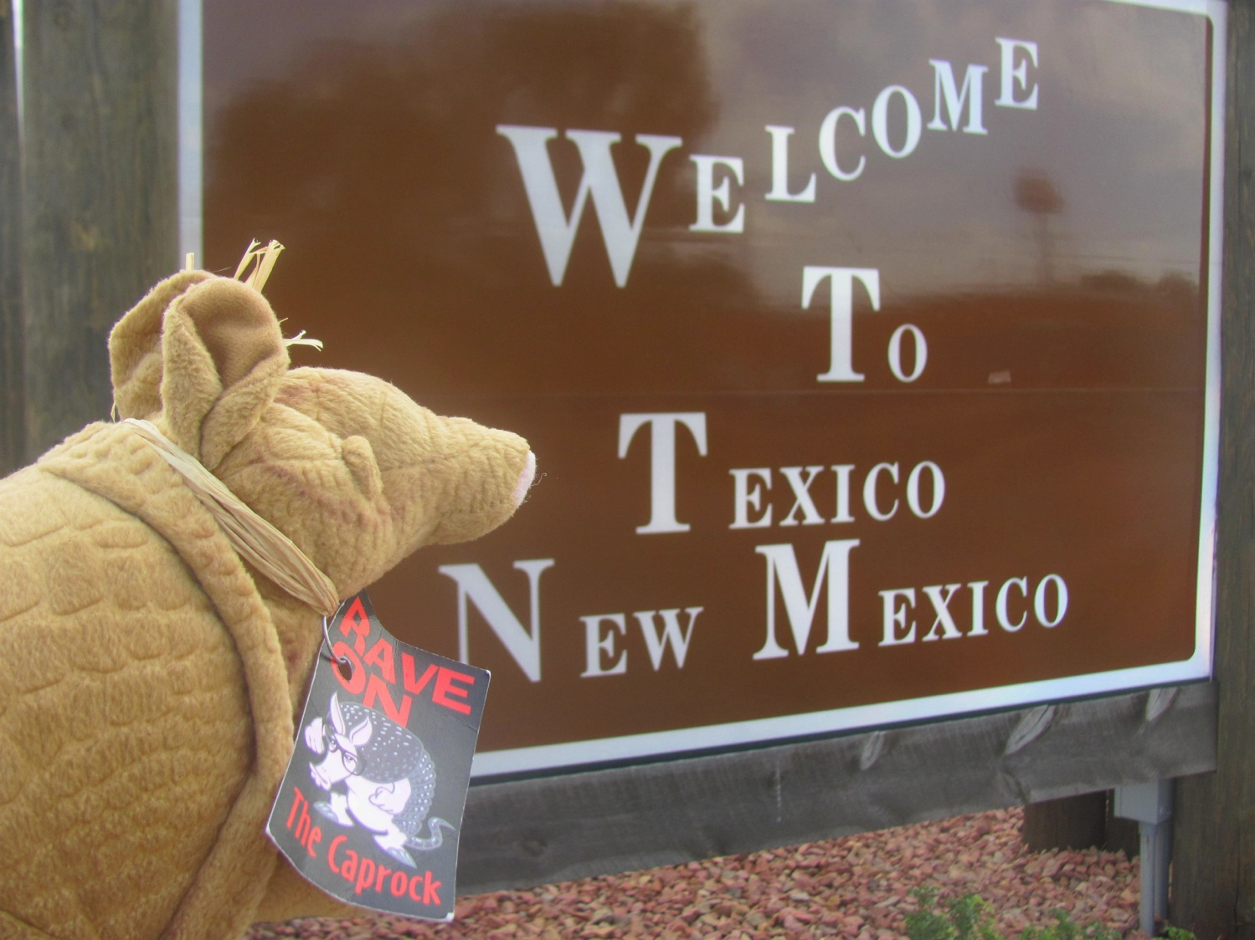
Photograph taken by Candia Thew

Slide 6
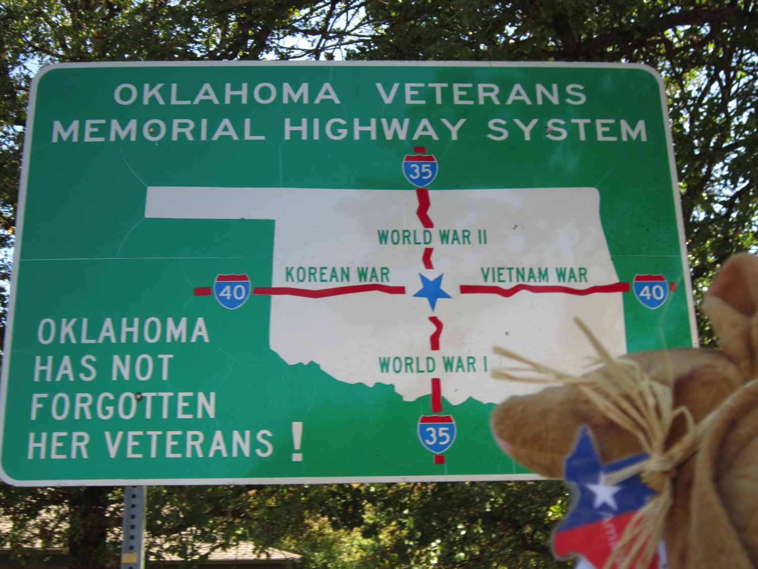

Slide 7
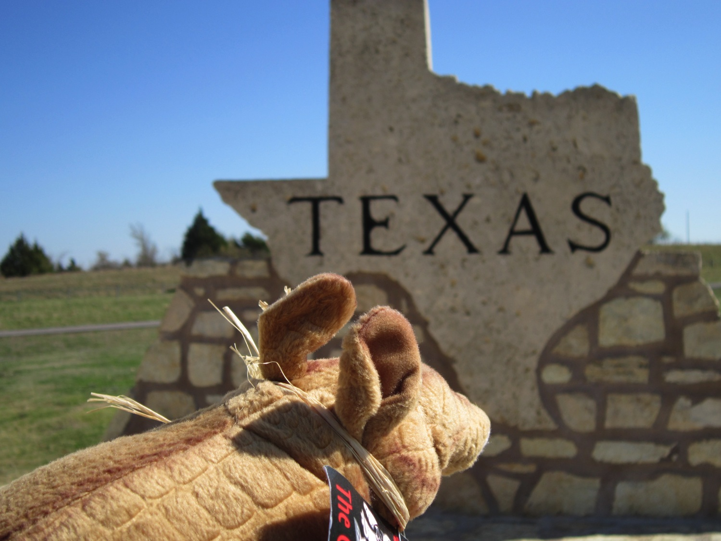

Slide 8
2011 Meeting
in
Baton Rouge, LA

Slide 9
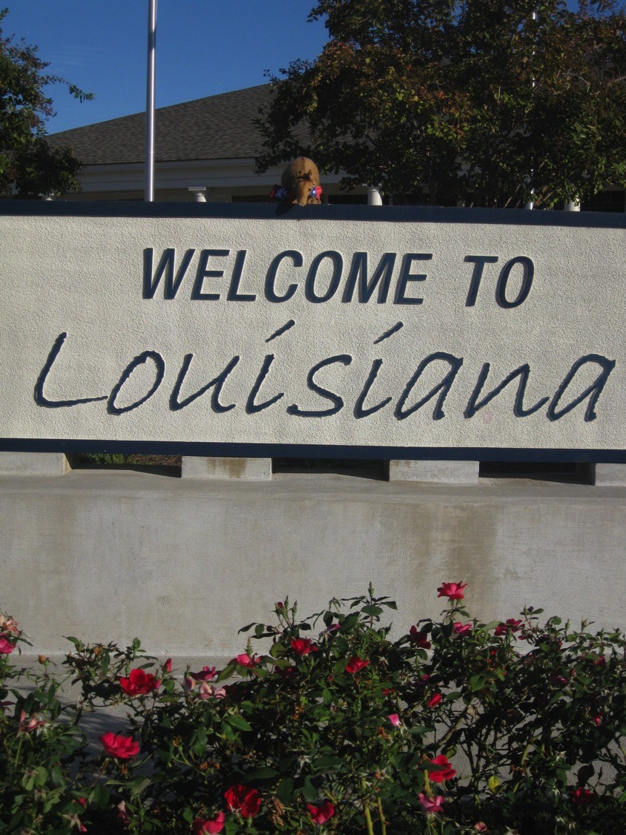

Slide 10
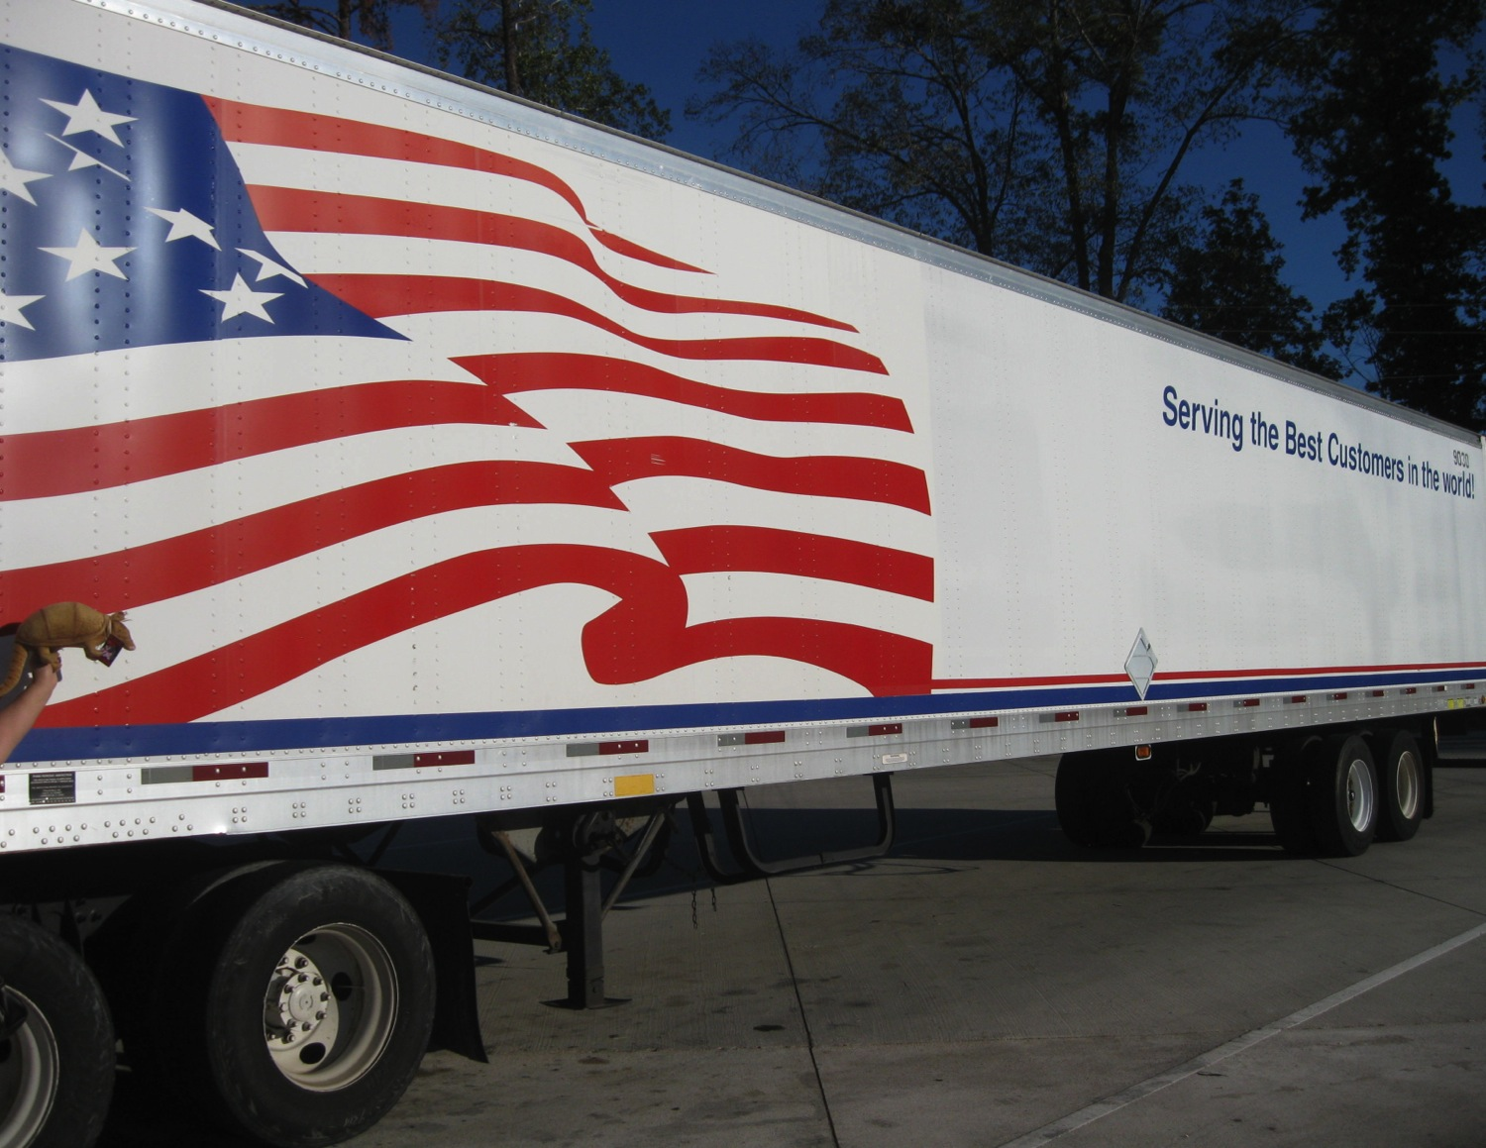
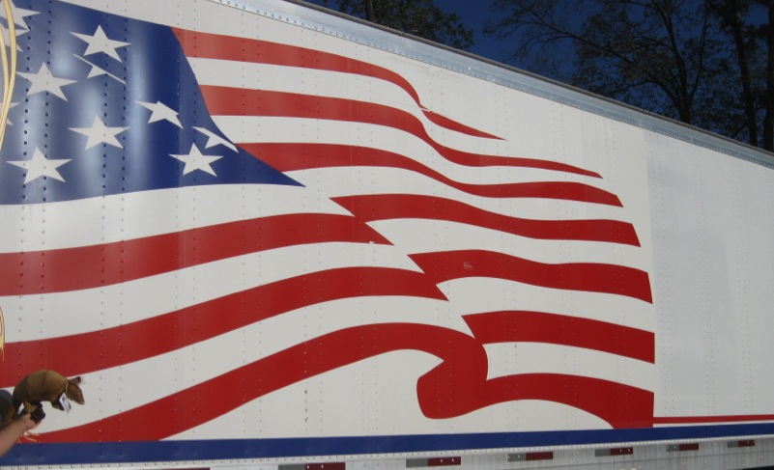
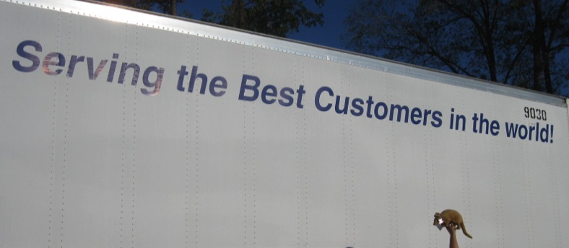
Going to
the meeting

Slide 11
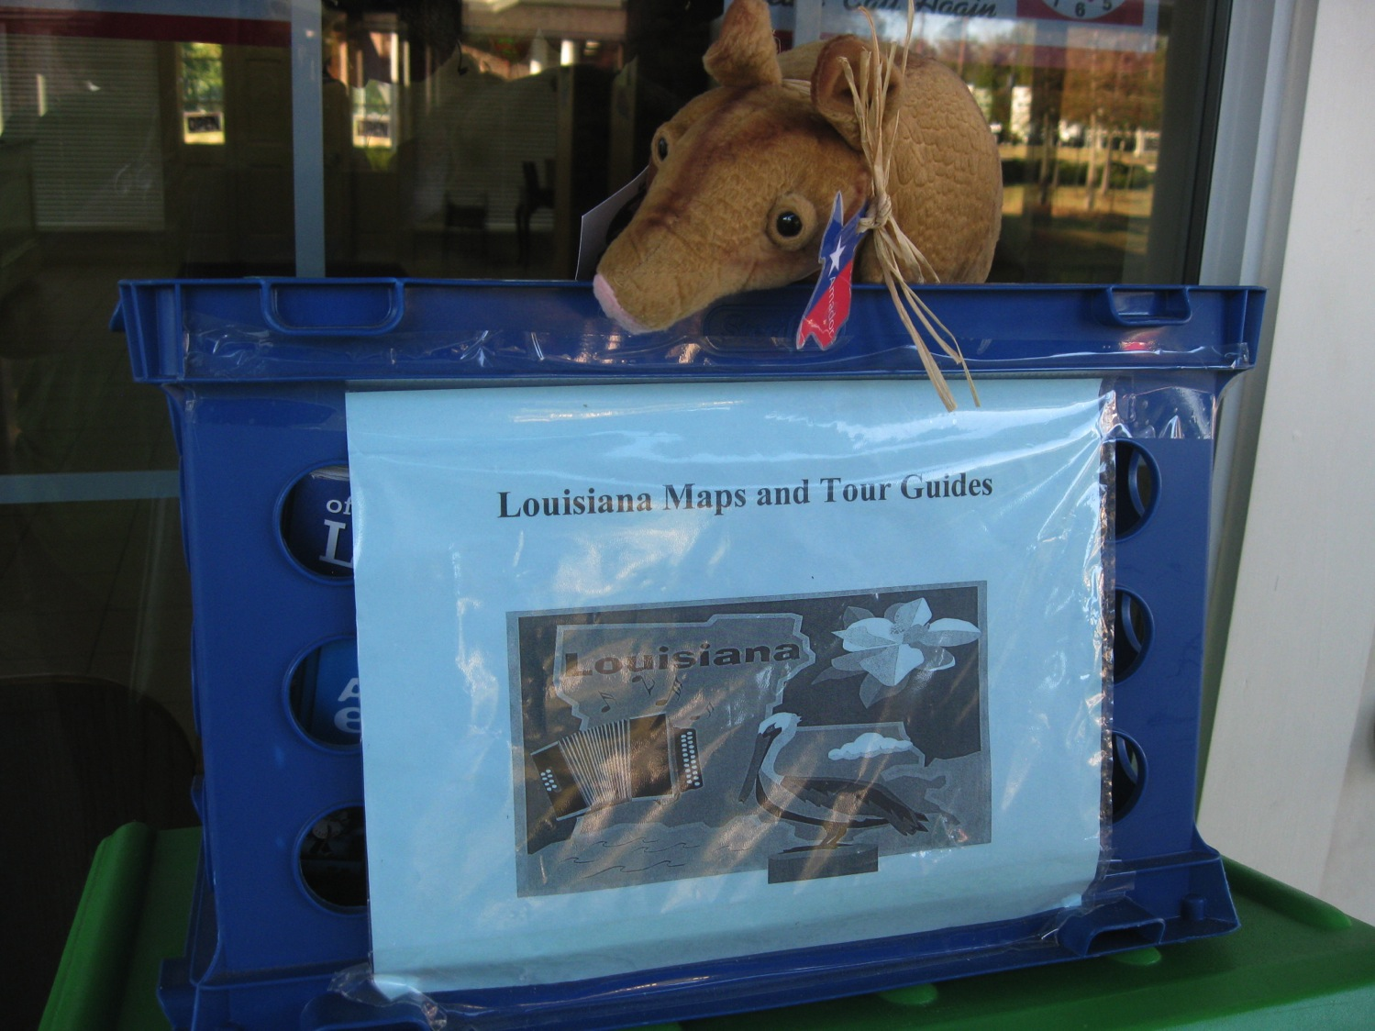

Slide 12
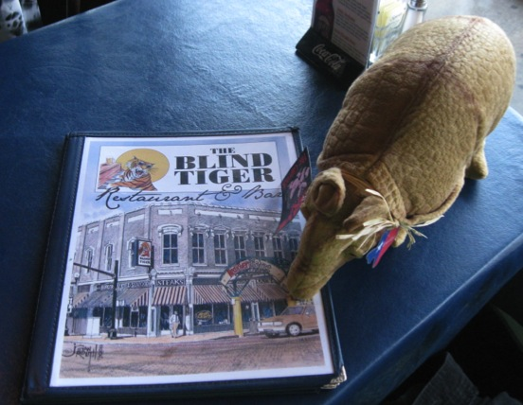
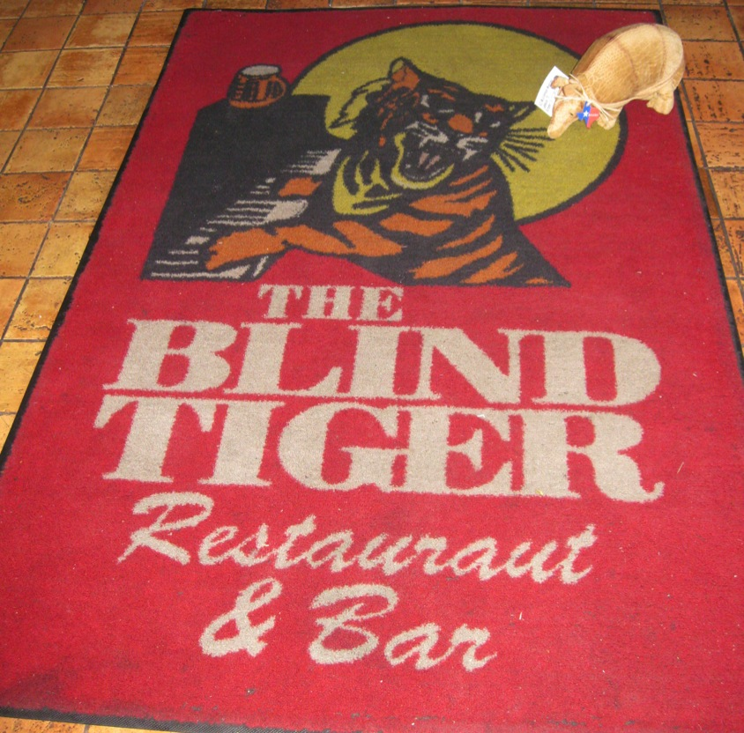
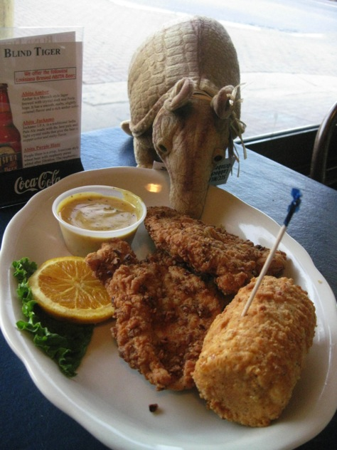
Overnight in Shreveport

Slide 13
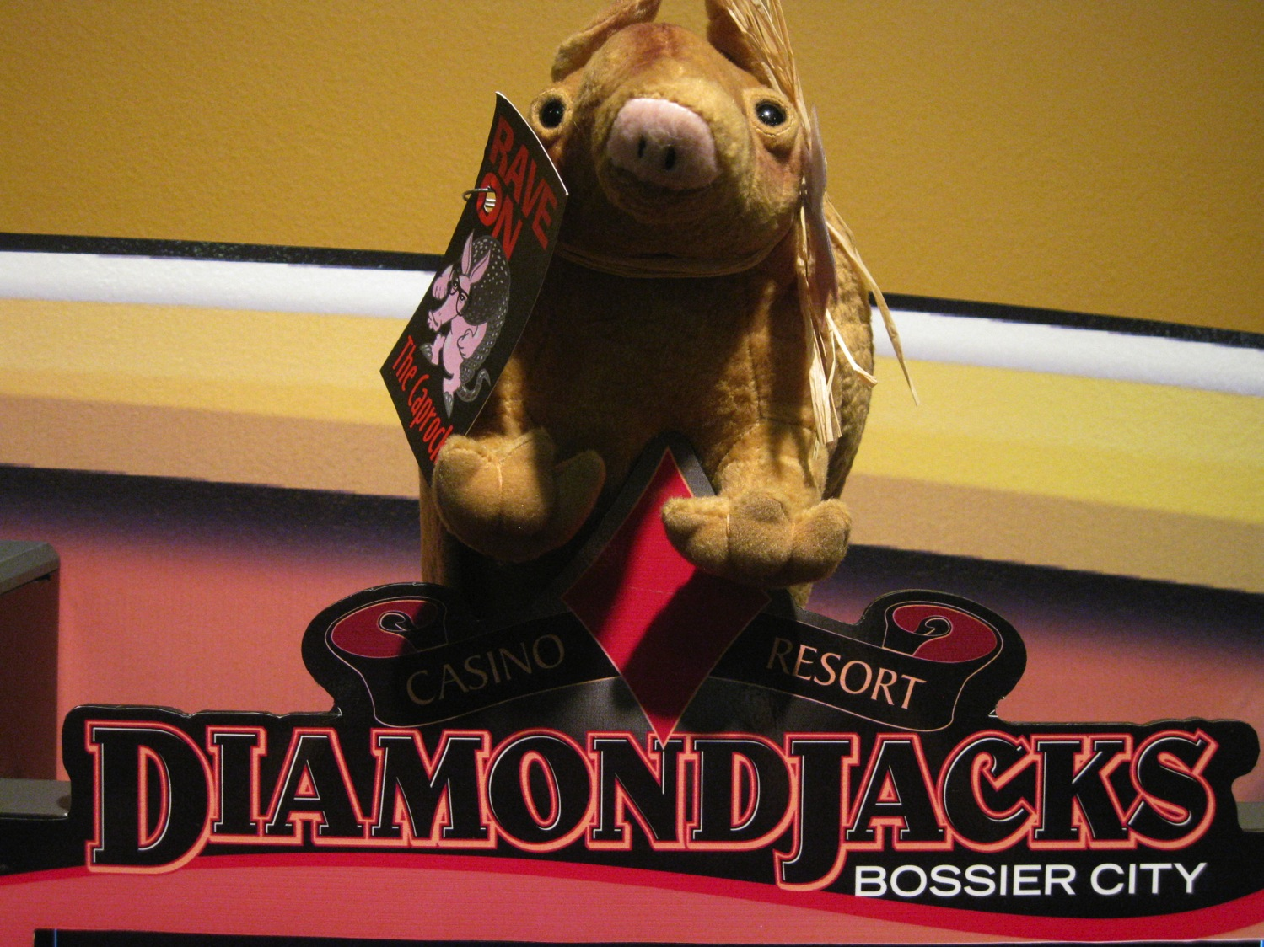
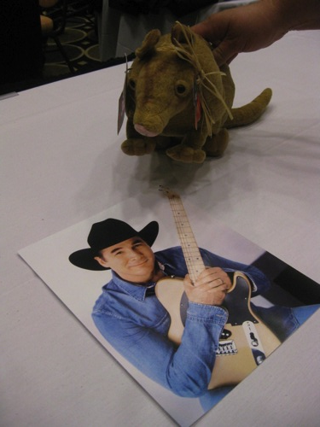

Slide 14
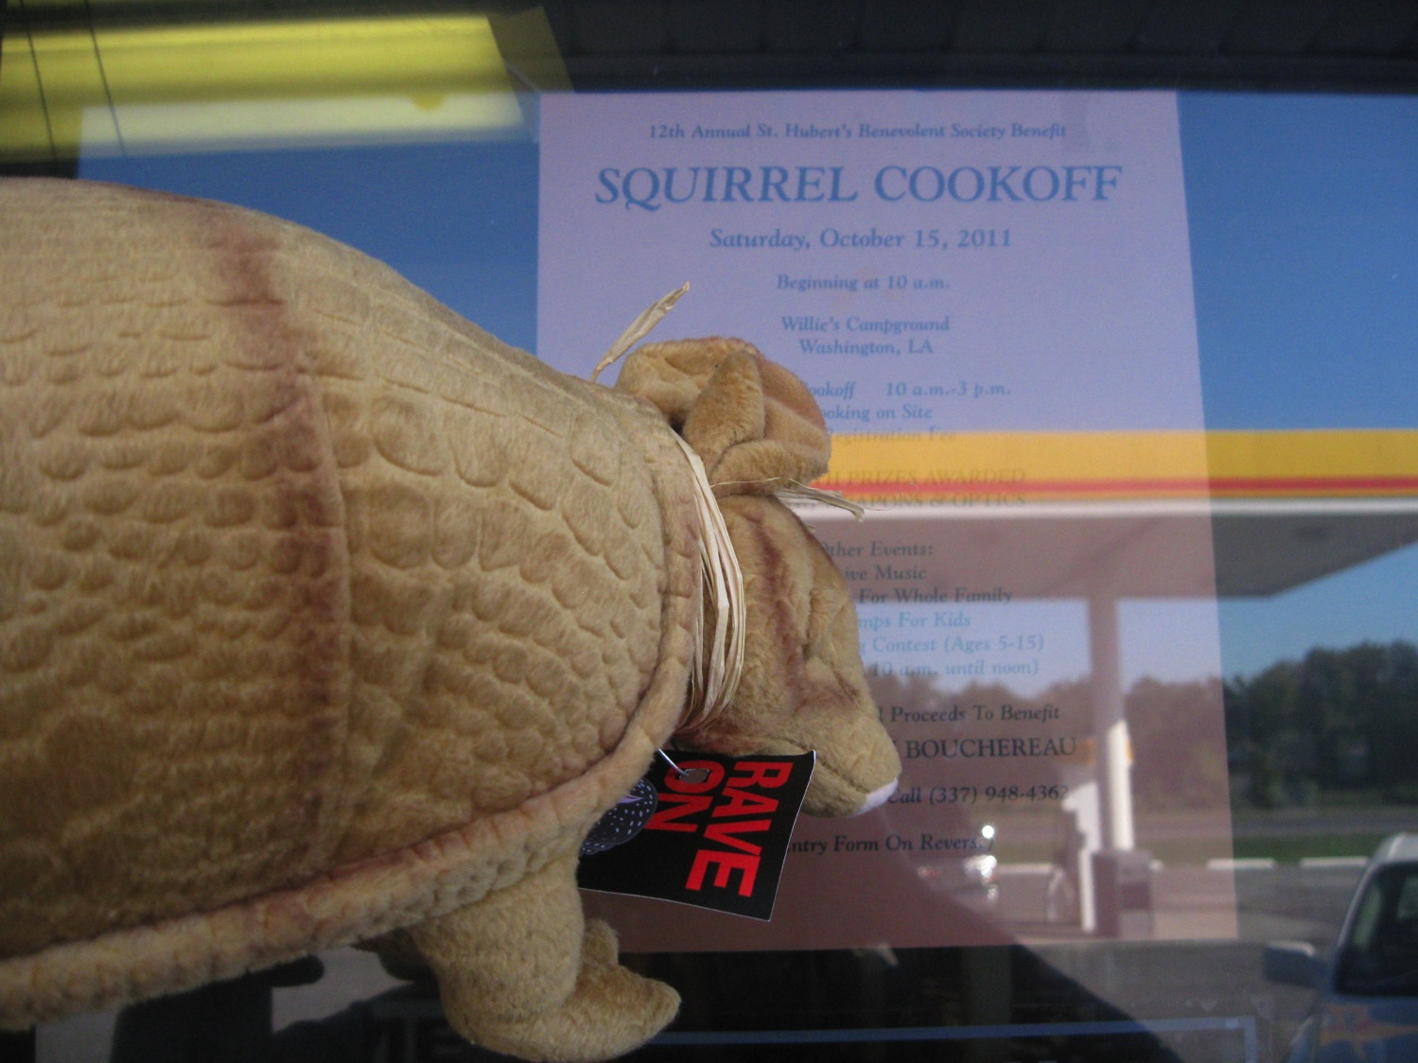
Driving from Shreveport to Baton Rouge

Slide 15
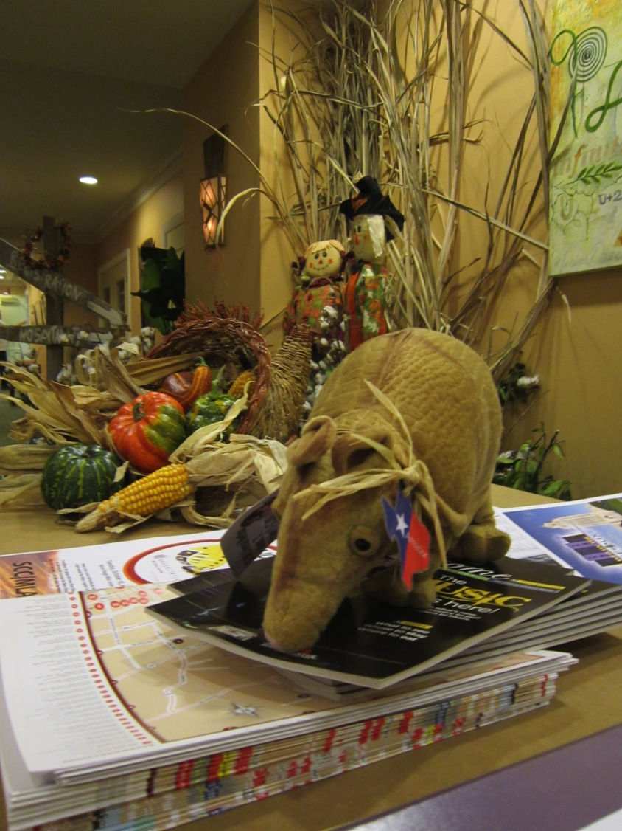
At the 2011 meeting

Slide 16
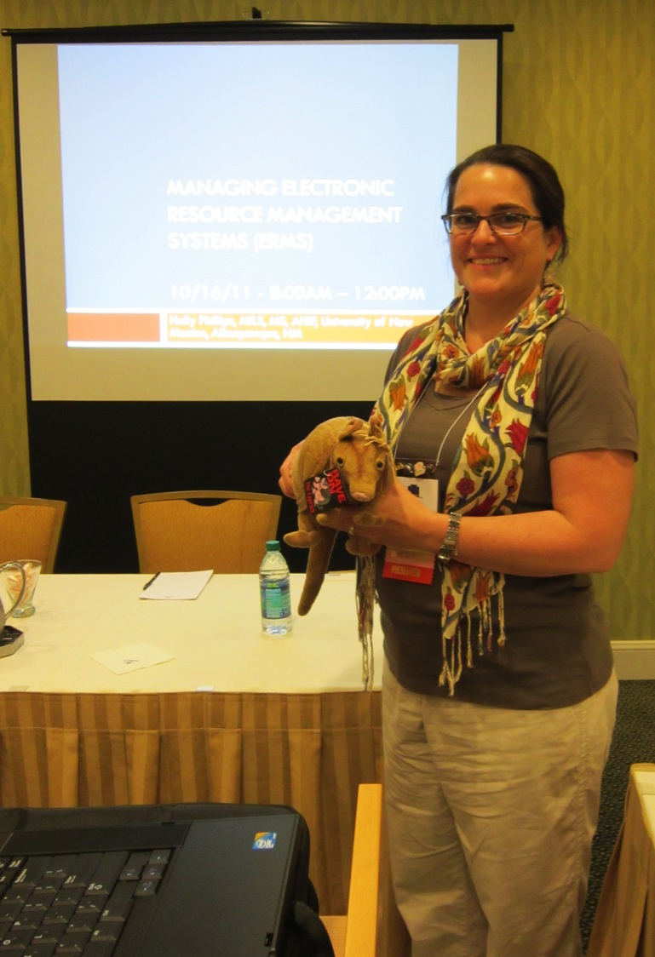
Holly Phillips

Slide 17
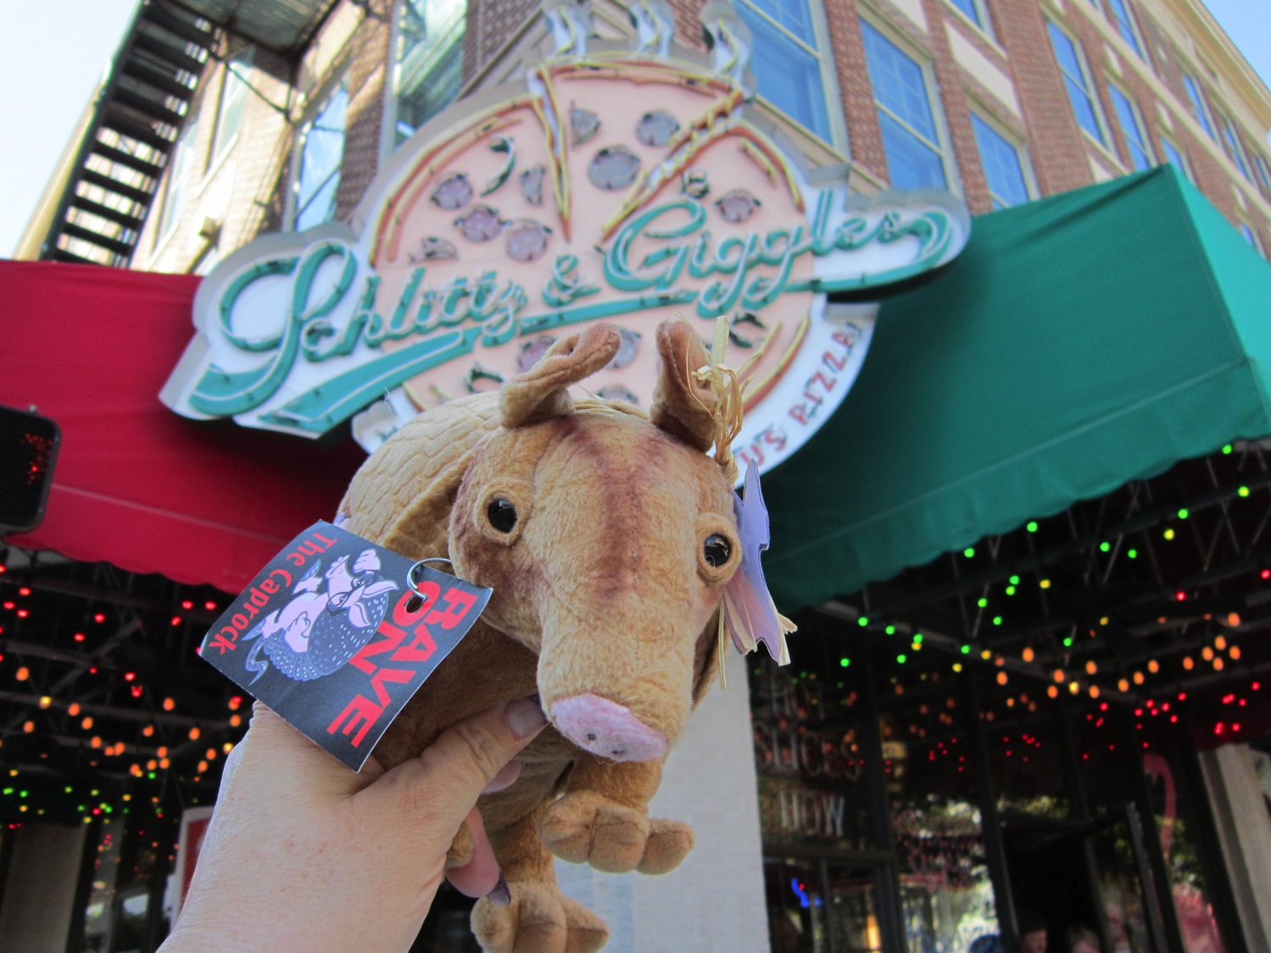

Slide 18
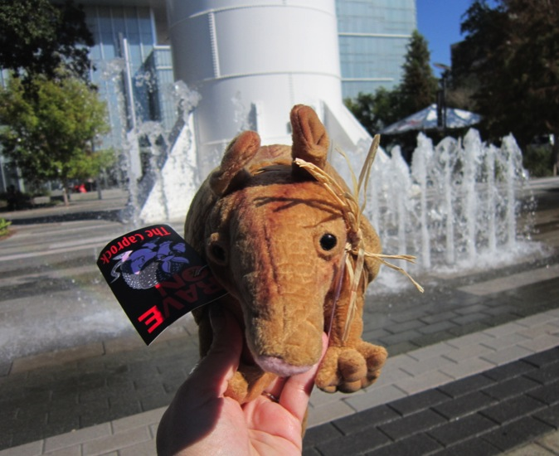
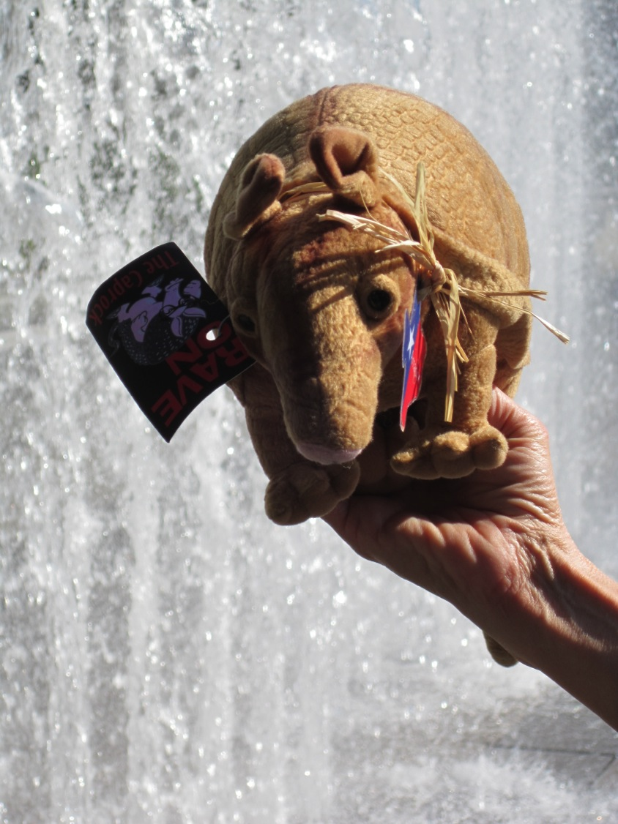

Slide 19
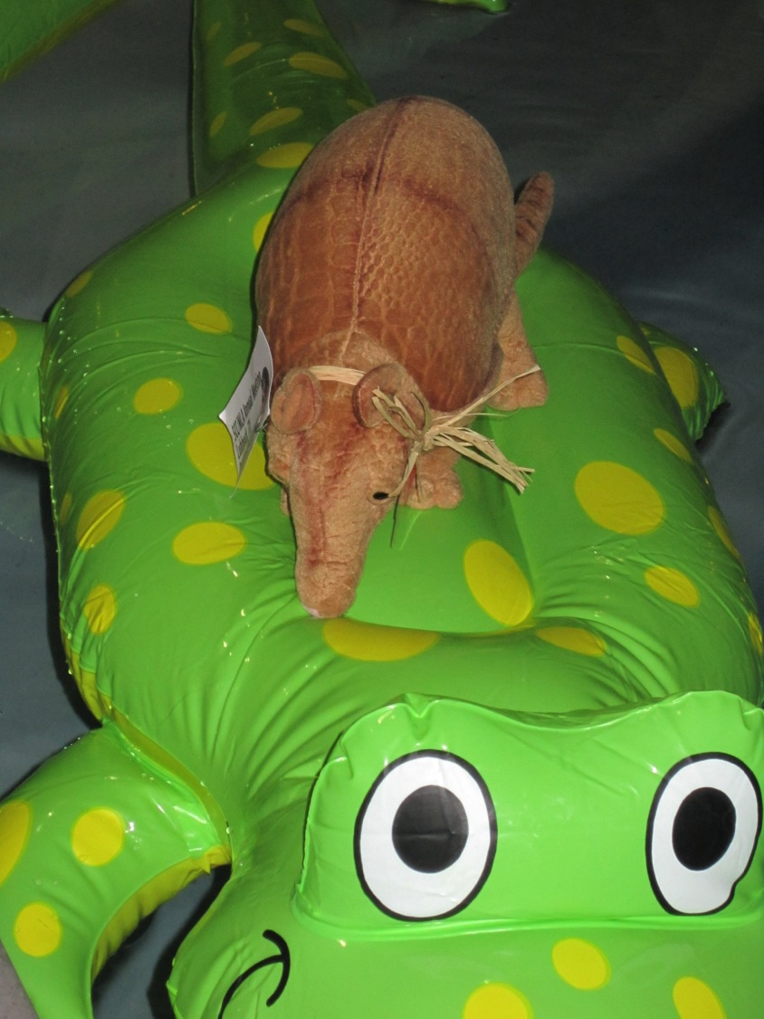
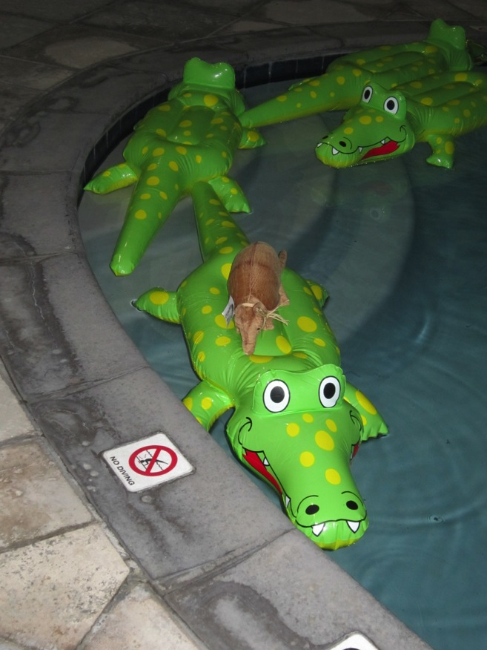

Slide 20
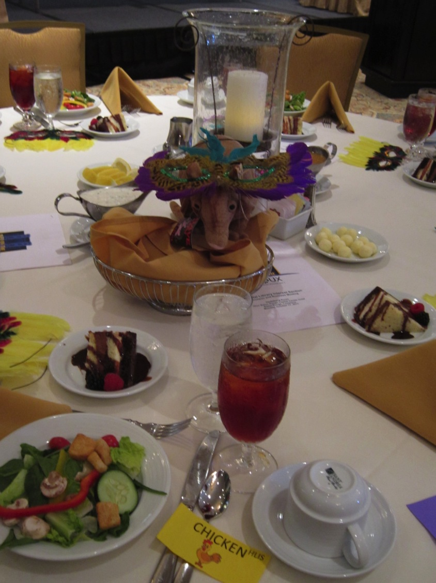

Slide 21
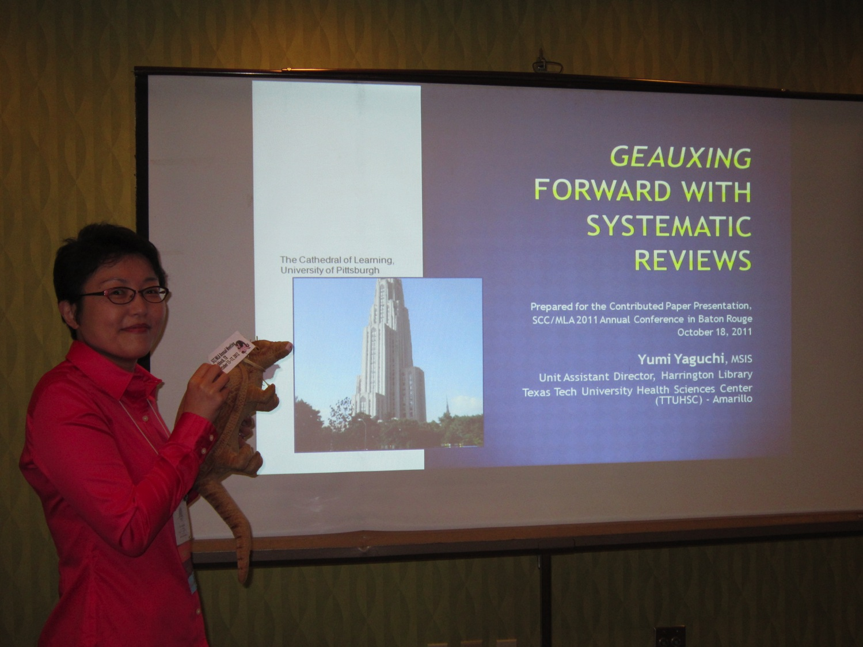
Yumi
Yaguchi

Slide 22
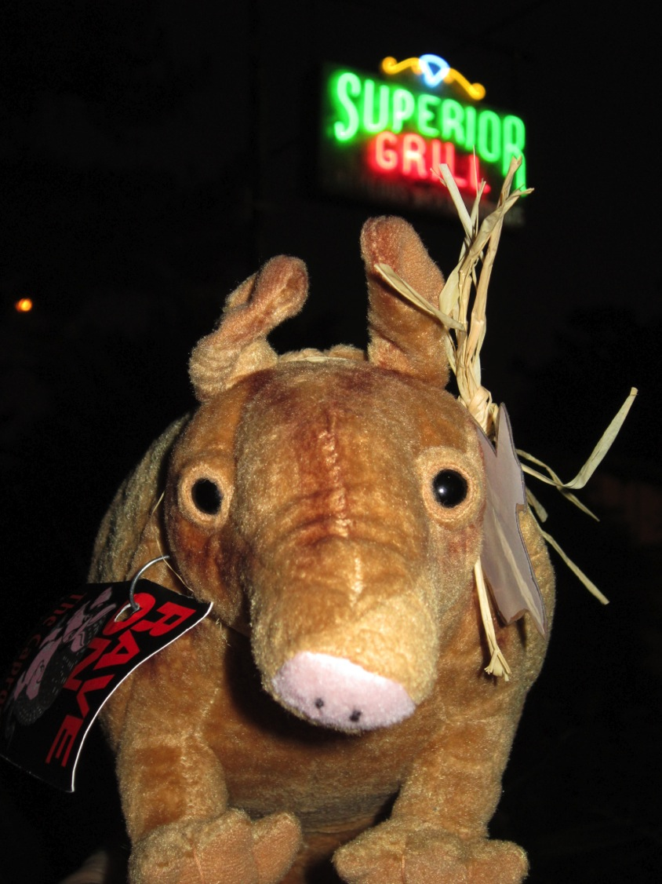

Slide 23
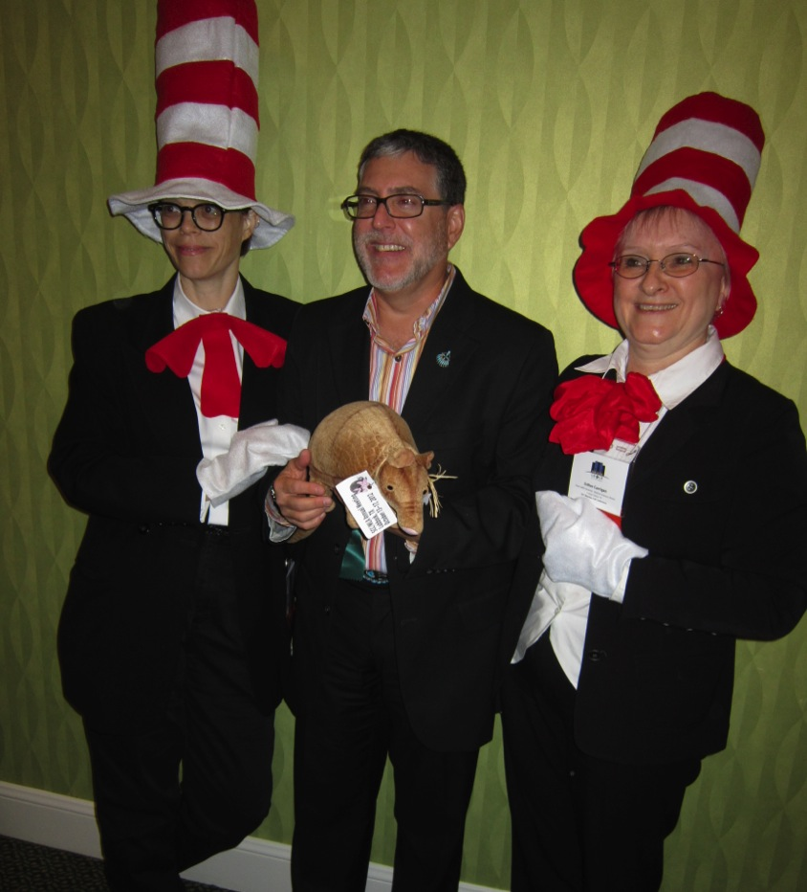
Heather Moberly,
Jerry Perry,
and
Esther Carrigan

Slide 24
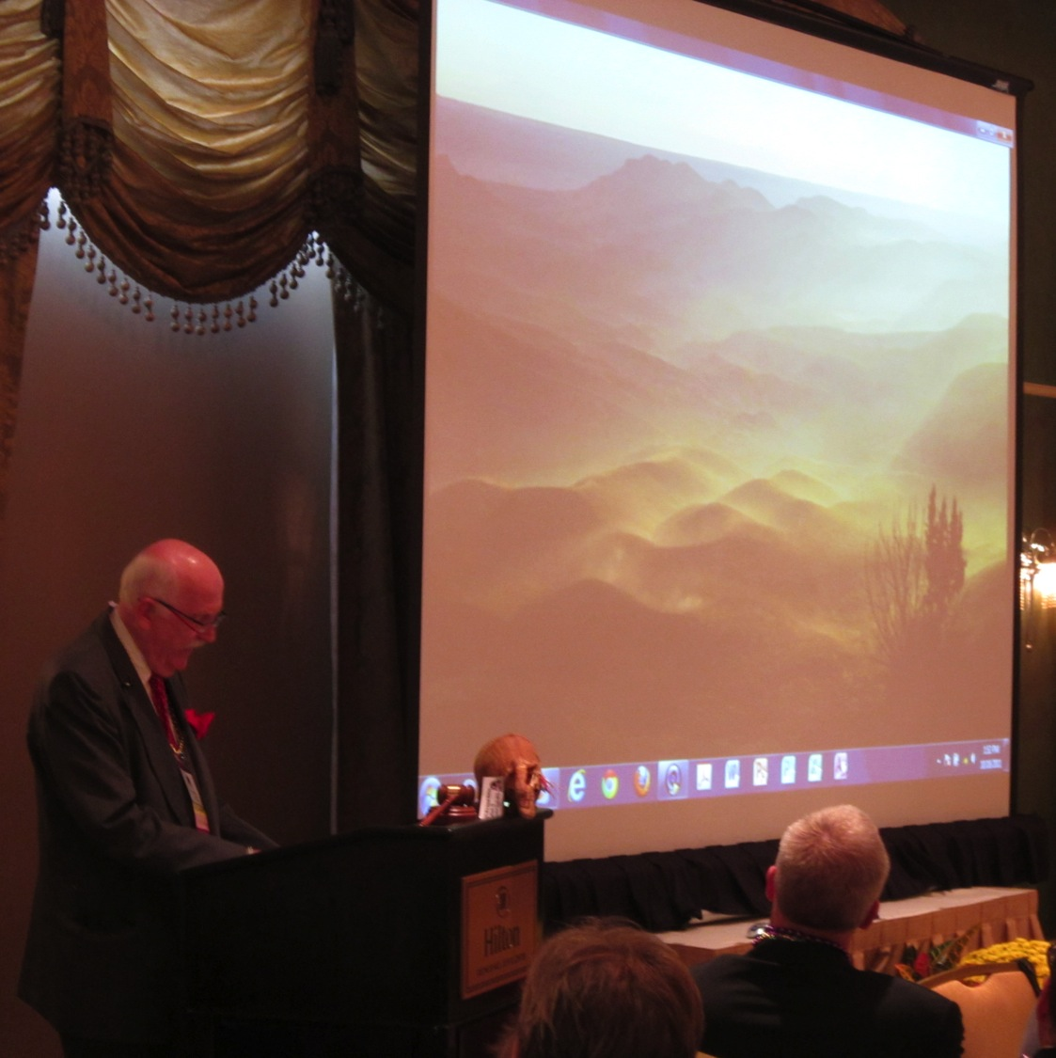
Richard Wood

Slide 25
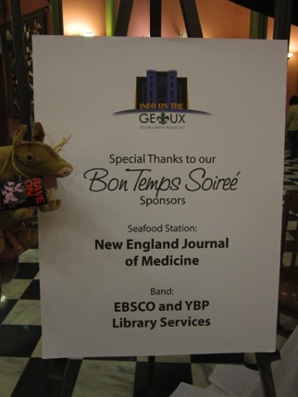
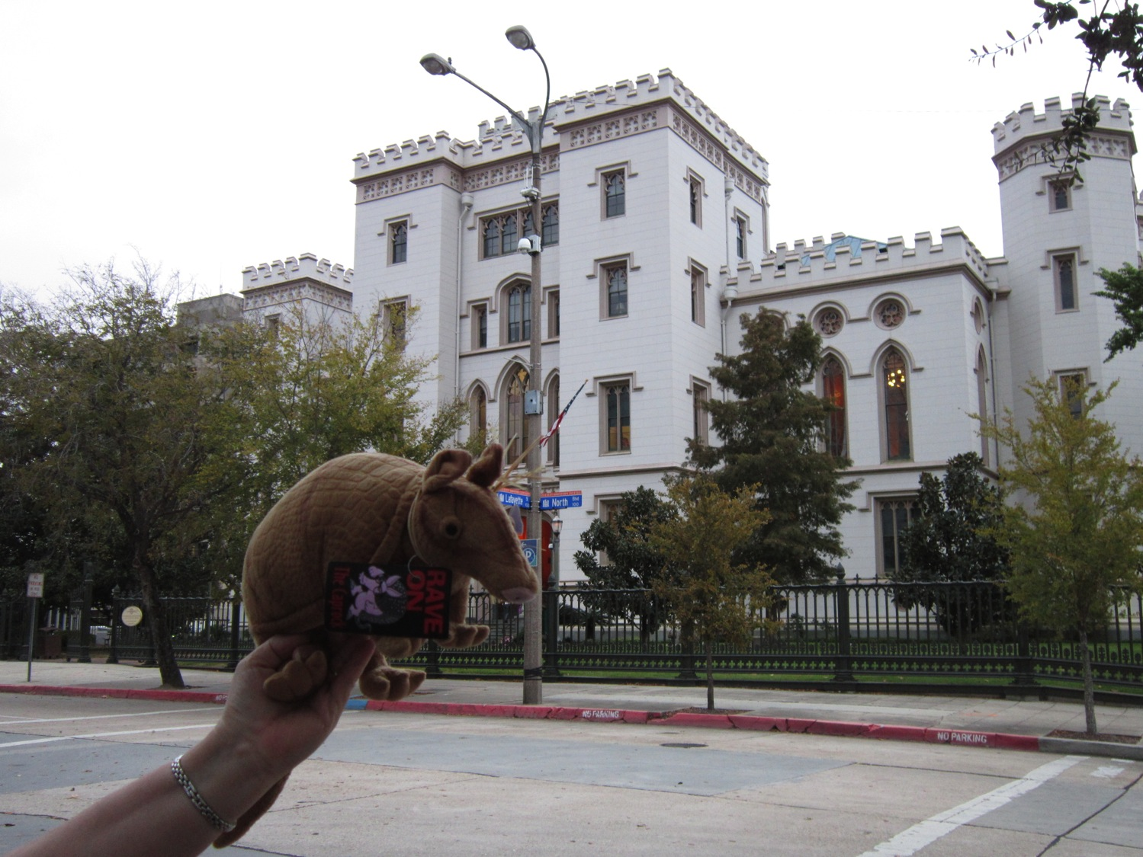
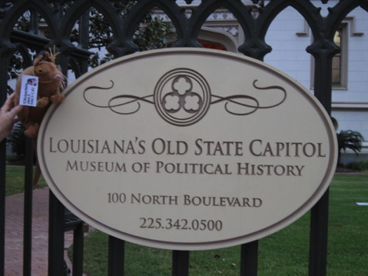

Slide 26
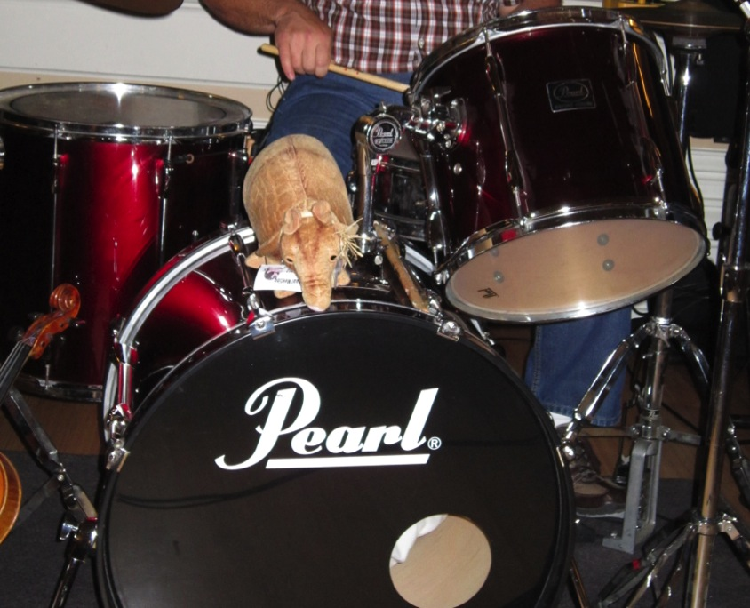

Slide 27
2012 Meeting
in
Lubbock, TX

Slide 28
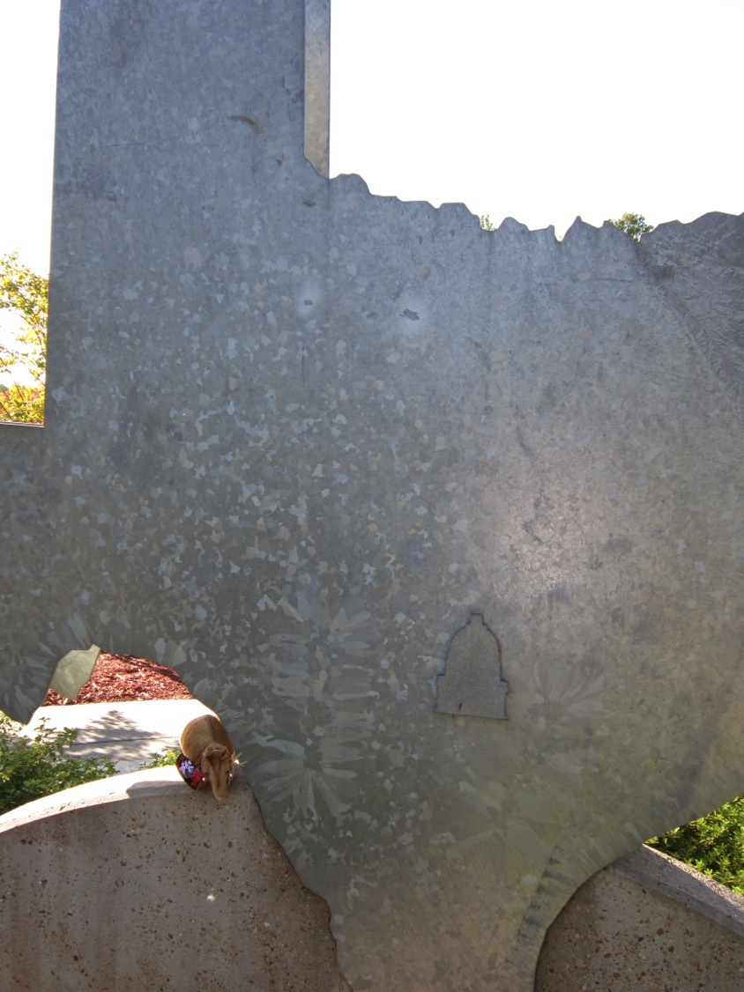

Slide 29
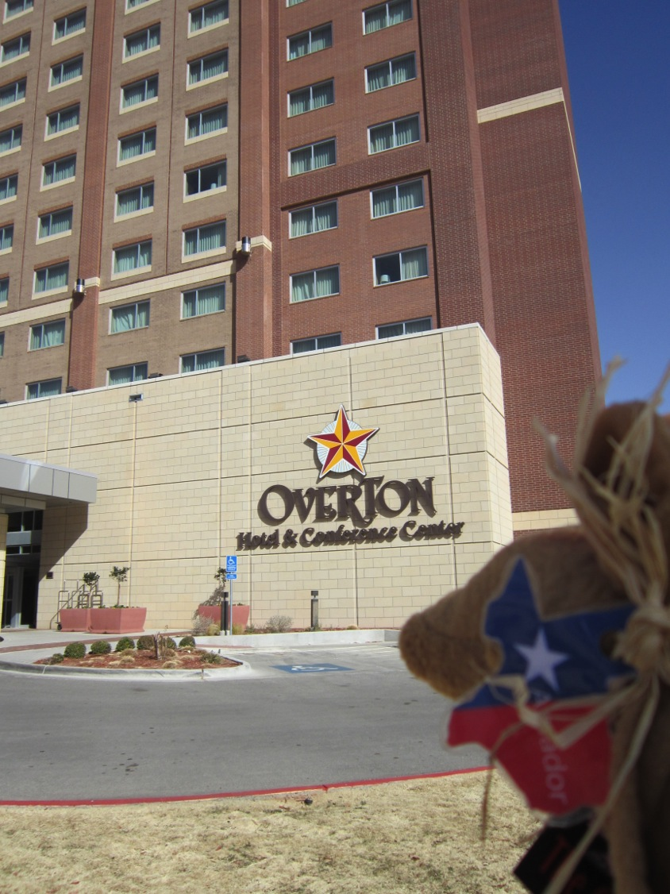
Conference Hotel

Slide 30
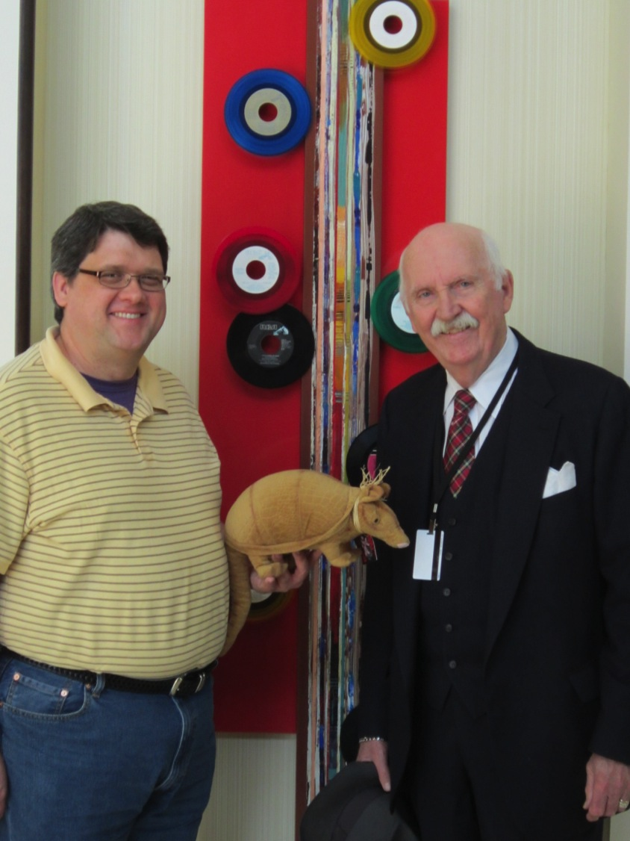
At Conference hotel
Jon Crossno and
Richard Wood

Slide 31
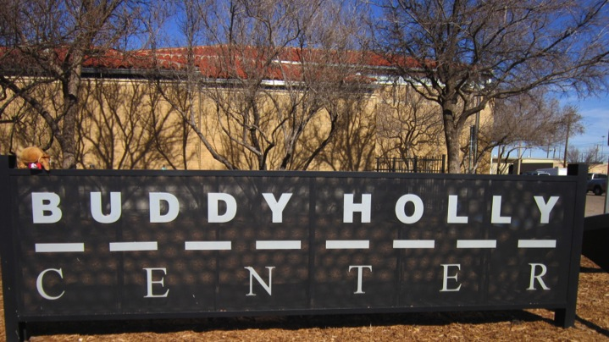
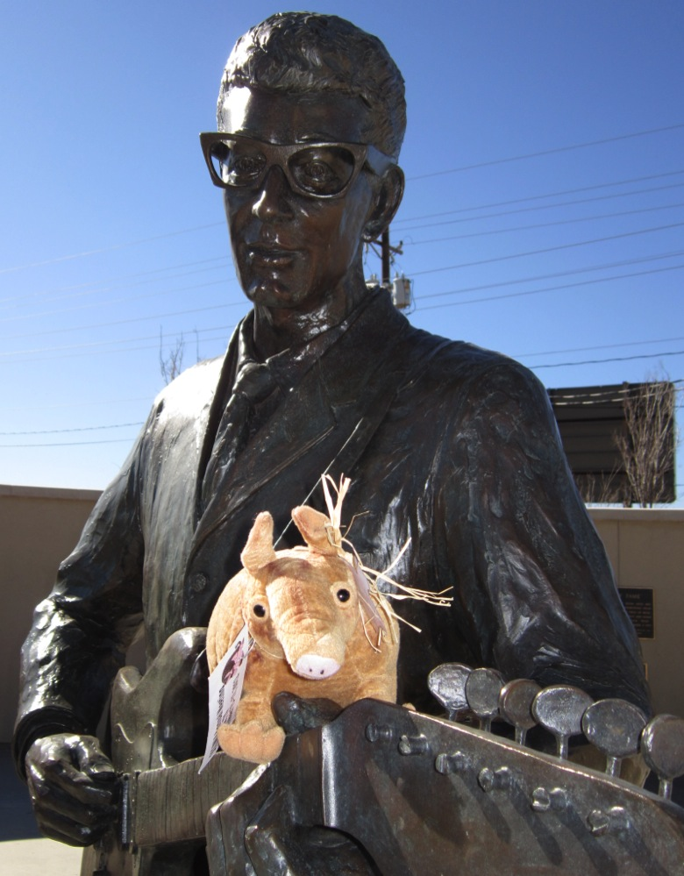
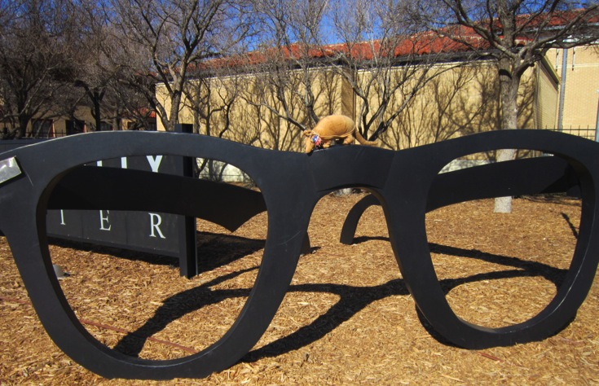
Welcome Party

Slide 32
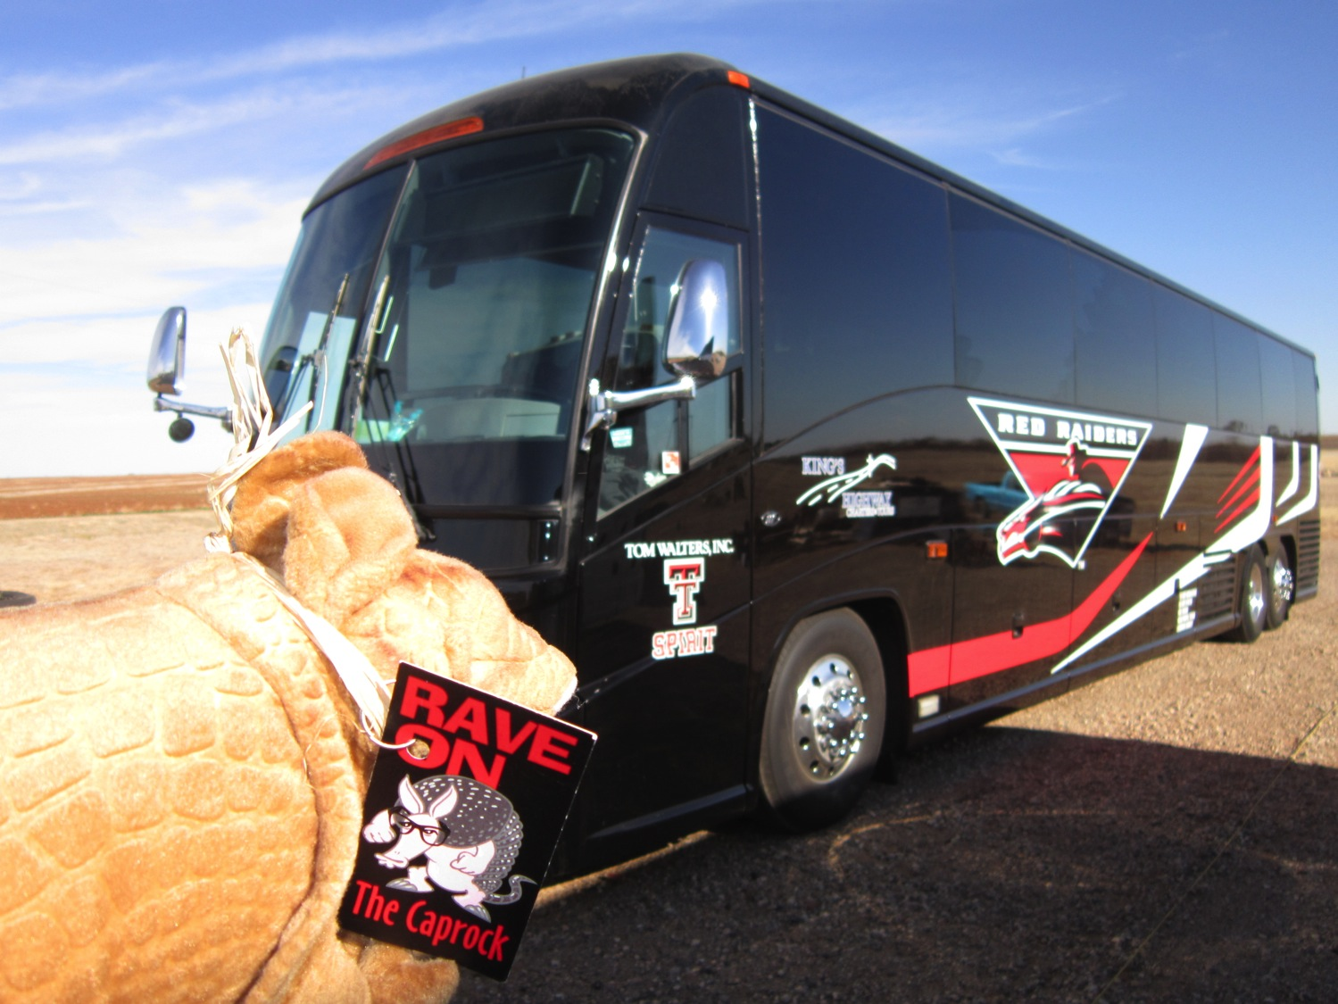
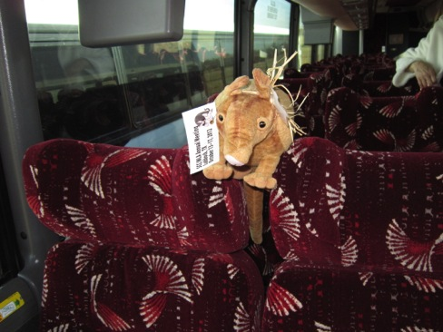
Our Comfortable Transportation

Slide 33
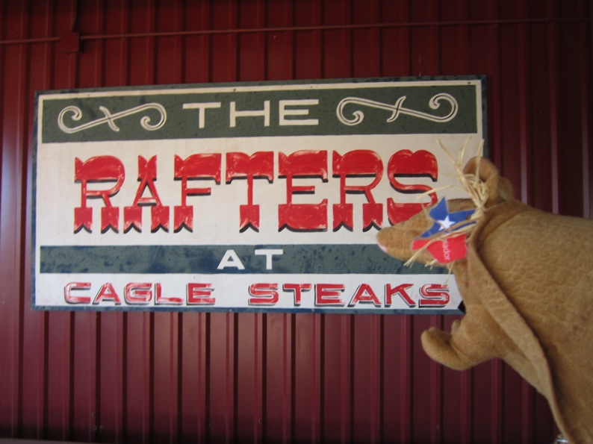
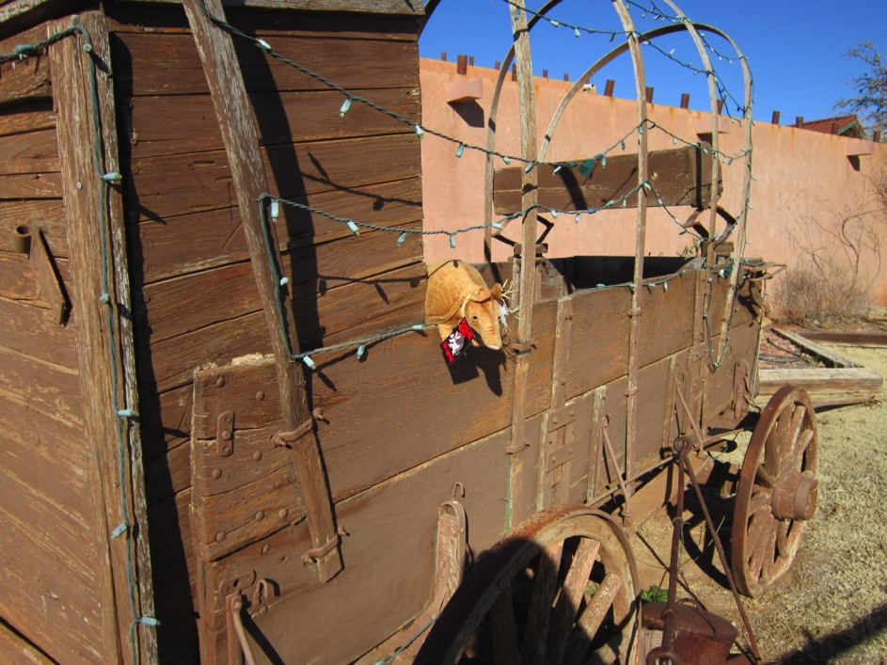
Farewell Dinner at
Cagle Ranch

Slide 34
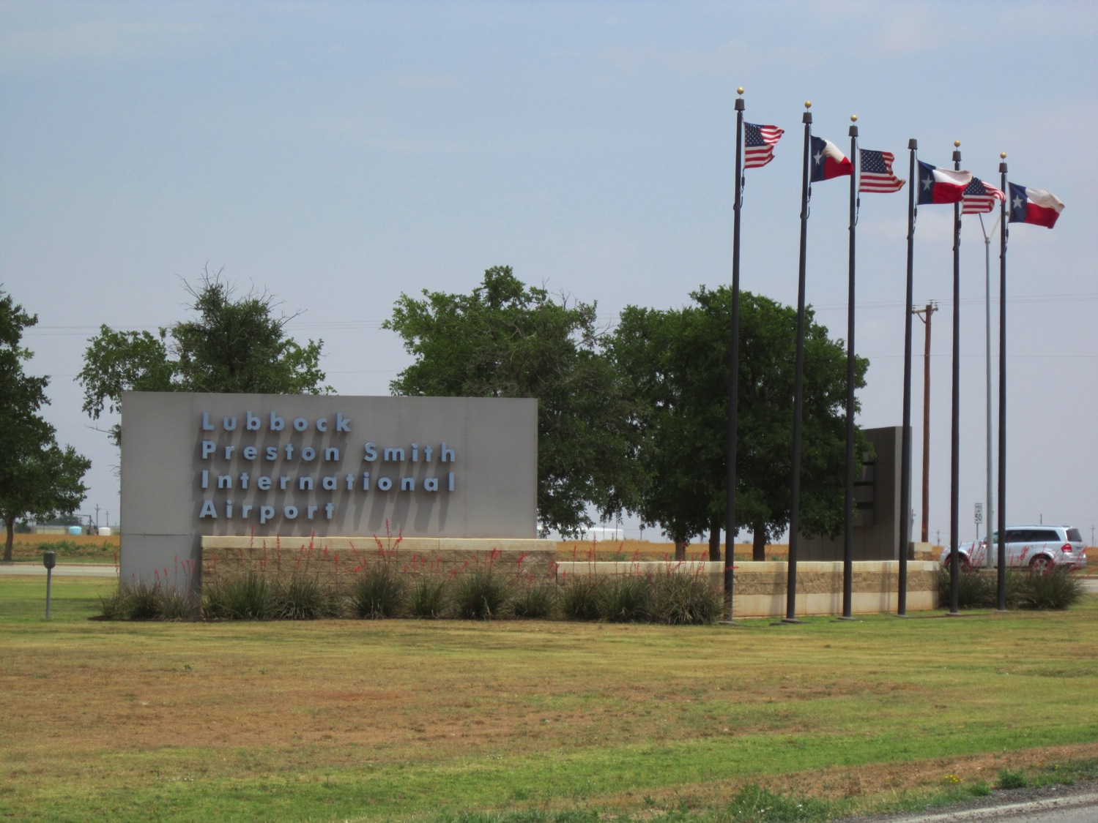
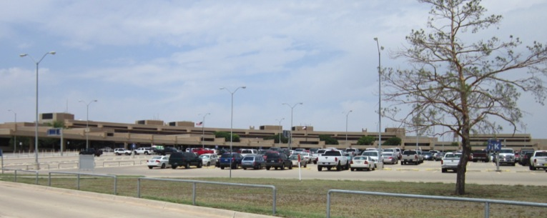
Lubbock International Airport

Slide 35
Sightseeing
Lubbock
on TTUHSC campus

Slide 36
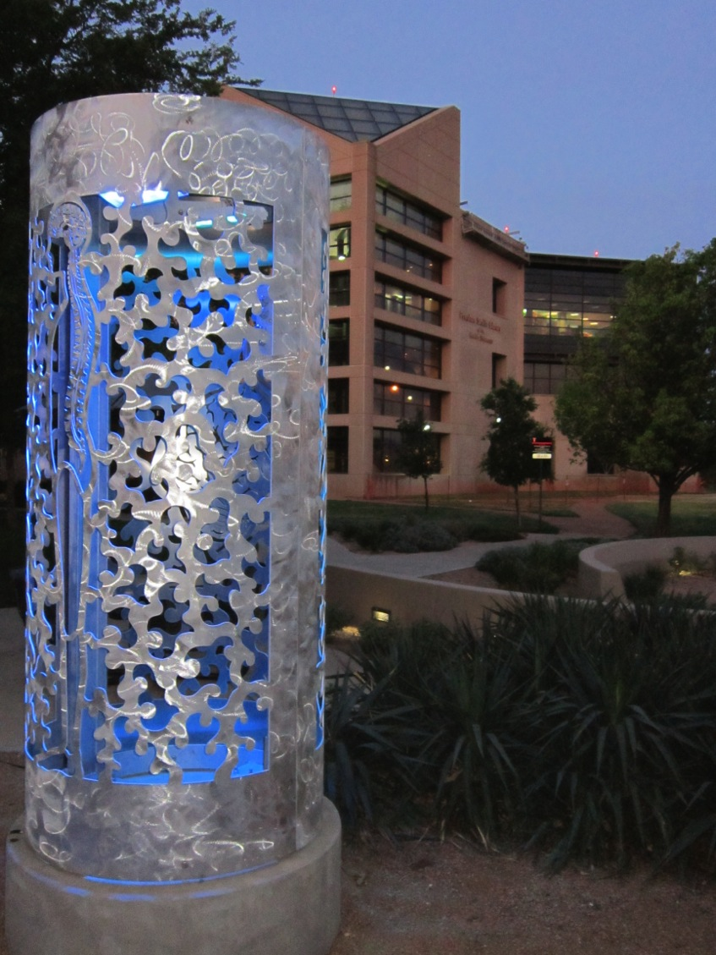
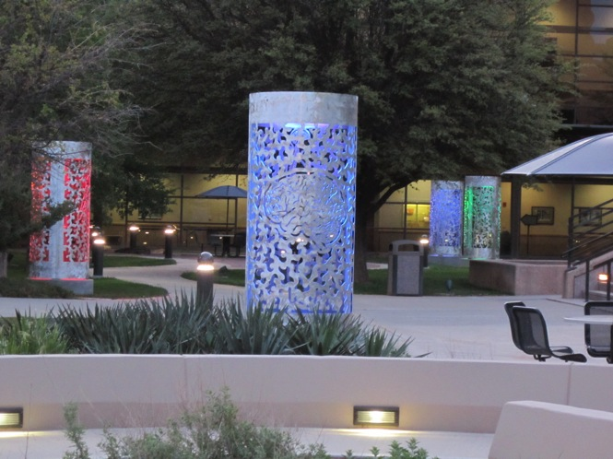
Academic Classroom Building
and the
Library courtyard

Slide 37
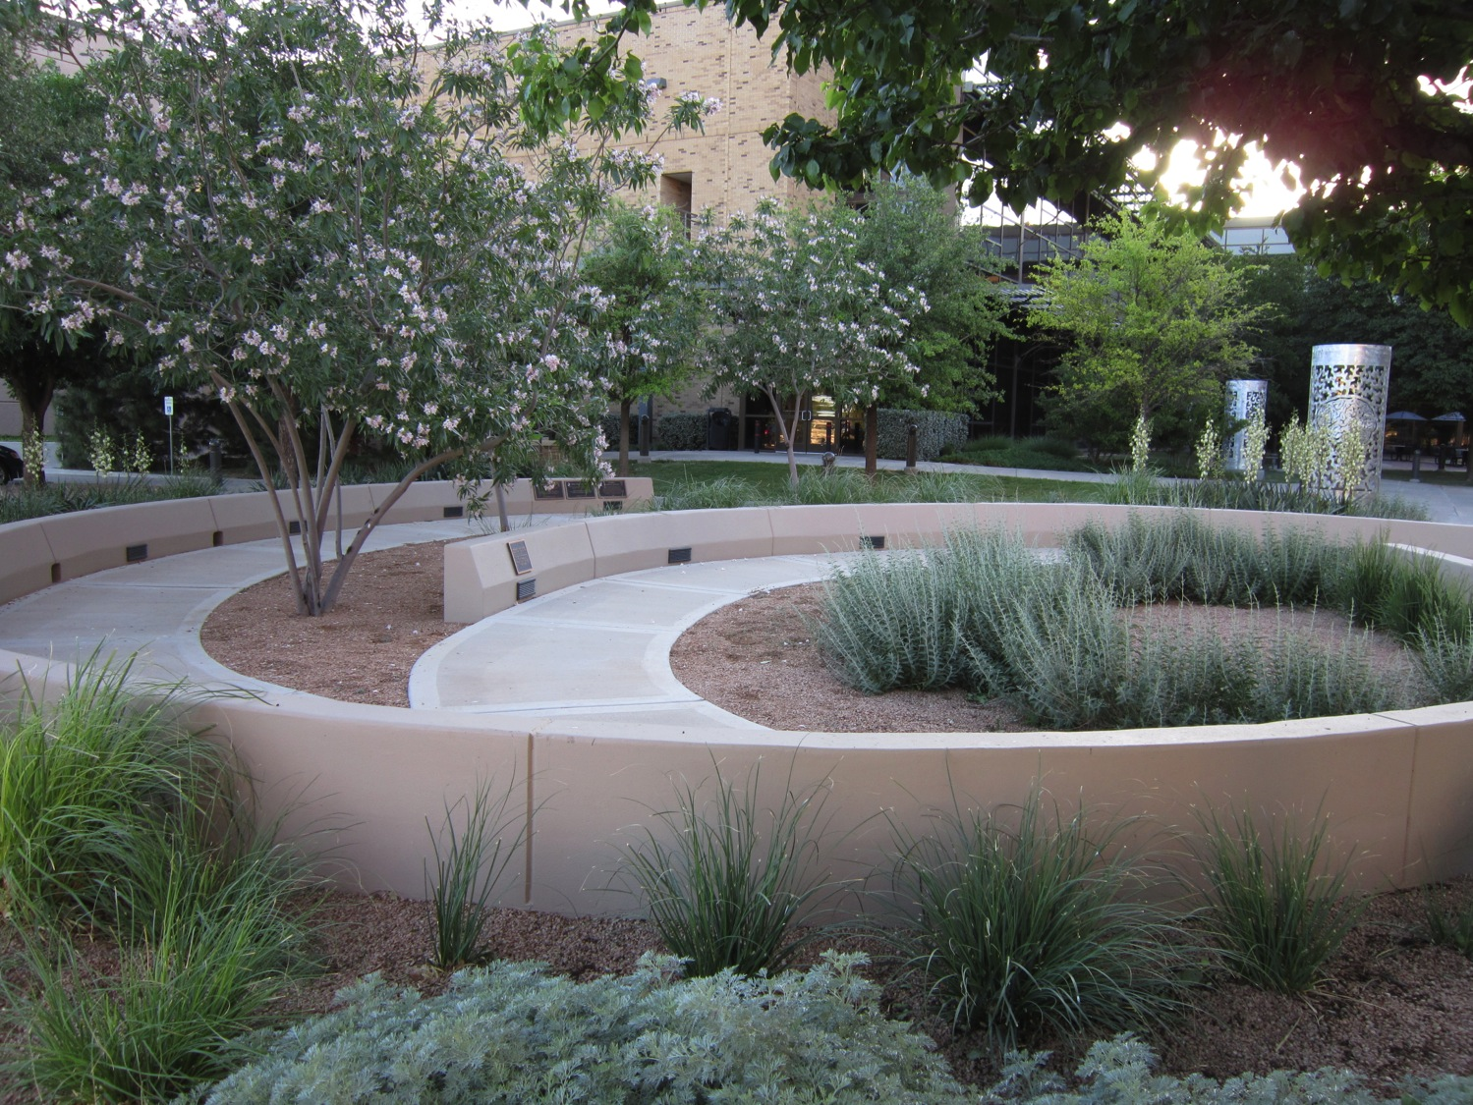
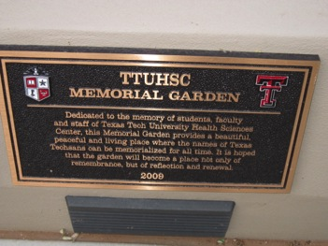

Slide 38
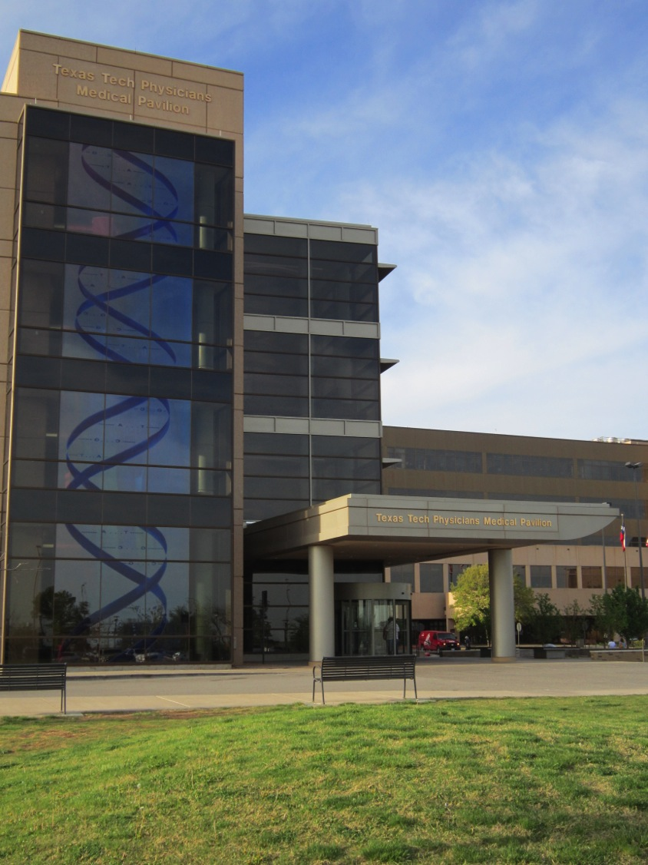

Slide 39

In Medical Pavilion

Slide 40


Outside
Medical Pavilion

Slide 41
Sightseeing
Lubbock
on TTU campus

Slide 42


School of Law
Indiana/19th

Slide 43



Administration Building/Former Gov.
Preston Smith

Slide 44





Art School Courtyard

Slide 45


Bell Tower
by Murray Hall

Slide 46


Animal Science Building Sculptures

Slide 47





Sculptures between library and student union

Slide 48



Jones AT&T football stadium and art seating

Slide 49


Fountain and Seal at University/Broadway

Slide 50

Memorial Circle off Broadway Ave

Slide 51



Will Rogers sculpture off Broadway Ave

Slide 52


Freedom of Youth sculpture in Holden Hall rotunda

Slide 53


Headwater sculpture behind the Foreign language building

Slide 54

601 Indiana Ave/4th st

Slide 55

Lapstrake Gateway

Slide 56


Masked Rider behind the Frazier Pavilion

Slide 57




Irish Madonna sculpture next to Memorial Circle

Slide 58

Original Southwest conference football team members

Slide 59


Square Spiral Arch by Experimental Sciences Building

Slide 60

The Way West sculpture
outside
Gordon Residence Hall

Slide 61


Wind River sculpture by Murray Residence Hall

Slide 62


The Southwest Collection (collection of
ranch records etc.)
15th Street/Detroit Ave.

Slide 63



TTU museum
Moody Planetarium
Indiana/4th St
Tug of War sculpture

Slide 64



TTU museum outdoor sculptures

Slide 65
Sightseeing
Lubbock
off campus

Slide 66




University/Genna Goodacre
(across from TTU campus)

Slide 67


City of Lubbock Cemetery

Slide 68



Depot District on Texas/17th St

Slide 69


Depot District on Buddy Holly between 17th and 19th St

Slide 70


Depot District on Buddy Holly between 17th and 19th St

Slide 71

Depot District on Buddy Holly between 17th and 19th St

Slide 72


Depot District on Buddy Holly/17th St

Slide 73


Depot District on Texas between 17th and 19th St

Slide 74



1701 Canyon Lake Dr

Slide 75

1121 Canyon Lake Dr

Slide 76



MacKenzie Park Mustangs
601 Municipal Dr.

Slide 77




MacKenzie Park Prairie Dog Town

Slide 78

Rawls Golf Course on Texas Tech Pkwy/4th St.

Slide 79


Lubbock Lake National Historical Landmark
2401 Landmark Dr/off North Loop 289

Slide 80


Silent Wings Museum
By Airport/Off I-27 Exit 9

Slide 81


5101 Clovis Highway (U.S. 84)

Slide 82


LHUCA
between Ave K and Ave L/Mac Davis

Slide 83



LHUCA between Ave K and Ave L/Mac Davis

Slide 84




LHUCA between Ave K and Ave L/Mac Davis

Slide 85




LHUCA between Ave K and Ave L/Mac Davis

Slide 86



LHUCA between Ave K and Ave L/Mac Davis

Slide 87

Kinetic Wind Sculpture on Quaker/24th in pond at Maxey Park

Slide 88



National Ranching Heritage Center
3121 4th St

Slide 89



Wells Fargo Amphitheater
413 E. Broadway

Slide 90


Wells Fargo Amphitheater
413 E. Broadway

Slide 91


Off the South Loop 289 between Indiana/University

Slide 92



Lubbock Area
Veterans War Memorial and
Meditation Circle
on 82nd/Nashville Ave

Slide 93


Willie McCool Memorial/Space Shuttle Columbia
82nd/Nashville

Slide 94

Depot District on Buddy Holly/16th St

Slide 95
The End
Pictures provided by
Candia Thew & Dawn Kruse Field
Permission from Holly Phillips, Yumi Yaguchi, Richard Wood, Jon Crossno, Heather Moberly, Jerry Perry and Esther Carrigan
for use of their likeness.

