Slide 1
Athletic Training library orientation
Margaret Vugrin, MSLS
Reference Librarian

Slide 2
Agenda
  Mobile Resources
AccessPhysiotherapy
Rehab Reference Center
  Locating articles
Q&A

Slide 3
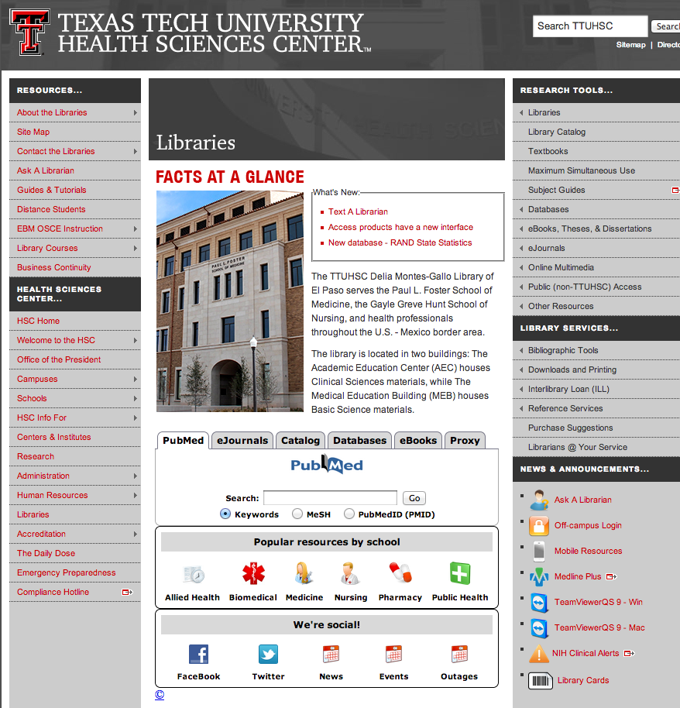
http://www.ttuhsc.edu/libraries

Slide 4
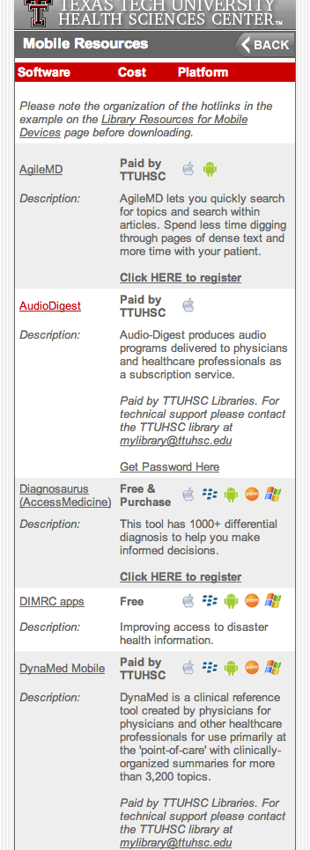
Library homepage

Slide 5
http://www.ttuhsc.edu/libraries

Slide 6
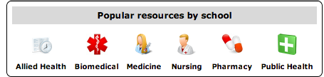
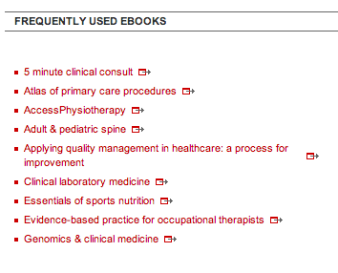

Slide 7
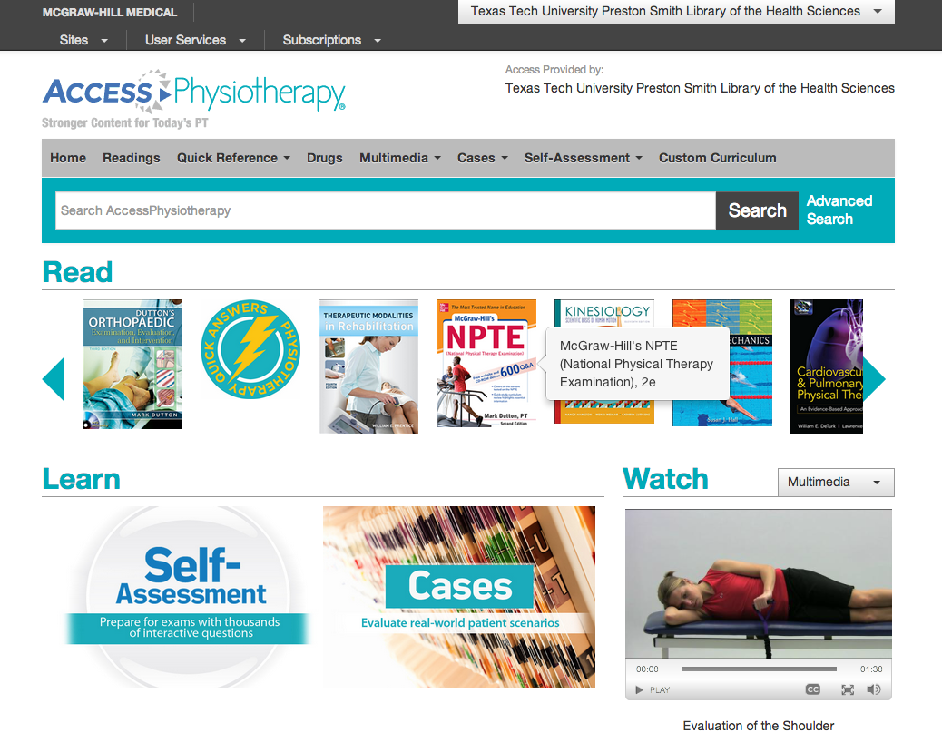

Slide 8
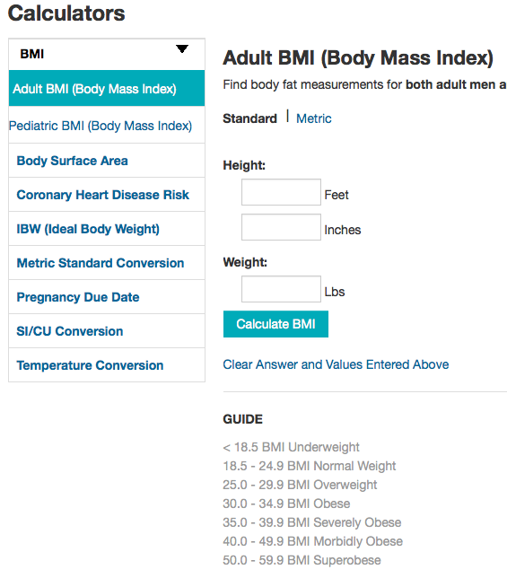
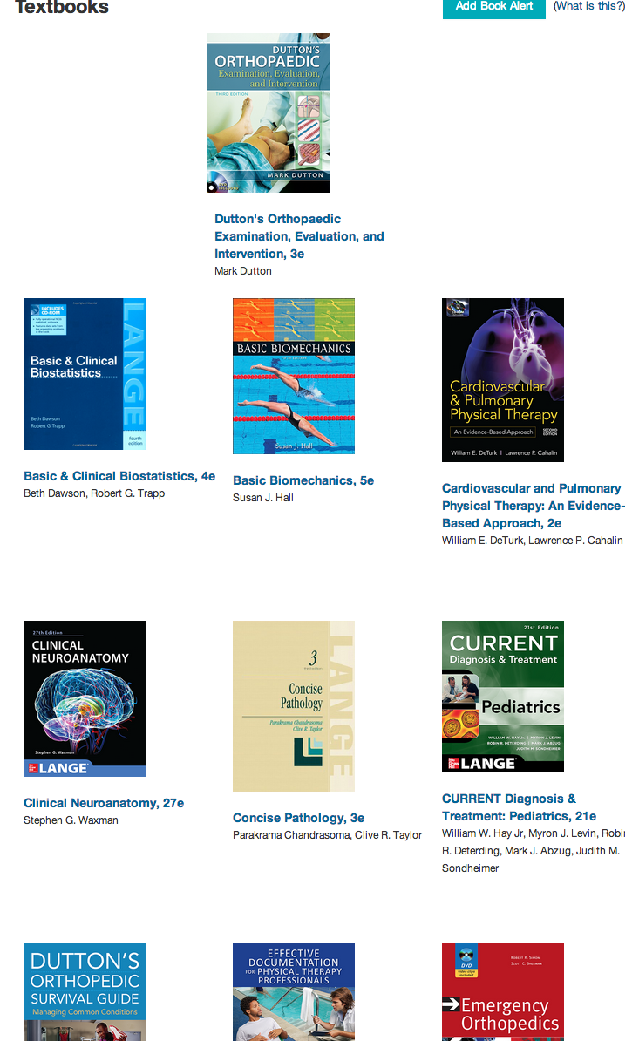
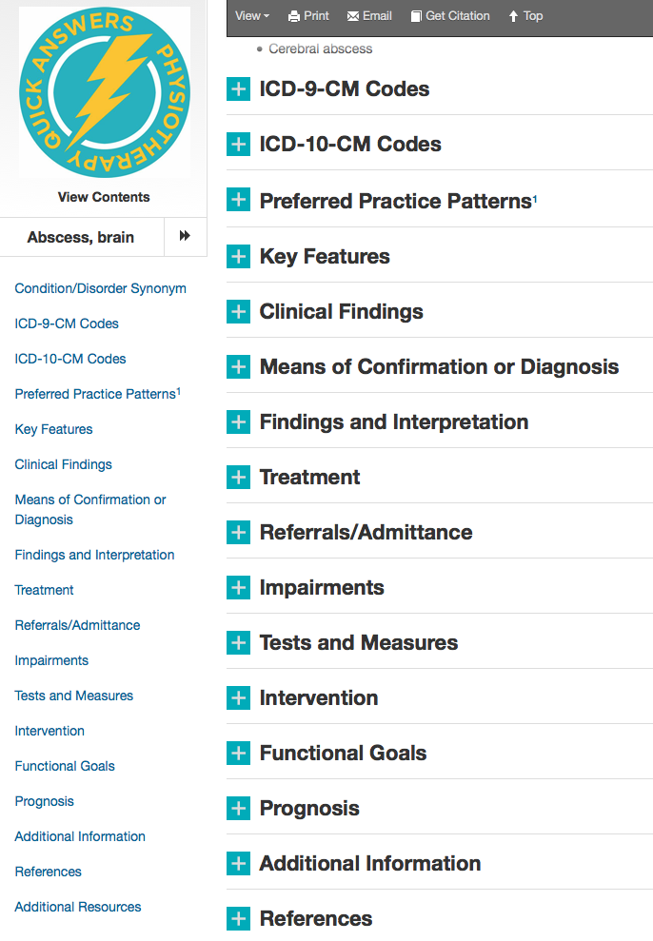

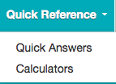

Slide 9
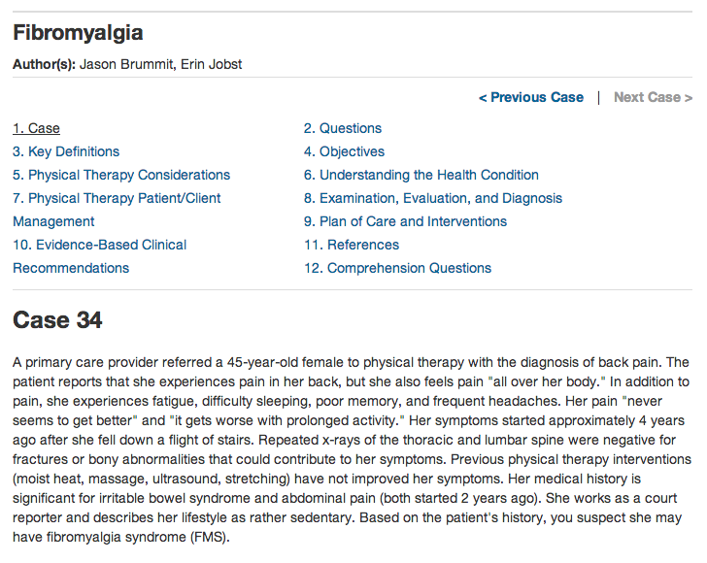

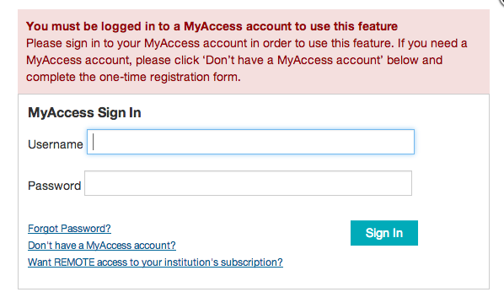
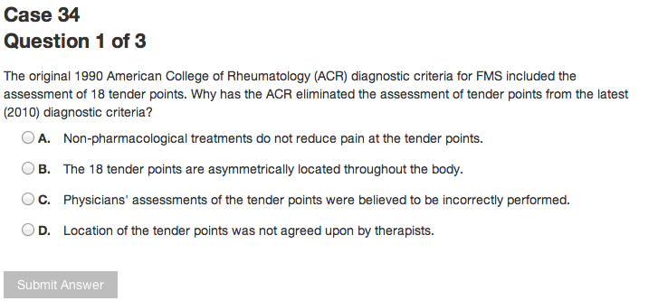

Slide 10


Slide 11
Exercises and answers
Can you locate a book to help study for the NPTE exam?
The NPTE text is one of the readings/textbooks available in AP.
How is fibromyalgia diagnosed? What are the tests?
Quick answers
Locate some images of how to do a correct lunge.
Type lunge into first screen, select images from left side options or under Multimedia tab.
Locate patient education and pricing information for lipitor?
Drugs >patient education >pricing information

Slide 12
Exercises and answers
How much grapefruit juice can I drink if on lipitor?
Less than a quart. Under Patient ed>Lipitor
Locate information on diagnosis and evaluation of SLAP tears of shoulder.
Pediatric practice: Sports medicine or other books

Slide 13
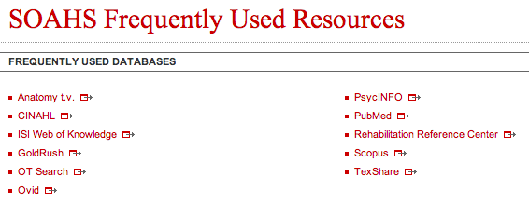

Slide 14
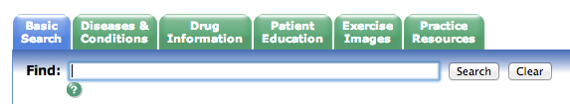
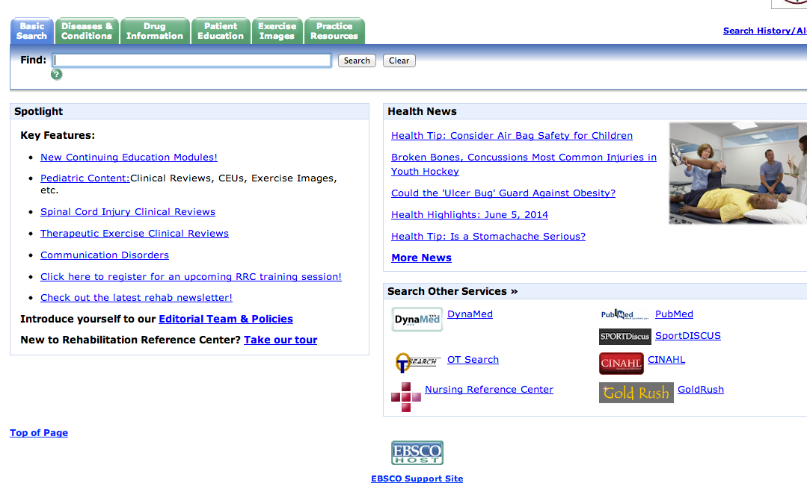
Soccer Injuries

Slide 15
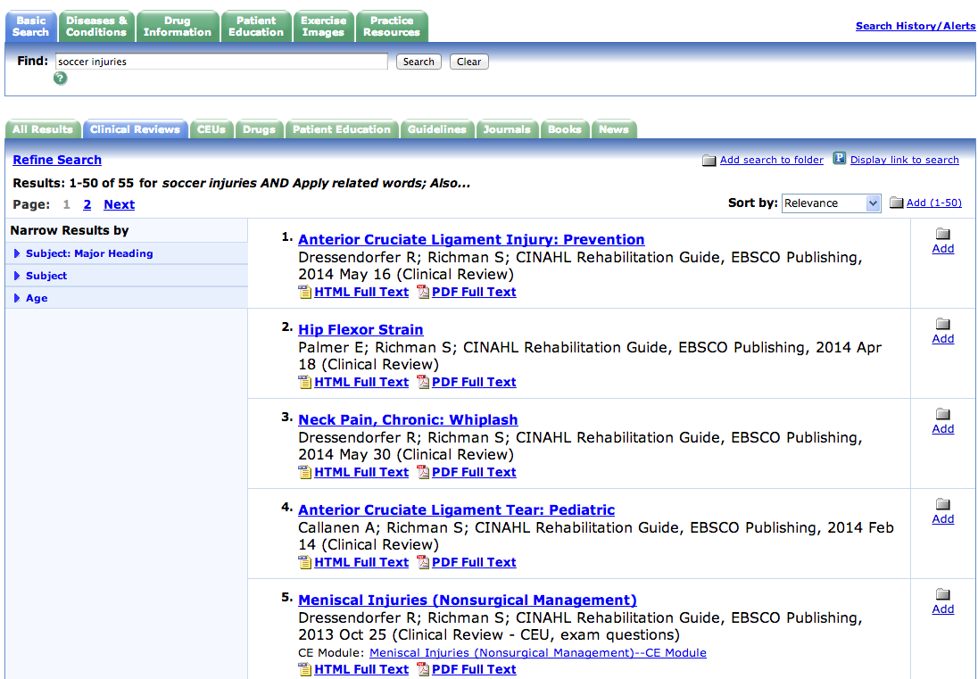
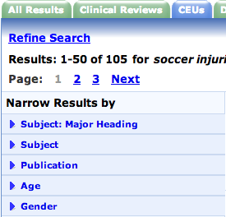
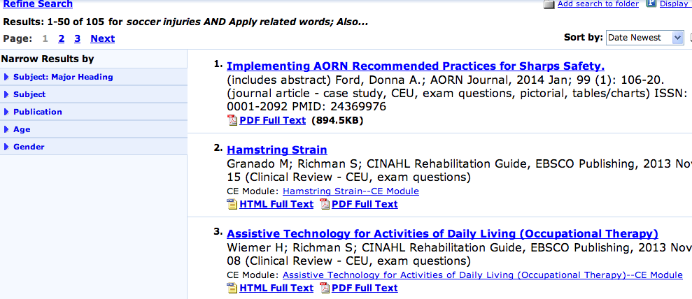
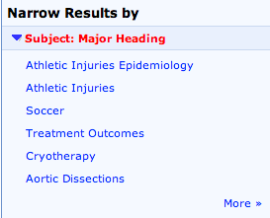

Soccer Injuries

Slide 16

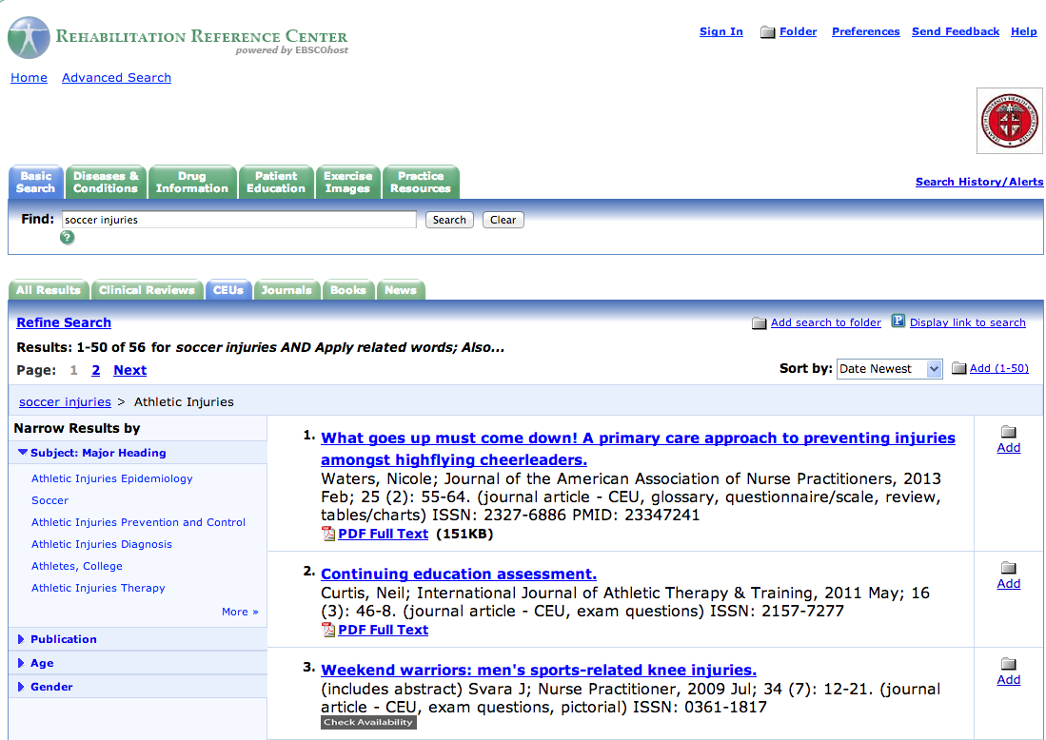


Slide 17
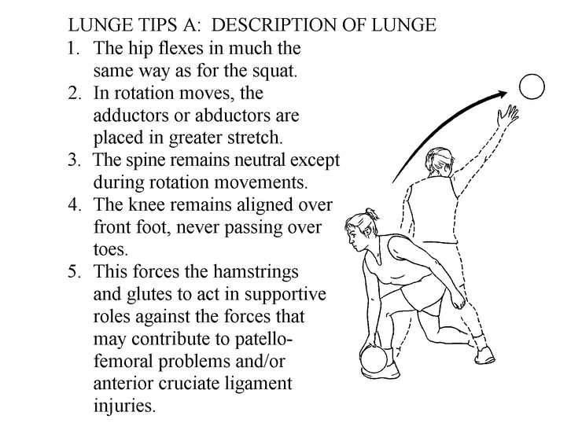
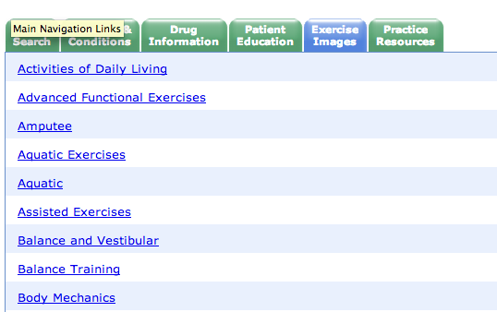
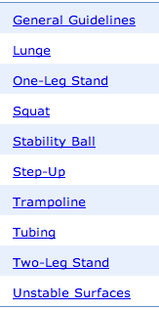
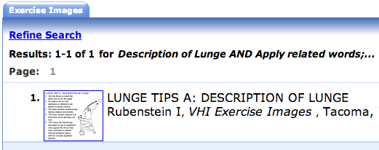

Slide 18

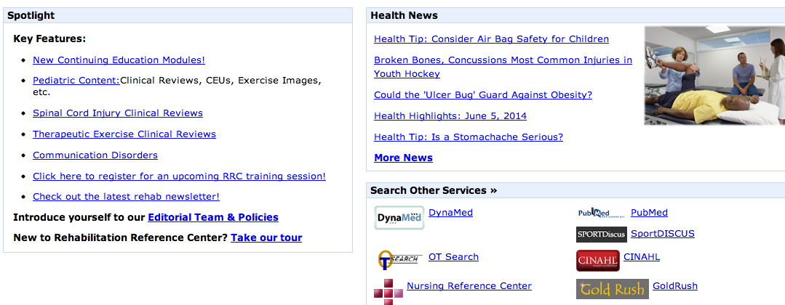

Slide 19
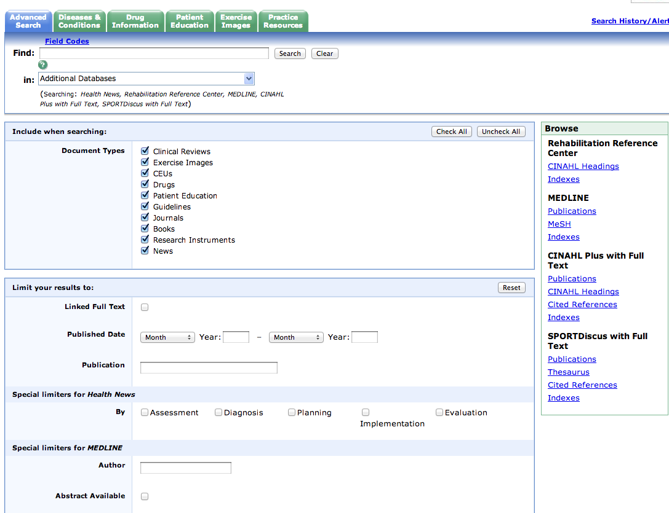
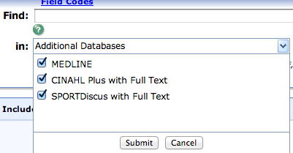
http://www.ttuhsc.edu/libraries

Slide 21
Exercises and answers
Locate some images of how to do a correct lunge.
Type lunge into first screen, select images from left side options or under Multimedia tab.
Locate patient information on Above the knee amputation.
In Spanish?
Patient education tab>”A”>link to English and Spanish

Slide 22
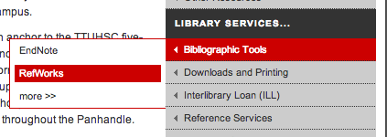

Slide 23
Bibliographic software managment
RefWorks
EndNote
Web based
Storage of citations
Write-n-cite
Embed citations into Word
Create bibliography
Web based
Desktop
Storage of citations
Cite-n-write
Embed citations into Word
Create bibliography
Library homepage

Slide 24
Thank you!

