Slide 1
Welcome to your Library
Peggy Edwards, AMLS
Jennifer Teichelman, MSIS
Micah Walsleben, MLS
Margaret Vugrin, AHIP, MSLS

Slide 2
Preferred Internet Browsers
Firefox
Chrome
Safari

Slide 3
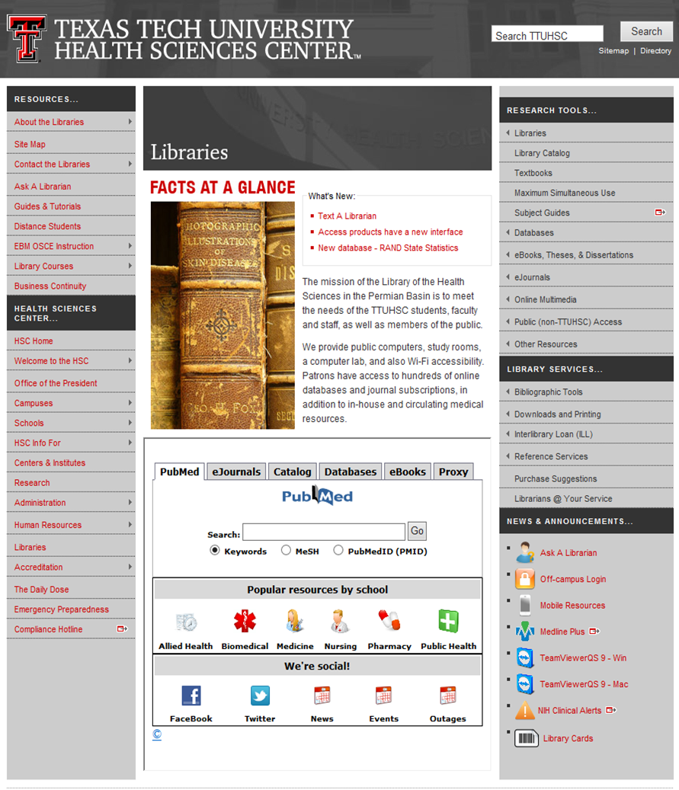
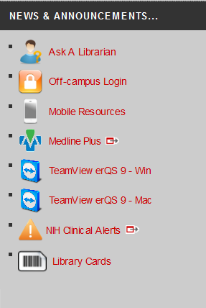

Library Cards
http://www.ttuhsc.edu/libraries/

Slide 4
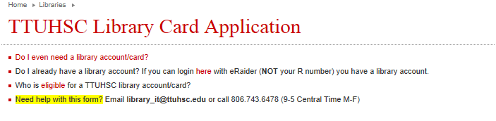
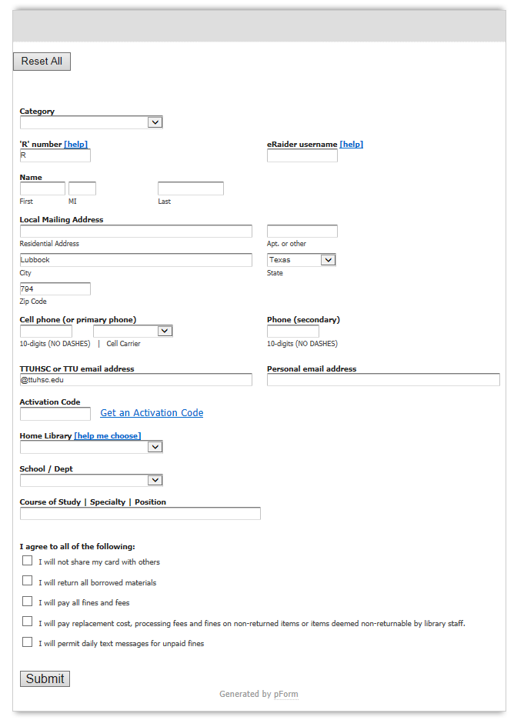
Library Card Application

Slide 5
Library Card
Stop by the circulation desk on your way out.
Apply barcode sticker to the back of your ID Card

Slide 6

Please go to the library home page when you have completed your library card application.
http://www.ttuhsc.edu/libraries/

Slide 7

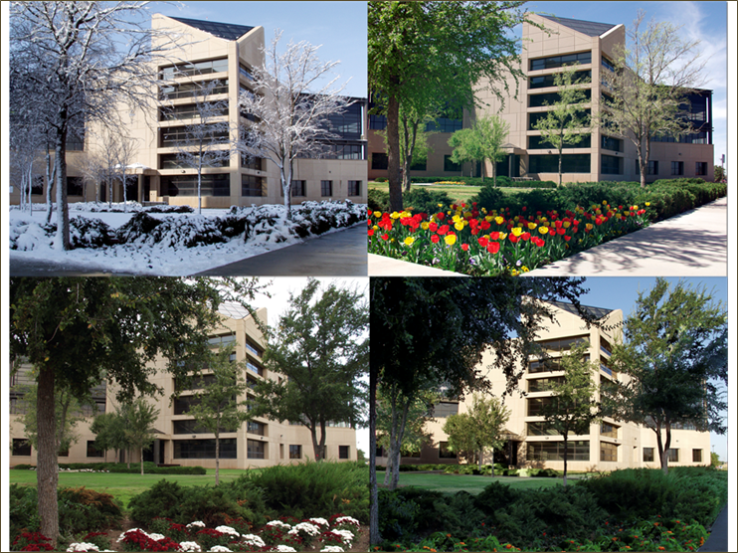


Slide 8

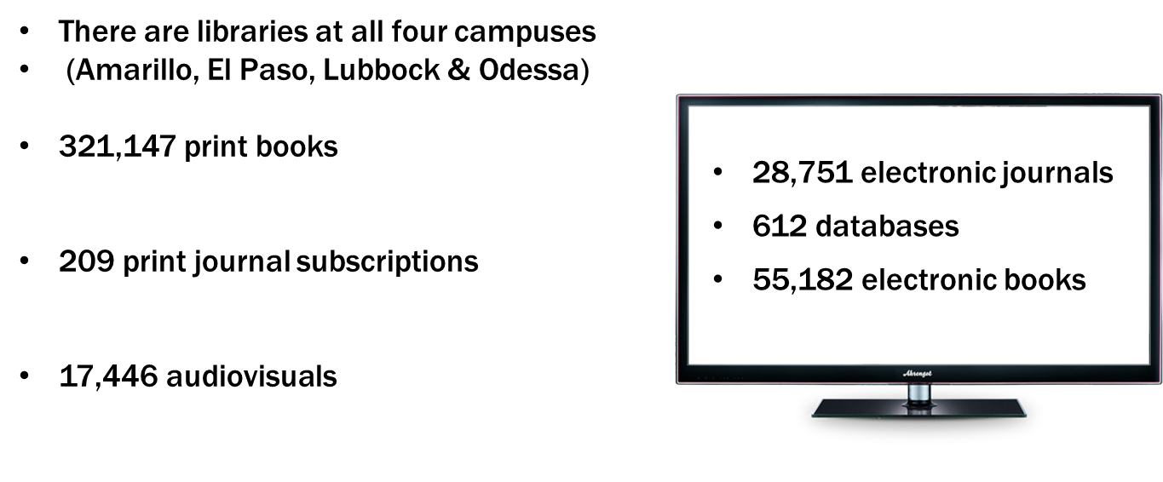
TTUHSC Libraries Statistics
As of April 2014

Slide 9

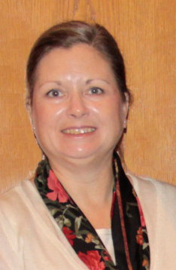

Reference Librarians
Available on 2nd floor of library, across from Learning Resource Center and public computers
8am–5pm
Monday–Friday
Jennifer Teichelman
Peggy Edwards
Micah Walsleben
Margaret Vugrin

Slide 10
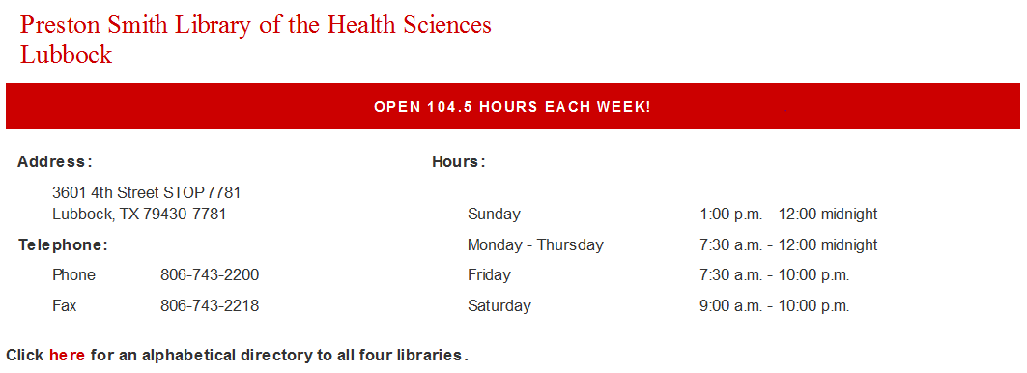
Library Hours
Phone: 806-743-2200
Holiday hours and early closings are also posted as announcements in your e-Raider portal.

Slide 11
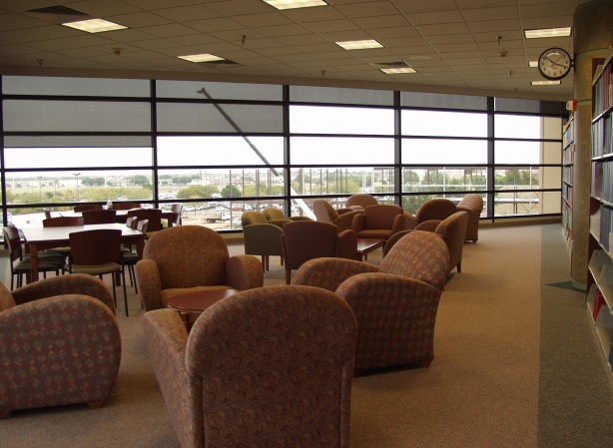

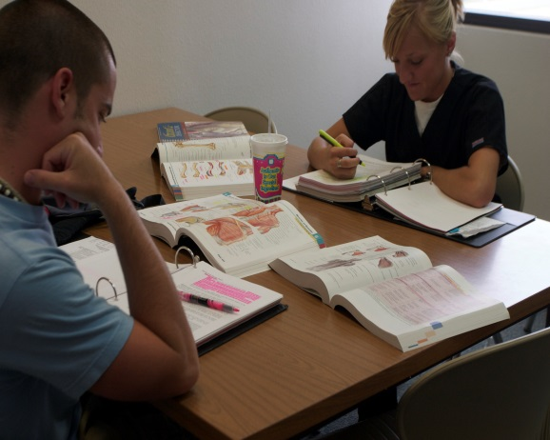
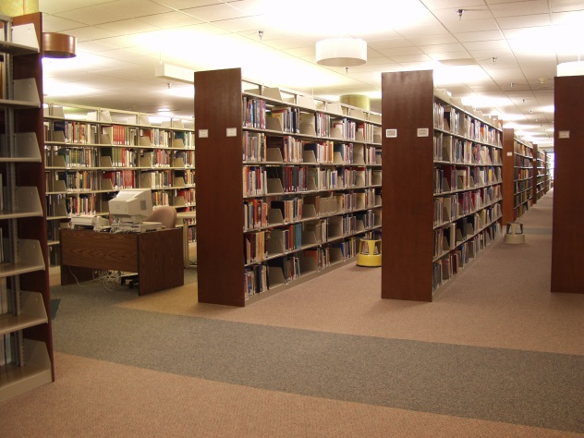
Library Facilities
29 study rooms
All rooms are first come, first serve.
Each room has a dry erase board, markers, and plenty of outlets!
Wireless internet

Slide 12
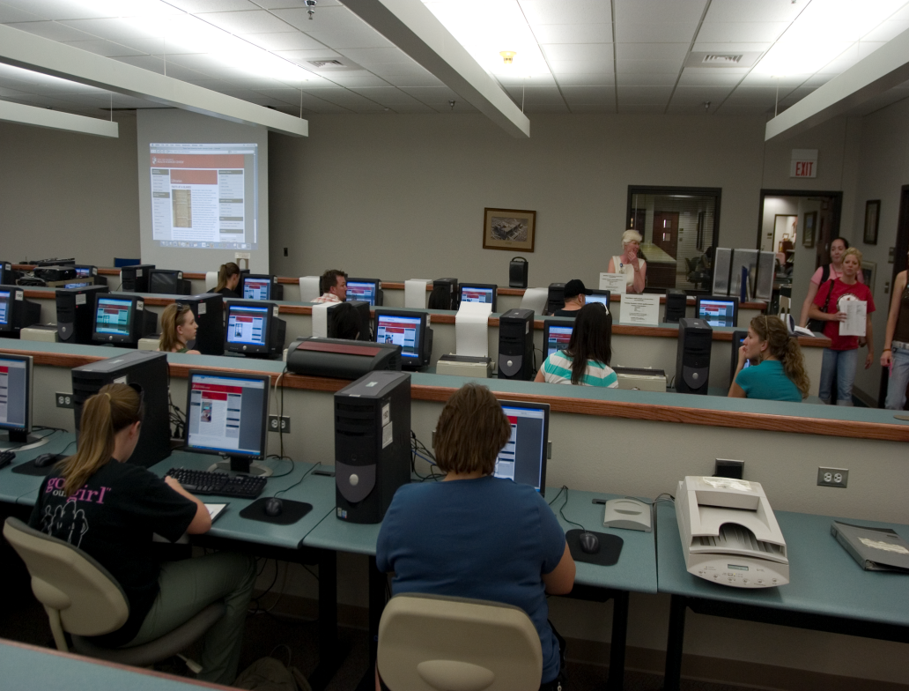
Learning Resource Center
Located on the 2nd floor of the library
Requires a library card
Check out computer stations, anatomical models, and more!
Notes:
The Learning Resource Center is located on the 2nd floor of the Lubbock library. Here, you can check out the library’s audiovisual materials, anatomical models, and computer stations. These materials, including the computer stations, require a library card in order to be checked out. Drinks only are allowed in the Learning Resource Center.

Slide 13
Library Policies
Books/Audiovisuals/Journals:
Checkout period for books is two weeks, audiovisuals for 10 days.
Journals in the print collection can be scanned but not checked out.
May renew items twice in person, over the phone (806-742-2200), or online through the library catalog.
Fines for overdue items:
50 cents per day per item
Library privileges are lost until fines are paid.

Slide 14


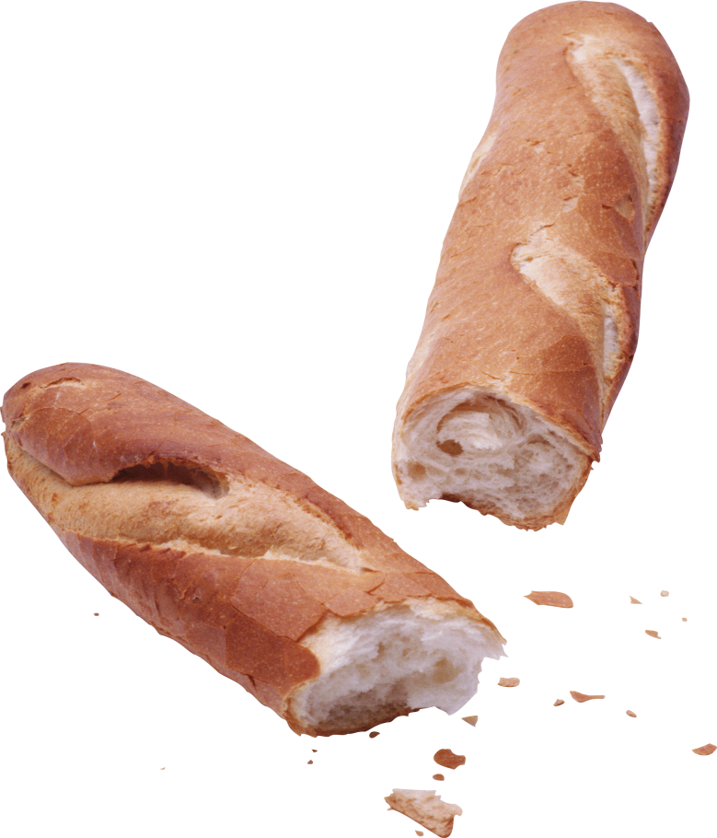

Library Policies
EAT, DRINK AND BE MERRY but Please Clean UP After Yourselves!

Slide 15
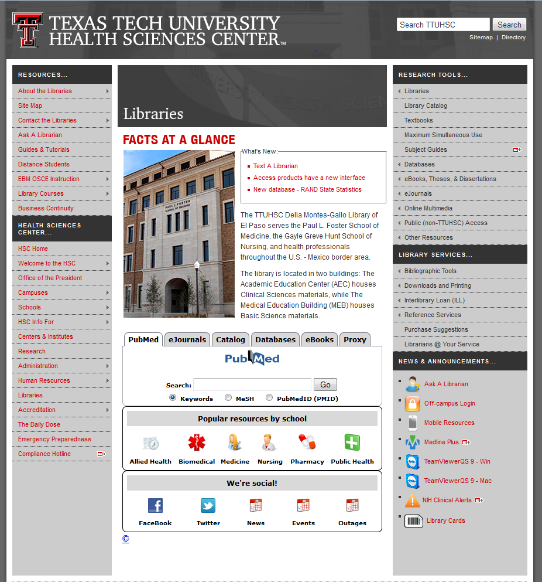
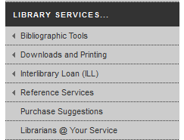
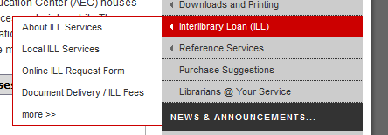
Interlibrary Loan (ILL) Policies

Slide 16
Interlibrary Loan (ILL) Policies
Online form makes submitting requests quick and easy
Response time for requests is anywhere from 2 – 10 business days, depending on location of the item
Books from any TTUHSC branch library are free.
All other locations are $4.00
Journal articles are charged per page, but fees will not exceed $4.00
There is a rush option available, but at a higher fee rate

Slide 17
Interlibrary Loan (ILL) Form

Slide 18
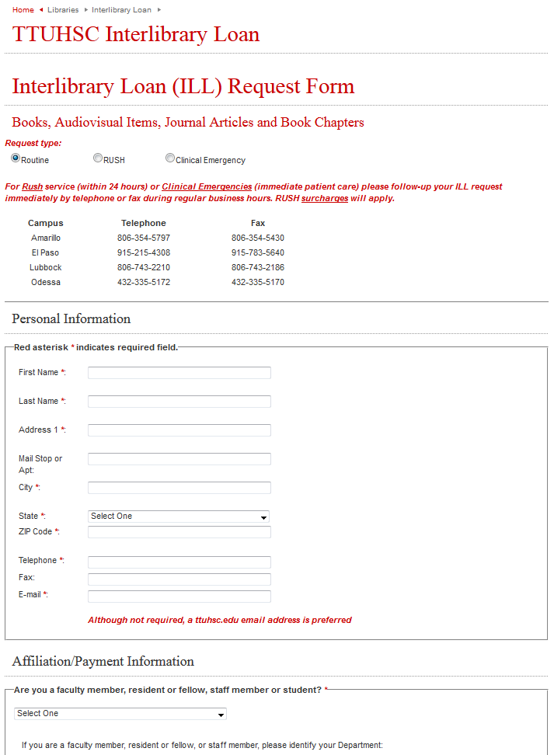
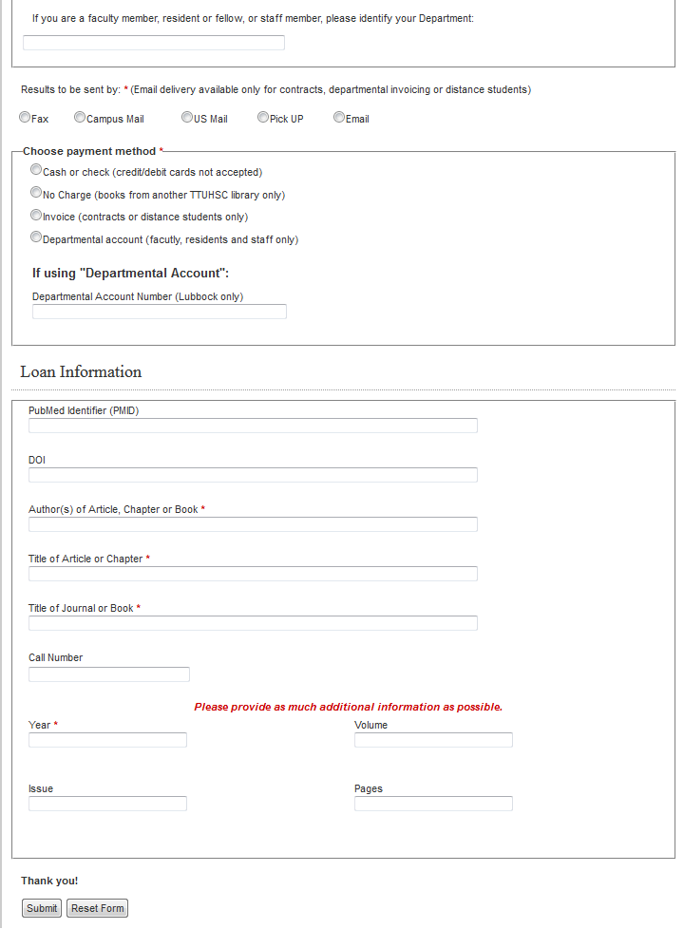
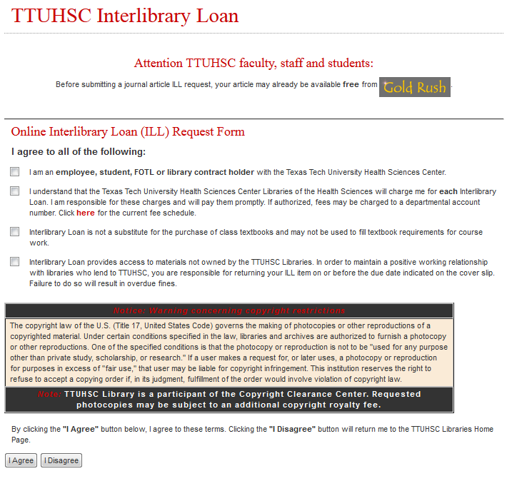
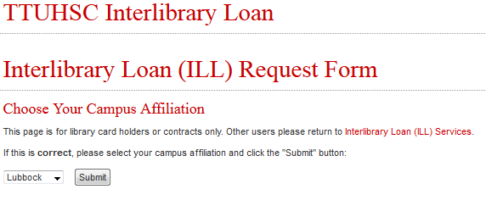
Interlibrary Loan(ILL) Form

Slide 19
Library Website
http://www.ttuhsc.edu/libraries/

Slide 20
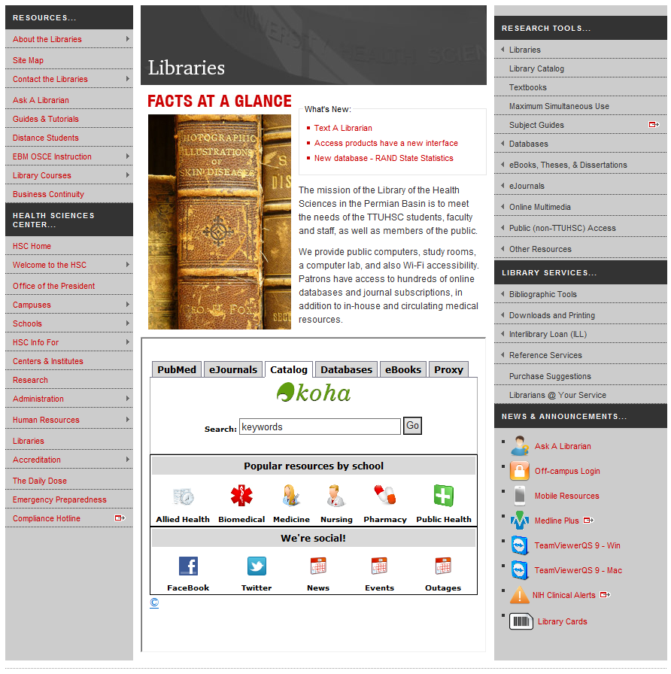
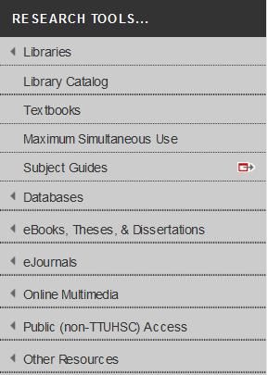
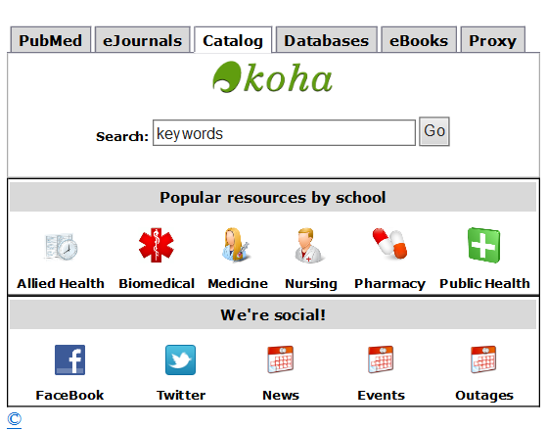
Library Catalog
There are two points of access for the library catalog off the homepage.

Slide 21
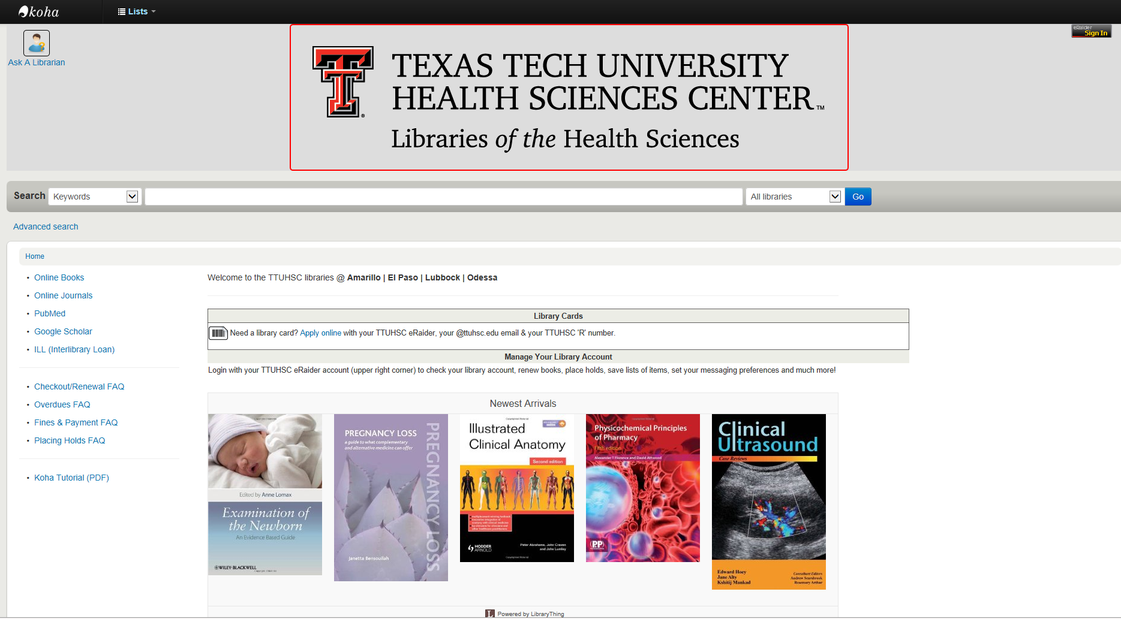
Library Catalog

Slide 22
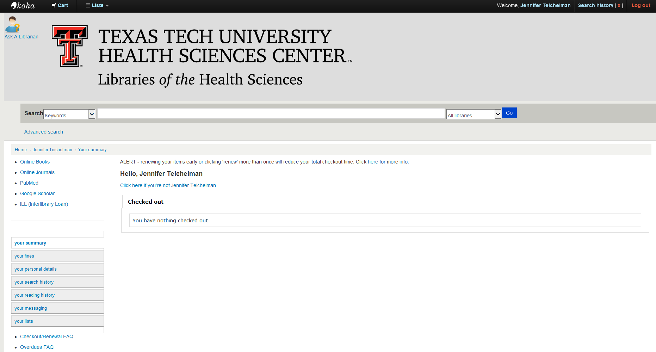
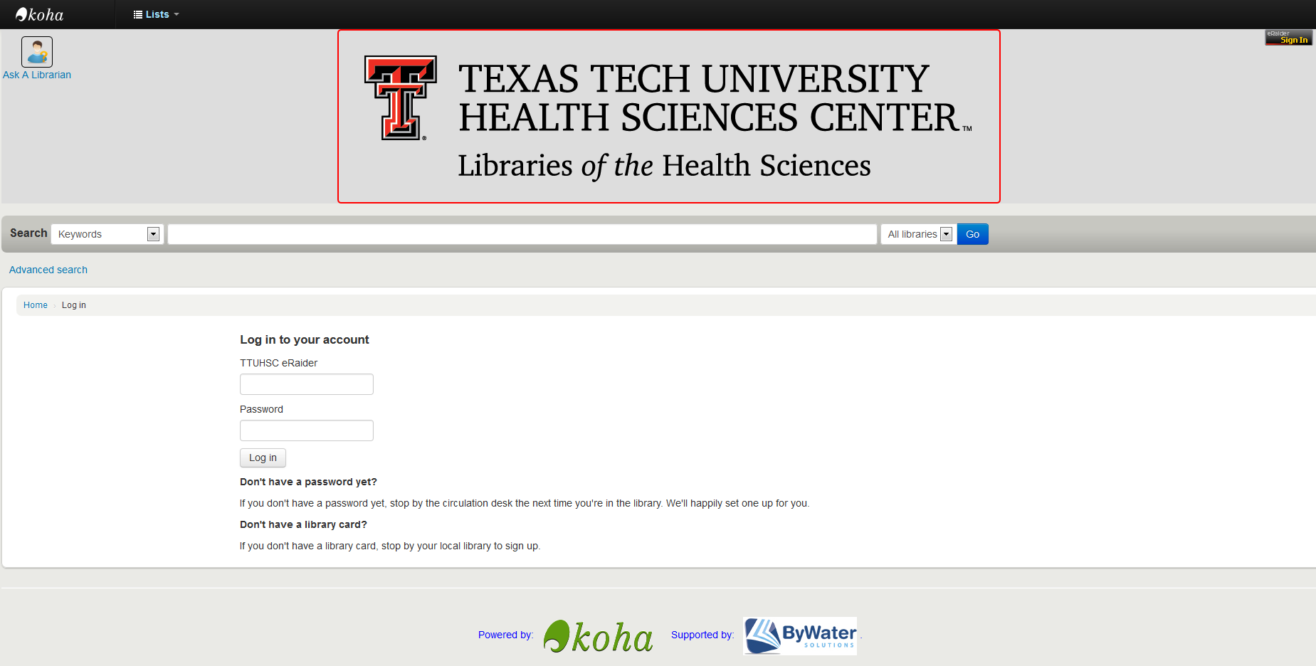
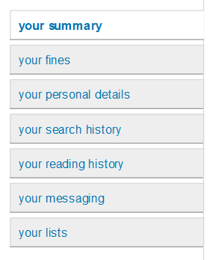
Library Catalog

Slide 23
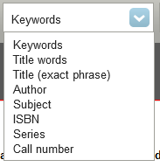
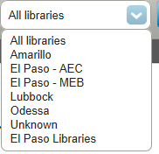
Library Catalog

Slide 24
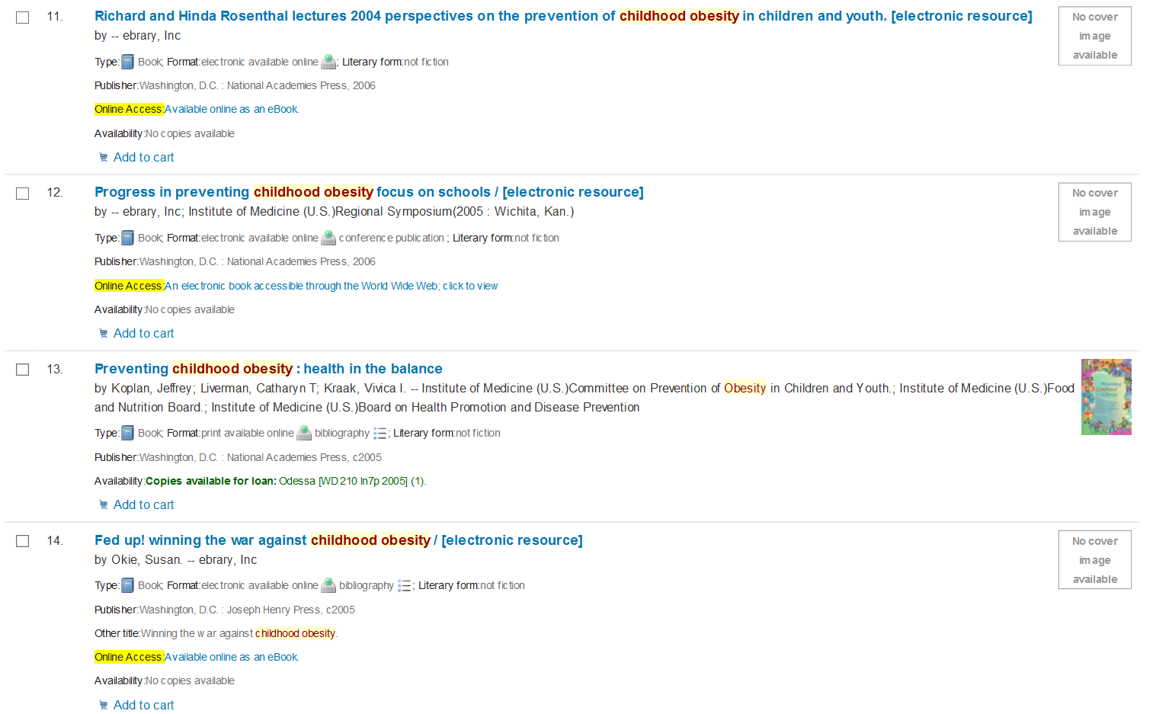
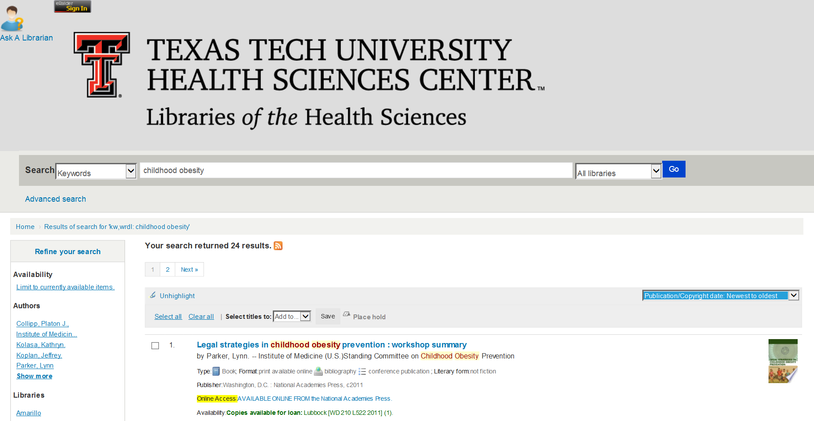
Library Catalog

Slide 25
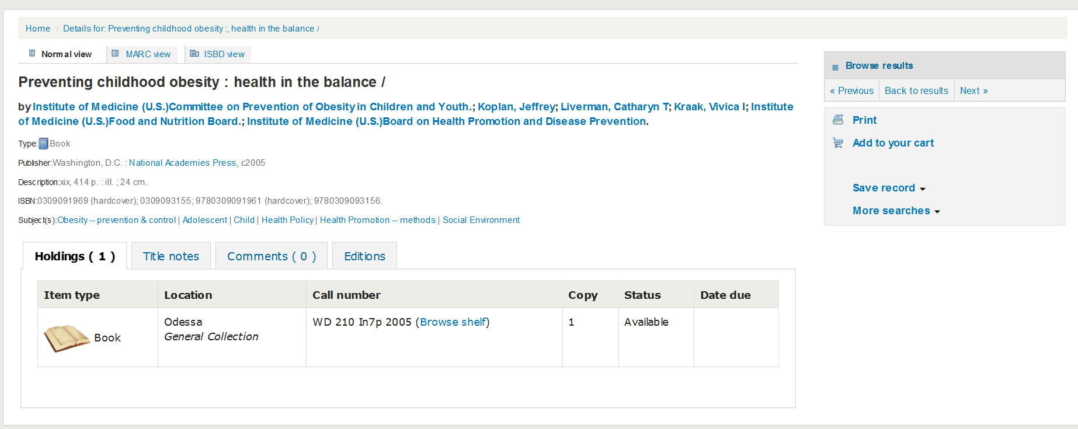
Library Catalog

Slide 26
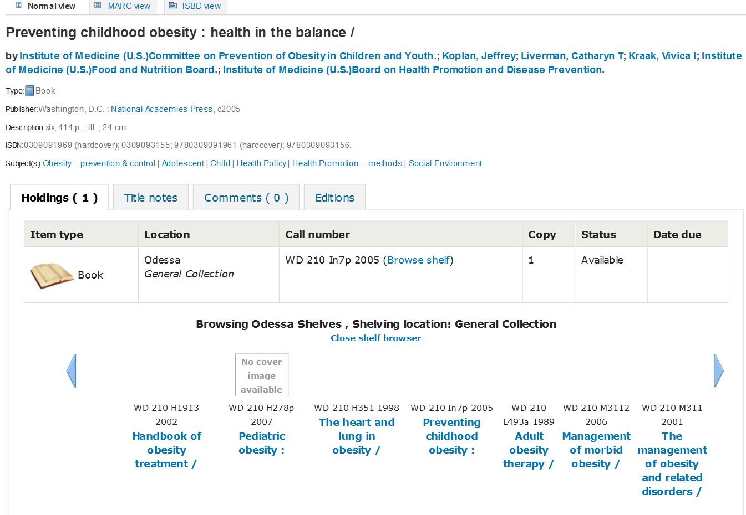

Slide 27
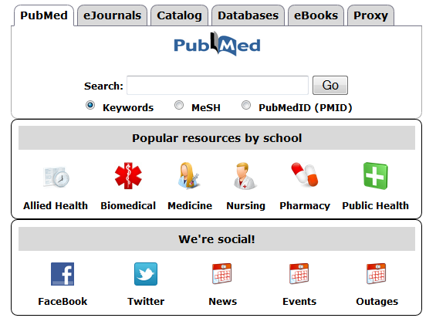
SOAHS Frequently Used Resources

Slide 28
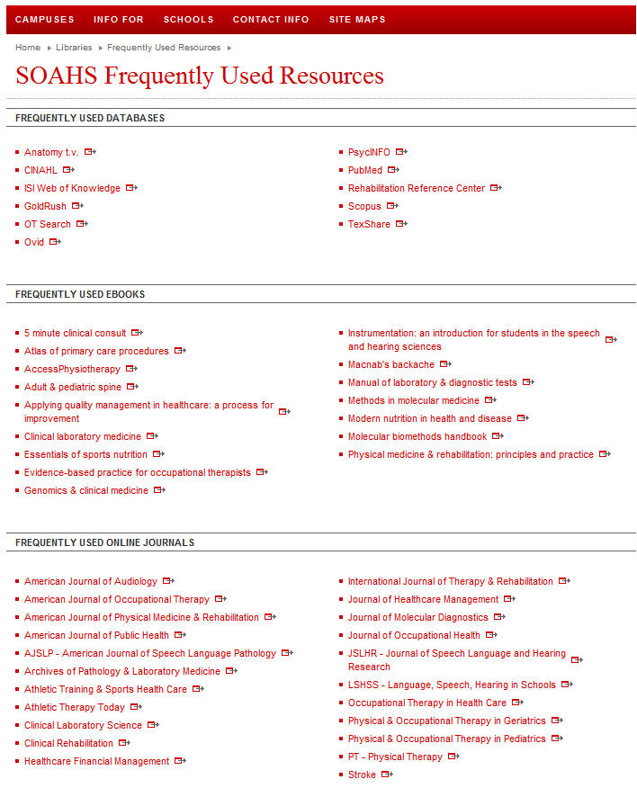
SOAHS Frequently Used Resources

Slide 29
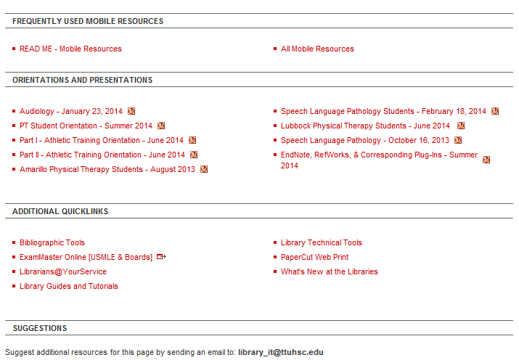
SOAHS Frequently Used Resources

Slide 30
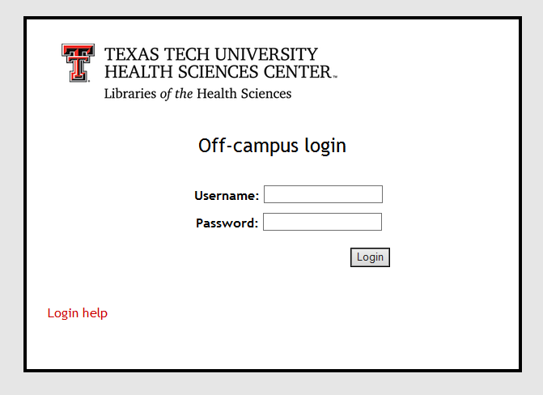
Off Campus: eRaider Access
You can always access TTUHSC online resources such as databases, journals, or eBooks through your eRaider login.

Slide 31
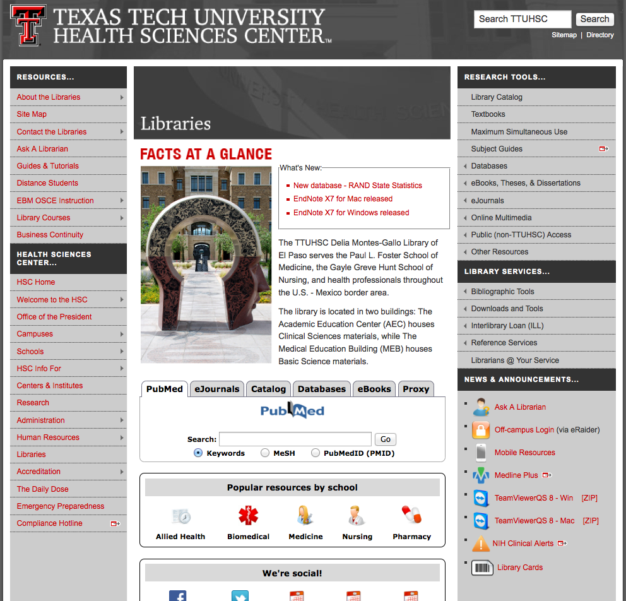
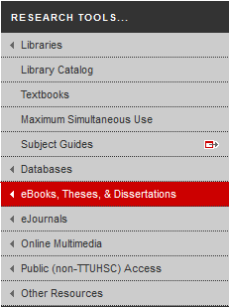
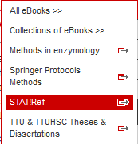
STAT!Ref

Slide 32
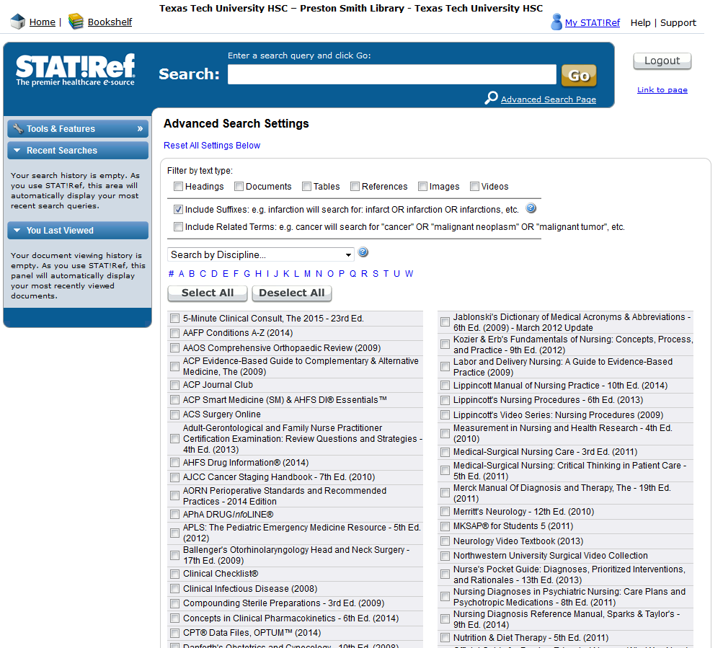

Slide 33
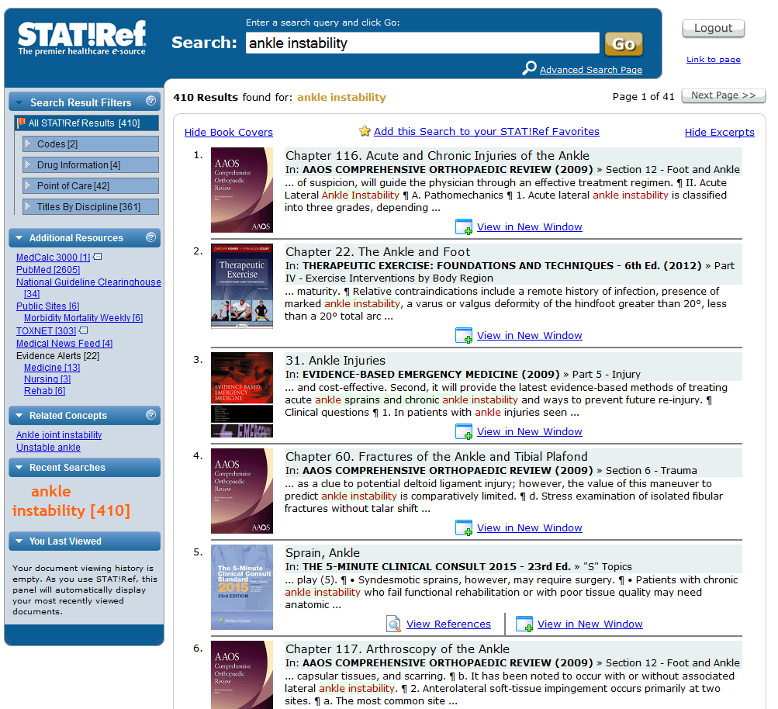

Slide 34
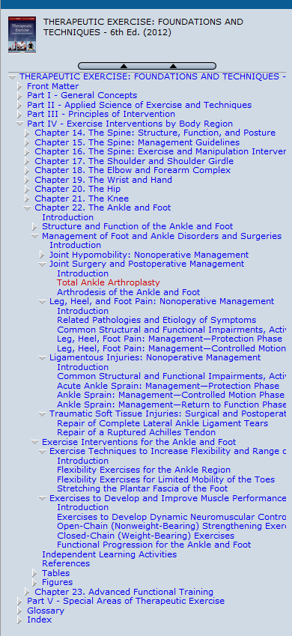
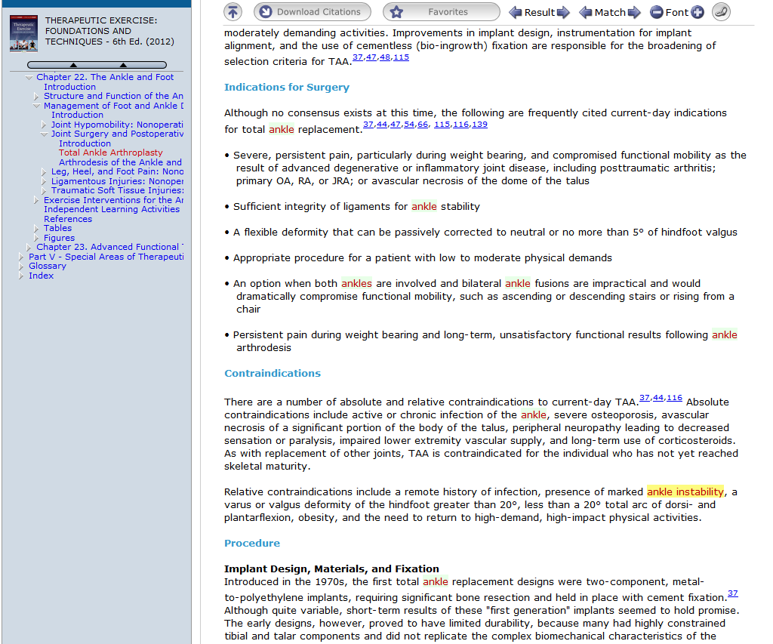

Slide 35
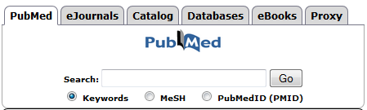
PubMed Clinical Queries

Slide 36
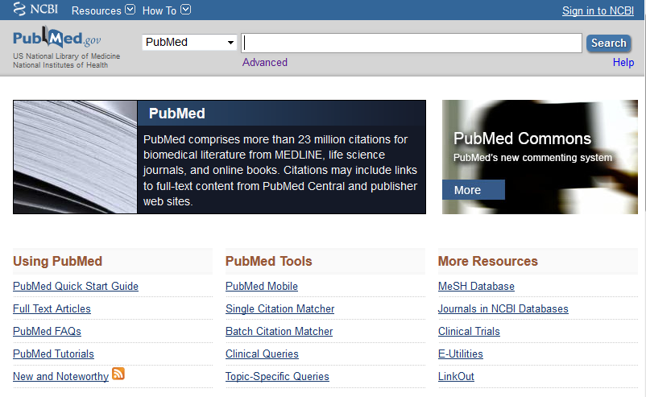

Slide 37
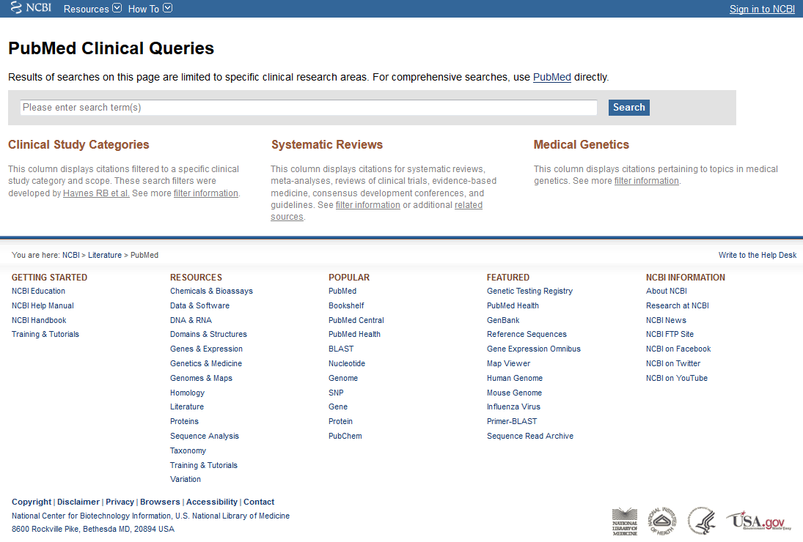

Slide 38
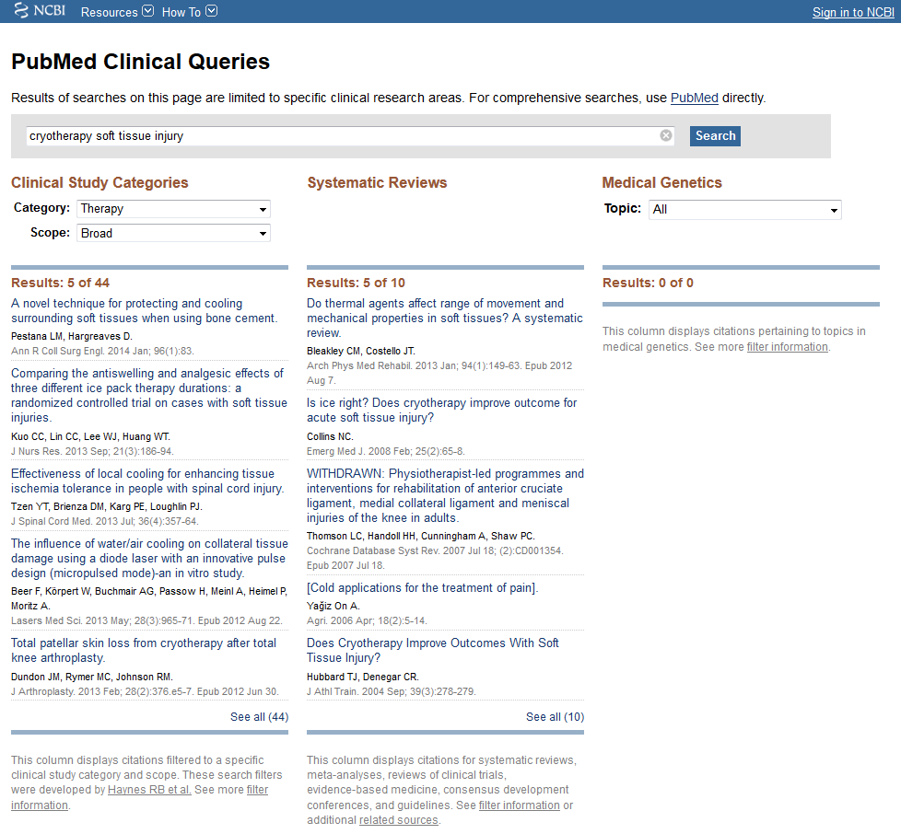
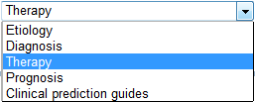


Slide 39
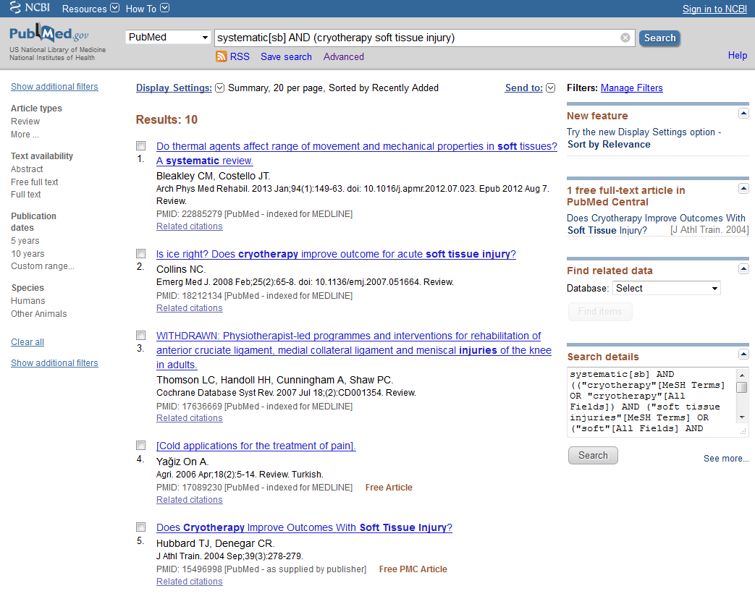

Slide 40

Gold Rush
Notes:
If you have a citation for a journal article and need to see if it’s in the library’s collection, Gold Rush is the place to go. The fastest way to access it is by selecting “eJournals” from the tabs in the middle of the library website. From here, you can search for the journal title, and now you can search for the article according to its PubMed I.D. number, if your article has one.

Slide 41

Notes:
This is the main Gold Rush page. It includes some additional information about this tool as well as links to tutorials and other helpful resources.

Slide 42


Slide 43


