Slide 1
Welcome
Information Resources for Athletic Training
Peggy Edwards, AMLS
TTUHSC - Preston Smith Library
Lubbock, Texas 79430
June 2014

Slide 2
ANATOMY.TV

Slide 3
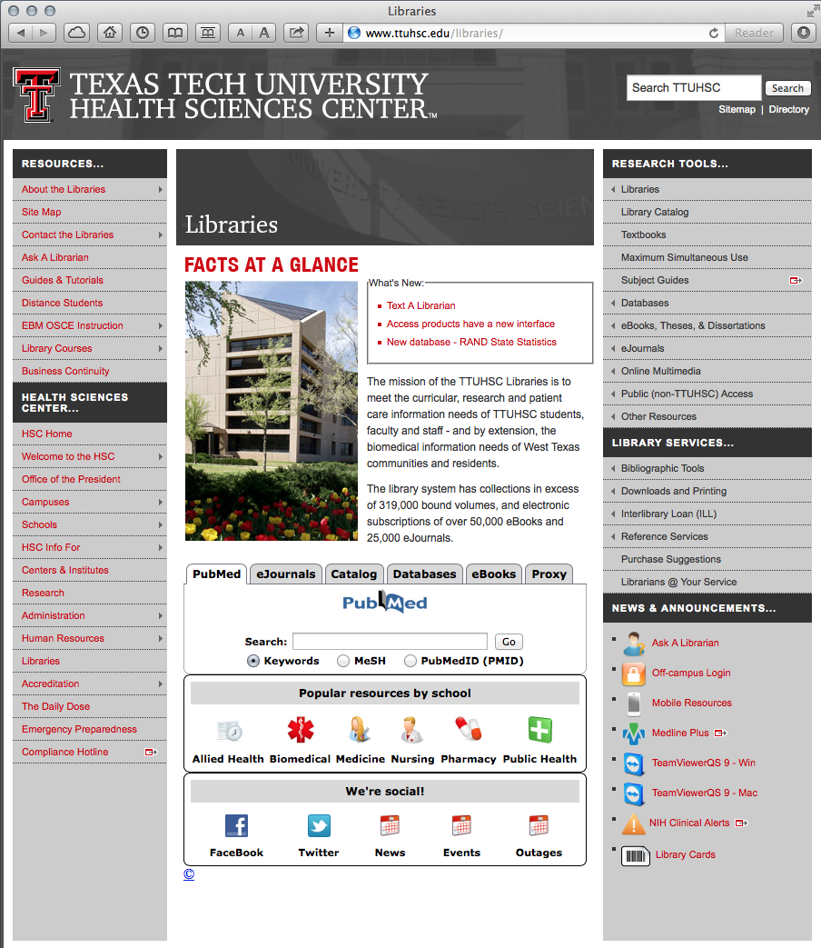
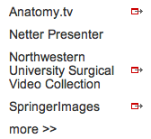
ANATOMY.TV
www.ttuhsc.edu/libraries
Hover over
Online Multimedia
Click Anatomy.tv

Slide 4
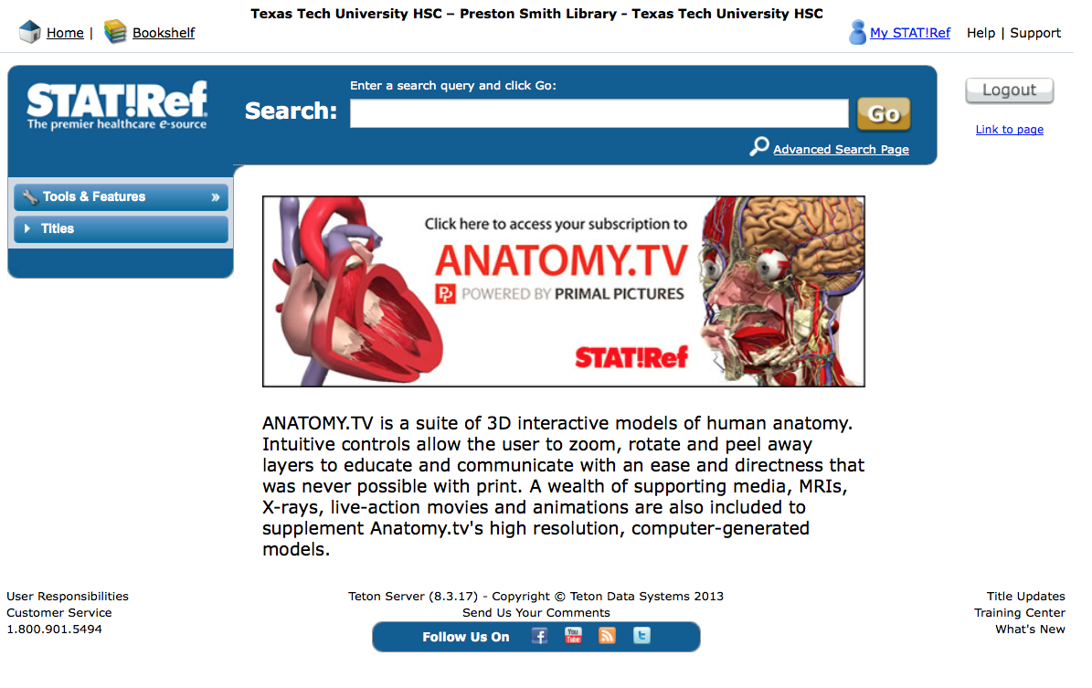
Click

Slide 5
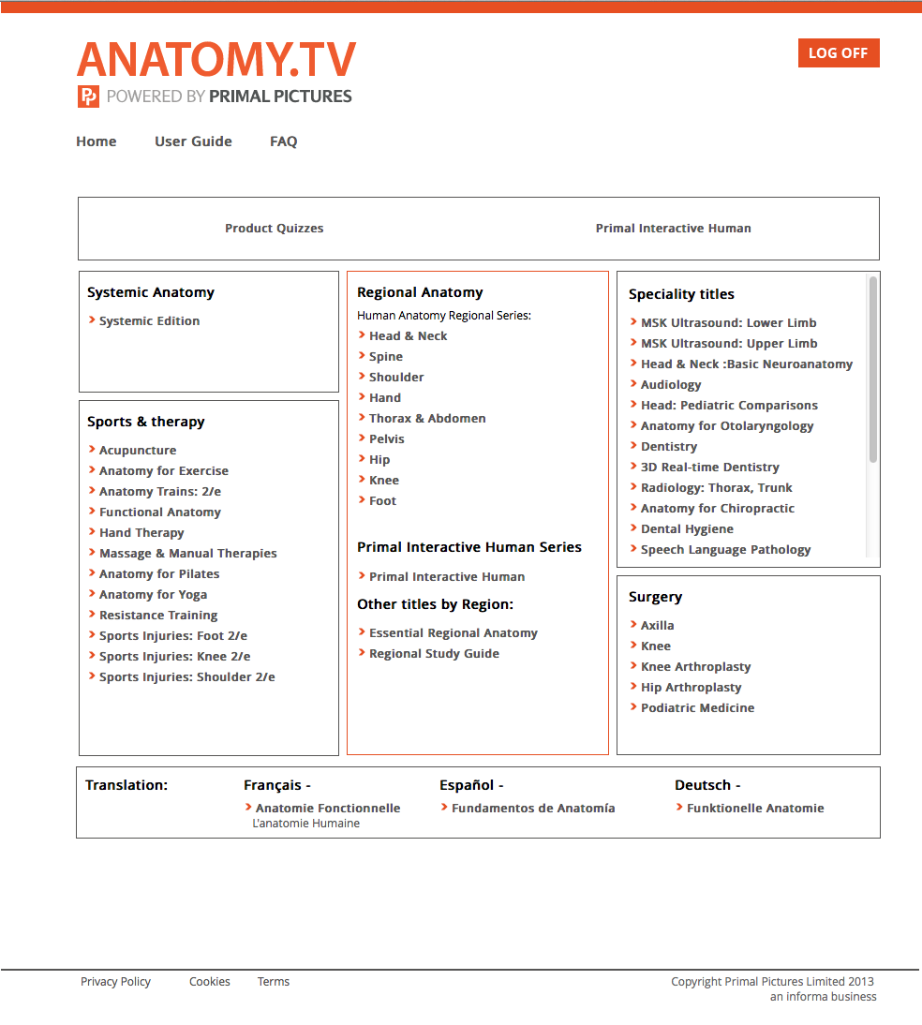
Select Hip for Region

Slide 6
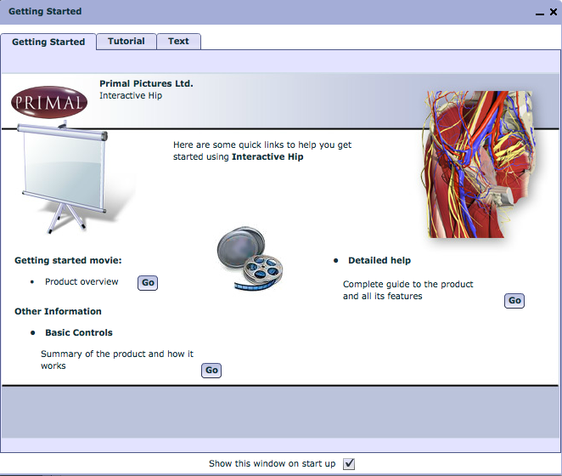
Great Tutorial –
view on own time
Close Screen

Slide 7
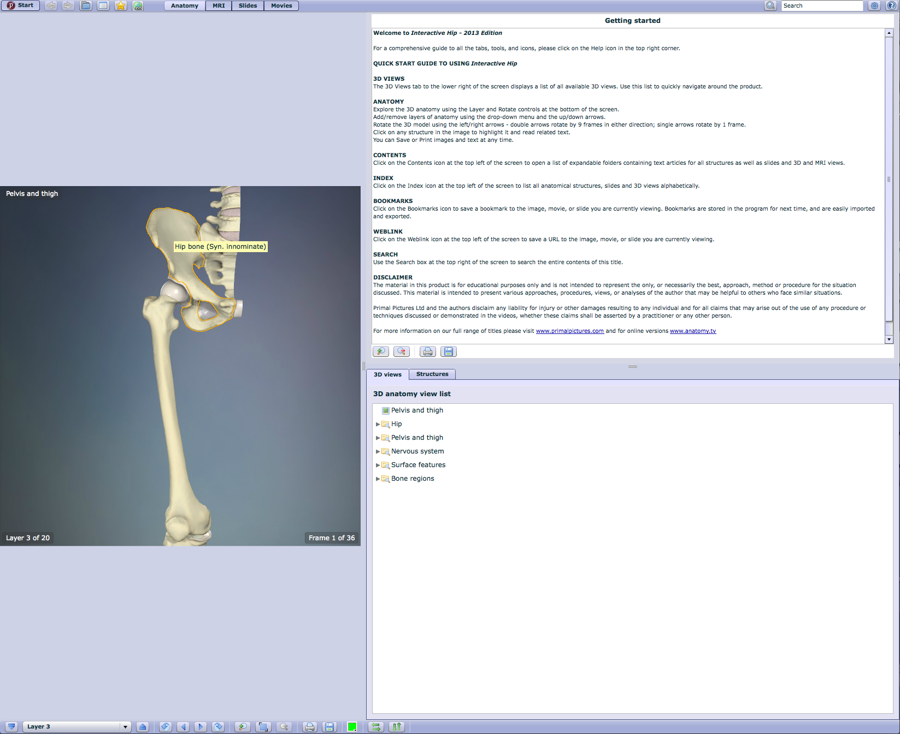
Hover mouse on feature for label
Instructions
Select Layer 10
Layer 3

Slide 8
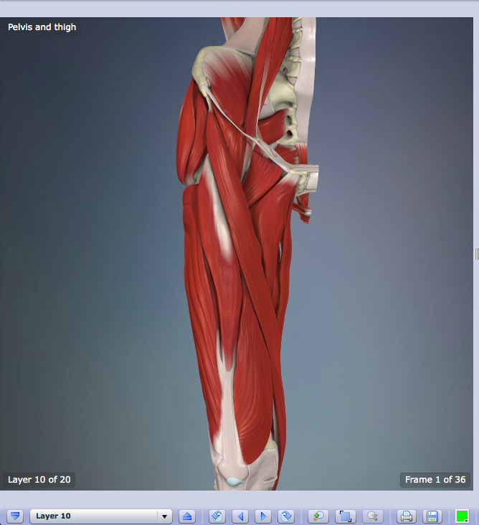
Click arrows
to rotate

Slide 9
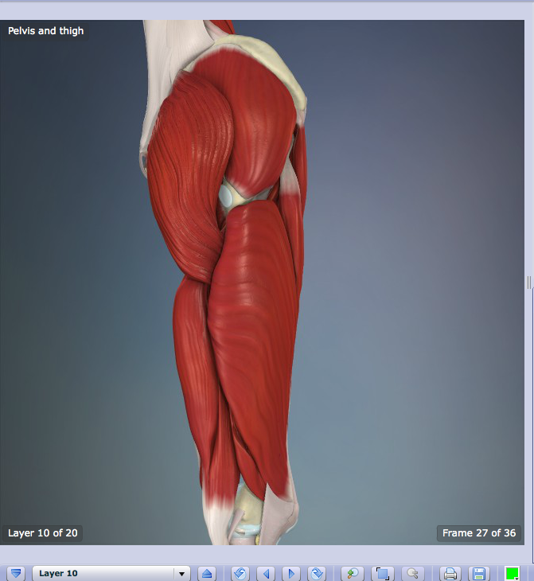
Rotated View

Slide 10
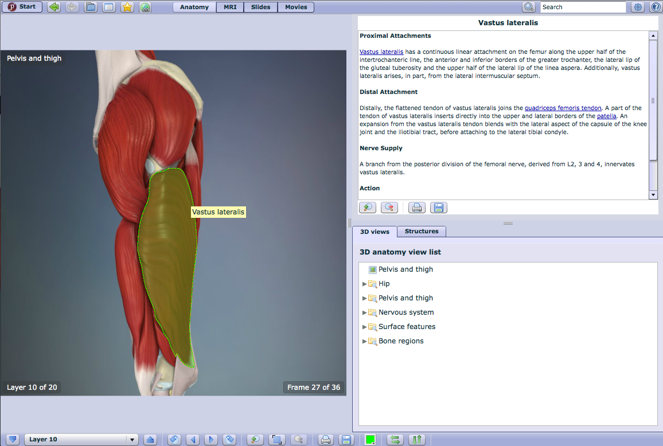
Structure name
and description
Click a
structure

Slide 11
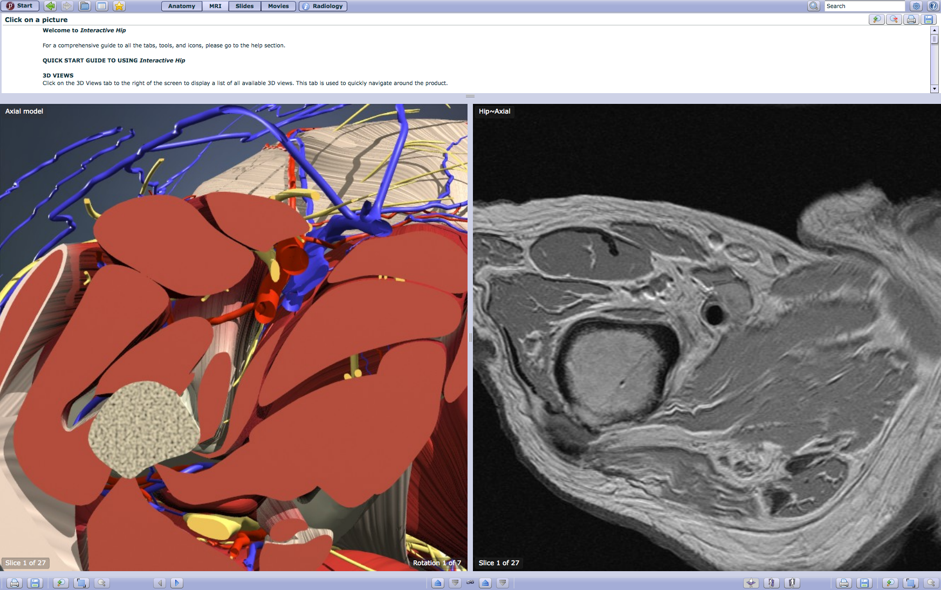
Click MRI

Slide 12
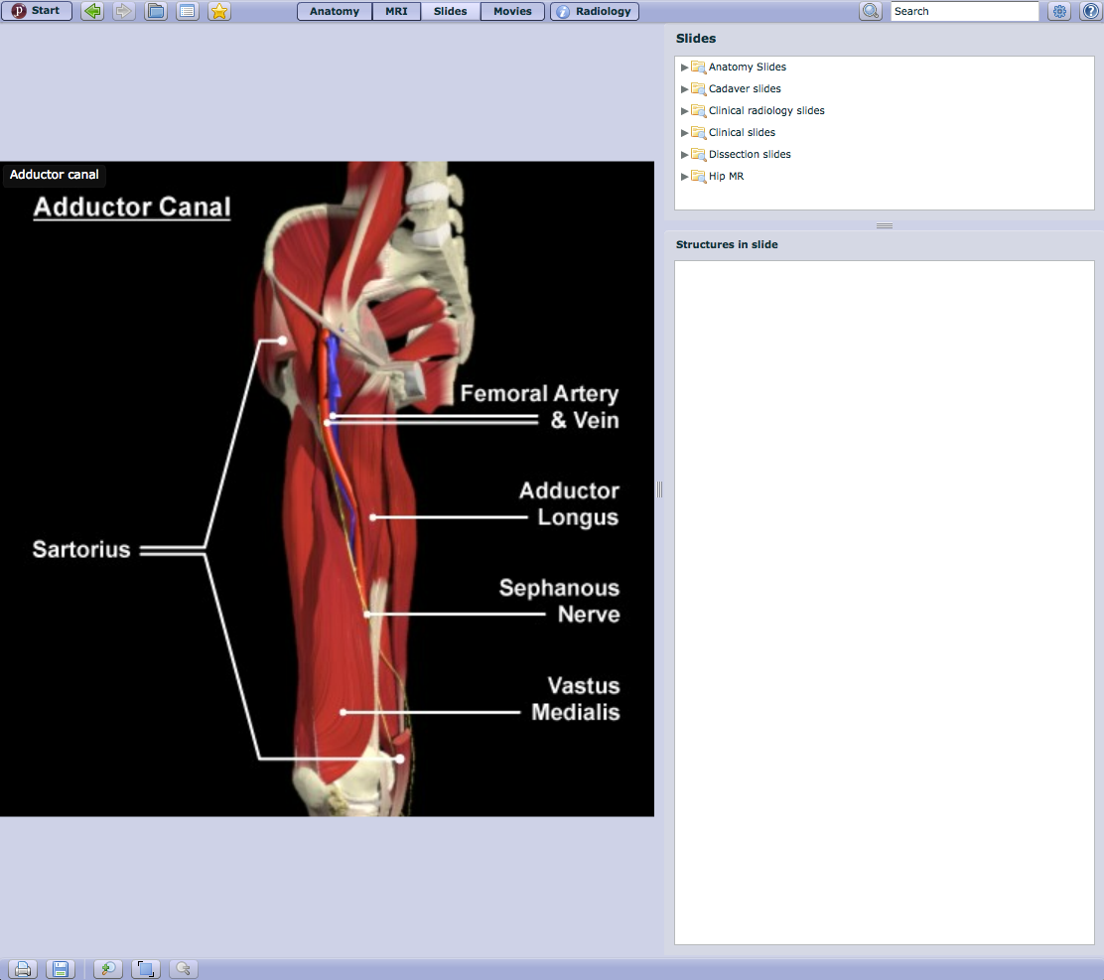
Click Slides

Slide 13
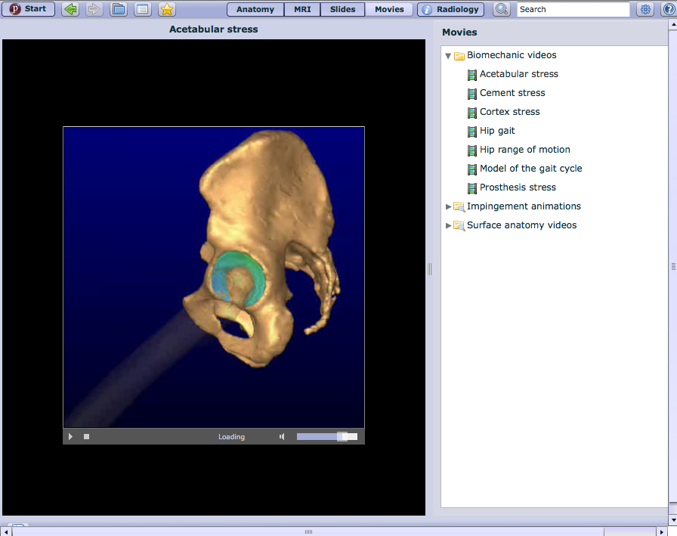
Click Movies

Slide 14
Click Product Quizzes

Slide 15
Netter Presenter
www.ttuhsc.edu/libraries
Hover over
Online Multimedia
Click Netter Presenter

Slide 16
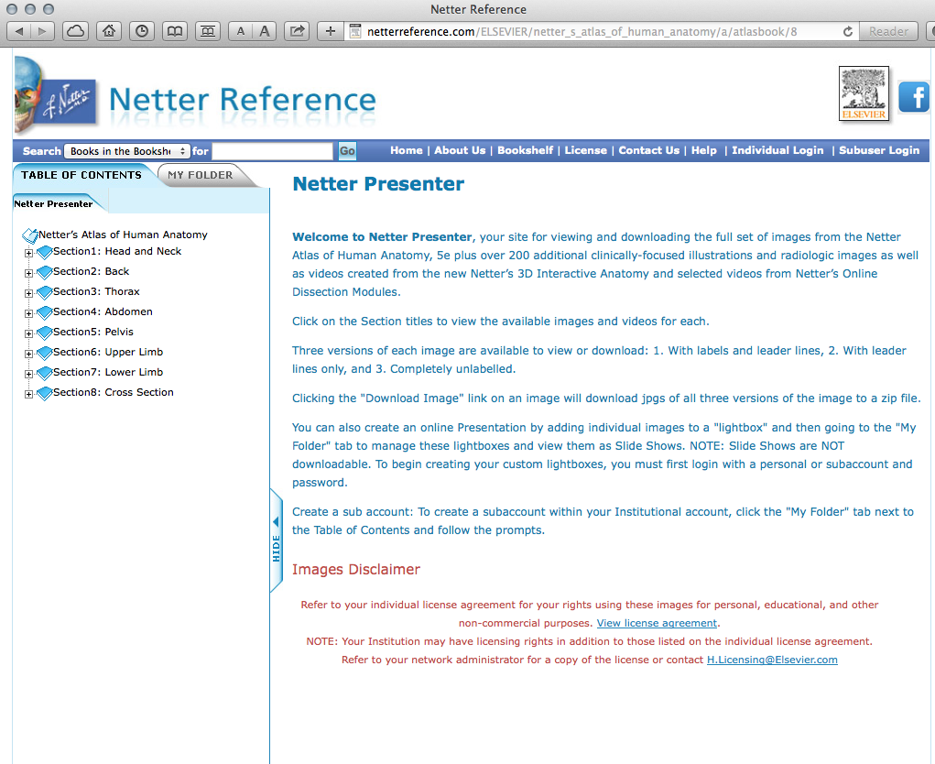
Instructions

Slide 17
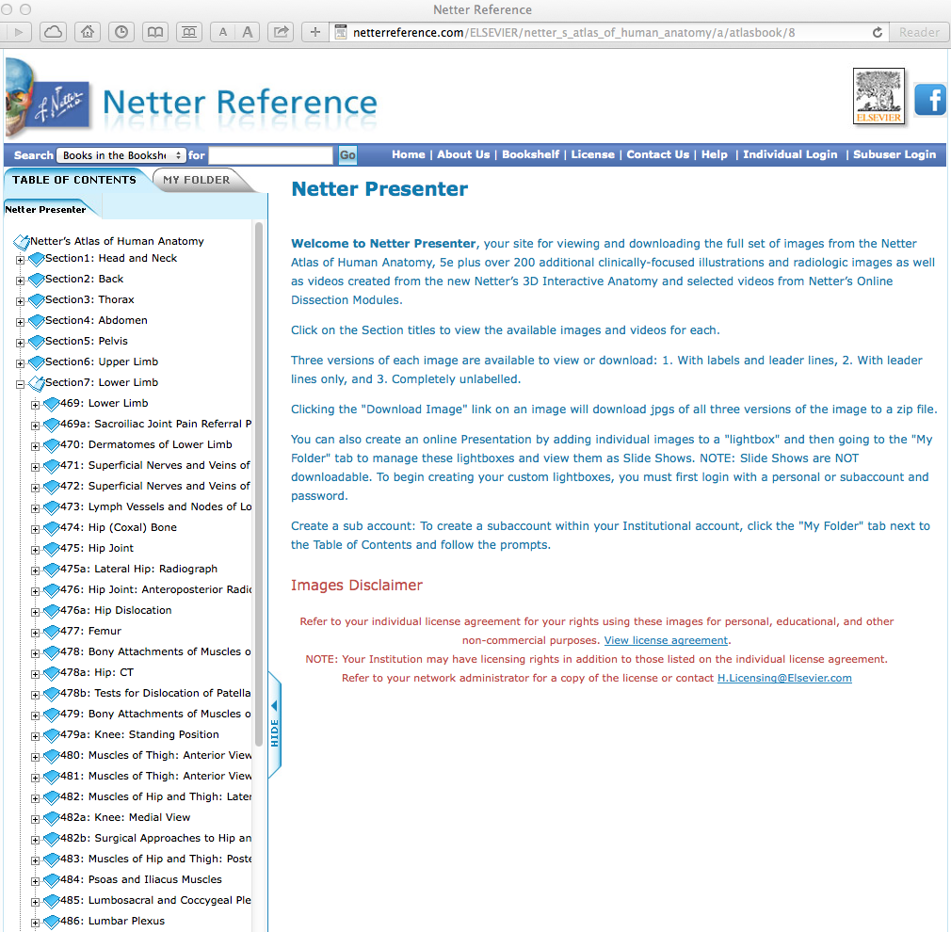
Click Hip Joint

Slide 18
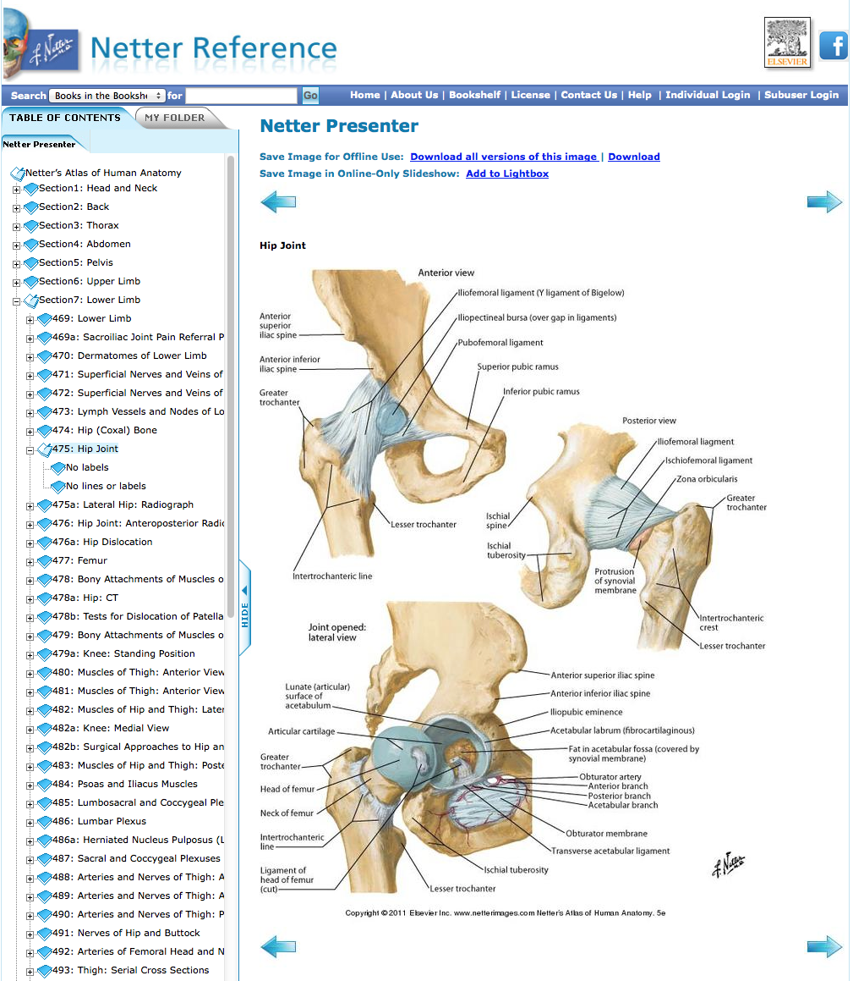

Slide 19
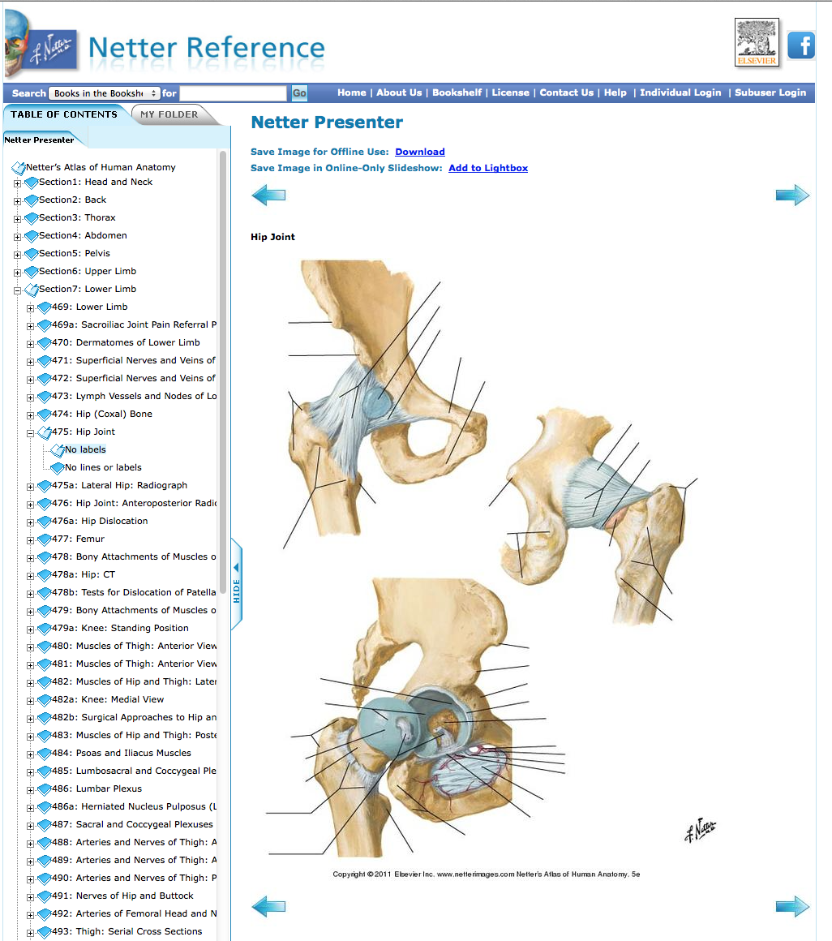
Click Hip Joint
No labels

Slide 20
Have Questions
or
Need Help?

Slide 21
Today’s PowerPoint
www.ttuhsc.edu/libraries
Click Popular
Resources
by School

Slide 22
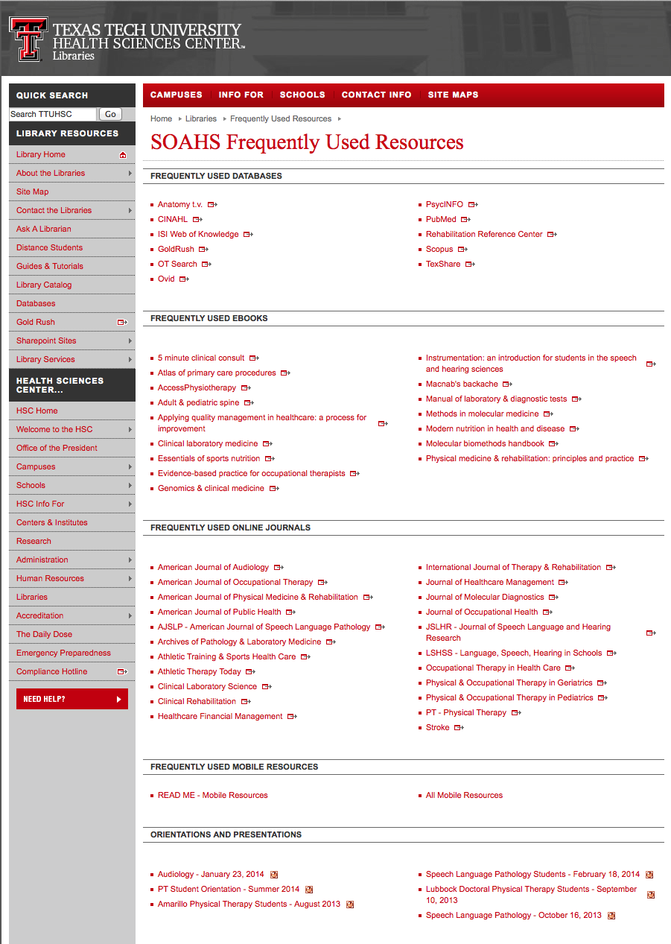
Select Presentation

Slide 23
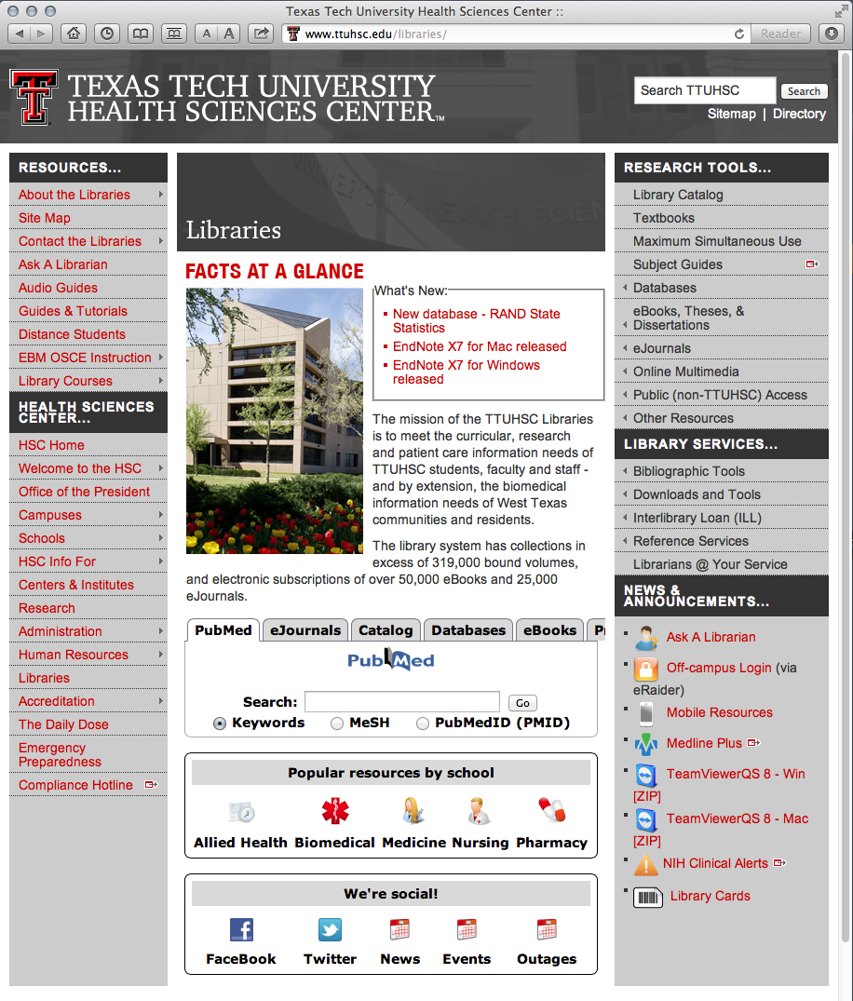
www.ttuhsc.edu/libraries
Guides & Tutorials
Click

Slide 24
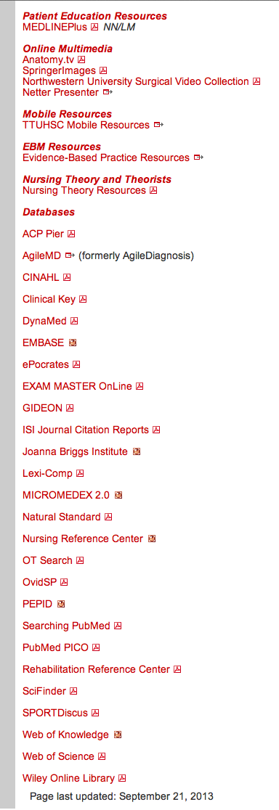
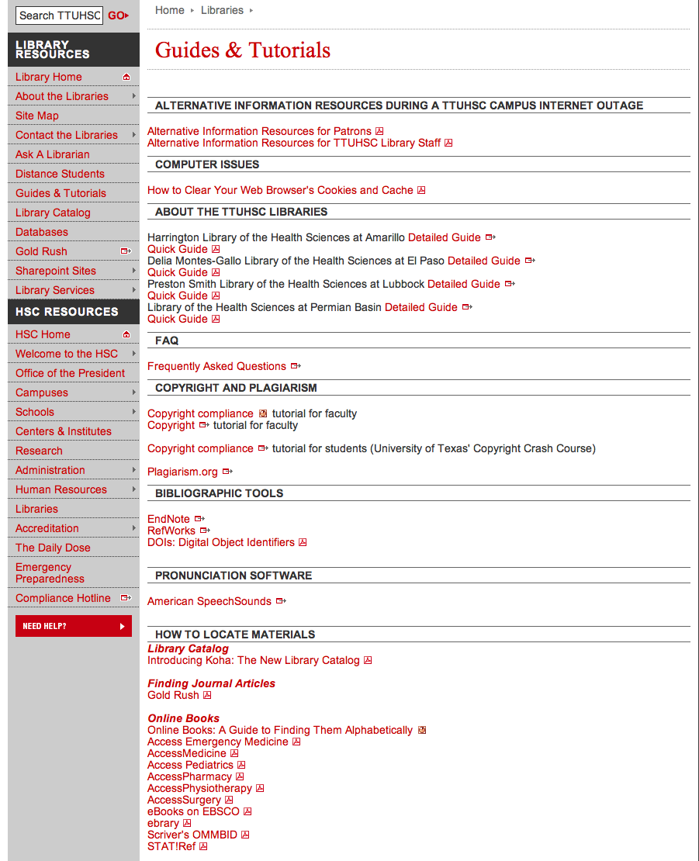

Slide 25
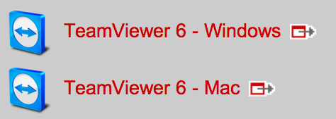
www.ttuhsc.edu/libraries
Download TeamViewer

Slide 26

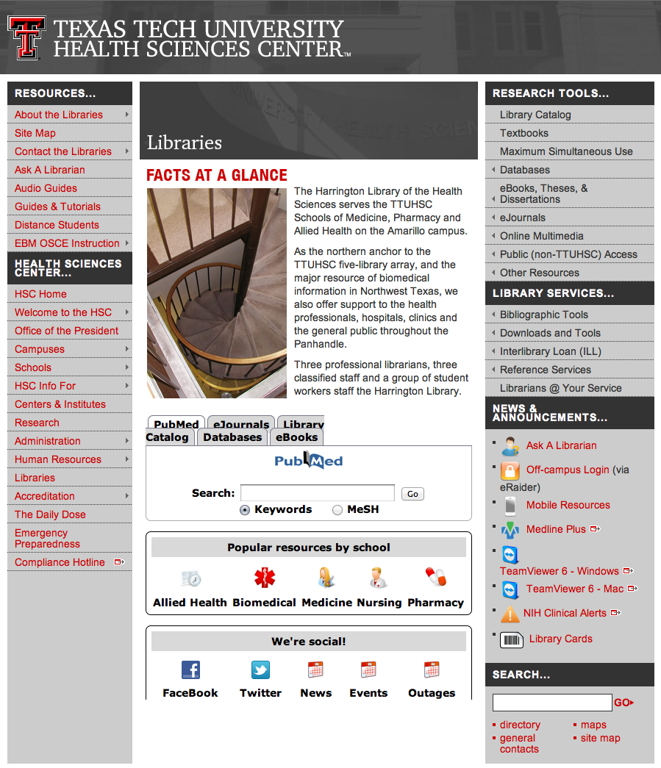

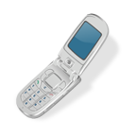
Call your TTUHSC Librarian

Slide 27
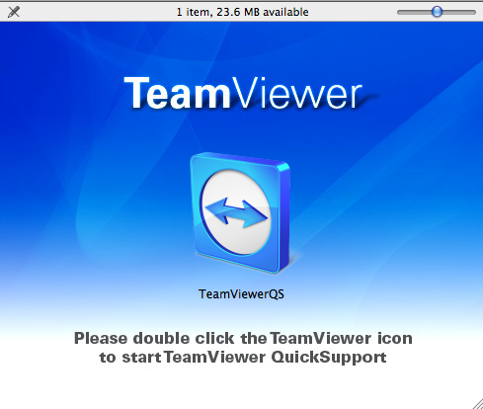
Double click the icon and follow the directions

Slide 28
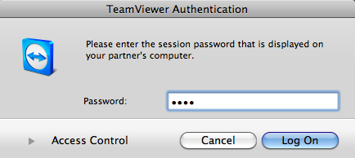
Give the password to the librarian to enter.
Log On
After logging on, the librarian can see your computer screen!
At the end of the session after logging off,
the librarian will not have access to your computer!
TeamViewer generates a new password each time it is used!

Slide 29

www.ttuhsc.edu/libraries
Go to
Ask a Librarian Icon

Slide 30

or contact us at:
Lubbock
(806) 743-2200
Amarillo
(806) 354-5448
El Paso
(915) 545-6652
Odessa
(432) 335-5171

Slide 31
The End
June 2014

