Slide 1
Audiology Library Session
September 9, 2014
Micah Walsleben, MLS

Slide 2
Preferred Internet Browsers
Firefox
Chrome
Safari

Slide 3
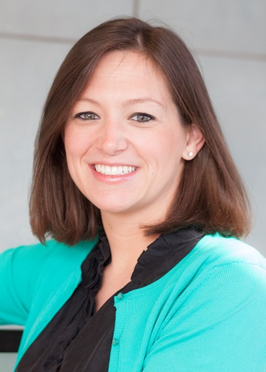
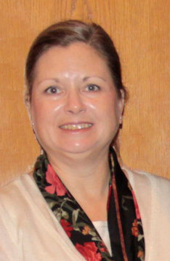

Reference Librarians
Available on 2nd floor of library, across from the Learning Resource Center and public computers
8am–5pm
Monday–Friday
Jennifer Teichelman
Peggy Edwards
Micah Walsleben
Margaret Vugrin

Slide 4
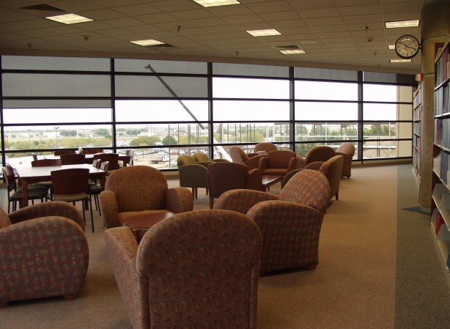
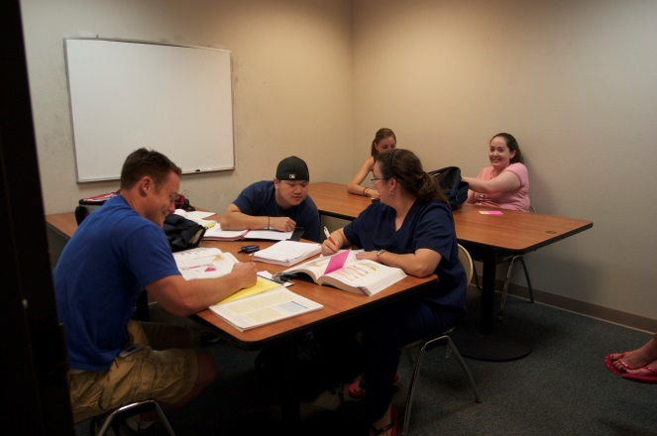
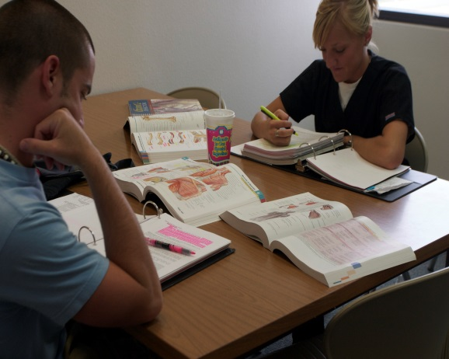
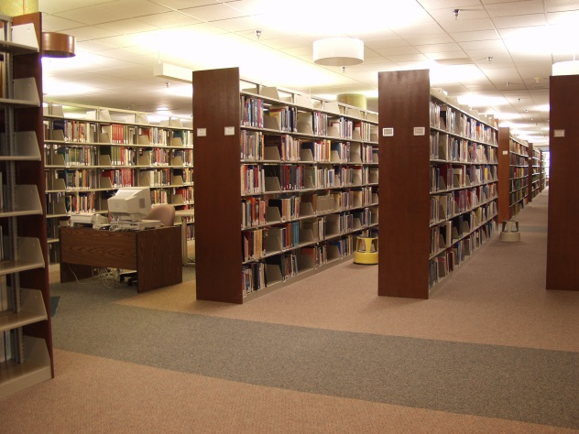
Library Facilities
29 study rooms
All rooms are first come, first serve.
Each room has a dry erase board, markers, and plenty of outlets!
Wireless internet

Slide 5
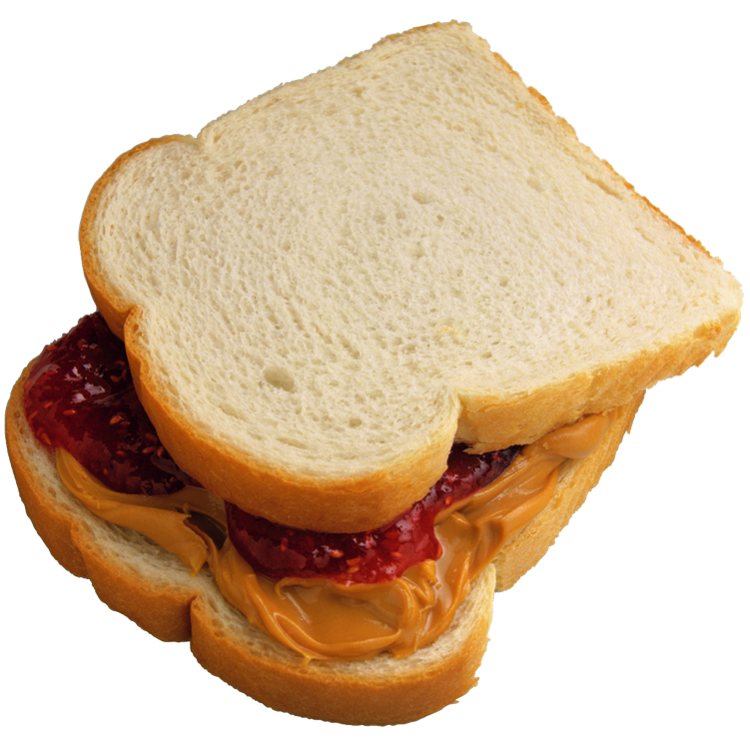

Library Facilities Cont.’d.
Food and drink allowed!

Slide 6
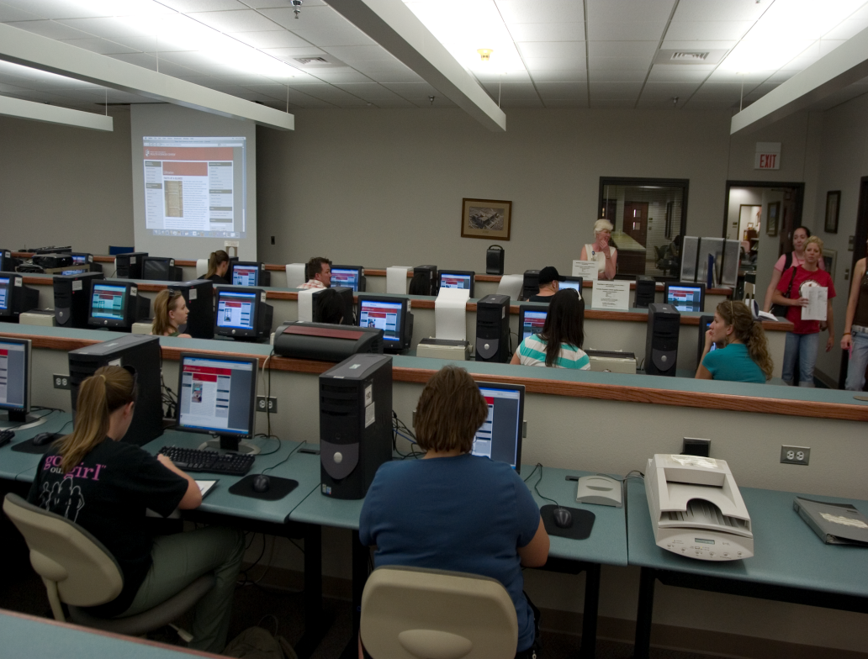
Learning Resource Center
Located on the 2nd floor of the library
Requires a library card
Check out computer stations, anatomical models, and more!

Slide 7
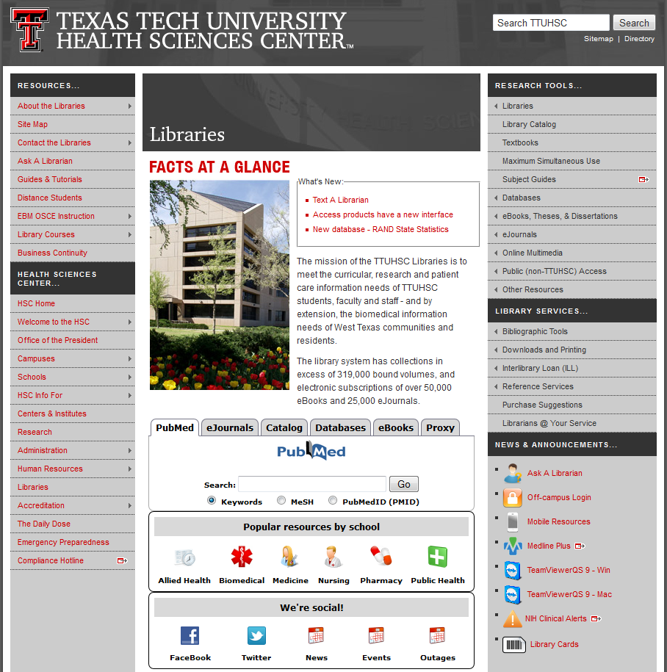
TTUHSC Libraries’ Website
www.ttuhsc.edu/libraries

Slide 8
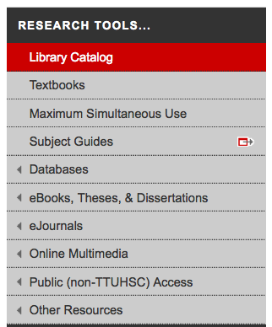
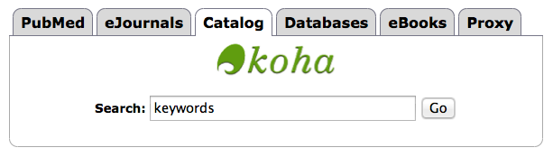
Library Catalog
Two points of access

Slide 9
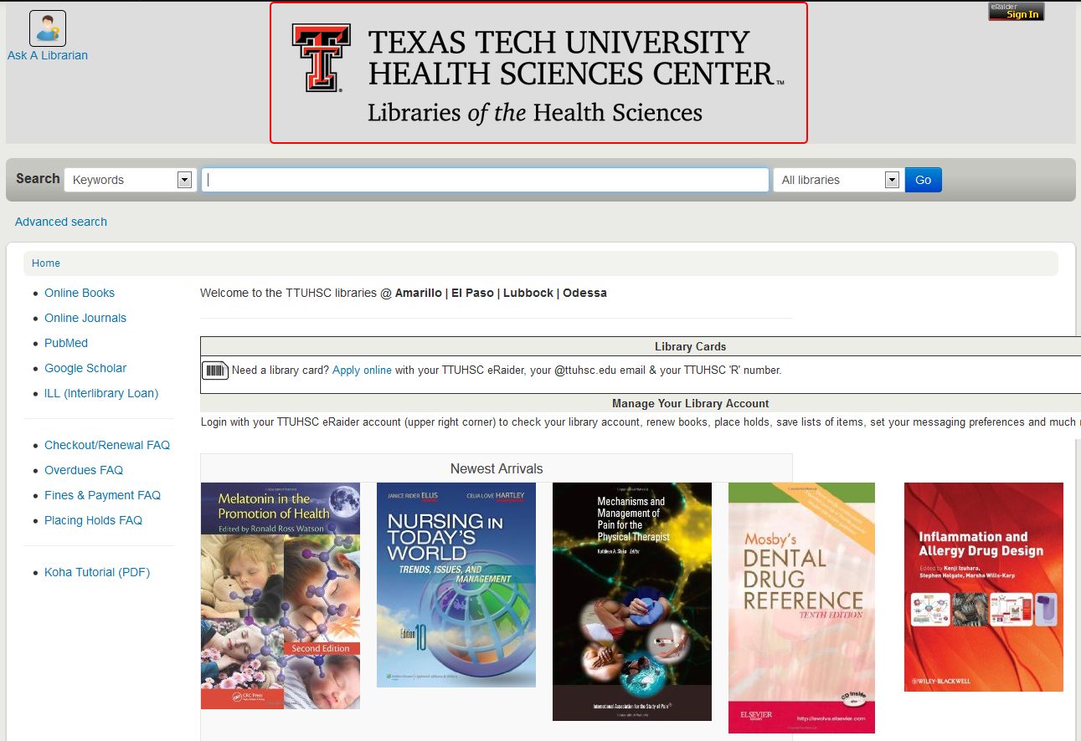


Sign in for your account information

Slide 10
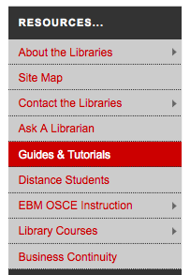
Guides and Tutorials
Online
step-by-step
guides

Slide 11
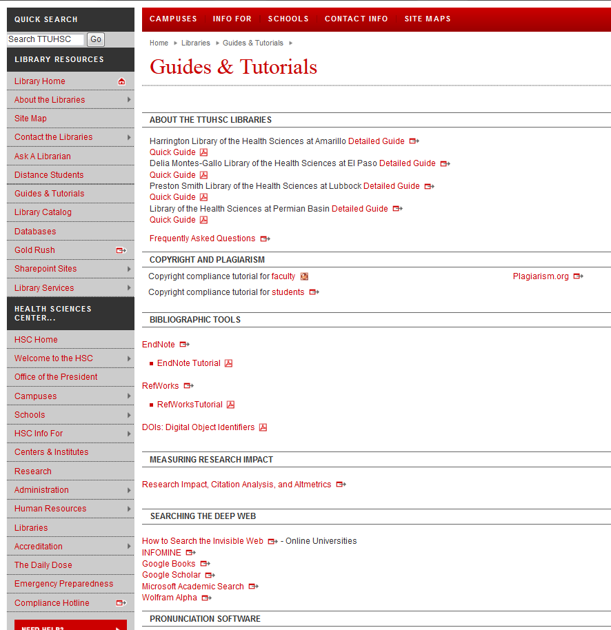
Scroll down to see additional tutorials

Slide 12
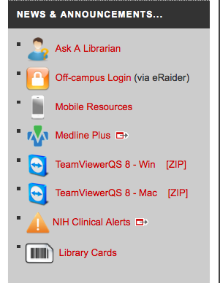
Ask A Librarian

Slide 13
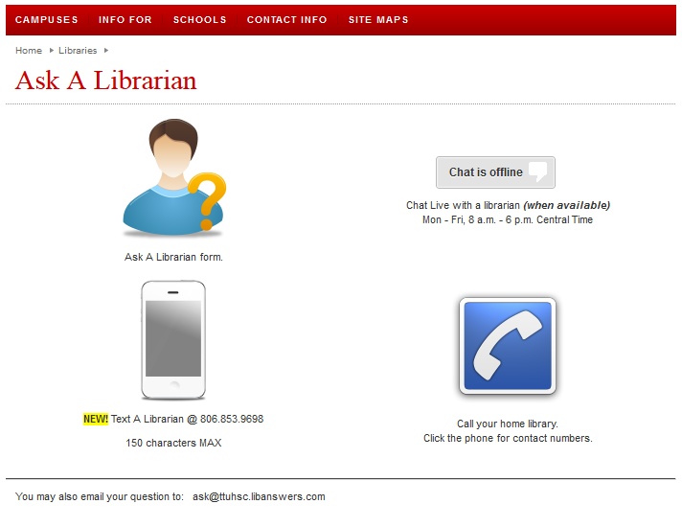

Slide 14
Team Viewer

Slide 15
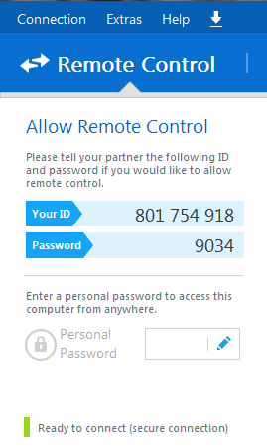
Give your ID and password to a librarian on the phone
We will be able to remotely control your desktop—we will see what you see as well as move your mouse, etc.
Please make an appointment in order to ensure plenty of time to work on your problem!

Slide 16

Resources just for you!

Slide 17
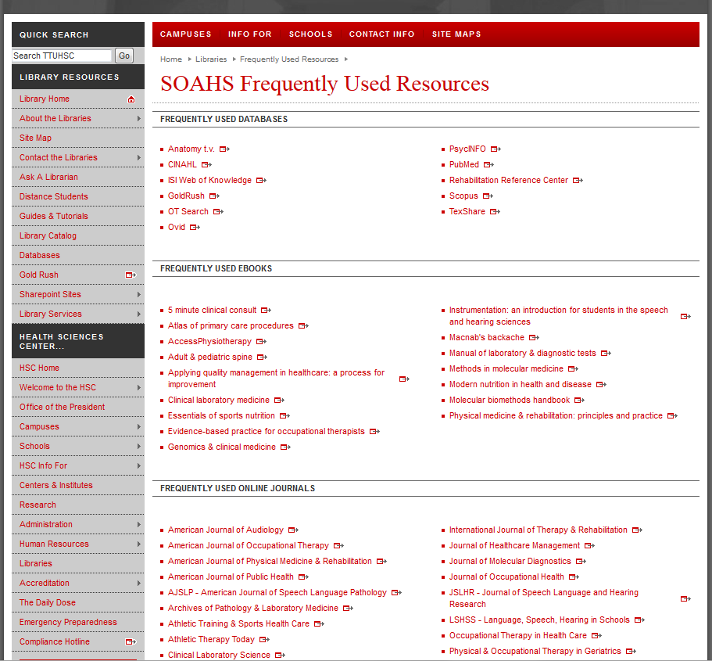

Slide 18
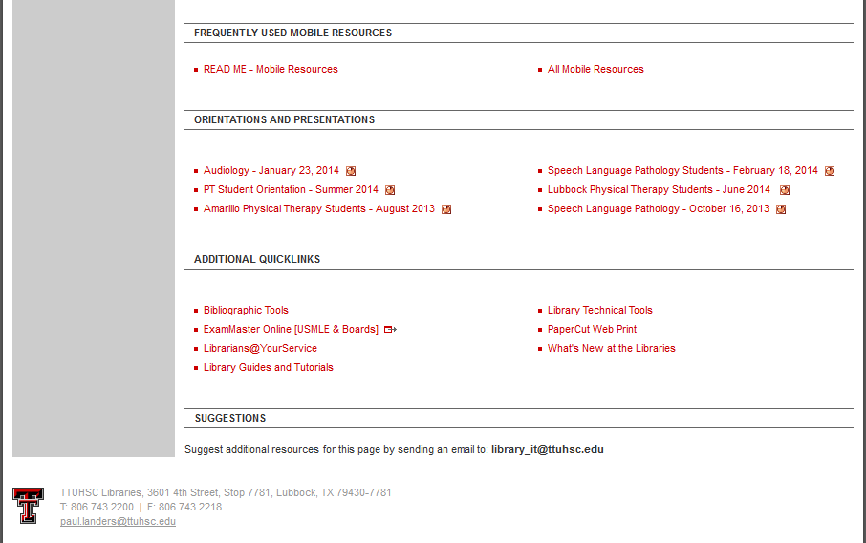
Today’s presentation will be here!

Slide 19
CINAHL
Cumulative Index to Nursing and Allied Health Literature
4+ million records
Subject coverage: Nursing and 14 Allied Health specialties
Evidence-based Care Sheets and Research Instruments available
Coverage back to 1937

Slide 22
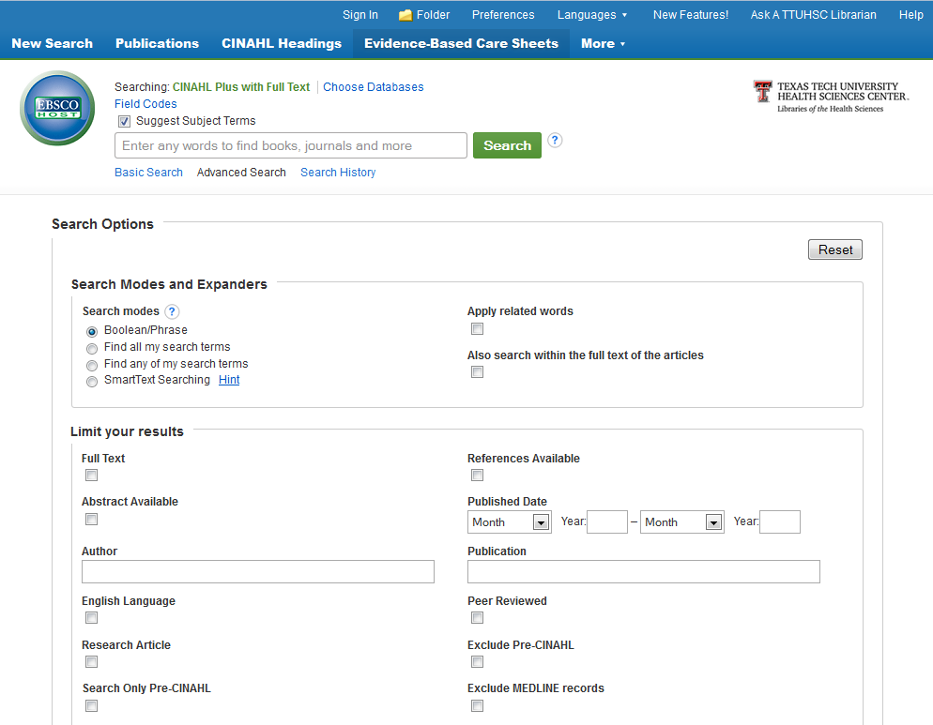
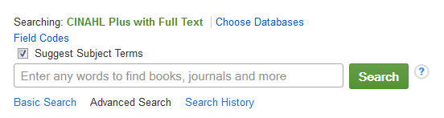
tinnitus

Slide 23
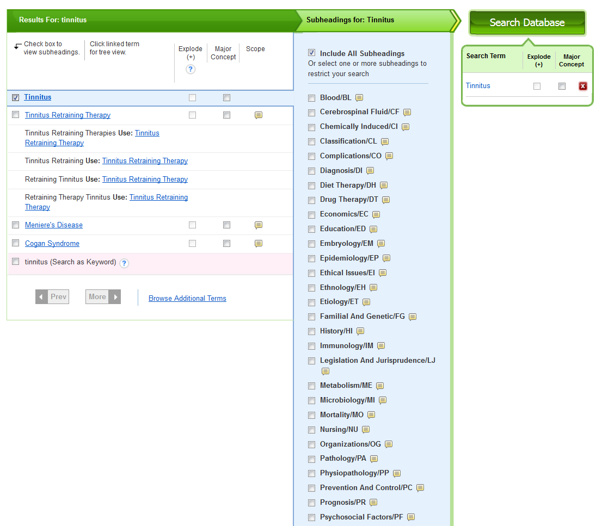
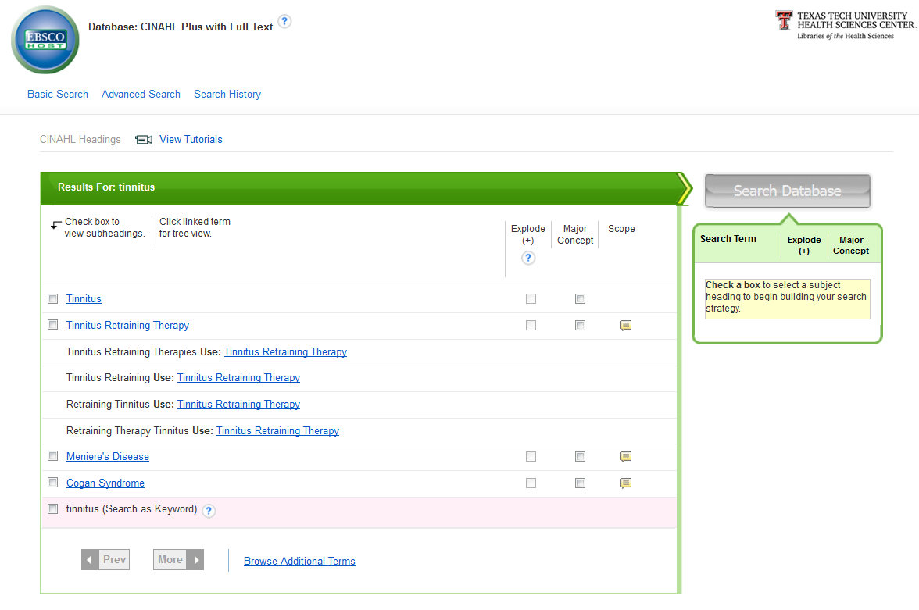

Slide 24
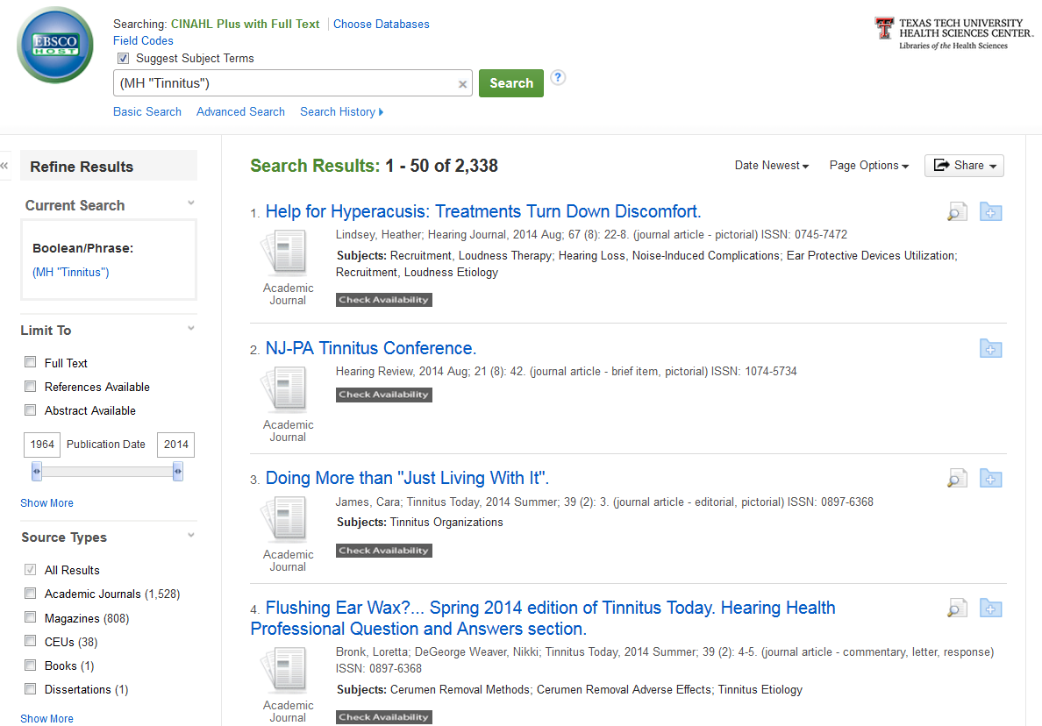
music therapy

Slide 25
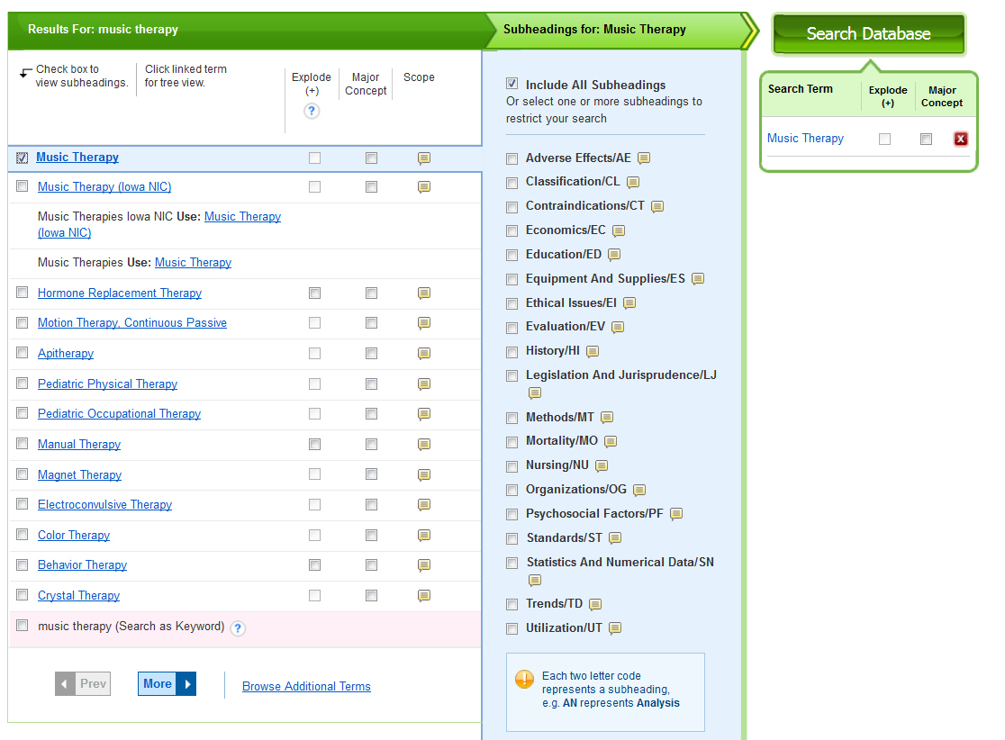
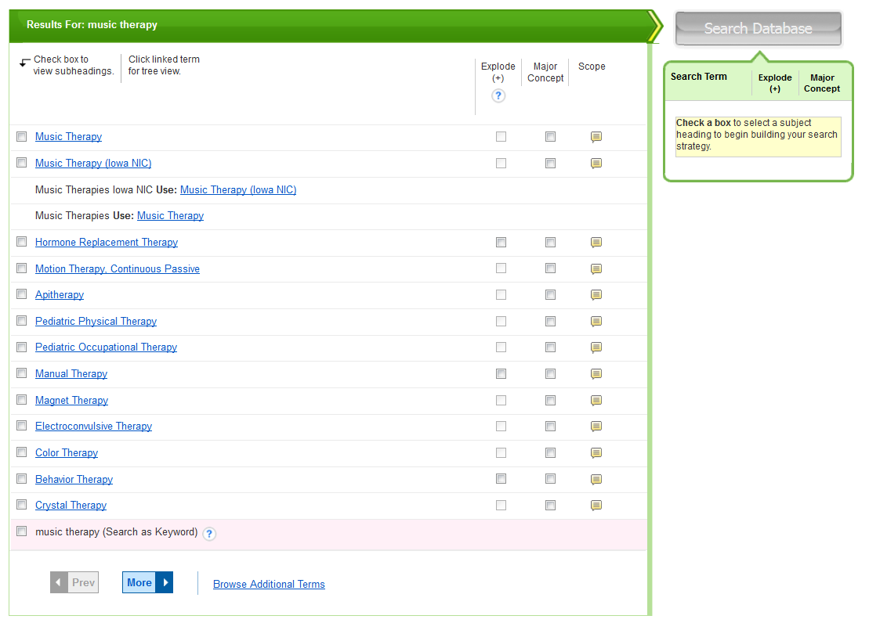

Slide 26
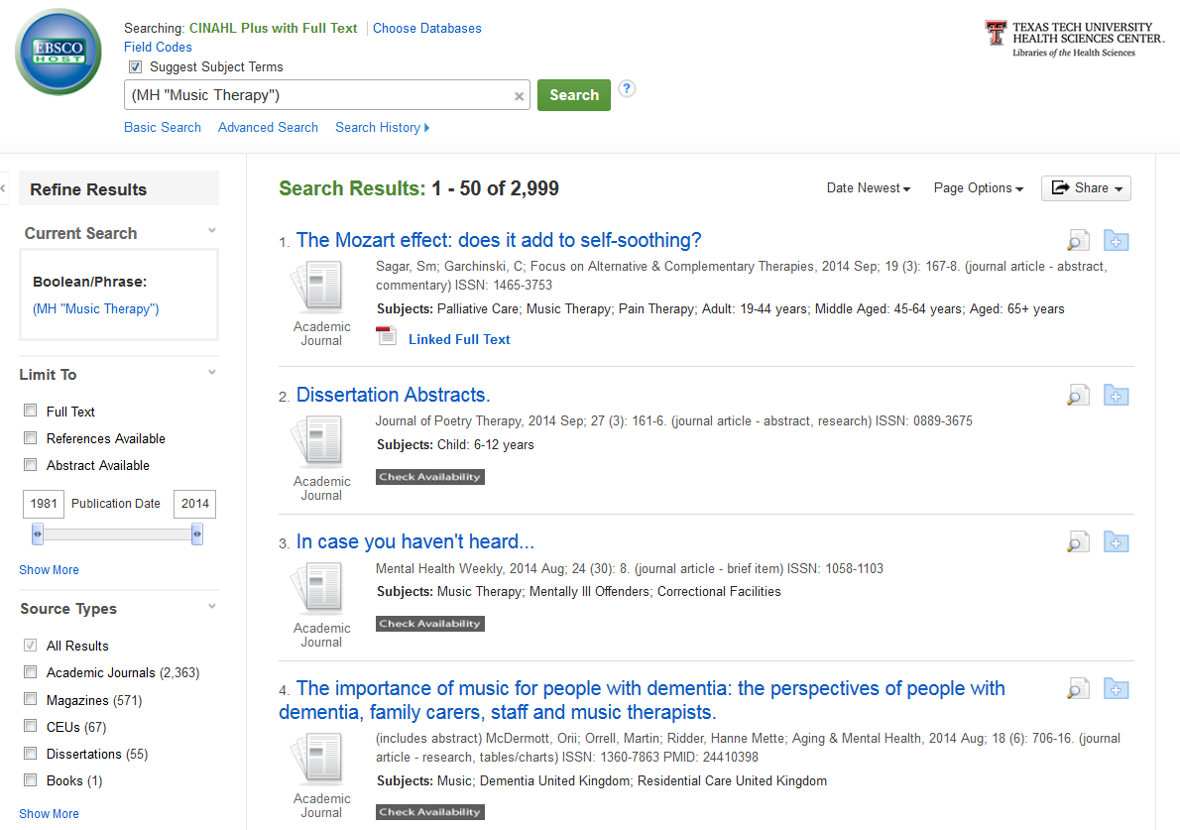
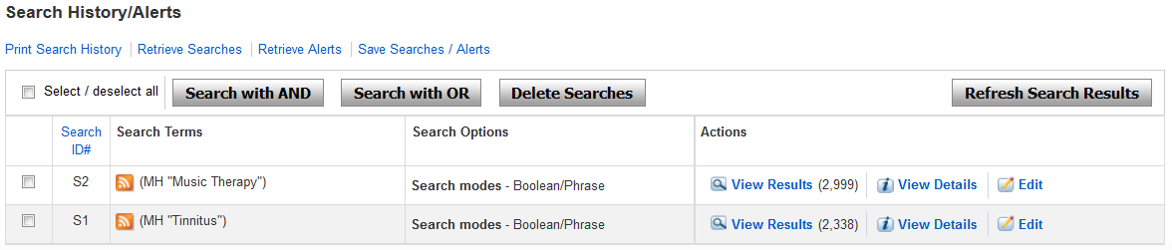

Slide 27

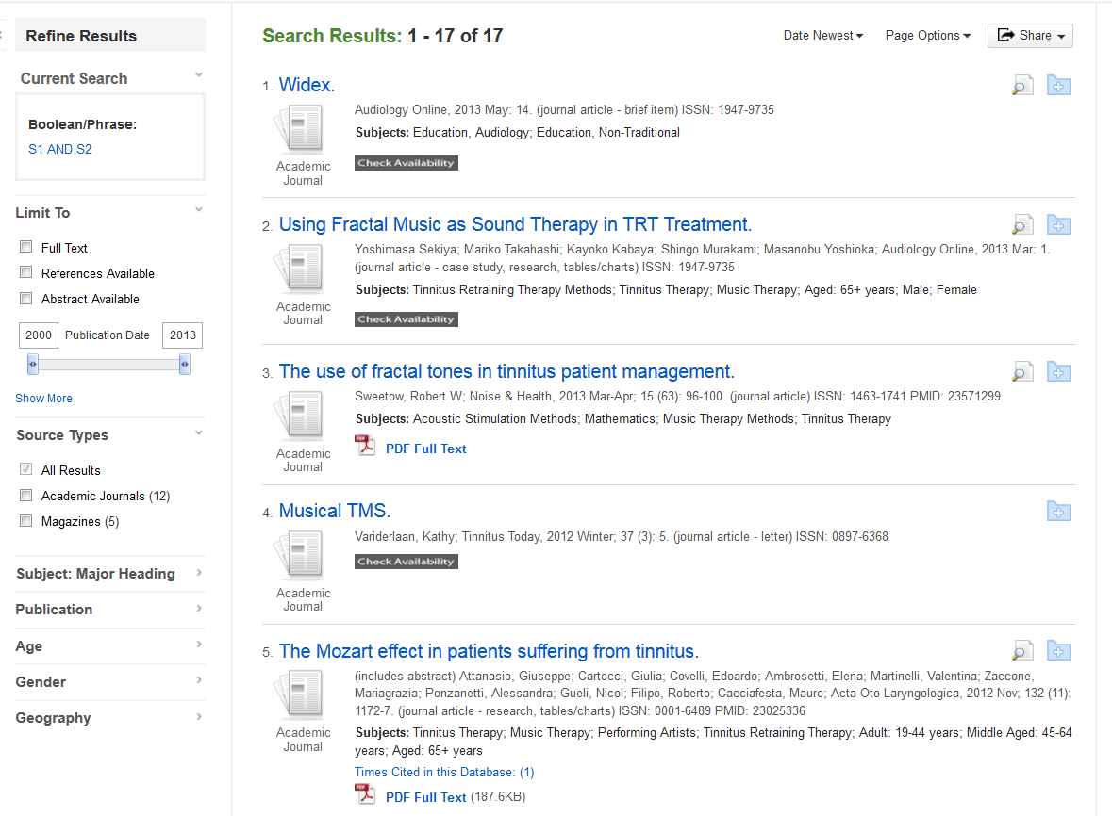

Slide 28
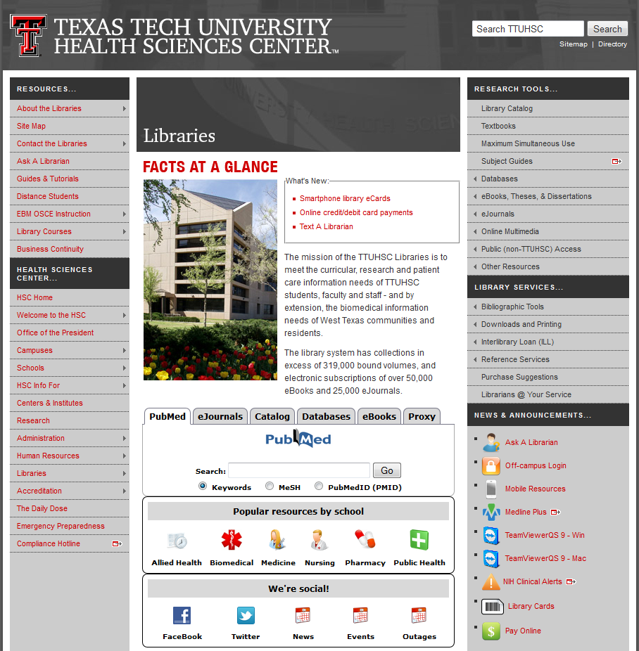

Slide 29
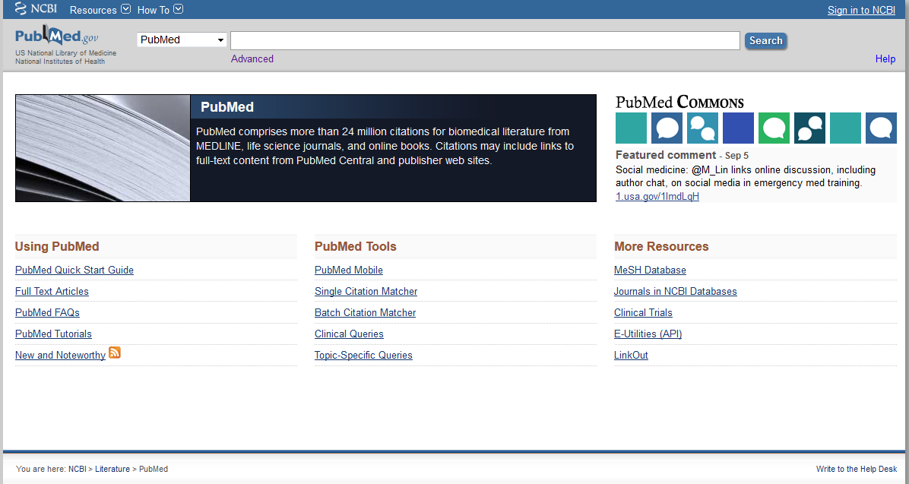

Slide 30
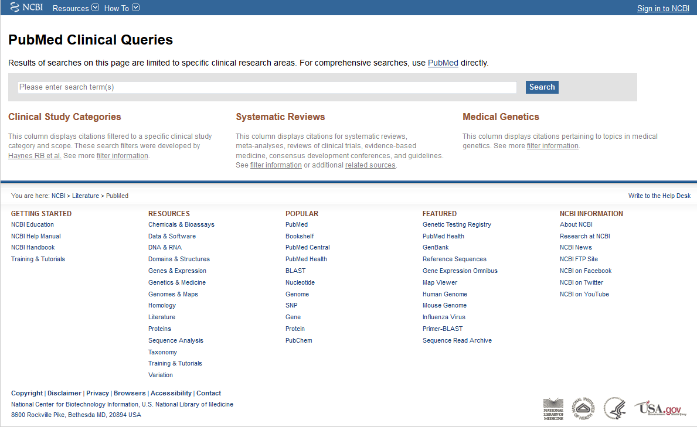
cochlear implant and vestibular function

Slide 31
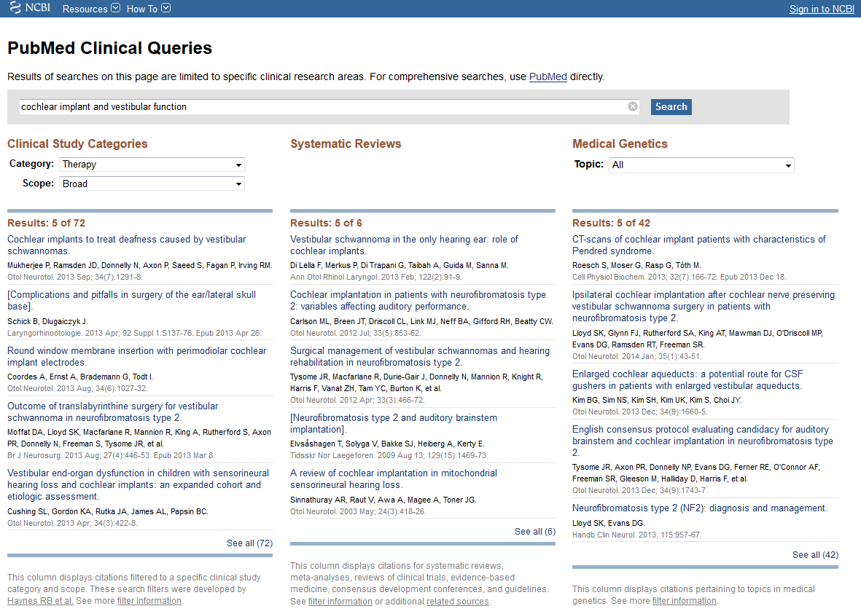
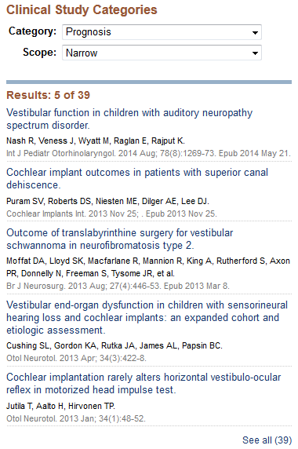



Slide 32
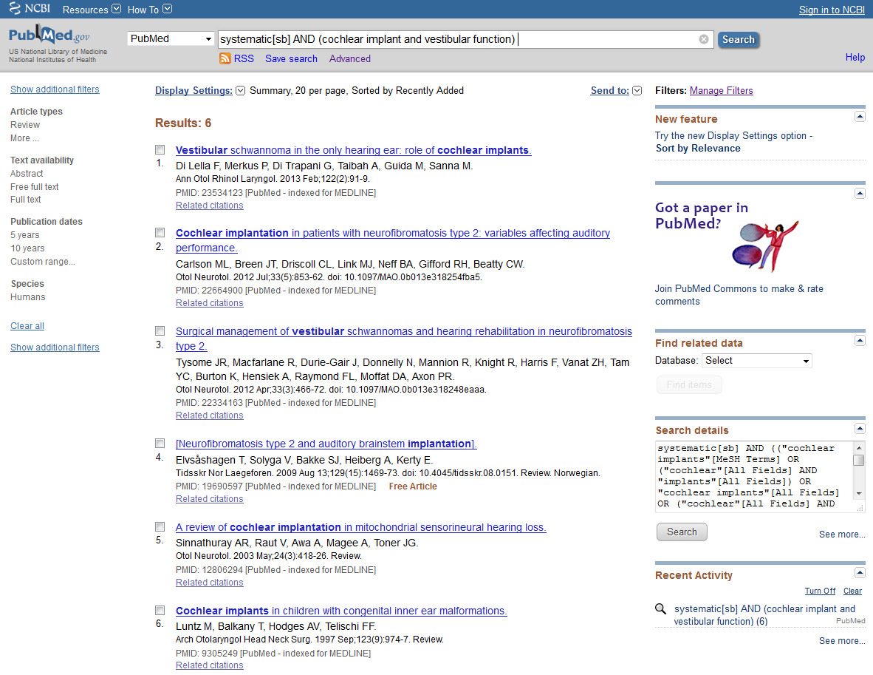
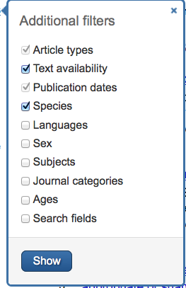

Slide 33
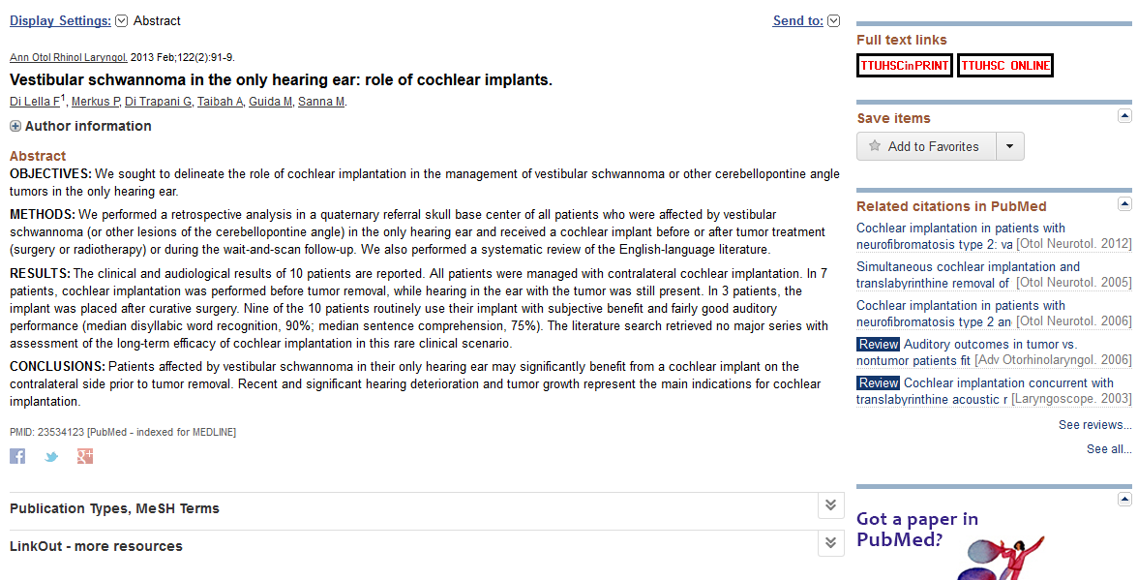

Slide 34
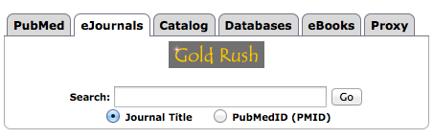
Gold Rush

Slide 35
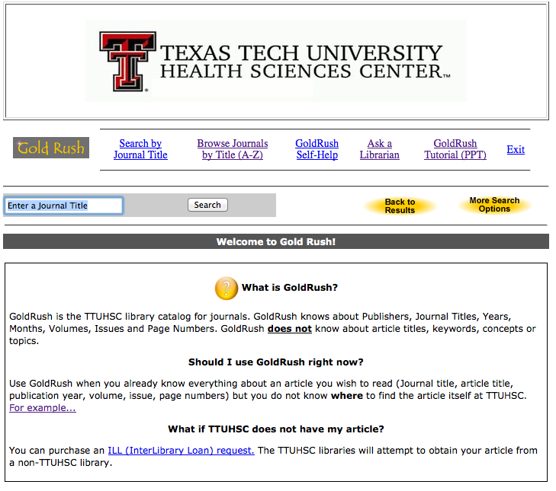
audiology

Slide 36
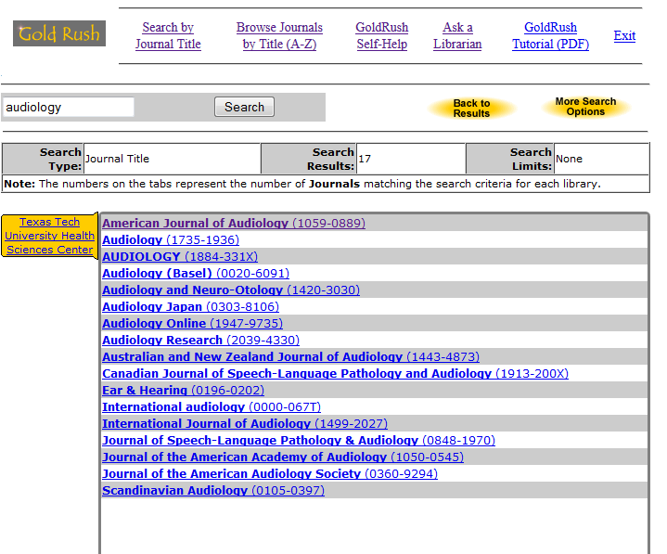

Slide 37
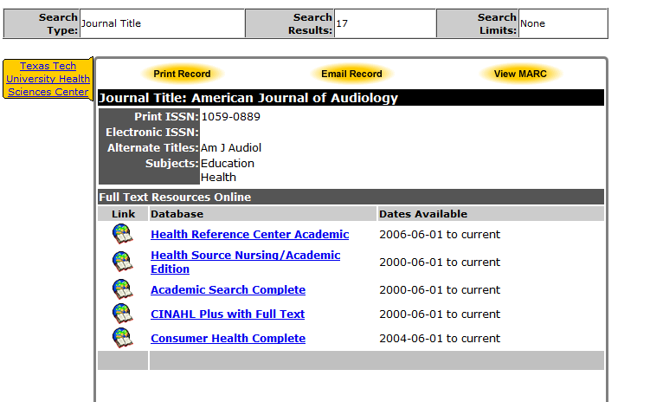

Slide 38
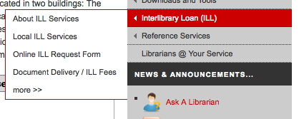
Interlibrary Loan (ILL)
Read all about it here!

Slide 39
Basic ILL Information
Online ordering form makes submitting requests quick and easy
Response time for requests is anywhere from 2 – 10 business days, depending on location of the item
Books from any TTUHSC branch library are free, all others are $4.00
Journal articles are charged per page, but fees will not exceed $4.00
There is a rush option available, but at a higher fee rate

