Slide 1
Welcome
Information Resources for Audiology
Peggy Edwards, AMLS
TTUHSC - Preston Smith Library
Lubbock, Texas 79430
Sept 2014

Slide 2
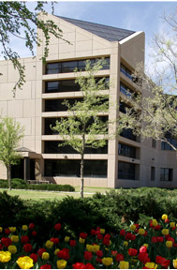
Welcome!
Preston Smith Library
located west of the
Academic Classroom
Building

Slide 3
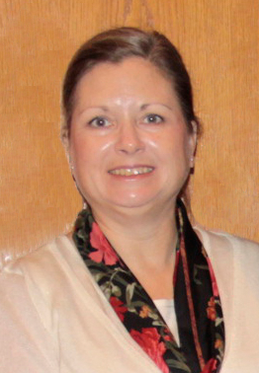

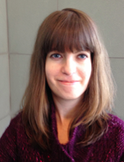
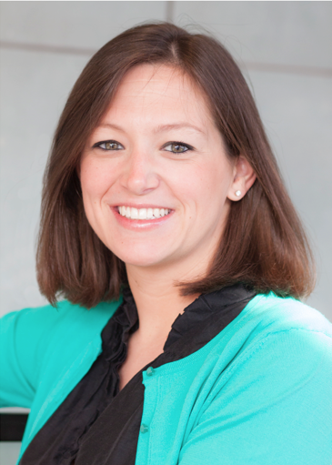
Reference Librarians - Lubbock
Micah
Walsleben
Peggy
Edwards
Available 8–5
Monday–Friday
Jennifer
Teichelman
Margaret
Vugrin

Slide 4
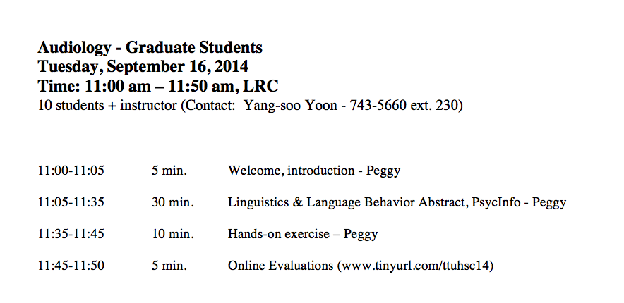
A
G
E
N
D
A

Slide 5
Library Home Page

Slide 6
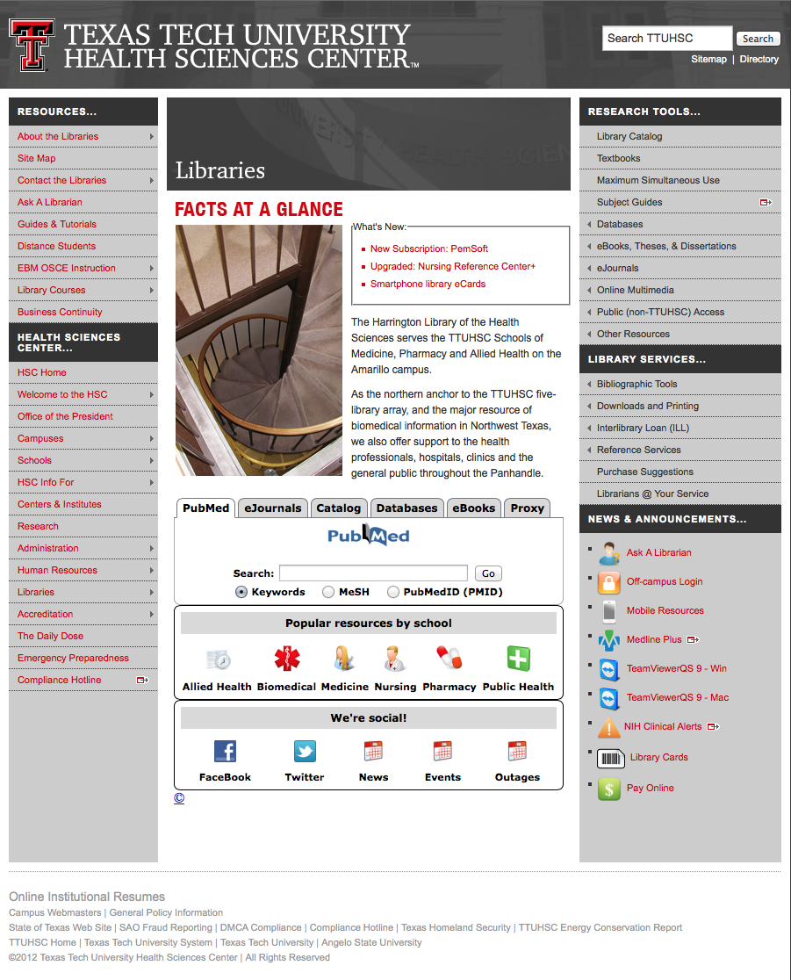
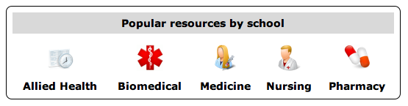
Popular Resources is a good starting point.

Slide 7
Linguistics and Language Behavior Abstracts

Slide 8
www.ttuhsc.edu/libraries
Click Databases

Slide 9
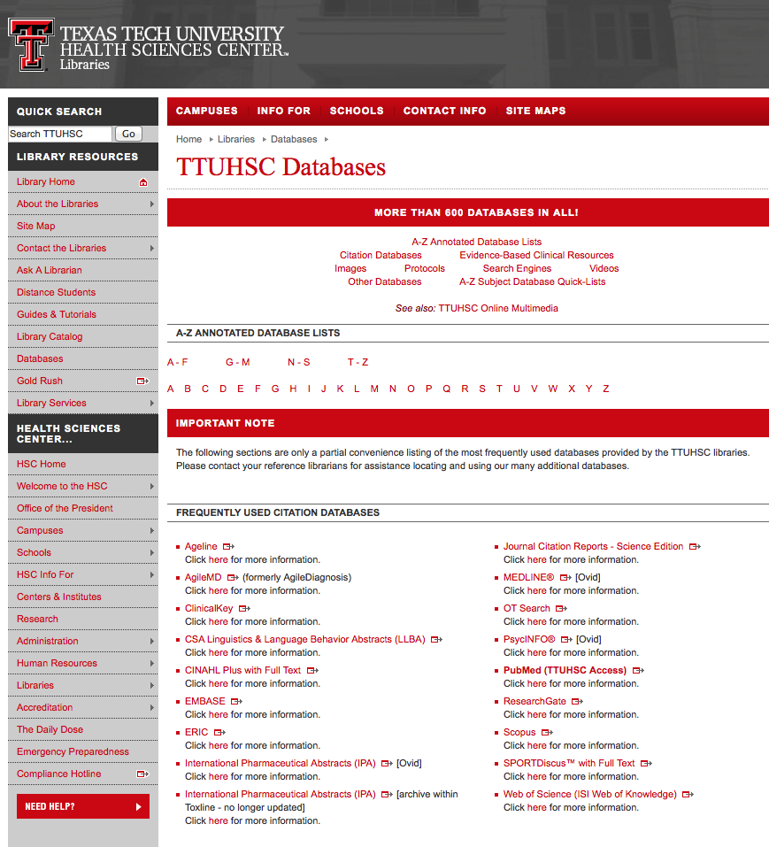
Click CSA Linguistics & Language Behavior Abstracts

Slide 10
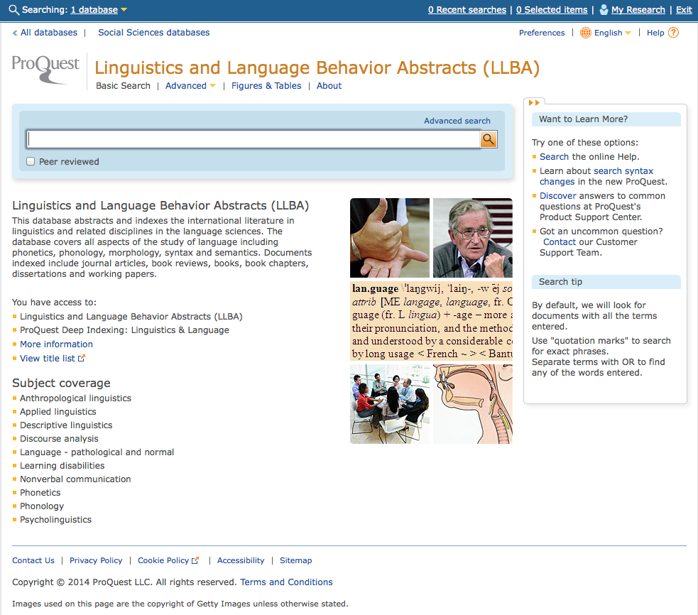
Click Advanced
Home Page

Slide 11
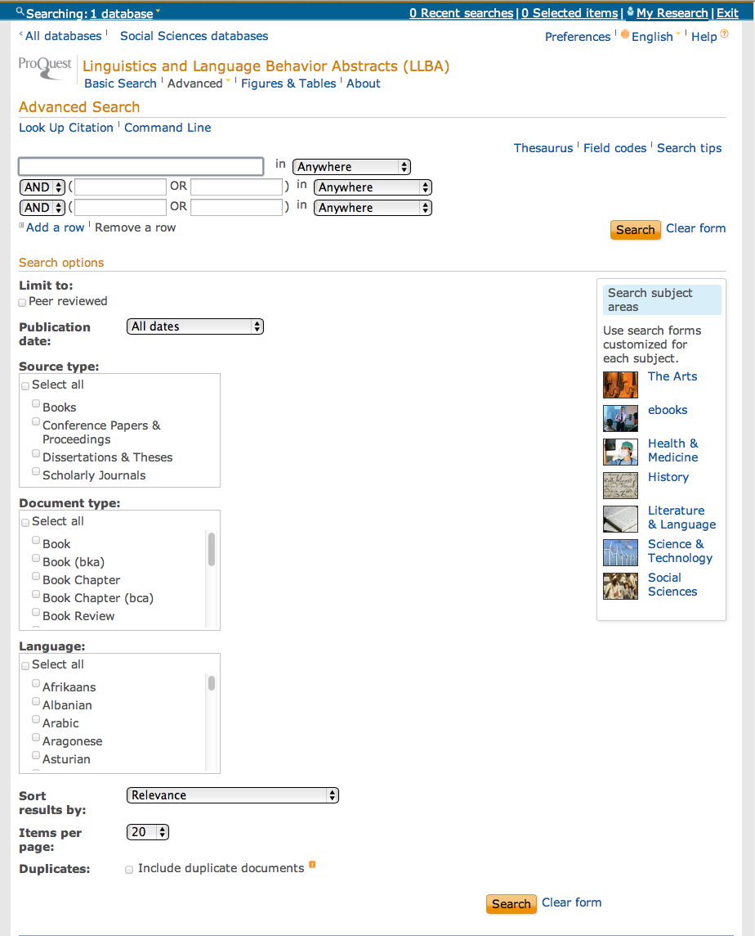
Click Thesaurus

Slide 12
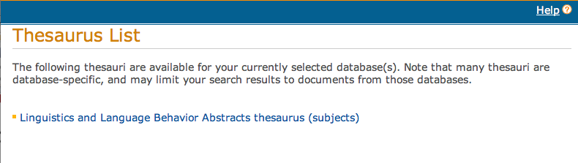
Click Link to Thesaurus

Slide 13
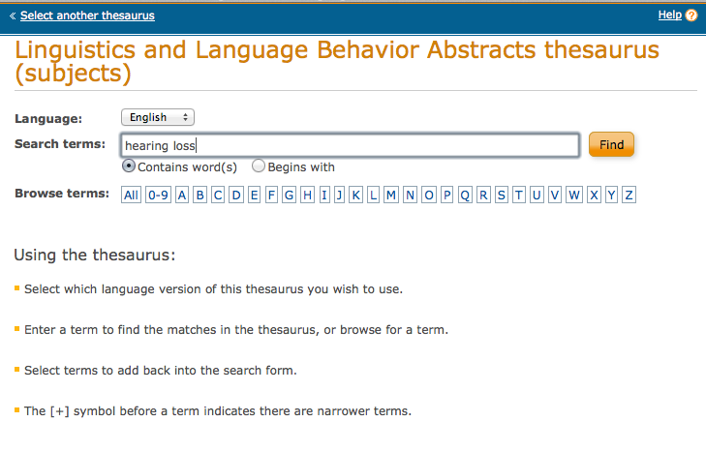
Enter Term
Click
Find

Slide 14
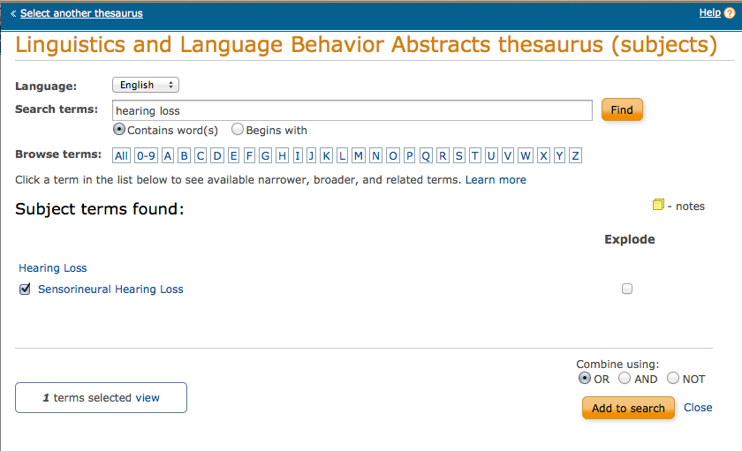
Click
Add to Search
Select Term

Slide 15
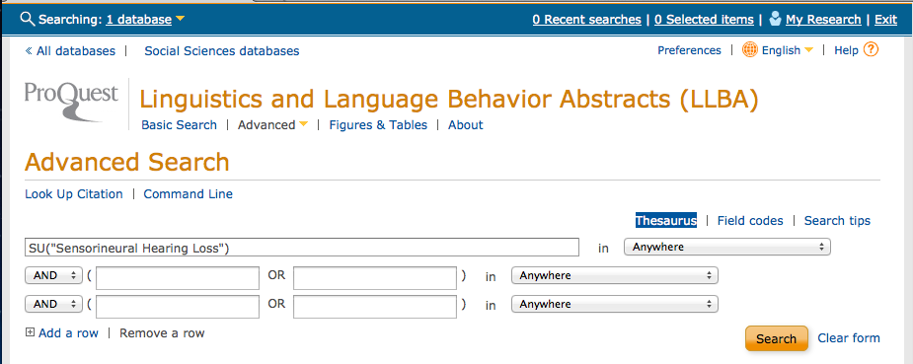
First Term is in Search Box

Slide 16
Click Thesaurus

Slide 17
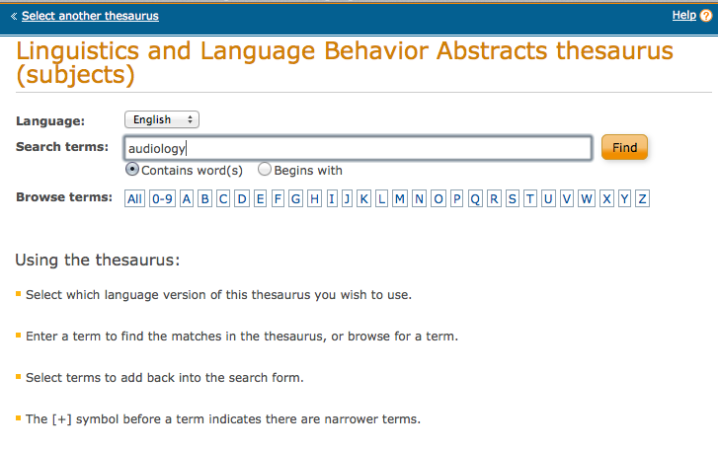
Enter Term
Click
Find

Slide 18
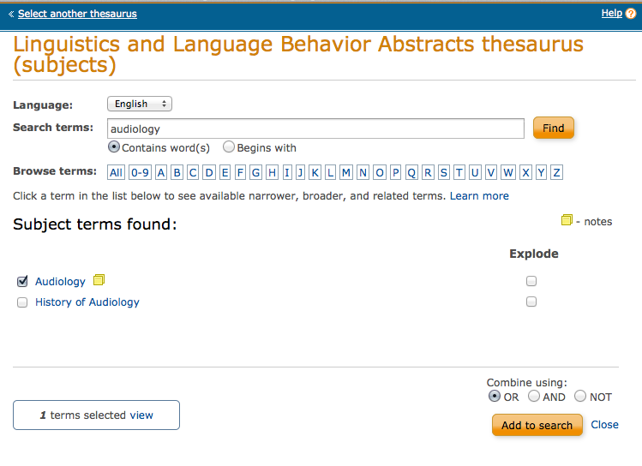
Click
Add to Search
Select Term

Slide 19
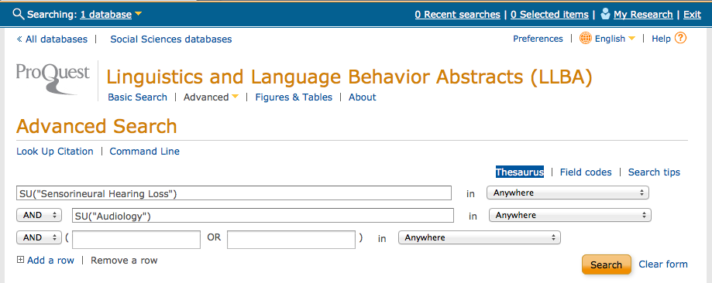
Click
Search

Slide 20
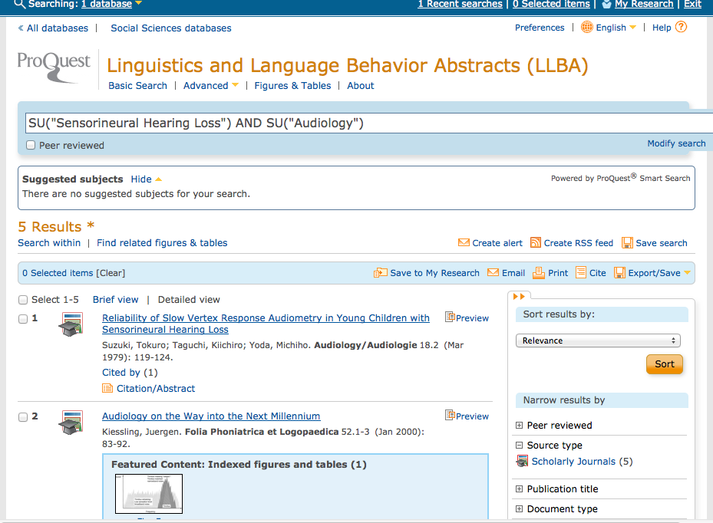
Results of AND combination.
(Note that AND narrows results.)

Slide 21
Continue to narrow
using appropriate filters

Slide 22
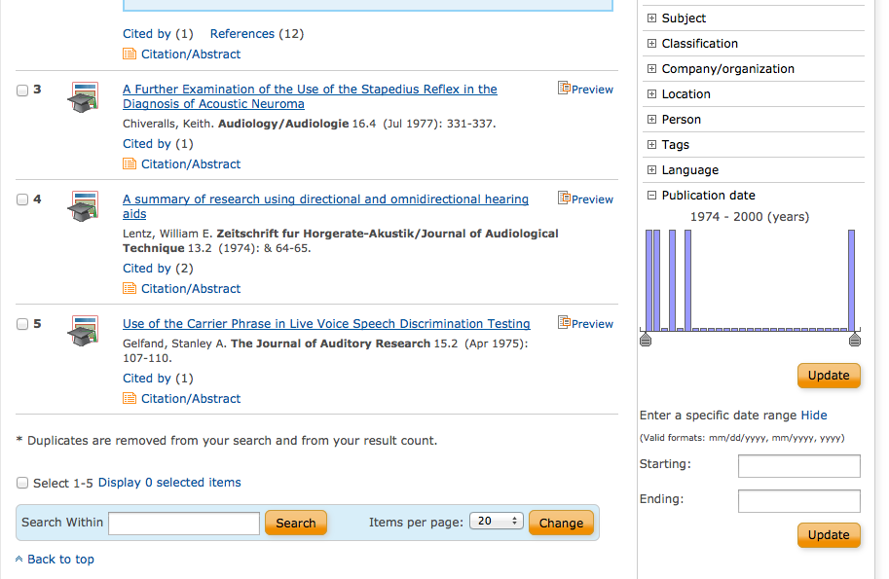

Slide 23
Use Gold Rush to access full-text.

Slide 24
PsychInfo

Slide 25
www.ttuhsc.edu/libraries
Mouse over Databases

Slide 26
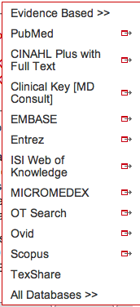
www.ttuhsc.edu/libraries
and click OVID®

Slide 27
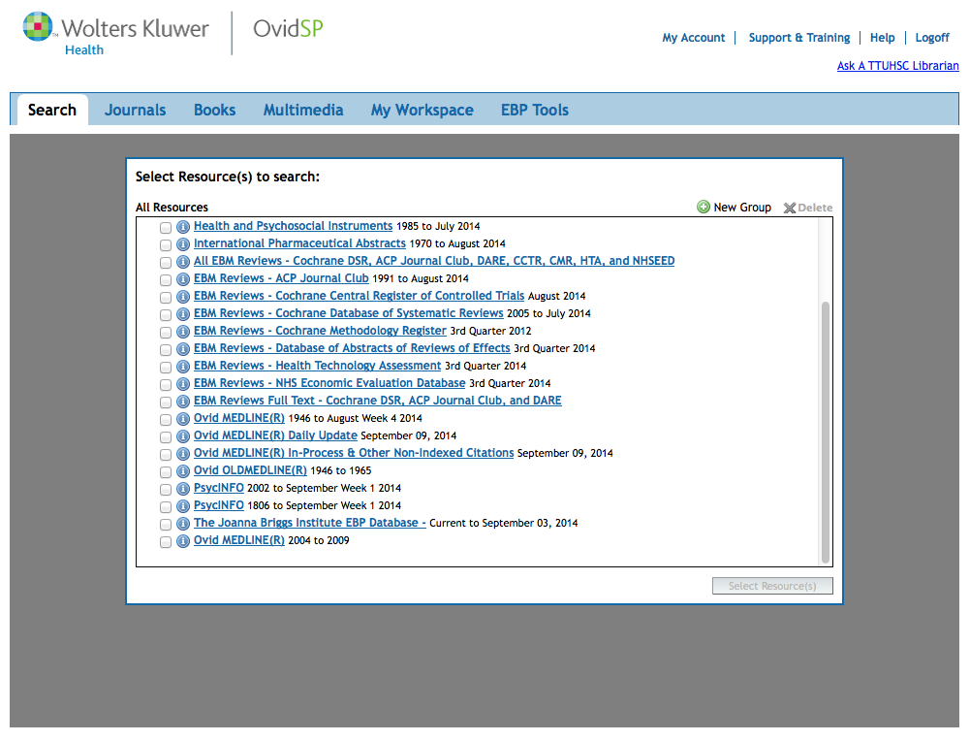
Click PsycINFO

Slide 28
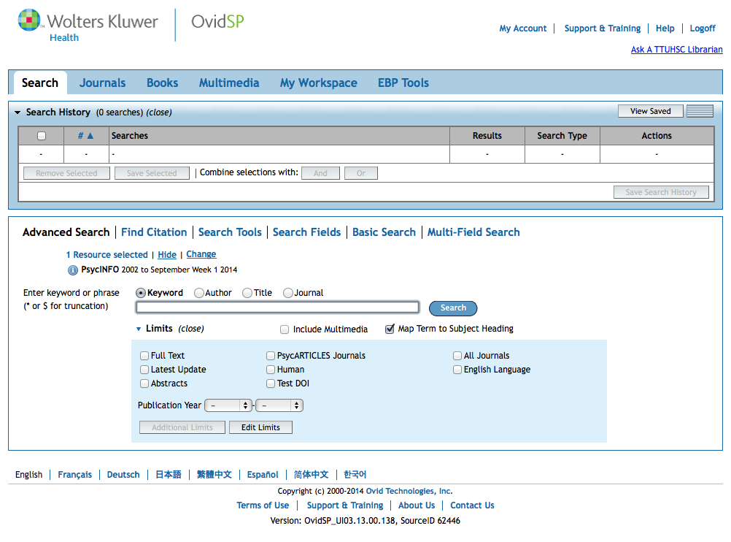
Home Page

Slide 29
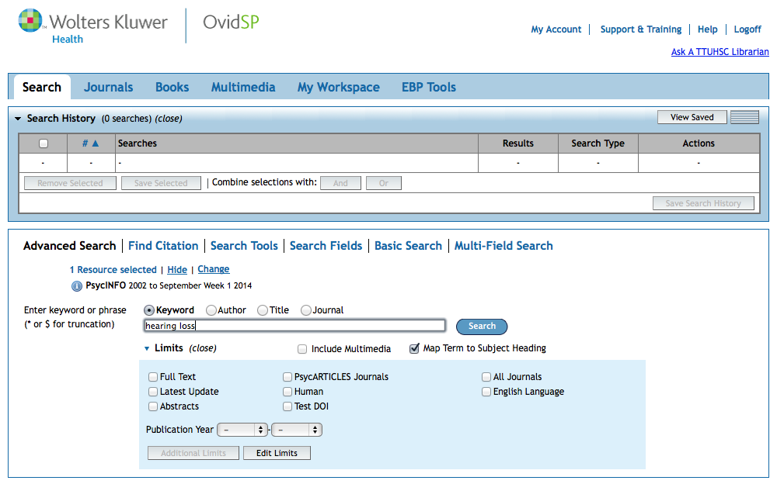
Click Search
Enter
as the first keyword search.
hearing loss

Slide 30
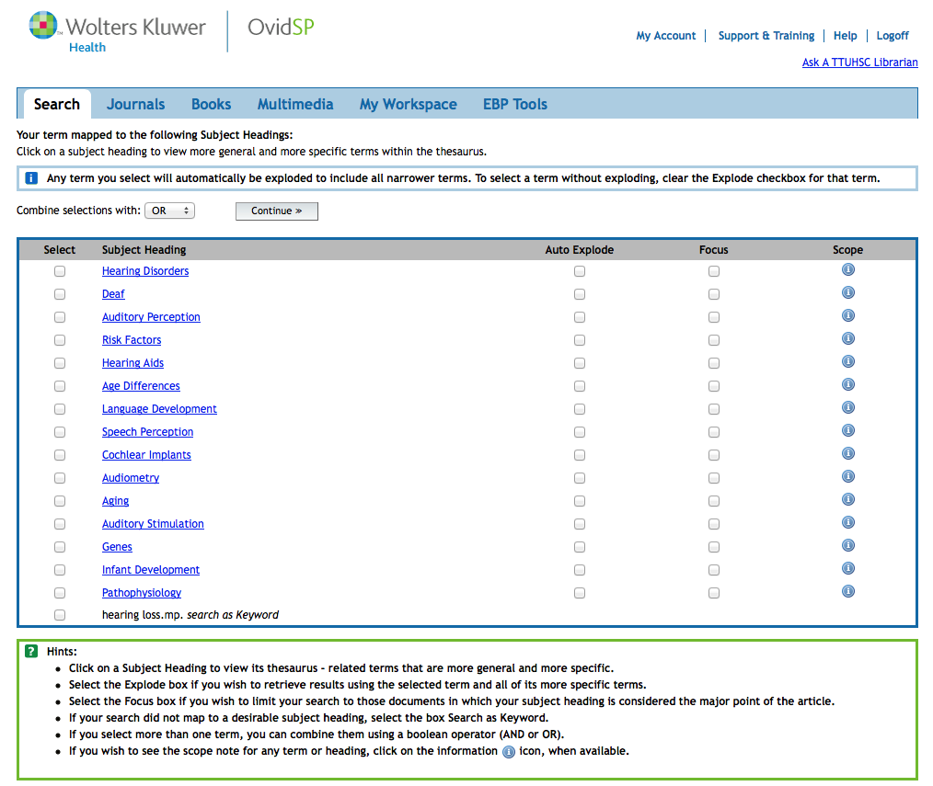
Click Subject Heading for Tree Structures

Slide 31
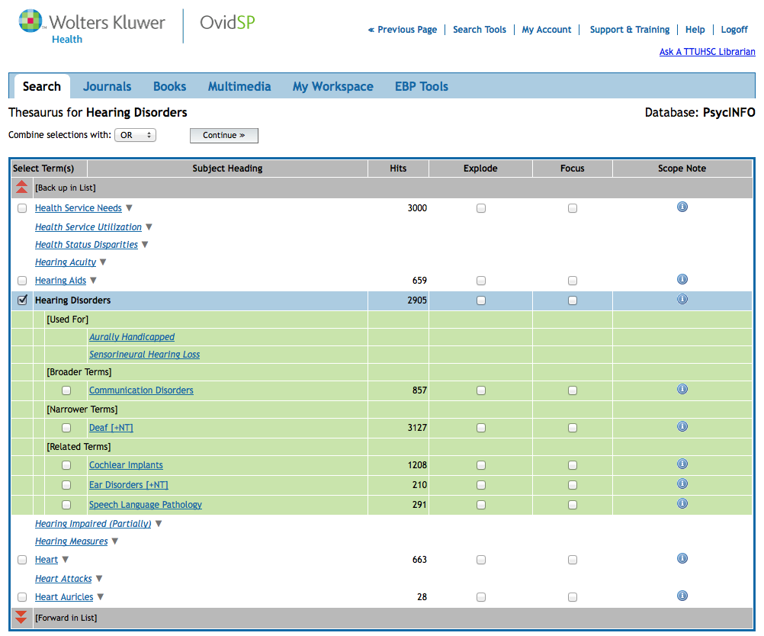

Slide 32
Click Continue
Click box next to Subject Heading

Slide 33
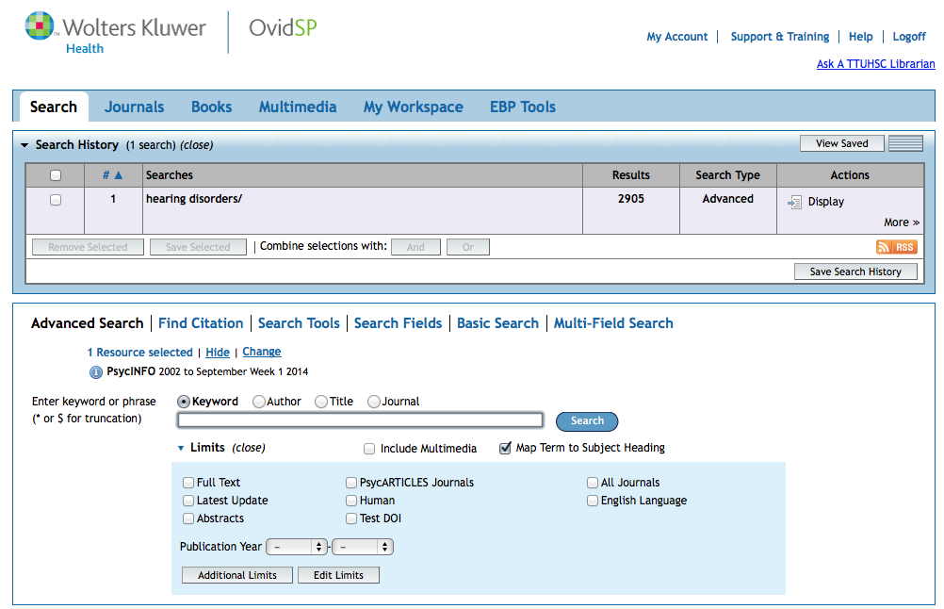
Results in the
first search set.

Slide 34
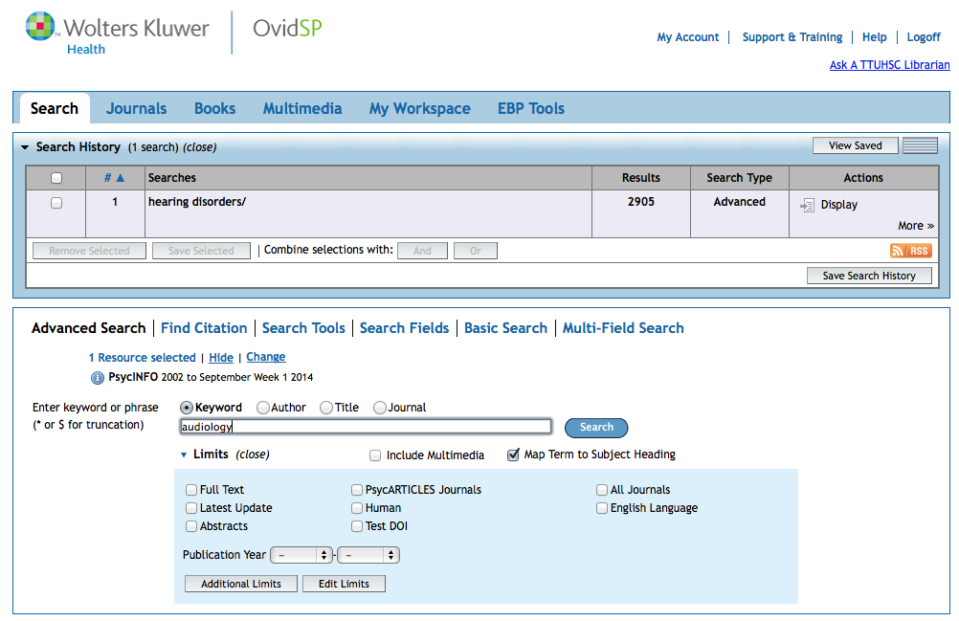
Click Search
Enter
as the second keyword search.
audiology

Slide 35
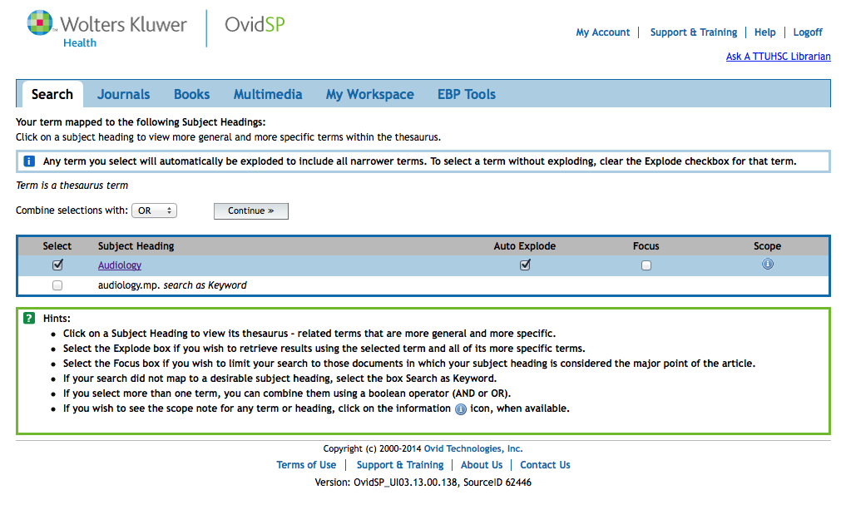
Select Subject Heading
Click Continue

Slide 36
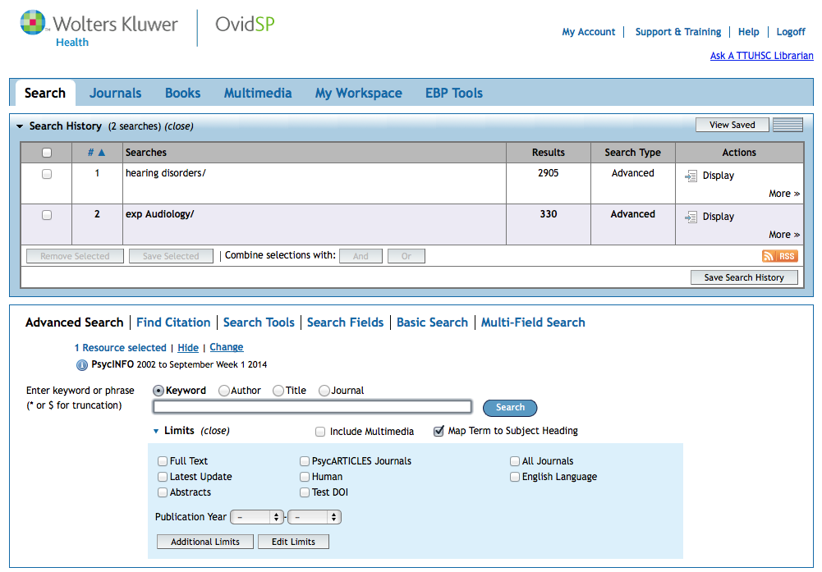
Click And
X
X
AND
Click on the boxes
next to set 1 and set 2.

Slide 37
Boolean Logic - AND
hearing
loss
audiology
and

Slide 38
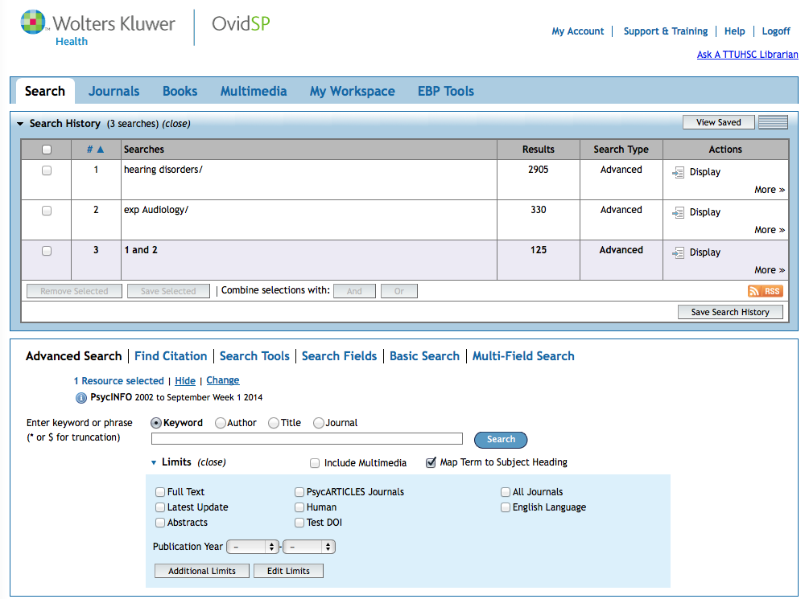
Results of AND combination.
(Note that AND narrows results.)

Slide 39
Limiting
Search Results

Slide 40
Click
Additional limits

Slide 41
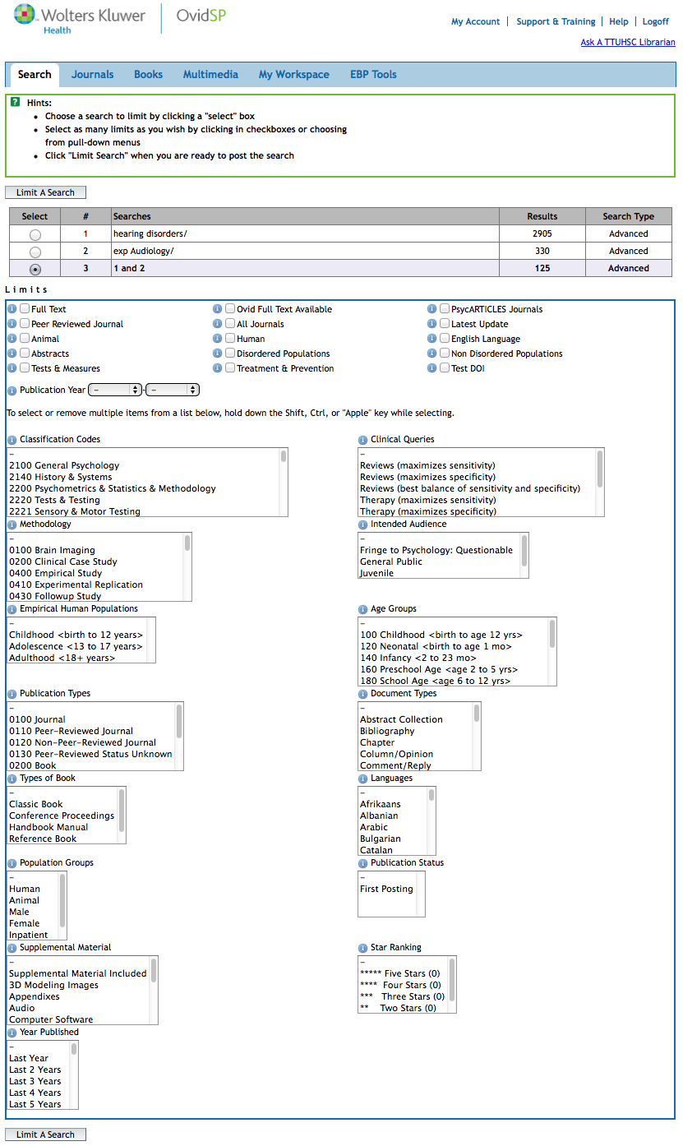
Scroll screen to
view limits
Publication Years
Publication Types
Age Groups
Languages
Click
Limit a Search

Slide 42
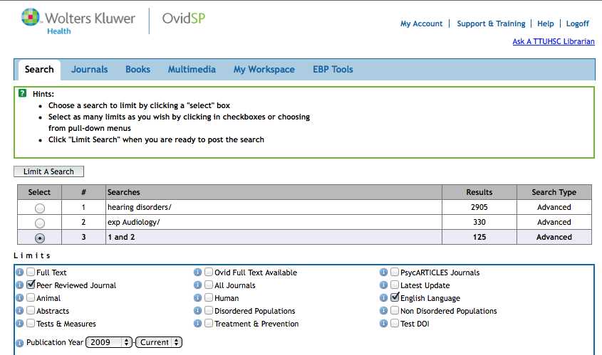
Click Limit a Search

Slide 43
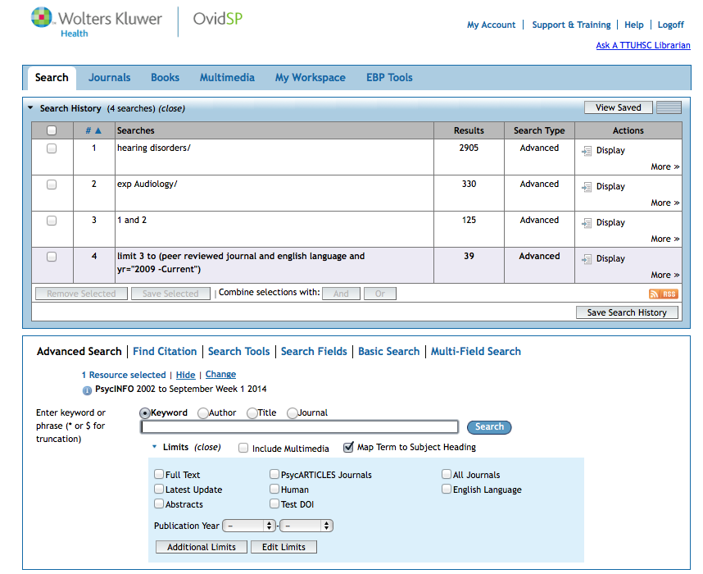
Click Display
to view articles

Slide 44
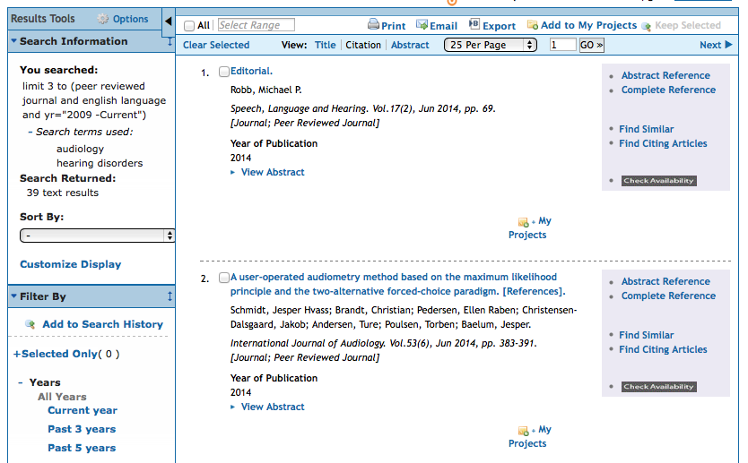
Check Availability
will often lead to the full-text.

Slide 45
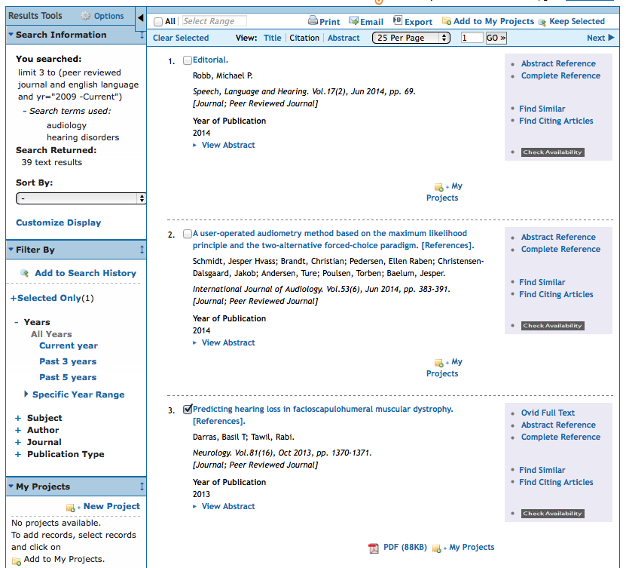
Click Email
Select Articles
✔

Slide 46
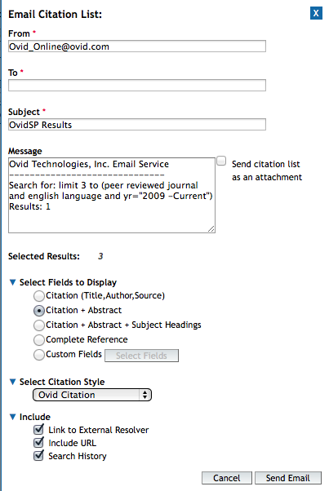
Select options and Send

Slide 47
Finding e-journals in Gold Rush

Slide 48

www.ttuhsc.edu/libraries
Mouse over eJournals
Click Gold Rush

Slide 49
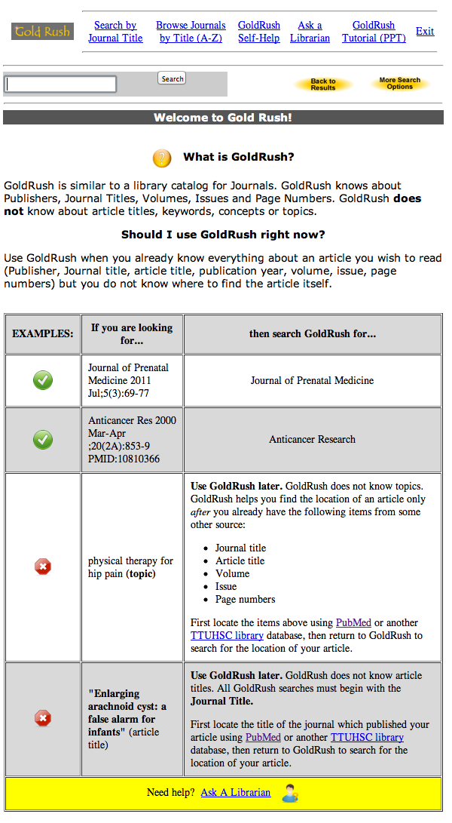
Instructions for using

Slide 50
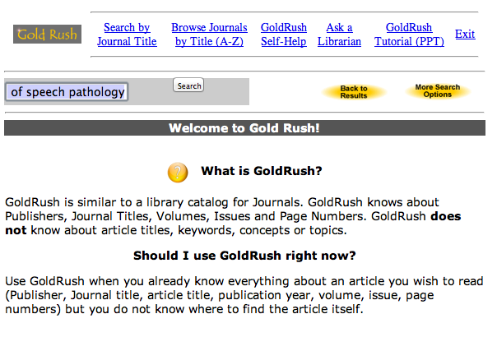
Enter journal title, click
Search
International journal of audiology

Slide 51
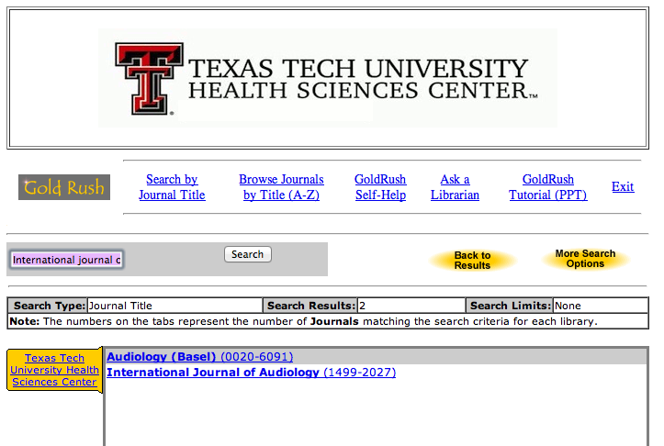
Click International Journal of Audiology

Slide 52
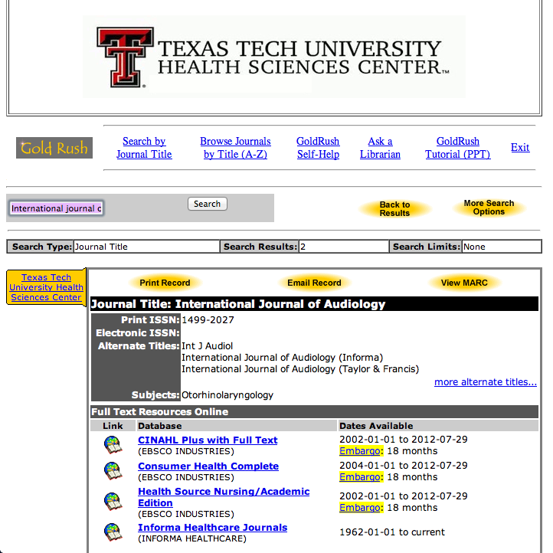
1) Check Dates Available
2) Select Publisher

Slide 53
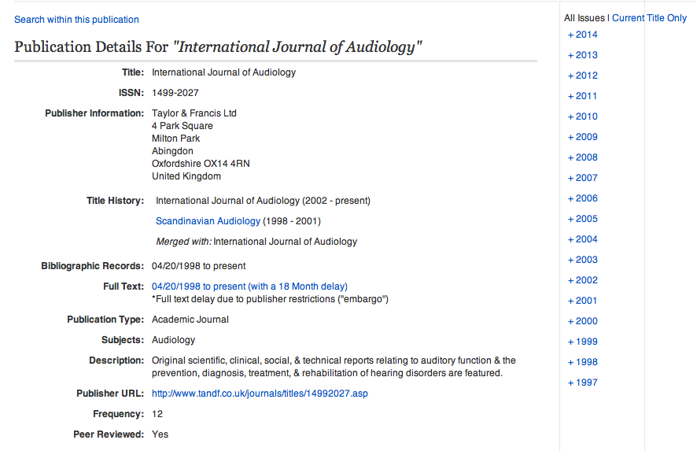
Select Year

Slide 54
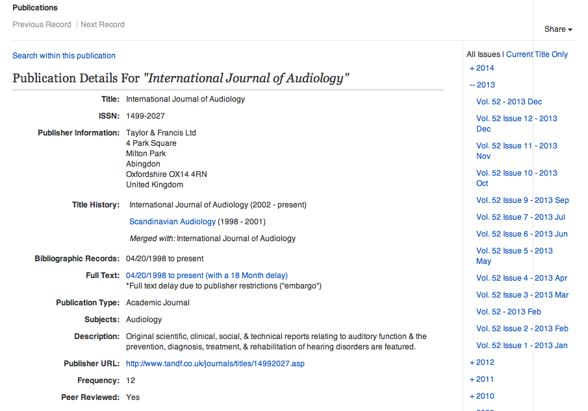
Select Volume, Issue

Slide 55
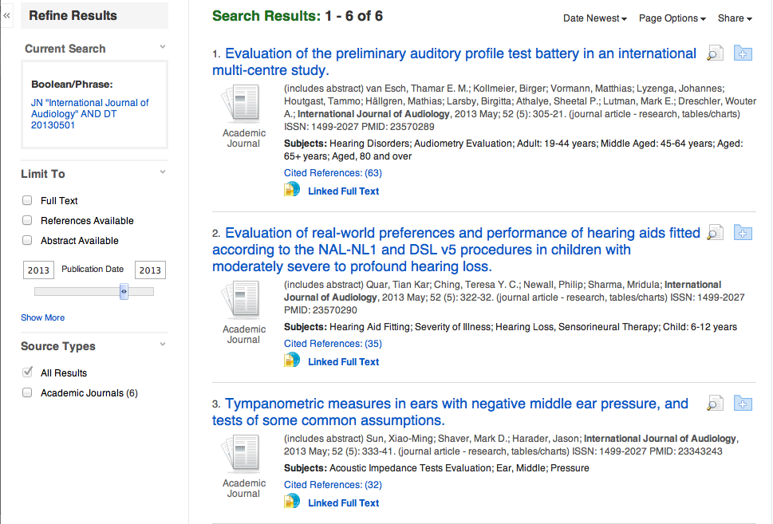
Locate article and click full text link

Slide 56
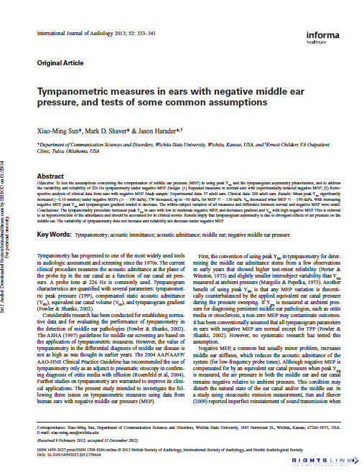
Full-text

Slide 57
Practice Questions
Hearing loss and auditory perception
Auditory thresholds
Clinical assessment and rehabilitation

Slide 58
Have Questions
or
Need Help?

Slide 59
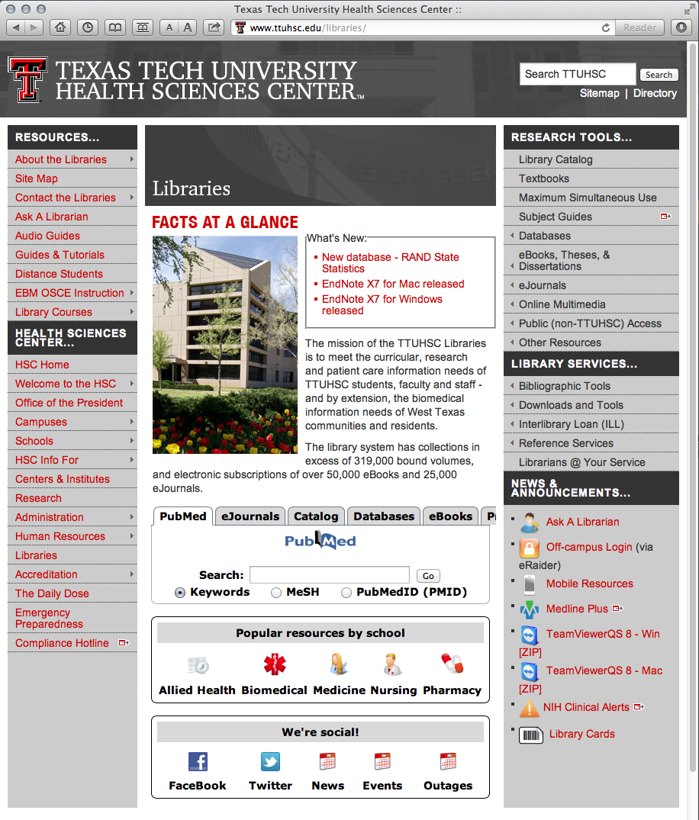

Today’s PowerPoint
Click the Allied Health Icon to go to Popular Resources

Slide 60
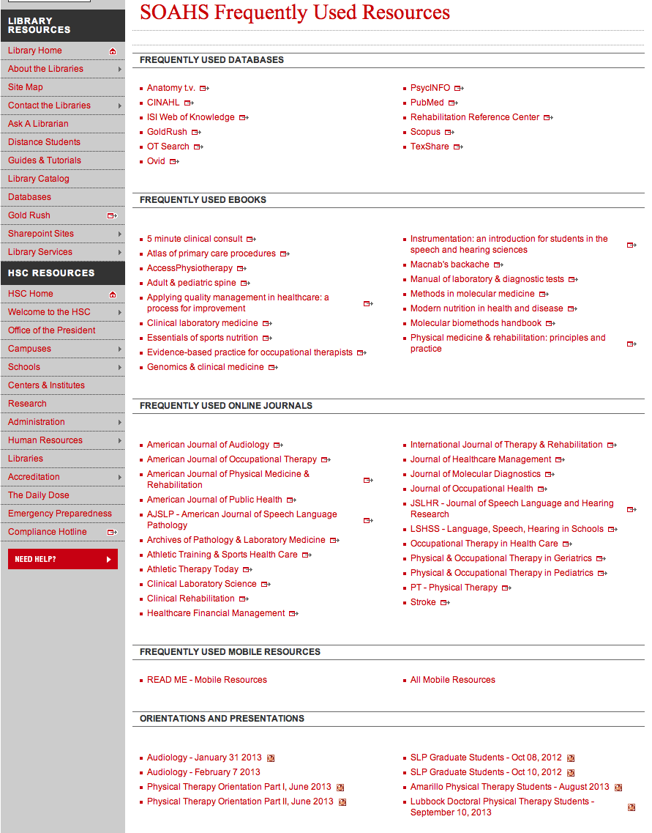
Audiology PowerPoint
September 16, 2014

Slide 61
www.ttuhsc.edu/libraries
Guides & Tutorials
Click

Slide 62
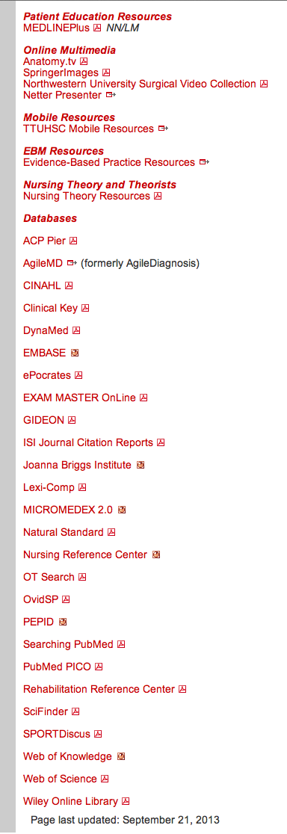
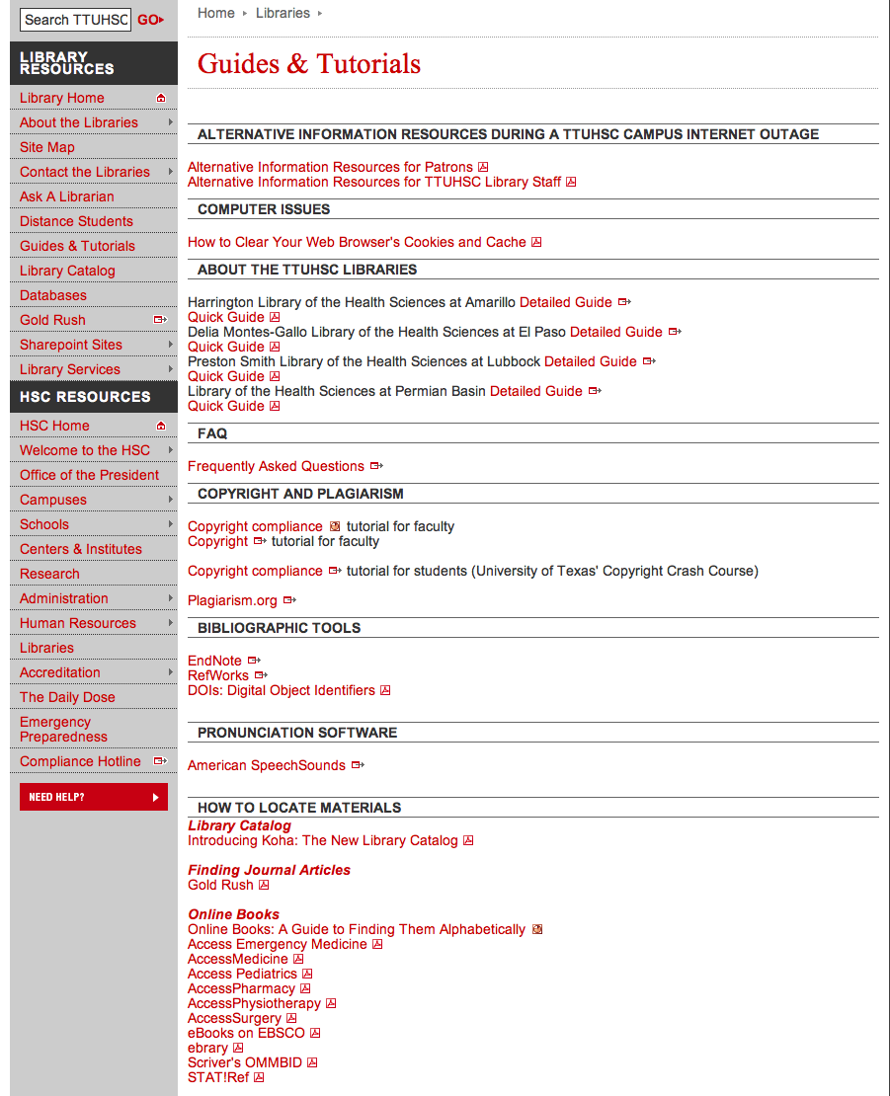

Slide 63

www.ttuhsc.edu/libraries
Go to
Ask a Librarian Icon

Slide 64

www.ttuhsc.edu/libraries
Download TeamViewer

Slide 65

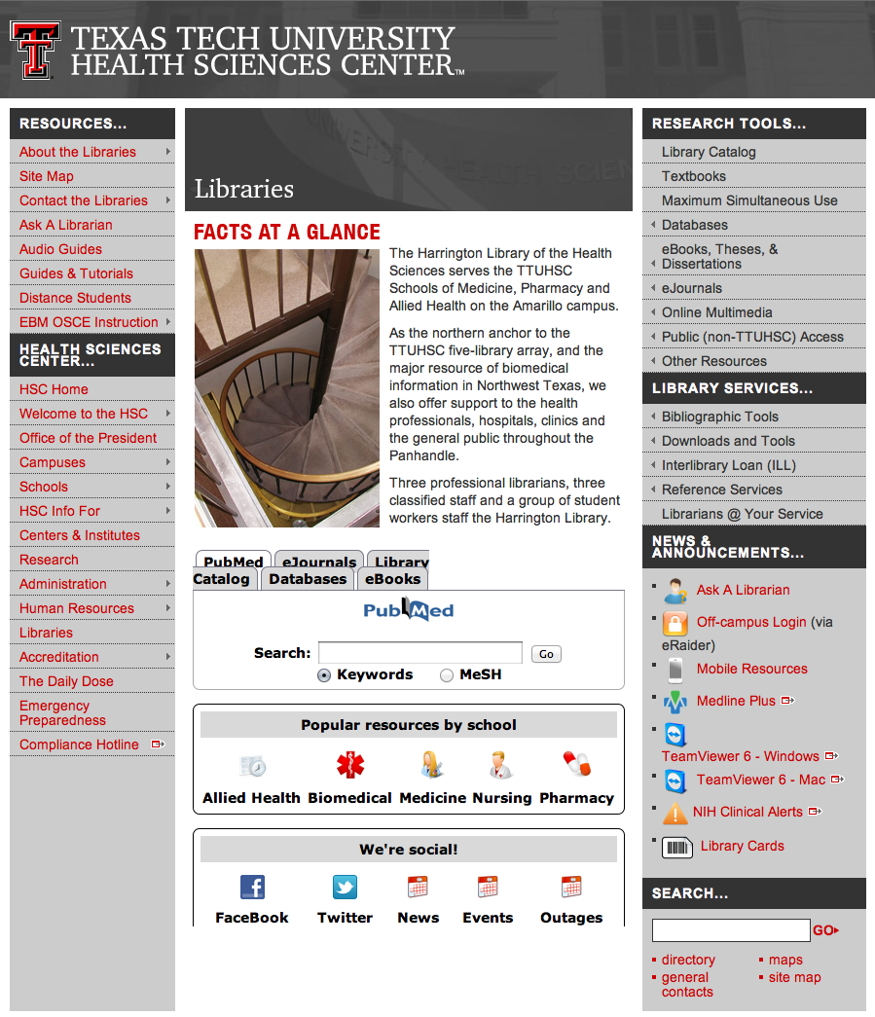

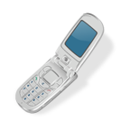
Call your TTUHSC Librarian

Slide 66

Double click the icon and follow the directions

Slide 67

Give the password to the librarian to enter.
Log On
After logging on, the librarian can see your computer screen!
At the end of the session after logging off,
the librarian will not have access to your computer!
TeamViewer generates a new password each time it is used!

Slide 68

OR contact us at:
Lubbock
(806) 743-2200
Amarillo
(806) 354-5448
El Paso
(915) 545-6652
Odessa
(432) 335-5171

Slide 69
The End

