Slide 1

How to search for a database that uses Subject Headings: PubMed
Margaret Vugrin MSLS, AHIP, MPH
Texas Tech University Health Sciences Center Library
Fall 2017
Notes:
Hi I’m Margaret Vugrin, one of the Reference Librarians at the TTUHSC library and today I am bringing you a presentation on the best way to search a database that uses subject headings. There are some databases that do not use subject headings. For our example databases we will be exploring PubMed.

Slide 2
Instructions
Get a piece of paper and something to write with; preferably colored markers.
Then cover the sheet of paper with dots all over it.
Notes:
For this exercise you will need a few sheets of paper, something to write with, possibly colored markers and access to a computer on the internet. Take your markers and fill the first sheet of paper with dots.

Slide 3
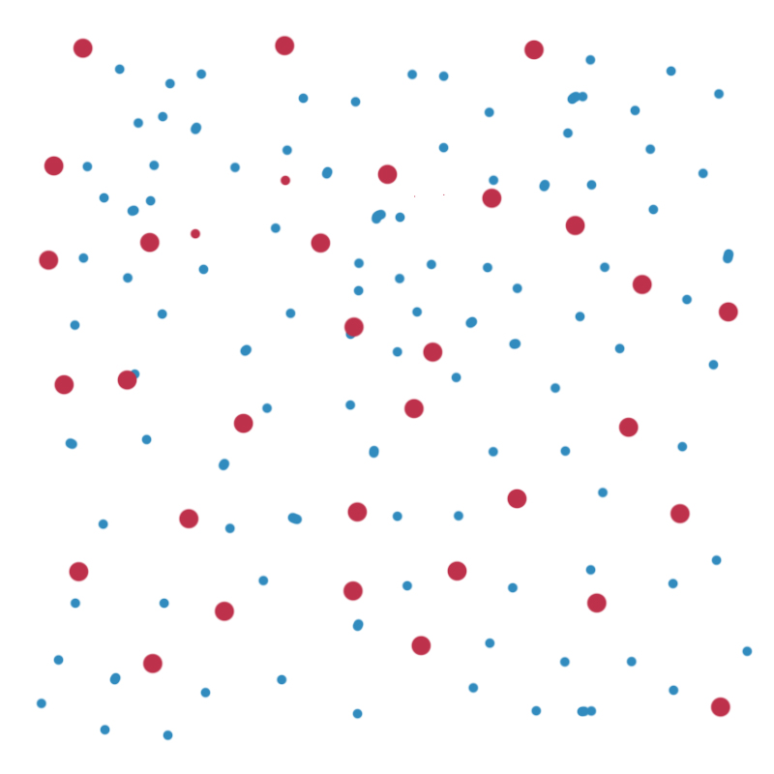
This is an example of: “All the published literature” each dot represents a journal…
We can’t see all of them but I’m sure you get the idea...there are lots, and lots of journals and lots, and lots of published articles within these journals.
Notes:
This is an example of: “All the published literature” each dot represents a journal…and we can’t see all of them but I’m sure you get the idea...there are lots, and lots of journals and lots, and lots of published articles.

Slide 4
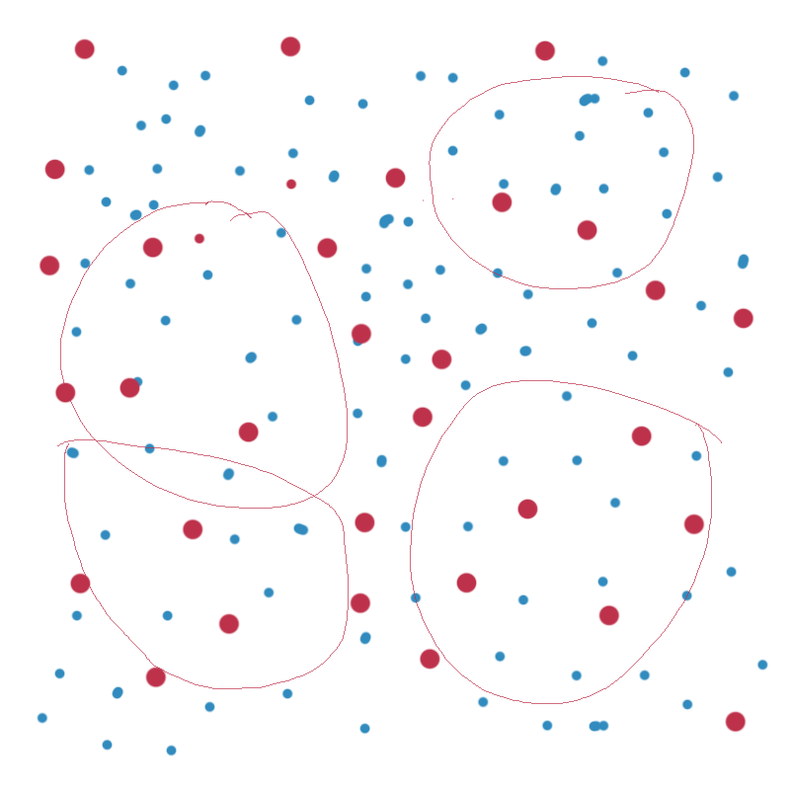
Different Databases = Different Journals
Databases index journal articles
so that the articles can be located.
Some journals are unique and these articles are indexed only in one database like the ones on the right side.
Other journals may be indexed in more than one database as in the overlapping circles on the left side.
Indexing refers to the organization of data according to a specific plan…like “tags” in Twitter.
Notes:
Databases index journal citations. Some journals are unique and are indexed only in a database like the circles on the right side, while other databases may overlap identical journal titles. So those journals will be found in multiple databases as the example on the left side. Indexing refers to the organization of data according to a specific plan…like “tags” in Twitter.

Slide 5
PubMed
For this exercise we will be looking at just one database, PubMed. Just one of the circles on the previous screen.
More than 6,000 journals are indexed in PubMed. As of 2017, it contained over 27 million articles going back to the 1960s.
The next slide begins the exercise that you will be doing today with the dots on your paper and following along on the database screens.
Notes:
PubMed: For this exercise we will be looking at just one database, PubMed. Just one of the circles on the previous screen.
More than 6,000 journals are indexed in PubMed. As of 2017, it contained over 27 million articles going back to the 1960s. It is the first database that researchers use when studying the biomedical literature. The next slide begins the exercise that you will be doing today with the dots on your paper and following along on the database screens

Slide 6
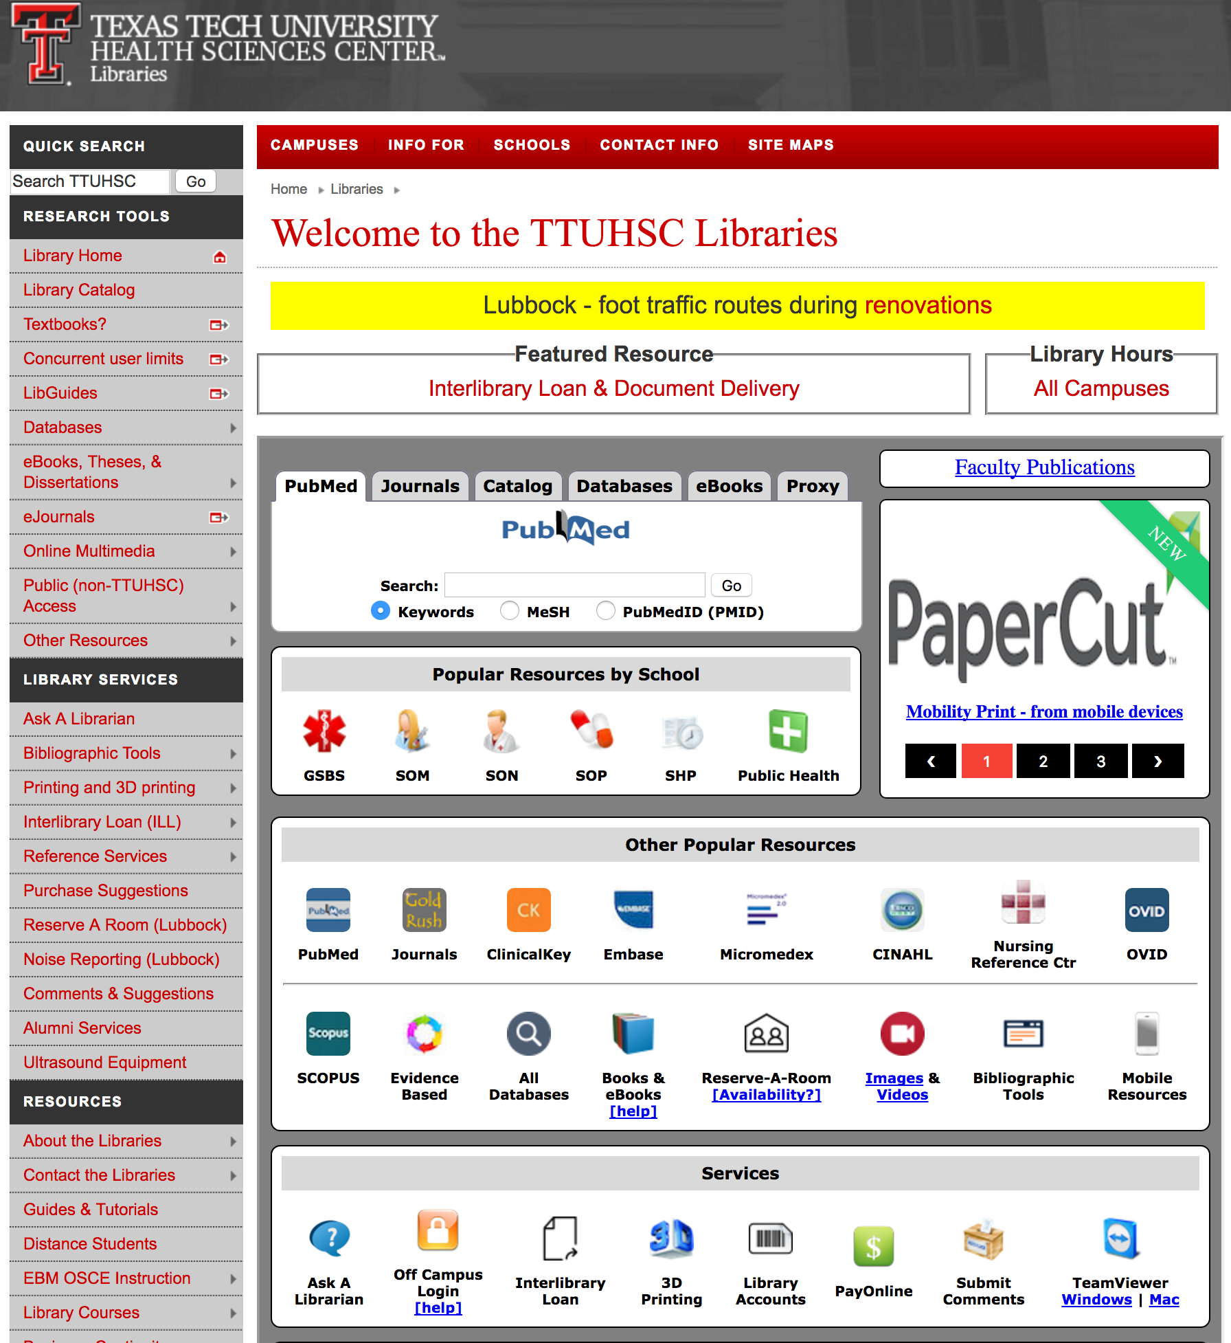

For full functionality of the
databases, including access
to full-text, one must start
at the library home page.
The library homepage is at:
http://www.ttuhsc.edu/libraries
Click on the PubMed Icon:
This will bring you to the PubMed Homepage.
Notes:
For full functionality of the databases, including access to full-text, one must start at the library home page. The library homepage is at:
http://www.ttuhsc.edu/libraries once at the homepage Click on the PubMed Icon…

Slide 7
What are hospital cost considerations of surgical wound infections?
Notes:
Today I would like to use this example: what are hospital cost considerations of surgical wound infections?

Slide 8
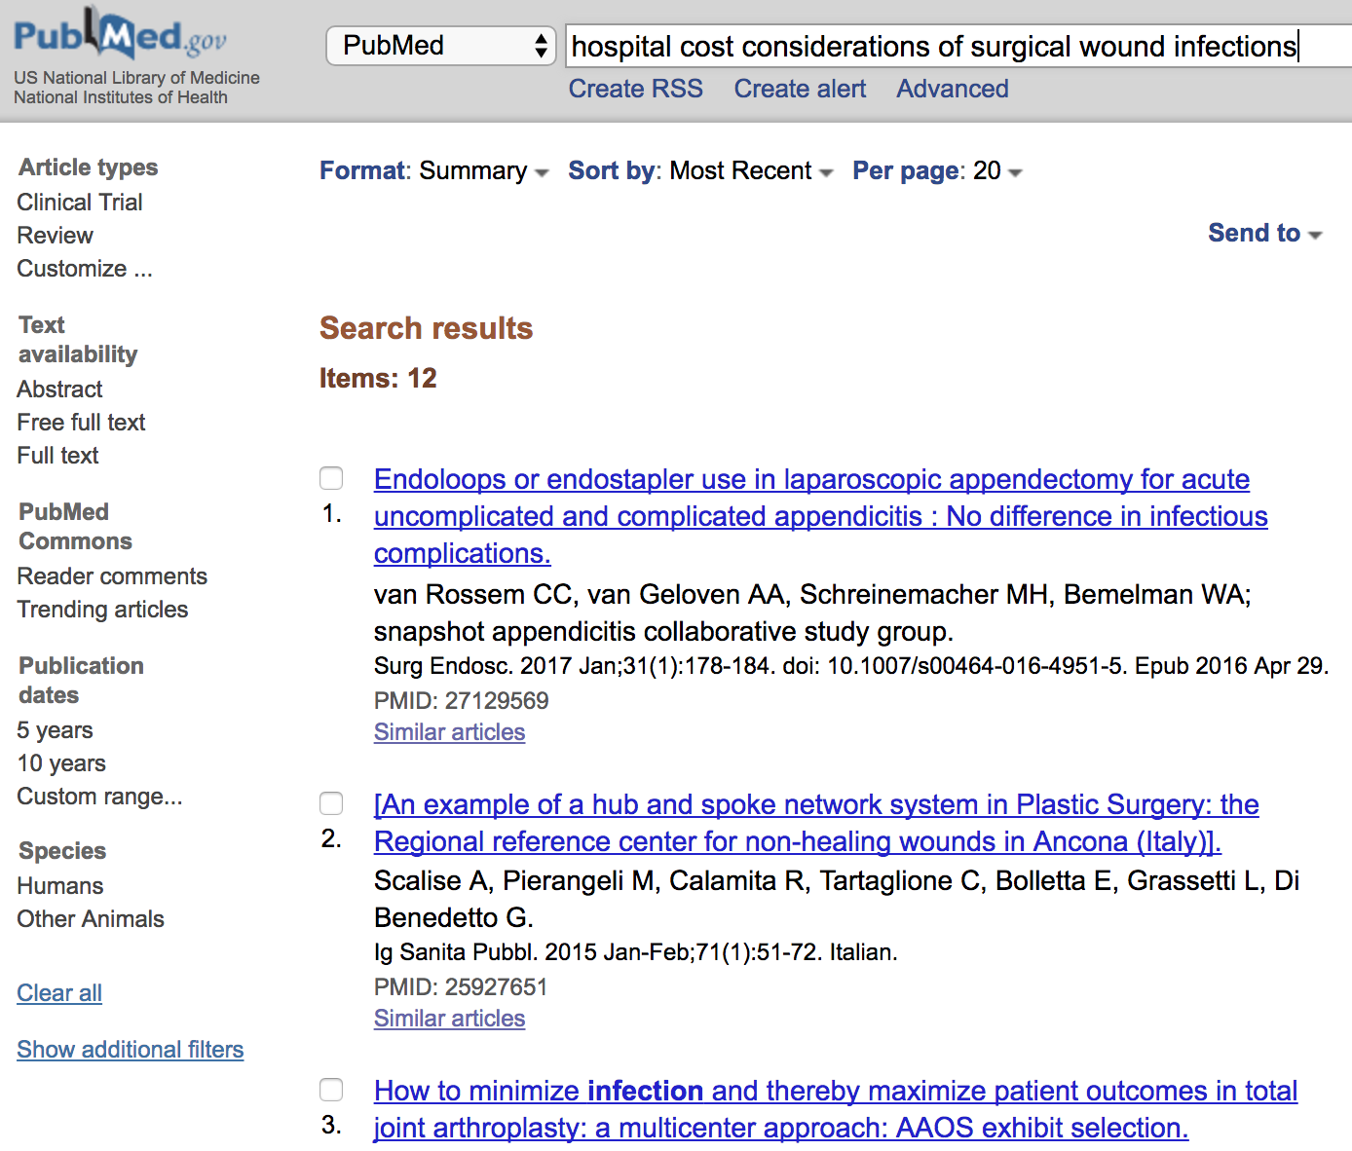
Notes:
Frequently when people Google search they just enter their question into the search box as is shown here. Yes, you do get results however there are better ways to do a more complete search of the literature. As you see here, today I retrieved only 12 articles (the database is updated daily so you may have different results). Let’s consider another search option.

Slide 9
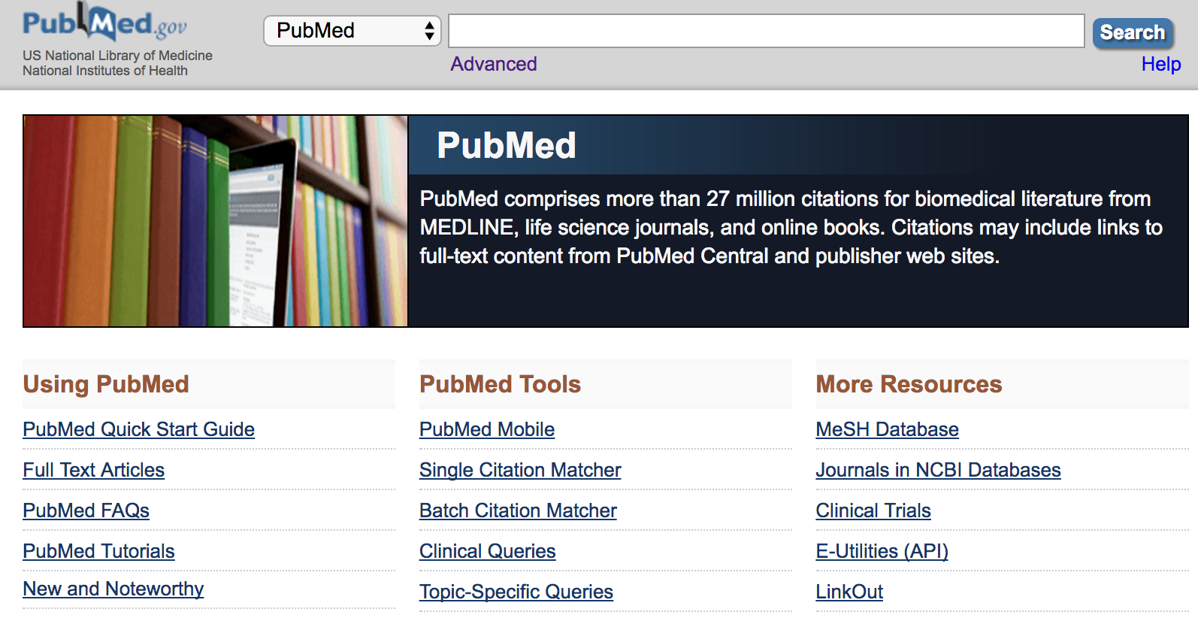
costs
In the search box type in the “combination of letters” that create: costs
The database doesn’t recognize “words” but just the “combination of letters.”
Let’s see how PubMed interprets this request for articles on the next screen.
Notes:
On the first PubMed screen…I just typed the combination of letters that created “c o s t s” The database doesn’t recognize “words” but just the “combination of letters.”
Let’s see how PubMed interprets this request for articles on the next screen.

Slide 10
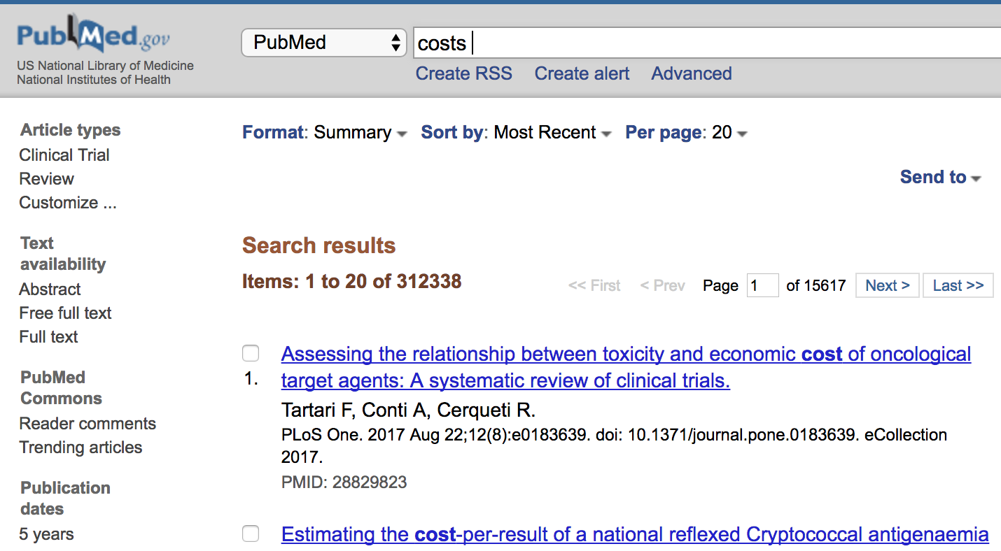
economics
The database searches for this “combination of letters” anywhere in the electronic record, including in the journal title, the article title, the author’s name, also in the abstract…
Will it locate other financial considerations using this search?
NO! it only looks for the “combination of letters”…not the meaning of the word.
NOTE: Your numbers will be different because the database is updated daily.
PubMed
costs
billing!
costs
costs
economics
costs
billing
costs…
costs
economics
Notes:
Here are all the dots in PubMed…When you type in a “combination of letters” into the PubMed search box…it looks for that combination of letters anywhere in the electronic record: Journal title, article title, author’s name, word in the abstract. Will it locate billing or economics or other financial considerations using this search? NO! as it’s only looking for the combination of letters…not the meaning of the word.

Slide 11
Return to the PubMed homepage, click on “MeSH Database.”
MeSH stands for Medical Subject Headings. One can search by CONCEPT when using MeSH.
Notes:
Return to the PubMed homepage, click on “MeSH Database.”
MeSH stands for Medical Subject Headings. One can search by CONCEPTS when using MeSH. When reviewing citations that are located by concept all of the articles are about that concept. On the previous screen, When just using the term…the term just appears anywhere in the electronic document. For example: an article that might pull up could have this sentance in the abstract: “there are numerous costs associated with this procedure.” period end of sentance that’s all the information you might receive. Let see what types of articles we can locate when we search by concept.

Slide 12
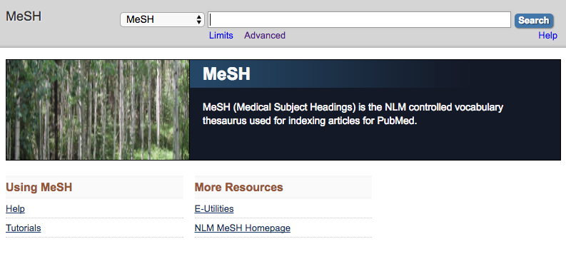
costs
On the MeSH page, type “costs” into the search box.
MeSH is the controlled vocabulary used for indexing articles.
Click on “Search.” If there is a match, it will show up on the next screen.
Notes:
On the MeSH page, type “costs” into the search box. MeSH (Medical Subject Headings) is the controlled vocabulary used for indexing articles. Indexers will “tag” an article with the appropriate subject headings…typically they wil have between 8 and 15 subject headings that are tagged per article. These will all be access points for you when you are searching by subject headings. Then click on the SEARCH button, if there is a match it will show up on the next screen.

Slide 13
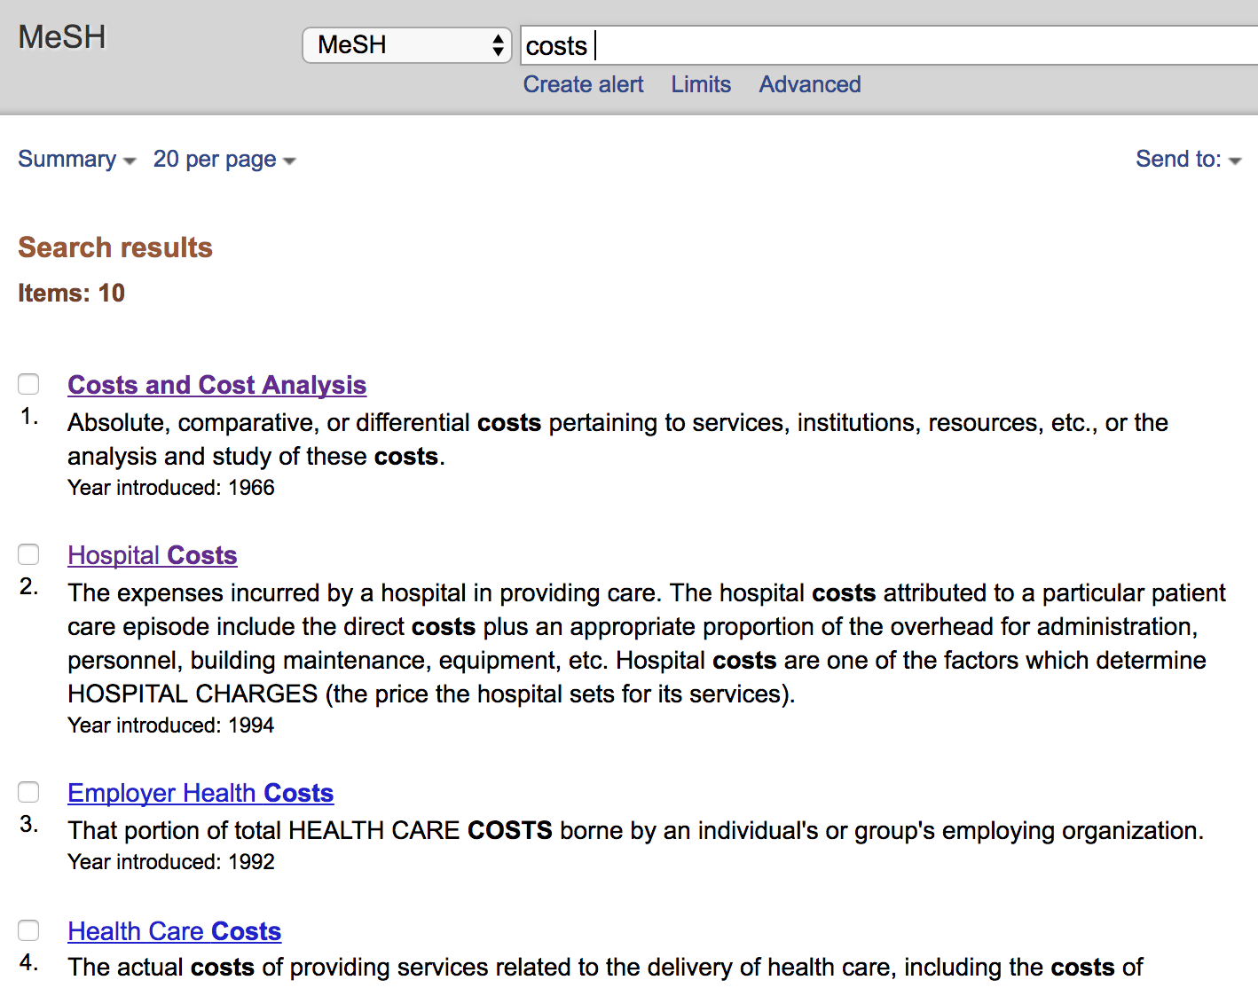
There are 10 possible matches.
Select the appropriate one. Click on the word(s) themselves.
The next screen helps to refine your topic, if needed.
Notes:
This screen shows us some possible subject headings related to the term “costs.” MeSH is giving us 10 options here. Cost and Cost Analysis, Hospital Costs, Employer health costs and a few more options. Typically each concept will have a definition and there may also be a date (the year this heading was introduced into the database.) NOTE: the date also means that if you are using this concept your research will only go back as far as that date. Look at the subject “Hospital costs.” How far back will this term search the PubMed literature? 1994. it will look at all the articles from 1994 to the present to retrieve your results. You may be interested in more than one of the concepts shown on this screen. However, let’s just choose one today. Let’s choose “Hospital costs” Please click on that term.

Slide 14
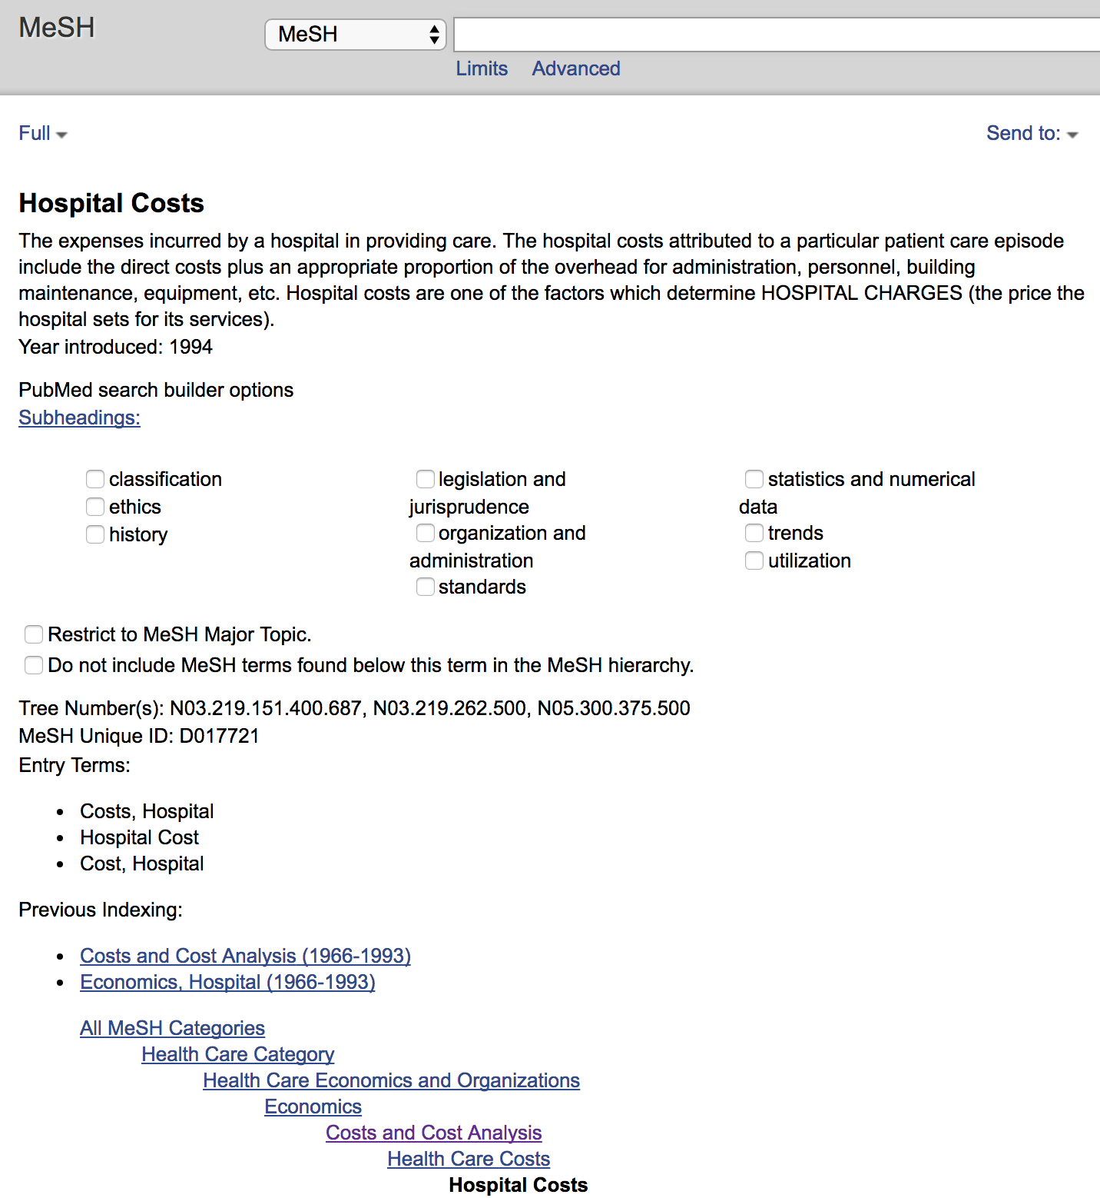
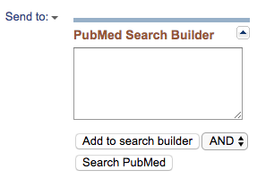
If you want EVERYTHING about your subject all you have to do is :
“Add to search Builder” then
“Search PubMed”
The next screen shows our actions on the dots page.
Notes:
Choosing “Hospital costs” has brought up this screen. There is the term and it’s definition, it entered into the database in 1994. then we have a number of small boxes with terms such as: classification, or ethics or history…I refer to these as “adjectives” as they modify the subject heading, in this case our subject is “Hospital Costs” and we could narrow our subject down to “Hopital costs/ethics” if we were to click on the little box next to ethics. We can choose as many adjectives or subheadings (as the database calls them) as we like. If we want all the articles related to this subject heading, when throwing out a large net...we don’t have to click on any of the small boxes but just (on the right side) click on ”Add to Search Builder” and then ”Search PubMed”.

Slide 15
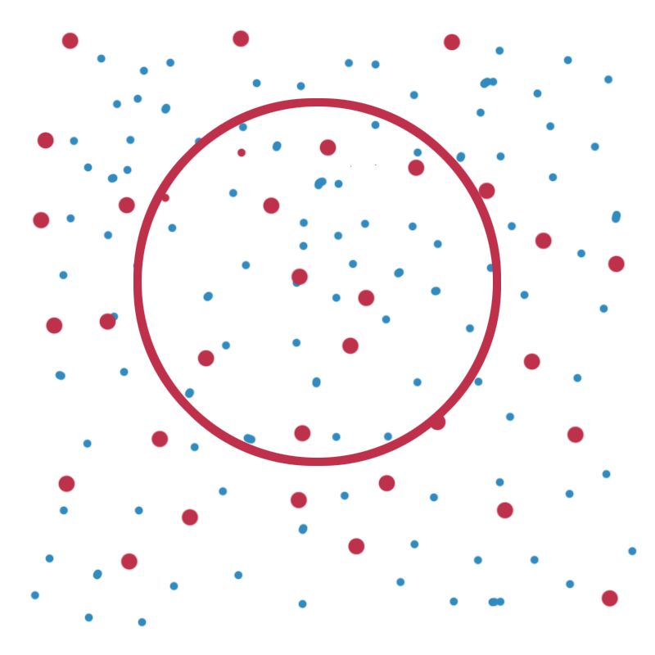
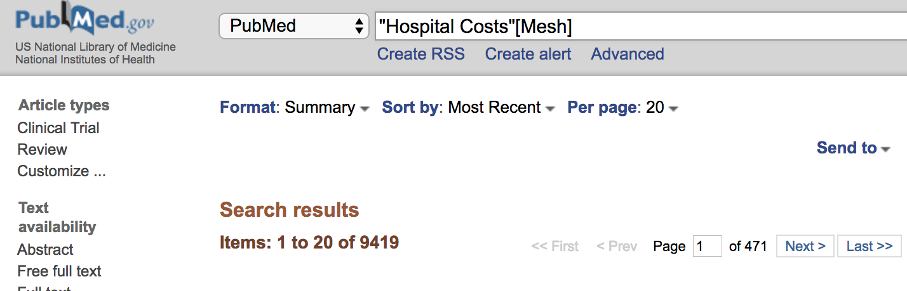
PubMed — MeSH (Medical Subject Headings)
Using PubMed’s-MeSH feature, we will only search for those articles that are tagged or indexed for our subject term, only those inside of the circle, inside of the MeSH circle.
The numbers in the screen shot show how many articles are within the entire MeSH circle/pie.
Hospital Costs
Notes:
Using PubMed’s-MeSH feature, we will only search for those articles that are tagged or indexed for our subject term, only those inside of the circle, inside of the MeSH circle. Here we are showing the results. The numbers show how many articles are in the entire pie… Please draw a circle on your dots page and label it “MeSH”

Slide 16
Click the back arrow until you return to this page:
There are small boxes next to subheadings or adjectives (because they modify the subject).
Using these terms we can make our research more precise and more accurate.
There are 88 different subheadings; there are different possible combinations, not all subject headings and subheading combinations are always applicable.
Notes:
Let’s examine what we see on this page. We have our concept and it’s definition, below that we have our small boxes and subheadings. There are 88 possible subheadings and the database offers optimal combinations as you see here. We don’t see them on this page but “toxicity” and “Abnormalities” are also subheadings. Looking at our subject heading of “Hospital Costs” we can understand why those subheadings don’t show up…they wouldn’t make sense.

Slide 17
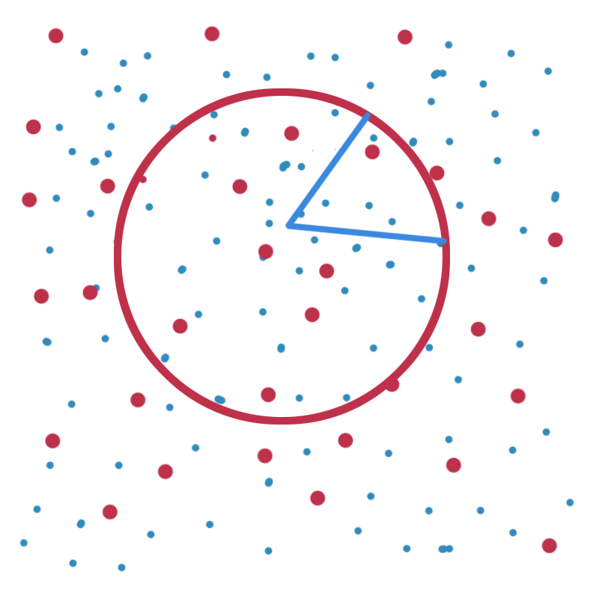
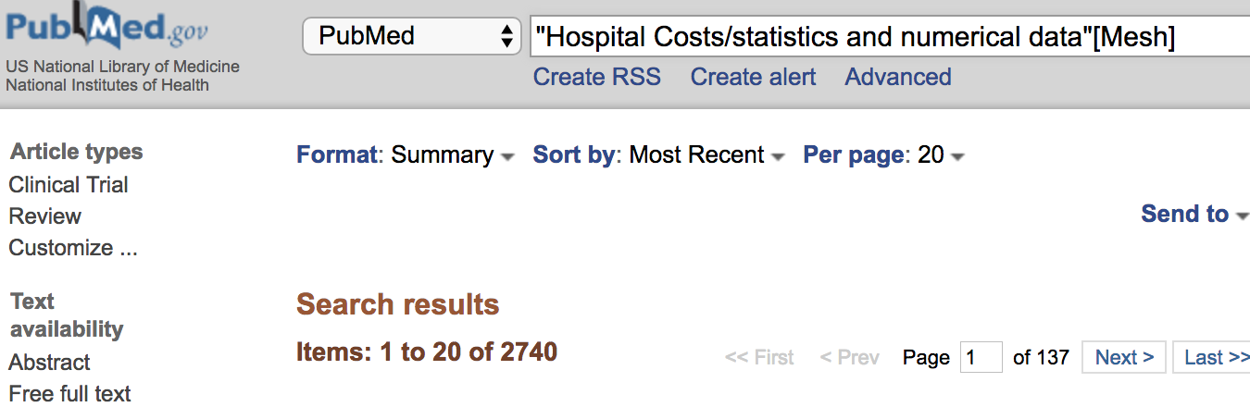
PubMed — Subheading/adjective
Choosing one subheading: “statistics and numerical data” narrows our search to just a piece of the pie. More choices can be made if needed.
Notice our numbers are much less than when we searched the entire circle.
Notes:
When you want to narrow your subject…you can easily do that using the subheadings/adjectives for the subject heading…adjectives describe their subject as they do here…you can make multiple selections by clicking on the box next to the term(s). If you don’t choose any subheadings you will get all the entire pie. But here we have just selected one one piece of pie.

Slide 18
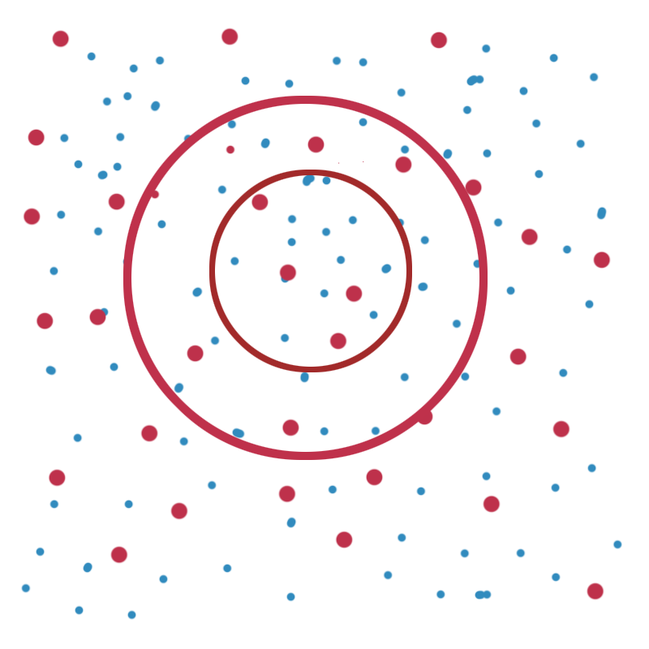
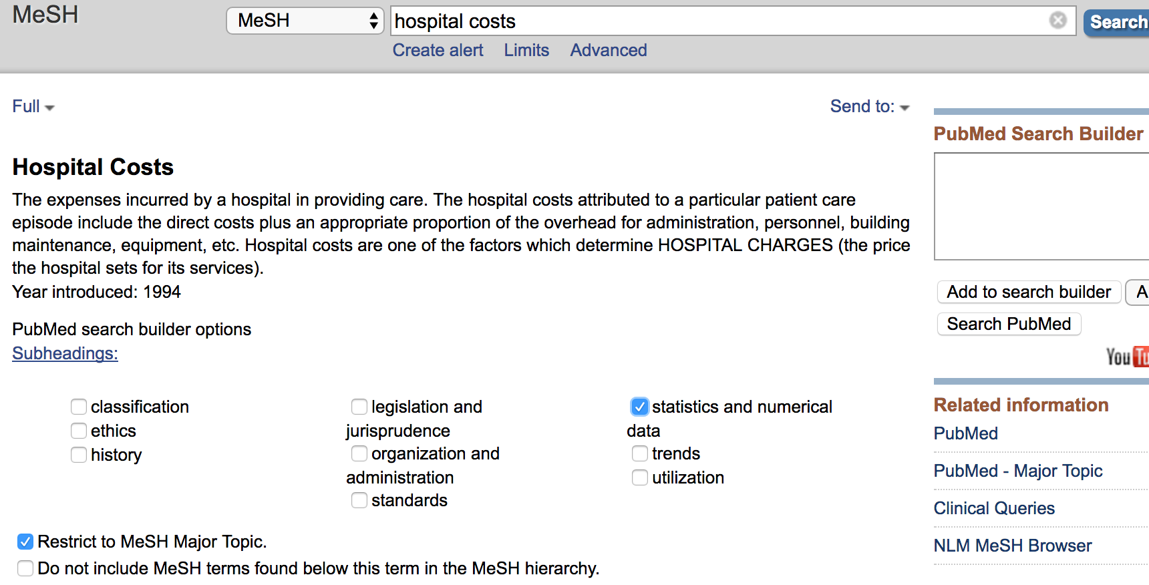
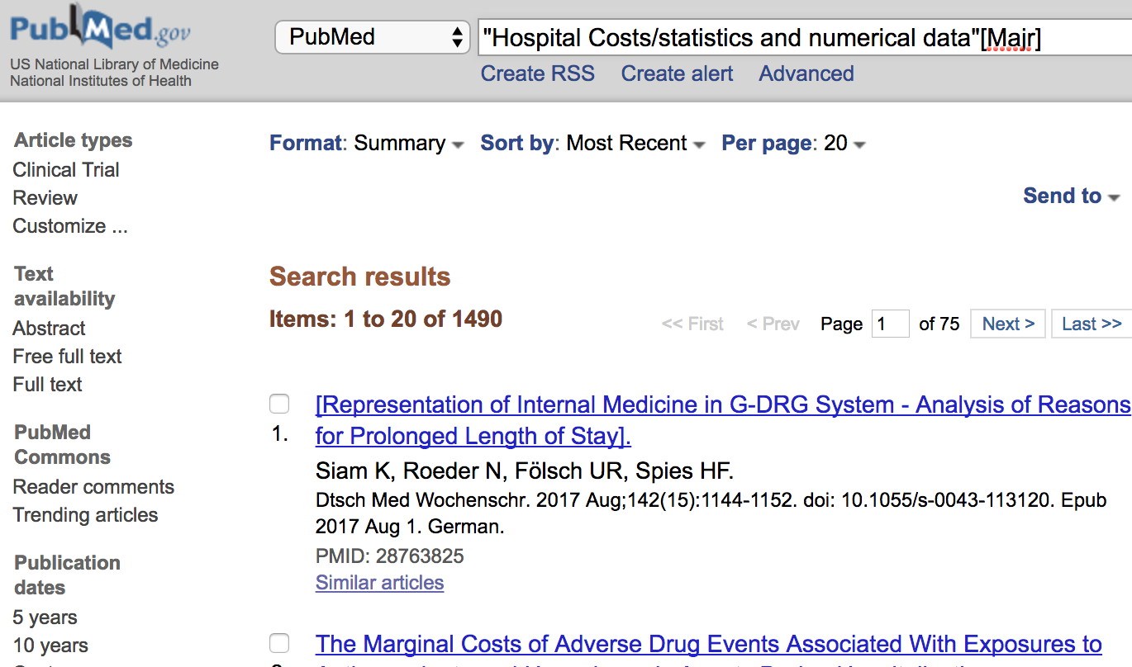
PubMed — Inner Circle = Major
If you want to focus your topic…then select the option “Restrict to MeSH Major Topic.”
As when horses wear blinders to help them focus on the race and not be distracted…
This option will search only the narrower more focused articles found in the inner circle.
Major
Notes:
If you want to focus your topic…then select the option “Restrict to MeSH Major Topic.” As when horses wear blinders to help them focus on the race and not be distracted…this option will search only the narrower more focused articles found in the inner circle.

Slide 19
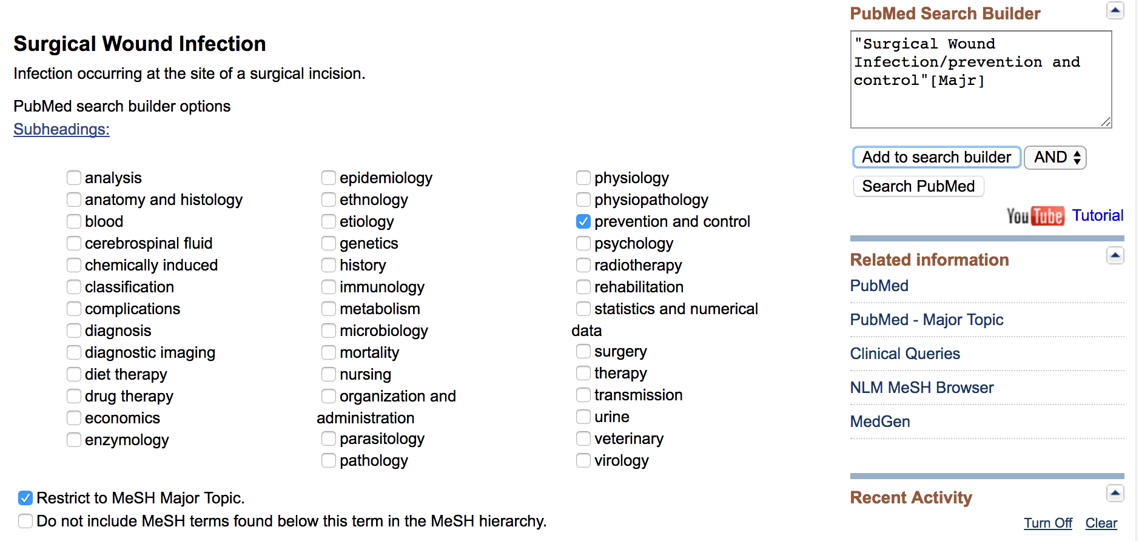
Click on the subheading(s) of interest or if you choose to retrieve all the articles, Then just “Add to Search Builder” on the upper right side.
Here we have chosen a subheadings and also decided to focus our search by choosing “Restrict to MeSH major topic”
Then “Add to Search Builder” and then click on “Search PubMed”
Notes:
Going back to MeSH from the PubMed homepage…we can then type surgical wound infection into the search box. There is an exact match and so you can click on the subject heading. This will be the next screen...it will have subheading options and we also have chosen to Focus by “Restrict to Mesh Major Topic”

Slide 20
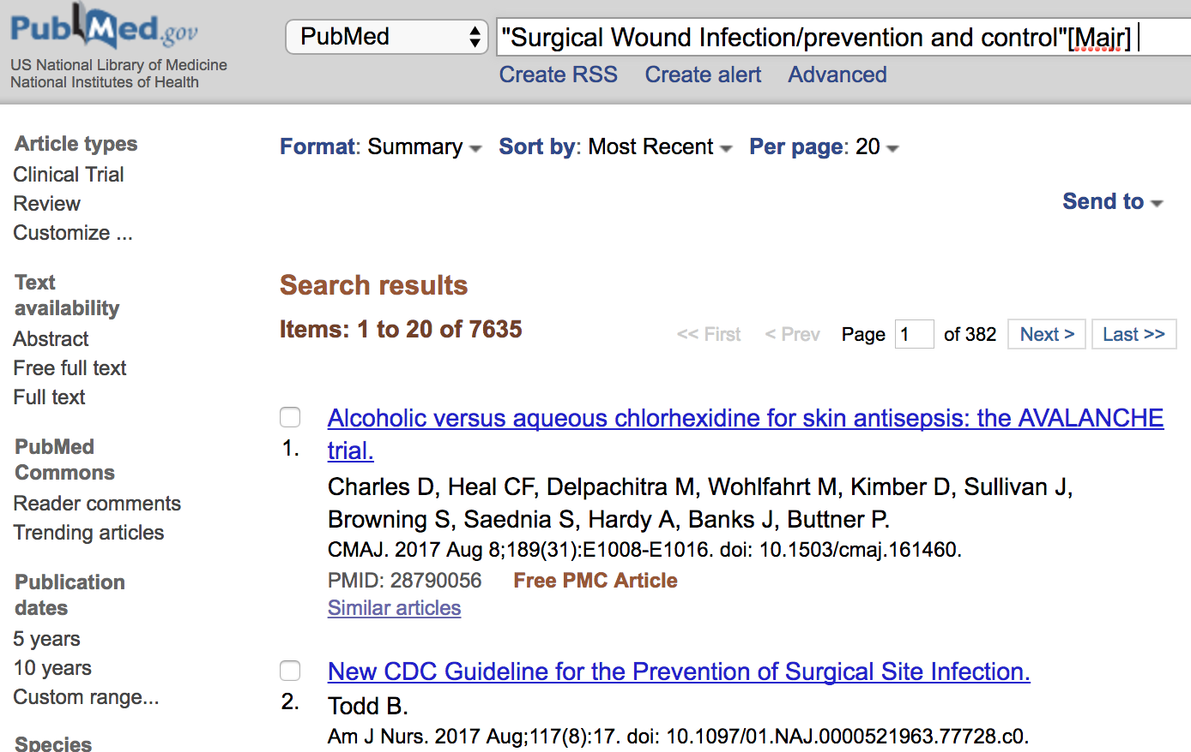
Here the screen shows us that we have retrieved over 7,000 articles
on surgical wound infection prevention

Slide 21
Once you have strategized your concept then you can figure out ways to narrow your topic down.
Typically you may want to combine two or more concepts…
How you combine your concepts will make a difference in results!

Slide 22
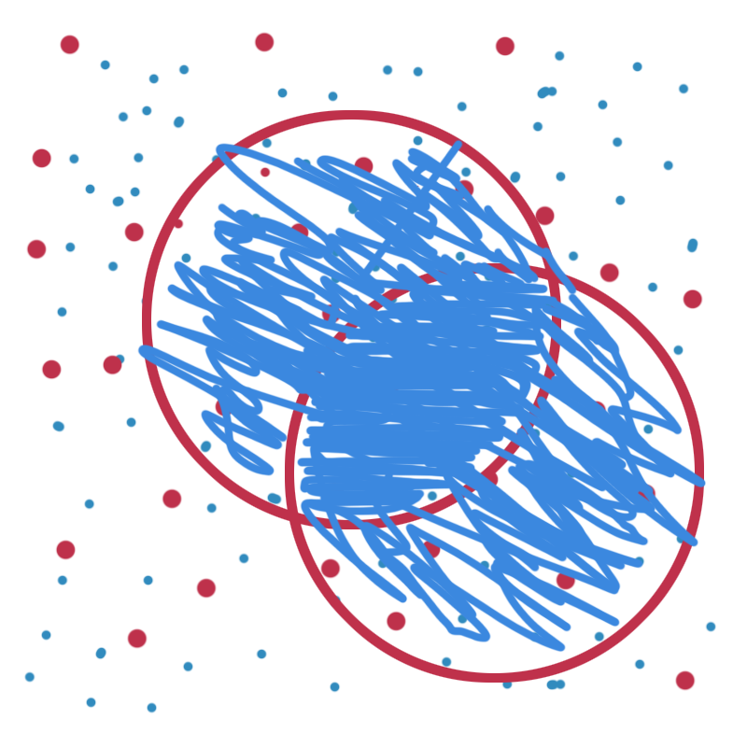
OR
Using the “OR” sometimes called “Boolean OR”…you will get all variations of your concepts, those that deal with one concept “OR” the other “OR” even those citations that have both concepts in the same article. For example, if you had concept A as well as concept B…having overlapping circles…the searcher would get the citations that have “A” concept OR the ones that have “B” concept and even those articles that have both “A” and “B” in the intersection of the circles.
A OR B
Notes:
Using the “OR” sometimes called “Boolean OR”…you will get all variations of your concepts, those that deal with one concept “OR A” the other “OR B” even those citations that have both concepts in the same article. For example, if you had concept A as well as concept B…having overlapping circles…the searcher would get the citations that have “A” concept OR the ones that have “B” concept and even those articles that have both “A” and “B” in the intersection of the circles.

Slide 23
OR
You might be interested in “Either” “Hospital Costs” OR “Ambulatory care”
Hospital costs OR
Ambulatory care
Notes:
Using the “OR” sometimes called “Boolean OR”…you will get all variations of your concepts, those that deal with one concept “OR A” the other “OR B” even those citations that have both concepts in the same article. For example, if you had concept A as well as concept B…having overlapping circles…the searcher would get the citations that have “A” concept OR the ones that have “B” concept and even those articles that have both “A” and “B” in the intersection of the circles.

Slide 24
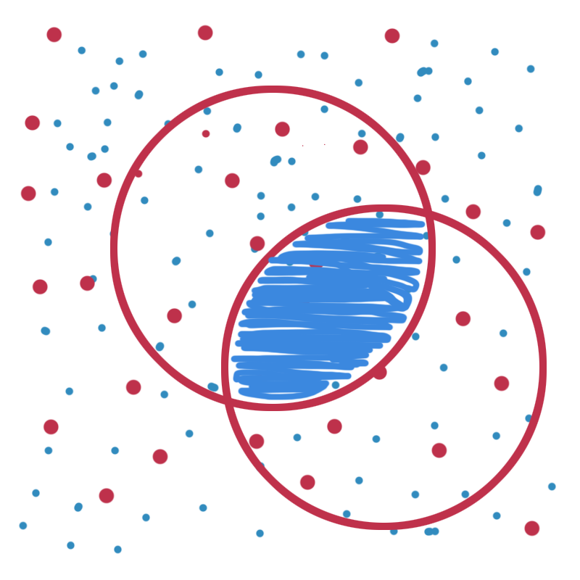
AND
AND will only give you the articles that appear in the overlap area.
“A AND B”
A
A AND B
B
Notes:
However AND will only give you the articles that appear in the overlap area. A AND B

Slide 25
AND
So we have “A” AND “B” and now we want to add a concept: e.g. Surgical Wound infections (the dark Blue circle).
”A” AND “B” AND “C” surgical wound infection
We would retrieve only these articles in orange zig zag area.
This way we can get very specific.
A
A AND B
B
C

Slide 26
So how do you use these skills?
You need to follow on your computer the following steps!

Slide 27
The library homepage is at:
http://www.ttuhsc.edu/libraries
Click on the PubMed Icon:
Start at the library home page>click on the PubMed Icon, then on the next screen …locate the link to MeSH database

Slide 28
Repeat the previous steps that we used to locate articles, this time on “hospital costs.”
Then using the same steps locate articles on “ambulatory care.”
Then locate articles on “surgical wound infection.”
Do these steps one at a time, do not try to combine.
Refer to the earlier slides if you need a refresher.

Slide 29
After you have searched for all three concepts…on the PubMed Homepage click on “ADVANCED

Slide 30
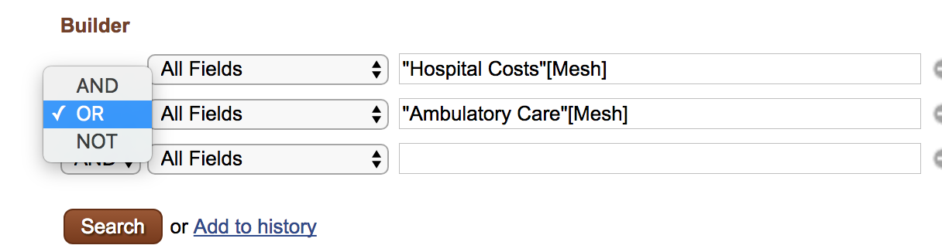
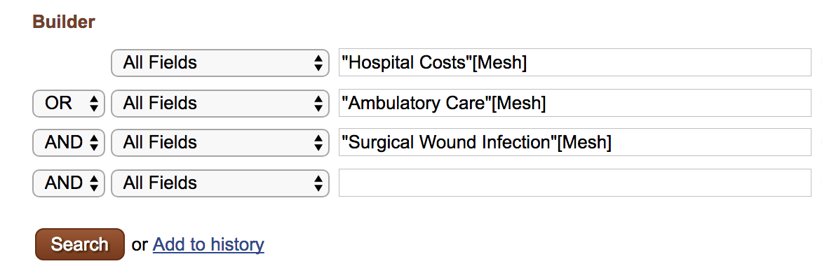
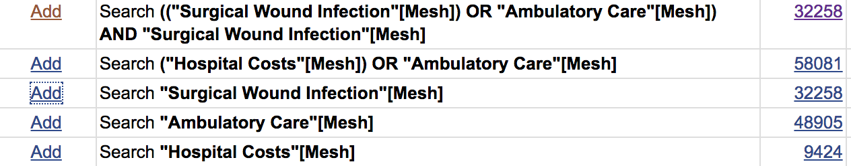
1)
“ADD” the terms you want to combine, start with the concepts that are to be “ORed”
Then “ADD” the concept to be “ANDed” and then “SEARCH” using the red button.
2)
Here are the results!

Slide 31
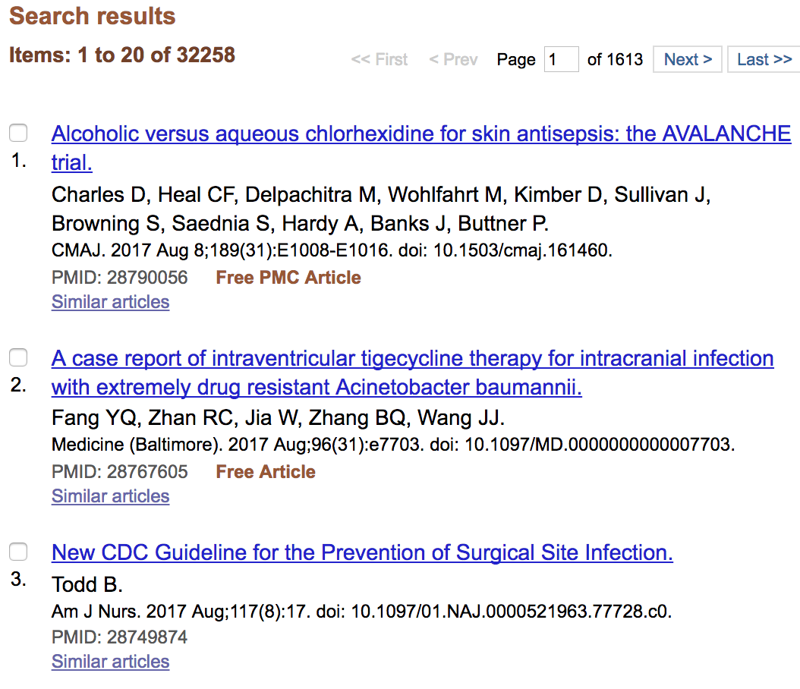
This is strategy…and the results will look something like this:
These are too many results to be effective and efficient. You may want to stop the video and research… this time using subheadings and possibly focusing your topic.

Slide 32
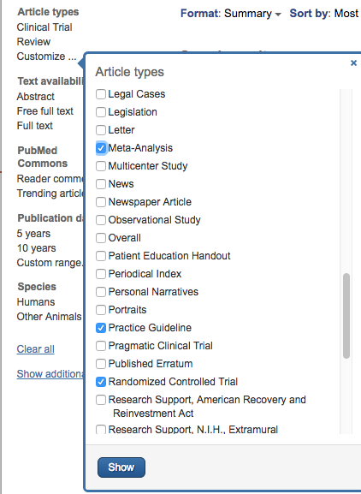
In the upper left corner…
LOCATE: “Article Types”
Select ”CUSTOMIZE”
Then select:
Guideline
Meta-analysis
Practice Guideline
Randomized controlled trials
Then click on the Blue “SHOW” button
The results do not change until you activate the filter(s).

Slide 33
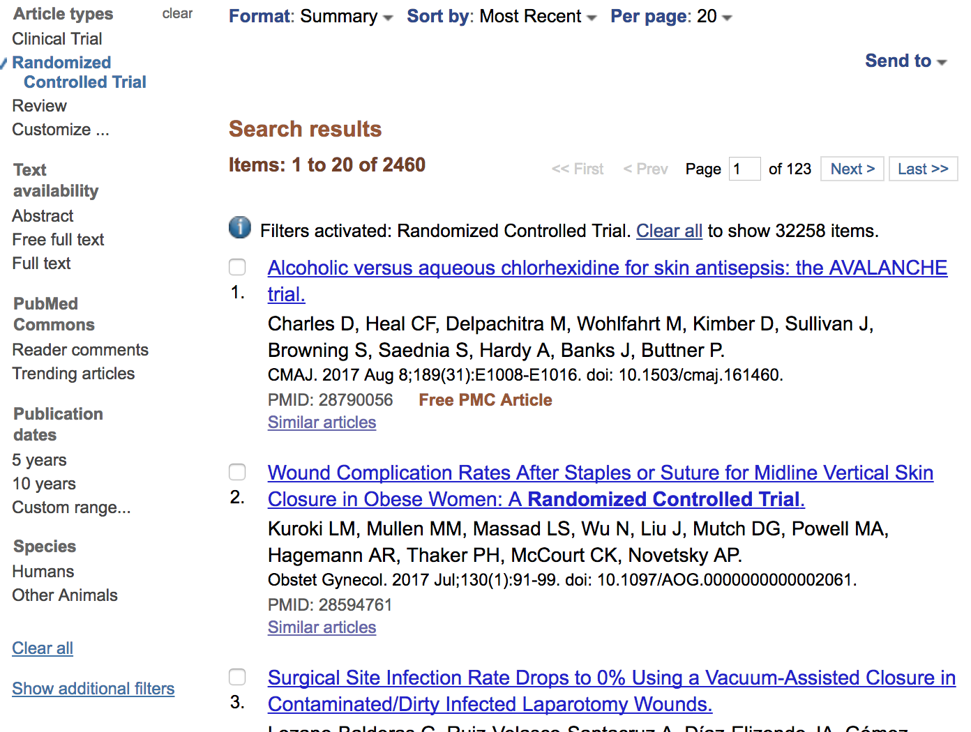

The filters are activated when you click on them. Here we see some of the results where RCTs have been activated.
When you change format to “ABSTRACT”
you will be able to see the
abstract and links to full-text

Slide 34
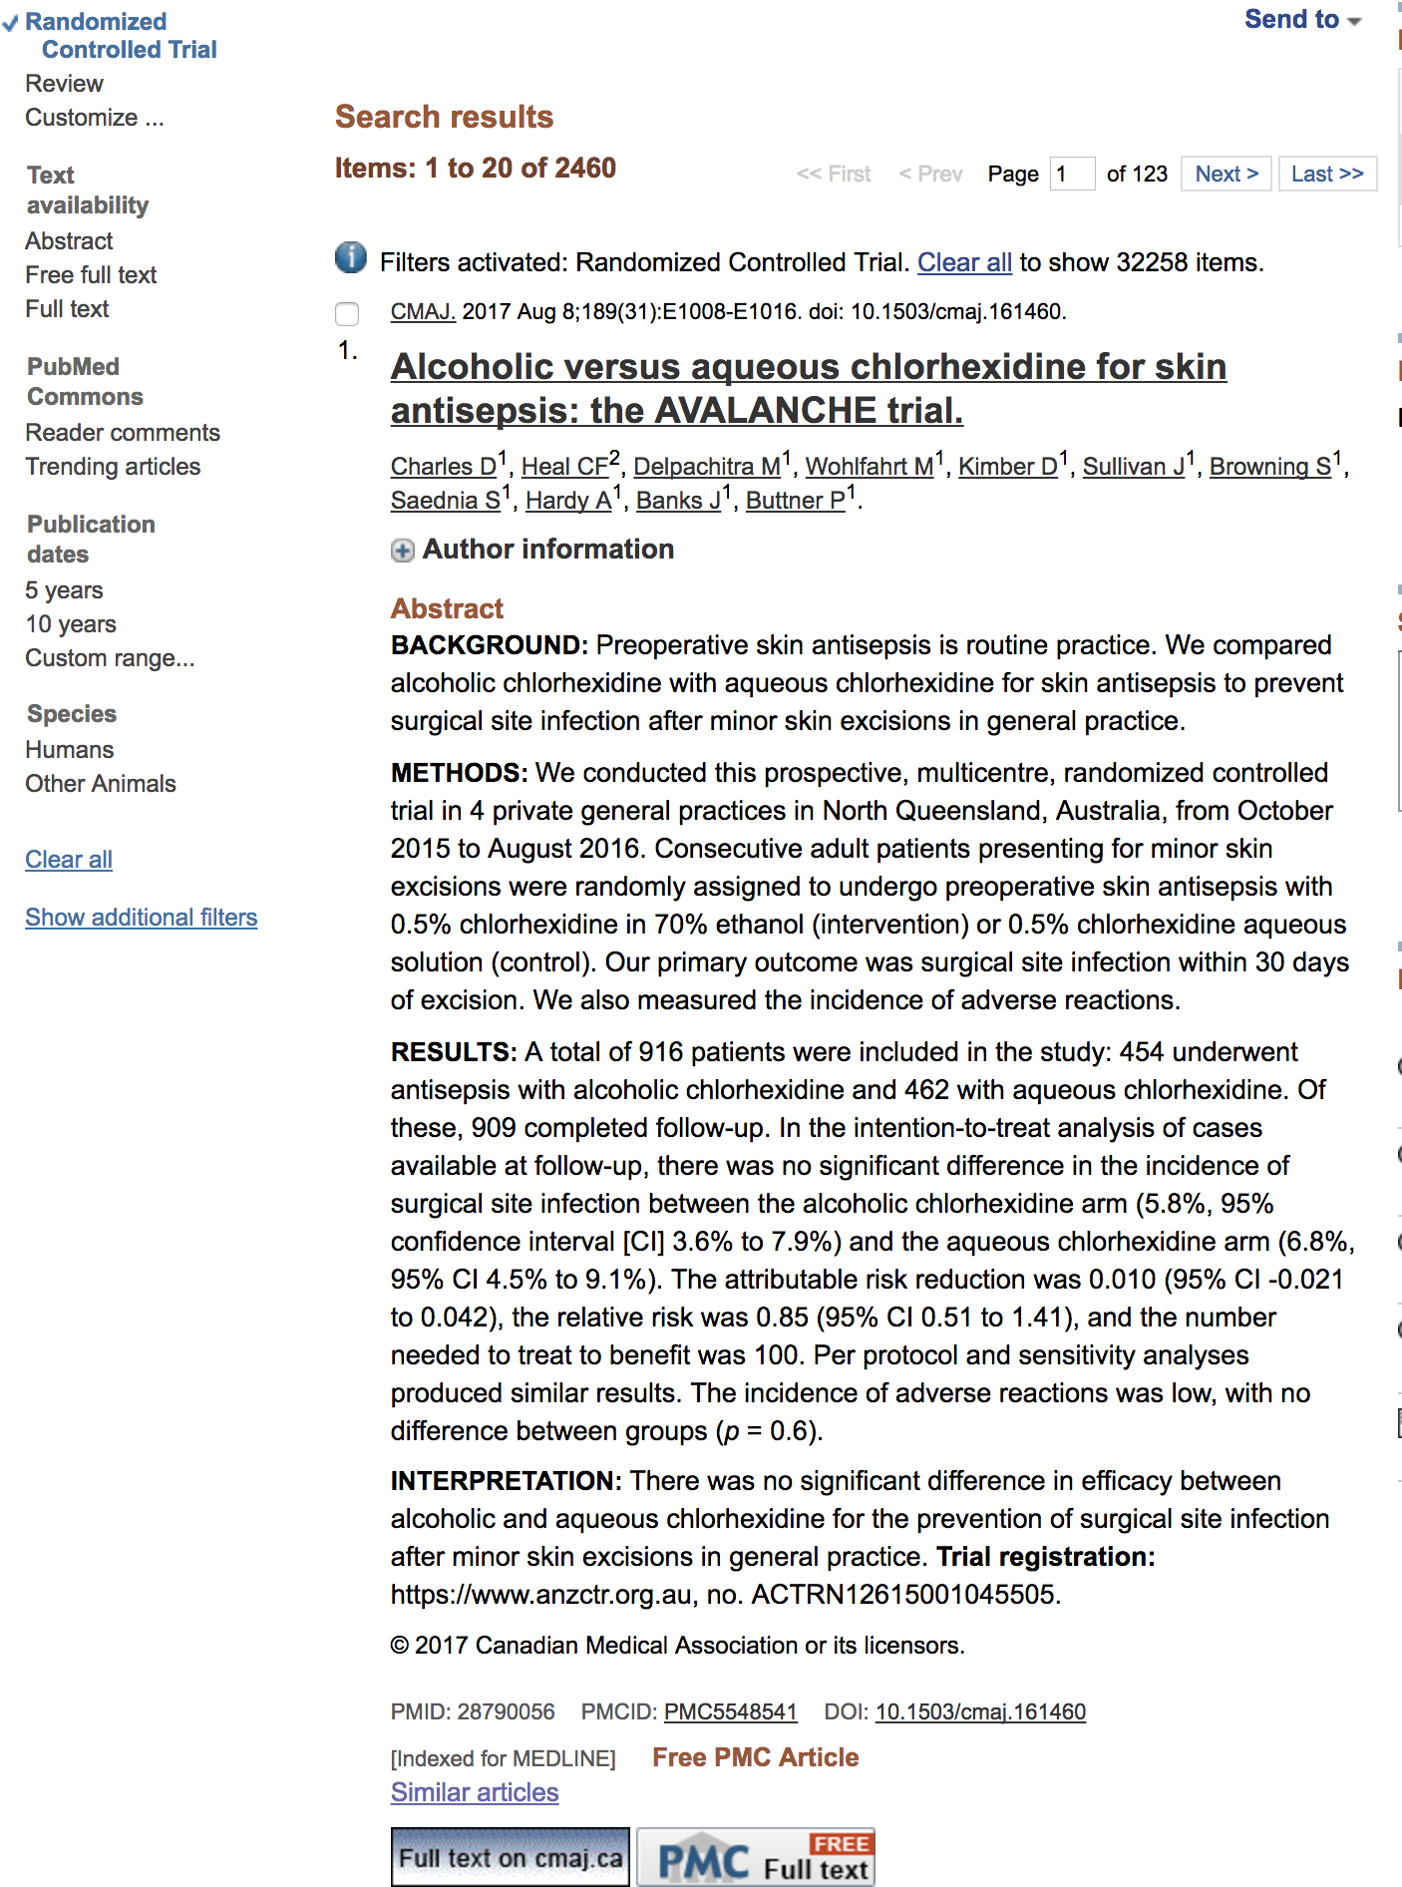

Slide 35
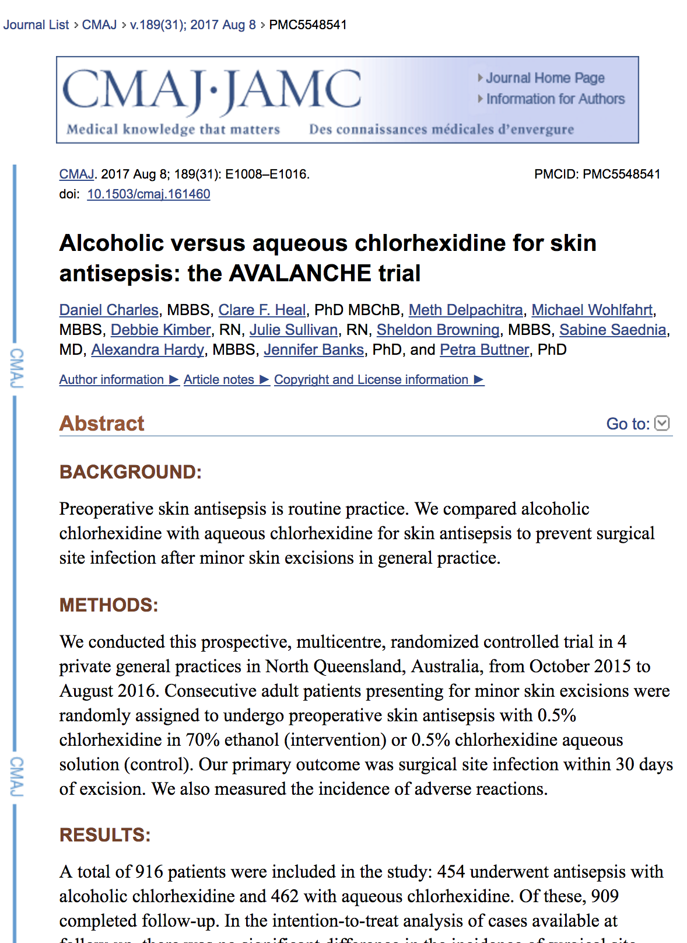

Slide 36
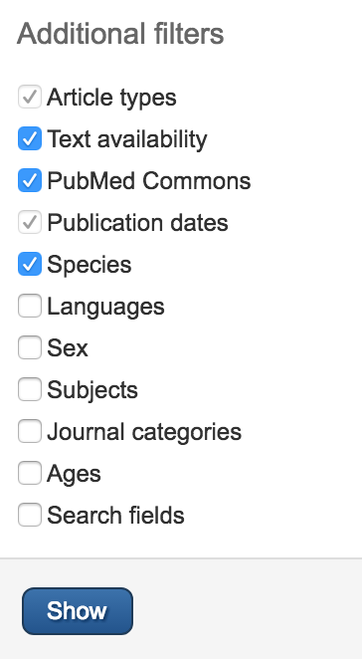
There are additional filters that can be applied…just click on the ”Show additional filters” on the PubMed page, click on ”SHOW” and then Activate by clicking on the filters of your choice.

Slide 37
What other information does the article help you with?
Lists of indexing terms (MeSH) terms that can be used for refining your search!

Slide 38
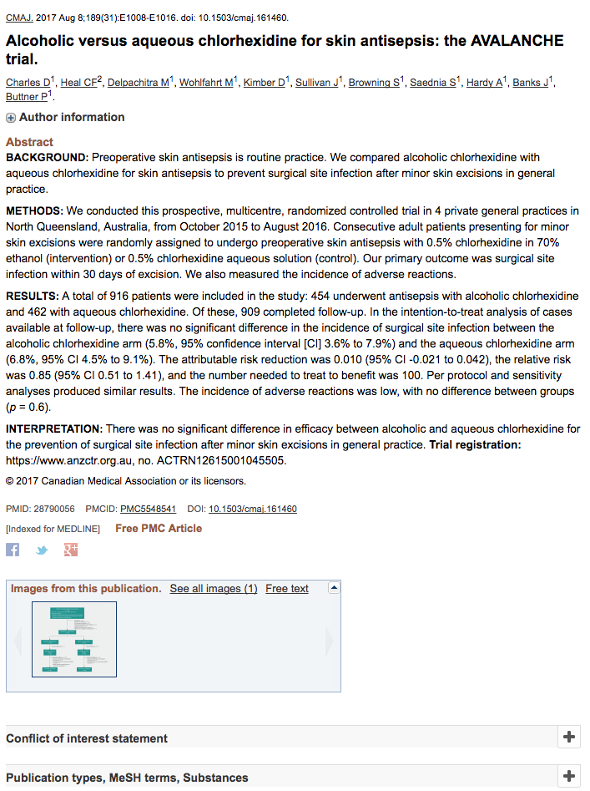
Click on the MeSH terms which you will find under the full citation of most of your articles. When you click on that it will show you the headings that have been used to tag this article. See the next slide.

Slide 39
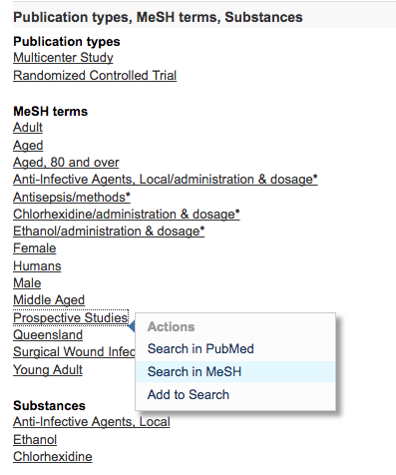
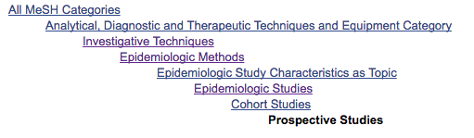
Here are the MeSH headings for the article that was just located. When you click on a individual heading it will give you a number of options. When you choose the option to “Search in MeSH” you will find more information on the term.
Indexers index to the most specific term, so you may consider choosing this term or in this case broadening by choosing higher level terms and “AND”ing with your other subject headings.

Slide 40
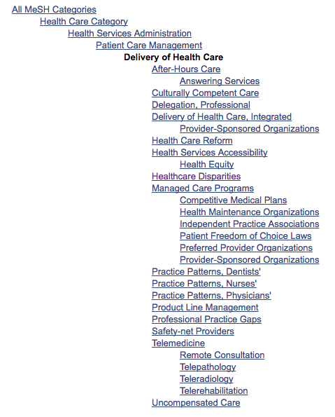
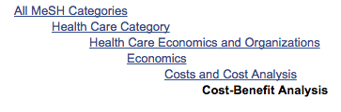
Now that you know how to manipulate the database…you can locate other MeSH subject headings to assist with your research. Here are a few examples:
c

Slide 41
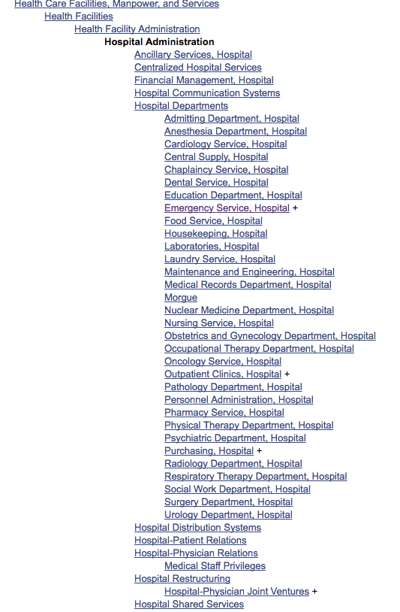
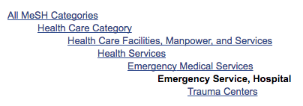
On this screen I have located the subject heading “Hospital Administration.”
Looking for broad terms often gives you a list as you see here and then you can choose the more specific term or stay with the broader entry term as you refine your research results.

Slide 42
Before you search… play the matching game!

Slide 43
Enter your question here…
Subject
_____________________
_____________________
_____________________
_____________________
_____________________
_____________________
SH subheading
Filter
These are pieces that you have to work with.
Filters will be types of articles, or age of patient, language etc.

Slide 44
Review articles on the prevention of knee injuries in female adolescent soccer players.
Subject
_____review__________
_____prevention_______
____knee injuries______
_____female__________
___adolescent_________
____soccer players_____
SH subheading
Filter
This is a matching game!
Here is an example!
I always suggest that all the subject terms are searched before any filters are applied.

Slide 45
Enter your question here…
Subject
_____________________
_____________________
_____________________
_____________________
_____________________
_____________________
SH subheading
Create this on a sheet of paper
Filter

Slide 46
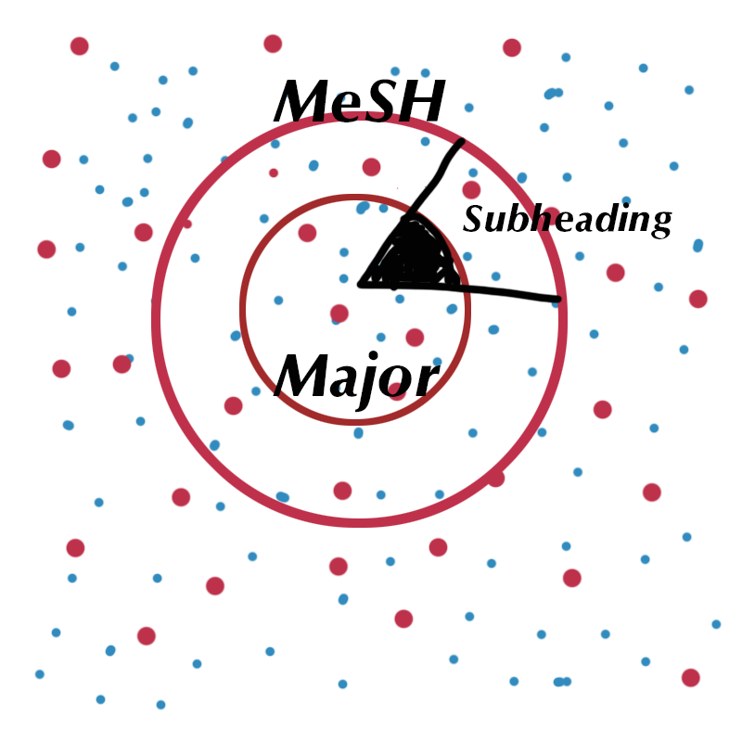
Now…it’s your turn!
Take another sheet of paper and create a picture with circles and triangles “AND”s and “OR”s how you would search for this topic: Locate articles that speak to the topic of delivery and organization of health care and methods to improve its quality.

Slide 47
Thank you!
If you have any questions please contact Margaret Vugrin at
margaret.vugrin@ttuhsc.edu or 806-743-2241

