Slide 1
Welcome
PubMed’s Clinical Queries
Peggy Edwards, AMLS
TTUHSC - Preston Smith Library
Lubbock, Texas 79430
April 2015

Slide 2



PubMed Database
Biomedical and life sciences journal literature
International scope
Developed and maintained by the:
National Center for Biotechnology Information
    at the U.S. National Library of Medicine
    at the National Institutes of Health

Slide 3

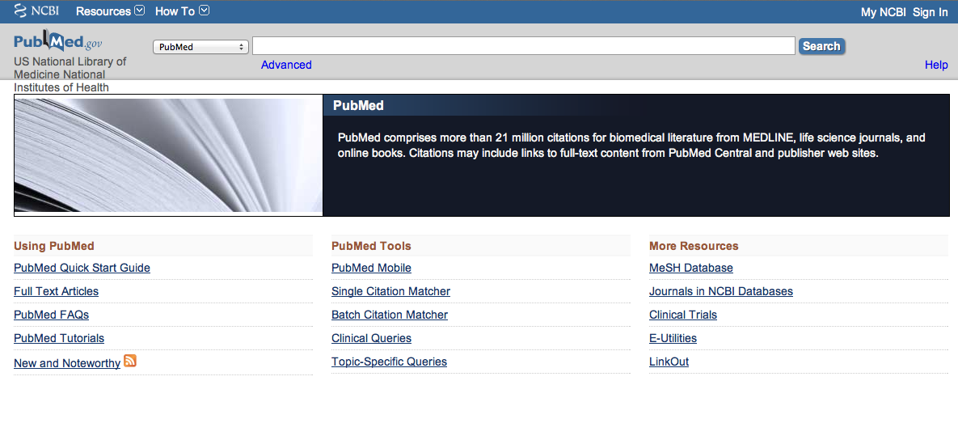
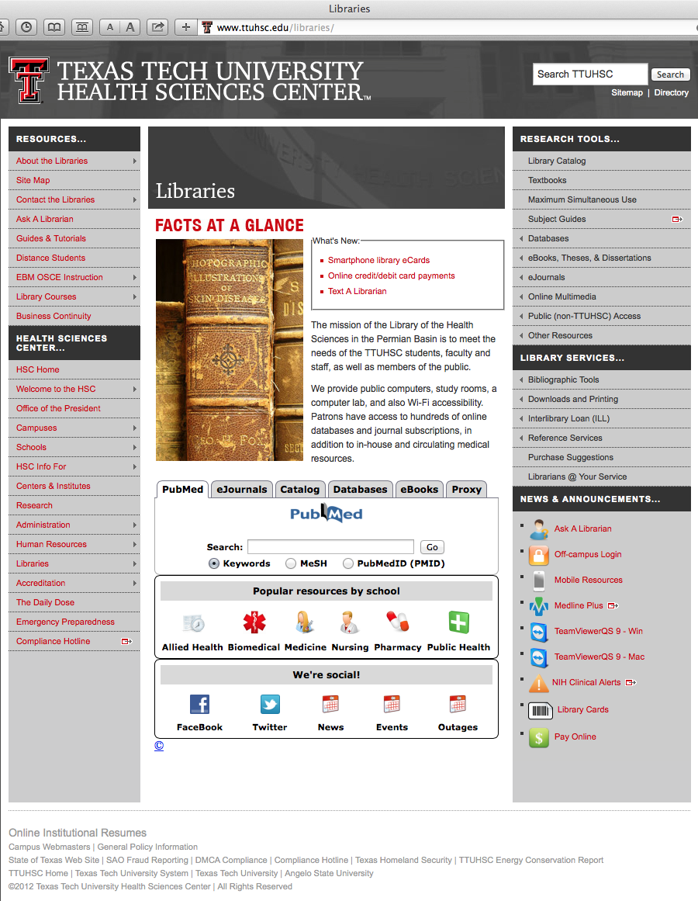
Accessing PubMed
Freely available over the Internet
@ www.pubmed.gov
Also through library’s home page

Slide 4
EBP Literature from
PubMed’s Clinical Queries

Slide 5


Evidence-Based Practice is guided by thoughtful integration
of the best available scientific knowledge with clinical expertise.

Slide 6
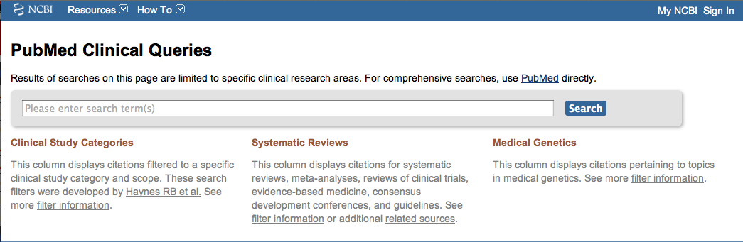
PubMed’s Clinical Queries
tool that searches for evidence-based literature

Slide 7



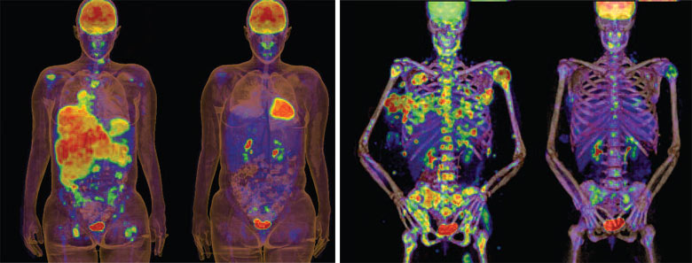
Clinical Queries Searchable by:
Diagnosis
Therapy
Prognosis (prediction of probable outcome)
Etiology (cause)

Slide 8
Clinical Queries Searchable by:
Diagnosis
Therapy
Prognosis (prediction of probable outcome)
Etiology (cause)

Slide 9
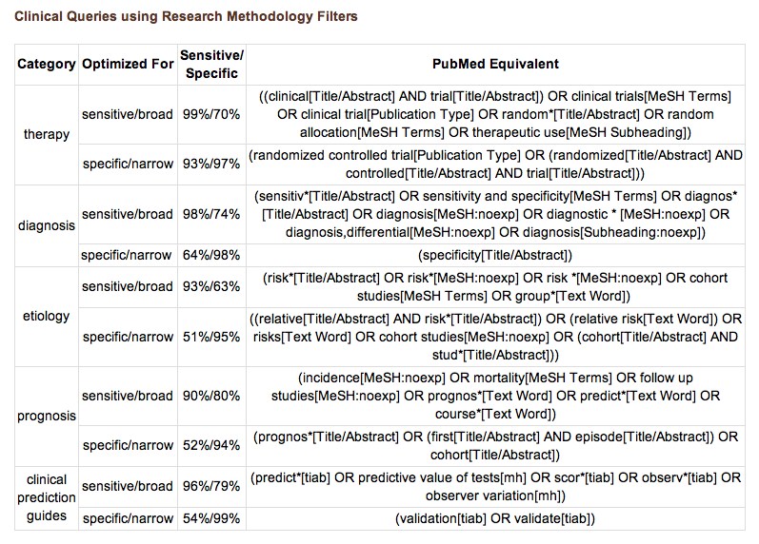
PubMed’s Clinical Queries
uses pre-formulated search strategies with a keyword search

Slide 10
To begin...

Slide 11
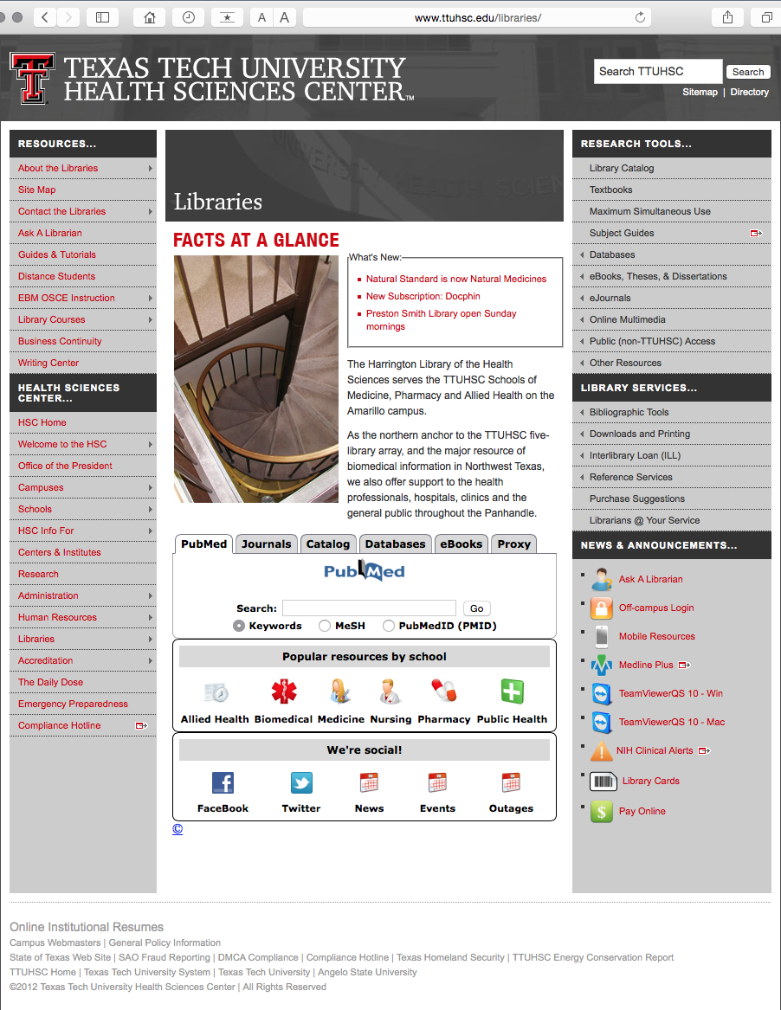
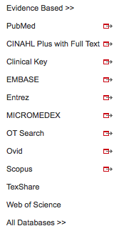
PubMed’s Clinical Queries
www.ttuhsc.edu/libraries
Mouse over Databases
Click PubMed

Slide 12
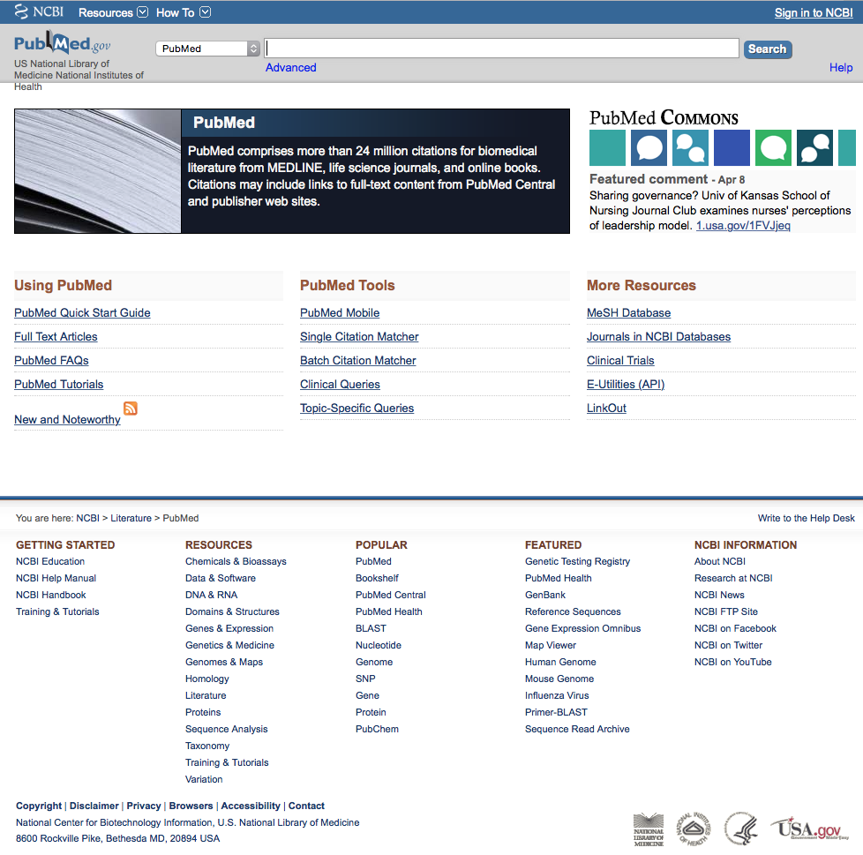
PubMed Home Page

Slide 13
Click Clinical Queries

Slide 14
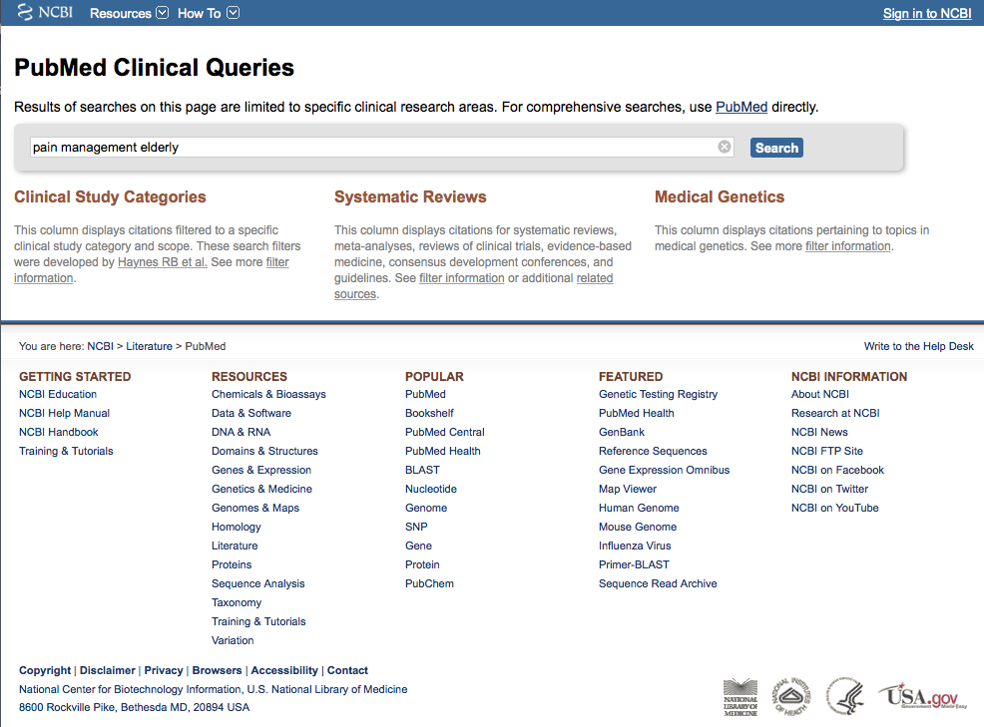
Enter pain management elderly
Click
Search

Slide 15
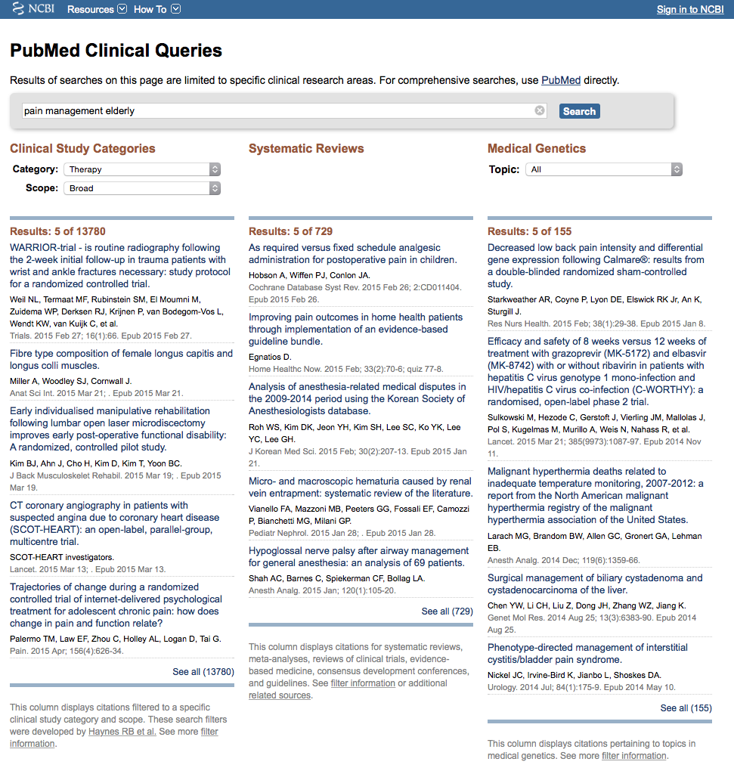
Change to Narrow Scope
Results for Therapy and
Broad Scope

Slide 16
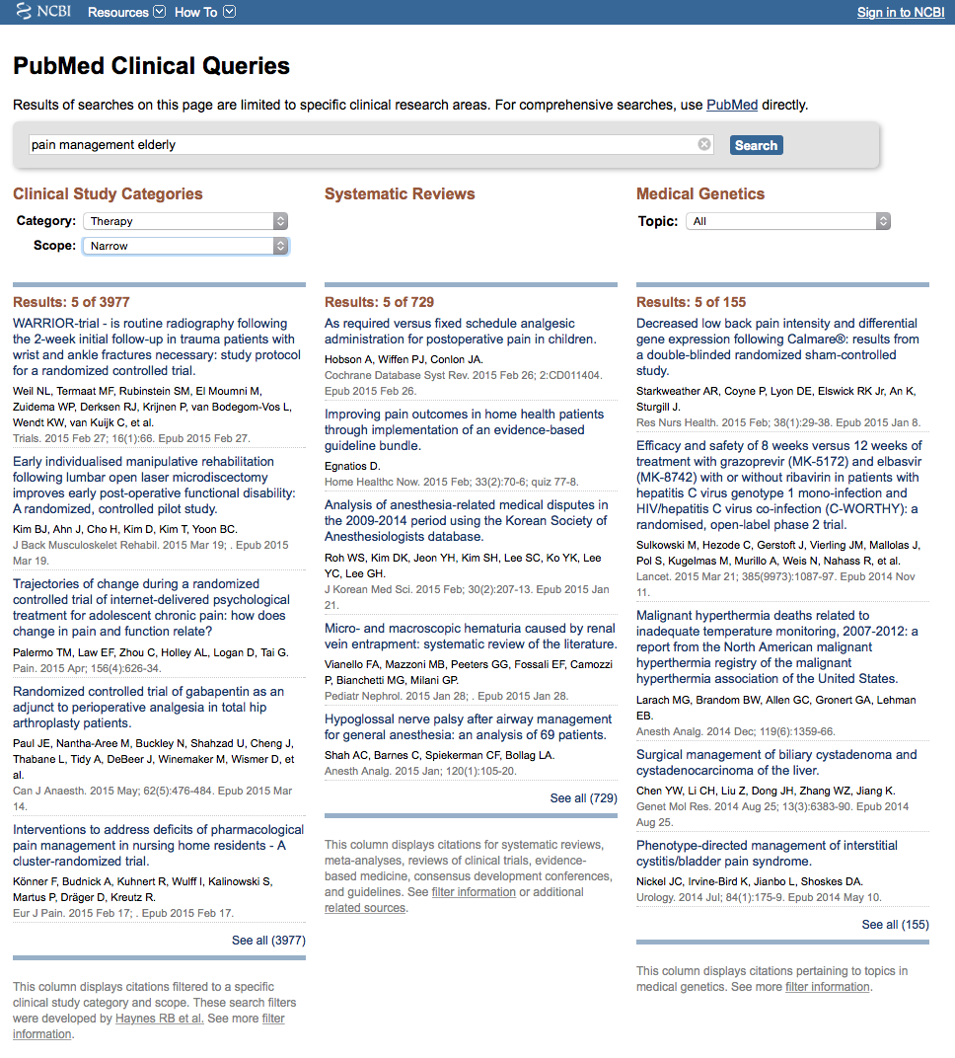
Results for Therapy and
Narrow Scope
Click See all (3977)

Slide 17
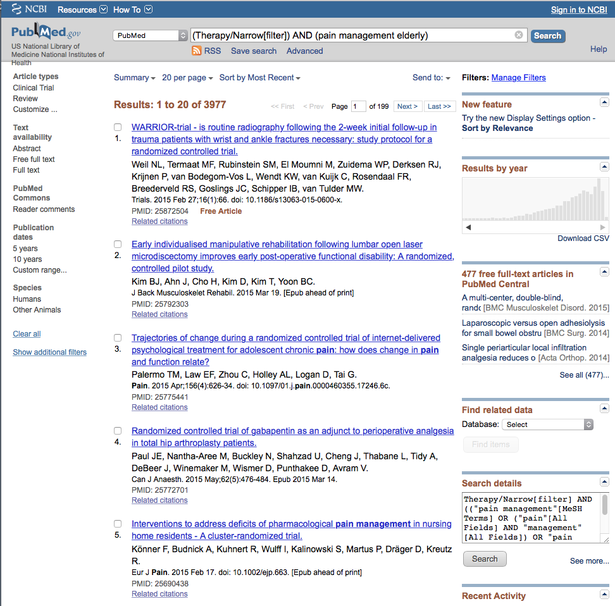
Select filters to narrow
Click Humans to select

Slide 18
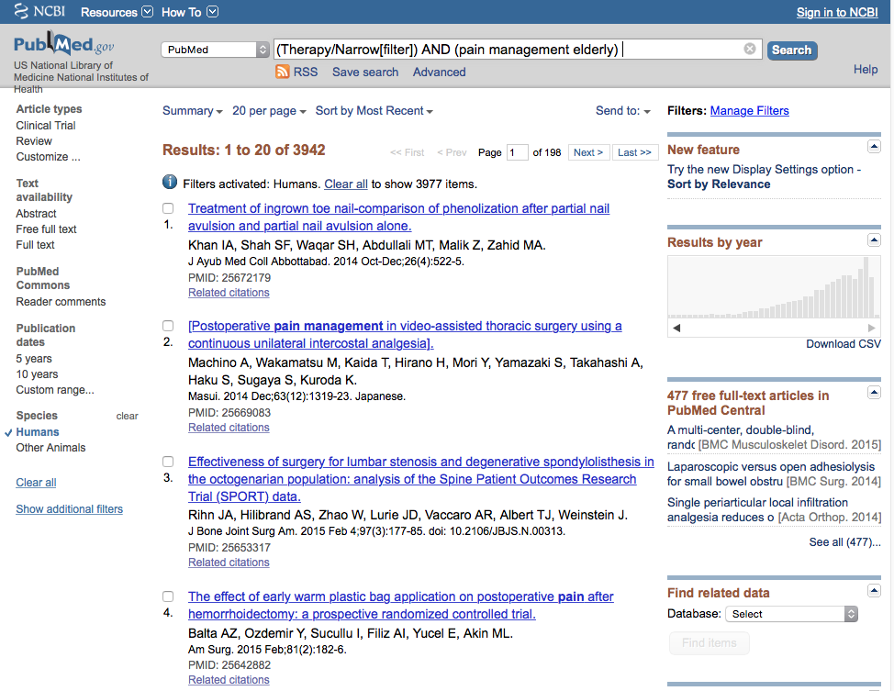
Selections will turn blue: ✓ Humans

Slide 19
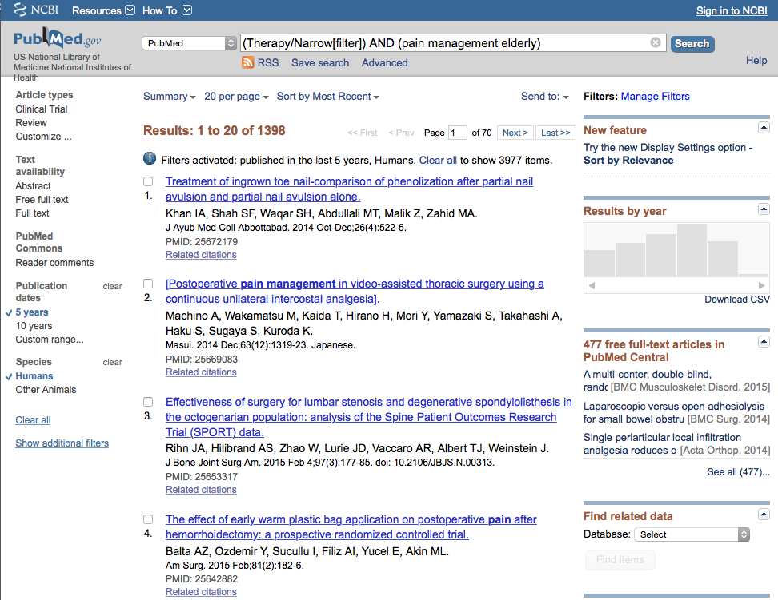
Click 5 years to limit

Slide 20
Click Show additional filters

Slide 21
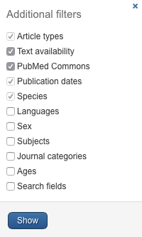
Select
Languages
Journal Categories
✔
✔
Click Show

Slide 22
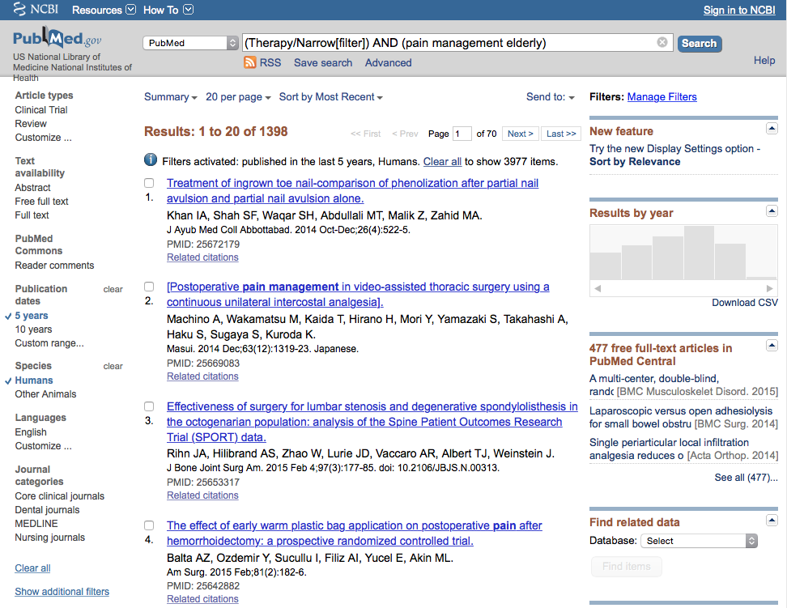
Click English
Click Nursing Journals

Slide 23
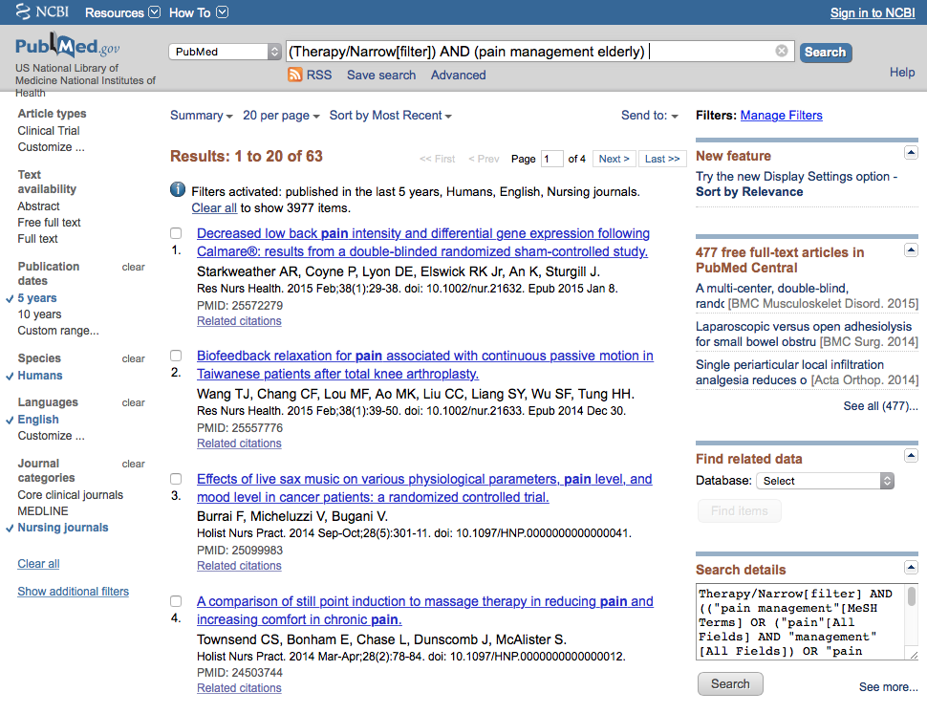
Selections turn blue: ✓ English, Nursing journals

Slide 24
Results have narrowed to 63
Click on the title of the article you wish to read

Slide 25
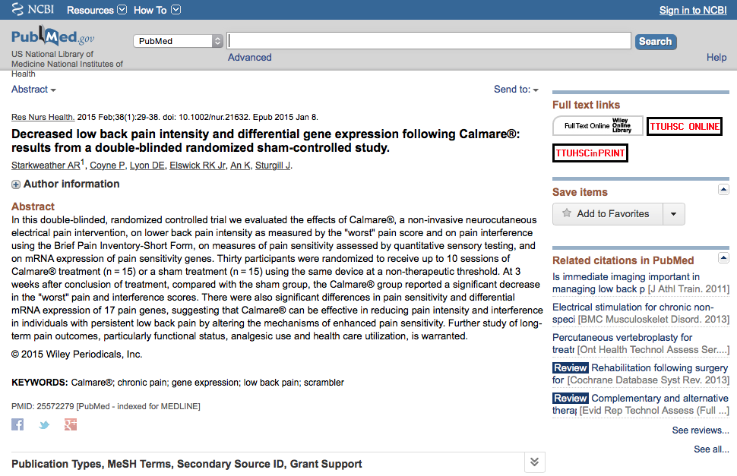
Click for Free Full Text
TTUHSC ONLINE

Slide 26
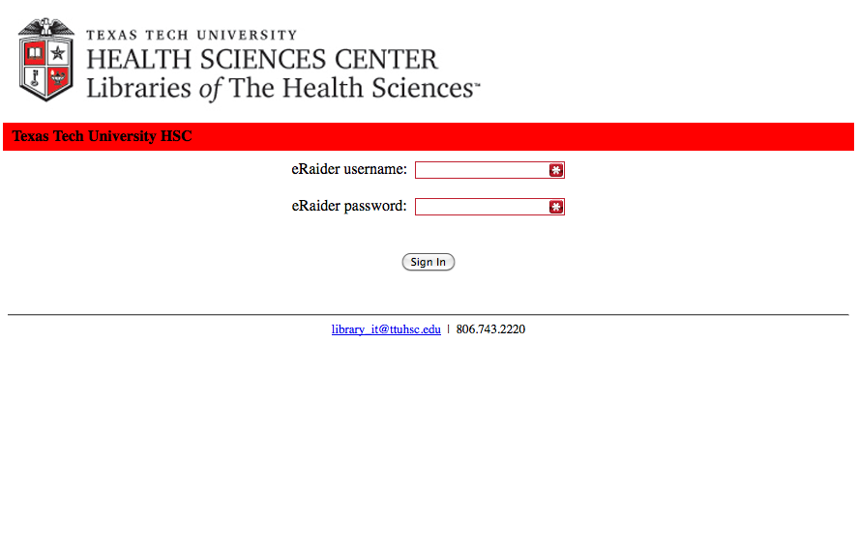
TTUHSC Libraries - Proxy Server
When Searching from Off Campus:
Enter the
Eraider username and password
assigned to you
by Information Services.
Problems with eRaider call: 806-743-1234
a

Slide 27
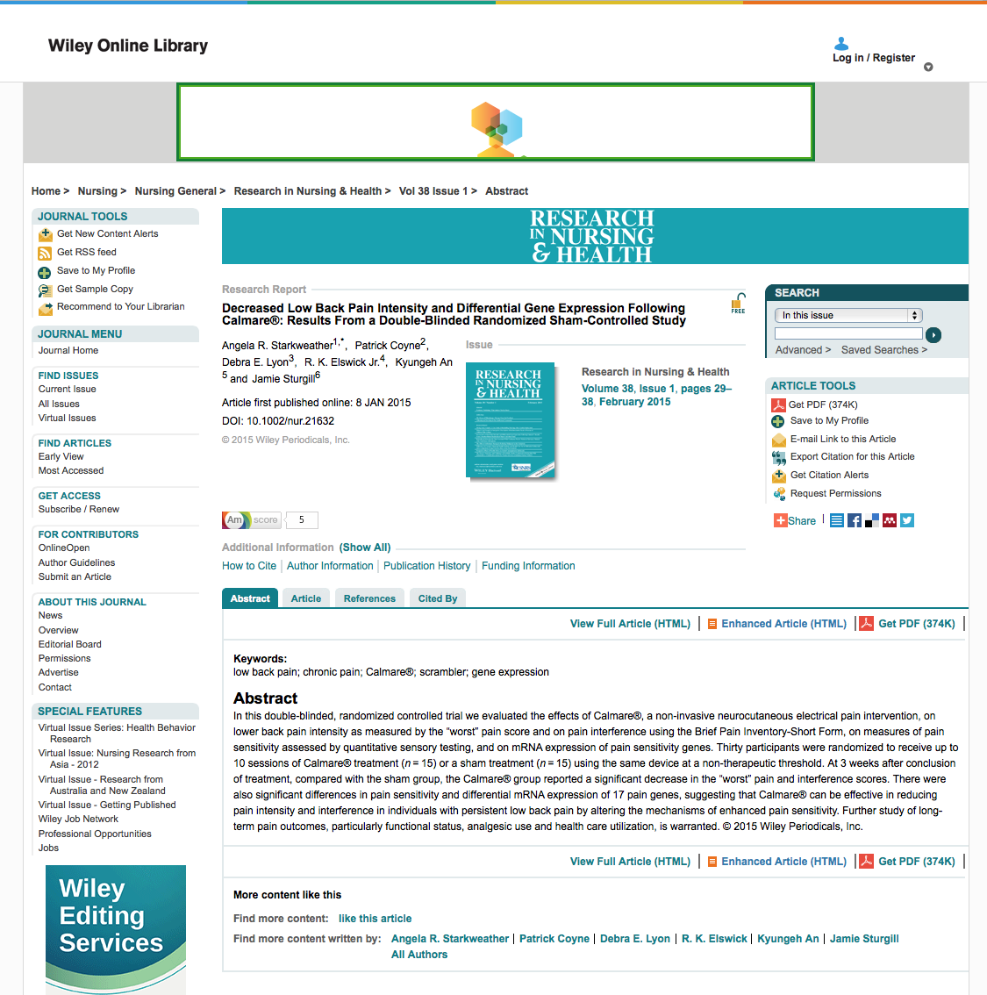

Click

Slide 28
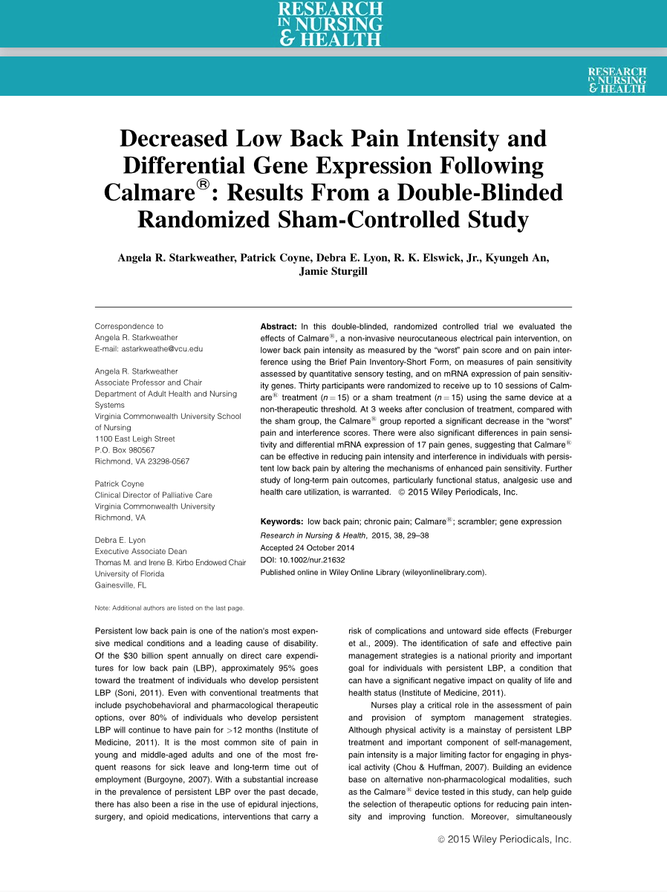
Full Text

Slide 29
Have Questions
or
Need Help?

Slide 30
Click Training & Tutorials for hands-on learning.

Slide 31

or contact us at:
Lubbock
(806) 743-2200
Amarillo
(806) 354-5448
El Paso
(915) 545-6652
Odessa
(432) 335-5171

Slide 32
www.ttuhsc.edu/libraries
Ask-A-Librarian

Slide 33
The End

