Slide 1
TTUHSC Preston Smith Library
presents
How to Search PubMed®
Information for Doctor of Nursing Practice
Rev. 11/09/12

Slide 2
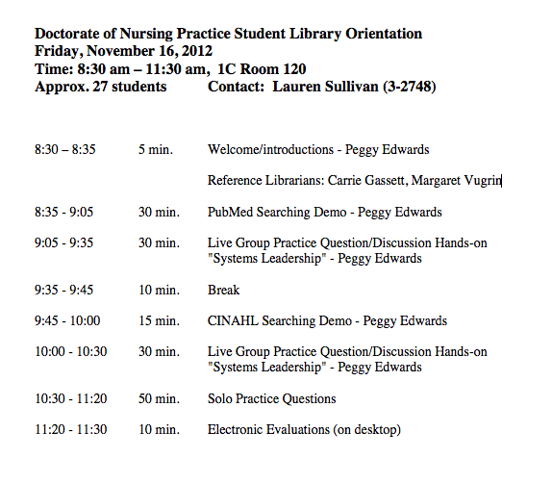

Slide 3
To begin...

Slide 4
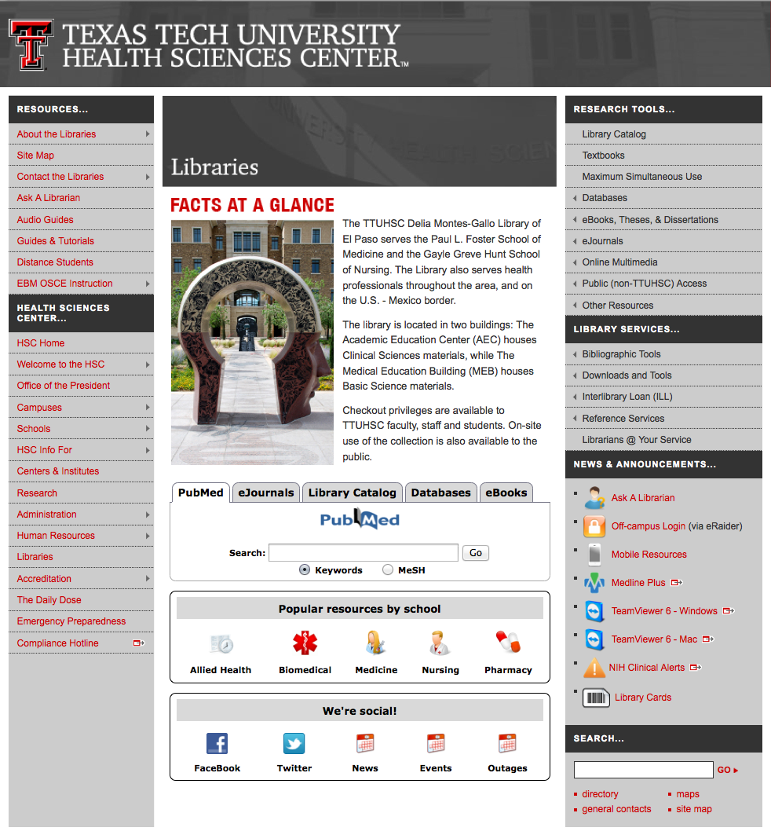
Hover-over Databases

Slide 5
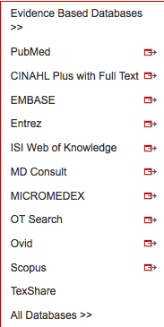
Click PubMed

Slide 6
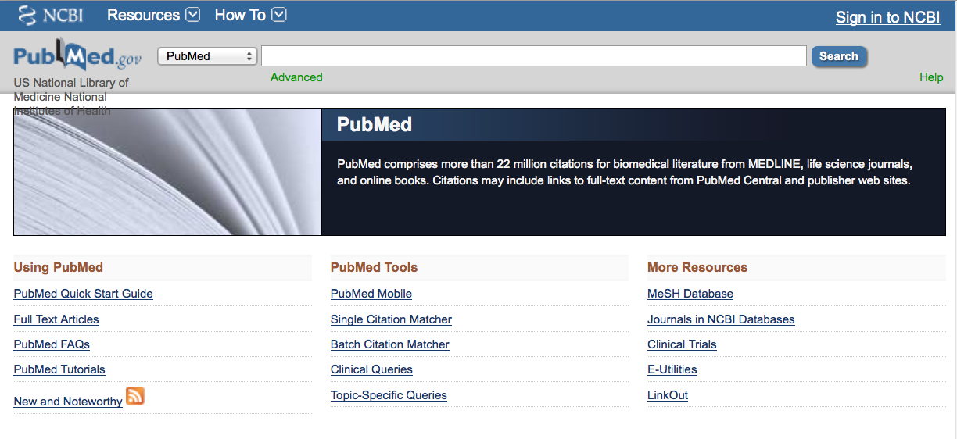
PubMed Home Page

Slide 7
Searching PubMed

Slide 8
Click MeSH Database

Slide 9
MeSH Database
Terms in the database are called
Medical Subject Headings or MeSH.
is a “controlled vocabulary list” of more than
25,000 subject headings.
10-15 MeSH are assigned to each article
in PubMed.
The MeSH index of 10-15 subject headings
is like a keyword abstract of the article.
MeSH are updated annually in December.

Slide 10
Frequently Used Mesh Categories – 2011
A Anatomy
C Diseases
D Chemicals & Drugs
A1 Body Regions
A2 Musculoskeletal System
A3 Digestive System
A4 Respiratory System
A5 Urogenital System
A6 Endocrine System
A7 Cardiovascular System
A8 Nervous System
A9 Sense Organs
A10 Tissues
A11 Cells
A12 Fluids and Secretions
A13 Animal Structures
A14 Stomatognathic System
A15 Hemic and Immune Systems
A16 Embryonic Structures
A17 Integumentary System
A18 Plant Structures
A19 Fungal Structures
A20 Bacterial Structures
A21 Viral Structures
C1 Bacterial Infections & Mycoses
C2 Virus Diseases
C3 Parasitic Diseases
C4 Neoplasms
C5 Musculoskeletal Diseases
C6 Digestive System Diseases
C7 Stomatognathic Diseases
C8 Respiratory Tract Diseases
C9 Otorhinolaryngologic Diseases
C10 Nervous System Diseases
C11 Eye Diseases
C12 Male Urogenital Diseases
C13 Female Urogenital Diseases
& Pregnancy Complications
C14 Cardiovascular Diseases
C15 Hemic & Lymphatic Diseases
C16 Congenital, Hereditary, &
Neonatal Diseases & Abnormalities
C17 Skin & Connective Tissue Diseases
C18 Nutritional & Metabolic Diseases
C19 Endocrine System Diseases
C20 Immune System Diseases
C21 Disorders of Environmental Origin
C22 Animal Diseases
C23 Pathologic Conditions,
Signs, and Symptoms
C24 Occupational Diseases
C25 Substance-Related Disorders
C26 Wounds and Injuries
D1 Inorganic Chemicals
D2 Organic Chemicals
D3 Heterocyclic Compounds
D4 Polycyclic Compounds
D5 Macromolecular Substances
D6 Hormones, Hormone Substitutes,
& Hormone Antagonists
D8 Enzymes, & Coenzymes
D9 Carbohydrates
D10 Lipids
D12 Amino Acids, Peptides,
& Proteins
D13 Nucleic Acids, Nucleotides,
& Nucleosides
D20 Complex Mixtures
D23 Biologic Factors
D25 Biomedical and Dental Materials
D26 Pharmaceutical Preparations
D27 Chemical Actions and Uses
B Organisms
B1 Eukaryota
B2 Archaea
B3 Bacteria
B4 Viruses
B5 Organism Forms

Slide 11
Other Categories Include:
Analytical, Diagnostic, & Therapeutic Techniques & Equipment
Psychiatry and Psychology
Biological Sciences
Natural Sciences
Anthropology, Education, Sociology & Social Phenomena
Technology, Industry, Agriculture
Information Science
Named Groups
Health Care
Publication Characteristics
Geographic Locations

Slide 12
Create a Search Strategy Plan
Identify the question and key concepts:
advanced nursing practice and
trends in graduate nursing education
Write the search program using
medical subject headings (MeSH)

Slide 13
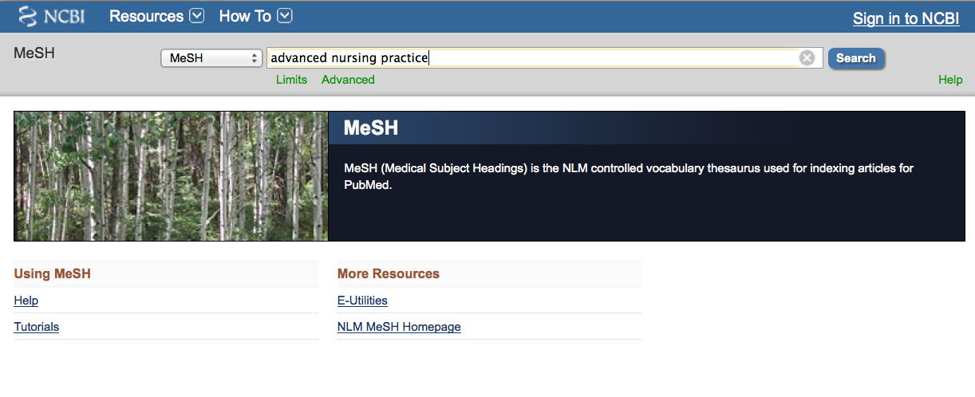
a
a
and click
Search
a
a
Enter
advanced nursing practice
(Note: If there is a Boolean OR relationship,
start with the “OR” statement first.)

Slide 14
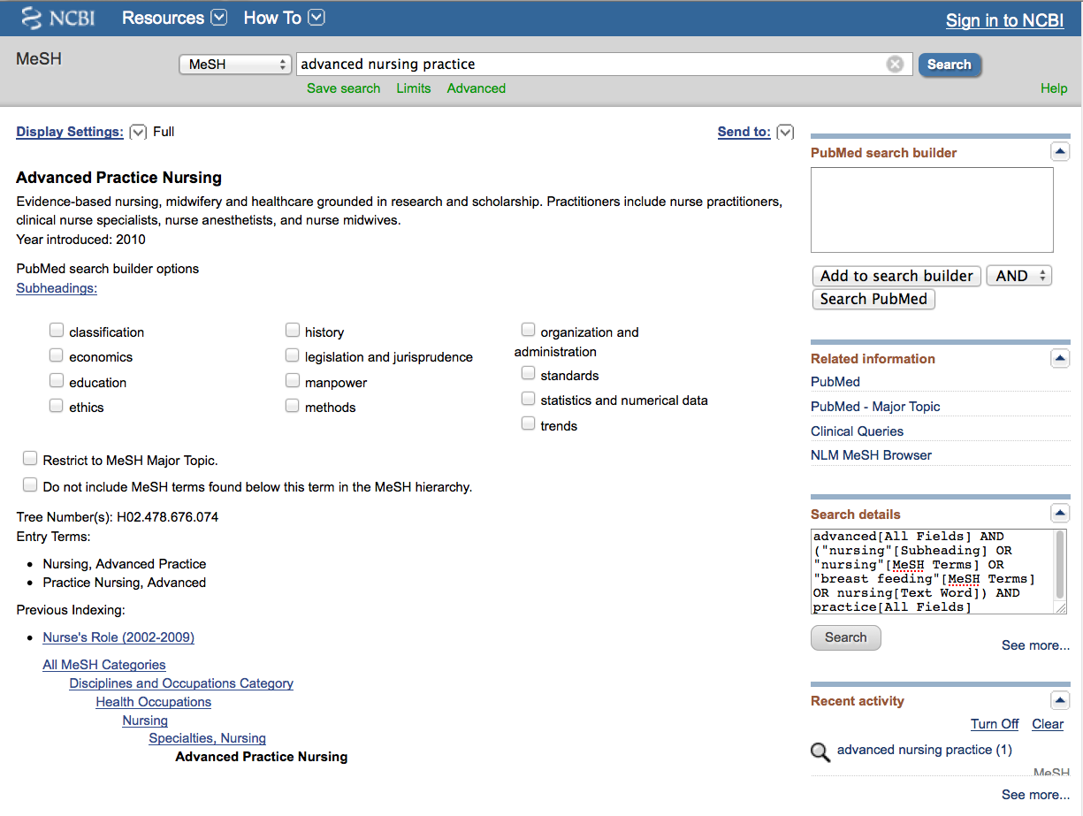
Term Definitions

Slide 15
Tree Structures are terms arranged in a hierarchy.
MeSH

Slide 16
Terms are listed from
broadest to narrowest.
If Advanced Practice Nursing
yields zero results, try using a
broader term such as: Nursing

Slide 17
Click
Add to search builder

Slide 18
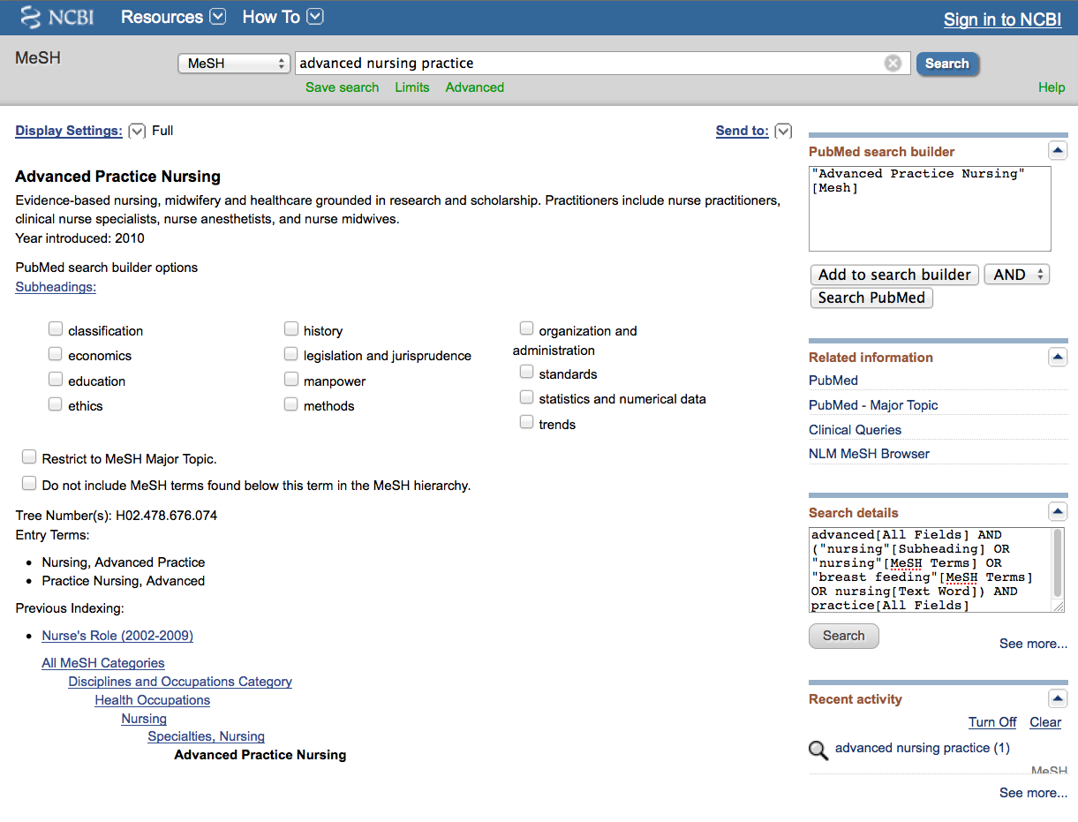
MeSH
The first term is in
the search program “box”

Slide 19
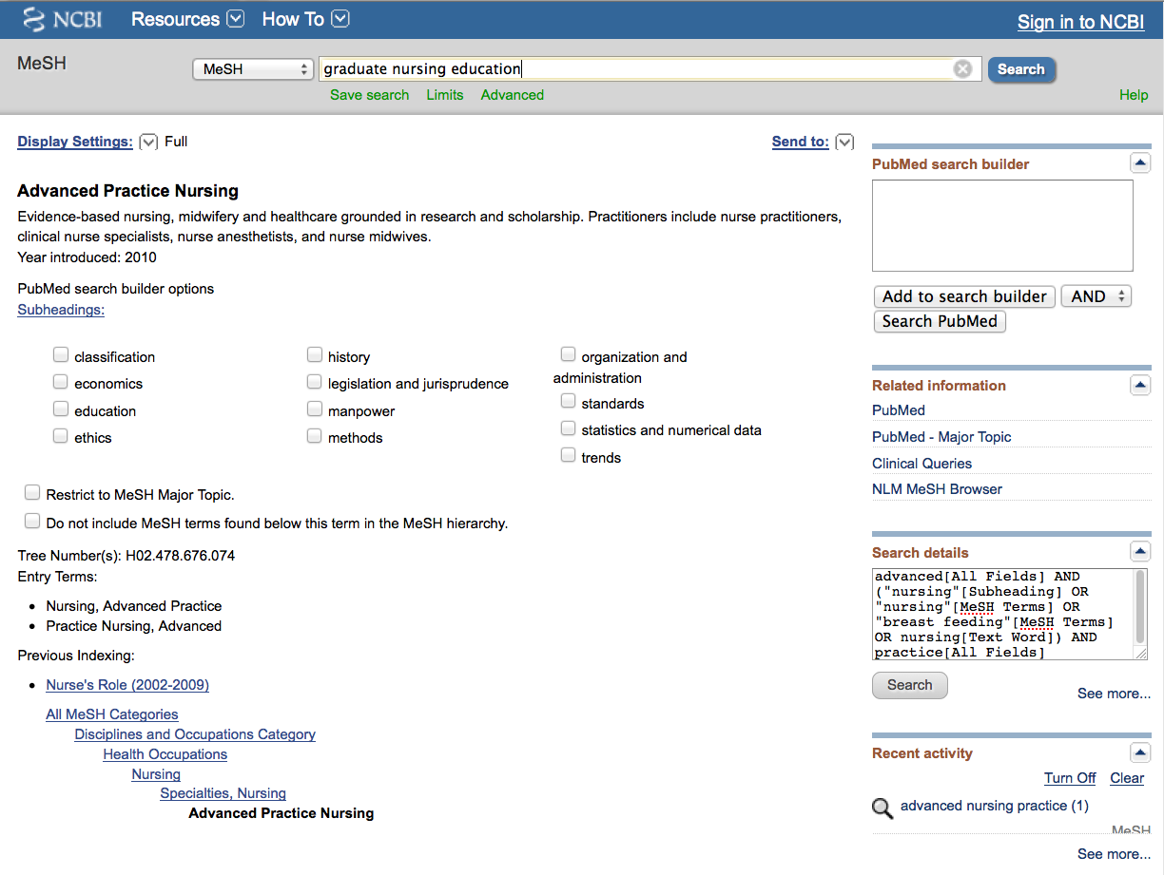
a
a
Enter
graduate nursing education
and click
Search

Slide 20
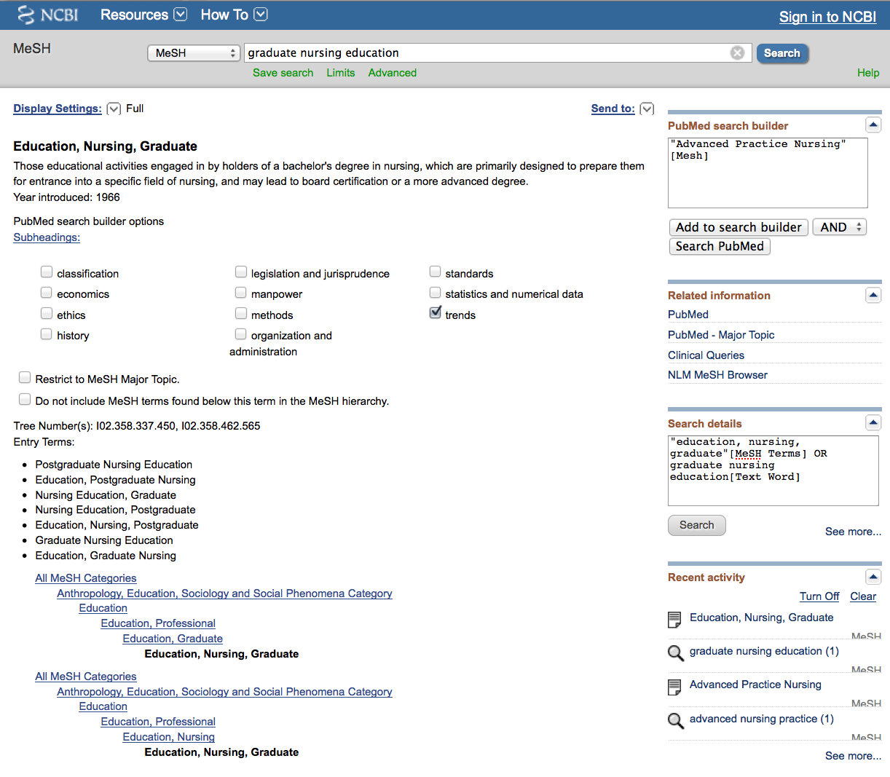
Sub-headings narrow the “meaning” of a MeSH term.
They are a “subset” of all the articles under the MeSH term: Education, Nursing, Graduate

Slide 21
✔
1) Check the box next
to the subheadinga

Slide 22
abnormalities embryology physiopathology
administrations & dosage enzymology poisoning
adverse effects epidemiology prevention & control
agonists ethics psychology
analogs & derivatives ethnology radiation effects
analysis etiology radiography
anatomy & histology genetics radionuclide imaging
antagonists & inhibitors growth & development radiotherapy
biosynthesis history rehabilitation
blood immunology secondary
blood supply injuries secretion
cerebrospinal fluid innervation standards
chemical synthesis instrumentation statistics & numerical data
chemically induced isolation & purification supply & distribution
chemistry legislation & jurisprudence surgery
classification manpower therapeutic use
complications metabolism therapy
congenital methods toxicity
contraindications microbiology transmission
cytology mortality transplantation
deficiency nursing
diagnosis organization & administration trends
diagnostic use parasitology
diet therapy pathogenicity ultrasonography
drug effects pathology ultrastructure
drug therapy pharmacokinetics urine
economics pharmacology utilization
education physiology veterinary
virology
83 SUBHEADINGS:

Slide 23
Click
Add to search builder

Slide 24
Boolean Logic - AND
education, nursing,
graduate/
trends
advanced nursing
practice
and

Slide 25
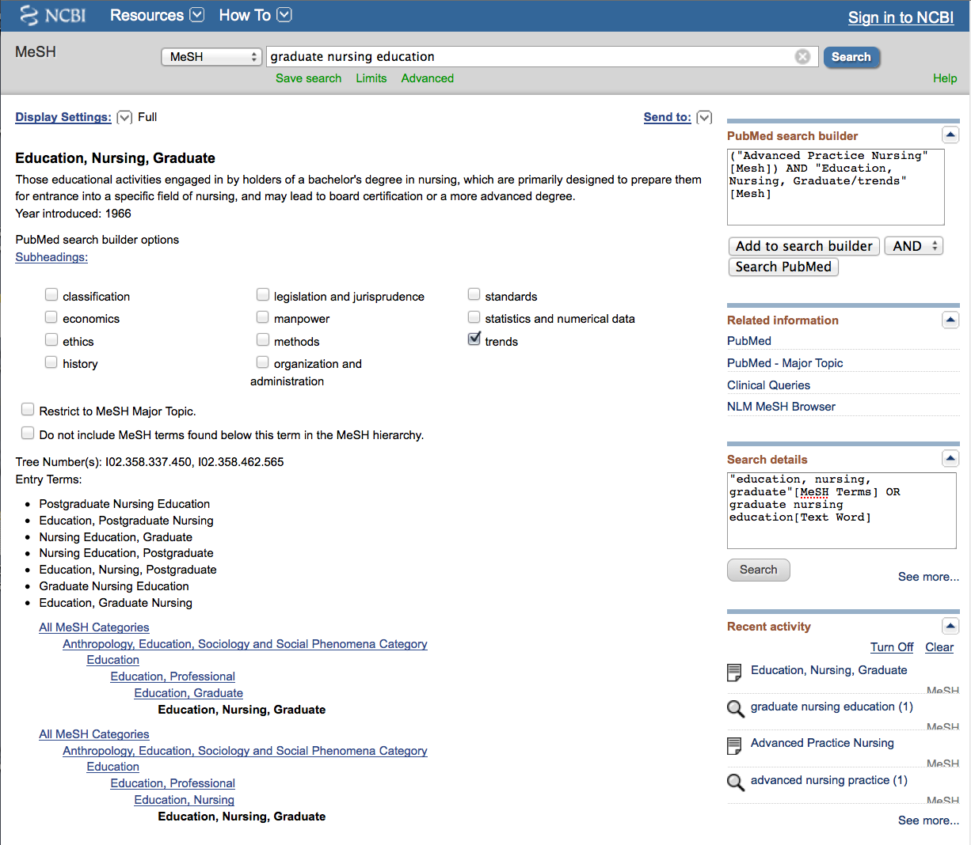
Final Search Strategy
Click
Search PubMed

Slide 26
Search Results

Slide 27
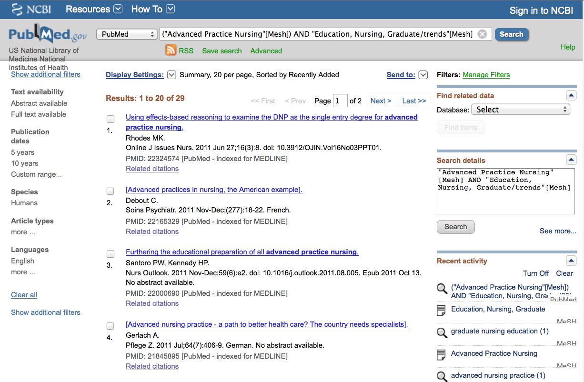
PubMed identifies
29 articles

Slide 28
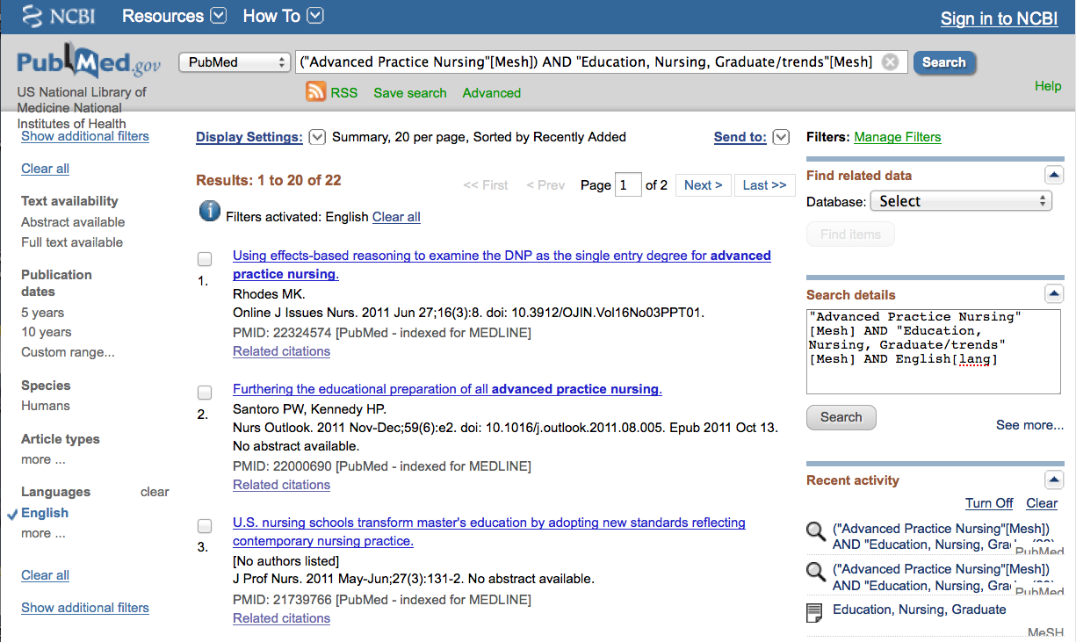
Select Filters such as English

Slide 29
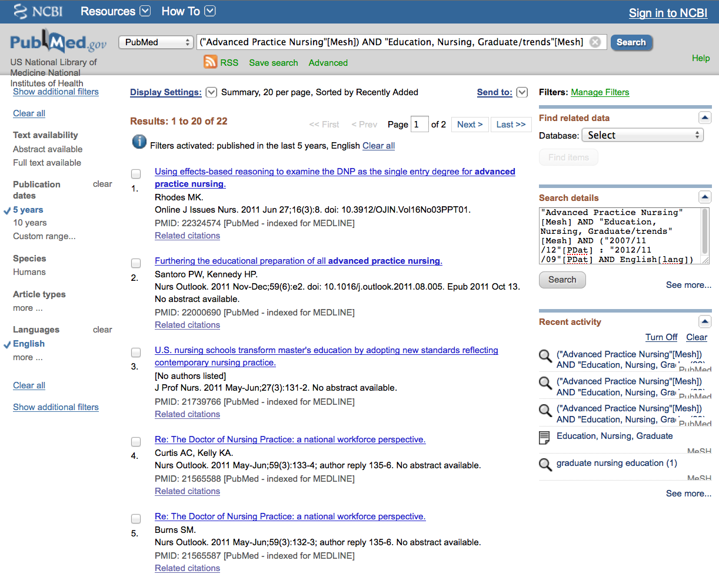
…and published during the last 5 years.

Slide 30
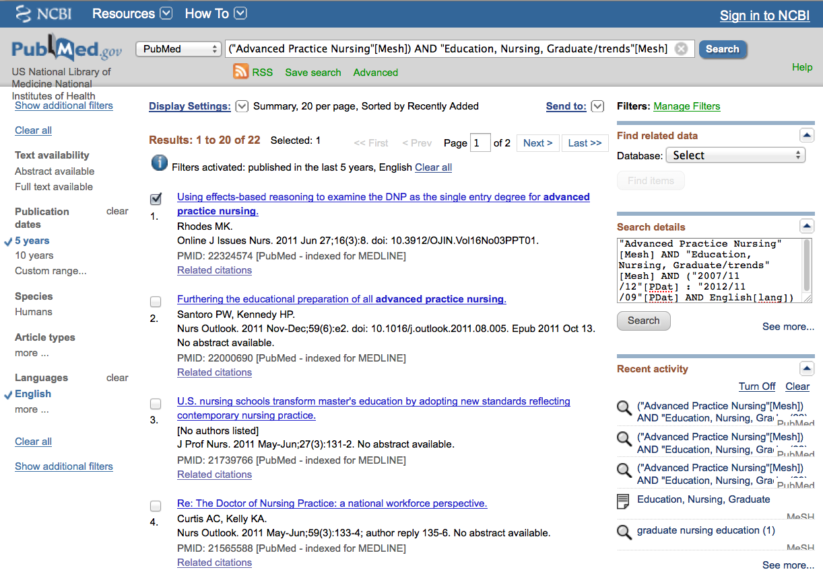
Results are reduced
From 29 to 22

Slide 31
Click Show additional filters

Slide 32
Scroll to article # 18

Slide 33
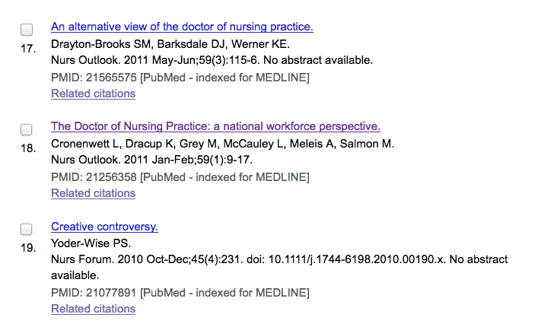
Scroll up
X
Select article(s).
X

Slide 34
Click Display Settings:

Slide 35
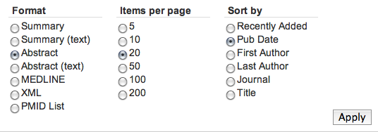
Select Abstract,
change to Pub Date to
sort to most recent articles appearing first,
then click
Apply

Slide 36
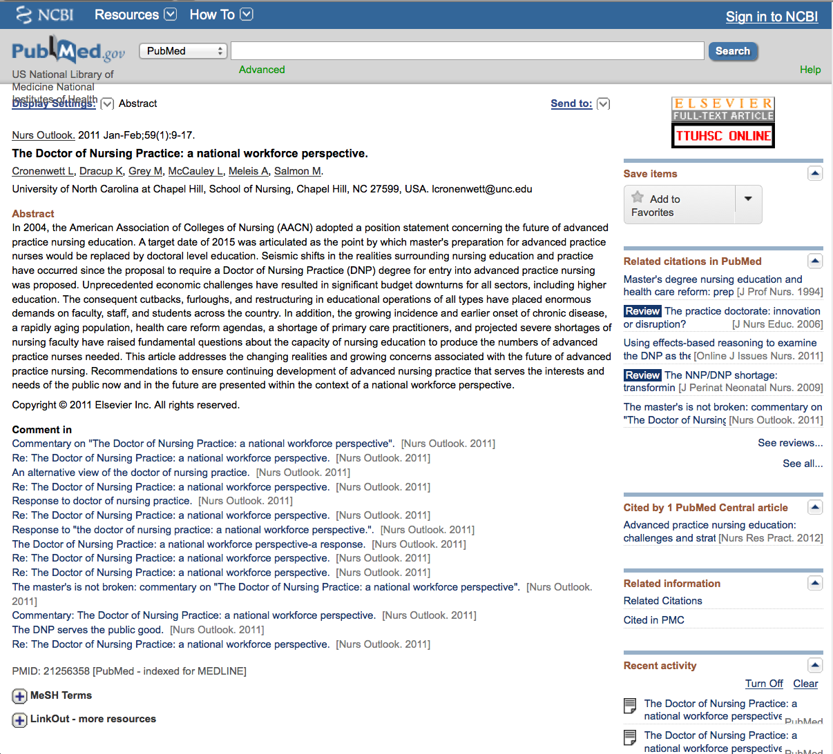
Click for MeSH terms index.
+

Slide 37
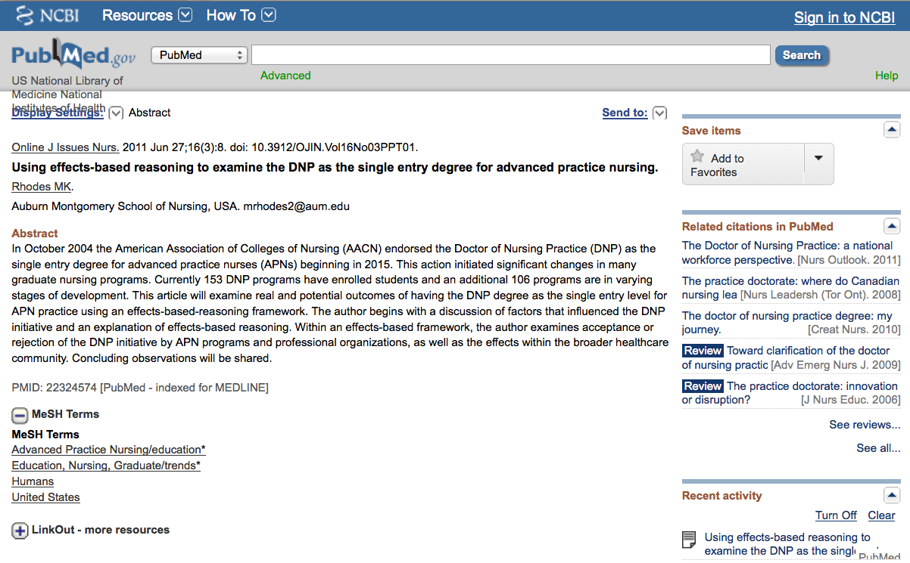
MeSH Database
searches only
the MeSH terms for:
advanced practice
nursing
AND
education, nursing, graduate/
trends

Slide 38
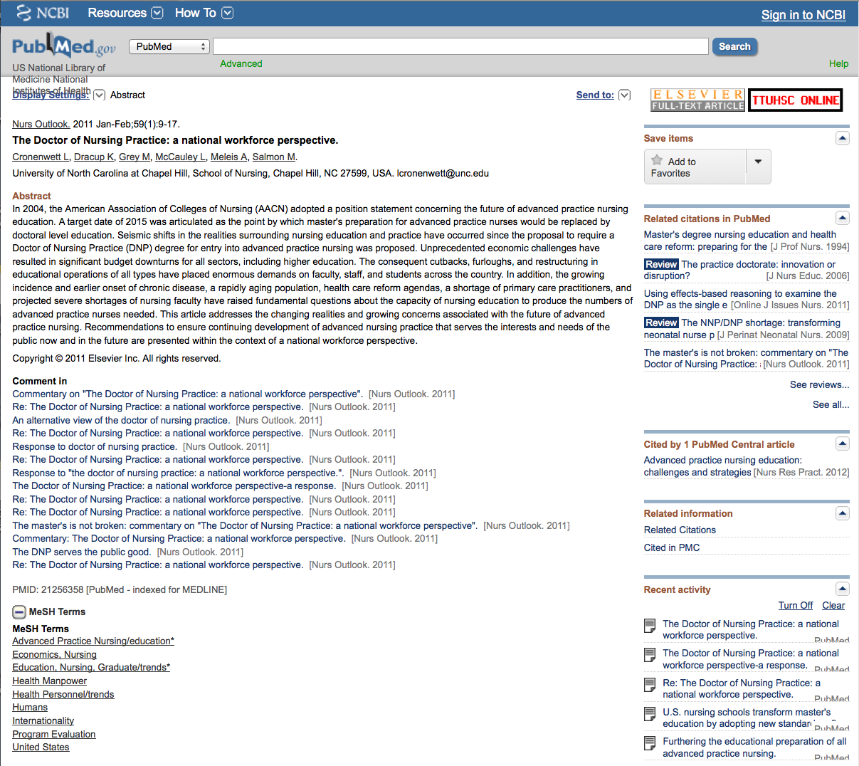
Look at subject headings
in the
MeSH Terms Index
for additional terms.
You may want to
write a new search
program using:
Program Evaluation

Slide 39
.
Click Send to: and select
File to save citations to a file on your computer or
Clipboard to temporarily store selected citations or
E-mail to send citations to self or colleague

Slide 40
…or click icon for full text.

Slide 41
Linking to
Full-Text Articles
in Electronic Journals

Slide 42
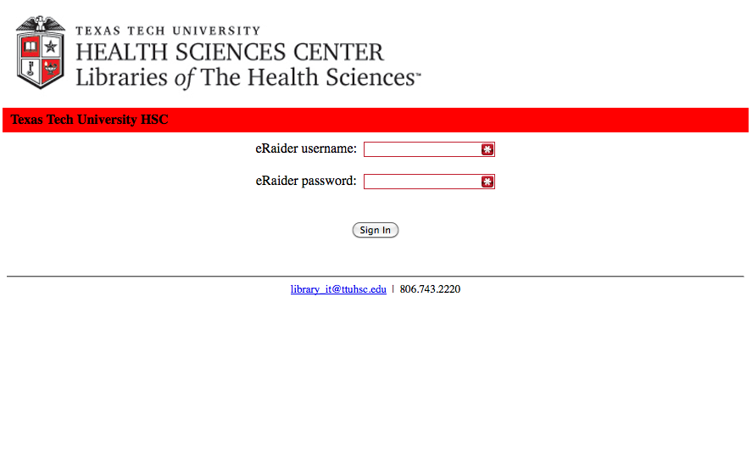
TTUHSC Libraries - Proxy Server
When Searching from Off Campus:
Enter the
Eraider username and password
assigned to you
by Information Services.
A
Problems with eRaider call: 806-743-1234 or email them at ITSolutions@ttuhsc.edu Monday-Friday 8:00 am to 6:00 pm
a

Slide 43
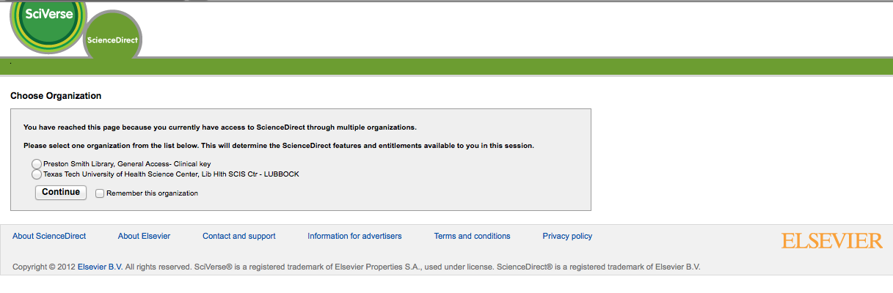
Select location

Slide 44
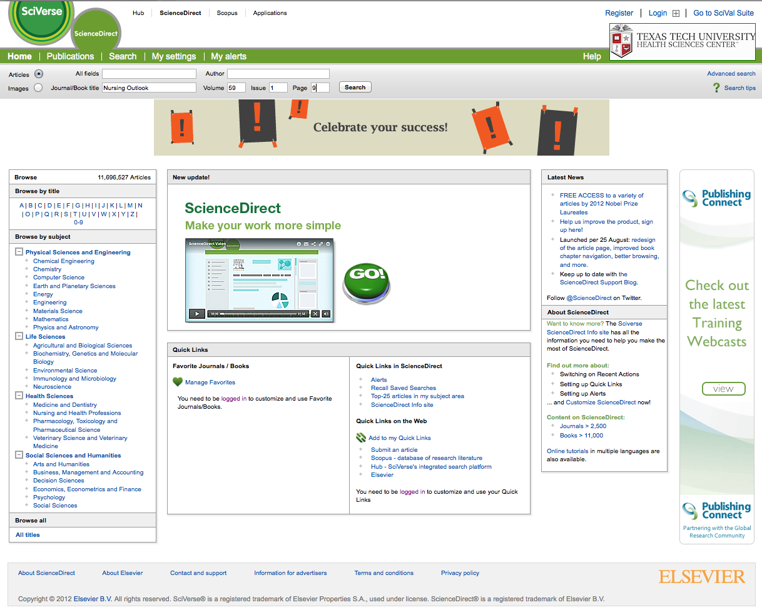
Enter article information

Slide 45
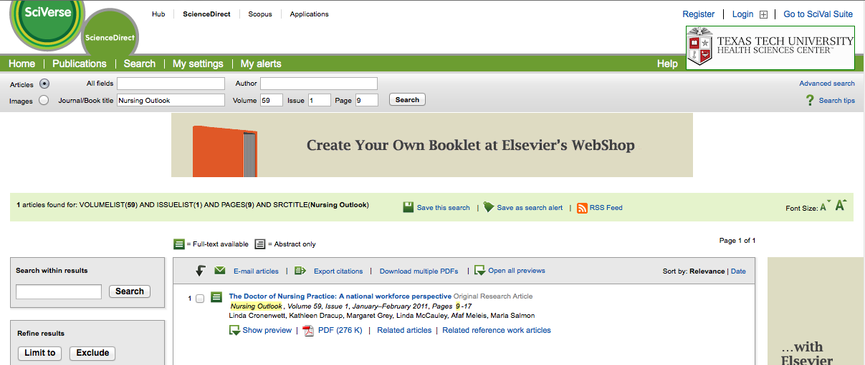
Click PDF

Slide 46
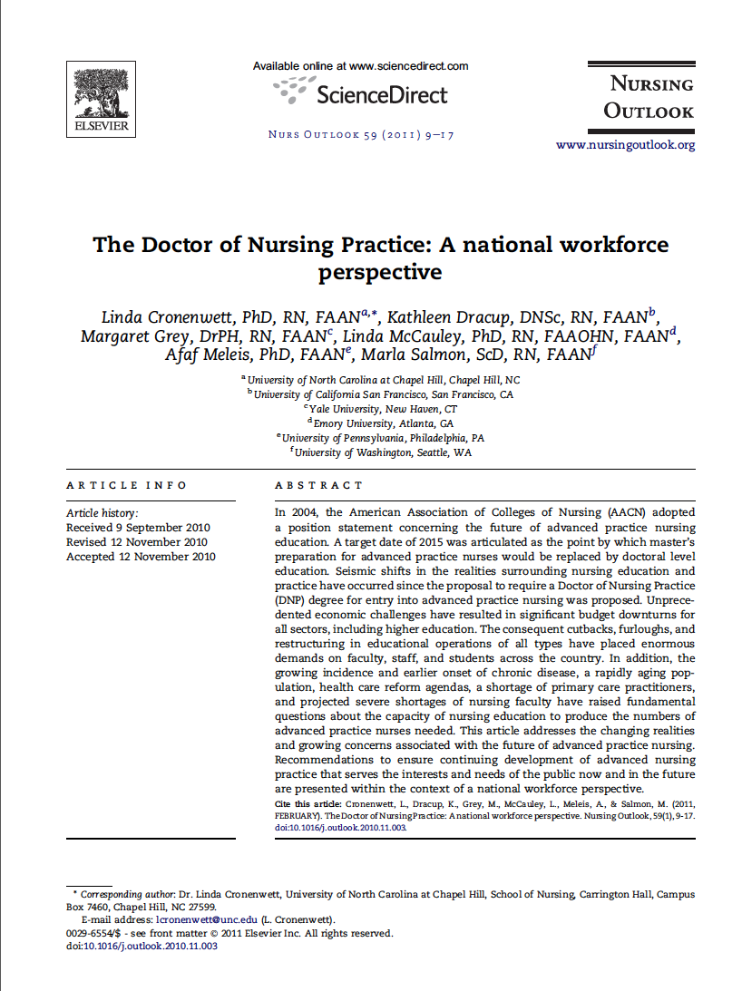
Full Text Article

Slide 47
Other Searching Featuresa
a
    MeSH, phrase, & title word searching
    Truncation

Slide 48
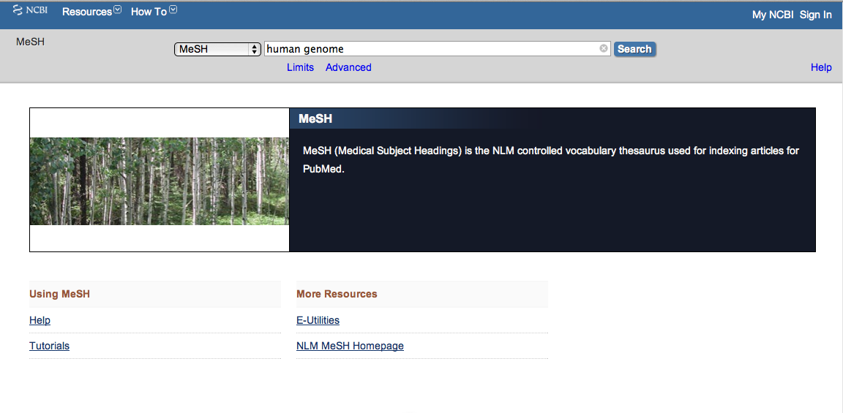
Enter and click a
a
Search
human genome

Slide 49
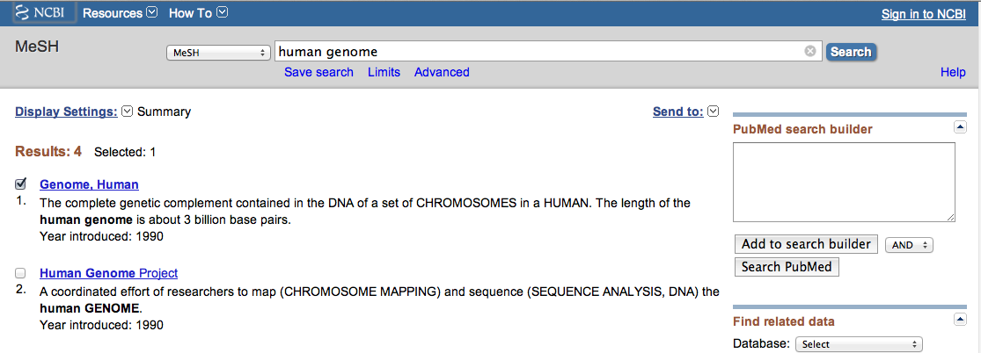
2) Select
1) Check the box next
to the MeSH heading
AND
✔
3) Then click
Add to search builder

Slide 50
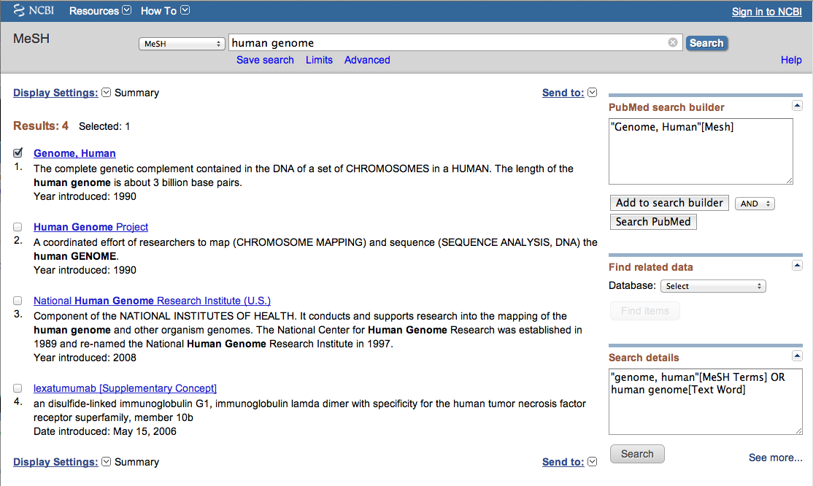
Click
Search PubMed

Slide 51
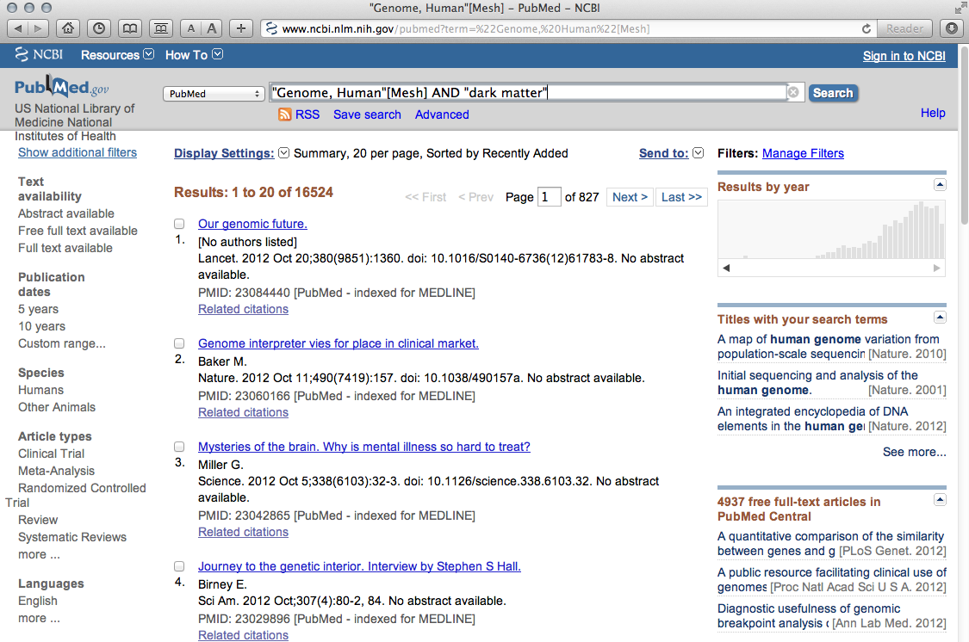
Enter and click
Search
“dark matter”

Slide 52
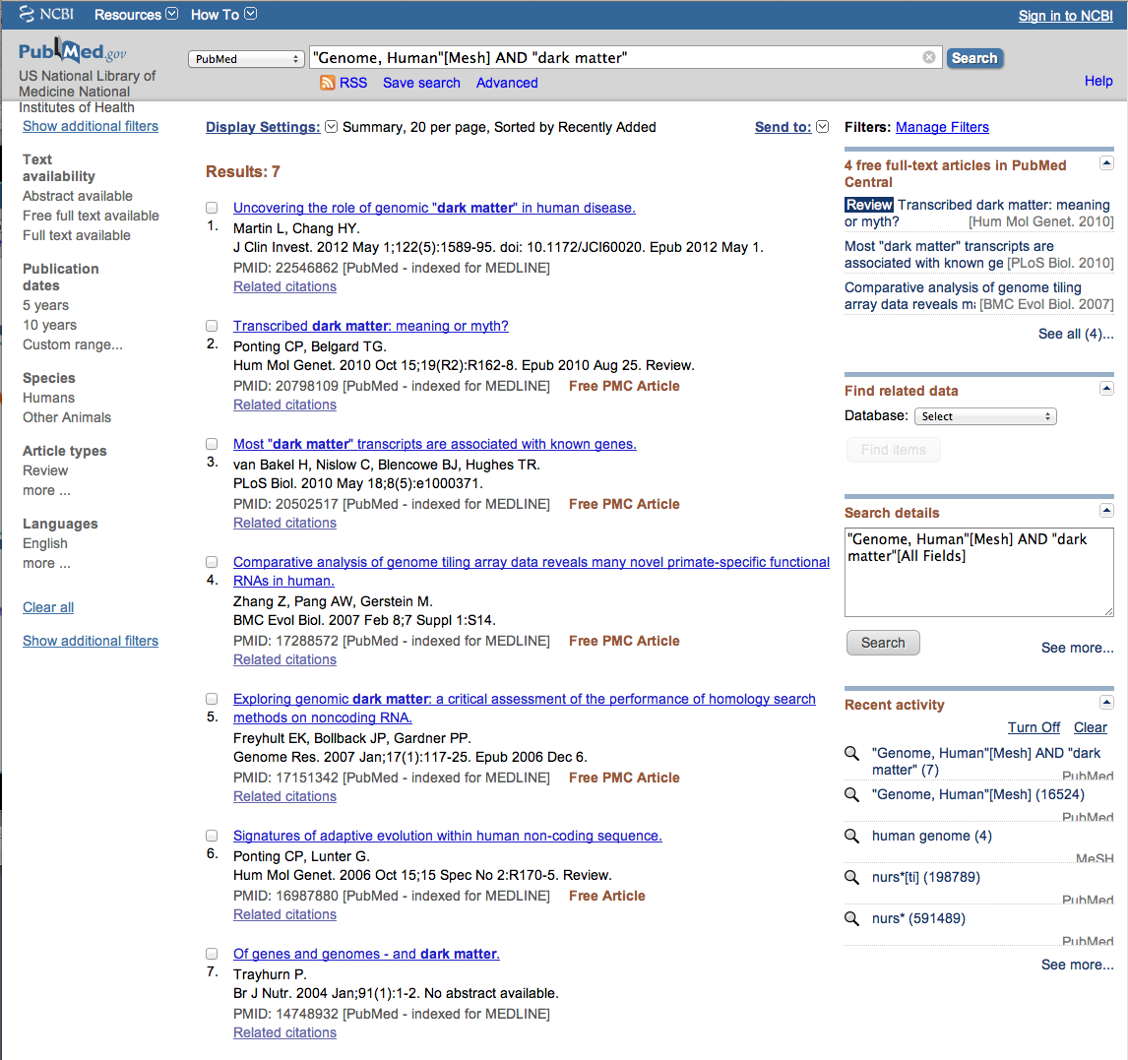
PubMed identifies
7 articles

Slide 53
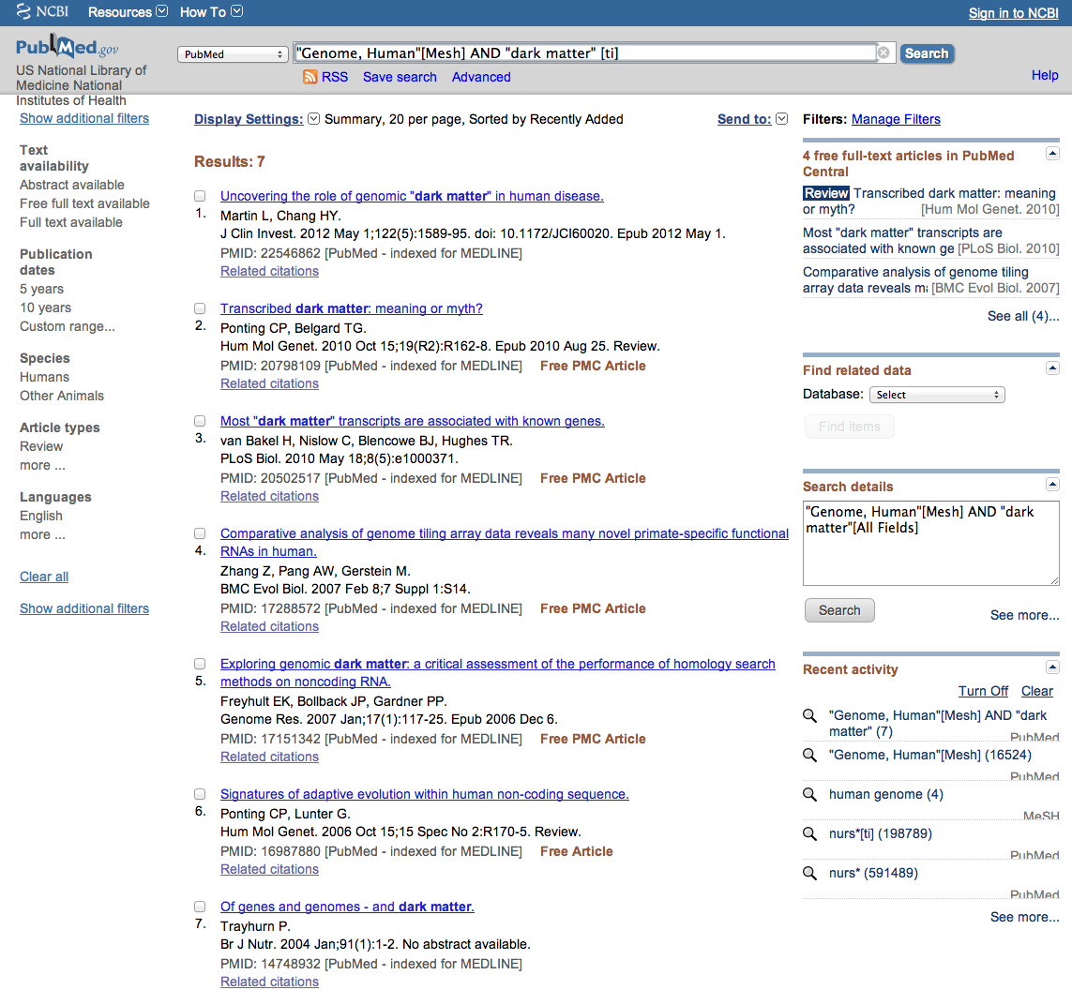
Enter and click
Search
“dark matter” [ti]

Slide 54
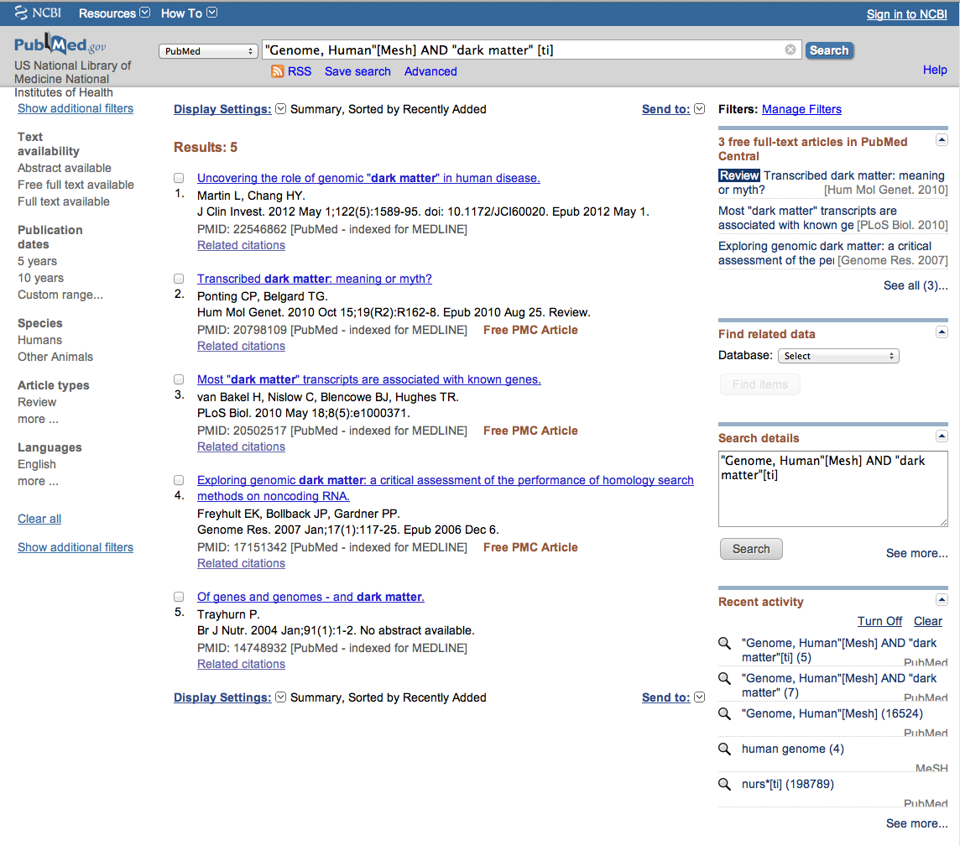
Results are narrowed to 5

Slide 55
Truncation

Slide 56
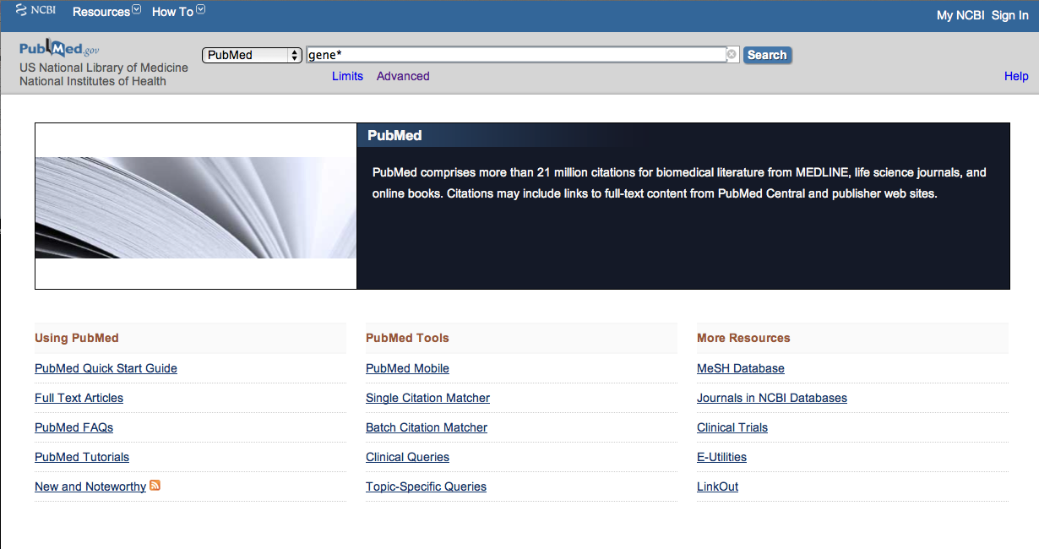
Enter gene* to truncate.

Slide 57
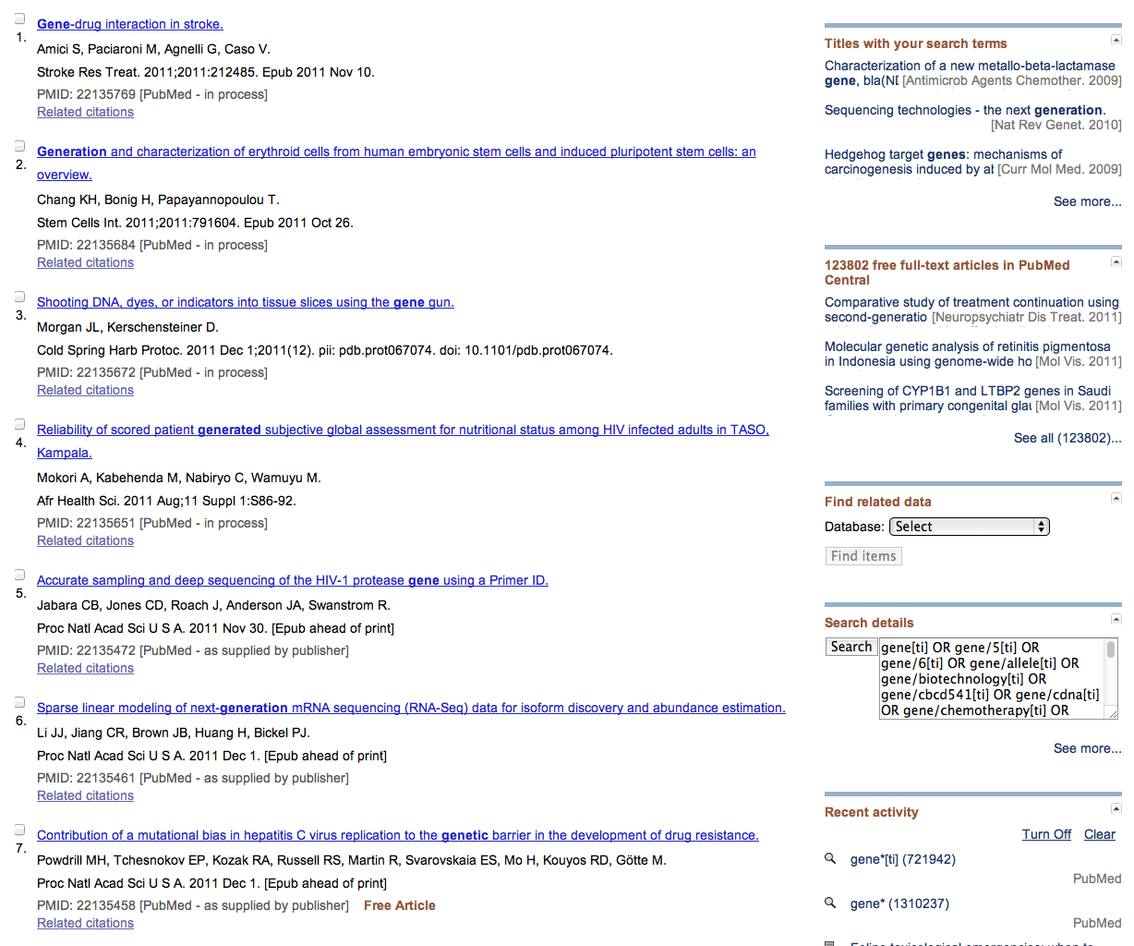
PubMed locates:
gene
generation
generated
genetic

Slide 58
My NCBI

Slide 59
About a My NCBI Account
A My NCBI account will allow you to:
* Save search strategies
* Receive automatic search updates via email
* Create “search filters”
NOTE: you will NOT receive any spam as a result of
this account.
This account is for databases from the
National Library of Medicine including PubMed.

Slide 60
Sign into NCBI

Slide 61
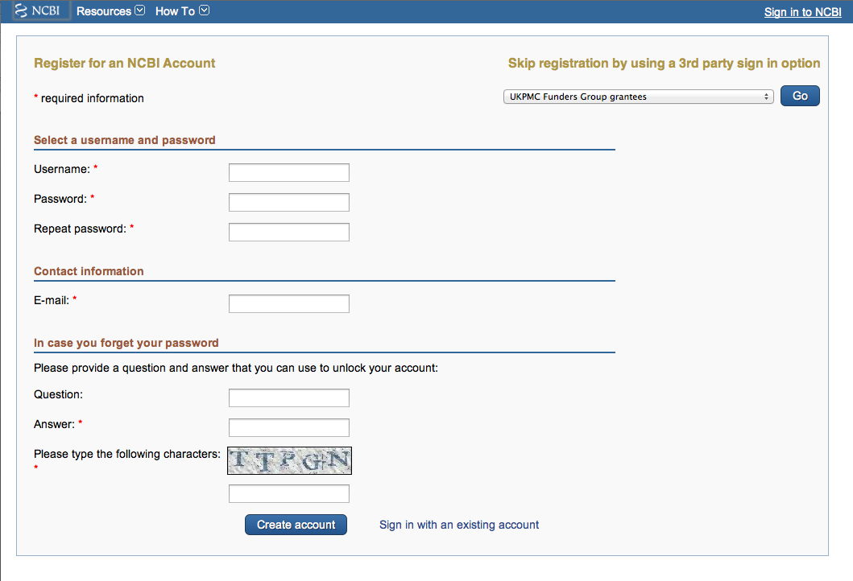
Register for an account
Create account

Slide 62
Verifying Your
My NCBI Account

Slide 63
Verifying Your
My NCBI Account
Open the email address you put in the contact information.
There will be message from NCBI.
3) Click the link or copy and paste the verification URL into the web address bar and enter.
4) Your account will be verified by the
National Library of Medicine.
5) NOTE: You will not receive any spam as a result of this account.

Slide 64
A
Visit this web site to verify
you’re My NCBI account.

Slide 65
Search Filters

Slide 66
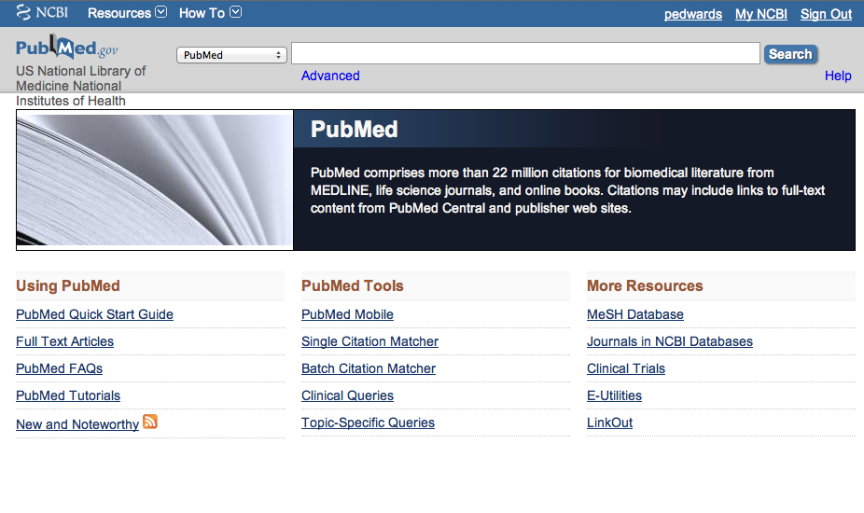
Click My NCBI

Slide 67
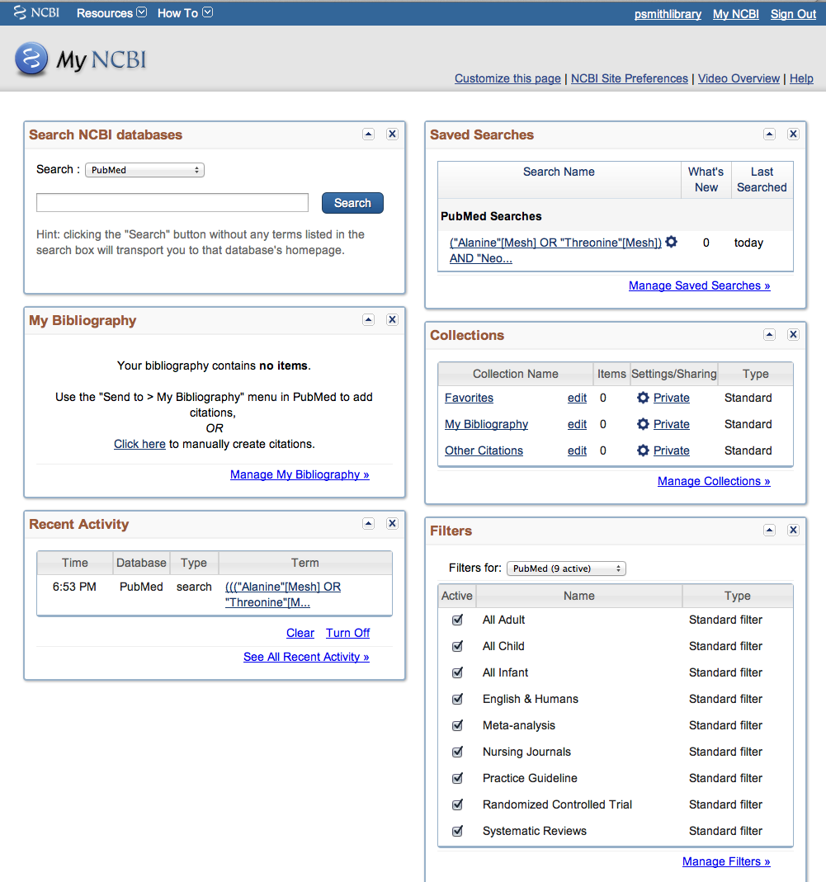
Click Manage Filters

Slide 68
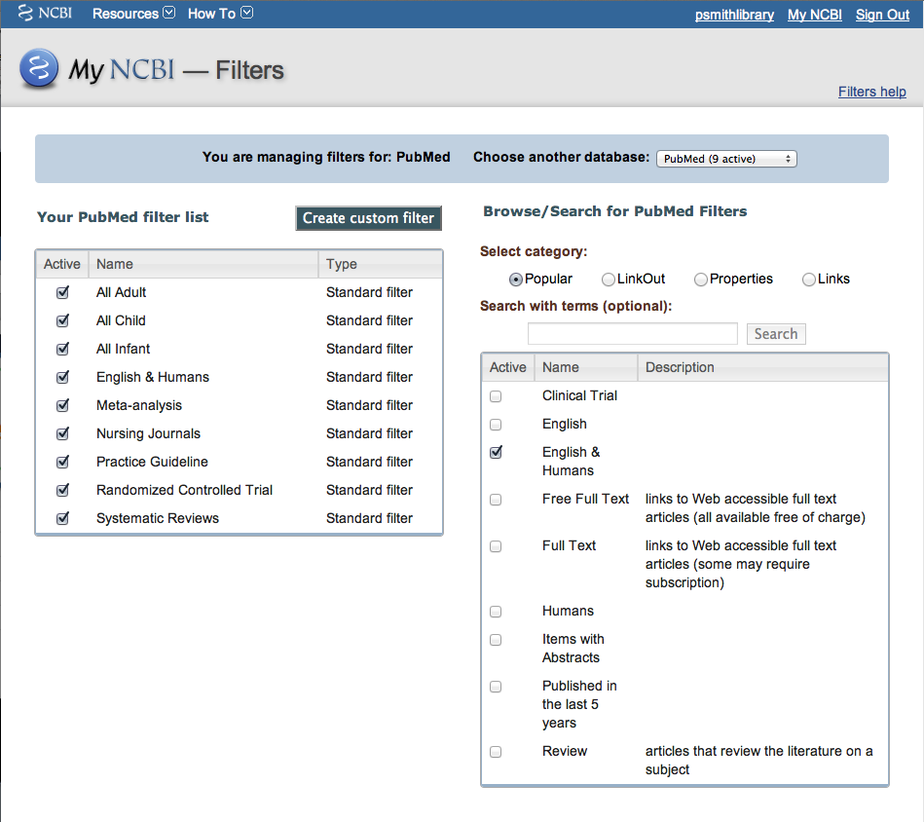
Select Properties
Select English & Humans

Slide 69
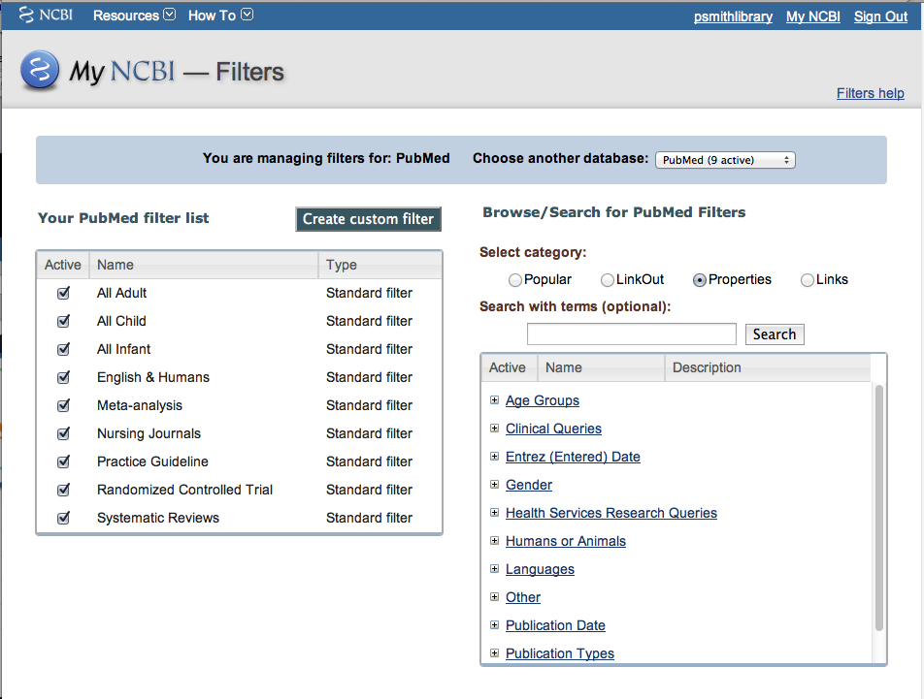
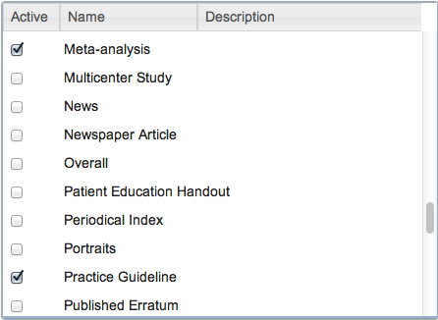
Under Publication Types select

Slide 70
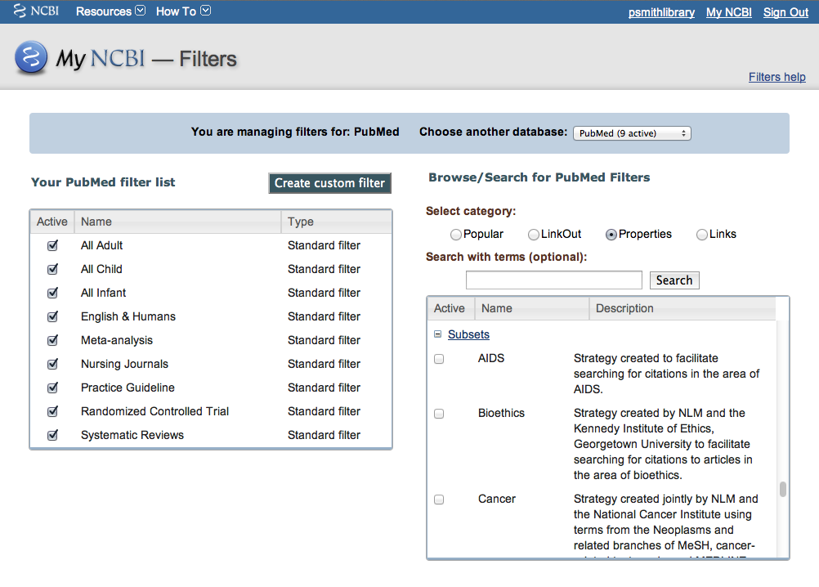


Under Subsets select

Slide 71
You may select up to 15 filters. These selections override the
default filters of Review and Free Full Text. These filters apply
to searches run while signed into you’re My NCBI account.

Slide 72
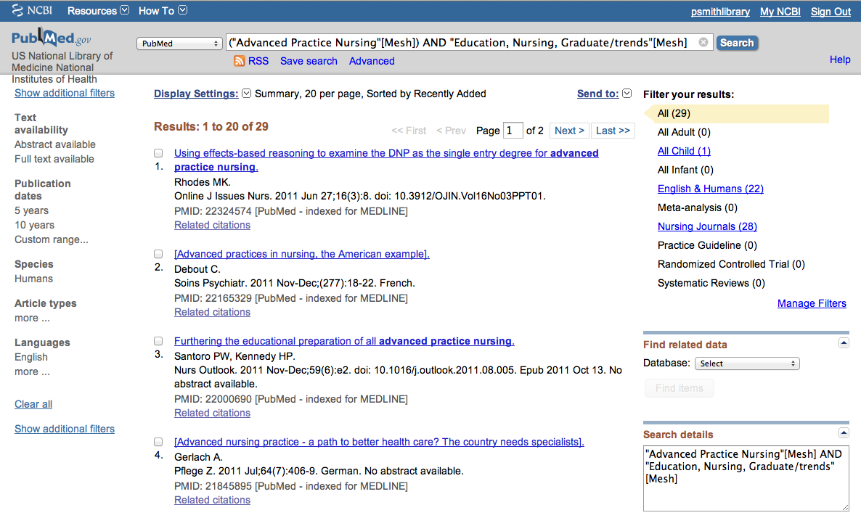
Example of results with customized filters

Slide 73
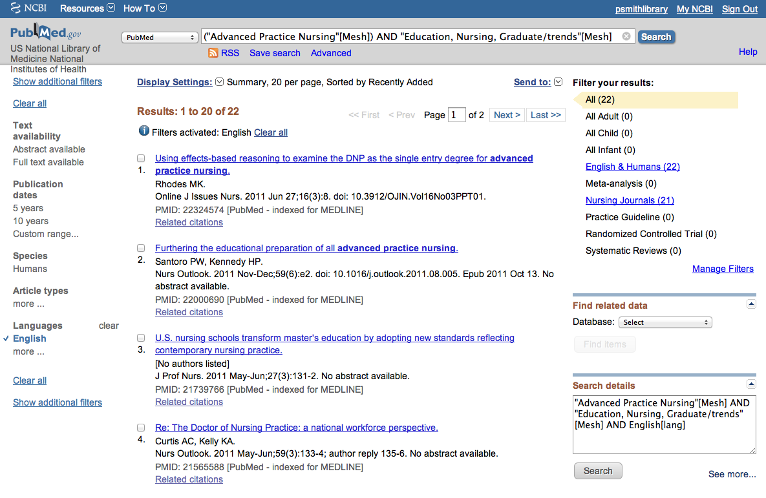
Example of results with standard filters

Slide 74
Save Search

Slide 75
Click Save Search

Slide 76
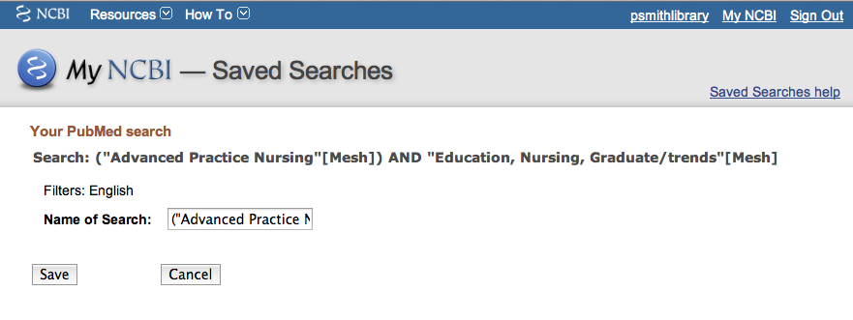
Click Save to receive automatic email updates of newly
published articles on this topic.

Slide 77
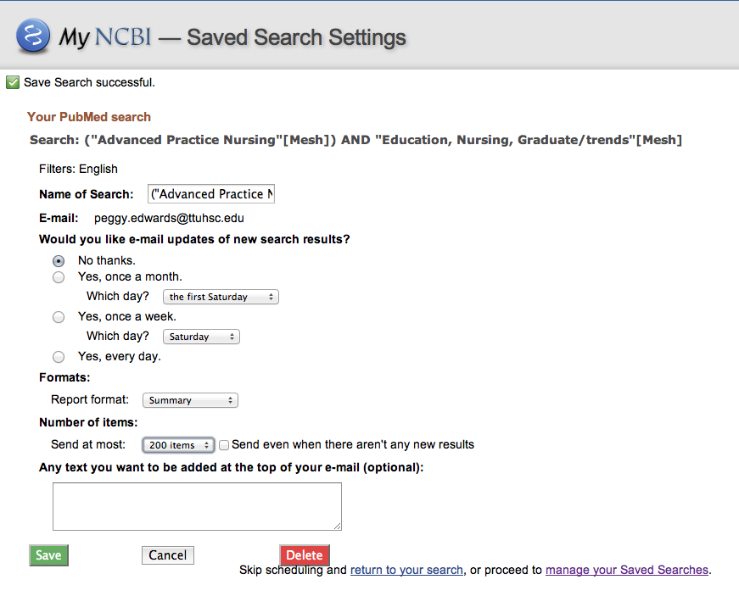
Select when and how often
you wish to receive updates,
report format,
and number of results.
Click
Click Save

Slide 78
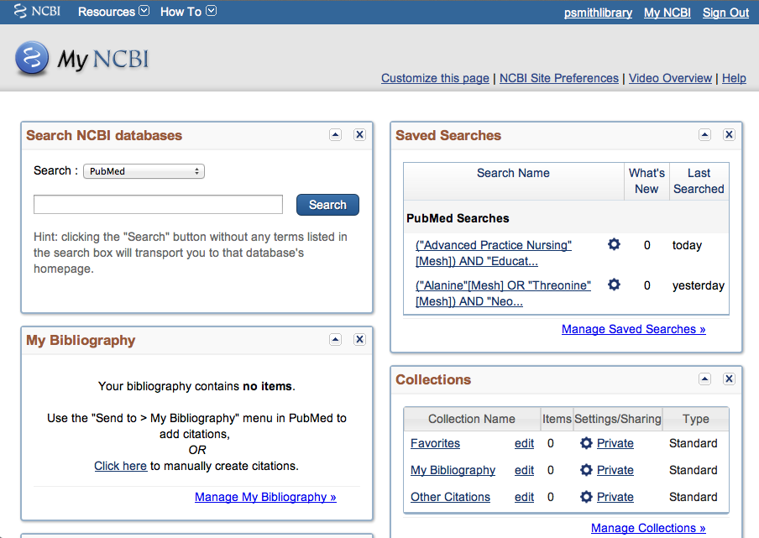
Click

Slide 79
Online Tutorial

Slide 80
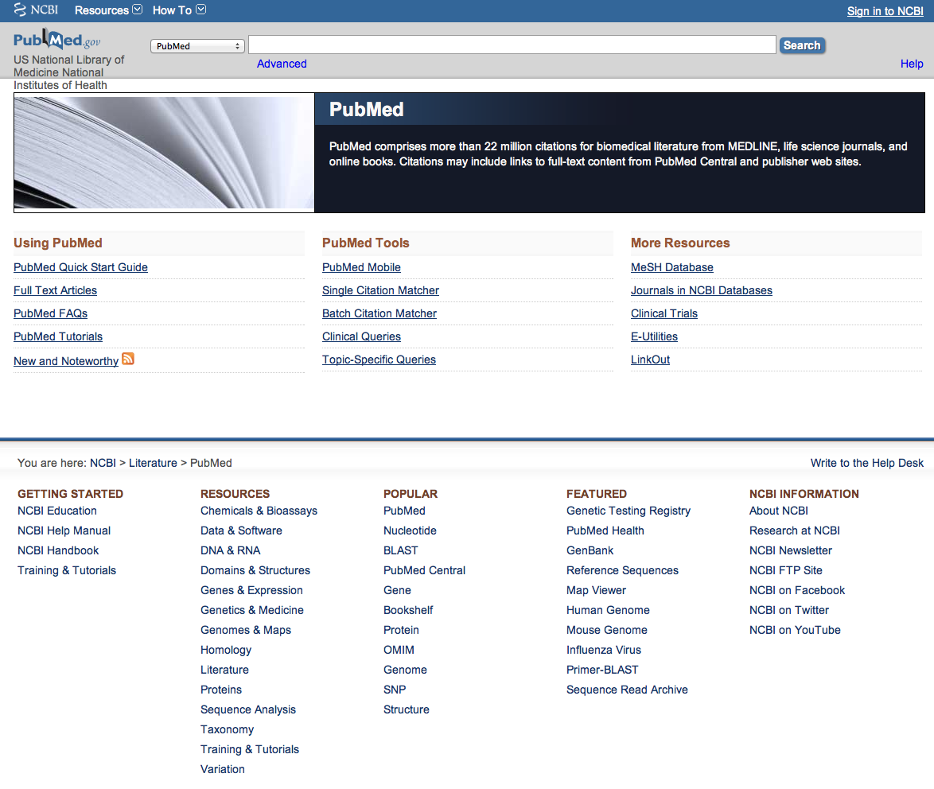
Click Training & Tutorials for hands-on learning.

Slide 81

Please contact us at:
Lubbock
(806) 743-2200
Amarillo
(806) 354-5448
El Paso
(915) 545-6652
Odessa
(432) 335-5171

Slide 82
The End

