Slide 1
Welcome
Nursing Information Resources
Peggy Edwards, AMLS
TTUHSC - Preston Smith Library
Lubbock, Texas 79430
DNP June 2016

Slide 2




When searching library applications, use
Mozilla Firefox
Safari

Slide 3
EBP Literature from
PubMed’s Clinical Queries

Slide 4



PubMed Database
Biomedical and life sciences journal literature
International scope
Developed and maintained by the:
National Center for Biotechnology Information
    at the U.S. National Library of Medicine
    at the National Institutes of Health

Slide 5

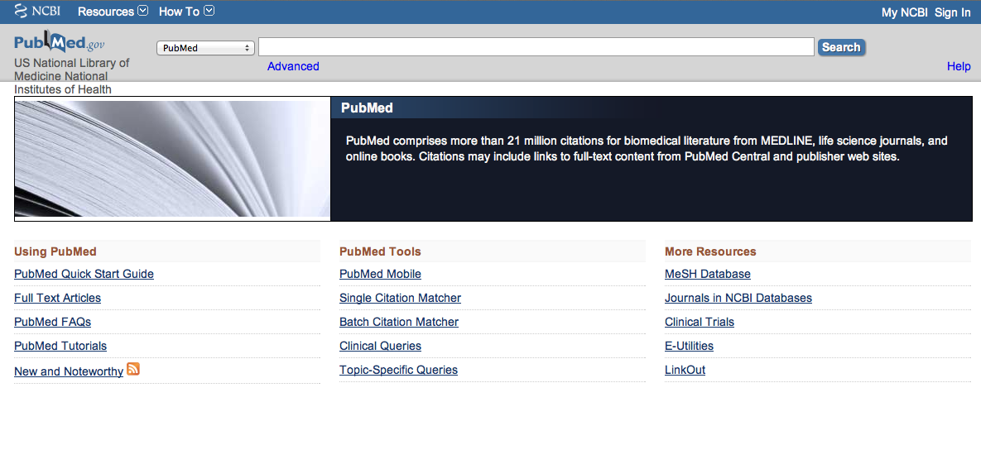
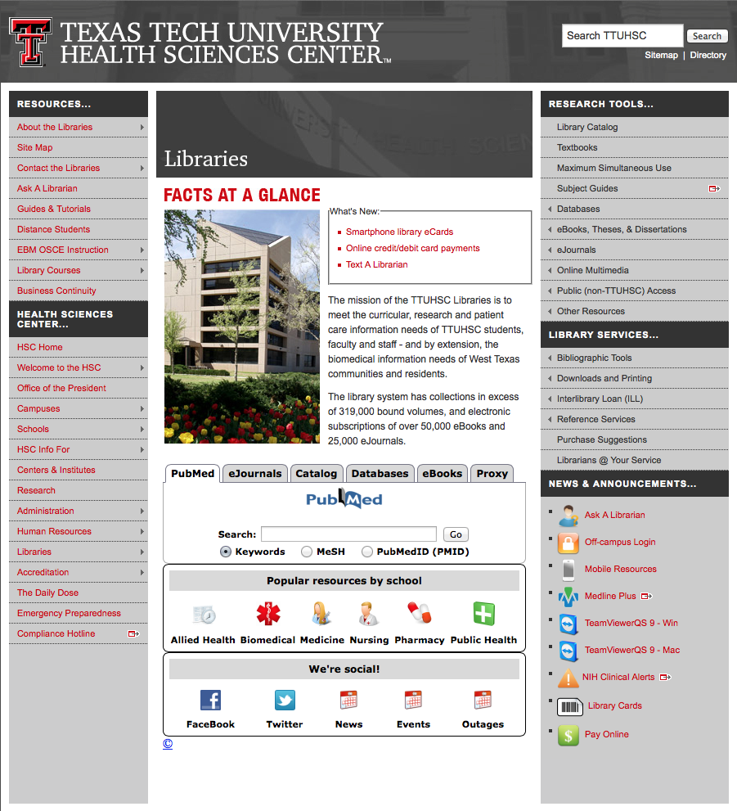
Accessing PubMed
Freely available over the Internet
@ www.pubmed.gov
Also through library’s home page

Slide 6


Evidence-Based Practice is guided by thoughtful integration
of the best available scientific knowledge with clinical expertise.

Slide 7
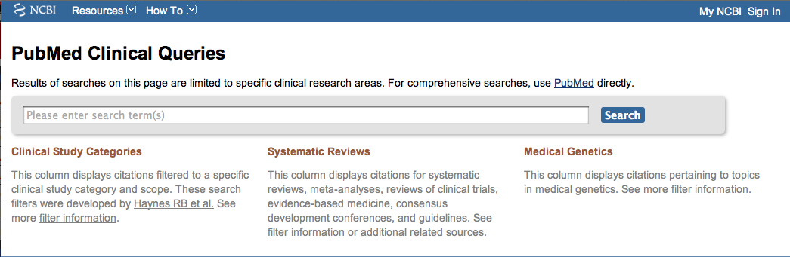
PubMed’s Clinical Queries
tool that searches for evidence-based literature

Slide 8

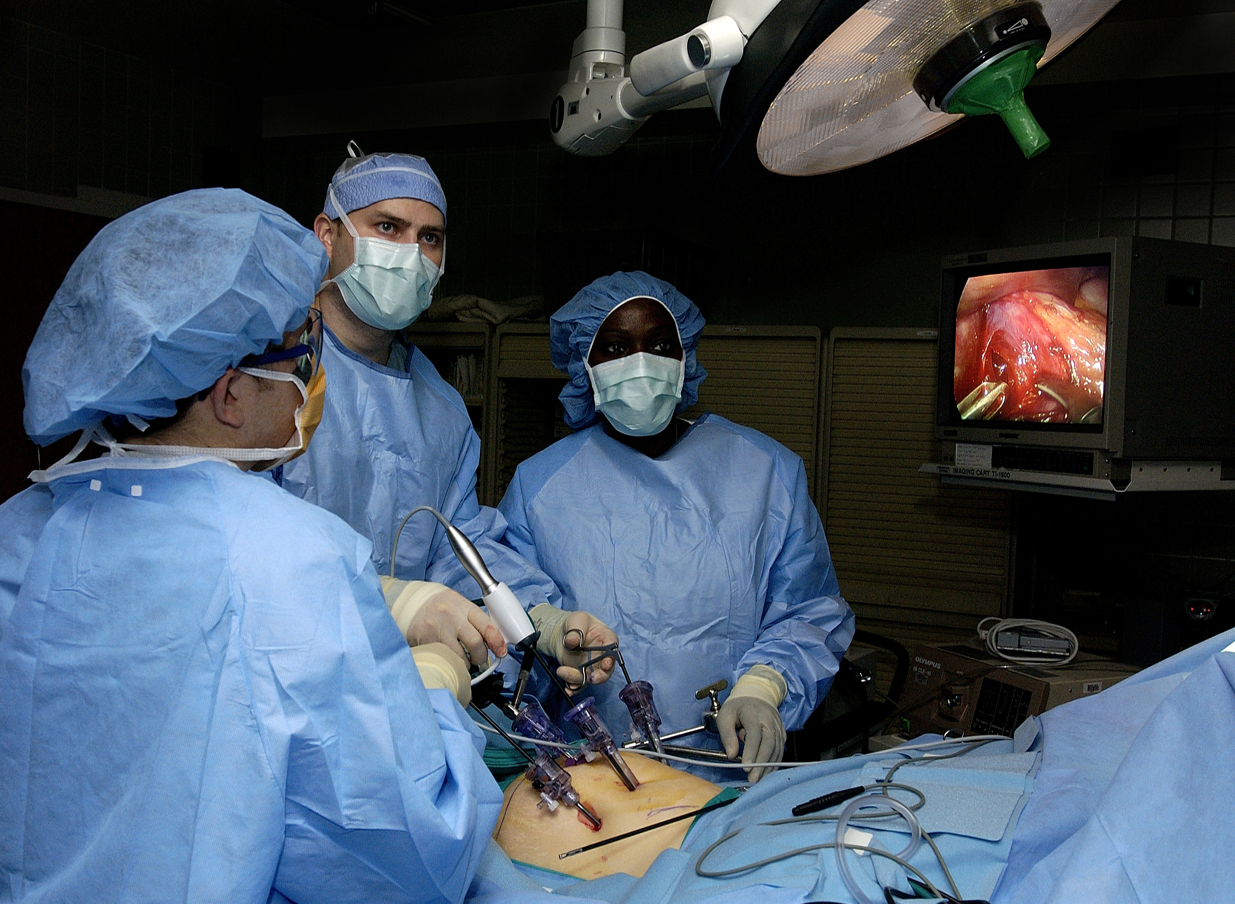
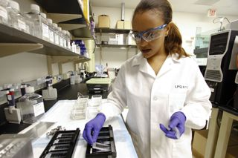
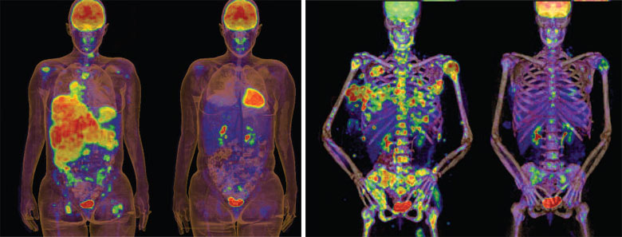
Clinical Queries Searchable by:
Diagnosis
Therapy
Prognosis (prediction of probable outcome)
Etiology (cause)

Slide 9
Clinical Queries Searchable by:
Diagnosis
Therapy
Prognosis (prediction of probable outcome)
Etiology (cause)

Slide 10
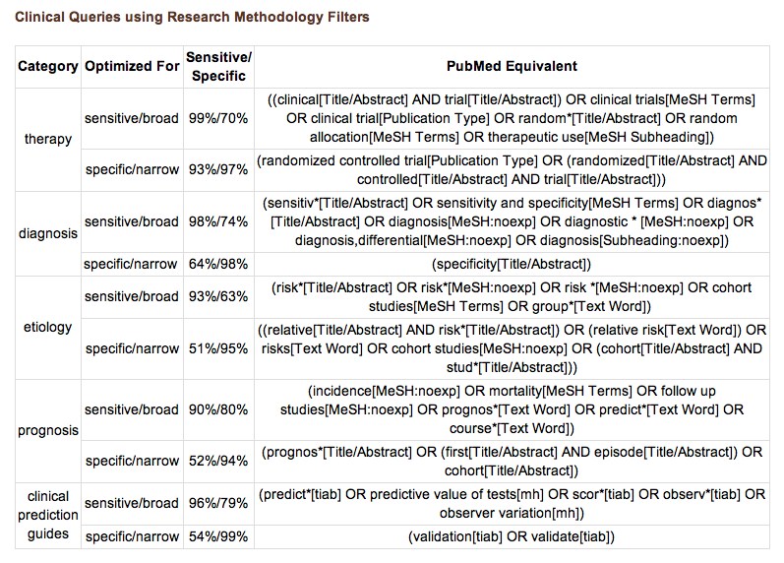
PubMed’s Clinical Queries
uses pre-formulated search strategies with a keyword search

Slide 11
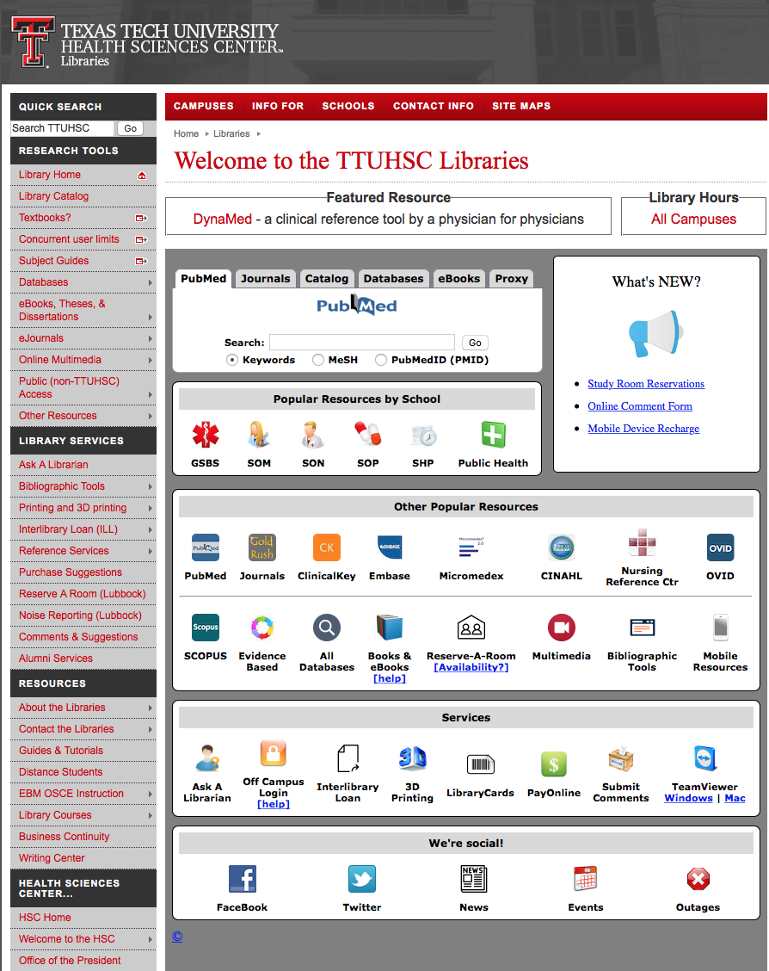

www.ttuhsc.edu/libraries
Click PubMed

Slide 12
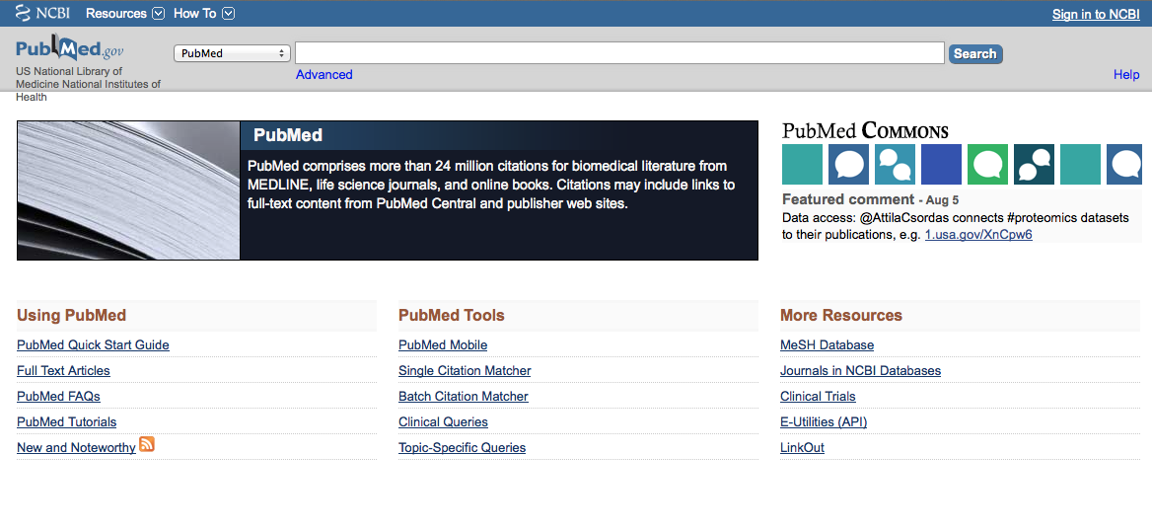
Click Clinical Queries

Slide 13
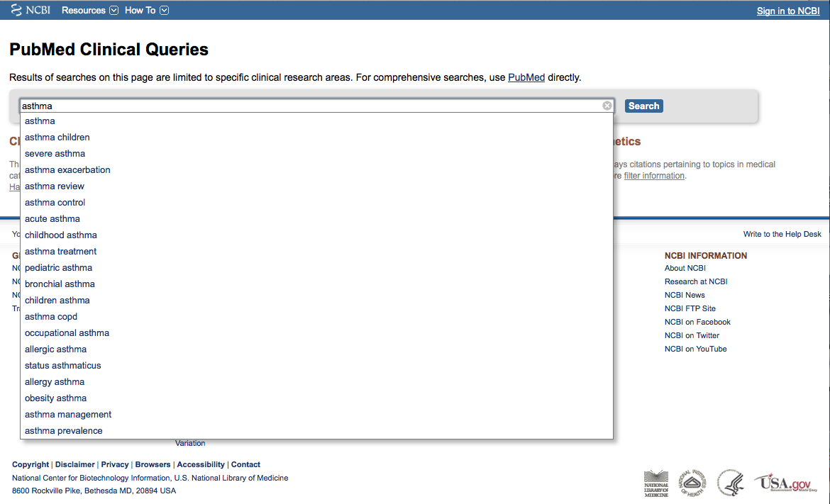
Enter asthma
Click
Search

Slide 14
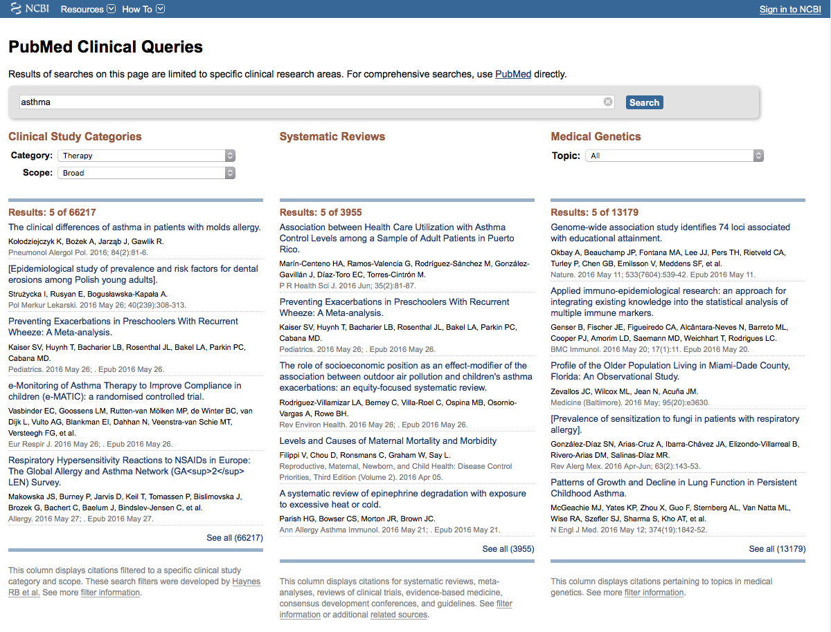
Results for Therapy and
Broad Scope

Slide 15

Click on the Therapy drop-down menu

Slide 16
Change to Narrow Scope

Slide 17
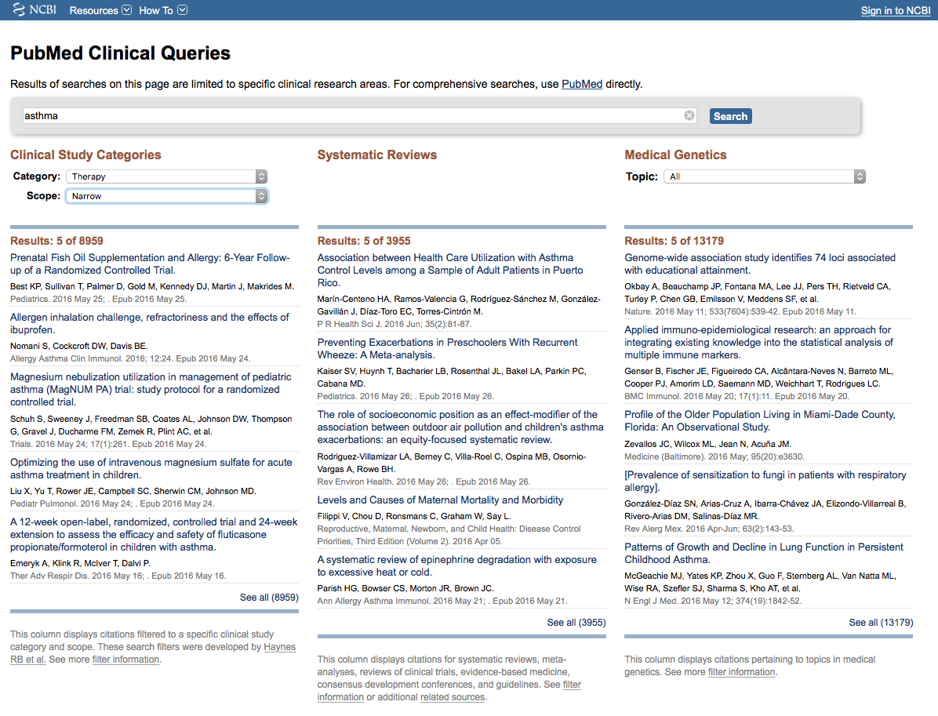
Results for Therapy and
Narrow Scope
Click See all (8959)

Slide 18
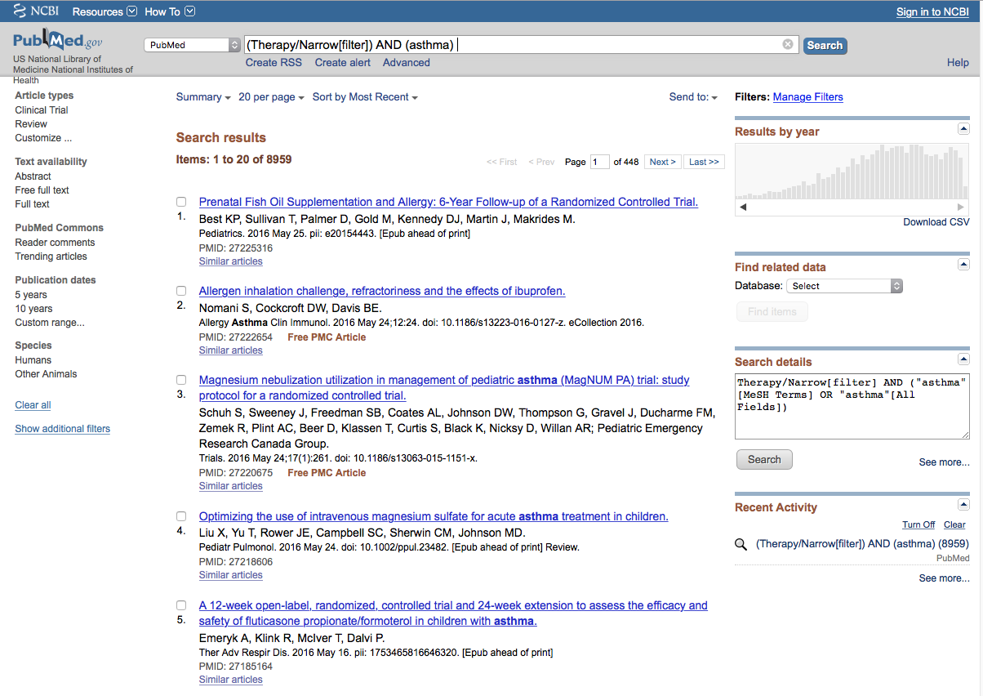
Click Limits

Slide 19
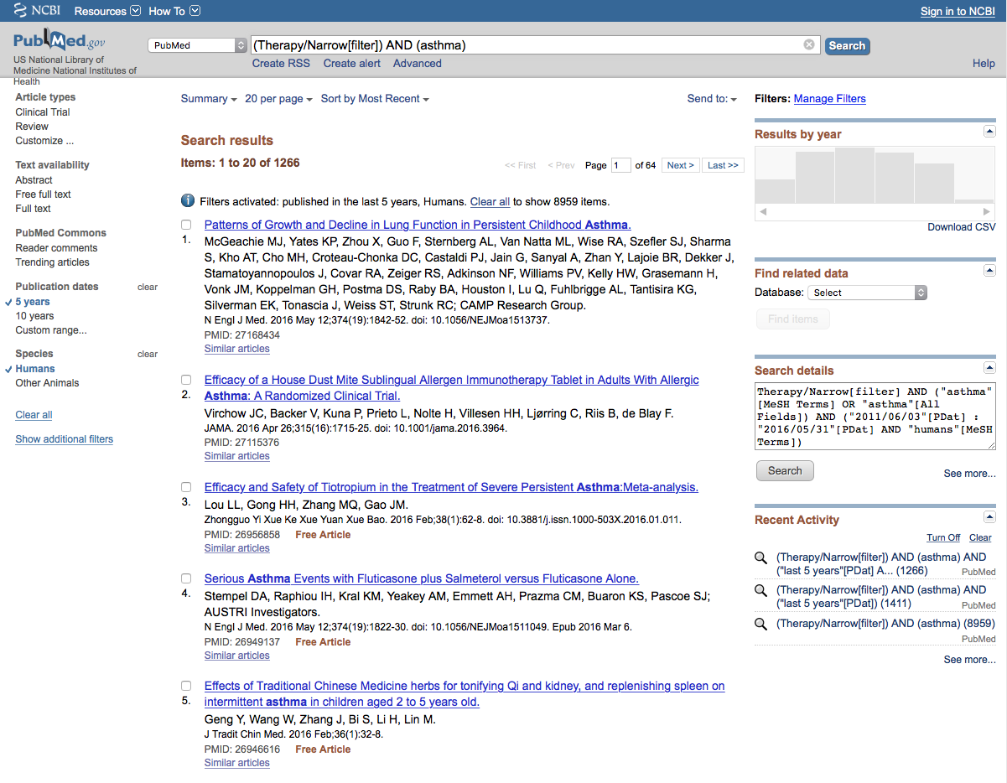
Selections will turn blue: ✓ 5 years
and ✓ Humans

Slide 20
Activated Filters
Click Show additional filters

Slide 21
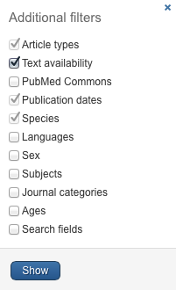
Select
Languages
✔
Click Show

Slide 22
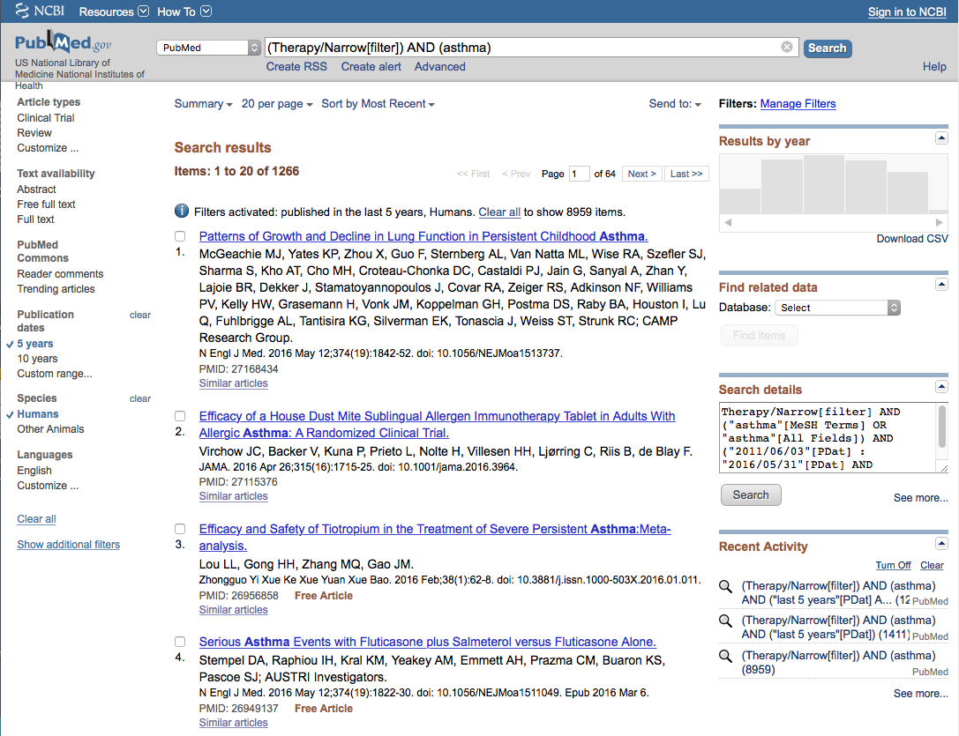
Click English

Slide 23
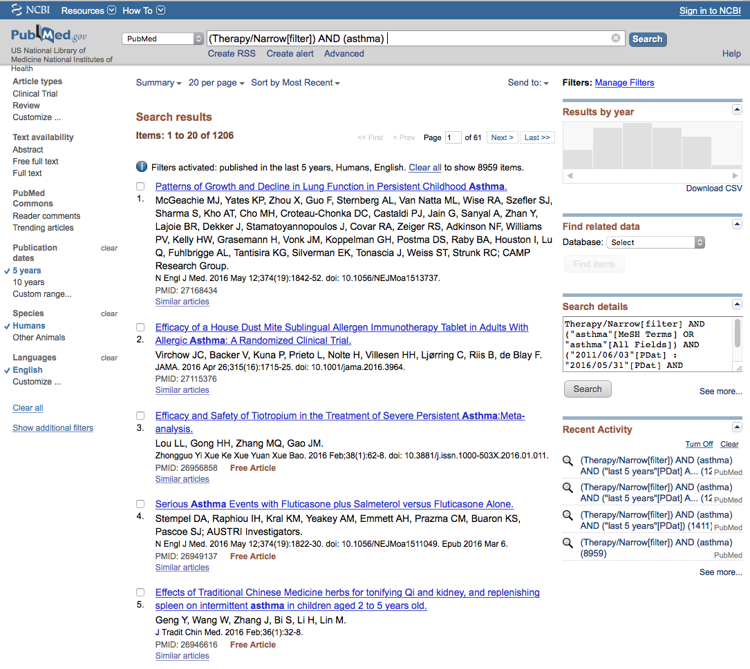
Click Show additional filters

Slide 24
Select Journal categories
✔
Click Show

Slide 25
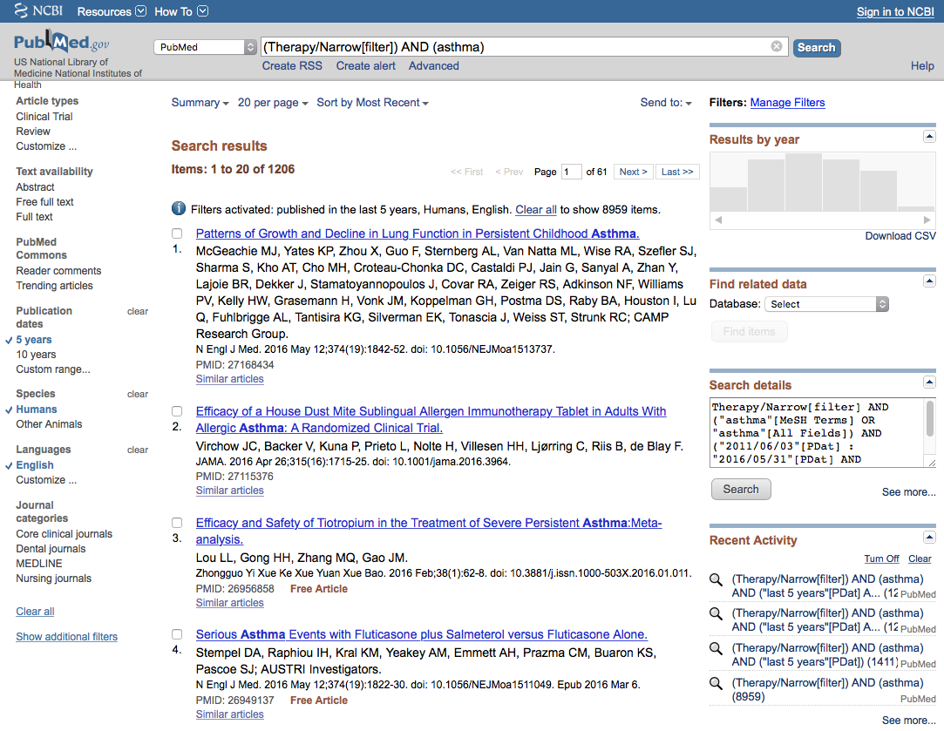
Click Nursing journals

Slide 26
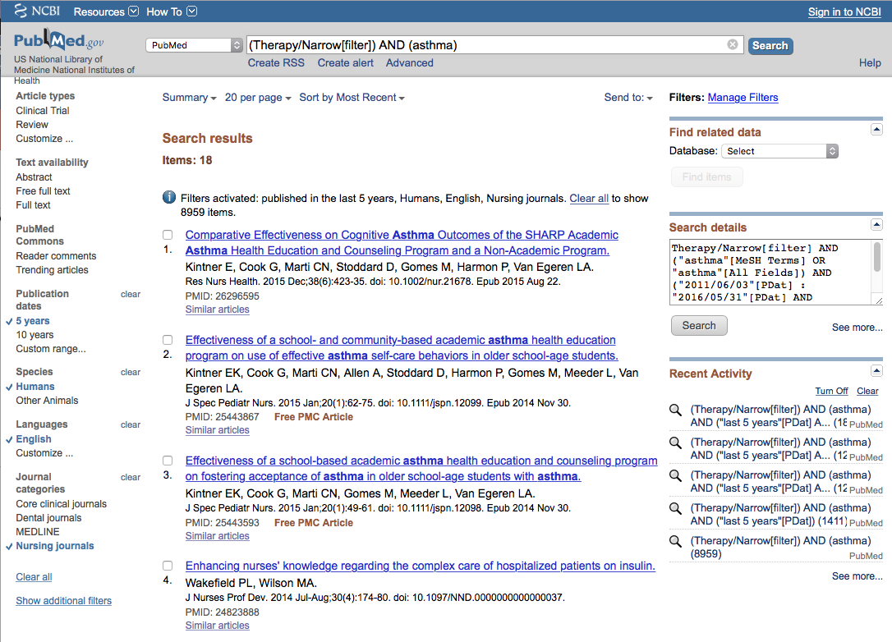
Results have narrowed to 18 articles

Slide 27
Click on the article title you wish to read

Slide 28
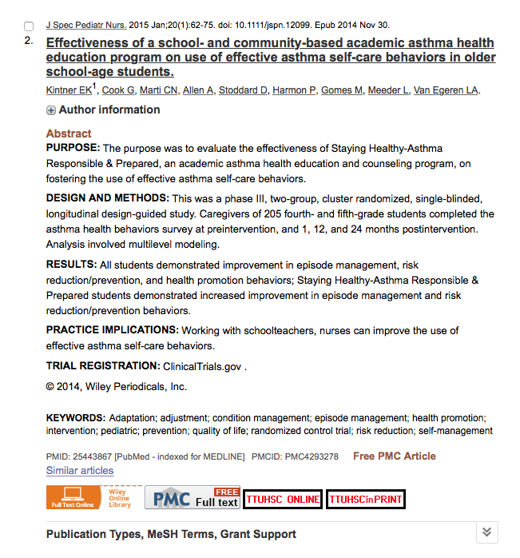
Click for Free Full Text
TTUHSC ONLINE

Slide 29
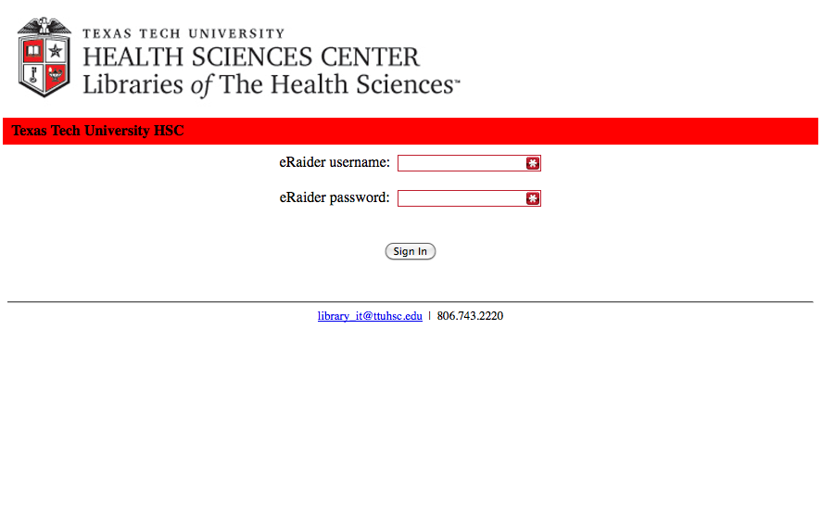
TTUHSC Libraries - Proxy Server
When Searching from Off Campus:
Enter the
Eraider username and password
assigned to you
by Information Services.
A
Problems with eRaider call: 806-743-1234a

Slide 30
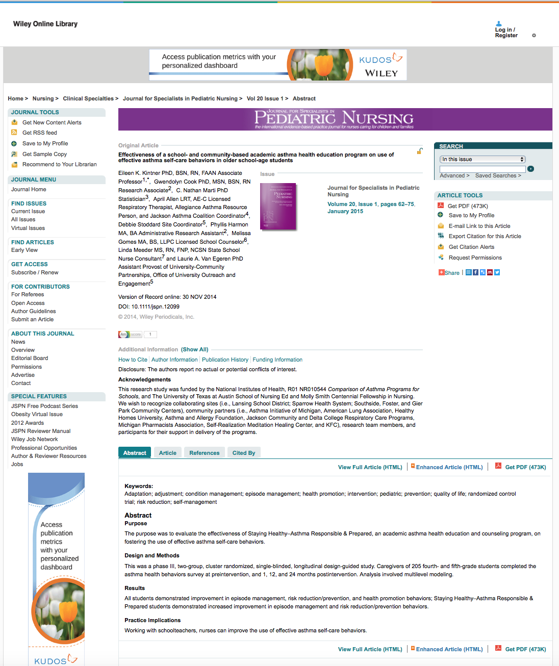

Click

Slide 31
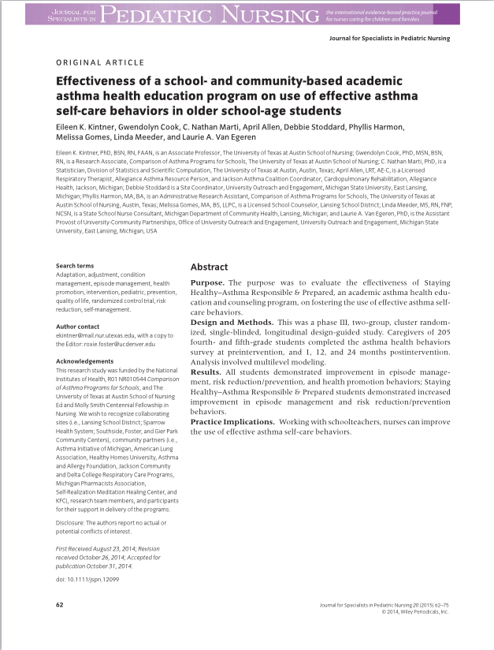
Full Text

Slide 32
What questions do you have?

Slide 33
Finding e-journals in Gold Rush

Slide 34

www.ttuhsc.edu/libraries
Click

Slide 35
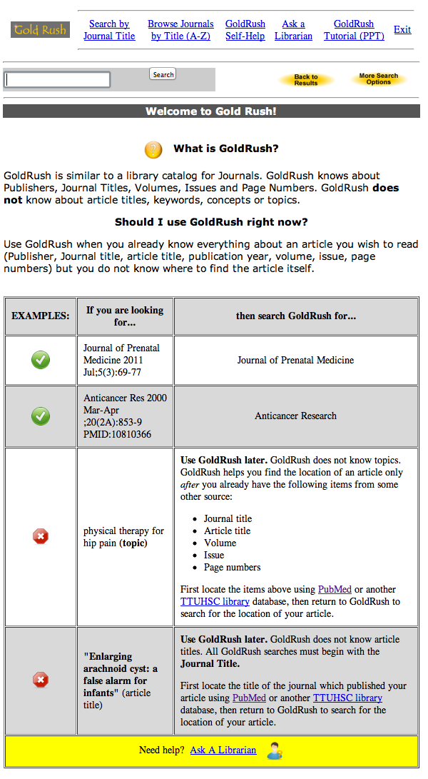
Instructions for using

Slide 36
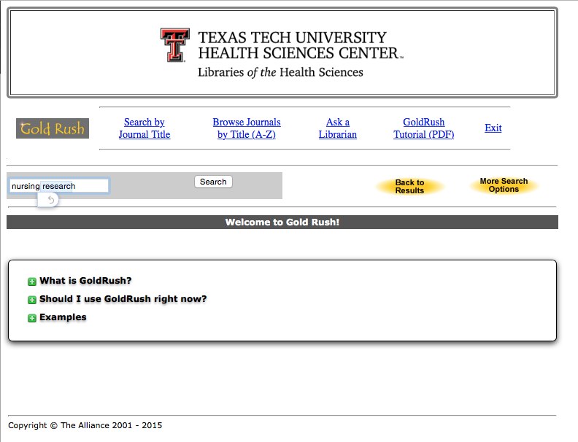
Enter journal title, click
Search
nursing research

Slide 37
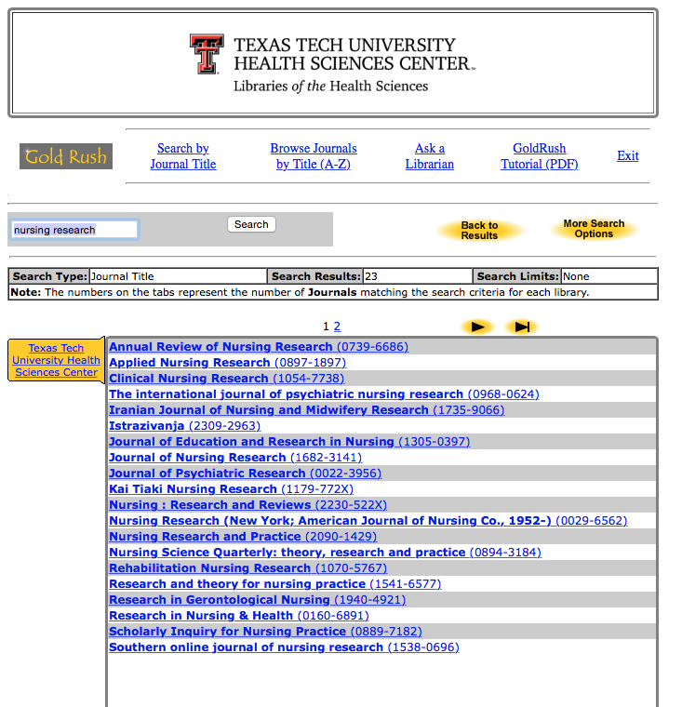
Click Nursing Research

Slide 38
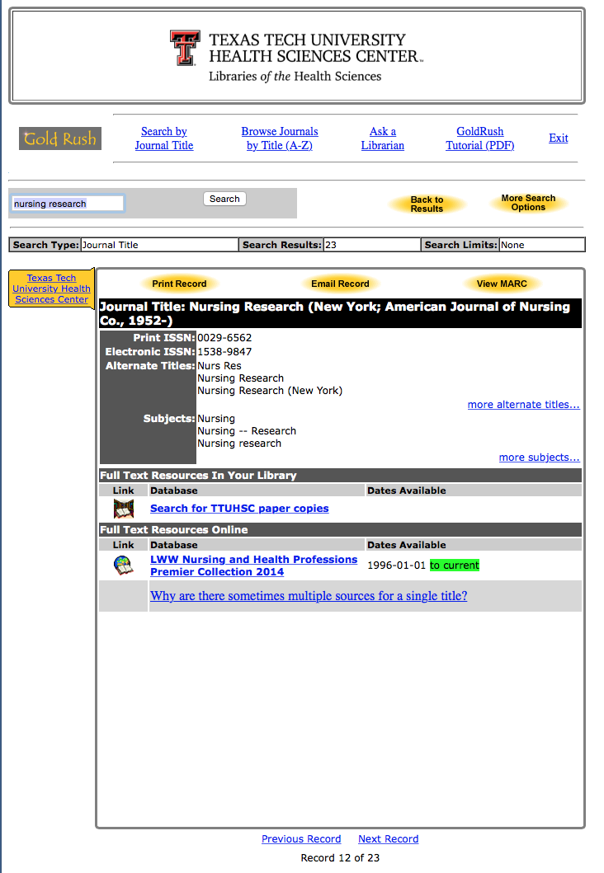
1) Check Dates Available
2) Click Publisher

Slide 39
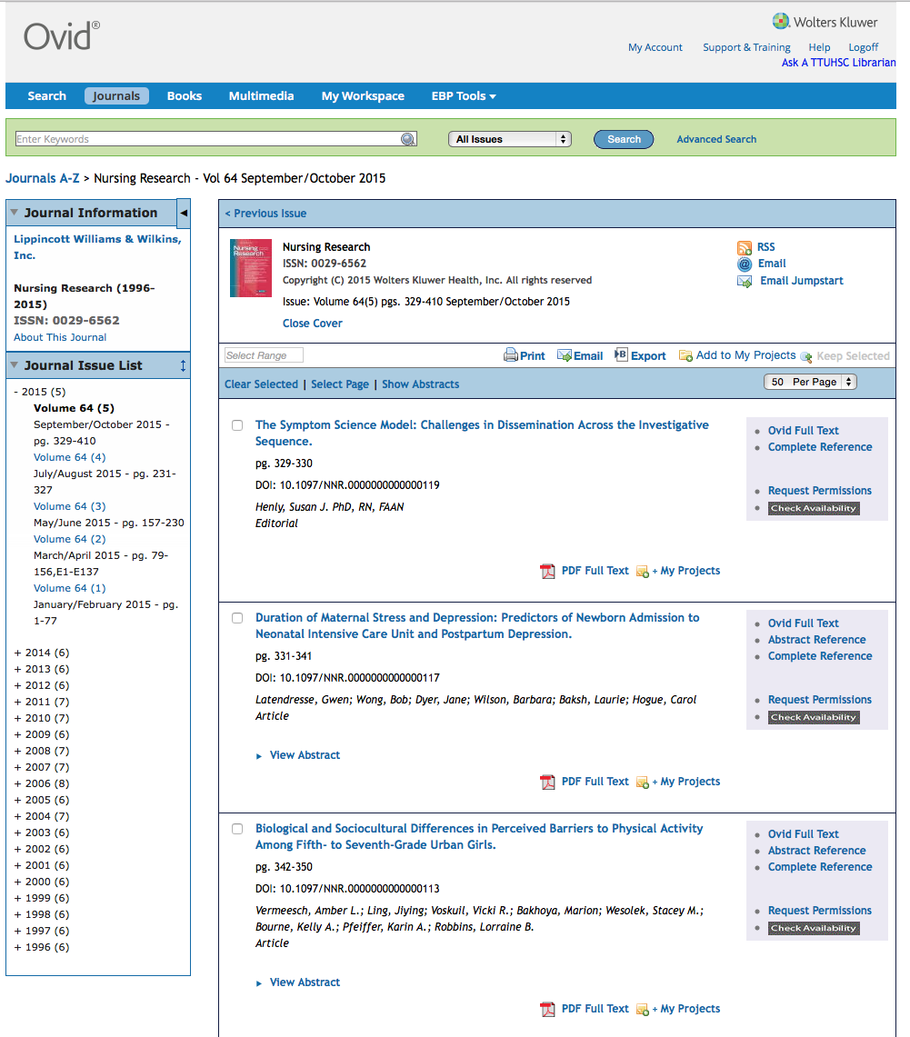
Select Year
Select Volume, Issue
Locate article and click full text link

Slide 40

Full-text

Slide 41
Joanna Briggs Institute’s
JBI COnNECT+
Evidence-based practice information
Developmental tools:
    Practice manuals
    Patient education pamphlets
*
*
*
*

Slide 42

www.ttuhsc.edu/libraries
Click

Slide 43
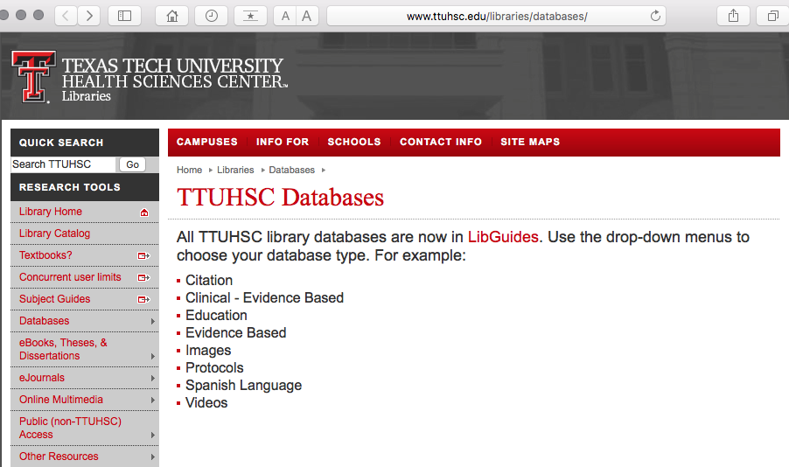
Click LibGuides

Slide 44
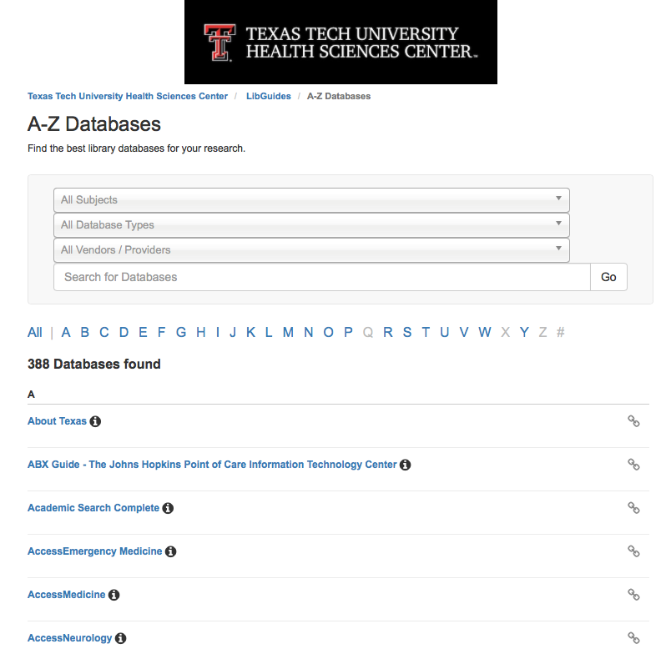
Click “J”

Slide 45
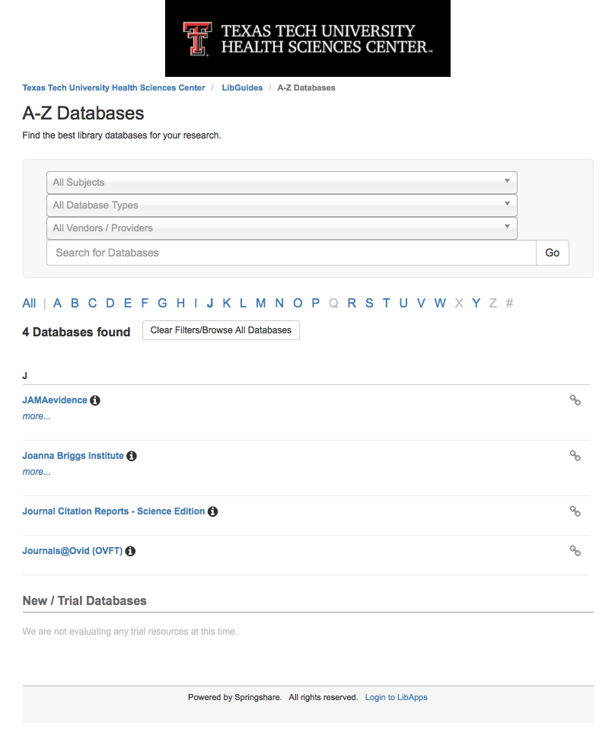
Click Joanna Briggs Institute

Slide 46
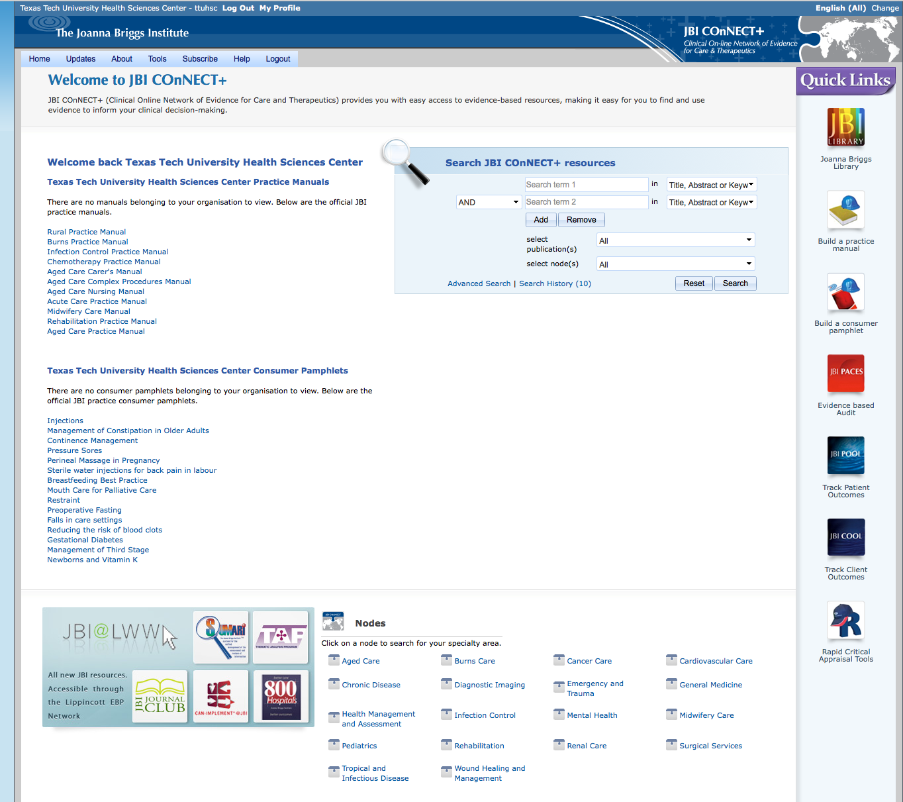
Home Page
Click Advanced Search

Slide 47
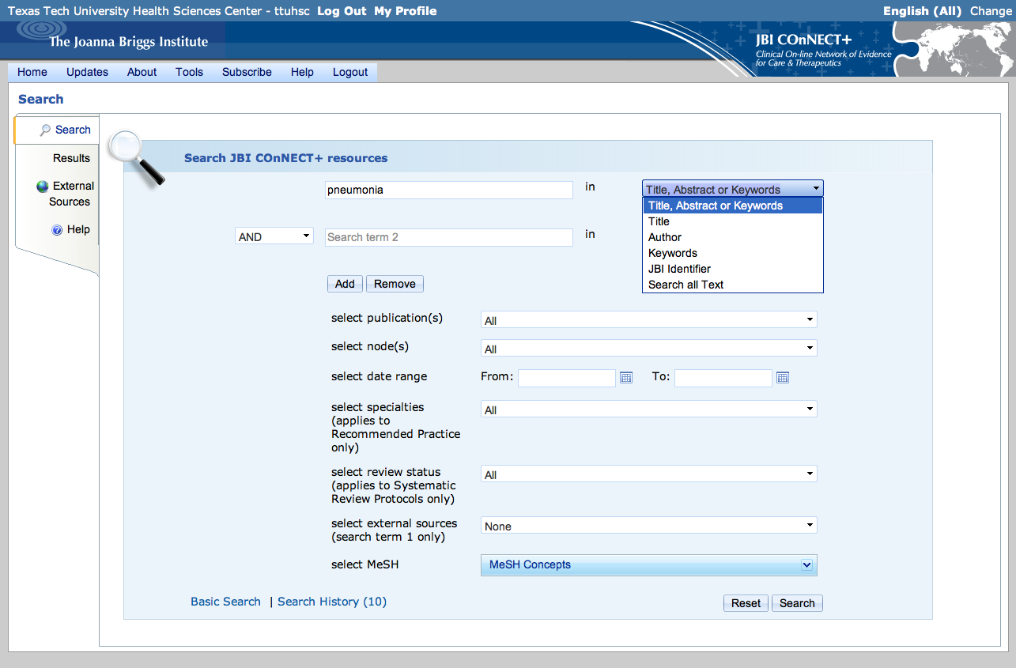
Enter pneumonia as a
Title, Abstract or Keyword search

Slide 48
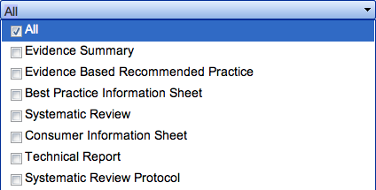
Keep All as the default

Slide 49
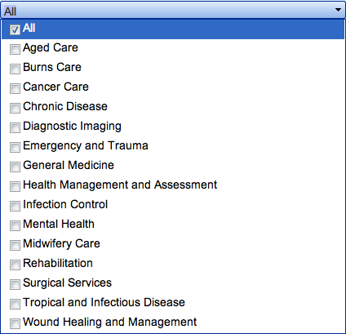
Select Aged Care

Slide 50
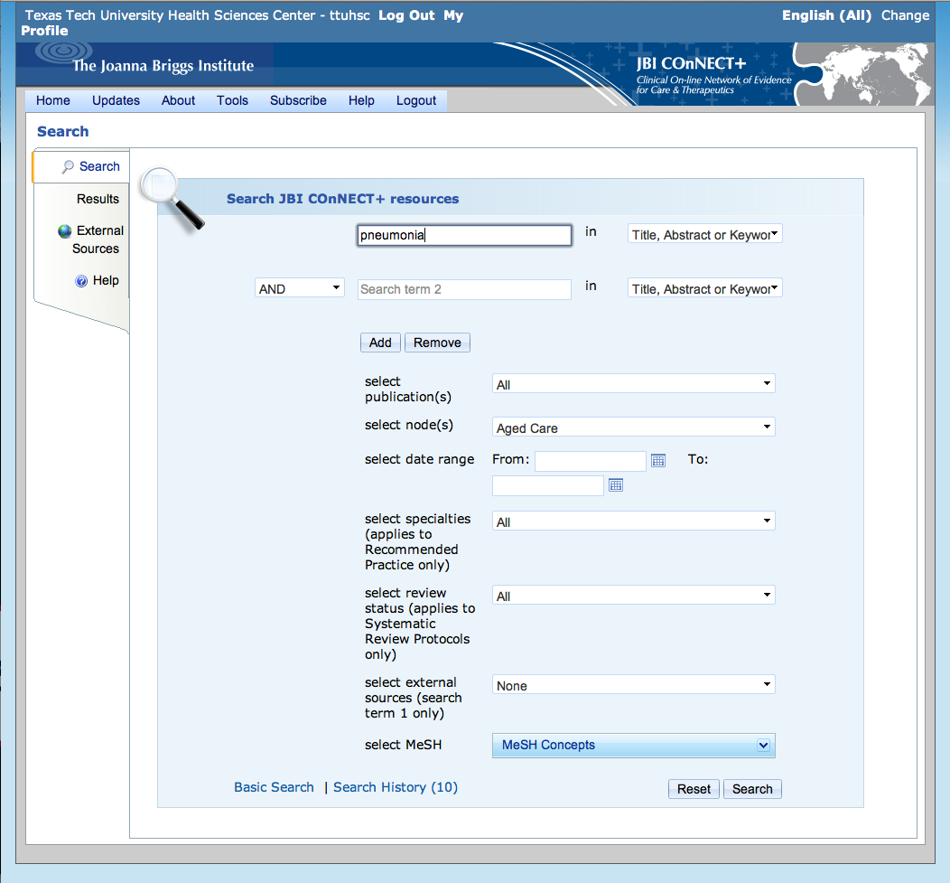
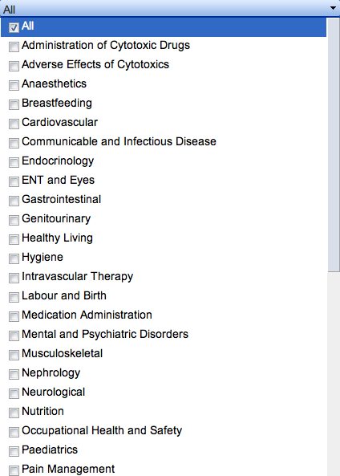
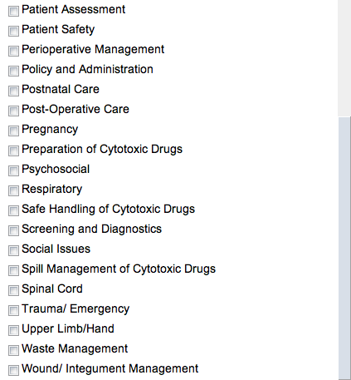
Keep All as the default

Slide 51

Keep All as the default

Slide 52
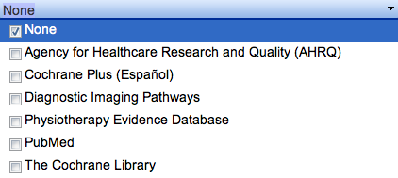
Keep None

Slide 53
Click Search

Slide 54
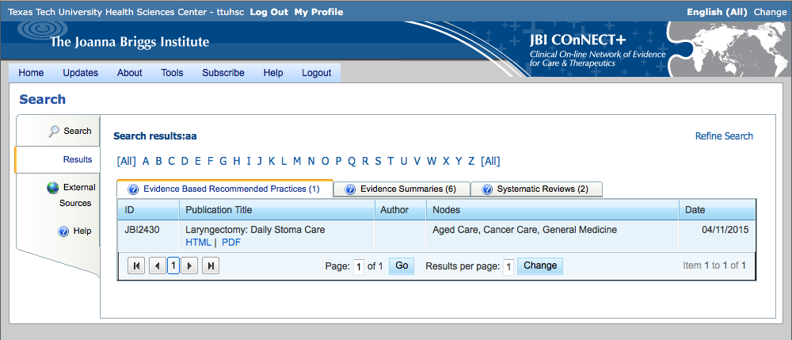
Search Results for Evidence Based Recommended Practices (1)

Slide 55
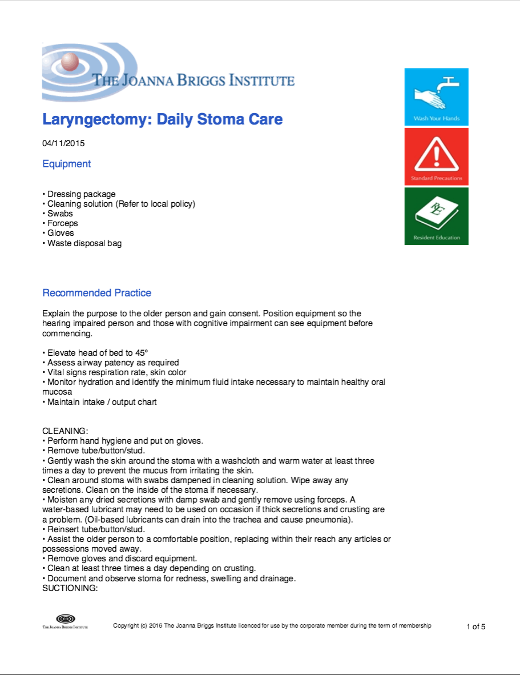
Full Text

Slide 56
Click Home

Slide 57
Practice Manuals

Slide 58
Official JBI Practice Manuals

Slide 59
Select Aged Care Nursing Manual

Slide 60
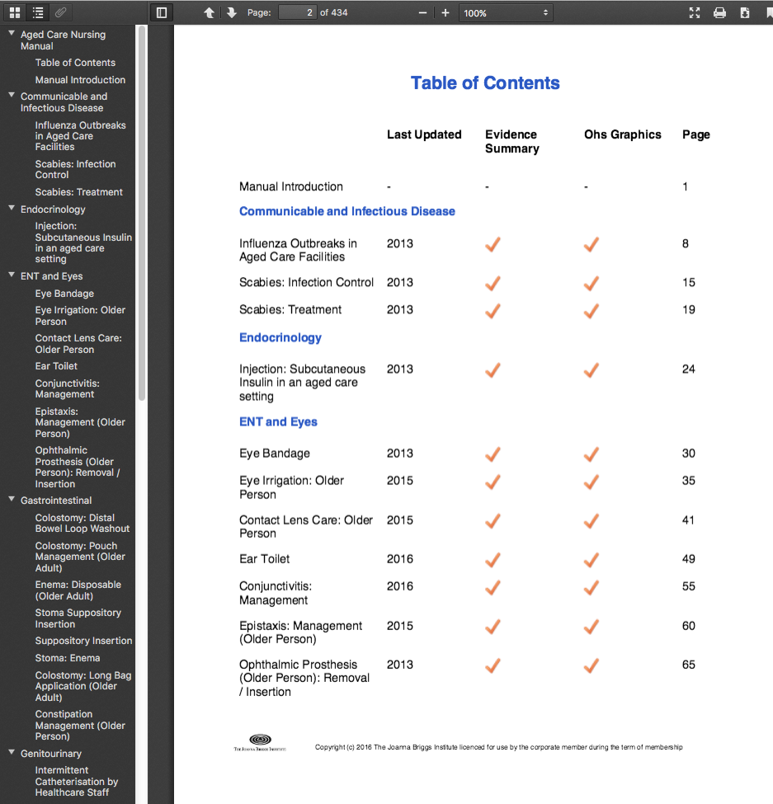
Table of Contents for Aged Care Nursing Manual
Select Influenza Outbreaks in Aged Care Facilities

Slide 61
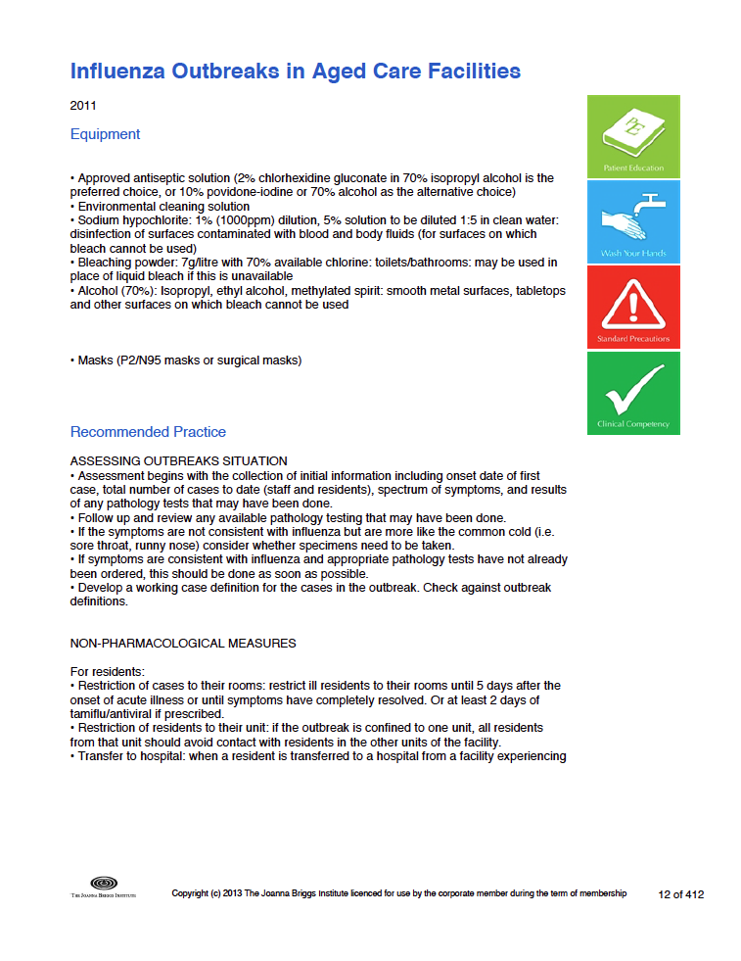
Full-Text Document

Slide 62
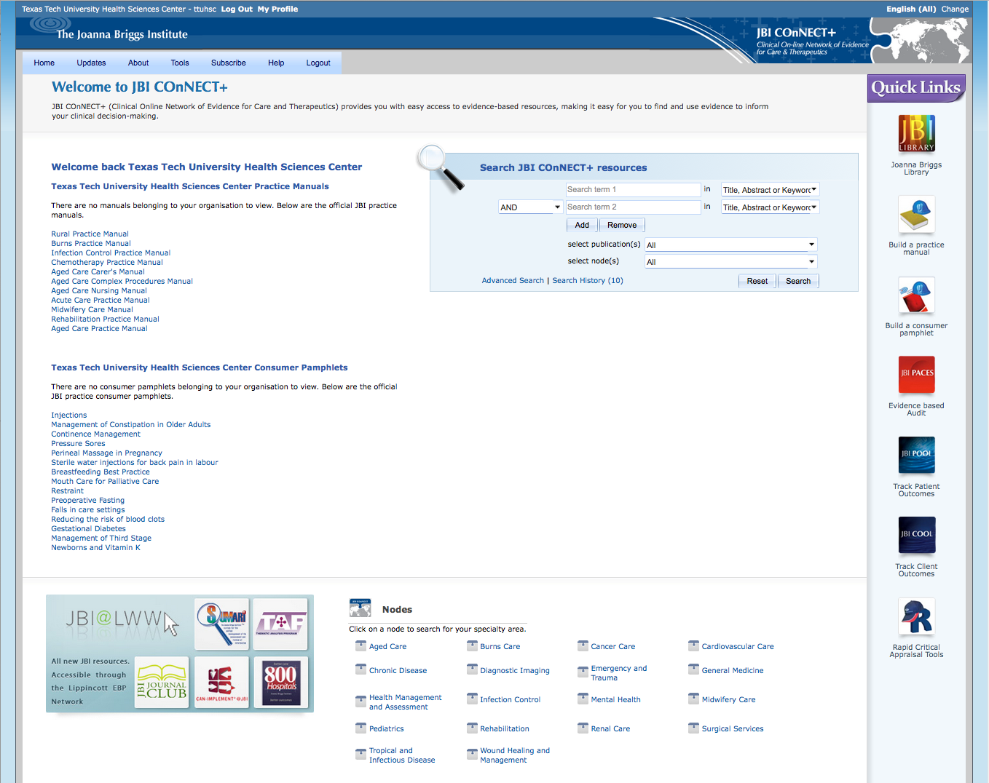
JBI Practice Consumer Pamphlets
Select Breastfeeding Best Practice

Slide 63

Example

Slide 64
Tools
Specialty Areas

Slide 65
What questions do you have?

Slide 66
PEPID
6/2/2015

Slide 67

www.ttuhsc.edu/libraries
Click Popular
Resources
by School

Slide 68
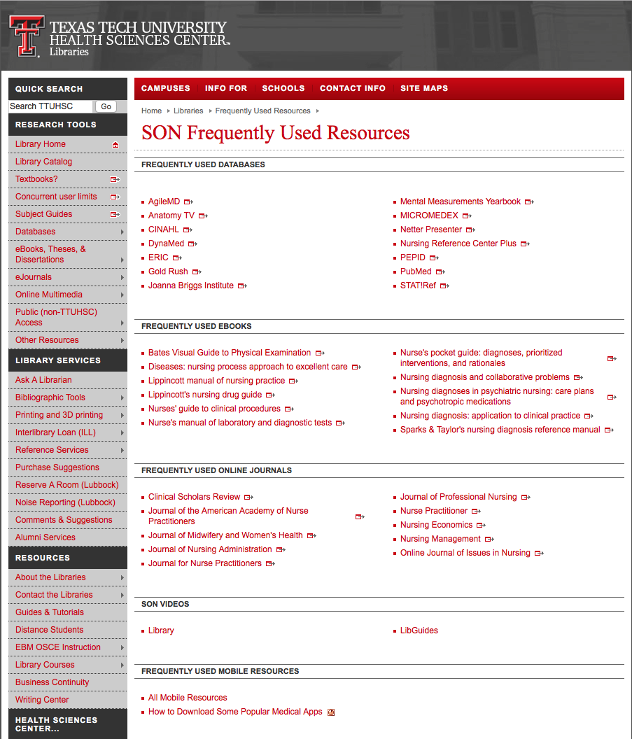
Click PEPID

Slide 69
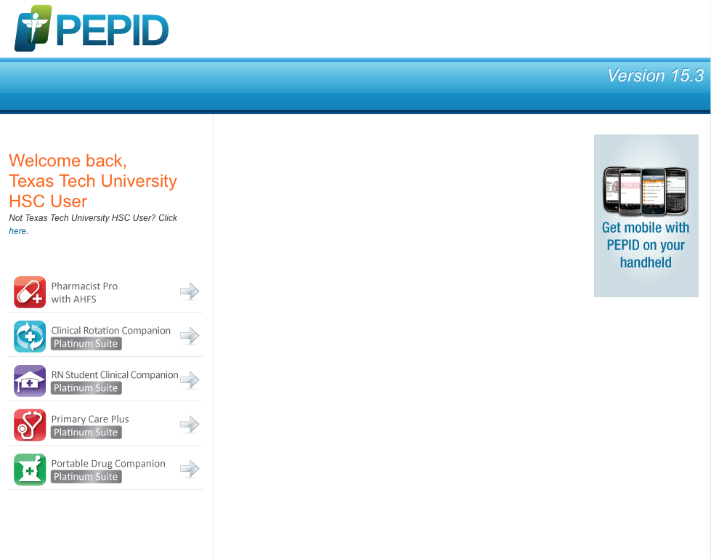
Click RN Student Clinical Companion

Slide 70
Comprehensive point-of care resource
Formatted for smart phones and tablets

Slide 71
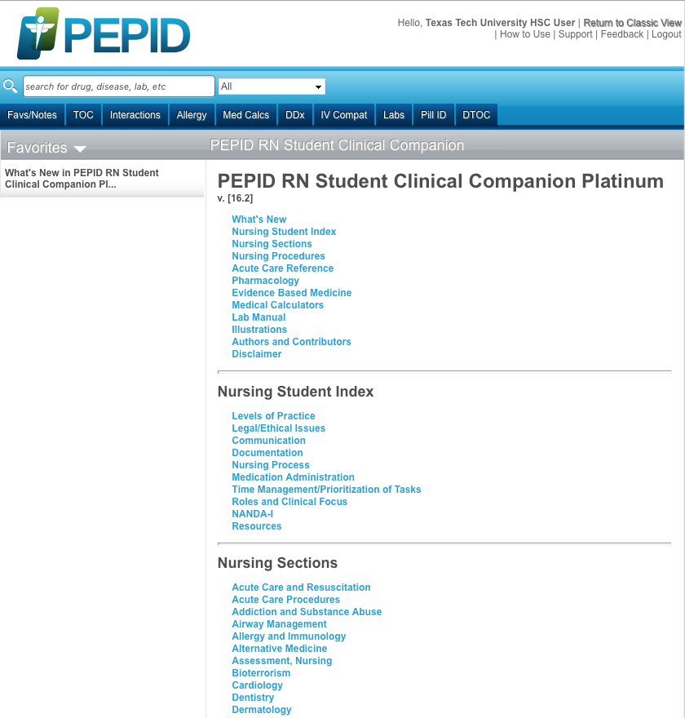
Home Page
Table of Contents
Scroll Screen

Slide 72
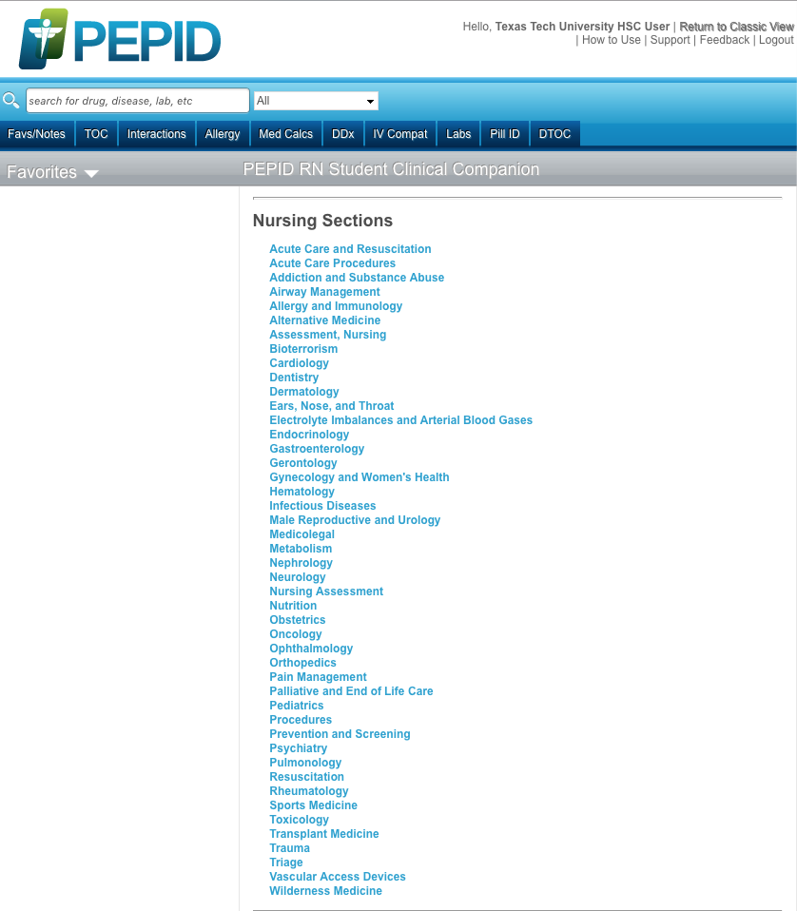
PEPID includes:
Information for different nursing specialties

Slide 73
PEPID includes:
Click Pediatrics

Slide 74
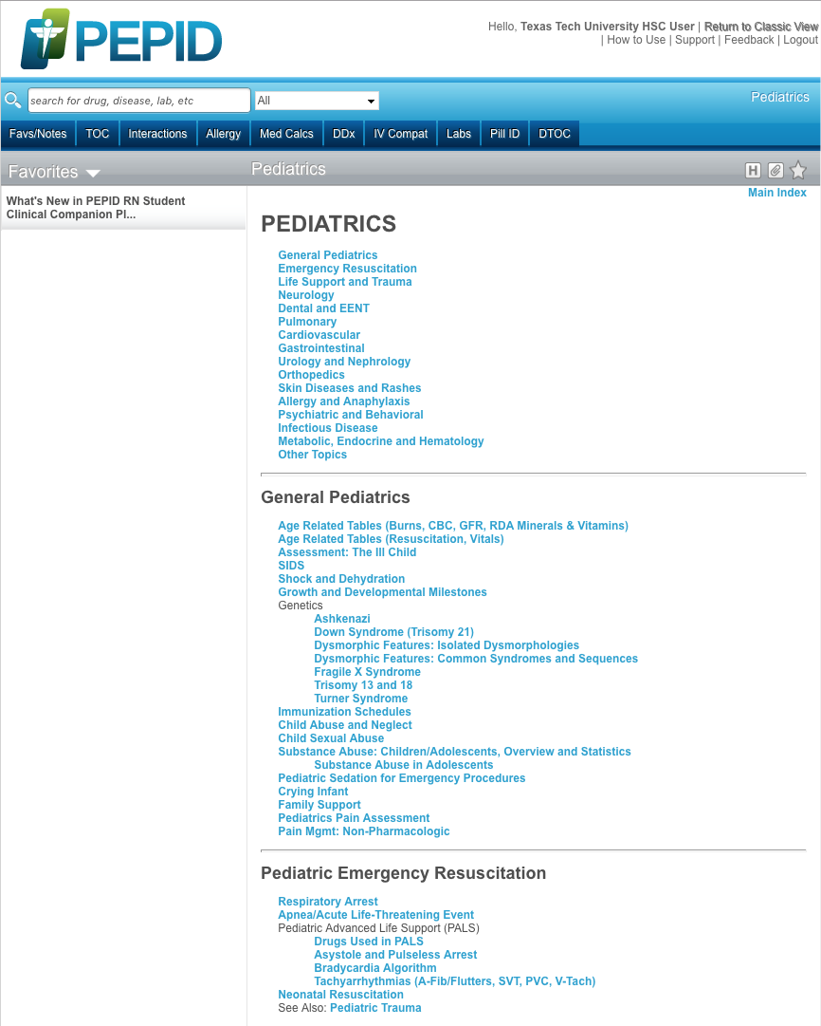
Click
Life Support & Trauma

Slide 75
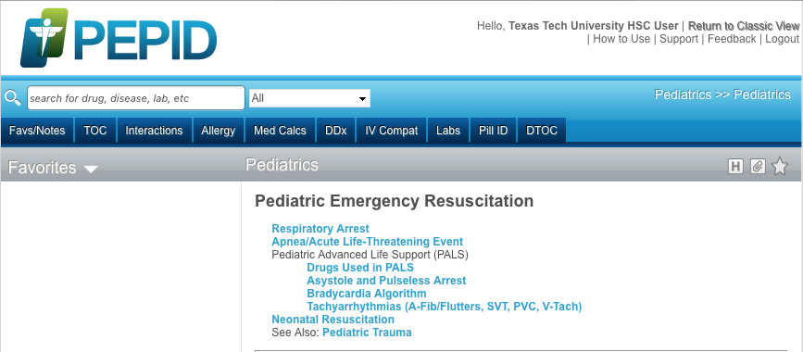
Click
Respiratory Arrest

Slide 76

Example

Slide 77
Click Table of Contents

Slide 78
Scroll Screen

Slide 79

PEPID includes:
Drug Information

Slide 80
PEPID includes:
Medical Calculators

Slide 81
PEPID includes:
Lab Manual

Slide 82
PEPID includes:
Illustrations

Slide 83
What questions do you have?

Slide 84
Bibliographic Tools

Slide 85


Bibliographic Tools
www.ttuhsc.edu/libraries
Click

Slide 86


Free subscriptions to
3 login
Link to Basics of APA Style

Slide 87
RefWorks or EndNote accounts:
create while within TTUHSC
Use online tutorials
(see following slides)

Slide 88

Create account

Slide 89

RefWorks LibGuide

Slide 90


Slide 91

Endnote.com/training/guide/windows
Endnote.com/training/guide/mac

Slide 92


Slide 93
What questions do you have?

Slide 94
Mobile Resources

Slide 95

Many Information Resources
are Mobile!

Slide 96

www.ttuhsc.edu/libraries
Click Mobile Resources

Slide 97


www.ttuhsc.edu/libraries
Click Mobile Resources

Slide 98




Scroll to resource
Click appropriate icon for your device

Slide 99
Have Questions
or
Need Help?

Slide 100
Guides & Tutorials

Slide 101
www.ttuhsc.edu/libraries
Click
Guides & Tutorials

Slide 102

Database Guides & Tutorials

Slide 103

Today’s PowerPoint
www.ttuhsc.edu/libraries
Click Popular
Resources
by School

Slide 104

PowerPoint for
DNP June 2016

Slide 105

www.ttuhsc.edu/libraries
Click

Slide 106

Fill out the form to email us a question!

Slide 107
Evaluation

Slide 108
The End

