Slide 1
Welcome
Surgery Clerkship
Introductory Orientation
EBM Resources Course
Peggy Edwards, AMLS
TTUHSC - Preston Smith Library
Lubbock, Texas 79430
7/2016

Slide 2
Welcome to the
Surgery Clerkship Orientation
EBM Searching Course!

Slide 3
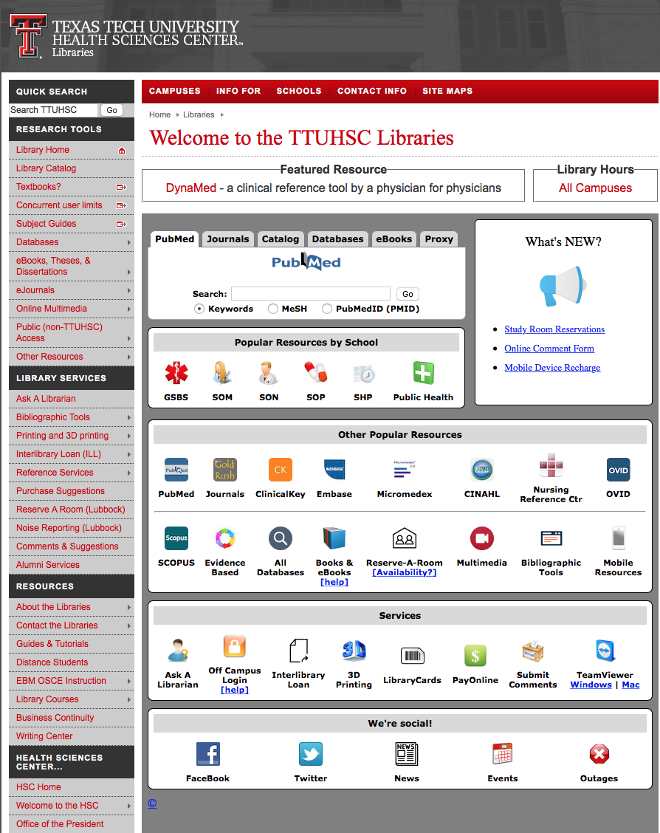
www.ttuhsc.edu/libraries
Click
Library Courses

Slide 4
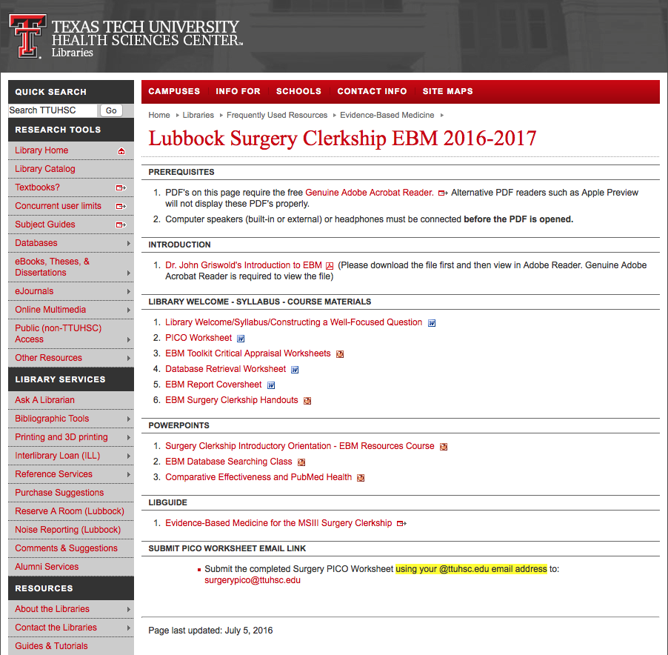
Course Materials

Slide 5
Dr. Griswold’s video

Slide 6
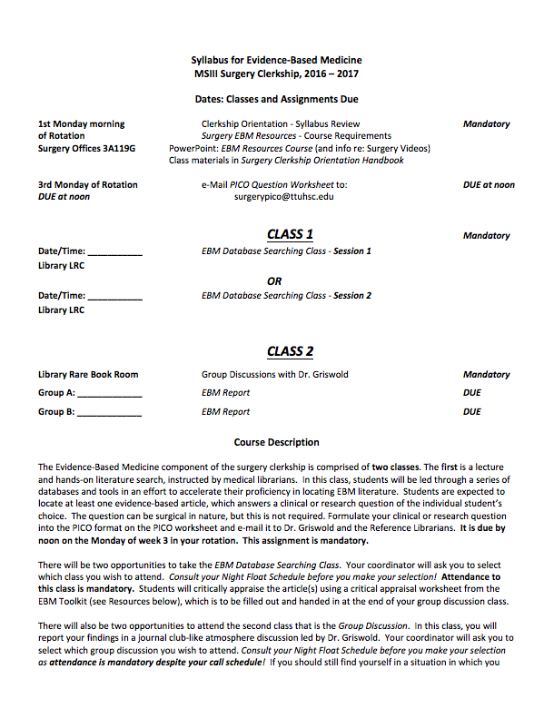
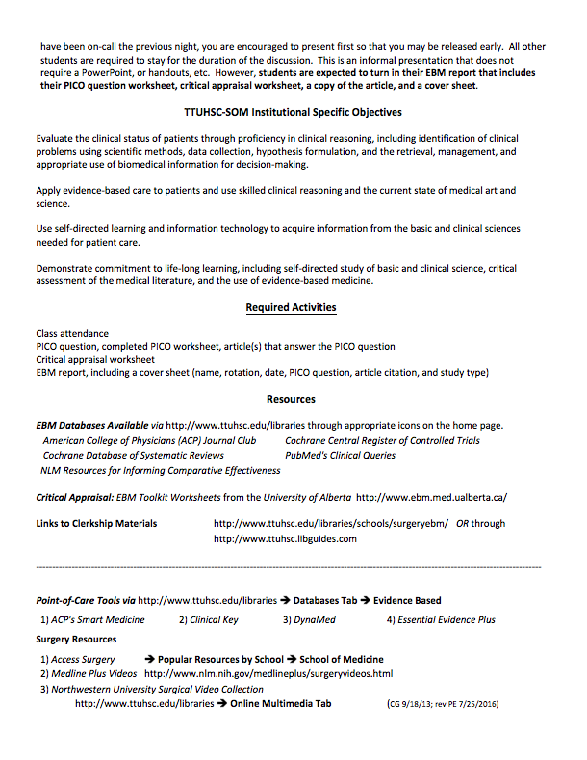
Syllabus

Slide 7
www.ttuhsc.edu/libraries
or Go to LibGuides
under Subject Guides

Slide 8
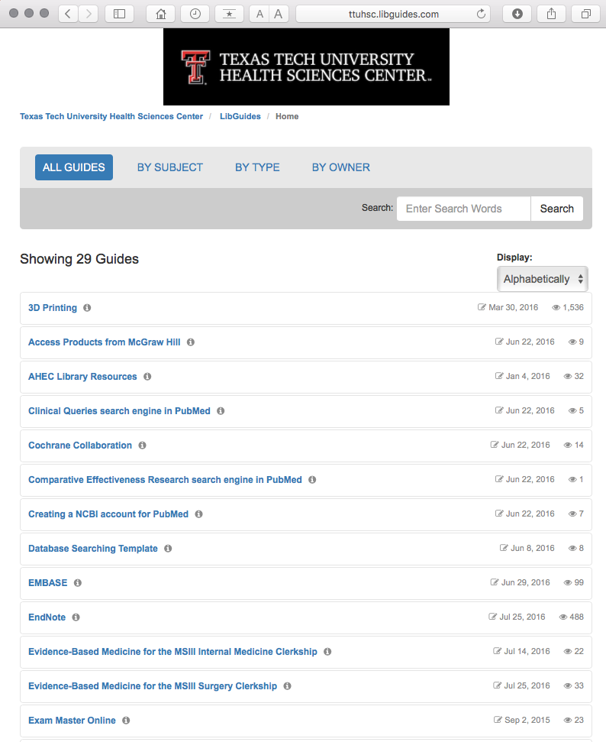
Select Evidence-Based Medicine for the MSIII Surgery Clerkship

Slide 9
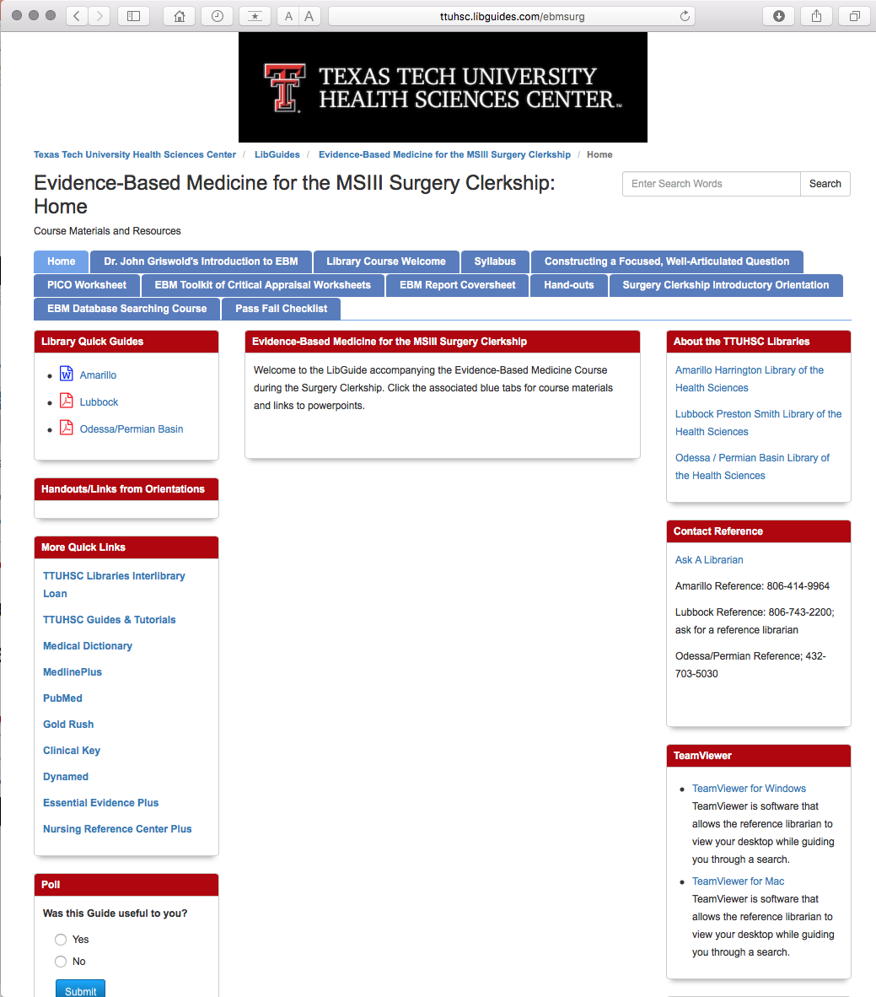

Slide 10
Two Classes:
1. EBM Database Searching
2. Group Discussion

Slide 11
EBM Database
Searching Class

Slide 12
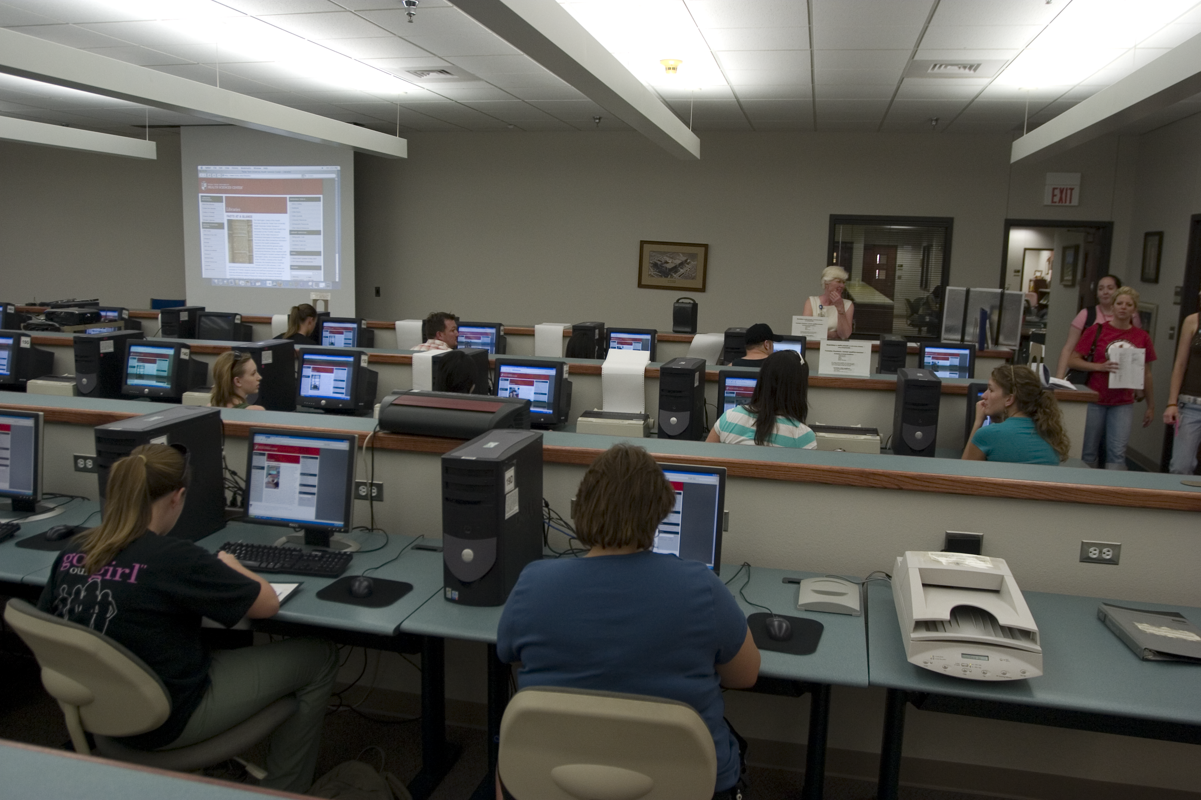
1) EBM Database Searching Class - Mandatory Attendance J
  1 Session for Group 1 and 1 Session for Group 2 (on separate weeks)
  in the Learning Resources Center
  how to search the Cochrane EBM Databases & NLM’s Comparative Effectiveness
  PowerPoint lecture and hands-on follow along
  search for article(s) that answer your PICO question
  searching guidance from assigned librarian

Slide 13
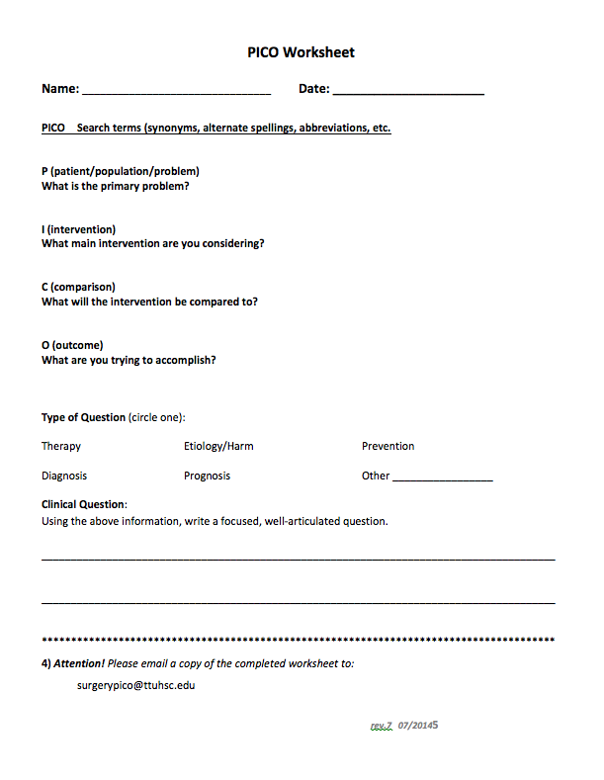
In adult male patients with recent myocardial infarction, does a
single daily dose of 300 mg of aspirin prevent re-infarction?
P
adult male patients with recent MI
I
daily dose of 300 mg of aspirin
C
placebo
O
prevent re-infarction

Slide 14
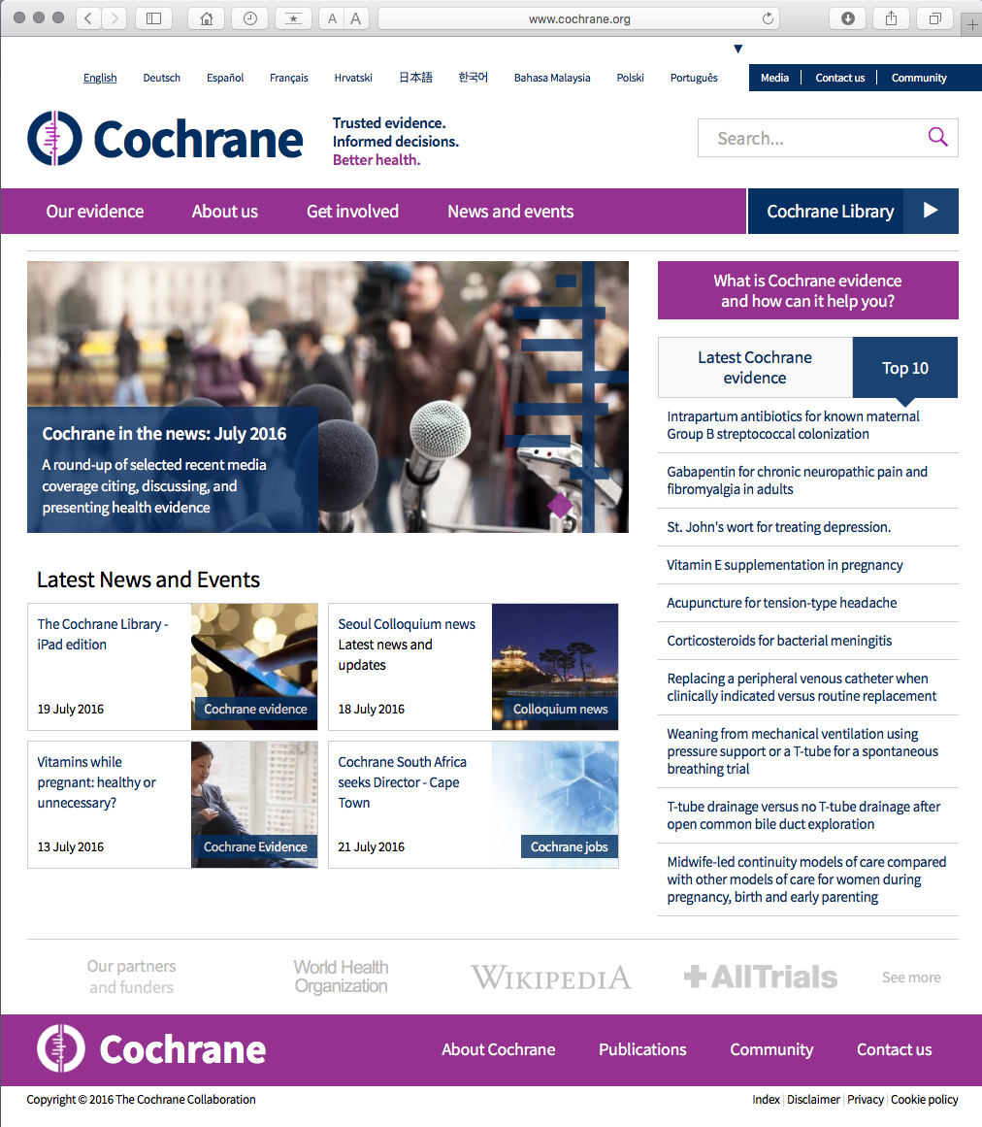
www.cochrane.org

Slide 15
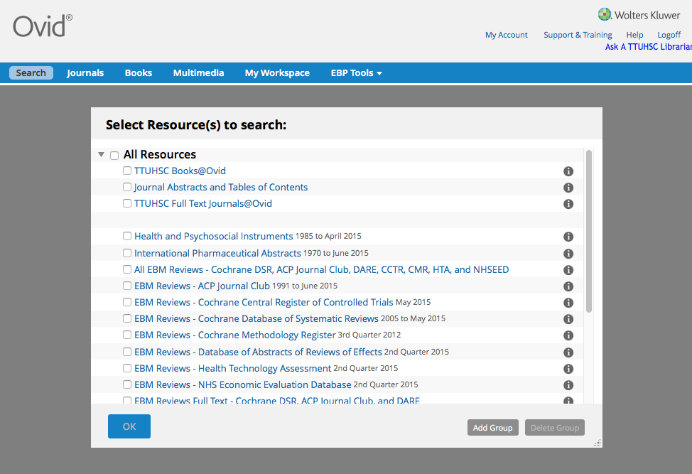
www.ttuhsc.edu/libraries

Slide 16
Critical Appraisal

Slide 17
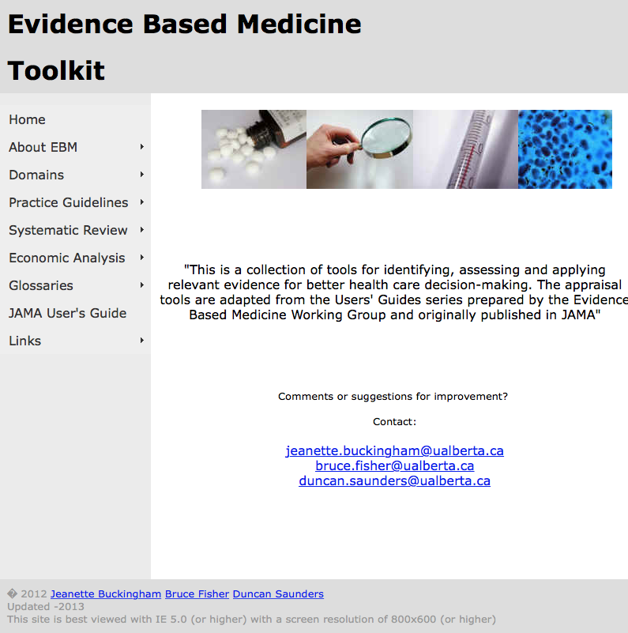
http://www.ebm.med.ualberta.ca/

Slide 18
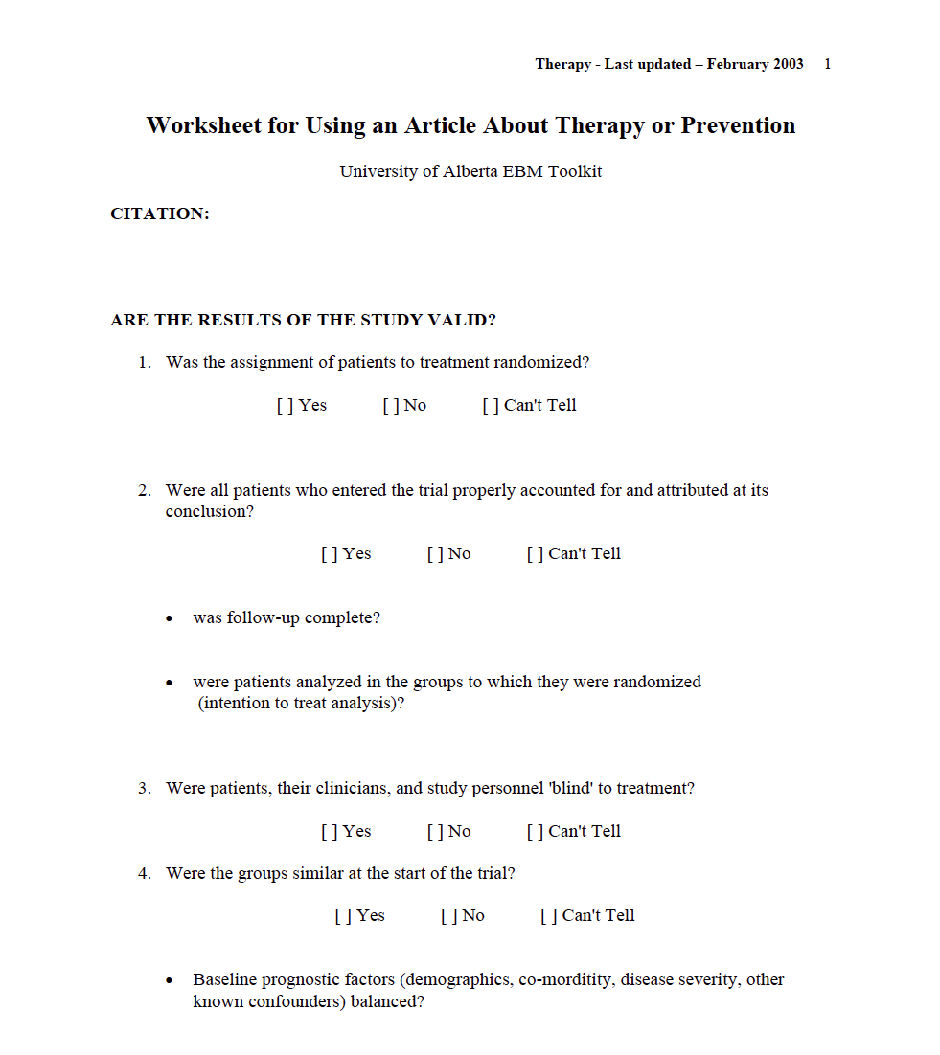
Critical Appraisal Worksheet: www.ebm.med.ualberta.ca

Slide 19
Group Discussion
Class

Slide 20
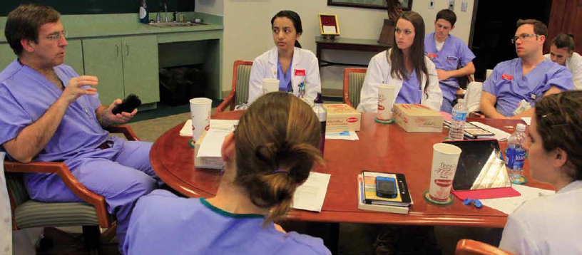
2) Group Discussion “EBM Journal Club” with Dr. Griswold
  in the Library’s Rare Books Conference Room
  state your focused, well-articulated PICO question
  describe databases searched and search strategy
  state author, article title, journal, and date published
  discuss study design, validity and reliability, research findings
  commentary and q & a from Dr. Griswold
  turn in your EBM report including PICO question worksheet, critical appraisal worksheet, copy of the article, and cover sheet
  casual atmosphere and bring your own lunch!

Slide 21
EBM Report

Slide 22
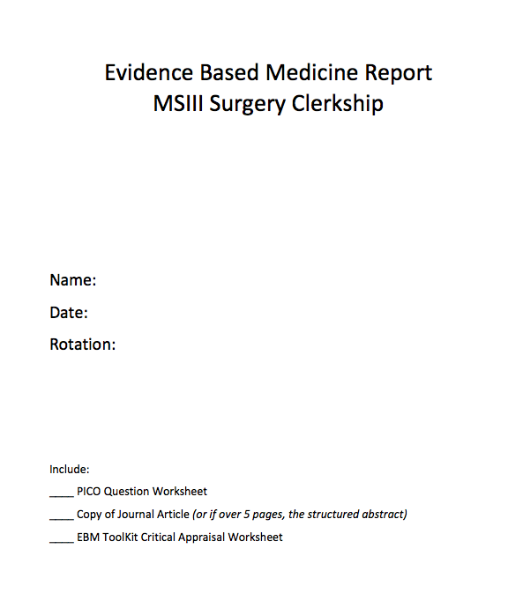
EBM Report Cover Sheet

Slide 23
Questions?

Slide 24
Surgery Resources

Slide 25
Access Surgery

Slide 26

www.ttuhsc.edu/libraries
Click
under Popular Resources by School

Slide 27
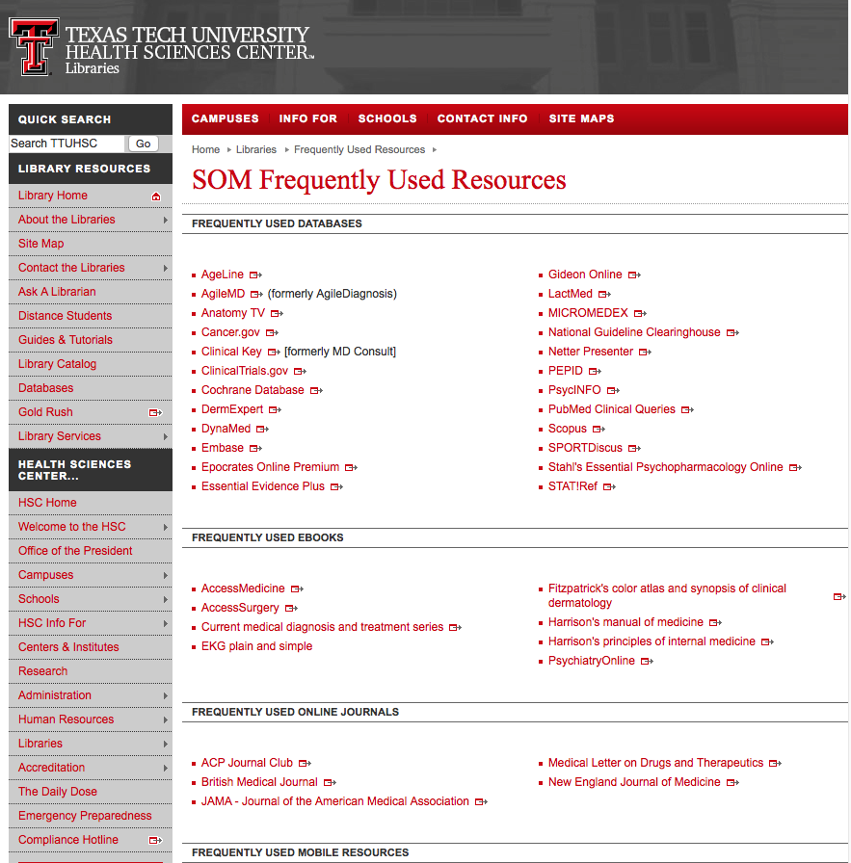
Click Access Surgery

Slide 28
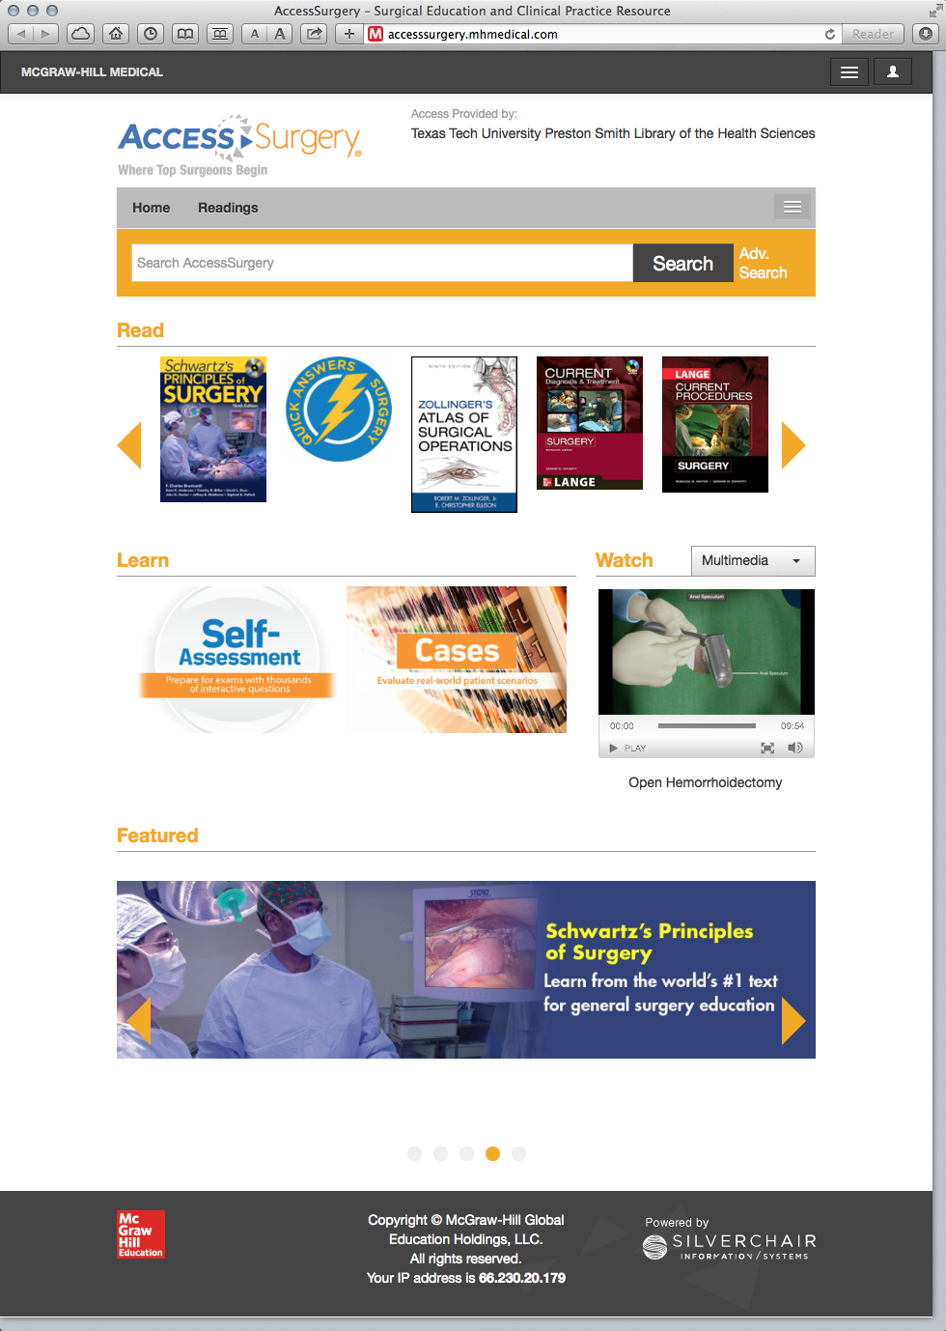
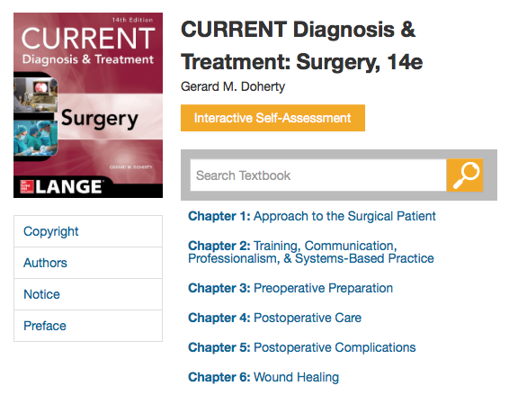
Major Surgical Electronic Textbooks- free!

Slide 29
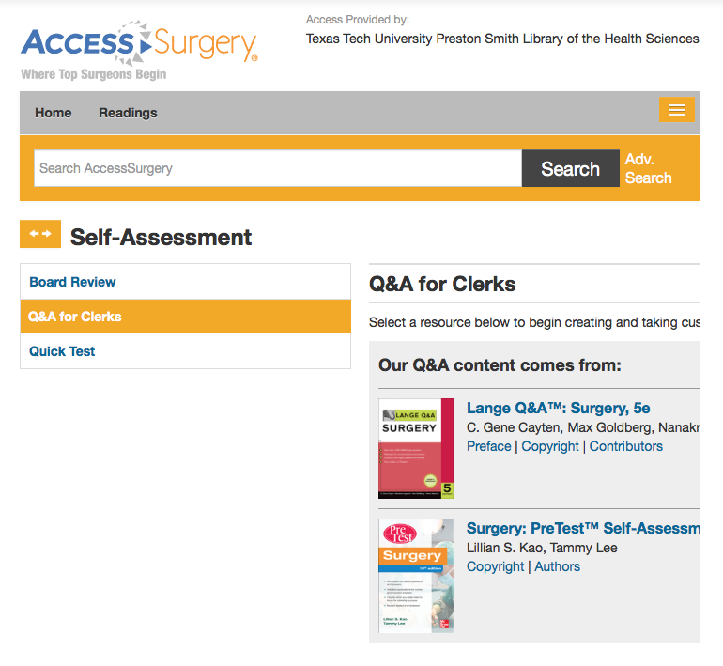
Click

Slide 30
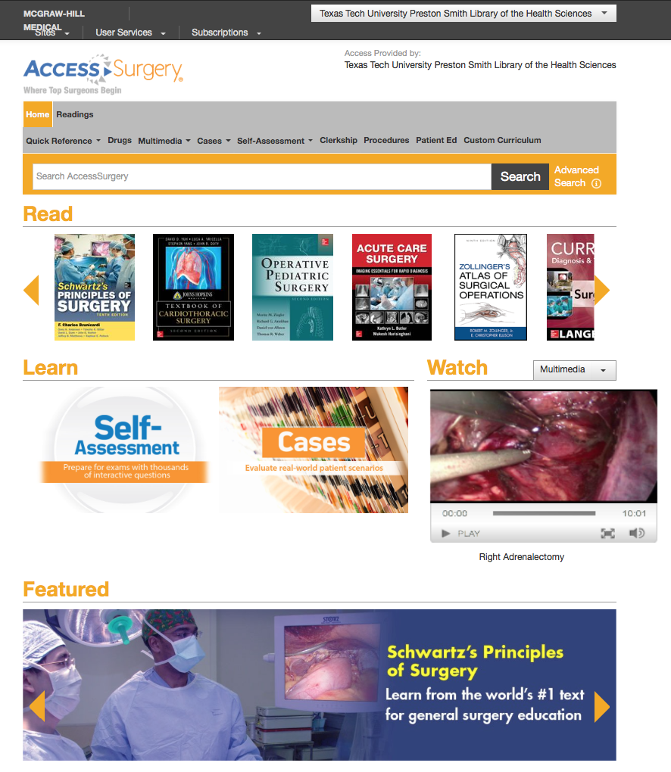

Slide 31
Medline Plus Videos

Slide 32
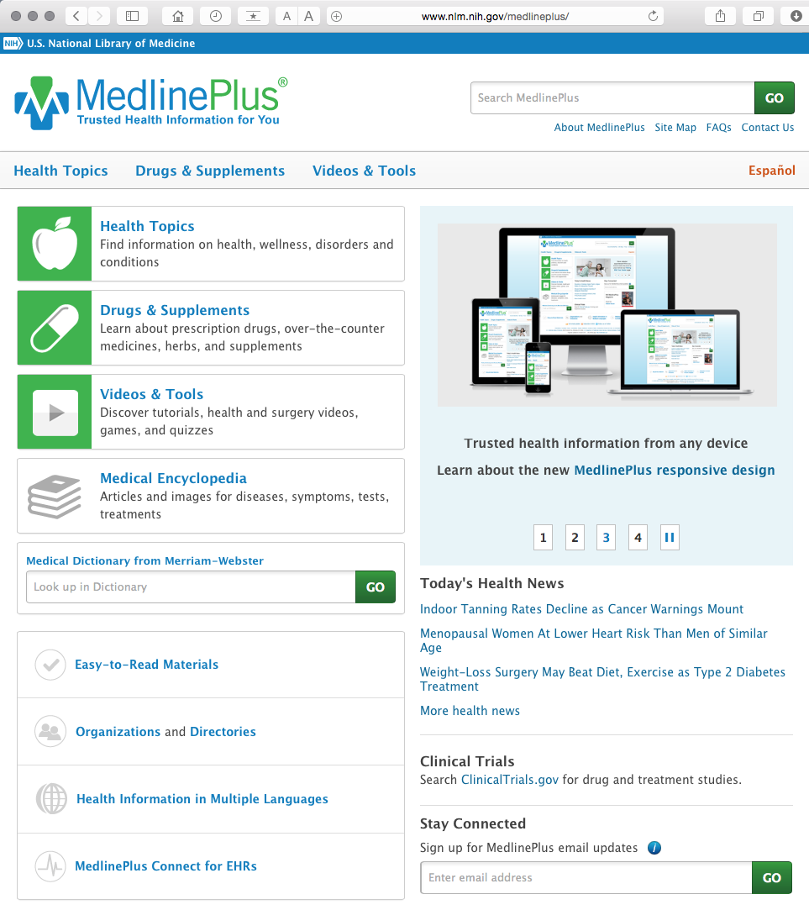
www.medlineplus.gov

Slide 33
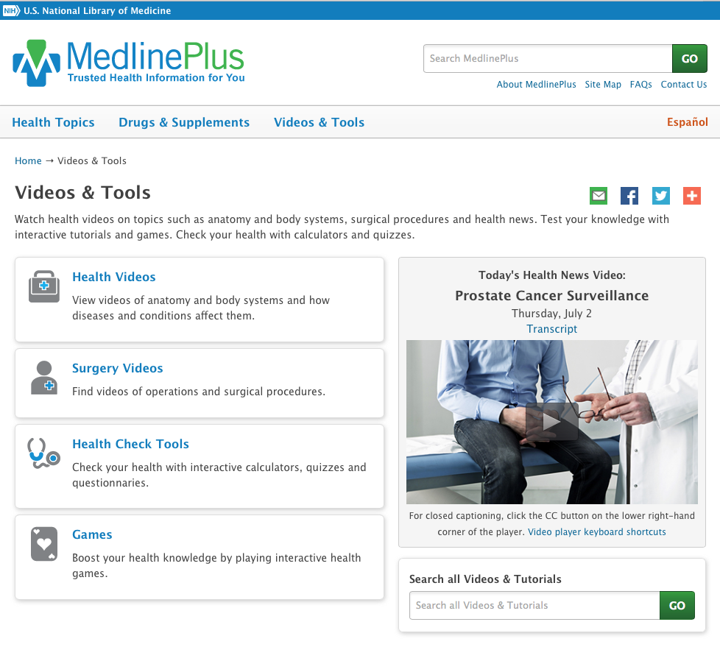

Slide 34
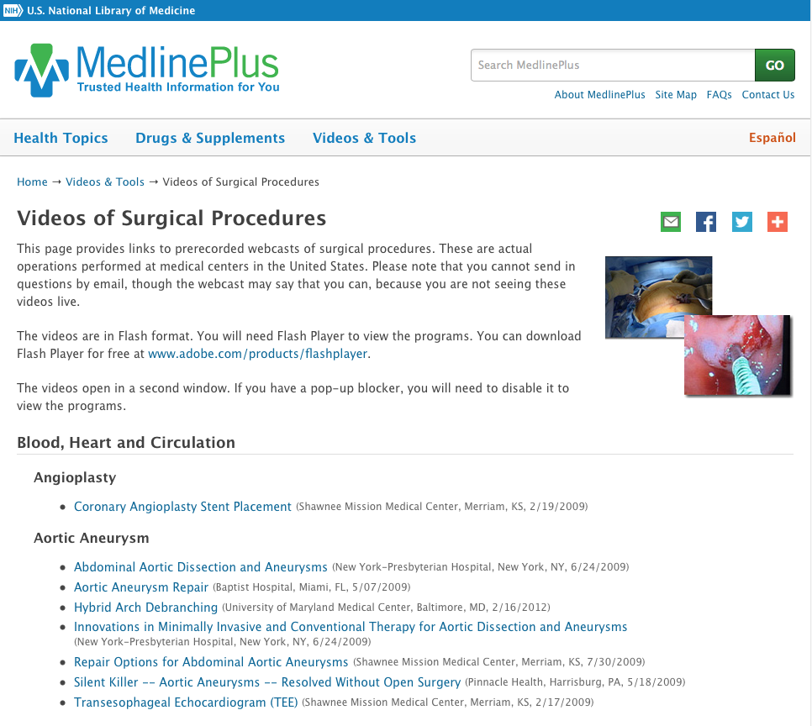

Slide 35
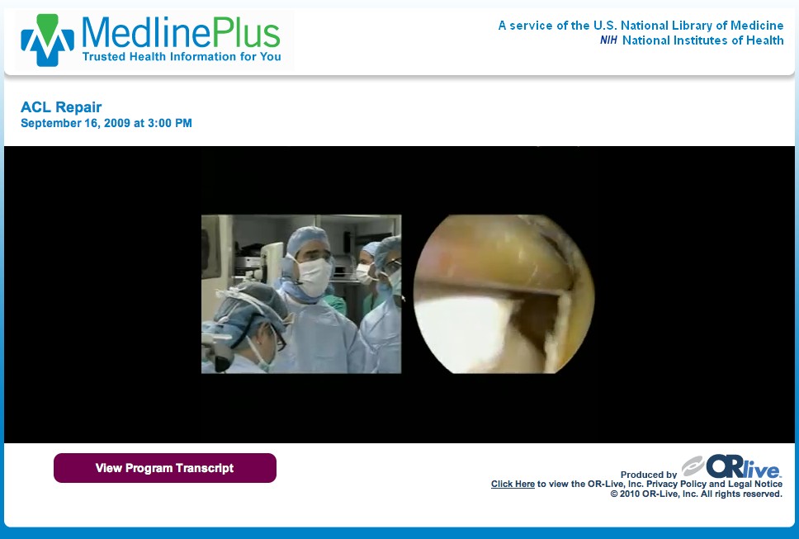

Slide 36
Northwestern University
Surgical Video Collection

Slide 37
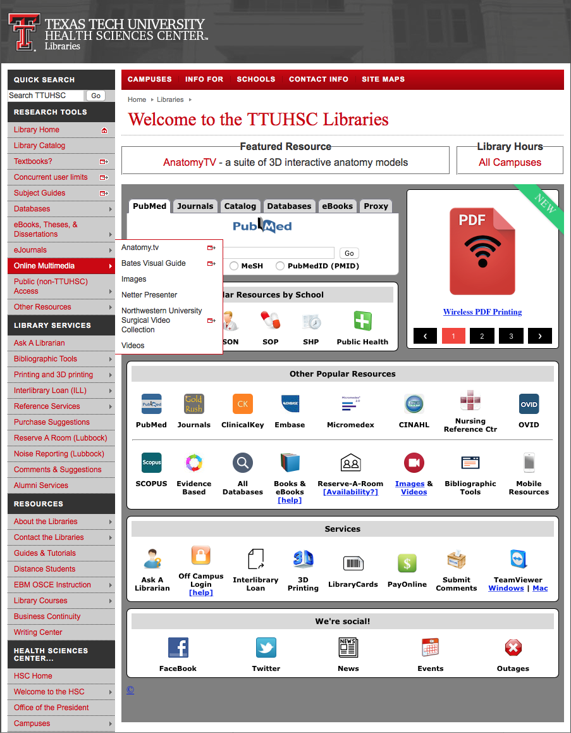
www.ttuhsc.edu/libraries
Click

Slide 38
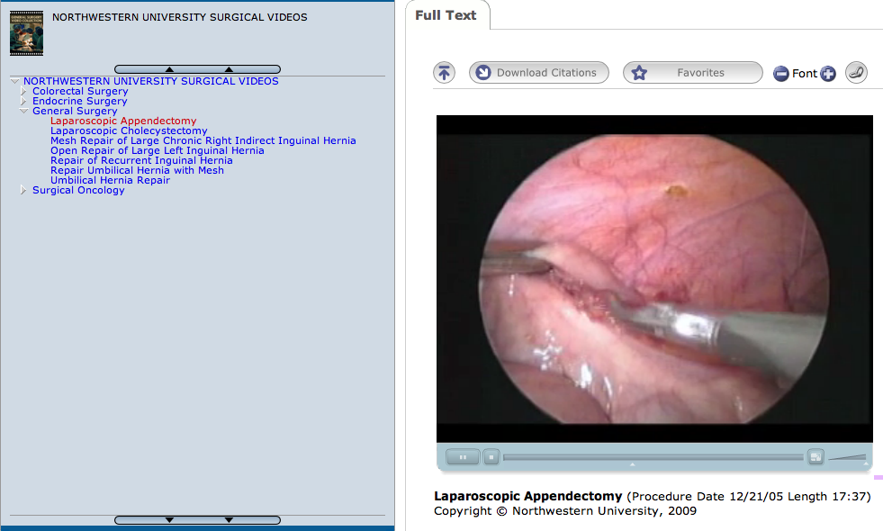

Slide 39
EBM Point of Care Tools
decision support information accessible at the patient’s bedside or the “point of care”
data that is evaluated and rated with levels of evidence
clinical information including
  history and physical
  signs and symptoms
  differential diagnosis
  diagnosis
  therapy
  follow-up
  guidelines

Slide 40
www.ttuhsc.edu/libraries
Click Clinical Key

Slide 41
Clinical Key
* content from books, journals, and videos
First Consult
*point of care decision support tool within Clinical Key
* main source of information is from the
Cochrane Collaboration where possible

Slide 42
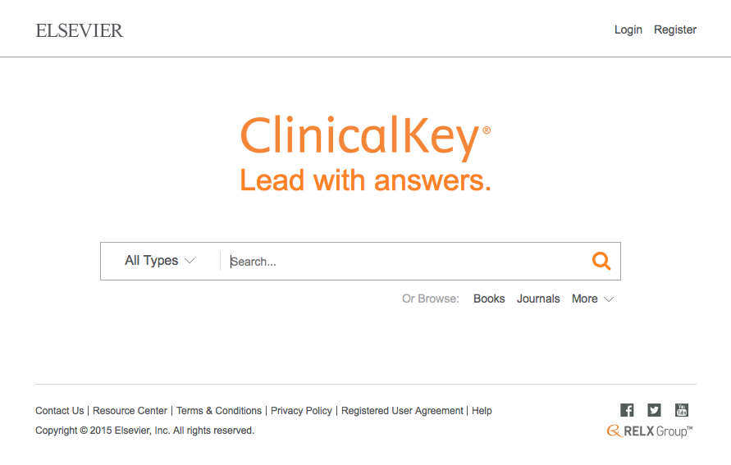
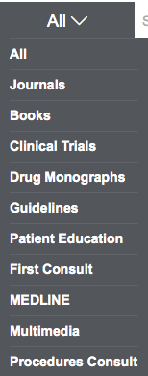
Click All
Select First Consult

Slide 43
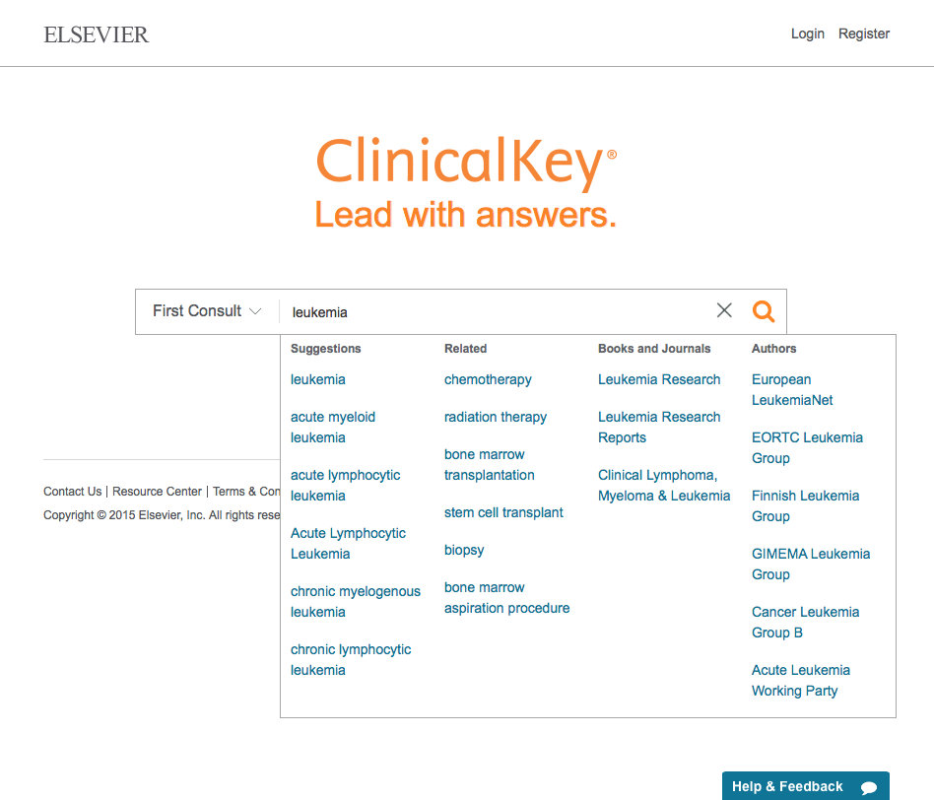
Click Search
Enter topic
Select topic

Slide 44
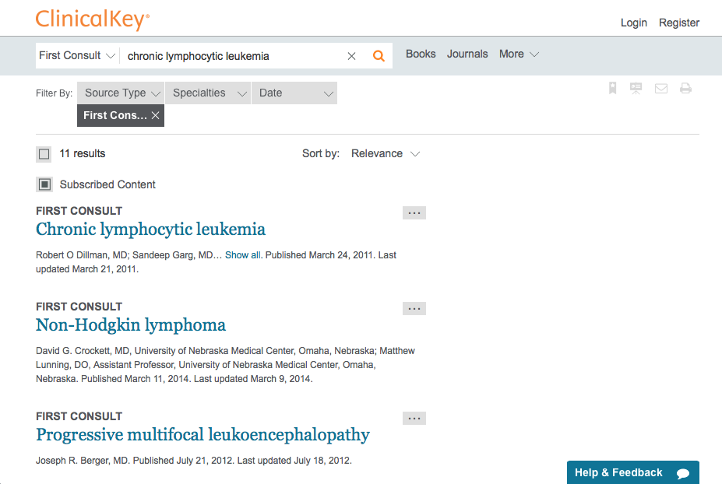
Click Chronic lymphocytic leukemia

Slide 45
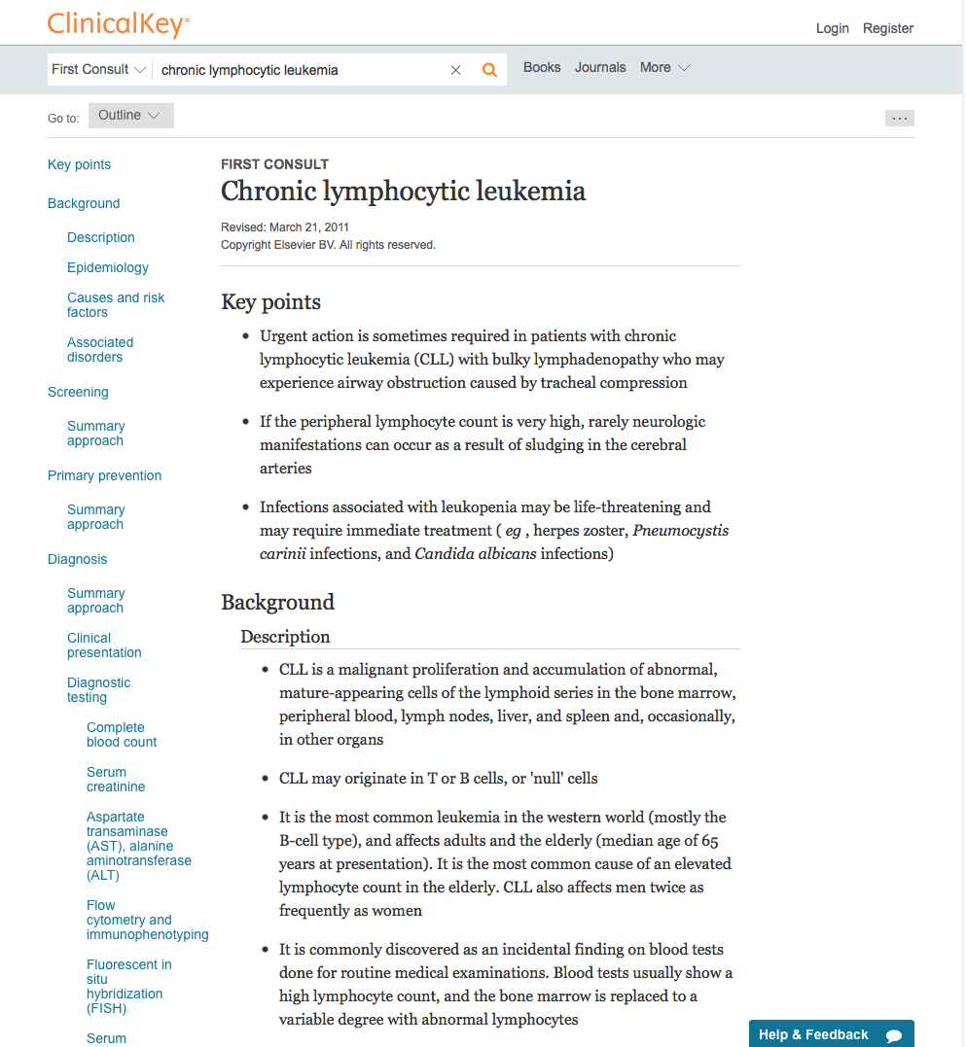

Slide 46
www.ttuhsc.edu/libraries
Click Evidence Based

Slide 47
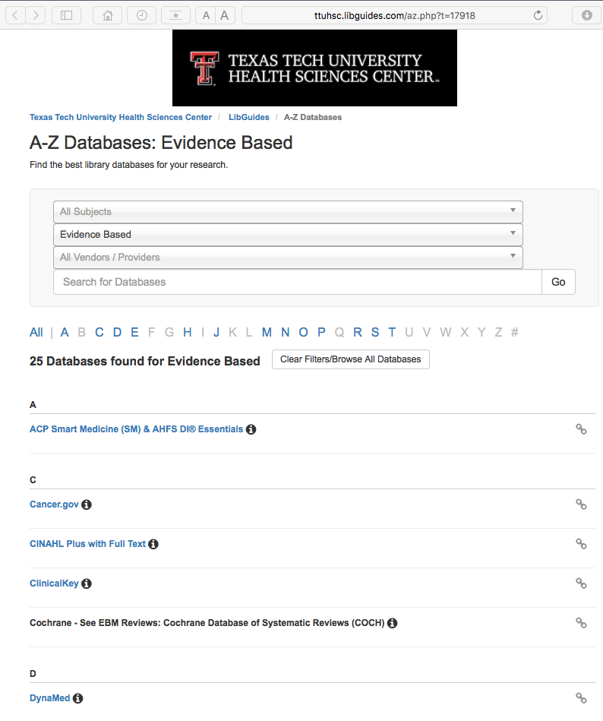
Click DynaMed

Slide 48
DynaMed
Updated daily
Monitors the content of over 500 medical journals
New evidence is integrated with existing content
Overall conclusions represent a synthesis of the
best available evidence.

Slide 49
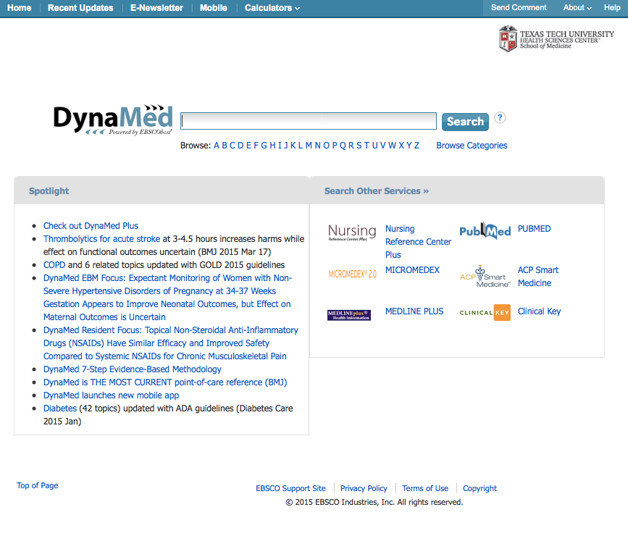
asthma
Enter search query
Home Page

Slide 50
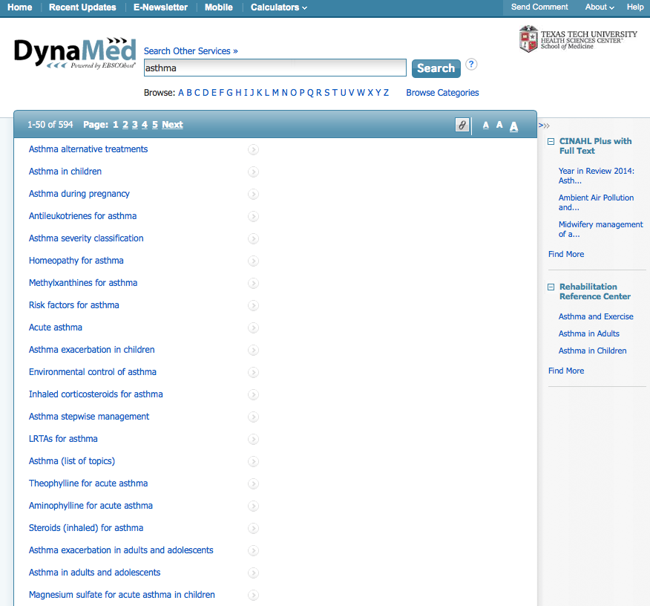
Click
Links to
Topic

Slide 51
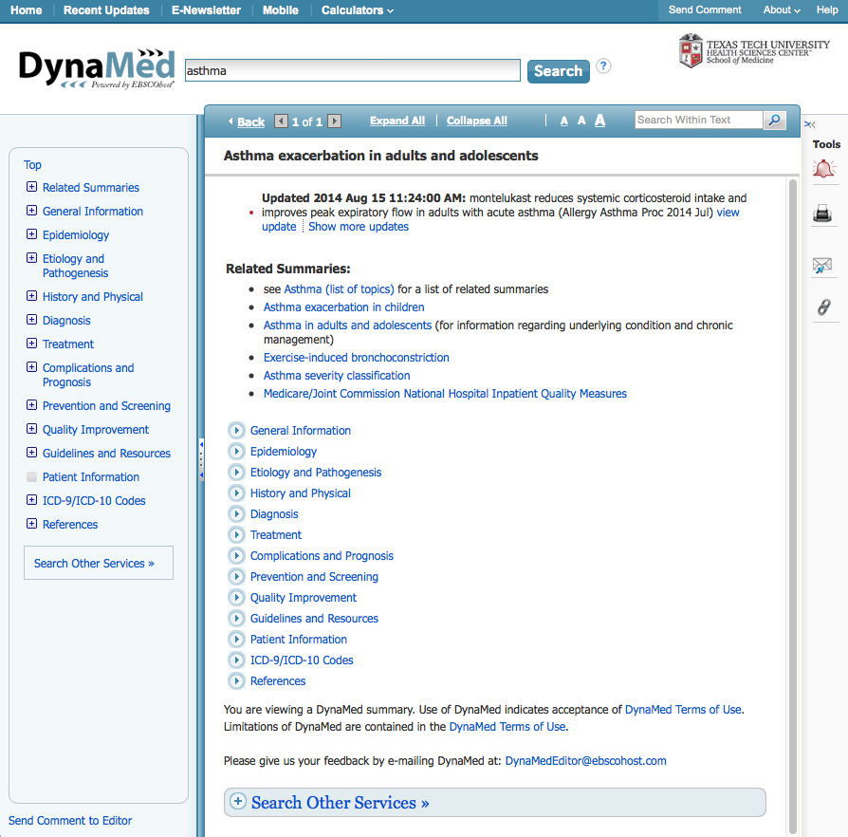
Click
Links to
Document

Slide 52
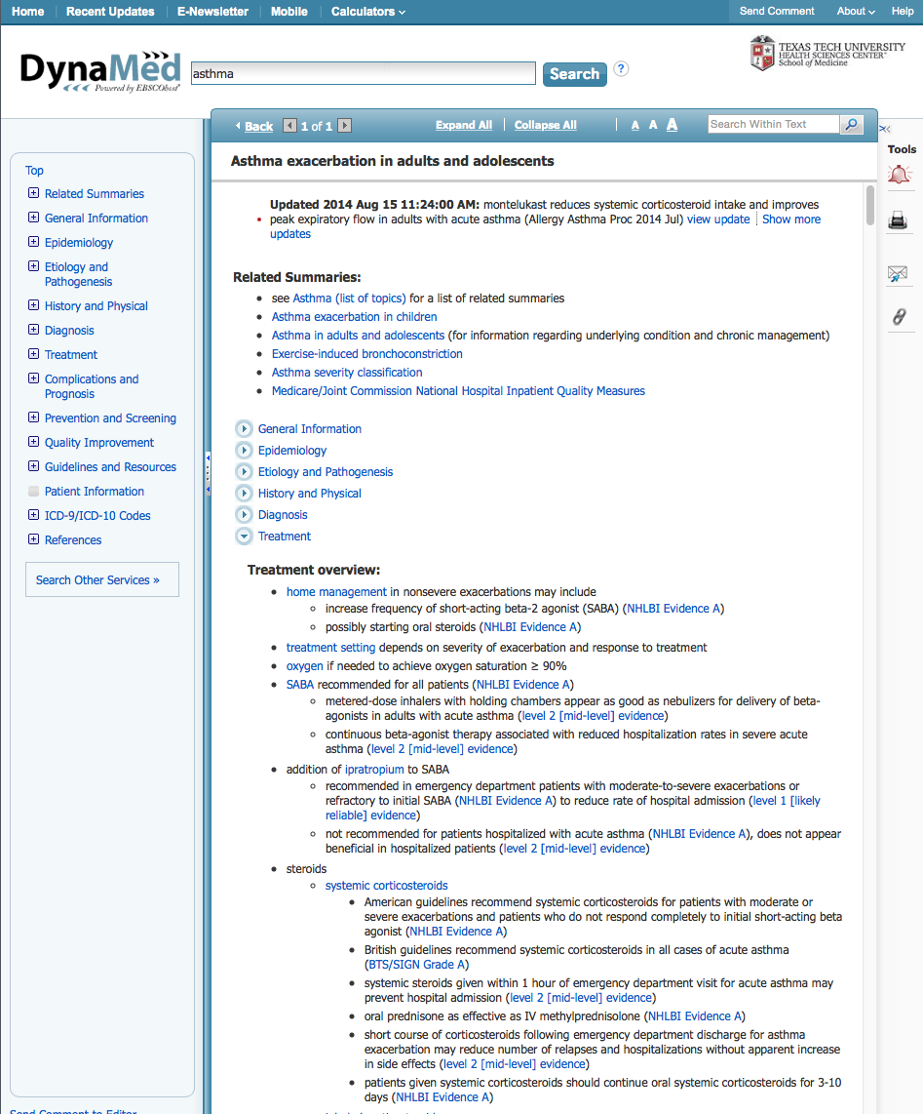
Document Text
Notice!

Slide 53
www.ttuhsc.edu/libraries
Click Evidence Based

Slide 54
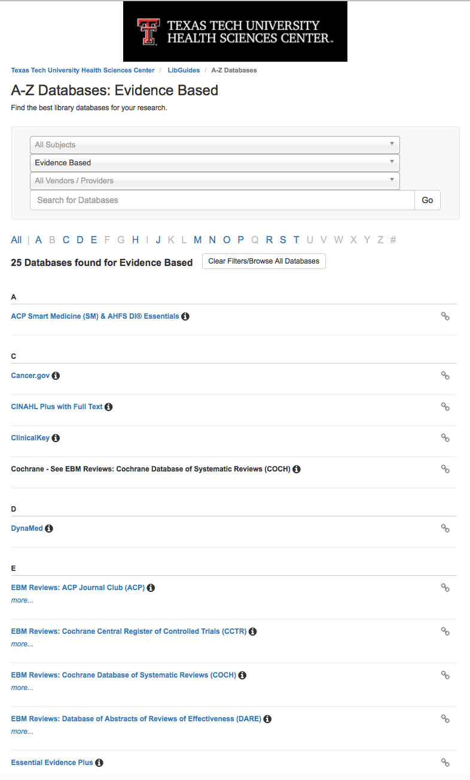
Click Essential Evidence Plus

Slide 55
ESSENTIAL EVIDENCE PLUS
  over 13,000 topics
  guidelines, abstracts, and summaries
  Systematic Reviews from Cochrane Collaboration
  Daily POEMS
  Calculators
  Derm Expert

Slide 56
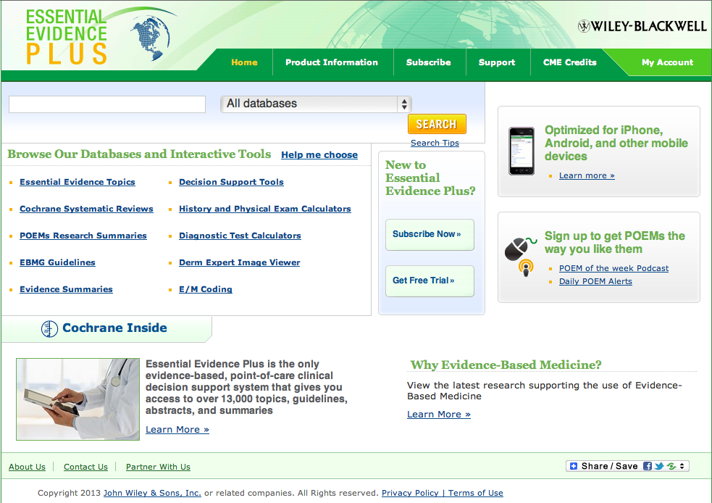
Home Page

Slide 57
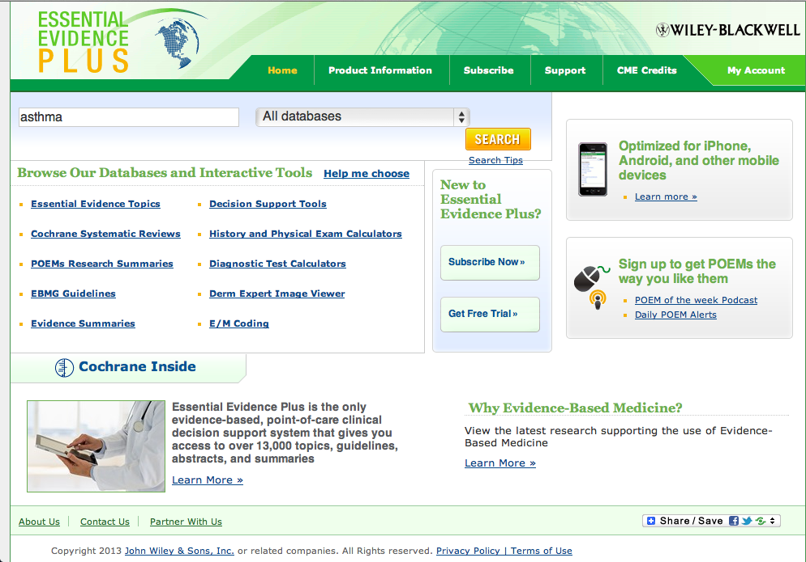
Enter asthma and
click SEARCH
asthma

Slide 58
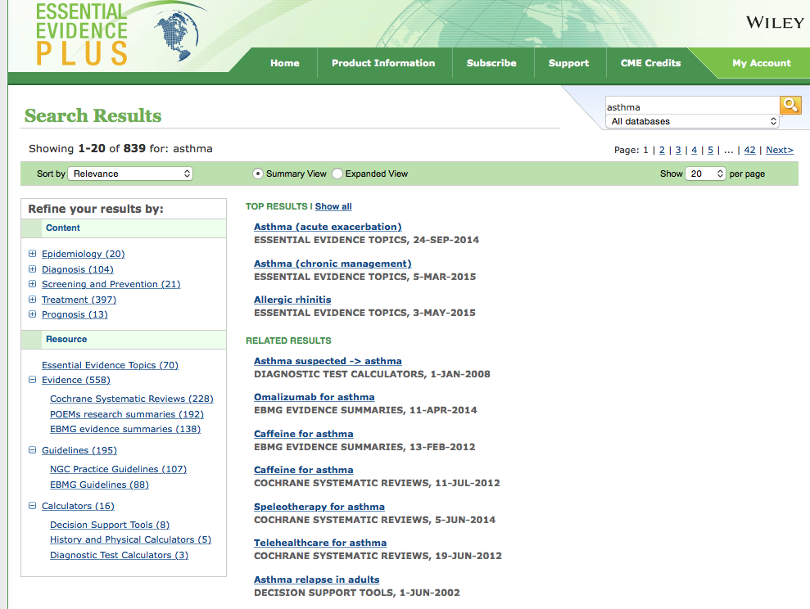
To access the disease information overview module, always select from Essential Evidence Topics
Click link

Slide 59
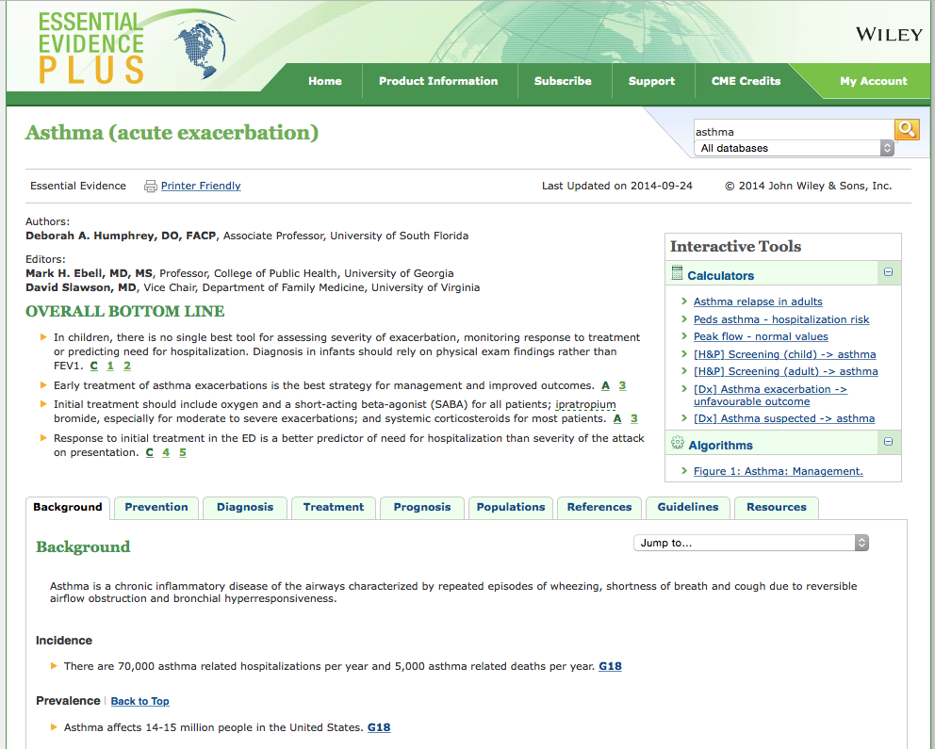
Information Index

Slide 60
Click to return to home page

Slide 61
Calculators & Tools

Slide 62
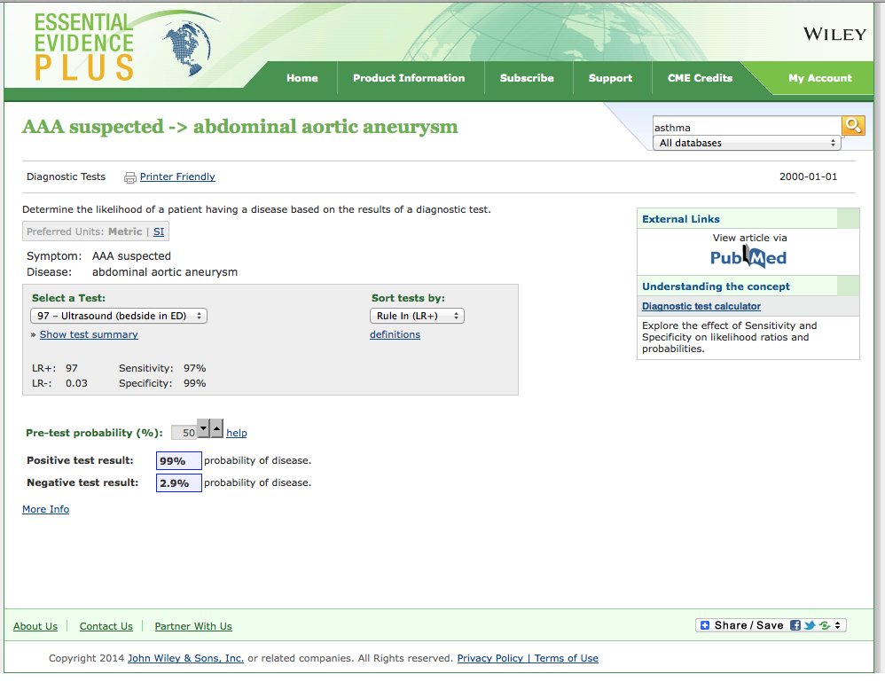

Slide 63
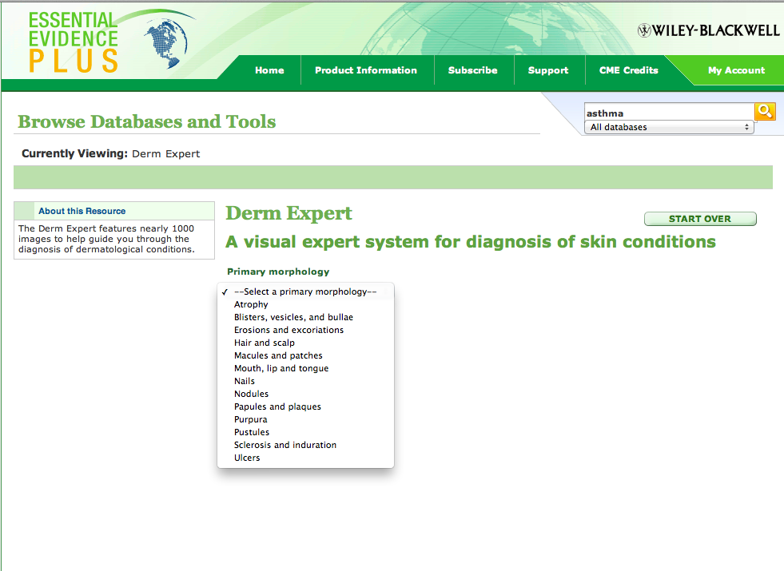
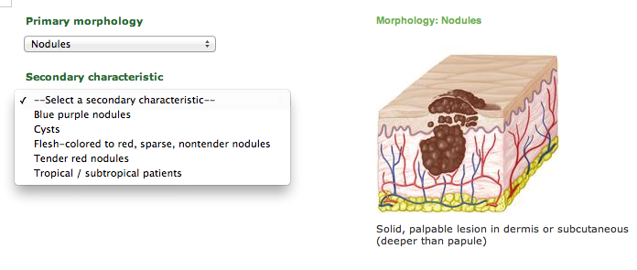
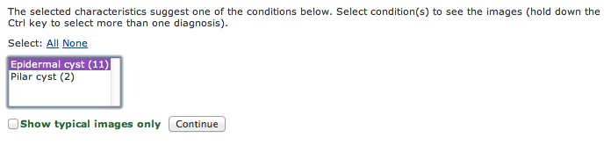
Click

Slide 64
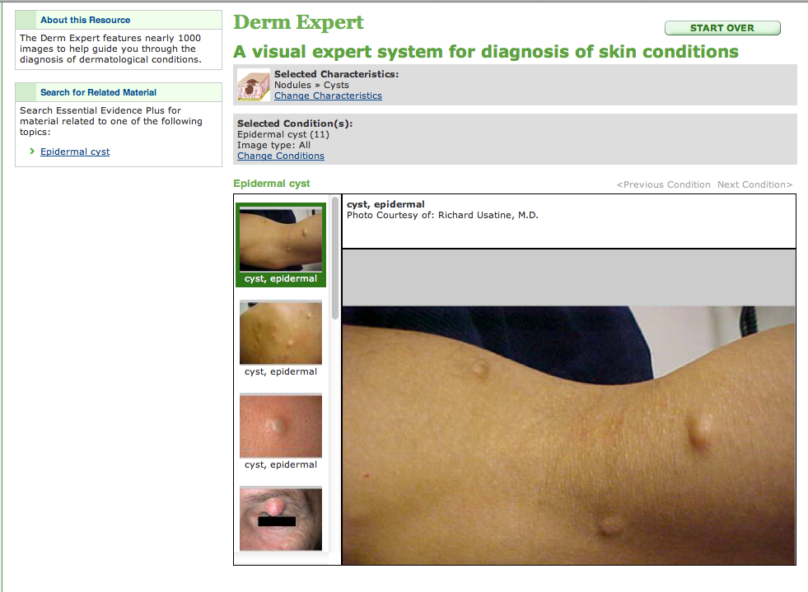

Slide 65
Practice Guidelines

Slide 66
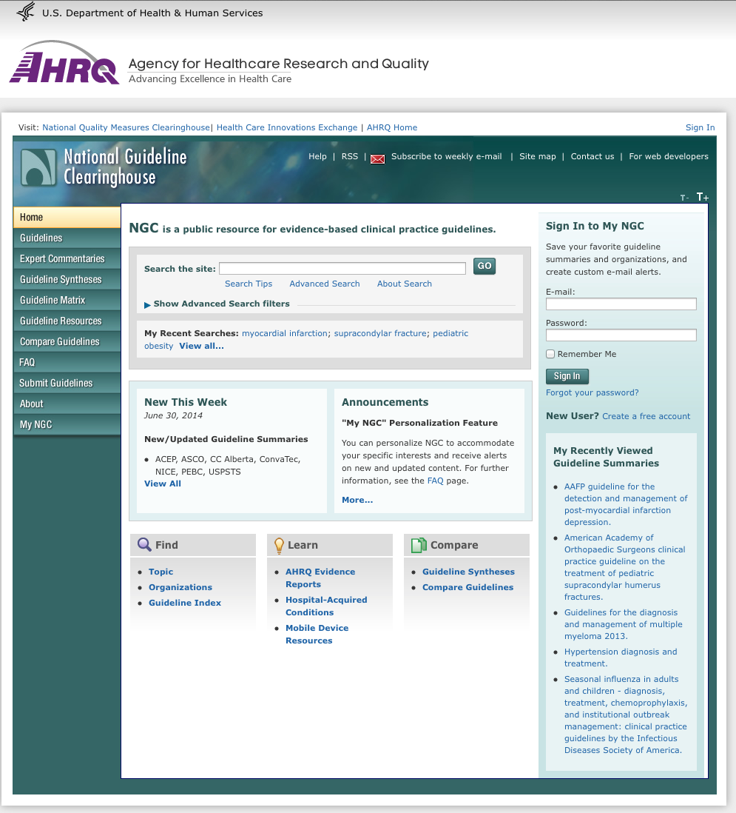
www.guideline.gov

Slide 67

Many Information Resources
are Mobile!

Slide 68
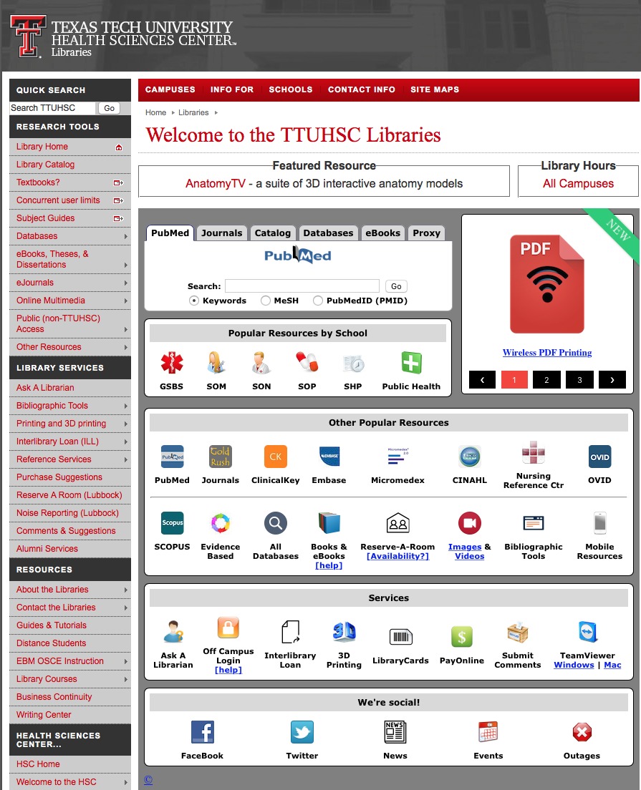
www.ttuhsc.edu/libraries
Click Mobile Resources

Slide 69
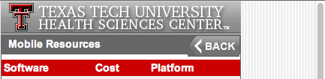

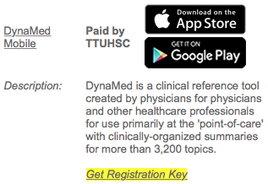
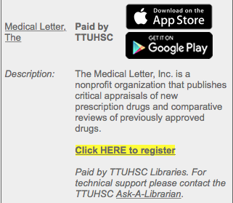
Scroll to resource
Click appropriate links for your device

Slide 70
www.ttuhsc.edu/libraries
Ask-A-Librarian

Slide 71
The End
July 2016

