Slide 1
Welcome
Surgery Clerkship
Introductory Orientation
EBM Resources Course
Peggy Edwards, AMLS
TTUHSC - Preston Smith Library
Lubbock, Texas 79430
7/2015

Slide 2
Welcome to the
Surgery Clerkship Orientation
EBM Searching Course!

Slide 3
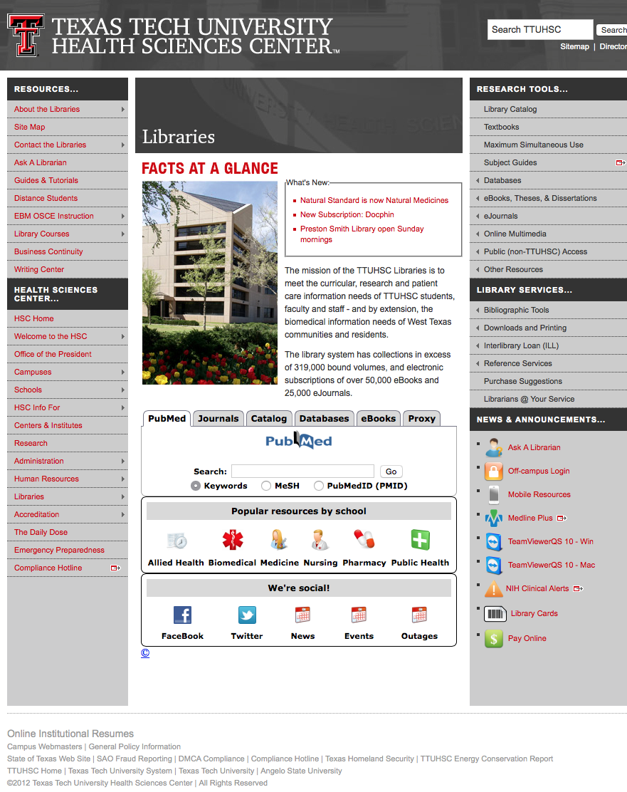
www.ttuhsc.edu/libraries
Click
Library Courses

Slide 4
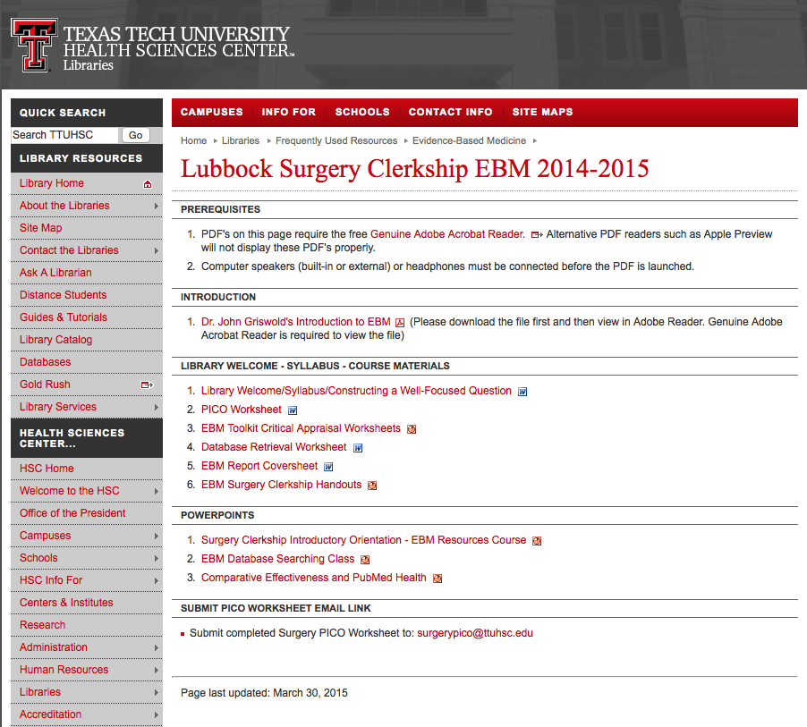
Course Materials

Slide 5
Dr. Griswold’s video

Slide 6
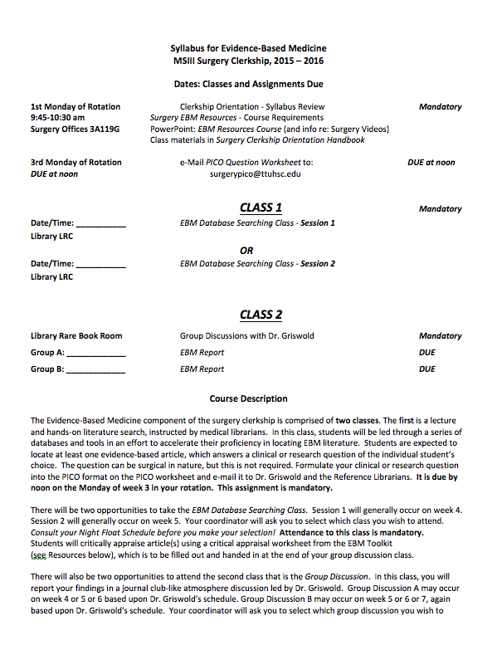
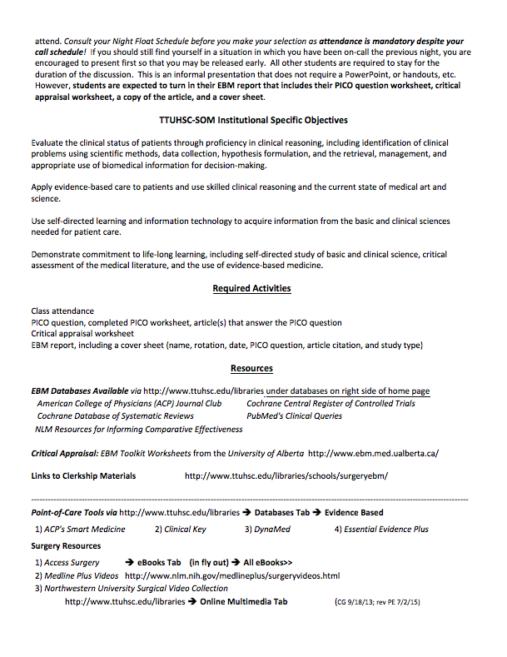
Syllabus

Slide 7
Two Classes:
1. EBM Database Searching
2. Group Discussion

Slide 8
EBM Database
Searching Class

Slide 9
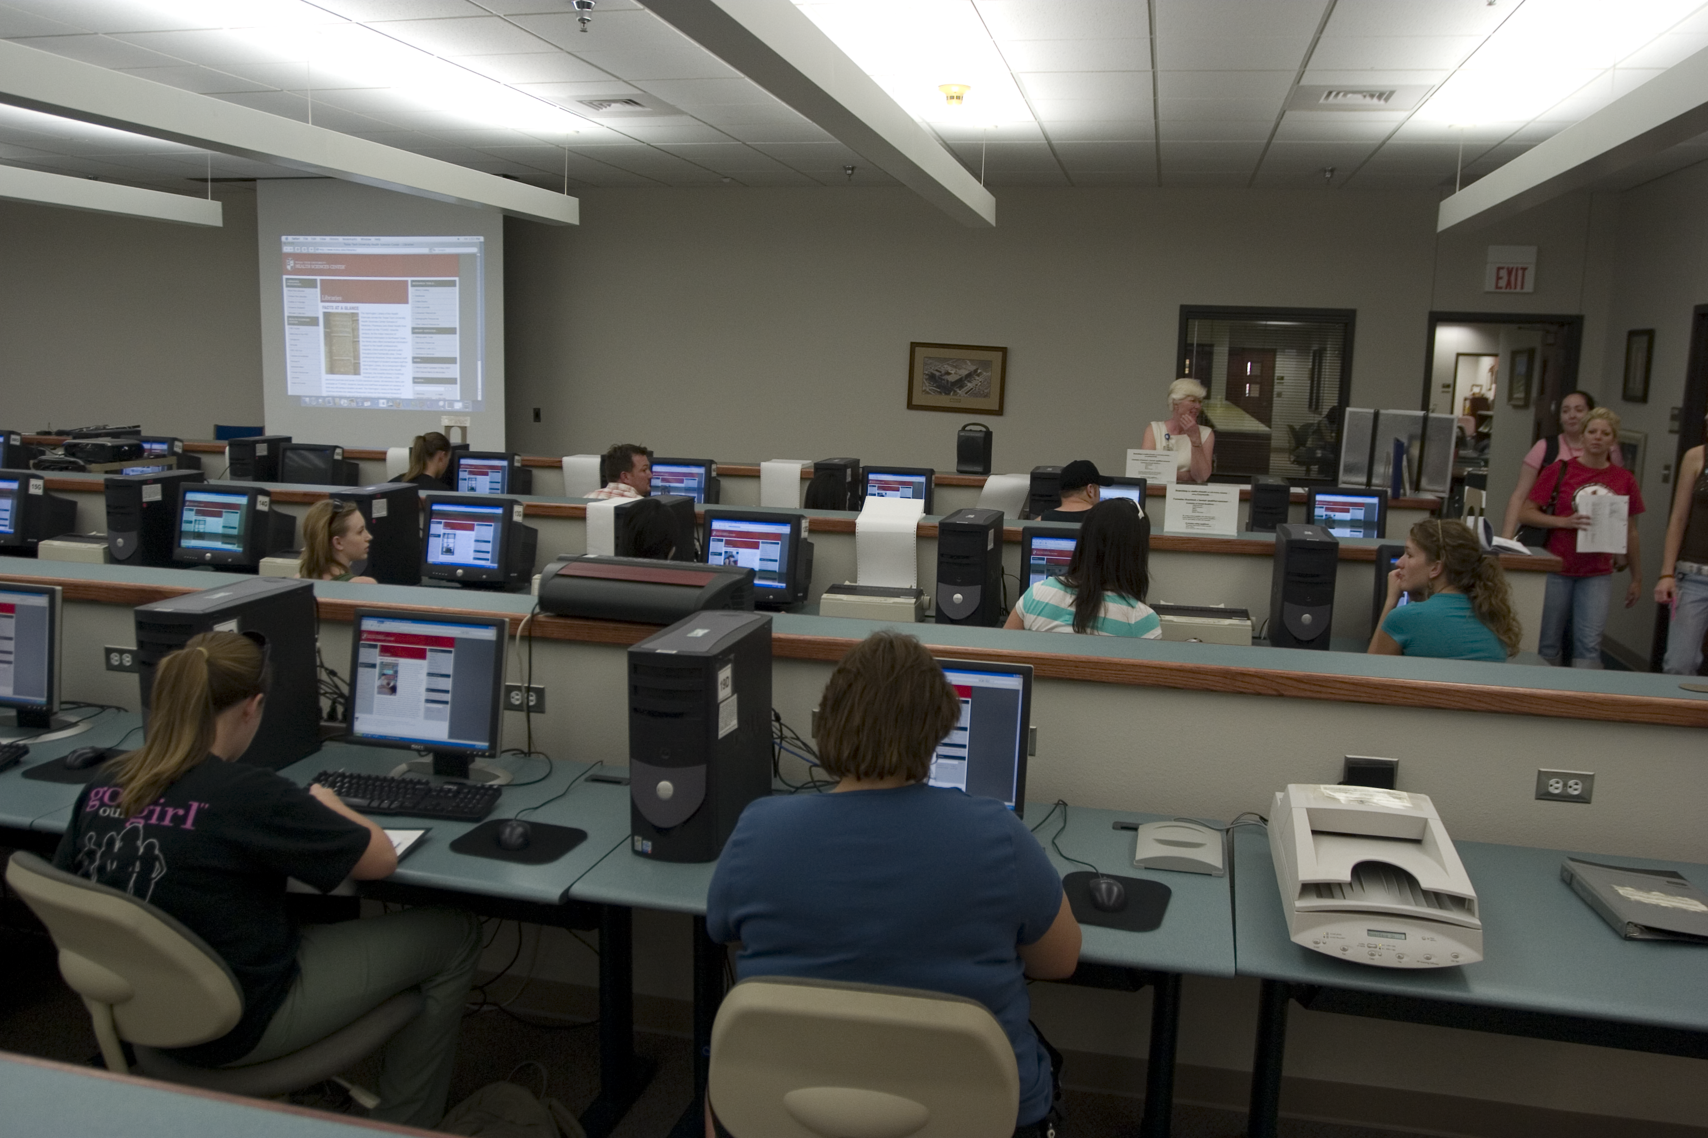
1) EBM Database Searching Class - Mandatory Attendance J
  1 Session for Group 1 and 1 Session for Group 2 (on separate weeks)
  in the Learning Resources Center
  how to search the Cochrane EBM Databases & NLM’s Comparative Effectiveness
  PowerPoint lecture and hands-on follow along
  search for article(s) that answer your PICO question
  searching guidance from assigned librarian

Slide 10
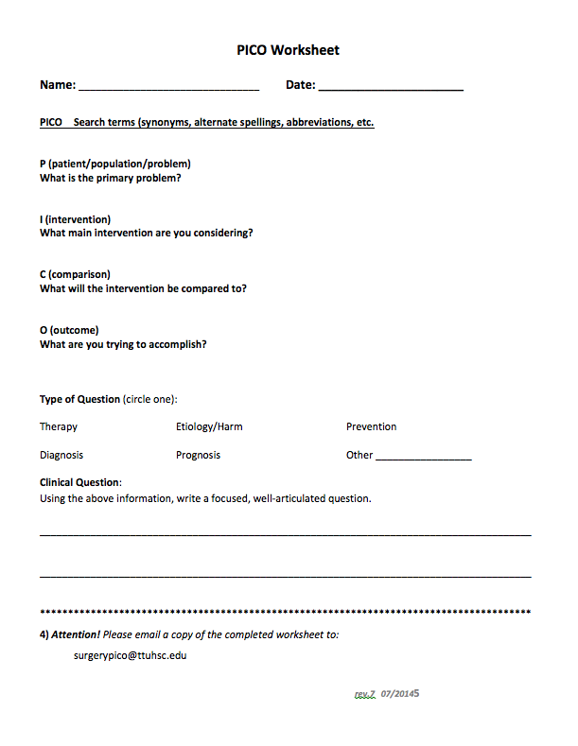
In adult male patients with recent myocardial infarction, does a
single daily dose of 300 mg of aspirin prevent re-infarction?
P
adult male patients with recent MI
I
daily dose of 300 mg of aspirin
C
placebo
O
prevent re-infarction

Slide 11
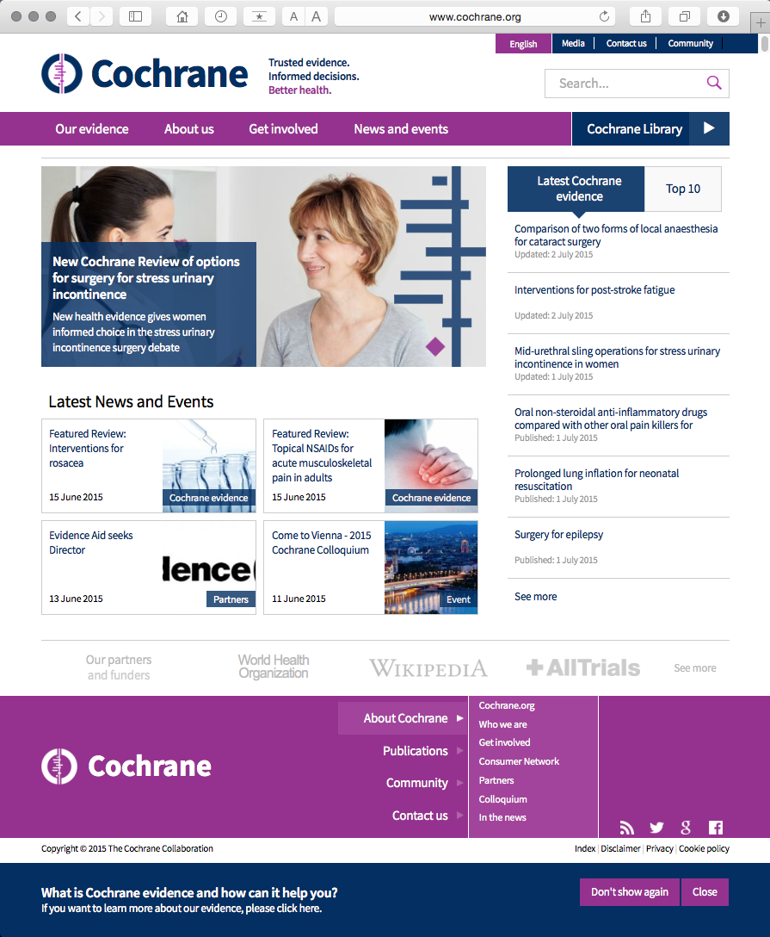
www.cochrane.org

Slide 12
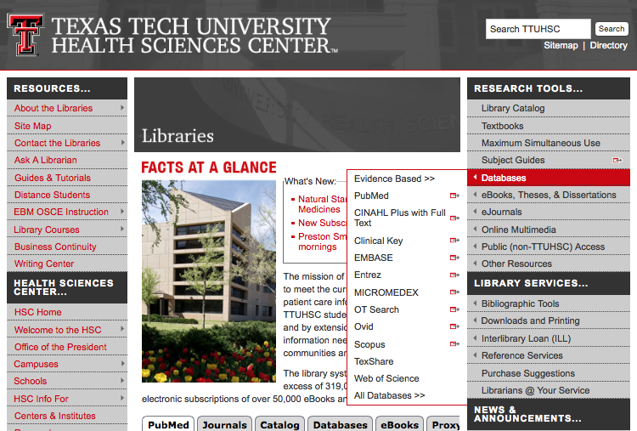
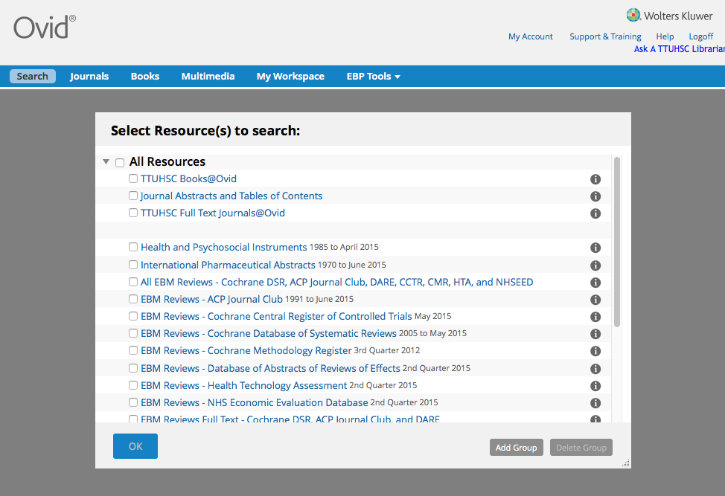

Slide 13
Critical Appraisal

Slide 14
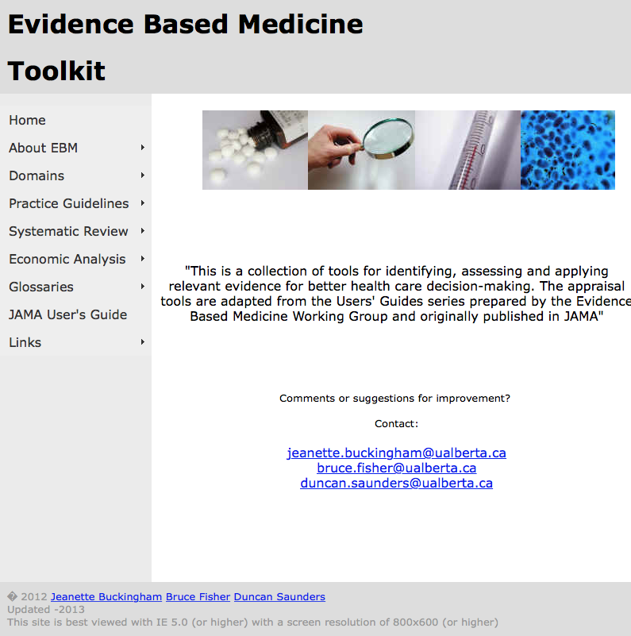
http://www.ebm.med.ualberta.ca/

Slide 15
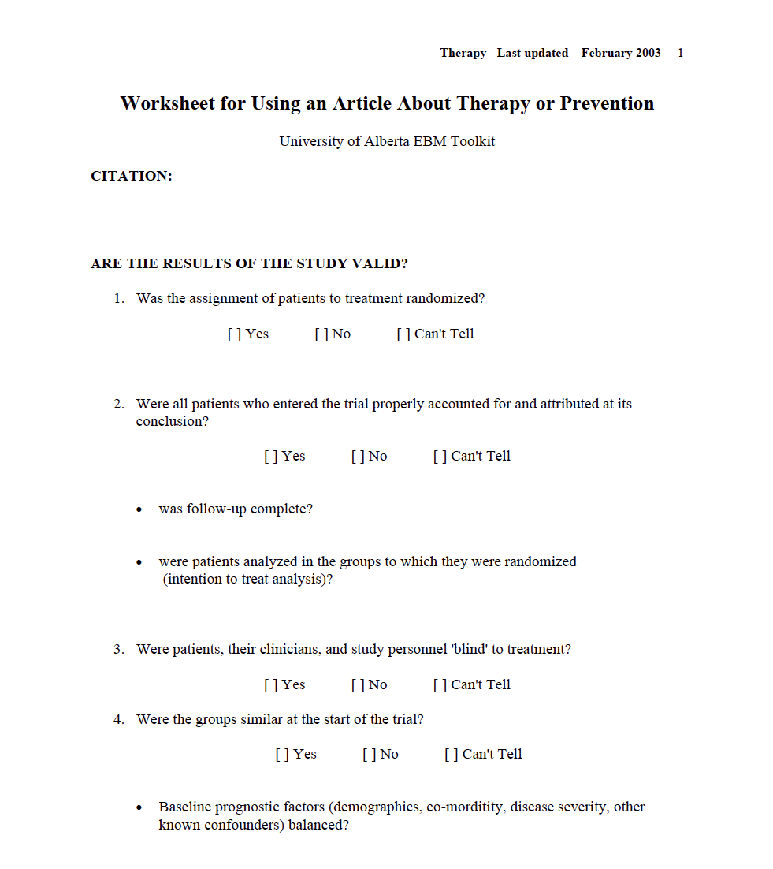
Critical Appraisal Worksheet: www.ebm.med.ualberta.ca

Slide 16
Group Discussion
Class

Slide 17
EBM Report

Slide 18
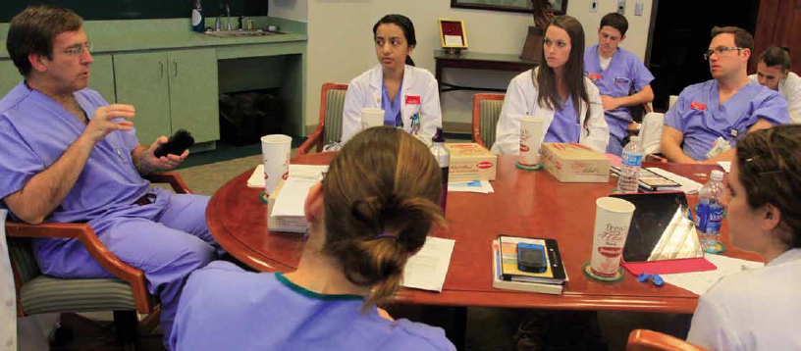
2) Group Discussion “EBM Journal Club” with Dr. Griswold
  in the Library’s Rare Books Conference Room
  state your focused, well-articulated PICO question
  describe databases searched and search strategy
  state author, article title, journal, and date published
  discuss study design, validity and reliability, research findings
  commentary and q & a from Dr. Griswold
  turn in your EBM report including PICO question worksheet, critical appraisal worksheet, copy of the article, and cover sheet
  casual atmosphere and lunch courtesy of Dr. Griswold!

Slide 19
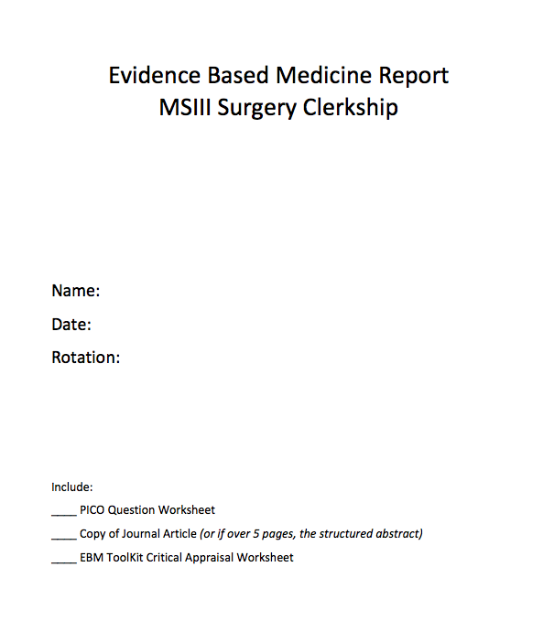
EBM Report Cover Sheet

Slide 20
Surgery Resources

Slide 21
Access Surgery

Slide 22
www.ttuhsc.edu/libraries
Click
Popular Resources by School

Slide 23
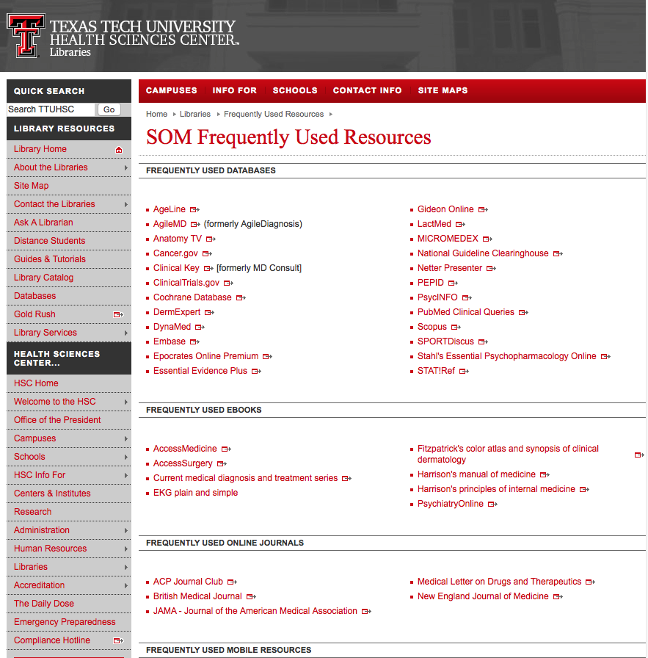
Click Access Surgery

Slide 24
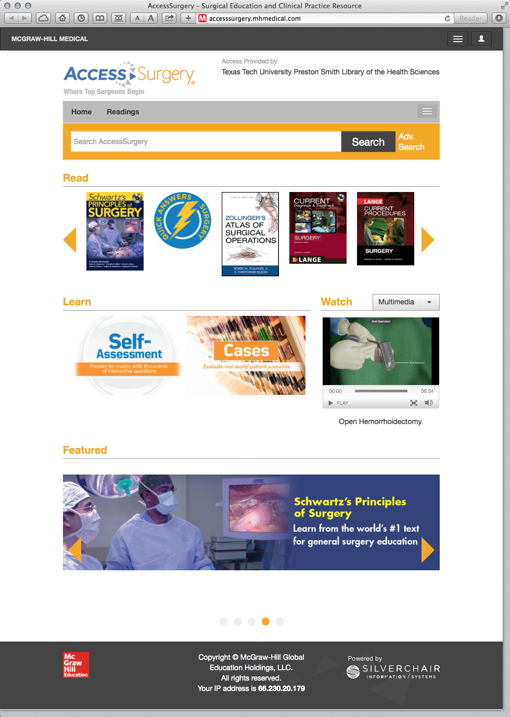
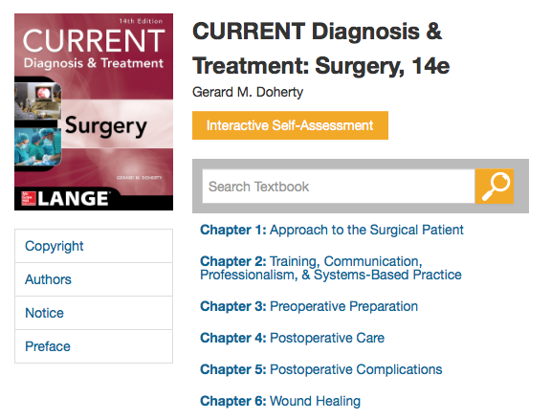
Major Surgical Electronic Textbooks- free!

Slide 25
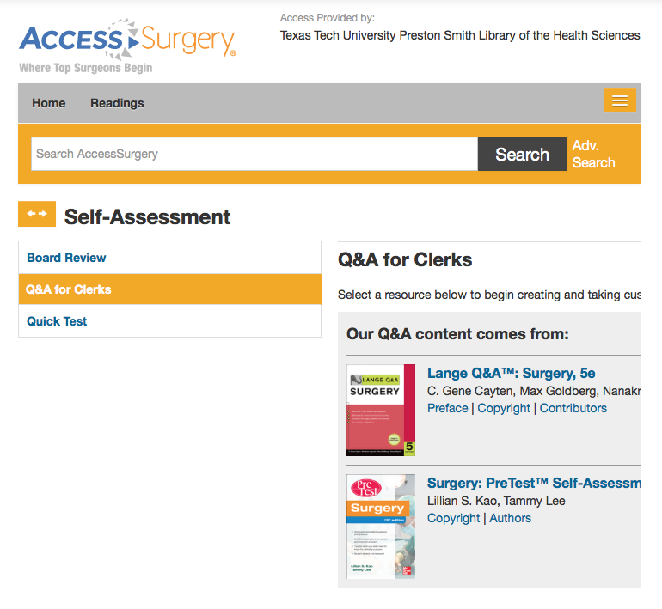
Click

Slide 26
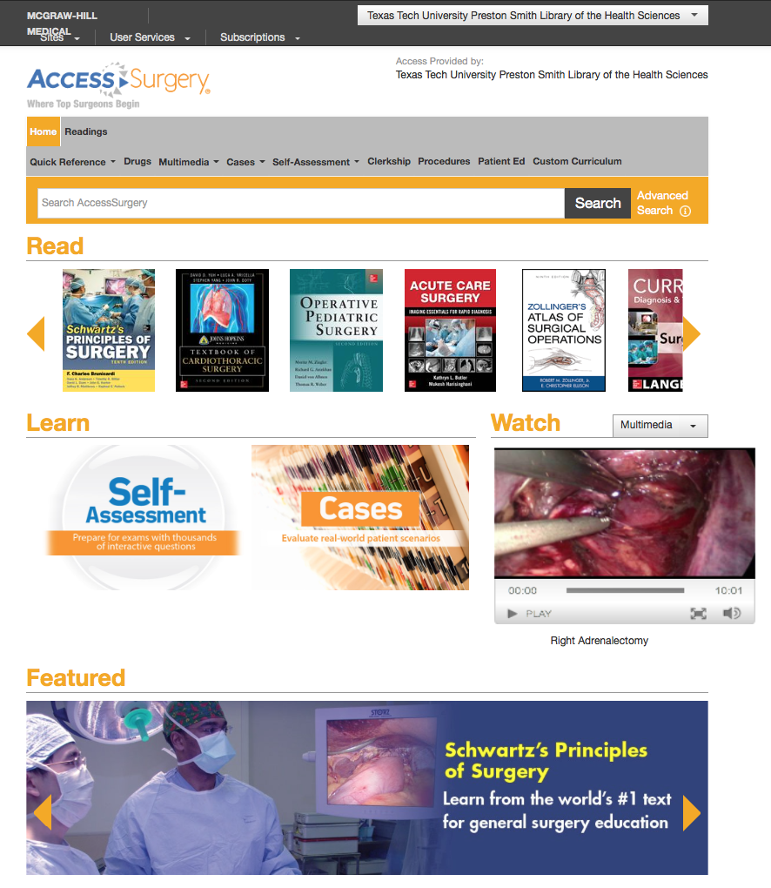

Slide 27
Medline Plus Videos

Slide 28
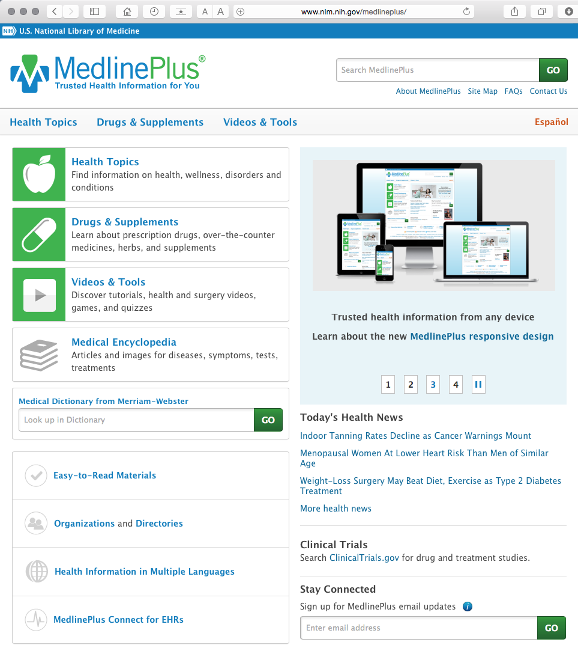
www.medlineplus.gov

Slide 29
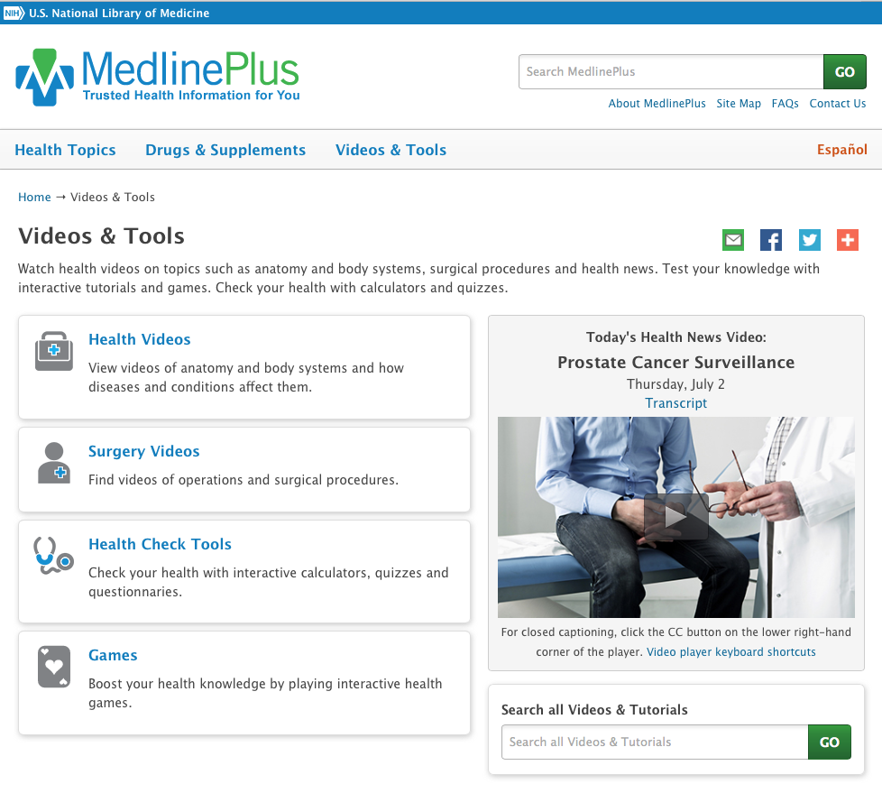

Slide 30
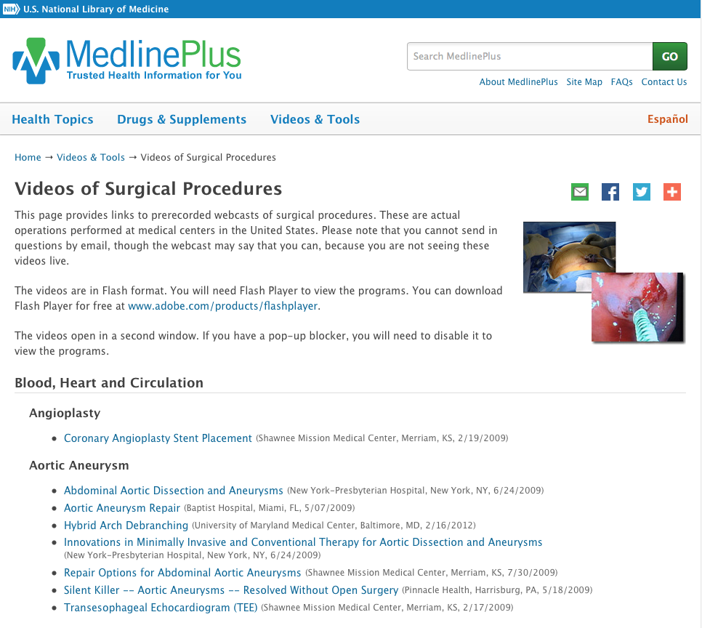

Slide 31
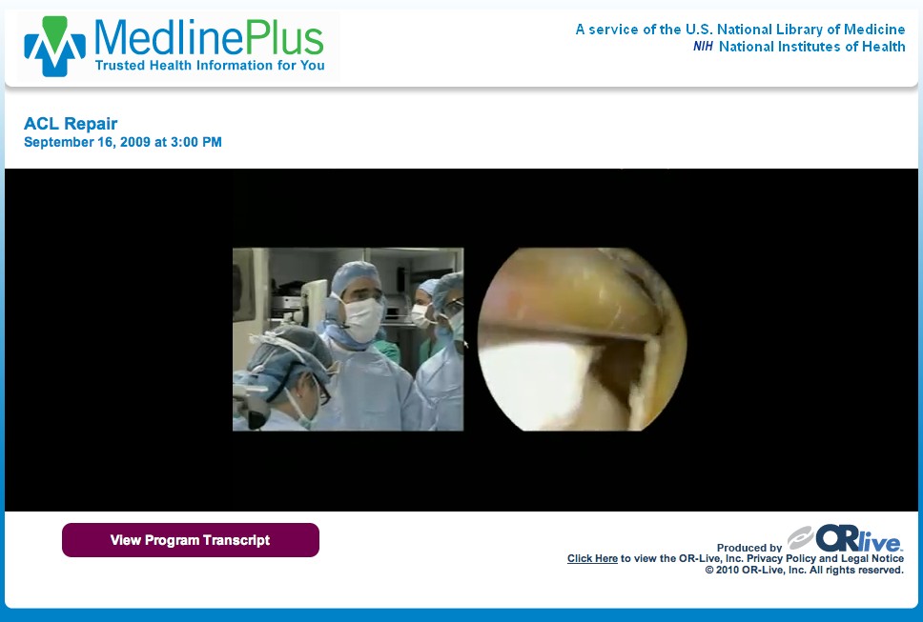

Slide 32
Northwestern University
Surgical Video Collection

Slide 33
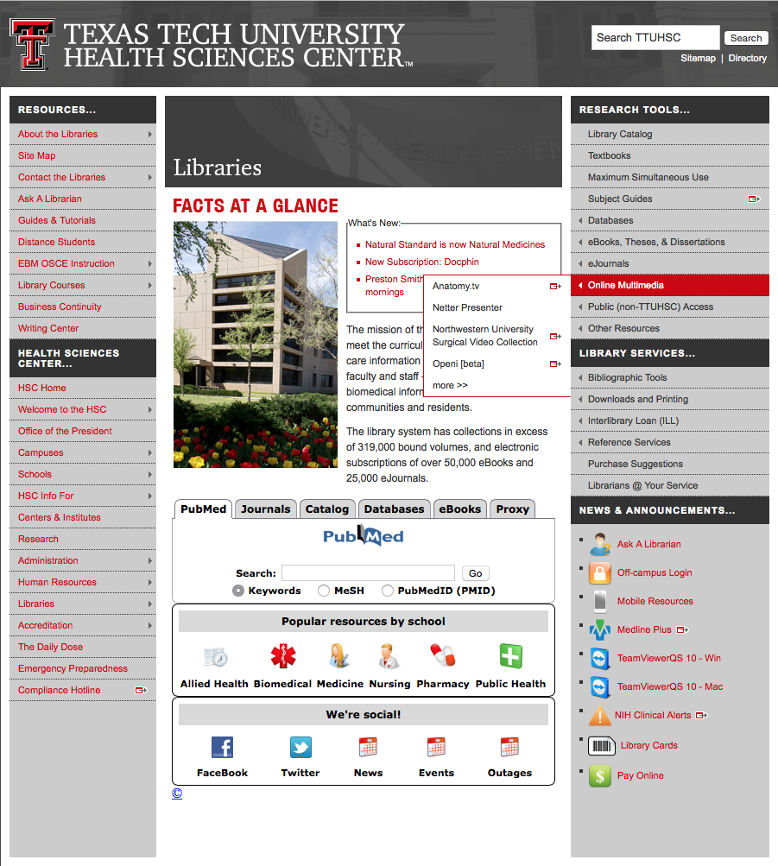
Click

Slide 34
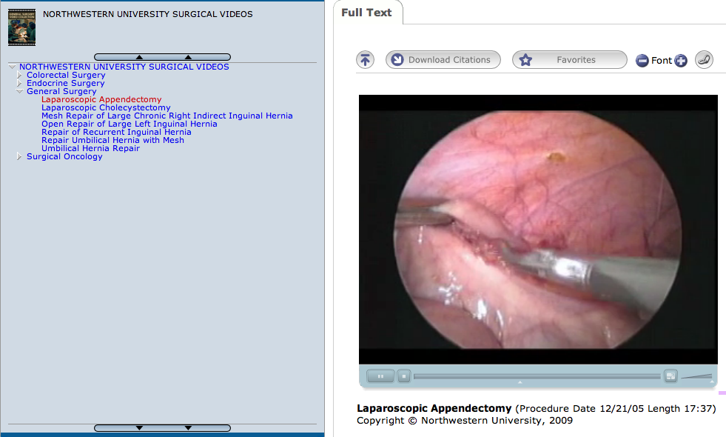

Slide 35
EBM Point of Care Tools
decision support information accessible at the patient’s bedside or the “point of care”
data that is evaluated and rated with levels of evidence
clinical information including
  history and physical
  signs and symptoms
  differential diagnosis
  diagnosis
  therapy
  follow-up
  guidelines

Slide 36
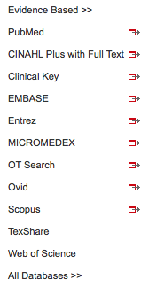
www.ttuhsc.edu/libraries
Mouse over Databases
Click Evidence Based

Slide 37
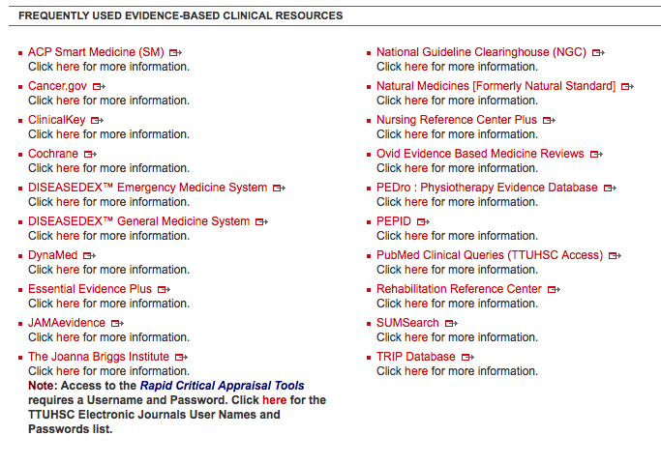
Click Clinical Key

Slide 38
Clinical Key
* content from books, journals, and videos
First Consult
*point of care decision support tool within Clinical Key
* main source of information is from the
Cochrane Collaboration where possible

Slide 39
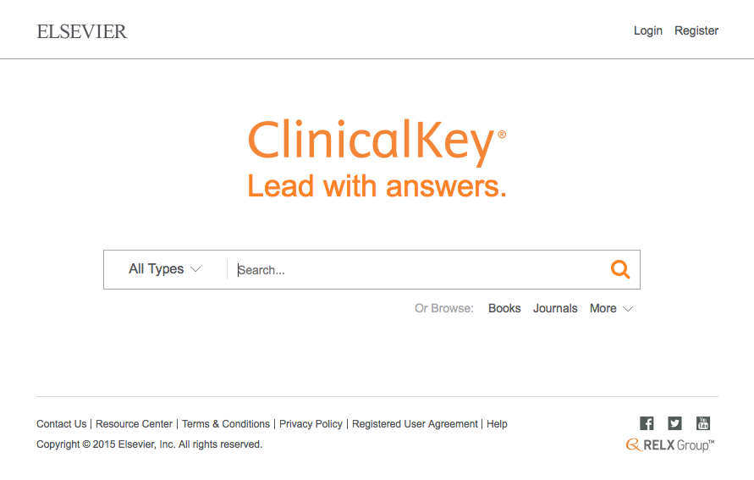
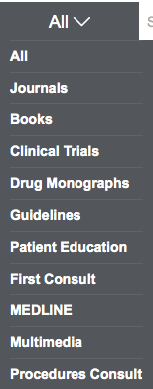
Click All
Select First Consult

Slide 40
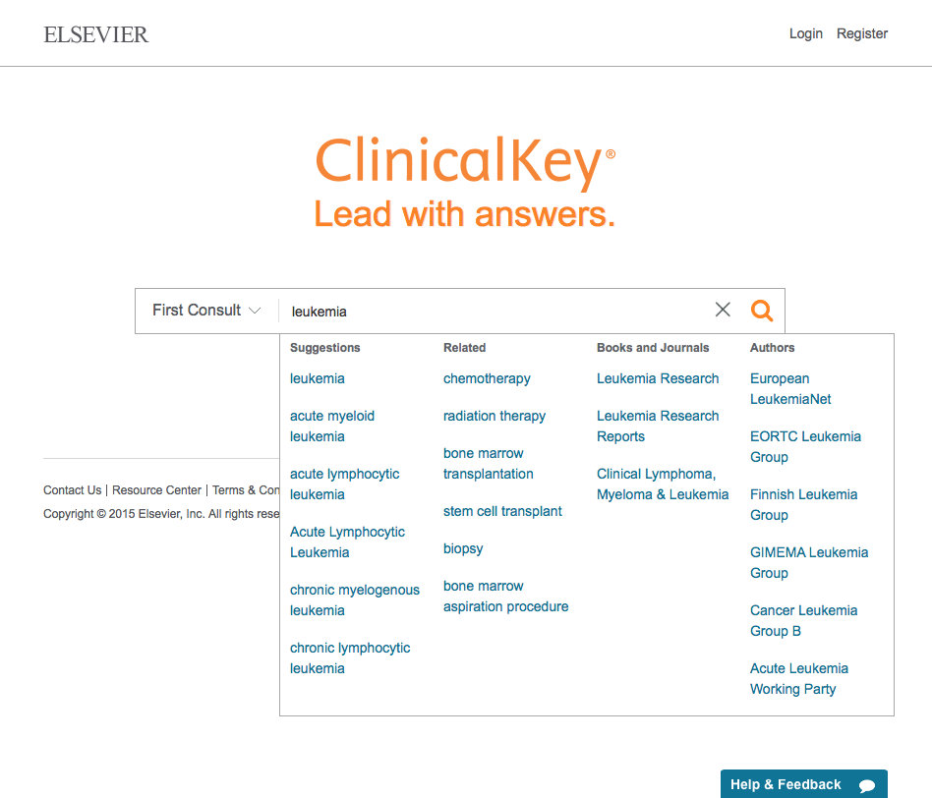
Click Search
Enter topic
Select topic

Slide 41
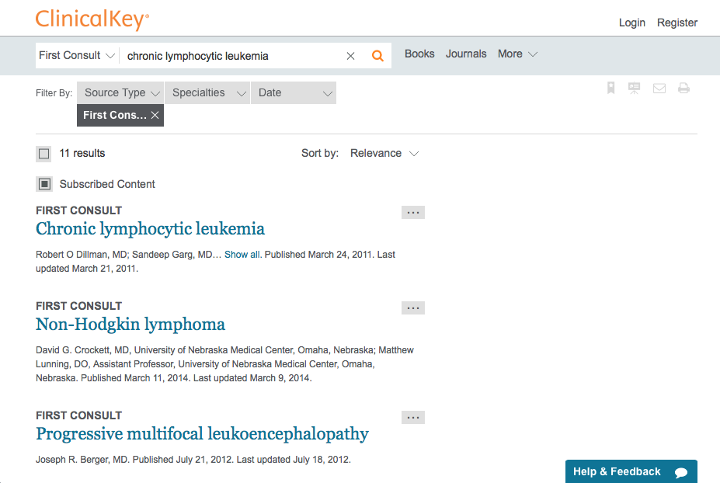
Click Chronic lymphocytic leukemia

Slide 42
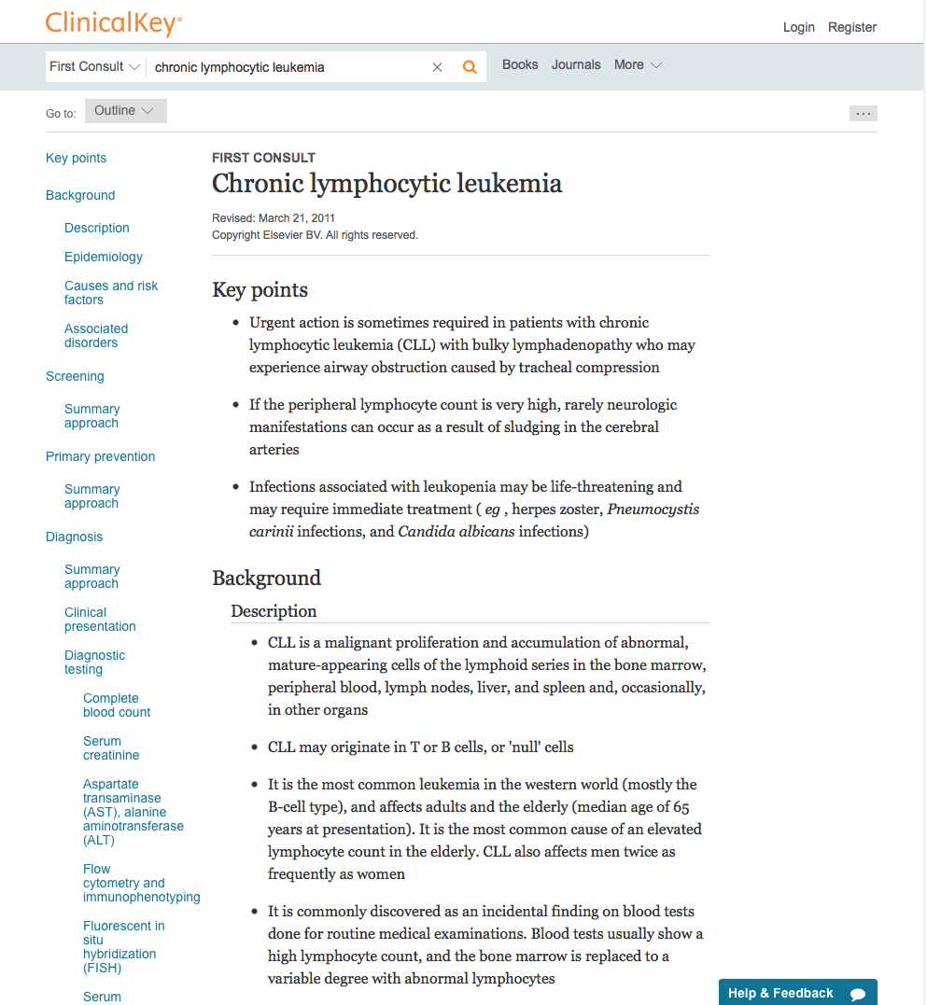

Slide 43
Click DynaMed

Slide 44
DynaMed
Updated daily
Monitors the content of over 500 medical journals
New evidence is integrated with existing content
Overall conclusions represent a synthesis of the
best available evidence.

Slide 45
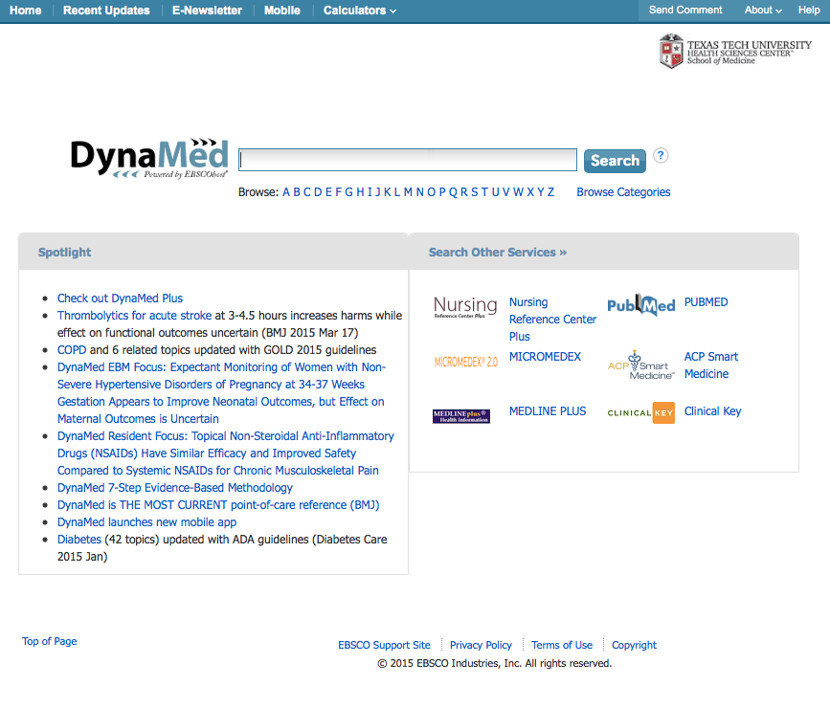
asthma
Enter search query
Home Page

Slide 46
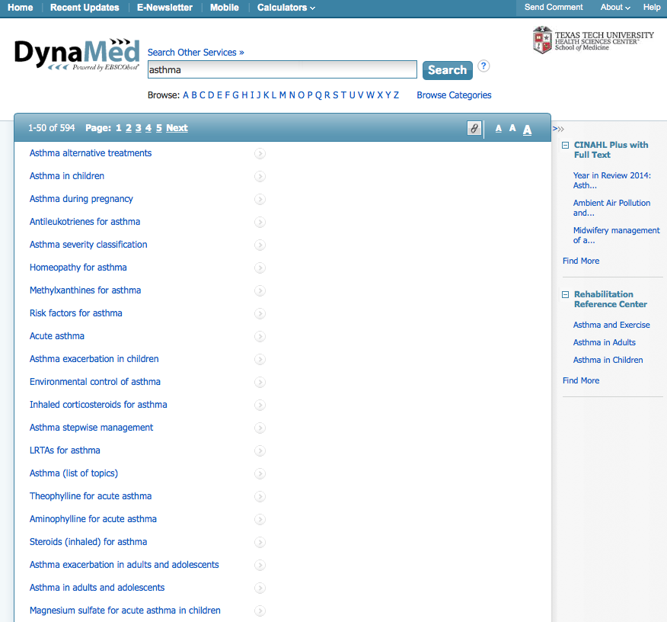
Click
Links to
Topic

Slide 47
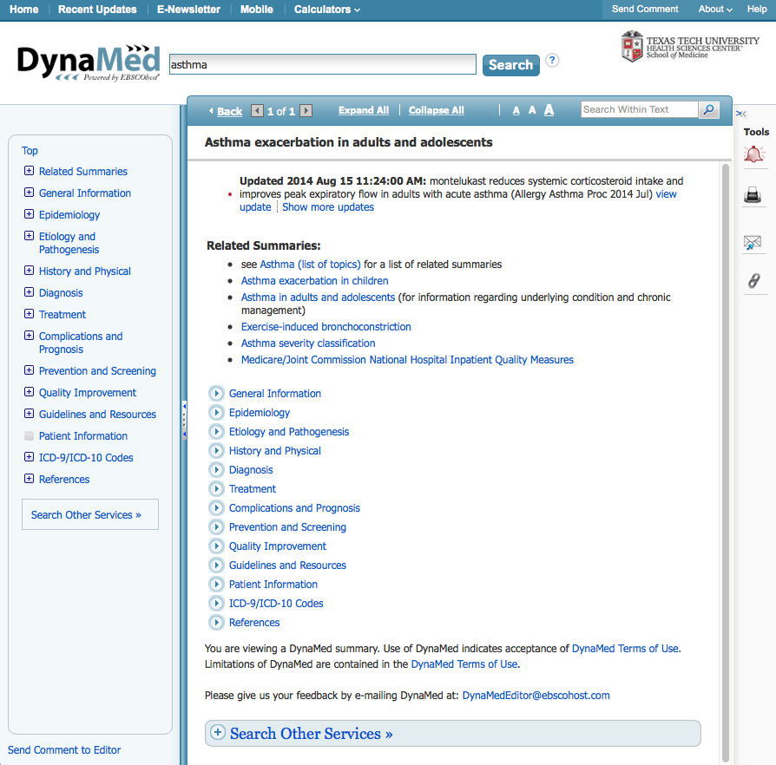
Click
Links to
Document

Slide 48
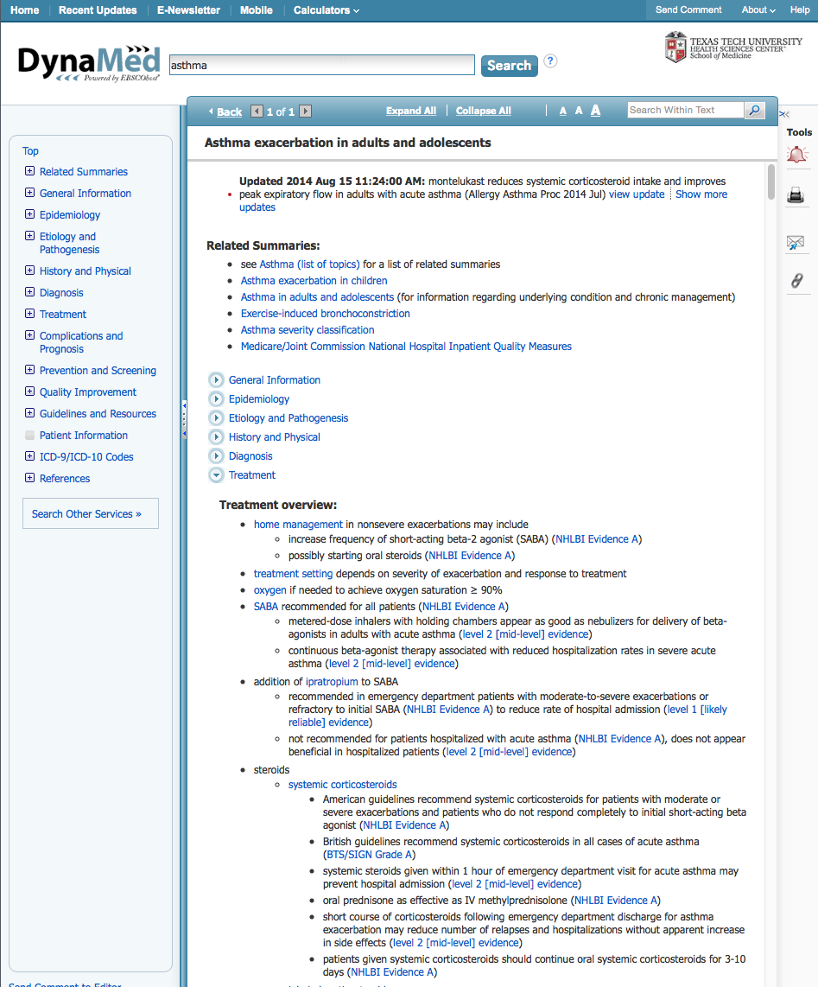
Document Text
Notice!

Slide 49
Click Essential Evidence Plus

Slide 50
ESSENTIAL EVIDENCE PLUS
  over 13,000 topics
  guidelines, abstracts, and summaries
  Systematic Reviews from Cochrane Collaboration
  Daily POEMS
  Calculators
  Derm Expert

Slide 51
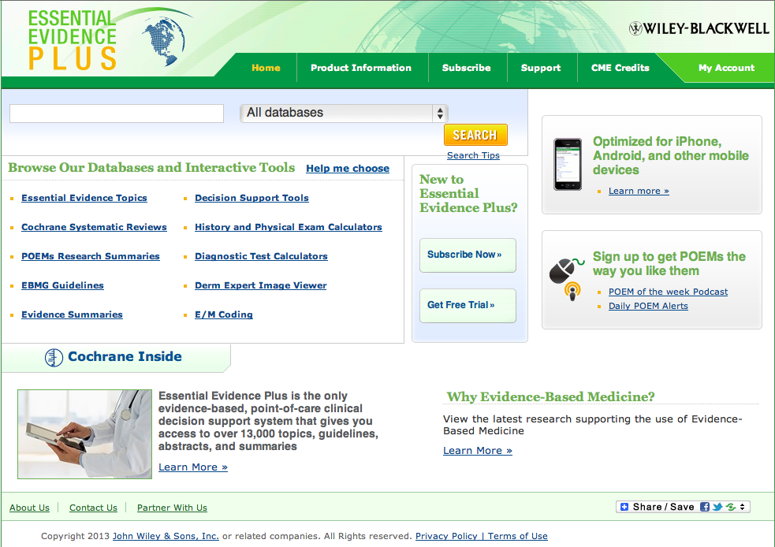
Home Page

Slide 52
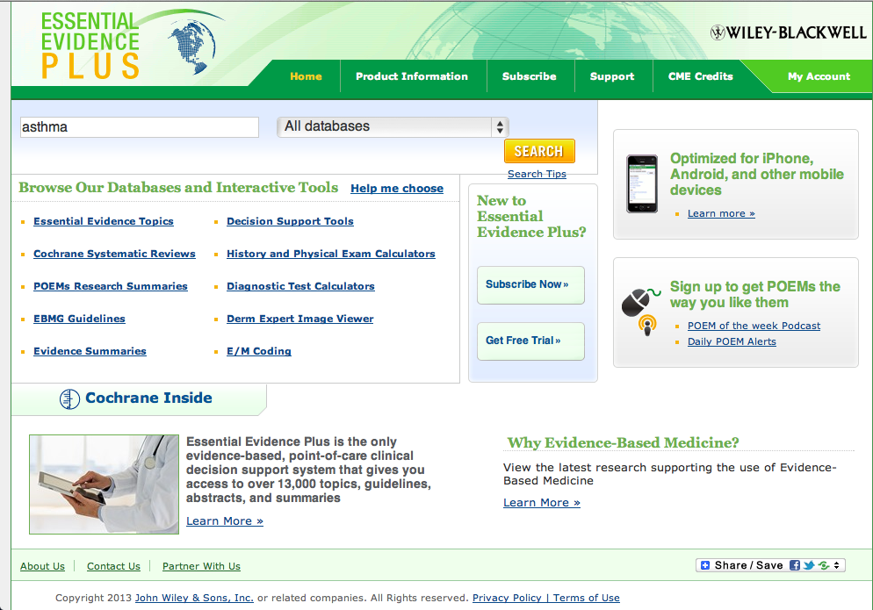
Enter asthma and
click SEARCH
asthma

Slide 53
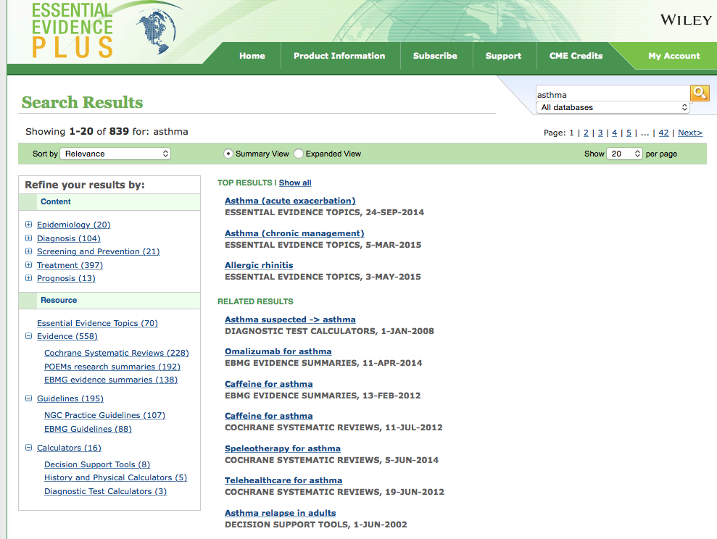
To access the disease information overview module, always select from Essential Evidence Topics
Click link

Slide 54
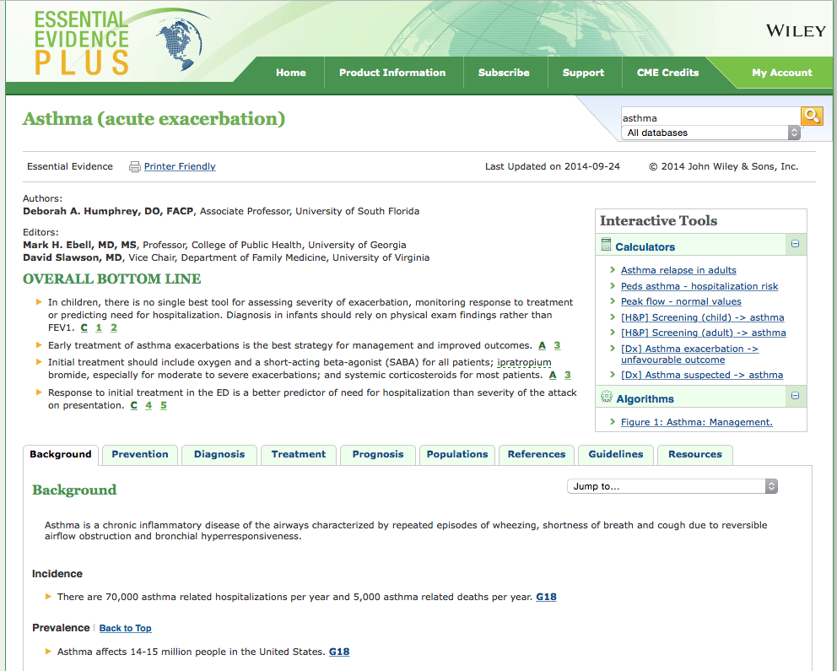
Information Index

Slide 55
Click to return to home page

Slide 56
Calculators & Tools

Slide 57
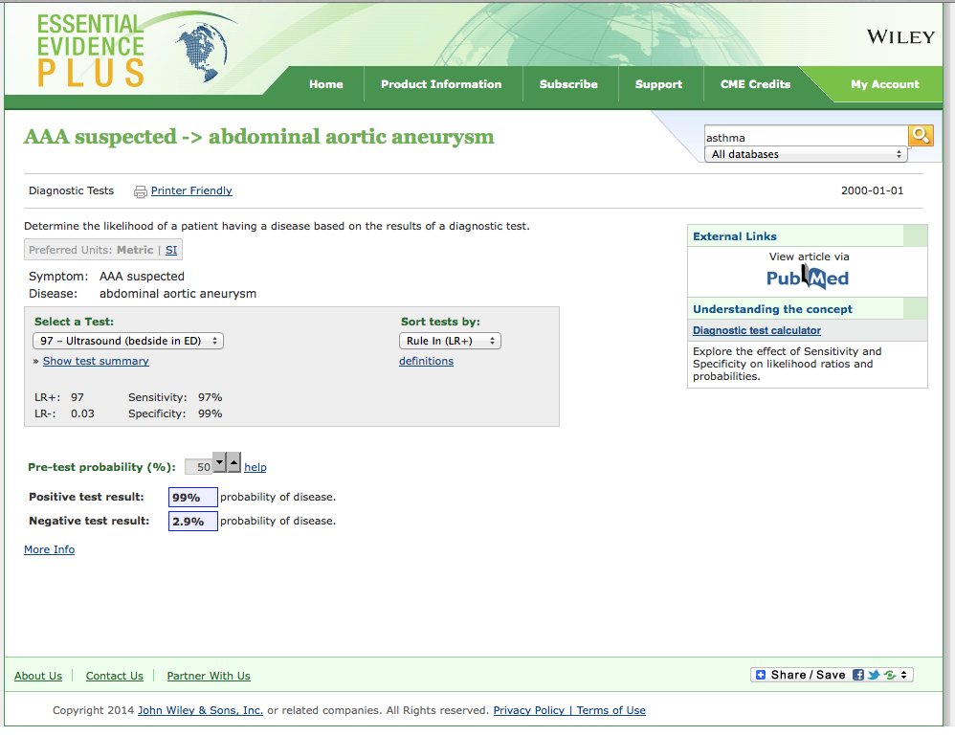

Slide 58
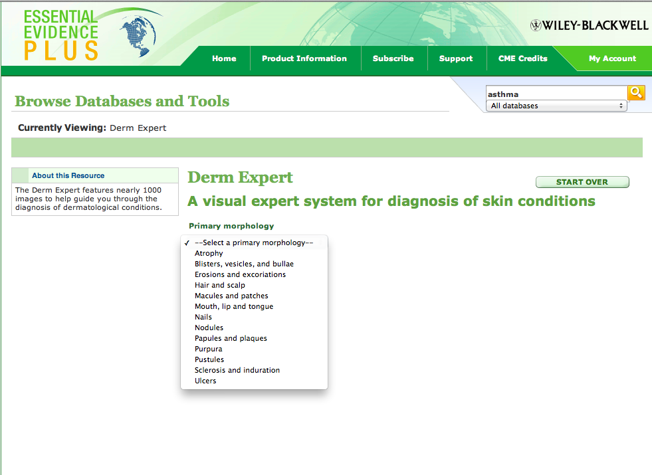
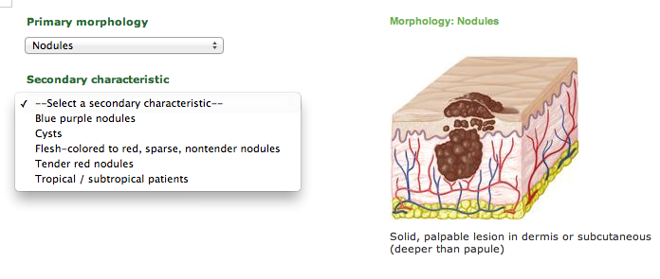
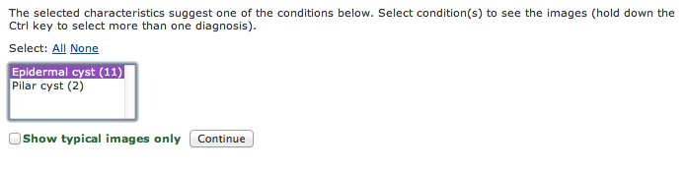
Click

Slide 59
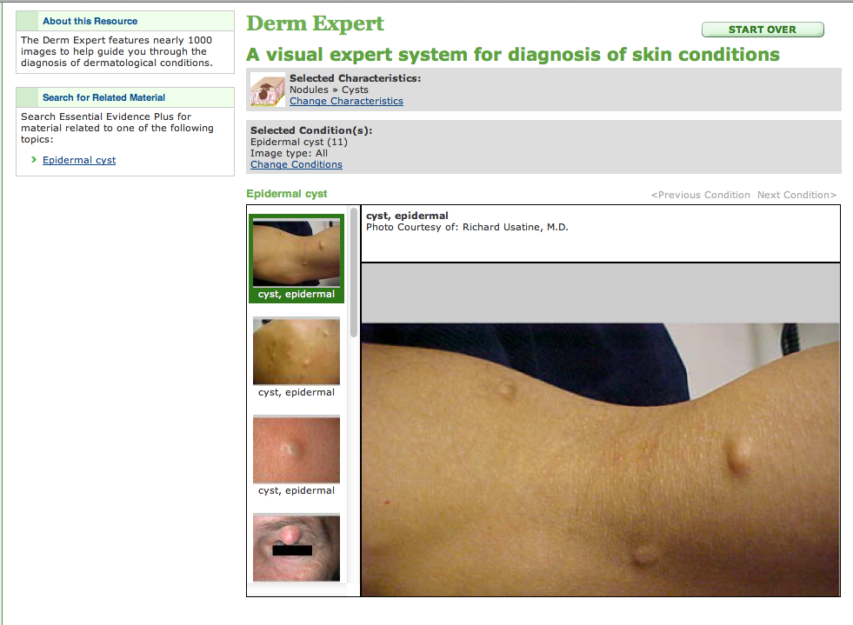

Slide 60
Practice Guidelines

Slide 61
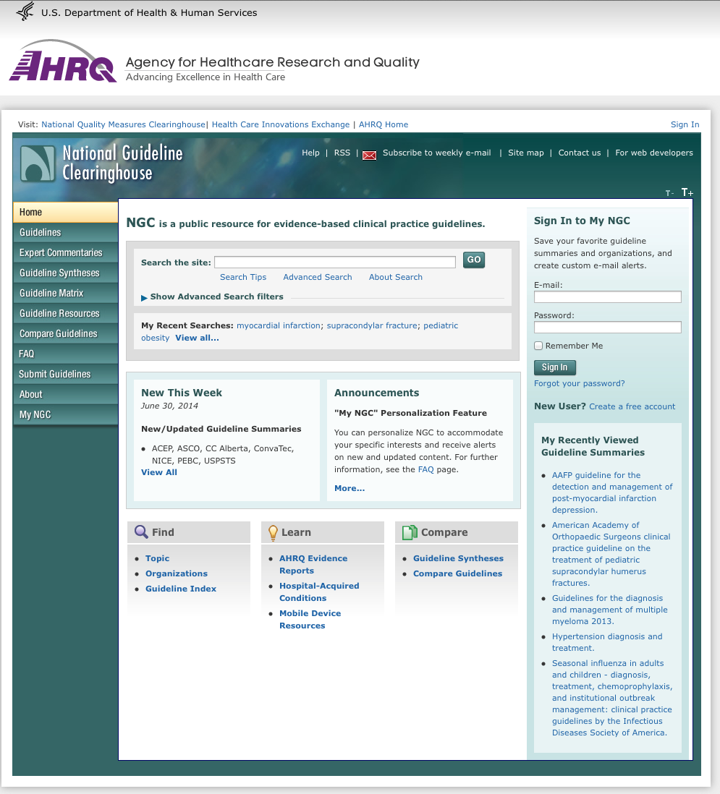
www.guideline.gov

Slide 62

Many Information Resources
are Mobile!

Slide 63
www.ttuhsc.edu/libraries
Click Mobile Resources

Slide 64
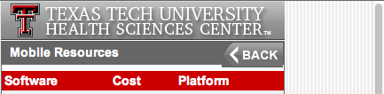

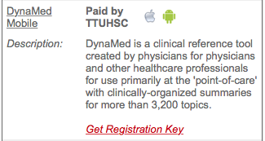
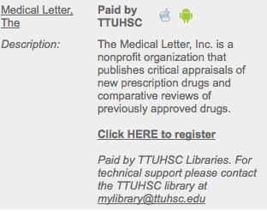
Scroll to resource
Click appropriate icon for your device

Slide 65
www.ttuhsc.edu/libraries
Ask-A-Librarian

Slide 66

Please contact us at:
Lubbock
(806) 743-2200
Amarillo
(806) 354-5448
El Paso
(915) 545-6652
Odessa
(432) 335-5171

Slide 67
The End
July 2015

