Slide 1

http://www.ebm.med.ualberta.ca/

Slide 2
Click About EBM

Slide 3
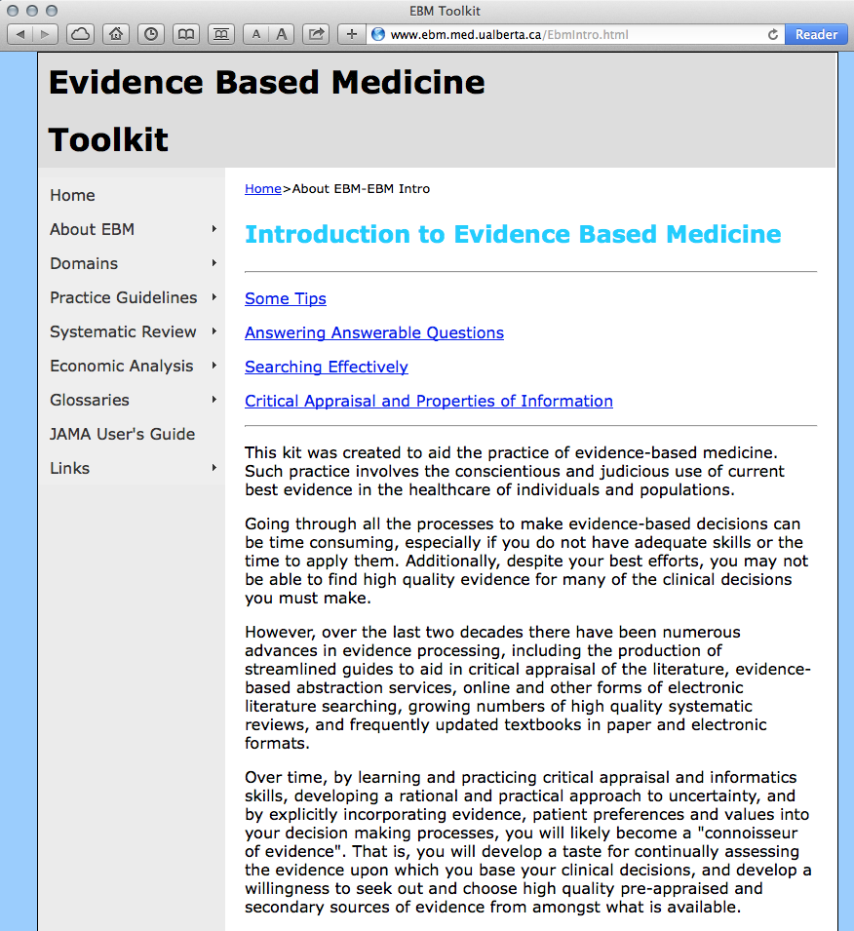

Slide 4


Mouse over
Domains,
Study Category,
and select
Worksheet.
Look at Calculations for calculators.
Then look at Systematic Review
for the worksheet for studies
that are Systematic Reviews or Meta-Analyses.

Slide 5
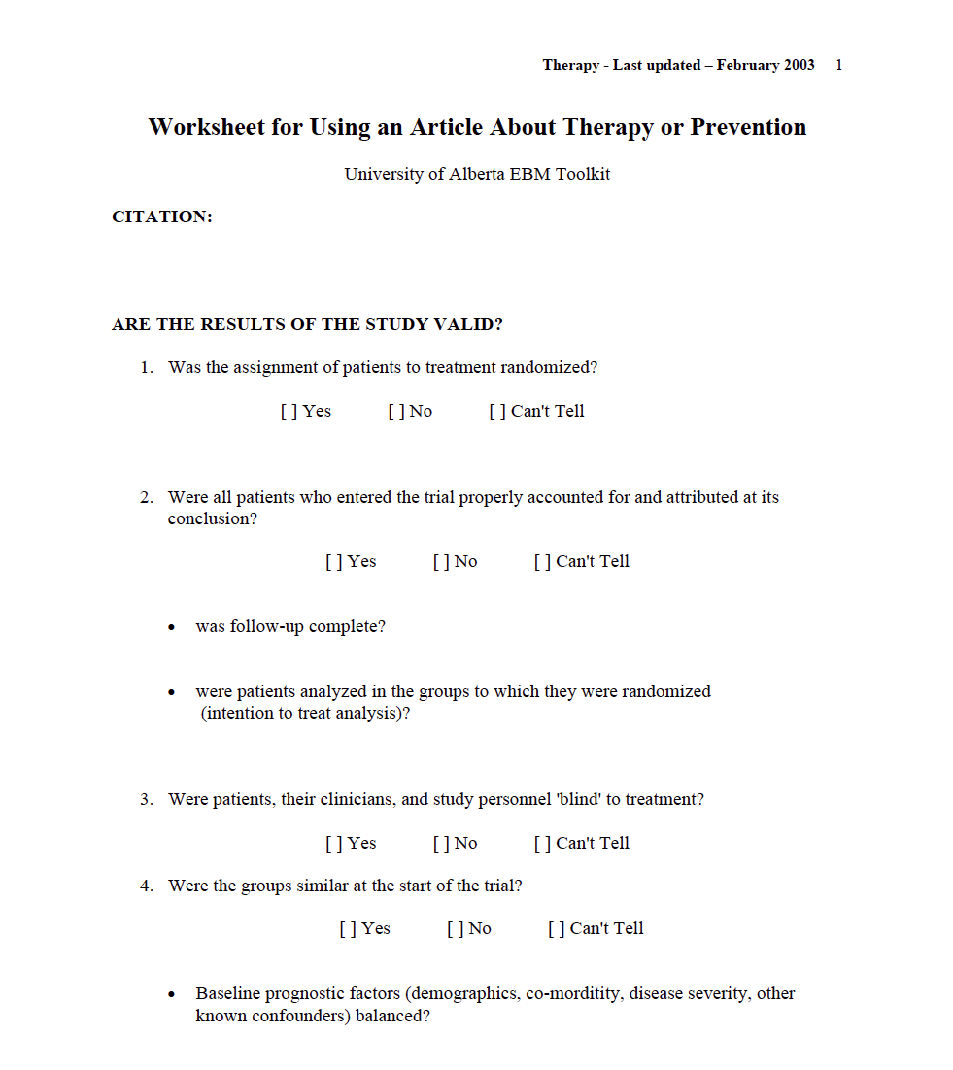
Example of a Critical Appraisal Worksheet

