Slide 1
Scholarship in Evidence-Based Practice
Micah Walsleben, MLS
September 18, 2017

Slide 2

Preferred Internet Browser
Chrome
Notes:
When accessing the library website and its resources from your computer at home or off campus, it is highly recommended that you stick to Chrome. Internet Explorer doesn’t support all of the technology we have on the library website, and we have had some reports of access issues as a result. Also, the HSC I.T. department has announced that they are ending support for Firefox as well.

Slide 3
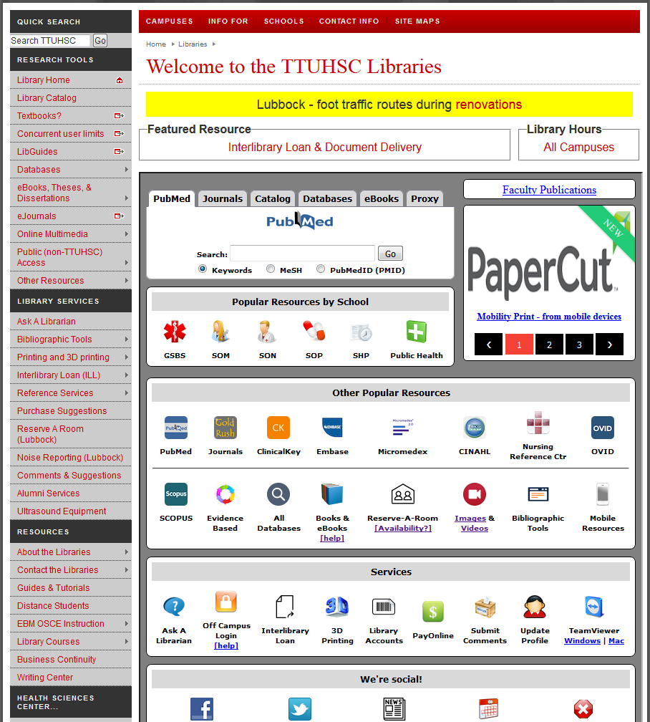
Library Cards (Account)
Notes:
If you haven’t already, please get your library account set up. The best way to do that is to sign in to our catalog.

Slide 4
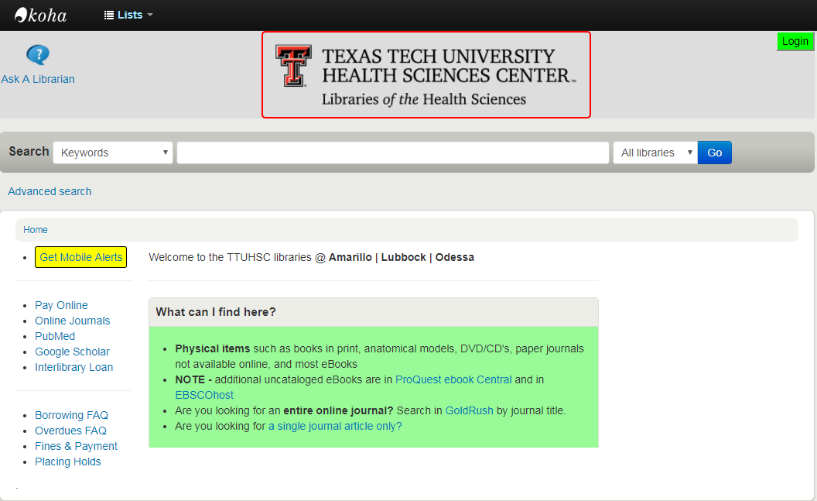
Notes:
In the upper right corner, there will be a green “login” button. Log in with your eRaider username and password. Once you log in, there will be a section called “Personal Details”. Fill that out and submit it, that’s all that’s needed to activate your library account!

Slide 5



Lubbock Reference Librarians
Available on 2nd floor of library, across from the Learning Resource Center and public computers
8am–5pm
Monday–Friday
Jennifer Yack
Peggy Edwards
Micah Walsleben
Margaret Vugrin
Notes:
These are the Reference Librarians at the Lubbock campus. Our office hours are Monday – Friday 8:00am – 5:00pm Central Time. Feel free to give us a call or send us an e-mail! We will be happy to help you.

Slide 6
TTUHSC Libraries’ Website
www.ttuhsc.edu/libraries
Notes:
This is the library website, along with the URL address. I recommend bookmarking this page to help you access our resources quickly and easily. Because our resources require you to log in from off campus, it’s best to bookmark the main page rather than any specific resource.

Slide 7
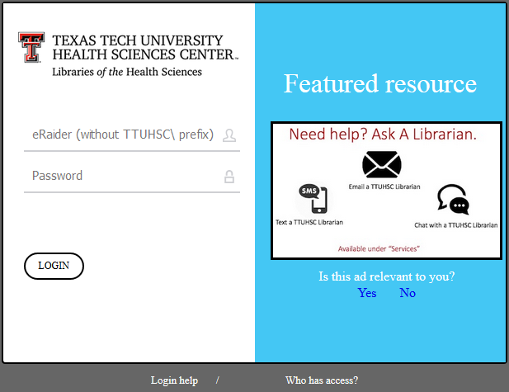
Proxy Server
Off-campus access for library resources:
Sign-in with your eRaider username & password
Problems with eRaider? Call: 806-743-1234
Notes:
All of the online resources provided by the library require that you log in with your eRaider username and password any time you are off campus. If you should ever encounter a problem logging in from off campus, please call the number on the slide as soon as possible.

Slide 8
Information for Distance Students
Notes:
The library has a list of information aimed specifically at distance students. It is available on the lower left side of the library website, under “Resources”.

Slide 9
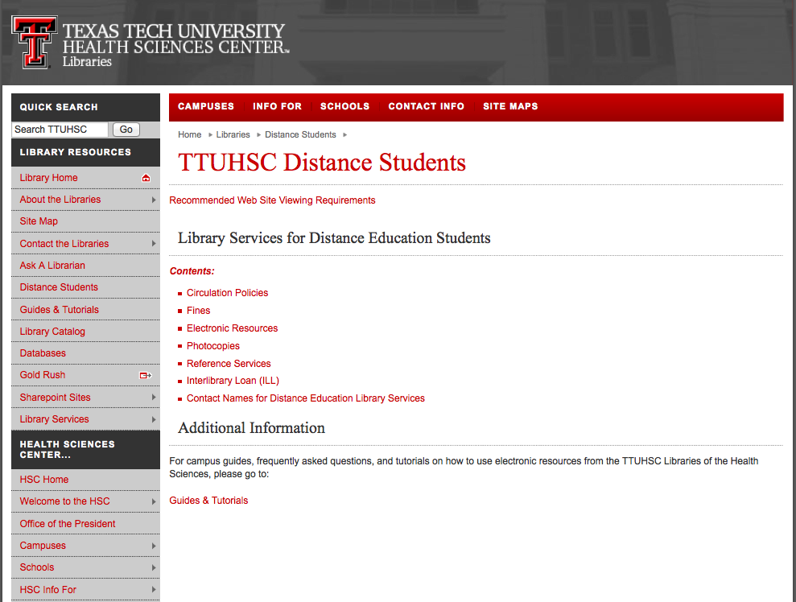
Notes:
Here, you will find much of the same information and policies covered in this presentation and in the library brochure you received. Please refer to this page if you should have any questions in the future about the library’s policies.

Slide 10
Guides and Tutorials
Online
step-by-step
guides
Notes:
Another place I’d like to point out is our “Guides and Tutorials” page. It’s located in the lower left corner of the library web site in the section labeled “Resources”.

Slide 11
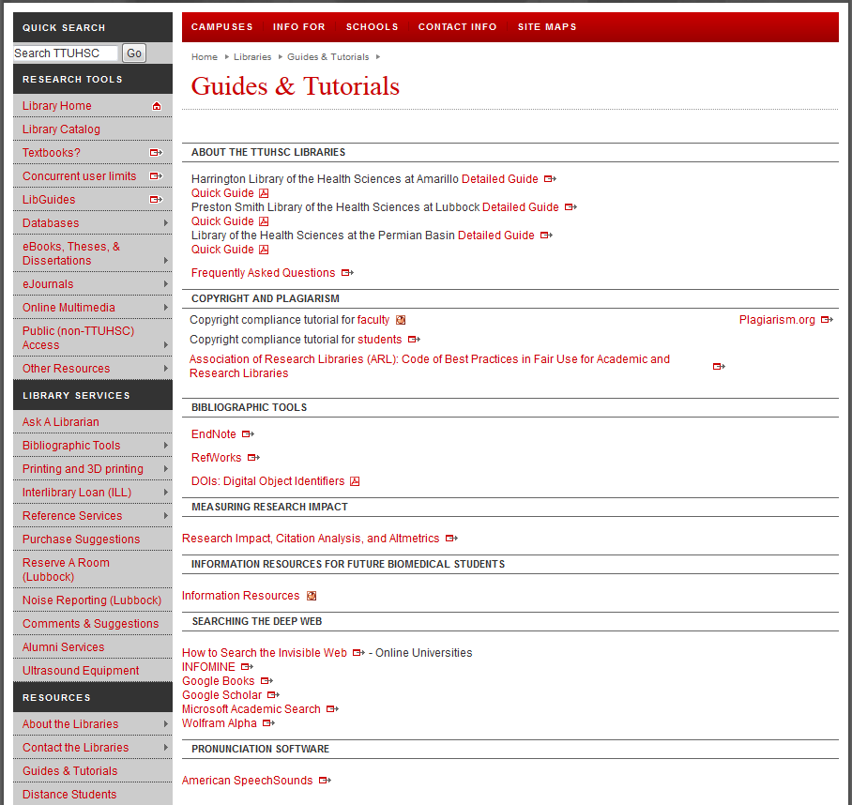
Scroll down to see additional tutorials
Notes:
Here is the “Guides and Tutorials” page. You’ll notice we have guides to all the branch libraries. If you plan to visit one of our libraries, this would be a good place to look up the library’s hours and policies before you go. Scrolling down the page will take you to helpful tutorials on our more popular databases and online resources.

Slide 12
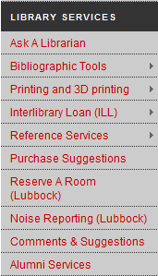
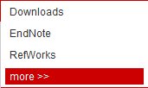
APA Help
Notes:
Are you writing a paper and need help with APA format? We’re not always experts on how to cite your paper, but we do have a compilation of tools and websites to help you. In the middle of the left column of the library website, mouse over “Bibliographic Tools” (found under “Library Services”), then click on “More”.

Slide 13
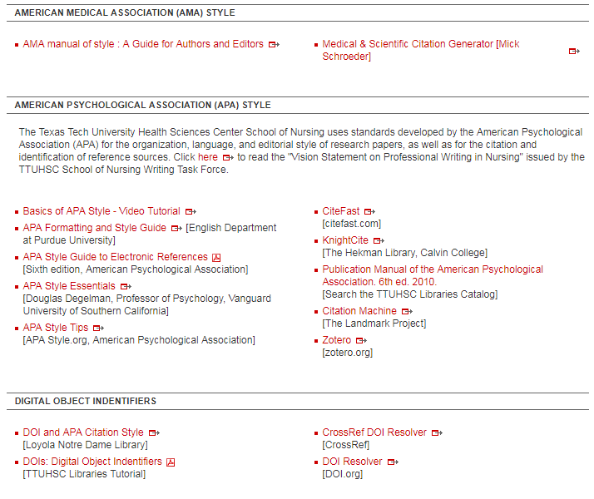
Notes:
Towards the middle of the “Bibliographic Tools” page is this information regarding APA. Here, we have online style manuals, various guides and tutorials, and a few online citation generator tools to help you format your citations. Remember, always double-check citations that are generated for you to make sure that they are what your professor requires for the assignment.

Slide 14
Online Writing Center!
Notes:
TTUHSC now has an online writing center! It’s located under “Resources” at the lower left of the web site. You can submit your papers for review and feedback. The online Writing Center follows the academic calendar for TTU, however, so make sure they are accepting papers before you submit yours.

Slide 15
Ask A Librarian
Notes:
If you have a question or need assistance, please don’t hesitate to contact us through our “Ask A Librarian” service. The best way to access this is through the Ask A Librarian logo, located under “Services”.

Slide 16
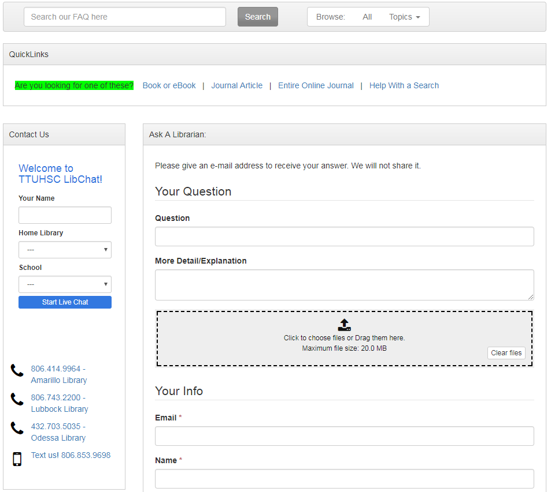
Notes:
From here, there are several ways to contact us. You can submit your question through our Ask A Librarian e-mail form (“Your Question”), call the library nearest you, or chat online with a librarian (when the service is available). You also have the option of texting your question and receiving a text in response. Both the e-mails and texts received are sent to each librarian in all branches of the Health Sciences Center, so you can be assured that your question will be answered in a timely manner.

Slide 17
Team Viewer
Notes:
Another option for receiving additional help from the library is through Team Viewer. Team Viewer is a program that allows the librarian to view your computer desktop remotely in order to help you with your research and other questions in real time. This program is located on the library web site under “Services”. Download options are available for both Windows and Mac systems.

Slide 18
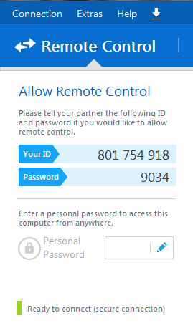
Give your ID and password to a librarian on the phone
We will be able to remotely control your desktop—we will see what you see as well as move your mouse, etc.
Please make an appointment in order to ensure plenty of time to work on your problem!
Notes:
When you download Team Viewer, you’ll see something like this, with an I.D. and a password. Once you have this, call a librarian. Relay the I.D. and password over the phone, and the librarian will be able to see what’s on your computer screen and control the mouse! The librarian will stay on the phone with you and walk you through your research question in real time. You can call and start a Team Viewer session immediately, or if you have a major project/assignment coming up, you can schedule an appointment as well. A key feature about Team Viewer that I’d like to point out is that the password changes each time you close the program. That way, anyone who was able to access your desktop once would not be able to do so again once you close out Team Viewer.

Slide 19
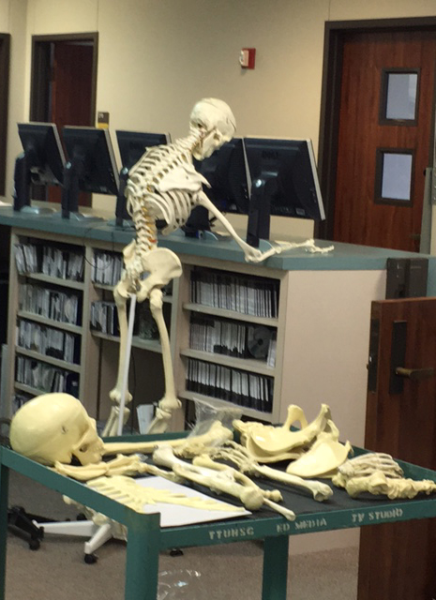
Don’t wait too long!!
Notes:
Contact us early and often! If you have an assignment or research project and you encounter problems with it, please call or e-mail us right away. One of the best parts of our job here at the library is being able to save you time and/or frustration, so don’t hesitate to reach out to us!

Slide 20
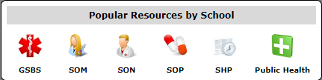
Resources just for you!
Notes:
The library has resources just for you! Starting at the library web site, find the tab in the upper middle of the page labeled “Popular resources by school”. From there, click on the icon labeled “SON”.

Slide 21
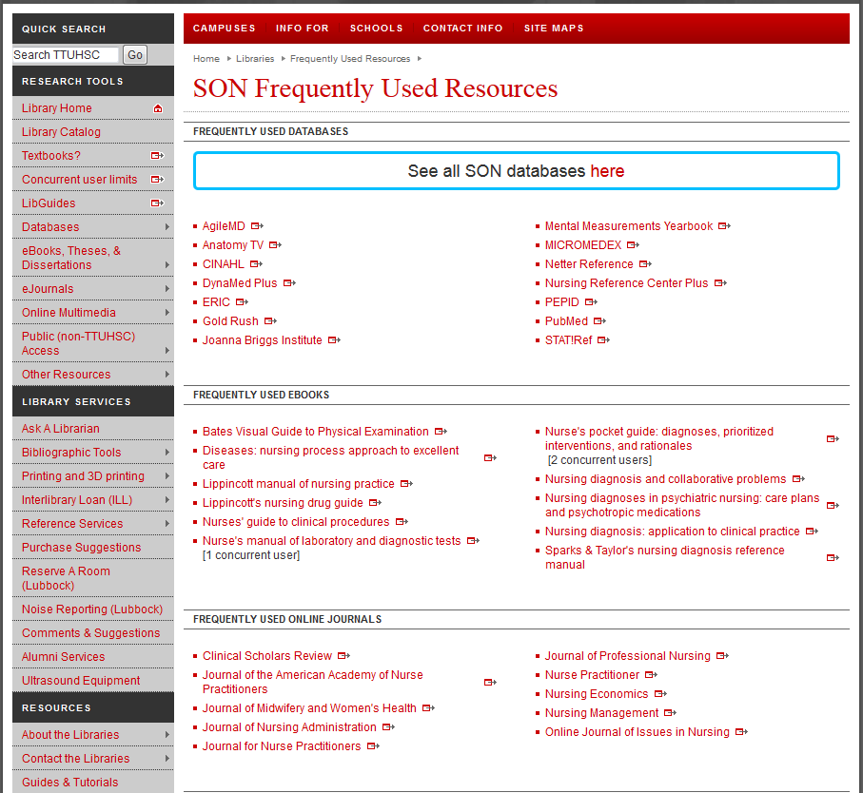
Notes:
This is a list of resources that the School of Nursing faculty has deemed the most important and helpful to their students, although it is by no means a comprehensive list of the resources available to you. It is a great place to start when conducting research for an assignment. Further down this page is where this power point is hosted for your benefit.

Slide 22
Database Searching 101
Get the Results You Want!
Notes:
In this section, I will be going through helpful tips on searching some of the databases that I will show you later in this presentation. While these databases are extremely useful and will be a great help in your studies, they are not as simple as Google, and searching them successfully requires a good search strategy.

Slide 23
Terms from a Question
Entering a whole question into a database doesn’t work
Use 2-3 words rather than a whole or partial sentence
How do I prevent medication errors in the hospital?
medication errors
hospital
Notes:
Let’s start with extracting search terms from a question. When searching online databases, you might find that entering a question into the search box verbatim doesn’t work. The reason for this is that when you enter a group of words into the search box, the database will search for every single word separately – even the words “and” and “the”! The best way to enter your research question into a database is to examine the question you want to ask and determine two or three words or phrases that best encompass your research topic. For example, if your research question is “how do I prevent medication errors in the hospital?”, you might just want to search “medication errors” and “hospital”.

Slide 24
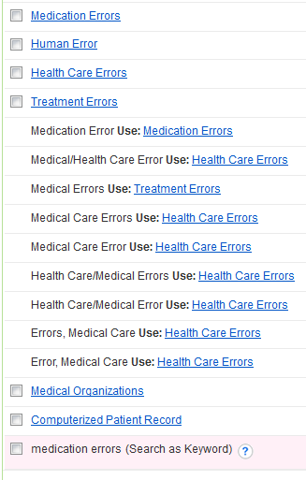
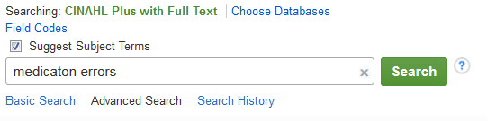
Subject Headings
Notes:
Once you’ve determined which specific words you would like to use to conduct your search, you’re ready to enter them into the database. But wait! Some databases, like CINAHL, have something called subject headings. When you search using your chosen words, the database will give you a list of other terms to choose from. What are these subject headings? Should you use them? How are these different from just searching with the words you chose earlier?

Slide 25
Subject Headings
Subject Headings act as a thesaurus for the database—it’s how the articles are indexed.
Helps clear up any issue with synonyms, making sure you find articles related to a concept, not just a term.
Search the database using terms it is programmed to understand.
Notes:
Subject Headings act like a thesaurus for the database. When articles are added to the database’s collection, they are indexed according to this list of terms. These subject headings also encompass known synonyms, for example, “Heart Attack” will also search for articles that use “Myocardial Infarction” instead. Using these subject headings allows you to search the database with terms it is programmed to understand. Think of it as “speaking the database’s language” in order to get the results you want.

Slide 26

Keywords
Keyword search will look for your word everywhere
Only the entered term is searched; synonyms are excluded
Notes:
As I’ve mentioned previously, searching for a term in the search box, without using any subject headings (also known as a keyword search), will search for that word; however, it will search for that word anywhere it’s found within the citations stored in the database. This means that the search results you find may have your word in the article title, journal title, anywhere in the abstract, even as part of an author’s name. Another point to consider is that keyword searches will only look for the specific word you entered, often leaving out any synonyms. Bottom line: if they’re available within the database, subject headings are best.

Slide 27
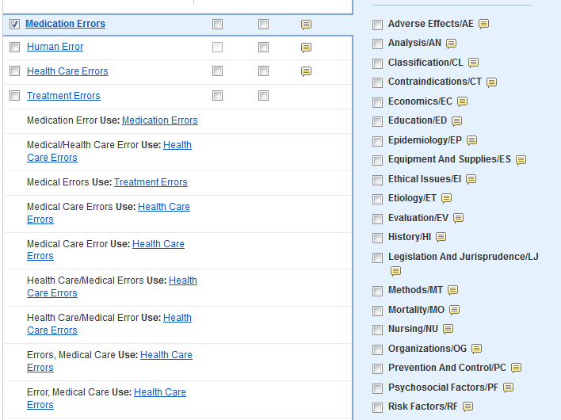

Subheadings
Subheadings act as a facet of subject headings
Narrow a broad subject heading to get more specific results
Notes:
In databases with subject headings, selecting a subject heading will allow you to choose a subheading associated with the term. What does that mean? Think of subheadings as different facets of the subject heading you’ve chosen. For example, one of the terms from our sample question is “medication errors”, but we want to know how to prevent them. Notice there is a subheading called “prevention and control”. This is a great way to narrow a broad topic and achieve more relevant search results.

Slide 28

Boolean Operators
NOT excludes a term from the search
AND searches both terms together
OR searches both terms separately
Notes:
Once you’ve chosen your subject headings and any subheadings you want, many databases will give you the opportunity to search using “AND”, “OR”, or “NOT”. These are called Boolean operators. The operator “NOT” excludes a term or concept from a search. In contrast, “AND” searches both terms together, while “OR” searches both terms separately. What exactly does that mean?

Slide 29
AND vs. OR
hospitals
medication
errors
AND
OR
Notes:
Here is a visual aid that might best illustrate the distinction between the Boolean operators “AND” and “OR”. Think of our two search terms as part of a Venn Diagram. Combining the two with “AND” will only produce those results where both terms are indexed. Combining the two with “OR” will produce the same results as “AND”. However, since it is searching for each term separately, it will also produce results dealing exclusively with one term or the other.

Slide 30
General Searching Tips
Start with a broad search, then narrow it as needed
  This ensures that you don’t miss potentially relevant results
Search each term separately, then combine them later
  This allows you to alter your strategy if your initial search doesn’t work
Notes:
Now that we’ve gone over specific concepts to help improve your search strategy, here are a few general searching tips to help you with your research: First, it’s always best to start with a broad search, then narrow it down further if you get too many results. This is helpful especially if you’re not sure how much information can be found on your topic. If you start with a search strategy that’s too narrow, you might miss some information that might be useful to you. Another tip is to search for each of your terms separately, then combine them in either the advanced search or search history section of the database. While it might seem like extra work, this is helpful in case your initial search strategy is unsuccessful. If your first combination of terms yields results that are unsatisfying (or produces no results at all), searching terms separately will make it easier to go back and combine some of your old terms with new ones. You only have to slightly tweak the work you did the first time, not do it all over again.

Slide 31

More General Tips
Don’t be afraid to hunt for the subject heading you need
  Try looking for it under a different name/synonym
  The more you search, the easier it will be!
Have fun!
Notes:
Don’t be afraid to play around with the terms or subject headings available to find the one that best suits your needs. Another thing to remember is that sometimes the subject heading used by the database might be different that the term you use in everyday life. If you can’t find a subject heading to match what you’re looking for, try looking for your term or concept under a different name, if it has one. And lastly, try to have fun! Once you understand how database searching works, the whole process becomes much easier and less overwhelming. If you work with the database, it will work with you!

Slide 32
Useful Databases
Finding the information you need!
Notes:
Here are some useful databases that will help you with this assignment in particular and your studies in general. I’ll be going through three databases: CINAHL, Nursing Reference Center Plus, and PubMed. In addition, I’ll also go over the basics of using Gold Rush to find articles in the library’s holdings with its citation information and briefly discuss our Interlibrary Loan service.

Slide 33
Today’s Databases
CINAHL
Nursing Reference Center Plus
PubMed

Slide 34
CINAHL
Cumulative Index to Nursing and Allied Health Literature
4+ million records
Subject coverage: Nursing and 14 Allied Health specialties
Evidence-based Care Sheets and Research Instruments available
Coverage back to 1937
Notes:
The first database we’ll visit is called CINAHL. The name stands for “Cumulative Index to Nursing and Allied Health Literature”. It has over 4 million records on nursing and 14 different allied health disciplines, with coverage going back as far as 1937.

Slide 35
Notes:
There are two ways to access CINAHL: the first way is through the CINAHL logo on the web site under “Other Popular Resources”. The second is through the SON popular resources page.

Slide 36
Notes:
CINAHL will be under “Frequently Used Databases” on the SON Frequently Used Resources page.

Slide 37
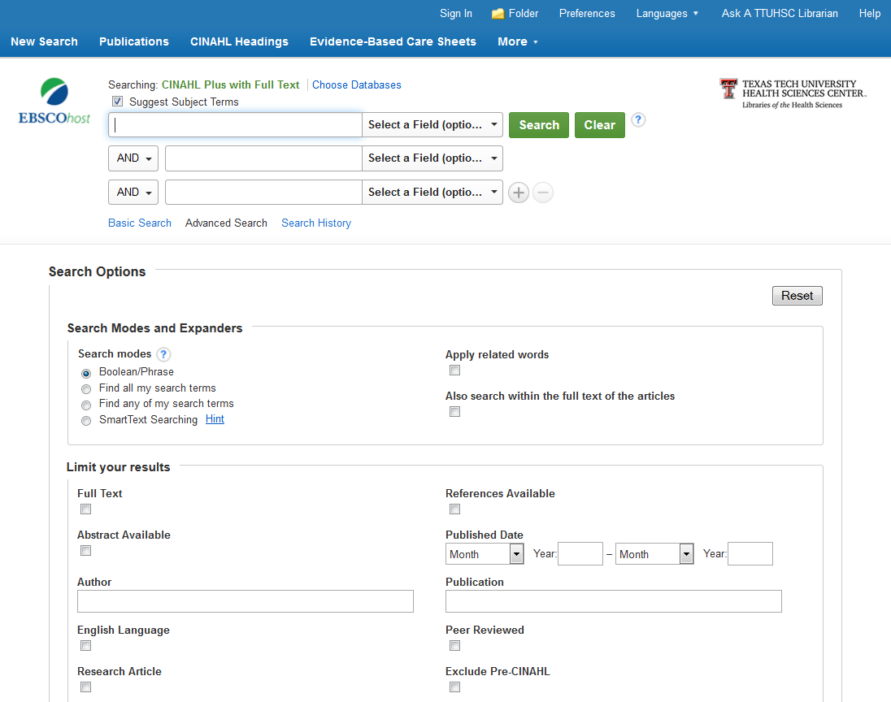
heart attack
Notes:
This is the CINAHL start page. The search box is located at the top of the page. You’ll notice that there is an option called “Suggest Subject Terms” that’s automatically checked. This will search CINAHL’s Subject Headings, a concept we discussed earlier. As an example, let’s search for articles about aspirin and heart attacks. We’ll start with the first part of the search, “heart attack”.

Slide 38
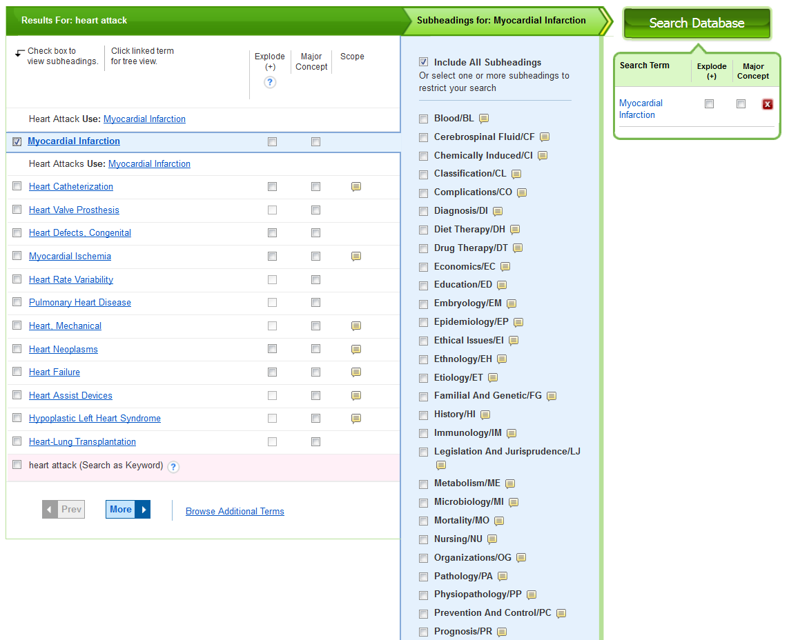
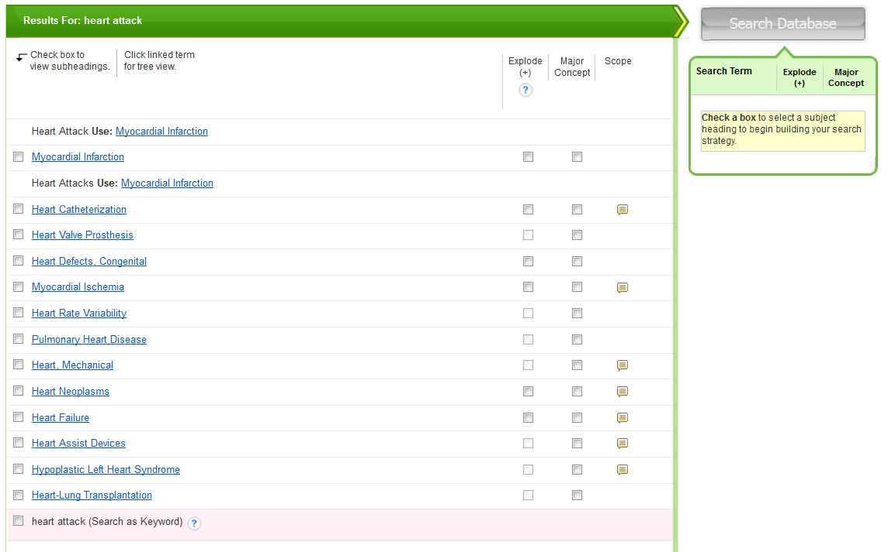
Notes:
CINAHL will give you a list of possible subject headings based on the words you searched. Notice that it corrected me and told me to use “Myocardial Infarction” instead of “Heart Attack”. This is a great example of how subject headings encompass synonyms and search for a whole concept, rather than just the words you enter. Check the box next to the term that best matches what you’re looking for, and a list of subheadings will appear. You can check the boxes next to the ones you want, or not choose any at all. Not choosing any by default will tell the database to search for all of them. This helps you collect all the information that exists in the database about your specific topic. When you’re finished making your selections, click the green button that says “Search Database”.

Slide 39
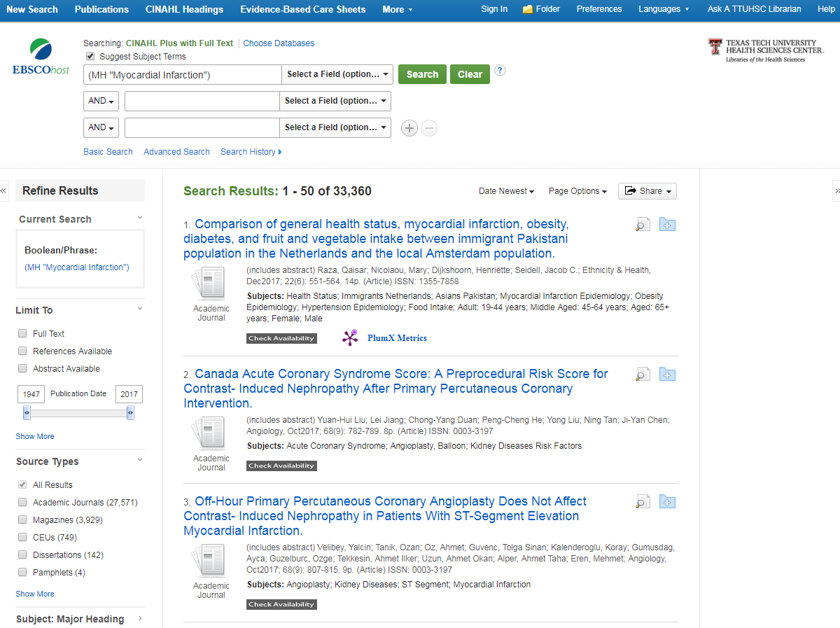
aspirin
Notes:
These results are for “heart attack” only. We still need to search for the second part of our topic, then combine them. Clear the search bar and put in “aspirin”.

Slide 40
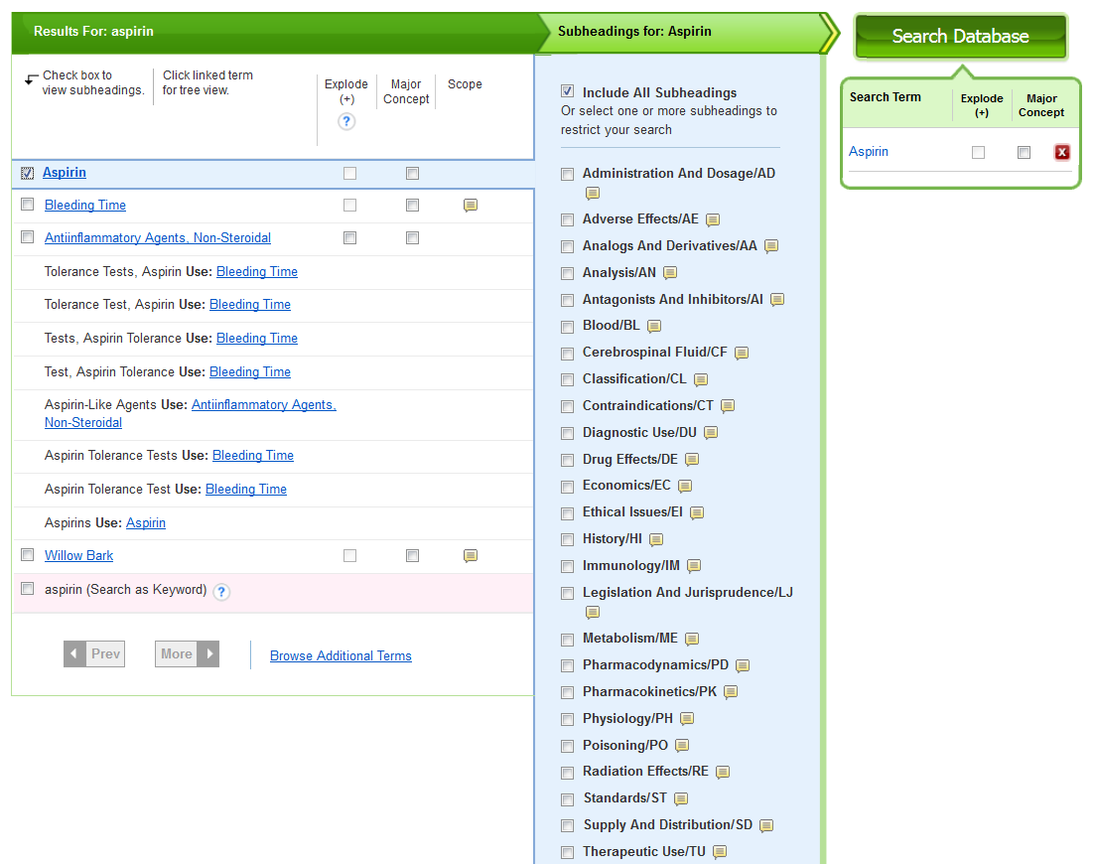
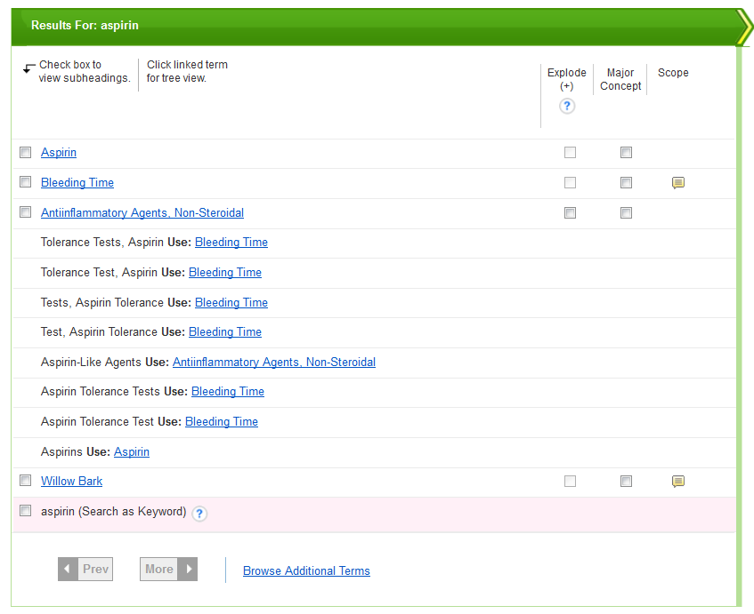
Notes:
Again, follow the same steps as before. Select the subject heading you want, any subheadings, then click “Search Database”.

Slide 41
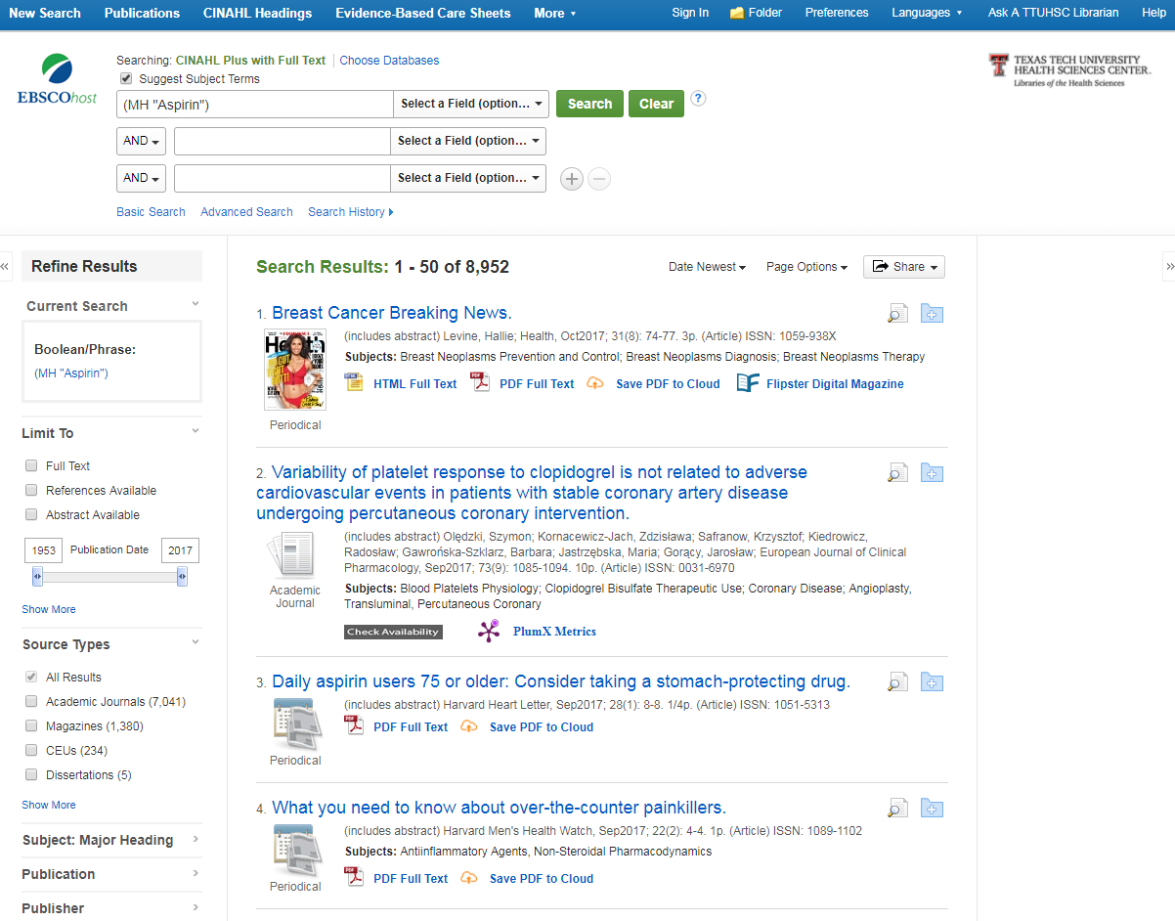
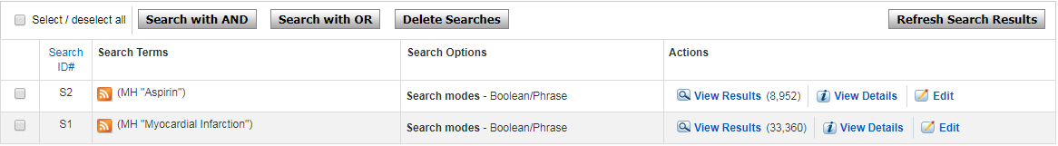
Notes:
These results now are only for “aspirin”. To combine them, clear the search box again (CINAHL has a weird quirk where anything left in the search box will be added to a combined search), and this time, click “Search History”. You’ll see the two searches you just performed. Check the boxes next to the searches, then choose “Search with AND”. Notice that CINAHL gives you the option of searching with the Boolean operators “AND” or “OR” that we discussed earlier.

Slide 42

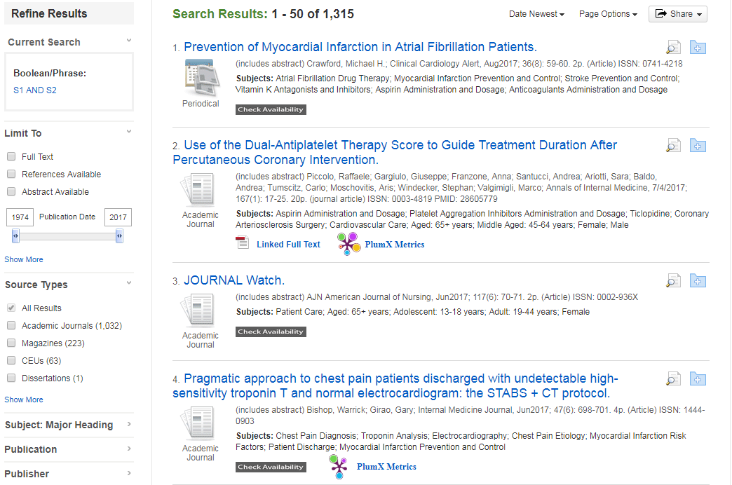
Notes:
Here now are your combined results. To the left is the filter sidebar, where you can limit the results to Year, Age, Geography (if you only want results pertaining to the U.S.), and more. Beneath each article title is the full text availability option. The gray “Check Availability” button will search the TTUHSC library holdings for your article, either online or in print. Seeing that button doesn’t automatically mean that your article isn’t available, it just might be available elsewhere. To the right of the title are two icons. The magnifying glass allows you to view the abstract of the article, and the folder allows you to add the article citation to a folder in CINAHL. From there, you can e-mail or export the information you’ve found.

Slide 43
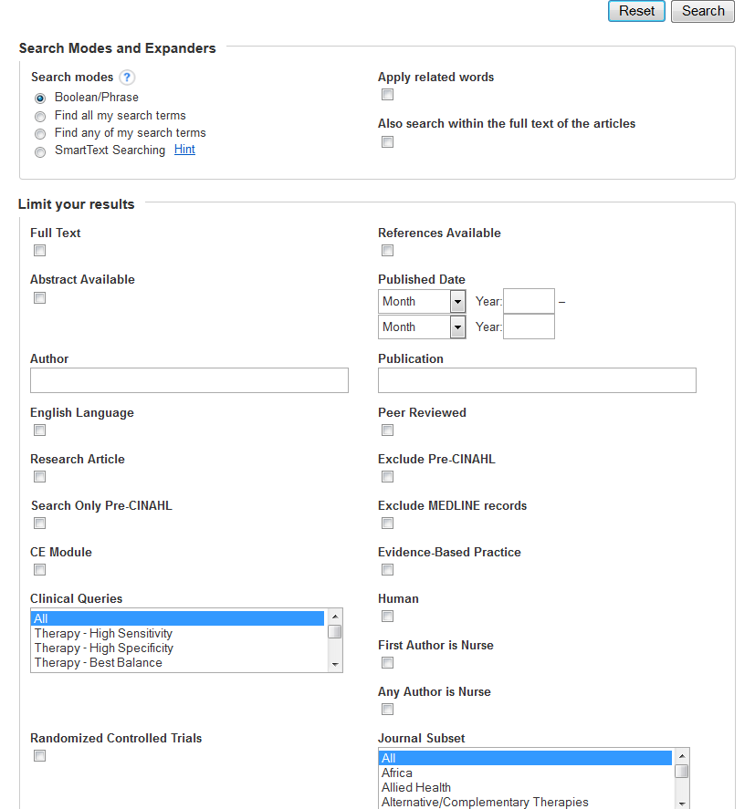
Notes:
To narrow these results to only articles from peer-reviewed journals, select “Show More” under “Limit To” on the filter bar at the left of the page (directly below the “publication date” sliding scale). A smaller screen of options will appear over the search results. Check the box under “Peer Reviewed” in the right column, then click “Search” in the upper right corner.

Slide 44
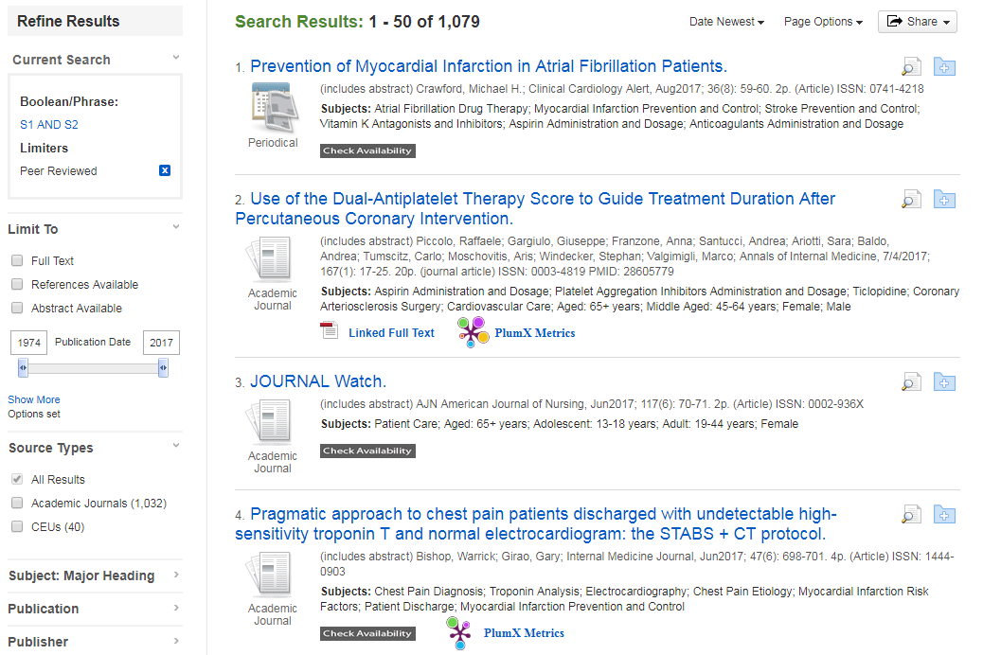
Notes:
Notice that there are fewer search results! Also notice, above the filter bar, the current search now has a limiter of “Peer Reviewed”.

Slide 45
Notes:
The next database we’ll look at is Nursing Reference Center Plus. It is located in the same places as CINAHL.

Slide 46
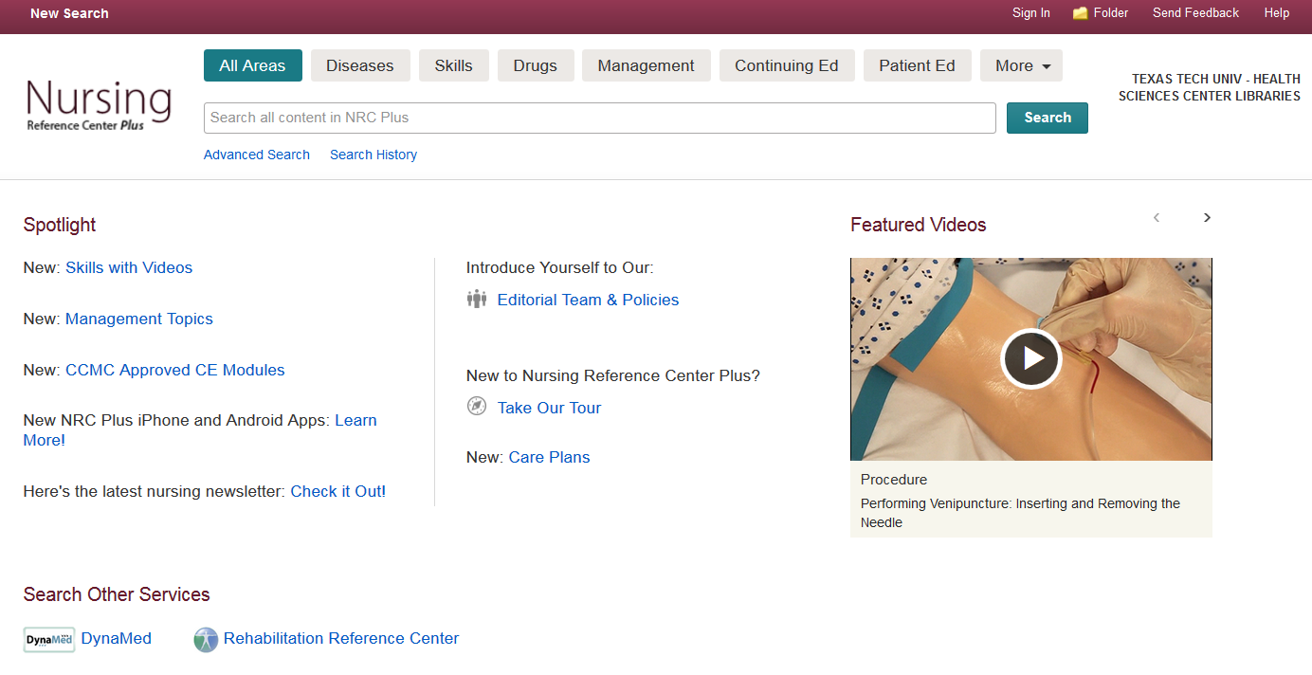
heart attack
Notes:
This is the Nursing Reference Center Plus start page. At the top, you’ll notice that in addition to a basic and advanced search option, there are tabs for Diseases, Skills, which features guides and videos of different procedures, Drugs, Continuing Education, Patient Education, and more. You’ll notice also that the start page has featured educational videos, as well as links to other resources like DynaMed and Rehabilitation Reference Center. Let’s continue with our previous search and look up “heart attack”, without clicking on any of the tabs at the top of the page.

Slide 47
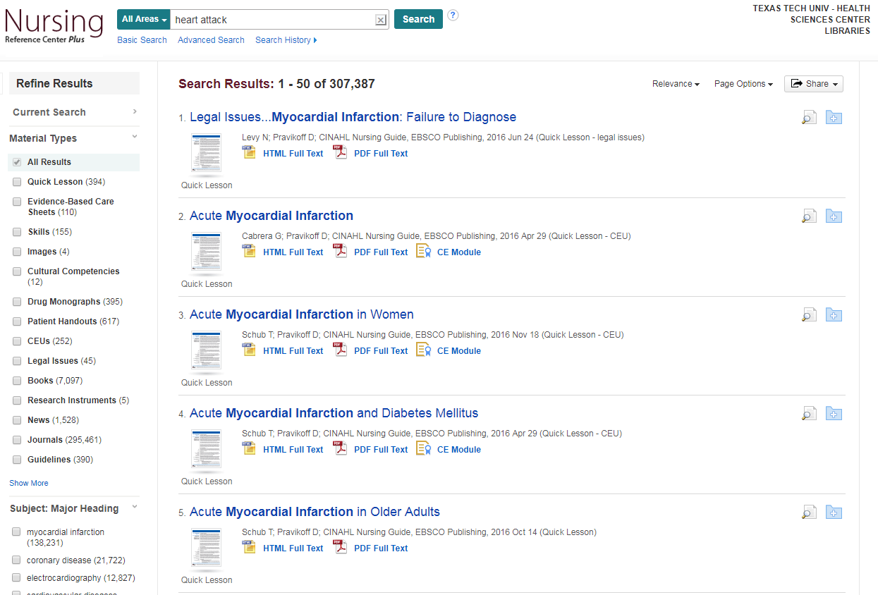
Notes:
This is the result page for everything Nursing Reference Center Plus has on “heart attack”, and it’s a lot! But, to the left of the results, you have the option of limiting the results to only the specific material types that interest you, such as guidelines, patient handouts, journals, etc. One material type unique to Nursing Reference Center Plus that I’d like to highlight is “Evidence-Based Care Sheet”. Check the box next to it to see them all.

Slide 48
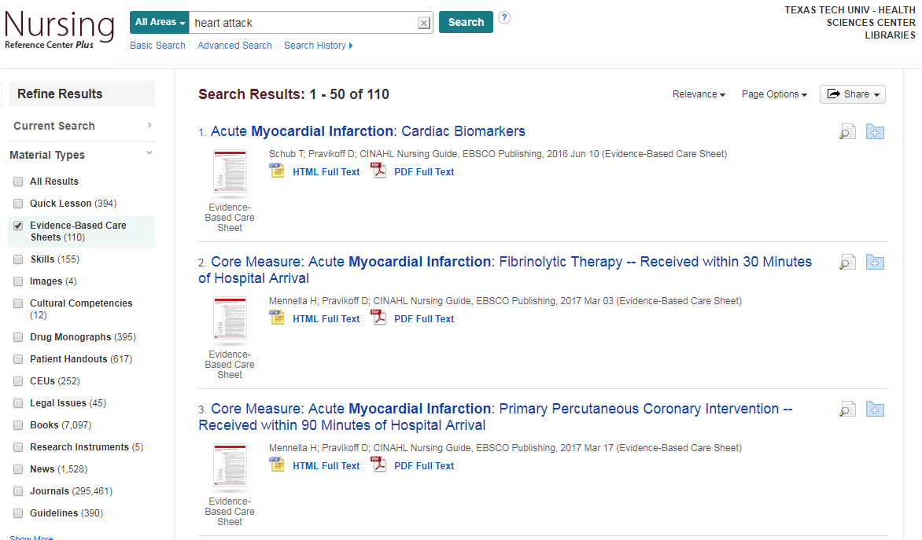
Notes:
These are the Evidence-Based Care sheets available that deal with “heart attack”. To see an example of what one looks like, click on the title of the third result.

Slide 49
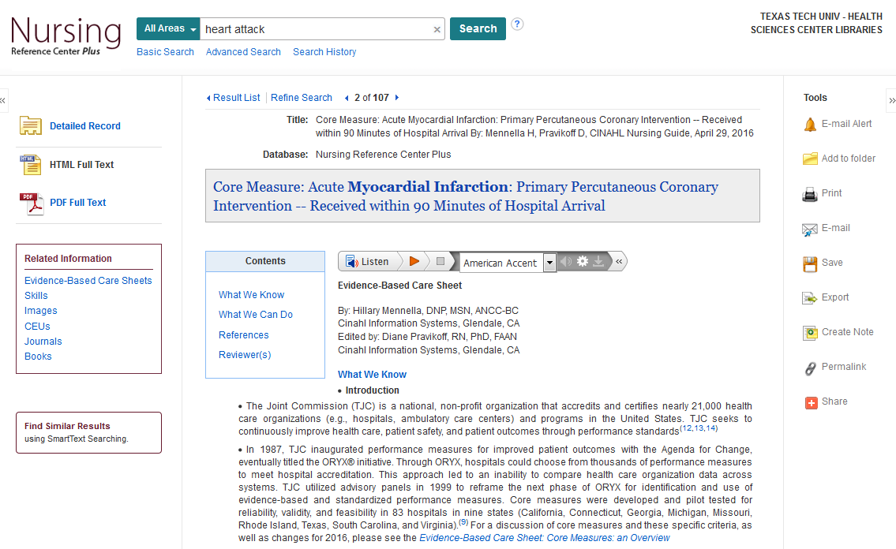
Notes:
This is what an Evidence-Based Care Sheet looks like in Nursing Reference Center Plus. To the left of the information, there is an option to go directly to the section of the care sheet that you want, and links to related information beyond that. To the right are links that will allow you to print, save, e-mail, or export this sheet. Above the grey title box is the Care Sheet’s citation information, and below it is the option to listen to the information, even in a variety of accents. One special aspect of these Care Sheets that I’d like to point out is in the References section. Click on the link in the blue “Contents” box.

Slide 50

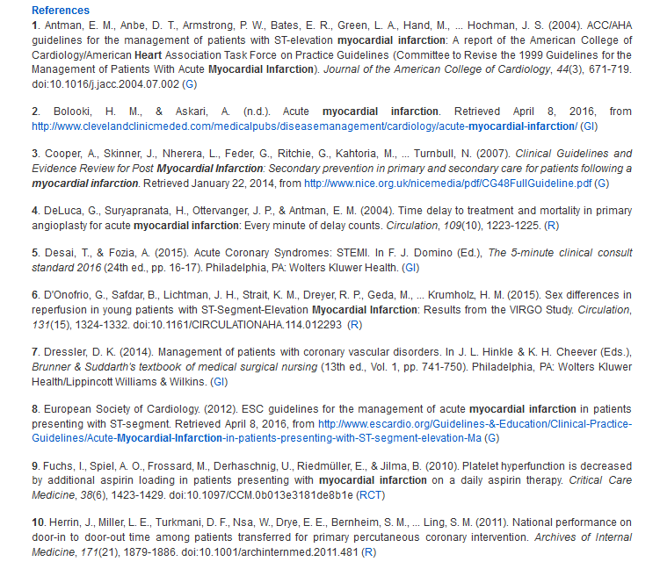
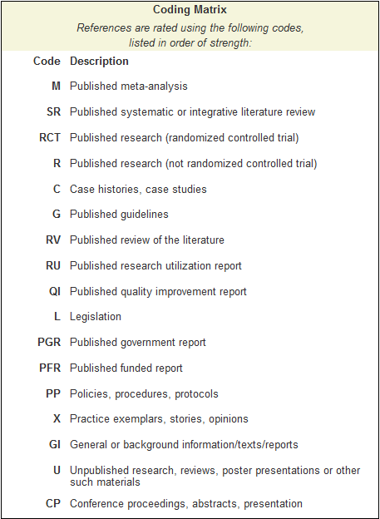
Notes:
This is the list of references for this care sheet. Notice that the references have letters in parentheses next to them. Some have a “GI”, “R”, “RCT”, etc. What are these, and what do they mean? Below the references is a “Coding Matrix” with a key to the letters, as well as their ranking in the levels of evidence. For example, reference #9 is labeled “RCT”. According to the matrix, that stands for “Randomized Controlled Trial”, and since it’s the third from the top of the matrix, it means the level of evidence is strong. This would be a good place to find a few evidence-based references as a jumping-off point for research assignments. Now, scroll back up to the top of the page and click on the “Nursing Reference Center Plus” icon. From the main starting page, click on “Diseases”.

Slide 51
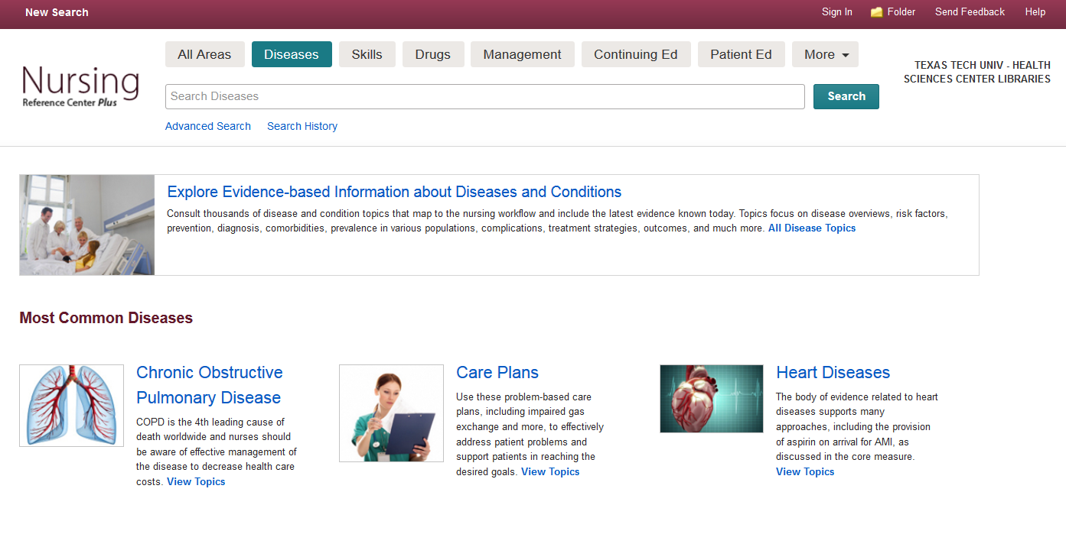
parkinson‘s disease
Notes:
This is the main page for diseases. Here, you have the option to “Explore Evidence-based Information about Diseases and Conditions”, but Nursing Reference Center Plus works better if you search for something specific, rather than browse. So, as an example, let’s search the Diseases section for “Parkinson’s Disease”.

Slide 52
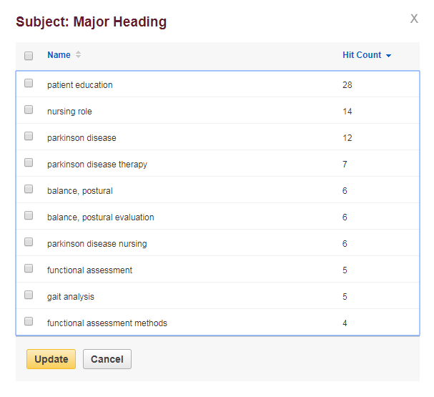
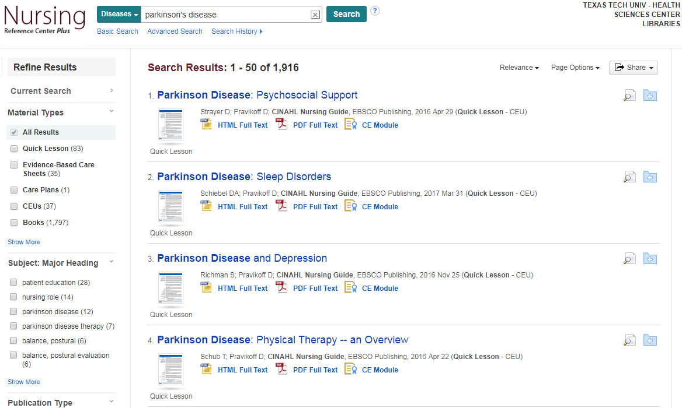
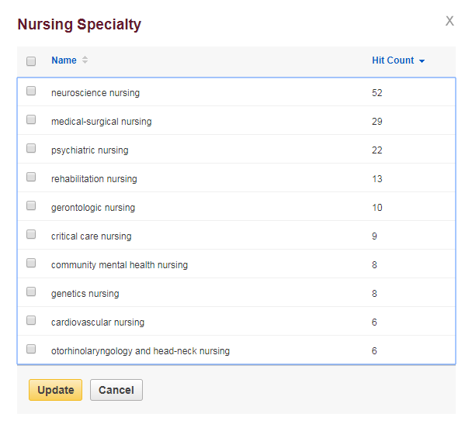
Notes:
This is the information available on “Parkinson’s Disease”. Notice that on the left, along with the material types filter we discussed earlier, you also have the option of filtering according to “Major Heading” or “Nursing Specialty”. “Major Heading” allows you to filter these results down to focus on cognition disorders, quality of life, etc. “Nursing Specialty” allows you to filter the results to only the ones concerning neuroscience nursing, rehabilitation nursing, etc.

Slide 53
Notes:
The last database tool we’ll be looking at is PubMed. There are two ways to access this through the library website, either Under “Other Popular Resources”, or the logo in the PubMed tab towards the top of the page.

Slide 54
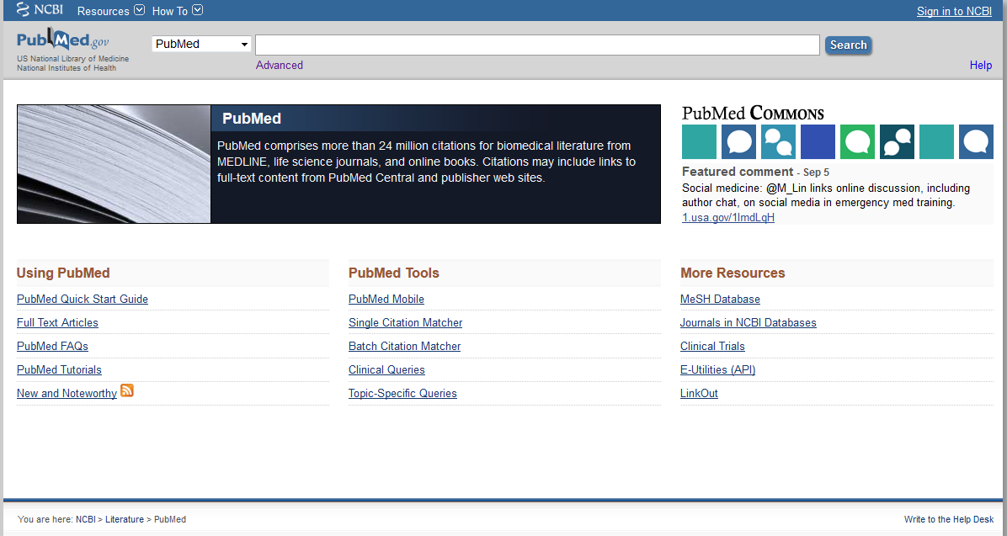
heart attack and aspirin
Notes:
This is the PubMed website. Let’s start by typing in our search completely plain, as is: heart attack and aspirin.

Slide 55
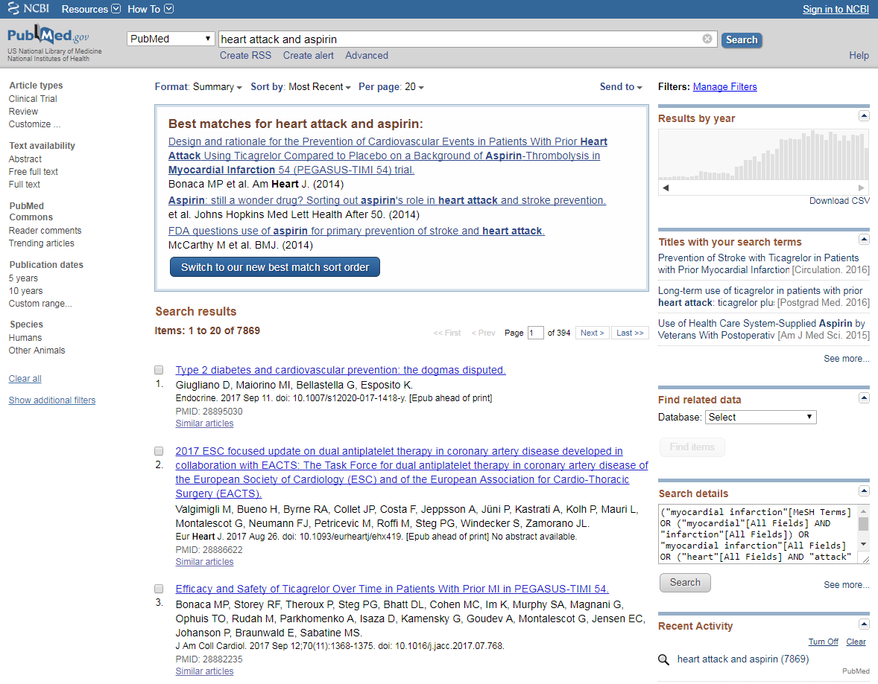
“heart attack” AND aspirin
Notes:
PubMed returns a lot of results! Far too many to sort through. Let’s re-run the search, this time structuring the terms a bit differently: “heart attack” AND aspirin. The quotes around “heart attack” serve to distinguish it as one complete term. When we searched PubMed before, without the quotes, it searched for “heart attack” but also “heart” and “attack”. Putting AND in all caps serves to differentiate it as a Boolean operator, not just an excess term.

Slide 56
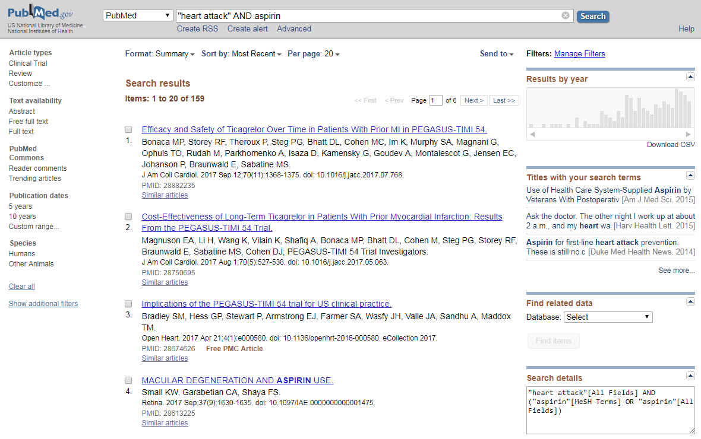
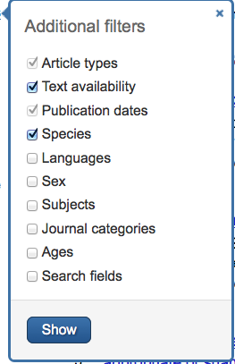
Notes:
Structuring the search like that cut down on the results tremendously! To the left of the search results is the filter bar. Here’s where you can narrow your results further: by publication date, article type (if you need a systematic review or other type of article, click “Customize” and take your pick), and more that are found under “Show additional filters” such as age, gender, and language (for articles written in English).

Slide 57
Gold Rush
Notes:
If you have a citation for a journal article and need to see if it’s in the library’s collection (perhaps you found an article with a full text link that didn’t work properly or didn’t have a link at all, and you would like to double check to see if we have it), Gold Rush is the place to go. It’s located either under “Other Popular Resources” or in the “Journals” tab towards the top of the page.

Slide 58
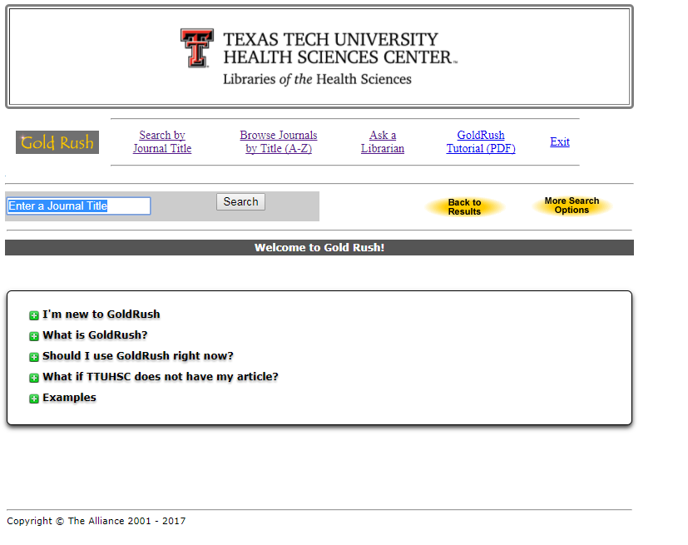
nursing education
Notes:
This is the main Gold Rush page. It includes some additional information about this tool as well as links to tutorials and other helpful resources, including an “Ask A Librarian” link if you need help. To give you an idea of what searching for a journal looks like in Gold Rush, let’s do a search for a journal. You can enter the full title, or just the words you remember. As an example, search for “nursing education”.

Slide 59
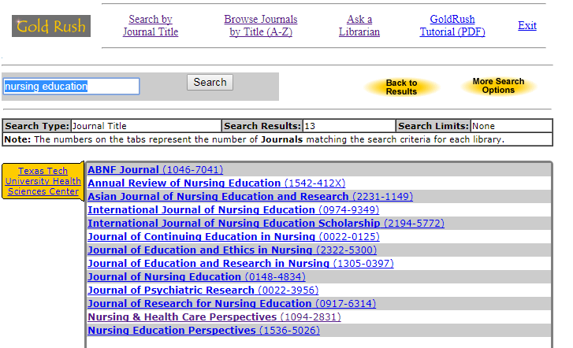
Notes:
This is the list of all the journals we have that have the words “nursing education” in them. From the list, choose the exact title you want.

Slide 60
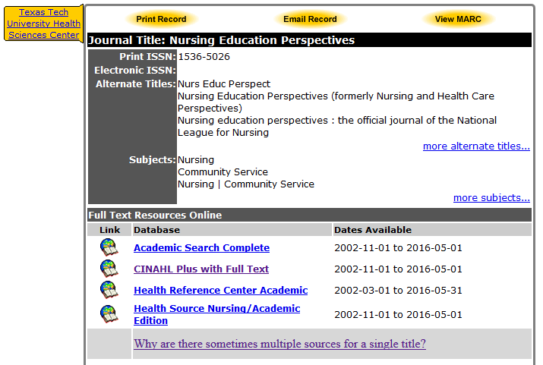
Notes:
The site will then direct you to a page that has some information about the journal, a link to search for it in our print collection, and links to the full text online (when applicable). Notice that this journal has four online options. Some journals have only one and some you encounter might have this many or more. How then do you choose which online option to click? The best way is to look at the “Dates Available” information to the right of the online links. Look at the year in which your article was published, then look at the dates available and find one that has the year you need. When you click on an online link, you will then need to find the year, volume, and issue of the journal, then scroll until you find your article. There should be a full text option from there.

Slide 61
Interlibrary Loan (ILL)
Read all about it here!
Notes:
If you need a book or article that is not available at the library, you have the option of ordering it through our Interlibrary Loan system. It’s found on the left side of the library web site under “Library Services”.

Slide 62
Basic ILL Information
Online ordering form makes submitting requests quick and easy
Response time for requests is anywhere from 2 – 5 business days, depending on location of the item
Books from any TTUHSC branch library are free, all others are $4.00
Journal articles are charged per page, but fees will not exceed $4.00
There is a rush option available, but at a higher fee rate
Credit Card payment option is available!
Notes:
Here is some basic information about our Interlibrary Loan system that will be useful for you to know. For distance students, it is important to note that if you need a book from any TTUHSC branch library, we will ship it to you for free. There is also an online ordering form grouped with the other Interlibrary Loan information on the library website for your convenience.

Slide 63
Credit Card Payment Option
Notes:
You can pay for your Interlibrary Loan orders (or any other library service that charges a fee) online! The link is found under “Services” on the library web site.

Slide 64
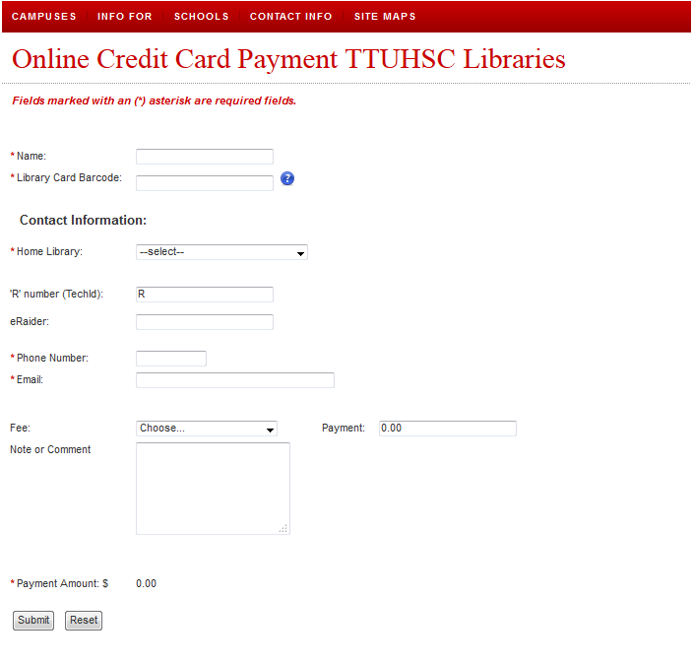
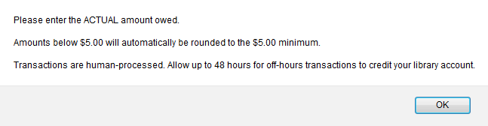
Notes:
A pop-up message will appear letting you know about the $5.00 minimum. This is the minimum amount we can charge your credit card. If the service you used had a fee less than $5.00, it will automatically be rounded up. If you agree to that and click “OK”, you’ll be re-directed to our online form where you can enter your information.

Slide 65
Thank You!
Notes:
Thank you for your time and attention during this presentation! Remember, the library is here to help you. If you have any questions or need any help at all, please give us a call or send us an e-mail or text. We’ll be happy to hear from you and will help you in any way we can. Have a great day!

