Slide 1
Welcome
Scholarship for
Evidence-Based Practice
Peggy Edwards, AMLS
TTUHSC - Preston Smith Library
Lubbock, Texas 79430
Jan 2017

Slide 2
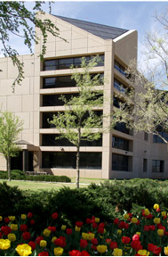
Welcome!
Preston Smith Library
located west of the
Academic Classroom
Building

Slide 3

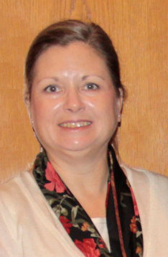

Available on 2nd floor of library, across from the Learning Resource Center and public computers
8am–5pm
Monday–Friday
Peggy Edwards
Micah Walsleben
Margaret Vugrin

Slide 4
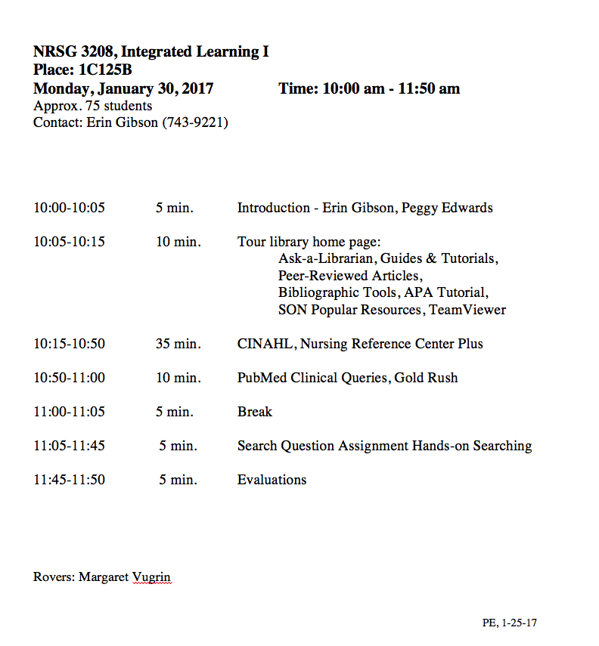
A
G
E
N
D
A

Slide 5




When searching library applications, use
Mozilla Firefox
Safari

Slide 6
Library Home Page

Slide 7
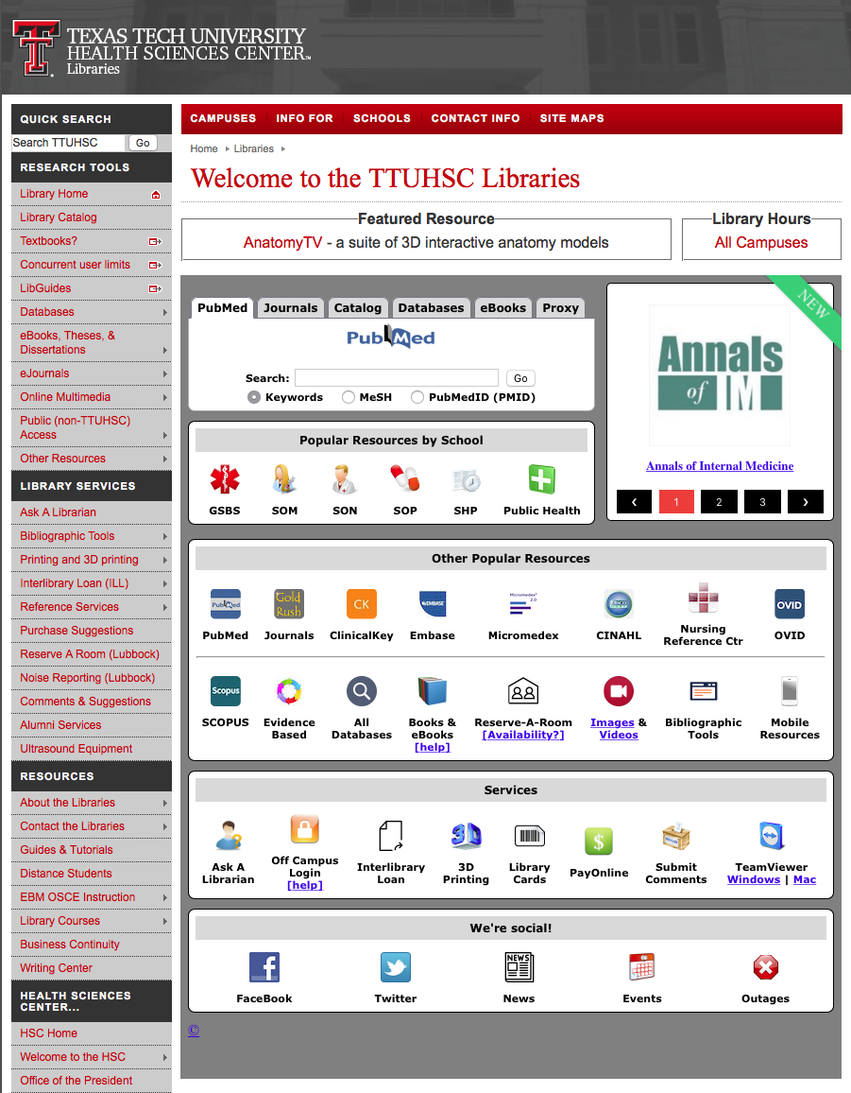
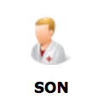
Popular Resources is a good starting point.
www.ttuhsc.edu/libraries
Click

Slide 8
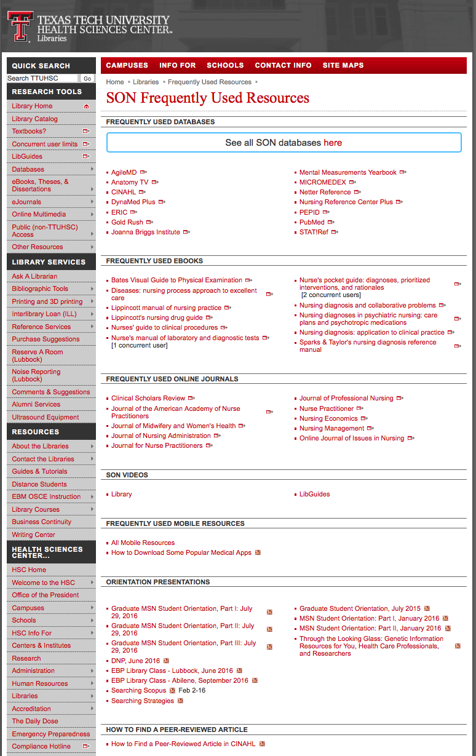
PowerPoint for
Resources for NRSG 3208

Slide 9
APA Style

Slide 10

Bibliographic Tools
www.ttuhsc.edu/libraries
Click

Slide 11
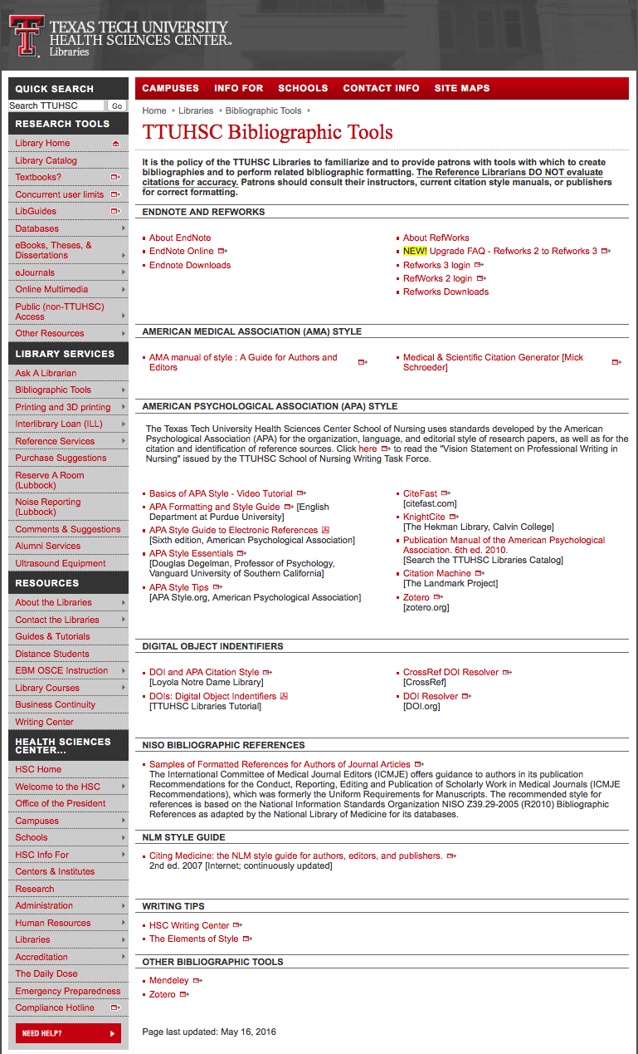

Free subscriptions
Link to Basics of APA Style – Video Tutorial

Slide 12
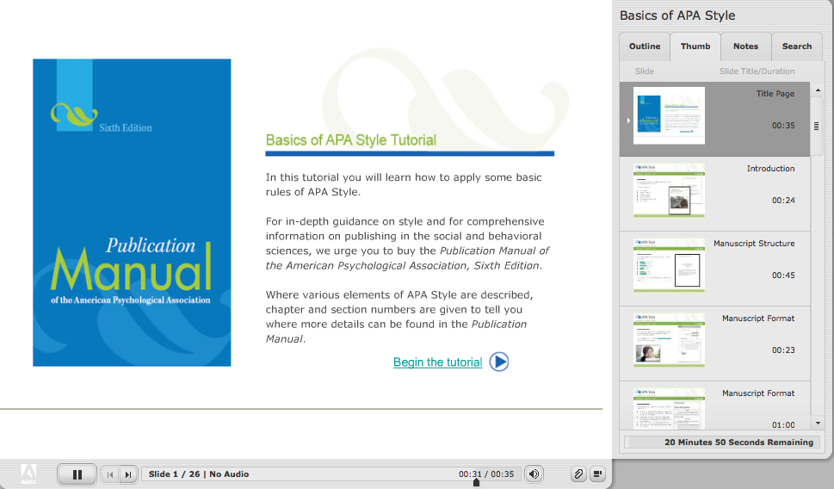

Slide 13
Identifying Citations
A citation is the:
author(s) of the article
title of the article
journal, volume, issue, pages where the article is located

Slide 14
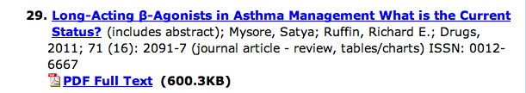
Article Title
Authors
Journal Article
Journal Title
Year, Volume, Issue, Page

Slide 15
Have Questions
or
Need Help?

Slide 16
Guides & Tutorials
www.ttuhsc.edu/libraries
Guides &
Tutorials

Slide 17
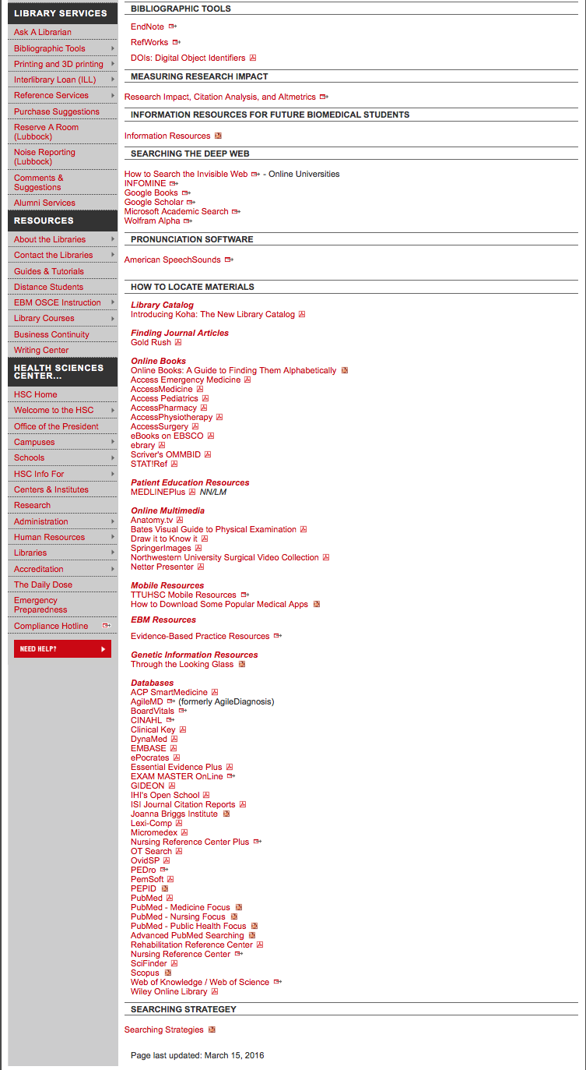
Database Guides & Tutorials

Slide 18

www.ttuhsc.edu/libraries
Click

Slide 19
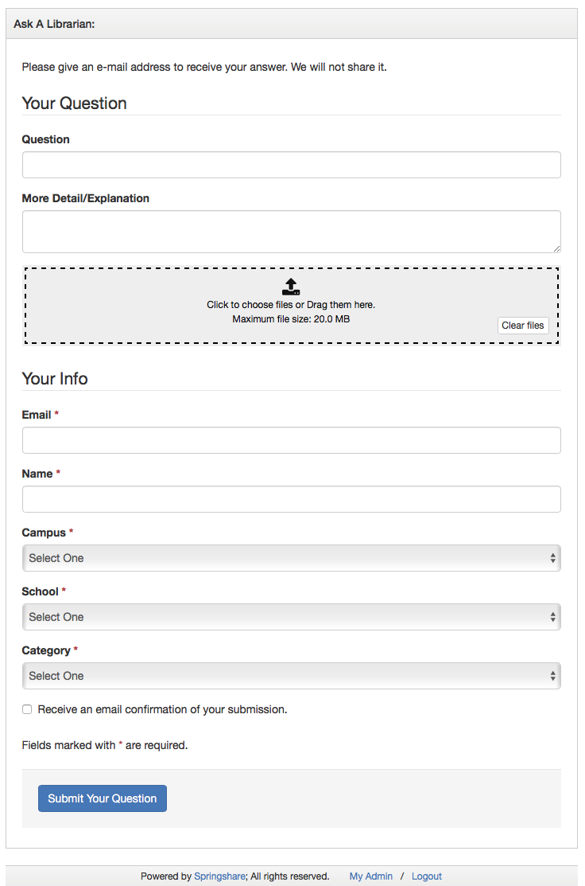
Fill out the form to email us a question!

Slide 20
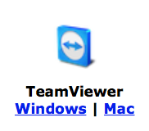
www.ttuhsc.edu/libraries
Download

Slide 21

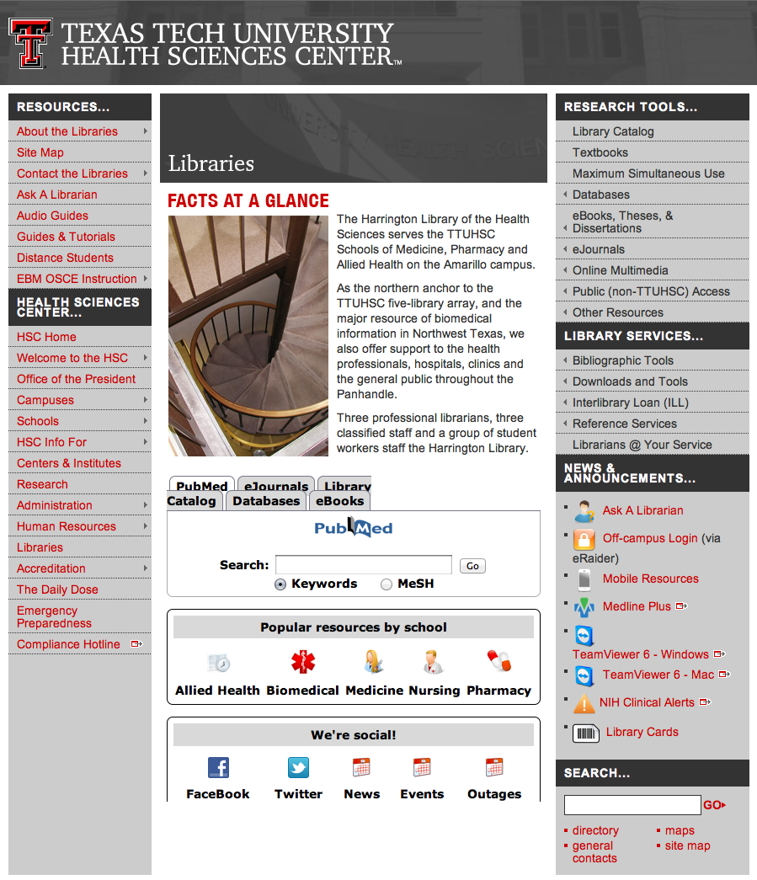

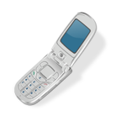
Call your TTUHSC Librarian

Slide 22
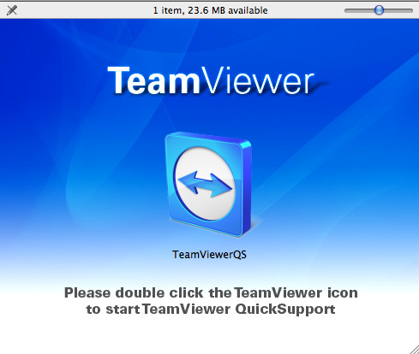
Double click the icon and follow the directions

Slide 23
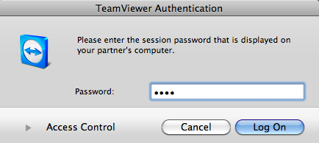
Give the id and password to the librarian to enter.
Log On
After logging on, the librarian can see your computer screen!
At the end of the session after logging off,
the librarian will not have access to your computer!
TeamViewer generates a new password each time it is used!

Slide 24
Searching CINAHL

Slide 25

www.ttuhsc.edu/libraries
Click

Slide 26
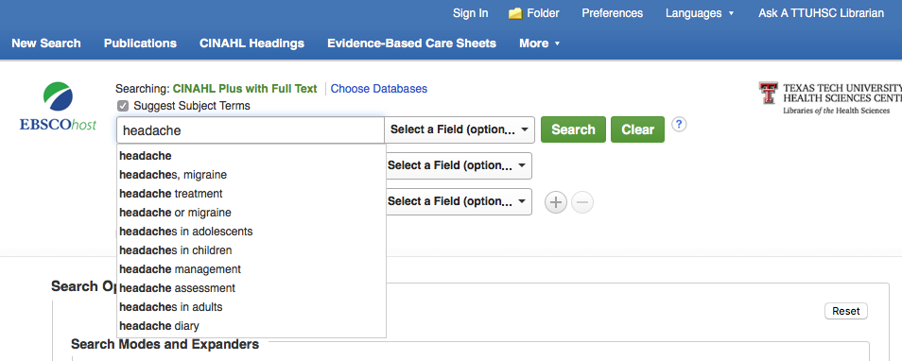
Enter headache
Suggested
Subject Headings
click
Search

Slide 27
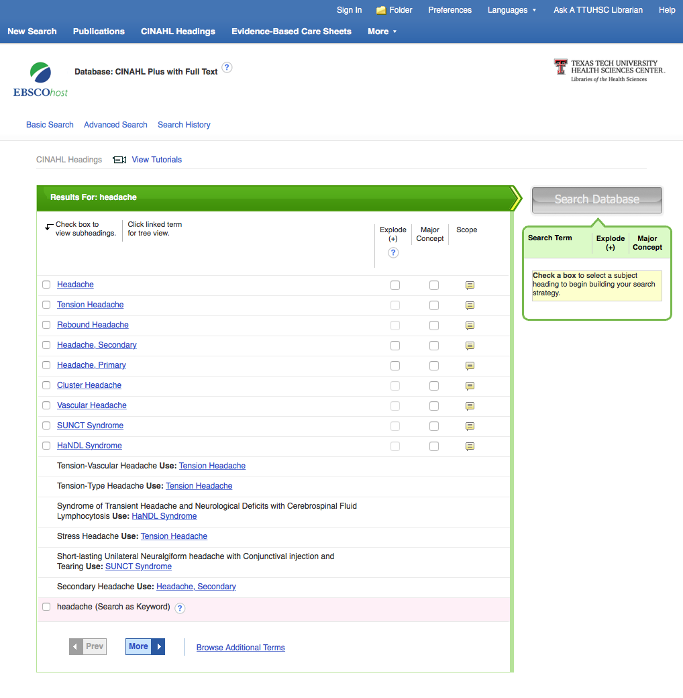
Click Headache, Primary
for
Tree Structure hierarchy

Slide 28
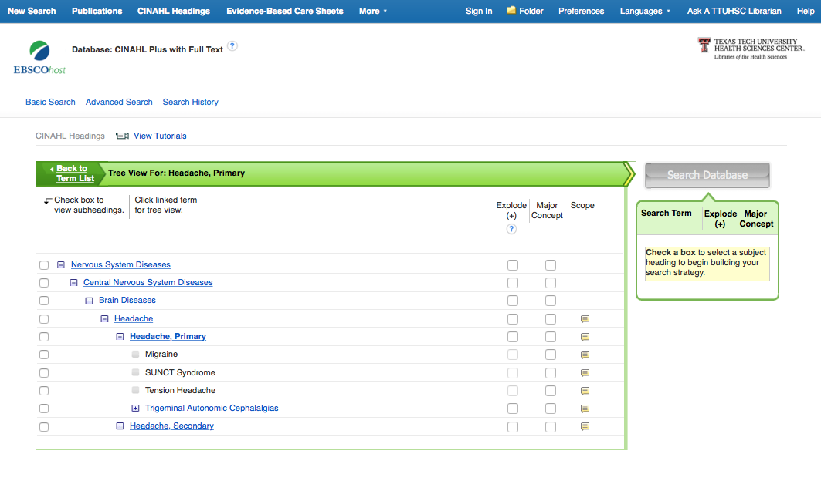
Terms are listed from
broadest to narrowest.
If Migraine yields zero results,
try using a broader term:
Headache, Primary.

Slide 29
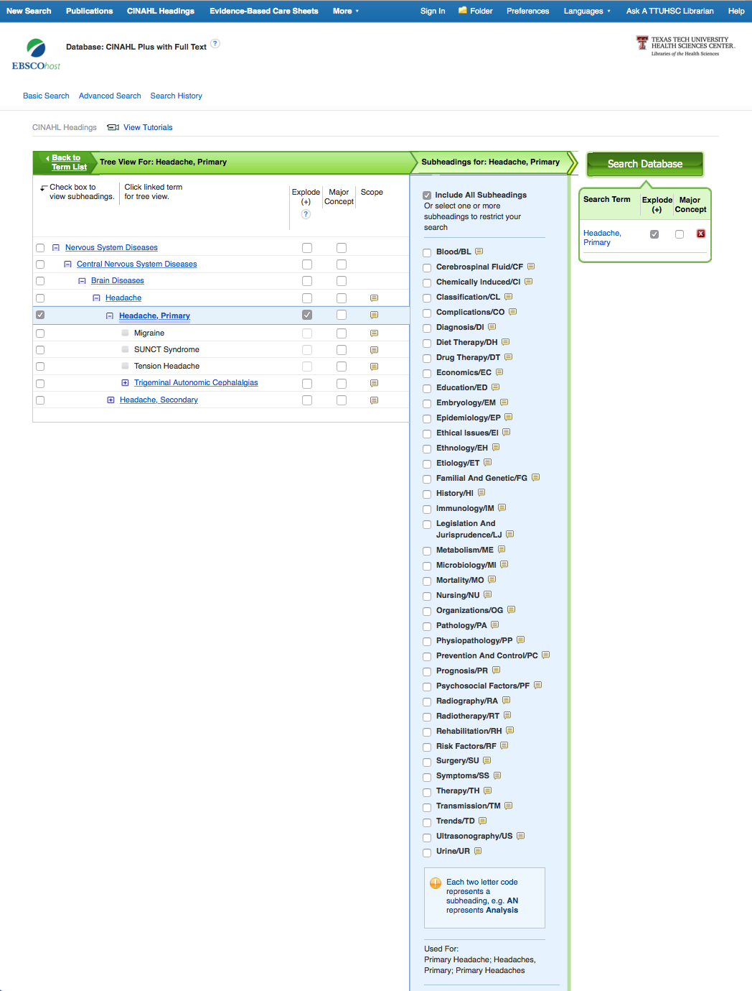
✔
Click the box under “Explode” to include articles indexed
to Headache, Primary; Migraine; & Tension Headache

Slide 30
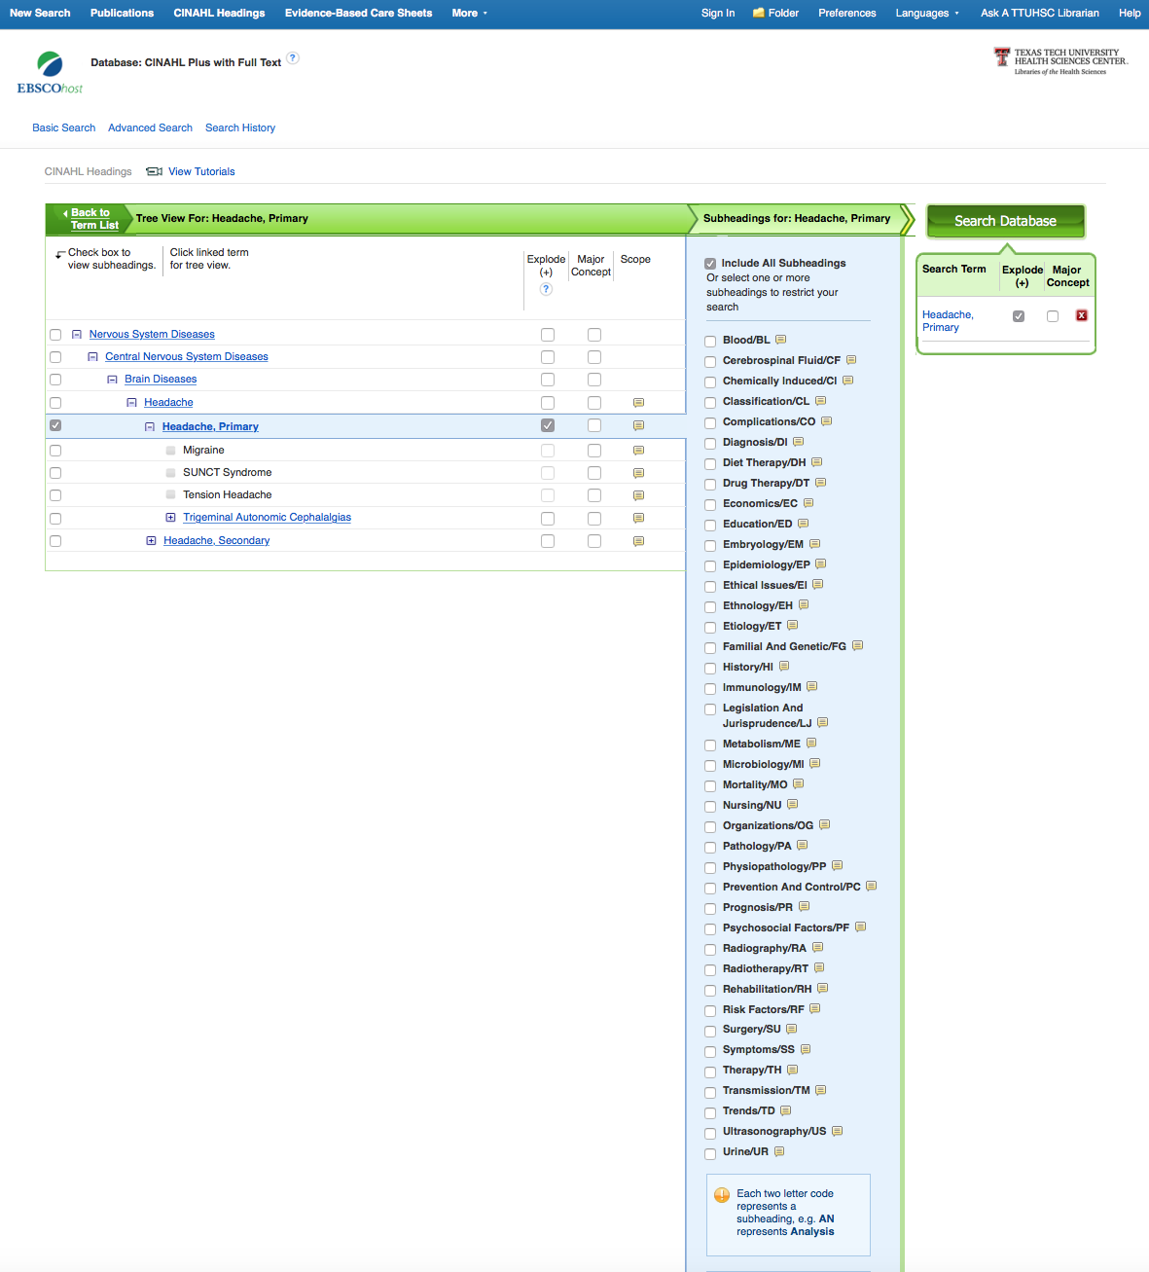
Subheadings
appear

Slide 31
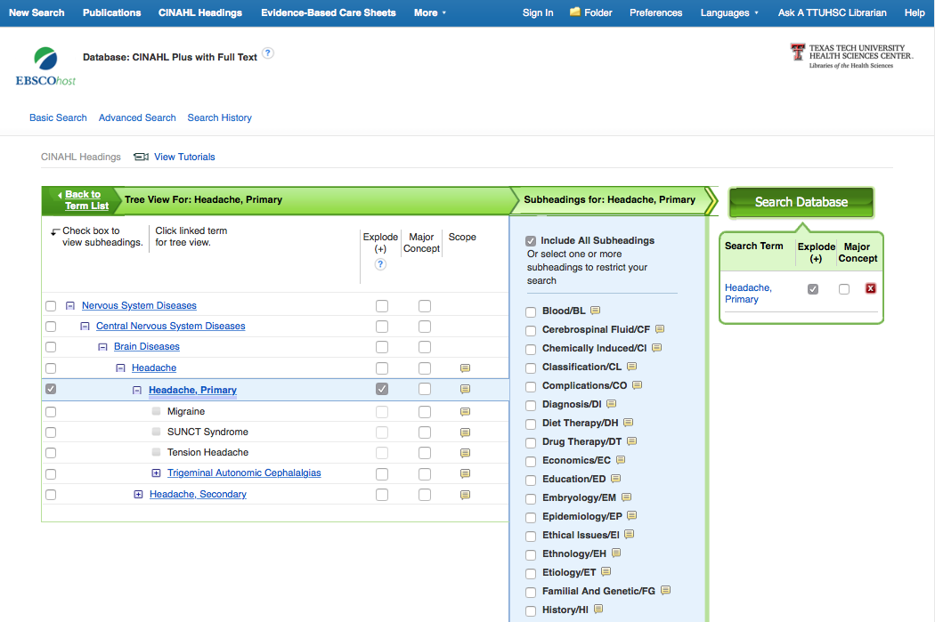
Select the subheading Familial And Genetic
click
Search Database
✔

Slide 32
Refining Results

Slide 33
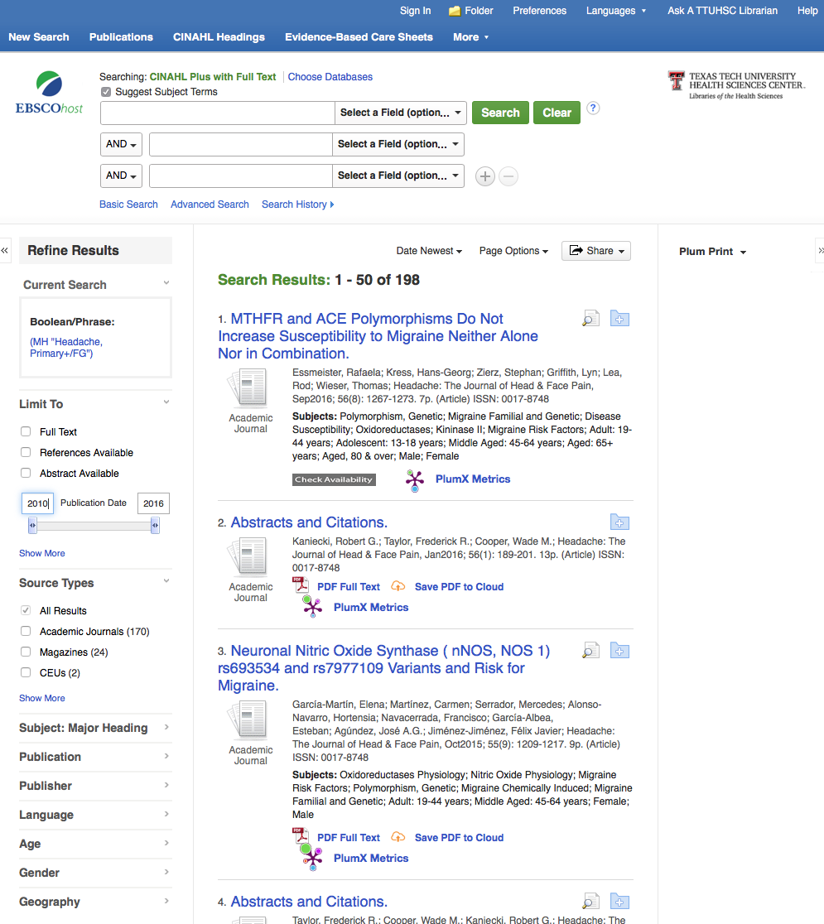
Change date to 2010 in the left-hand box to narrow to articles published in the last 5 years.
Press Return

Slide 34
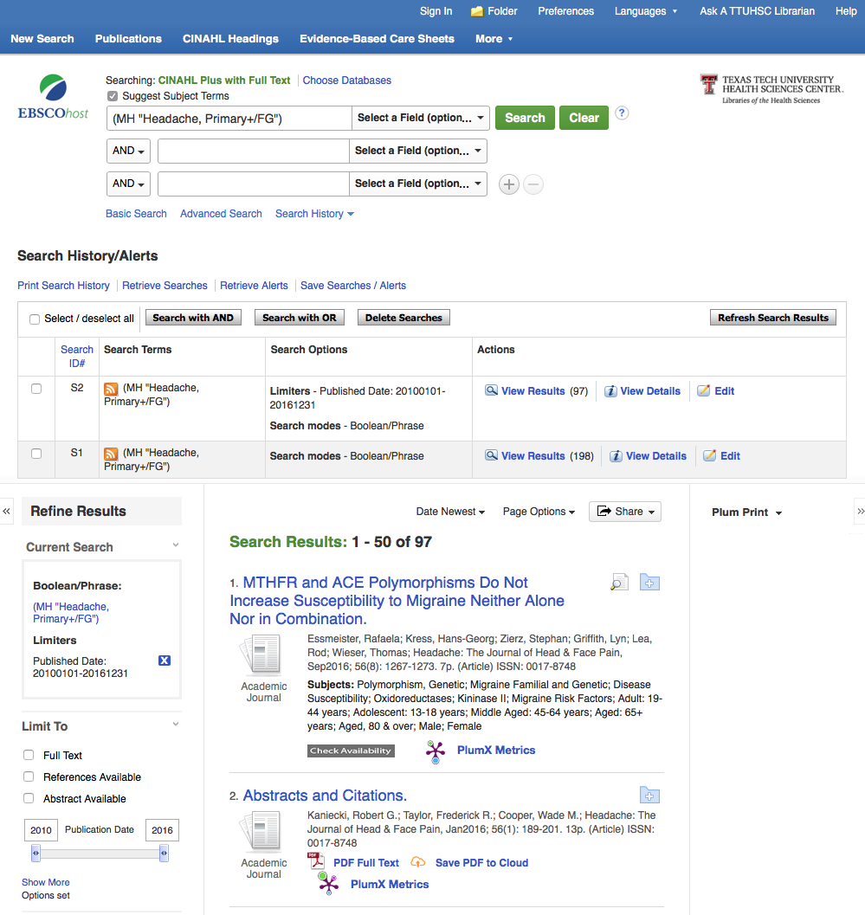
Results
Click Advanced Search

Slide 35
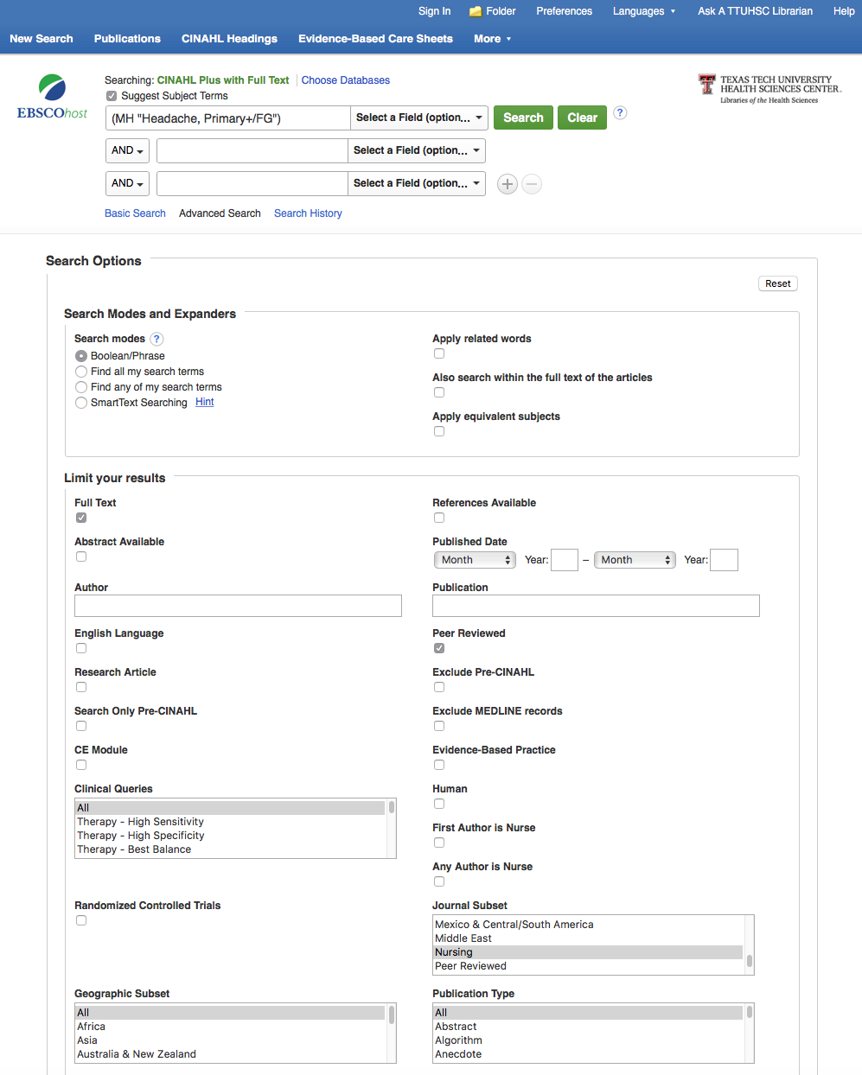

Slide 36
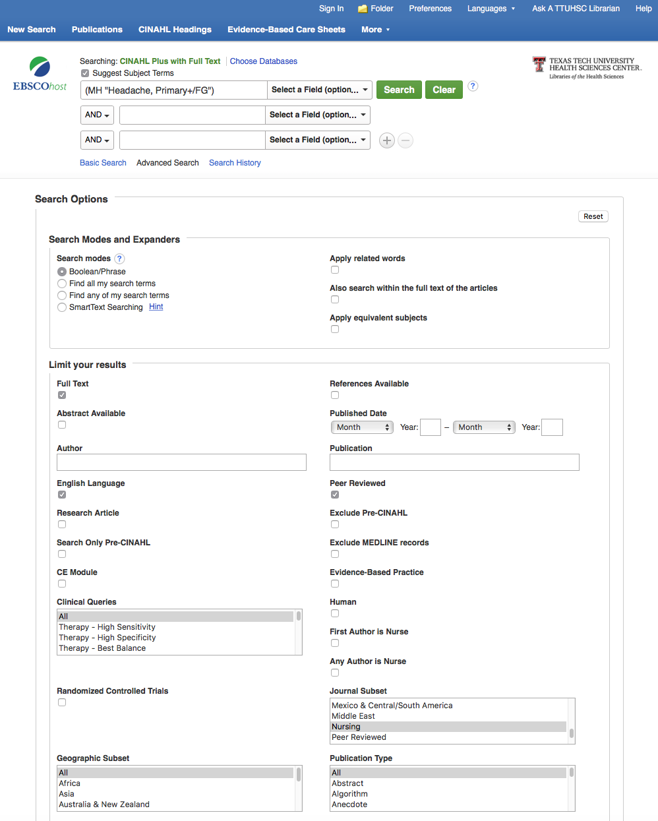
Select filters relevant to search.
Peer
Reviewed
English
Nursing Journals

Slide 37
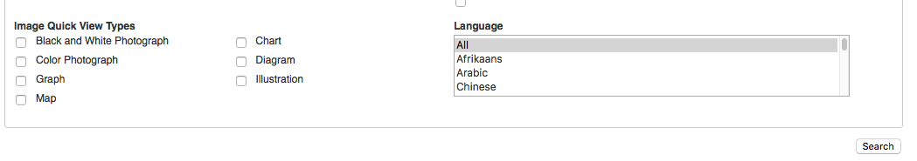
Scroll to the bottom of the screen and click Search

Slide 38
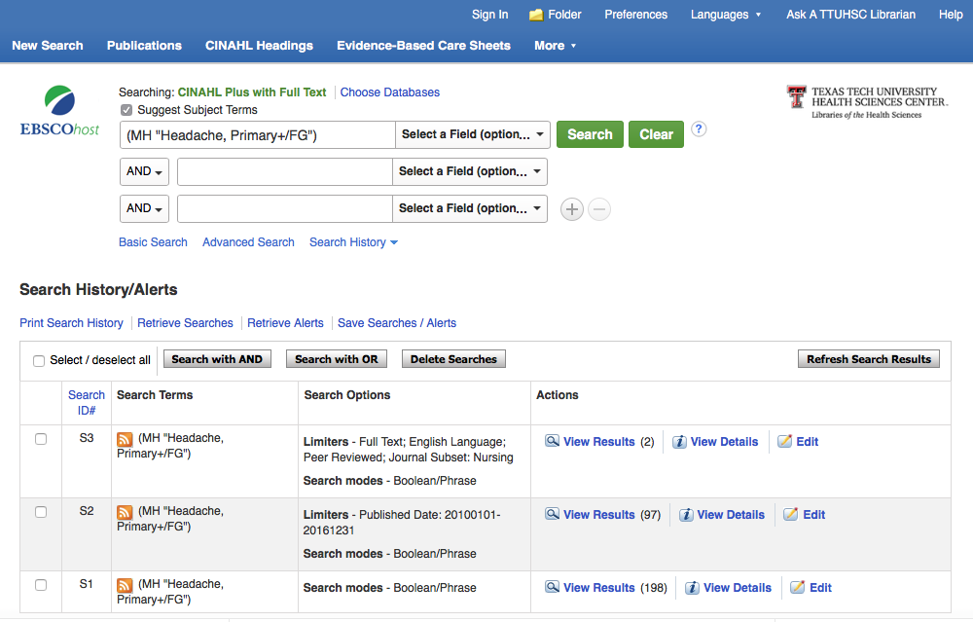
Results have narrowed
to 2 articles

Slide 39
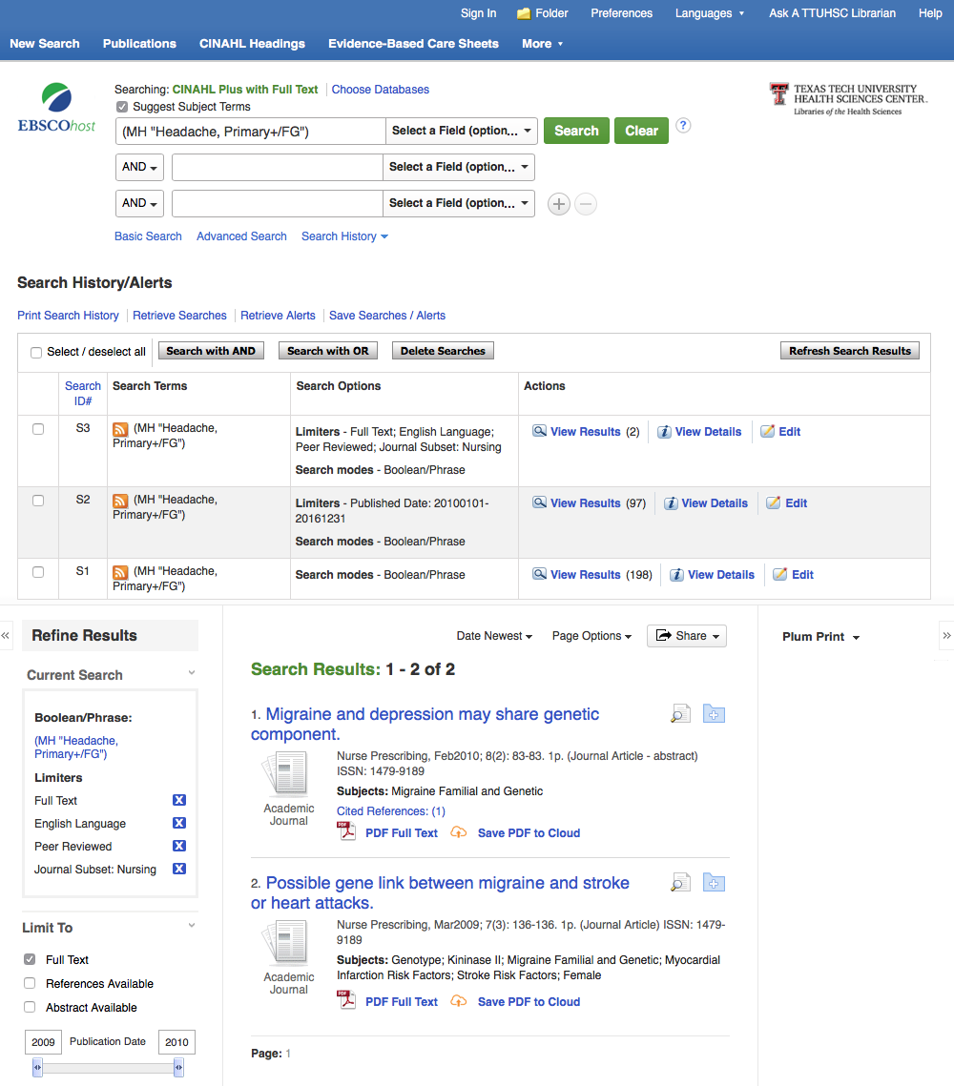

Scroll to View Results
Click

Slide 40
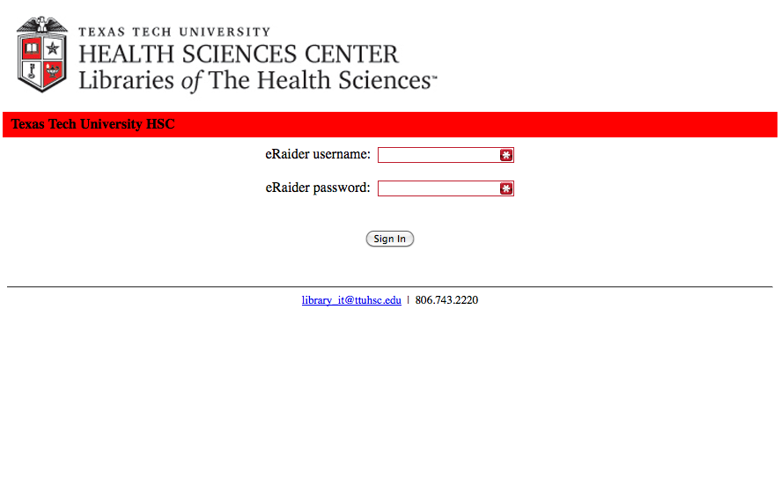
When Searching from Off Campus:
Enter the
Eraider username and password
assigned to you
by Information Services.
A
Problems with eRaider call: 806-743-1234a

Slide 41
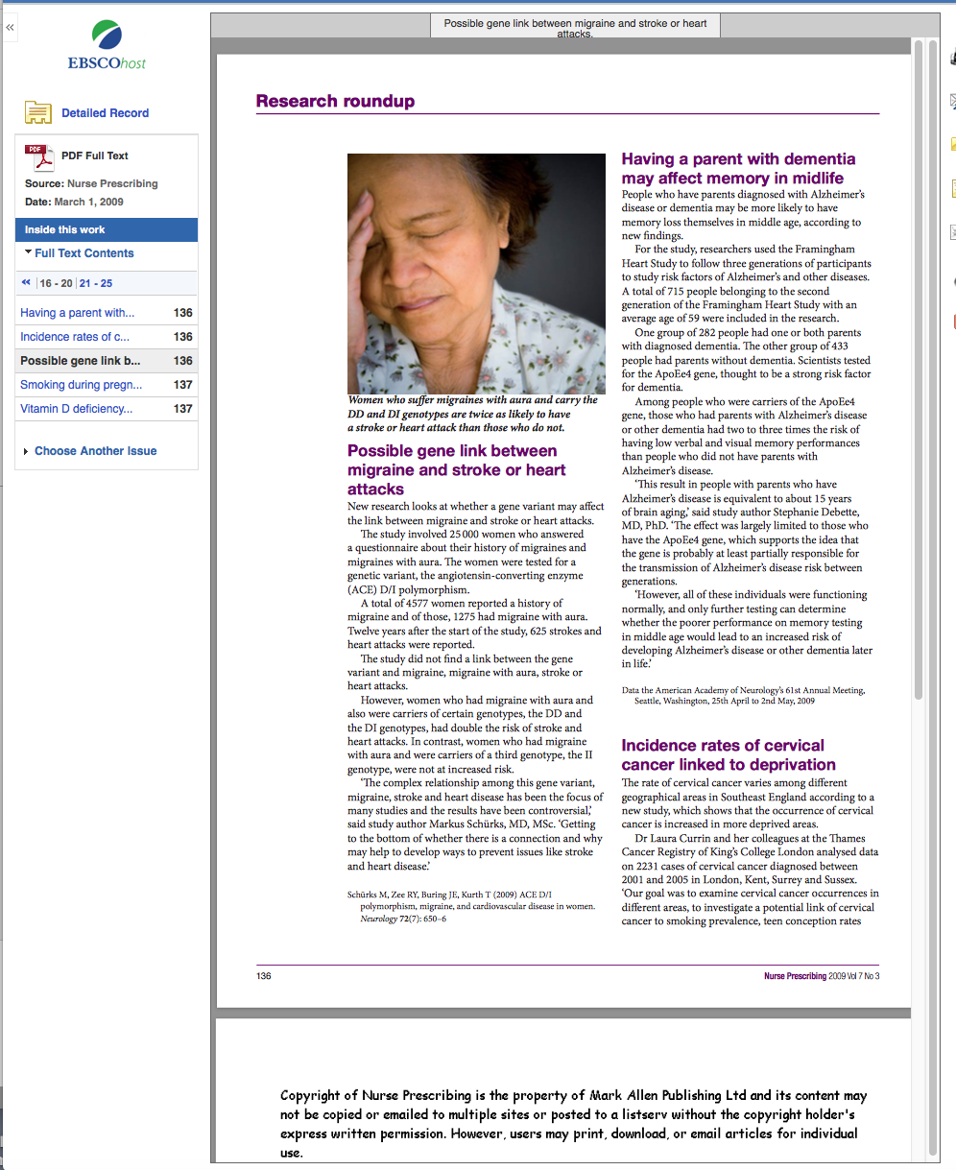

Slide 42
What questions do you have?

Slide 43
Searching
Nursing Reference Center

Slide 44

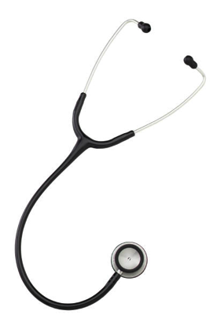
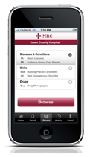

clinical information
at the point-of care…
…and comprehensive
scholarly literature.

Slide 45


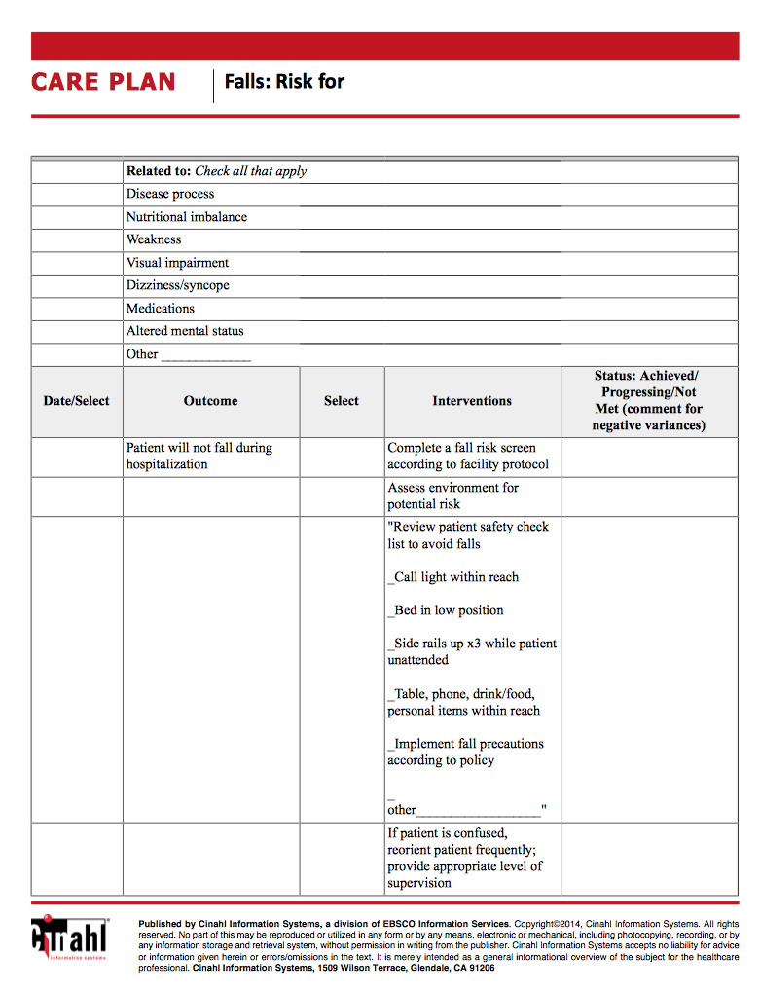
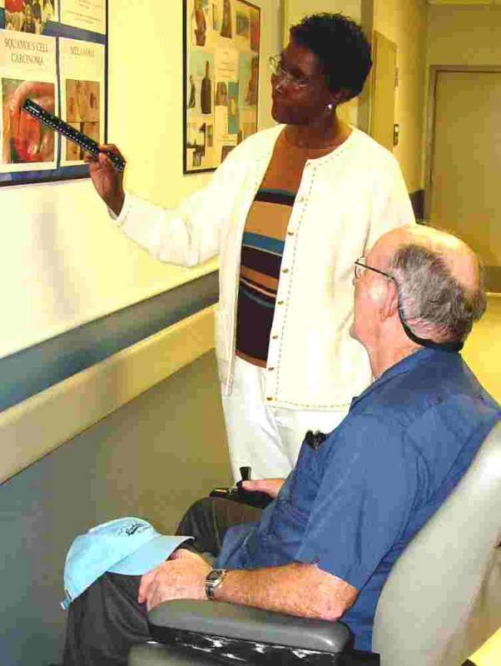
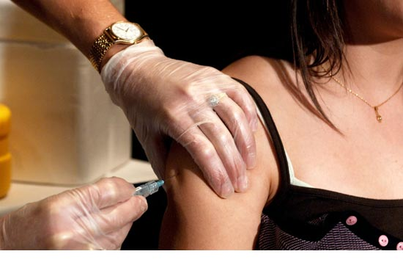
drug information
diseases
care plans
skills
patient education

Slide 46

www.ttuhsc.edu/libraries
Click

Slide 47
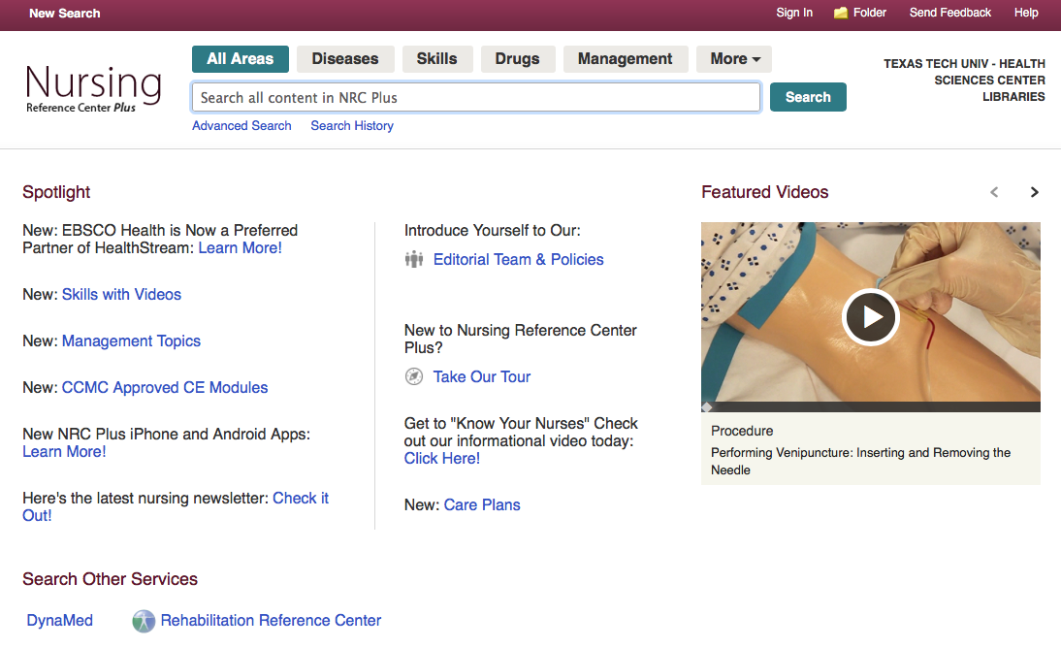
Home Page

Slide 48
Click
Diseases

Slide 49
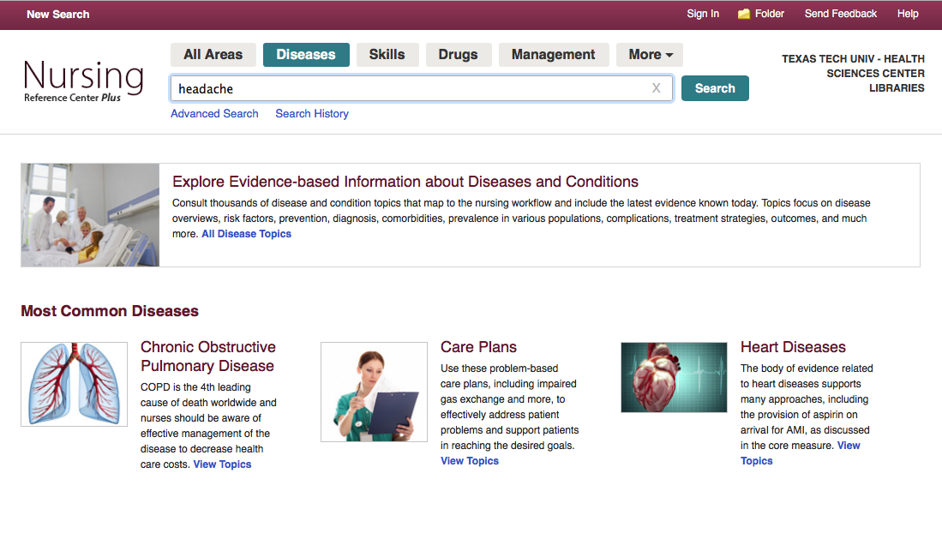
Enter headache
Click
Search

Slide 50
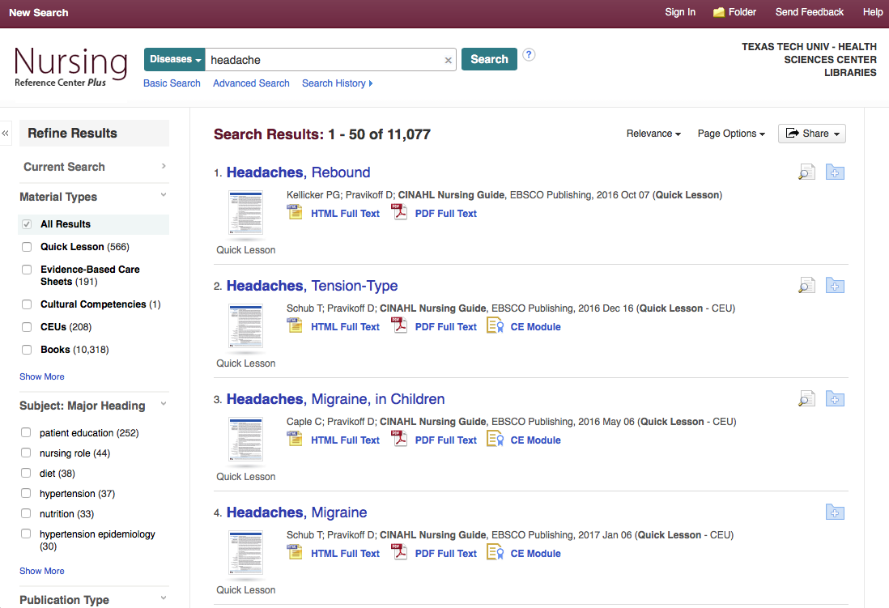
Material Types

Slide 51
Tour of Material
Types

Slide 52
Quick Lesson

Slide 53
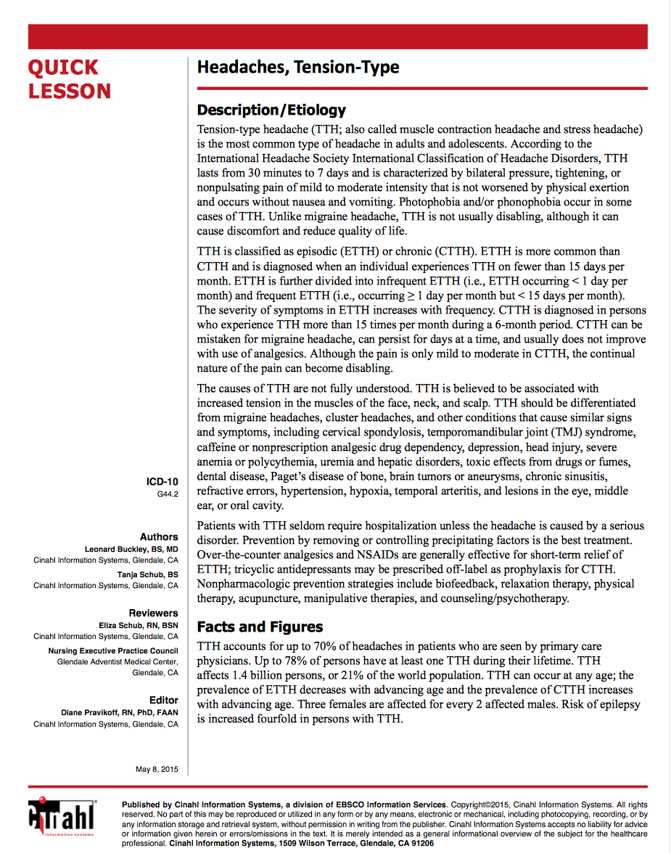

Slide 54
Evidence-Based Care Sheets

Slide 55
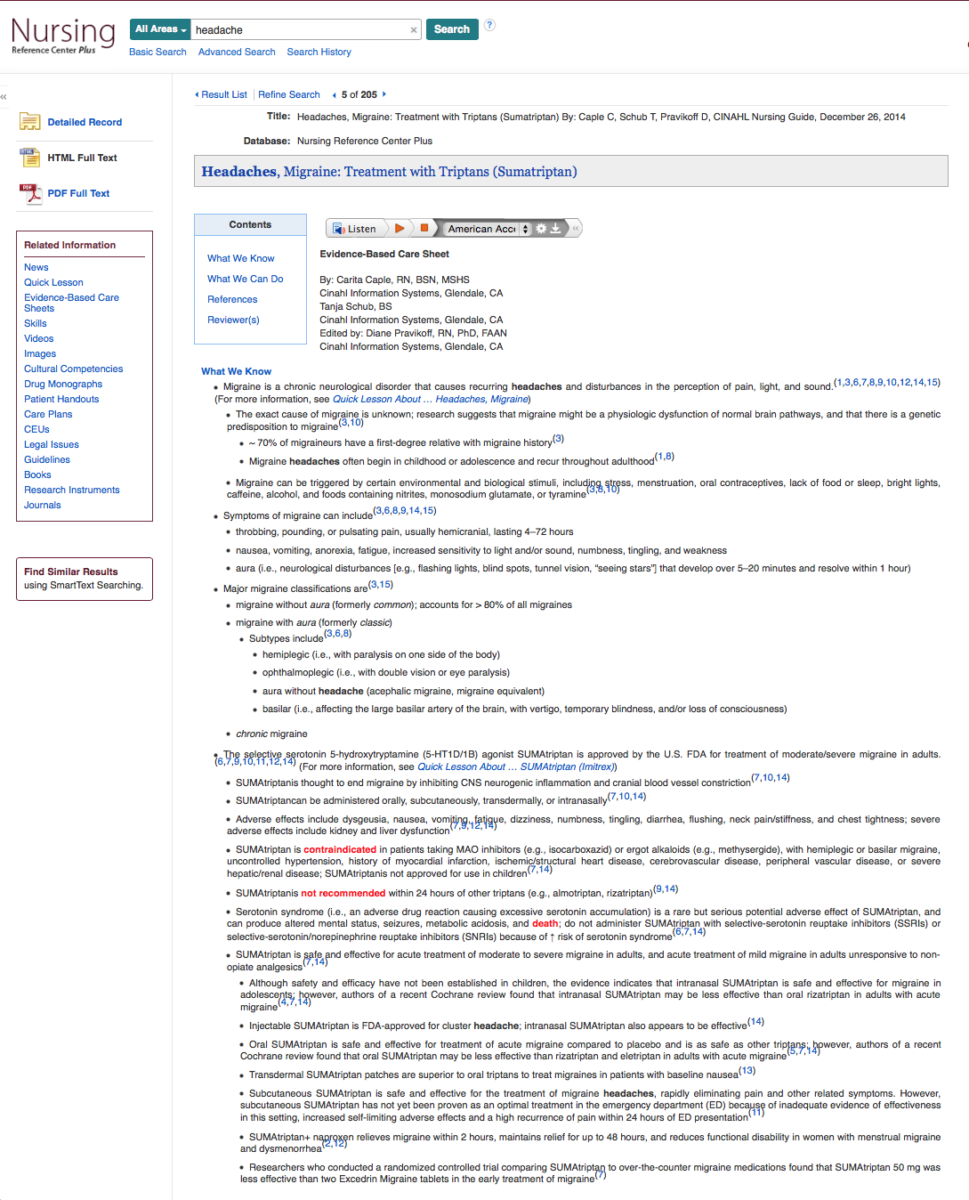

Slide 56
Cultural Competencies

Slide 57
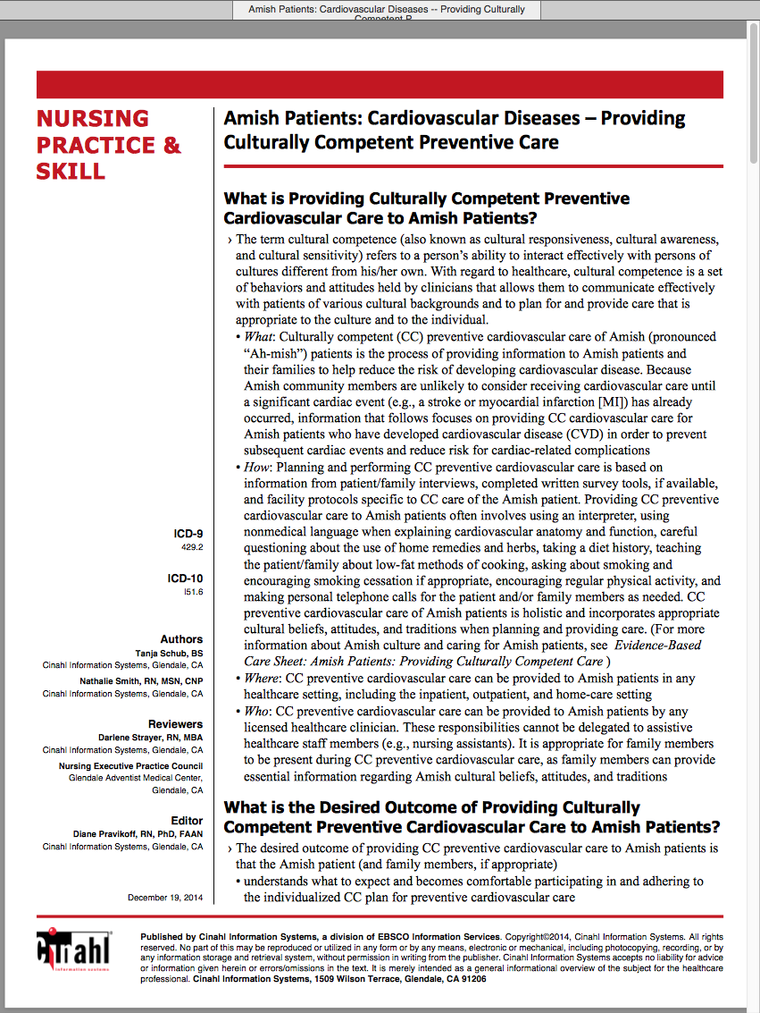

Slide 58
What questions do you have?

Slide 59
EBP Literature from
PubMed’s Clinical Queries

Slide 60



PubMed Database
Biomedical & life sciences journal literature - @6,000 journals
International scope
Developed and maintained by the:
National Center for Biotechnology Information
at the U.S. National Library of Medicine
at the National Institutes of Health

Slide 61

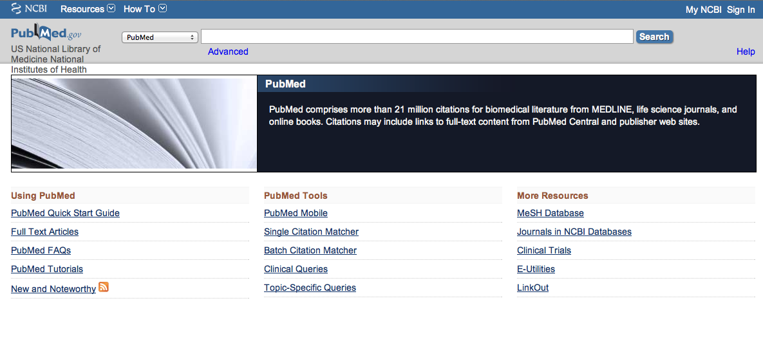
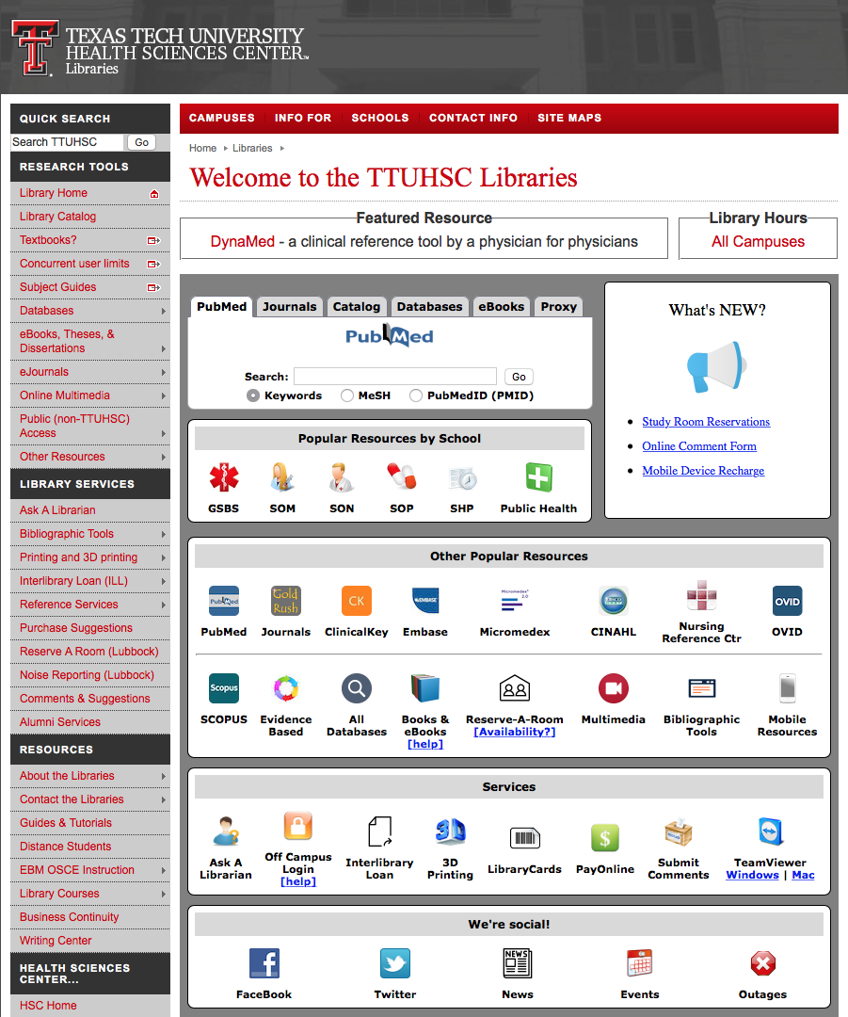
Accessing PubMed
Freely available over the Internet
@ www.pubmed.gov
Also through library’s home page

Slide 62


Evidence-Based Practice is guided by thoughtful integration
of the best available scientific knowledge with clinical expertise.

Slide 63
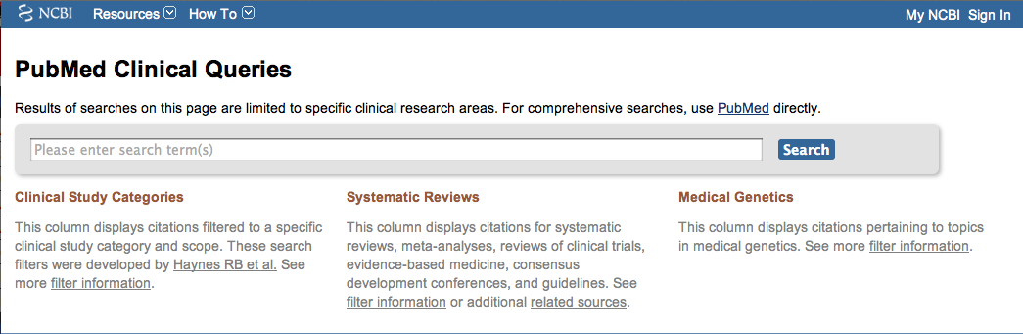
PubMed’s Clinical Queries
tool that searches for evidence-based literature

Slide 64

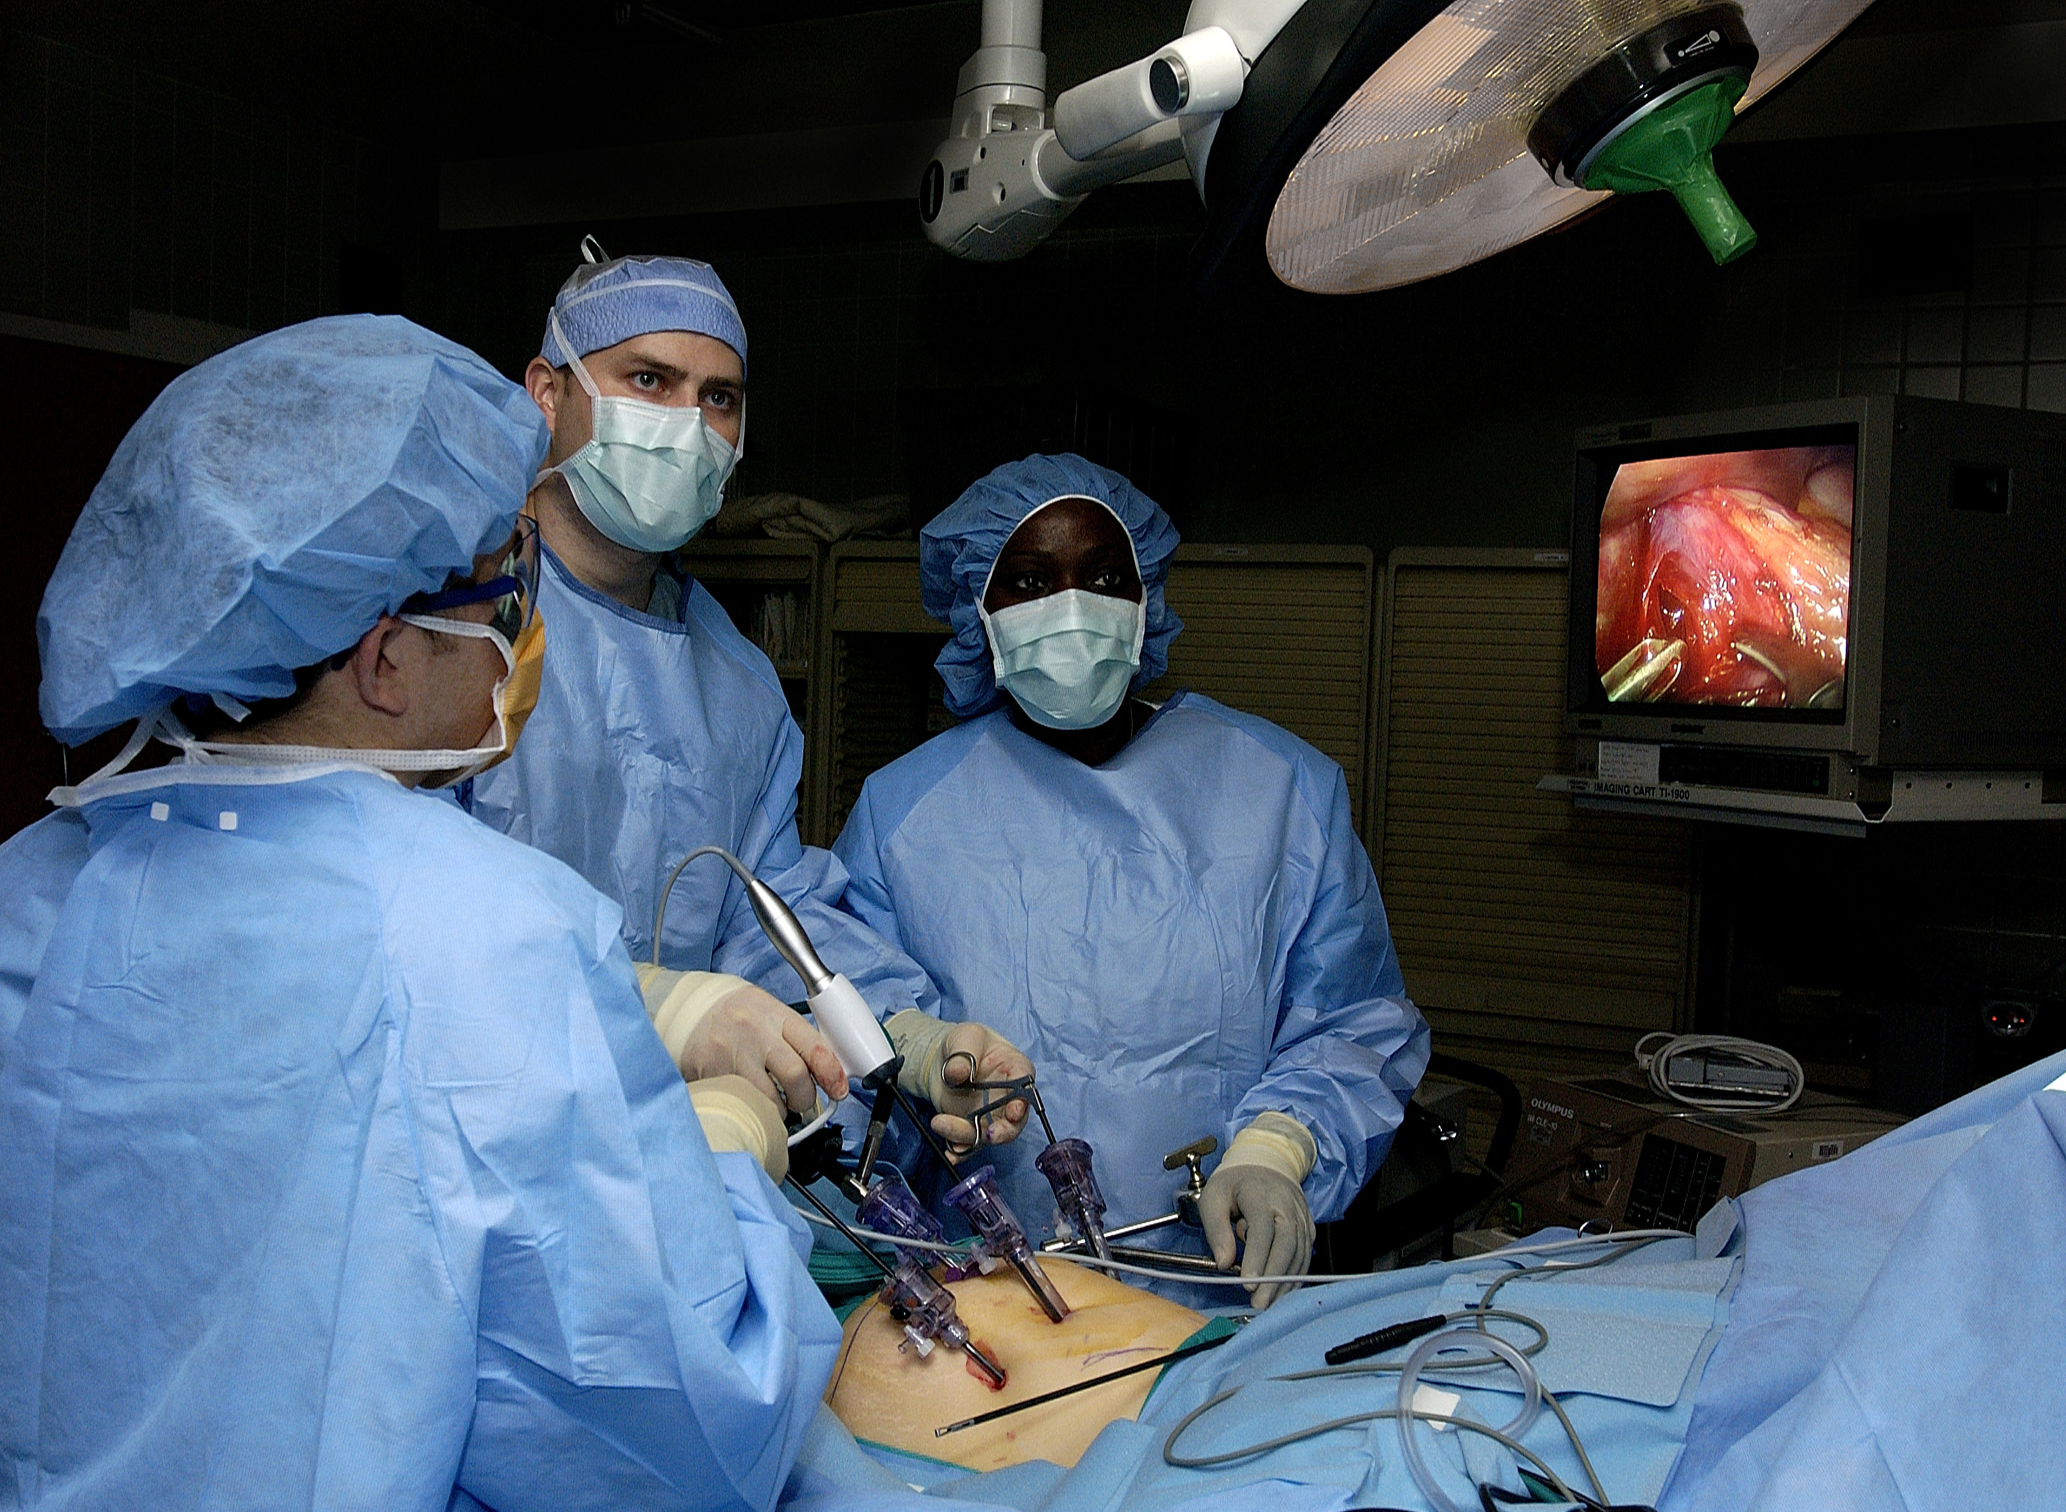
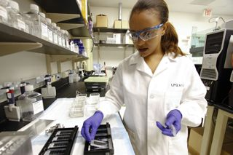
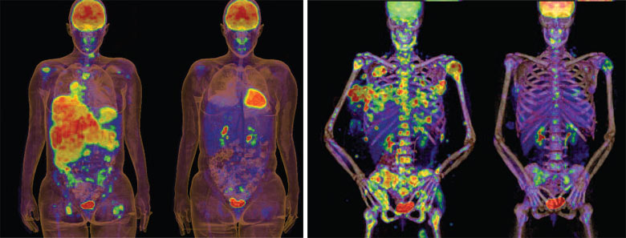
Clinical Queries Searchable by:
Diagnosis
Therapy
Prognosis (prediction of probable outcome)
Etiology (cause)

Slide 65
Clinical Queries Searchable by:
Diagnosis
Therapy
Prognosis (prediction of probable outcome)
Etiology (cause)

Slide 66
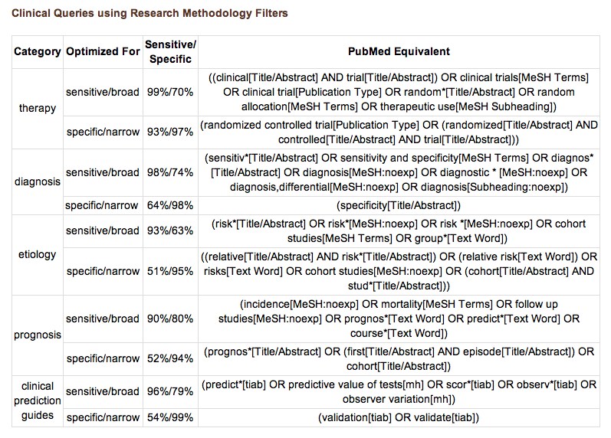
PubMed’s Clinical Queries
uses pre-formulated search strategies with a keyword search

Slide 67

www.ttuhsc.edu/libraries
Click

Slide 68
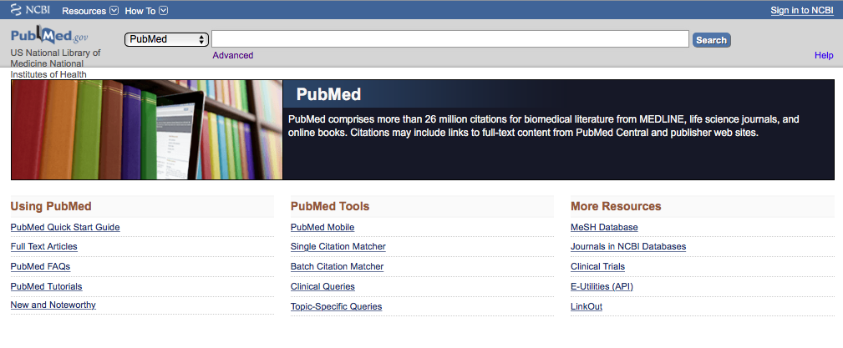
Click Clinical Queries

Slide 69

Enter asthma
Click
Search

Slide 70

Results for Therapy and
Broad Scope

Slide 71

Click on the Therapy drop-down menu

Slide 72
Change from Broad to Narrow Scope

Slide 73

Results for Therapy and
Narrow Scope
Click See all (9160)

Slide 74

Click Limits

Slide 75

Results and activated filters.
Click Show additional filters

Slide 76

Select
Languages
and
Journal categories
✔
✔
Click Show

Slide 77

Click English
Click Nursing journals

Slide 78

Results have narrowed to 19 articles

Slide 79
Click on the article title you wish to read

Slide 80

Click for Free Full Text
TTUHSC ONLINE

Slide 81

Click

Slide 82
What questions do you have?

Slide 83
Finding e-journals in Gold Rush

Slide 84

www.ttuhsc.edu/libraries
Click Gold Rush

Slide 85

For instructions,
Click
What is Gold Rush?

Slide 86

Enter journal title, click
Search
nursing research

Slide 87

Click Nursing Research

Slide 88

1) Check Dates Available
2) Click Publisher

Slide 89

Locate article and click full text link
Select Year
Select Volume, Issue

Slide 90

Full-text

Slide 91
What questions do you have?

Slide 92
Guides & Tutorials
www.ttuhsc.edu/libraries
Guides &
Tutorials

Slide 93
Hands-On Exercises

Slide 94
The End

