Slide 1
Welcome
Scholarship for
Evidence-Based Practice
Peggy Edwards, AMLS
TTUHSC - Preston Smith Library
Lubbock, Texas 79430
Jan 2018

Slide 2
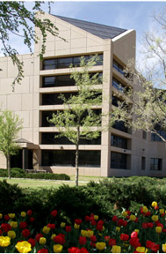
Welcome!
Preston Smith Library
located west of the
Academic Classroom
Building

Slide 3
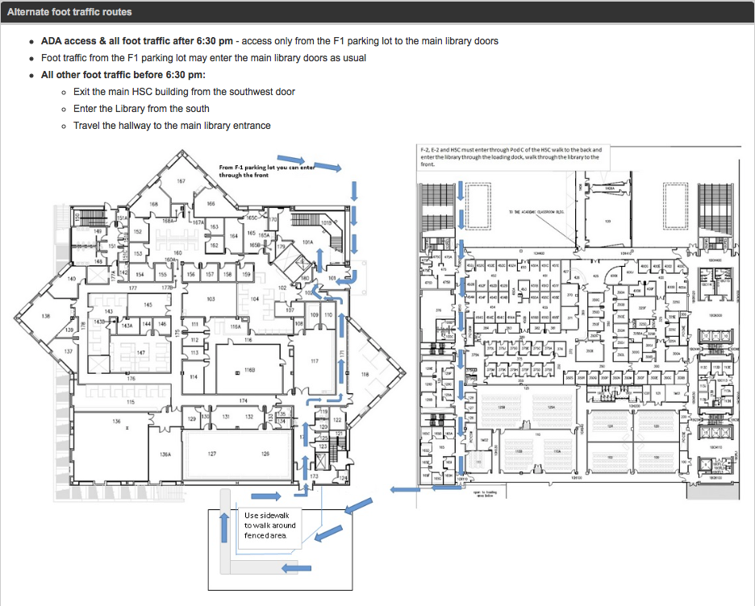


4th Street
Parking Lots
Library
HSC
ER/UMC

Slide 4



Available on 2nd floor of library, across from the Learning Resource Center and public computers
8am–7pm
Monday–Friday
Dan Stuart
Peggy Edwards
Micah Walsleben
Margaret Vugrin

Slide 5
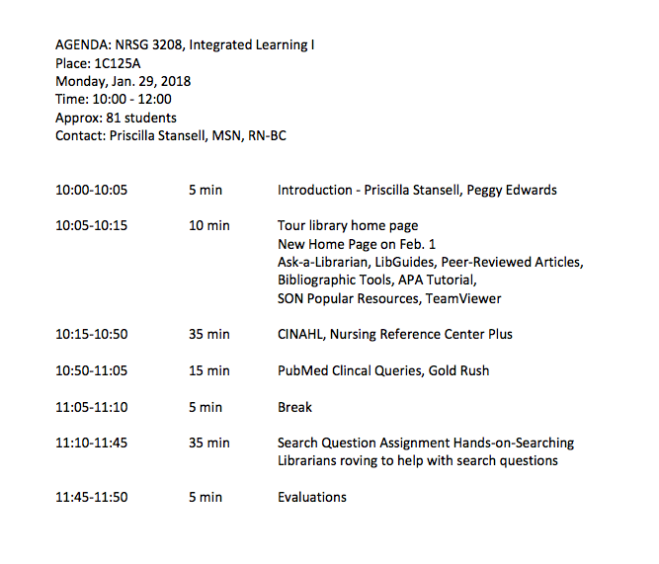
A
G
E
N
D
A

Slide 6


When searching library applications, use
Mozilla Firefox, Safari, or Internet Explorer often do not work with library applications!
Plus, Chrome is TTUHSC IT’s supported browser!

Slide 7
New Library Home Page!

Slide 8
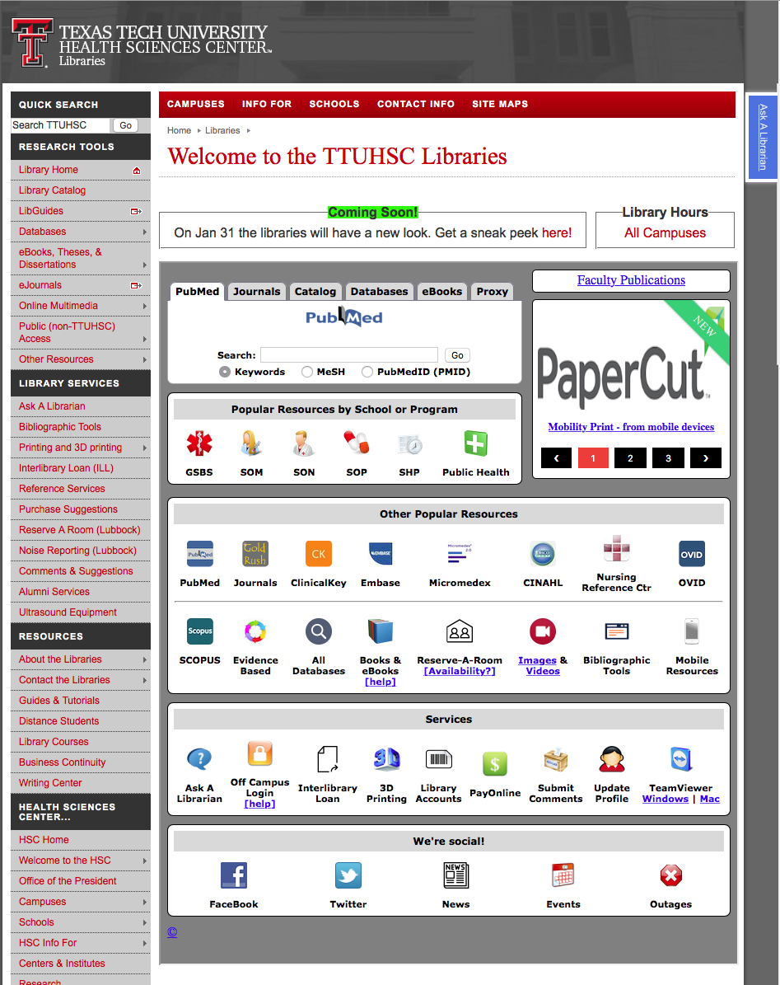
from
www.ttuhsc.edu/libraries
Click here!

Slide 9
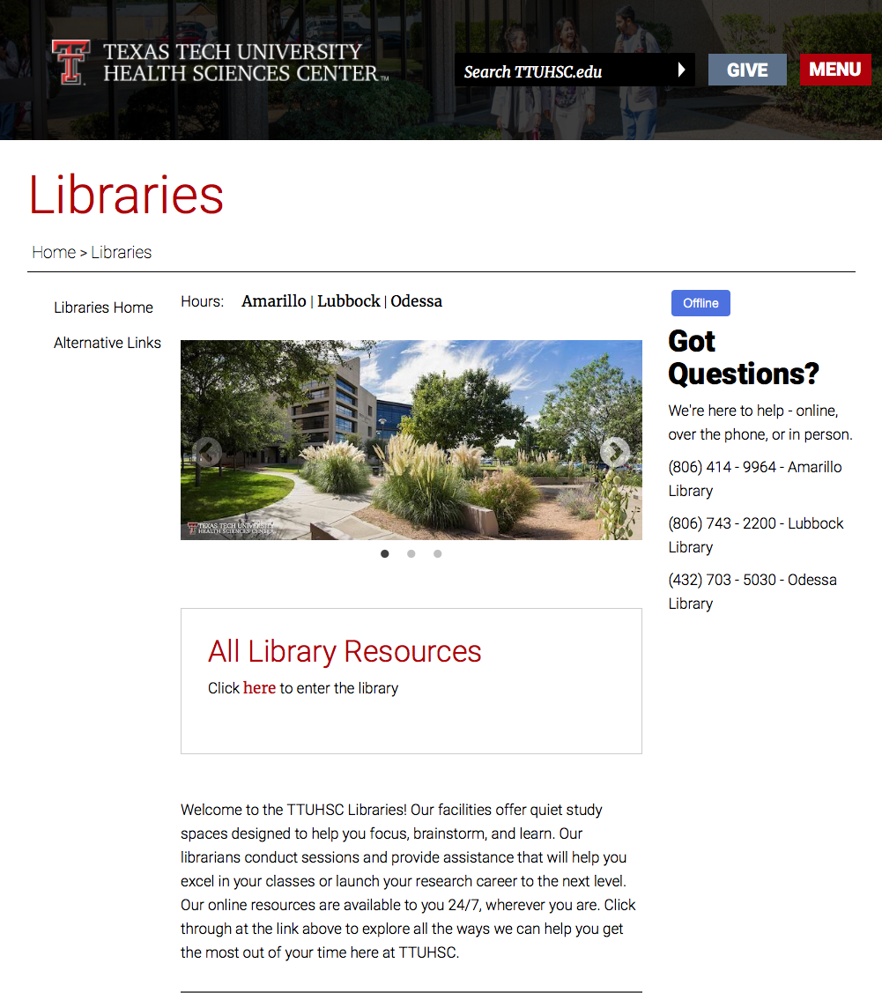
Click here to go to library resources

Slide 10
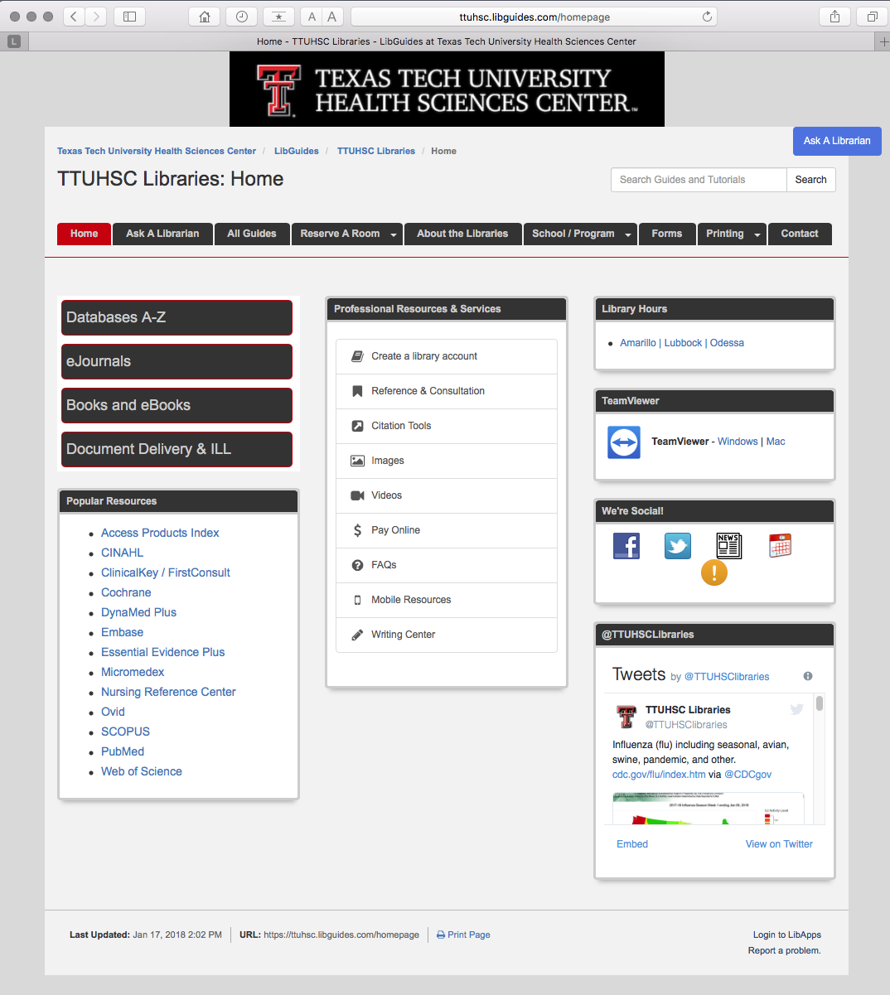
Where to go to access
CINAHL
or
Nursing Reference Center

Slide 11
Go back to
www.ttuhsc.edu/libraries

Slide 12

Popular Resources is a good starting point.
Click

Slide 13
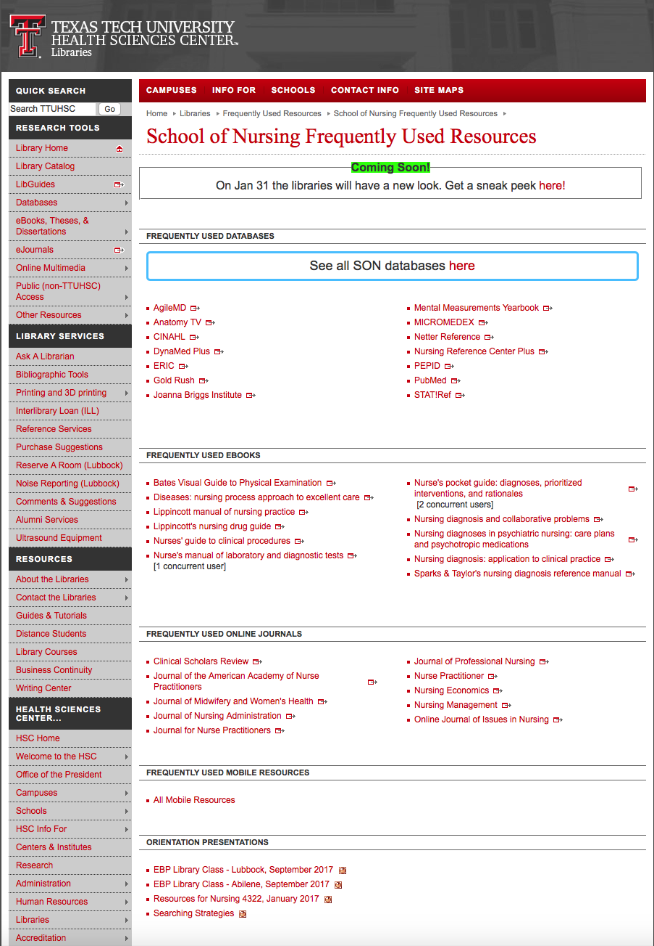
PowerPoint for
Resources for NRSG 3208

Slide 14
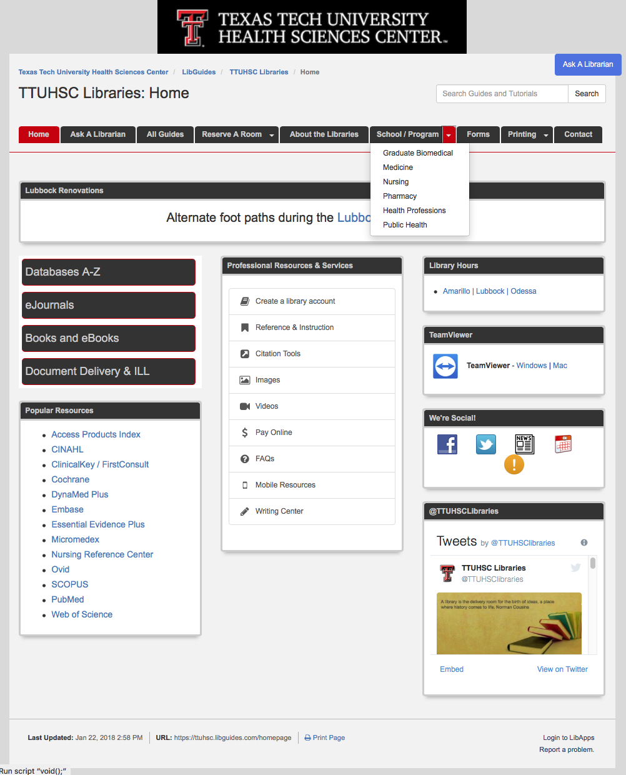
Hover on
School/Program
select Nursing

Slide 15
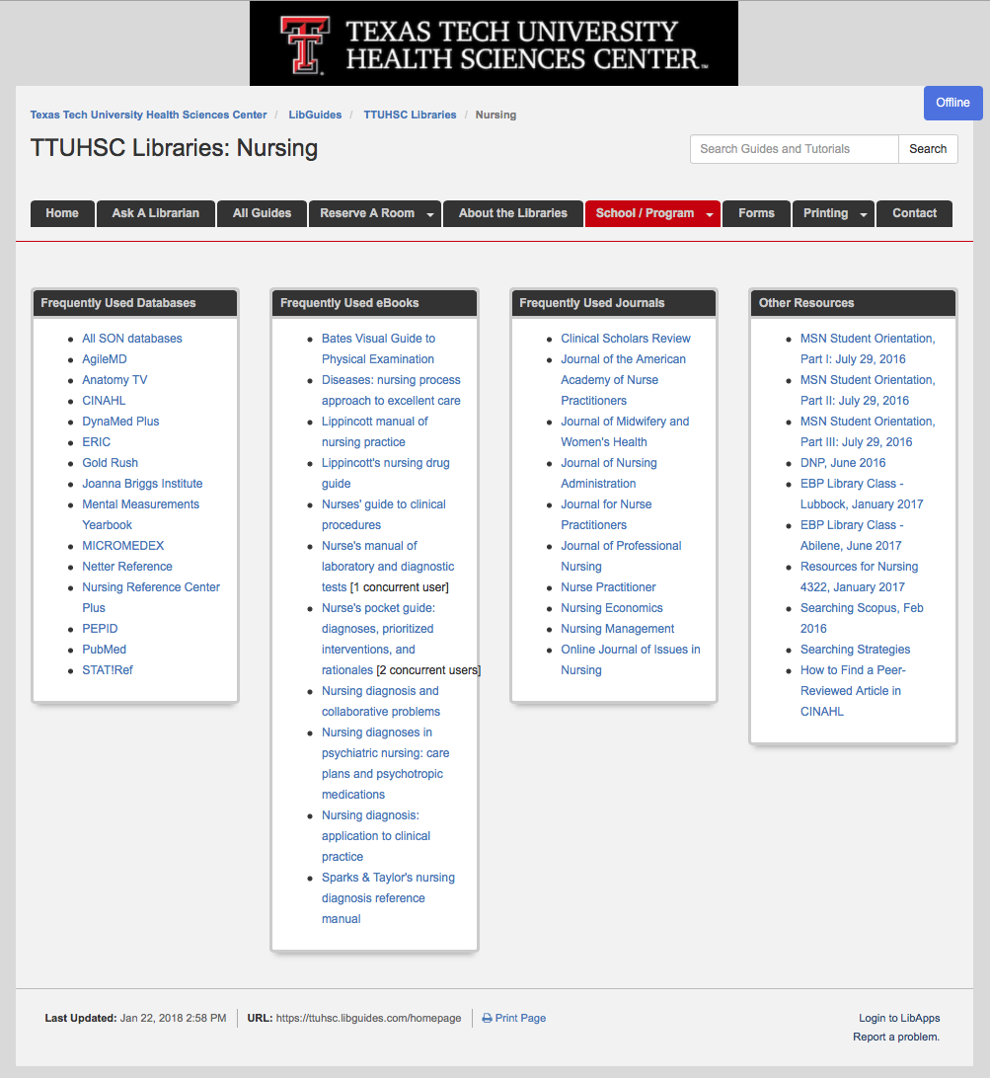
PowerPoint for
Resources for NRSG 3208

Slide 16
APA Style

Slide 17

Bibliographic Tools
www.ttuhsc.edu/libraries
Click

Slide 18
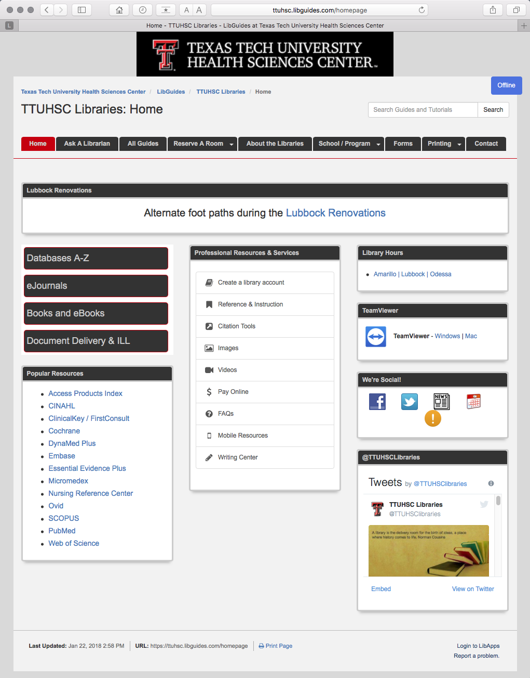
Click
Citation Tools

Slide 19
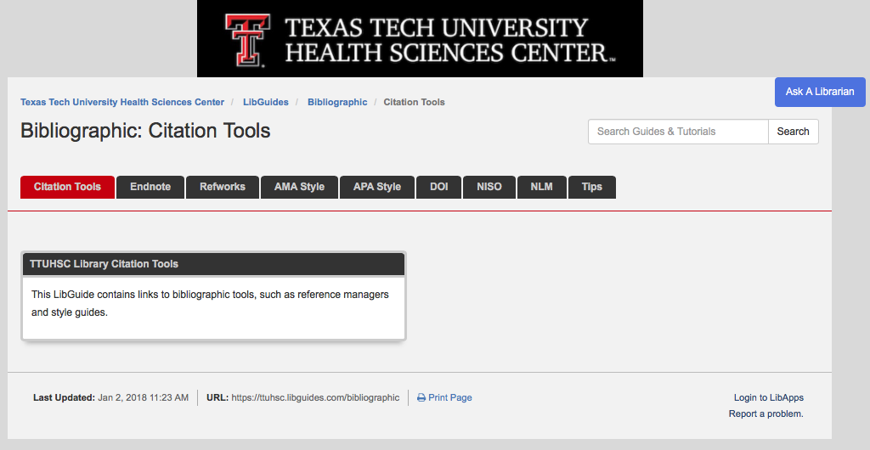

Click for link to Basics of APA Style – Video Tutorial
Free subscriptions

Slide 20
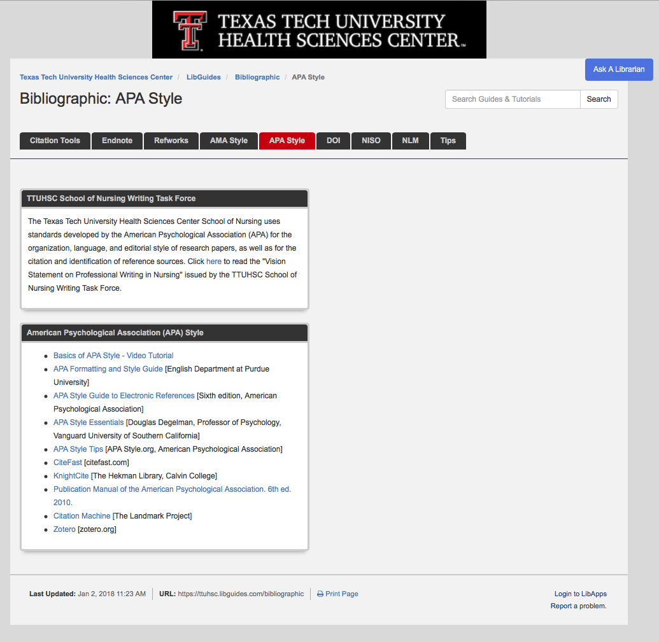
Click for link to Basics of APA Style – Video Tutorial

Slide 21
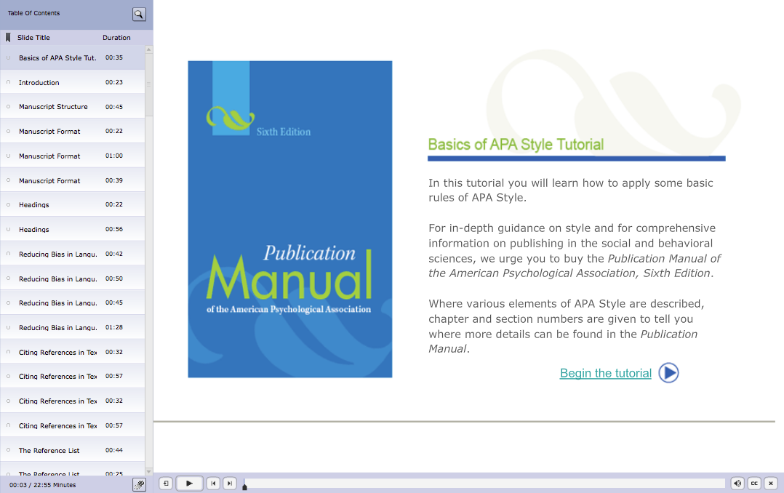

Slide 22
Identifying Citations
A citation is the:
author(s) of the article
title of the article
journal, volume, issue, pages where the article is located

Slide 23
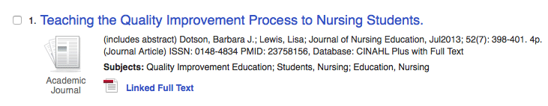
Authors
Journal Title
Article Title
Year, Volume, Issue, Page

Slide 24
Have Questions
or
Need Help?

Slide 25
www.ttuhsc.edu/libraries
Go to LibGuides for guides/tutorials

Slide 26
Click for LibGuides
(guides/tutorials)

Slide 27

www.ttuhsc.edu/libraries
Ask-A-Librarian

Slide 28
Ask A Librarian

Slide 29
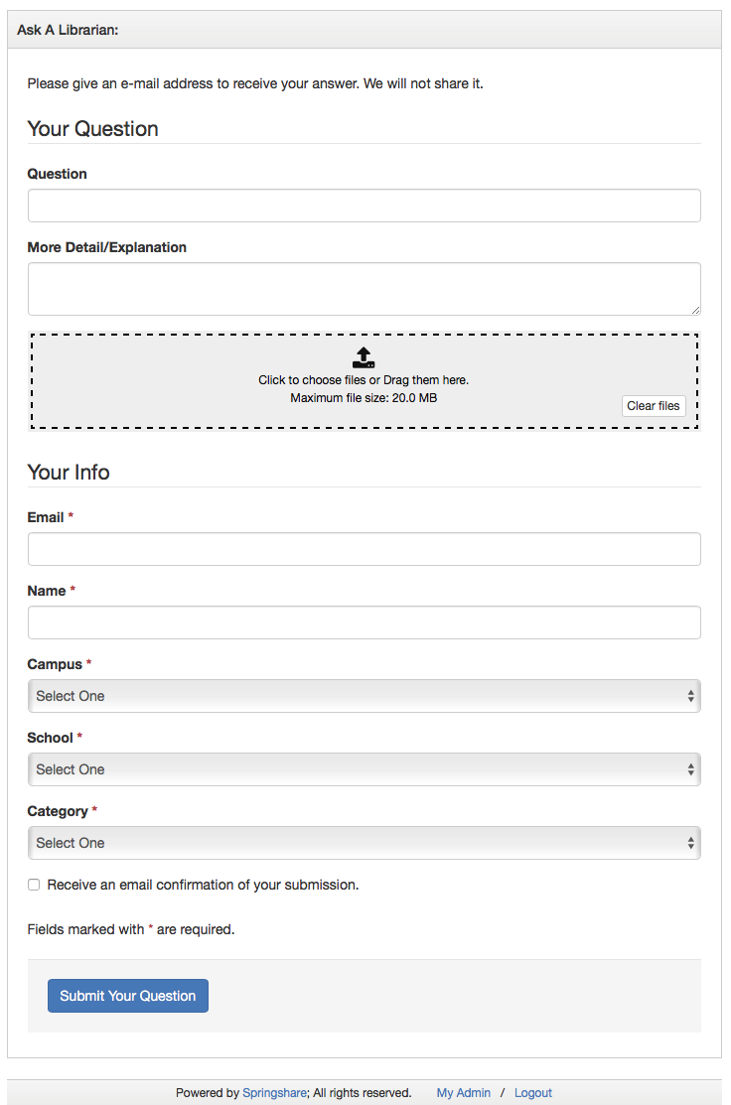
Fill out the form to email us a question!

Slide 30

www.ttuhsc.edu/libraries
Download

Slide 31
Click
Citation Tools

Slide 32



Call your TTUHSC Librarian

Slide 33

Run the software

Slide 34
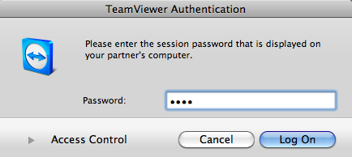
Give the id and password to the librarian to enter.
Log On
After logging on, the librarian can see your computer screen!
At the end of the session after logging off,
the librarian will not have access to your computer!
TeamViewer generates a new password each time it is used!

Slide 35
Searching CINAHL

Slide 36

www.ttuhsc.edu/libraries
Click

Slide 37
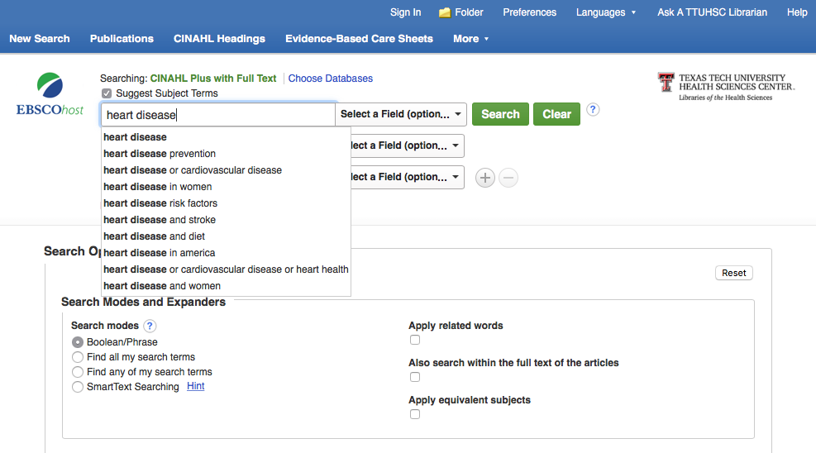
Enter heart disease
Suggested
Subject Headings
click
Search

Slide 38
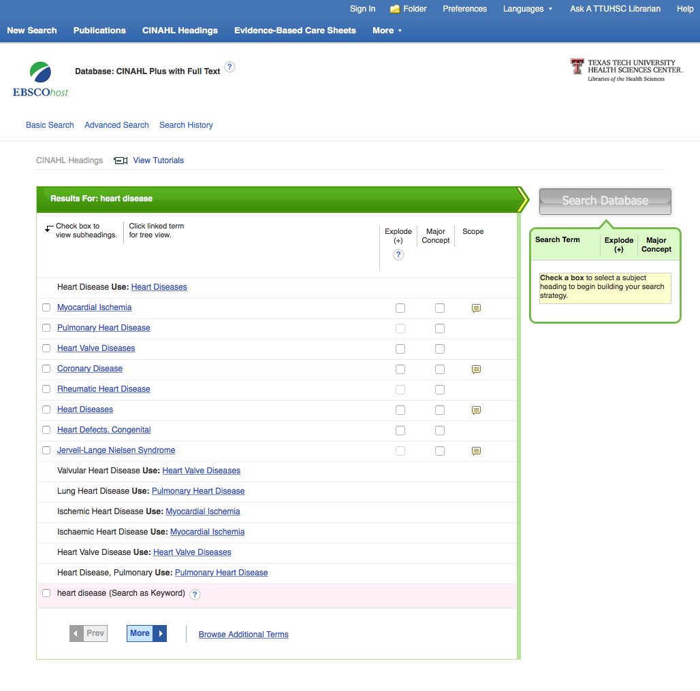
Click the underlined term Heart Diseases

Slide 39
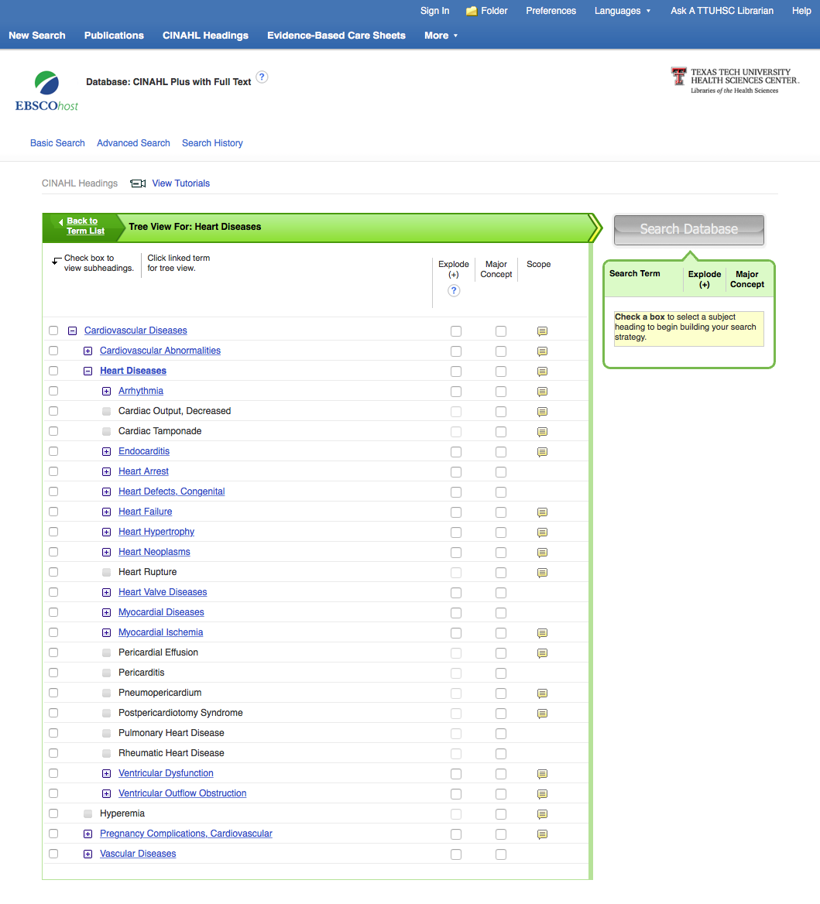
✔
Click the box next to Heart Diseases
✔

Slide 40
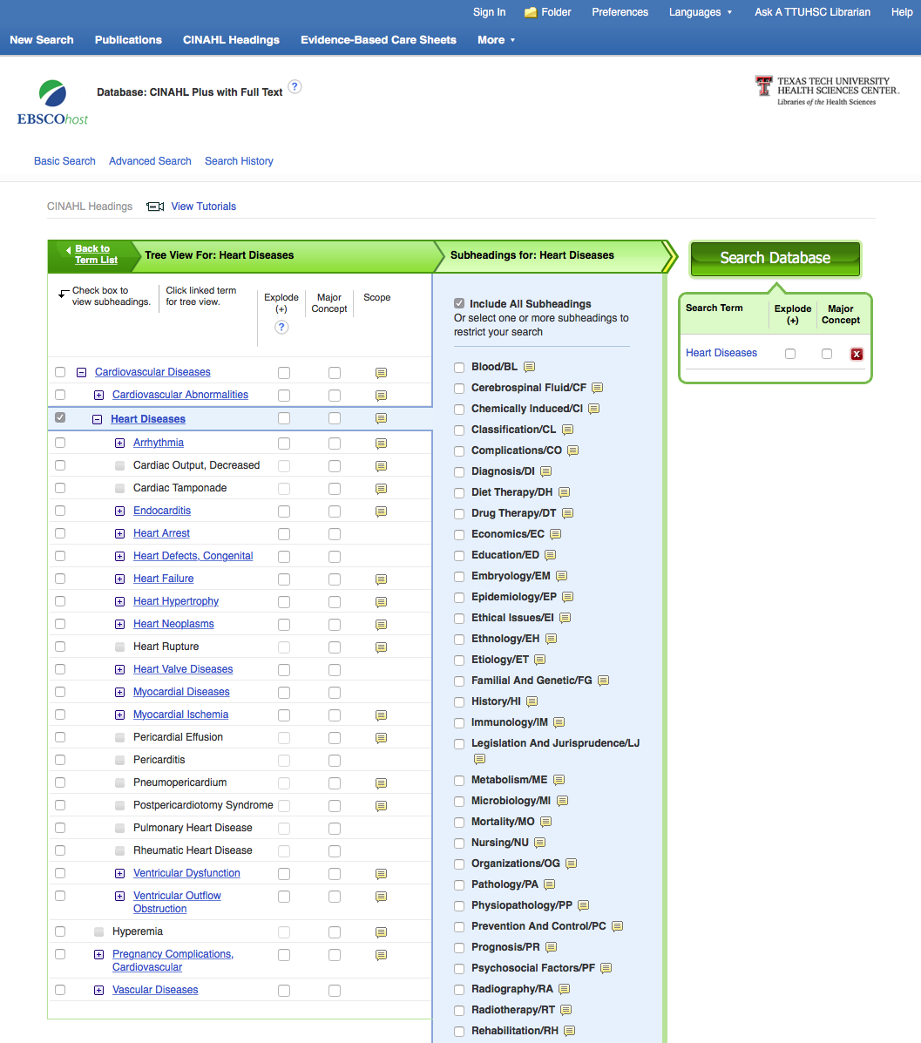
Subheadings
appear

Slide 41

Select the subheading Familial And Genetic
click
Search Database
✔

Slide 42
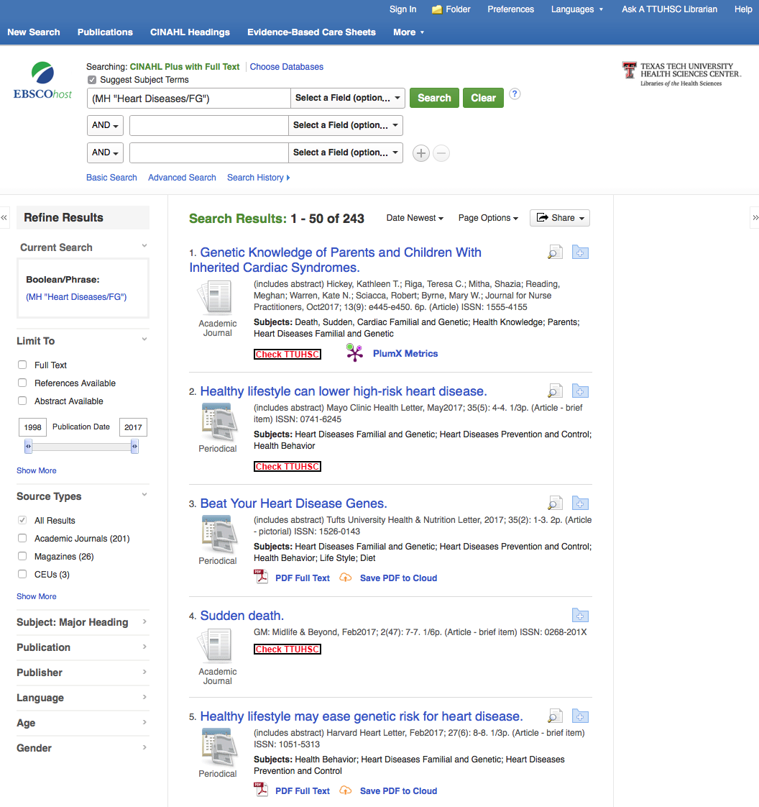
Click Advanced Search

Slide 43
Refining Results

Slide 44
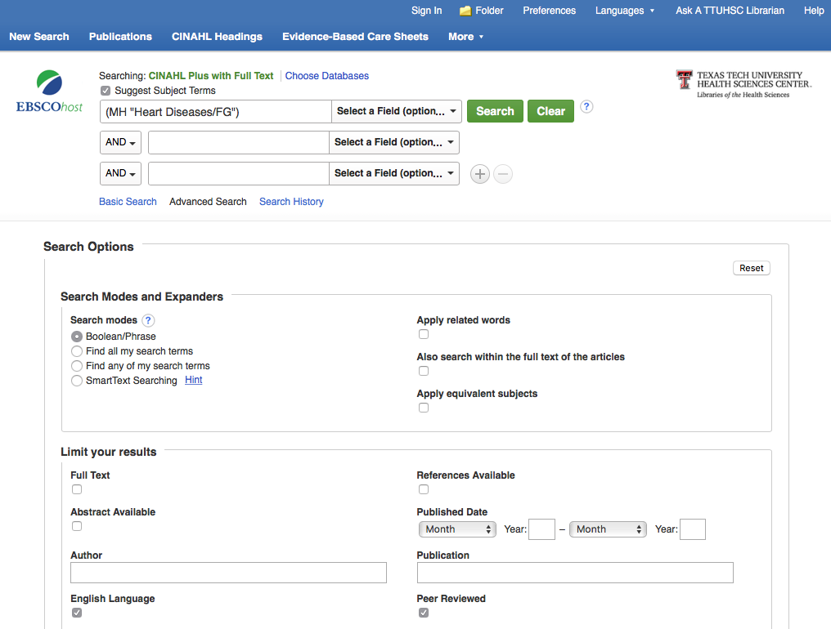
Select English Language and Peer Reviewed
✔
✔

Slide 45
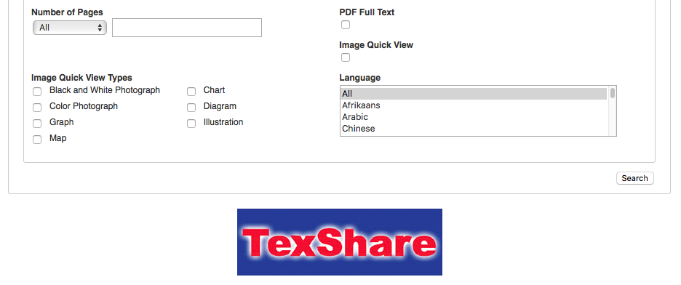
Search
At the bottom of the screen, click

Slide 46
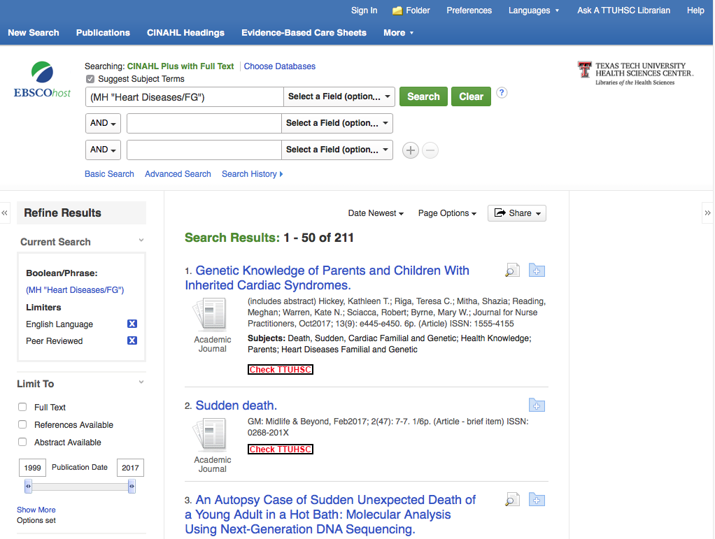
Change date to 2012 in the left-hand box to narrow to articles published in the last 5 years.
2012
Press Return

Slide 47
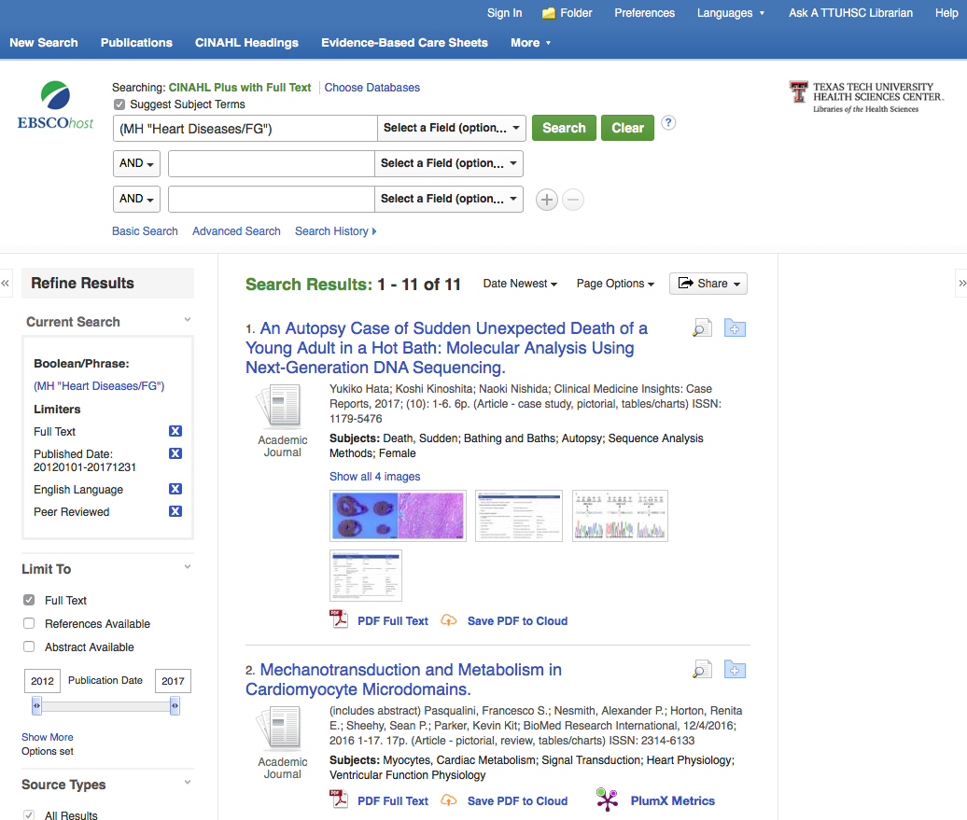
Click the box next to Full Text
✔
✔

Slide 48
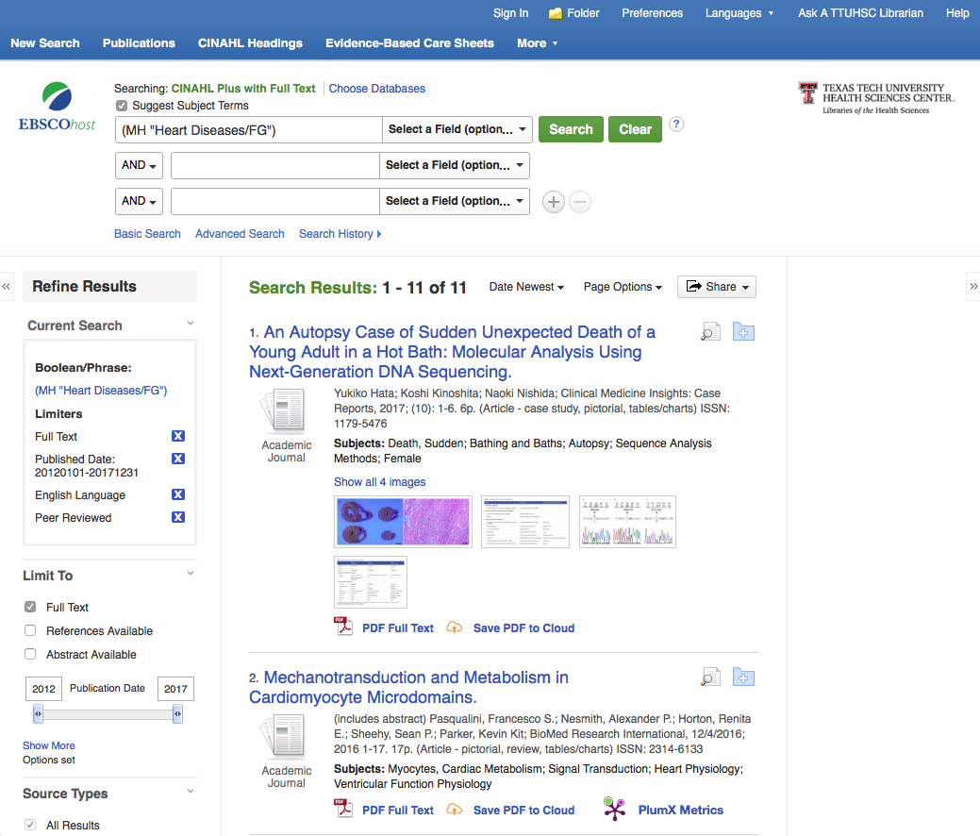
Results have narrowed
to 11 articles

Slide 49

Click

Slide 50
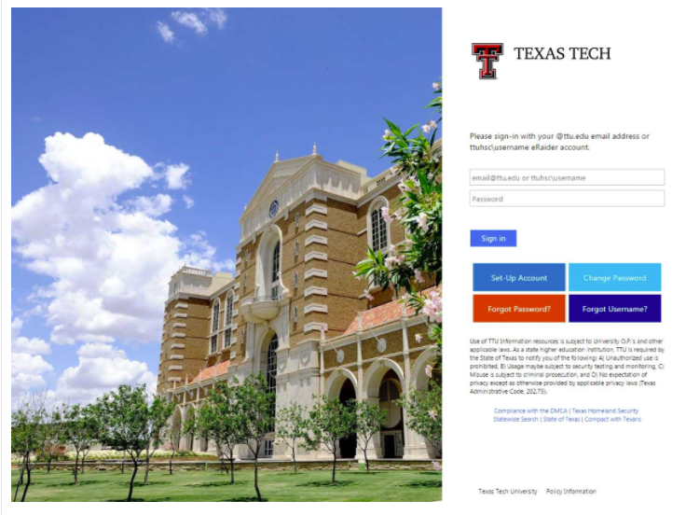
When Searching from Off Campus:
Enter the
Eraider username and password
assigned to you
by Information Services.
Problems with eRaider call: 806-743-1234a

Slide 51
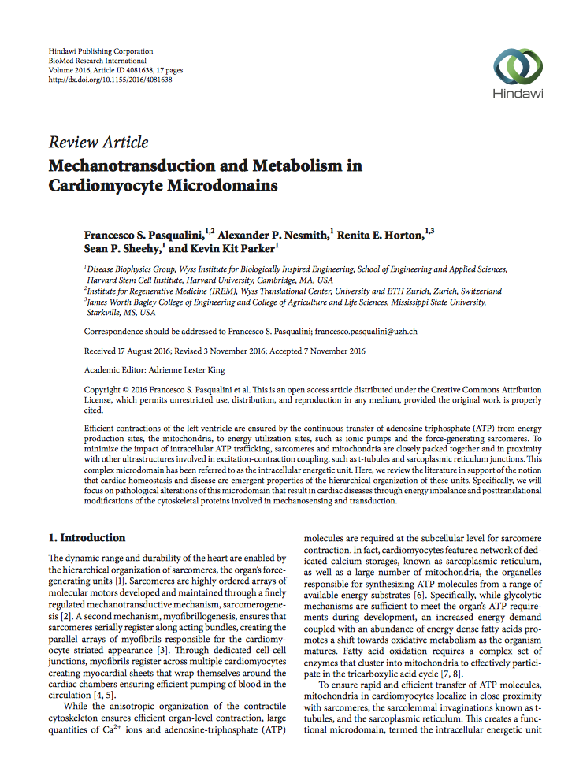
Full-Text Article

Slide 52
What questions do you have?

Slide 53
Searching
Nursing Reference Center

Slide 54


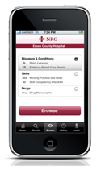

clinical information
at the point-of care…
…and comprehensive
scholarly literature.

Slide 55


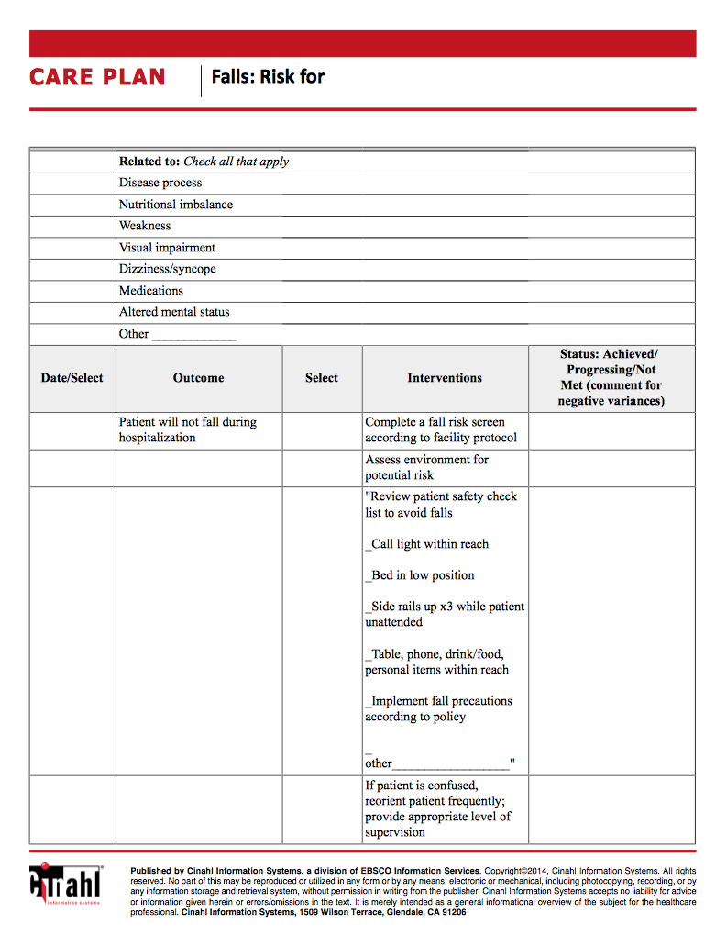
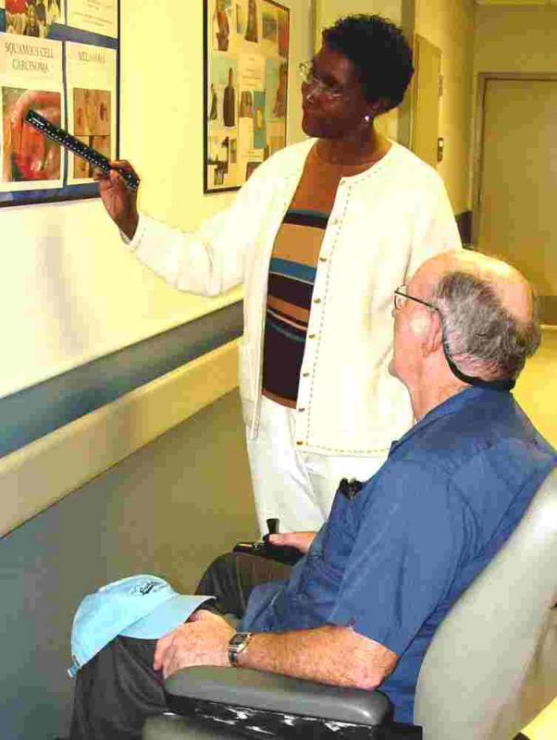

drug information
diseases
care plans
skills
patient education

Slide 56

www.ttuhsc.edu/libraries
Click

Slide 57
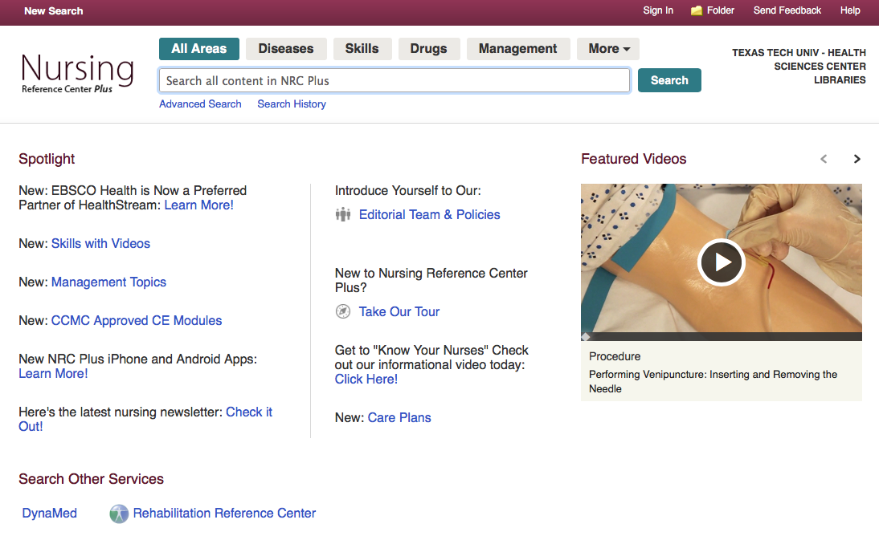
Home Page

Slide 58
Click
Diseases

Slide 59
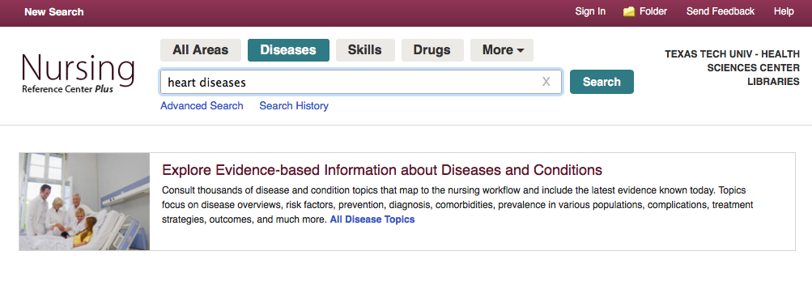
Click
Search
Enter heart diseases

Slide 60
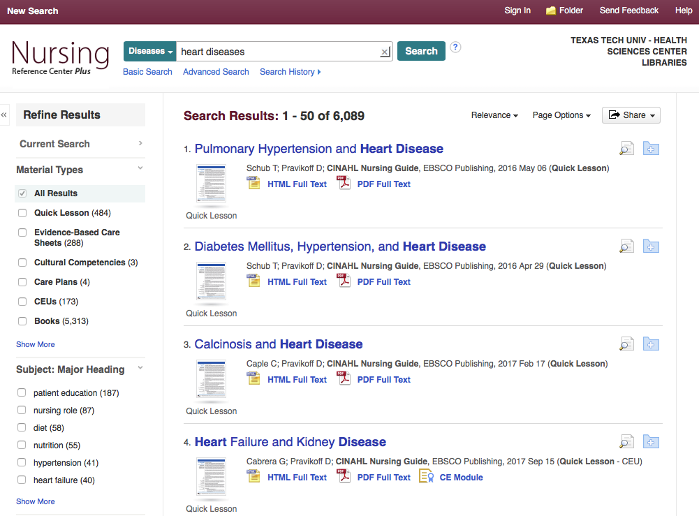
Material Types

Slide 61
Tour of Material
Types

Slide 62
Quick Lesson

Slide 63
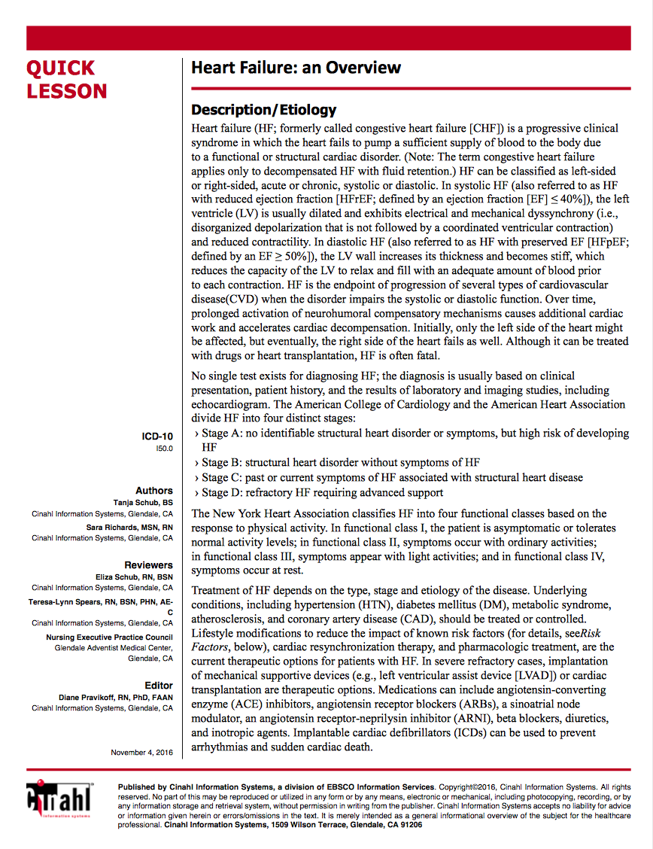

Slide 64
Evidence-Based Care Sheets

Slide 65
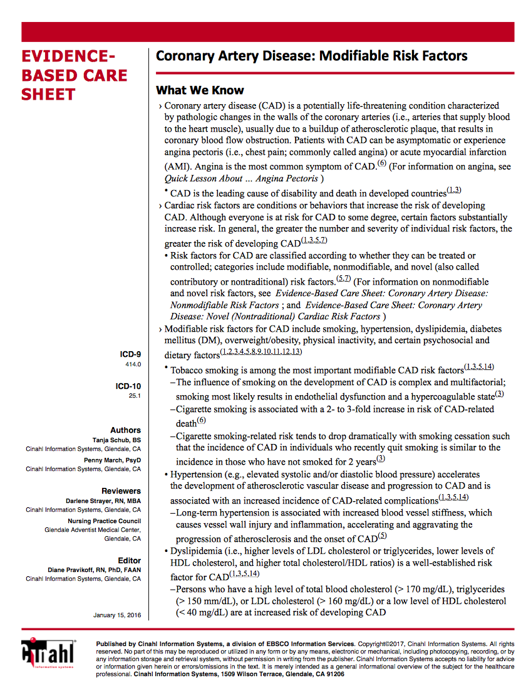

Slide 66
Care Plans

Slide 67
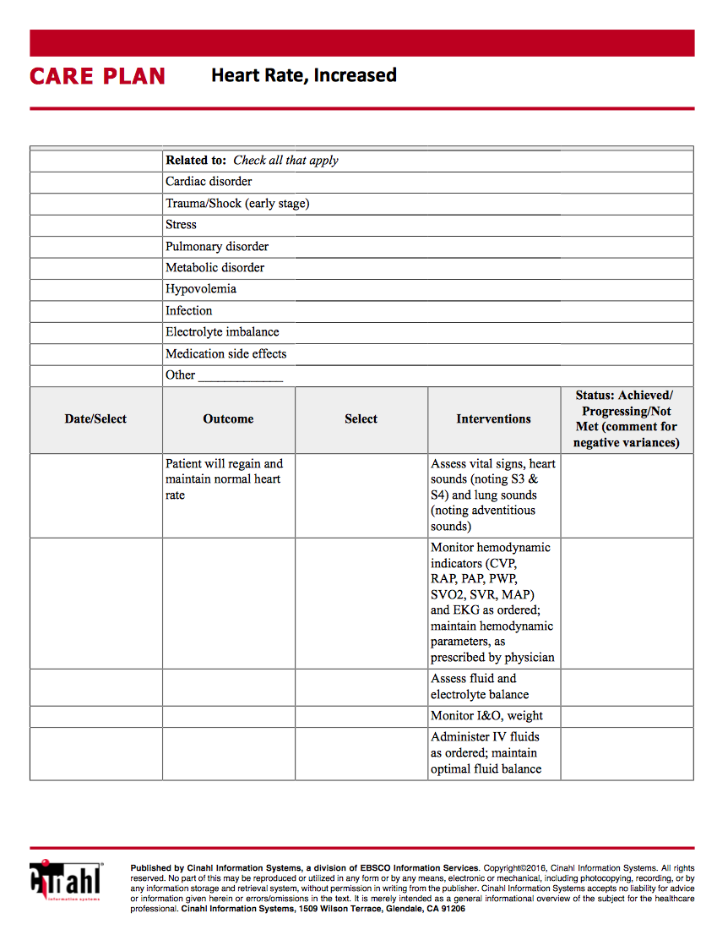

Slide 68
What questions do you have?

Slide 69
EBP Literature from
PubMed’s Clinical Queries

Slide 70



PubMed Database
Biomedical & life sciences journal literature - @6,000 journals
International scope
Developed and maintained by the:
National Center for Biotechnology Information
    at the U.S. National Library of Medicine
    at the National Institutes of Health

Slide 71

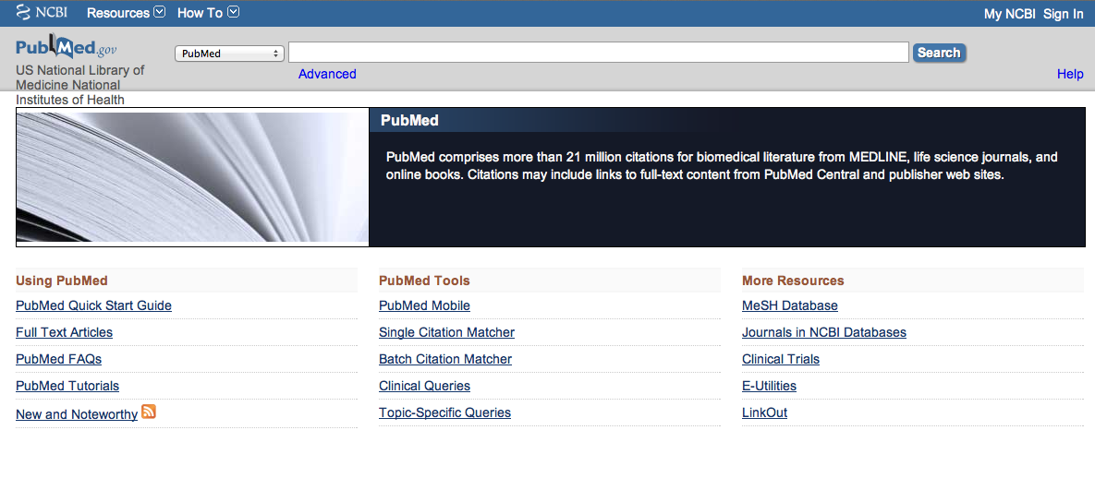
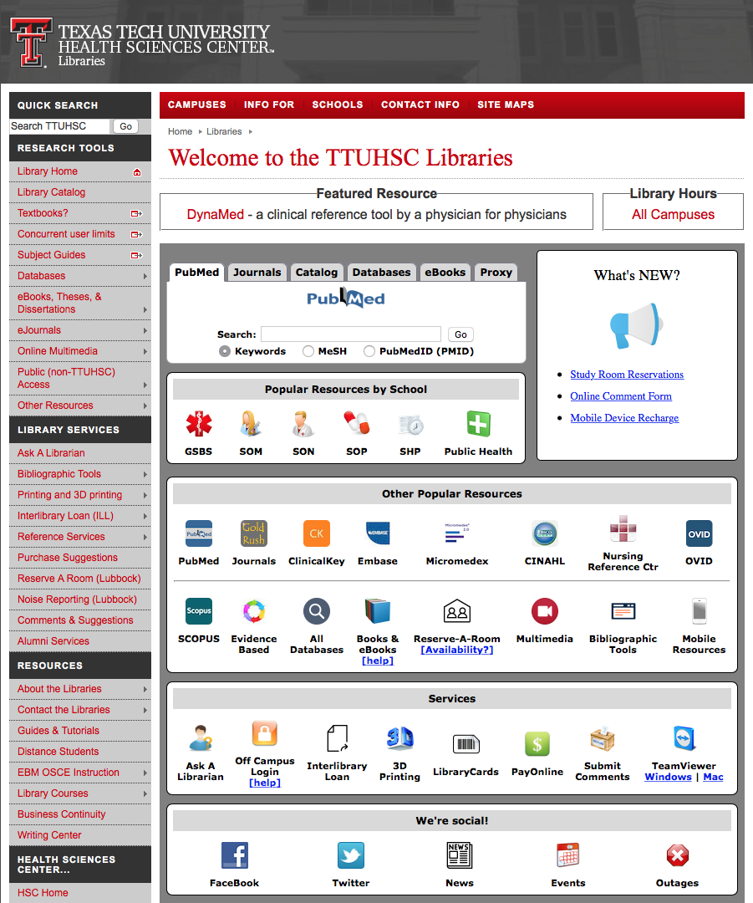
Accessing PubMed
Freely available over the Internet
@ www.pubmed.gov
Also through library’s home page

Slide 72


Evidence-Based Practice is guided by thoughtful integration
of the best available scientific knowledge with clinical expertise.

Slide 73
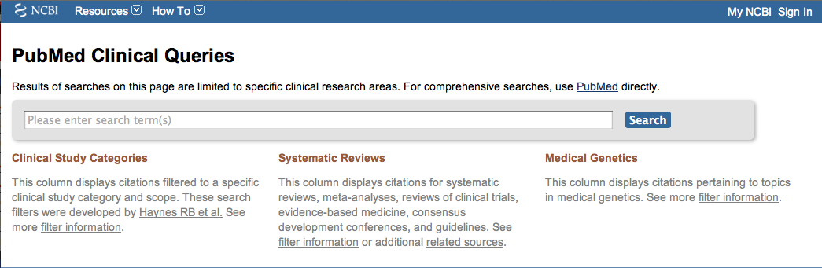
PubMed’s Clinical Queries
tool that searches for evidence-based literature

Slide 74

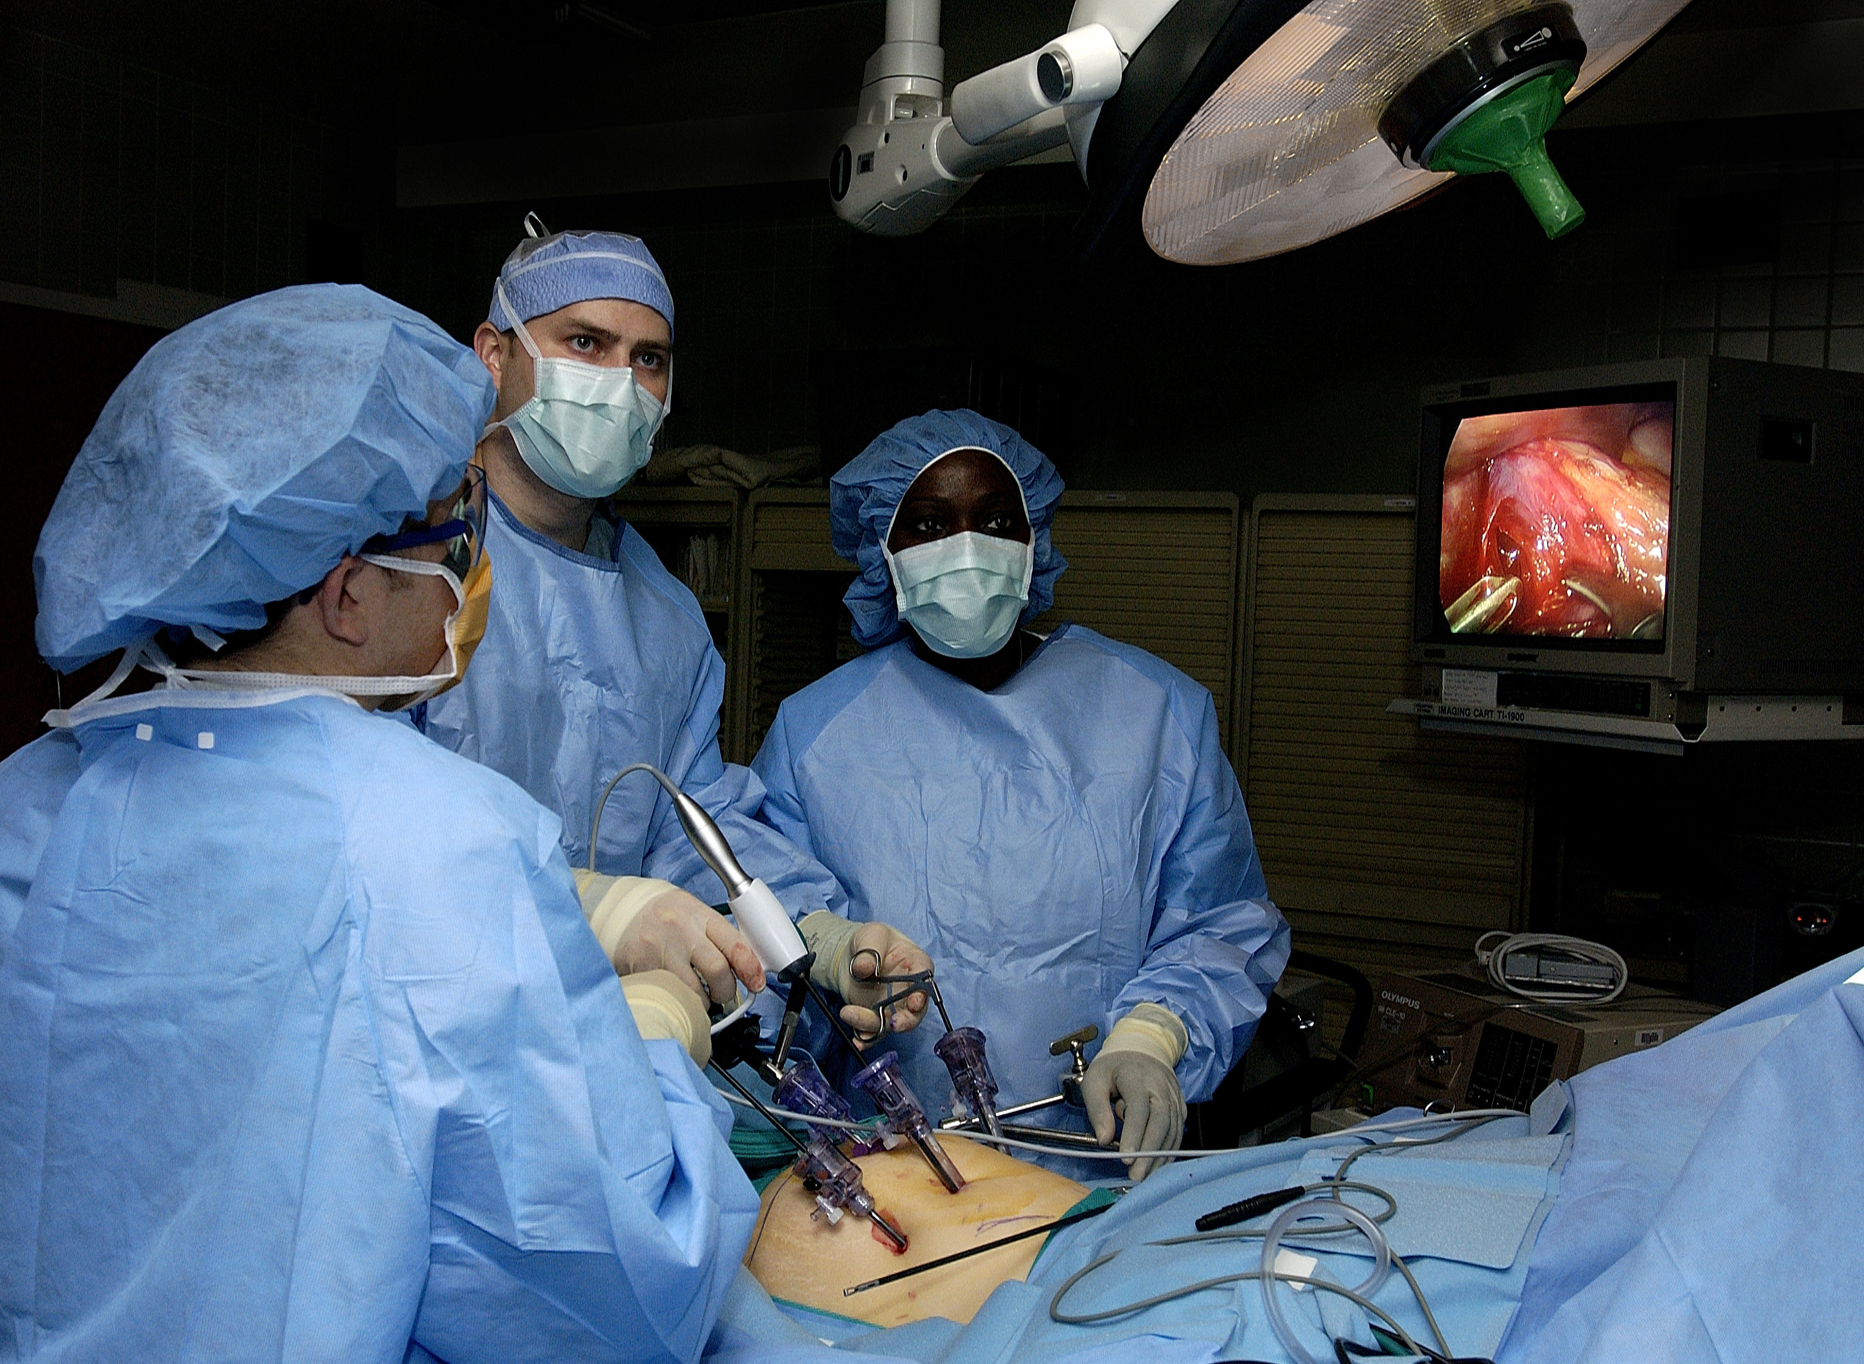
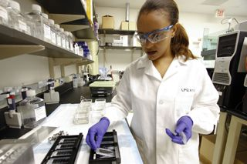
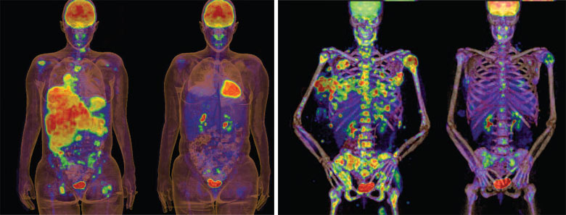
Clinical Queries Searchable by:
Diagnosis
Therapy
Prognosis (prediction of probable outcome)
Etiology (cause)

Slide 75
Clinical Queries Searchable by:
Diagnosis
Therapy
Prognosis (prediction of probable outcome)
Etiology (cause)

Slide 76
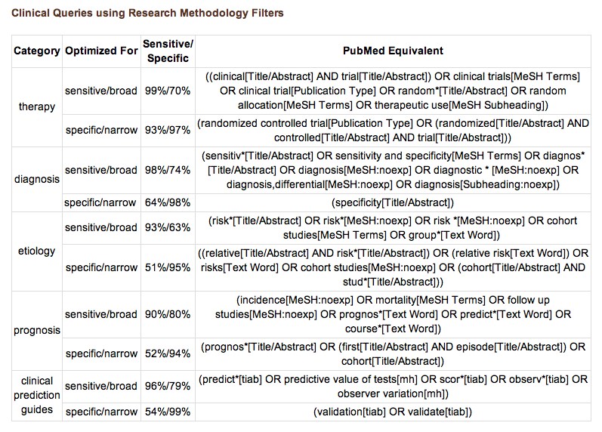
PubMed’s Clinical Queries
uses pre-formulated search strategies with a keyword search

Slide 77

www.ttuhsc.edu/libraries
Click

Slide 78
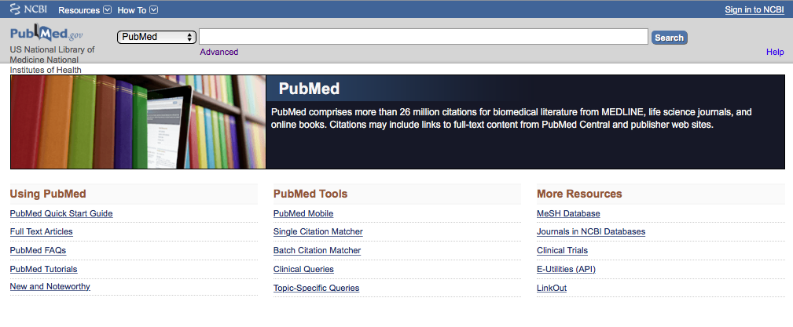
Click Clinical Queries

Slide 79
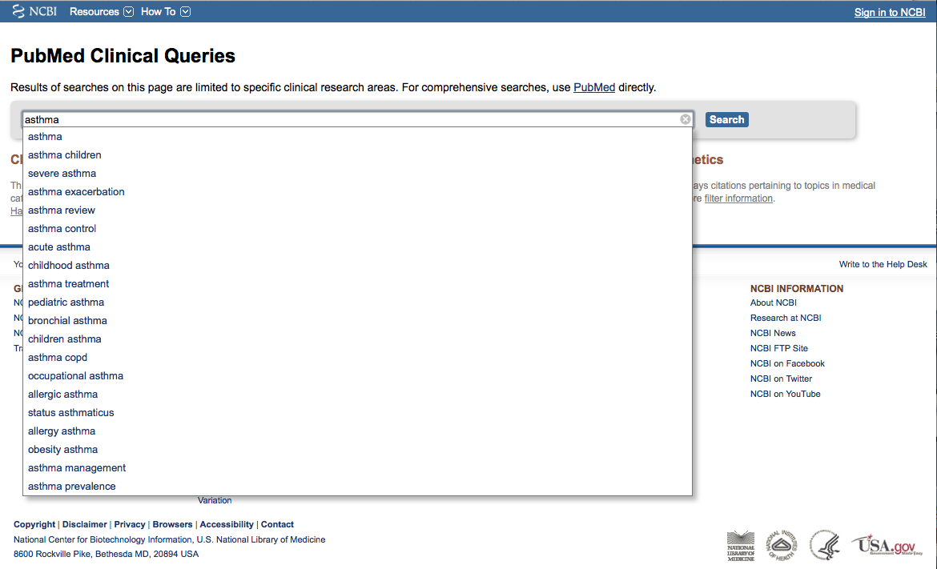
Enter asthma
Click
Search

Slide 80
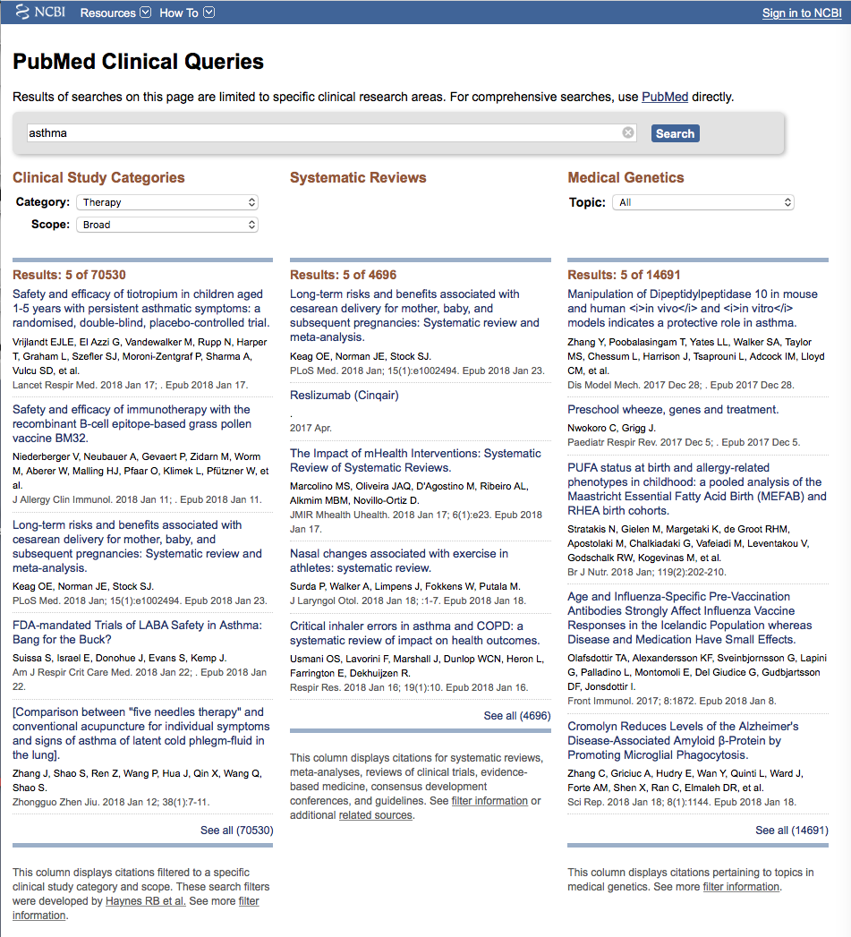
Results for Therapy and
Broad Scope

Slide 81

Click on the Therapy drop-down menu

Slide 82
Change from Broad to Narrow Scope

Slide 83
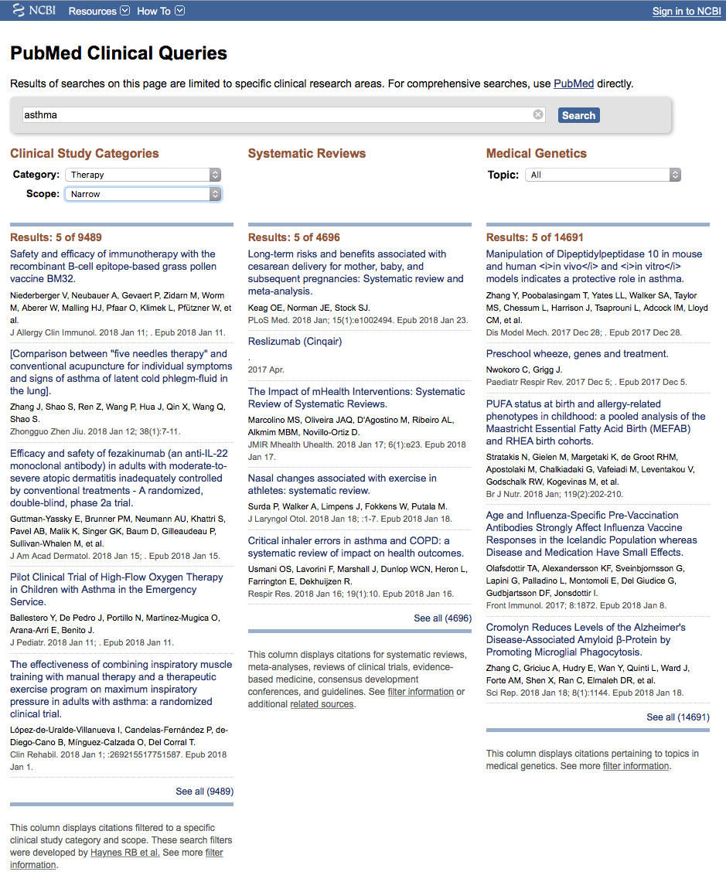
Results for Therapy and
Narrow Scope
Click See all (9489)

Slide 84
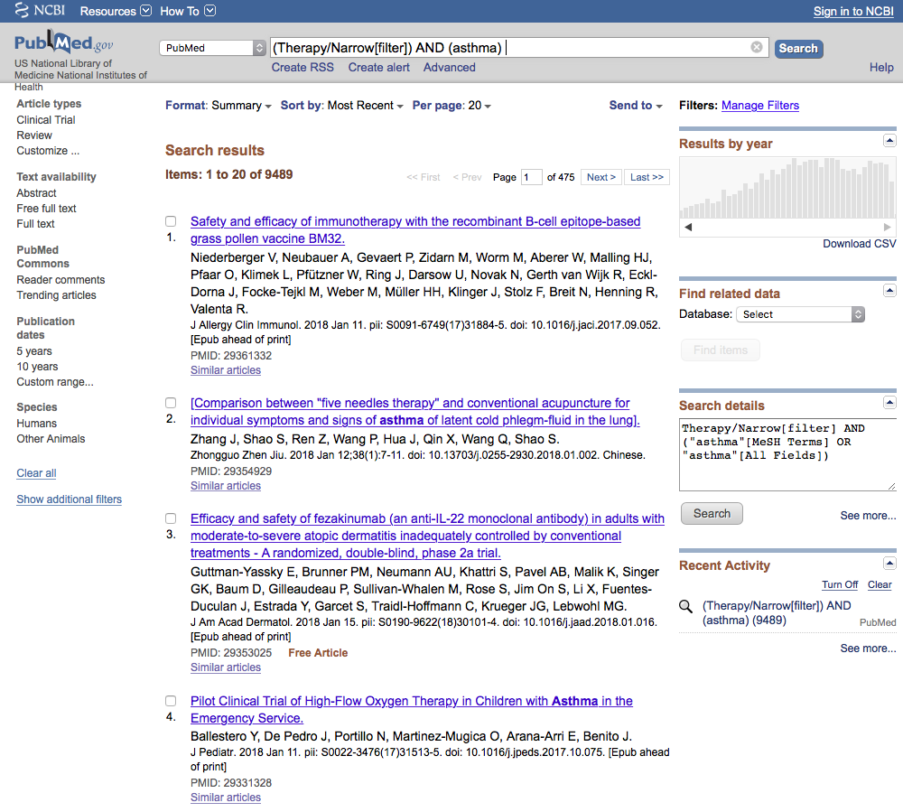
Locate the Limitor: Publication Dates
Click 5 years

Slide 85
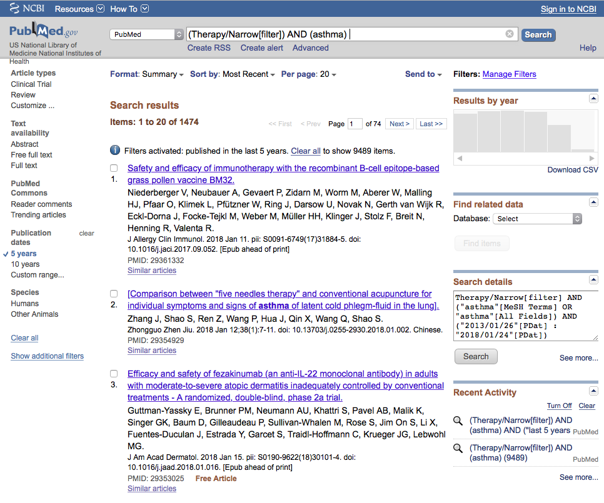
Results have narrowed to 1474 articles

Slide 86
Click Humans

Slide 87

Click Show additional filters

Slide 88

Select
Languages
and
Journal categories
✔
✔
Click Show

Slide 89

Click English
Click Nursing journals

Slide 90

Activated filters

Slide 91
Results have narrowed to 20 articles

Slide 92
Click on the article title you wish to read

Slide 93

Click for Free Full Text
TTUHSC ONLINE

Slide 94

Click

Slide 95

Full Text Article

Slide 96
What questions do you have?

Slide 97
Finding e-journals in Gold Rush

Slide 98

www.ttuhsc.edu/libraries
Click Gold Rush

Slide 99

For instructions,
Click
Gold Rush FAQ

Slide 100

Enter journal title, click
Search
nursing research

Slide 101

Click Nursing Research (New York:…

Slide 102

1) Check Dates Available
2) Click Publisher

Slide 103

Locate article. Click
Select Year
Select Volume, Issue

Slide 104
What questions do you have?

Slide 105
Guides & Tutorials
www.ttuhsc.edu/libraries
Guides &
Tutorials

Slide 106
Ask-A-Librarian
www.ttuhsc.edu/libraries
Ask a Librarian

Slide 107
Hands-on Help With Assignment

Slide 108
Please…
fill out the evaluation at
http://tinyurl.com/ttuhsc18
Thank-you…
we appreciate your feedback!

Slide 109
The End

