Slide 1
End Note, RefWorks and Corresponding Plug-Ins

Slide 2
Instructions for
Accessing RefWorks and Downloading Write n Cite

Slide 3

What is RefWorks?
Gather, manage, store, and share research information
Personal information management of journal article citations
Generates instantly formatted citations and bibliographies as you write your research paper

Slide 4
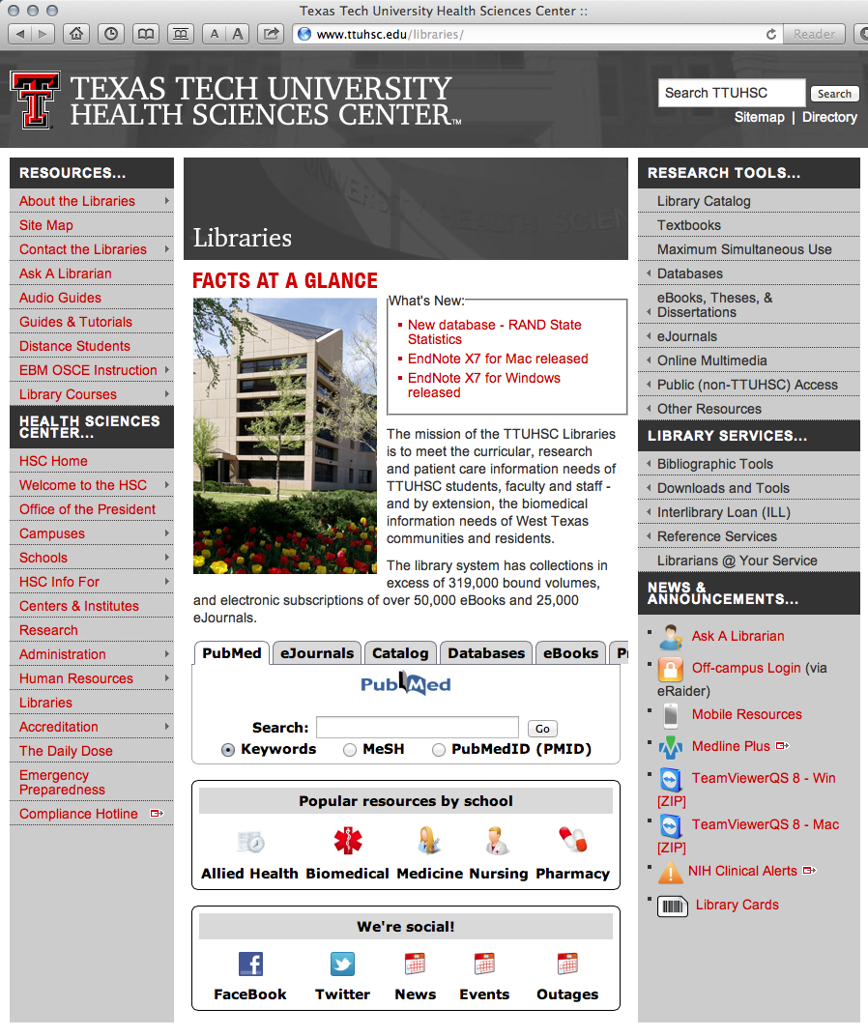

1) Go to www.ttuhsc.edu/libraries
2) Hover mouse over
Bibliographic Tools
3) Click RefWorks

Slide 5

Click
RefWorks

Slide 6
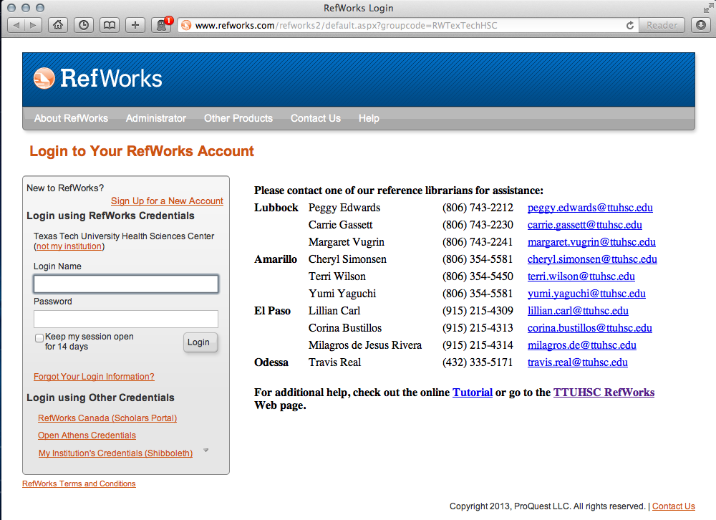
Click
Sign Up for a New Account

Slide 7
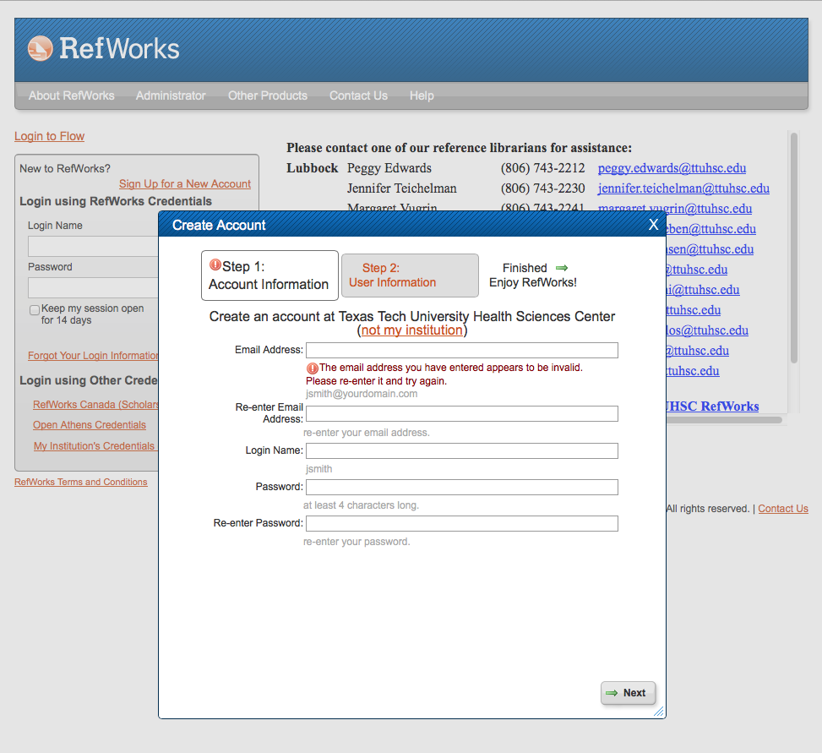
Enter
User Information
Complete application,
to Create Account

Slide 8
What is Write-n-Cite?
Write-n-Cite is a plug-in that works with RefWorks
It must be downloaded separately
You must have Write-N-Cite to create footnotes and
    a bibliography within your Word doc

Slide 9
What is Write-n-Cite?
You should download Write-n-Cite on your own computer
It will link with your Word software program
See following slides for download instructions

Slide 10
1) Go to www.ttuhsc.edu/libraries
2) Hover mouse over
Bibliographic Tools
3) Click RefWorks

Slide 11
Click
RefWorks

Slide 12
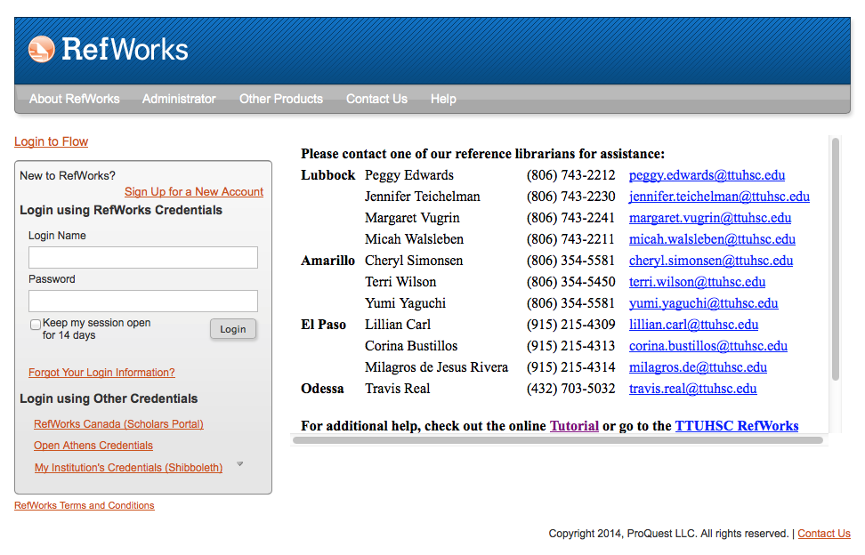
Login to your account

Slide 13
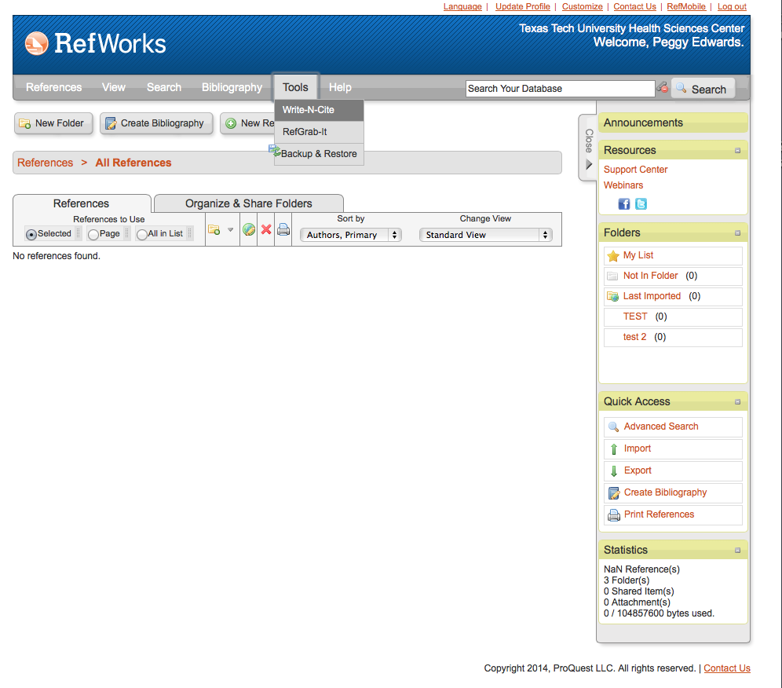
Under Tools,
click Write-N-Cite

Slide 14
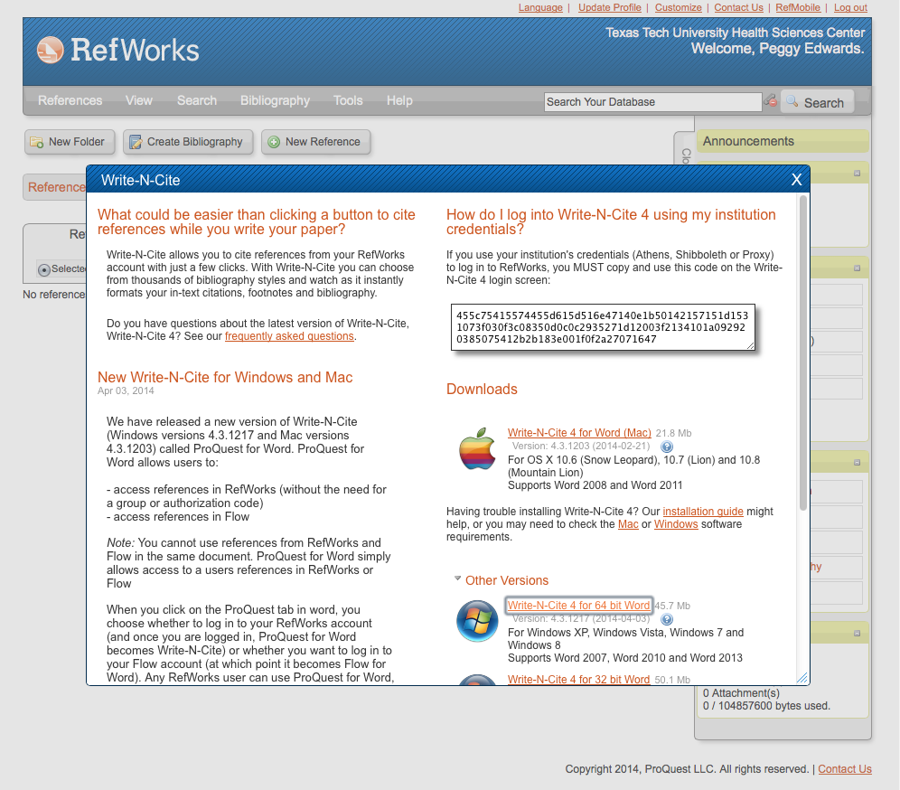
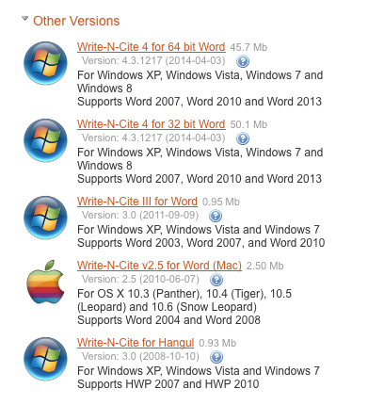
➔
3. Click appropriate download & install
2.Copy
code
1. Close Microsoft Word

Slide 15
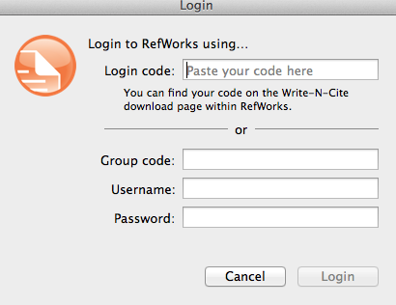
1. Open Microsoft Word
Sometimes
may need to
“sync”
MAC info
Login

Slide 16

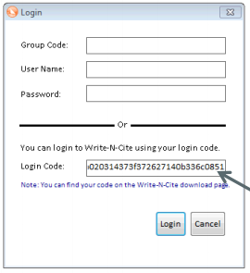
Open Microsoft Word, Open new “RefWorks’ tab
2. Login
then enter code
PC info

Slide 17
Instructions for
Accessing EndNote
and Downloading
Cite While You Write

Slide 18
1) Go to www.ttuhsc.edu/libraries
2) Hover mouse over
Bibliographic Tools
3) Click EndNote

Slide 19




Slide 20
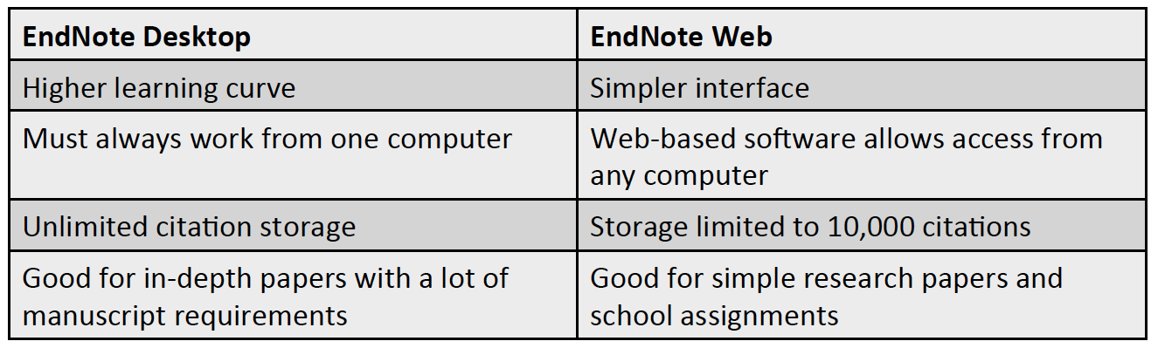
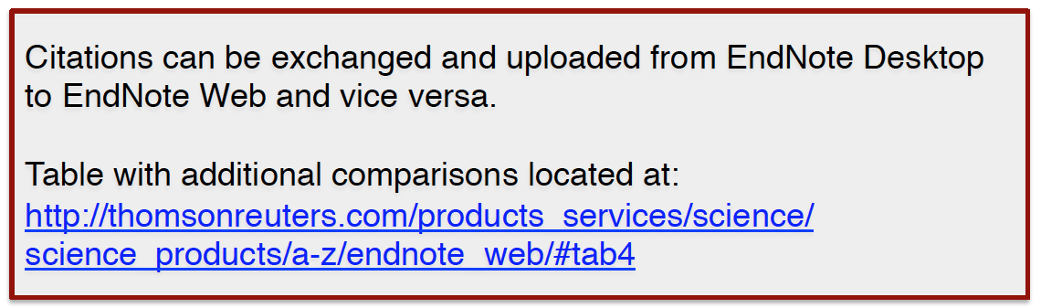
EndNote Desktop vs. EndNote Web

Slide 21
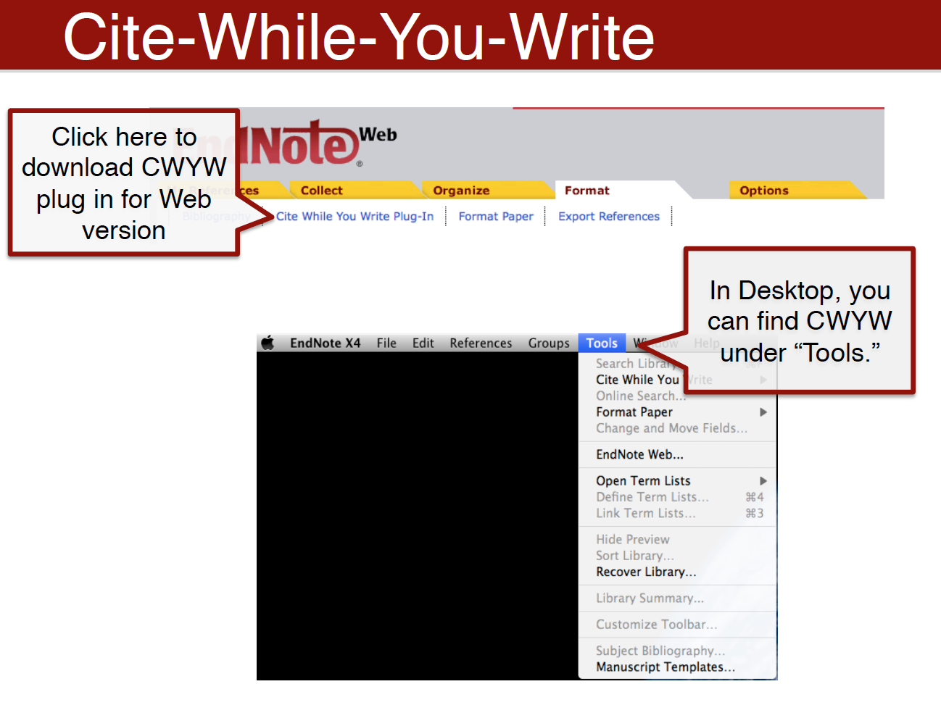

Slide 22
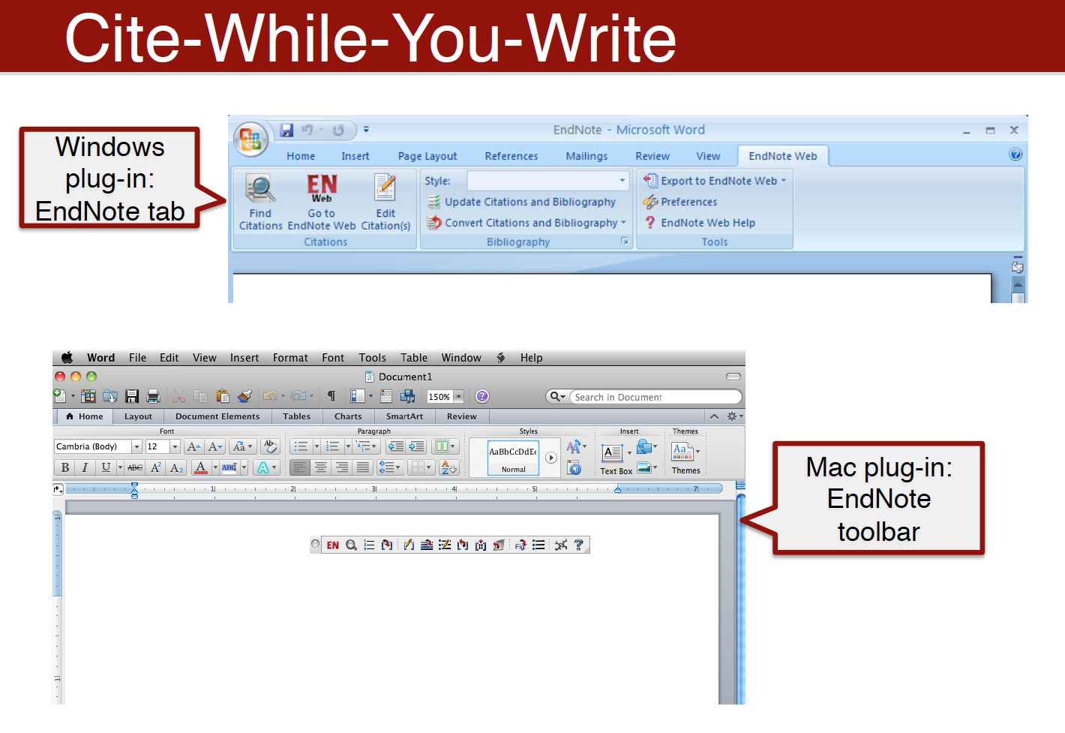

Slide 23
