Slide 1

Through the Looking Glass:
Genetic Information Resources
for
You, Health Care Professionals, and Researchers
Texas Tech Universities Health Sciences Center Libraries – Peggy Edwards, AMLS

Slide 2

Let’s go on a journey…
using x-ray crystallographic diffraction!
Retrieved January 5, 2015 from http://www.neurtrons.ornl.gov

Slide 3

What is it?
Spiral IV – X-ray crystallographic data was used from real DNA molecules to paint a unique portrait of the double helix. The image omits the chemical bonds that crisscross the center of the molecule, so that the structural features of the helix, such as the major and minor grooves, can be seen more easily.
Credit: Kenneth Eward,
BioGrafx Scientific & Medical Images,
Ovid Michigan
Retrieved January 5, 2015 from http://www.nsf.gov/news/mmg/mmg_disp.jsp?med_id=70960

Slide 4


Who are they?
J. Craig Venter, Ph.D.
founder Celera Genomics,
The Institute for Genomic Research, &
J. Craig Venter Institute
Francis Collins, M.D.
director (in the year 2000) of
National Center for Human Genome Research
Retrieved January 5, 2015 from http://www.nsf.gov
Retrieved January 5, 2015 from http://www.nih.gov

Slide 5

The Human Genome Project
Identified and mapped all genes in human genome
Largest international collaborative effort ever
Dr. Collins directed
NIH’s public project
Dr. Venter directed
Celera’s private project
Completed in February 2001
Retrieved January 5, 2015 from http://www.genome.gov

Slide 6

Genetics Research Produces Big Data!!
Retrieved January 5, 2015 from http://www.ndep.nv.gov

Slide 7
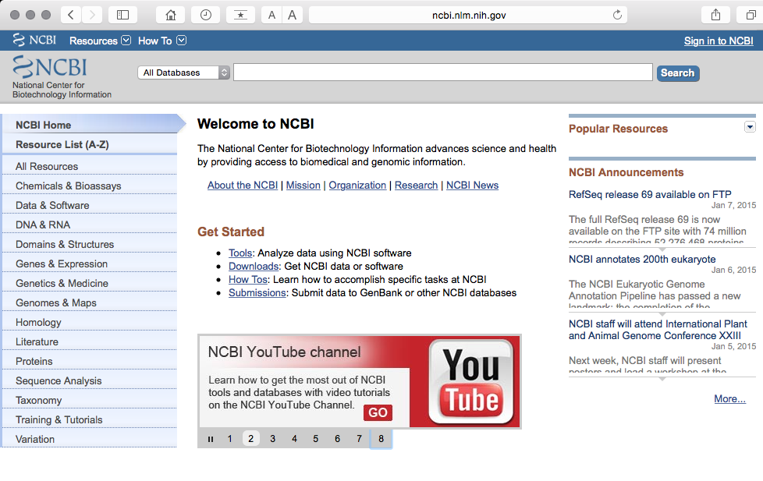
NCBI’s Databases are Freely Available for Anyone!
www.ncbi.nlm.nih.gov

Slide 8
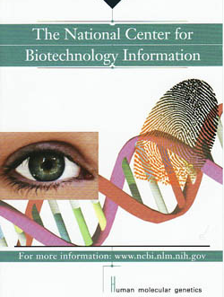

Produced by
at the National Library of Medicine
at the National Institutes of Health
Retrieved January 5, 2015 from http://ncbi.gov
Retrieved January 5, 2015 from http://www.nlm.nih.gov

Slide 9
But I’m Not a Scientist or a Doctor or …
Why is this important to me???

Slide 10
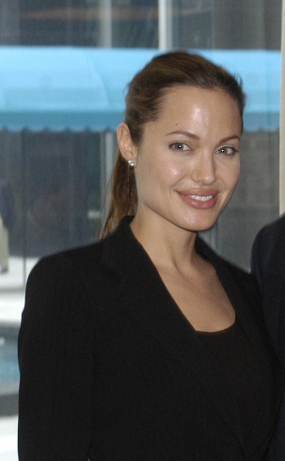



Angelina Jolie
Abraham Lincoln
Breast Cancer
Marfan’s Syndrome
http://www.research.archives.gov
www.loc.gov
What do they have in common?
Genetic predispositions or inherited diseases!
Sam Berns
Sonia Sotomayor
Progeria
Type 1 Diabetes
http://www.directorsblog.nih.gov
http://www.blogs.america.gov
All images retrieved January, 2015

Slide 11
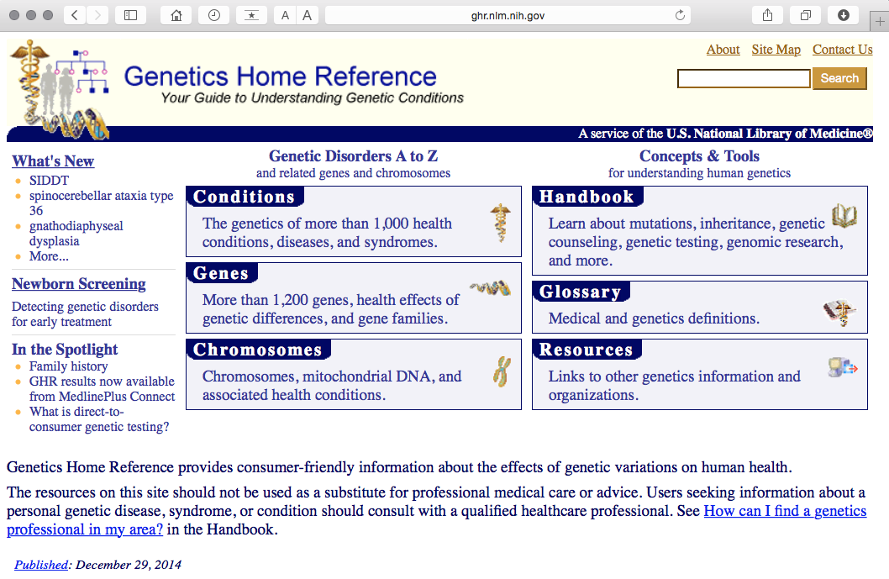
Free Genetic Information Resources for Everyone!
www.ghr.nlm.nih.gov

Slide 12
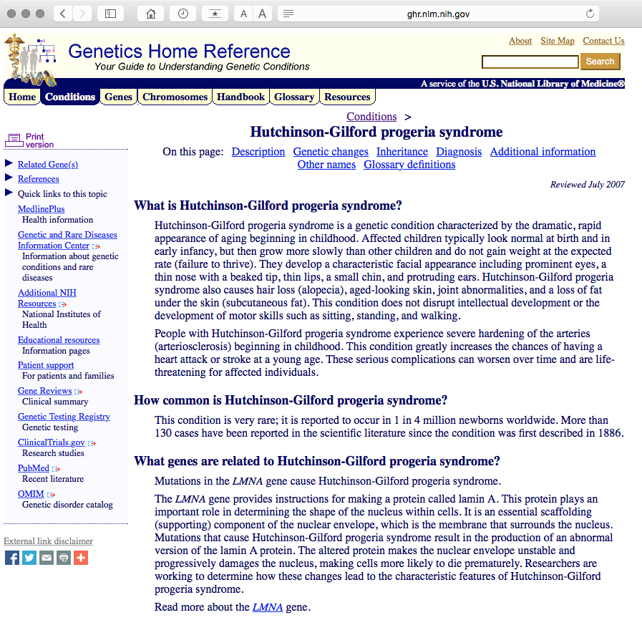
What is Progeria?
Sam Berns
Retrieved January, 2015 from http://www.directorsblog.nih.gov

Slide 13
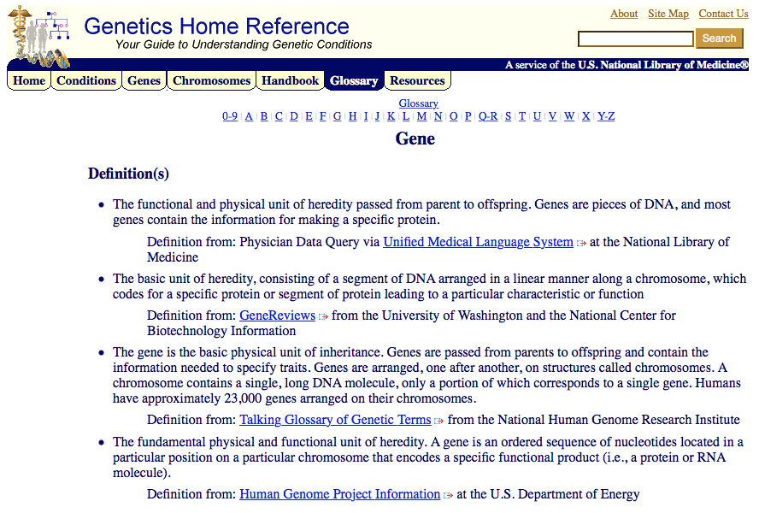
What is a gene?

Slide 14
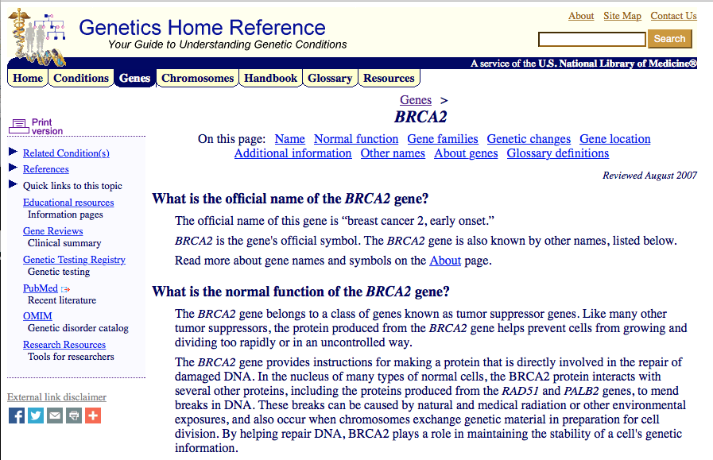
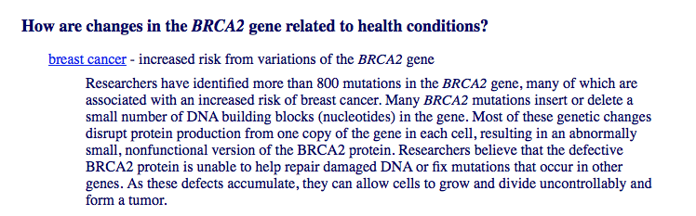
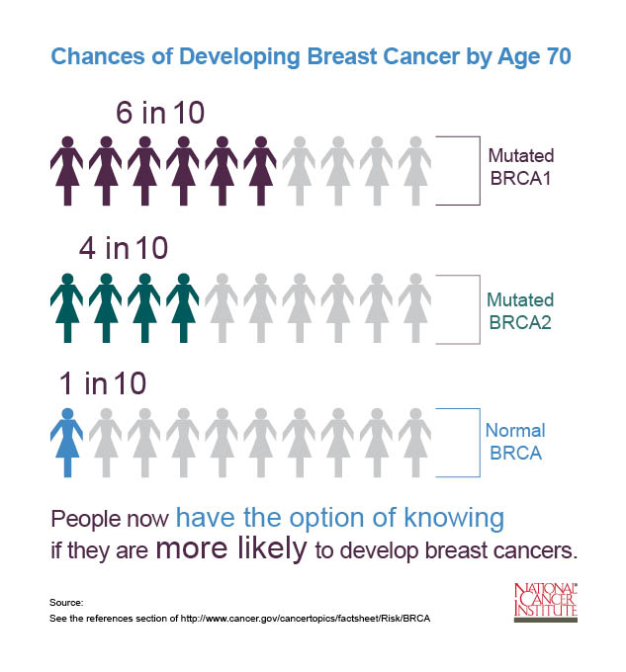
My Doctor says I have a BRCA2 gene variant -

Slide 15
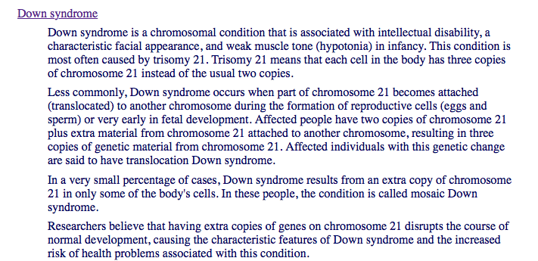

Which chromosome is related to Down Syndrome?
Retrieved January 5, 2015 from http://nichd.nih.gov

Slide 16
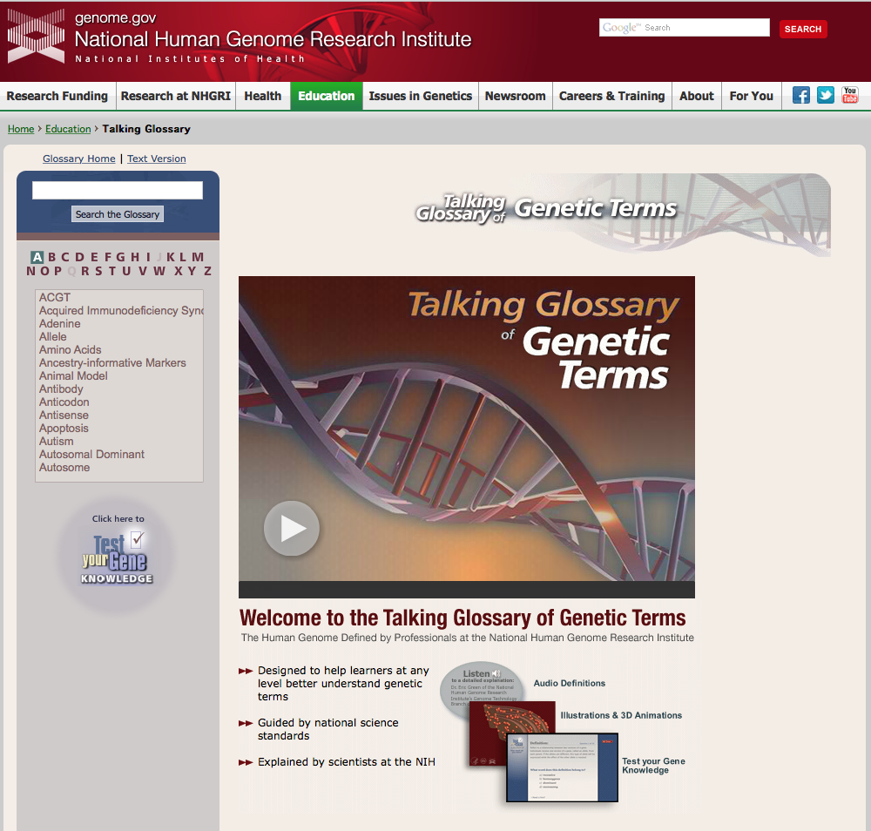
Talking Glossary of Genetic Terms
www.genome.gov

Slide 17
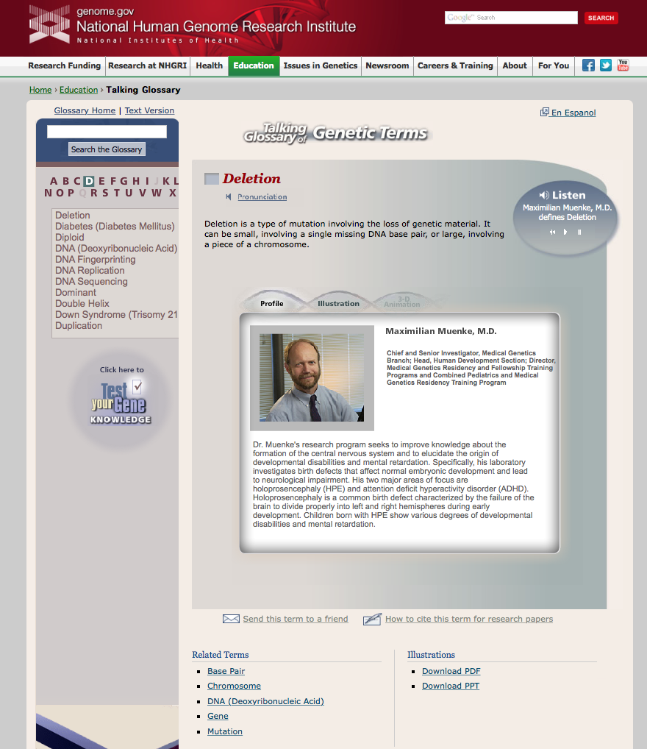

Slide 18

I want to know more about health …
www.MedlinePlus.gov
from National Library of
Medicine at N.I.H.
free, reliable information
easy to understand
links to more resources
many different languages

Slide 19
I’m a Clinician or a Nurse or a Therapist…
Why is this important to me???

Slide 20
Web-Based Resources for Clinical Bioinformatics
Anthony M. Joshua and Paul C. Boutros
Methods in Molecular Medicine. 2008; 141:309-29
PMID: 18453097
In the post-Human Genome Project era, awareness of the resources available through the internet is essential to both molecular biologists and clinicians.
… (it) is important to understand the principles upon which hypotheses are generated, experiments are based and conclusions reached.
… (knowing about) resources often facilitates their use and adoption

Slide 21

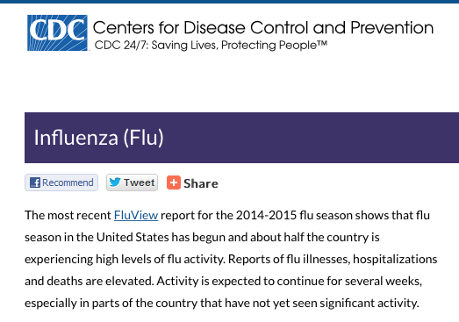
Have you had a lot of flu patients?
Retrieved January 5, 2015 from http://www.nih.gov

Slide 22
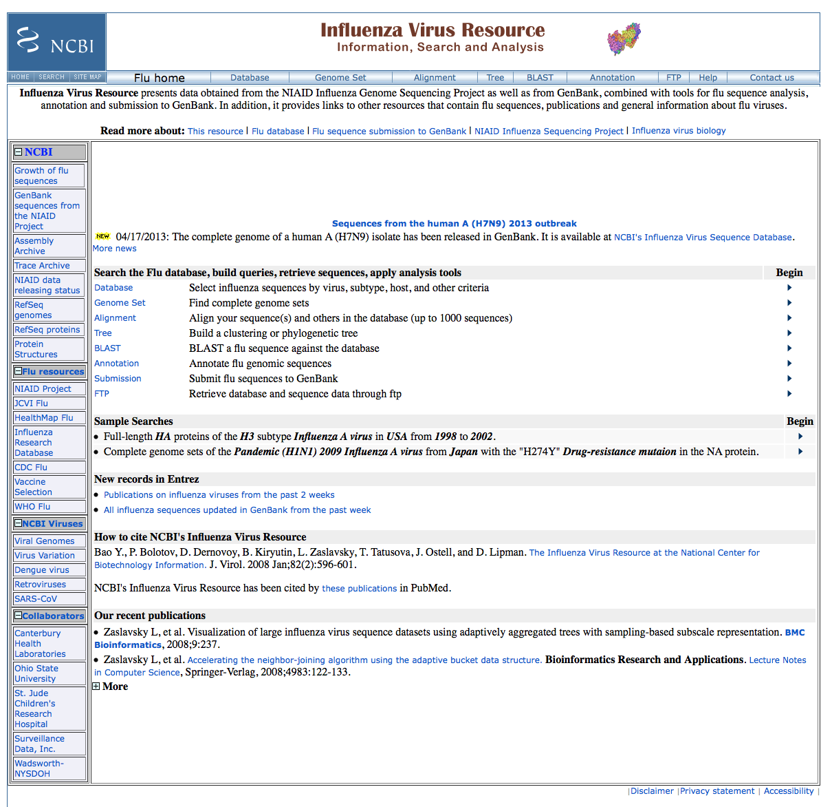
Data from NIAID Influenza Genome Sequencing Project and GenBank
data essential to identification of the genetic determinants of influenza pathogenicity
tools for flu sequence
analysis

Slide 23
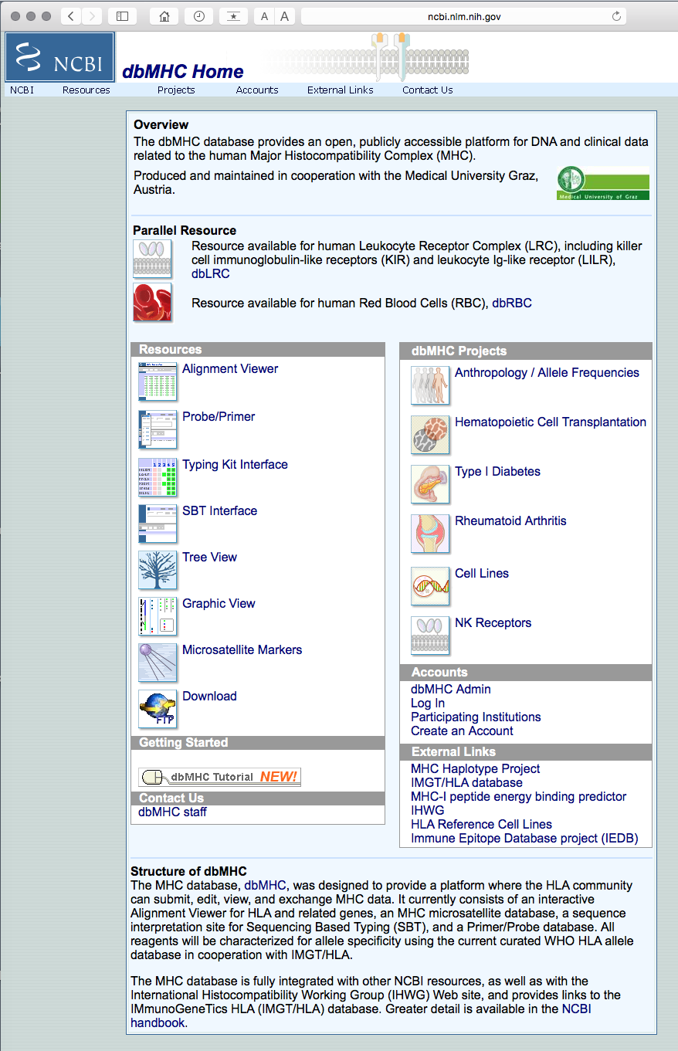


DNA & clinical data related to human Major Histocompatibility Complex
MHC:
array of genes that play a central role in
susceptibility to infectious diseases
the success of organ transplants
Retrieved January 5, 2015 from http://www.iipdigital.usembassy.gov and www.health.wyo.gov

Slide 24
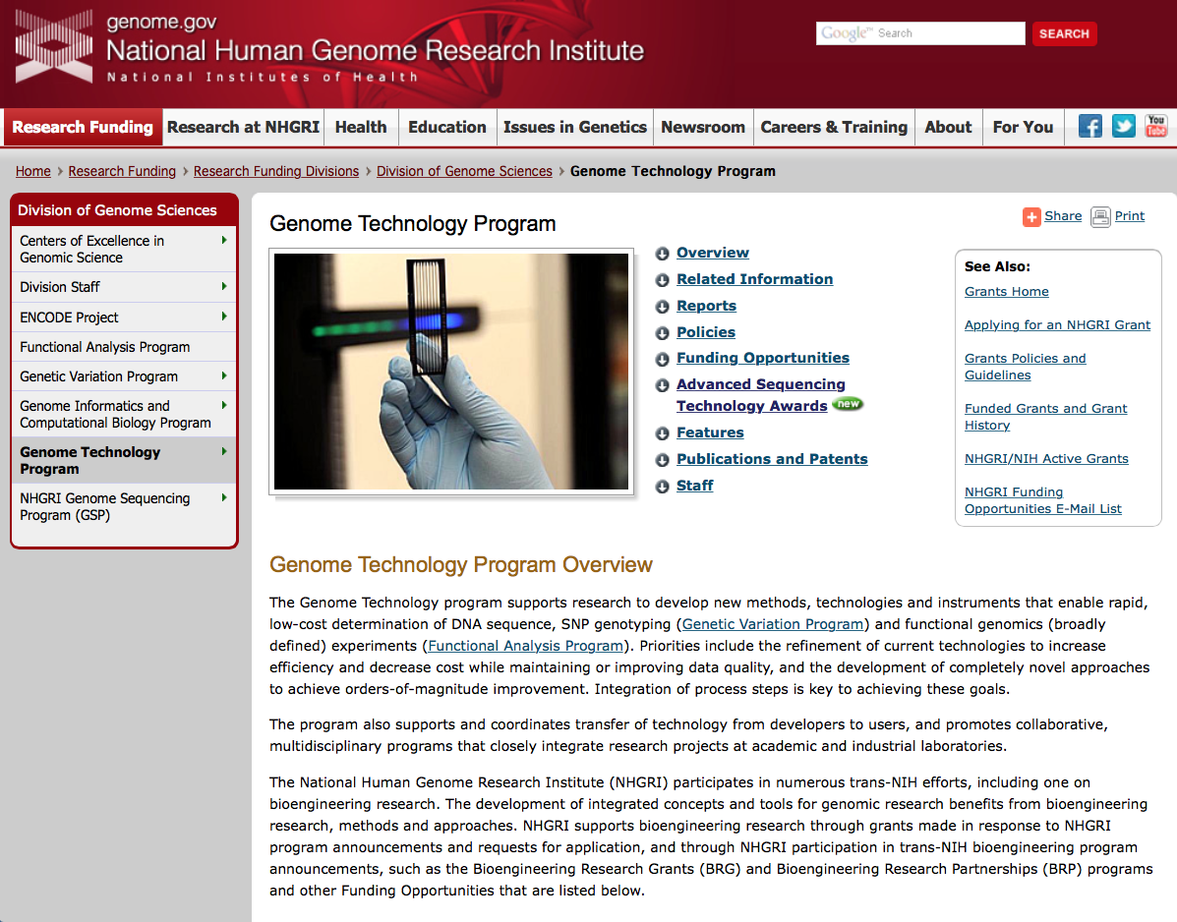

National Human Genome Research Institute
Grants!
NHGRI GOAL:
Sequencing a genome for only $1,000.00!

Slide 25
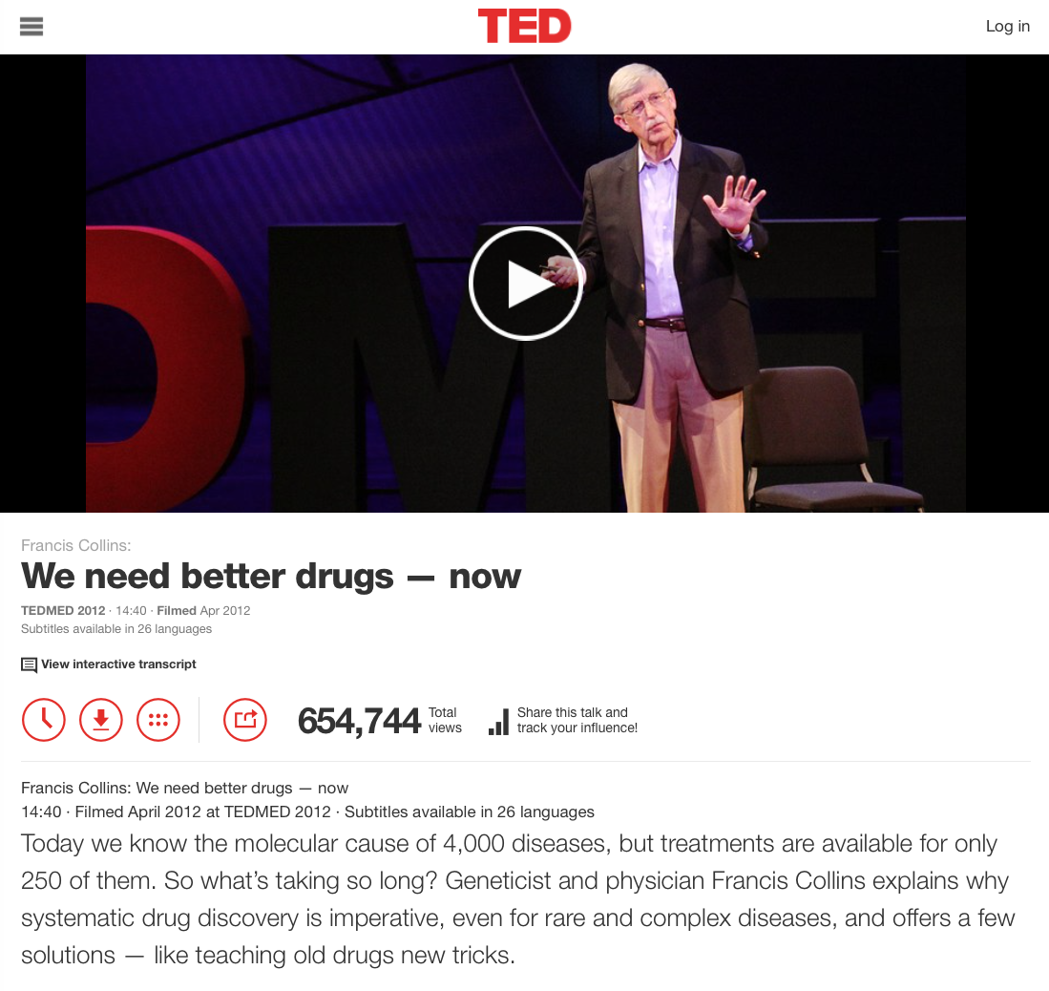
NIH Director: Francis Collins, M.D.
“We know the molecular cause of 4,000 diseases, but treatments are available for only 250.”
Retrieved January 5, 2015 from http://www.ted.com

Slide 26
I’m a Research Scientist…
What do the NCBI Genetics Databases include???

Slide 27
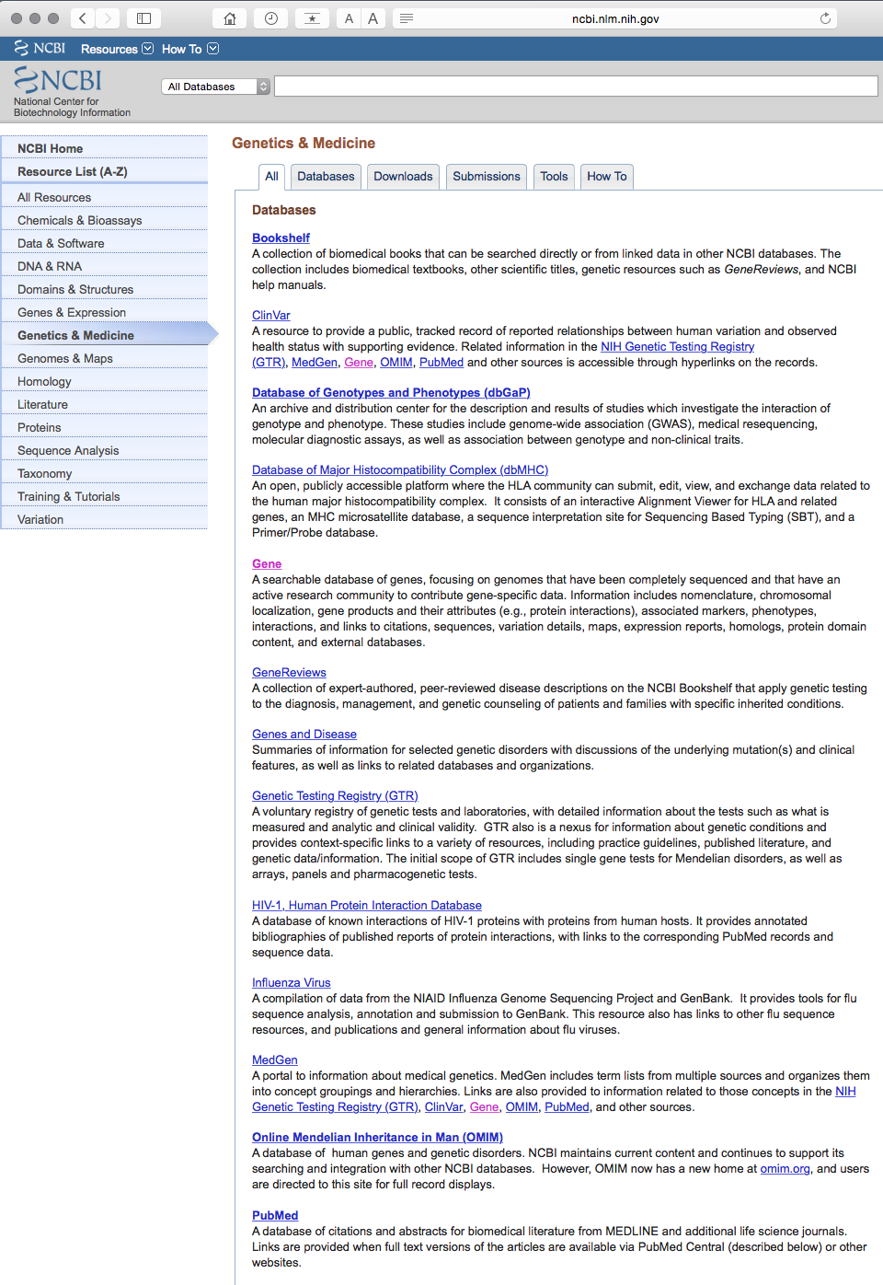
Growing Collection of Publicly Available Databases
www.ncbi.nlm.nih.gov

Slide 28
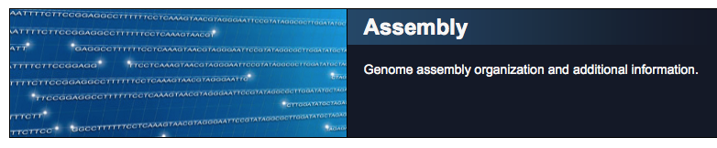
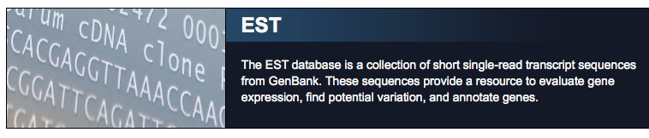
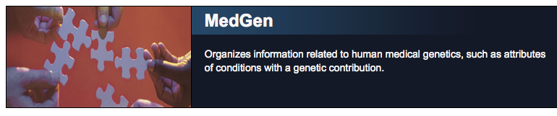
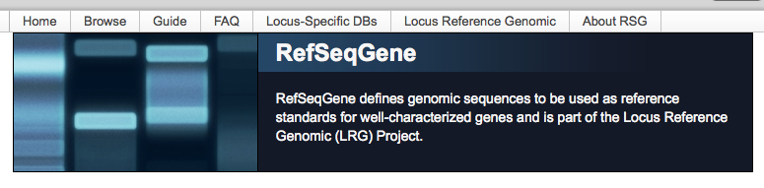

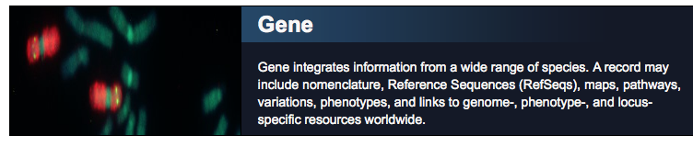
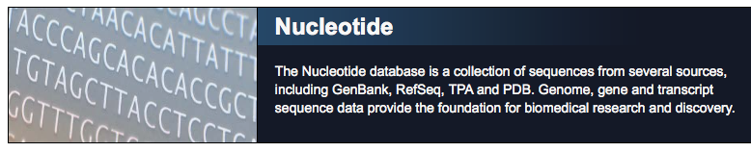
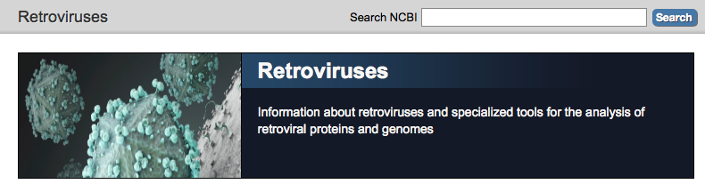
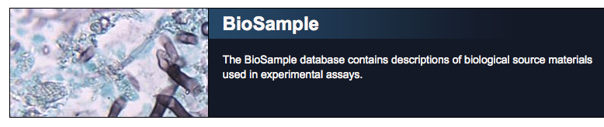
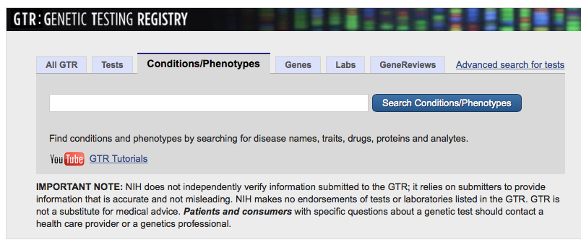
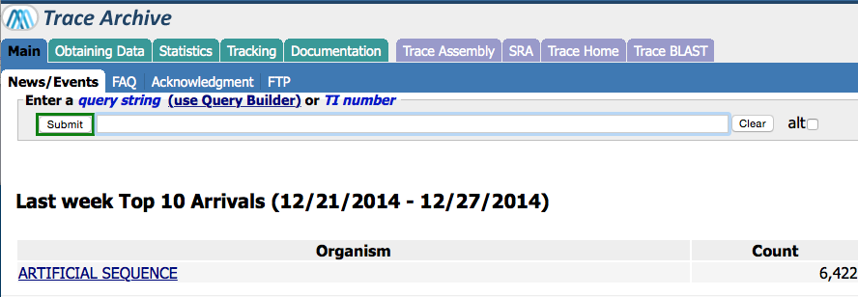

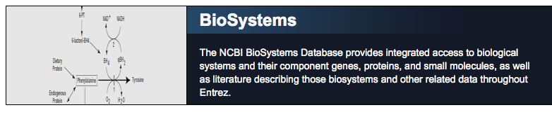
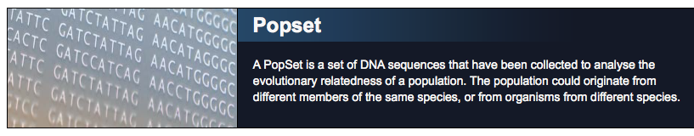

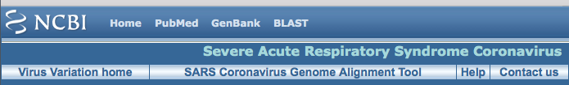

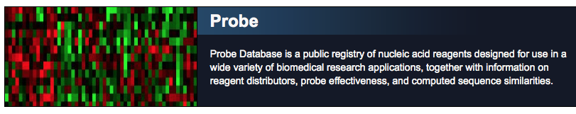
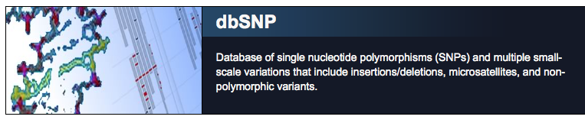
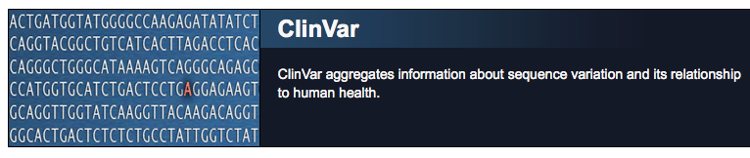
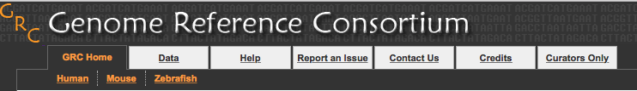
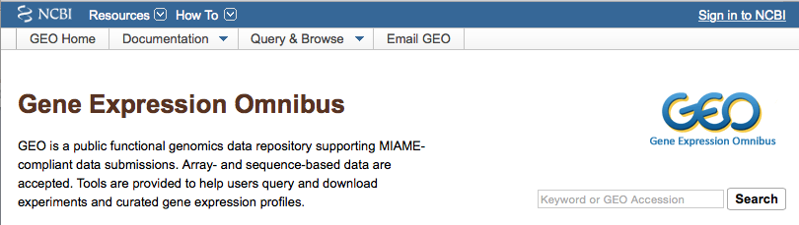
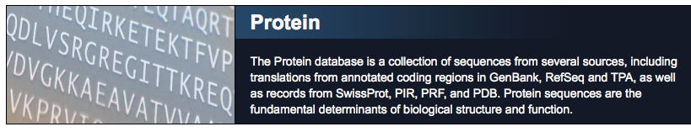
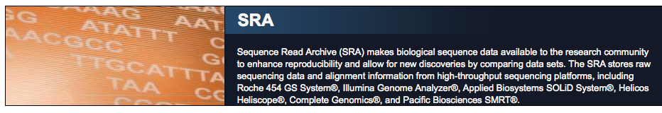
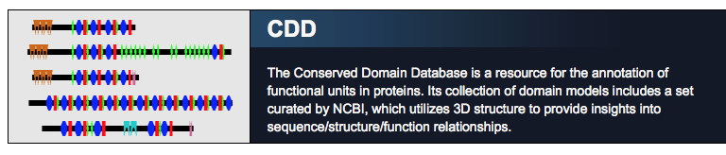
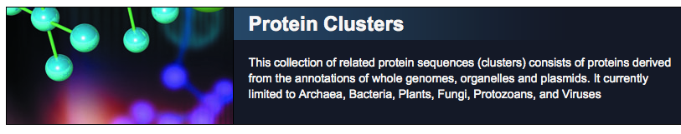
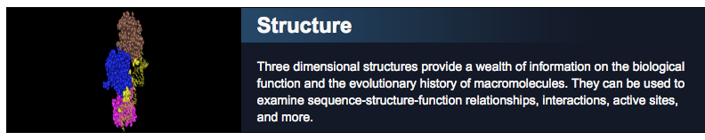
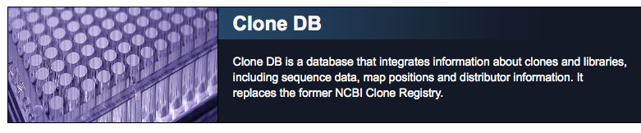
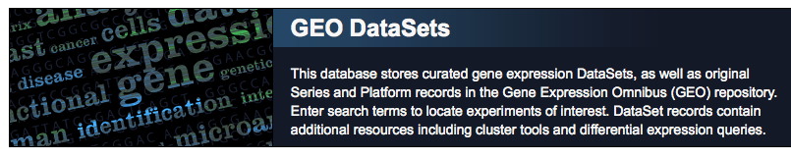
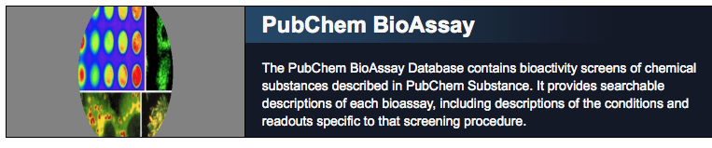
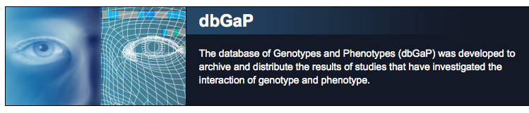
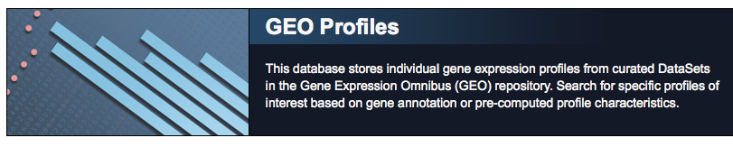
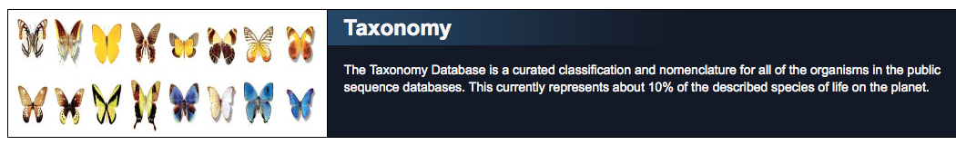
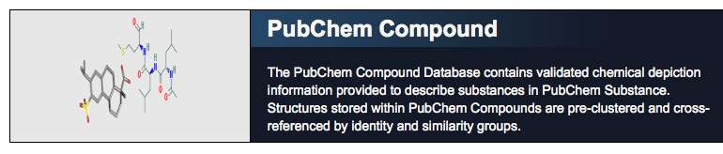
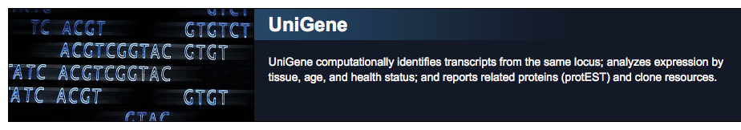
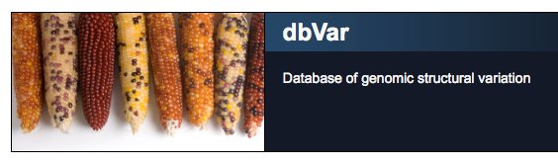









NCBI’s Molecular Biology Databases

Slide 29


Chemical and Bioassays

Slide 30


DNA and RNA

Slide 31


Domains and Structures

Slide 32


Genes and Expression

Slide 33


Genomes and Maps

Slide 34



Homology

Slide 35






Literature
Retrieved January 5, 2015 from www.nih.gov and www.nlm.nih.gov

Slide 36


Proteins

Slide 37

Sequence Analysis

Slide 38


Taxonomy

Slide 39



Variation

Slide 40


More Information
Database resources of the National Center for Biotechnology Information
Nucleic Acids Research. 2010 Jan;38(Database issue):D13-D25
PMID: 19910364
PMID: 19910364

Slide 41
How do I learn to search the NCBI Genetics Databases???

Slide 42

www.ncbi.nlm.nih.gov

Slide 43
What are some websites where I can learn more about genetics?

Slide 44

www.genome.gov

Slide 45


www.dnalc.org
includes

Slide 46

The Future of Medicine
diagnosis and treatment based on your genome!
Retrieved January 5, 2015 from http://www.genome.gov

Slide 47

We live in the age of information.
Retrieved January 5, 2015 from http://www.energy.gov

Slide 48




http://www.research.archives.gov
http://www.iipdigital.usembassy.gov
http://www.in.gov
http://www.nihrecord.nih.gov
http://www.directorsblog.nih.gov
http://www.blogs.america.gov
http://www.nichd.nih.gov
http://www.ncbi.nlm.nih.gov
All images retrieved January, 2015

Slide 49

Retrieved January 5, 2015 from http://www.nasa.gov

Slide 50
The End

