Slide 1
TTUHSC Preston Smith Library
presents
Searching PubMed®
NCBI, NLM Resources,
Micromedex -GSBS
Rev. 08/17/14

Slide 2
To begin...

Slide 3
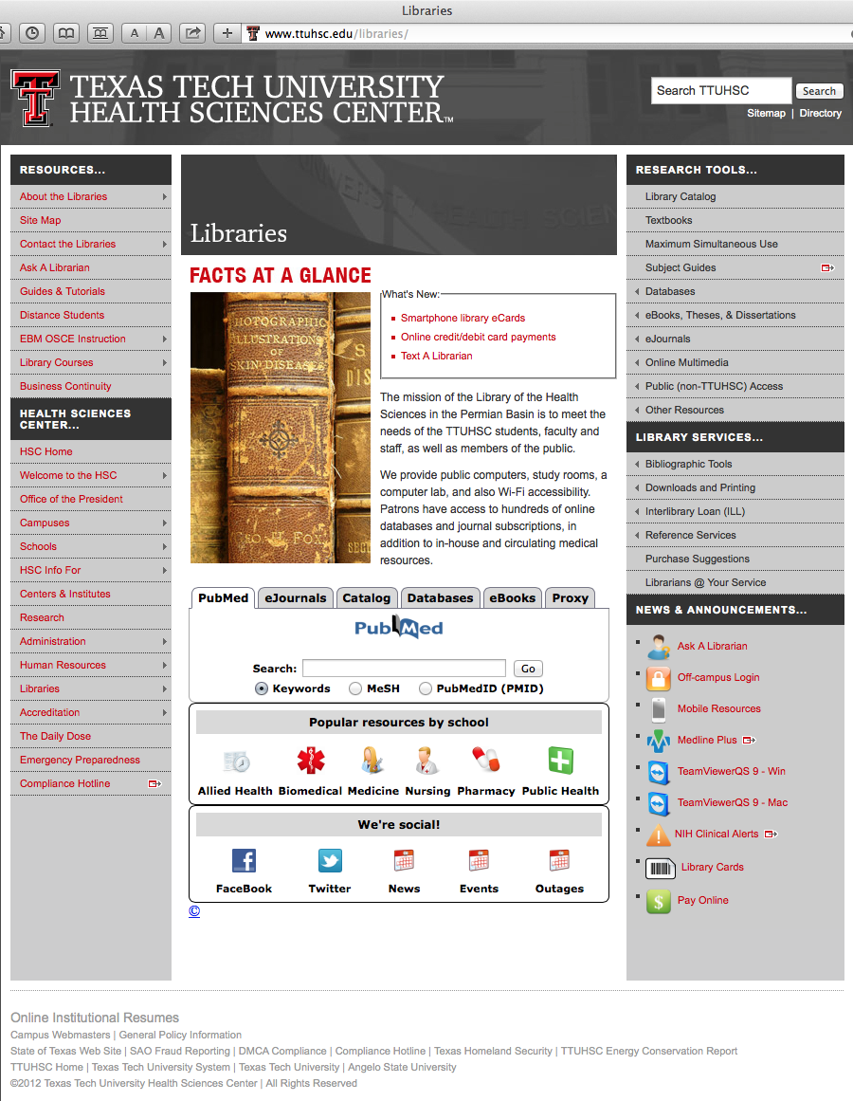
Hover mouse over Databases

Slide 4
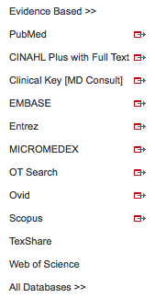
Click PubMed

Slide 5



PubMed Database
Biomedical & life sciences journal literature - @6,000 journals
International scope
Developed and maintained by the:
National Center for Biotechnology Information
    at the U.S. National Library of Medicine
    at the National Institutes of Health

Slide 6

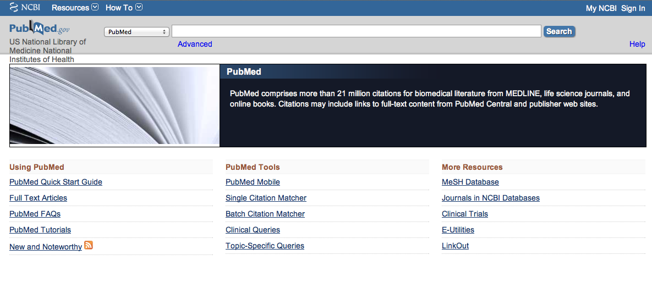
Accessing PubMed
Freely available over the Internet
@ www.pubmed.gov
Also through library’s home page

Slide 7
Create a Search Strategy Plan
Identify the question and key concepts:
In the CFTR gene, how does
sequence deletion impact protein structure
and nucleotide metabolism?
Write the search program using
medical subject headings (MeSH)

Slide 8
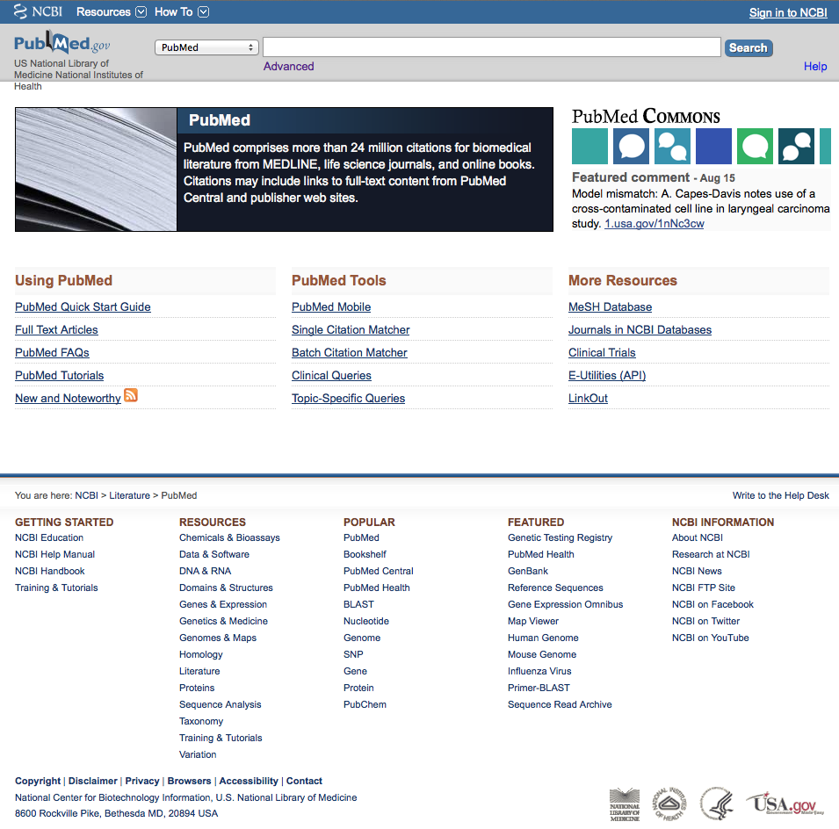
PubMed Home Page

Slide 9
Gene Sensor

Slide 10
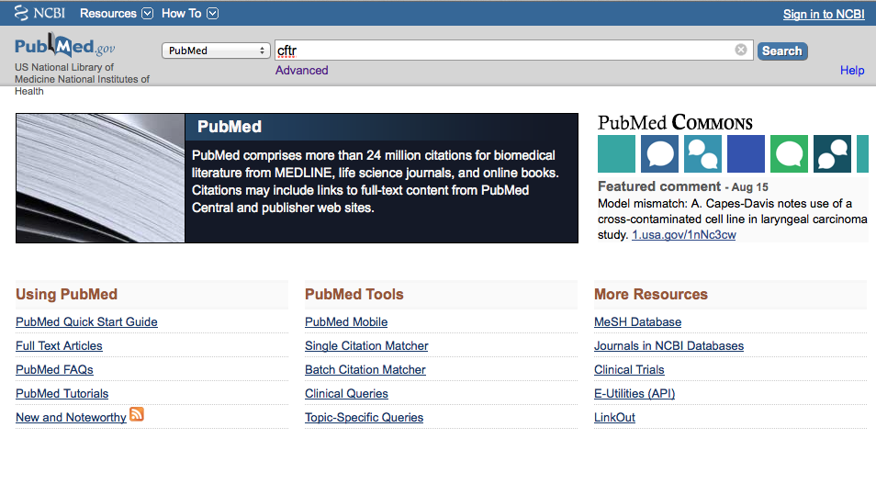
a
a
Enter
cftr
and click
Search

Slide 11
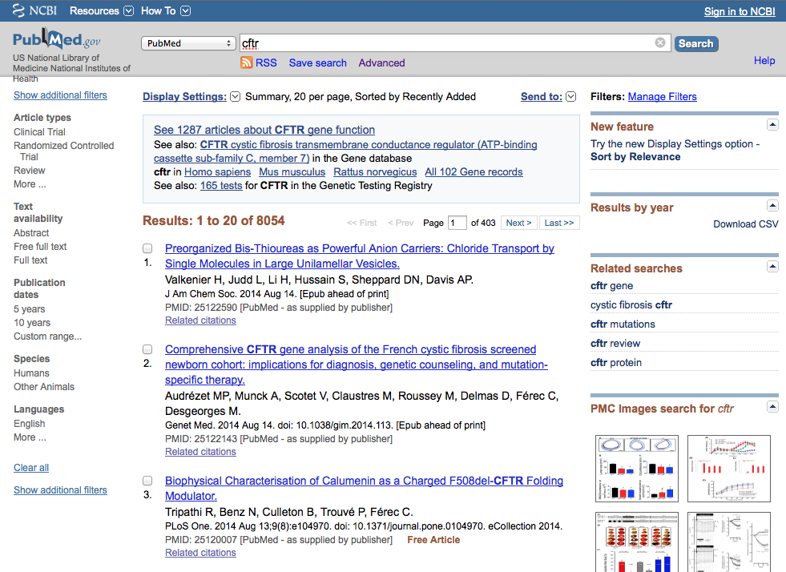
Gene Sensor
Click See 1287 articles about CFTR gene function

Slide 12

Click the PubMed icon

Slide 13
Using MeSH Database

Slide 14
MeSH Database
is a “controlled vocabulary list” of more than
25,000 subject headings.
Terms in the database are called
Medical Subject Headings or MeSH.
The 10-15 MeSH assigned to each article
in PubMed is like a keyword abstract
of the article.

Slide 15
Click MeSH Database

Slide 16
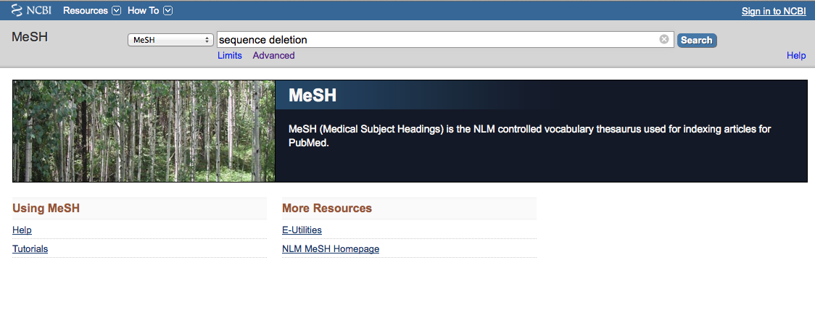
a
a
Enter
and click
Search
sequence deletion
(Note: If there is a Boolean OR
relationship, start with the
“OR” statement first.)

Slide 17
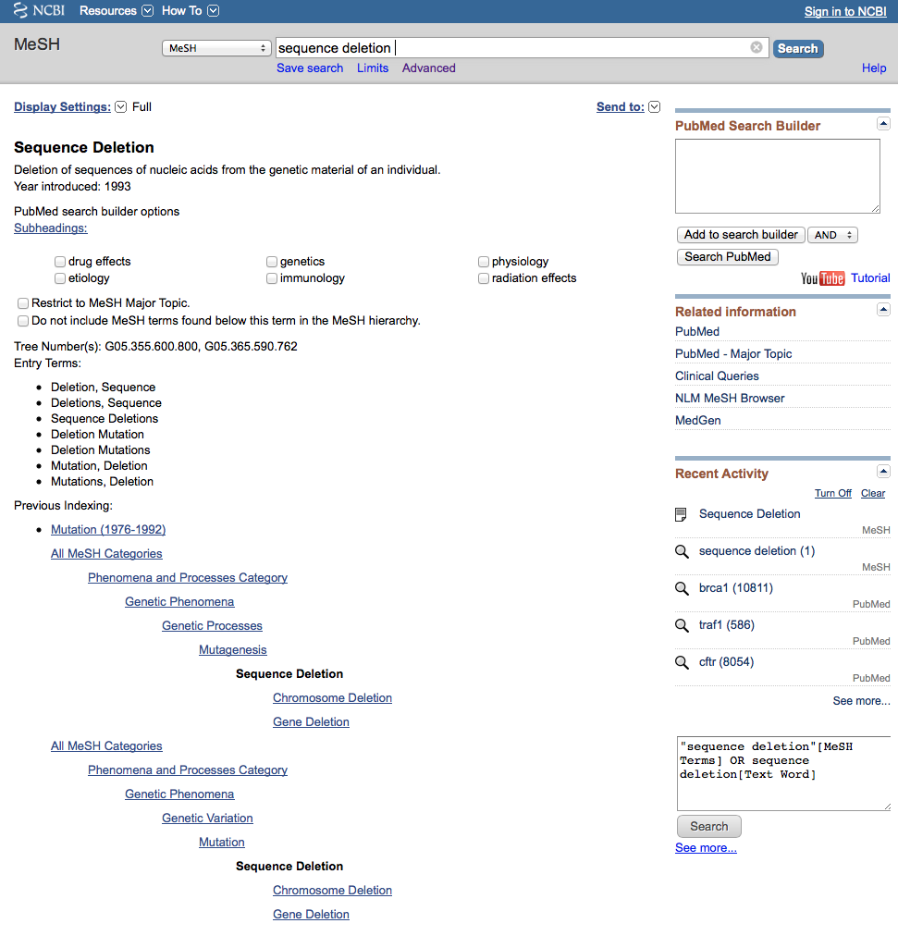
Term Definition

Slide 18
MeSH
terms arranged in
tree structure hierarchy
Terms are listed from
broadest to narrowest.
If Sequence Deletion
yields zero results, try using a
broader term: Mutagenesis.

Slide 19
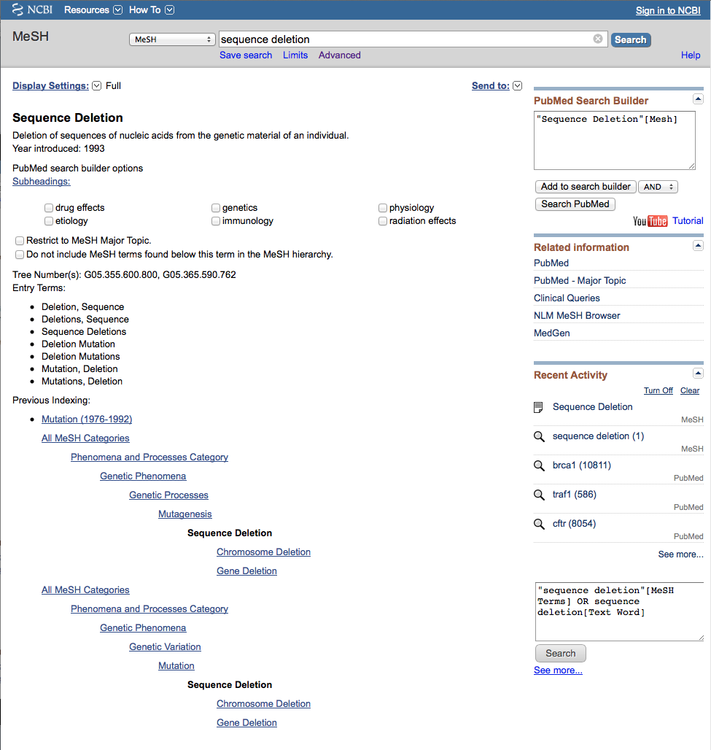
Click
Add to search builder

Slide 20
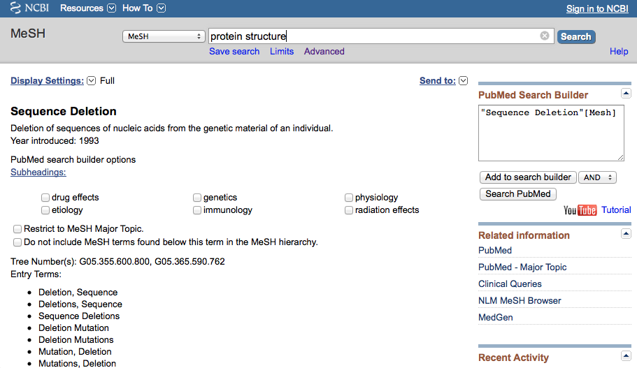
a
Enter
protein structure
and click
Search

Slide 21
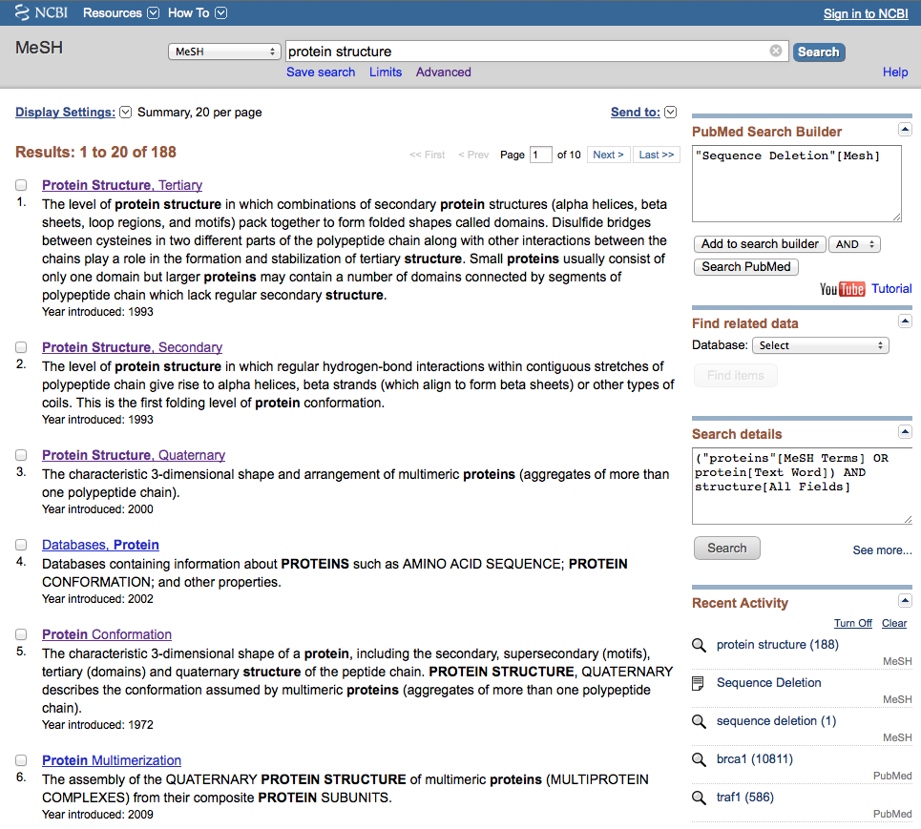
Click the underlined term

Slide 22
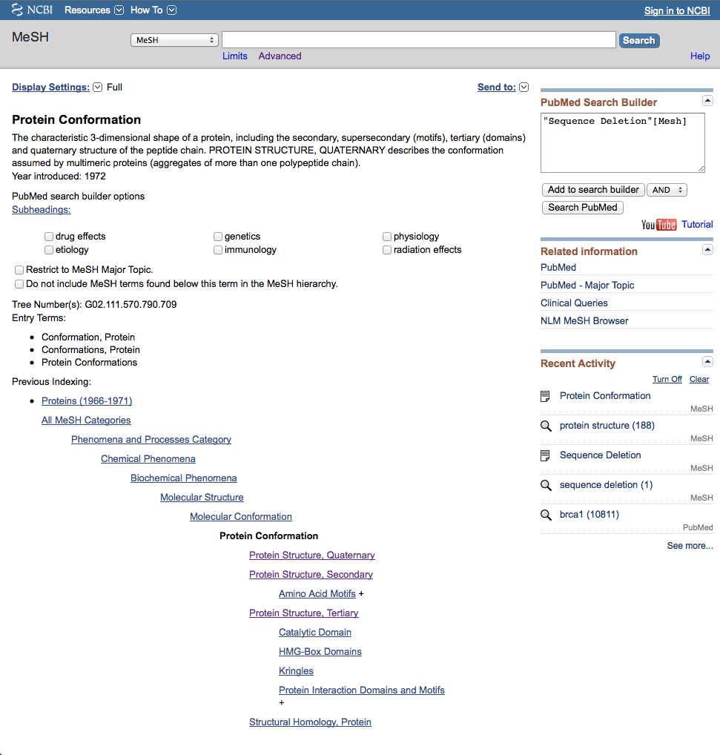
Note:
PubMed automatically
OR’s indented terms
under a broader term…

Slide 23
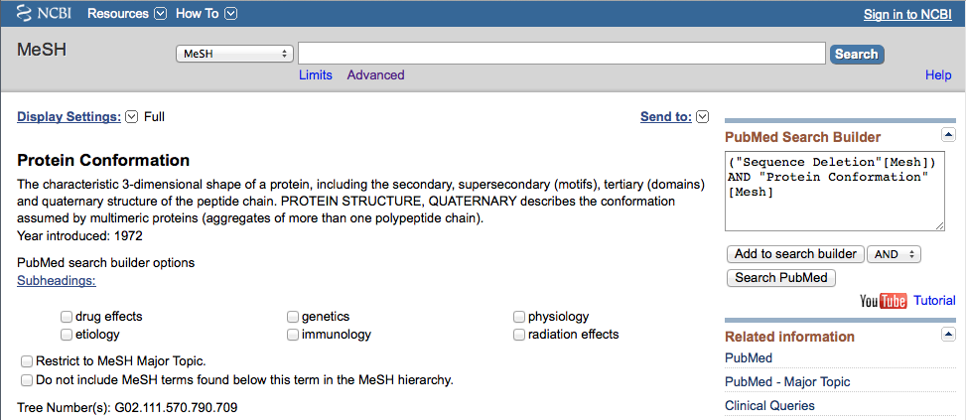
Click
Add to search builder

Slide 24
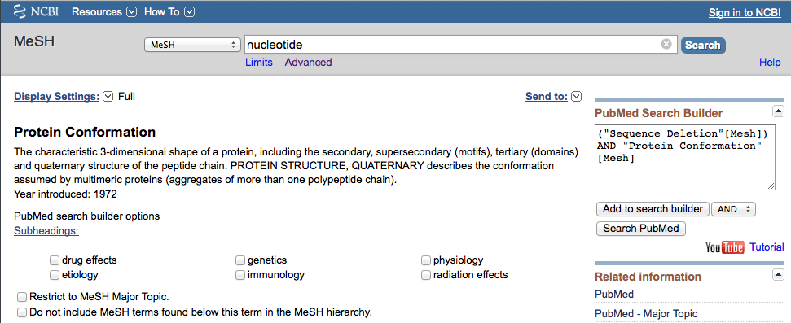
a
Enter
nucleotide
and click
Search

Slide 25
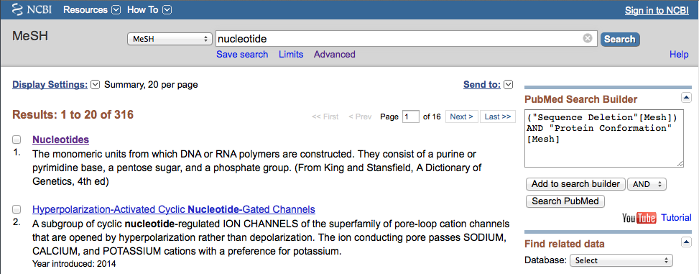
Click the underlined term

Slide 26
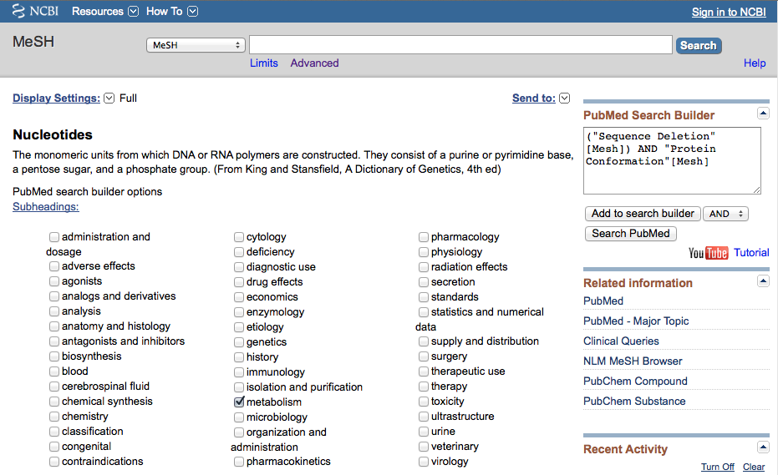
Sub-headings narrow the “meaning” of a
MeSH term.
They are a “subset” of all the
articles under the MeSH term: Nucleotides.

Slide 27
2)Then click
Add to search builder
✔
✔
1) Check the box next
to the subheadinga

Slide 28
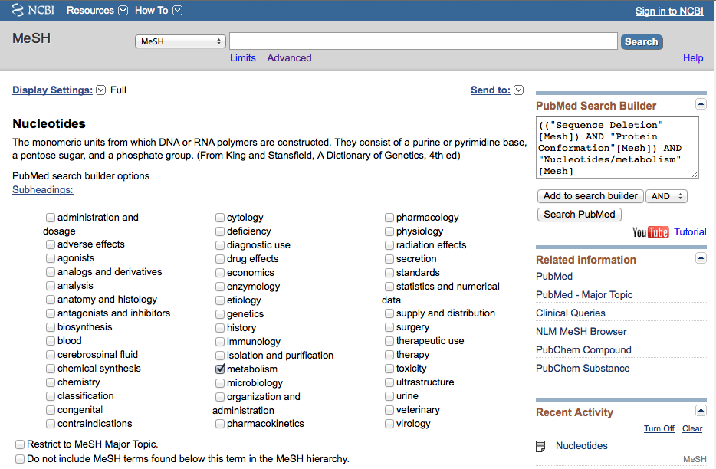
Click
Search PubMed

Slide 29
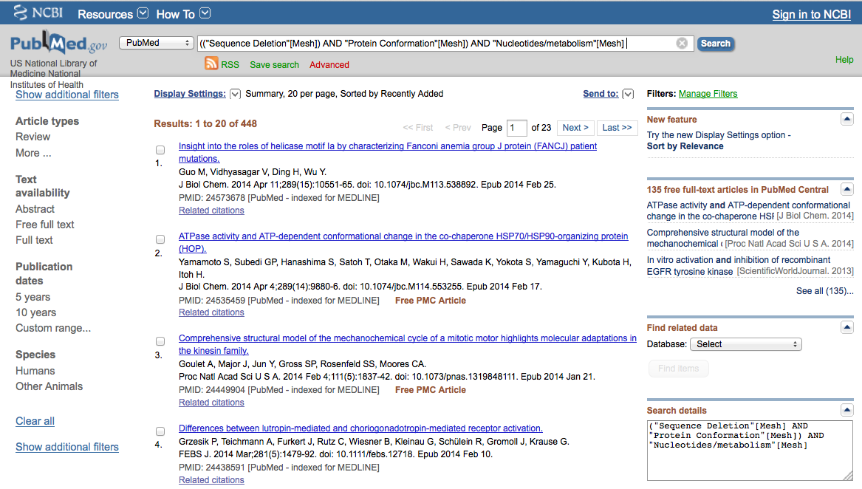
Click Advanced

Slide 30
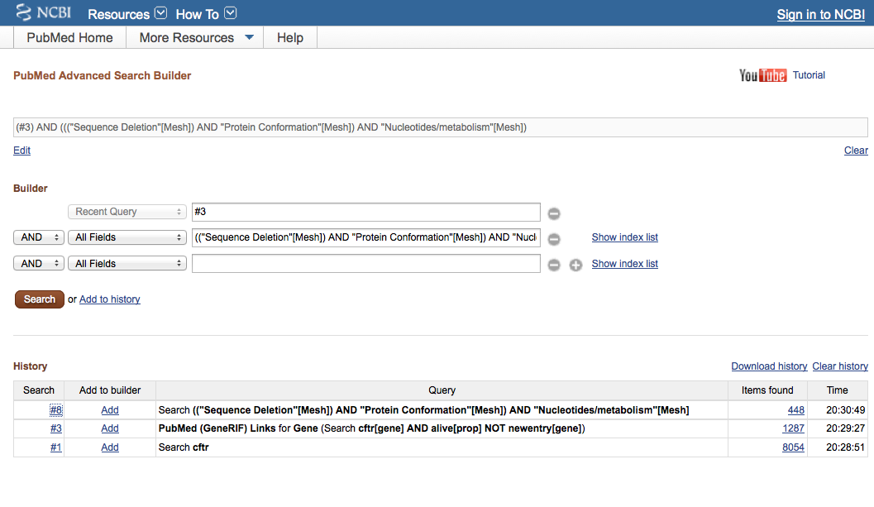
Click
Search
Click Add next to the set for
PubMed (GeneRIF) Links for Gene (Search cftr[gene]…
and the set for
Search ((“Sequence Deletion”[Mesh]) AND “Protein Conformation”…

Slide 31
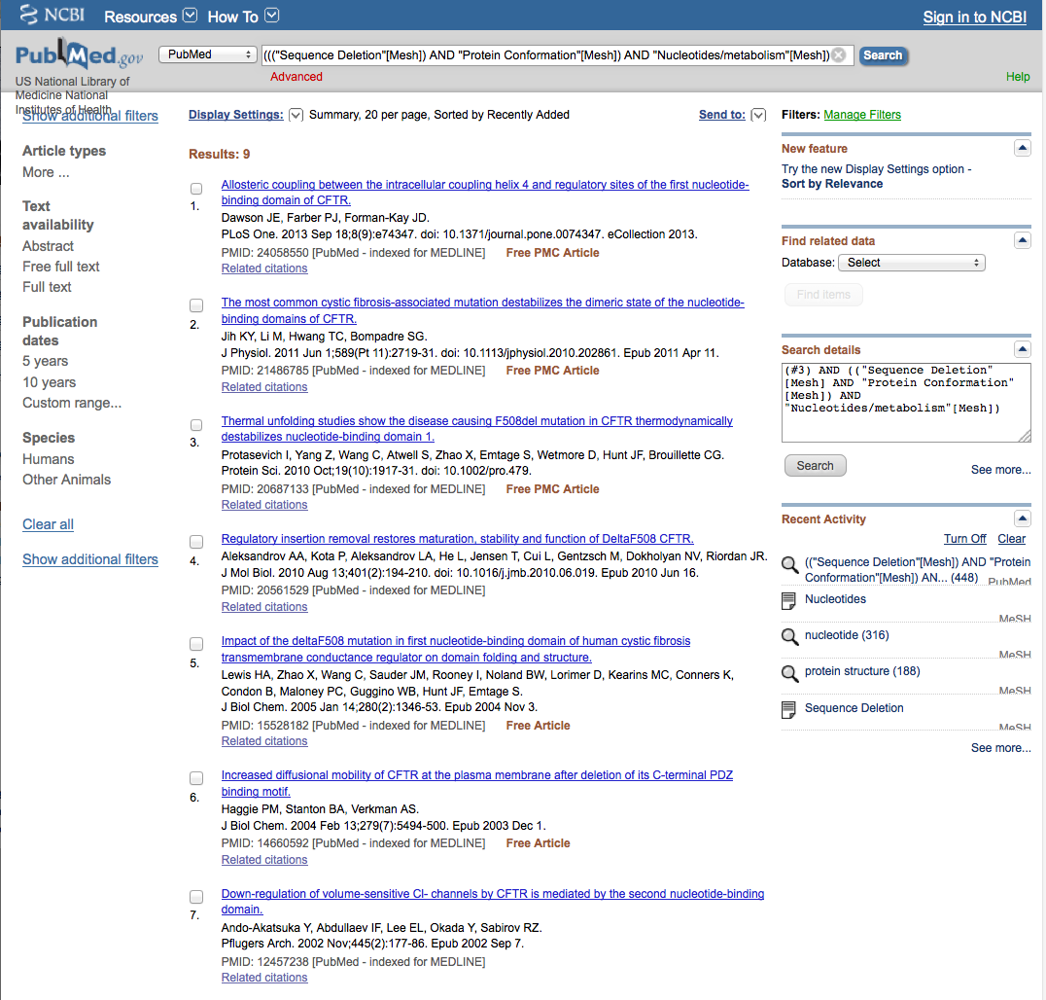
PubMed identifies
9 articles

Slide 32
Search Results

Slide 33
Limiting Filters

Slide 34
X
Select article #2.

Slide 35
Click Display Settings

Slide 36
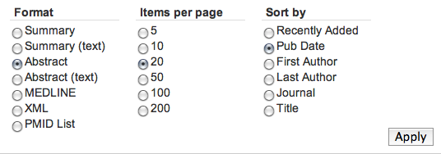
Select Abstract,
change to Pub Date to
sort to most recent articles appearing first,
then click
Apply

Slide 37
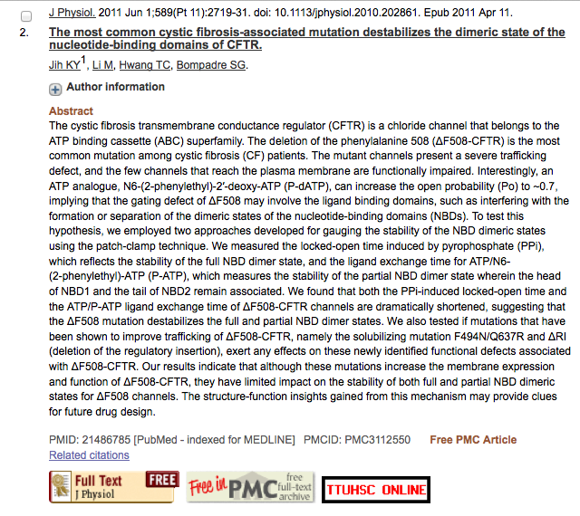
Icons for full text.

Slide 38
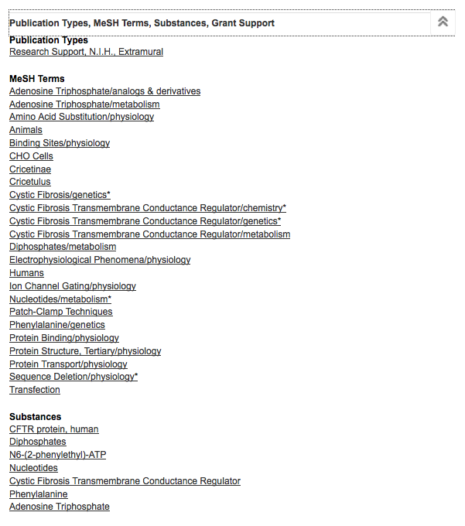
Click for MeSH terms.
∨∨

Slide 39
MeSH Database
searches only
the MeSH terms for:
sequence deletion
AND
protein structure
AND
nucleotides/metabolism

Slide 40
Look at subject headings
in the
MeSH Terms Index
for additional terms.
You may want to
write a new search
program using:
Protein Binding

Slide 41
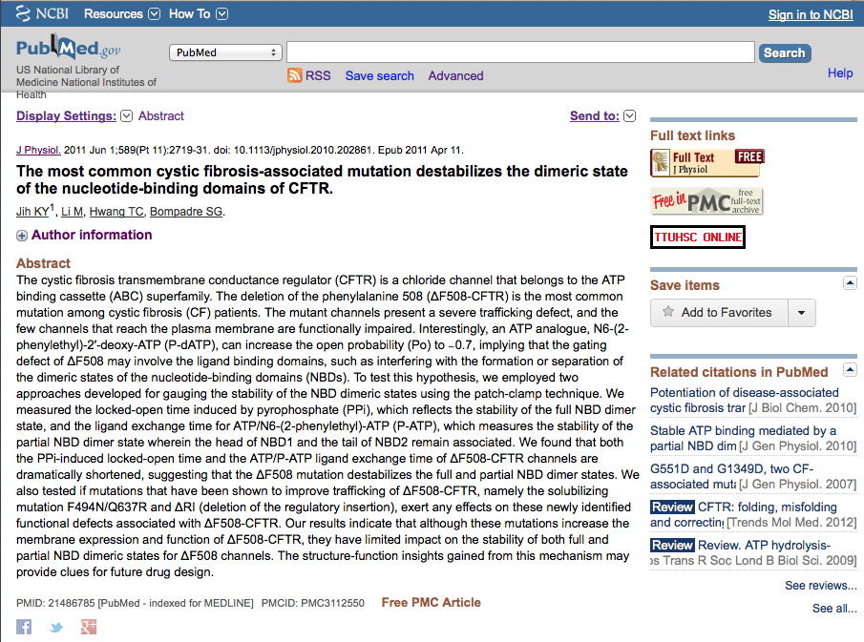
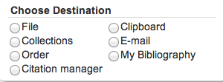
.
Click Send to: and select
File to save citations to a file on your computer or
Clipboard to temporarily store selected citations or
E-mail to send citations to self or colleague

Slide 42
Linking to
Full-Text Articles
in Electronic Journals

Slide 43
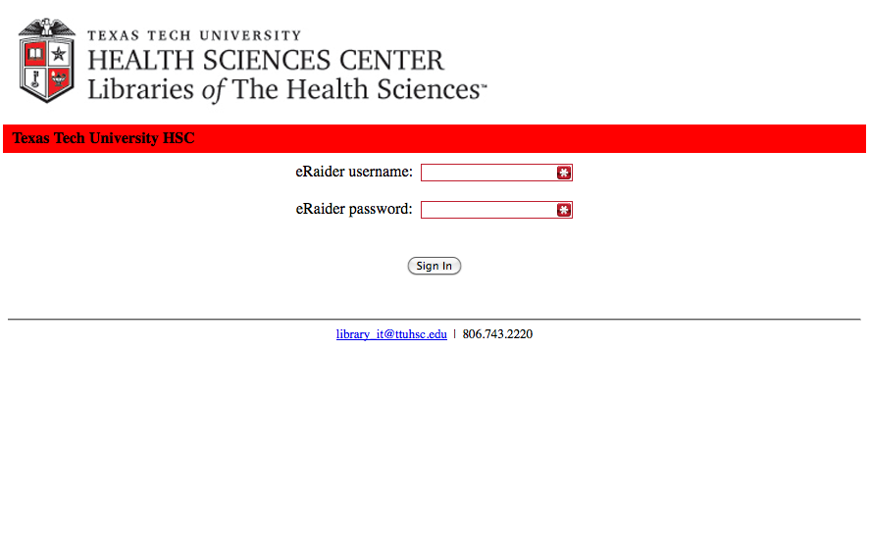
When Searching from Off Campus:
Enter the
Eraider username and password
assigned to you
by Information Services.
A
Problems with eRaider? Call: 806-743-1234 a

Slide 44
Icons for full text.

Slide 45
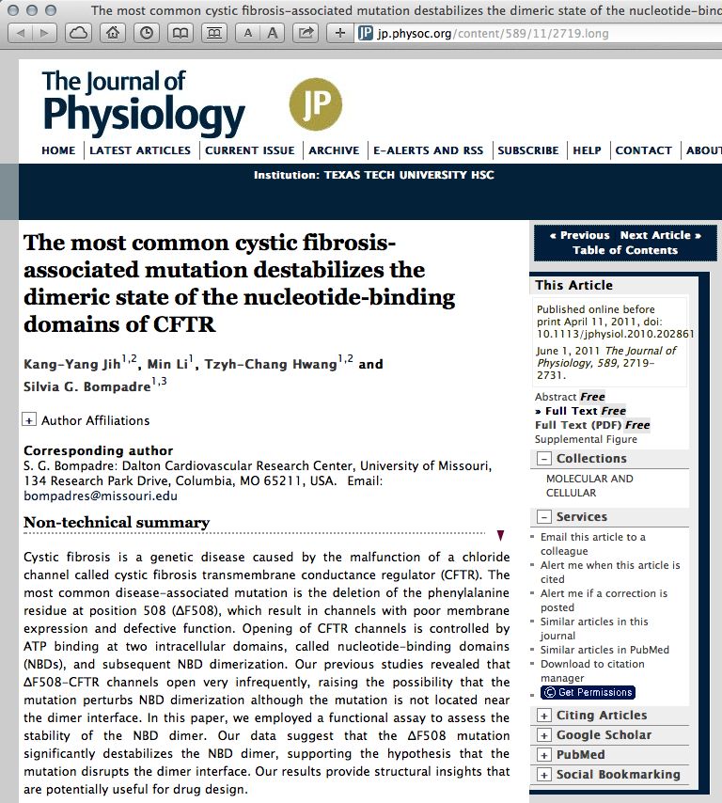
Click PDF

Slide 46
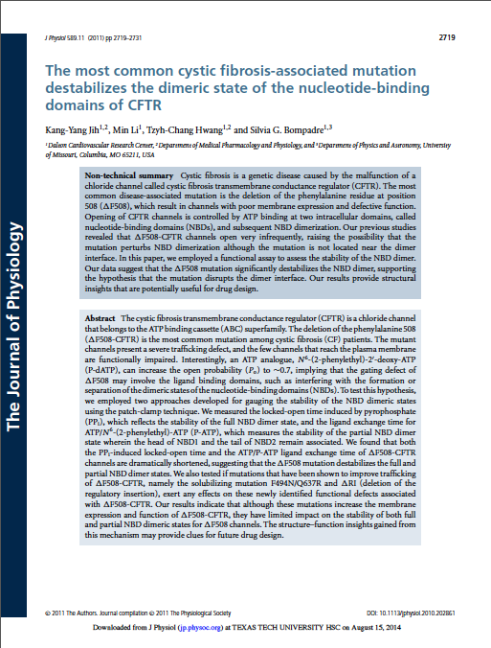
Full Text Article
Close Article

Slide 47
Online Tutorial

Slide 48
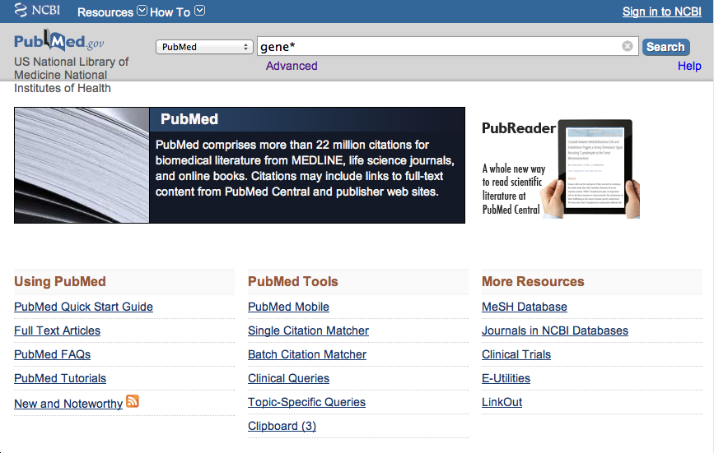
Click Training & Tutorials for hands-on learning.

Slide 49
NCBI

Slide 50
National Center for Biotechnology Information
Mission:
create automated systems
store and analyze information
molecular biology
biochemistry
genetics
facilitate use of databases by the research and medical community

Slide 51
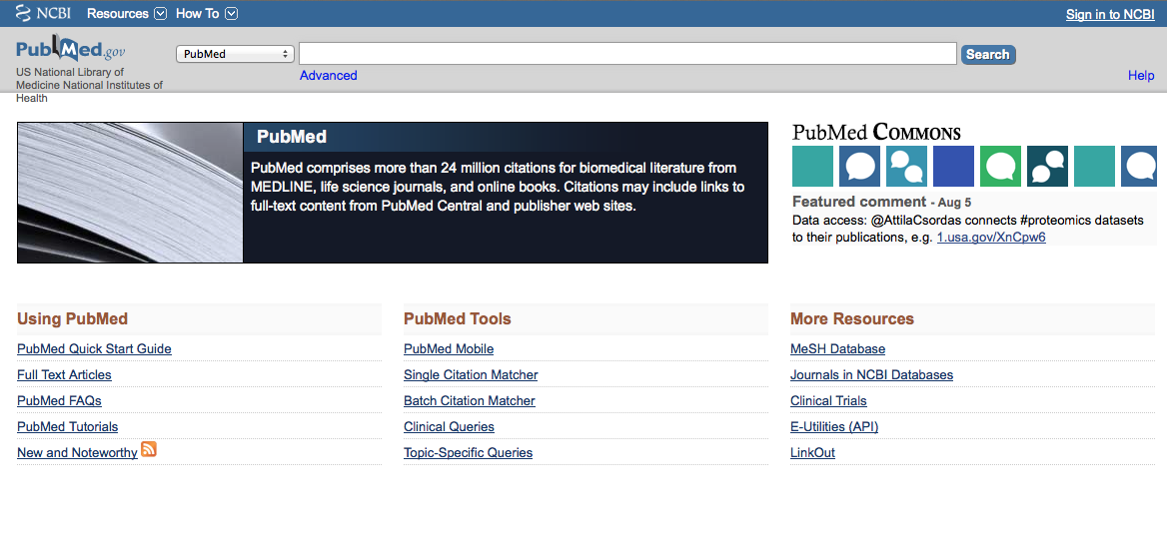
Click DNA Helix to go
to the NCBI databases

Slide 52
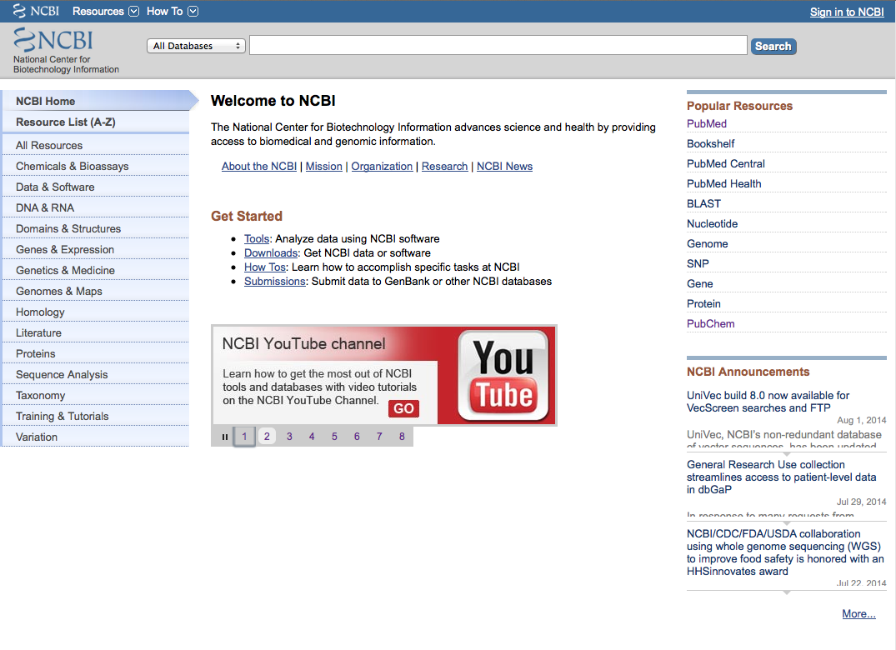

Slide 53
National Center for Biotechnology Information Databases
Assembly
BioProject
BioSample
BioSystems
ClinVar
CloneDB
Conserved Domain Database
Database of Genomic Structural Variation
Database of Genotypes and Phenotypes
Epigenomics
EST (short single-read transcript sequences)
Gene
Genome
GEO Datasets
GEO Profiles
GSS (short single-read transcript sequences)
HomoloGene
Nucleotide Database
Online Mendelian Inheritance in Man
PopSet
Probe
Protein Database
RefSeqGene
Reference Sequence (RefSeq)
Sequence Read Archive
SNP
Structure (Molecular Modeling Database)
Taxonomy
UniGene

Slide 54
Gene

Slide 55
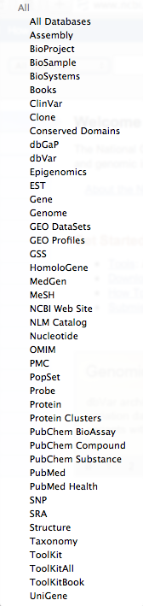
Select Gene

Slide 56
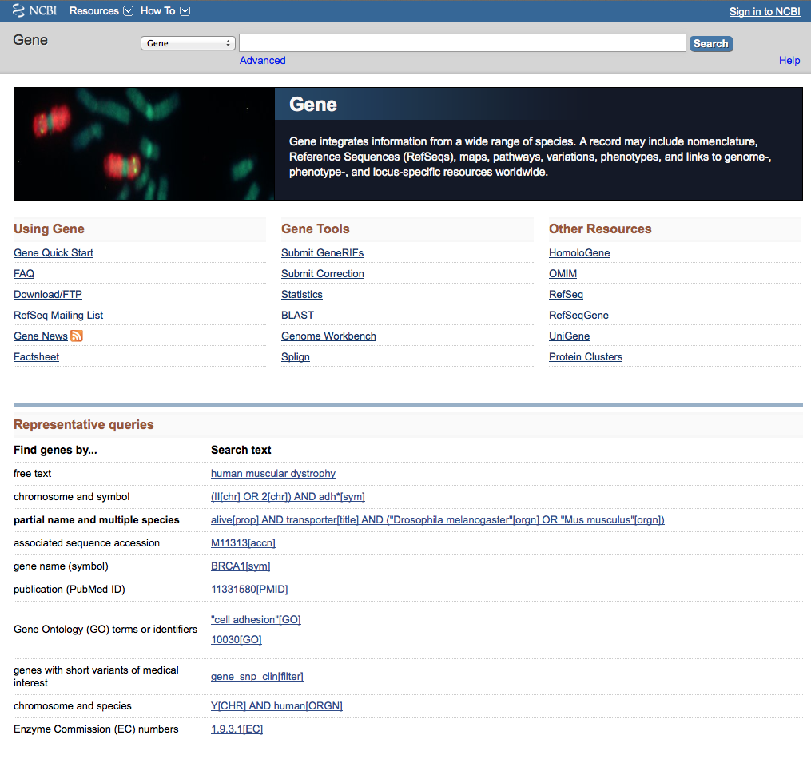
Search CFTR

Slide 57
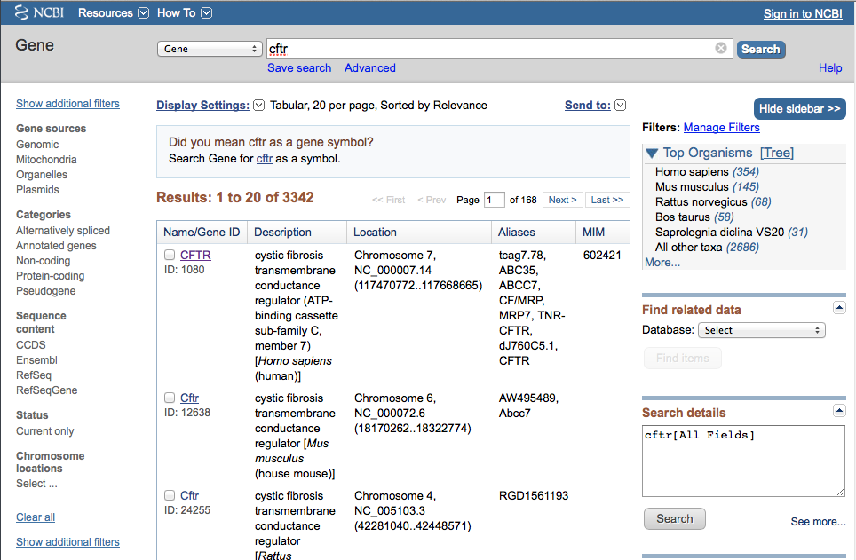
Click

Slide 58
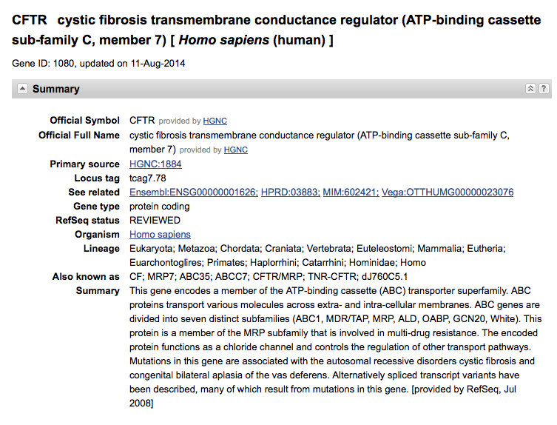

Slide 59
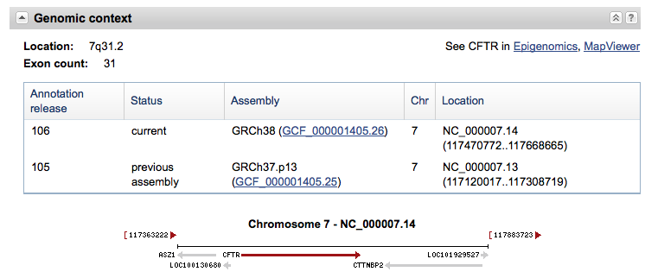

Slide 60
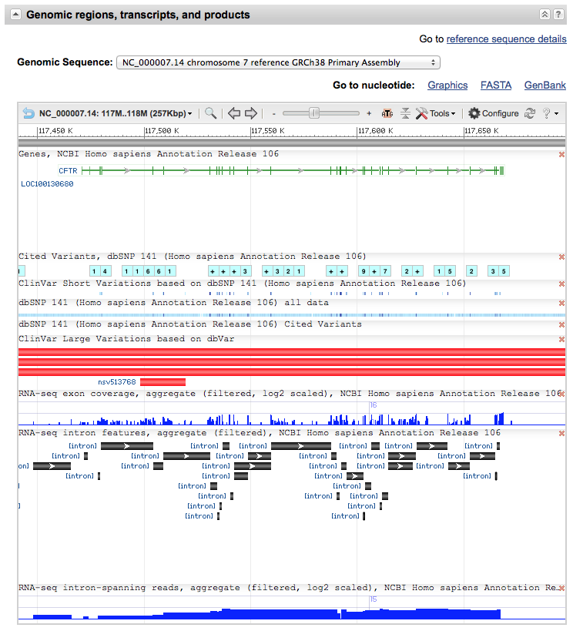

Slide 61
Protein

Slide 62
Select Protein

Slide 63
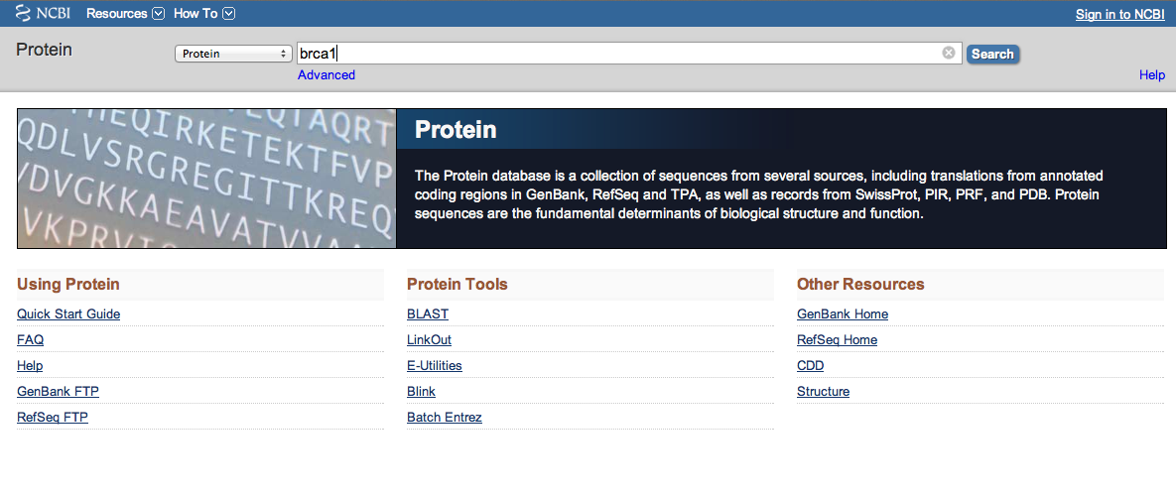
Search brca1

Slide 64
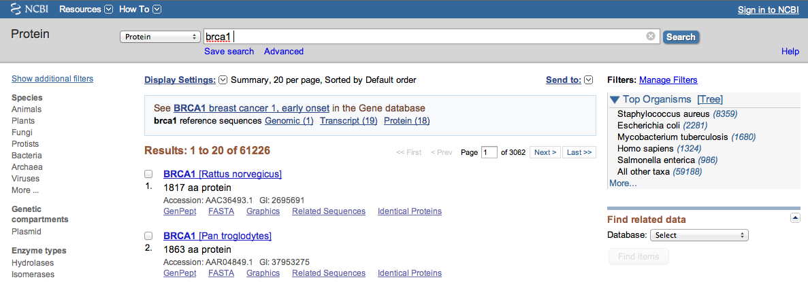
Click Homo sapiens (1324)

Slide 65
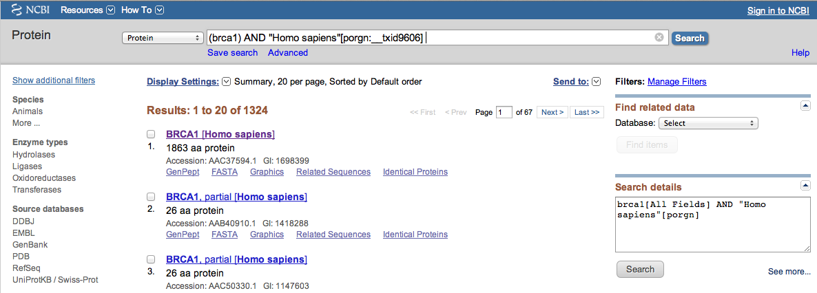
Click BRCA1 Homo sapiens

Slide 66
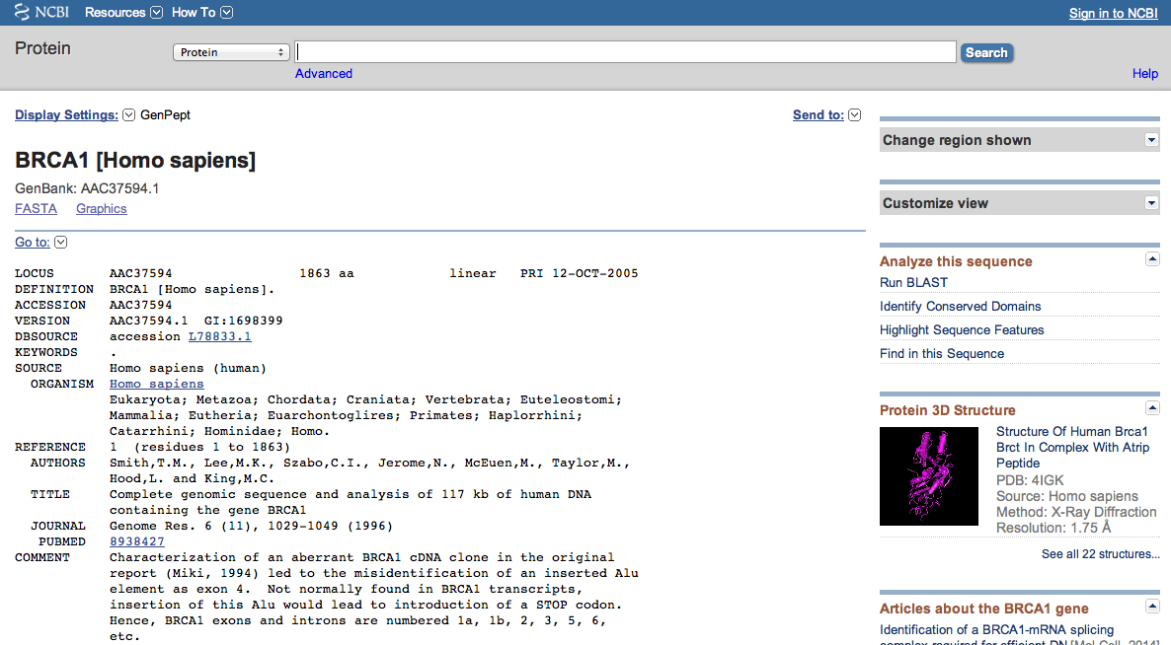
Sequence Data

Slide 67
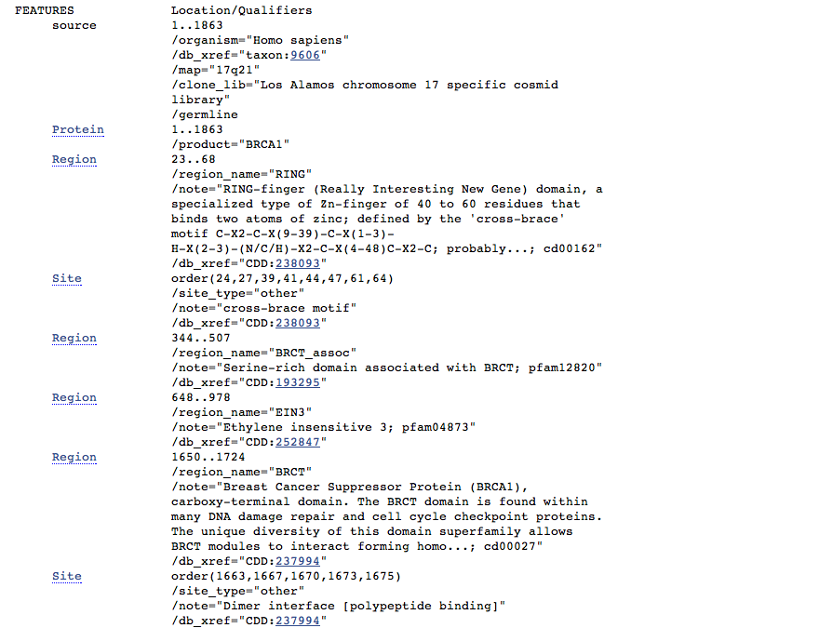

Slide 68
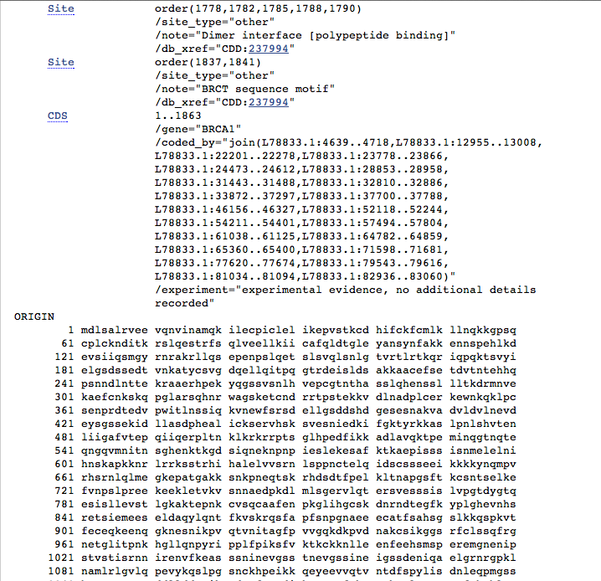

Slide 69
Structure

Slide 70
Select Structure

Slide 71
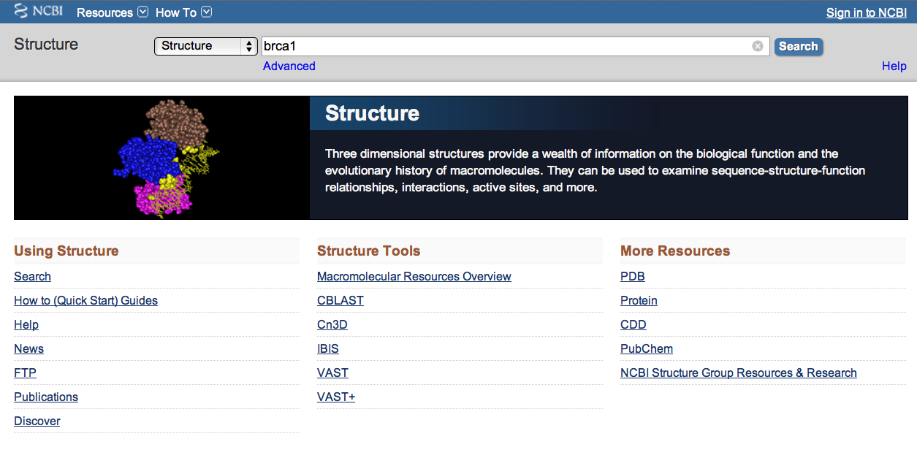
Search brca1

Slide 72
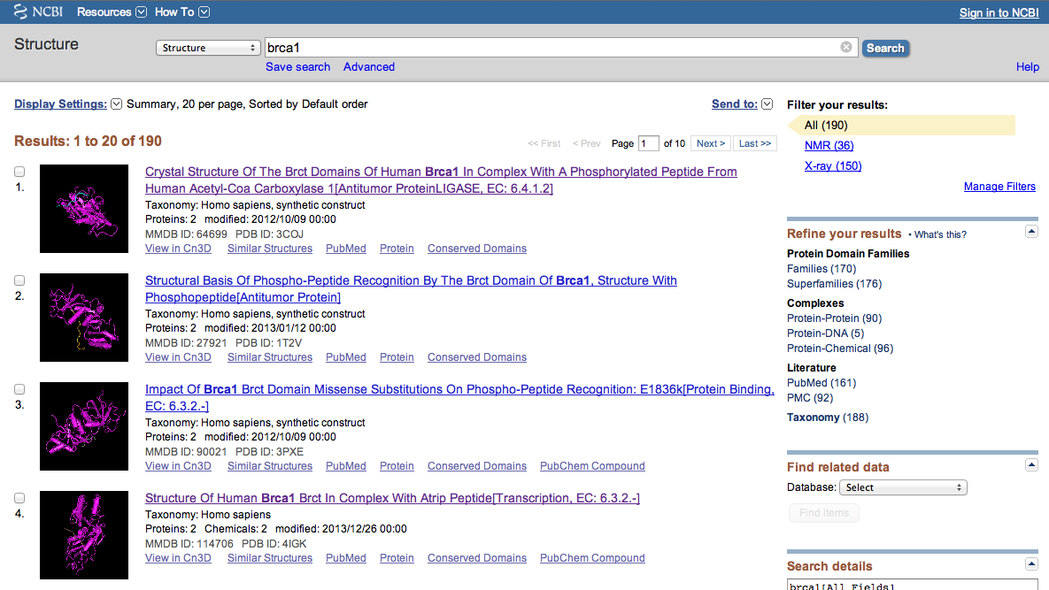
Click structure

Slide 73
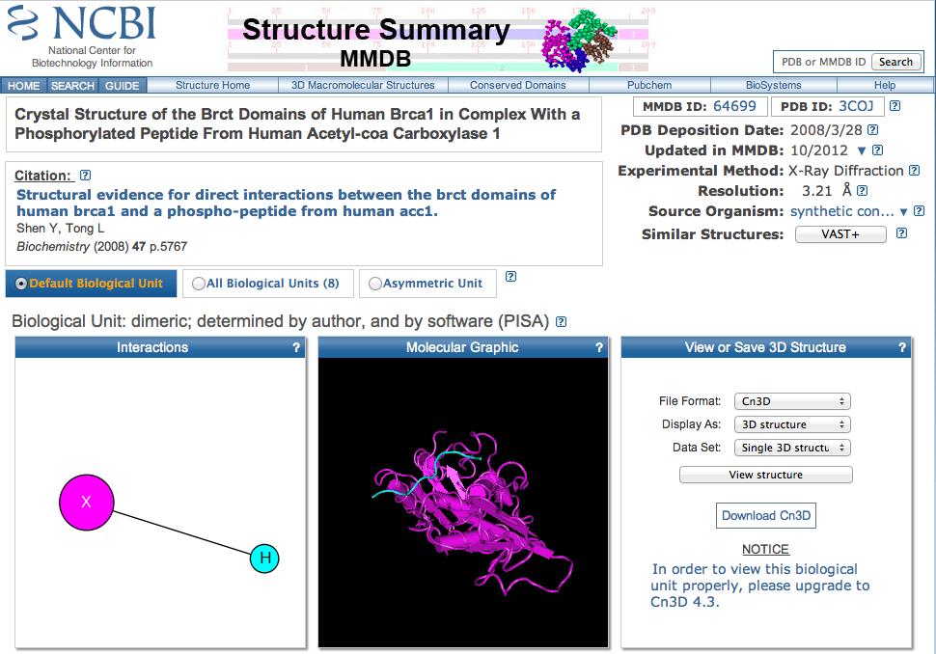
View, zoom, highlight in 3D

Slide 74
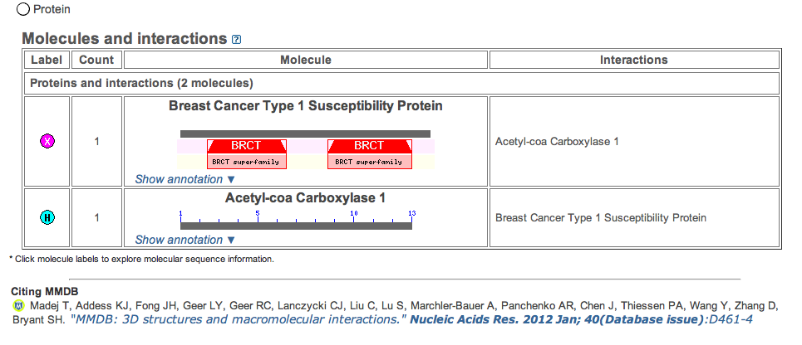
Proteins and interactions

Slide 75
Nucleotide

Slide 76
Select Nucleotide

Slide 77
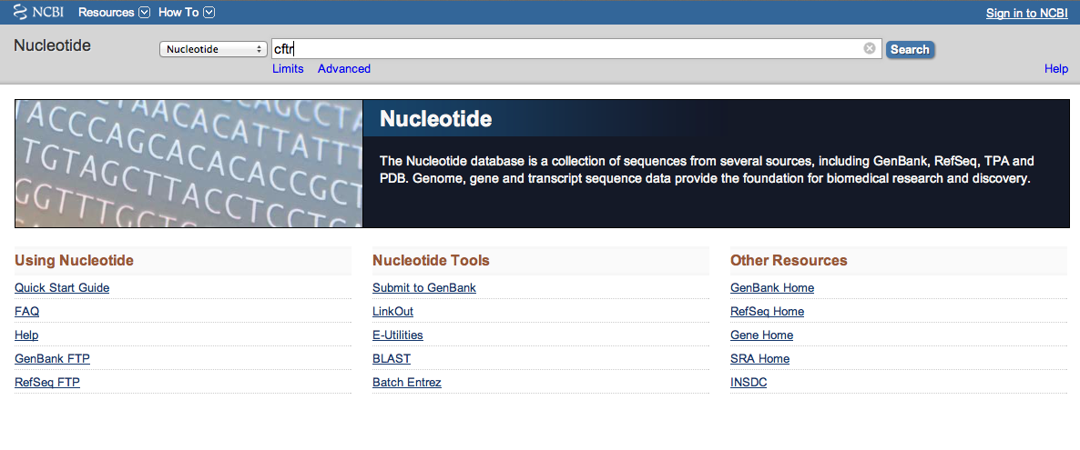
Search CFTR

Slide 78
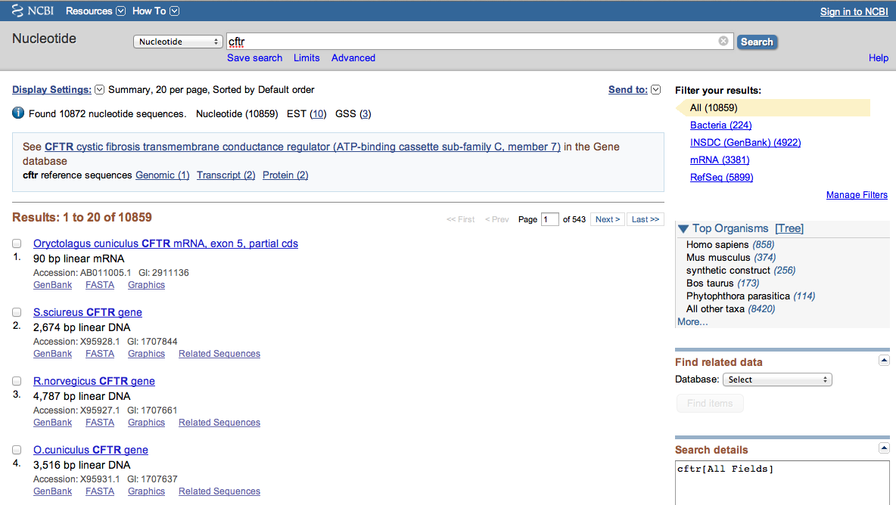
Click Homo sapiens (858)

Slide 79
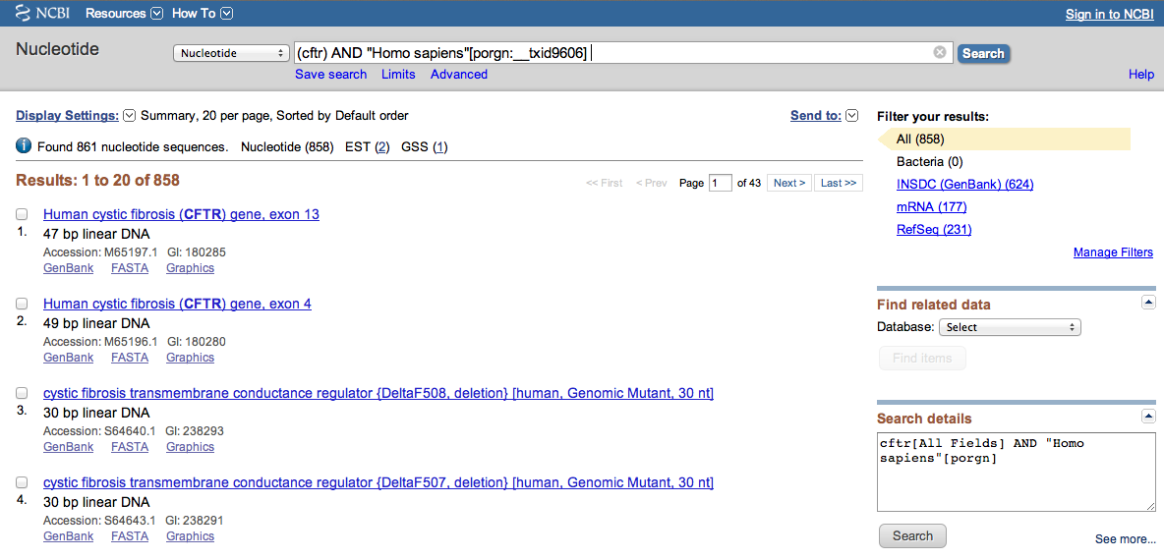
Select deletion

Slide 80

Sequence Data
Click graphics

Slide 81

Graphical Sequence Data

Slide 82
dbSNP

Slide 83

Click Advanced

Slide 84

Search

Slide 85

5 variants with sensitivity to Warfarin

Slide 86
Other NLM Databases

Slide 87

www.ttuhsc.edu/libraries
Click Databases

Slide 88


Click “N”
Scroll and click National Library of Medicine

Slide 89

Click All NLM Databases & API’s

Slide 90

Locate and Click Database Name

Slide 91


Slide 92


MICROMEDEX
Authoritative drug information
Entire US National Formulary

Slide 93


www.ttuhsc.edu/libraries
Mouse over Databases
Click MicroMedex

Slide 94

warfarin
Begin entering drug name.
Select correct drug.

Slide 95

Select links or detailed document

Slide 96

Drug Monograph

Slide 97

Select Drug Interactions
Special Tools
A

Slide 98

Interactions table includes:

Slide 99




MICROMEDEX – drug identification

Slide 100




MICROMEDEX: also includes
Diseases & Acute Care
Toxicology & Product Info
Alternative Medicines
Patient Education

Slide 101
The End
Aug 2014

