Slide 1
Welcome
The Preston Smith Library of the Health Sciences
Margaret Vugrin, MSLS

Slide 2
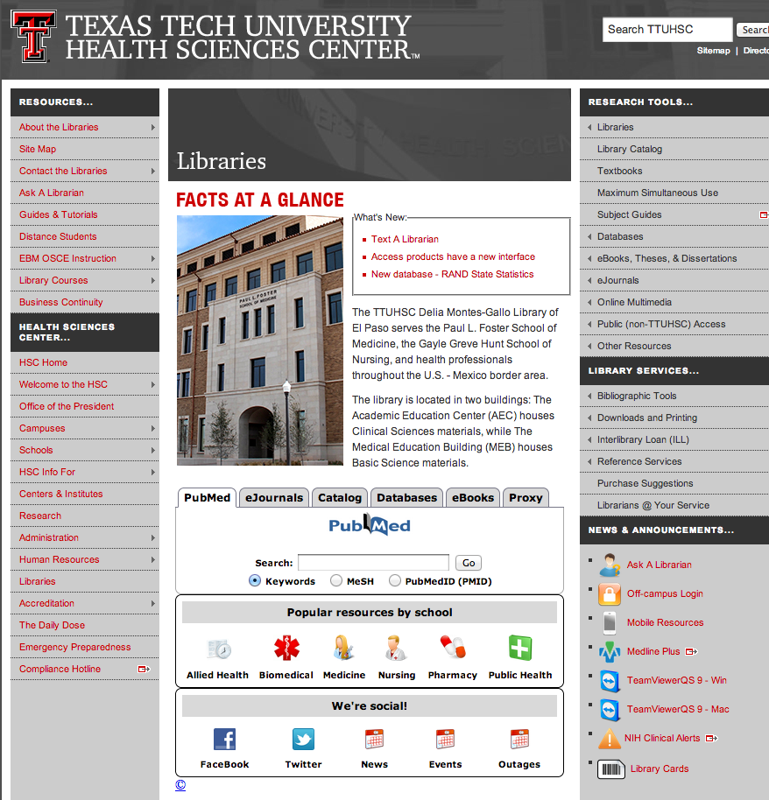
http://www.ttuhsc.edu/libraries

Slide 3
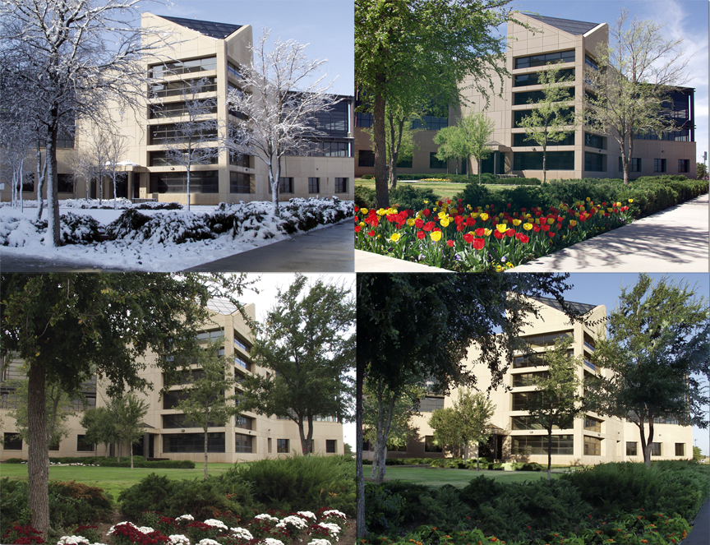
3601 4th just West of the main TTUHSC buildings and in front of E1 Parking Lot
Where?

Slide 4
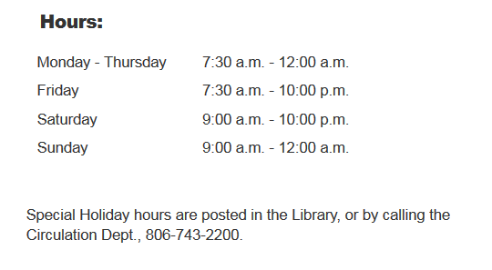
Library Hours
Phone: 806-743-2200
Ask for Reference Librarian
Holiday hours and early closings are also posted as announcements in your e-Raider portal.

Slide 5
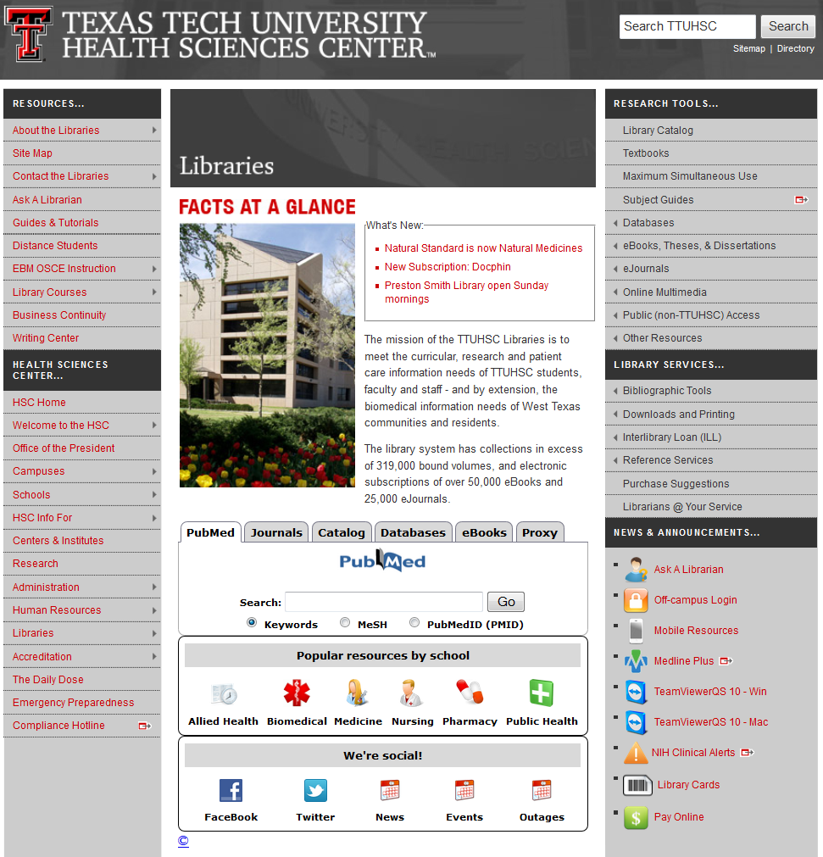
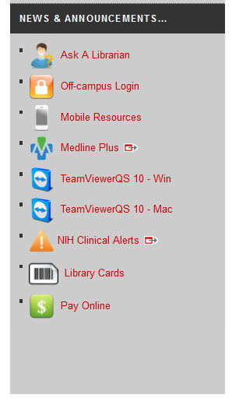
LiBRARY CARDS

Slide 6
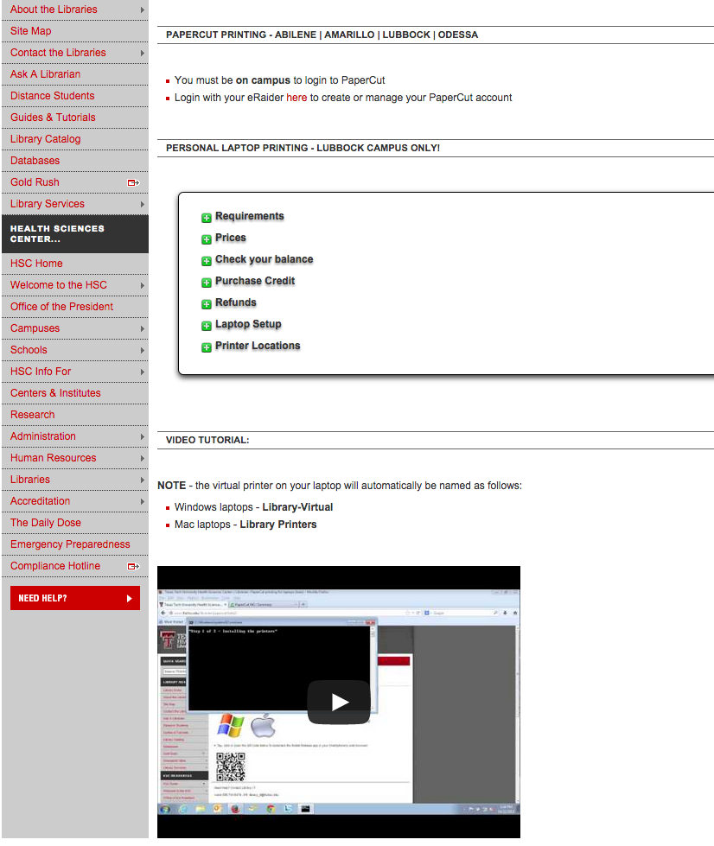
LiBRARY CARDS

Slide 7
LiBRARY CARDS

Slide 8
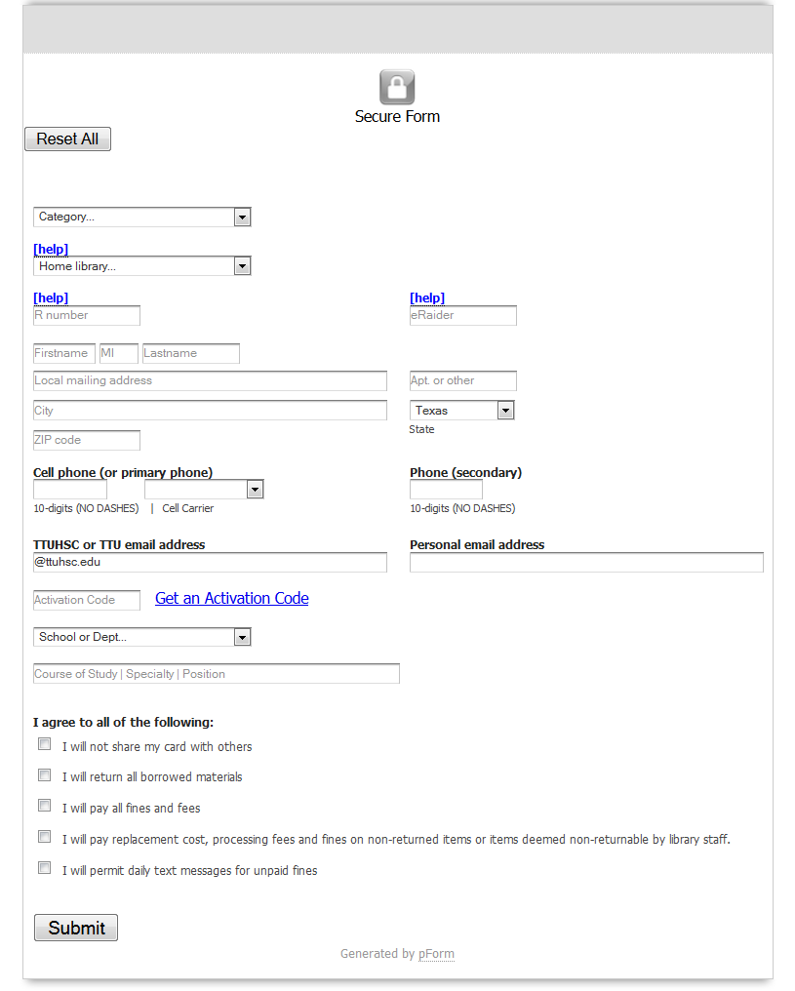
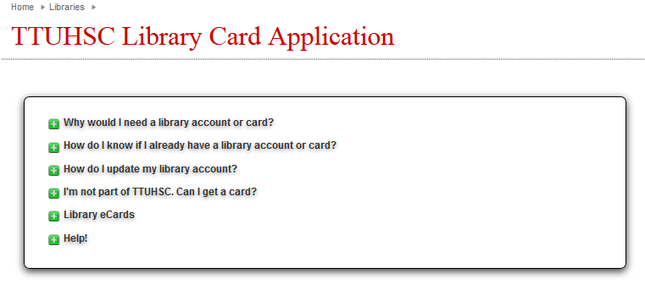

Slide 9
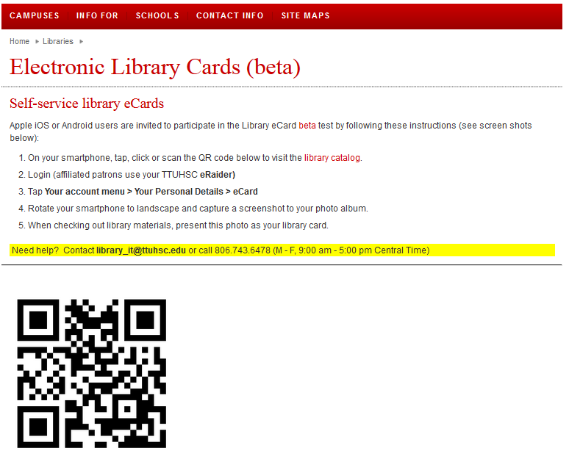


Slide 10


TTUHSC libraries statistics
eBooks are now
searchable in the Catalog
There are libraries at all four campuses
(Amarillo, El Paso, Lubbock & Odessa)
321,952 print books
209 print journal subscriptions
17,691 audiovisuals
24,439 electronic journals*
574 databases
62,963 electronic books
As of April 24, 2015

Slide 11
Check out & Finesibrary Policies
Books/Audiovisuals/Journals:
Checkout period for books is two weeks, audiovisuals for 10 days.
May renew items twice in person, over the phone (806-742-2200), or online through the library catalog.
Journals in the print collection can be scanned but not checked out.
Fines for overdue items:
50 cents per day per item
Library privileges are lost until fines are paid.

Slide 12
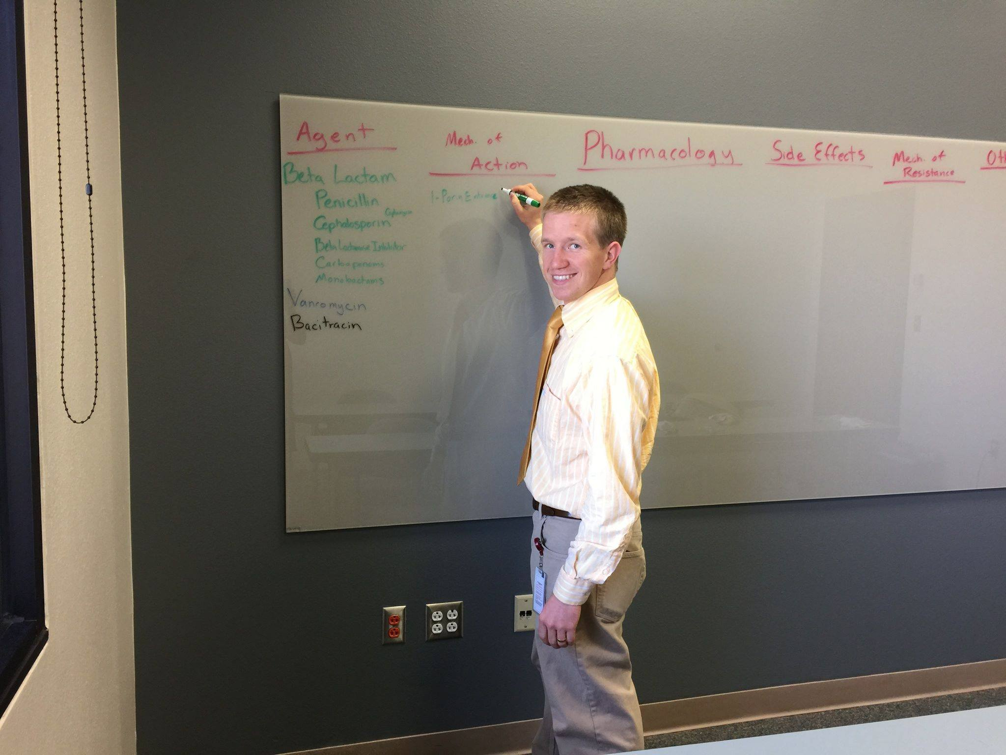
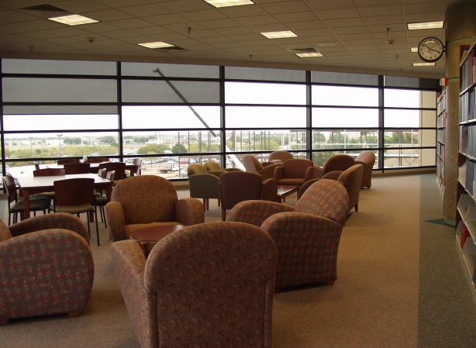

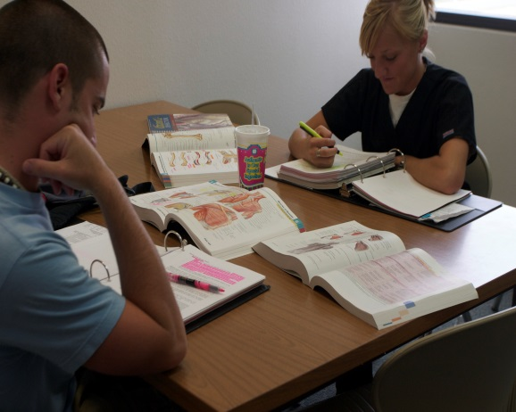
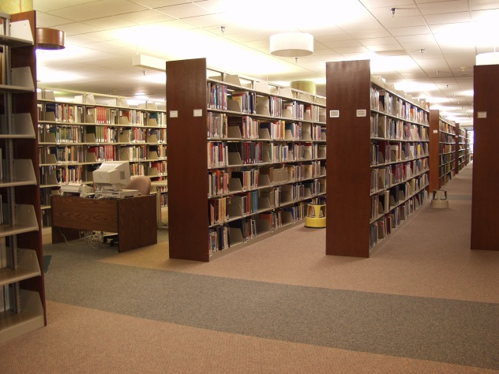
Library Facilities
29 study rooms
All rooms are first come, first serve.
Each room has a dry erase board, glass board or chalkboard and plenty of outlets!
Wireless internet

Slide 13
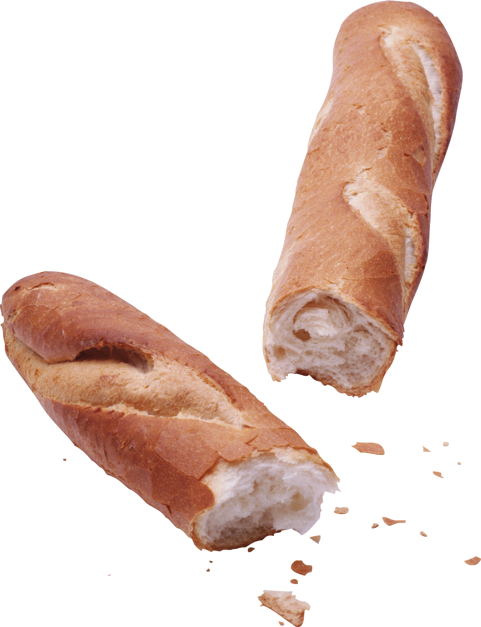



Eat, drink and be merry!
Please
Clean Up… Thank YOU!

Slide 14
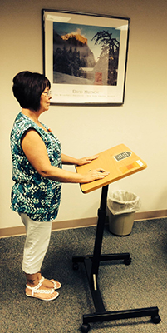
Check out podiums from circulation

Slide 15
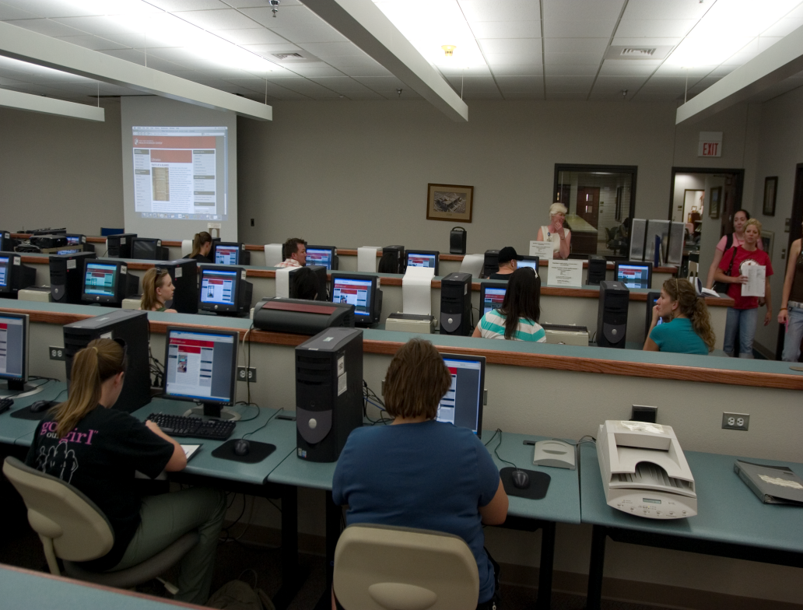
Learning Resource Center
Located on the 2nd floor of the library
Requires a library card
Check out computer stations, anatomical models, and more!
3-D printer
Notes:
The Learning Resource Center is located on the 2nd floor of the Lubbock library. Here, you can check out the library’s audiovisual materials, anatomical models, and computer stations. These materials, including the computer stations, require a library card in order to be checked out. Drinks only are allowed in the Learning Resource Center.

Slide 16

Need Help?
on library homepage (Right side)
mylibrary@ttuhsc.edu
806-743-2200
(Ask to speak to a Reference Librarian)

Slide 17



Reference Librarians
Available on 2nd floor of library, across from circulation and reading room area
8am–5pm
Monday–Friday
Jennifer Teichelman
Peggy Edwards
Micah Walsleben
Margaret Vugrin
Notes:
These are the Reference Librarians at the Lubbock campus. Our office hours are Monday – Friday 8:00am – 5:00pm Central Time. Feel free to give us a call or send us an e-mail, text us! We will be happy to help you.

Slide 18
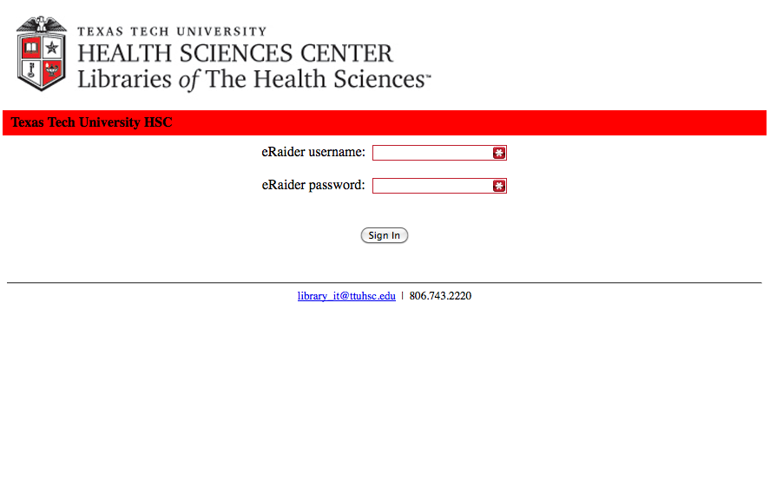
Proxy server
(off campus)
eRaider Username eRaiderPassword

Slide 19
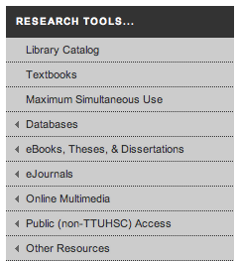
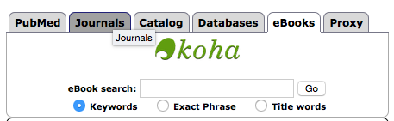
E-books
Over 62,000 eBooks

Slide 20
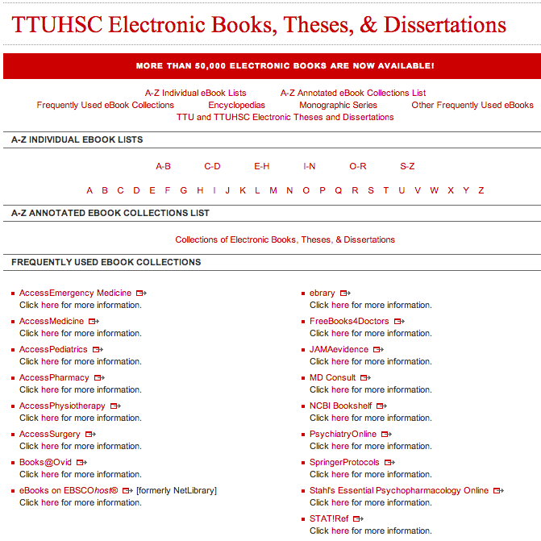
E-books
X

Slide 21
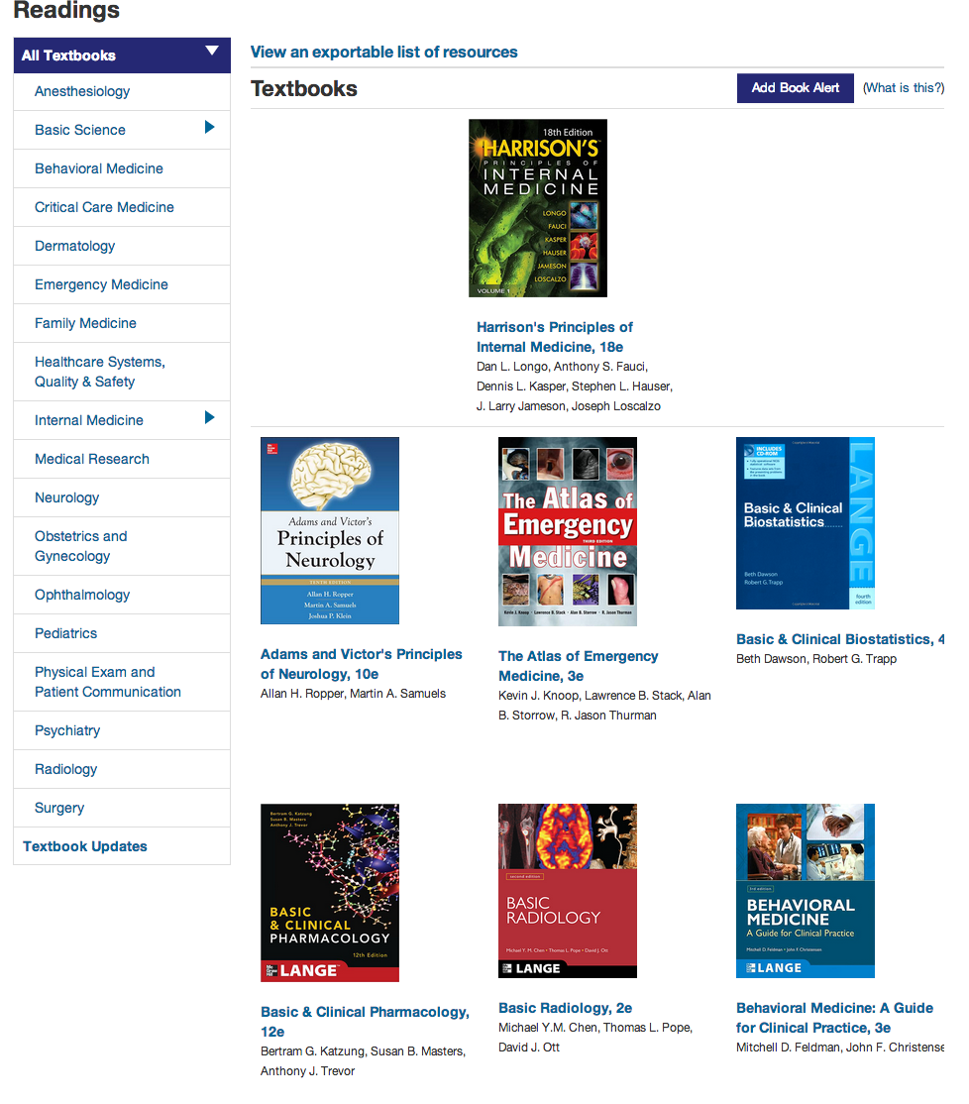
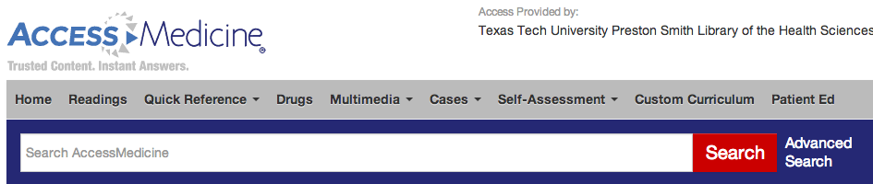
E-books
UNLIMTED ACCESS
Access
EmergencyMedicine
AccessMedicine
AccessPediatrics
AccessPharmacy
AccessPhysiotherapy
AccessSurgery

Slide 22
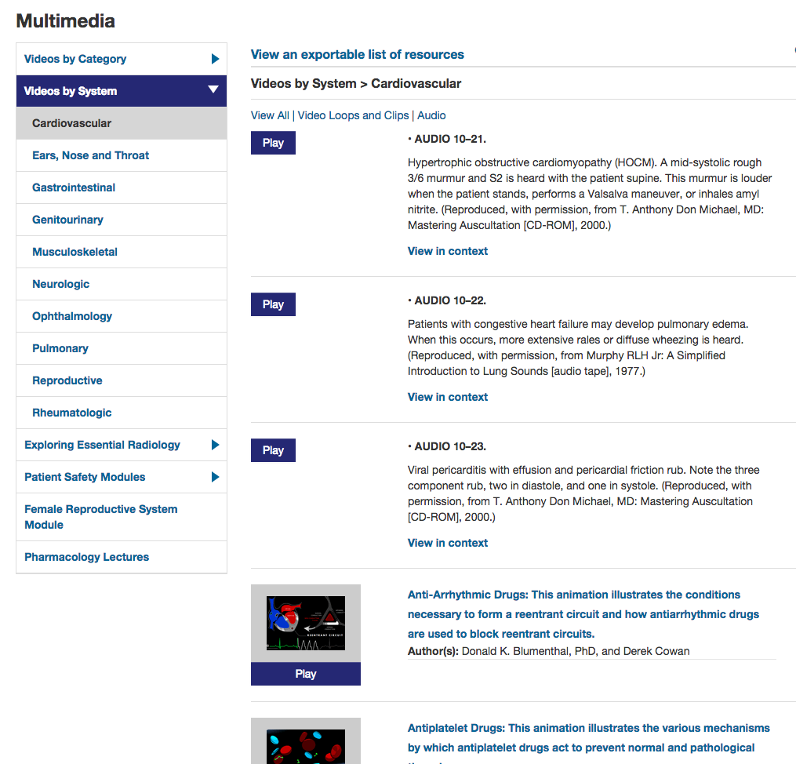
accessmedicine

Slide 23
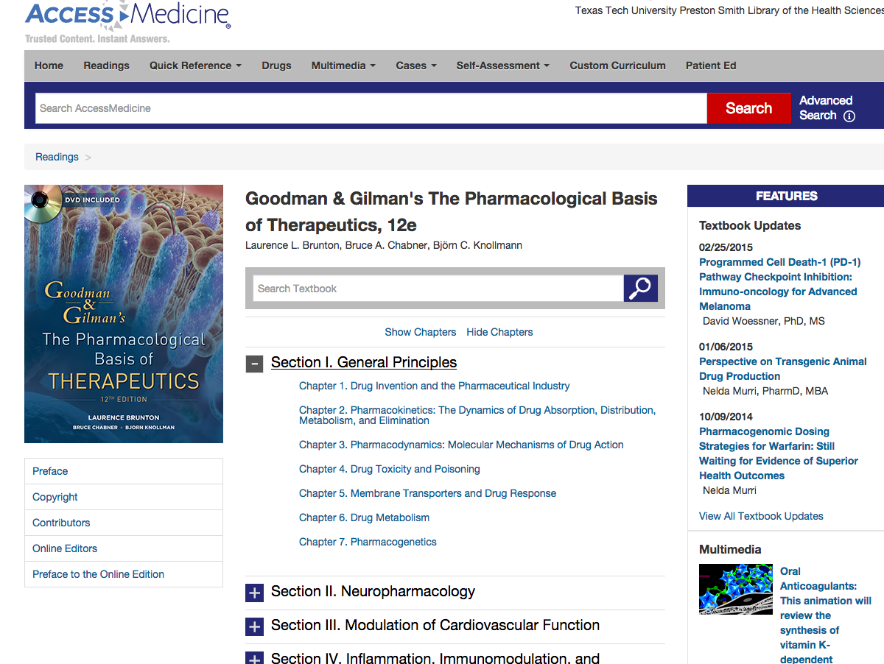
Free Register for special features

Slide 24
eBooks in Catalog
NEW

Slide 25
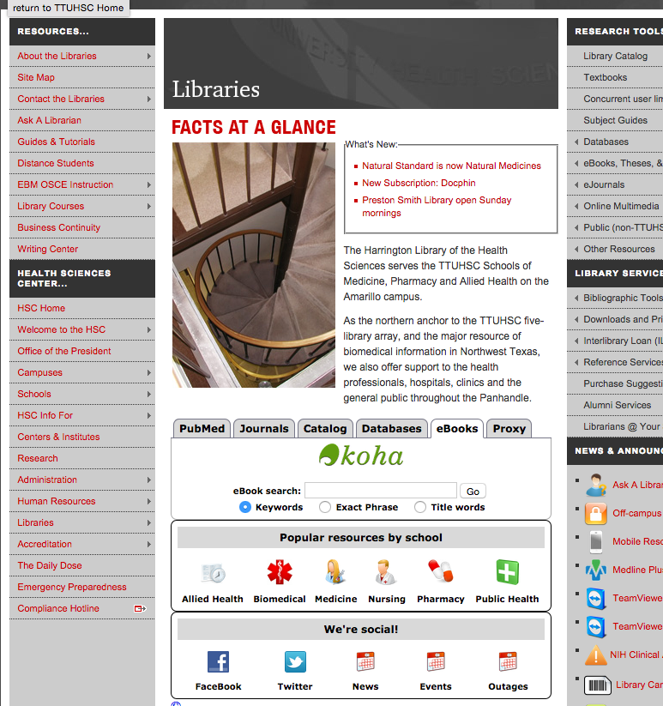
Netter atlas

Slide 26
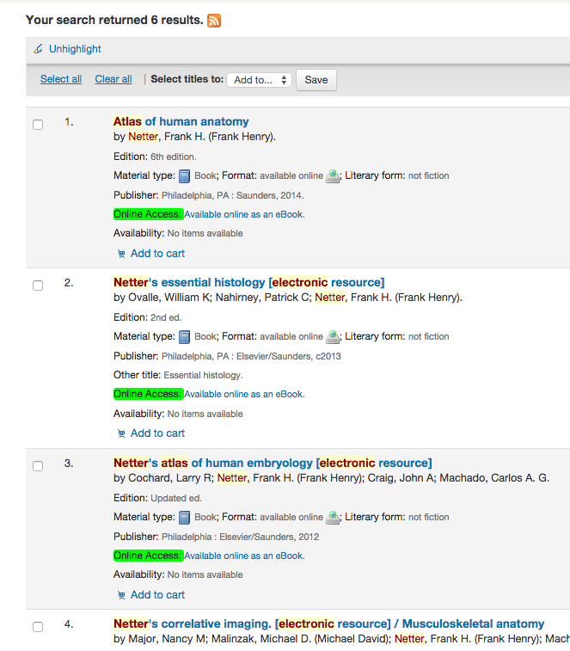
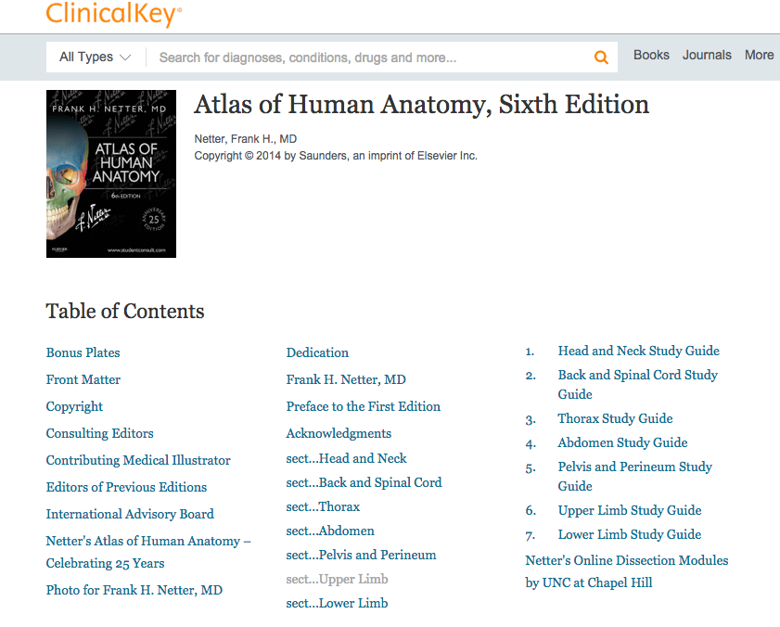

Slide 27
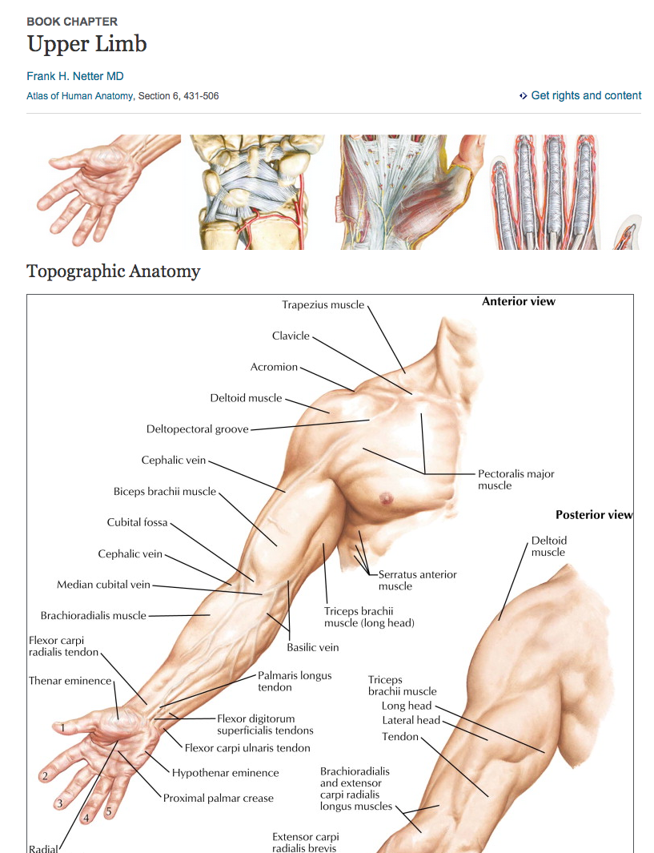

Slide 28
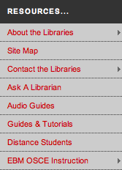
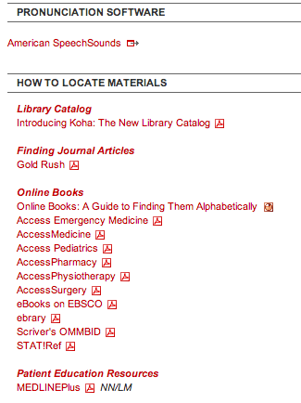
Upper
Left

Slide 29
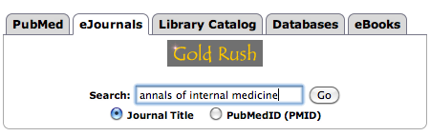
How do I access articles?
Gold Rush –
Most complete record
of TTUHSC Journals
Have your citation before you start looking!

Slide 30
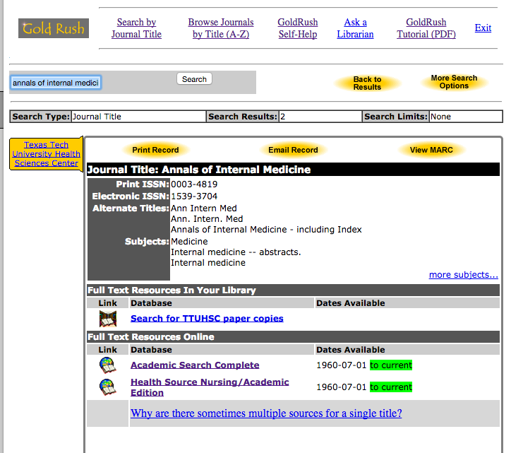
Gold Rush–Journal Records
Multiple electronic access options
Print
Check dates!
Full-text Electronic
Follow links!

Slide 31
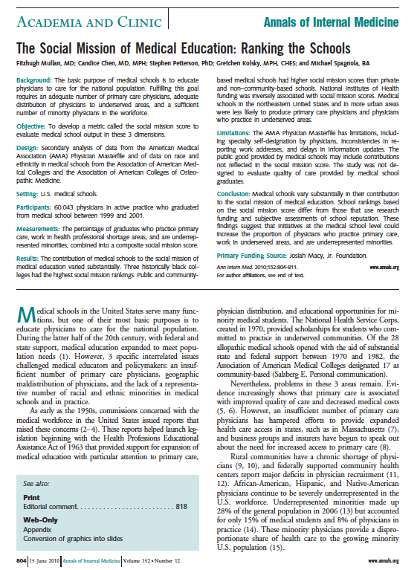
Gold Rush–
Journal Article
– PDF
PMID: 20547907

Slide 32
Still can’t find it!

Slide 33
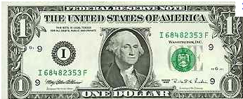
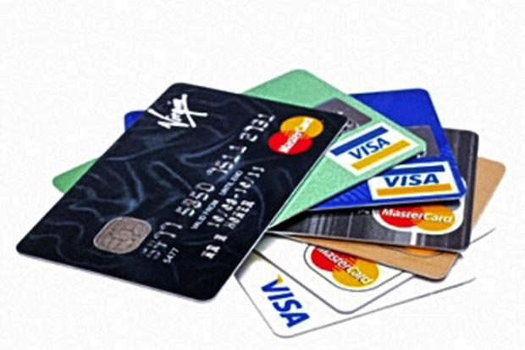
Interlibrary Loan (ILL) Policies
Online form makes submitting requests quick and easy
Response time from 2 – 10 business days, depending on location of the item
Books from TTUHSC branch free
All other locations are $4.00
Journal articles are charged
per page, but fees will not
exceed $4.00
There is a rush option
available, but at a
higher fee rate

Slide 34
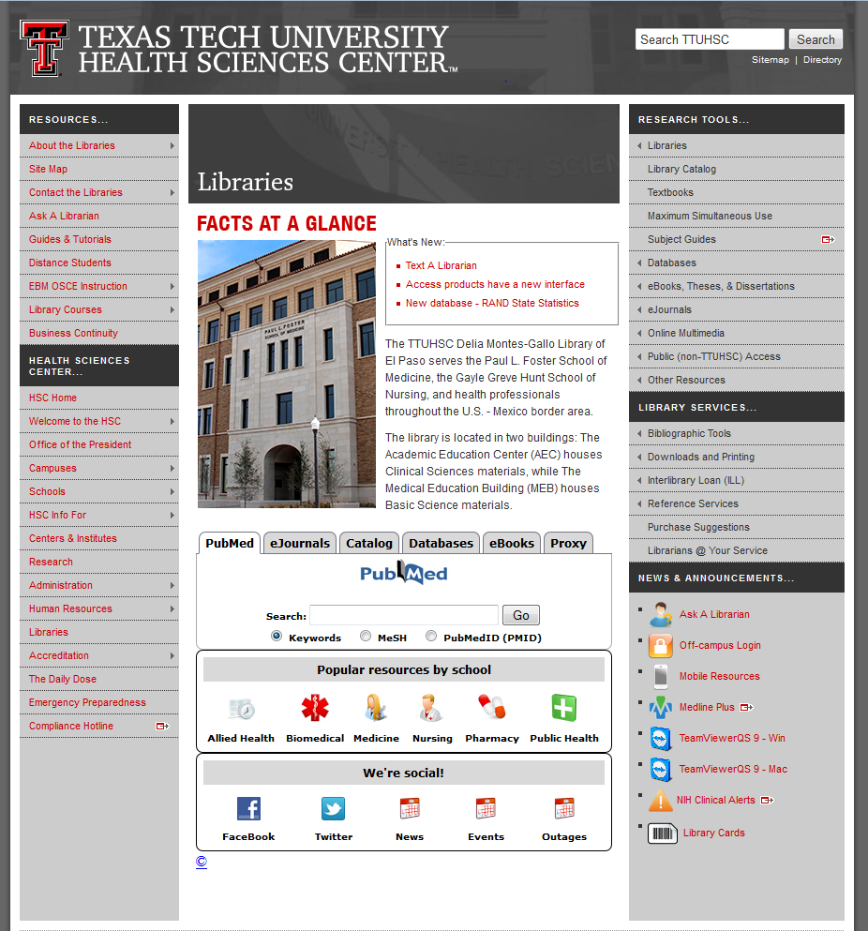
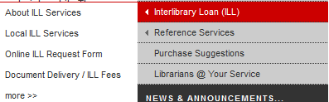
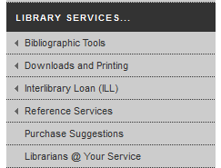

Interlibrary Loan (ILL)

Slide 35
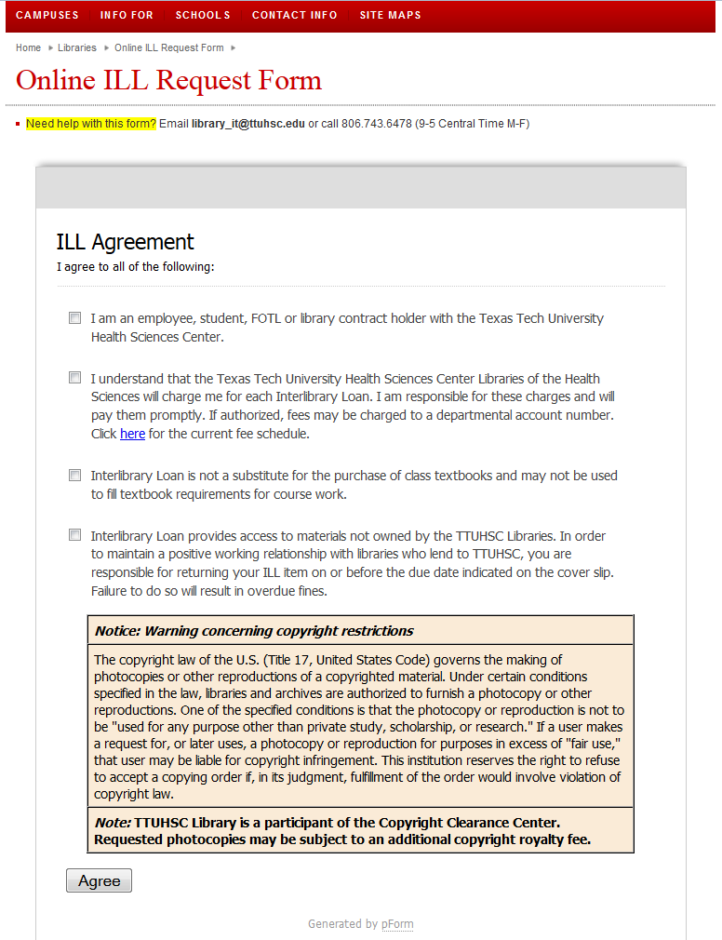

Slide 36
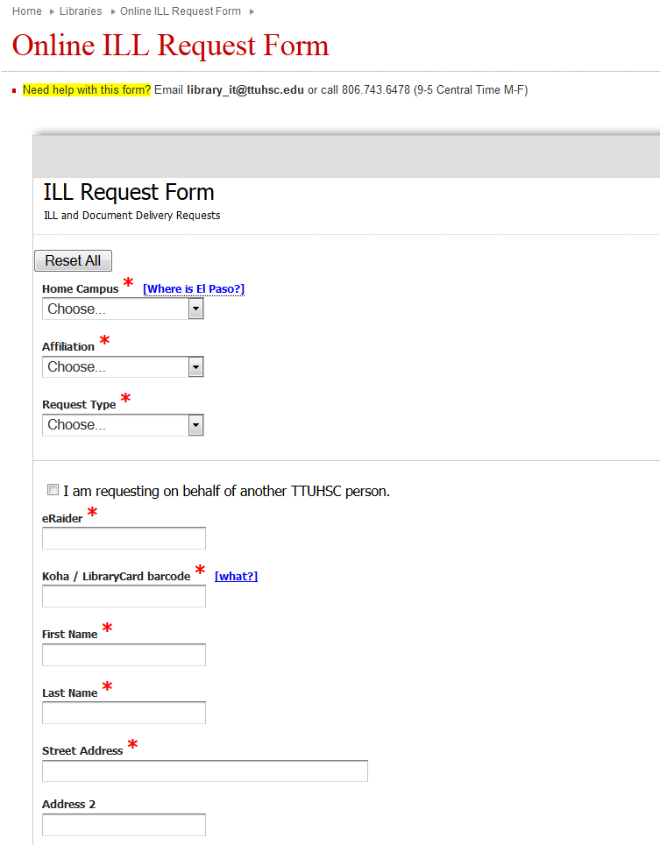
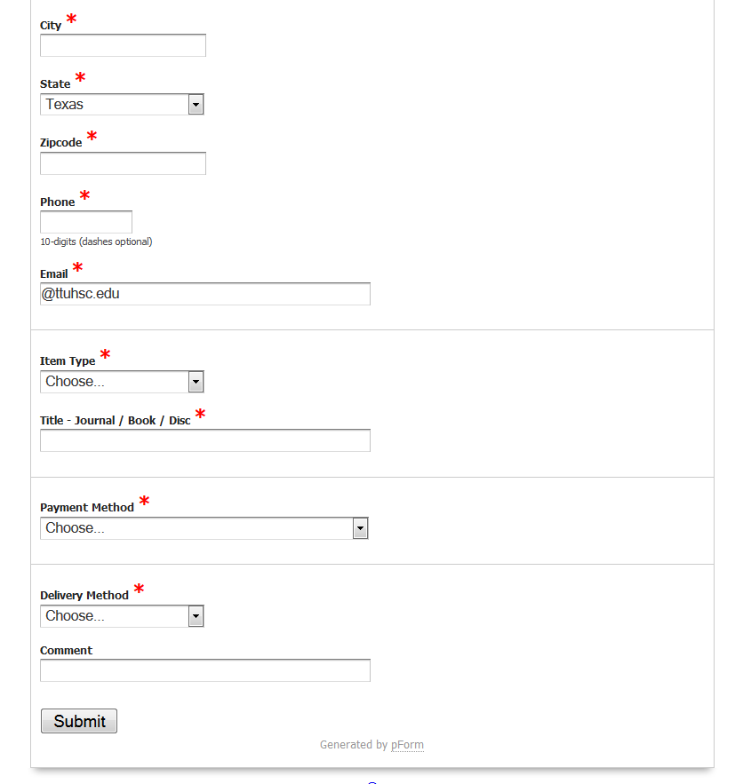

Slide 37
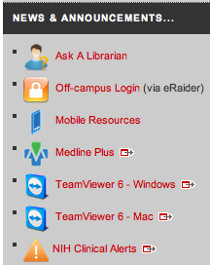
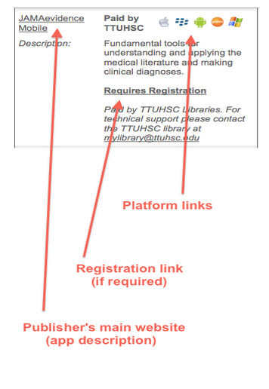
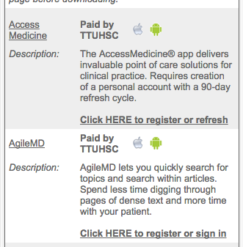
Right bottom
Platform links

Slide 38


Slide 39
Databases

Slide 40
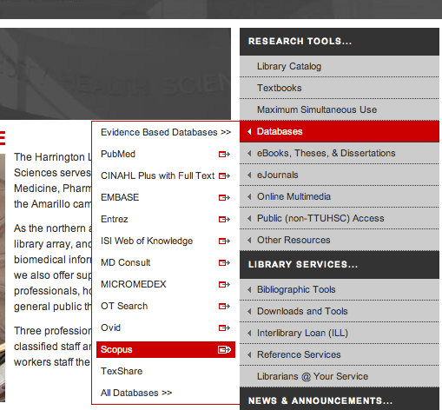
Scopus
Sort by Relevance
Locate landmark articles
Who has cited the article?
Keyword searching
Exporting available

Slide 41
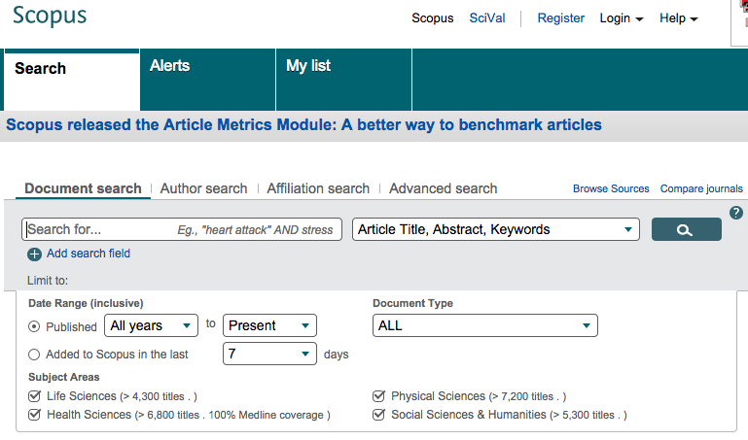
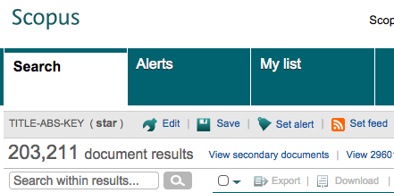
STAR
Large database
No subject headings

Slide 42
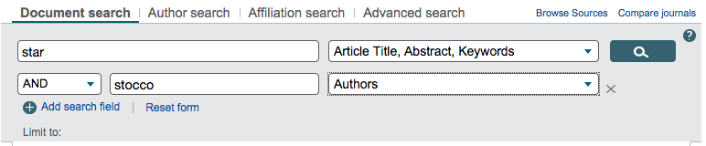
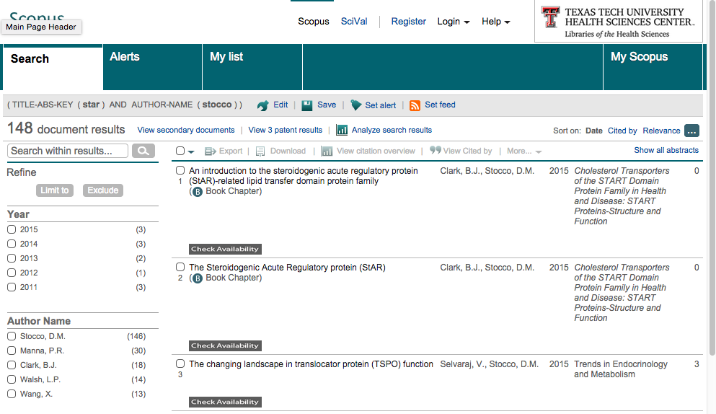

STAR
stocco

Slide 43


Slide 44
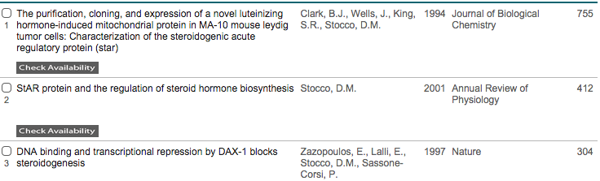
IF YOU CLICK THE HYPERLINKED NUMBER, YOU CAN SEE
WHICH ARTICLES HAVE CITED THIS ORIGINAL ARTICLE.

Slide 45


Scopus – Special Features

Slide 46


NEW
7/29/15
article metrics

Slide 47

Need
help?

Slide 48

Right bottom

Slide 49




Team viewer
Remote support
With computer and phone!

Slide 50

Team Viewer
Librarian can see your screen…
Need telephone for audio
Both can move mouse around
One Time Use!
Your info
Librarian info
Once the ID & password are entered on our computer…
we have one time access to your desktop!

Slide 51
Thank you!

Slide 52
Welcome
Information Resources for Graduate Biomedical Sciences
Peggy Edwards, AMLS
TTUHSC - Preston Smith Library
Lubbock, Texas 79430
August 2015

Slide 53

When searching library applications,
use Mozilla Firefox!

Slide 54


www.ttuhsc.edu/libraries
Click
Popular Resources by School

Slide 55



PubMed Database
Biomedical and life sciences journal literature
International scope
Developed and maintained by the:
National Center for Biotechnology Information
    at the U.S. National Library of Medicine
    at the National Institutes of Health

Slide 56



Accessing PubMed
Freely available over the Internet
@ www.pubmed.gov
Also through library’s home page

Slide 57

www.ttuhsc.edu/libraries
Mouse over Databases
Click PubMed

Slide 58
Creating a
My NCBI Account

Slide 59

Click
Sign in to NCBI
PubMed Home Page

Slide 60

Click
Register for an NCBI account

Slide 61

Fill out form
and click
Create account

Slide 62
Verifying your MY NCBI Account
Open the email you used in the account:
1) Locate the link from NCBI
2) Click the link
3) Tells NCBI you are a real user requesting the account
(not computer generated)
4) Your user name will now appear on the top right-hand side

Slide 63
Your username
Click Sign into NCBI
username

Slide 64
Enter your username
and password

Slide 65

Click My NCBI

Slide 66

Click Manage Filters

Slide 67

Select database
✔
Select filters

Slide 68

Filter activated

Slide 69

Click Properties
Click + to open
+

Slide 70

Click Other Animals

Slide 71

Filter Activated

Slide 72

Click Publication Types

Slide 73

Select filters appropriate to your research discipline
✔
✔
✔

Slide 74

✔
✔
✔

Slide 75

✔
✔
✔
✔
✔
✔

Slide 76


Scroll to
and select
Systematic Reviews
✔
-
Subsets

Slide 77

Click
Create custom filter
Subject headings options:
bioinformatics
biomedical informatics
biotechnology
public health
Other words specific to your research!

Slide 78

Enter key word
Click
Test This Query

Slide 79


Click
Test This Query

Slide 80
Click box next to Save filter as:

Slide 81
Click
Save Filter

Slide 82

Click PubMed

Slide 83
Searching PubMed

Slide 84

Home Page

Slide 85

Enter metastatic pathway* [ti]
Click
Search

Slide 86

Search Results
Click article title

Slide 87

Click to open
MeSH Terms Index

Slide 88


Menu appears, click
Search in MeSH
Click relevant MeSH term:
Neoplasm Metastasis

Slide 89

✓
Click
Add to search builder

Slide 90

Click
Search PubMed

Slide 91

Enter AND metastatic pathway* [ti]
Click
Search

Slide 92

Click Limits

Slide 93

Results and activated filters.
Click Show additional filters

Slide 94

Select
Languages
✔
Click Show

Slide 95

Click English

Slide 96

Custom filters
Narrowed Results

Slide 97
Click custom filter

Slide 98

55 Results vs 24

Slide 99
Click on the article title you wish to read

Slide 100

Click for Free Full Text
TTUHSC ONLINE

Slide 101
TTUHSC Libraries - Proxy Server
When Searching from Off Campus:
Enter the
Eraider username and password
assigned to you
by Information Services.
A
Problems with eRaider call: 806-743-1234a

Slide 102


Click

Slide 103

Full Text

Slide 104

PubMed – searching with MeSH
more efficient, accurate searching
libraries home page
  under Guides & Tutorials
appointment for training

Slide 105
Other NLM Databases:
PubChem

Slide 106

Click one to select
Enter compound, click
Go

Slide 107

Results
Click
<

Slide 108

Click Bioactivity Summary

Slide 109

Search Menu

Slide 110
Take some time to explore PubChem

Slide 111

Note: Beta Test Site for new PubChem

Slide 112
Other NLM Databases:
Public Health

Slide 113

Public Health

Slide 114


Slide 115


Slide 116


Slide 117



Slide 118
Other NLM Databases:
Toxicology Data Network

Slide 119


Training Manual & Schedule

Slide 120
Other NLM Databases:
Biotechnology

Slide 121
www.ttuhsc.edu/libraries
Click PubMed

Slide 122

US National Library of Medicine
Click

Slide 123

Click All NLM Databases & API’s

Slide 124

Biotechnology

Slide 125


Slide 126


Slide 127
NCBI Databases

Slide 128

Growing Collection of Publicly Available Databases
www.ncbi.nlm.nih.gov

Slide 129






Chemical and Bioassays

Slide 130


















DNA and RNA

Slide 131




Domains and Structures

Slide 132











Genes and Expression

Slide 133











Genomes and Maps

Slide 134



Homology

Slide 135






Literature
Retrieved January 5, 2015 from www.nih.gov and www.nlm.nih.gov

Slide 136




Proteins

Slide 137

Sequence Analysis

Slide 138



Taxonomy

Slide 139



Variation

Slide 140


More Information
Database resources of the National Center for Biotechnology Information
Nucleic Acids Research. 2010 Jan;38(Database issue):D13-D25
PMID: 19910364
PMID: 19910364

Slide 141
NCBI Databases:
Tutorial

Slide 142

NIH Director: Francis Collins, M.D.
“We know the molecular cause of 4,000 diseases, but treatments are available for only 250.”
Retrieved January 5, 2015 from http://www.ted.com

Slide 143

www.ncbi.nlm.nih.gov

Slide 144


National Human Genome Research Institute
Grants!
NHGRI GOAL:
Sequencing a genome for only $1,000.00!

Slide 145
Clinical Trials.gov

Slide 146


Slide 147
Web of Science

Slide 148

www.ttuhsc.edu/libraries
Mouse over Databases

Slide 149

www.ttuhsc.edu/libraries
Click Web of Science

Slide 150

Main Search Page

Slide 151
Truncation and Wild Cards Find Term Variations
Symbol Retrieves
Zero or more characters
*carbon*
carbon, hydrocarbon, polycarbonate
*
Zero or one character
colo$r
color, colour
$
One character only
en?oblast
entoblast, endoblast
?
Thomson Reuters. (2013). Web of Science: search tips [Video file]. Retrieved from https://www.youtube.com/watch?v=vq4tCtUgXLI&feature=youtu.be

Slide 152

Enter metastatic pathway*
pathway* truncated
retrieves:
pathway and pathways

Slide 153

Click
>
Click +Add Another Field
Select Title field

Slide 154


Click
Search
Enter suppress*
<
Title
Select Title field
Select Last 5 years

Slide 155

Filters that Refine Results

Slide 156
Times Cited

Slide 157

Sort Options

Slide 158
Marked List

Slide 159
To see abstract, click title: Notch signaling pathway…

Slide 160

Citation Network
Click Times Cited

Slide 161

Click Return to Search Results
Citing Articles

Slide 162

Click article title

Slide 163

View Journal Information
Click to close
X

Slide 164
Click Return to Search Results

Slide 165

Click
Create Citation Report

Slide 166

Times Cited
Click Return to Search Results
By Year

Slide 167
Click
Check Availability

Slide 168

Gold Rush indicates availability

Slide 169
ScienceDirect
is selected

Slide 170

Click to Download PDF
…and opens the full-text article

Slide 171

Close screens
Click to download full-text

Slide 172
Note:
Save to EndNote online

Slide 173
Saved Searches and Citation Alerts

Slide 174


Click Results
Click Search History

Slide 175

Click to Save History

Slide 176

Saving your search history creates
e-mail alerts of new articles

Slide 177

Create a Personal Profile
Close Screen

Slide 178


Click My Tools

Slide 179
Clicking Results
Displays article list

Slide 180
Click Reset Form to begin again

Slide 181
Cited Reference Search:
or
Who has cited this paper?

Slide 182



WATSON, J. D., & CRICK, F. H. (1953).
Molecular Structure of Nucleic Acids: A Structure for Deoxyribose Nucleic Acid.
Nature. 171 (4356):737-8 doi:10.1038/171737a0

Slide 183

Click
>
Select Cited Reference Search
Main Search Page

Slide 184

Step 1: Enter Article Information
Change to
Cited Author
<
Watson J*
Crick F*
<
Cited Author
Nature
<
Cited Work
Change to
Cited Work
<

Slide 185
Watson J*
Crick F*
<
Cited Author
Nature
<
Cited Work
Click +Add Another Field

Slide 186

Watson J*
Change to
Cited Years
Crick F*
<
<
Cited Author
Nature
<
Cited Work
1953
<
Cited Years
Enter date
Click
Search

Slide 187

Step 2: Select cited reference
✔
Click
Finish Search

Slide 188

Newly published papers citing Watson & Crick’s 1953 paper

Slide 189
Journal Citation Reports®

Slide 190

Click Journal Citation Reports®
for impact factor information

Slide 191

Click WELCOME
Calculationsa
a

Slide 192



Select Options
Click
SUBMIT

Slide 193

Click
SUBMIT
Scroll to and select
BIOCHEMISTRY & MOLECULAR BIOLOGY

Slide 194

Other Subjects

Slide 195



Click
SUBMIT

Slide 196

Journal Citation Report Data

Slide 197
Questions???

Slide 198

Help

Slide 199
EndNote

Slide 200

www.ttuhsc.edu/libraries
Mouse over Bibliographic Tools
Click Endnote

Slide 201

EndNote Web or Endnote Desktop?
Download Desktop
Tutorials

Slide 202

Start writing your paper. When you quote, locate the source information in EndNote. Use EndNote’s Cite While You Write to insert the citation
https://en.wikipedia.org/wiki/Hippocrates

Slide 203

Use EndNote’s Cite While You Write to insert the citation in the correct format.
https://en.wikipedia.org/wiki/Hippocrates

Slide 204

Continue writing your paper and inserting citations.
https://en.wikipedia.org/wiki/Hippocrates

Slide 205

Complete your paper. Click Create Bibliography. EndNote automatically inputs information into your paper.
https://en.wikipedia.org/wiki/Hippocrates

Slide 206
Tutorials

Slide 207


MICROMEDEX
Authoritative drug information
Entire US National Formulary

Slide 208

www.ttuhsc.edu/libraries
Mouse over Databases
Click MicroMedex

Slide 209

Enter a drug name.

Slide 210

Drug Monograph

Slide 211




MICROMEDEX – drug identification

Slide 212




MICROMEDEX: also includes
Diseases & Acute Care
Toxicology & Product Info
Alternative Medicines
Patient Education

Slide 213

Interactions table

Slide 214
Have Questions?

Slide 215

Please contact us at:
Lubbock
(806) 743-2200
Amarillo
(806) 354-5448
El Paso
(915) 545-6652
Odessa
(432) 335-5171

Slide 216


www.ttuhsc.edu/libraries
email us

Slide 217

Today’s Powerpoint

Slide 218


Date: Month Day, 2015
Time: 1:00 p.m.
Instructors:
Peggy Edwards

Slide 219
The End

