Slide 1
Evidence–Based Practice
Peggy Edwards, AMLS
Travis Real, MLIS
May 2018

Slide 2
Basics: Evidence–Based Practice
Use of Evidence–Based Practice resources is an important part of information literacy in health care and health sciences.
This module is a web–based tutorial designed to teach beginning biomedical and health care students about Evidence–Based Practice principles and resources.

Slide 3
Goals
To comprehend:
  the principles of Evidence–Based Practice.
  the use of Evidence–Based resources.
  and to be motivated to strive for better patient outcomes.

Slide 4
Objectives
During this learning module, participants will:
  learn the definition of Evidence–Based Practice (EBP).
  understand the steps of the EBP process.
  recognize central issues around which clinical questions revolve: diagnosis, therapy, prognosis, or etiology.
  know how to build focused clinical questions with PICO.
  learn how to use the Evidence–Based literature searching tool PubMed's Clinical Queries.
  identify a discipline–related EBP point–of–care tool and learn how to access a guide or tutorial.

Slide 5
Objectives continued
  become familiar with types of study design and the hierarchy of study designs.
  learn about quality of evidence and the Strength of Recommendation Taxonomy.
  describe criteria used to evaluate resources critically.
  consider how to integrate evidence-based practice with the patient’s values
  recognize the visual elements necessary for low literacy health education tools.
  recommend MedlinePlus.gov to patients.

Slide 6
Definition and Process
What is Evidence–Based Practice?
Evidence–Based Practice (EBP) requires the integration of the best research evidence with clinical expertise and the patient’s unique values and circumstances. (Straus, 2005)
Steps in the Evidence–Based Process are:
  In priority, what are the issues?
  Is it critical, correctable, common, contextual, comprehensive?
Assess
  What is the question’s study category? Prevention? Therapy? Harm/Causation? Diagnosis? Prognosis? Outcomes? Economic? Qualitative? Guidelines?
  Build a well–articulated, focused question using the PICO model: Patient, Intervention, Comparison, Outcome.
Ask
  What types of evidence and what levels of evidence might exist?
  Where is the evidence likely to be found?
  Select from pre–filtered versus unfiltered resources: systems, syntheses, summaries, synopses, or studies.
Acquire
  Is the information valid? Are the results valid?
  Will the information, if true, make an important difference? What are the results?
  Is the information applicable? How can the results be applied?
Appraise
  If valid, will it make a difference to the patient?
  If important, is it relevant?
  If relevant, can it be used?
Apply
(JAMAevidence, 2011)

Slide 7
Assess the Patient
Determine what the issues are
Prioritize the issues (The JAMA Network)
What if too many questions arise?
  Patients may have several active problems:
    possible questions about diagnosis, prognosis, therapy for each problem
    questions may be too numerous to even ask, let alone answer
  What is the most important issue for this patient now?
  Which question, when answered, will help the most?
  Select the few questions that are most important to answer right away. (Dawes, 2001)

Slide 8
Assess the Patient
Classify the issues:
  Is this issue a matter of treatment?
  Is it a matter of whether the treatment is going to hurt my patient?
  Is it a matter of what is going to happen in the future? Prognosis?
  Is it a matter of whether I want to implement a clinical policy? Practice Guidelines?
Knowing the category of the issue leads to the next stage: ASKING
The JAMA Network.
The 5As of the health information cycle: Robert Hayward, MD, defines the 5As of the health information cycle and helps learners understand the process.
JAMAevidence audio [audio podcast]. Retrieved from https://jamaevidence.mhmedical.com/podcasts.aspx

Slide 9
ASK the Question: Clinical Question Categories
  Clinical questions often arise from central issues: (Straus, 2005)
    Diagnosis the process of identifying a disease or condition. Making the correct diagnosis is the foundation for making decisions on clinical intervention. (McKibbon, 2009)
      What disease or condition does the patient have?
    Therapy an action or intervention that can potentially improve care or prevent diseases or conditions. (McKibbon, 2009)
      What is the best treatment for this disease or condition?
    Etiology the cause of a disease, condition or situation. It may also be referred to as harm or causation. (McKibbon, 2009)
      What is the cause of the patient’s disease or condition?
    Prognosis the progression of a treated disease. (McKibbon, 2009)
      What outcome can be expected from the treatment or intervention used?

Slide 10
Using PICO to Focus Questions
A clinical question should be directly relevant to the problem. Using the PICO format, the question can be phrased to facilitate searching for a precise answer.
    the Patient, population or problem being addressed.
    the Intervention being considered.
    the Comparison intervention or exposure, when relevant.
    the clinical Outcomes of interest.
    Click here to go back to review point quiz
    (Washington Health Sciences Libraries, 2009)

Slide 11
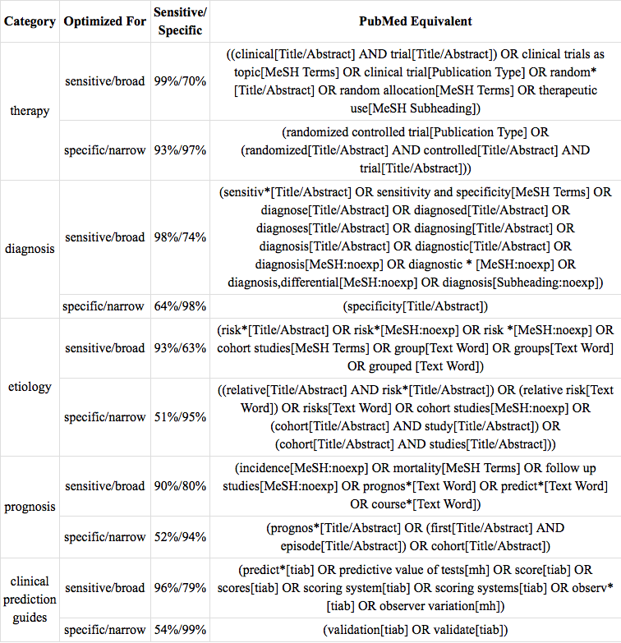
ACQUIRE: EBP Tool
PubMed’s Clinical Queries
  search tool that quickly locates EBP journal articles
  uses study question categories: therapy, diagnosis, etiology, prognosis
  includes appropriate study designs
Utilizes pre–formulated strategies to filter to the best evidence
(Haynes, R.B. & et al., 2005)

Slide 12
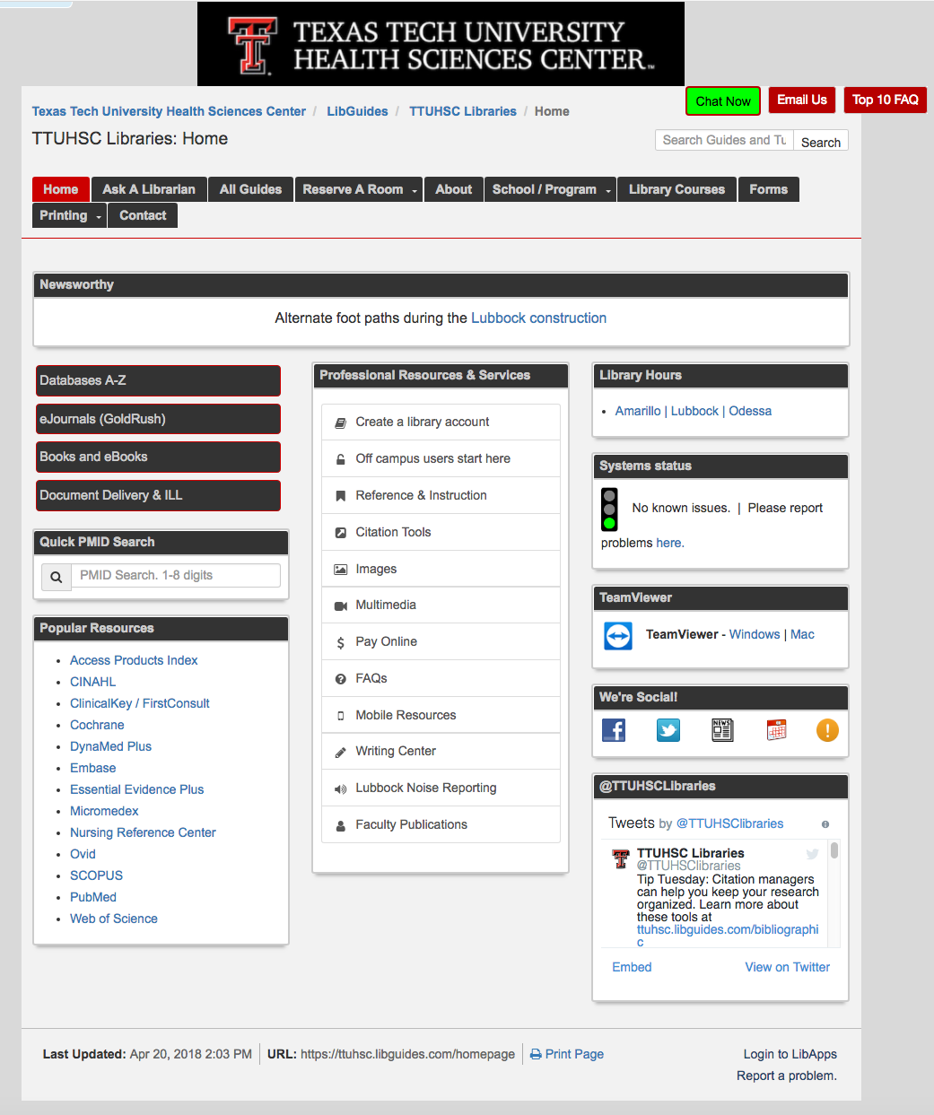
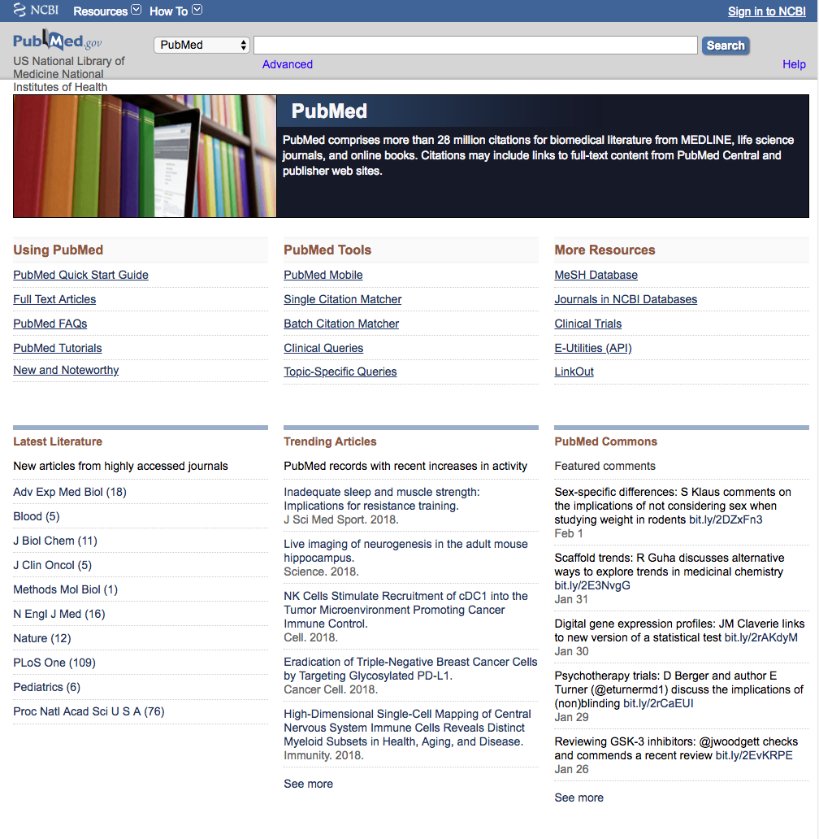
PubMed’s Clinical Queries
1) https://ttuhsc.libguides.com/homepage
3) Click Clinical Queries
2) Click PubMed

Slide 13
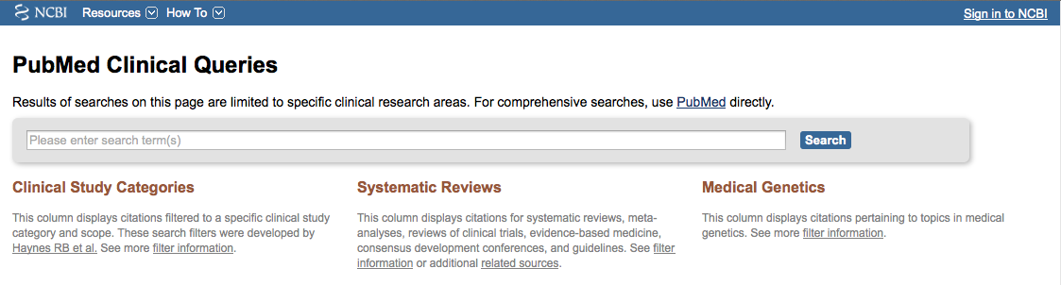
Clinical Queries – Search Process
Clinical Queries provides rapid access to evidence–based journal articles.
stroke "patient care team"
Enter terms and click
Search

Slide 14
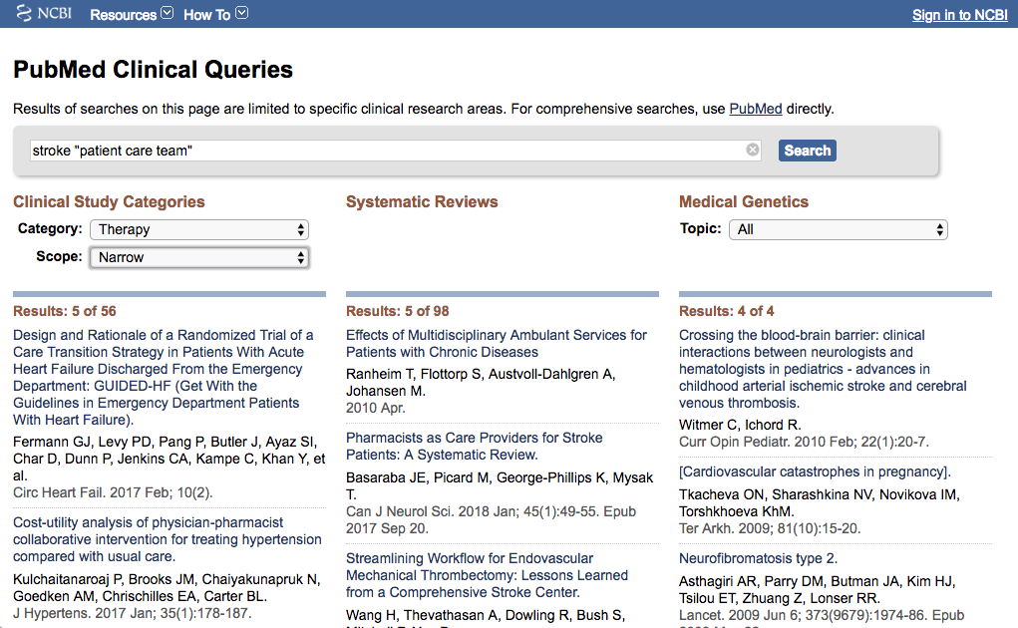

Clinical Queries – Question Categories
Clinical Queries defaults to Boolean "AND" when processing the searcher's terms. See pre–formulated strategy on page 10 for specifics on category and scope.
Select Category and Scope
Click title for abstract and for full–text icon:

Slide 15
ACQUIRE: Information at Point of Care
Point–of–Care Systems
  Contain detailed modules about diseases.
  Information overviews; rapid electronic updating.
  Generally includes information on:
    Etiology
    Diagnosis
    Therapy
    Prognosis
  Information is rated according to evidence quality level.
  Available via smartphones for access at patient bedside.

Slide 16
Accessing Point–of–Care Tools
https://ttuhsc.libguides.com/homepage
TTUHSC Libraries subscribe to
these Point–of–Care Databases:
    * Dynamed Plus™.
    Essential Evidence Plus©.
    * FirstConsult™ within Clinical Key.
    * MICROMEDEX®.
    # Nursing Reference Center Plus™.
  All of these databases provide
  web-based mobile access.
    * also have true mobile apps
    # app for Androids, iPhones
Click on the name of tool you wish to search

Slide 17


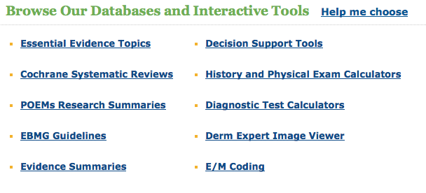
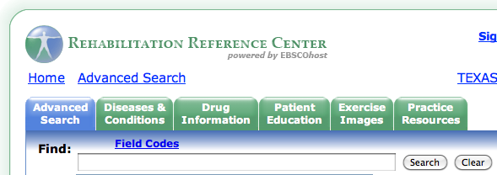
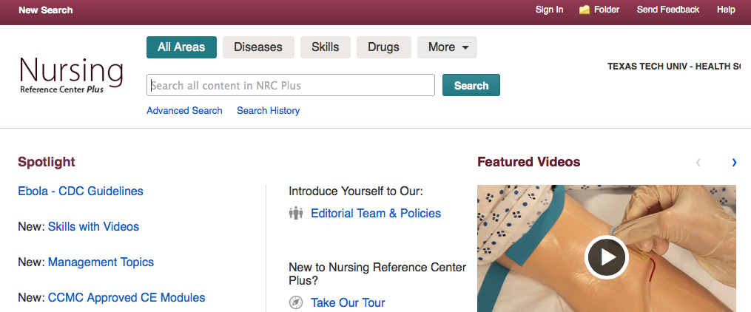
Point–of–Care Tools
MICROMEDEX®
First Consult/Clinical Overviews ∨
in
Clinical Key®
Notes:
Hi Cheryl
This is approved. I have attached it, in case you need it.
Regards,
Lily
–––––Original Message–––––
From: Simonsen, Cheryl [mailto:cheryl.simonsen@ttuhsc.edu]
Sent: Wednesday, December 22, 2010 9:36 AM
To: Rodriguez, Lily – Hoboken
Subject: Use of Essential Evidence Plus Logo in Educational Materials
From: Ogolini, Christie (ELS–STL) [mailto:C.Ogolini@Elsevier.com] Sent: Tuesday, January 11, 2011 9:10 AM To: Simonsen, Cheryl Subject: RE: Permission to Use First Consult Logo in Educational Materials
Good Morning Cheryl,
I apologize for the delay in getting back with you. I’ve been out of town for the past week at an internal sales meeting. I don’t see any problem with Texas Tech using the First Consult logo within the PP format for training. Please go ahead and use it. The more that students are aware of the product will only help drive usage of the product.
Thank you so much and enjoy your day.
Christie O
Christie Ogolini
Account Representative : Gulf Coast Region Elsevier – Clinical Decision Support
3251 Riverport Lane St. Louis, MO 63043
From: Lauren Kadziel [mailto:LKadziel@STATref.com] Sent: Wednesday, December 22, 2010 10:12 AM To: Simonsen, Cheryl Subject: RE: Use of Logo in Educational Materials
Hi Cheryl,
I have confirmed that you are able to use the ACP PIER & STAT!Ref logo for educational purposes. I’ve attached some logos but feel free to use anything related.
I cannot get an answer from Micromedex! I called our rep., Stefanie Clinton, on 12/21/10 and left her a message. I did not hear back from her. On 1/5/11 I sent her an email. She replied the same day and said she is not the one to contact, that I would need to contact someone else. However, she gave me no names nor any ideas on what department to contact. I emailed her back and requested a suggestion as to person(s) or department to contact and I never got a reply. I called her again on 1/14/11 and left another message and again got no reply.
I looked at the Micromedex website and then the general Thomson Reuters website to see if I could figure out how to contact them, and nothing stood out as a possibility. So, as of now, unless you have other ideas, I am giving up.
Since everyone else has given permission and is happy to have us promote their product, I say we use their logo and not worry about it. If they should try to come back on us, we can document that we tried to get permission.
Cheryl Simonsen, MLIS
Associate Director
Harrington Library of the Health Sciences
1400 Wallace
Amarillo, Texas 79106
806–354–5447

Slide 18
ACQUIRE: EBP Literature Databases
Access databases below via https://ttuhsc.libguides.com/homepage under the School/Program pull down or click on Databases A-Z
Cochrane Library
  collection of six databases that contain different types of high-quality, independent evidence to inform healthcare decision-making and are produced the The Cochrane Collaboration (The Cochrane Collaboration, 2016)
Joanna Briggs Institute (JBI). (nursing)
  includes the JBI Library of Systematic Reviews, Best Practice Information sheets, Evidence Summaries and Evidence-Based Recommended Practice.
OTseeker
  abstracts of systematic reviews and randomized controlled trials relevant to occupational therapy. (Bennett, S., 2003)
PEDro (physical therapy)
  abstracts of randomized controlled trials, systematic reviews, and practice guidelines in physiotherapy
  links to full text articles where possible. (CEBP, 1999)

Slide 19
TTUHSC Guides & Tutorials
https://ttuhsc.libguides.com/homepage
Additional information on:
  PubMed.
  PubMed’s Clinical Queries.
  Evidence–Based databases.
  Point–of–Care databases.
By clicking the All Guides tab.
Or contact the library for additional training at:
  “Ask-a-Librarian”
All Guides tab
Ask-a-Librarian

Slide 20
Point-of-Care Producer Tutorial Links
Click here for links to producer tutorials listed:
    After viewing first tutorial, click back arrow to get back to next link!
  DynamedPlus™
  Essential Evidence Plus©
  Clinical Overviews/First Consult™ (within Clinical Key)
  MICROMEDEX®
  Nursing Reference Center™
  PubMed
  Rehabilitation Reference Center™
Click

Slide 21
Review point #1
Your patient is a 45–year–old female just diagnosed with mild hypertension. She does not want to start taking pills and has asked you if she can make other changes that might bring her blood pressure back within normal range.
  The PICO statement is:
    P 45–year–old female with mild hypertension.
    I lifestyle modifications.
    C medication.
    O B/P within normal limits.
Is this PICO statement correctly stated to help you answer your patient’s question? Yes or No? To review, click here to go back to pg. 10

Slide 22
Answer #1
Yes. Each element of the scenario is precisely stated. This will help you develop a search strategy that will answer your patient’s question.

Slide 23
ACQUIRE: Quality of Evidence
Study design is important in determining the quality of evidence (Guyatt et al., 2008, p. 998)
  Insufficient attention to quality of evidence risks inappropriate guidelines and recommendations that may lead clinicians to act to the detriment of their patients. (Guyatt et al., 2008, p. 924-925)
  Factors that affect the strength of a recommendation
    Quality of evidence
    Uncertainty about the balance between desirable and undesirable effects
    Uncertainty or variability in values and preferences (of patients)
    Uncertainty about whether the intervention represents a wise use of resources (Guyatt et al., 2008, p. 926)

Slide 24
Definitions of Study Design
Case–control study
  A study that compares people with a specific disease or outcome of interest (cases) to people from the same population without that disease or outcome (controls), and which seeks to find associations between the outcome and prior exposure to particular risk factors. This design is particularly useful where the outcome is rare and past exposure can be reliably measured. Case-control studies are usually retrospective, but not always.
Case series
  A study reporting observations on a series of individuals, usually all receiving the same intervention, with no control group.
Cohort study
  An observational study in which a defined group of people (the cohort) is followed over time. The outcomes of people in subsets of this cohort are compared, to examine people who were exposed or not exposed (or exposed at different levels) to a particular intervention or other factor of interest. A prospective cohort study assembles participants and follows them into the future. A retrospective (or historical) cohort study identifies subjects from past records and follows them from the time of those records to the present. Because subjects are not allocated by the investigator to different interventions or other exposures, adjusted analysis is usually required to minimize the influence of other factors (confounders).

Slide 25
Definitions of Study Design continued
Meta–analysis
  The use of statistical techniques in a systematic review to integrate the results of included studies. Sometimes misused as a synonym for systematic reviews, where the review includes a meta-analysis.
Prospective study
  In evaluations of the effects of healthcare interventions, a study in which people are identified according to current risk status or exposure, and followed forwards through time to observe outcome. Randomized controlled trials are always prospective studies. Cohort studies are commonly either prospective or retrospective, whereas case-control studies are usually retrospective. In Epidemiology, 'prospective study’ is sometimes misused as a synonym for cohort study.
Randomized controlled trial
  An experiment in which two or more interventions, possibly including a control intervention or no intervention, are compared by being randomly allocated to participants. In most trials one intervention is assigned to each individual but sometimes assignment is to defined groups of individuals (for example, in a household) or interventions are assigned within individuals (for example, in different orders or to different parts of the body).

Slide 26
Definitions of Study Design continued
Retrospective study
  A study in which the outcomes have occurred to the participants before the study commenced. Case-control studies are usually retrospective, cohort studies sometimes are, randomized controlled trials never are.
Systematic Reviews
  A review of a clearly formulated question that uses systematic and explicit methods to identify, select, and critically appraise relevant research, and to collect and analyze data from the studies that are included in the review. Statistical methods (meta-analysis) may or may not be used to analyze and summarize the results of the included studies.
All definitions from (The Cochrane Collaboration, 2018)

Slide 27
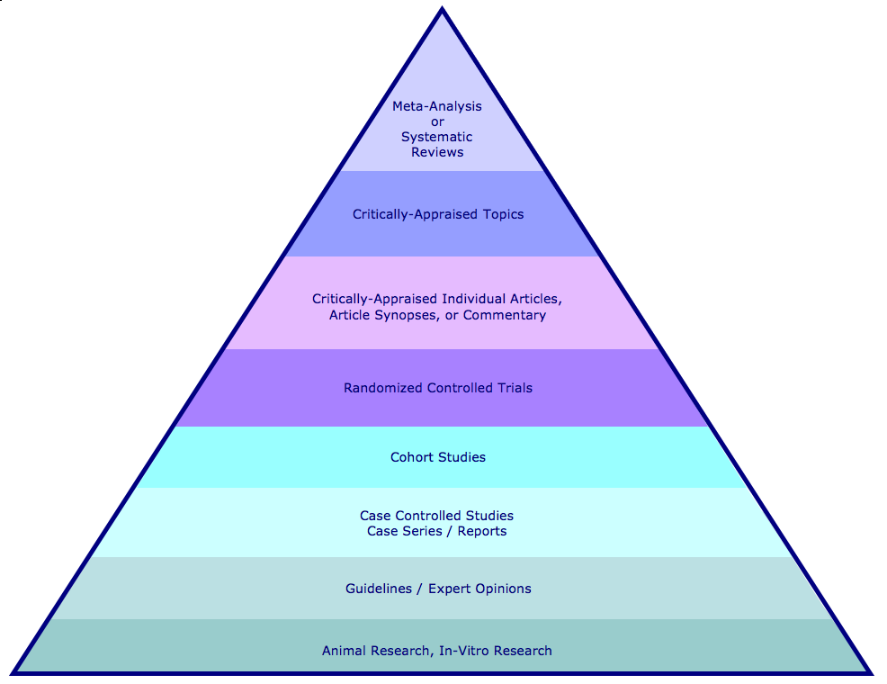
Hierarchy of Study Design & Databases
Click link for glossary
definition of
Hierarchy of Study Design
Cochrane Database of Systematic Reviews
Joanna Briggs Institute Library of Systematic Reviews (Nursing)
OT Seeker
PEDro (Physical Therapy)
PubMed
Topic Reviews in the Cochrane Database of Systematic Reviews
PubMed
NHS Economic Evaluation Database
Cochrane Methodology Register
ACP Journal Club PubMed
Cochrane Central Register of Controlled Trials
OT Seeker
PEDro
PubMed
PubMed, CINAHL
PubMed, CINAHL
Health Technology Assessment
Nursing Reference Center
PubMed, CINAHL
(TTUHSC Preston Smith Library, 11/21/2008)

Slide 28
N–of–1 Randomized Controlled Trials
Experiment designed to
  determine effect of an intervention/exposure on a single study participant
In a one N–of–1 design
  the patient undergoes pairs of treatment periods
  1 period involves the use of the experimental treatment
  1 period involves the use of an alternate treatment/placebo
  if possible, patient and clinician are blinded
  outcomes are monitored
Treatment periods are replicated
  until clinician and patient are convinced that
    treatments are definitely different
    or definitely not different
(Guyatt, 2008)
Go back to quiz

Slide 29

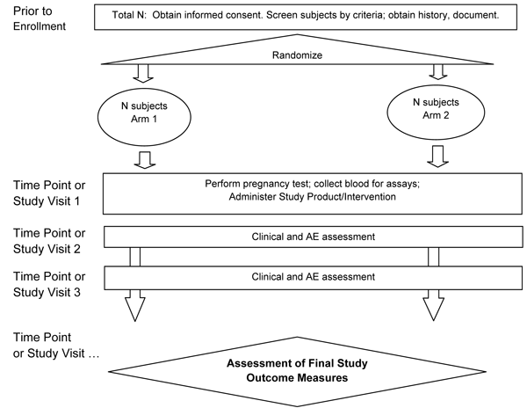
Evidence–Based Treatment
“Clinicians should use the results of randomized controlled trials (RCTs) of groups of patients to guide their clinical practice. However, clinicians cannot always rely on the results of RCTs…To determine the best care for an individual patient, clinicians can conduct N–of–1 randomized controlled trials in individual patients.” (Guyatt, 2008)
Notes:
rct graph:
U.S. Department of Health, National Institutes of Health, National Institute of Dental and Craniofacial Research. (2010). NIDCR interventional clinical protocol template Bethesda, MD: National Institute of Dental and Craniofacial Research. Retrieved from http://www.nidcr.nih.gov/clinicaltrials/toolkitclinicalresearchers/clinicaltrialsprotocoltemplate/interventionprotocoltemplate.htm
test tube image:
U.S. Department of Health and Human Services, National Institutes of Health, National Library of Medicine. (2010). MedlinePlus, clinical trials Bethesda, MD: National Library of Medicine. Retrieved from http://m.medlineplus.gov/topic/clinicaltrials.htm

Slide 30
Quality of Evidence - GRADE
Grading of Recommendations, Assessment, Development, and Evaluation – GRADE
Code Quality of Evidence Definition
Further research is very unlikely to change our confidence in the estimate of effect.
Several high–quality studies with consistent results.
In special cases: one large, high–quality multi–center trial.
A
High
Further research is likely to have an important impact on our confidence in the estimate of effect and may change the estimate.
One high–quality study.
Several studies with some limitations.
B
Moderate
Further research is very likely to have an important impact on our confidence in the estimate of effect and is likely to change the estimate.
One or more studies with severe limitations.
C
Low
Any estimate of effect is very uncertain.
Expert opinion.
No direct research evidence.
One or more studies with severe limitations.
D
Very Low
(Essential Evidence Plus EBM Guidelines Editorial Team, 2010)

Slide 31
Hierarchy of Strength of Evidence
Hierarchy of Strength of Evidence for Prevention and Treatment Decisions
• N–of–1 randomized trial
• Systematic reviews of randomized trials
• Single randomized trial
• Systematic review of observational studies addressing patient–important outcomes
• Single observational study addressing patient–important outcomes
• Physiologic studies (studies of blood pressure, cardiac output, exercise capacity, bone density, and so forth)
• Unsystematic clinical observations
(Guyatt, 2008)

Slide 32
Recommendations
Judgements about evidence and recommendations are complex.
("Grading quality of evidence and strength of recommendations," 2004, p. 1)
The strength of a recommendation reflects the extent to which we can be confident that desirable effects of an intervention outweigh undesirable effects. (Guyatt et al., 2008, p. 1049)
  The Grading of Recommendations Assessment, Development and Evaluation (GRADE) approach is a system for rating the quality of evidence and strength of recommendations that is explicit, comprehensive, and increasingly adopted by guideline organizations. The system classifies the confidence in estimates of effect into 1 of 4 levels (high, moderate, low, or very low). Recommendations are graded as strong or weak. (In Guyatt, Rennie, Meade, & Cook, 2015, Glossary & American Medical Association, 2015, glossary)

Slide 33
Strength of Recommendation
"Recommendations to administer, or not administer, an intervention, should be based on the tradeoffs between benefits on the one hand, and risks, burdens and, potentially, costs on the other. If benefits outweigh risks and burdens, experts will recommend that clinicians offer a treatment to typical patients. The uncertainty associated with the tradeoff between the benefits and risks and burdens will determine the strength of recommendation."
(GRADE Working Group, 2005)
Strength Of Recommendation Taxonomy (SORT)
Code Definition
A
Consistent, good–quality patient–oriented evidence *
B
Inconsistent or limited–quality patient–oriented evidence *
C
Consensus, disease–oriented evidence *: usual practice, expert opinion,
or case series for studies of diagnosis, treatment, prevention, or screening
*Patient–oriented evidence measures outcomes that matter to patients: morbidity, mortality, symptom improvement, cost reduction, and quality of life.
Disease–oriented evidence measures: immediate, physiologic, or surrogate end points that may or may not reflect improvements in patient outcomes (e.g. blood pressure, blood chemistry, physiologic function, pathologic findings).
(Essential Evidence Plus EBM Guidelines Editorial Team, 2010)

Slide 34
GRADE: Summary Points
Guidelines should inform clinicians what the quality of the underlying evidence is and whether recommendations are strong or weak. (Guyatt, 2008)

Slide 35
Appraisal: Critical Evaluation Criteria
The fourth step in the EBP process is to critically appraise the retrieved articles. The three main questions are:
    Are the results valid? (validity)
      Did intervention and control groups start with the same prognosis?
      Was prognostic balance maintained as the study progressed?
      Were the groups prognostically balanced at the study’s completion?
    What are the results? (reliability)
      How large was the treatment effect?
      How precise was the estimate of the treatment effect?
    How can I apply the results to patient care? (applicability)
      Were the study patients similar to my population of interest?
      Were all clinically important outcomes considered?
      Are the likely treatment benefits worth the potential harm and costs?
      Back to Quiz question
(Guyatt, 2008)

Slide 36
Review point #2
An N–of–1 randomized controlled trial determines the effect of an intervention or exposure on
    a) patients from several cooperating centers
    b) patients in a test group and in a control group
    c) a single study participant
    d) multiple patients

Slide 37
Answer #2
    An N–of–1 randomized controlled trial determines the effect of an intervention or exposure on____________.
    The correct answer is (c) a single study participant
    For more information: N-of-one study

Slide 38
Review point #3
Critical evaluation of your retrieved articles is an important part of Evidence–Based Practice. The three main questions you need to ask about the results are:
    What are the results?
    Are the results valid?
    Are the results from a meta–analysis or a systematic review?
  Yes or No?

Slide 39
Answer #3
No. The third question to ask is:
  How can I apply the results to patient care?
  Even if the research you find has been done well and you feel the results are valid, if it is not applicable to your patient then it is not helpful to you.
    To refresh your knowledge of: Critical Evaluation

Slide 40
Apply: Integrating EBP with Patient Values
The fifth step in the EBP process:
  integrate the patient’s values
Patient preferences
  Relative values patients place on various health states
  Determined by values, beliefs, and attitudes patients consider during decision–making (Guyatt, 2008)
Decision making approaches
  consistent with patient’s values:
    Clinician ascertains preferences, makes decision on behalf of patient.
    Informed: Physician provides information, patient makes decision.
    Shared: patient and clinician both bring information/evidence and values/preferences to the decision. (Guyatt, 2008)
Patient Education Tools
  Reliable, free consumer medical information in MedlinePlus.gov
  Consider patient’s literacy and information literacy level.

Slide 41
Low Literacy Skills
Health literacy is “the degree to which individuals have the capacity to make appropriate health decisions.”
  Low literacy skills indicate problems with reading, writing, listening, speaking, comprehension and math.
  Health care professionals must be aware of their patients’ health literacy levels to maximize the effectiveness of their interactions.
  One way to help patients with low literacy skills is to use visual cues to enhance health education messages.
  (Nielsen–Bohlman, L., 2004)

Slide 42
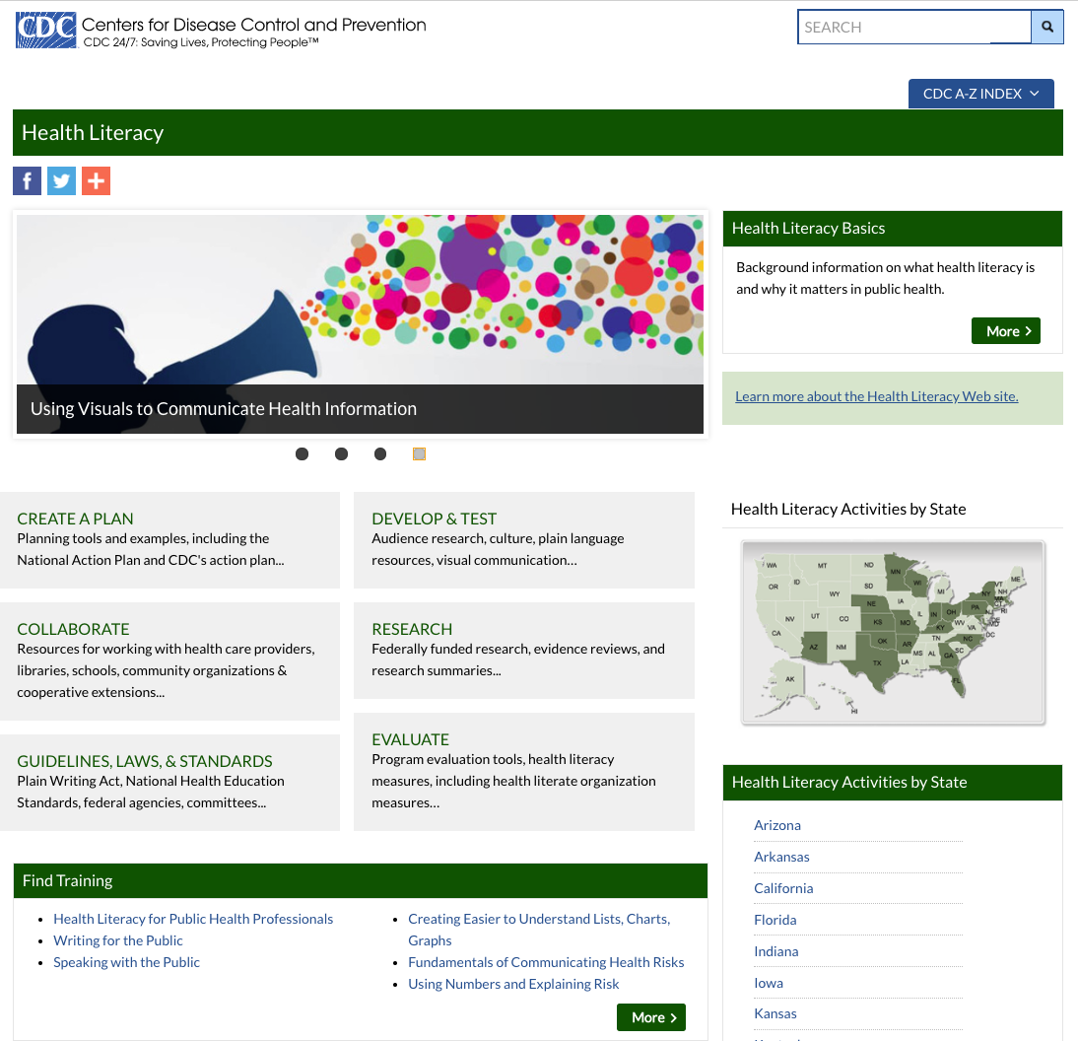
CDC’s Health Literacy Web Site
CDC’s Health Literacy site provides
  information
  tools
  links
on health literacy research, practice, and evaluation for public health topics and situations.
(Centers for Disease Control and Prevention, 2017)
Click to link to site
https://www.cdc.gov/healthliteracy/index.html#

Slide 43
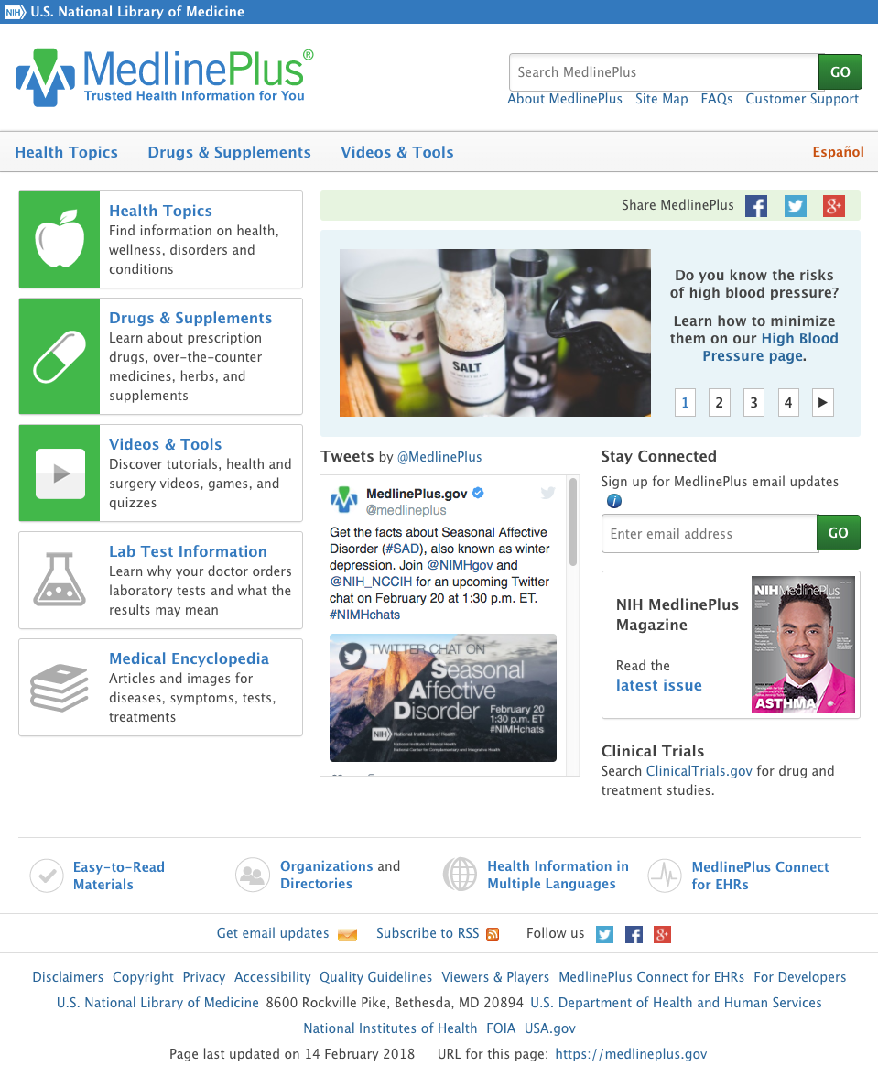
MedlinePlus.gov
MedlinePlus®
  patient education database.
  authoritative, reliable information.
  easily understood reading level.
      Health topics.
      Drugs, herbals, supplements.
      Medical dictionary.
      Medical encyclopedia.
      Directories.
      Organizations.
      Interactive videos.
      Health information in
      multiple languages.
(U.S. Department of Health and Human Services, 2016)

Slide 44
Final Points
Integrating the principles of EBP into your future practice will include:
  using the five steps of the evidence–based process.
  building a focused well–articulated clinical question using PICO.
  using EBP information resources.
  determining the strength of recommendations, the quality of evidence, and the strength of the evidence.
  critically appraising the information.
  integrating the information with the patient's values.

Slide 45
For Future Study
CEBM, Centre for Evidence Based Medicine. (2016). CEBM. Website, Centre for Evidence Based Medicine, University of Oxford, Oxford, U.K. http://www.cebm.net
Straus, S.E., Richardson, W.S., Glasziou, P., & Haynes, R.B. (2005). Evidence–based medicine: how to practice and teach EBM. Edinburgh: Elsevier/Churchill Livingstone.
The Cochrane library. (2016). Cochrane Library.
  http://www.cochranelibrary.com
U.S. Department of Health and Human Services, Office of Disease Prevention and Health Promotion. (2008). Quick guide to health literacy (2008). Washington, D.C.: U.S. Department of Health and Human Services. Retrieved from https://health.gov/communication/literacy/quickguide/

Slide 46
Glossary p. 1
Best research evidence
  Valid and clinically relevant research, often from the basic sciences of medicine. (Straus, 2005)
Clinical Queries
  Provides specialized searches for clinicians. It includes clinical search filters based on research done by R. Brian Haynes, M.D., Ph.D. Five study categories or filters are provided: etiology, diagnosis, therapy, prognosis, and clinical prediction guidelines.
  Two scope filters are provided:
Broad/Sensitive search – includes relevant citations but probably less relevant; will retrieve more.
Narrow/Specific search – will get more precise, relevant citations but less retrieval. (U.S. Department of Health and Human Services, 2016)

Slide 47
Glossary p. 2
Clinical expertise
  The ability to use clinical skills and past experience to identify each patient’s unique health state and diagnosis rapidly. (Straus, 2005)
Cochrane Collaboration
  An independent global network... that gathers and summarizes the best evidence from research to help users make informed choices about treatment. They produce the Cochrane Library.
  (The Cochrane Collaboration, 2018)
Critical appraisal
  The process of assessing and interpreting evidence by systematically considering its validity, results and relevance. (The Cochrane Collaboration, 2018)

Slide 48
Glossary p. 3
Evidence–based practice (EBP)
  "Evidence based medicine is the conscientious, explicit, and judicious use of current best evidence in making decisions about the care of individual patients. The practice of evidence based medicine requires the integration of individual clinical expertise with the best available external clinical evidence from systematic research and our patient's unique values and circumstances. (Sackett, 2000)
  By clinical expertise we mean the ability to use our clinical skills and past experience to rapidly identify each patient's unique health state and diagnosis, their individual risks and benefits of potential interventions, and their personal circumstances and expectations.
  By patient values we mean the unique preferences, concerns and expectations each patient brings to a clinical encounter and which must be integrated into clinical decisions if they are to serve the patient. By patient circumstances we mean their individual clinical state and the clinical setting." (Straus, 2005)

Slide 49
Glossary p. 4
GRADE
  Grading of Recommendations, Assessment, Development, and Evaluation (GRADE Working Group, 2005)
Hierarchy of Study Designs
  A system of classifying and organizing types of evidence, typically for questions of treatment and prevention. Clinicians should look for the evidence from the highest position in the hierarchy. (Guyatt, 2008)

Slide 50
Glossary p. 5
Patient circumstances and unique values
  Circumstances: Their individual clinical state and the clinical setting.
  Values: The unique preferences, concerns, and expectations each patient brings to a clinical encounter. (Straus, 2005)
PICO
  A method for answering clinical questions. (Guyatt, 2008)
  Quality of Evidence
  Can be categorized as high, moderate, low, or very low.
  (GRADE Working Group, 2005)

Slide 51
Glossary p. 6
Strength of Recommendation Taxonomy (SORT)
  Addresses the quality, quantity, and consistency of evidence and allows authors to rate individual studies or bodies of evidence. The taxonomy is built around the information mastery framework, which emphasizes the use of patient–oriented outcomes that measure changes in morbidity or mortality.
    A–level recommendation is based on consistent and good–quality patient–oriented evidence.
    B–level recommendation is based on inconsistent or limited–quality patient–oriented evidence.
    C–level recommendation is based on consensus, usual practice, opinion, disease–oriented evidence, or case series for studies of diagnosis, treatment, prevention, or screening. (Ebell, & et al., 2004)

Slide 52
References
Bennett, S., Hoffmann, T., McKenna, K., Strong, J. & Tooth, L. (2003). Welcome to OTseeker. Retrieved from http://www.otseeker.com/default.aspx
Carlise, A., Jacobson, K., Lorenzo, D., & Parker, R. (2011). Practical Strategies to Improve Communication With Patients. Pharmacy & Therapeutics, 36(9), 576-589. Retrieved from http://www.ncbi.nlm.nih.gov/pmc/articles/PMC3278143/
Centre of Evidence–Based Physiotherapy. (1999). Welcome to PEDro. Retrieved from http://www.pedro.org.au/
Citrome, L., & Ketter, T. A. (2009). Teaching the philosophy and tools of evidence–based medicine: Misunderstandings and solutions. Journal of Evidence-Based Medicine, 2 (4) pp.220-5, November, 2009, doi: 10.1111/j.1756–5391.2009.01041.x
Dawes, Martin. (2001). Practice of Evidence–Based Medicine [PowerPoint slides] . Retrieved from: http://slideplayer.com/slide/4593145/ 23 Apr. 2018.
Essential Evidence Plus EBM Guidelines Editorial Team. (2010). Modification of GRADE (grading of recommendations assessment, development and evaluation) working group 2007, http://www.gradeworkinggroup.org/. Retrieved from http://www.essentialevidenceplus.com/product/ebm_loe.cfm?show=grade
Ebell, M.H., Siwek, J., Weiss, B.D., Woolf, S.H., Susman, J., Ewigman, B., & Bowman, M. (2004). Strength of recommendation taxonomy (sort): a patient–centered approach to grading evidence in the medical literature. American Family Physician, 69(3) 548-56, Retrieved from http://www.aafp.org/afp/2004/0201/p548.html
GRADE Working Group. (2004). Grading quality of evidence and strength of recommendations. (2004). BMJ, 328(7454), 1490. Retrieved from https://www.ncbi.nlm.nih.gov/pmc/articles/PMC428525/ doi: https://doi.org/10.1136/bmj.328.7454.1490
Guyatt, G. H., Oxman, A. D., Vist, G. E., Kunz, R., Falck-Ytter, Y., Alonso-Coello, P., & Schünemann, H. J. (2008). GRADE: an emerging consensus on rating quality of evidence and strength of recommendations. BMJ, 336(7650), 924-926. PMC2335261
Guyatt, G. H., Oxman, A. D., Kunz, R., Falck-Ytter, Y., Vist, G. E., Liberati, A., & Schünemann, H. J. (2008). Going from evidence to recommendations. BMJ, 336(7652), 1049-1051. PMC2376019
Guyatt, G. H., Oxman, A. D., Kunz, R., Vist, G. E., Falck-Ytter, Y., & Schünemann, H. J. (2008). What is “quality of evidence” and why is it important to clinicians? BMJ, 336(7651), 995-998. PMC2364804
Guyatt, G., Rennie, D., Meade, M., & Cook, D. (2015). Users' guides to the medical literature. New York: McGraw-Hill Education Medical.
Haynes, R.B., & et al. (2005). In U.S. Department of Health and Human Services, U.S. National Institutes of Health, U.S. National Library of Medicine (Ed.), Summary of enhancements for clinical queries for medline for studies. Bethesda, MD: U.S. Department of Health and Human Services. Retrieved from http://www.nlm.nih.gov/pubs/techbull/jf04/cq_info.html

Slide 53
References
McKibbon, A., & Wilczynski, N. (2009). PDQ: Evidence-based principles and practice (2nd ed.). Shelton, CT: People’s Medical Publishing House.
Nielsen–Bohlman, L., Panzer, A., & Kindig, D.A. (2004). Health literacy: a prescription to end confusion. Washington, D.C.: The National Academies Press.
https://www.ncbi.nlm.nih.gov/books/NBK216032/
Peregrin, T. (2010). Picture this: visual cues enhance health education messages for people with low literacy skills. Journal of the American Dietetic Association, 110(4), 500–5. PMID: 20338272 DOI: 10.1016/j.jada.2010.02.019
Ratzan, S.C., & Parker, R.M. U.S. Department of Health and Human Services, U.S. Public Health Service, U.S. National Institutes of Health, U.S. National Library of Medicine, Reference Section. (2000). Introduction. In: National library of medicine current bibliographies in medicine: health literacy (NLM Pub. No. CBM 2000–1). Bethesda, MD: U.S. Department of Health and Human Services http://www.nlm.nih.gov/archive//20061214/pubs/cbm/hliteracy.html
Rennie, D. (2008). Users' guides to the medical literature. New York: McGraw–Hill Medical. https://jamaevidence.mhmedical.com/book.aspx?bookID=847&TopLevelContentDisplayName=Books
Sackett, D.L. (2000). Evidence–based medicine: how to practice and teach EBM. Edinburgh: Churchill Livingstone.
Straus, S.E., Richardson, W.S., Glasziou, P., & Haynes, R.B. (2005). Evidence–based medicine: how to practice and teach EBM. Edinburgh: Elsevier/Churchill Livingstone.
The Cochrane collaboration. (2016). About the cochrane library Retrieved from http://www.cochranelibrary.com/about/about-the-cochrane-library.html
The Cochrane Collaboration. (2018). Glossary. Retrieved April 24, 2018, from http://community.cochrane.org/glossary
The JAMA Network. The 5A’s of the health information cycle: Robert Hayward, MD, defines the 5A’s of the health information cycle and helps learners understand the process. JAMAevidence audio [audio podcast]. Retrieved from https://jamaevidence.mhmedical.com/podcasts.aspx
U.S. Department of Health & Human Services, Centers for Disease Control and Prevention. (2017). Health literacy. Atlanta, GA: Centers for Disease Control and Prevention. Retrieved from https://www.cdc.gov/healthliteracy/index.html
U.S. Department of Health and Human Services, Public Health Service, U.S. National Institutes of Health, U.S. National Library of Medicine. (2010). Medlineplus®: trusted health information for you. Bethesda, MD: U.S. Department of Health and Human Services. Retrieved from http://www.nlm.nih.gov/medlineplus/
U.S. Department of Health and Human Services, Public Health Service, U.S. National Institutes of Health, U.S. National Library of Medicine. (2016). PubMed Help [Internet]. Using clinical queries. Bethesda, MD: U.S. Department of Health and Human Services. Retrieved from http://www.ncbi.nlm.nih.gov/books/NBK3827/#pubmedhelp.Clinical_Queries_Filters
University of Washington Health Sciences Libraries. (2014). LibGuides. Evidence-Based Practice. PICO. Retrieved from http://libguides.hsl.washington.edu/content.php?pid=231619&sid=1931590

