Slide 1
Joanna Briggs Institute’s
JBI COnNECT+
Evidence-based practice information
Developmental tools:
    Practice manuals
    Patient education pamphlets
*
*
*
*
rev. 1-2017

Slide 2




When searching library applications, use
Mozilla Firefox
Safari

Slide 3
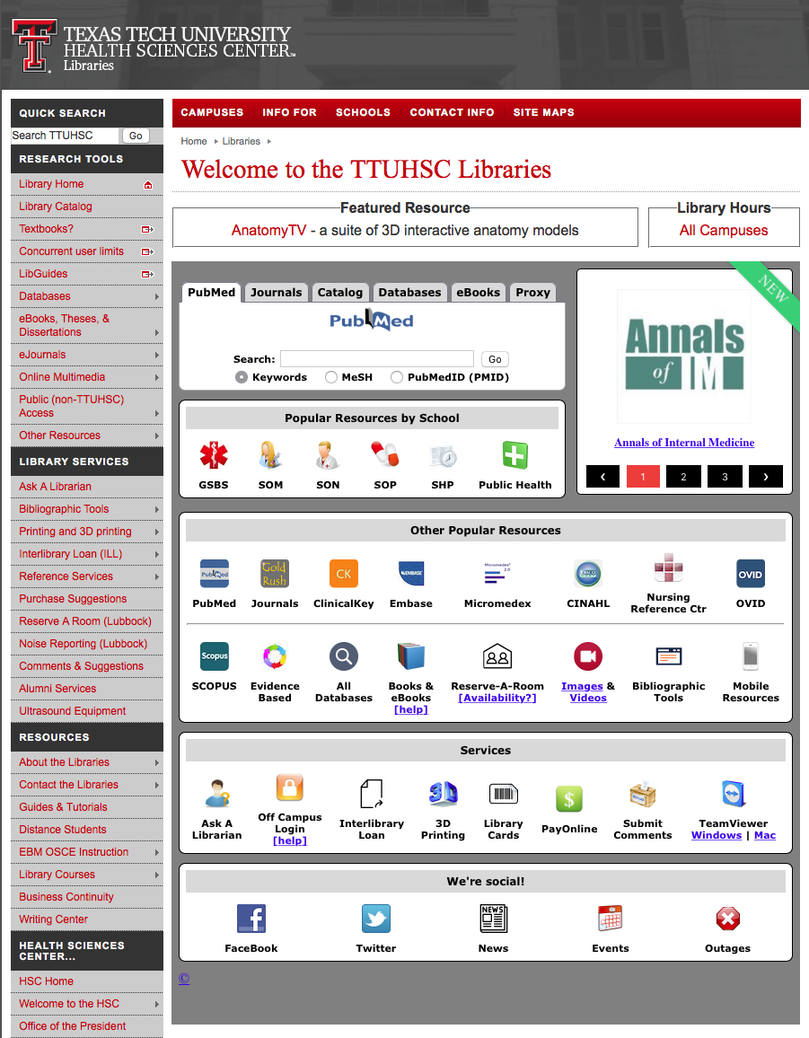
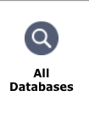
www.ttuhsc.edu/libraries
Click

Slide 4
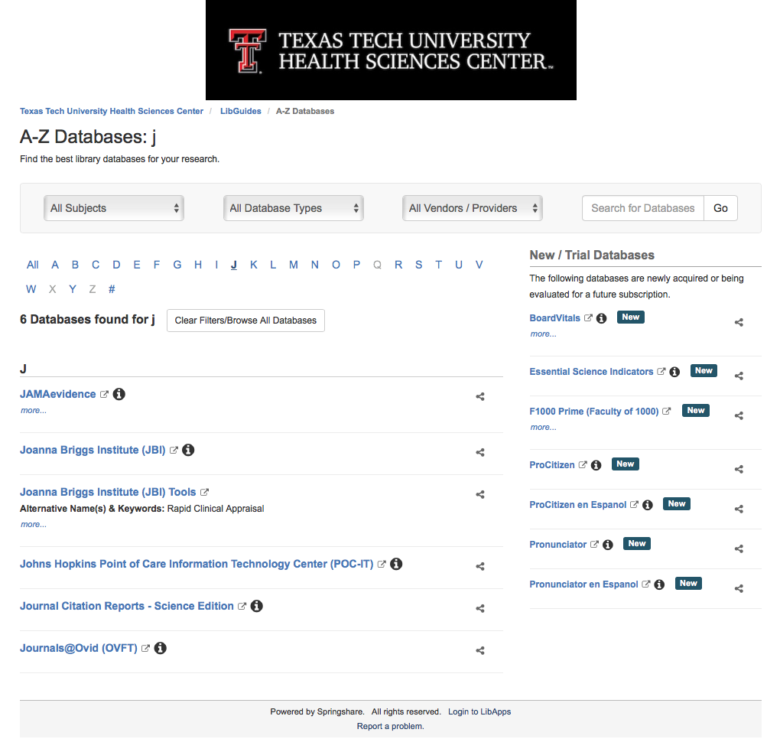
Click “J”
Click Joanna Briggs Institute

Slide 5
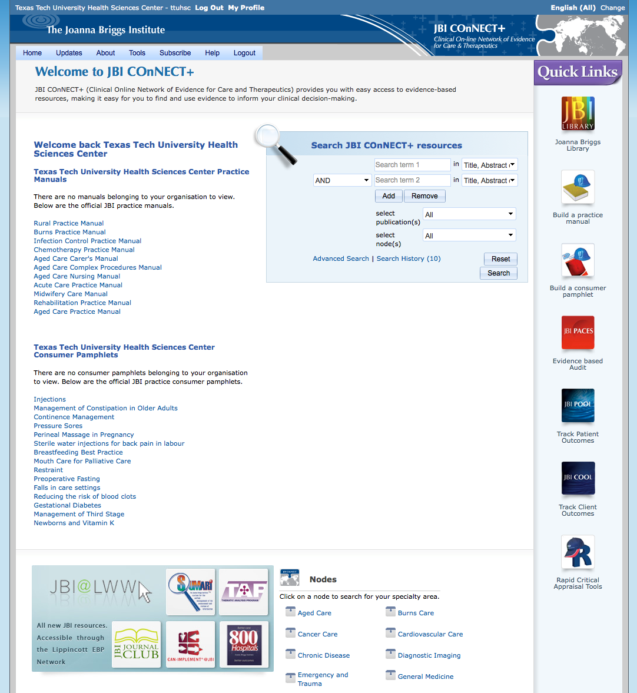
Home Page
Click Advanced Search

Slide 6
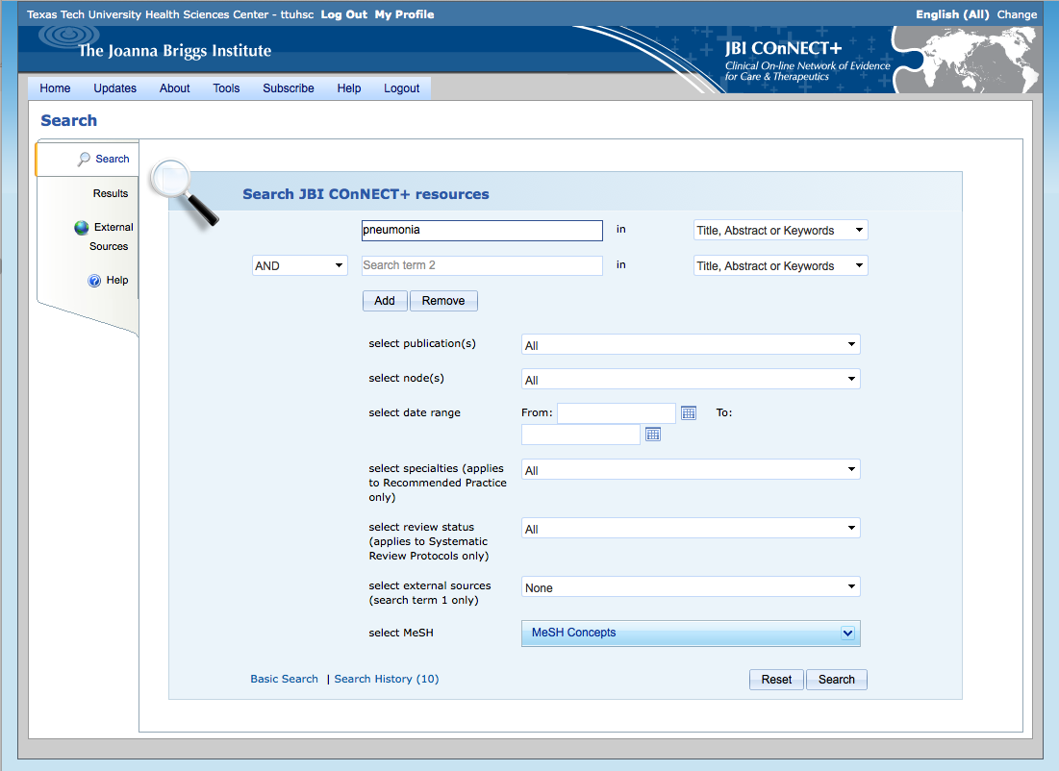
Enter pneumonia as a
Title, Abstract or Keyword search

Slide 7
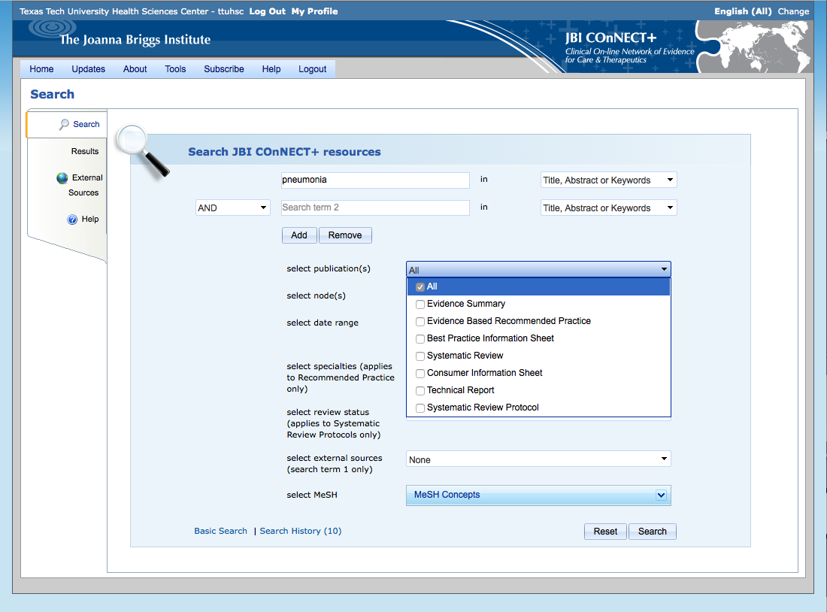
Keep All as the default

Slide 8
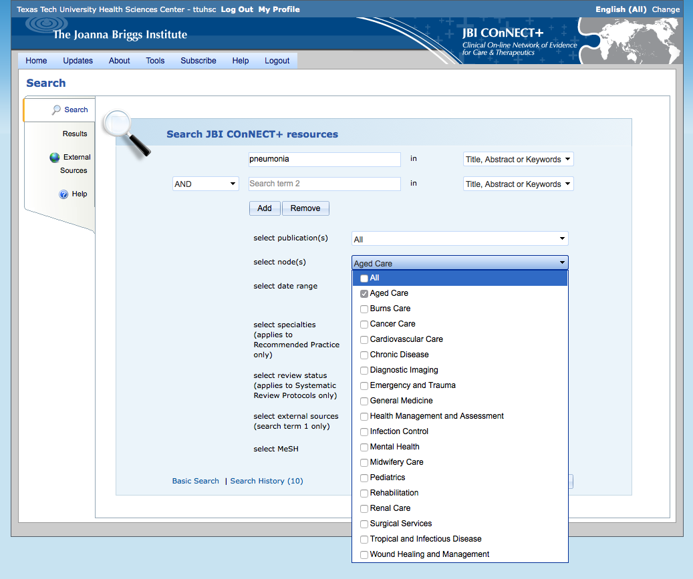
Select Aged Care

Slide 9
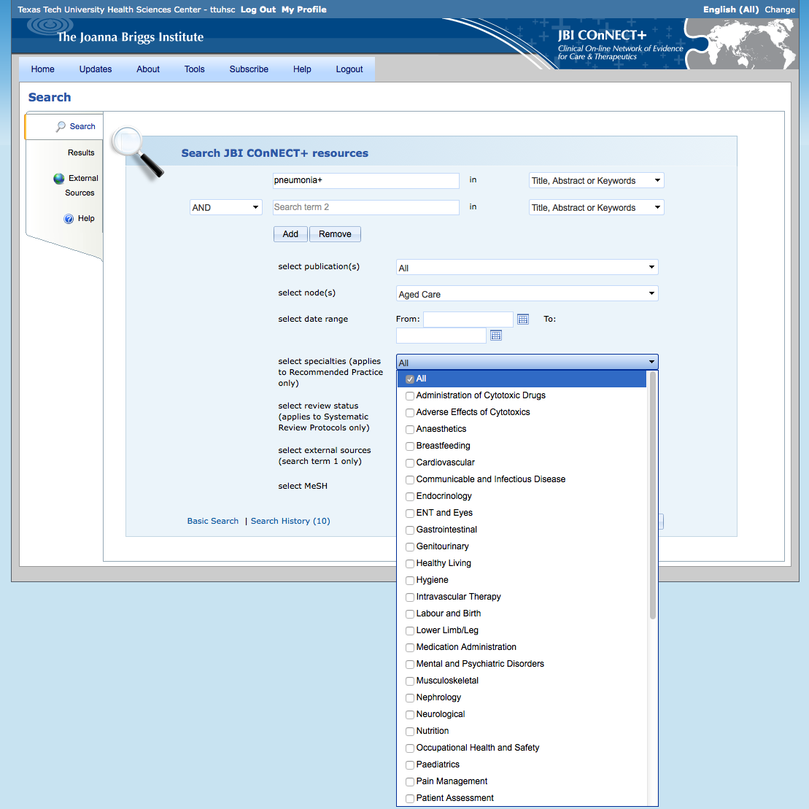
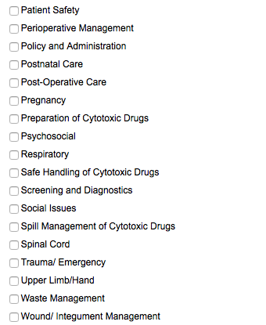
Keep All as the default

Slide 10
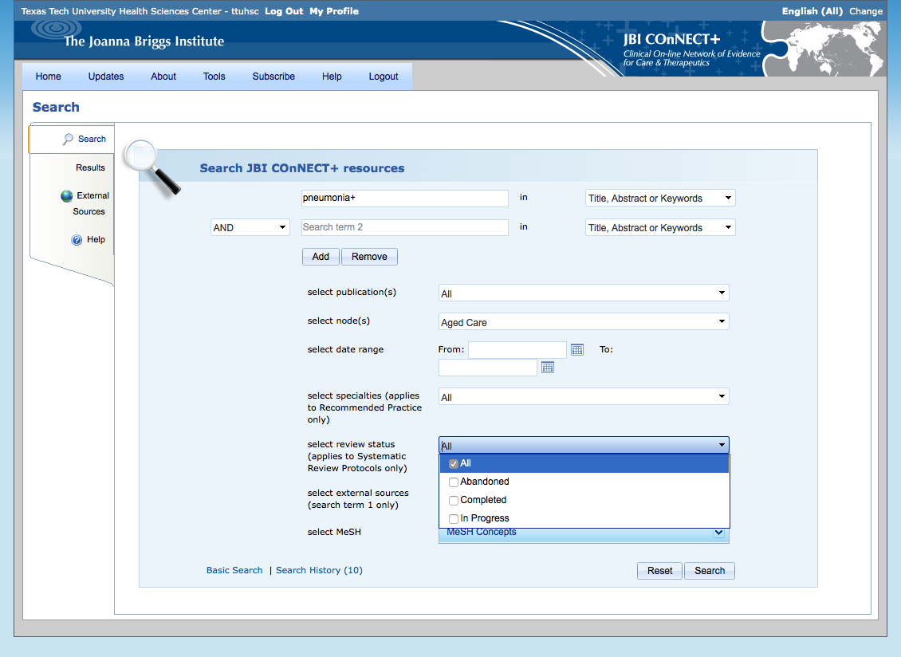
Keep All as the default

Slide 11
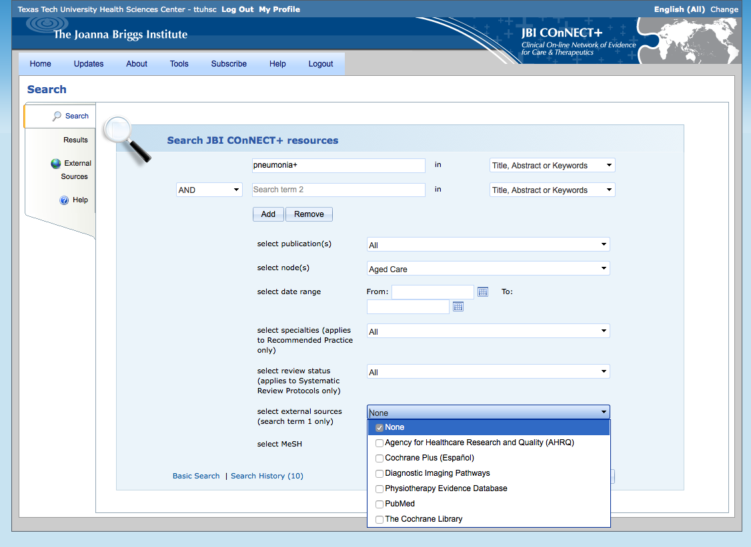
Keep None

Slide 12
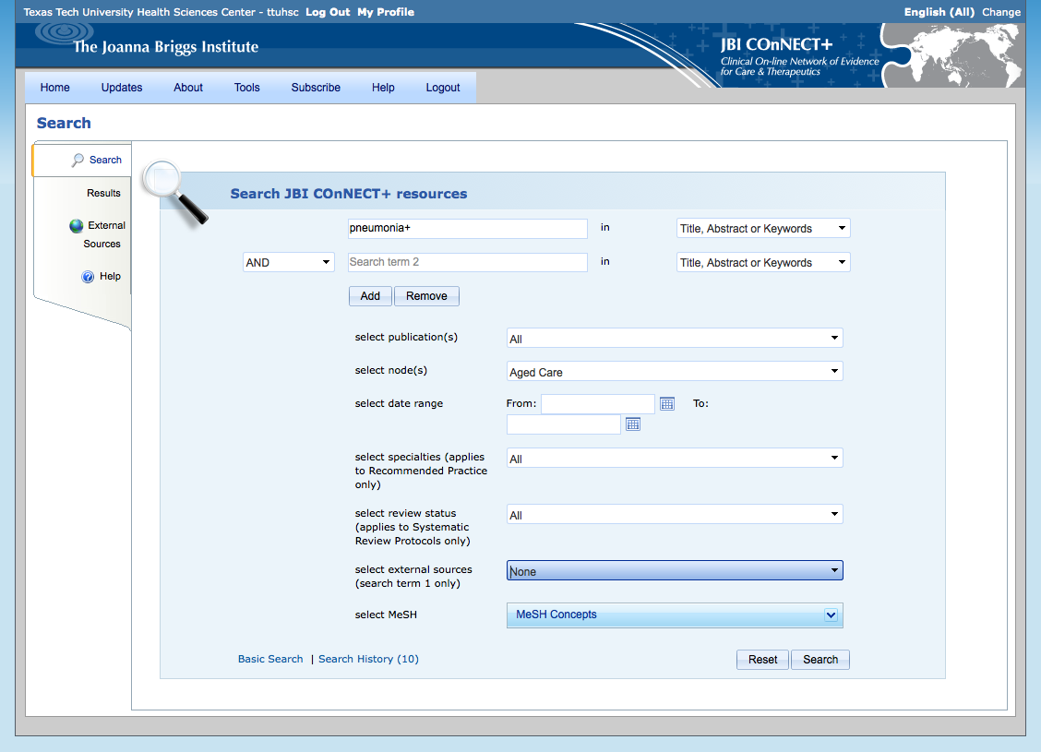
Click Search

Slide 13
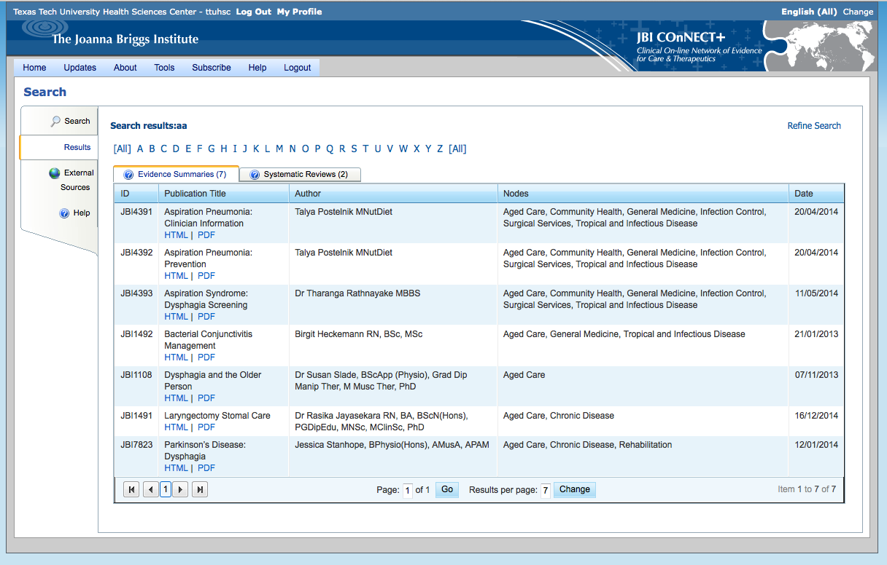
Click Home
Search Results

Slide 14
Home Page
Click Advanced Search

Slide 15
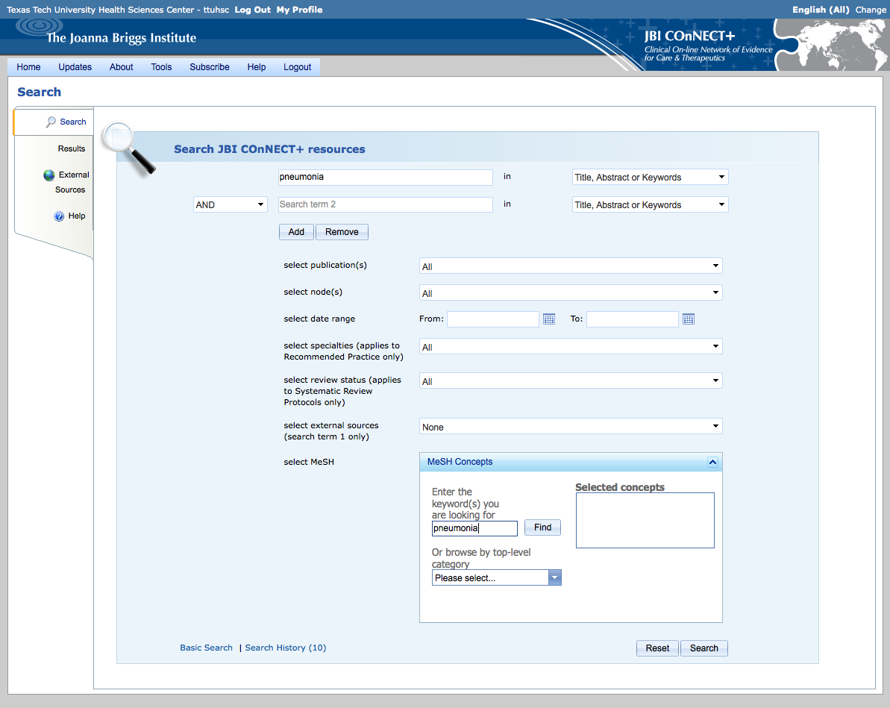
Click
Enter pneumonia
and click
Find

Slide 16
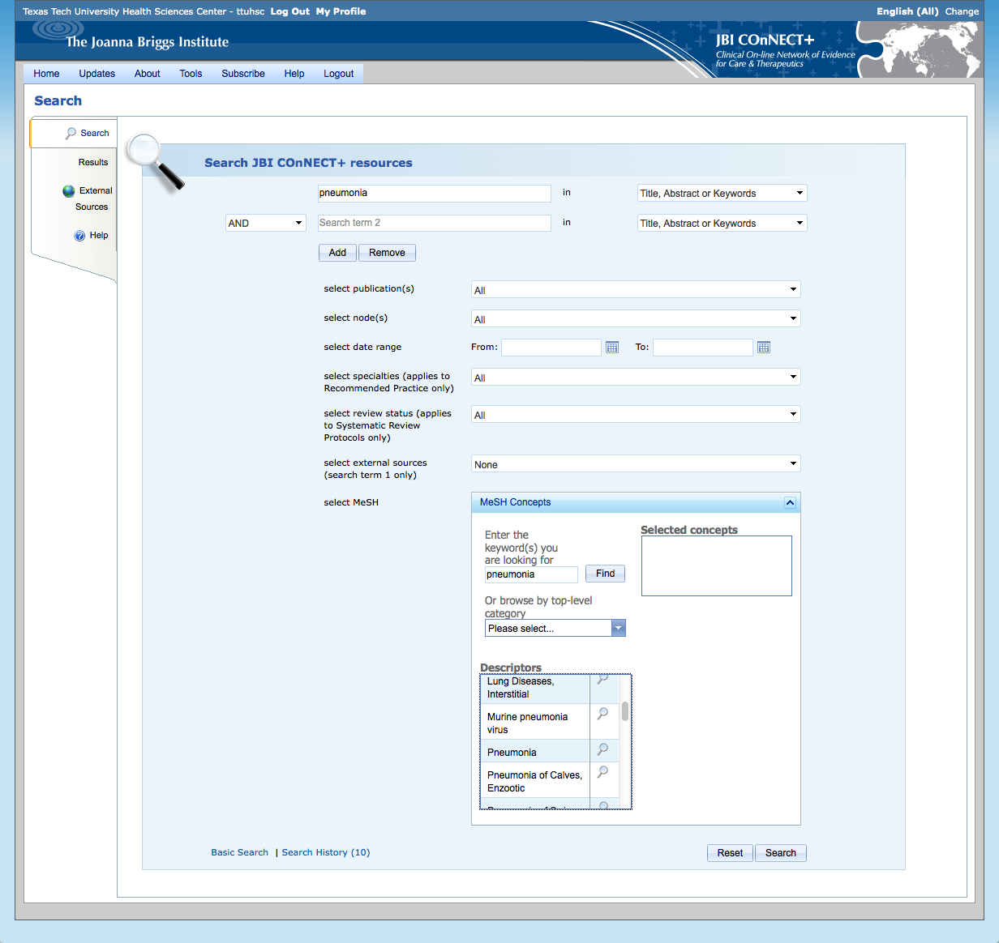

Scroll to Pneumonia
Click icon

Slide 17
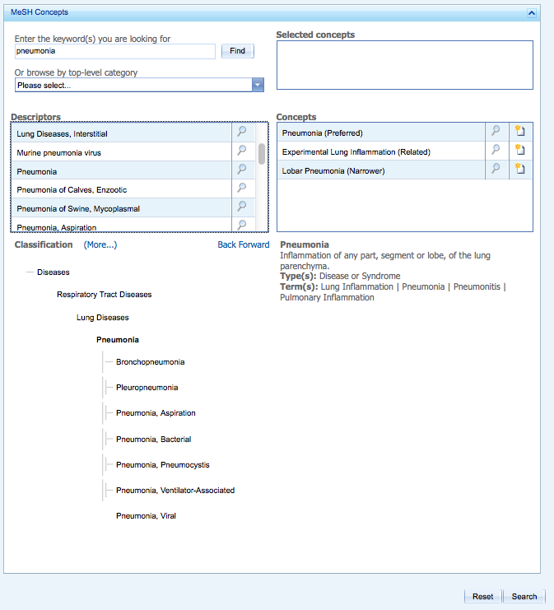
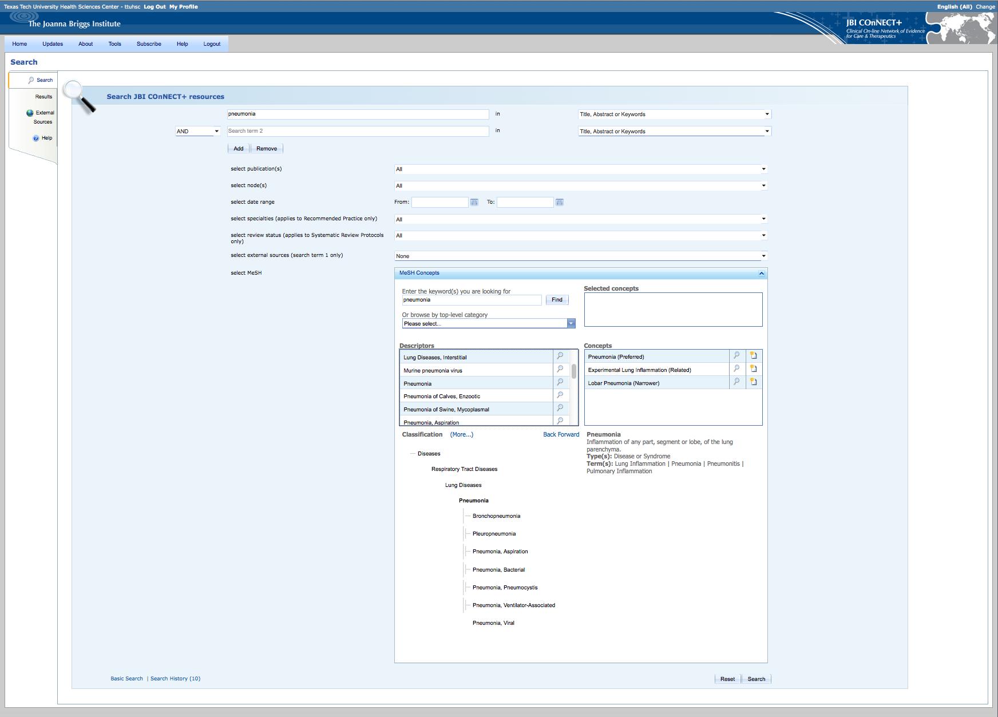

Click icon to select
MeSH Concepts
Click Search

Slide 18
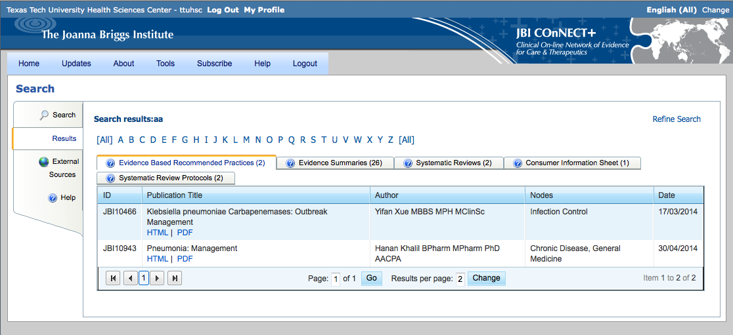
Results

Slide 19
Aged Care Manual

Slide 20
Select Aged Care Nursing Manual

Slide 21
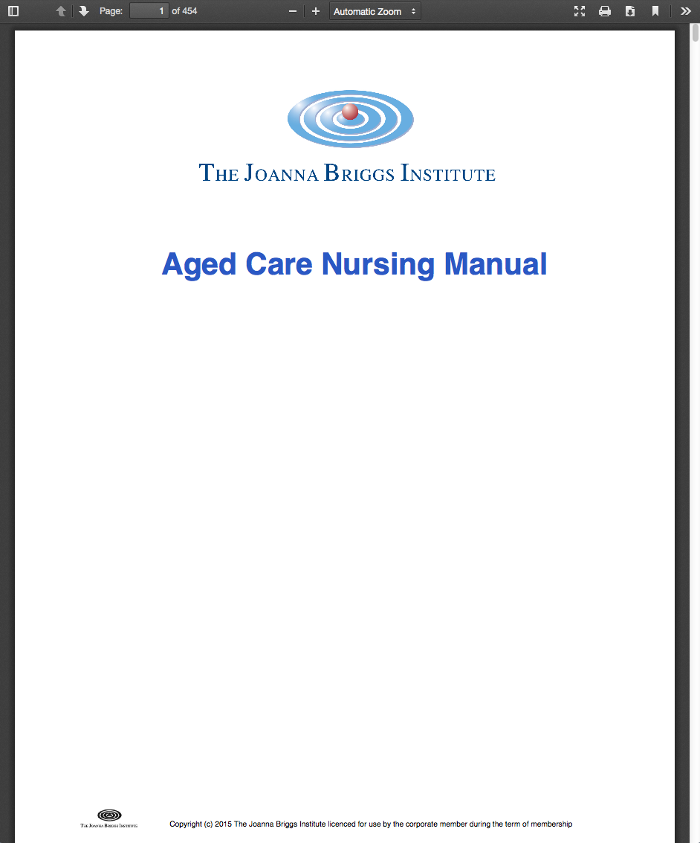
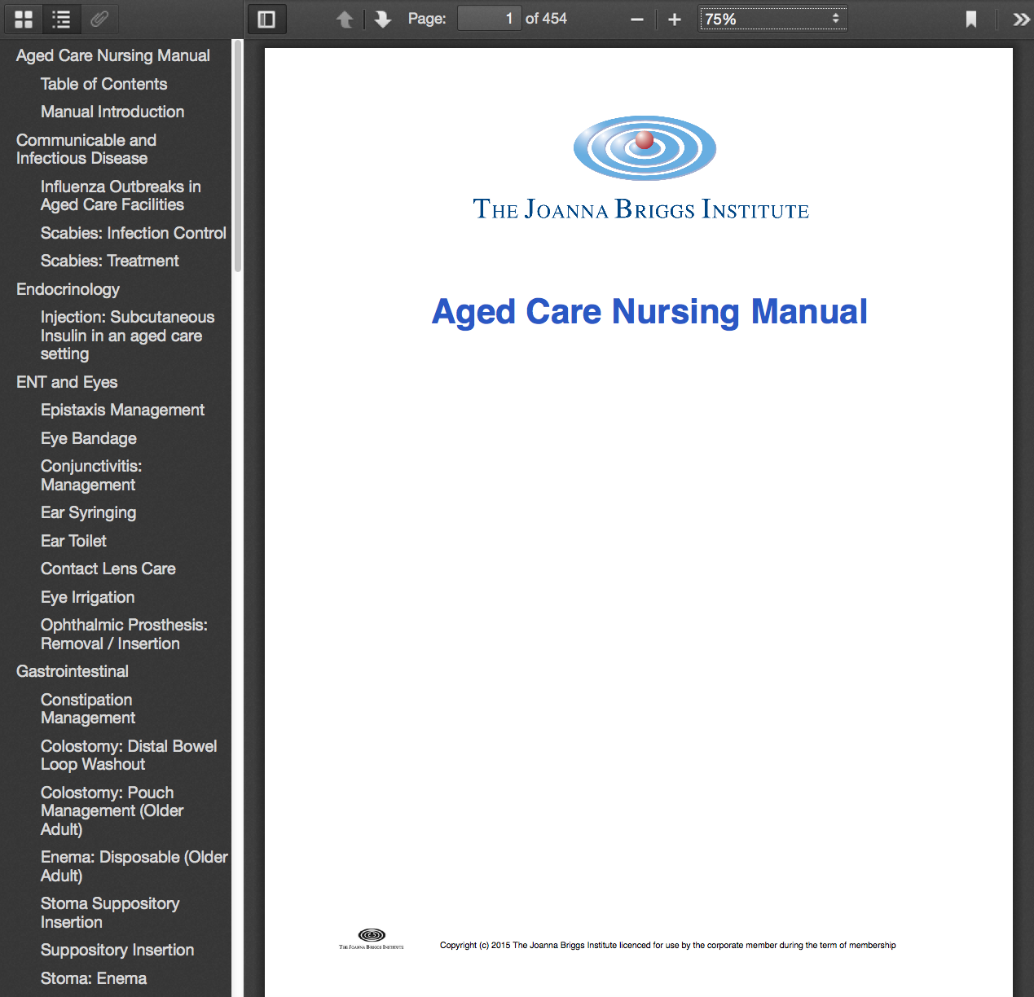
Click
Select Influenza Outbreaks in Aged Care Facilities

Slide 22
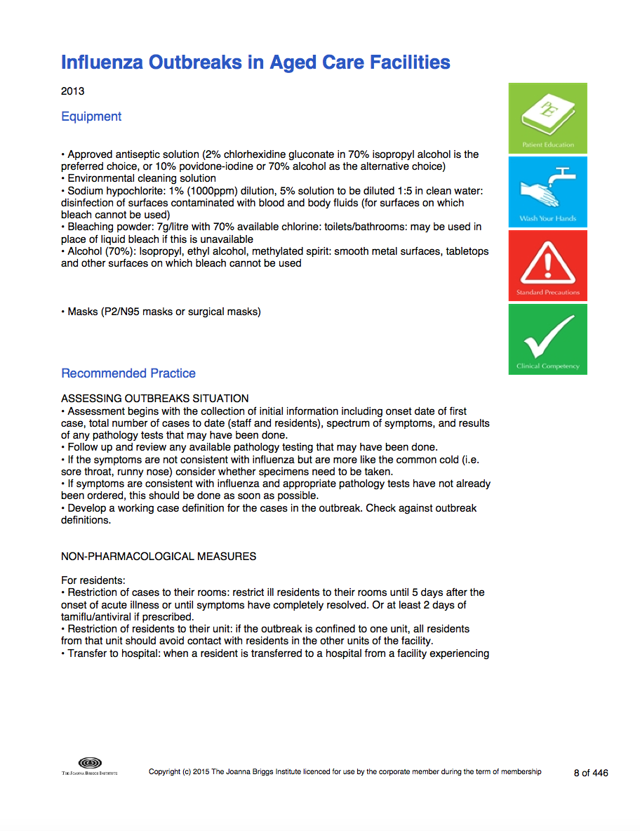
Full-Text Document

Slide 23
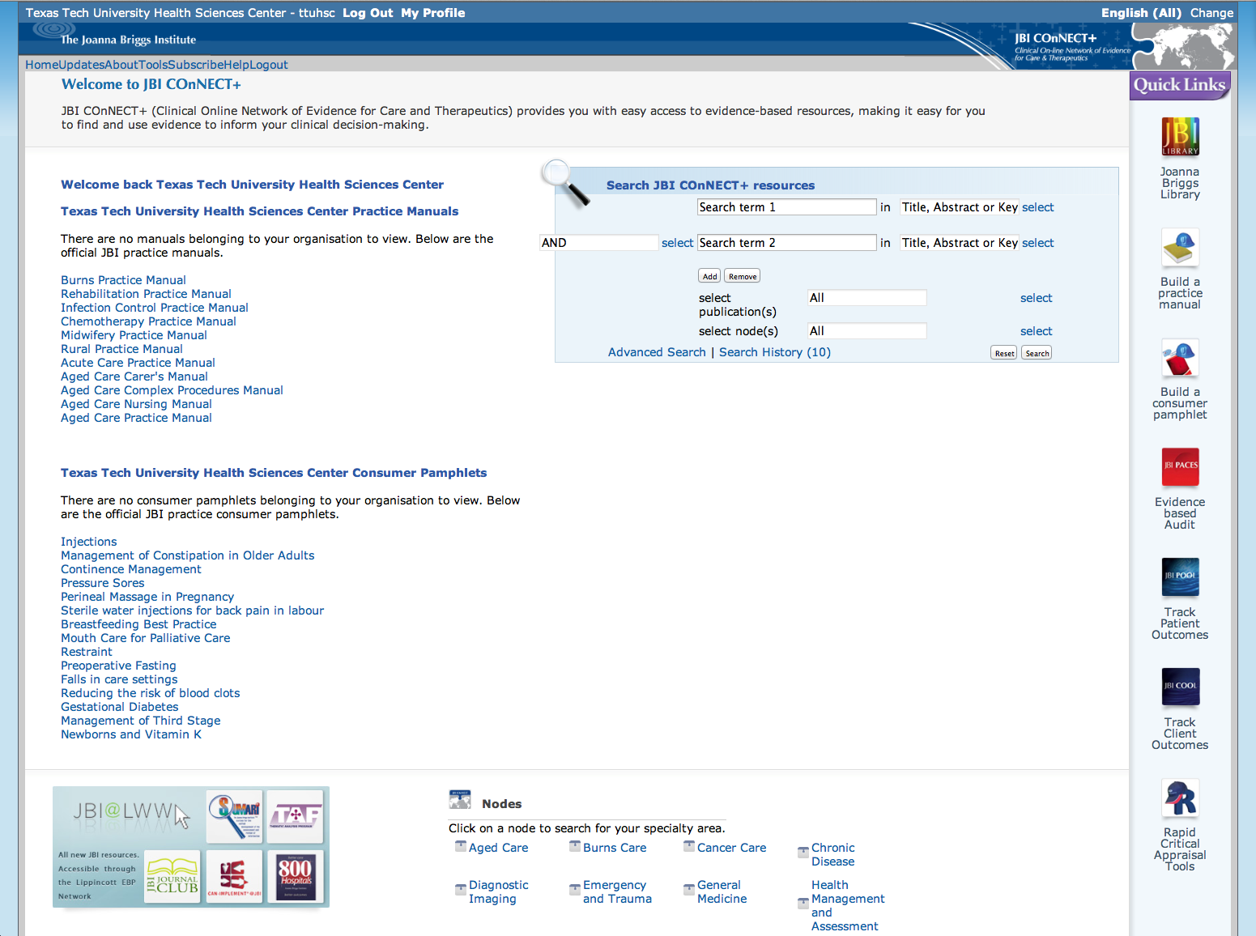
JBI Practice Consumer Pamphlets
Select Breastfeeding Best Practice

Slide 24
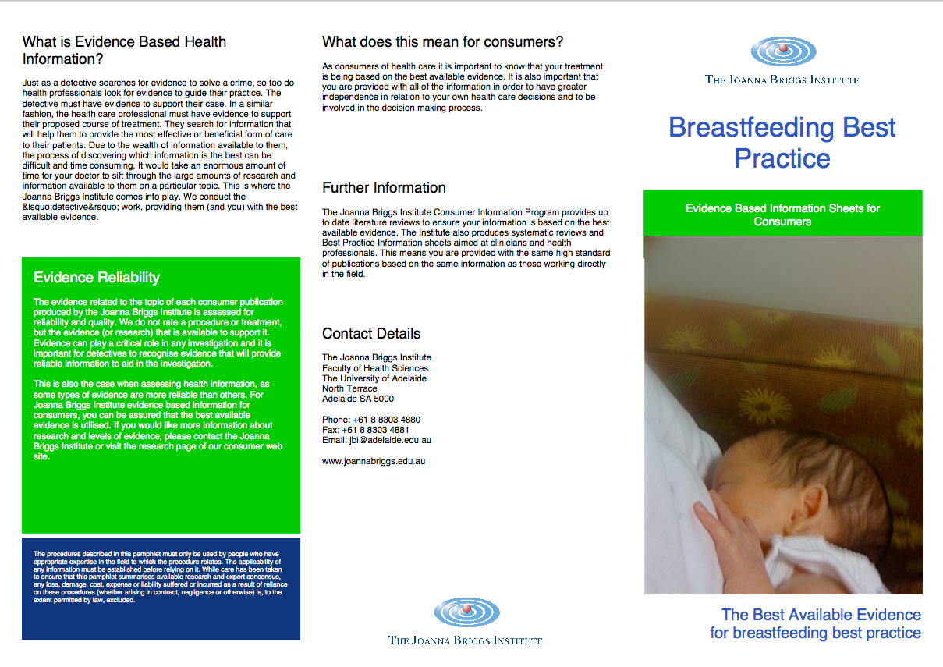
Example

Slide 25
Tools
Scroll

Slide 26
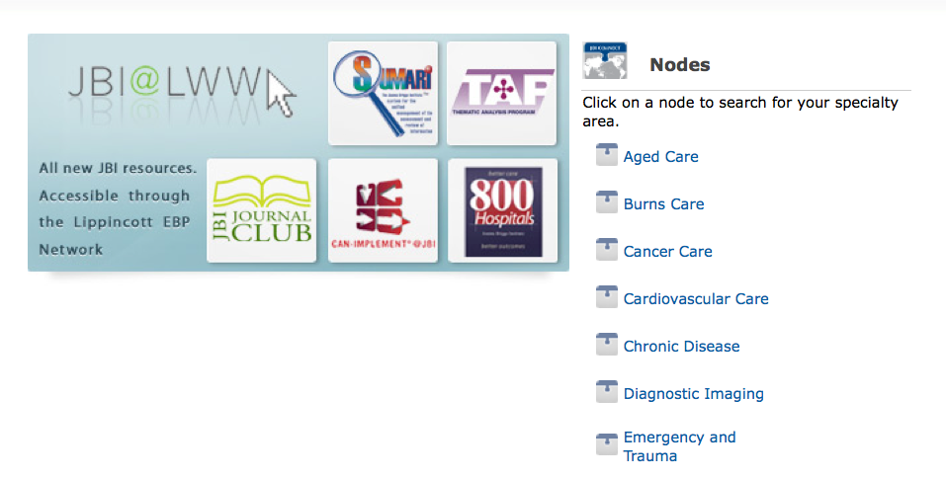
Nodes

Slide 27
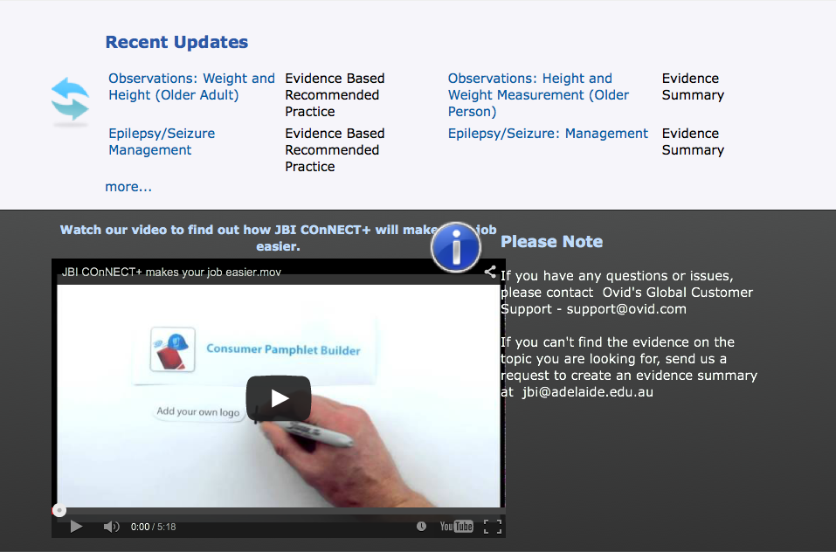
Video Tutorial

Slide 28
The End

