Slide 1
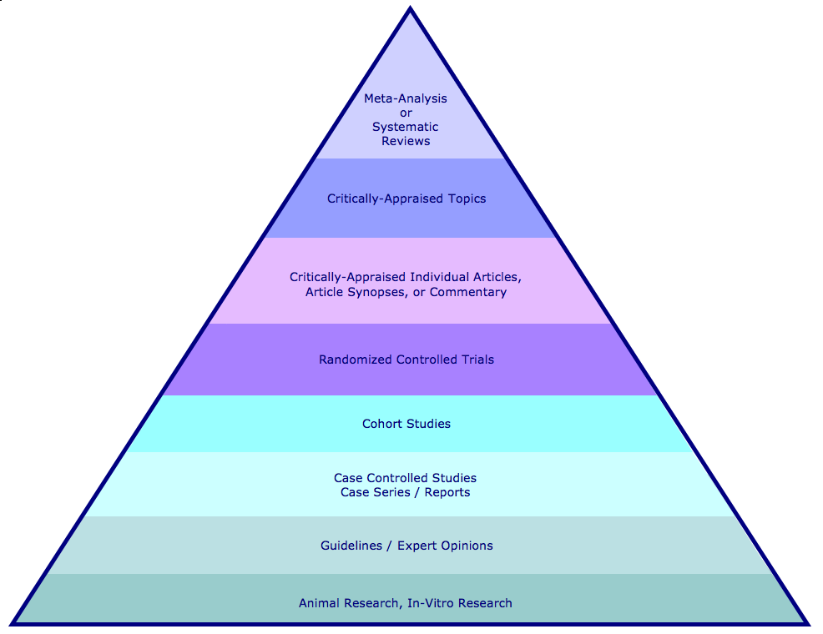
Hierarchy of Evidence and Corresponding Databases
Filtered Information
Cochrane Database of Systematic Reviews
Topic Reviews in the Cochrane Database of Systematic Reviewsa
a
Database of Abstracts of Reviews of Effectiveness (DARE)
NHS Economic Evaluation Database
Cochrane Methodology Register
ACP Journal Club
Unfiltered Information
Cochrane Central Register of Controlled Trials
PubMed
PubMed
National Guideline Clearinghouse
Health Technology Assessment
PubMed

Slide 2
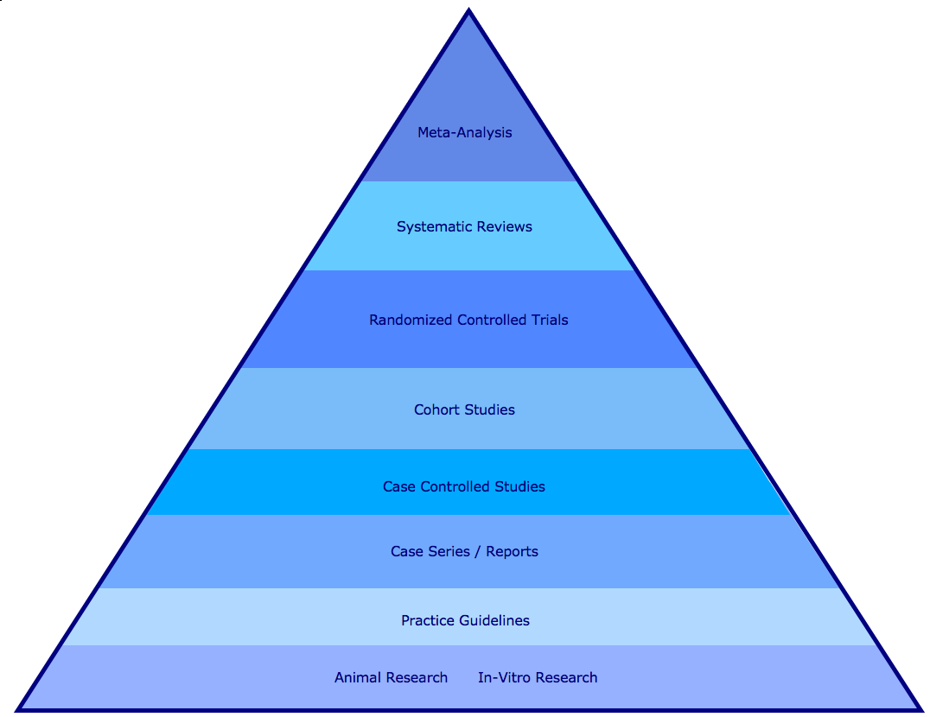
Hierarchy of Evidence and PubMed Search Strategies
Search for meta-analysis using the publication type limit.
Search for systematic review using the subset limit.
Search for randomized controlled trials using the publication type limit.
Search for cohort studies as a MeSH term.
Longitudinal studies, follow-up studies, and prospective studies will be included unless the Do Not Explode function is used.
Search for case control study as a MeSH term.
Retrospective studies included unless Do Not Explode is used.
Search for case report using the publication type limit.
Search for practice guideline using the publication type limit.
Search for animal research using the animal limit. Search for in-vitro research using in vitro as a publication type limit.

Slide 3
Study Category
Suggested Best Method of Investigation
Therapy
RCT>cohort>case control>case series
Diagnosis
prospective, blind comparison to a gold standard
Etiology/Harm
RCT>cohort>case control>case series
Prognosis
cohort>case control>case series
Prevention
RCT>cohort>case control>case series
Clinical Exam
prospective, blind comparison to a gold standard
Cost
Economic Analysis
Medical Library Association. MLANET, Education, Web-based Learning. Hp. Nov, 2001.
Web-based Courses: EBM and the Medical Librarian.
Available: http://www.mlanet.org/education/web/web_courses.html 10 Apr. 2005.

