Slide 1
Welcome
Locating EBM Literature
Peggy Edwards, AMLS
TTUHSC - Preston Smith Library
Lubbock, Texas 79430
March 6 2017

Slide 2




When searching library applications, use
Mozilla Firefox
Safari

Slide 3
P3 Goals
Demonstrate skills in:
  self-assessment of personal learning needs
  independent identification, analysis and synthesis of
  relevant information for purposes of lifelong learning
  critical assessment of the medical literature
  evidence-based medical practice
(L2, L3, L4, S2)

Slide 4
Link
Today’s power point Locating EBM Literature:
under Orientations and Presentations
http://www.ttuhsc.edu/libraries/schools/som.aspx

Slide 5
Life Long Learning with
LibGuides Tutorials

Slide 6
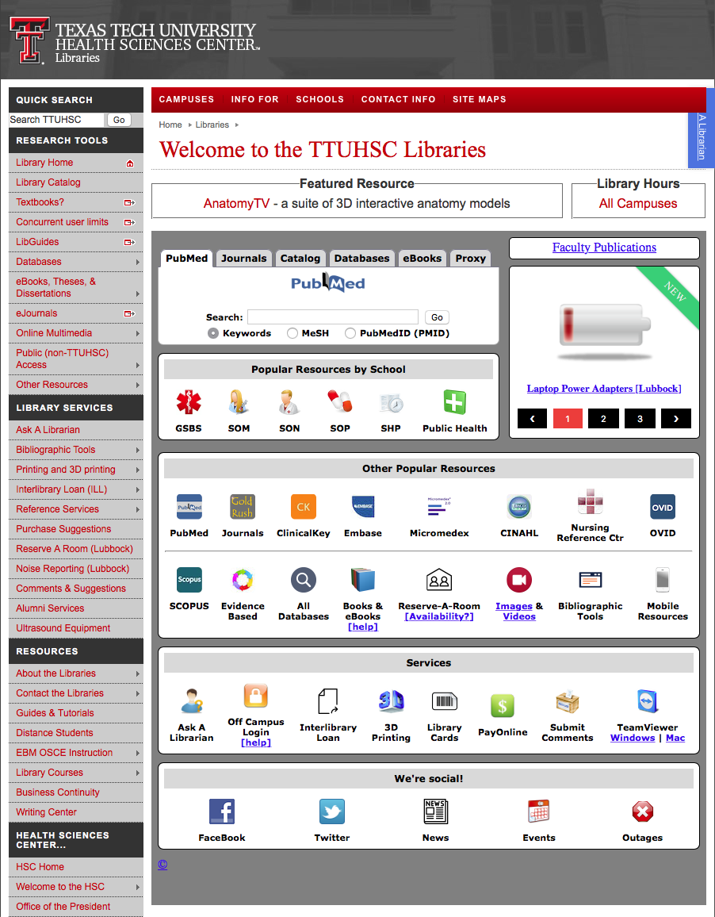
www.ttuhsc.edu/libraries
Click
LibGuides

Slide 7
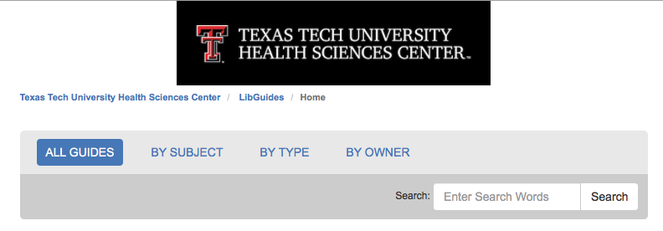
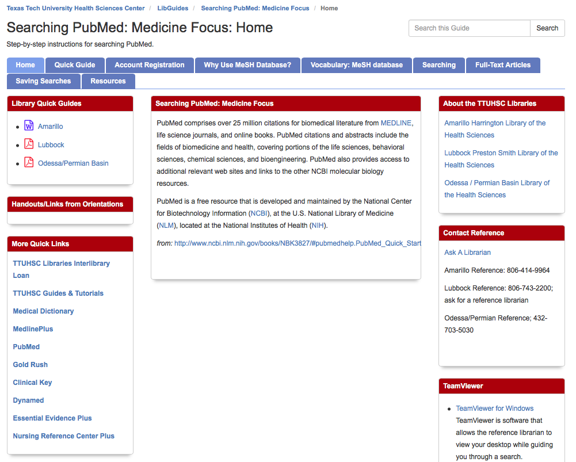
Scroll and select
Searching PubMed:
Medicine Focus
Link:
http://ttuhsc.libguides.com/pubmed1

Slide 8
EBM and the
Cochrane Databases

Slide 9
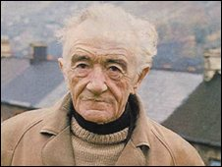
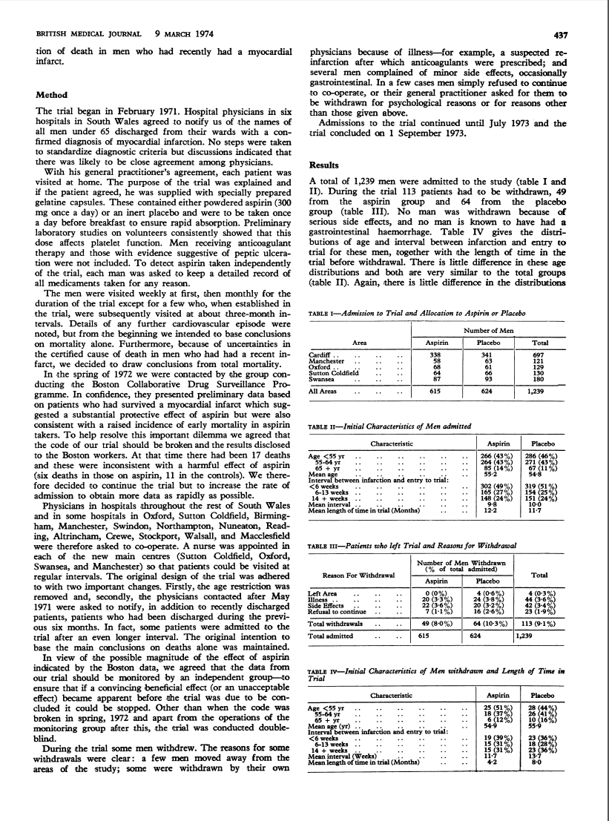
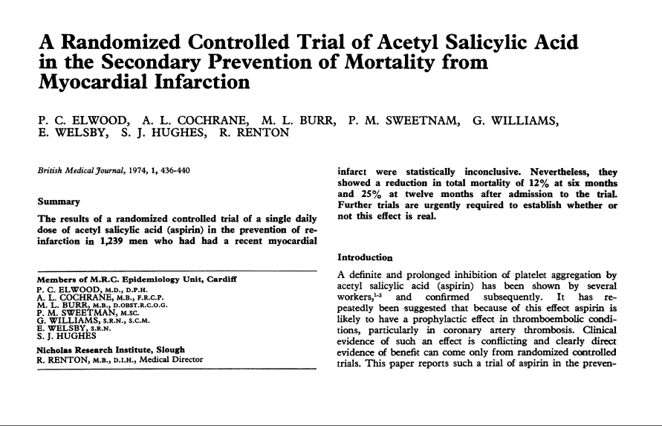
How EBM and the Cochrane Databases Got Started
by Archie Cochrane, M.D.

Slide 10

Scroll
www.thecochranelibrary.com

Slide 11
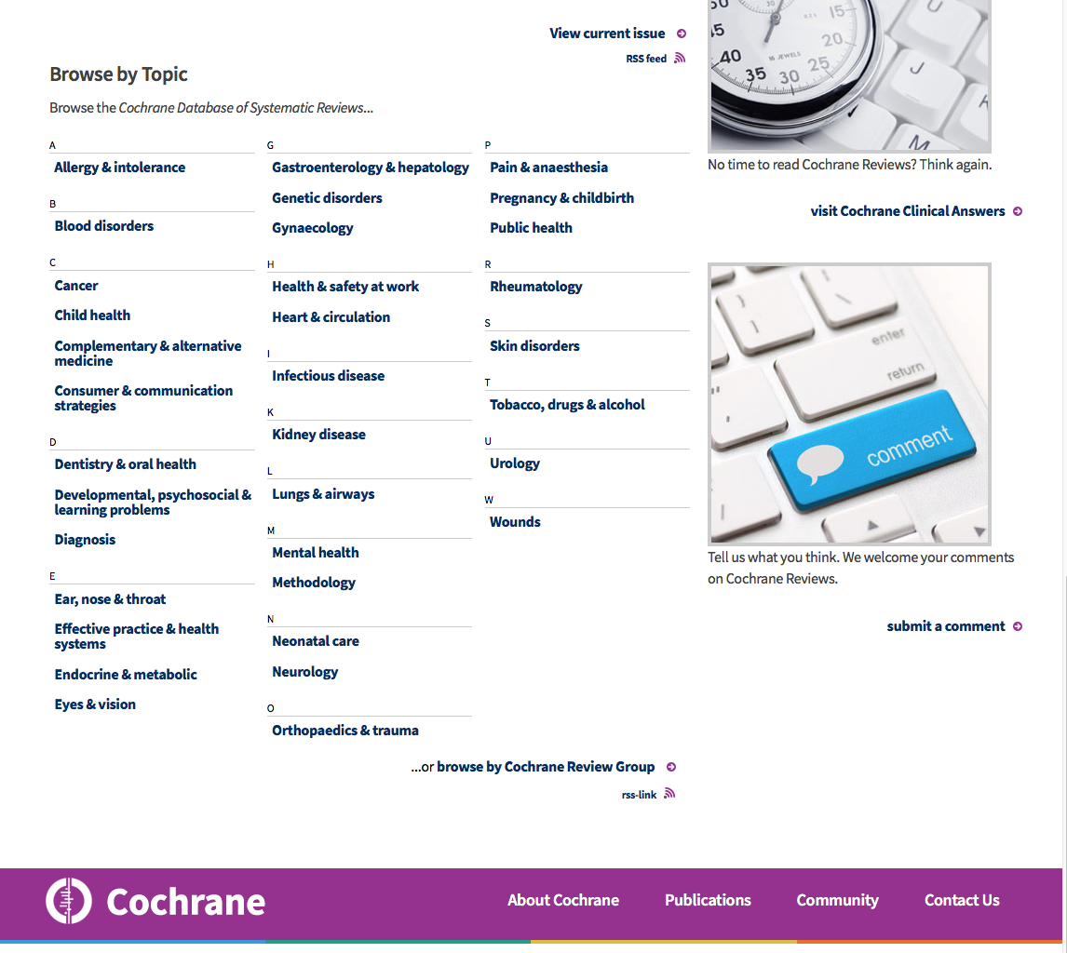
Browse by Topic

Slide 12
Creating a
My NCBI Account

Slide 13

www.ttuhsc.edu/libraries
Click PubMed

Slide 14
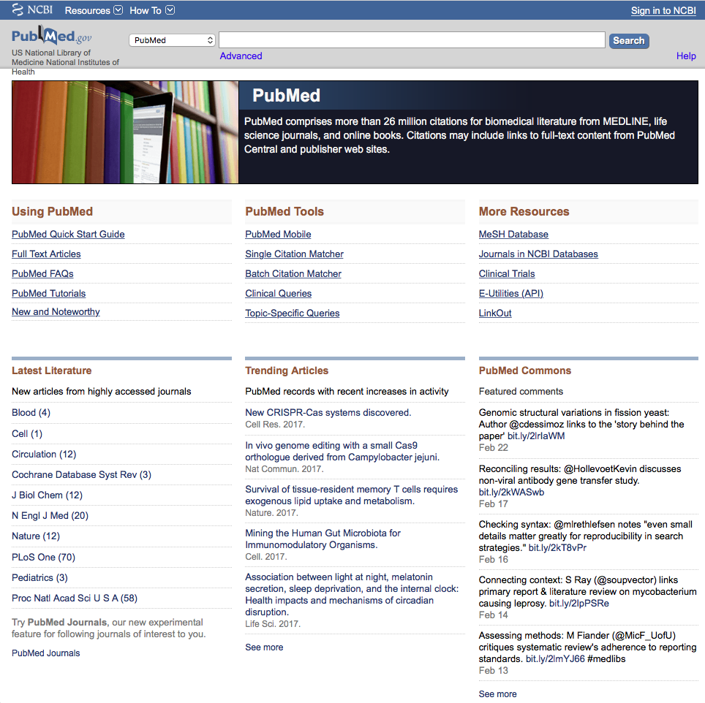
Click
Sign in to NCBI
PubMed Home Page

Slide 15
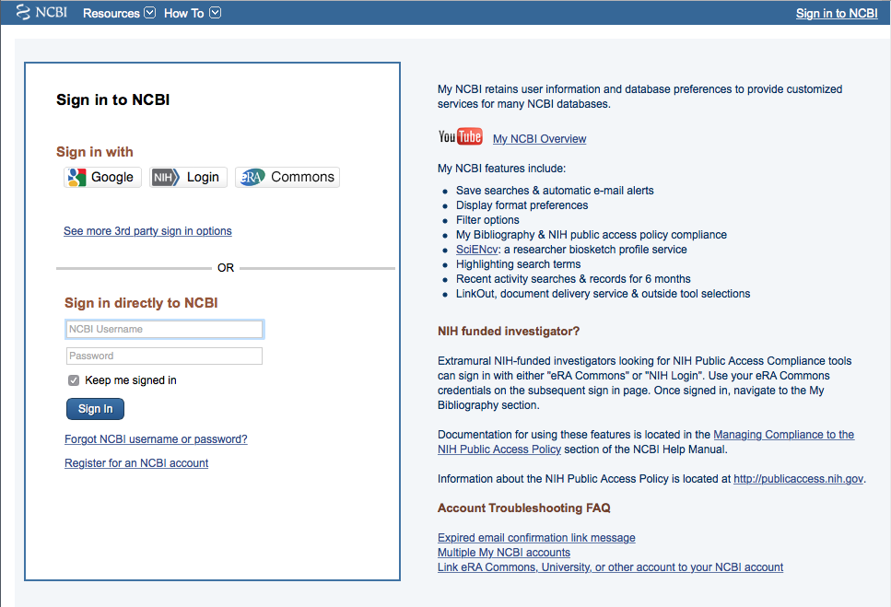
Click
Register for an NCBI account

Slide 16
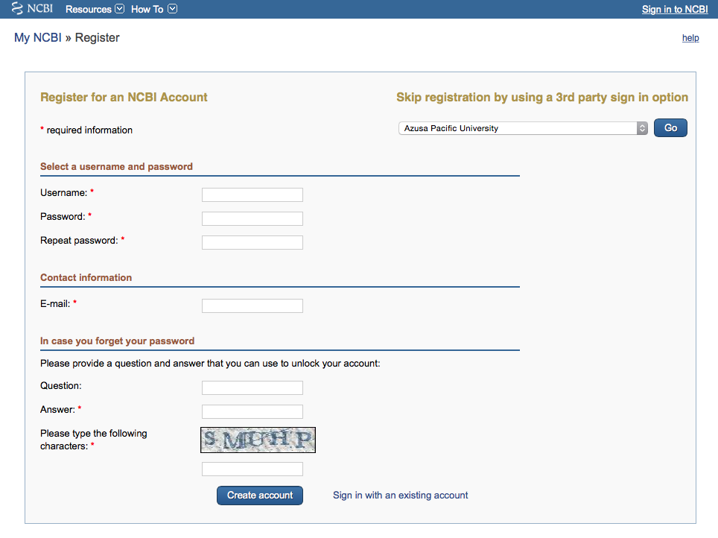
Fill out form
and click
Create account

Slide 17
Verifying your MY NCBI Account
Open the email you used in the account:
1) Locate the link from NCBI
2) Click the link
3) Tells NCBI you are a real user requesting the account
(not computer generated)
4) Your user name will now appear on the top right-hand side

Slide 18
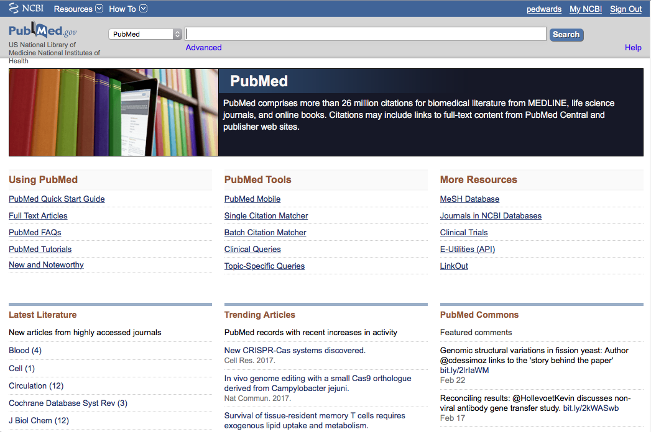
Your username
Your user name
Click My NCBI

Slide 19
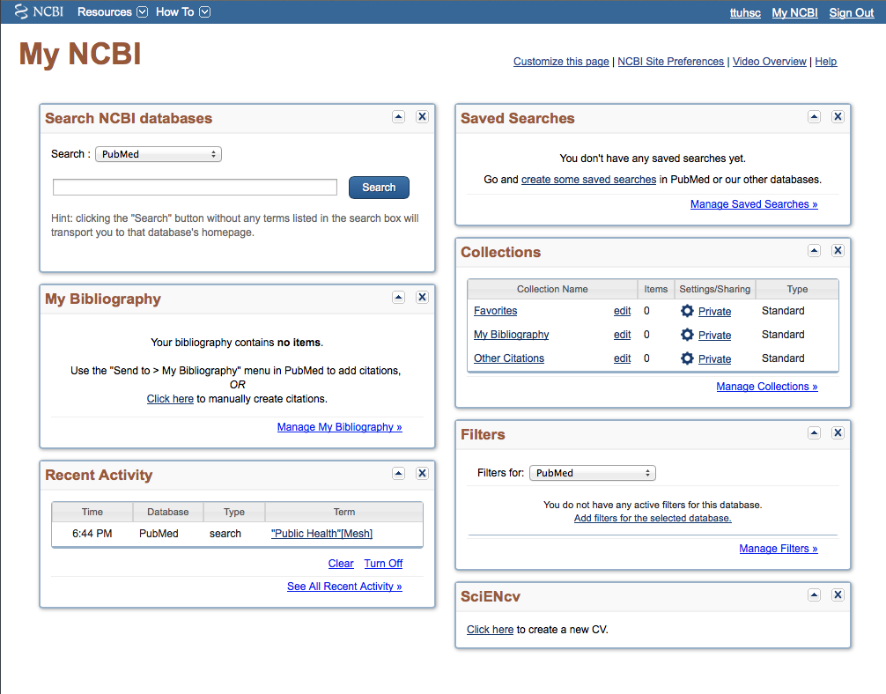
Click Manage Filters

Slide 20
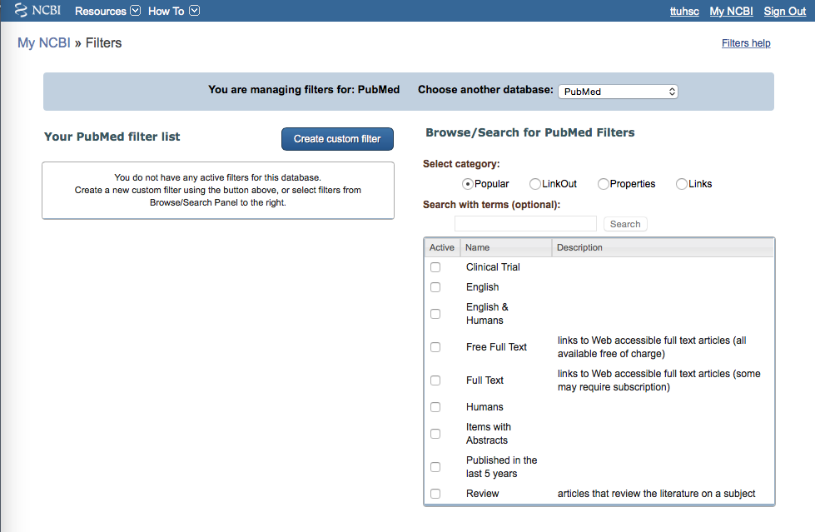
Database is PubMed
Select
English & Humans
✔

Slide 21
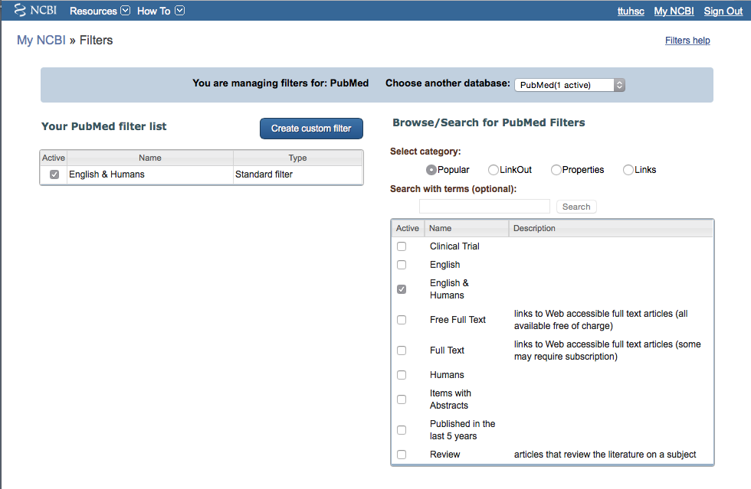
Filter activated
You may set up to 15 filters

Slide 22
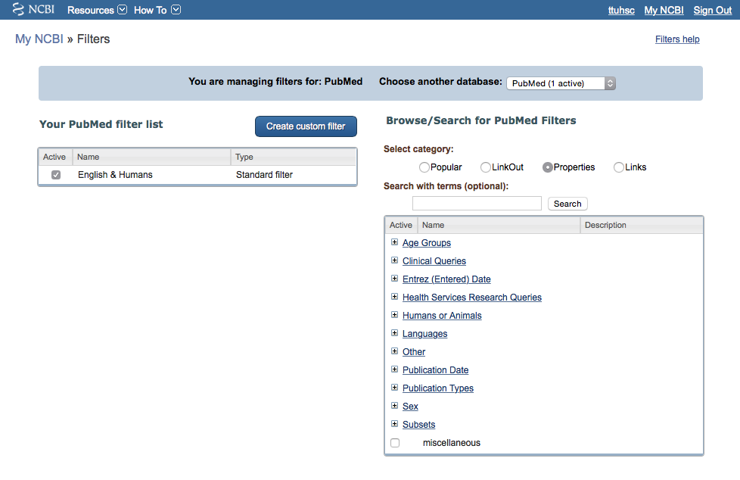
Click Properties

Slide 23
Click
+
Age Groups

Slide 24
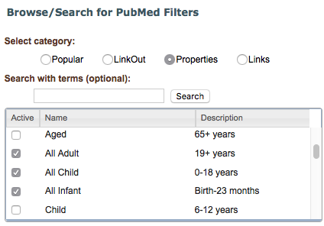
Scroll
Select
✔
All Adult
✔
All Child
✔
All Infant

Slide 25
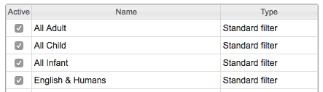
Click
+
Publication Types

Slide 26
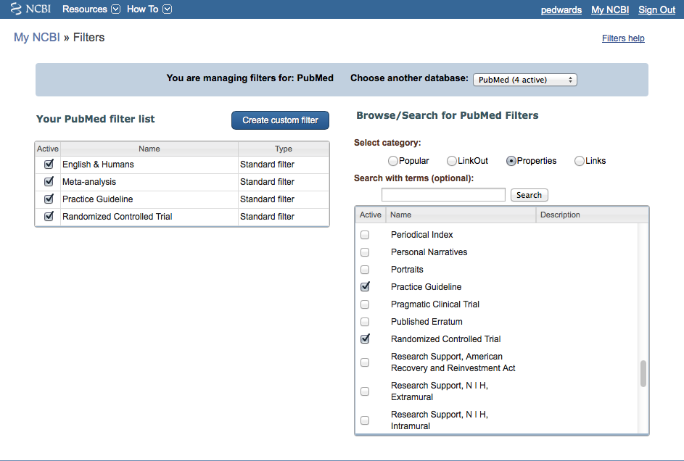
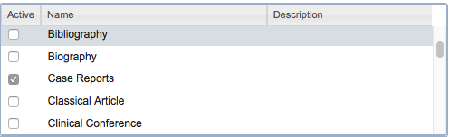
User name
Select
Case Reports
✔

Slide 27
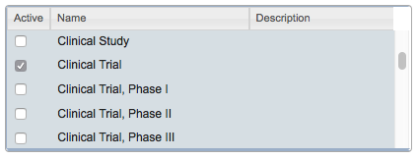
User name
ttuhsc
Active
Name
Description
Meta-analysis
Multicenter Study
News
Newspaper Article
Observational Study
Overall
Patient Education Handout
Periodical Index
Personal Narratives
Portraits
Practice Guideline
Pragmatic Clinical Trial
Published Erratum
Randomized Controlled Trial
Select
Clinical Trial
✔

Slide 28
User name
Active
Name
Description
✔
Meta-analysis
Multicenter Study
News
Newspaper Article
Observational Study
Overall
Patient Education Handout
Periodical Index
Personal Narratives
Portraits
Practice Guideline
Pragmatic Clinical Trial
Published Erratum
Randomized Controlled Trial
✔
Select
Meta-analysis
Multicenter Study
Practice Guideline
Randomized Controlled Trial
✔
✔

Slide 29
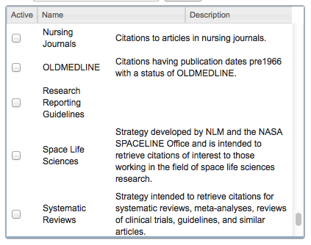
User name
Scroll to
Subsets
-
and select
Systematic Reviews
✔

Slide 30
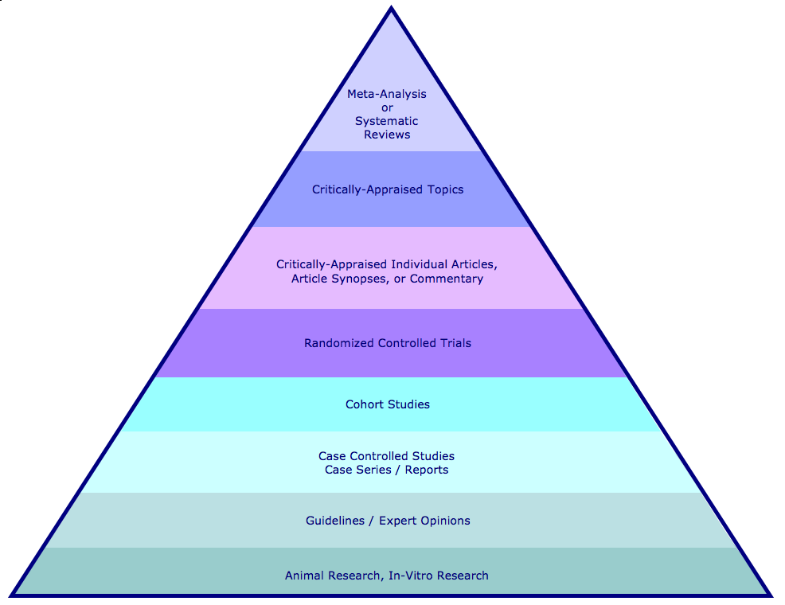
Hierarchy of Evidence
Meta-Analysis or Systematic Reviews
Critically Appraised Topics or Articles are found in the Cochrane Library
Randomized Controlled Trials
Case Reports
Practice Guidelines

Slide 31
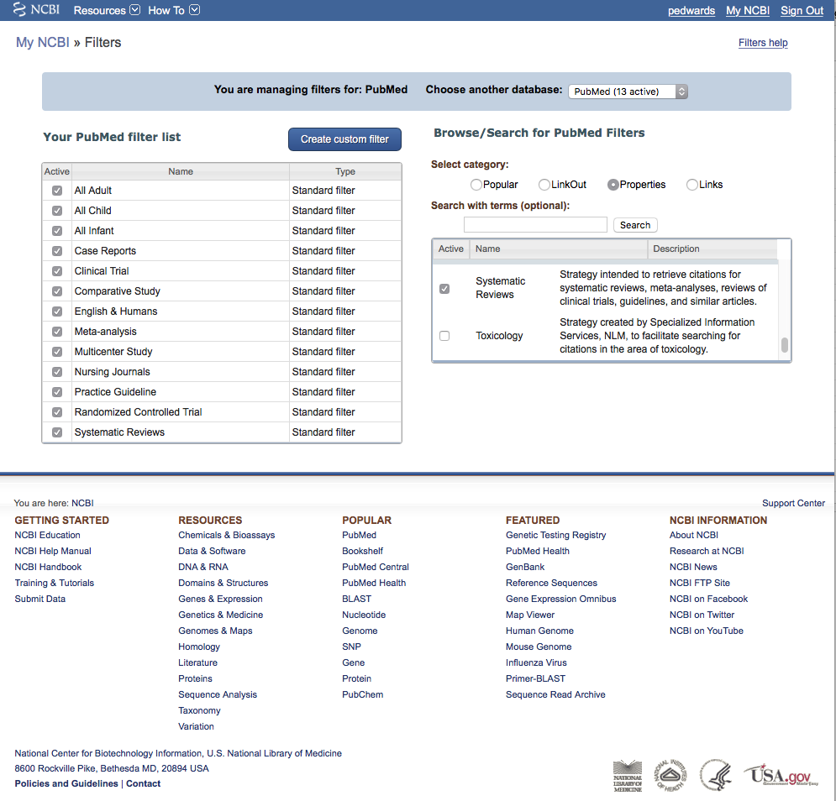
Click PubMed

Slide 32



PubMed Database
Biomedical and life sciences journal literature
International scope
Developed and maintained by the:
National Center for Biotechnology Information
    at the U.S. National Library of Medicine
    at the National Institutes of Health

Slide 33

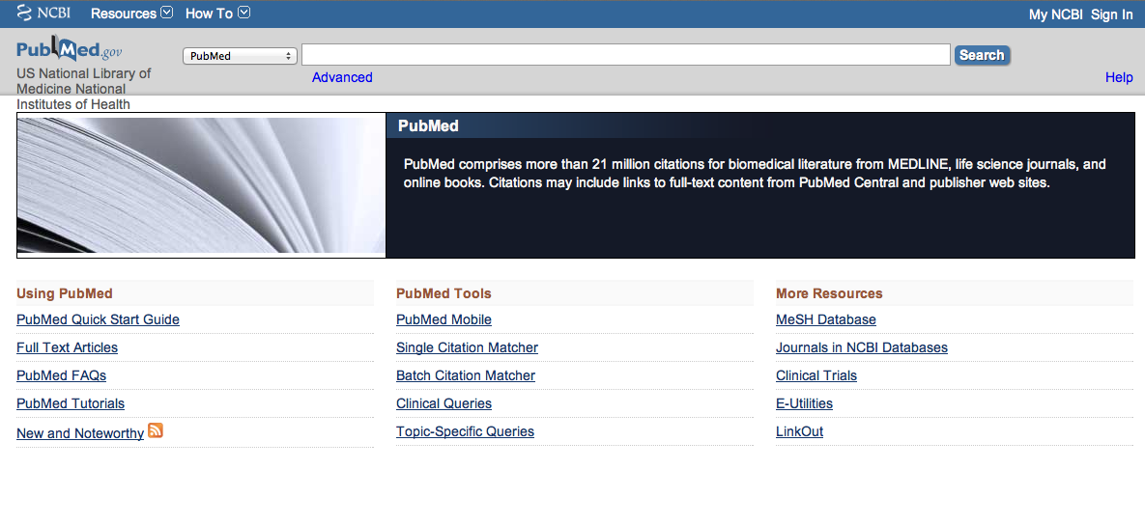
Accessing PubMed
Freely available over the Internet
@ www.pubmed.gov
Always access through ttuhsc.edu/libraries
for free access to journals the
libraries subscribe to!

Slide 34
Always
Sign in to NCBI

Slide 35
Clinical Queries is a tool that searches for evidence-based literature
Click Clinical Queries

Slide 36

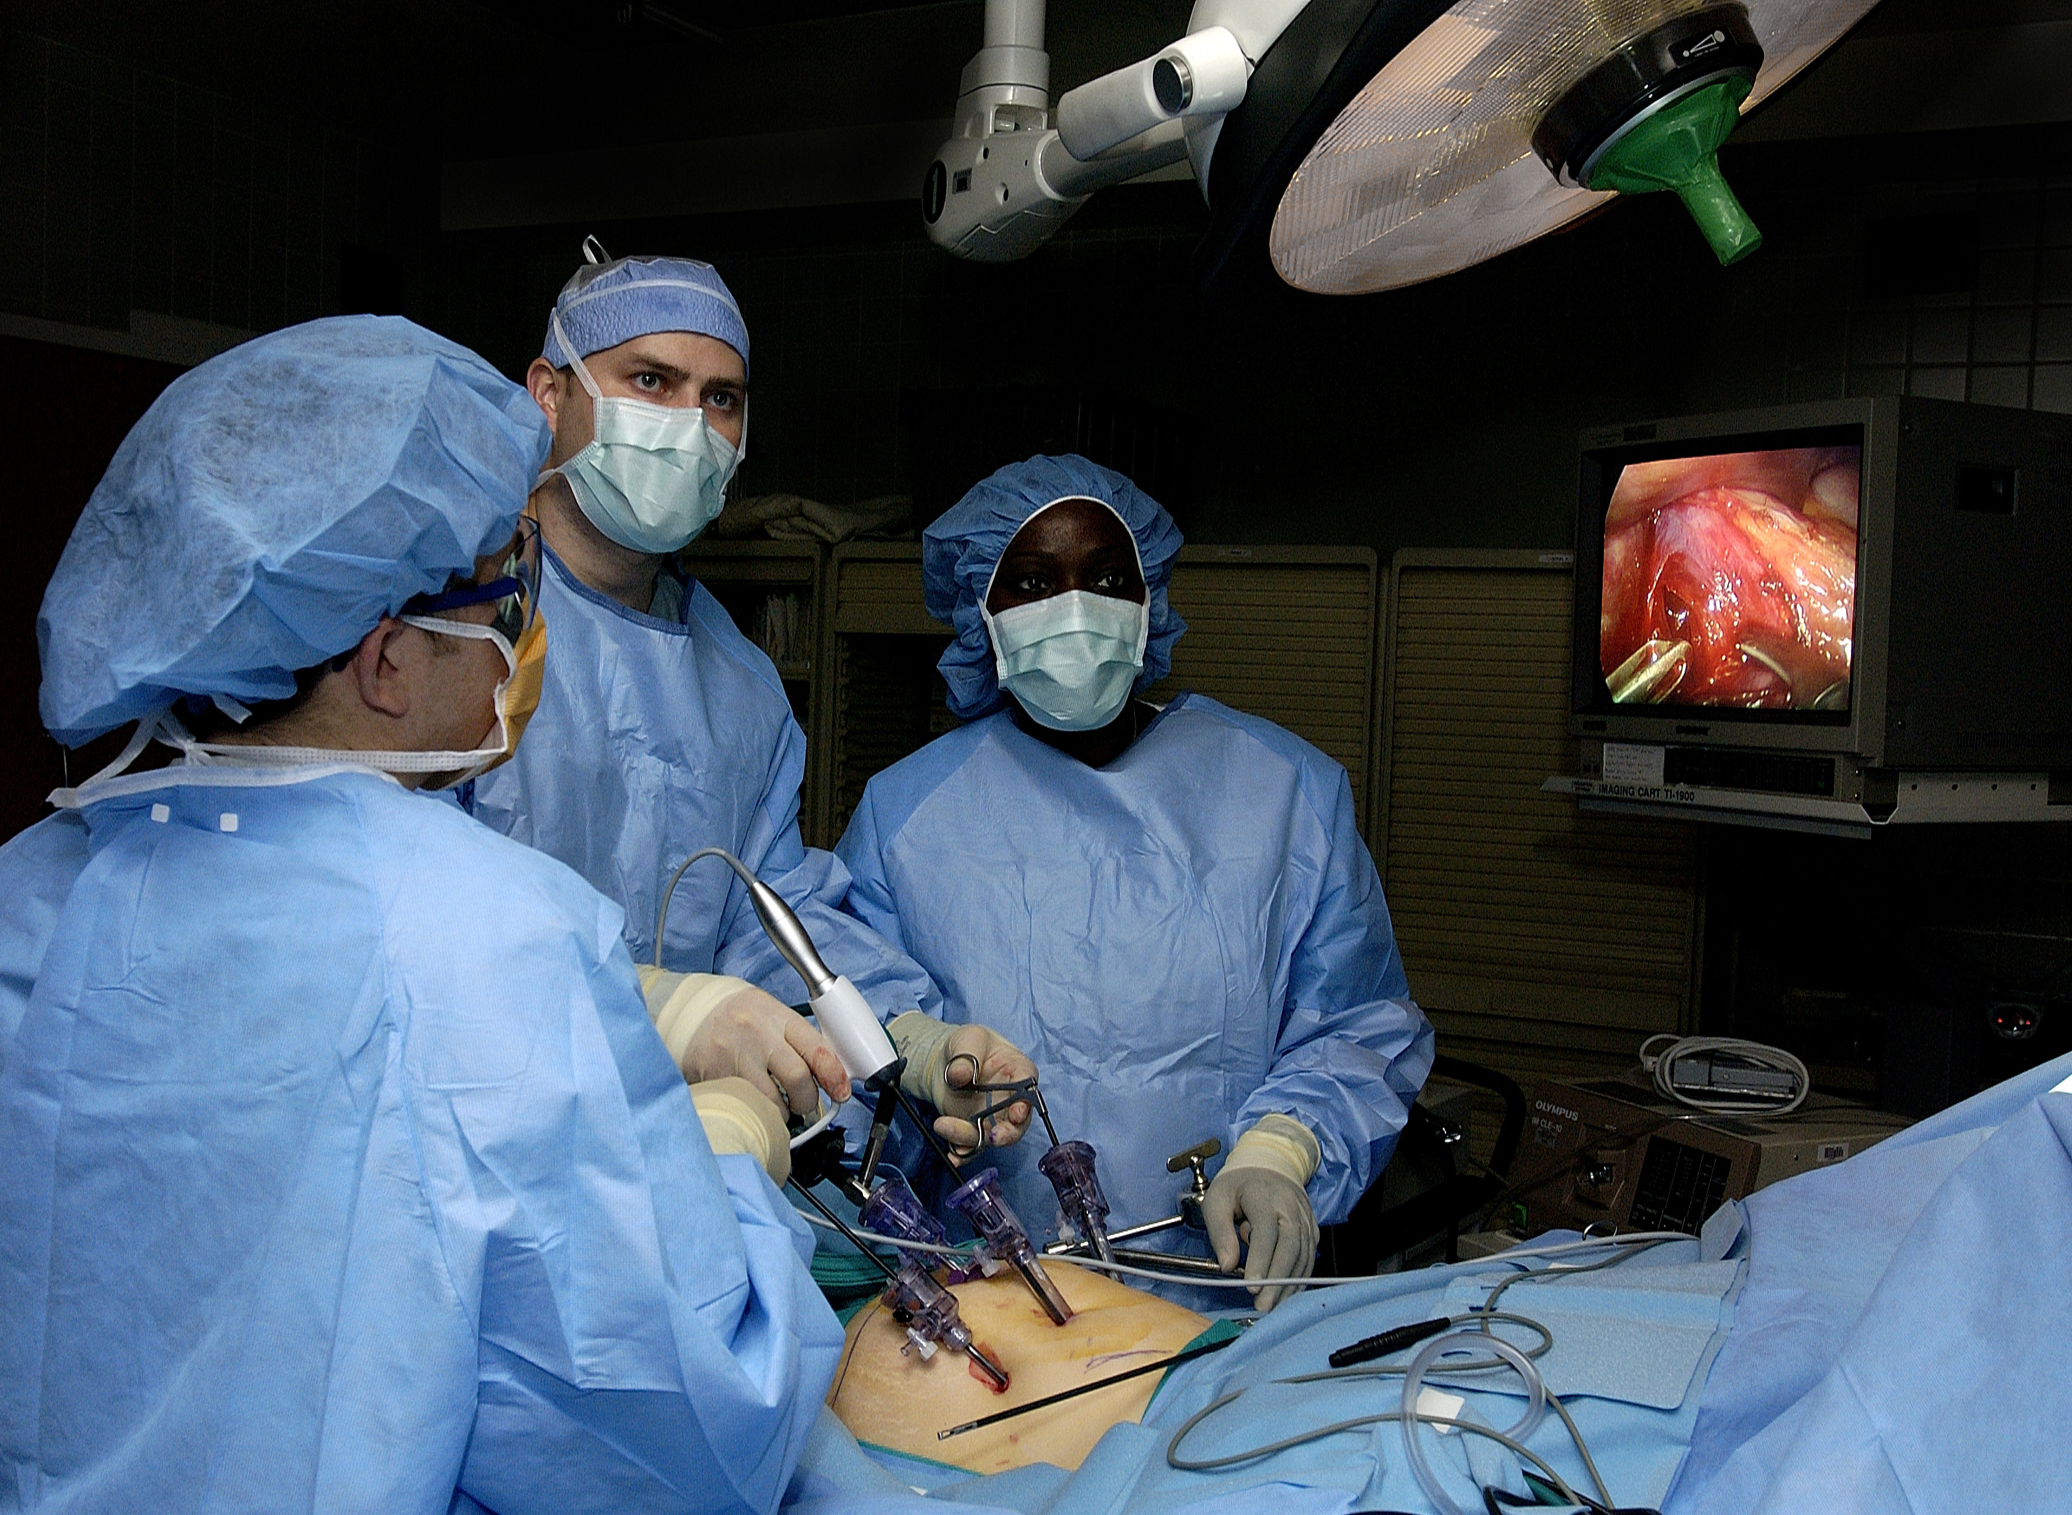
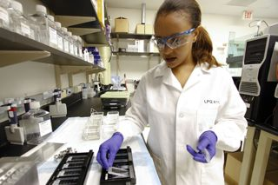
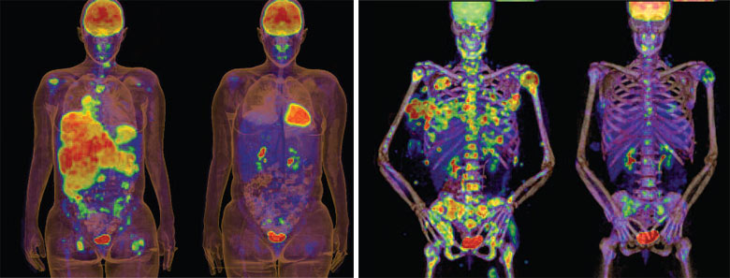
Clinical Queries Searchable by:
Diagnosis
Therapy
Prognosis (prediction of probable outcome)
Etiology (cause)

Slide 37
Clinical Queries Searchable by:
Diagnosis
Therapy
Prognosis (prediction of probable outcome)
Etiology (cause)

Slide 38
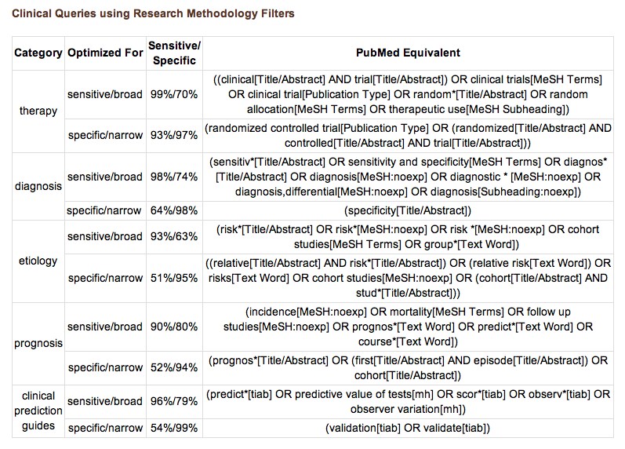
PubMed’s Clinical Queries
uses pre-formulated search strategies with a keyword search

Slide 39
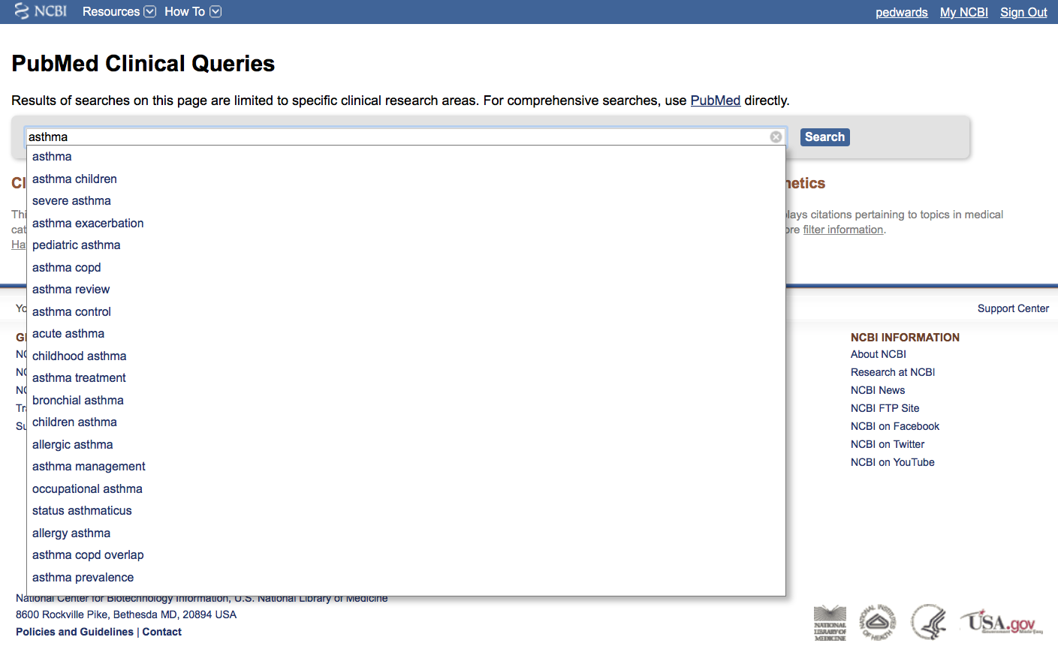
Enter asthma
User Name
Click
Search

Slide 40
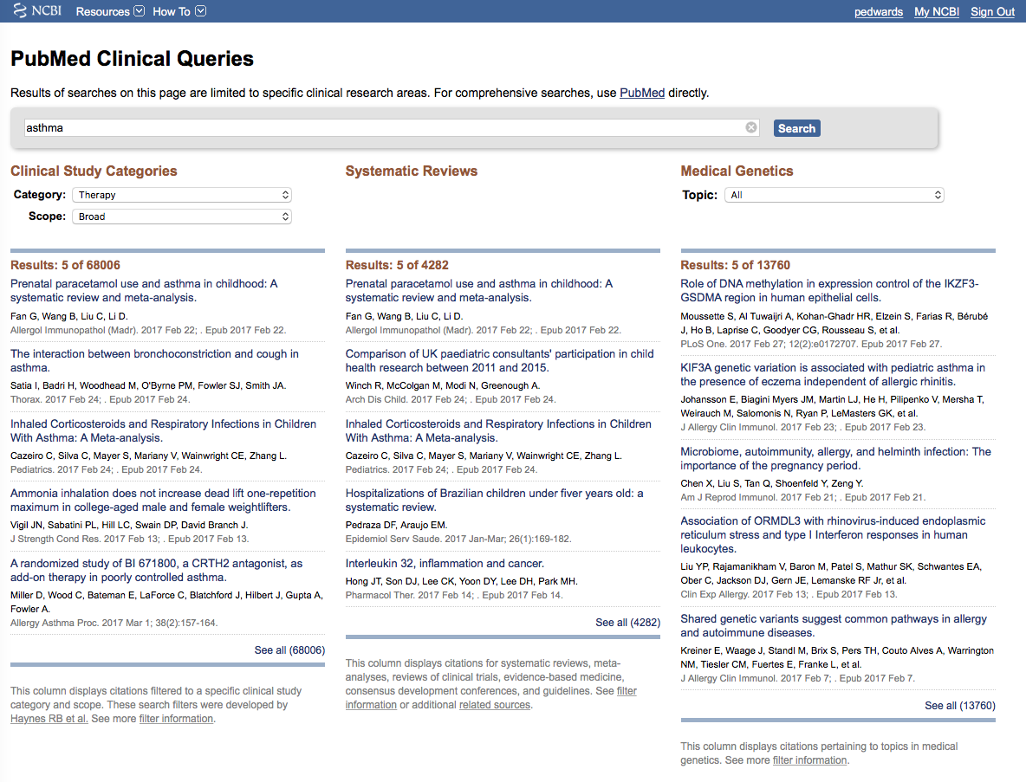
User Name
Results for Therapy and
Broad Scope

Slide 41
User Name
Notice: Results for
Systematic Reviews
and
Medical Genetics

Slide 42

User Name
Click on the Therapy drop-down menu

Slide 43
User Name
Change to Narrow Scope

Slide 44
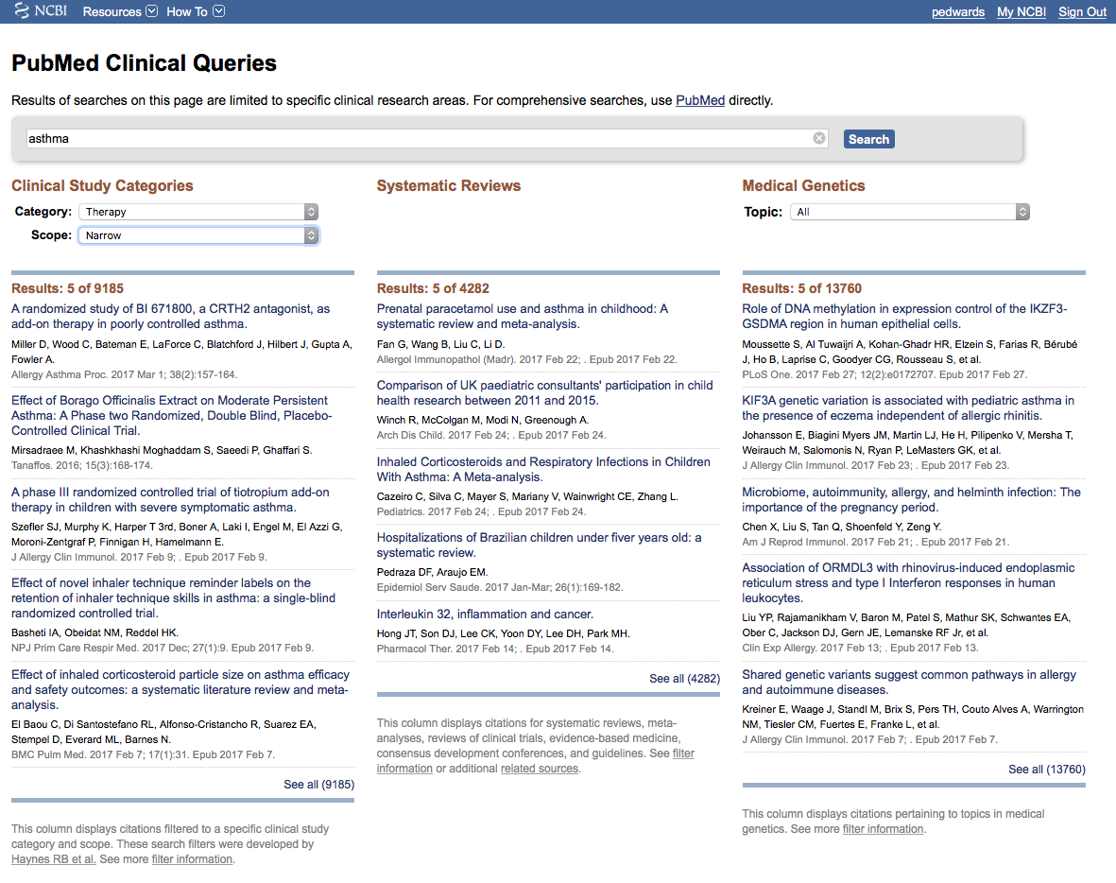
User Name
Results for Therapy
and Narrow Scope
Click See all (9185)

Slide 45
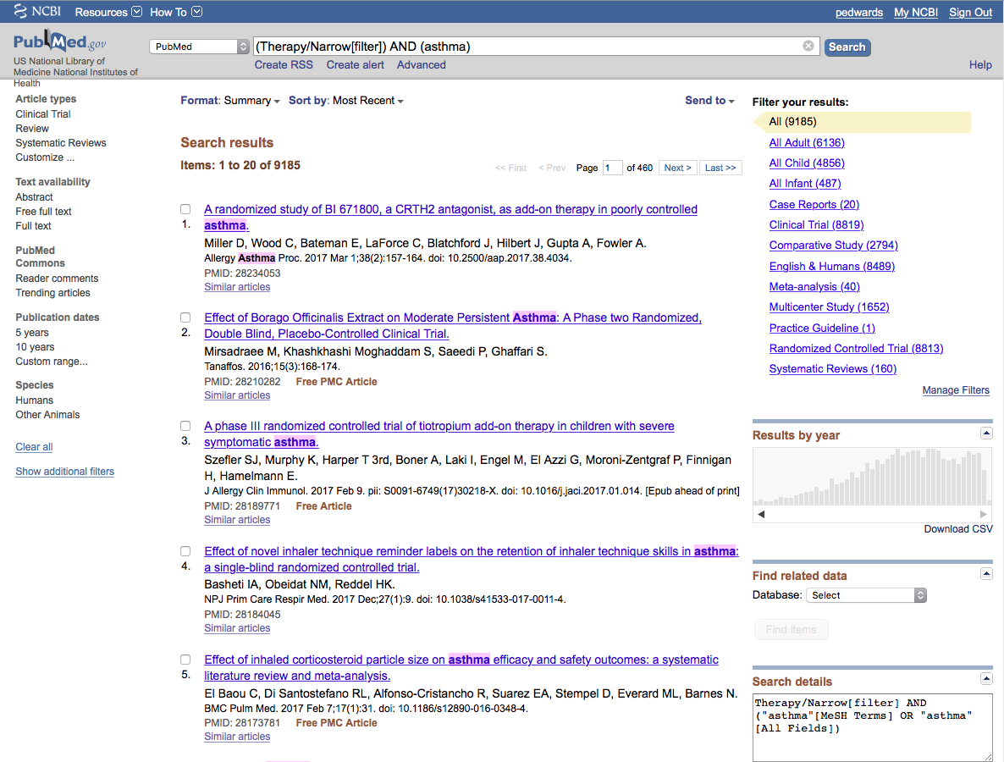
Click Limits
User Name
Selections will turn blue: ✓ 5 years
and ✓ Humans

Slide 46
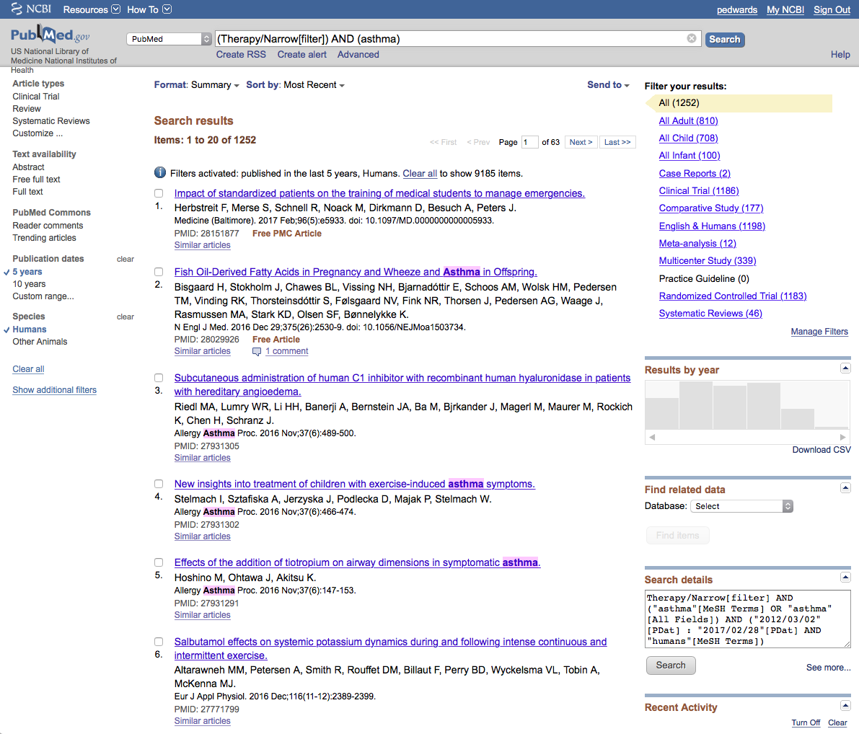
User Name
Activated Filters
Results have narrowed to 1252 articles

Slide 47
User Name
Click Show additional filters

Slide 48
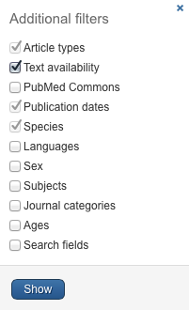
User Name
Select
Languages
✔
Click Show

Slide 49
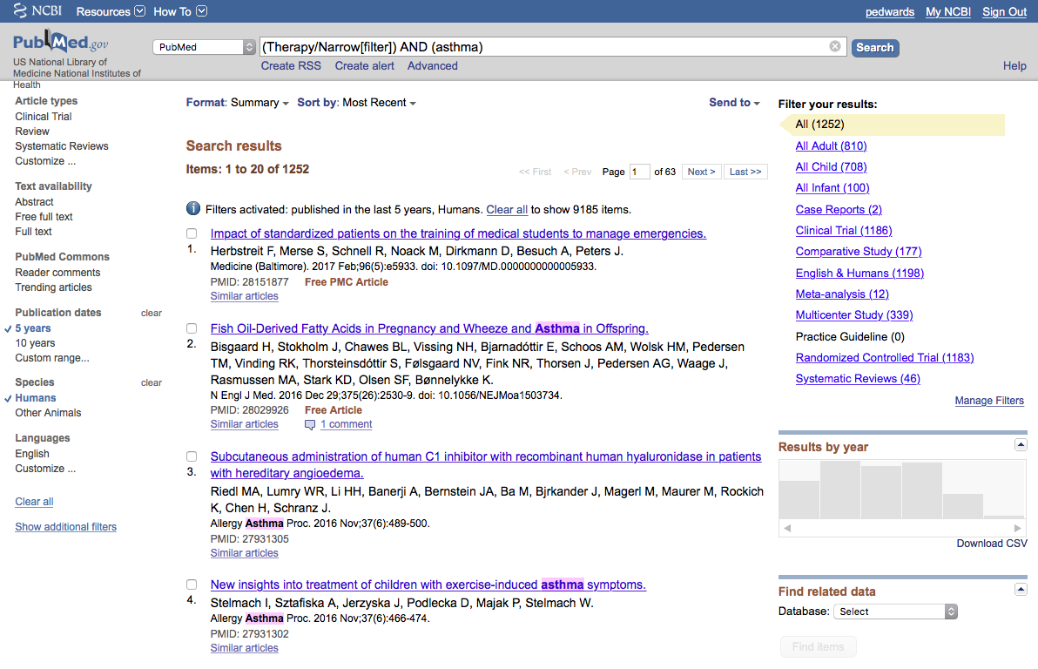
User Name
Click English

Slide 50
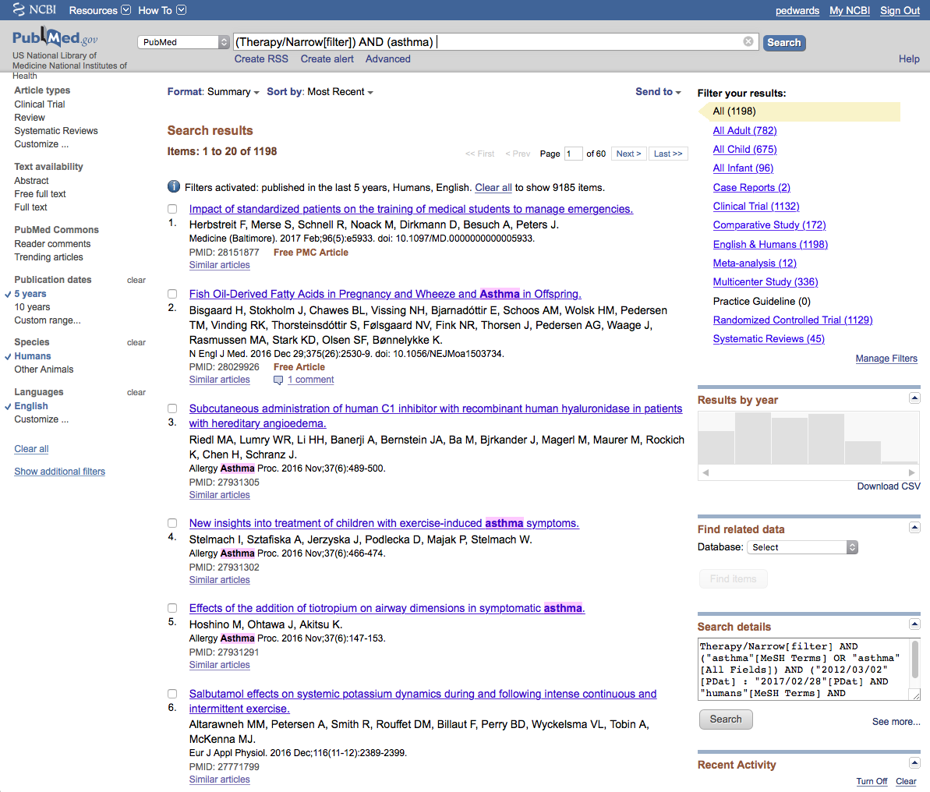
User Name
Results have narrowed to 1198 articles

Slide 51
User Name
To narrow results further,
click the white search bar.

Slide 52
AND smokers
User Name
Enter AND in all CAPS.
Enter an additional topic
such as smokers.
Click
Search

Slide 53
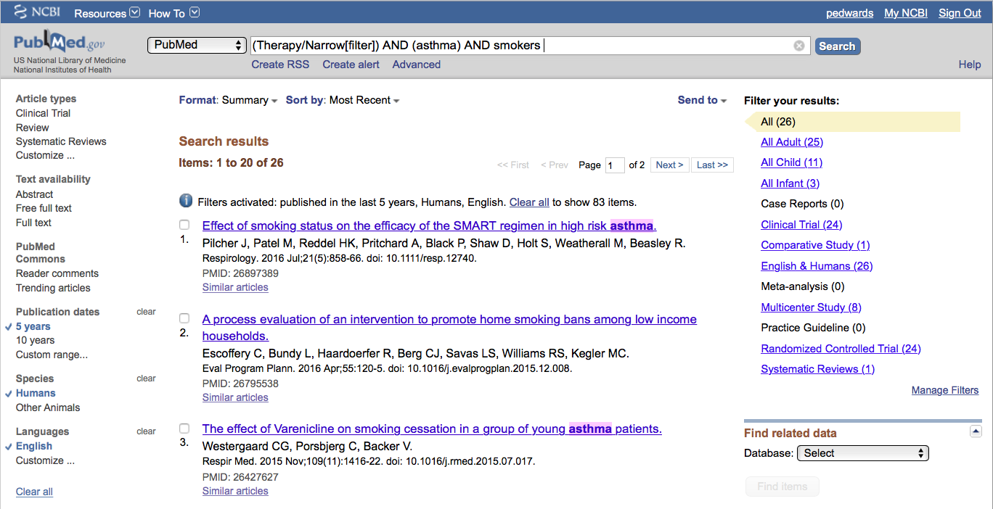
User Name
Results have narrowed to 26 articles

Slide 54
User Name
Note customized filter results

Slide 55
User Name
Click
Randomized Controlled Trial (24)

Slide 56
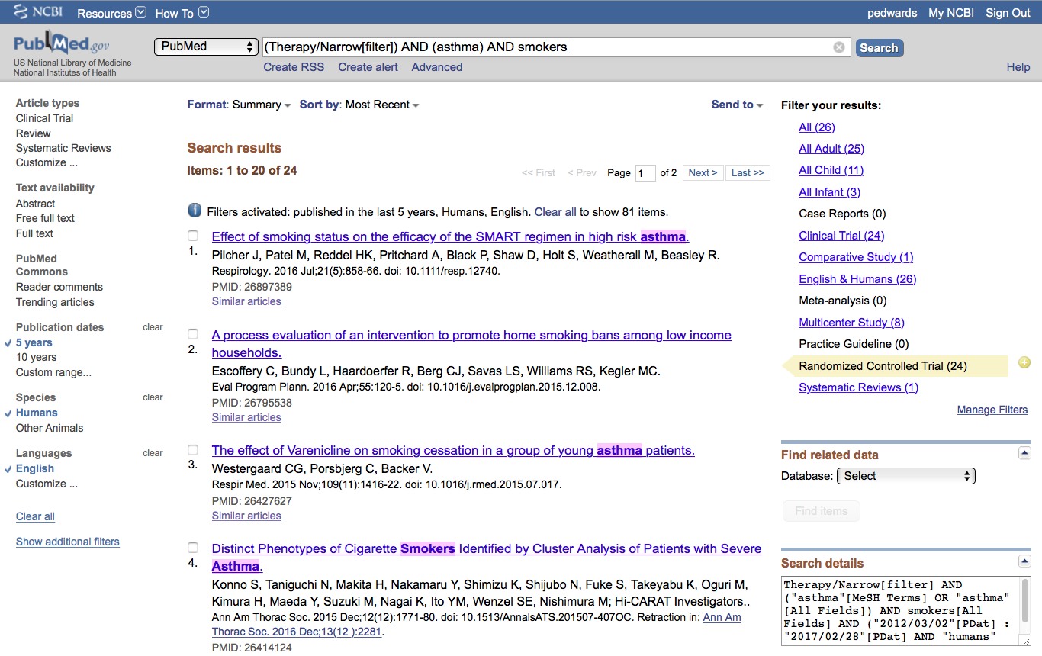
Click on the article title you wish to read
User Name

Slide 57
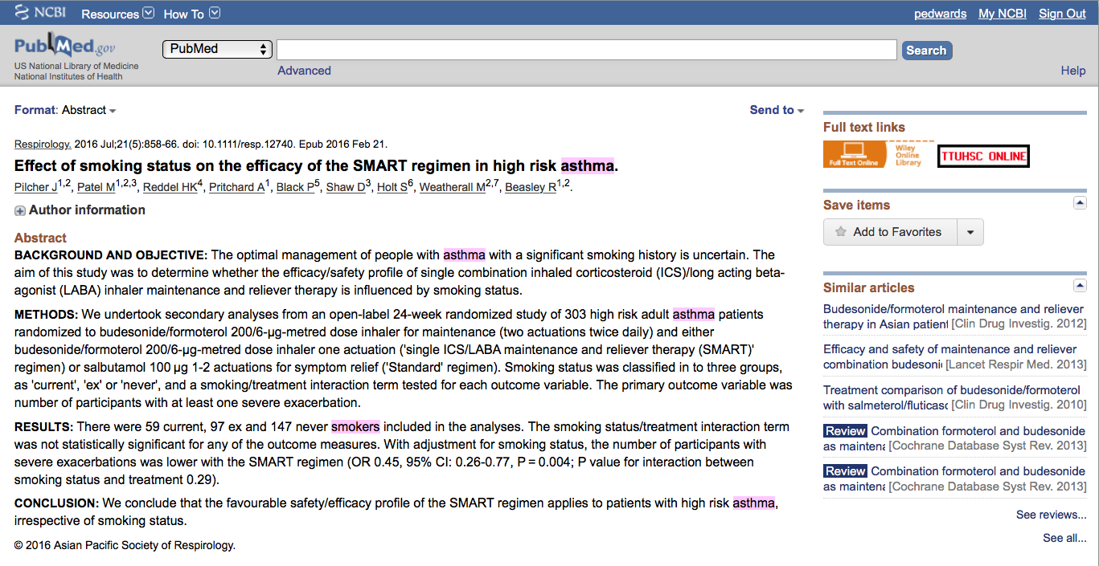
Click for Free Full Text
TTUHSC ONLINE
User Name

Slide 58
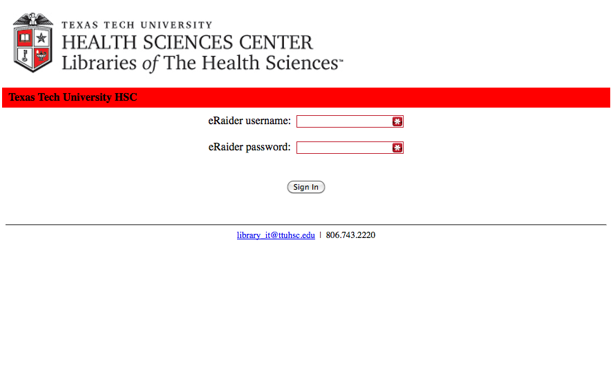
TTUHSC Libraries - Proxy Server
When Searching from Off Campus:
Enter the
Eraider username and password
assigned to you
by Information Services.
A
Problems with eRaider call: 806-743-1234a

Slide 59
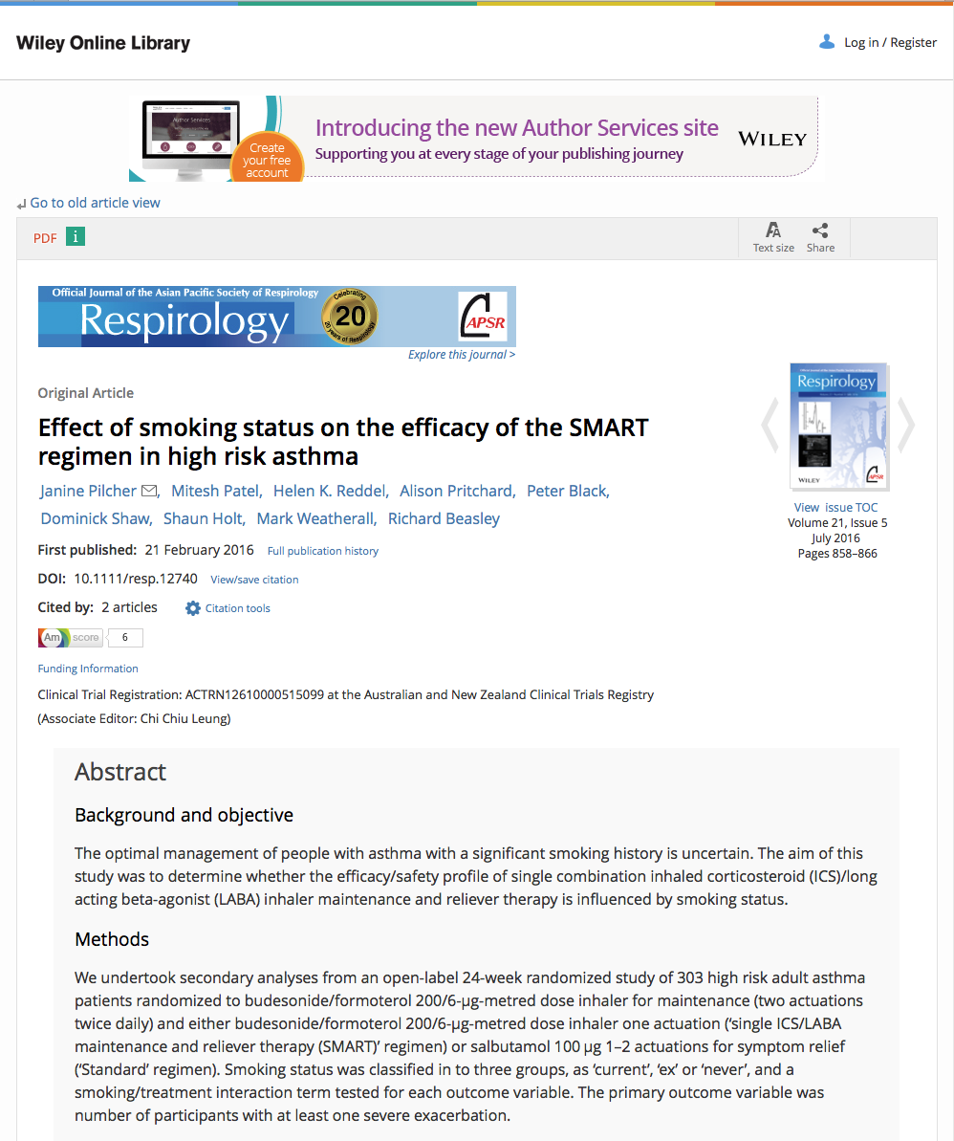
Click PDF

Slide 60
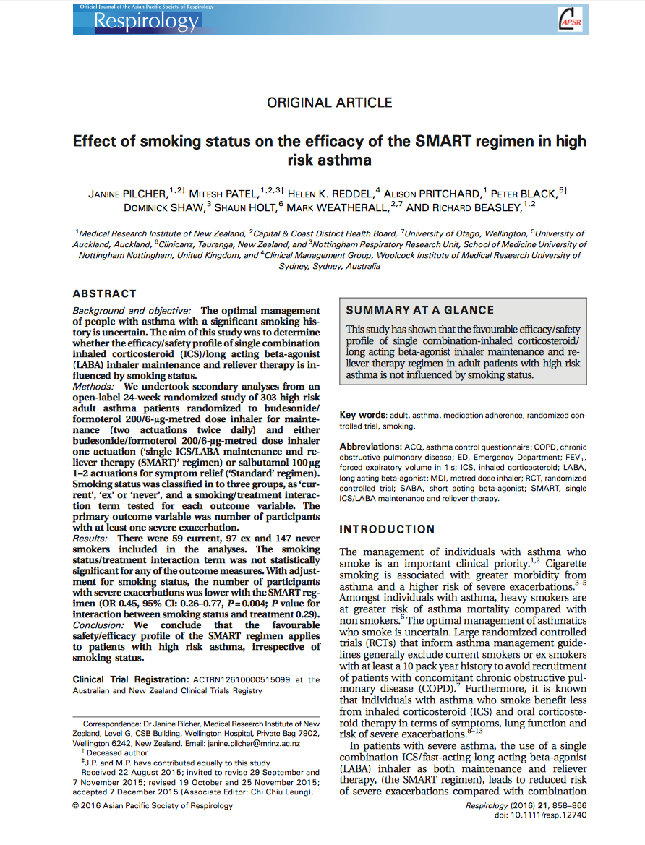
Full Text

Slide 61
Critical Assessment of the
Biomedical Literature

Slide 62
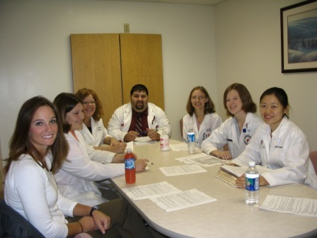
What is Critical Appraisal?
“The process of assessing and interpreting
evidence by systematically considering its
validity, results, and relevance.”
The Cochrane Collaboration Glossary http://www.cochrane.org/glossary/5#letterc

Slide 63
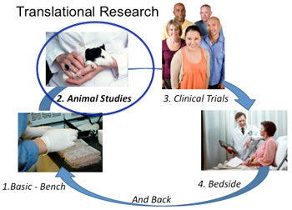
“Critical appraisal is the first step in transferring research knowledge into practice.”
Das, K., Malick, S., & Khan, K. (2008). Tips for teaching evidence-based medicine in a clinical setting: lessons from adult learning theory. part one. Journal of the Royal Society of Medicine, 101(10), 493-500. doi: 10.1258/jrsm.2008.080712 web address: http://www.ncbi.nlm.nih.gov/pmc/articles/PMC2586873/?tool=pubmed

Slide 64
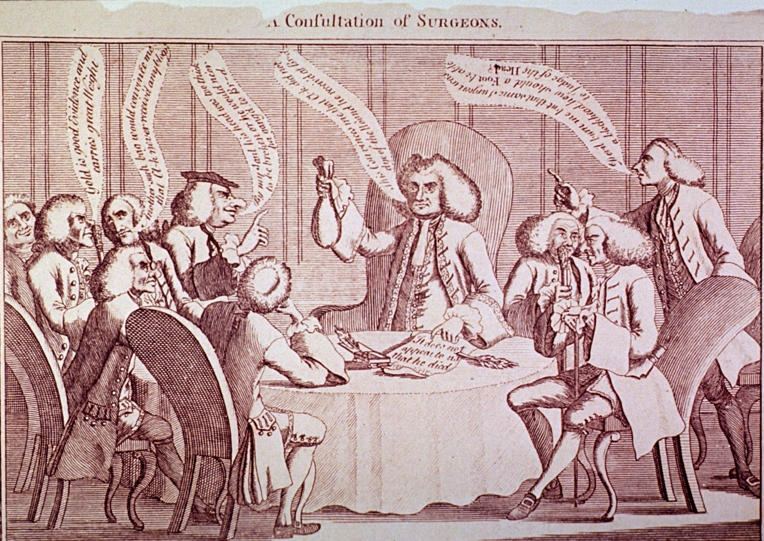
Purpose of Critical Appraisal
“Randomized controlled trials and systematic reviews are the highest levels of evidence but they are not automatically of good quality and should always be appraised critically.”
Das, K., Malick, S., & Khan, K. (2008). Tips for teaching evidence-based medicine in a clinical setting: lessons from adult learning theory. part one. Journal of the Royal Society of Medicine, 101(10), 493-500. doi: 10.1258/jrsm.2008.080712 web address: http://www.ncbi.nlm.nih.gov/pmc/articles/PMC2586873/?tool=pubmed
A Consultation of Surgeons, old negative no. 62-116 [engraving]. [Bethesda, MD., United States of America]: Images from the History of Medicine, U.S. National Library of Medicine, National Institutes of Health; accessed June 12, 2012. The National Library of Medicine believes this item to be in the public domain. print: 11 x 16 cm.

Slide 65

www.ttuhsc.edu/libraries
Click

Slide 66
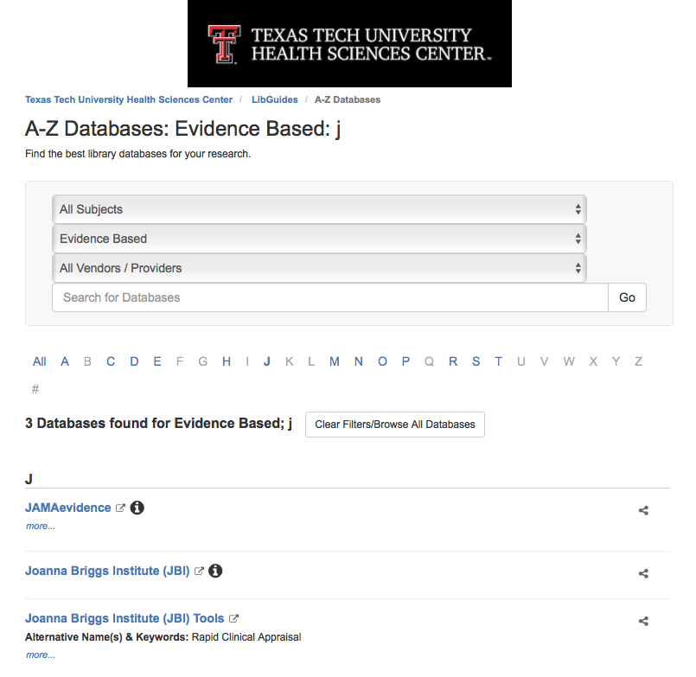
Click “J”
Select JAMAevidence

Slide 67
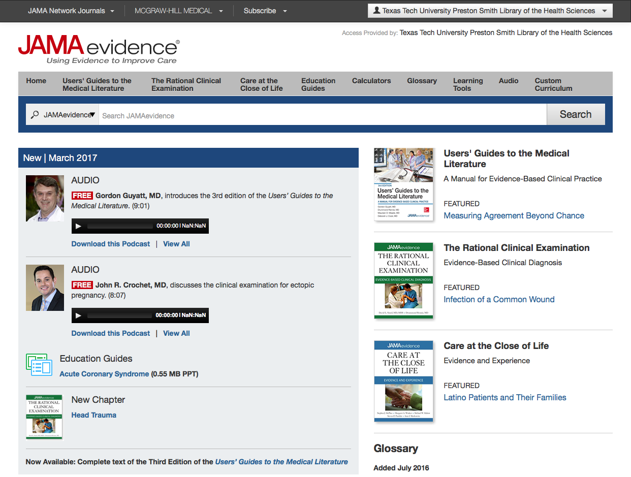

Slide 68
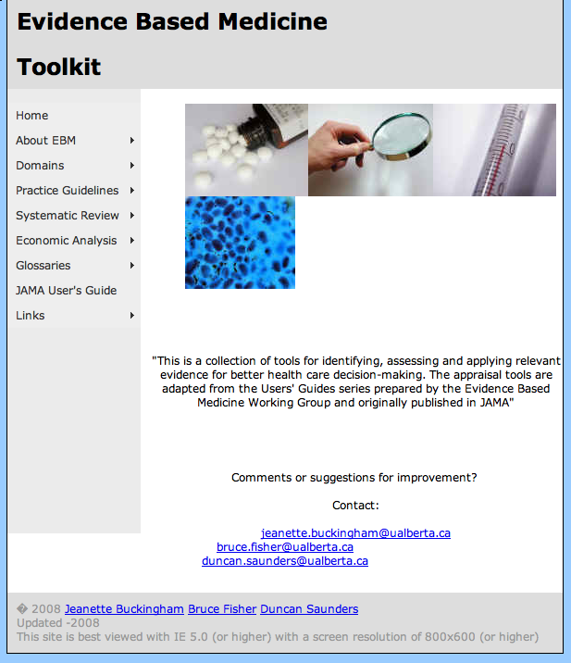
http://www.ebm.med.ualberta.ca/

Slide 69


Mouse over
Domains,
Study Category,
and select
Worksheet.
Look at Calculations.
Then look at
Systematic Review.

Slide 70
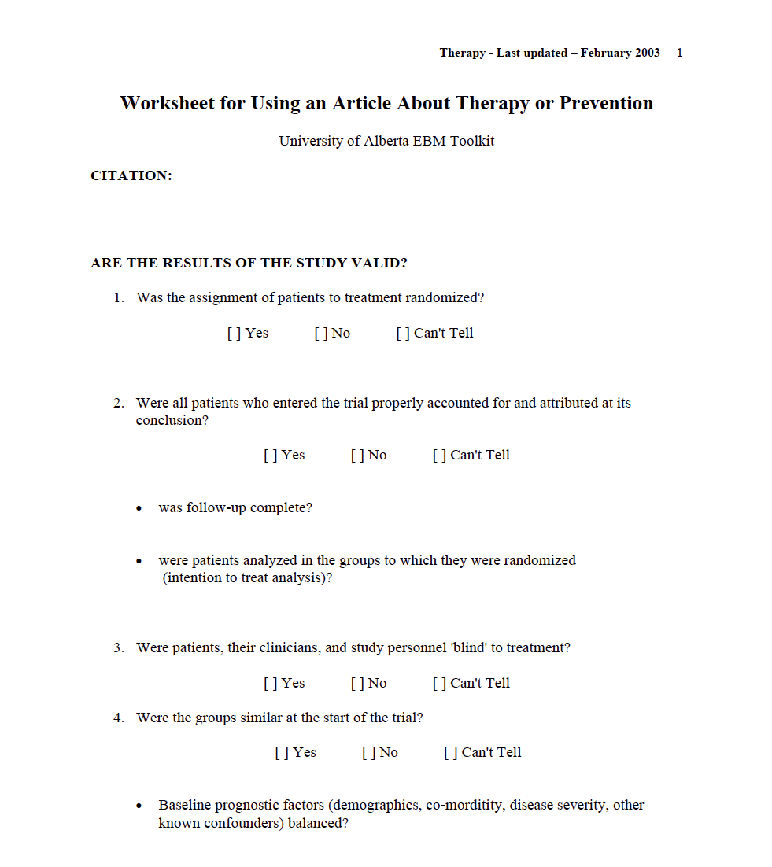
Critical Appraisal Worksheet

Slide 71
Hands-On Exercises

Slide 72
Hands-On Practice Questions
Hypertension
Type 2 Diabetes Mellitus
Back Pain
Upper respiratory tract infection
Autism
ADHD
Cataracts
Coronary artery bypass
Pregnancy complications
Dysmenorrhea
Using filters on
left-hand side,
narrow to:
  English
  Humans
  5 years
Use narrow scope

Slide 73
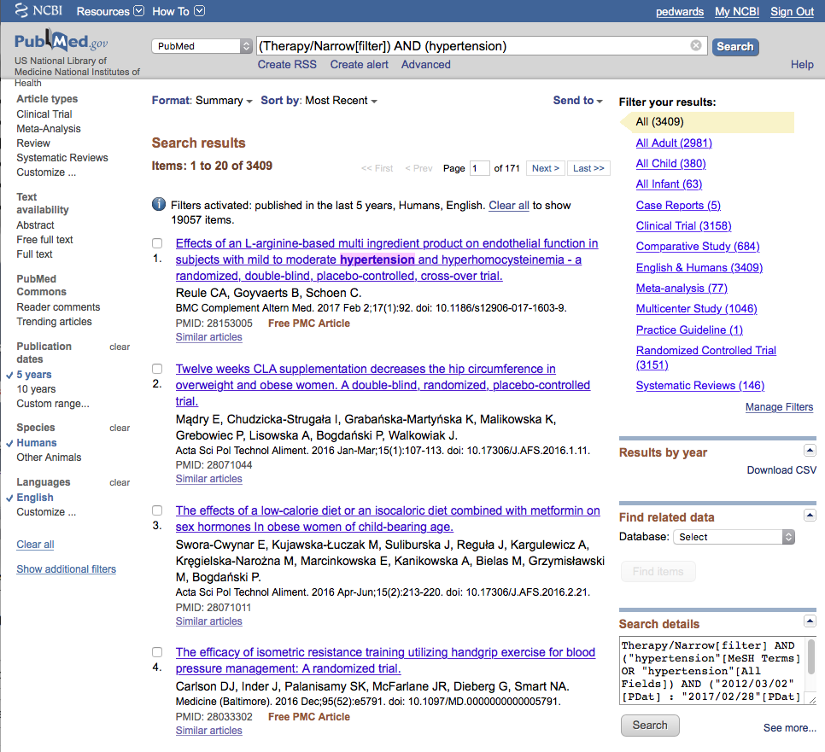
Your User name
Hypertension

Slide 74

Type 2 diabetes mellitus
Your User name

Slide 75

Back pain
Your User name

Slide 76

Upper respiratory tract infection
Your User name

Slide 77

Autism
Your User name

Slide 78

Your User name
ADHD

Slide 79

Cataracts
Your User name

Slide 80

Coronary artery bypass
Your User name

Slide 81

Pregnancy complications
Your User name

Slide 82

Dysmenorrhea
Your User name

Slide 83
The End

