Slide 1
Welcome
The Preston Smith Library of the Health Sciences

Slide 2
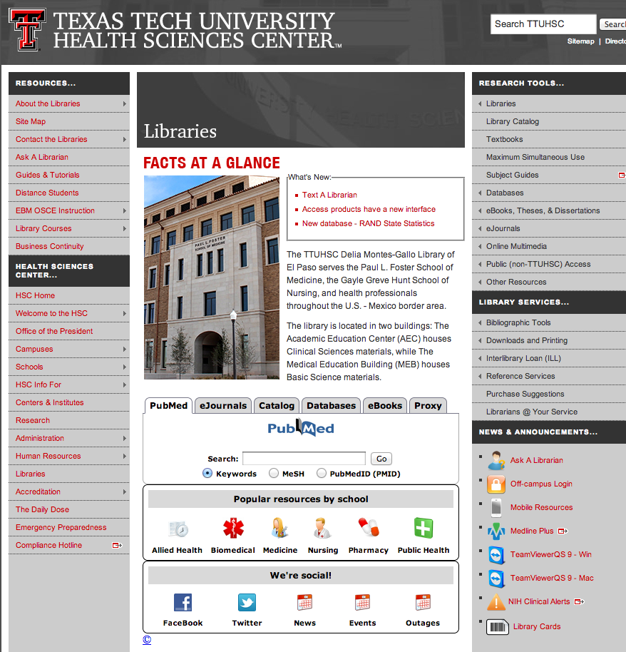
http://www.ttuhsc.edu/libraries

Slide 3
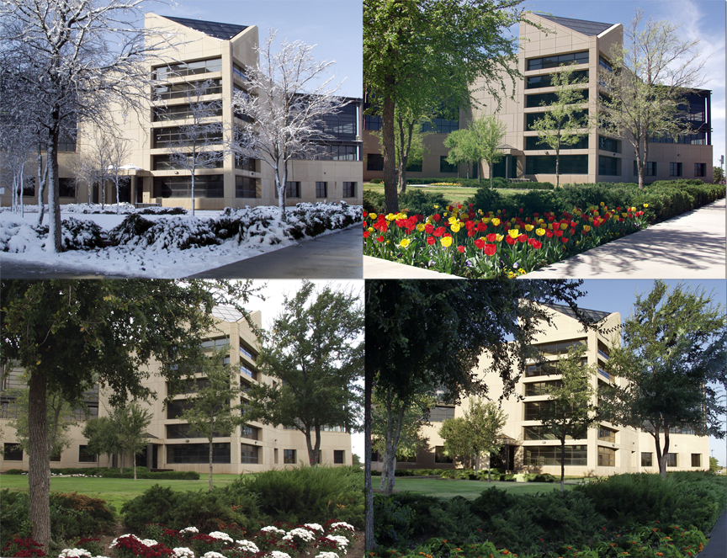
3601 4th just West of the main TTUHSC buildings and in front of E1 Parking Lot
Where?

Slide 4
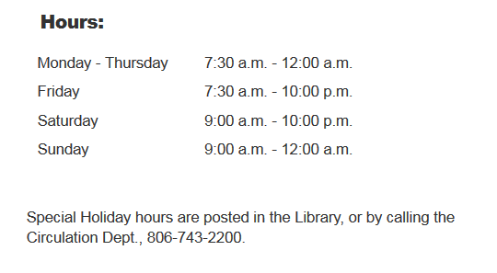
Library Hours
Phone: 806-743-2200
Ask for Reference Librarian
Holiday hours and early closings are also posted as announcements in your e-Raider portal.

Slide 5
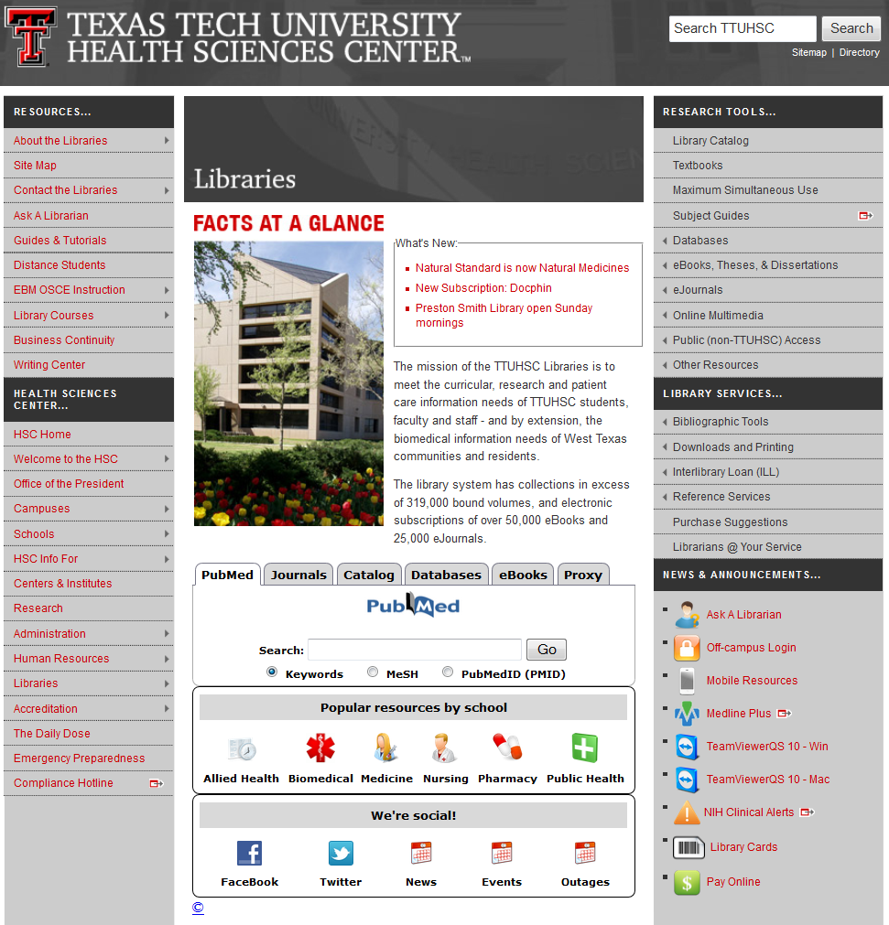
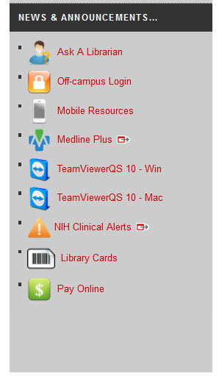
LiBRARY CARDS

Slide 6
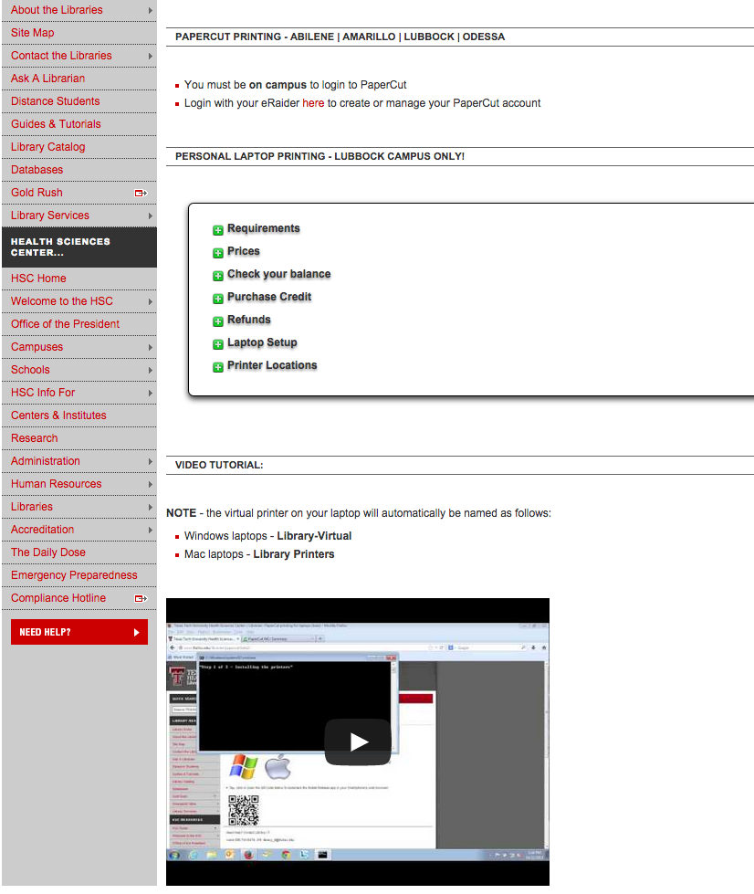
LiBRARY CARDS

Slide 7
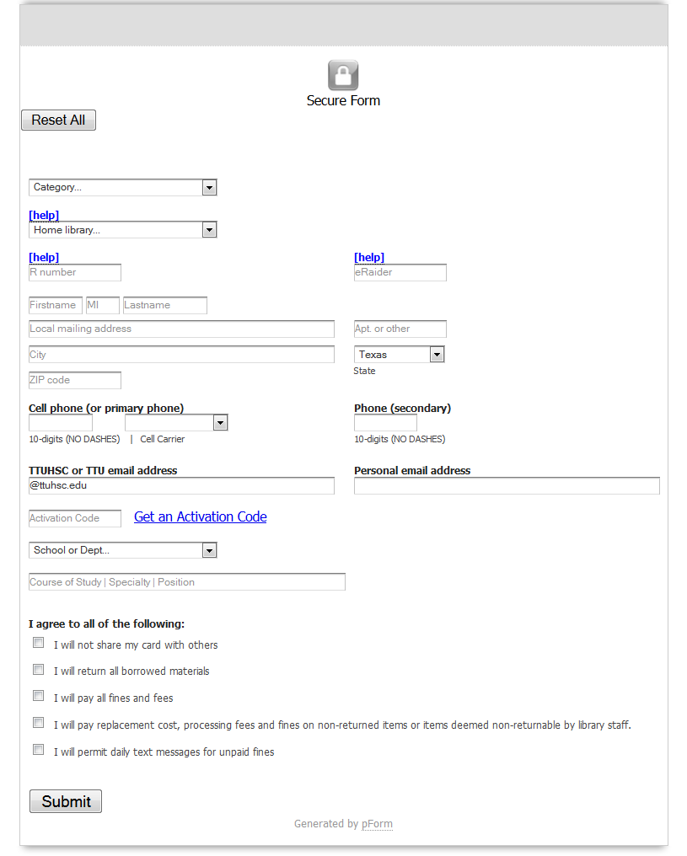
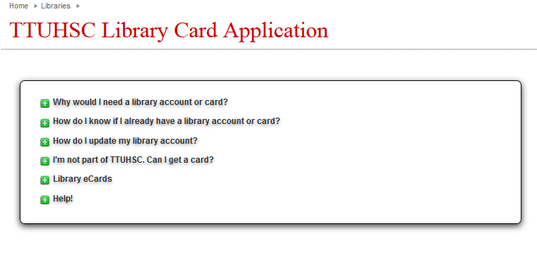

Slide 8
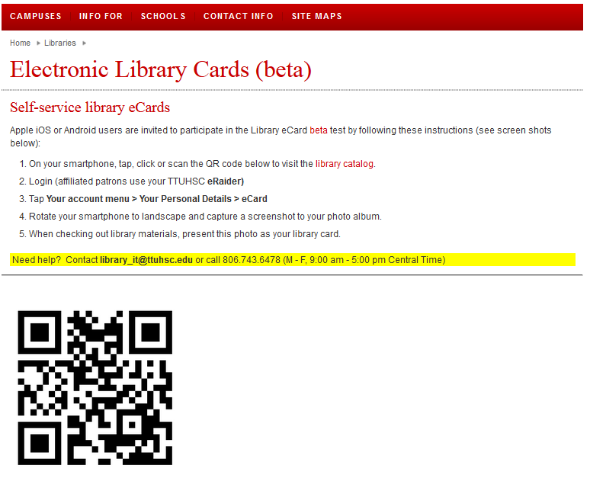


Slide 9


TTUHSC libraries statistics
eBooks are now
searchable in the Catalog
There are libraries at all four campuses
(Amarillo, El Paso, Lubbock & Odessa)
321,952 print books
209 print journal subscriptions
17,691 audiovisuals
24,439 electronic journals*
574 databases
62,963 electronic books
As of April 24, 2015

Slide 10
Check out & Finesibrary Policies
Books/Audiovisuals/Journals:
Checkout period for books is two weeks, audiovisuals for 10 days.
May renew items twice in person, over the phone (806-742-2200), or online through the library catalog.
Journals in the print collection can be scanned but not checked out.
Fines for overdue items:
50 cents per day per item
Library privileges are lost until fines are paid.

Slide 11
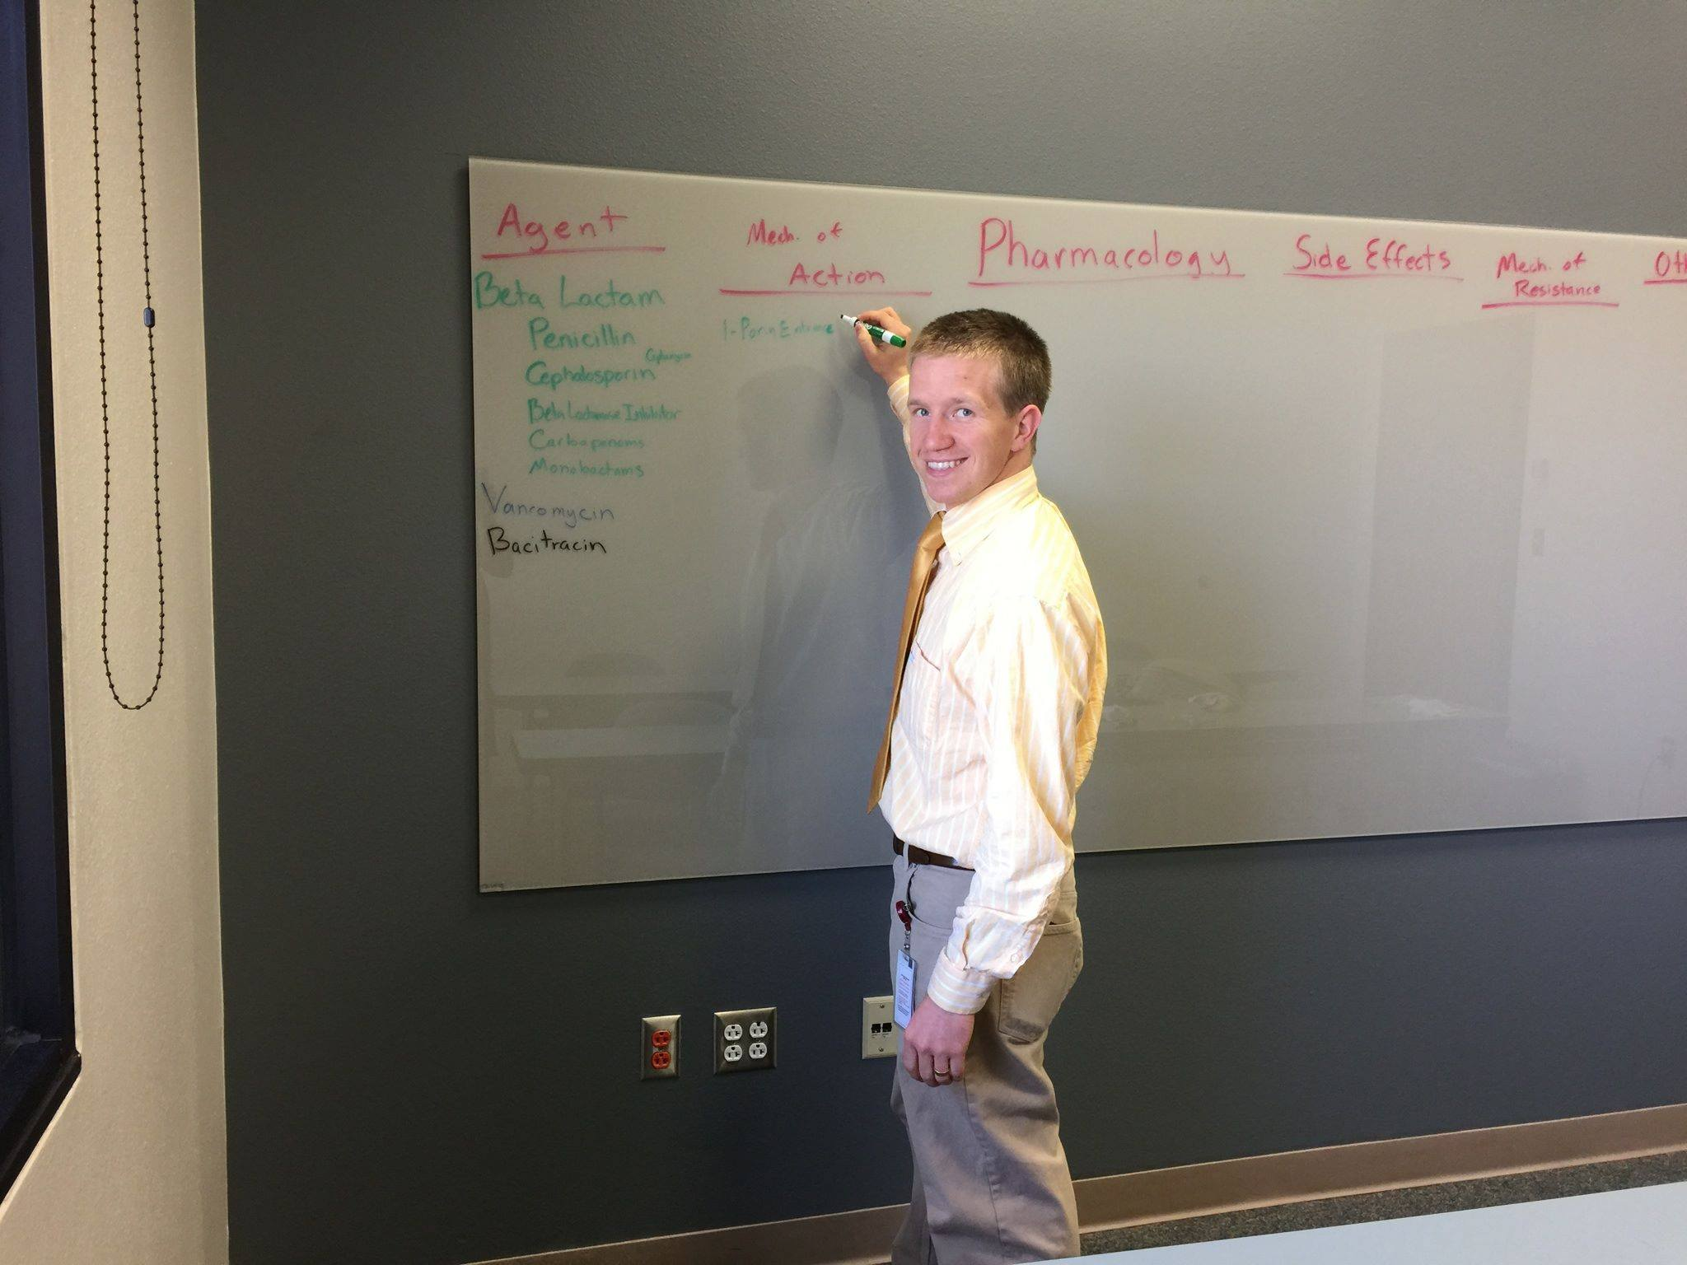
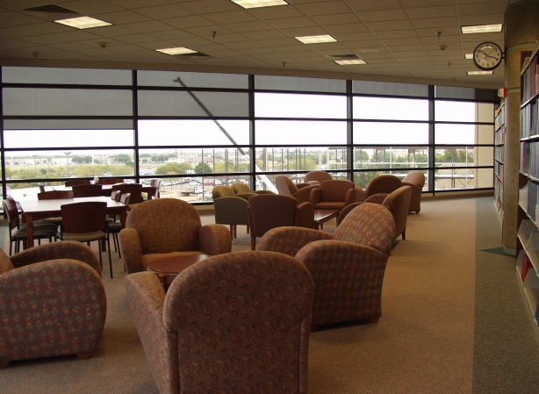
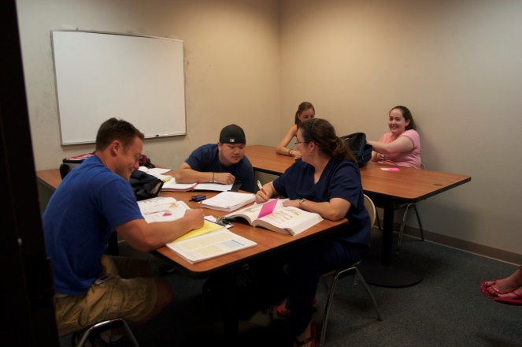
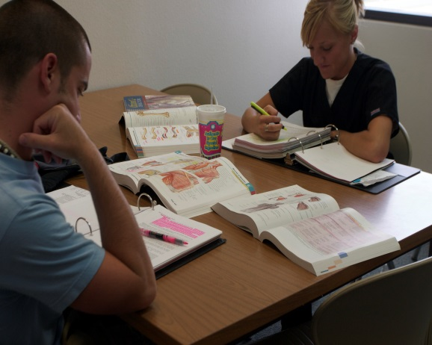
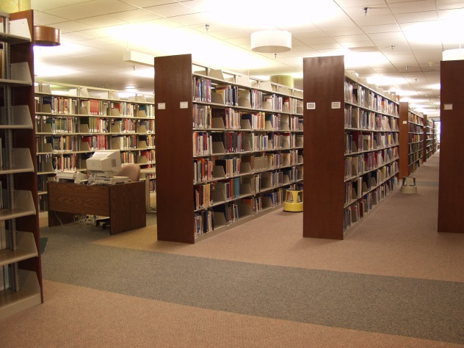
Library Facilities
29 study rooms
All rooms are first come, first serve.
Each room has a dry erase board, glass board or chalkboard and plenty of outlets!
Wireless internet

Slide 12




Eat, drink and be merry!
Please
Clean Up… Thank YOU!

Slide 13
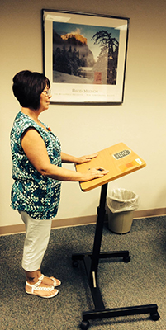
Check out podiums from circulation

Slide 14
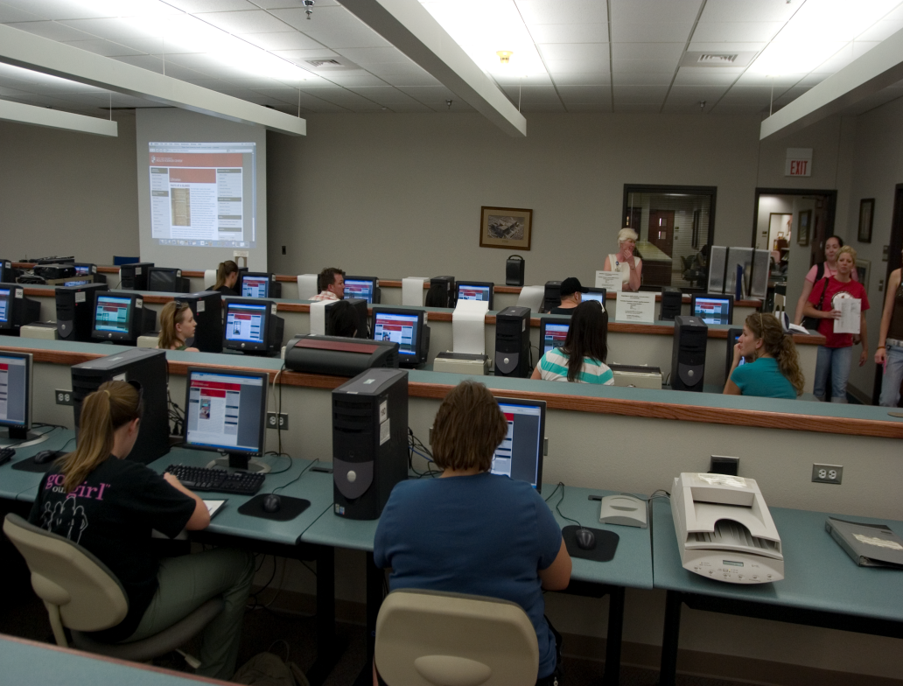
Learning Resource Center
Located on the 2nd floor of the library
Requires a library card
Check out computer stations, anatomical models, and more!
3-D printer
Notes:
The Learning Resource Center is located on the 2nd floor of the Lubbock library. Here, you can check out the library’s audiovisual materials, anatomical models, and computer stations. These materials, including the computer stations, require a library card in order to be checked out. Drinks only are allowed in the Learning Resource Center.

Slide 15

Need Help?
from library homepage (Right side)
mylibrary@ttuhsc.edu
806-743-2200
(Ask to speak to a Reference Librarian)

Slide 16
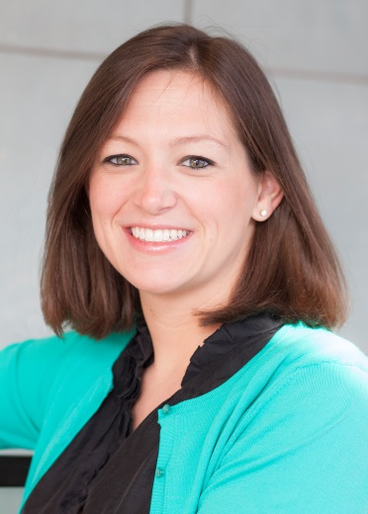
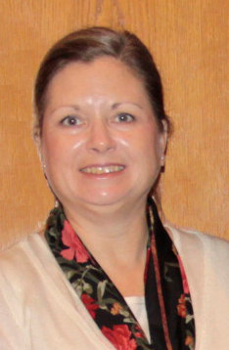

Reference Librarians
Available on 2nd floor of library, across from circulation and reading room area
8am–5pm
Monday–Friday
Jennifer Teichelman
Peggy Edwards
Micah Walsleben
Margaret Vugrin
Notes:
These are the Reference Librarians at the Lubbock campus. Our office hours are Monday – Friday 8:00am – 5:00pm Central Time. Feel free to give us a call or send us an e-mail, text us! We will be happy to help you.

Slide 17
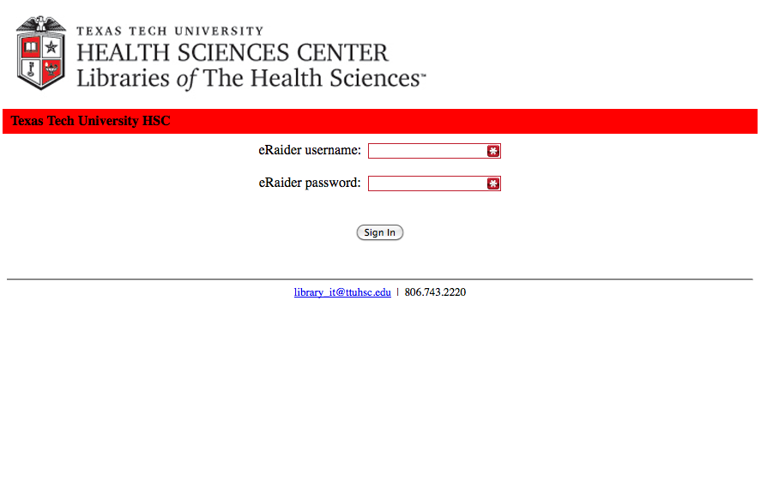
Proxy server
(off campus)
eRaider Username eRaiderPassword

Slide 18
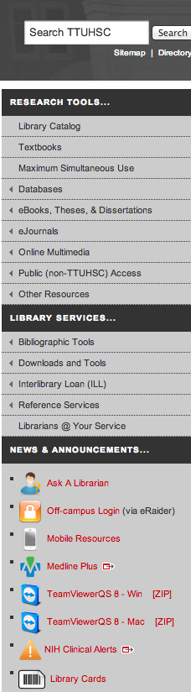
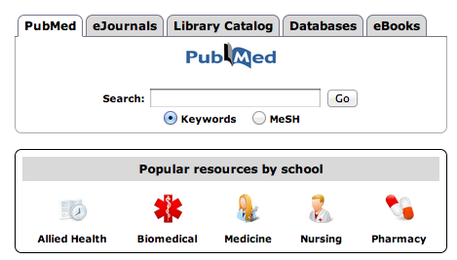

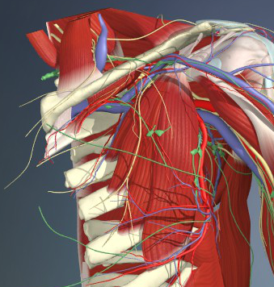
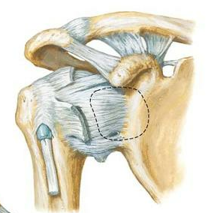
Upper right side

Slide 19
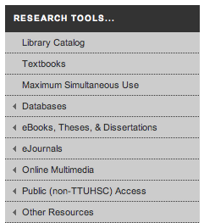
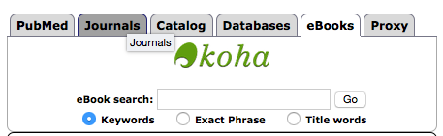
E-books
Over 62,000 eBooks

Slide 20
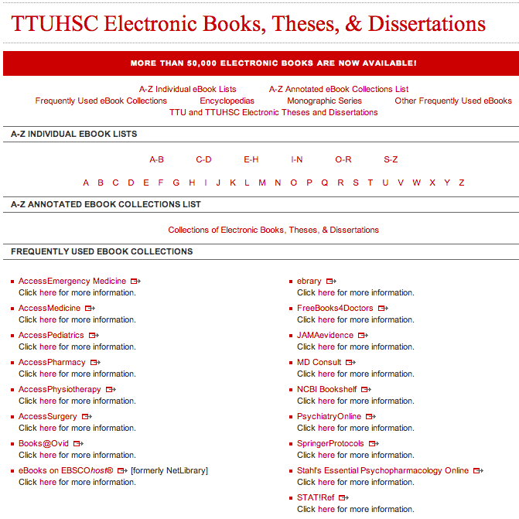
E-books
X

Slide 21
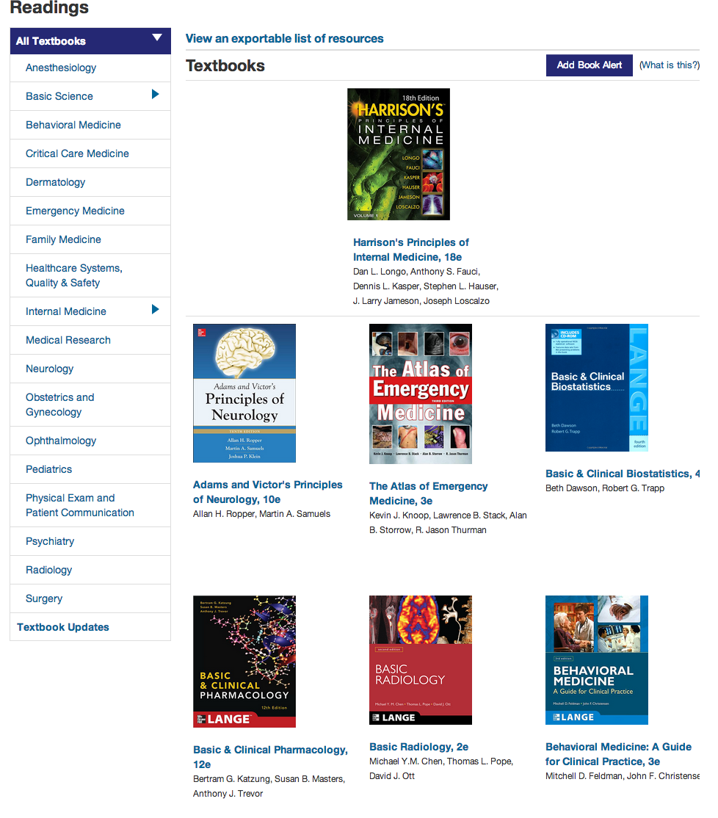
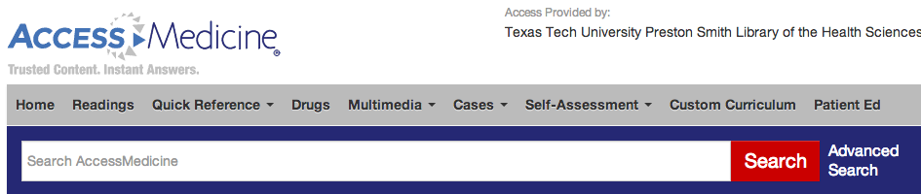
E-books
UNLIMTED ACCESS
Access
EmergencyMedicine
AccessMedicine
AccessPediatrics
AccessPharmacy
AccessPhysiotherapy
AccessSurgery

Slide 22
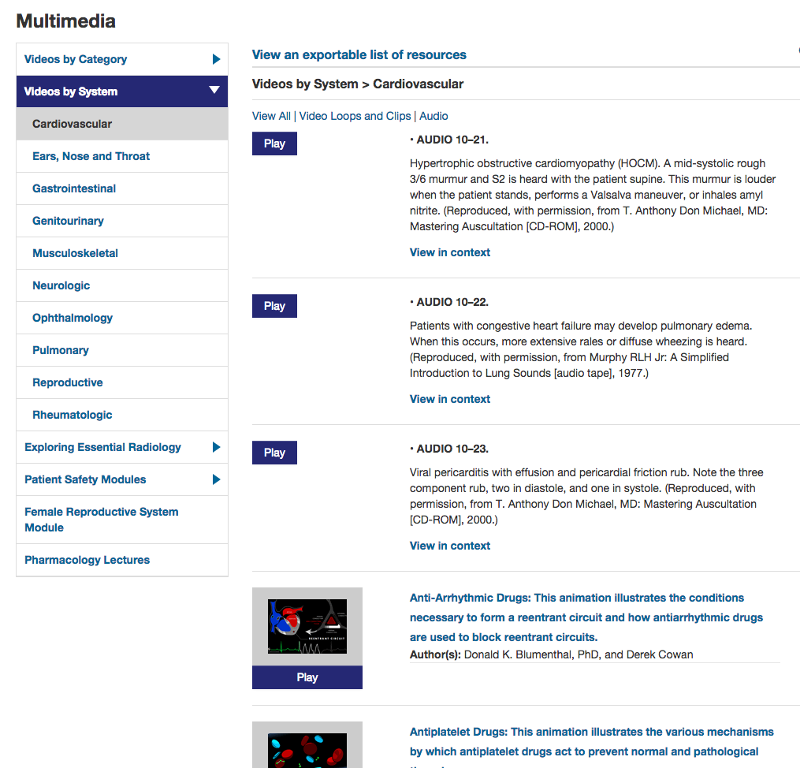
accessmedicine

Slide 23
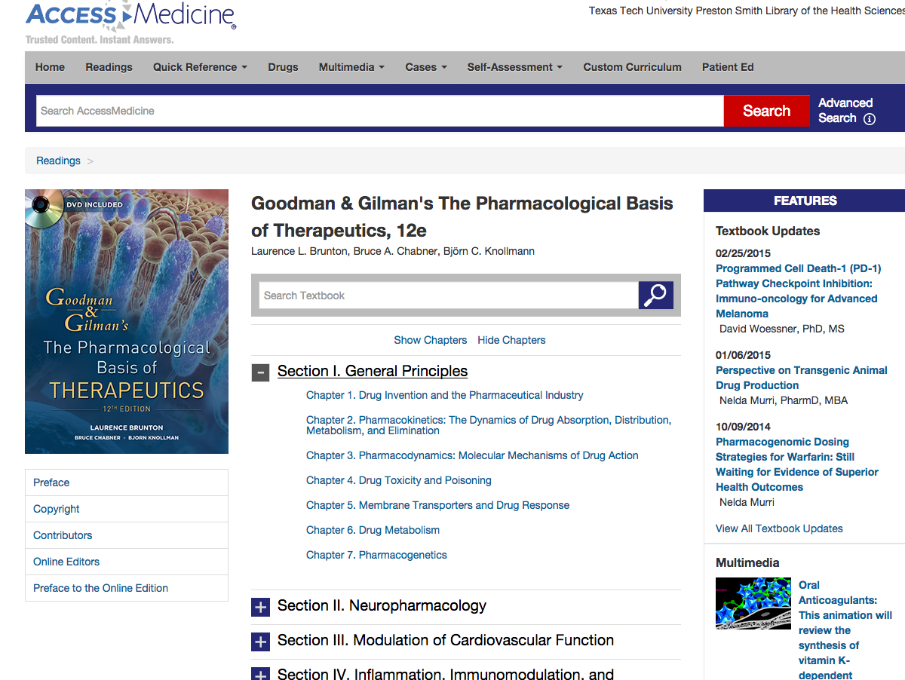
Free Register for special features

Slide 24
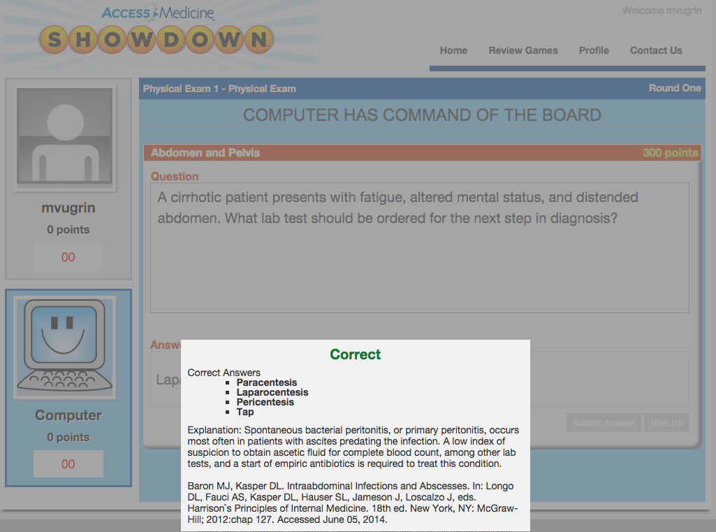
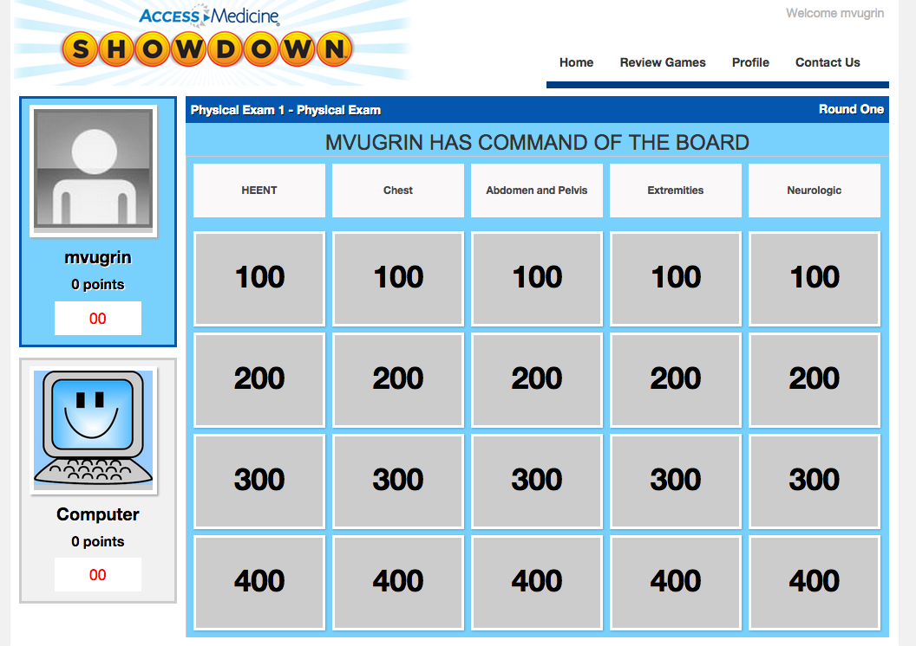

Slide 25
eBooks in Catalog
NEW

Slide 26
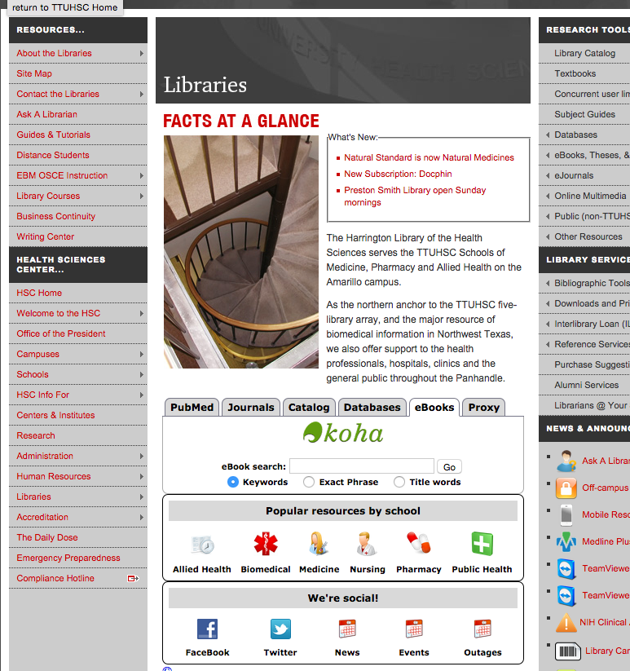
Netter atlas

Slide 27
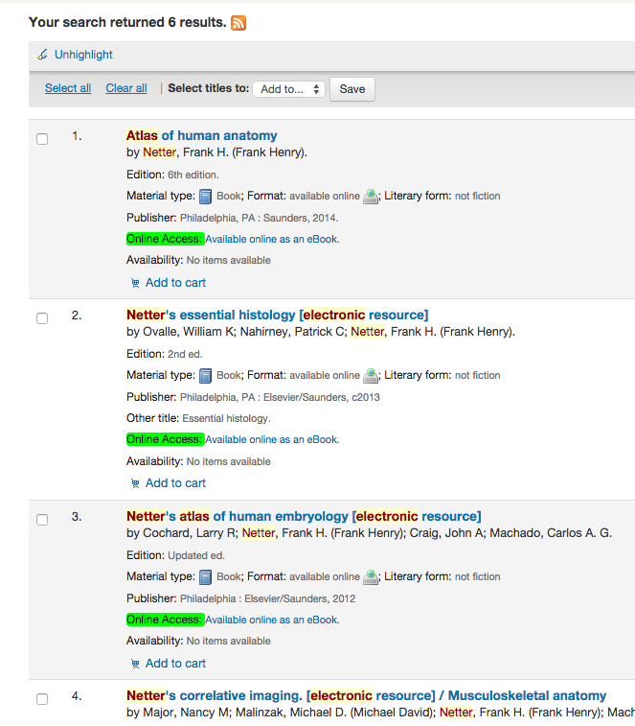
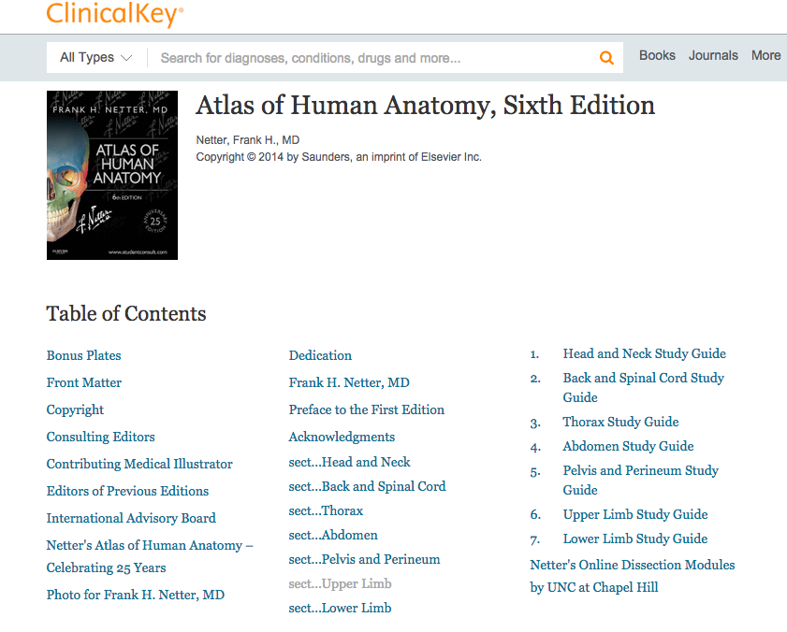

Slide 28
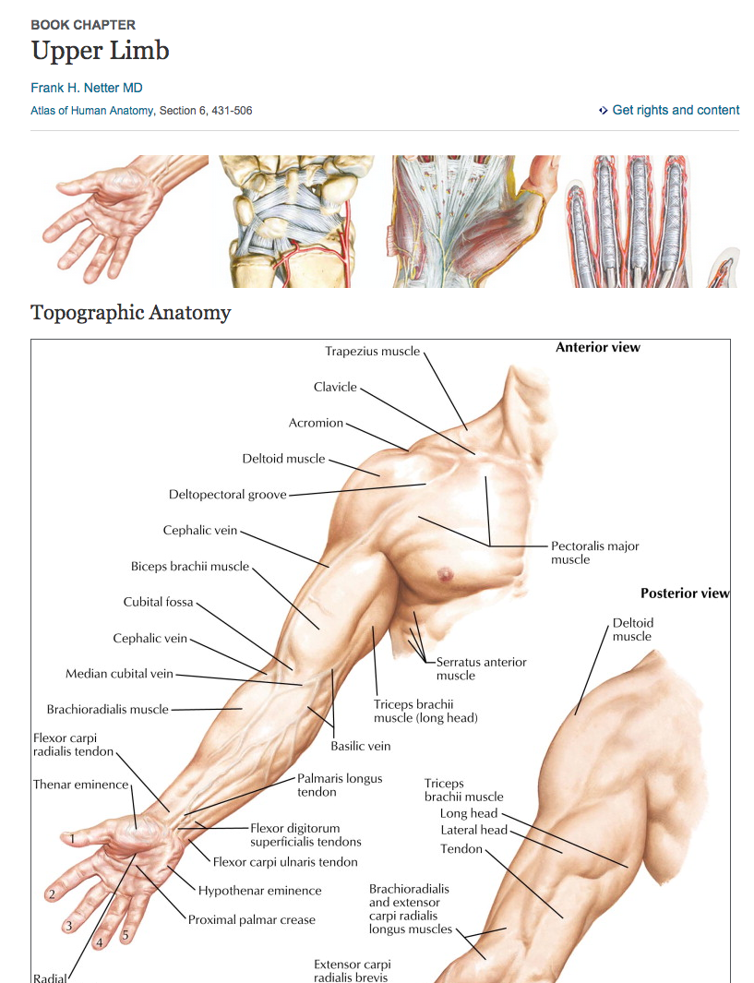

Slide 29
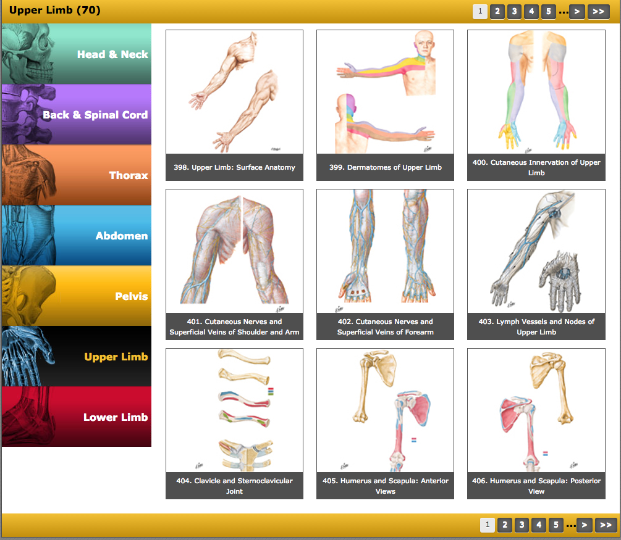
Upper right side

Slide 31
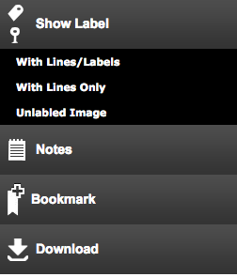
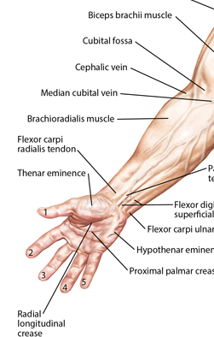
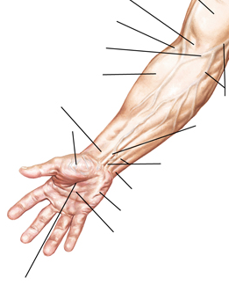
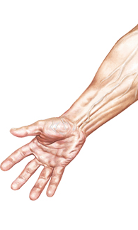

Slide 32
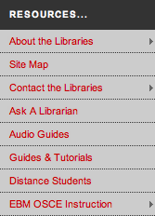
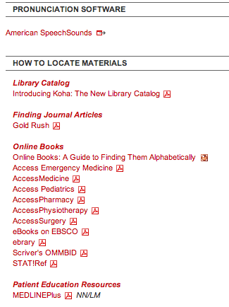
Upper
Left

Slide 33
Databases = 574+

Slide 34
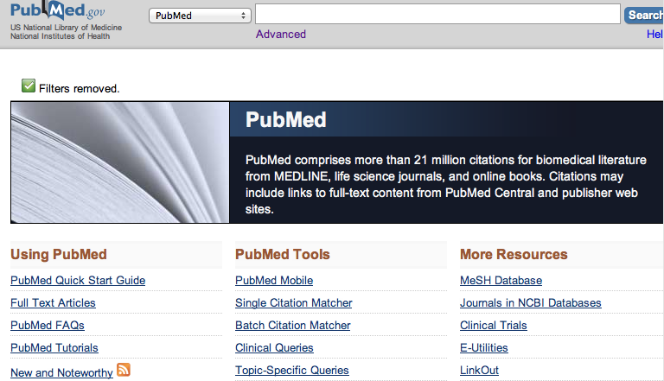
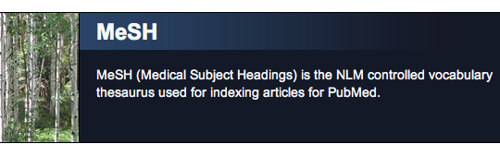

Slide 35
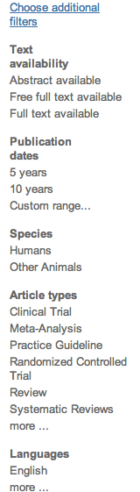
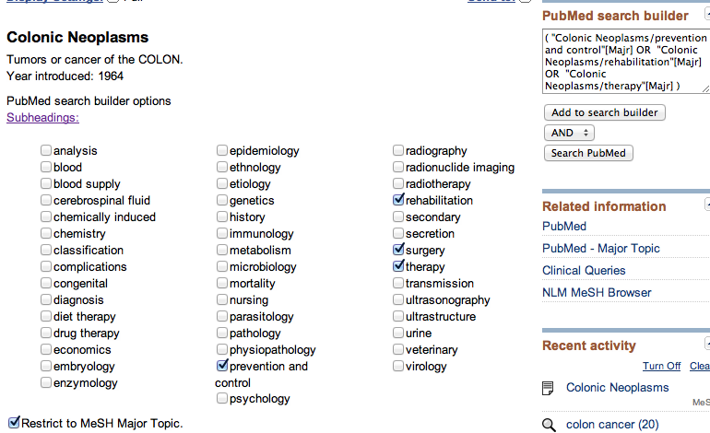
Why MESH?
Colon Cancer (Keyword) Results: 114,057
Colonic Neoplasms + 4 subheadings + Major concept = Results: 46,646

Slide 36

Follow these links to PDFs
PAPER
Visible in PubMed: Abstract format ONLY

Slide 37
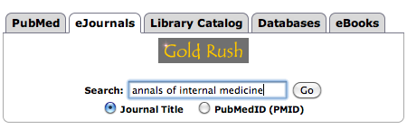
How to access articles?
Gold Rush –
Most complete record
of TTUHSC Journals
Have your citation before you start looking!

Slide 38
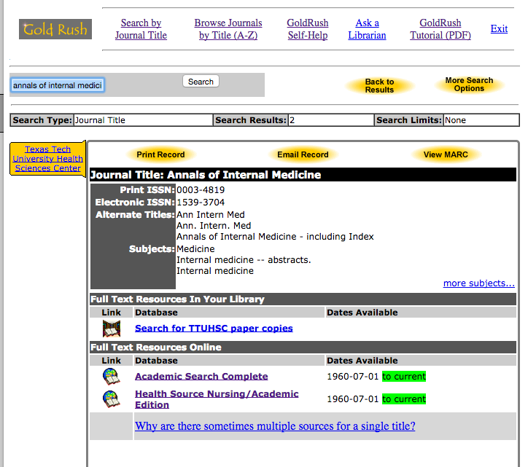
Gold Rush–Journal Records
Multiple electronic access options
Print
Check dates!
Full-text Electronic
Follow links!

Slide 39
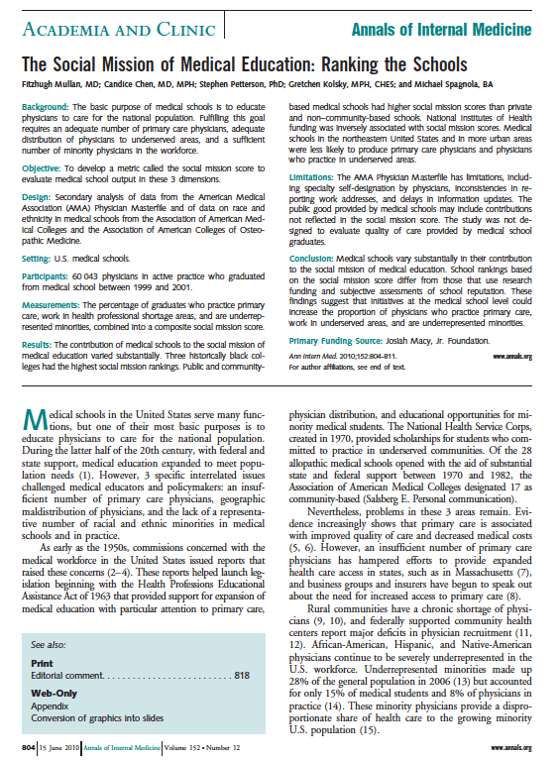
Gold Rush–
Journal Article
– PDF
PMID: 20547907

Slide 40
Still can’t find it!

Slide 41




Interlibrary Loan (ILL)

Slide 42

Interlibrary Loan (ILL) Policies
Online form makes submitting requests quick and easy
Response time for requests is anywhere from 2 – 10 business days, depending on location of the item
Books from any TTUHSC branch library are free.
All other locations are $4.00
Journal articles are charged
per page, but fees will not
exceed $4.00
There is a rush option
available, but at a higher
fee rate

Slide 43


Interlibrary Loan (ILL) Policies

Slide 44


Slide 45



Slide 46


Slide 47
Databases

Slide 48

Scopus
Sort by Relevance
Locate landmark articles
Who has cited the article?
Keyword searching
Exporting available
5986

Slide 49


DATABAses
Cochrane
OVID Evidence Based
Dynamed
Essential Evidence Plus

Slide 50



MOST CURRENT Point-of-care tool (BMJ 2011Sep 23)
7-step Evidence-Based Methodology
  Identify, select, appraise, report, synthesize, derive conclusions and UPDATED DAILY
Practice changing updates
MOBILE APP

Slide 51


Is an evidence-based, point-of-care clinical decision support system (over 2,000 calculators) with access to over 13,000 topics, abstracts, guidelines, and summaries

Slide 52

Evidence-Based
EBM Reviews
presented by OVID
Up-to-Date
Available thru
School of Medicine
not from library

Slide 53


AgileMD

Slide 54


Slide 55



Slide 56


Slide 57

Abdominal Pain
Symptom to Diagnosis

Slide 58
Drugs?

Slide 59




Slide 60
Exam master

Slide 61


Question Banks for:

Slide 62



Right bottom
Platform links

Slide 63

Need
help?

Slide 64
Right bottom

Slide 65

Right bottom

Slide 66




Team viewer
Remote support
With computer and phone!

Slide 67

Team Viewer
Librarian can see your screen…
Need telephone for audio
Both can move mouse around
One Time Use!
Your info
Librarian info
Once the ID & password are entered on our computer…
we have one time access to your desktop!

Slide 68



Middle right side
For training with
Bibliographic Software Management contact one of the Reference Librarians at:
mylibrary@ttuhsc.edu or
the Ask a Librarian link

Slide 70


Team Viewer & Ask a Librarian

Slide 71
Thank you!

