Slide 1
Welcome
Information Resources for Nursing
Peggy Edwards, AMLS
TTUHSC - Preston Smith Library
Lubbock, Texas 79430
July 2014

Slide 2



PubMed Database
Literature from 5,600 biomedical and life sciences journals
International scope
Developed and maintained by the:
National Center for Biotechnology Information
    at the U.S. National Library of Medicine
    at the National Institutes of Health

Slide 3

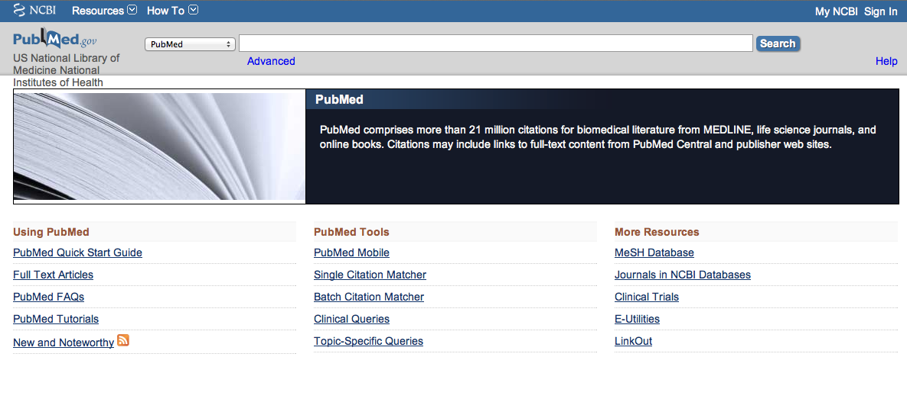
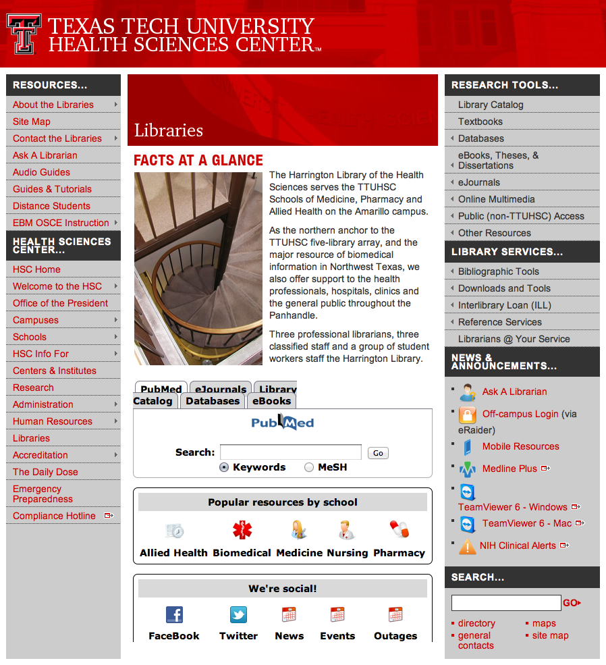
Accessing PubMed
Freely available over the Internet
@ www.pubmed.gov
Also through library’s home page

Slide 4
EBP Literature from
PubMed’s Clinical Queries

Slide 5


Evidence-Based Practice is guided by thoughtful integration
of the best available scientific knowledge with clinical expertise.

Slide 6
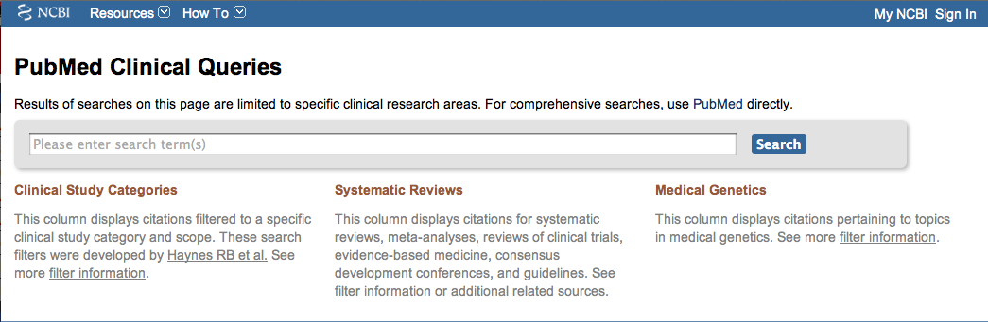
PubMed’s Clinical Queries
tool that searches for evidence-based literature

Slide 7

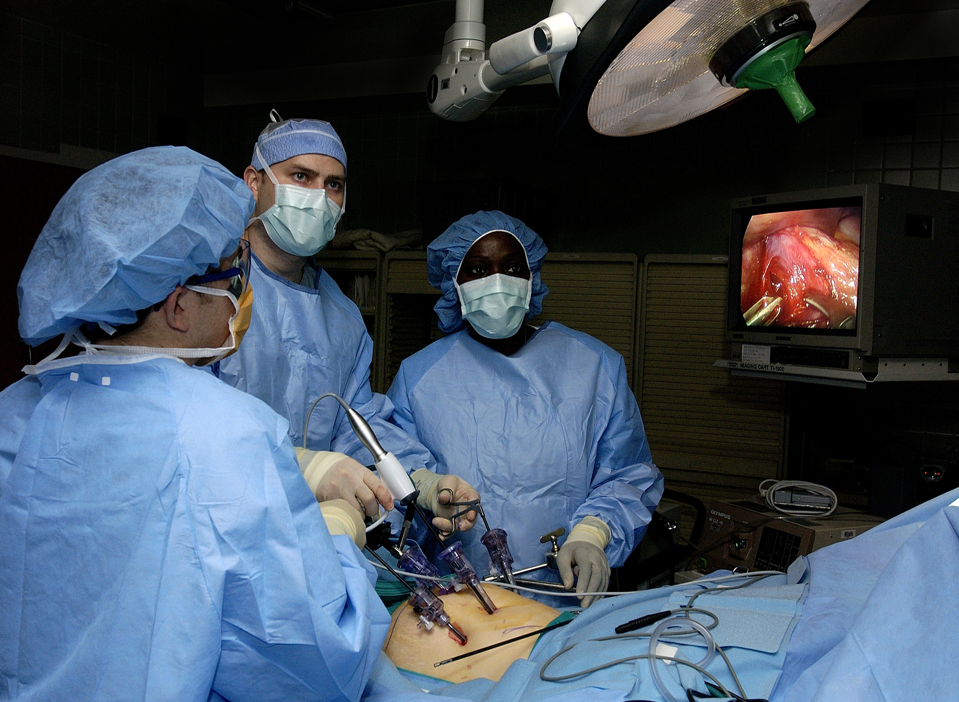
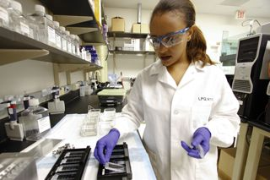
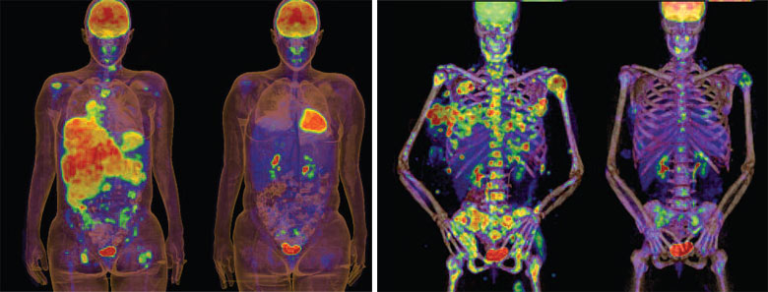
Clinical Queries Searchable by:
Diagnosis
Therapy
Prognosis (prediction of probable outcome)
Etiology (cause)

Slide 8
Clinical Queries Searchable by:
Diagnosis
Therapy
Prognosis (prediction of probable outcome)
Etiology (cause)

Slide 9
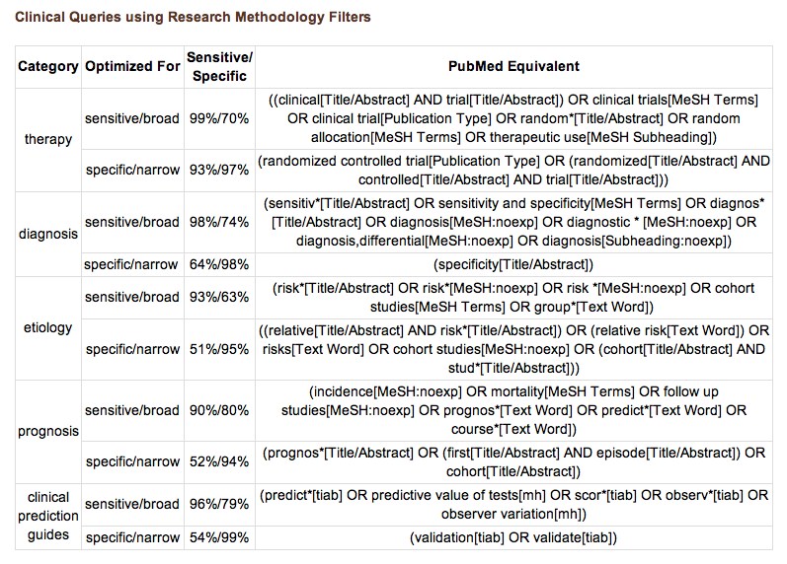
PubMed’s Clinical Queries
uses pre-formulated search strategies with a keyword search

Slide 10
To begin...

Slide 11
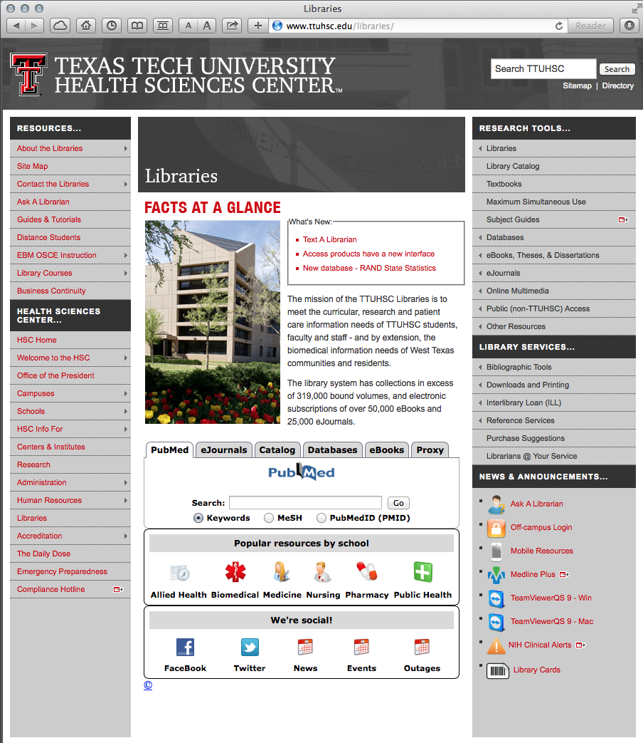
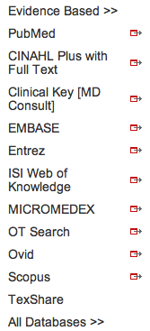
PubMed’s Clinical Queries
www.ttuhsc.edu/libraries
Mouse over Databases
Click PubMed

Slide 12
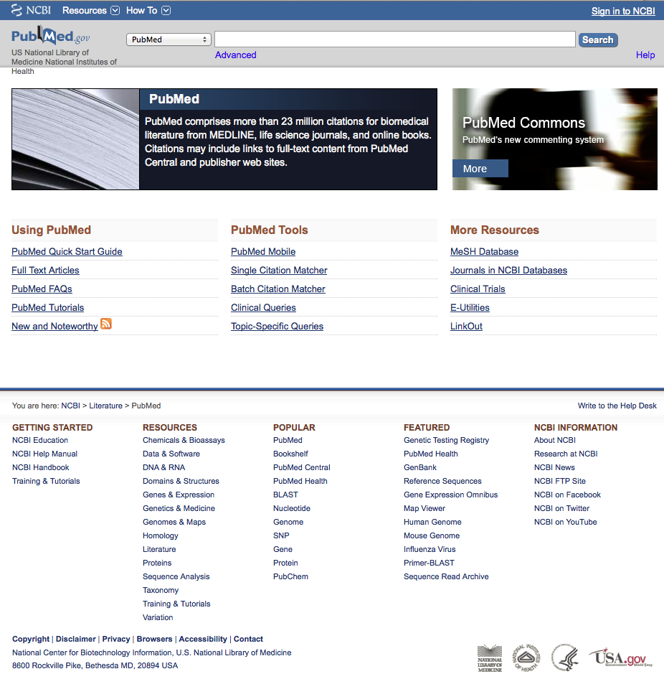
PubMed Home Page

Slide 13
Click Clinical Queries

Slide 14
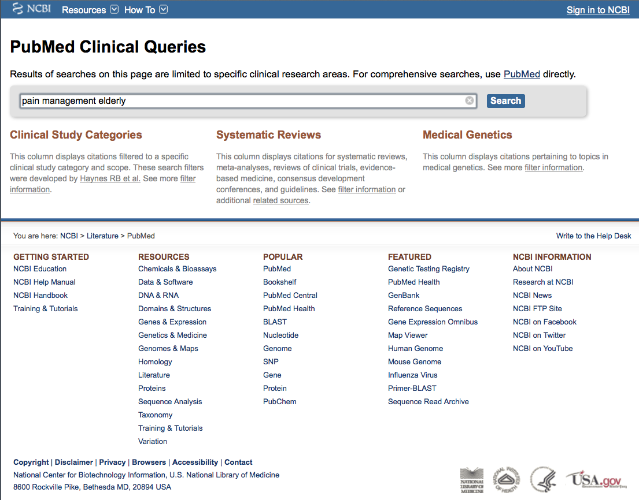
Enter pain management elderly
Click
Search

Slide 15
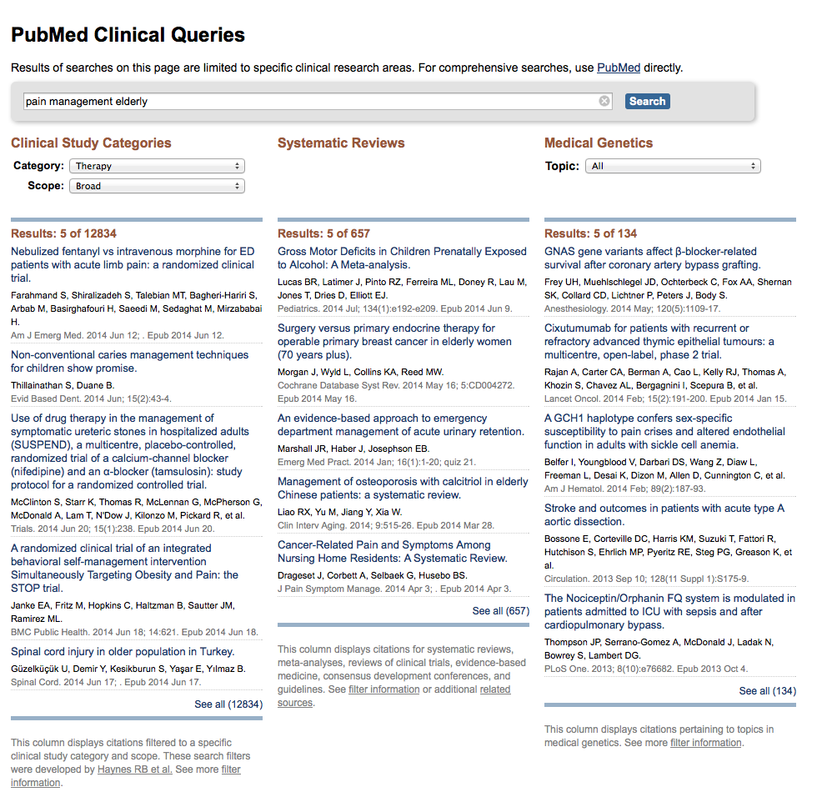
Change to Narrow Scope
Results for Therapy and
Broad Scope

Slide 16
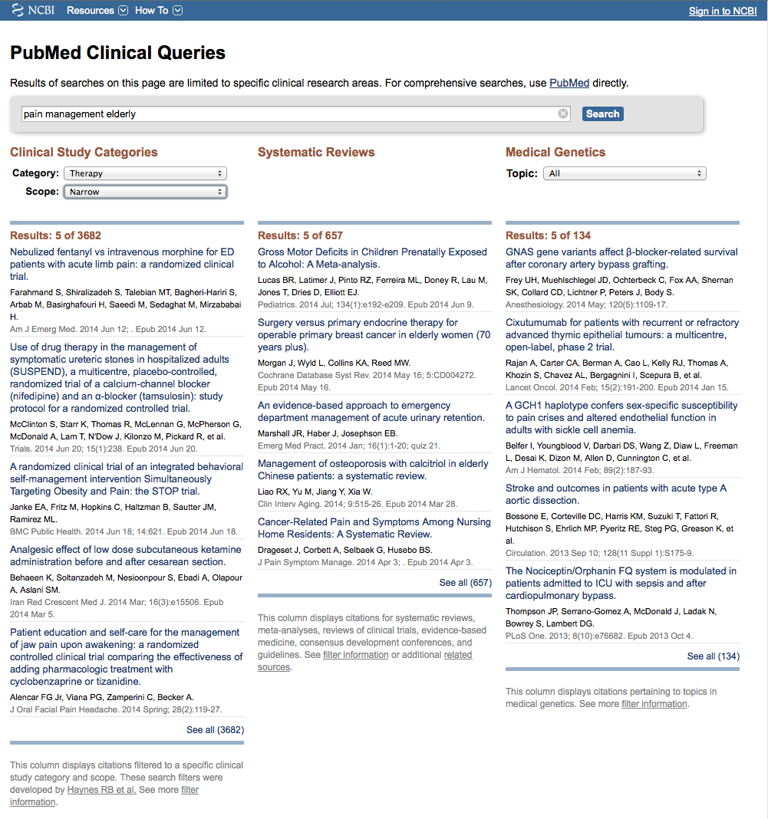
Results for Therapy and
Narrow Scope
Click See all (3682)

Slide 17
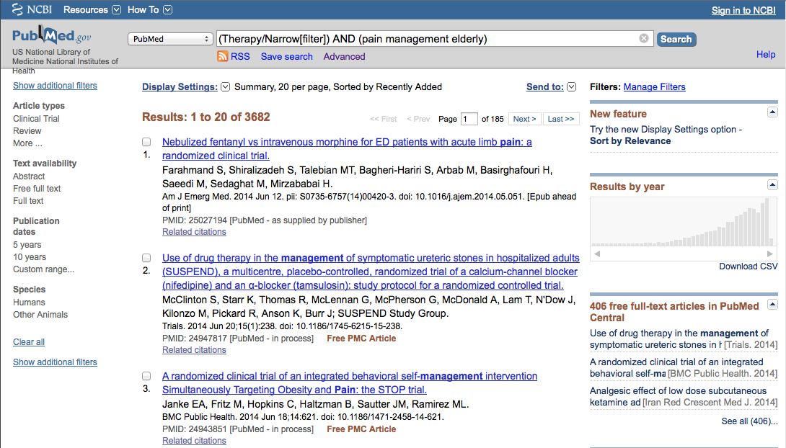
Select filters to narrow
Click Humans to select

Slide 18
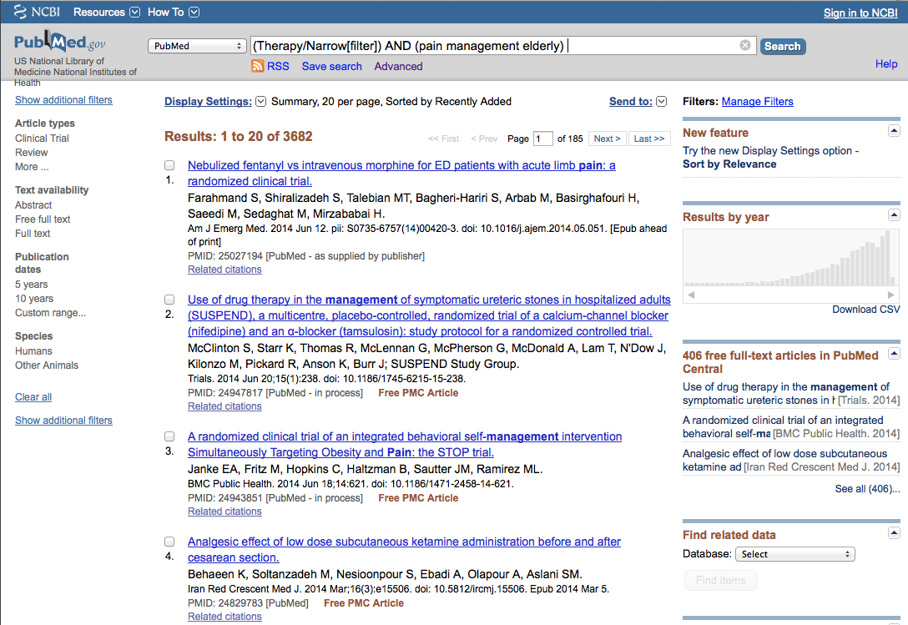
Selections will turn blue: ✓ Humans

Slide 19
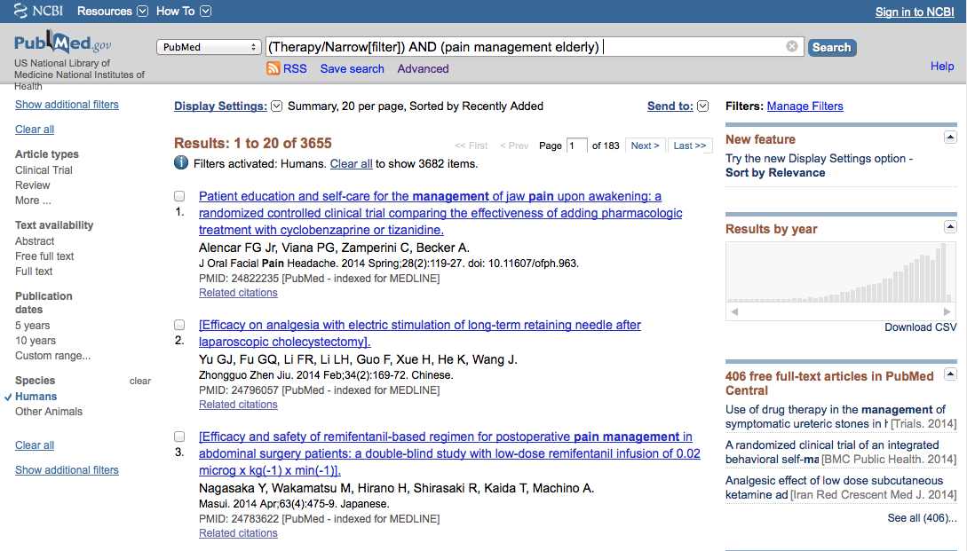
Click 5 years to limit

Slide 20
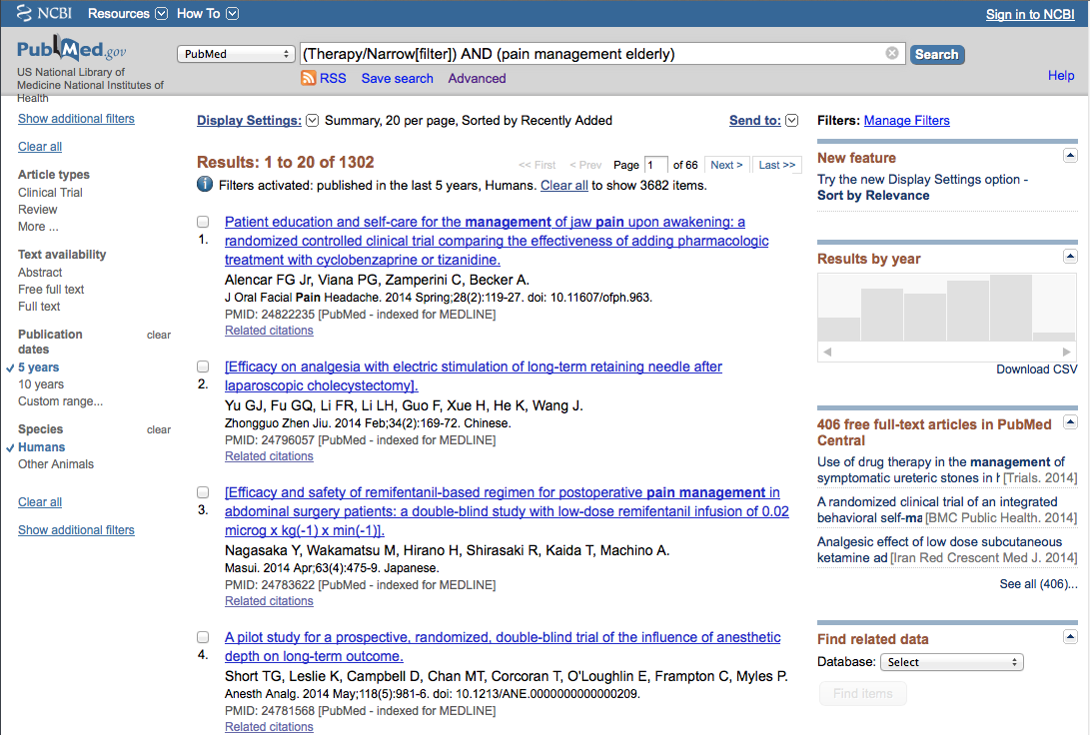
Click Show additional filters

Slide 21
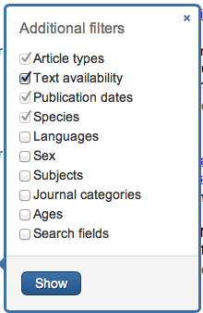
Select
Languages
Journal Categories
✔
✔
Click Show

Slide 22
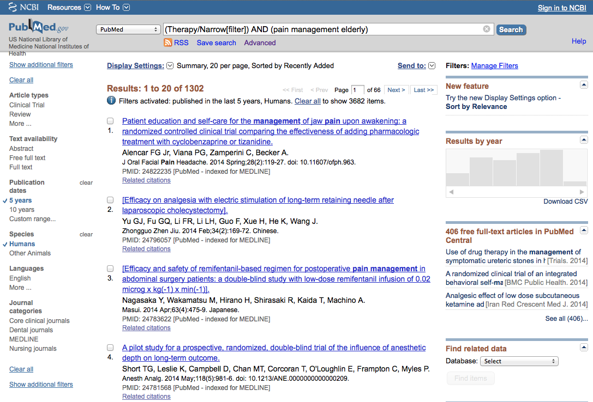
Click English
Click Nursing Journals

Slide 23
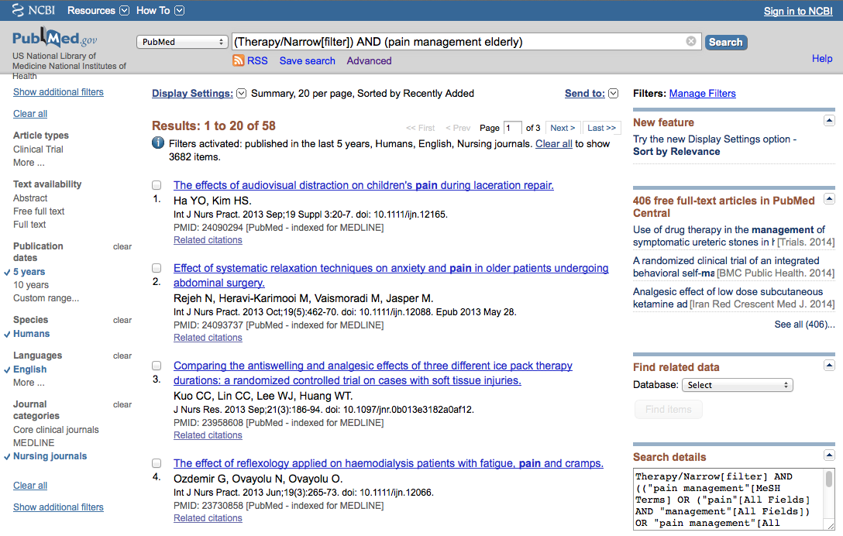
Selections turn blue: ✓ English, Nursing journals

Slide 24
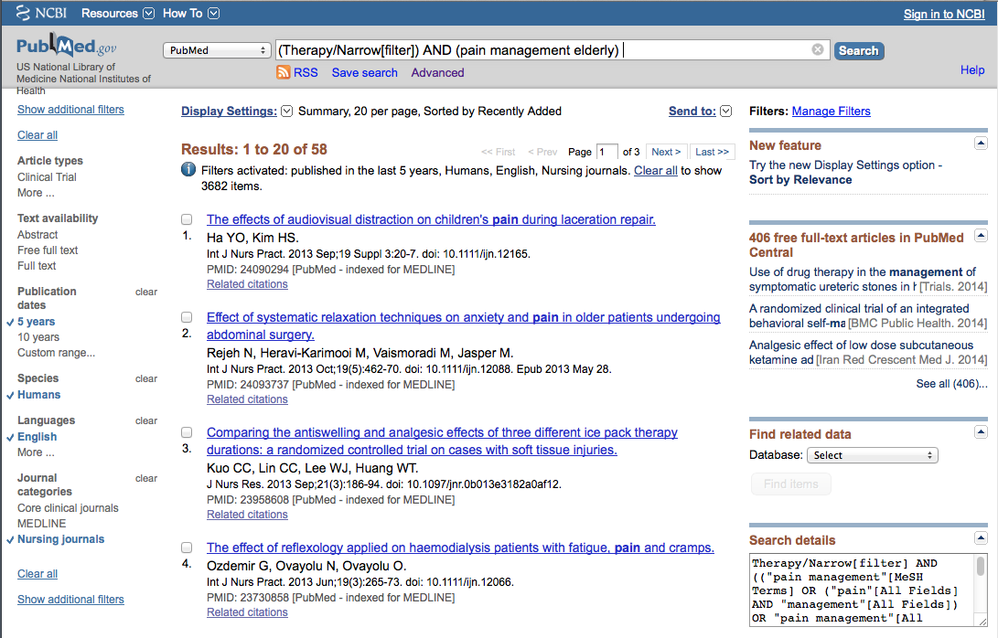
Results have narrowed to 58
Click on the title of the article you wish to read

Slide 25
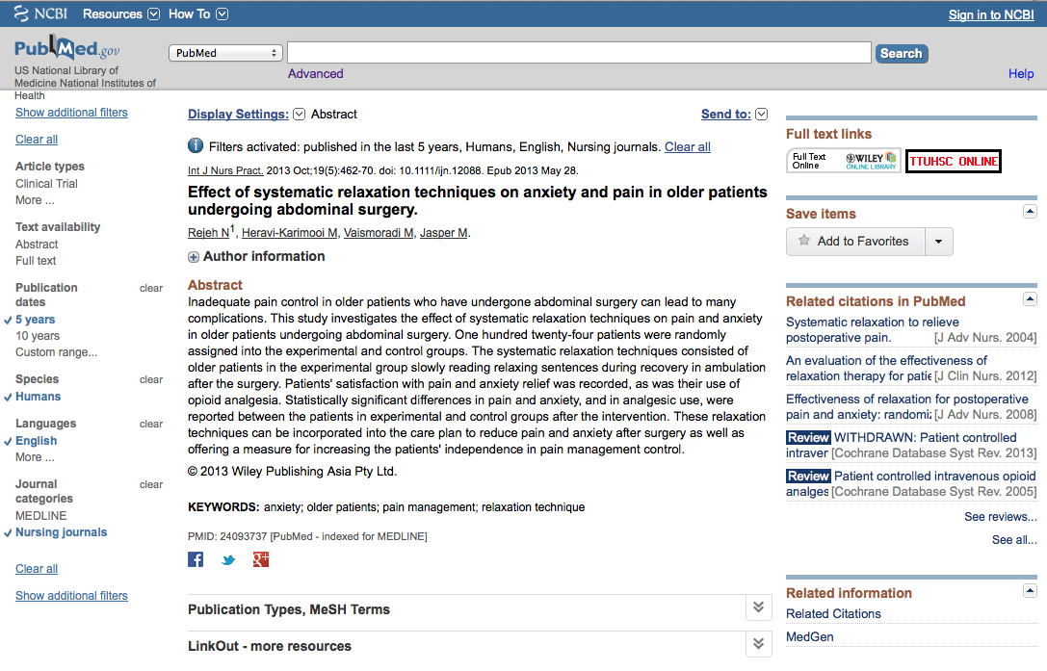
Click for Free Full Text
TTUHSC ONLINE

Slide 26
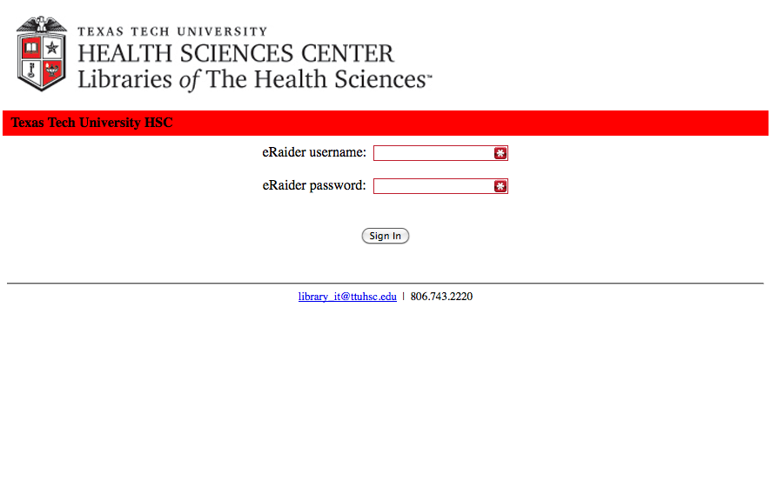
TTUHSC Libraries - Proxy Server
When Searching from Off Campus:
Enter the
Eraider username and password
assigned to you
by Information Services.
Problems with eRaider call: 806-743-1234
a

Slide 27
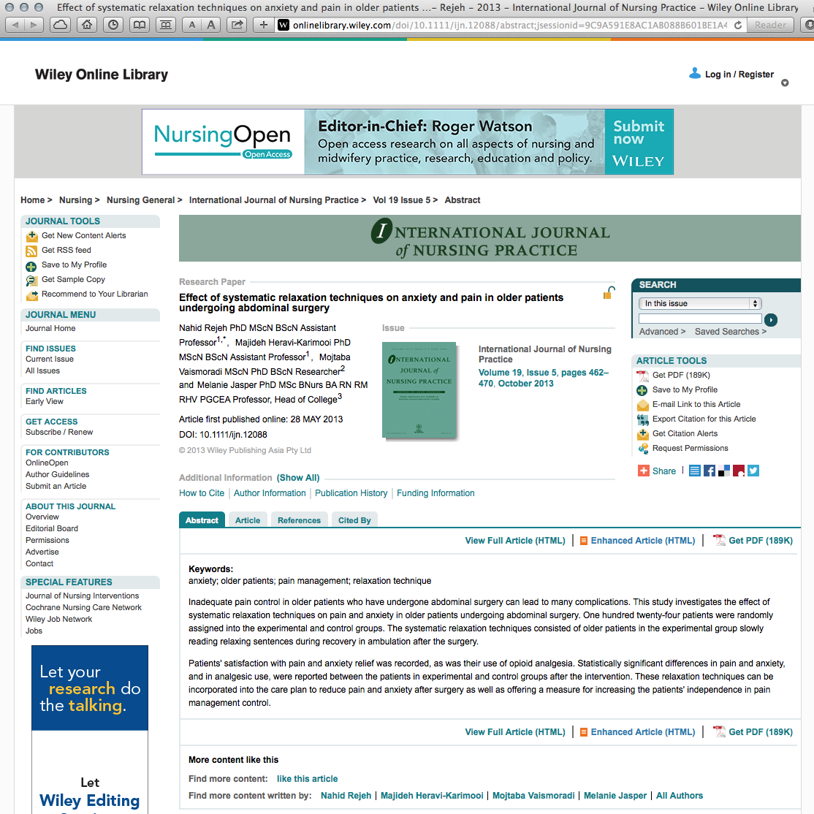

Click

Slide 28
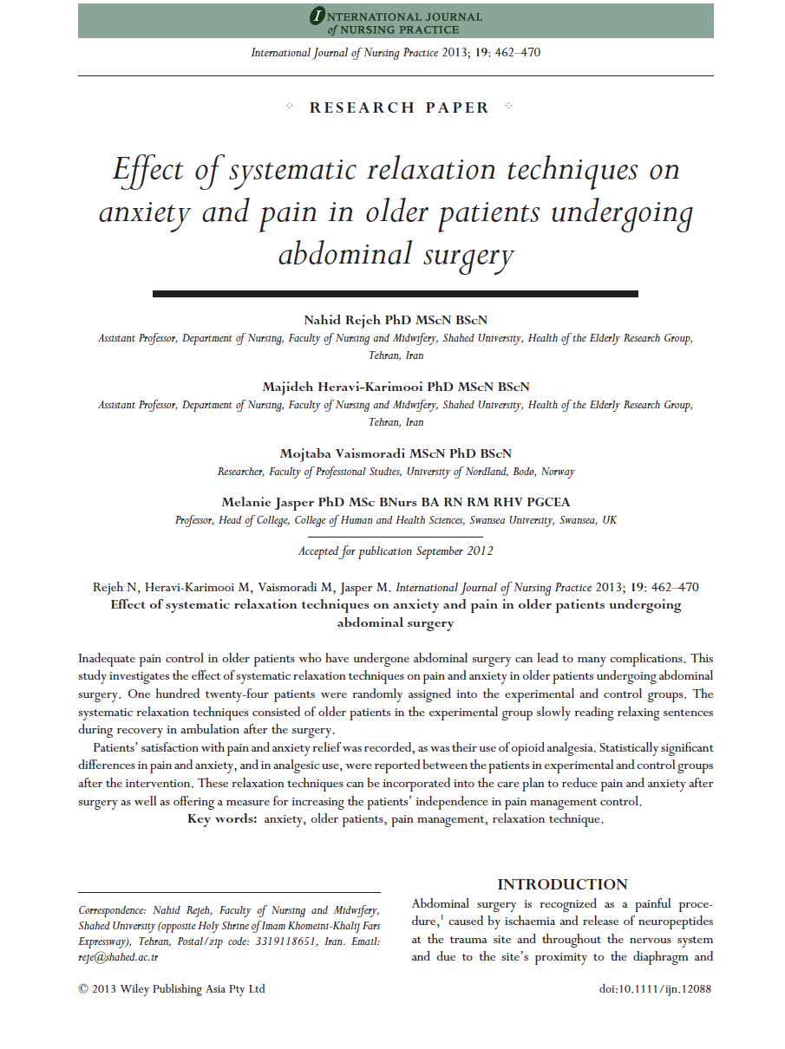
Full Text

Slide 29
PEPID

Slide 30
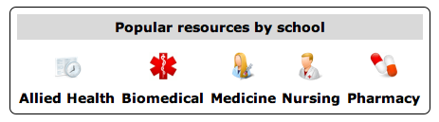
PEPID
www.ttuhsc.edu/libraries
Click Nursing

Slide 31
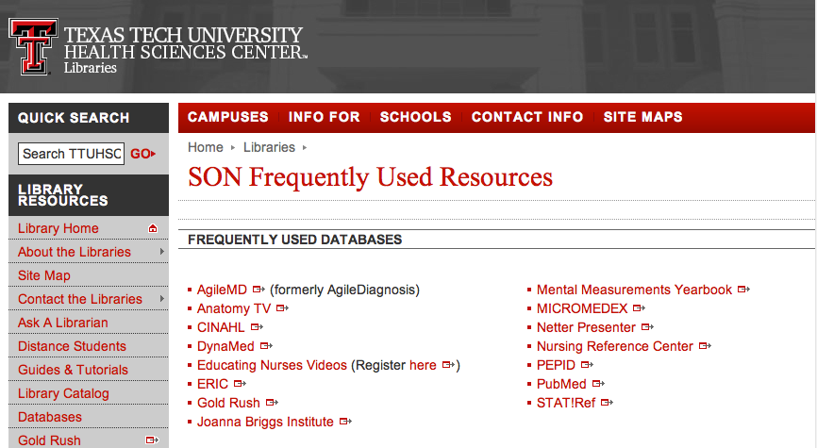
Click PEPID

Slide 32
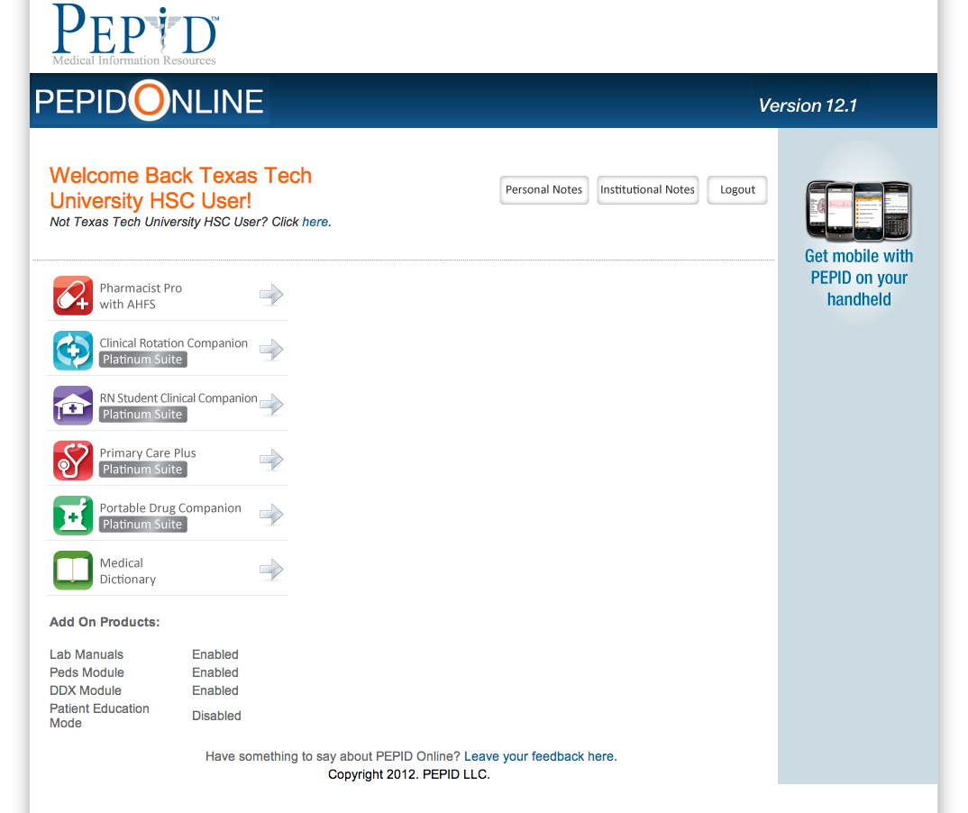
Click RN Student Clinical Companion

Slide 33
Comprehensive point-of care resource
Formatted for smart phones and tablets

Slide 34
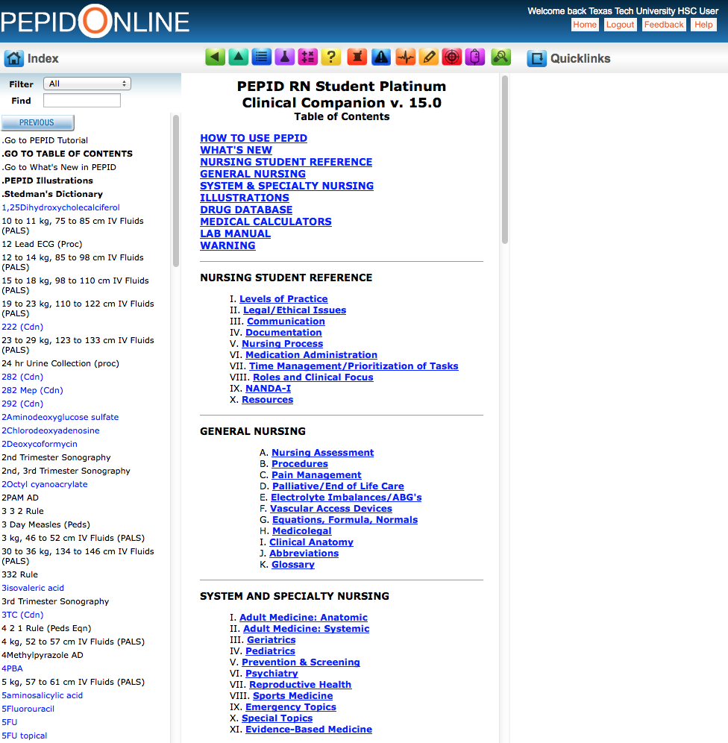
Home Page
Table of Contents

Slide 35
PEPID includes:

Slide 36
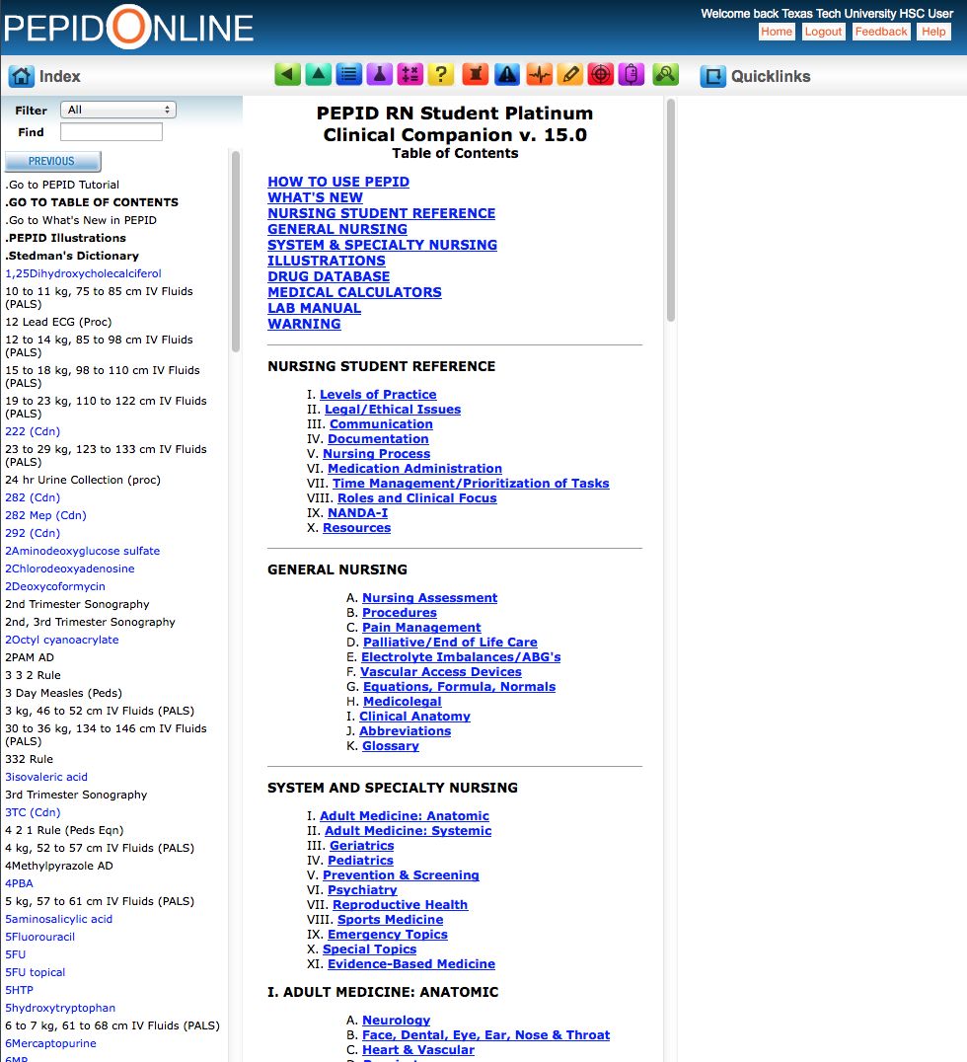
Scroll Screen
Click
IV. Pediatrics

Slide 37
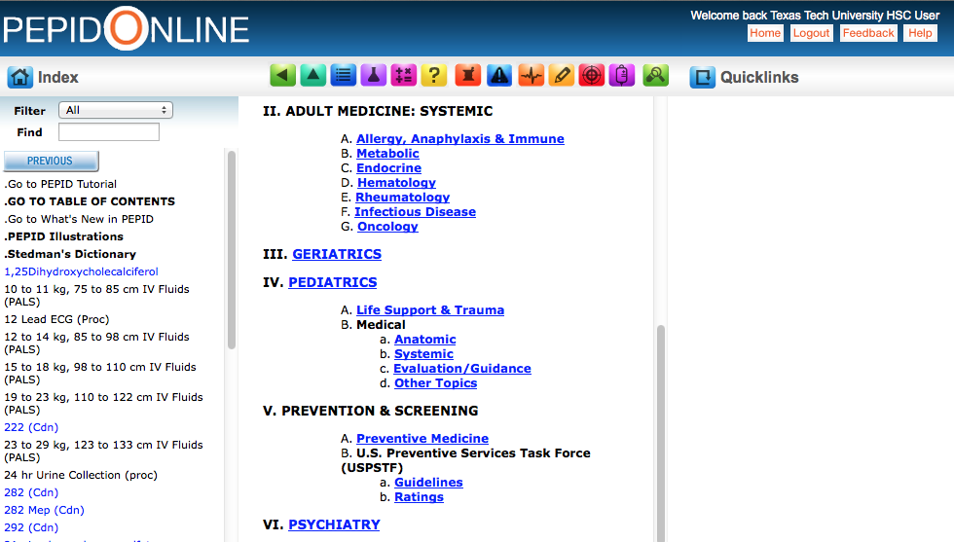
Click
Life Support & Trauma

Slide 38
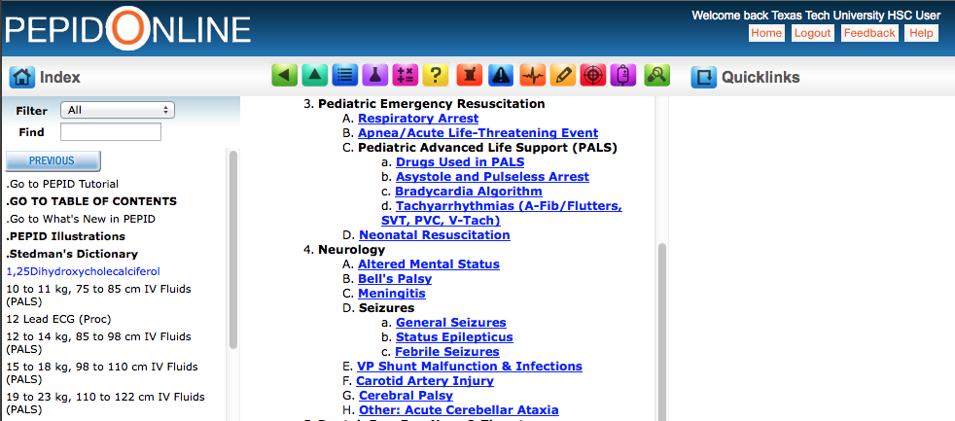
Click
Neonatal Resuscitation

Slide 39
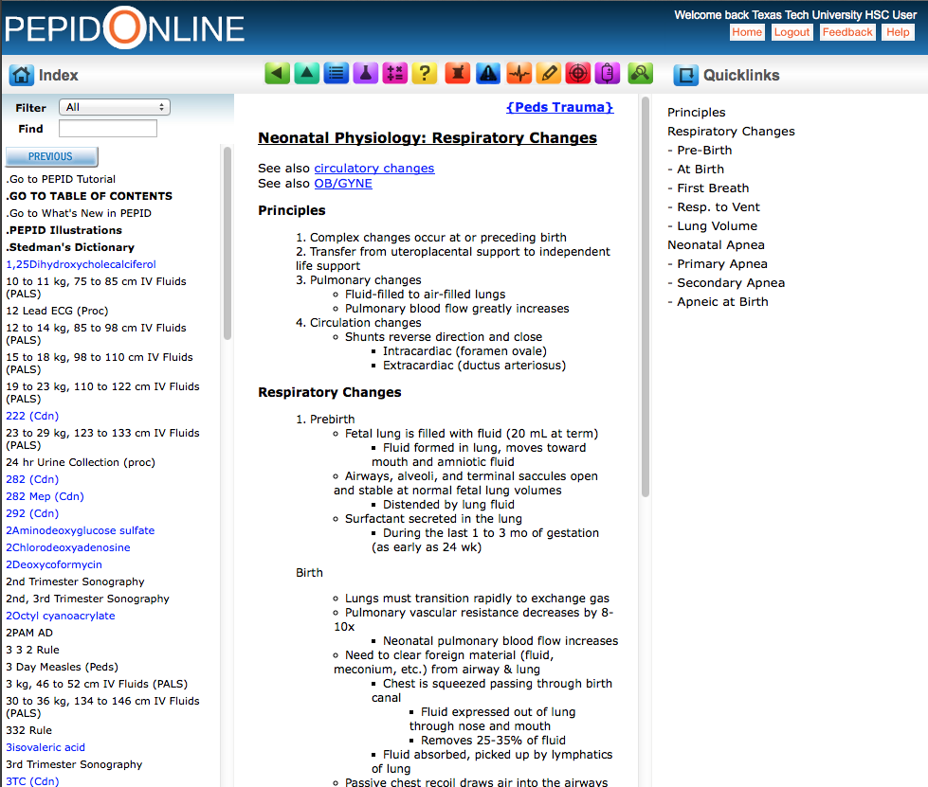
Example

Slide 40

General Nursing
Adult Medicine
Geriatrics
Pediatrics
Prevention & Screening
Psychiatry
Reproductive Health
Sports Medicine
Emergency Nursing
Evidence Based Medicine
Other Information Topics Include:
*
*
*
*
*
*
*
*
*
*

Slide 41

Click Table of Contents Icon

Slide 42
Table of Contents
Click appropriate database

Slide 43
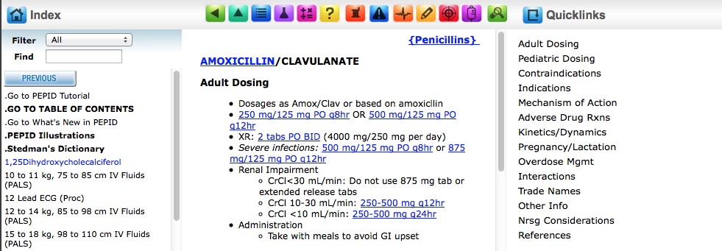
Drug Database:
Clickable links

Slide 44
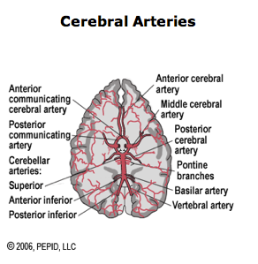
There are also:
Illustrations

Slide 45
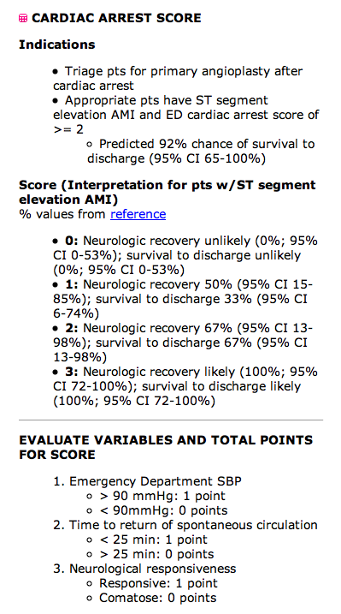
Medical Calculators:

Slide 46
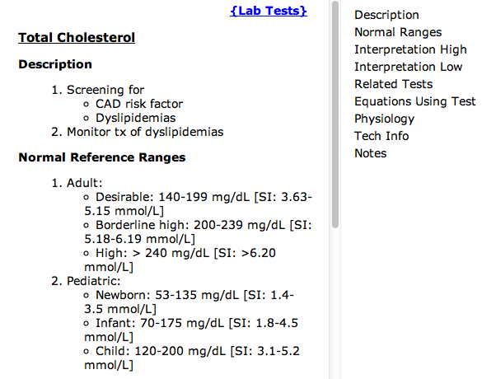
and a Lab Manual:

Slide 47
Drug Information in
MICROMEDEX

Slide 48

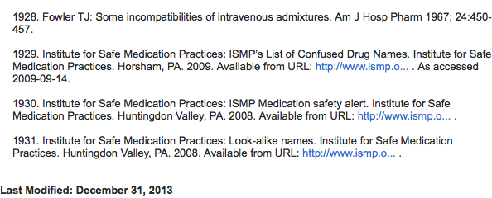
MICROMEDEX
Authoritative drug information

Slide 49
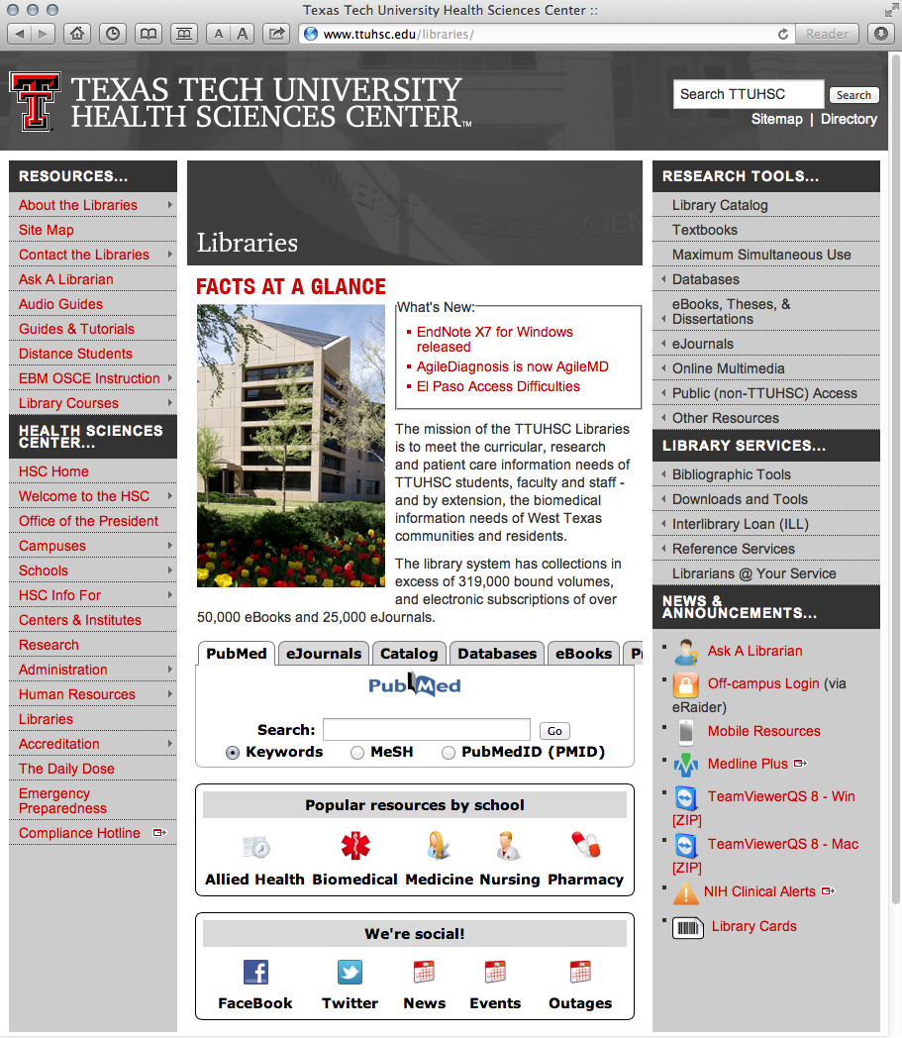
www.ttuhsc.edu/libraries
Click Nursing

Slide 50
Click MICROMEDEX

Slide 51
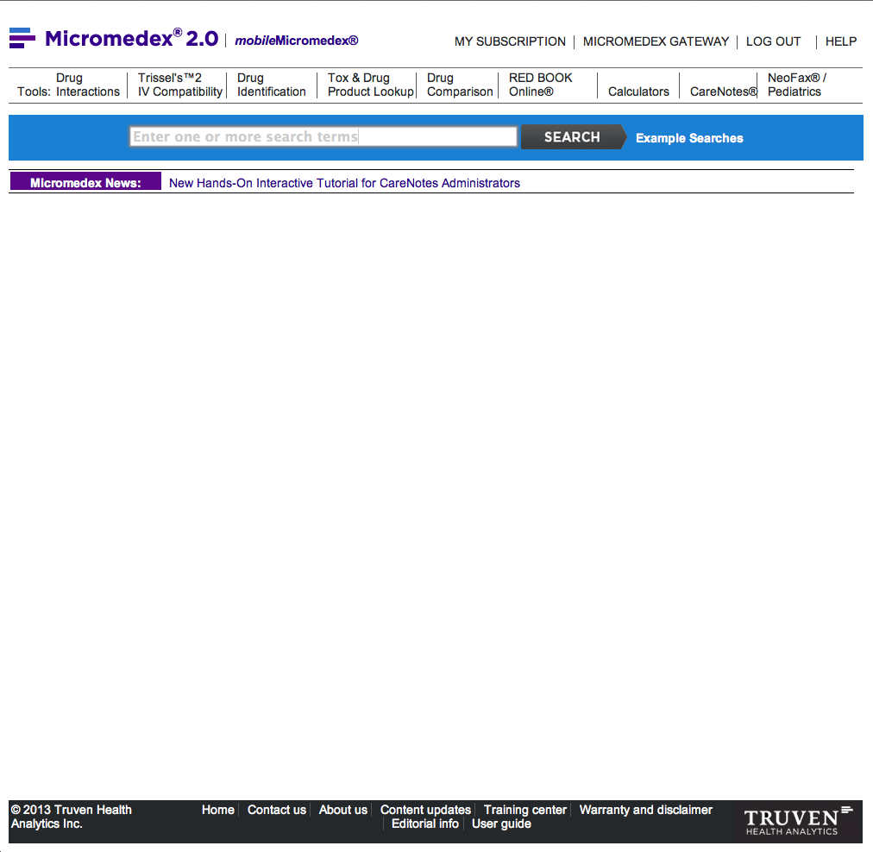
Drug Name Search Bar

Slide 52
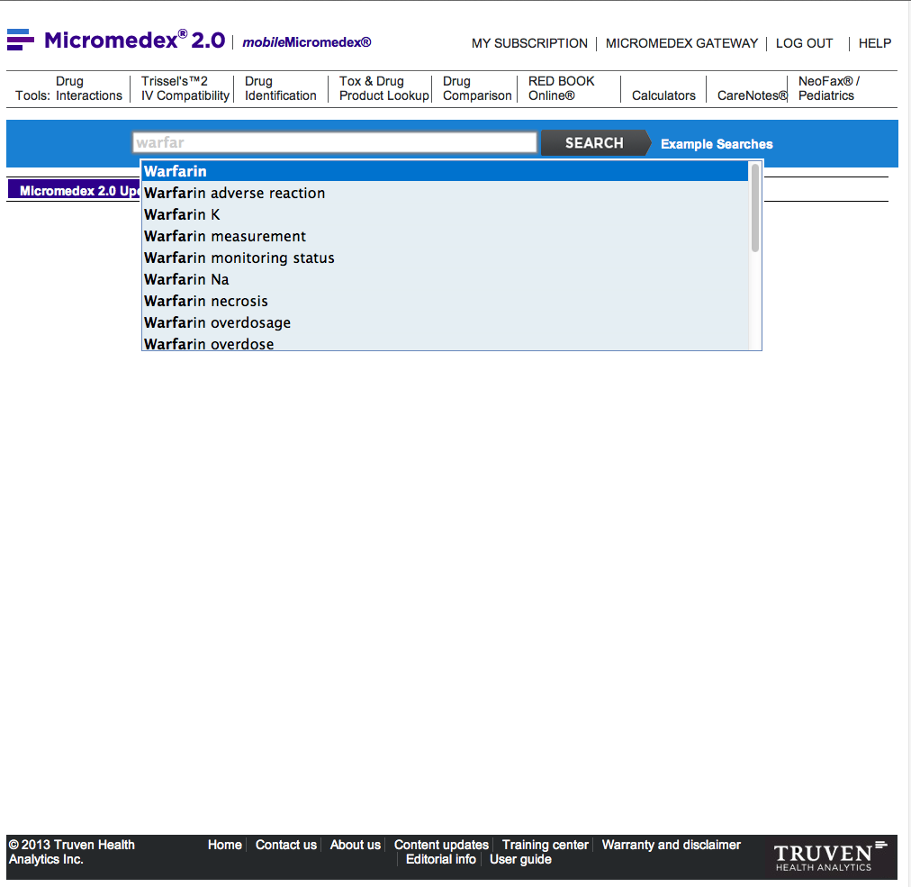
warfarin
Begin entering drug name.
Select correct drug.

Slide 53
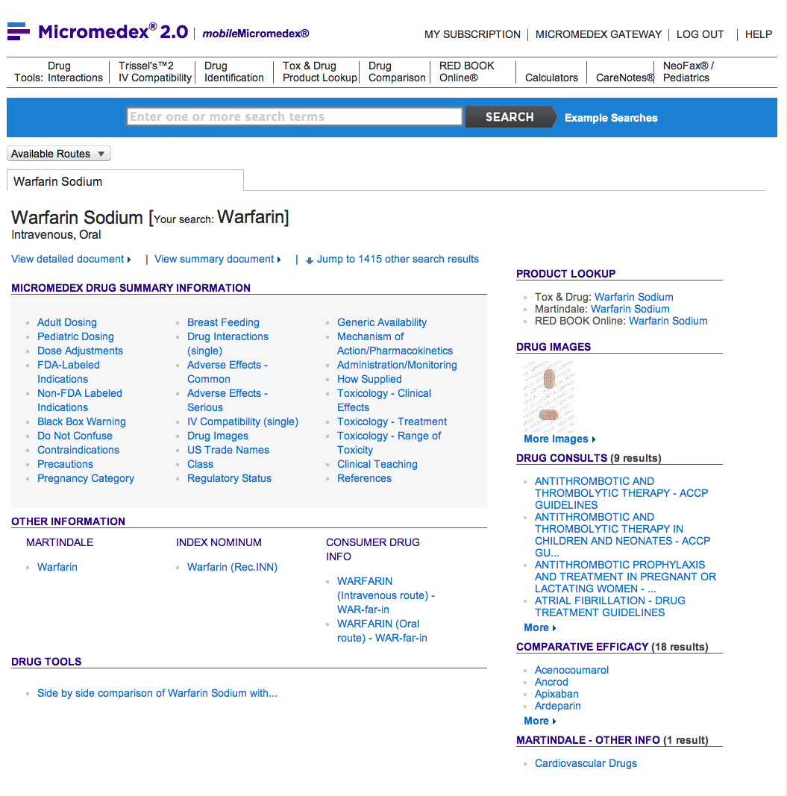
Select detailed document

Slide 54
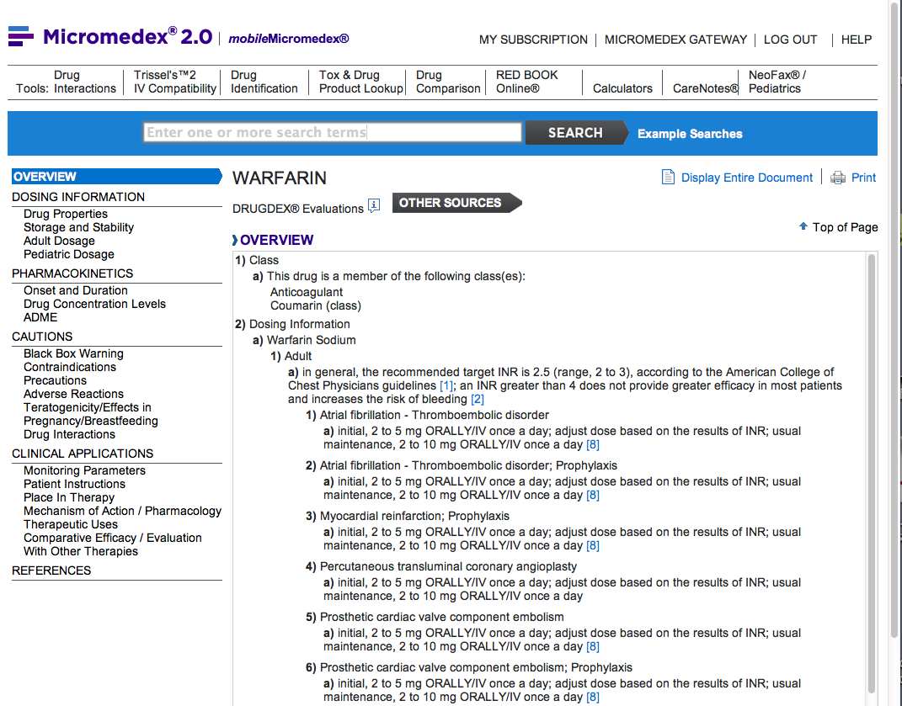
Drug Monograph

Slide 55
Special Tools
A

Slide 56
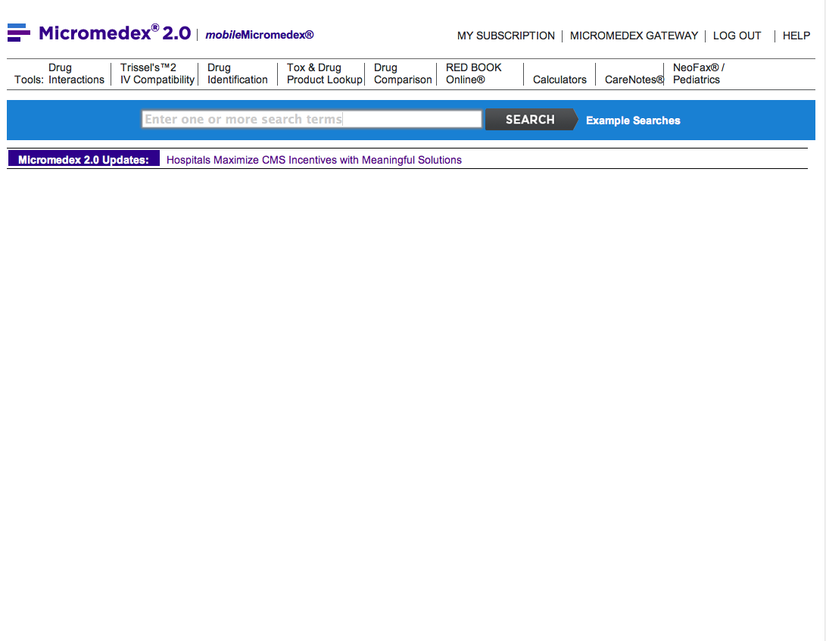

MICROMEDEX – drug interactions
Select Drug Interactions

Slide 57
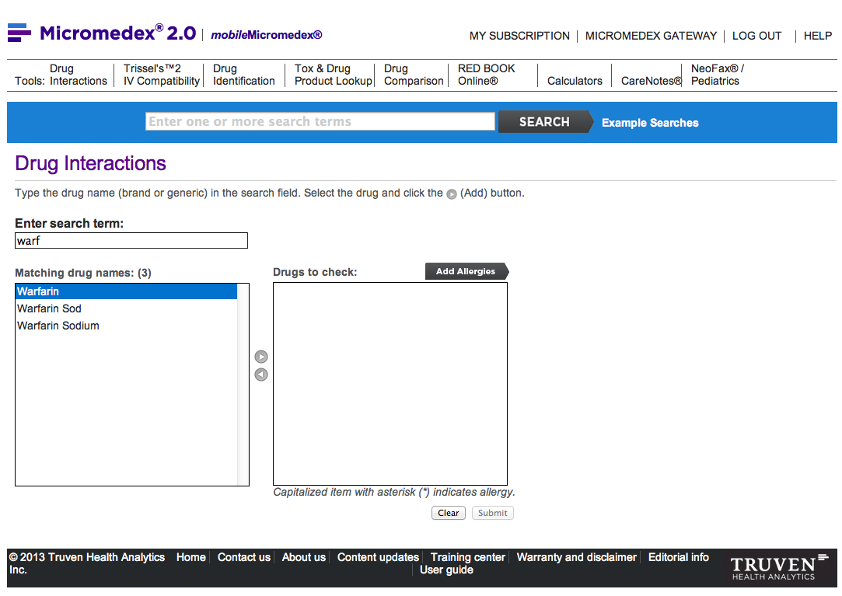
Start entering drug name
warf
Highlight correct drug
Click arrow

Slide 58
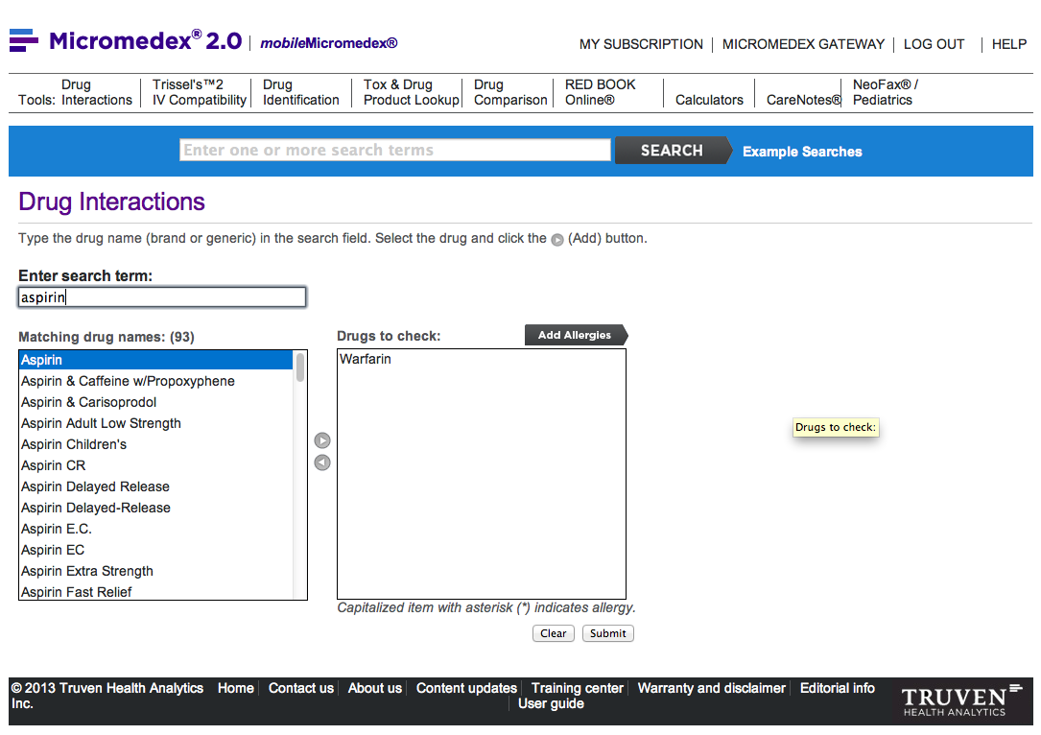
Start entering drug name
aspirin
Warfarin is in the search box
Highlight correct drug
Click arrow
Click
SUBMIT

Slide 59
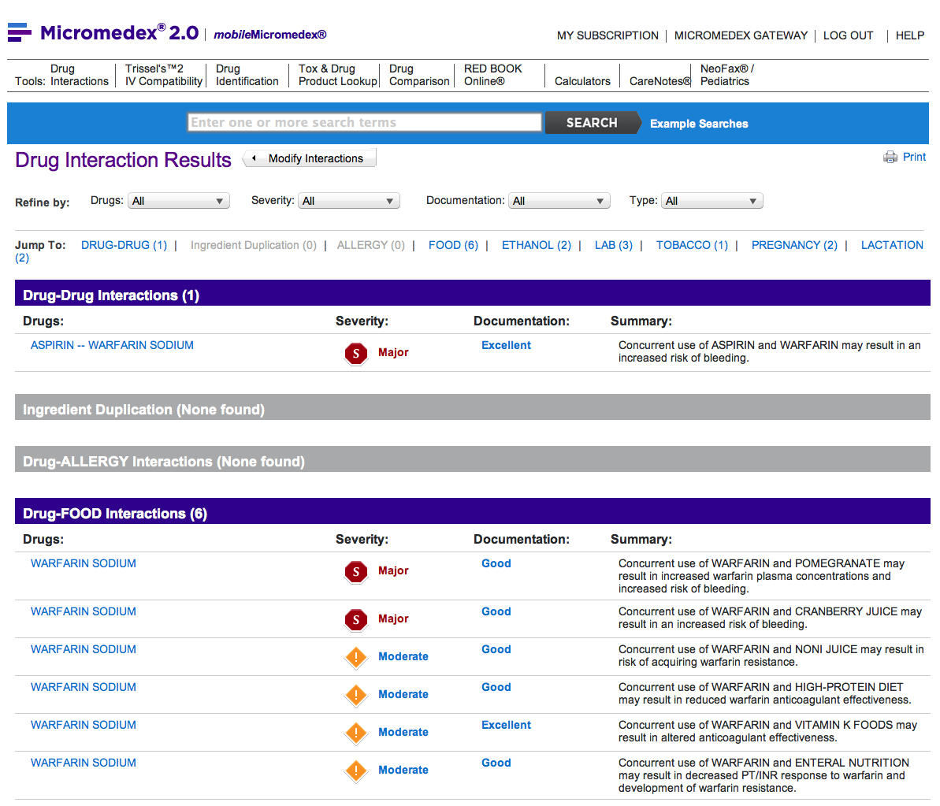
Interactions table includes:

Slide 60
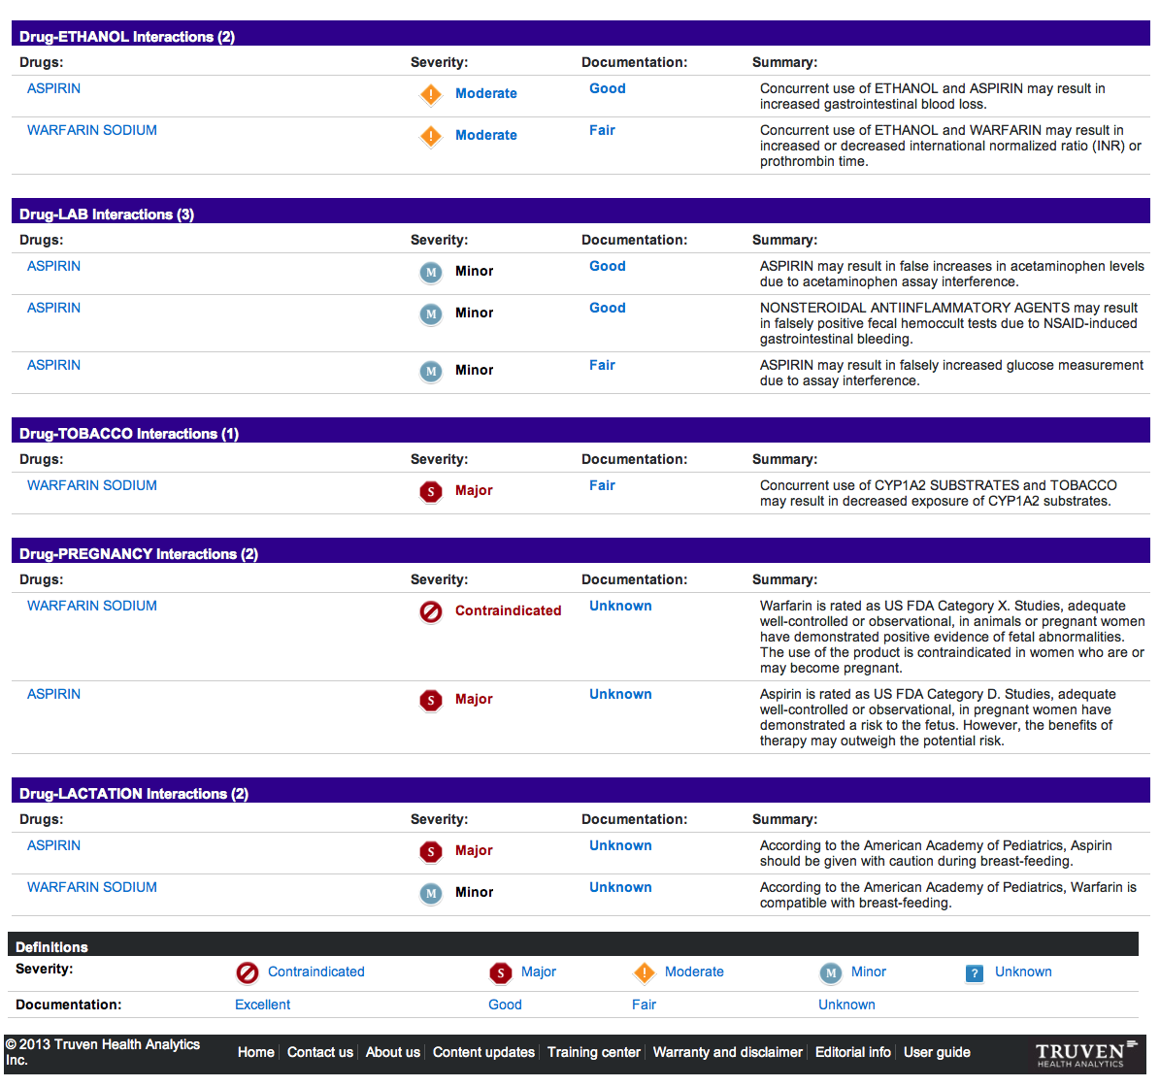

Slide 61
Click Calculators

Slide 62
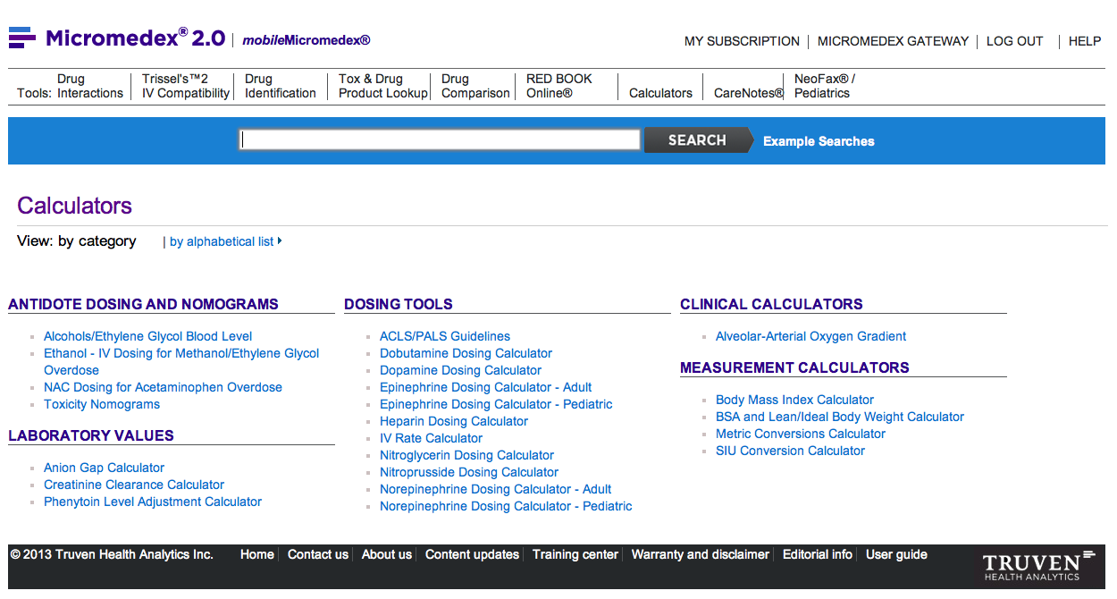
Note the various tools

Slide 63
Click CareNotes

Slide 64
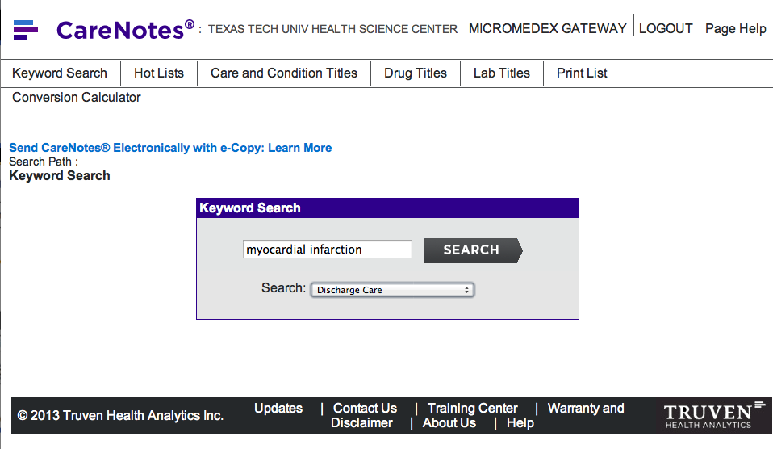
Search for
myocardial infarction
Select Discharge Care and
click
SEARCH

Slide 65

Select MYOCARDIAL INFARCTION

Slide 66

Select English and
Print Now

Slide 67

Customize print-out

Slide 68

Customized print-out

Slide 69




MICROMEDEX – drug identification

Slide 70


MICROMEDEX – Tox & Drug Product Lookup

Slide 71



MICROMEDEX: also includes
Diseases and Acute Care
Alternative Medicines
Patient Education

Slide 72
Have Questions
or
Need Help?

Slide 73
Today’s PowerPoint
www.ttuhsc.edu/libraries
Click Popular
Resources
by School

Slide 74

Select
Presentation

Slide 75

or contact us at:
Lubbock
(806) 743-2200
Amarillo
(806) 354-5448
El Paso
(915) 545-6652
Odessa
(432) 335-5171

Slide 76
The End

