Slide 1
TTUHSC Preston Smith Library
presents
Information Resources
for Residents
Rev. 06/2017

Slide 2
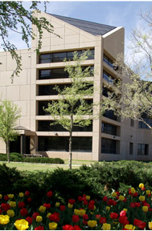
Welcome!
Preston Smith Library located west of the
Academic Classroom Building
Temporary entrance during upcoming construction

Slide 3
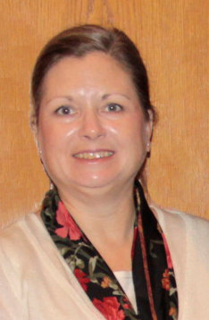

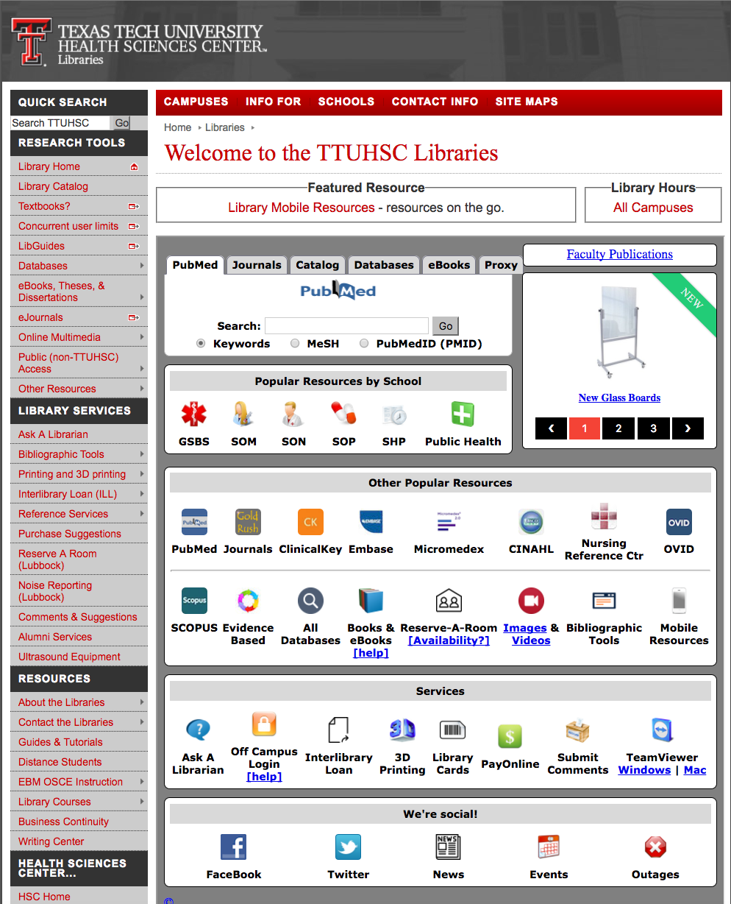

Available on 2nd floor of library, across from the Learning Resource Center and public computers
8am–5pm
Monday–Friday
Peggy Edwards
Also through
Micah Walsleben
Margaret Vugrin

Slide 4
Library Account/Card

Slide 5
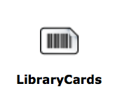
www.ttuhsc.edu/libraries
Click

Slide 6
Library Home Page

Slide 7


When searching library applications, use

Slide 8
LibGuides

Slide 9
www.ttuhsc.edu/libraries
Click
LibGuides

Slide 10
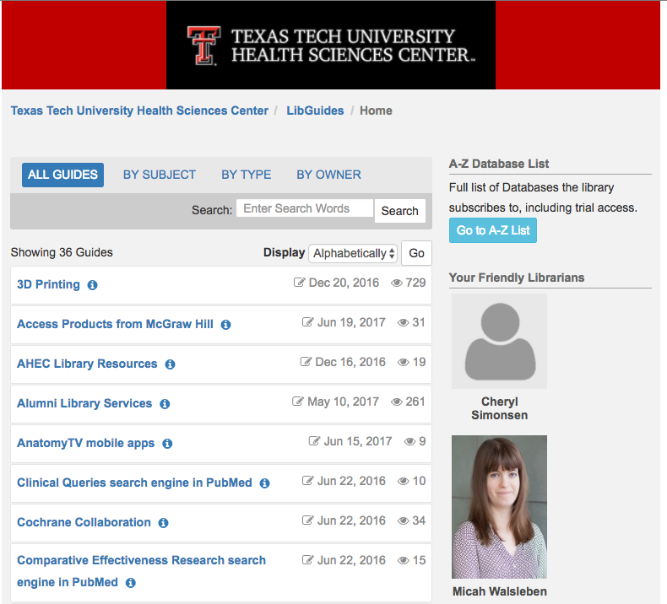
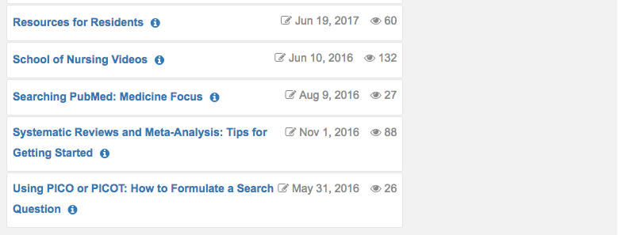
Scroll to and click
Resources for Residents

Slide 11
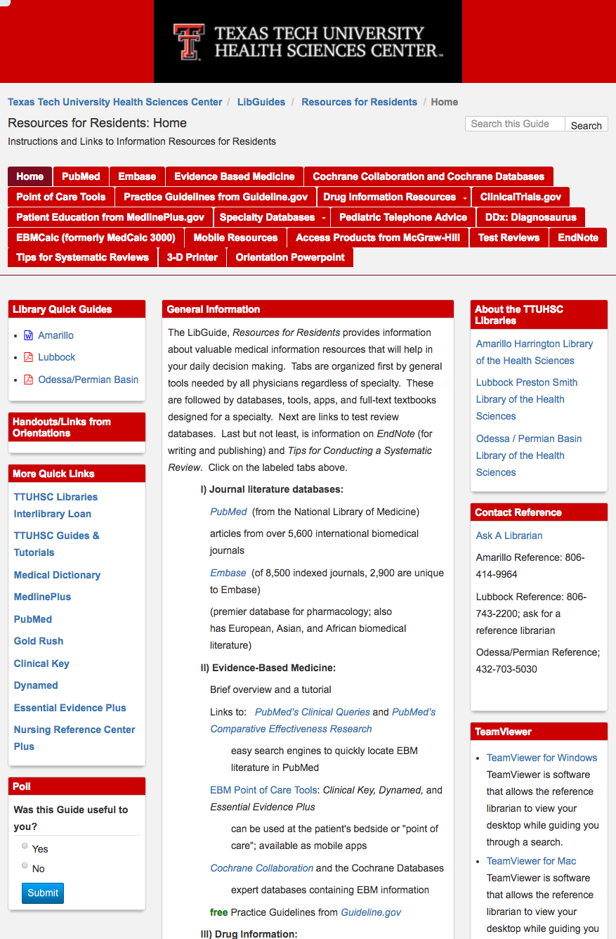
Tabs to pages
Overview
Ask-A-Librarian

Slide 12
There’s so much information! Where do I start???
Do you need background information such as:
an overview on management of disease and treatment?
If so, use any of the following:
an ebook from one of the Access Products or Clinical Key
a point-of-care tool such as:
Dynamed, First Consult (in Clinical Key), or
Essential Evidence Plus

Slide 13
Do you need information for a specific problem? Such as a patient with a unique problem?
If so, use any of the following:
do a search in PubMed and/or Embase
use any of the special tools listed in the
LibGuide: Resources for Residents

Slide 14
Resources- Top 5

Slide 15
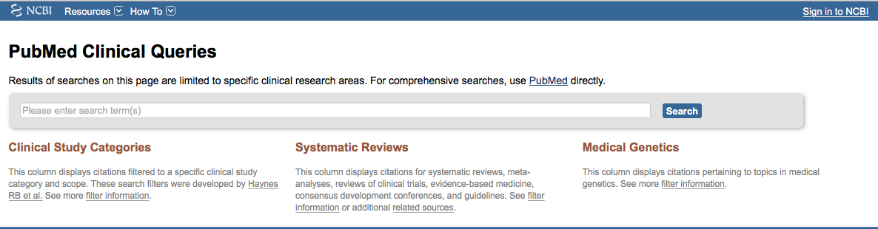
Fast Identification of EBM articles on specific problems or an overview in a systematic review

Slide 16
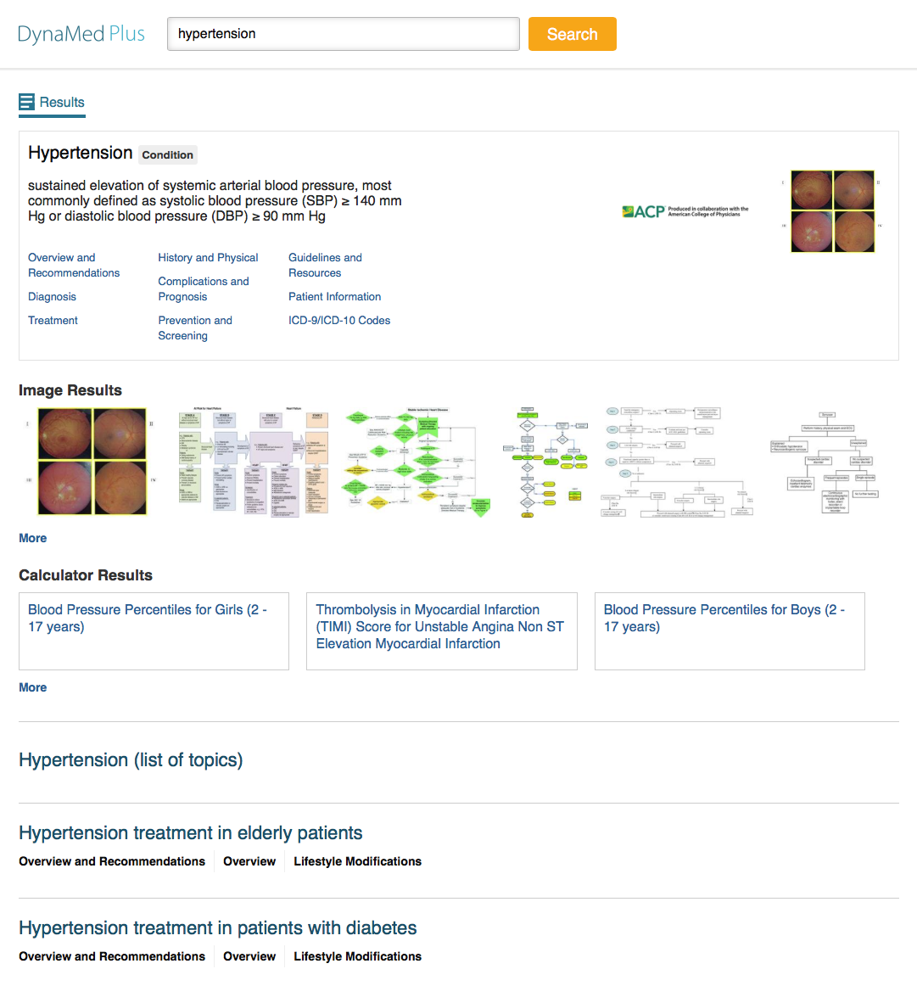

Dynamed Plus for background information and ICD10 codes
Click Icon on
ttuhsc.edu/libraries

Slide 17
Meta-Analysis
Systematic Reviews
Randomized Controlled Trials
Cohort Studies
Case Controlled Studies
Case Series Case Reports
Practice Guidelines
Animal Research In-Vitro Research

Slide 18
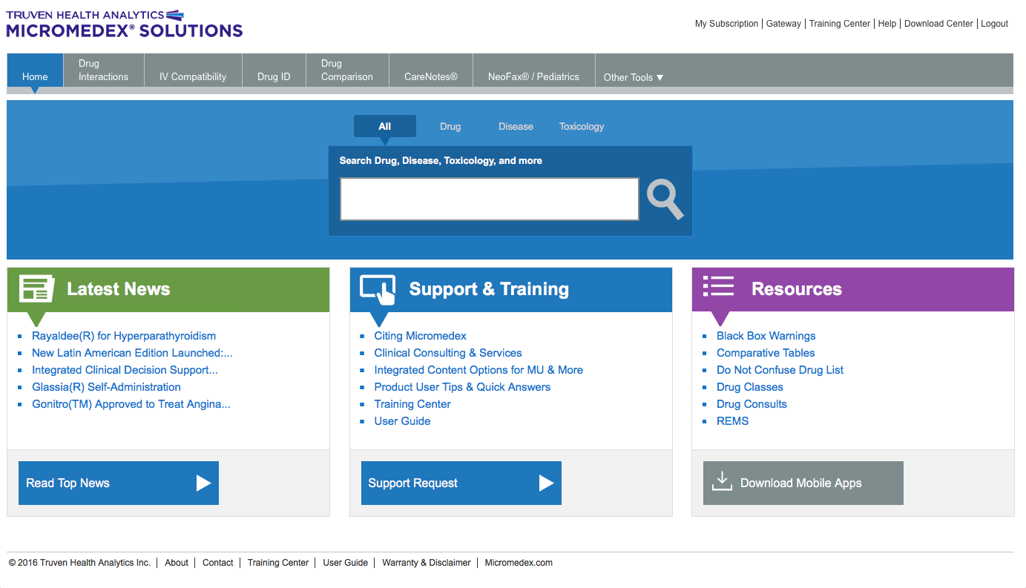
Comprehensive drug information: Micromedex
Has a free mobile app through TTUHSC Libraries!
entire U.S. National Formulary online!

Slide 19
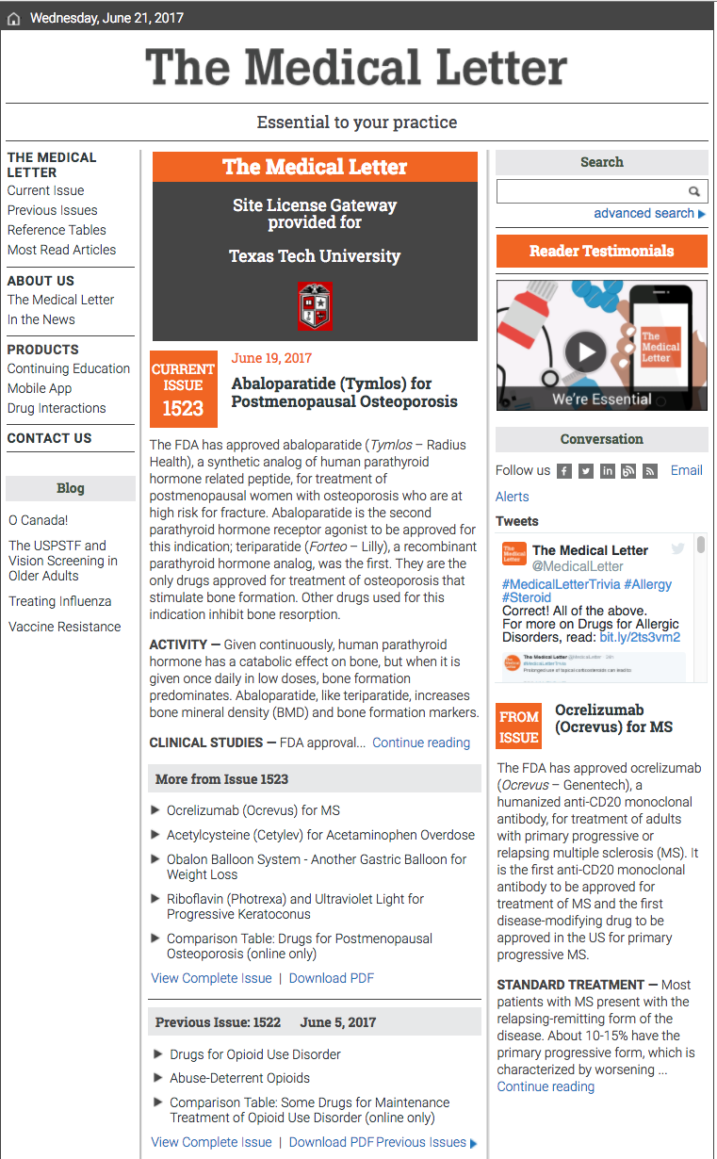
Keeping Current with Drug Information: Medical Letter
Has a free mobile app through TTUHSC Libraries!

Slide 20
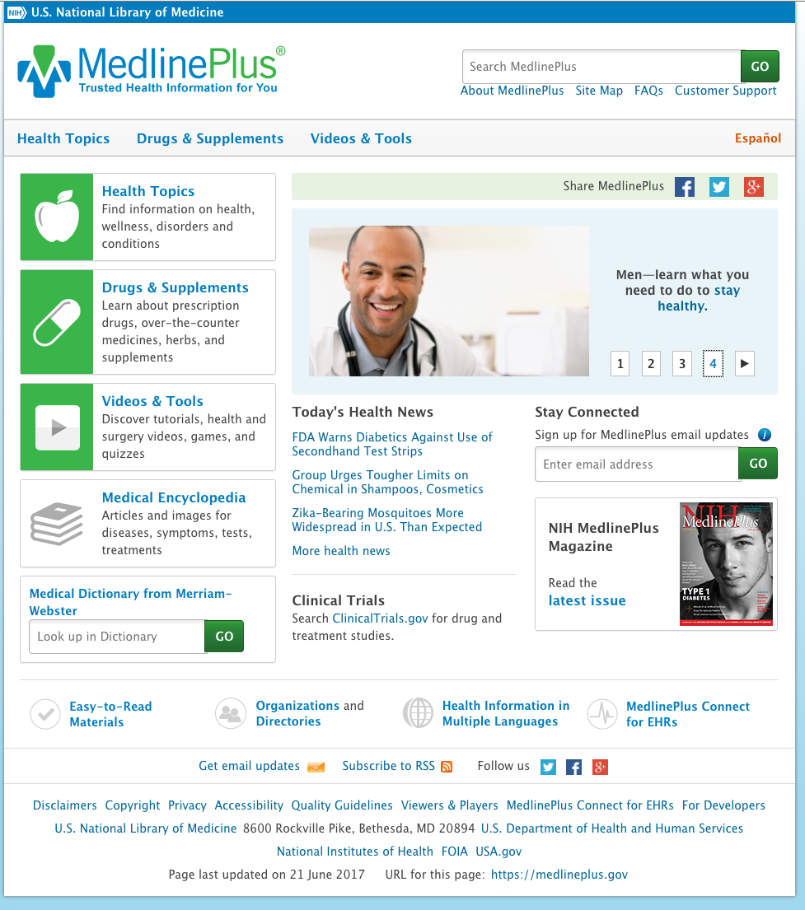
Free reliable Patient Education materials: MedlinePlus.gov
Free mobile app!
Includes multiple languages

Slide 21
Specialty Resources

Slide 22
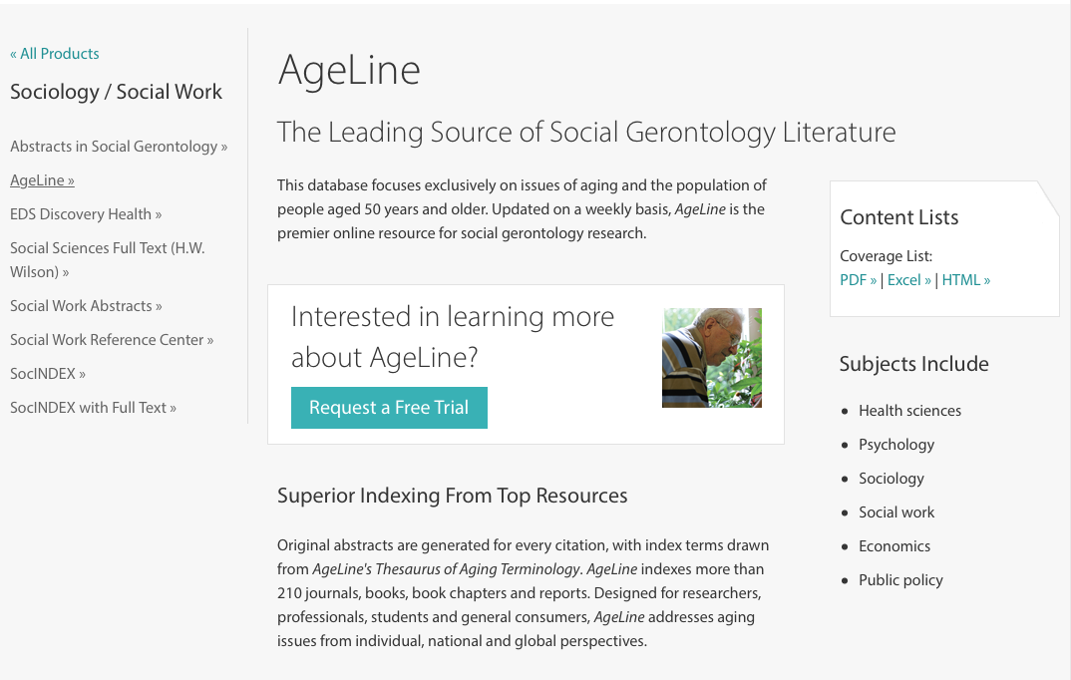
Ageline
Geriatrics,
Family Medicine, Internal Medicine

Slide 23
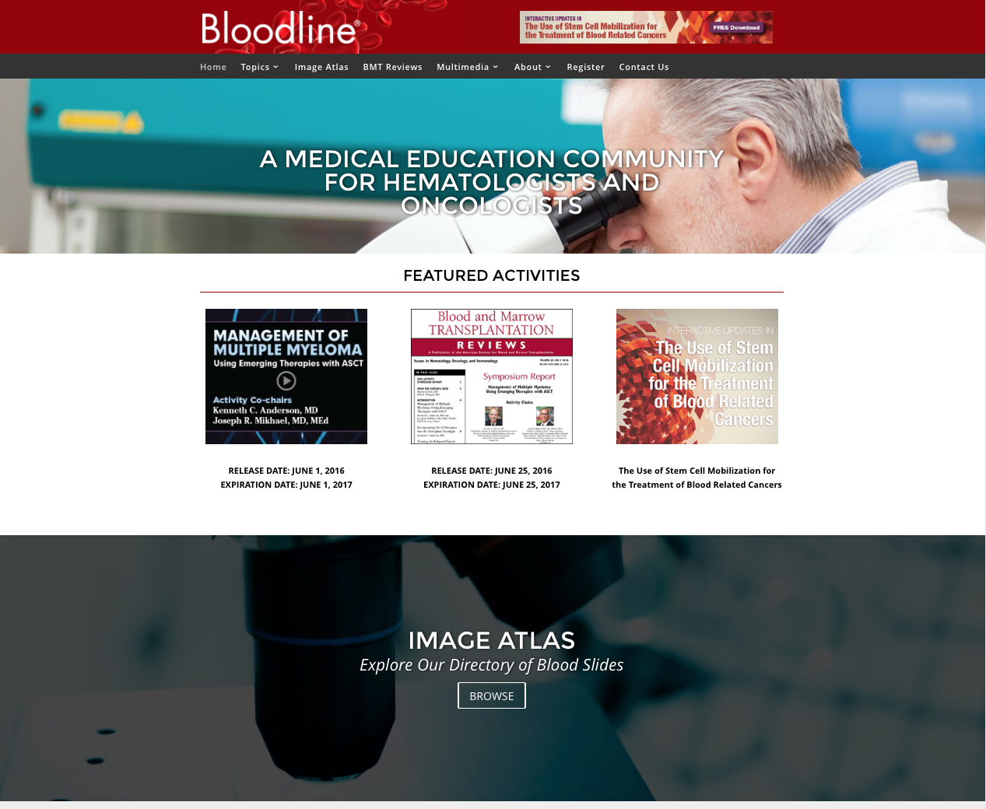
Bloodline
Hematology
/Oncology,
Internal Medicine,
Family Medicine

Slide 24
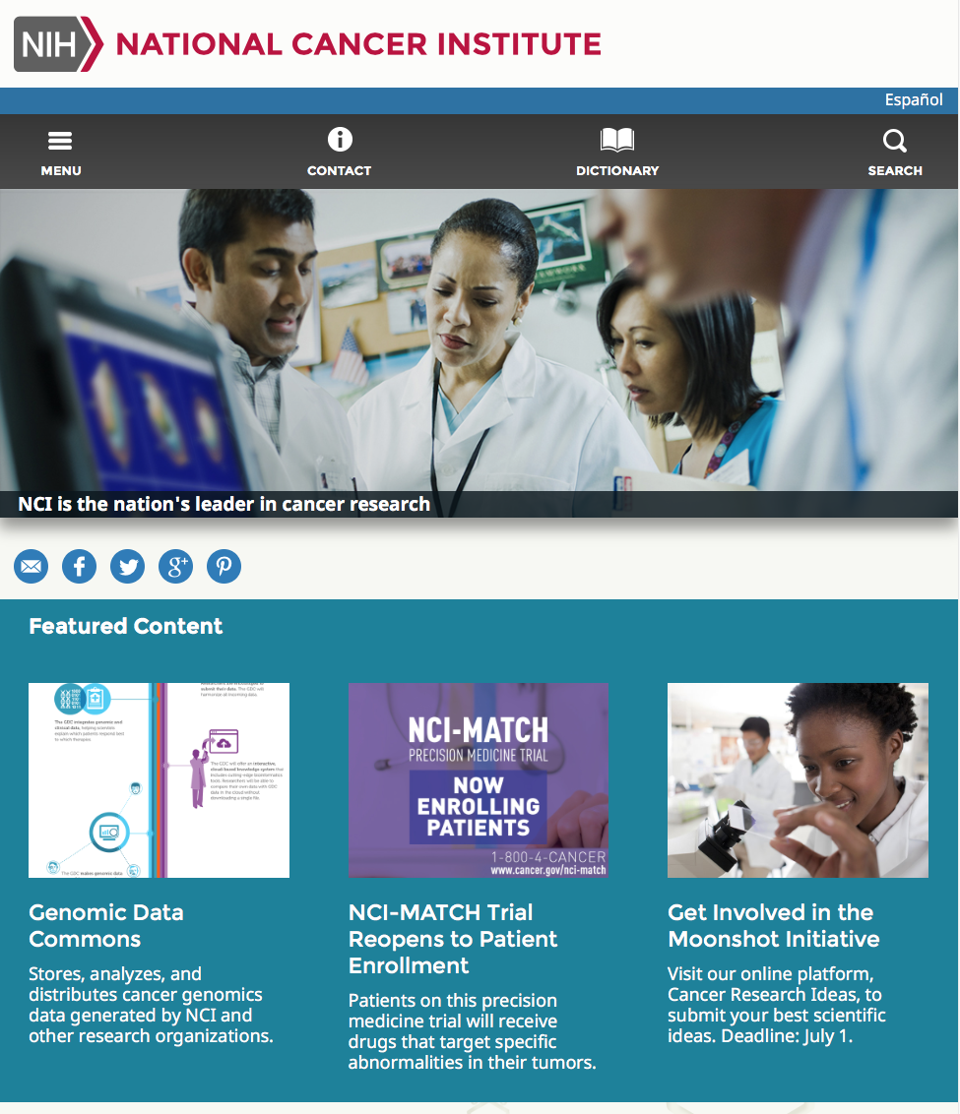
Cancer.gov
Hematology
/Oncology,
Internal Medicine,
Family Medicine

Slide 25
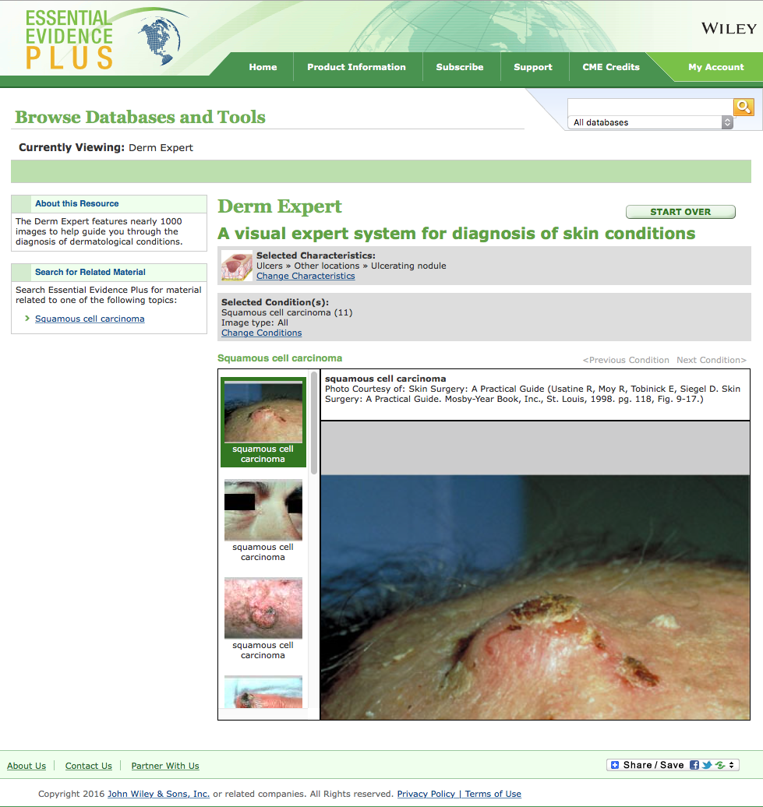
Derm Expert
Dermatology and any skin problems

Slide 26
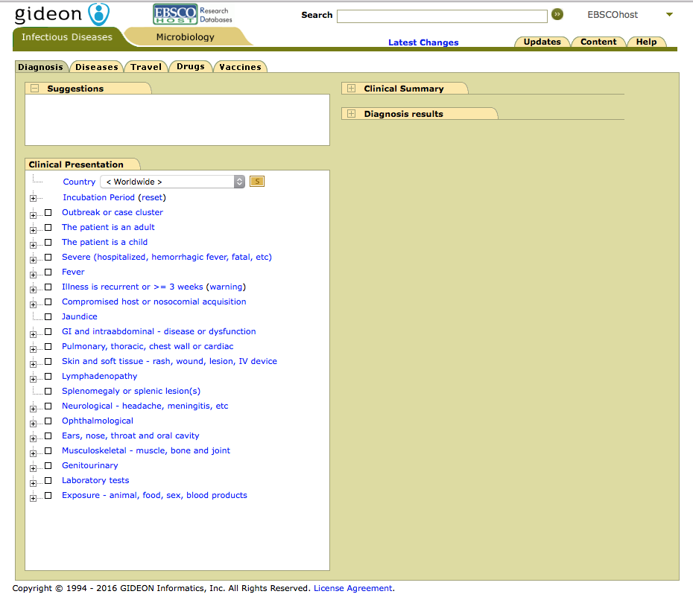
Gideon
Infectious Disease,
Internal Medicine, Family Medicine

Slide 27
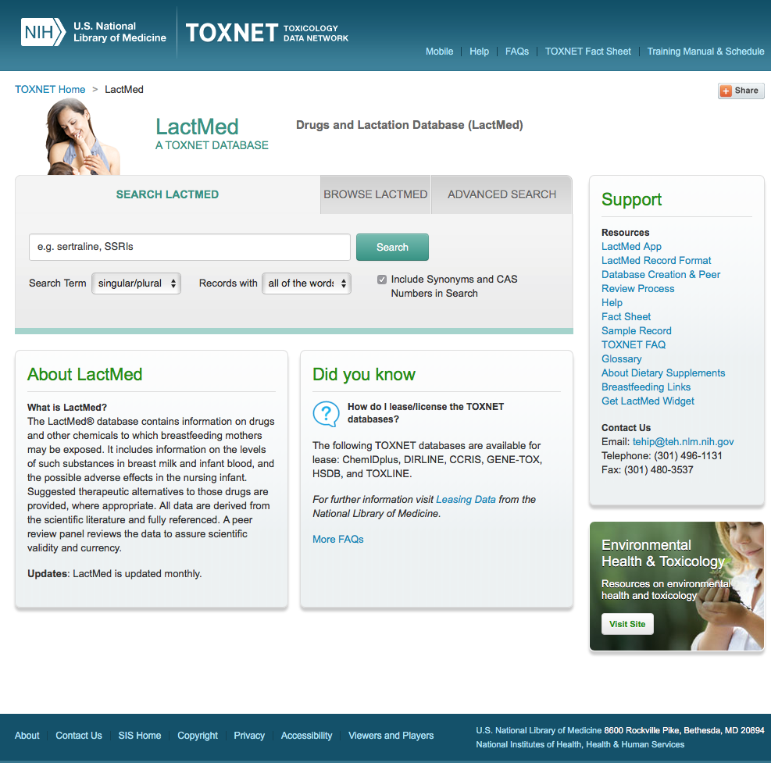
LactMed
Obstetrics/
Gynecology,
Family Medicine,
Pediatrics

Slide 28
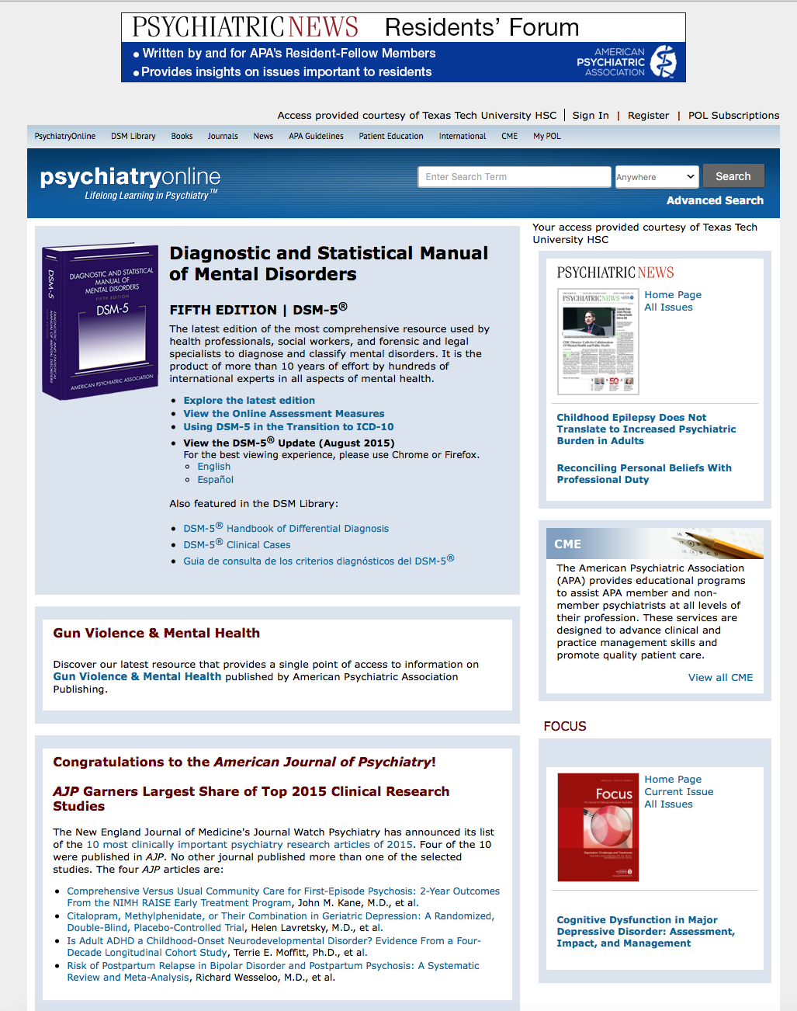
Psychiatry Online

Slide 29
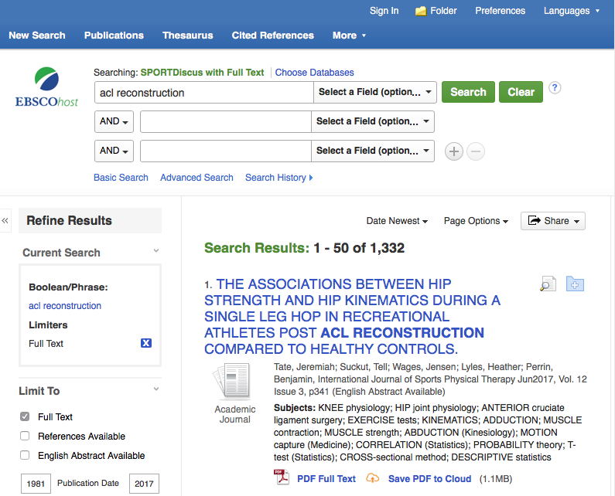
Sport Discus
Sports Medicine
Orthopedic Surgery

Slide 30
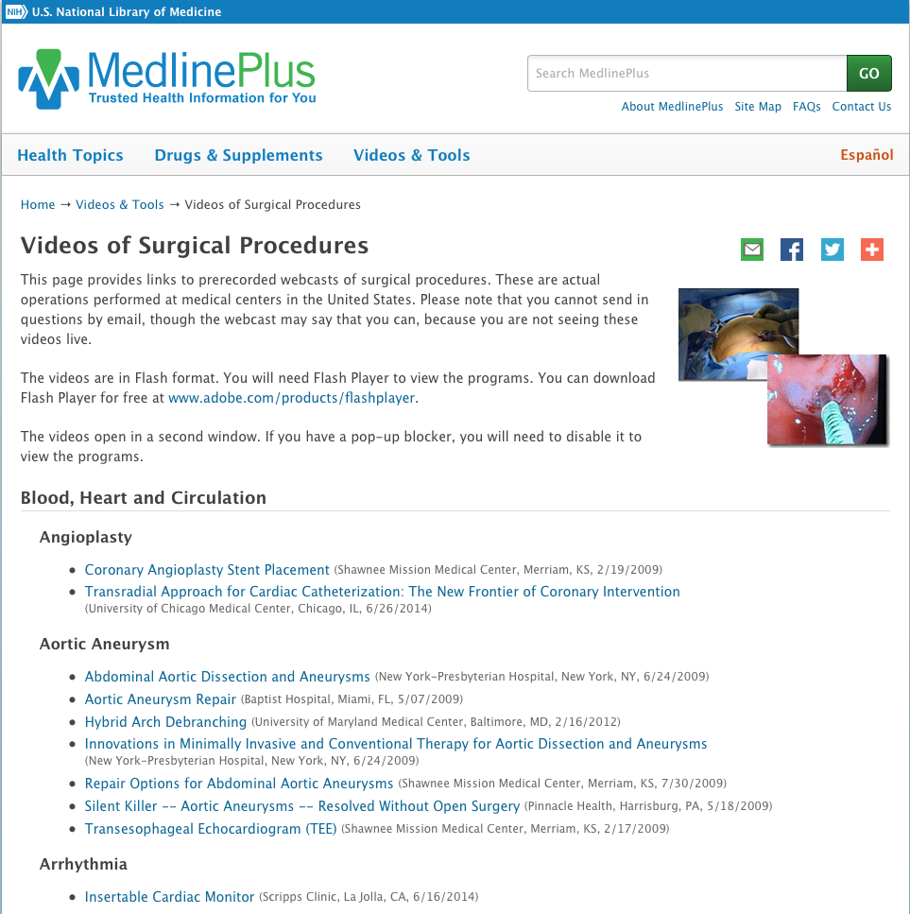
Surgical Videos in MedlinePlus
Surgery,
Cardiology,
Ob/Gyn,
Opthalmology

Slide 31
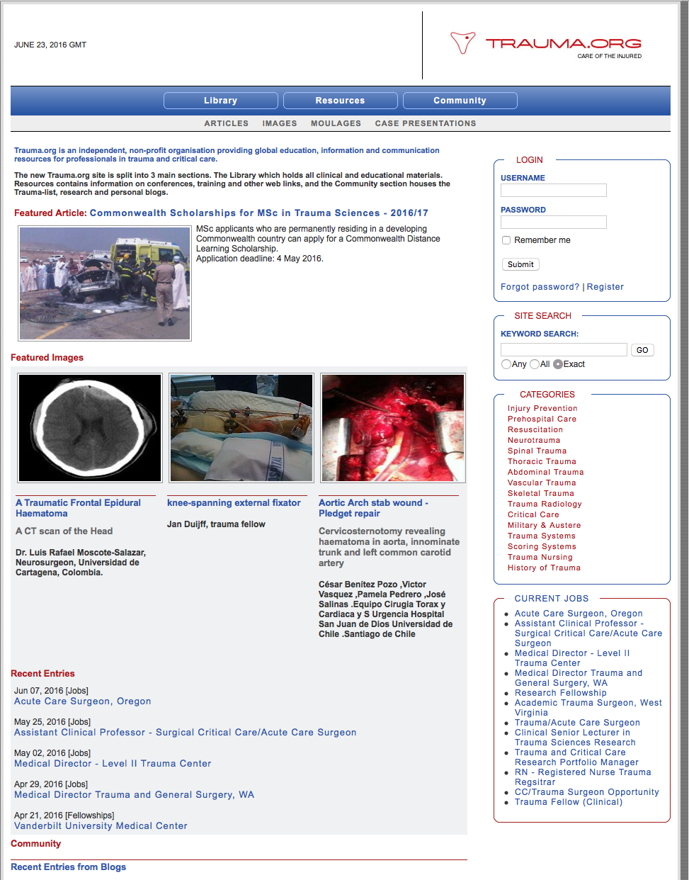
Trauma.Org
Surgery

Slide 32
Free Full-Text Textbooks
in Access Products
Quick Reference Tools
Case Files
Review Questions

Slide 33
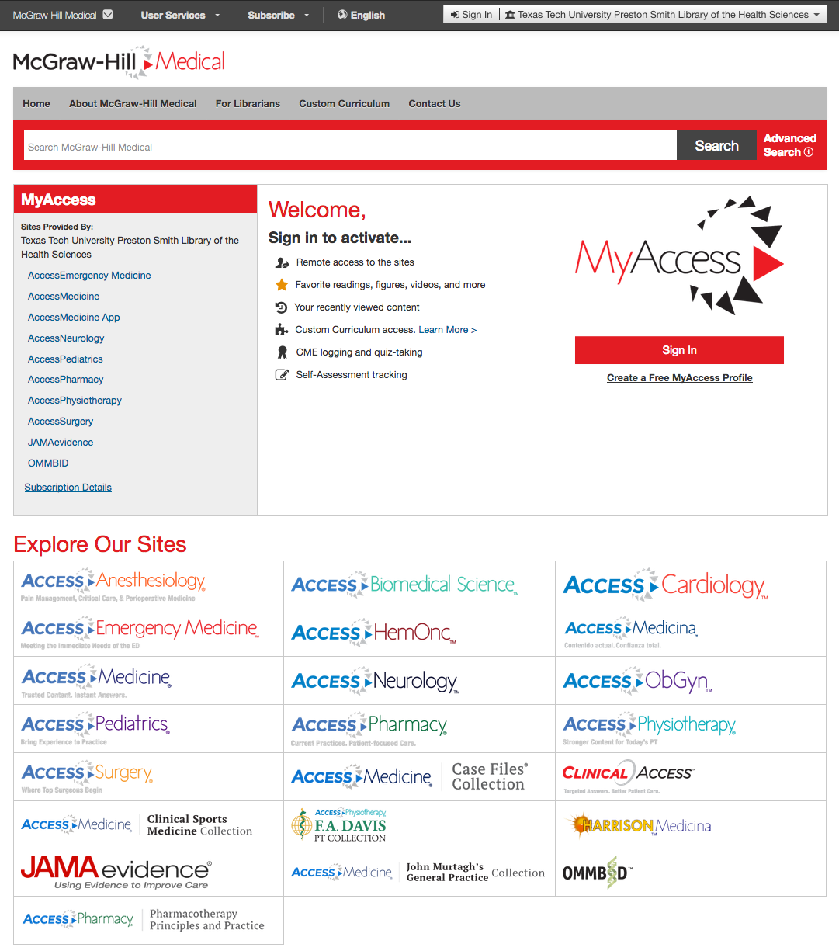
Access Products from McGraw-Hill
Anesthesiology
Emergencies, Cardiology, HemOnc, Internal Medicine, Neurology,
Ob-Gyn, Pediatrics, Surgery,
Family Medicine

Slide 34
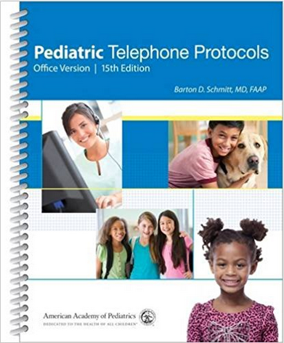
Print Book
140 tested decision-support protocols covering 98% of everyday pediatric complaints

Slide 35
Mobile Resources

Slide 36
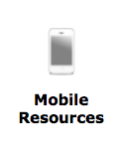
www.ttuhsc.edu/libraries
Click

Slide 37
3-D Printer

Slide 38
http://ttuhsc.libguides.com/3dprinter

Slide 39
Evaluation

Slide 40
Please…
fill out the evaluation at
http://tinyurl.com/ttuhsc17
Thank-you…
we appreciate your feedback!

Slide 41
The End

