Slide 1
Welcome
Resources for
Integrated Learning
Barbara Ballew, MALS; Peggy Edwards, AMLS
TTUHSC - Preston Smith Library
Lubbock, Texas 79430
September 2018

Slide 2
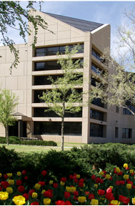
Welcome!
Preston Smith Library
located west of the
Academic Classroom
Building

Slide 3



Available on 2nd floor of library, across from the Learning Resource Center and public computers
8am–7pm
Monday–Friday
Peggy Edwards
Dan Stuart
Micah Walsleben
Margaret Vugrin

Slide 4
A
G
E
N
D
A

Slide 5


When searching library applications, use
Mozilla Firefox, Safari, or Internet Explorer often do not work with library applications or open journal articles!
Chrome is TTUHSC IT’s supported browser!

Slide 6
Library Home Page

Slide 7
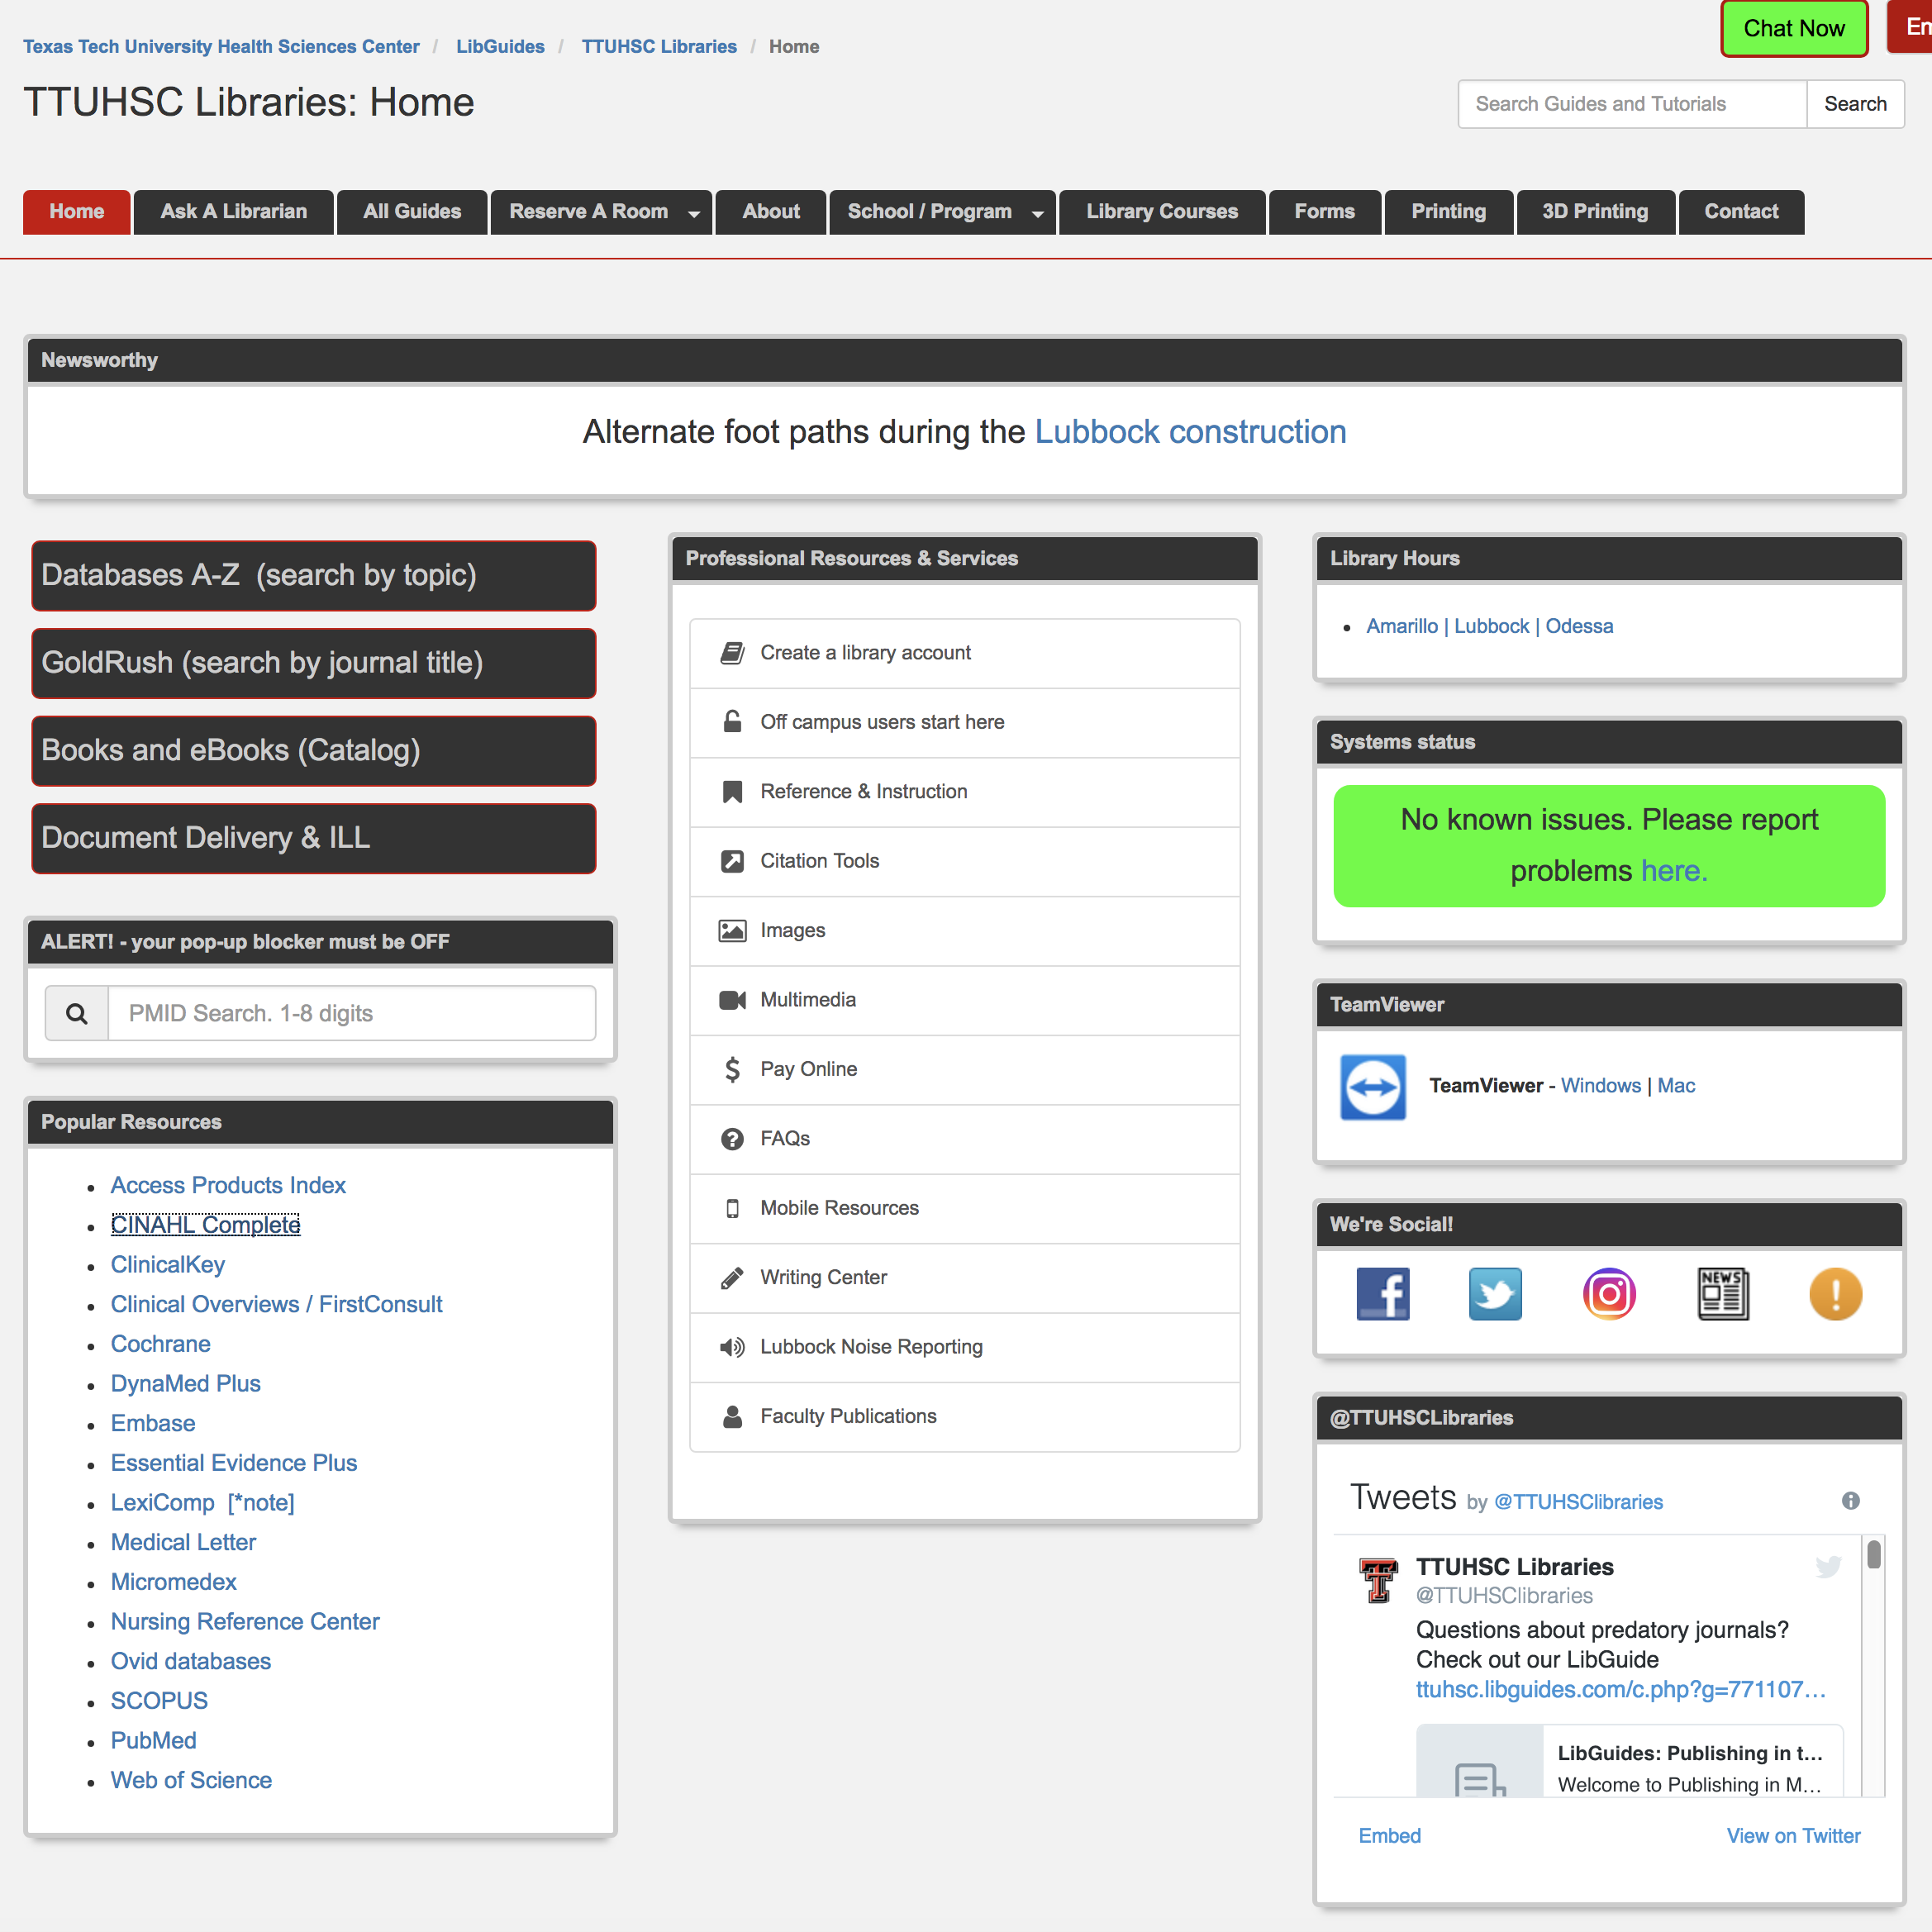
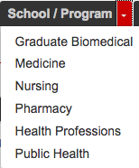
https://ttuhsc.libguides.com/homepage
Nursing

Slide 8
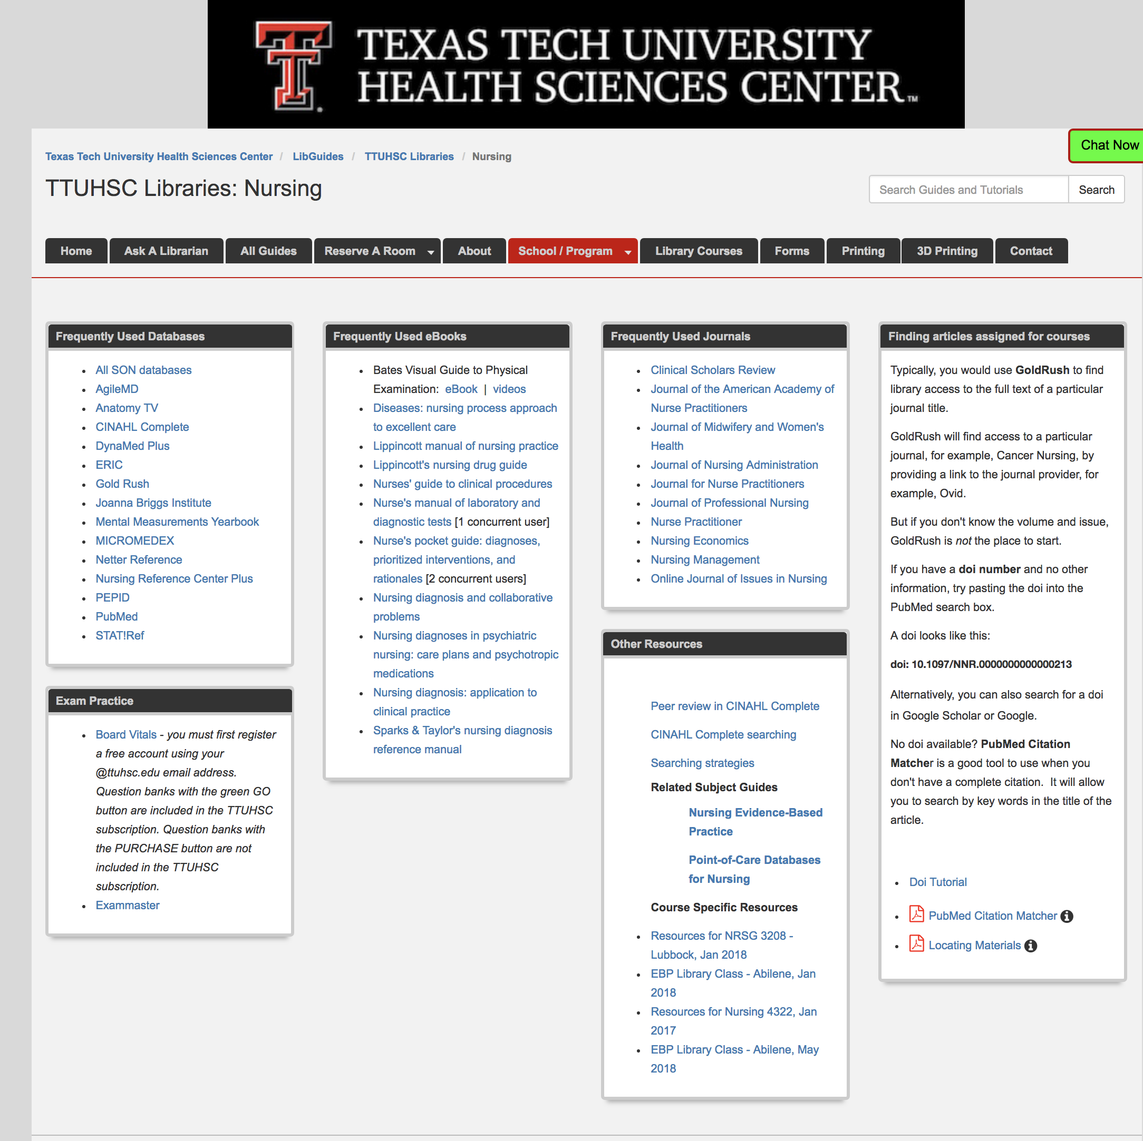
Frequently Used Databases

Slide 9
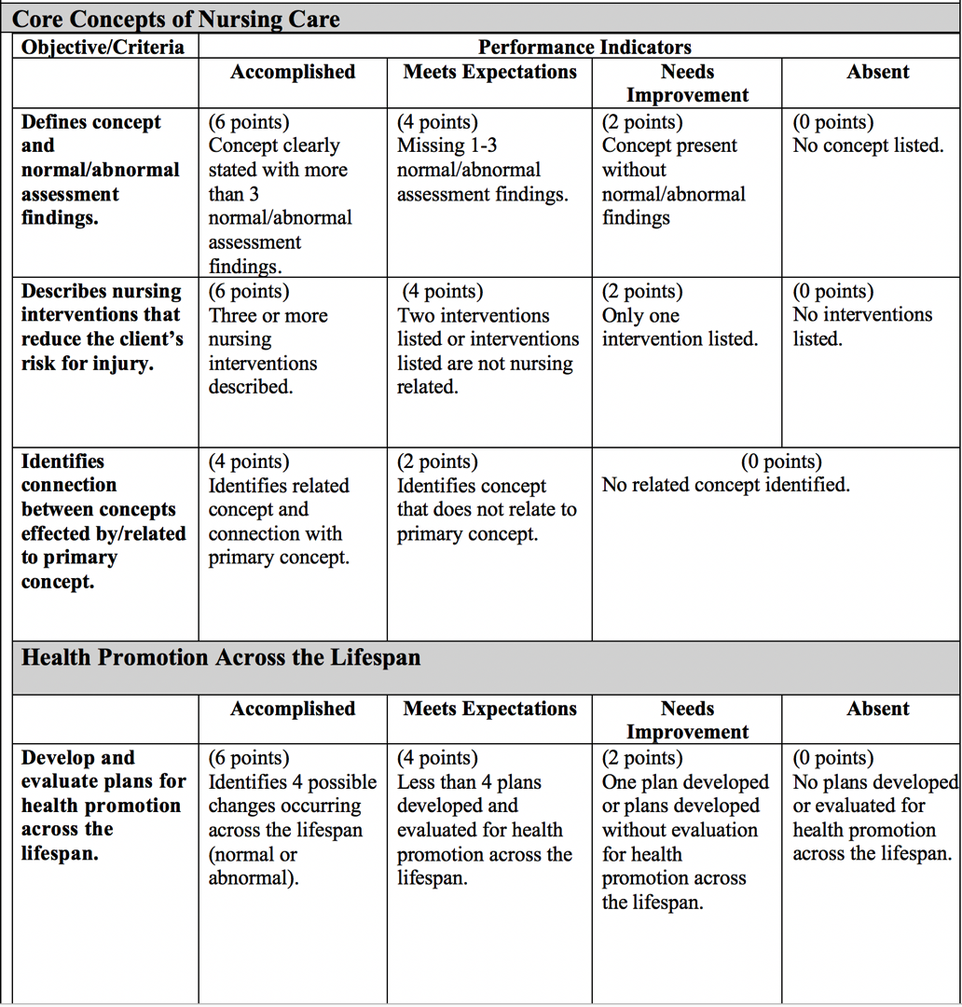
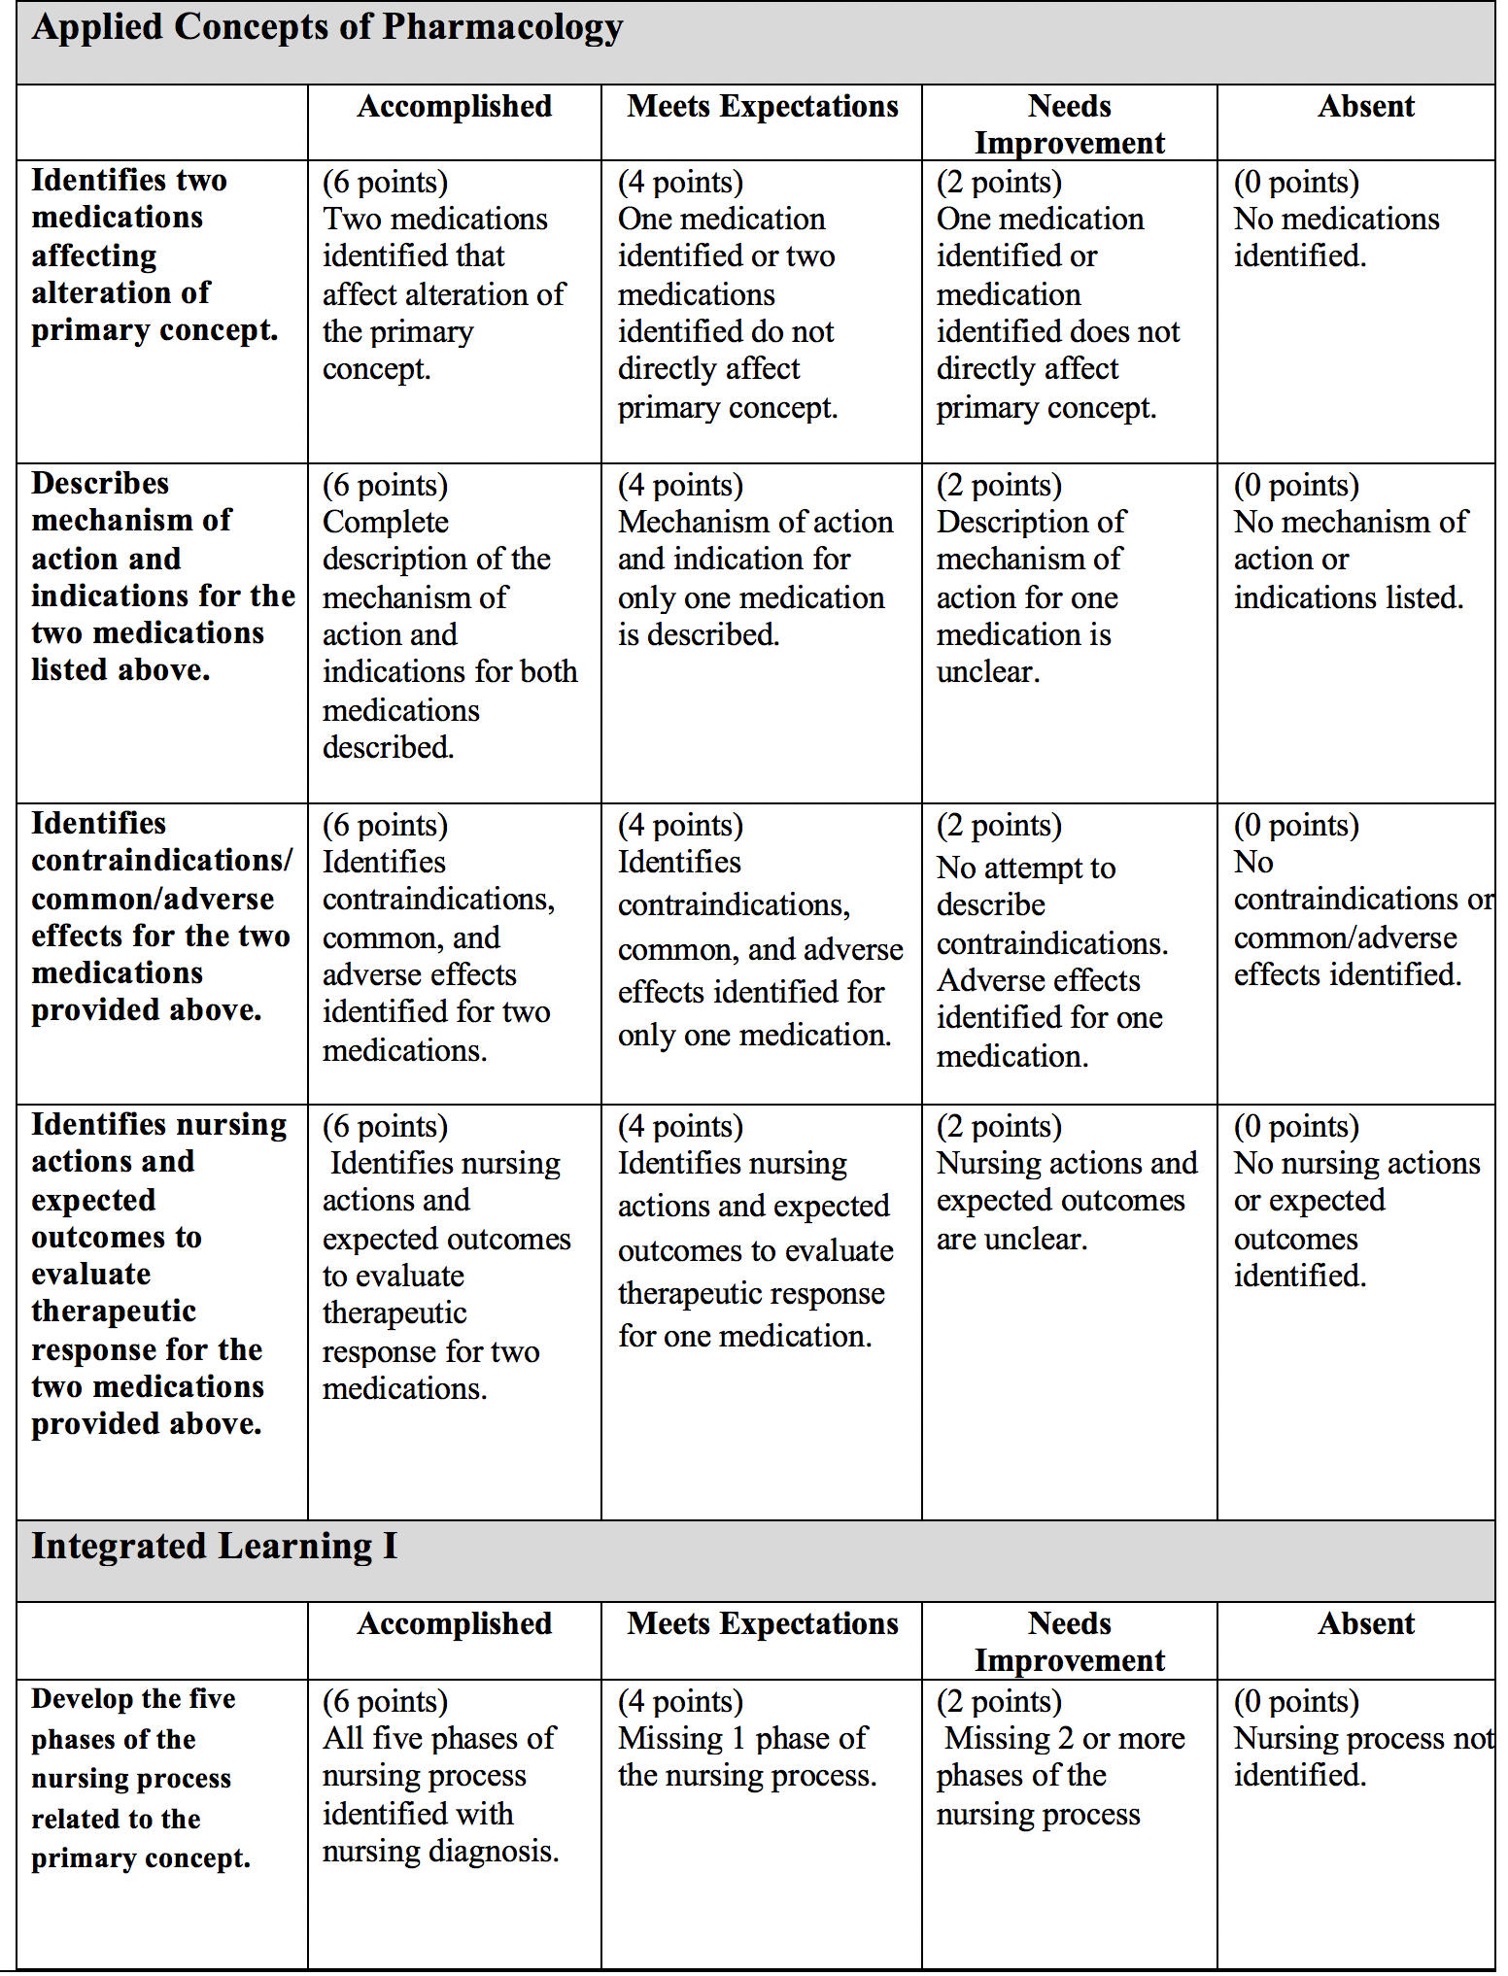
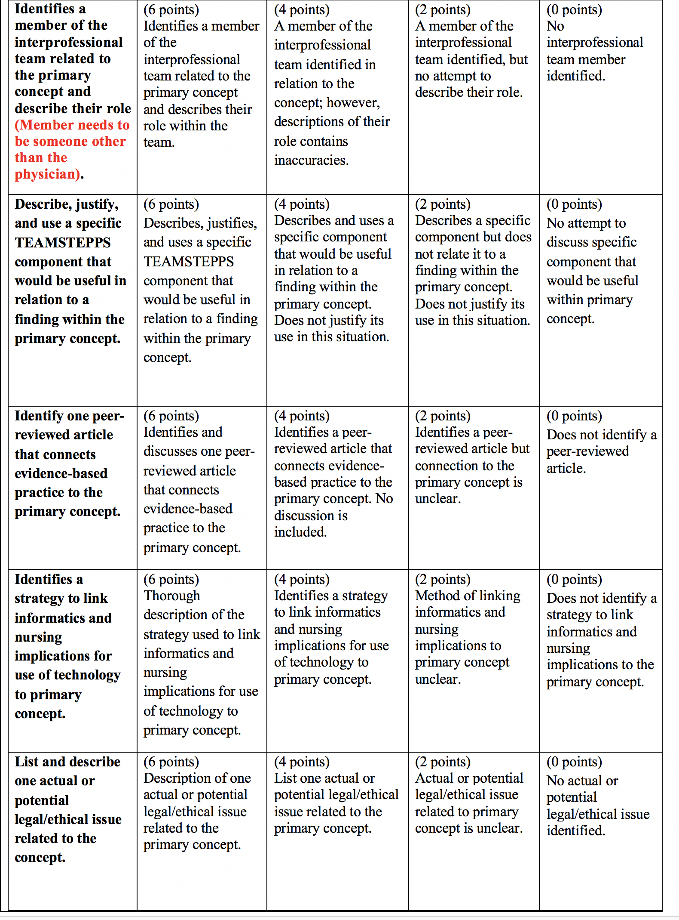
Project Rubric
Notes:
The project Rubric will help you determine what information you need.

Slide 10

Notes:
You will practice searching for information resources to meet the criteria for course and assignment objectives.

Slide 11
Project Elements
Core Concepts of Nursing Care
  Assessment findings
  Injury risk reduction via nursing intervention
Health Promotion Across the Lifespan
A. Plans for health promotion across the lifespan
Applied Concepts of Pharmacology
  A. PEPID
4. Integrated Learning
A. Nursing process
B. Role of team member
C. TEAMSTEPPS
D. Peer Review and EBP filter
E. Informatics, use of technology, and nursing implications
F. Legal/ethical issues related to primary concept
Notes:
Understanding how to search databases will help you find information on these concepts.

Slide 12
Searching
Nursing Reference Center

Slide 13
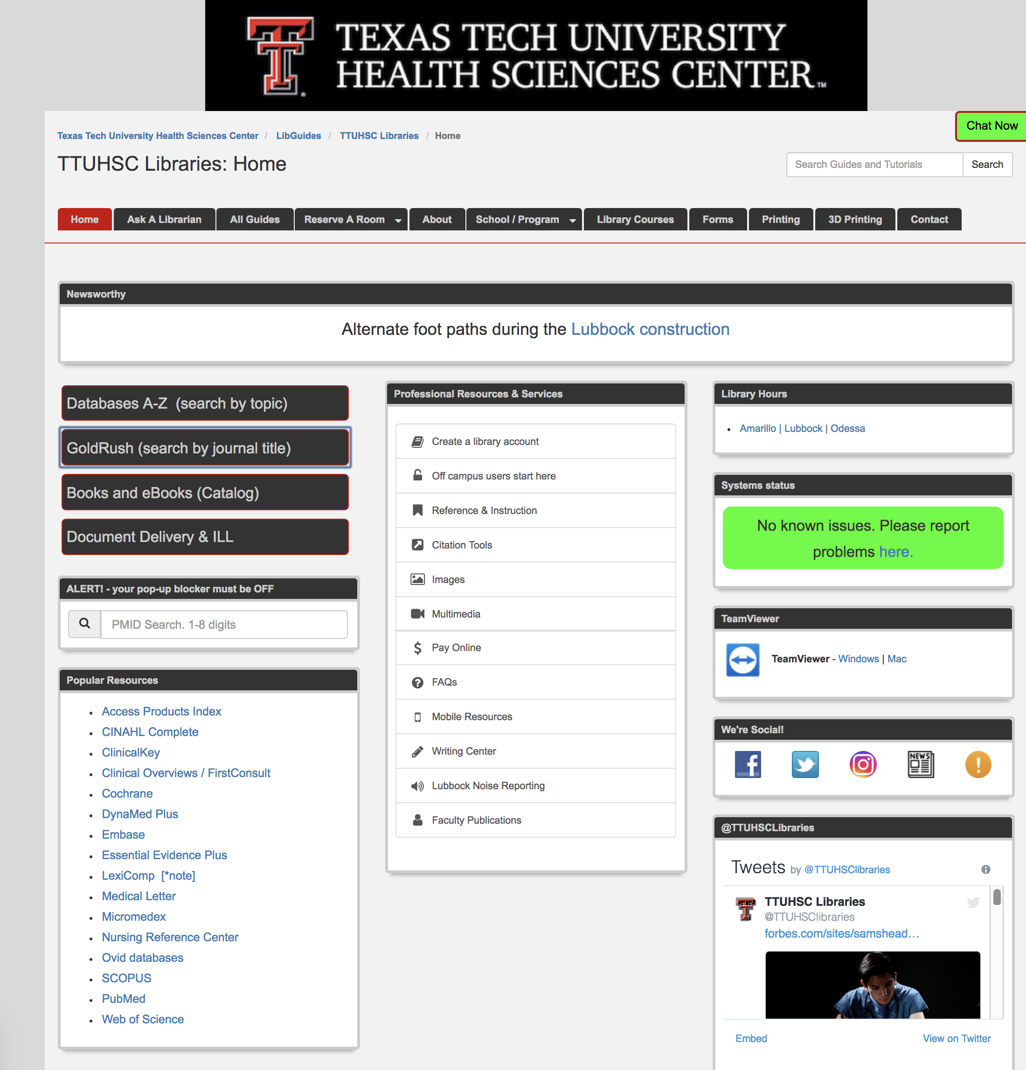
https://ttuhsc.libguides.com/homepage
Nursing Reference Center

Slide 14


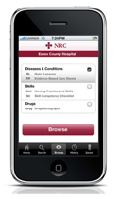

clinical information
at the point-of care…
…and comprehensive
scholarly literature.
Notes:
Nursing Reference Center is great point-of-care resources designed for busy nurses. Mobile app is available. Clinical information in NRC is evidence-based. In addition, journal articles are easy to find.

Slide 15


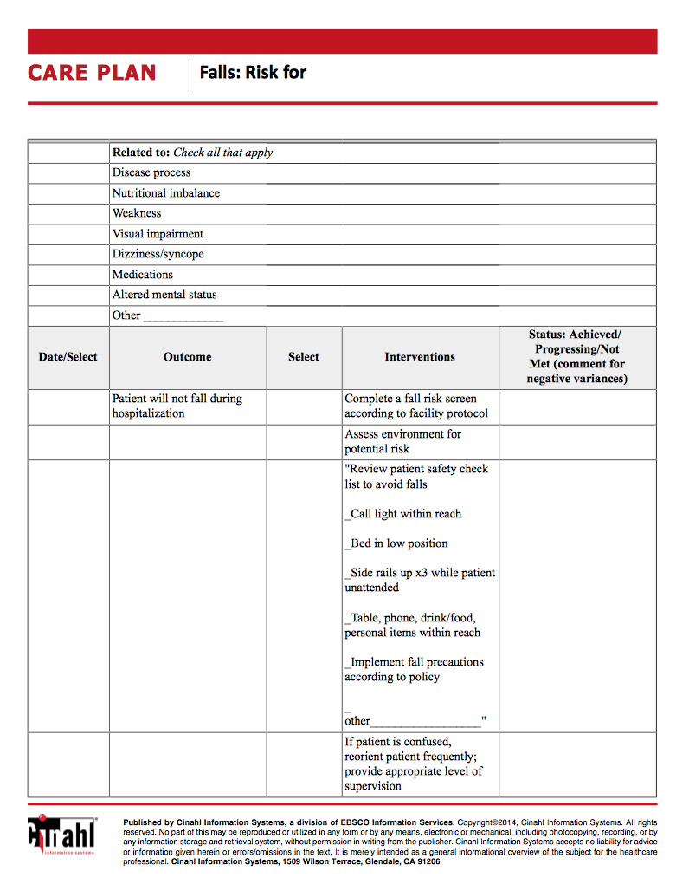
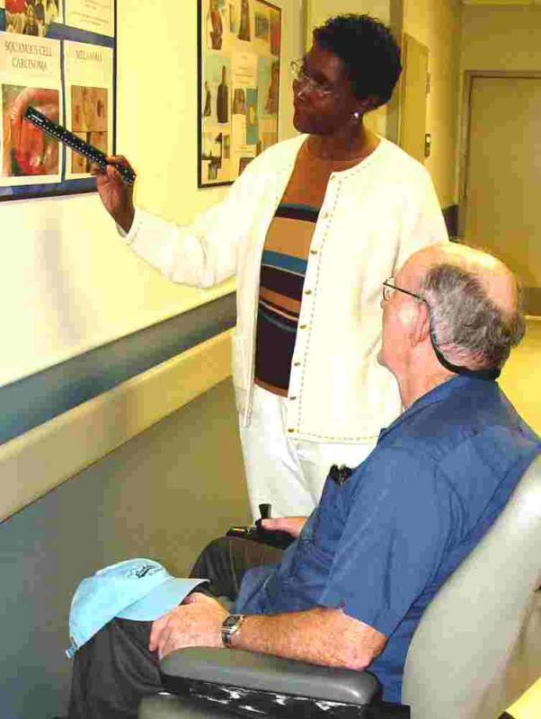
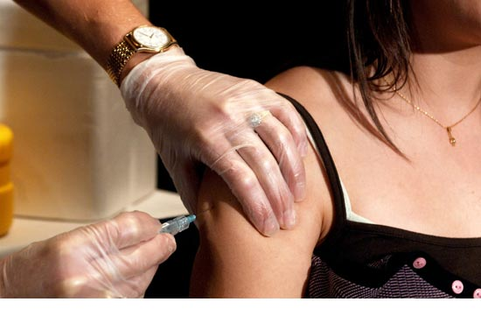
drug information
diseases
care plans
skills
patient education

Slide 16
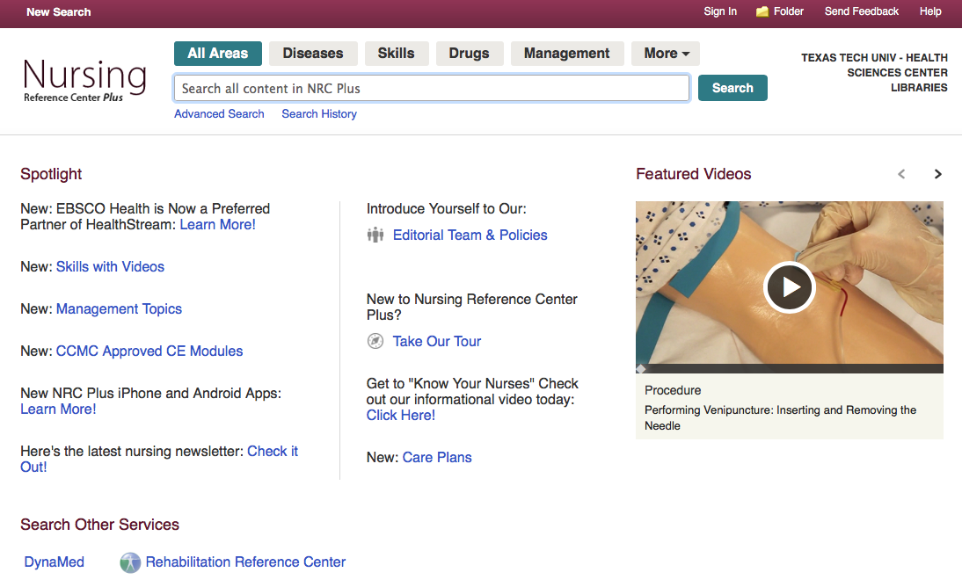
burns
Search
Notes:
Content groupings at the top of the screen allow users to focus on a particular broad topic area, for example, diseases. You can search all areas at the same time. Example: burns

Slide 17
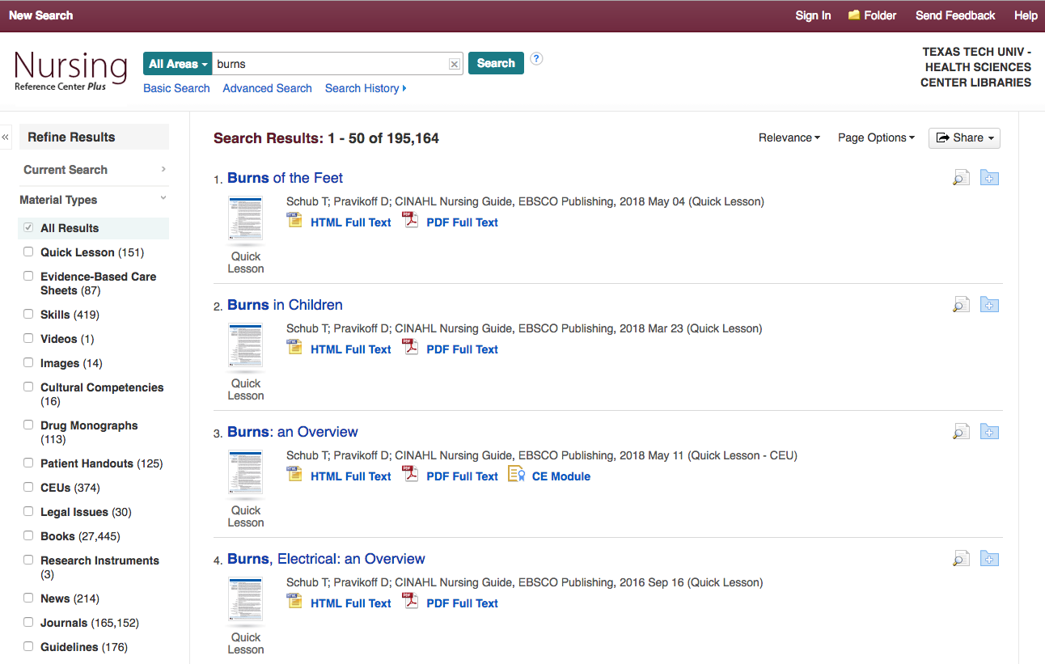
Material Types

Slide 18
Quick Lesson includes assessment and treatment goals
Skills includes treatment descriptions

Slide 19
Drug Information
Legal Issues
Notes:
Also note, patient handouts, cultural competencies.

Slide 20
Tour of Material
Types

Slide 21
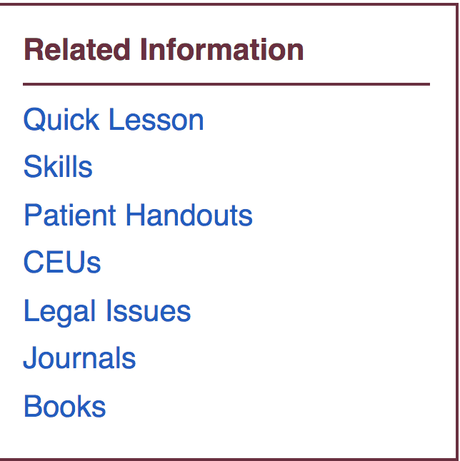
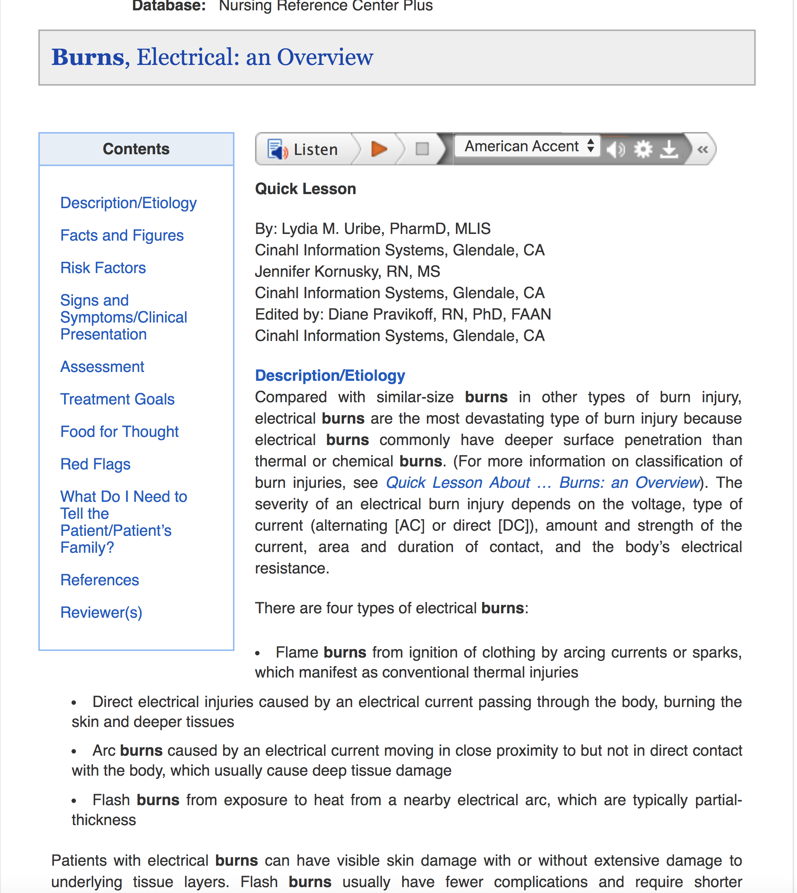
Quick Lesson
Notes:
The html versons contain hyperlinks to the sections in the table of contents; assessment, treatment goals, red flags, what to tell the patient?
also links to related information such as legal issues or guidelines

Slide 22
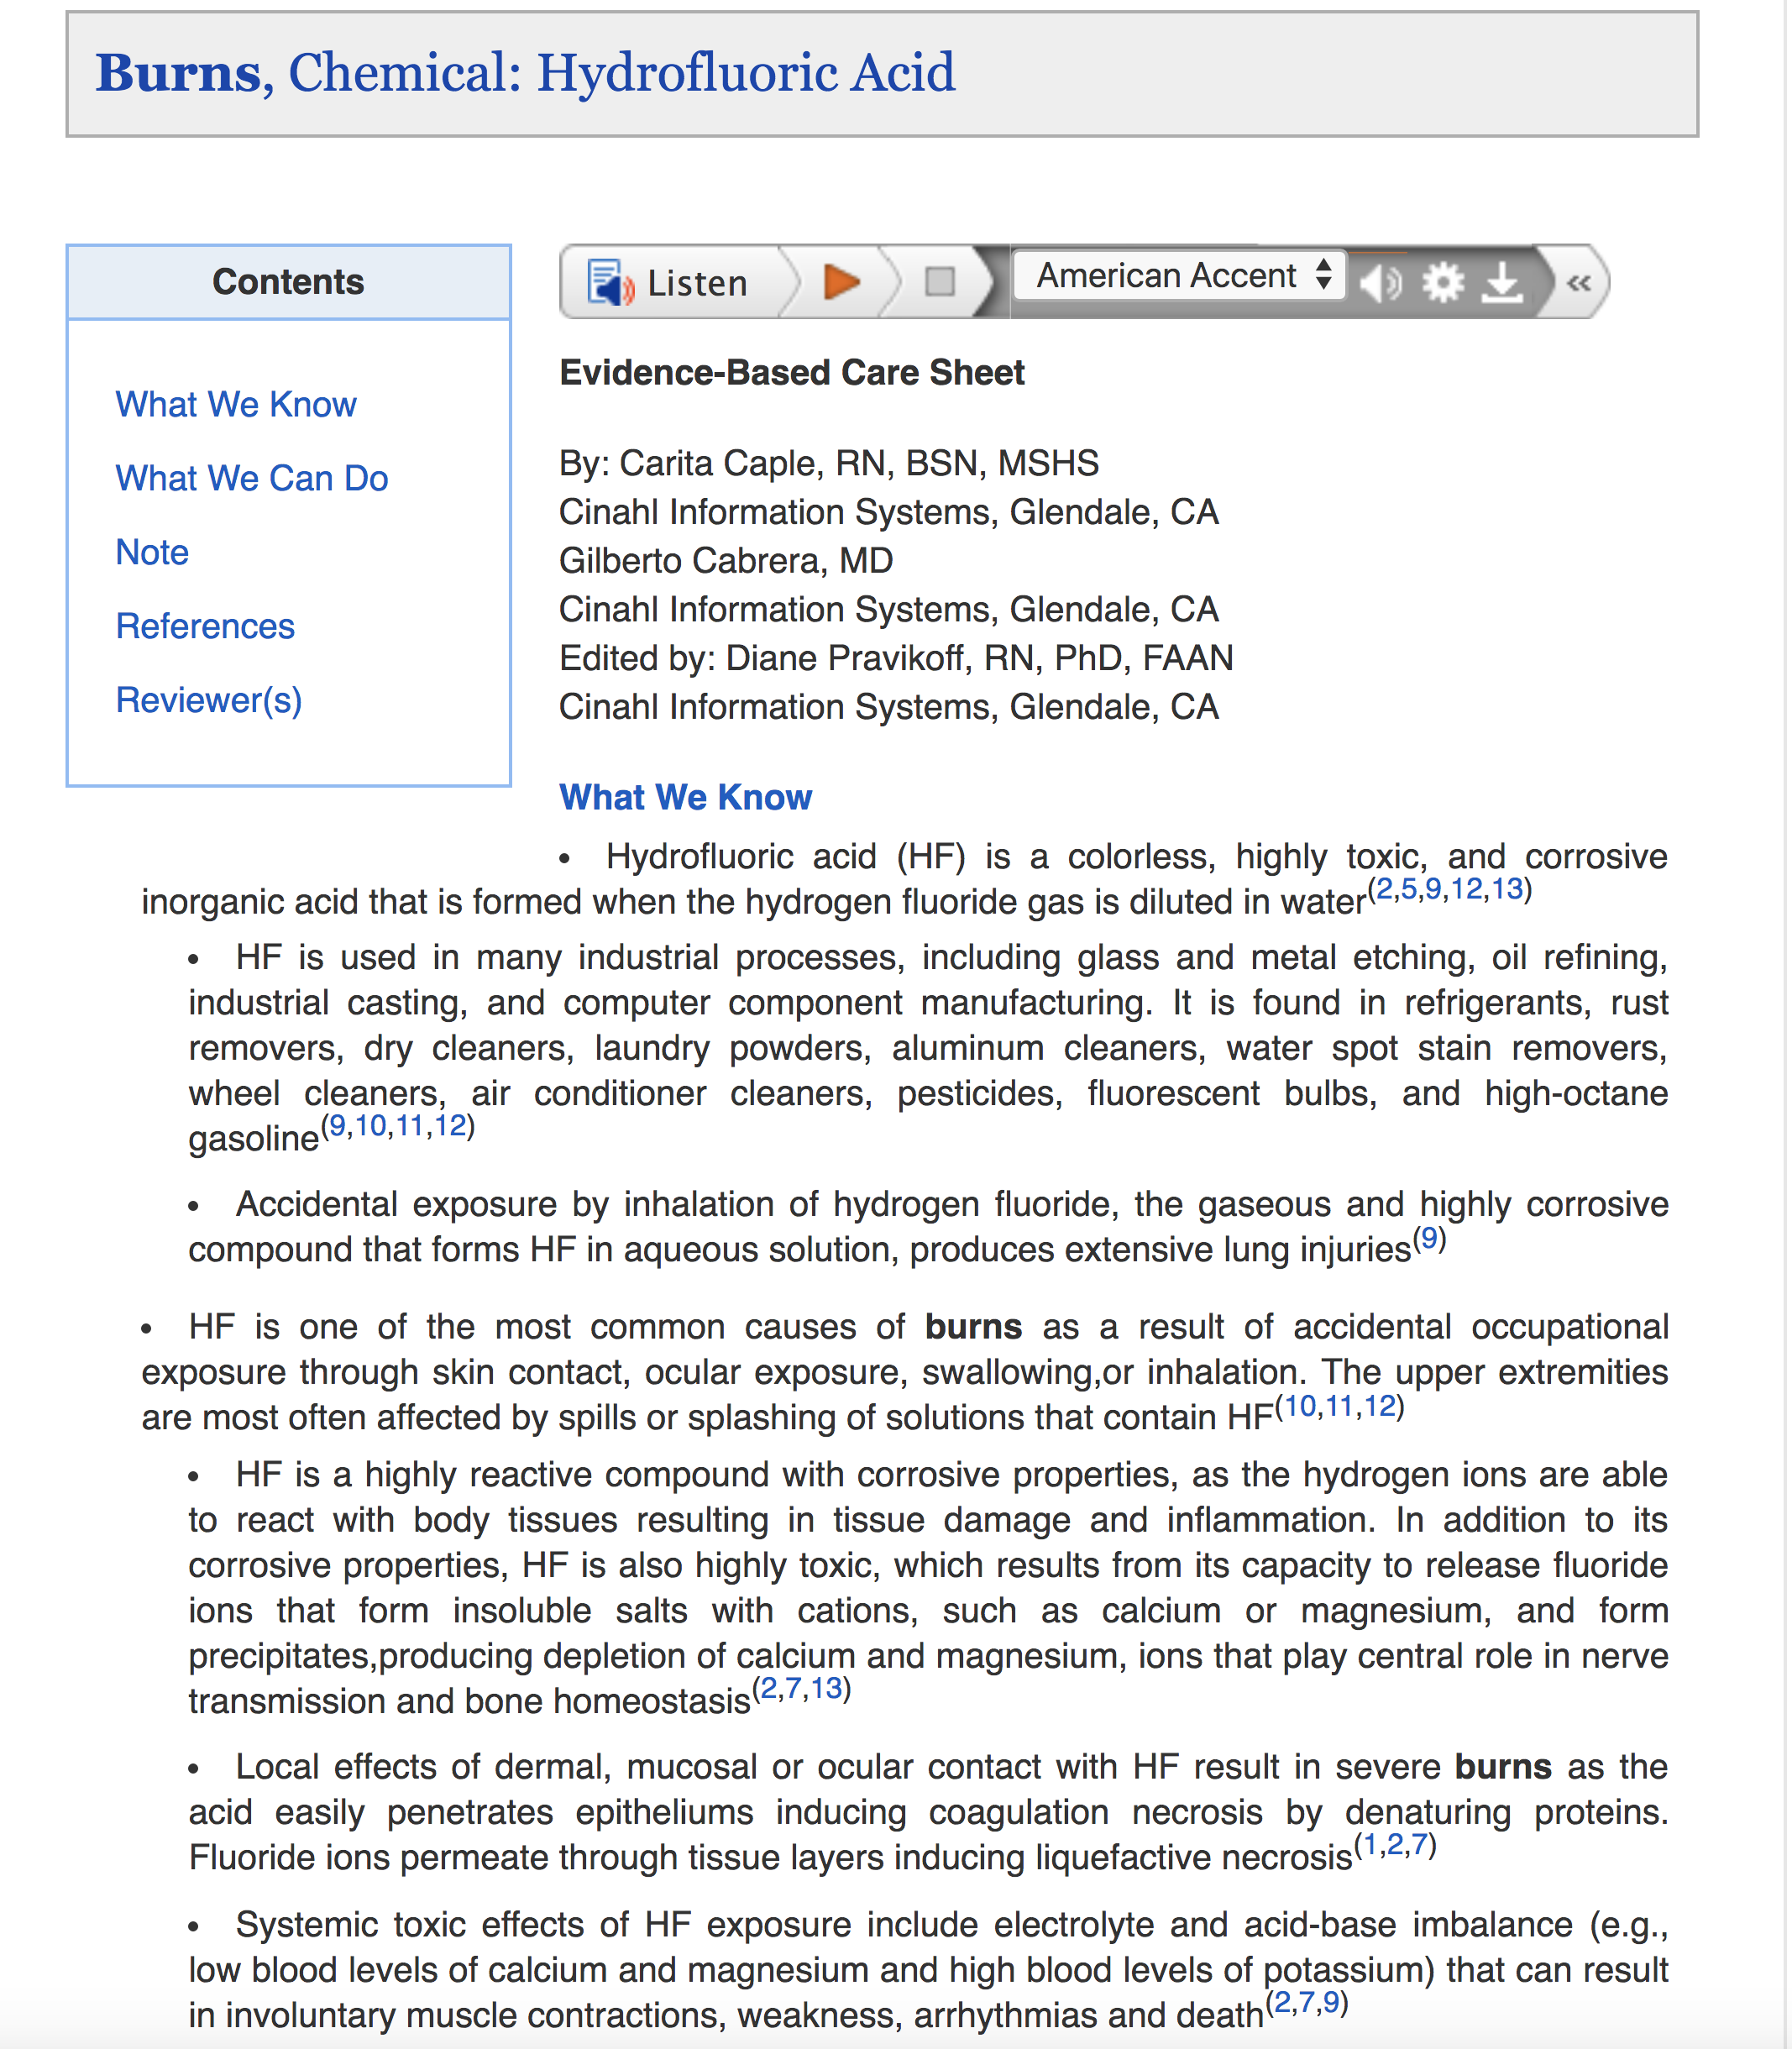
Evidence-Based Care Sheets

Slide 23
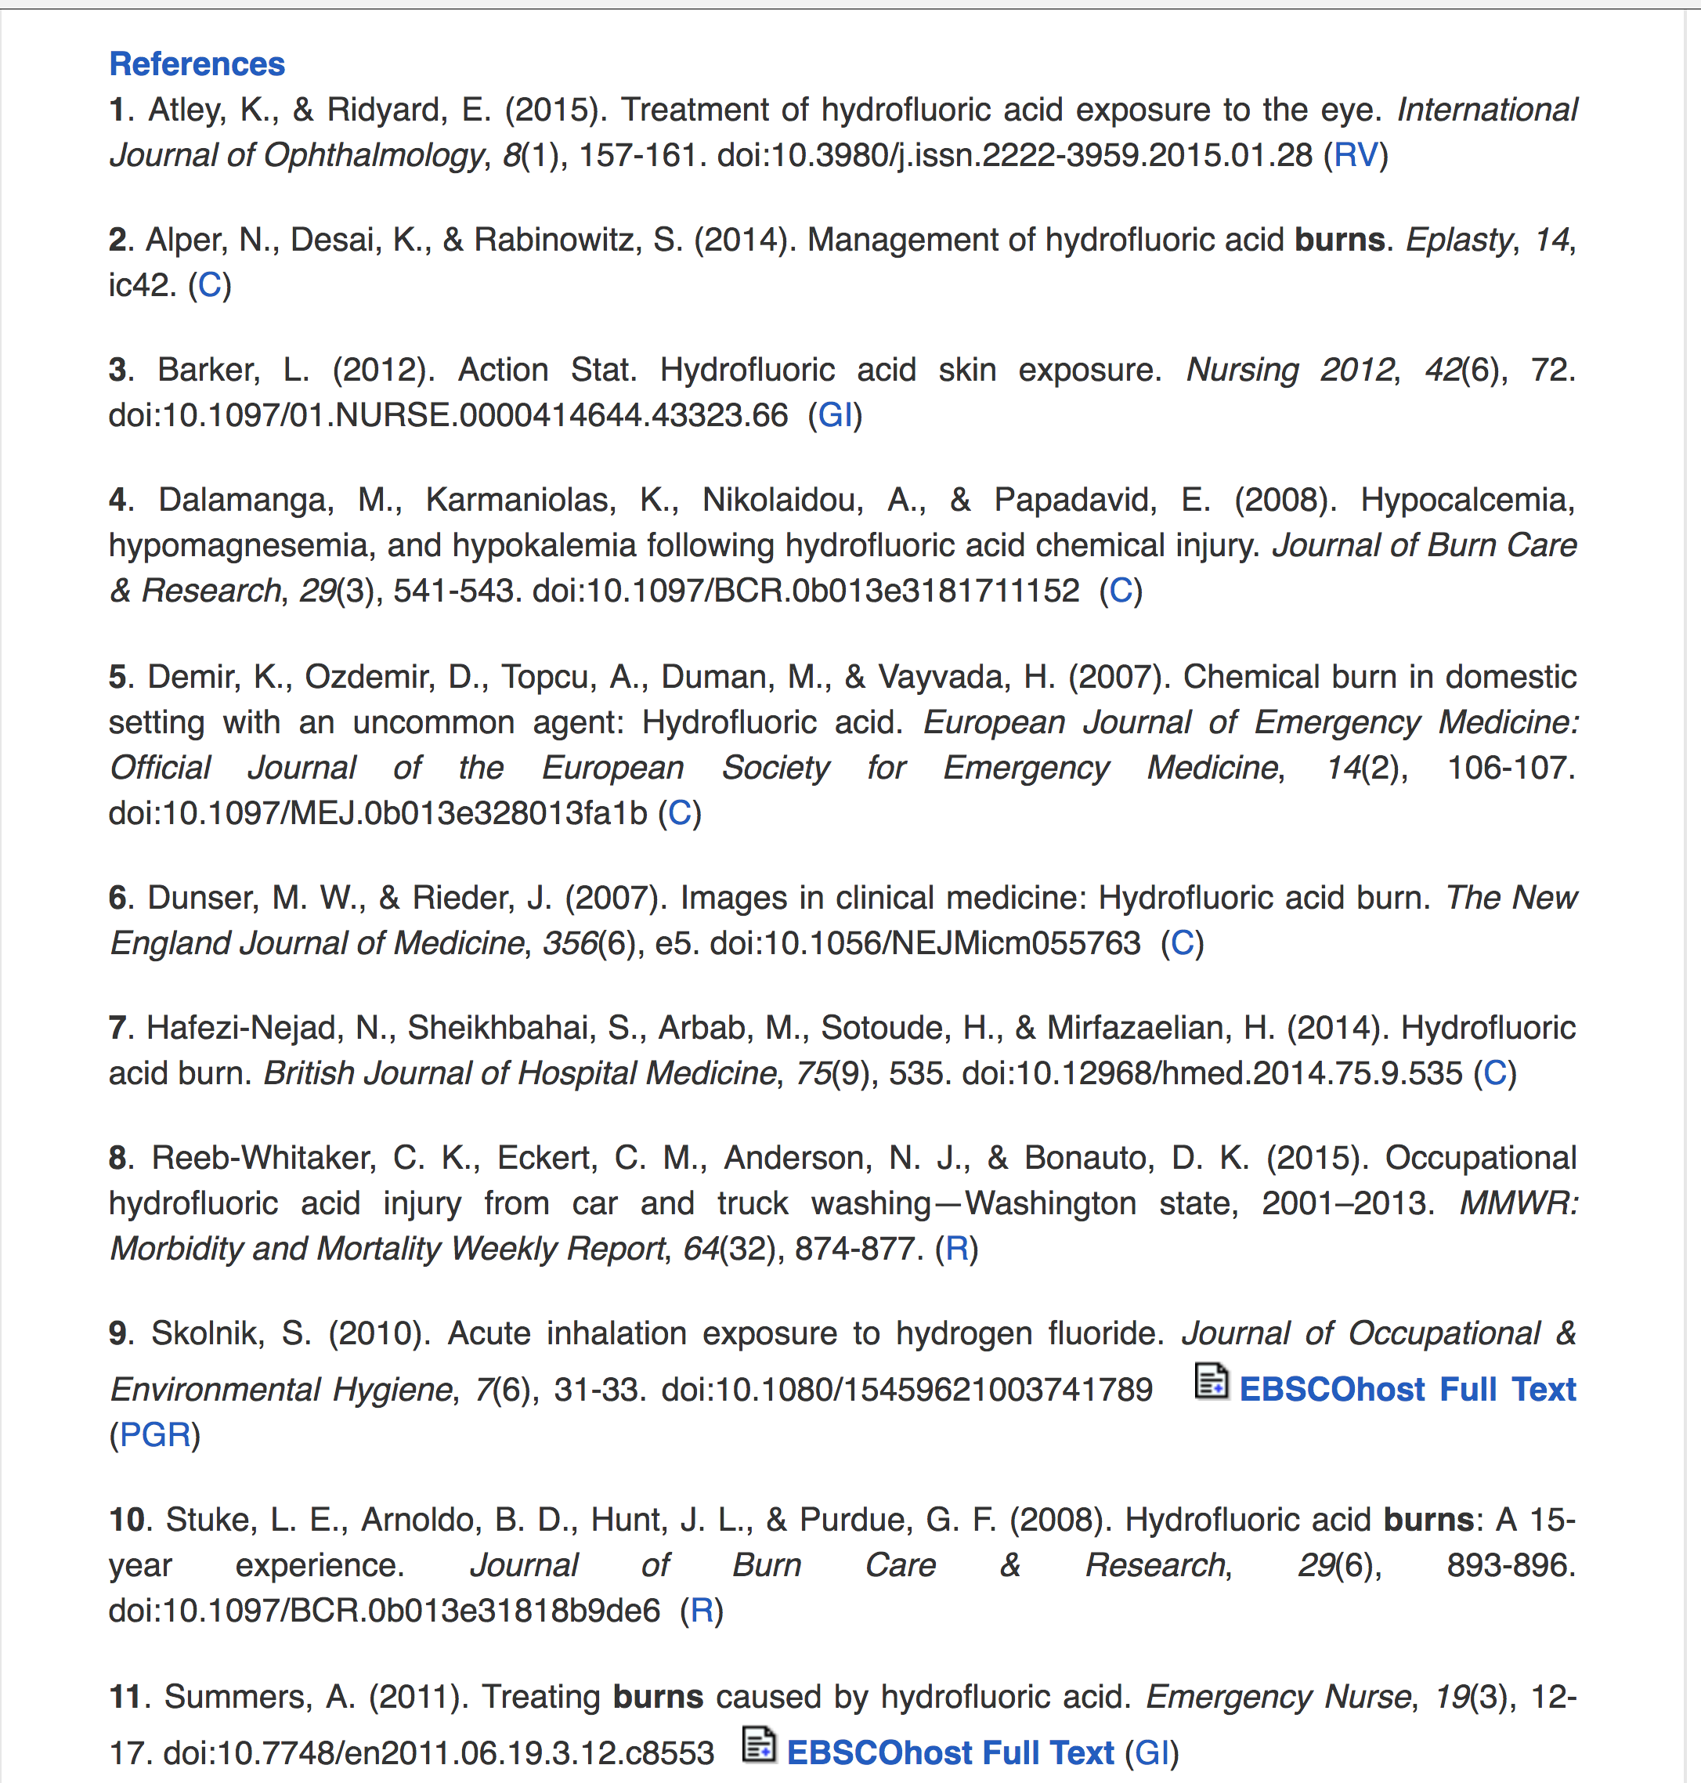
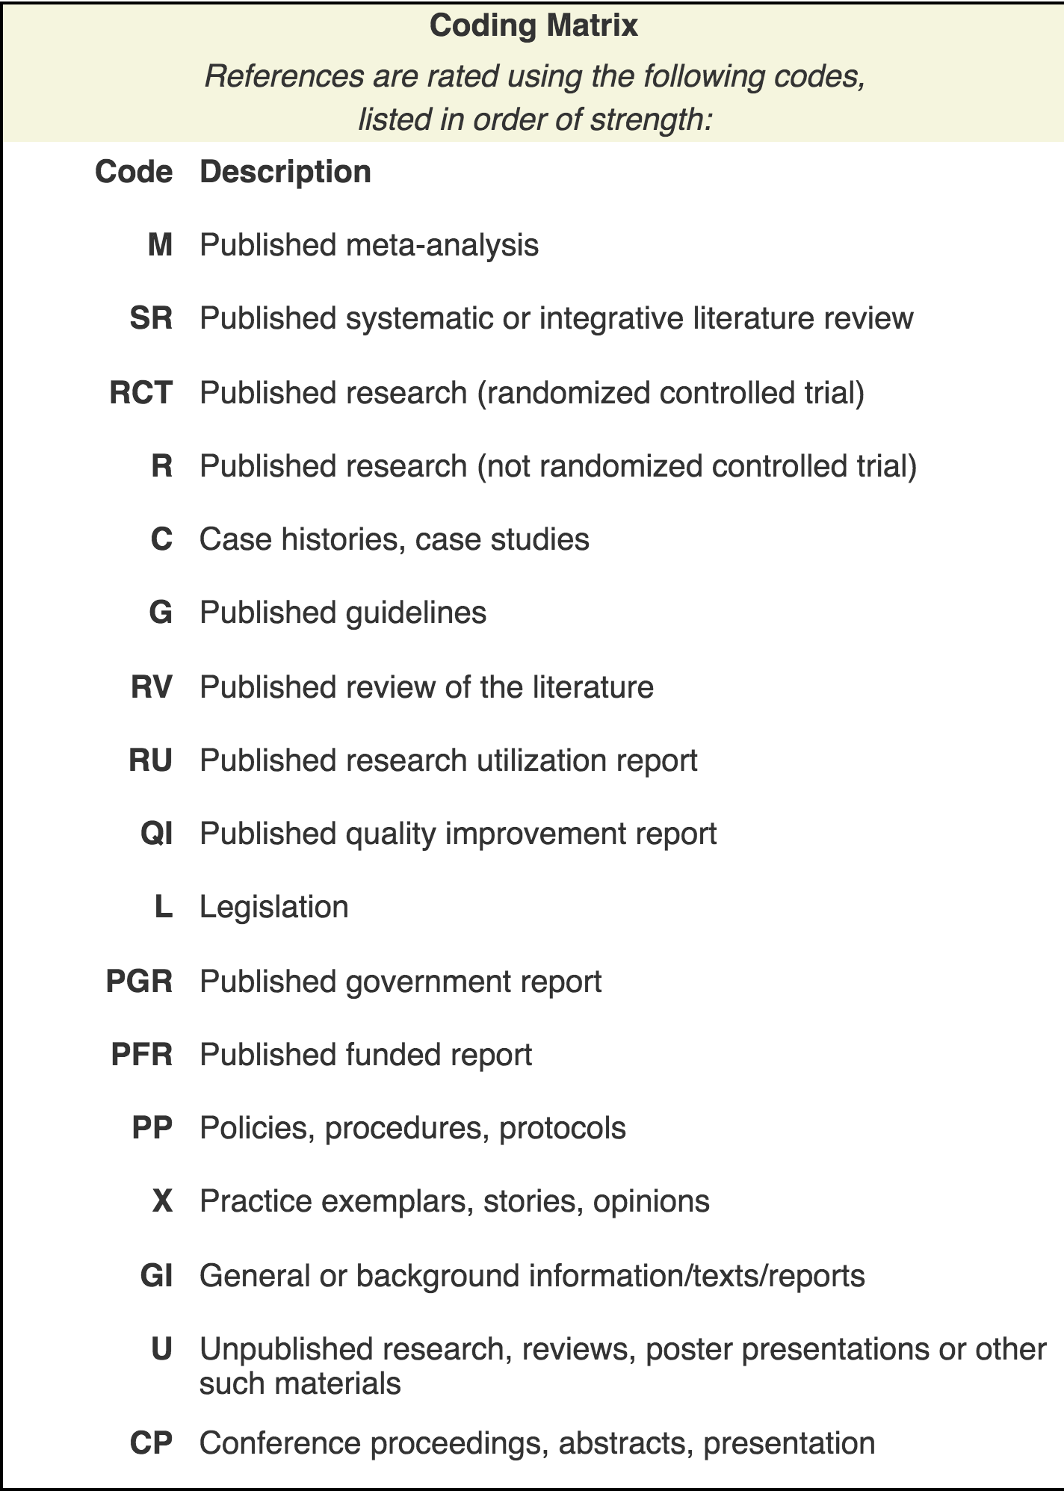
Notes:
Evidence synthesized from the cited articles makes up the content of the care sheet. Evidence codes describe the strength of evidence in articles referenced.

Slide 24
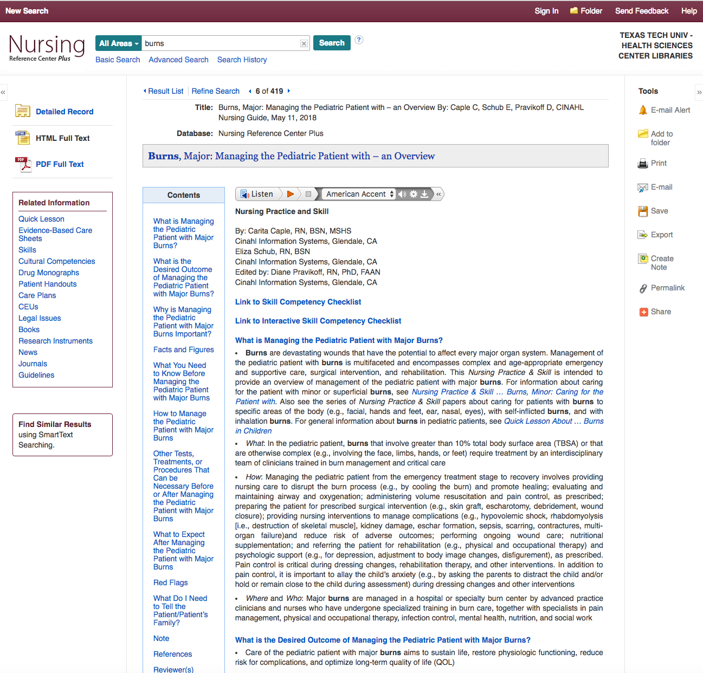
Skills
Notes:
Skills describes tests, treatments, or procedures that can be necessary before or after managing the patient.

Slide 25
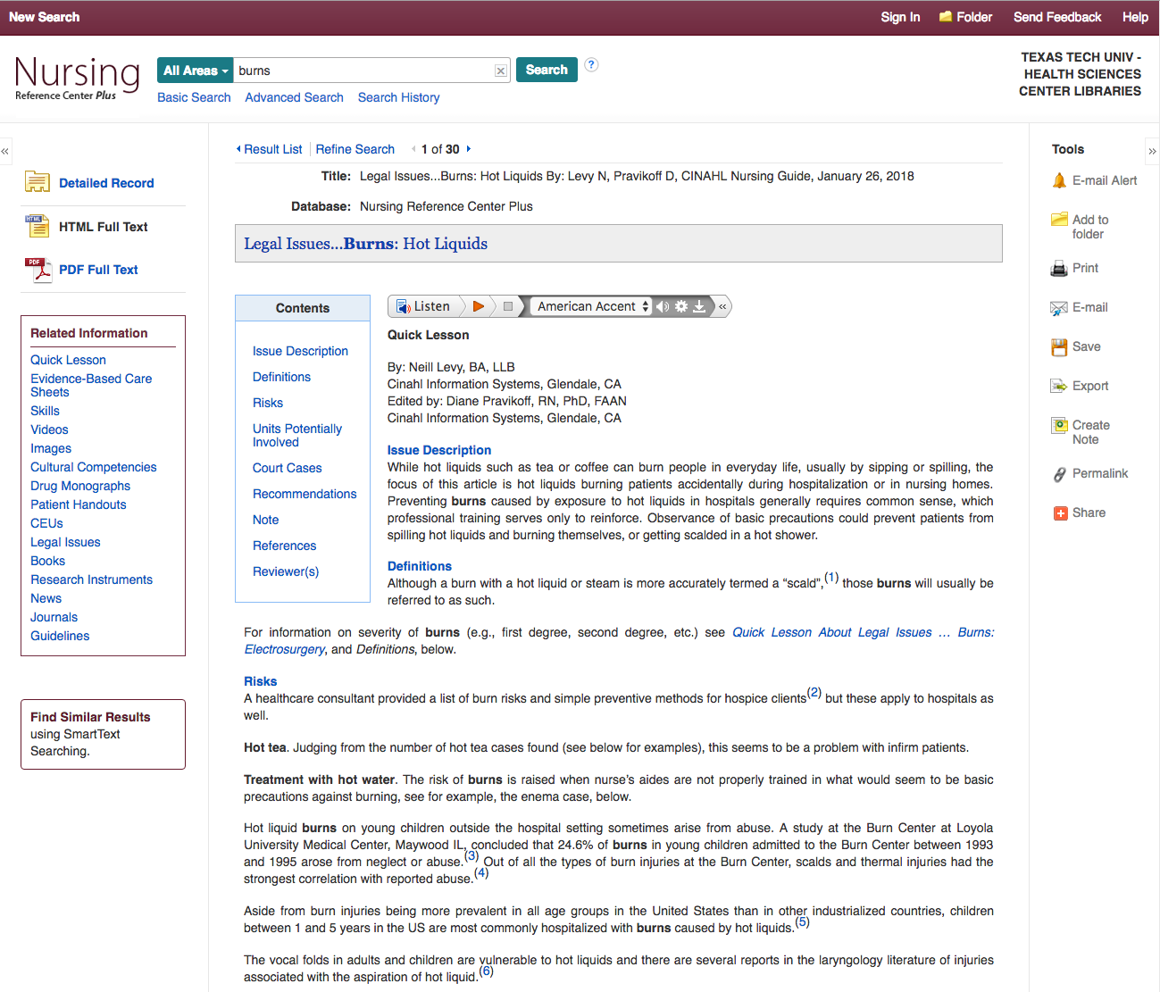
Legal Issues

Slide 26
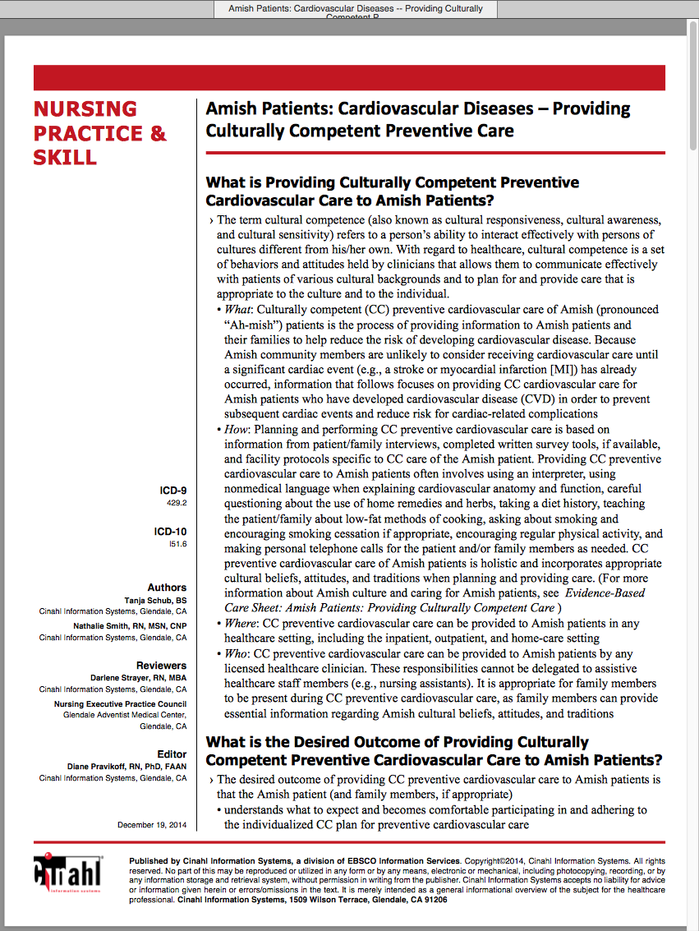
Cultural Competency
Notes:
Culturally competent preventive care is detailed in this nursing practice & skill document. The What, How, Where, and Who questions are answered, along with desired outcome.

Slide 27
Questions?

Slide 28
What is a citation?
A citation is the:
author(s) of the article
title of the article
journal, volume, issue, and page numbers
Notes:
You need to understand what is included in a citation, which give information a user will need to find the full text of the journal articles.

Slide 29
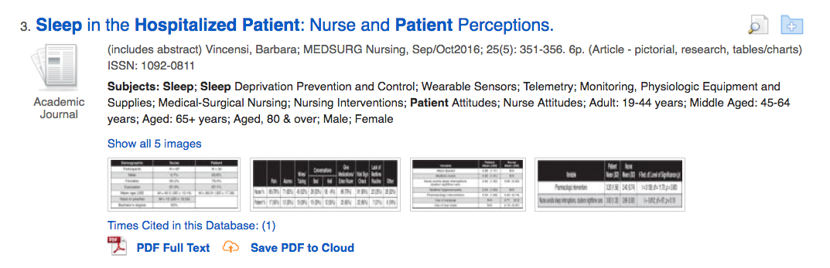
Volume = 25 Issue = (5) Page = 351-356
Article Title
Authors
Journal Name is: MEDSURG Nursing

Slide 30
Up Next:
Searching for journal articles
CINAHL Complete

Slide 31
Combining Subjects
Disease or Condition
Nursing concepts
AND
Notes:
We need to find a subject heading used to describe our patient’s condition. And we will also look for subject headings that describe nursing concepts. We will use the Boolean operator, and to find the intersection between the two subjects.

Slide 32
https://ttuhsc.libguides.com/homepage
Click CINAHL Complete

Slide 33
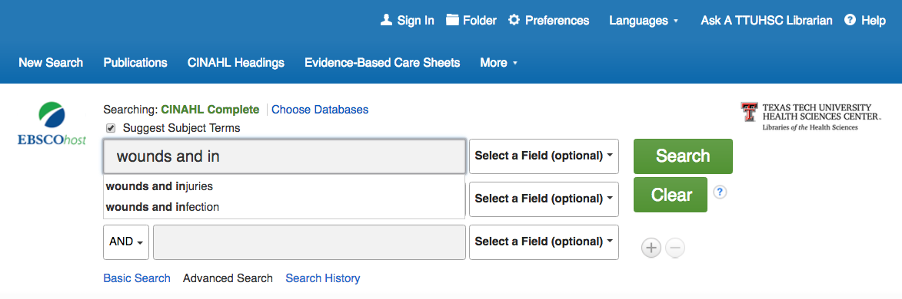
wounds and injuries
Suggested
Subject Headings
Notes:
To see a list of all subject headings that describe the many kinds of wounds and injuries, we will search for the broad topic. At this point we are not looking at articles, but concepts used to describe subjects that articles have been written about.

Slide 34
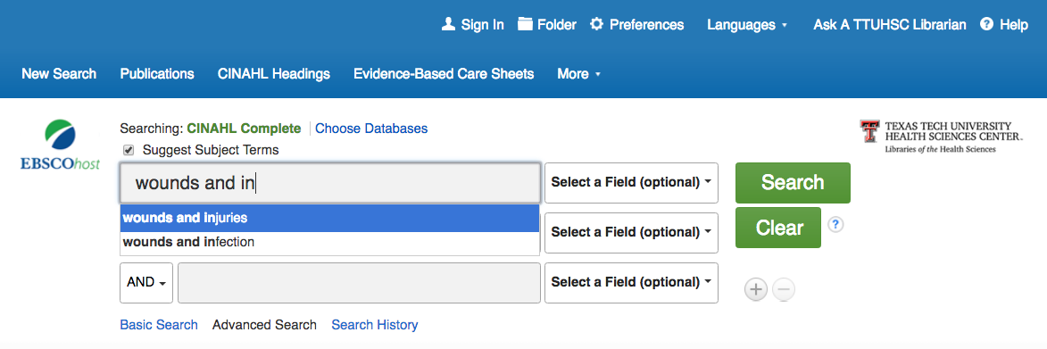
Select wounds and injuries
Search

Slide 35
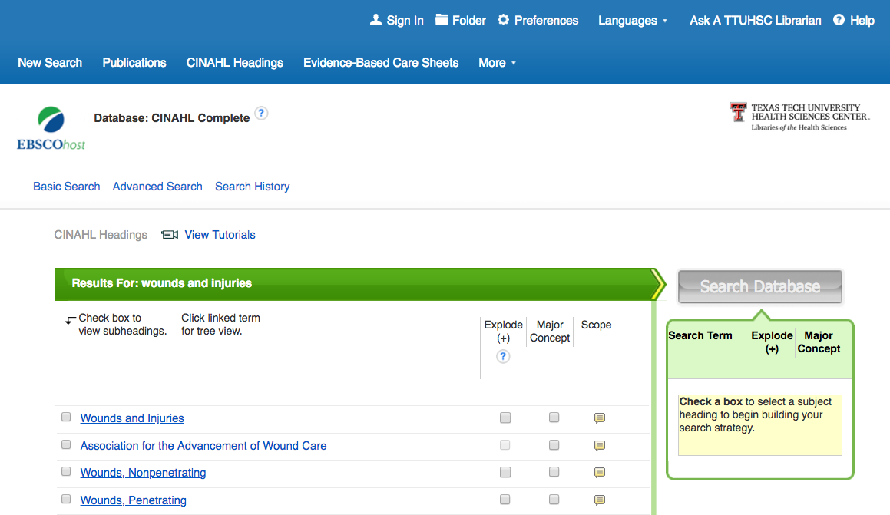
Click Wounds and Injuries
for
Tree Structure hierarchy
Notes:
Tree structure shows the specific subjects related to wounds and injuries.

Slide 36
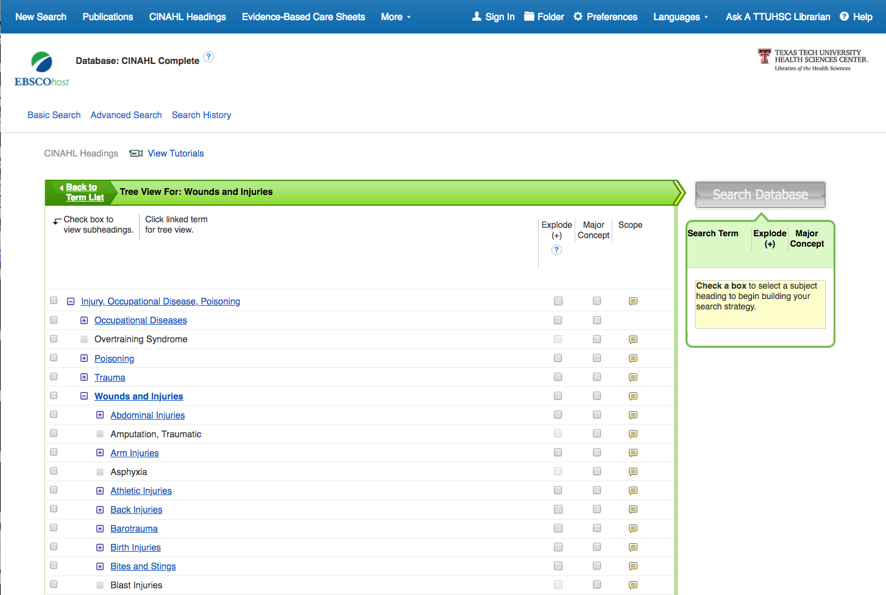
Scroll to view subjects
Notes:
Wounds and Injuries would be a very broad search; we can be more specific. Let’s look at one specific type of injury: Burns

Slide 37
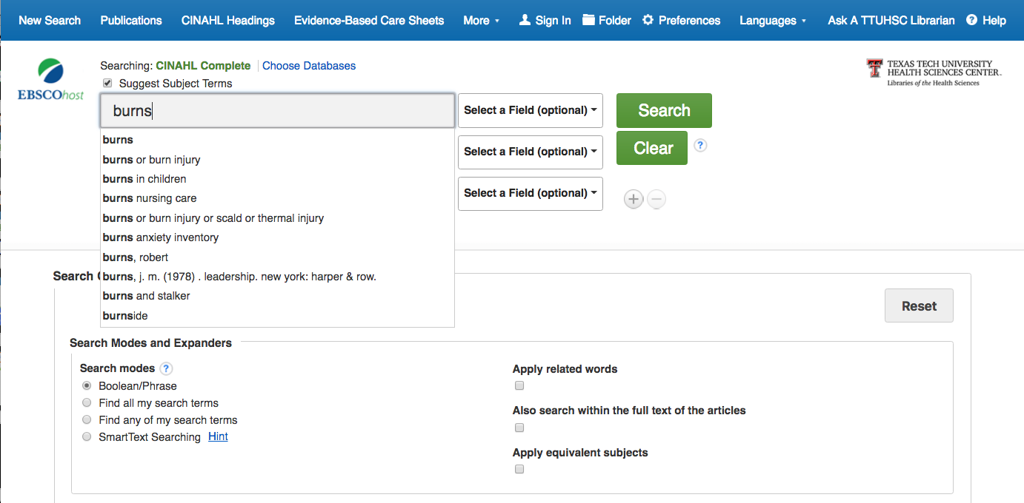
burns
Suggested
Subject Headings

Slide 38
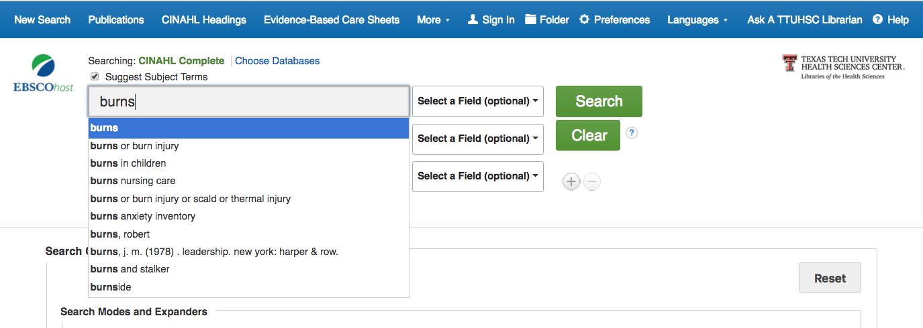
Select burns
Search

Slide 39
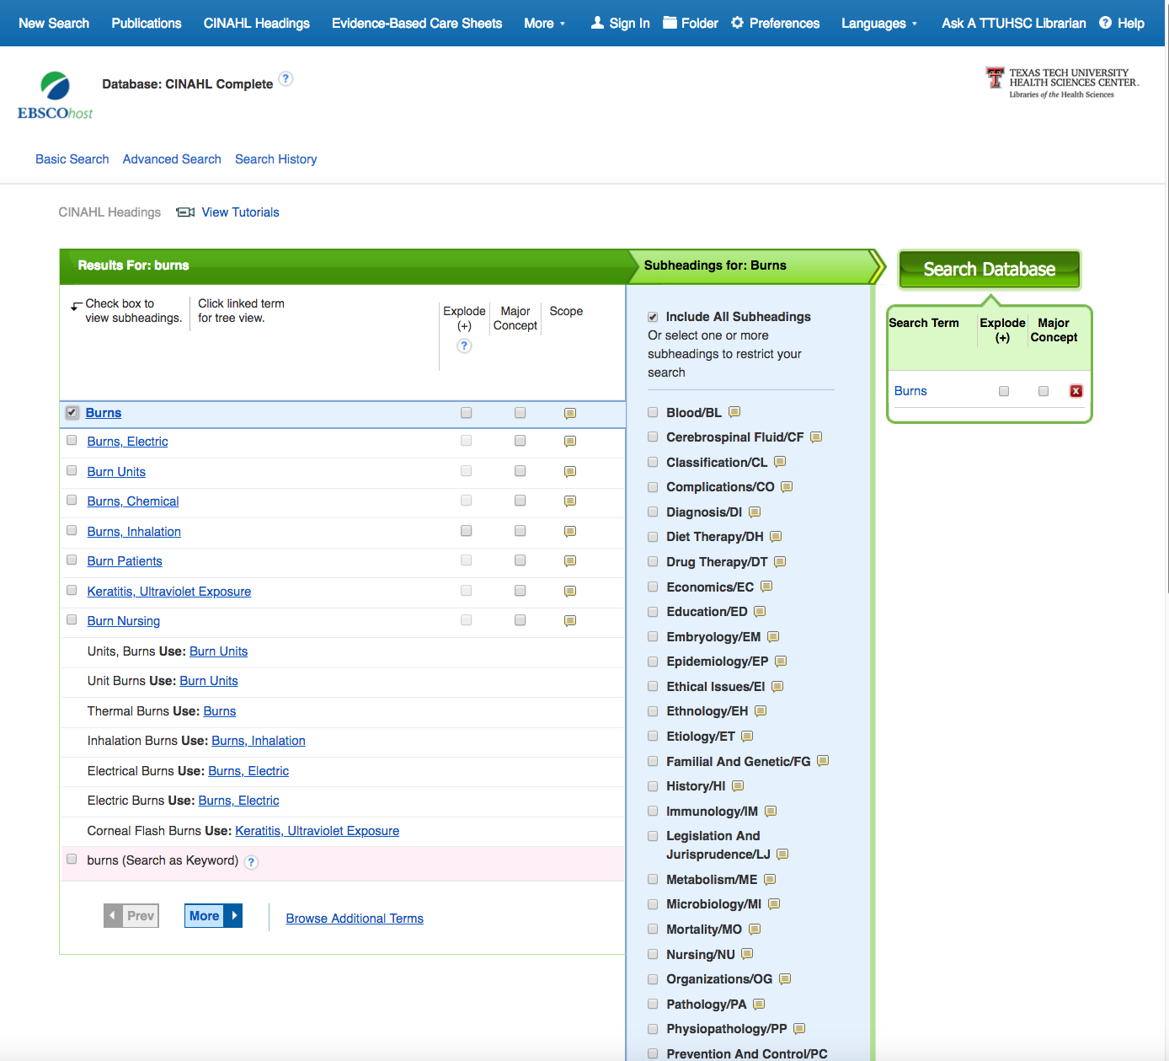
✔
✔
Click the box next to Burns
Notes:
Also, consider Major Concept.

Slide 40
click
Search Database
Subheadings
appear

Slide 41
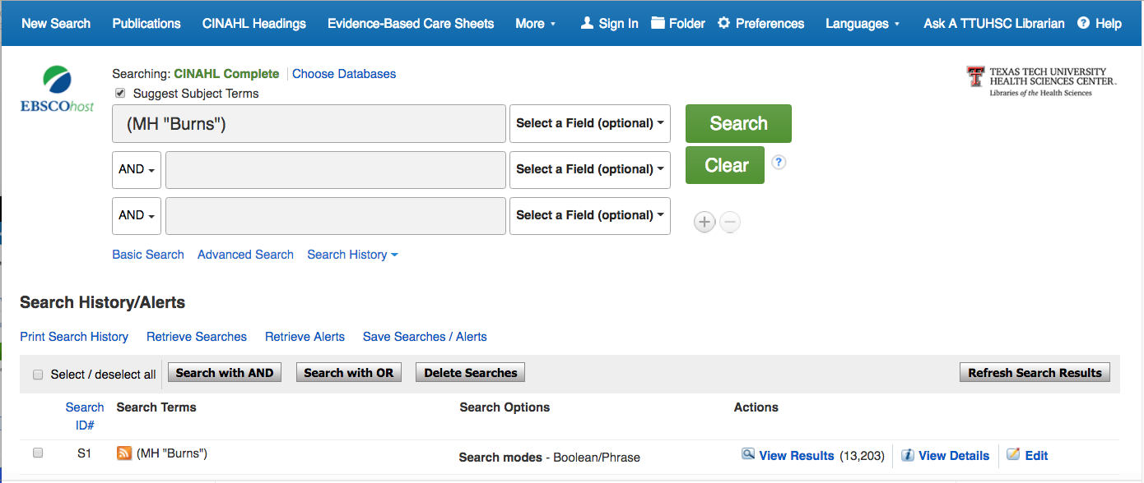
click
Clear

Slide 42
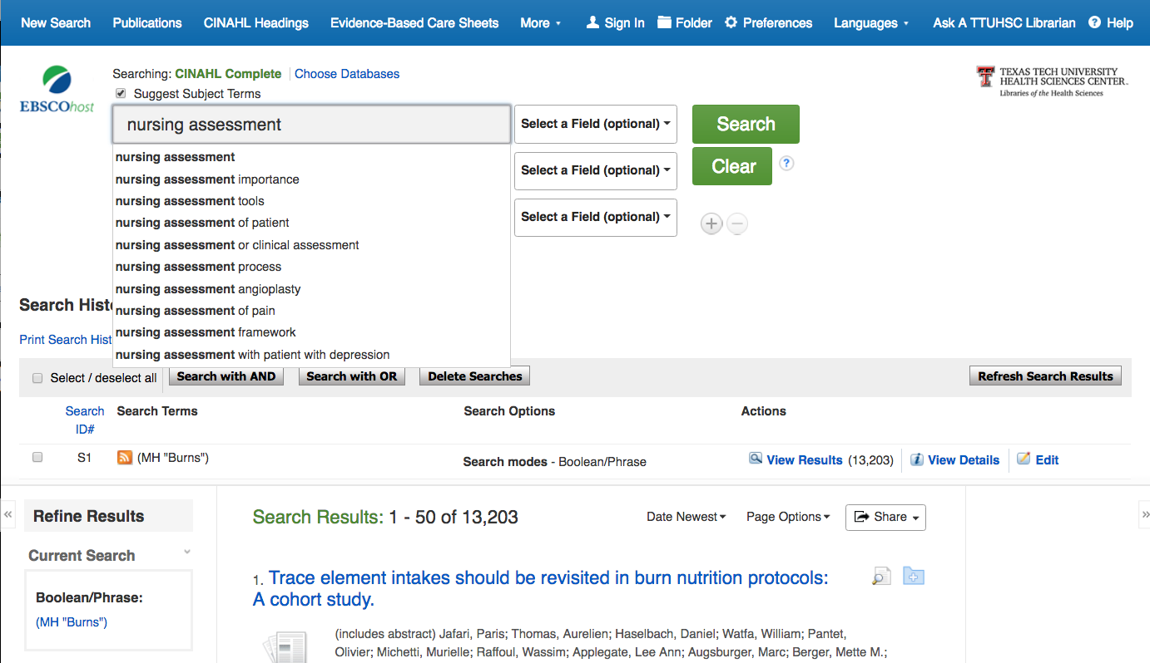
nursing assessment
Suggested
Subject Headings

Slide 43
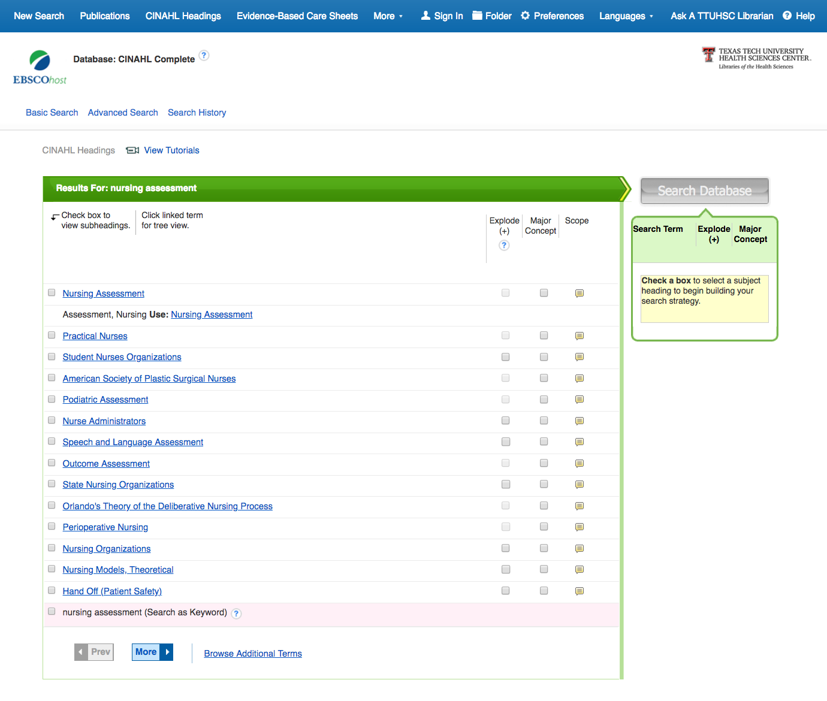
✔
Click the box next to Nursing Assessment

Slide 44
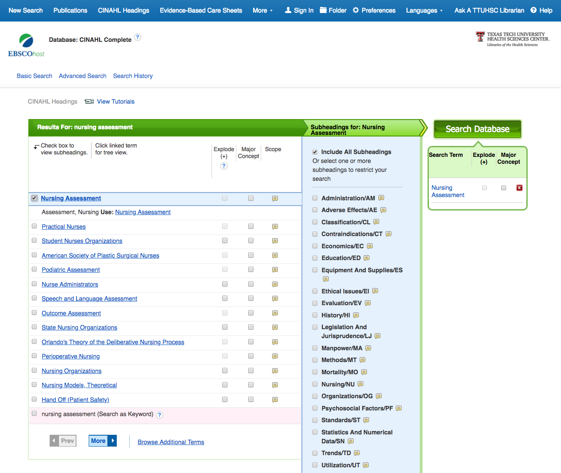
Search Database

Slide 45
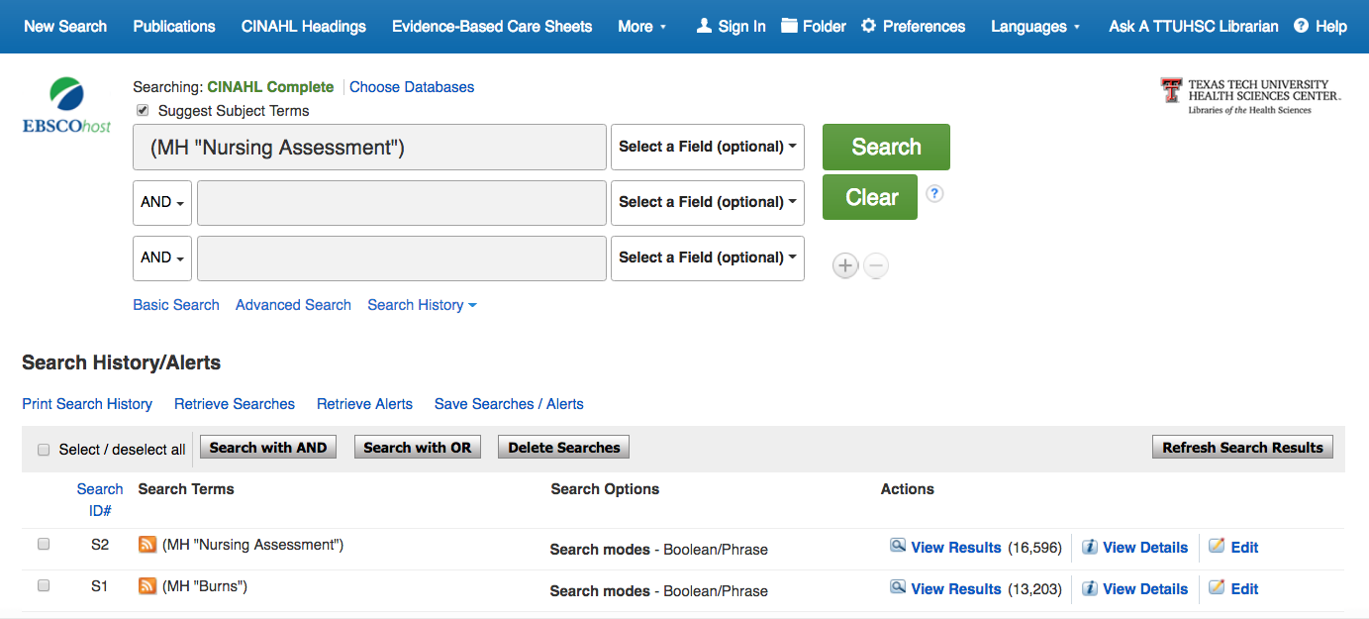
click
Clear
Notes:
Remember to clear the search box. This will keep your searches for different concepts separated.
We will combine them later.

Slide 46
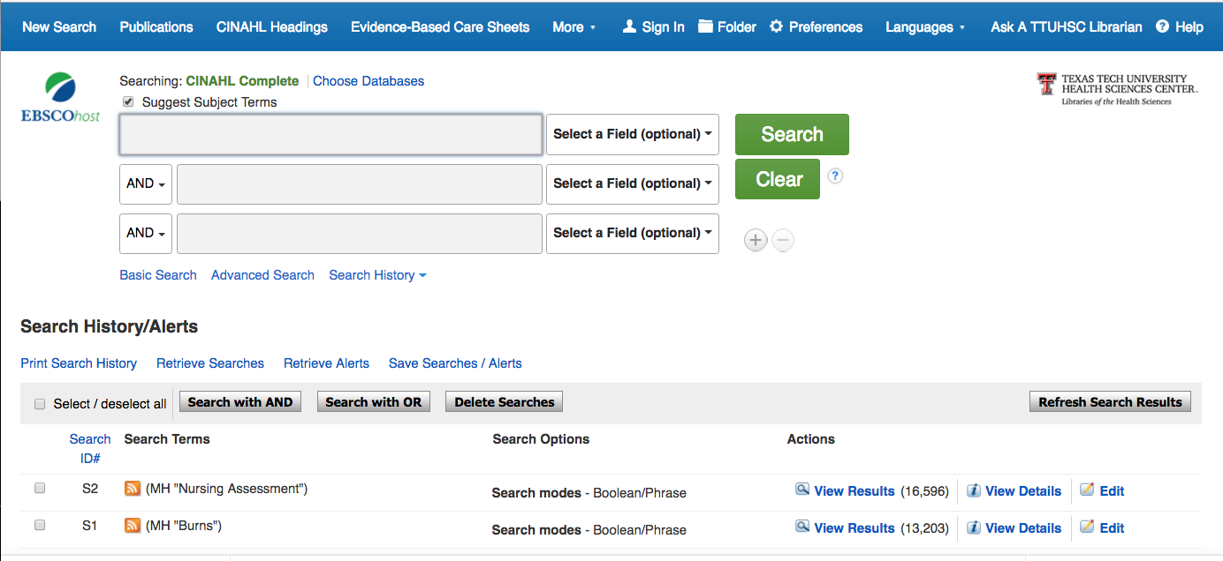
Search with AND
✔
✔
Select the boxes next to S1 and S2

Slide 47
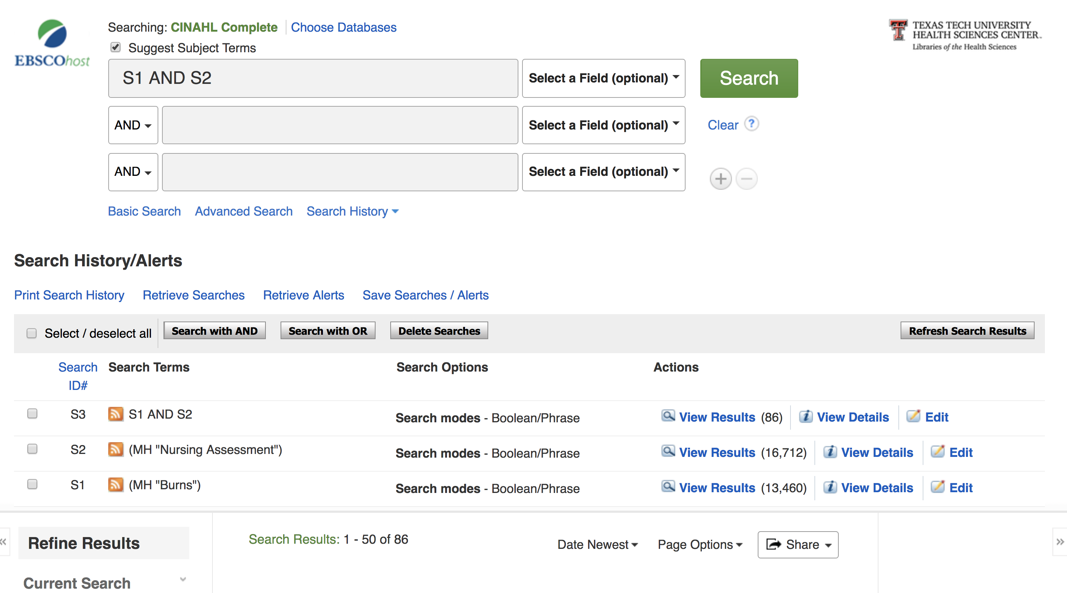
Results equal 86 articles

Slide 48
Refining Results

Slide 49
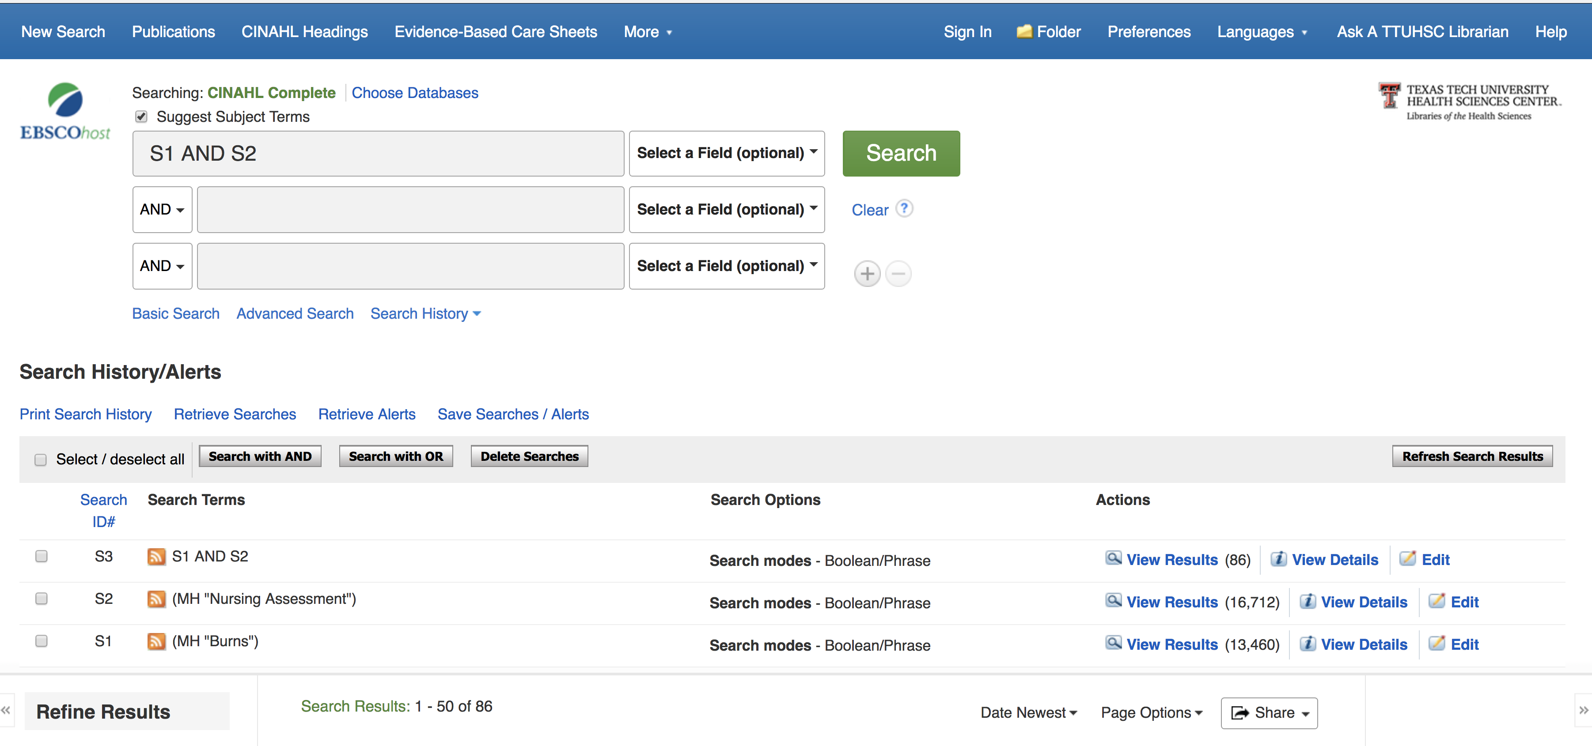
Results
Advanced Search

Slide 50
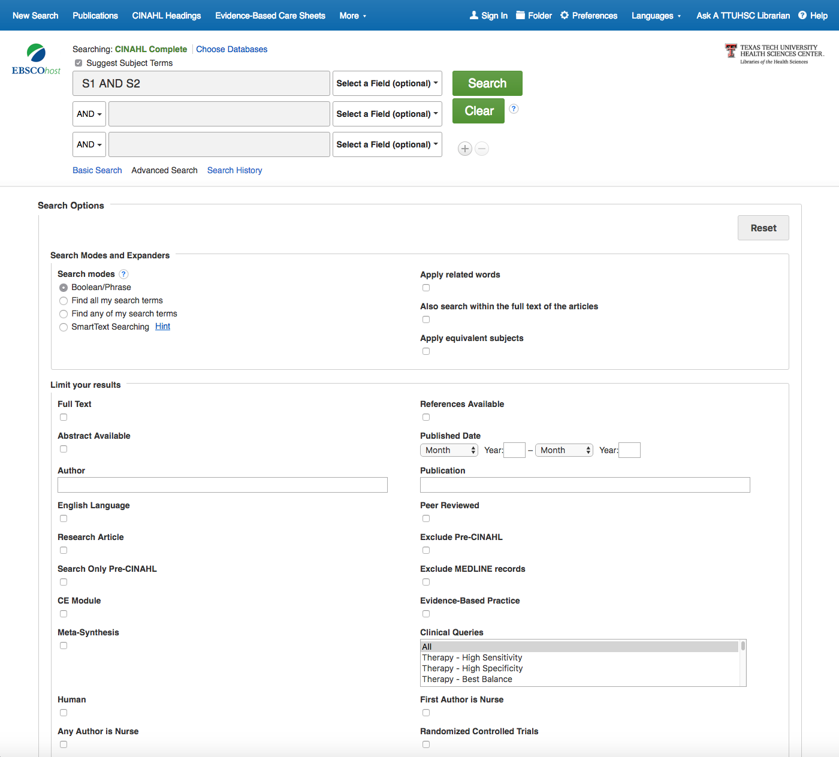
Select filters relevant to search.
Peer
Reviewed
English
Research Article
Evidence-Based Practice
Notes:
English language; Research article; Peer Reviewed; Evidence-based Practice
Be careful with full text limit, because it only refers to EBSCO; we have other full text articles available. See Peggy’s presentation coming up on looking for full text articles.

Slide 51

Scroll to the bottom of the screen and click Search

Slide 52
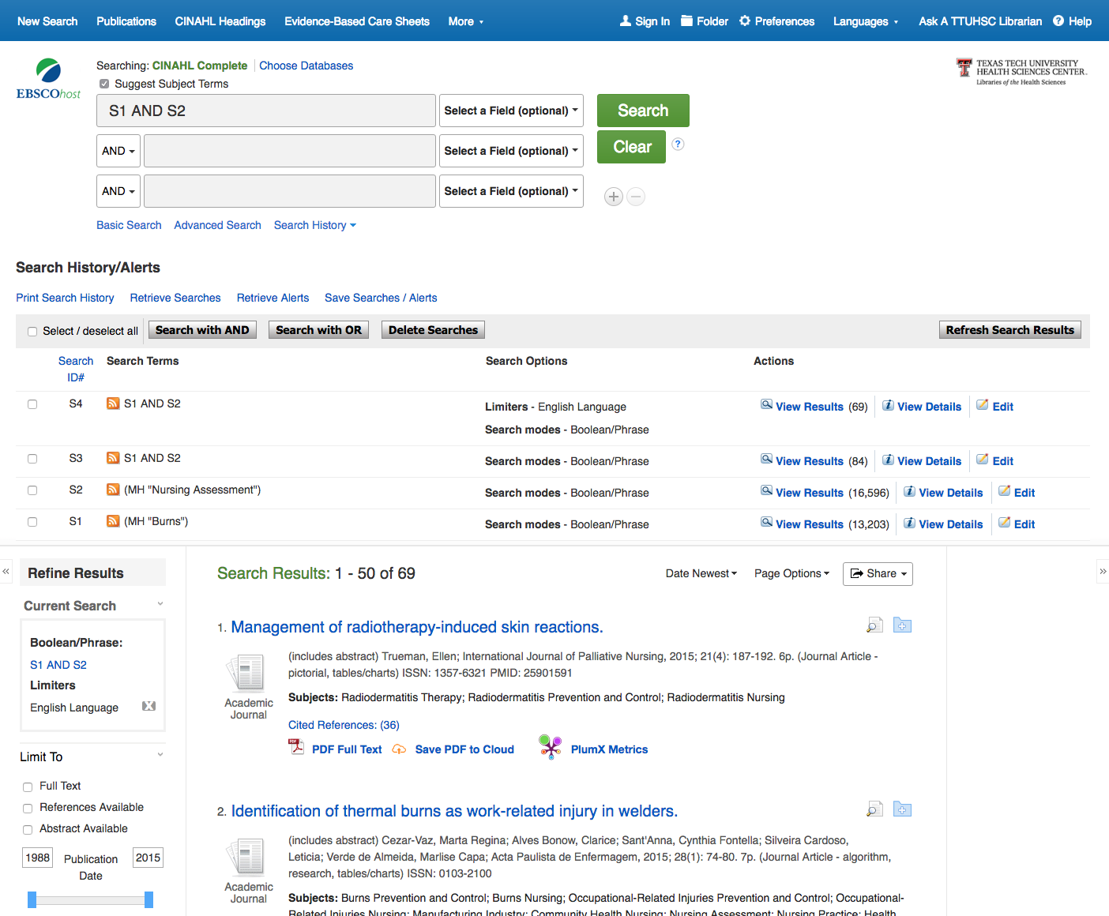
Change date to 2012 in the left-hand box to narrow to articles published in the last 5 years.
Type the year. Hit ‘Enter’
Notes:
The date range may be tricky if you use the slider. Filters automatically when it works.

Slide 53
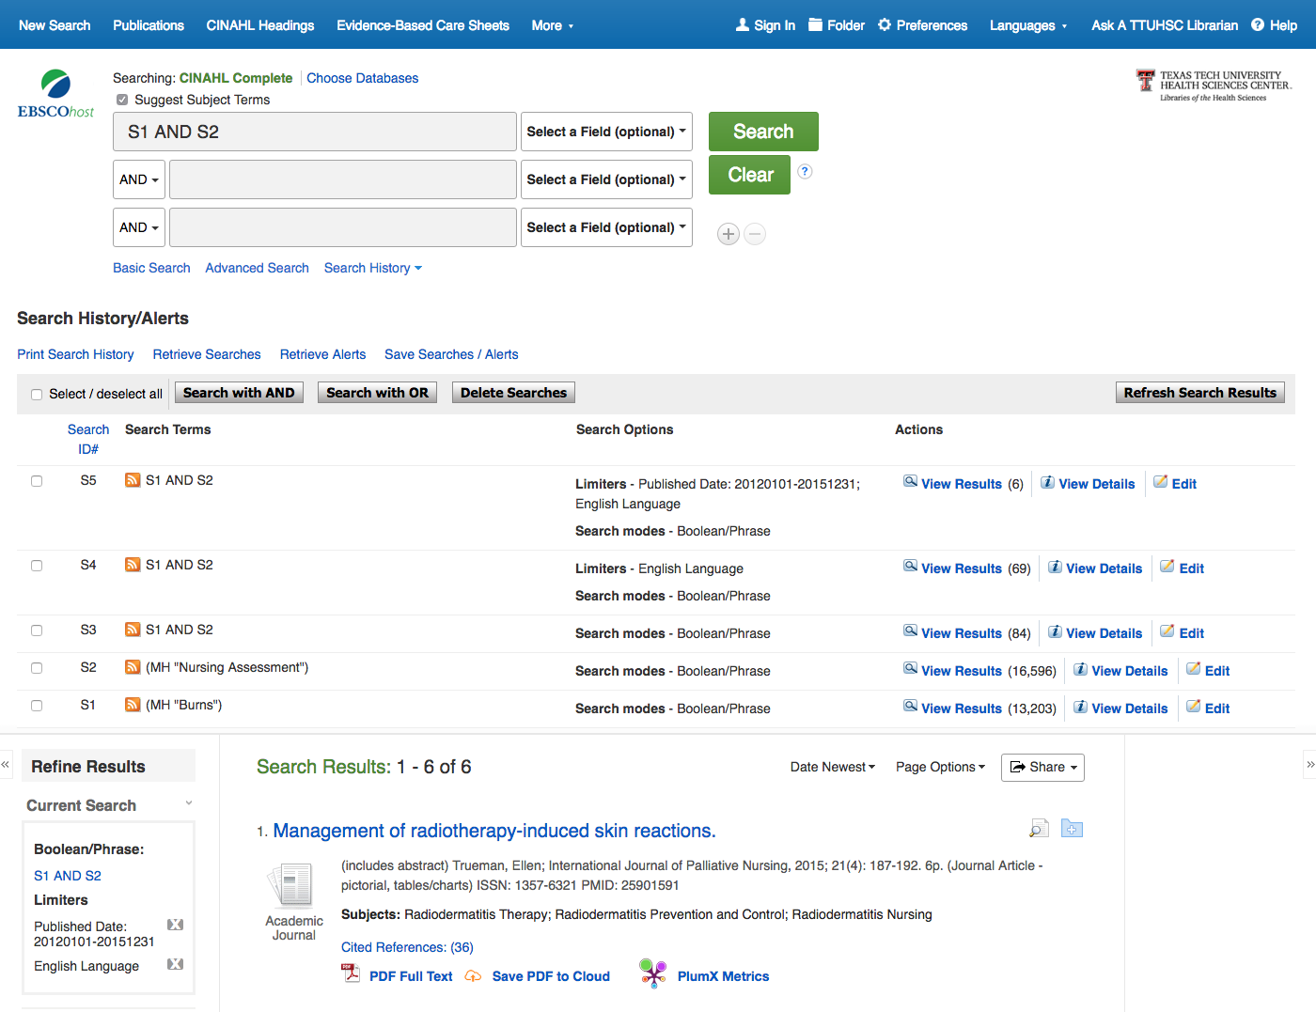
Click on the blue folder to save articles of interest to you.

Slide 54
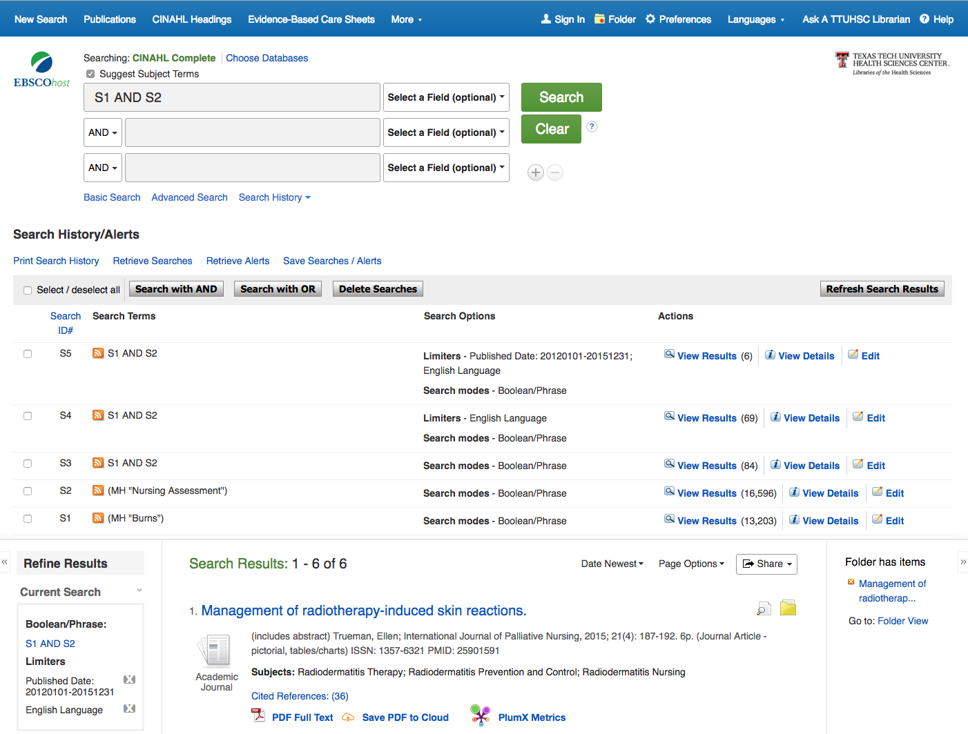
Icon turns yellow and stores the article in the yellow folder above.

Slide 55
Click the yellow folder.
Notes:
This folder is temporary. It will go away, so you might want to email citations to yourself to view later.

Slide 56
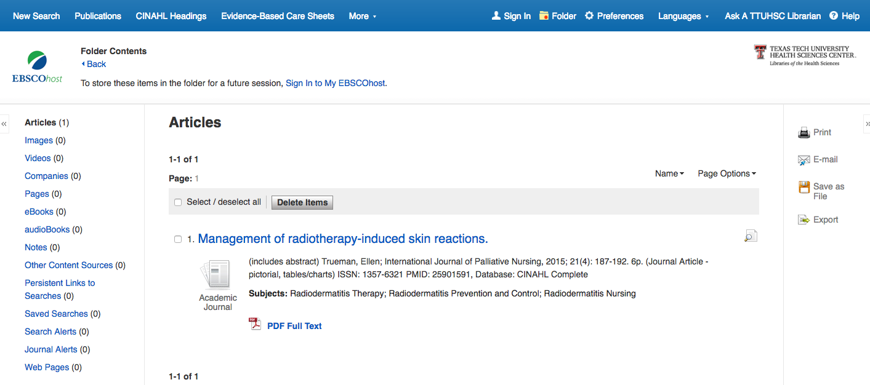
2) Click E-mail
1) Click Select

Slide 57
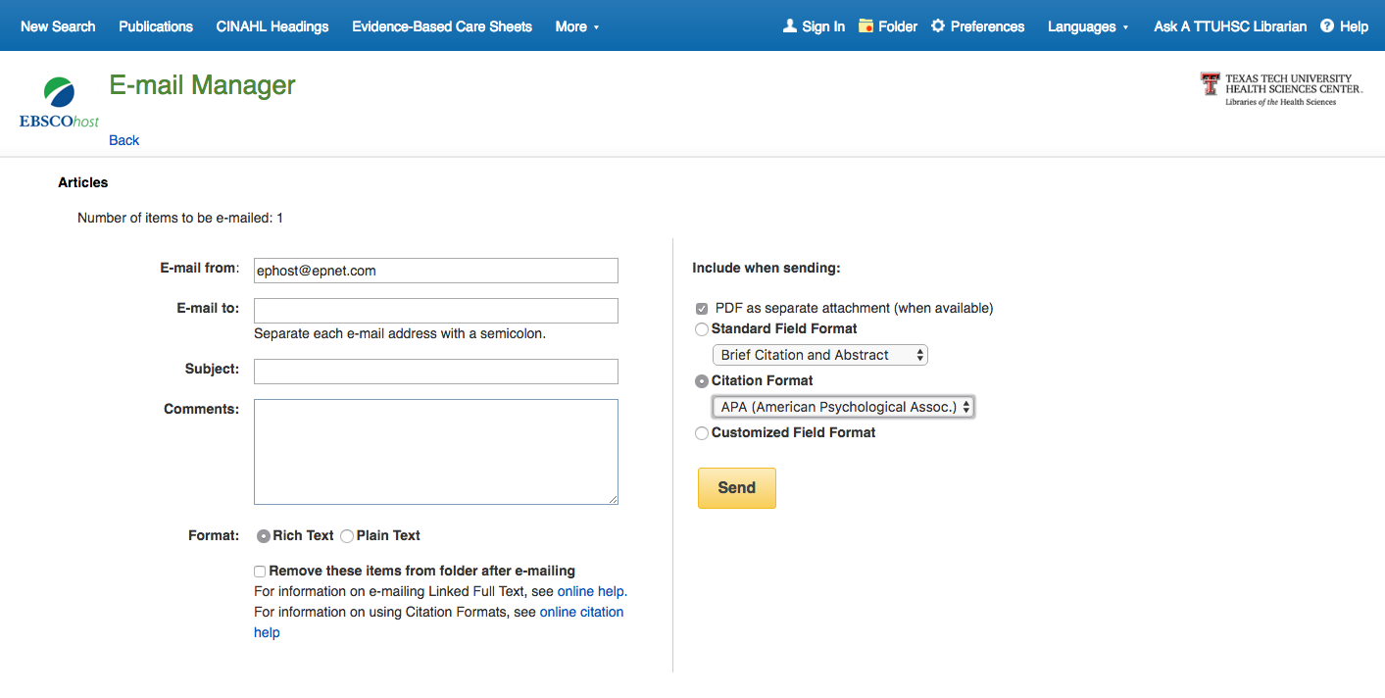
1) Enter your E-mail
2) Change to Brief Citation and Abstract
4) Click Send
3) Change to APA.
WARNING: CINAHL’s APA format is often wrong! Be sure to check your print APA manual before turning in your paper!!
Notes:
Remember that this folder is temporary, but it does not require a login.

Slide 58

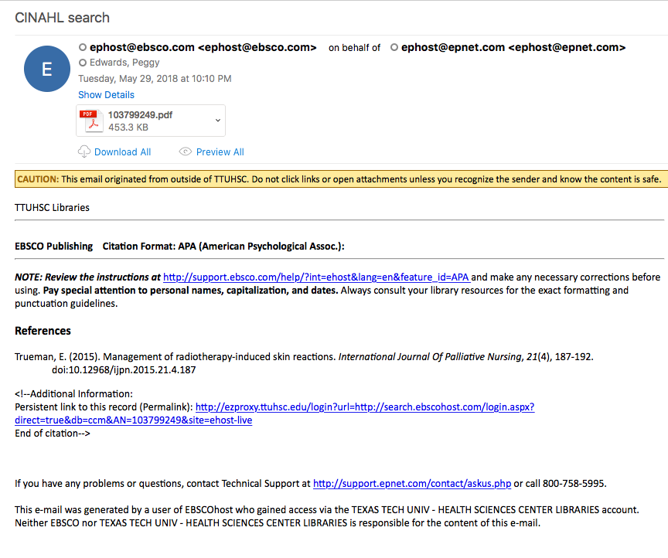
from line in email
Click ezproxy link to download the PDF of the article

Slide 59

Consider Creating an Account
Save & re-run searches
  Helps you manage your time
You will be asked to create a strong password
  Wait until you have a few un-interrupted minutes to create your account
  Record your password in a secure place or app
  MyEbscoHost is the account
Notes:
You can save searches when logged in to your account. It will be a MyEbscohost account. Saves you from having to re-create a search strategy to view all of the search results.

Slide 60
Notes:
Use the Sign In link when you get ready to create your account.

Slide 61
Combining Subjects
Disease or Condition
Nursing Concept
AND
Notes:
We need to find a subject heading used to describe our patient’s condition. And we will also look for subject headings that describe nursing concepts. We will use the Boolean operator, and to find the intersection between the two subjects.

Slide 62
Repeat search process with any of these subject headings:
nursing assessment
nursing interventions
health promotion
nursing process
multidisciplinary care team
nursing informatics or informatics
Notes:
Search for the condition concept. You may already have that search in your search history.
Find the subject heading for the nursing concept. Search CINAHL.
Go to search history. Combine the condition and the nursing concept searches with AND.

Slide 63
Subject With Subheading
A subheading attached to a CINAHL subject heading finds articles on the concept, but limited to a particular facet of the subject
Example:
Hypertension, prevention & control
Notes:
One way to focus on a particular facet of a subject is to use subheadings.

Slide 64
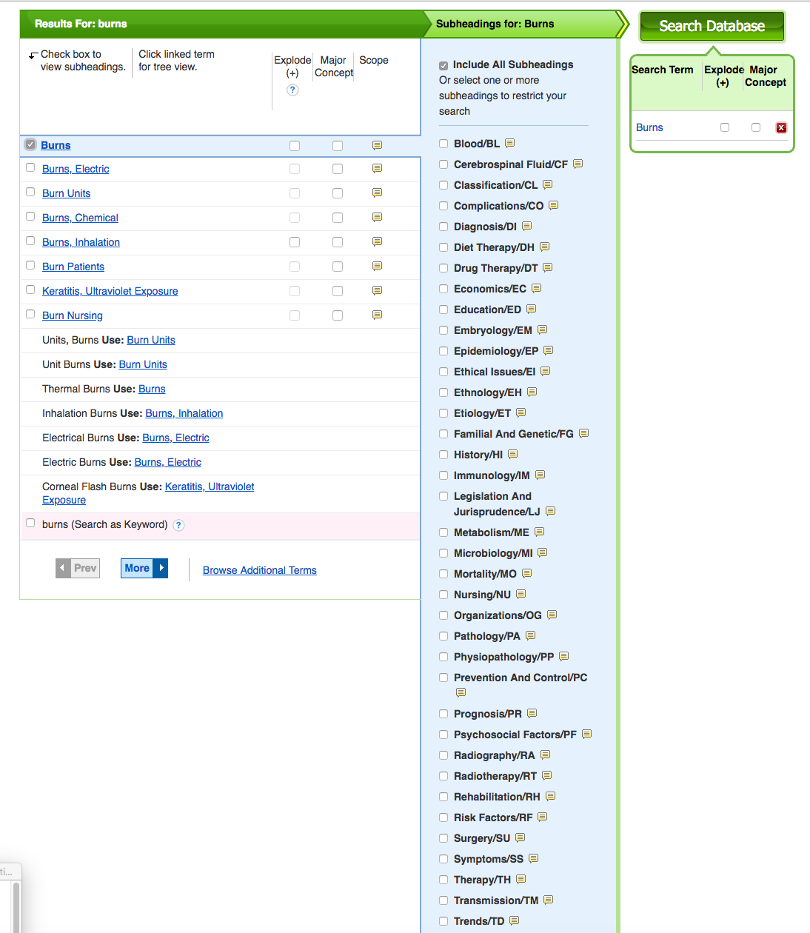
Relevant
subheadings
ethical issues
legislation & jurisprudence
nursing
prevention & control

Slide 65
What questions do you have?

Slide 66
Stretch Break!

Slide 67
PEPID

Slide 68
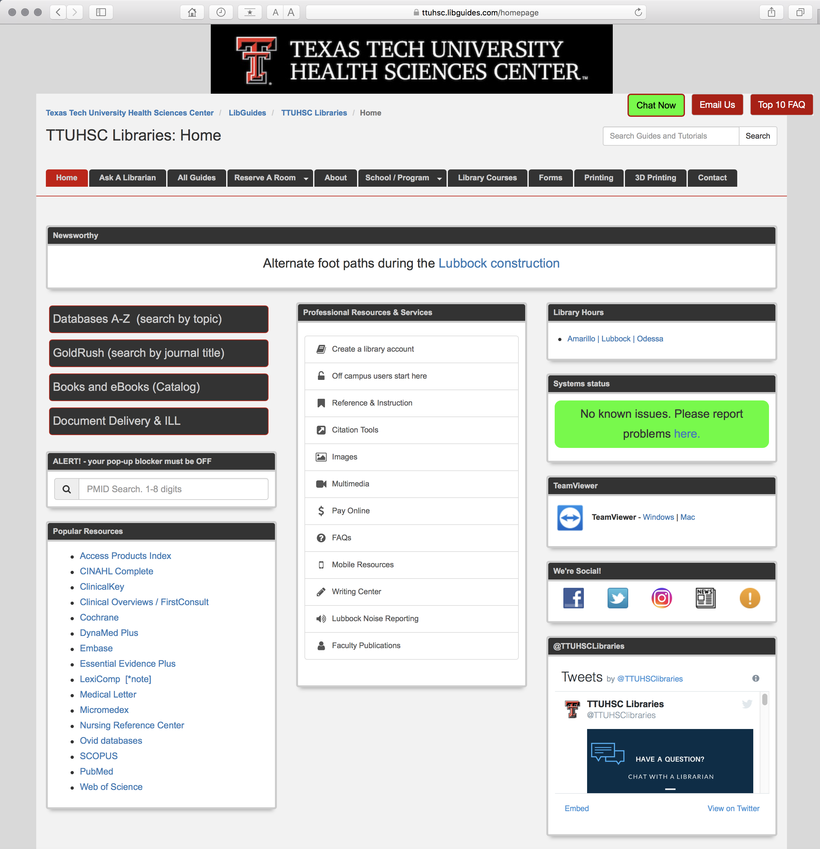
https://ttuhsc.libguides.com/homepage
Nursing

Slide 69
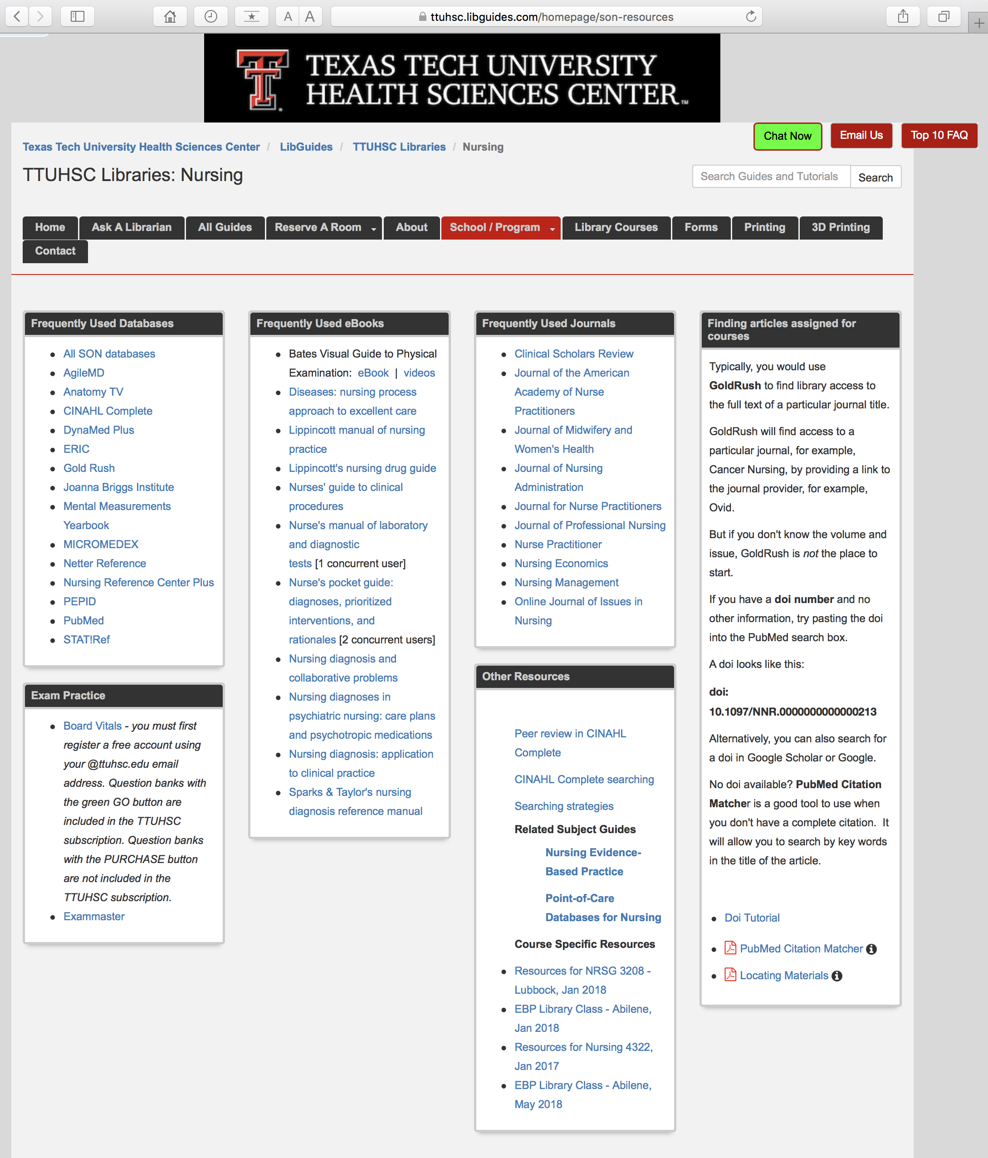
https://ttuhsc.libguides.com/homepage/son-resources
Click PEPID

Slide 70


Click RN Student Clinical Companion

Slide 71
Comprehensive point-of-care resource
Formatted for smart phones and tablets

Slide 72
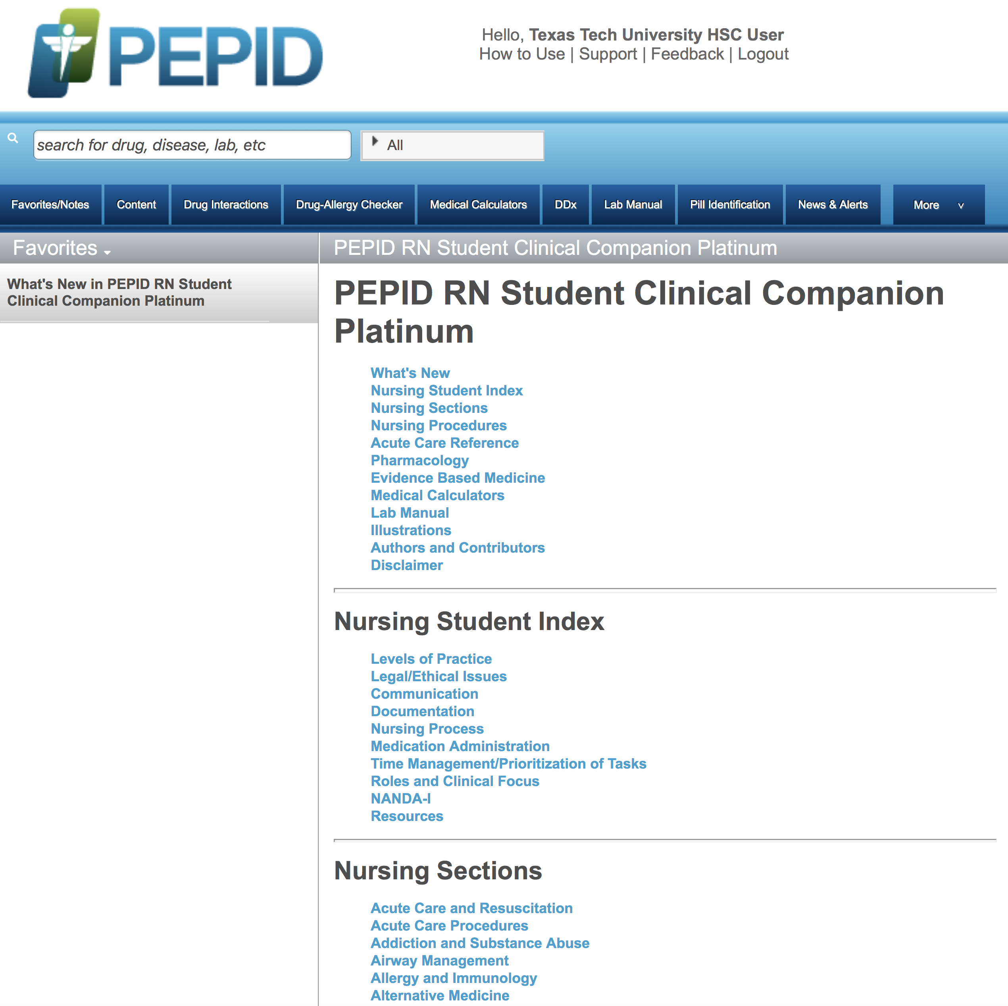
Home Page
Table of Contents
Scroll Screen

Slide 73
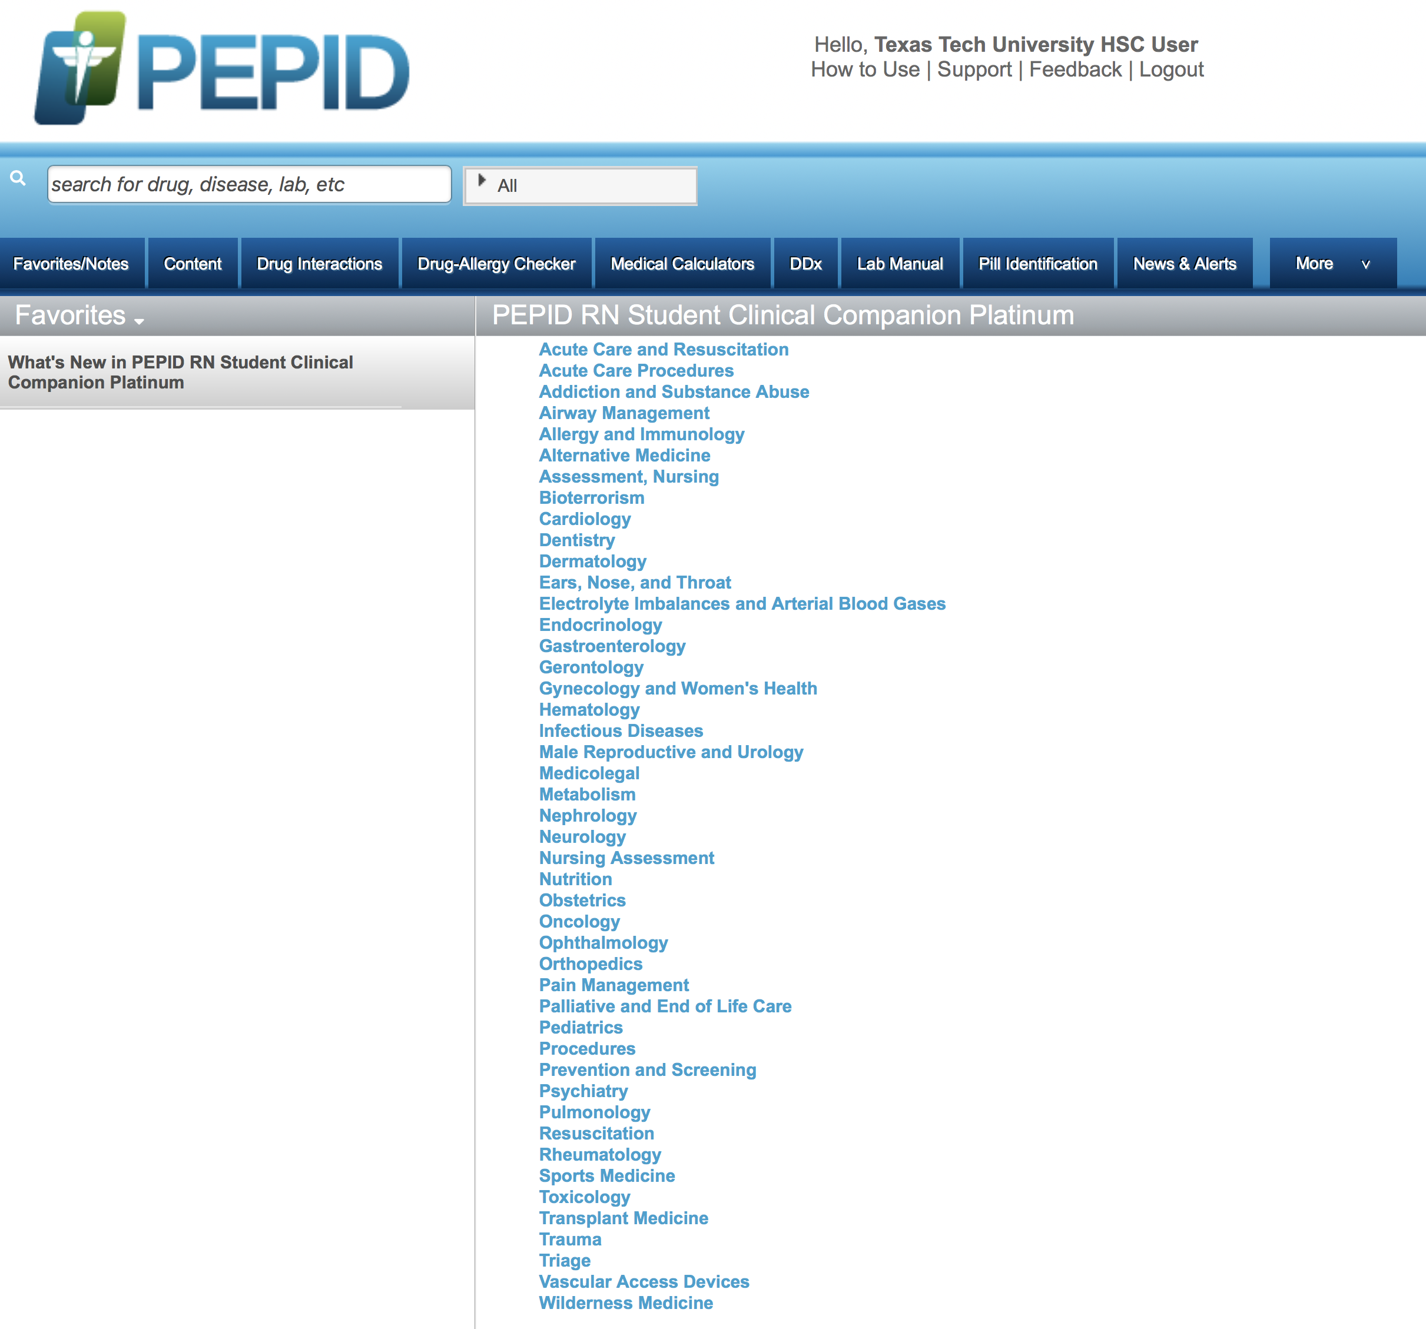
NOTE: Nursing Assessment
Information for different nursing specialties

Slide 74

PEPID includes:
Drug Information

Slide 75
PEPID includes:
Medical Calculators

Slide 76
PEPID includes:
Lab Manual

Slide 77
PEPID includes:
Illustrations

Slide 78

Enter topic and select

Slide 79

Search Results

Slide 80
What questions do you have?

Slide 81
Finding
e-journals
in Gold Rush

Slide 82
https://ttuhsc.libguides.com/homepage
Click GoldRush

Slide 83

Enter journal title
Search
and click
nursing research

Slide 84

Click to go to page 2

Slide 85

Click Nursing Research (New York...)

Slide 86

1) Check dates
2) Click Link

Slide 87

Locate article and click PDF Full Text link
Select Year
Select Volume, Issue

Slide 88

Email Jumpstart sends a full-text link to you
Download or Print

Slide 89
What questions do you have?

Slide 90
APA Style

Slide 91
https://ttuhsc.libguides.com/homepage
Click Citation Tools

Slide 92

Click APA Style

Slide 93

Link to
Basics of APA Style
- Video Tutorial

Slide 94


Slide 95
What questions do you have?

Slide 96
for PowerPoint go to
Integrated Learning 1 NRSG 3208
https://ttuhsc.libguides.com/
integrated_learning_1

Slide 97
Hands-On Exercises

Slide 98
What questions do you have?

Slide 99
Have Questions
or
Need Help?

Slide 100
https://ttuhsc.libguides.com/homepage
for Guides & Tutorials click All Guides

Slide 101

Orientation PowerPoint

Slide 102
For questions,
Chat Now
Email Us
or

Slide 103
CINAHL Subject Headings
nursing assessmenta
a
nursing interventionsa
a
health promotiona
a
nursing processa
a
multidisciplinary care teama
a
nursing informatics or informatics
Notes:
Search for a condition concept. Find the subject heading for the nursing concept. Search CINAHL.
Go to search history. Combine the condition and the nursing concept searches with AND.

Slide 104
Please…
fill out the evaluation at
http://tinyurl.com/ttuhsc19
Thank-you for your feedback!

Slide 105
The End

