Slide 1
Scholarship in Evidence-Based Practice
Micah Walsleben, MLS

Slide 2
Preferred Internet Browsers
Firefox
Chrome
Safari
Notes:
When accessing the library website and its resources from your computer at home, it is highly recommended that you use one of these browsers. Internet Explorer doesn’t support all of the technology we have on the library website, and we have had some reports of access issues as a result.

Slide 3



Reference Librarians
Available on 2nd floor of library, across from the Learning Resource Center and public computers
8am–5pm
Monday–Friday
Jennifer Teichelman
Peggy Edwards
Micah Walsleben
Margaret Vugrin
Notes:
These are the Reference Librarians at the Lubbock campus. Our office hours are Monday – Friday 8:00am – 5:00pm Central Time. Feel free to give us a call or send us an e-mail! We will be happy to help you.

Slide 4
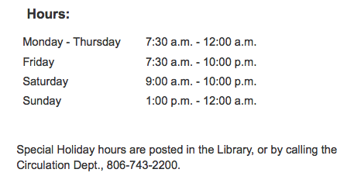
Library Hours
Phone: 806-743-2200
Holiday hours and early closings are also posted as announcements in your e-Raider portal.
Notes:
Here are the normal hours of operation for the Lubbock library. Any special holiday hours or early closing announcements are posted within the library itself and in the announcement section of your eRaider portal. Of course, you can always call the library at the number shown on this slide.

Slide 5
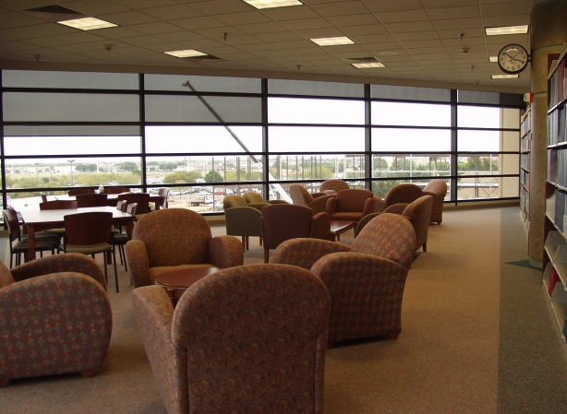

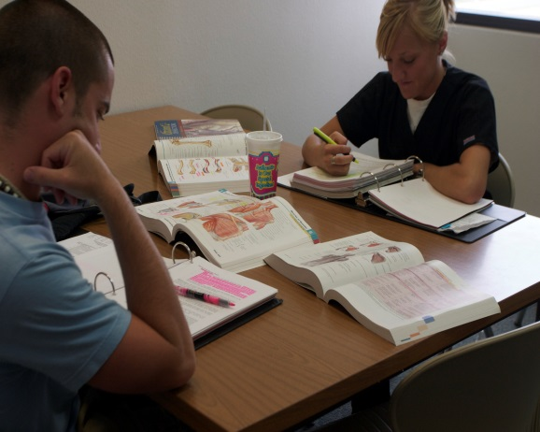
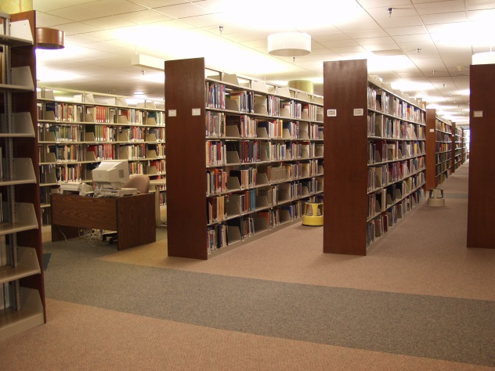
Library Facilities
29 study rooms
All rooms are first come, first serve.
Each room has a dry erase board, markers, and plenty of outlets!
Wireless internet
Notes:
The Lubbock library has a total of 29 study rooms. They are located on the 2nd floor, within the Learning Resource Center, also on the 2nd floor, and on the 3rd floor. There is no reservation system for these rooms; all of them are available to groups or individuals on a “first come, first serve” basis. Each room has a dry erase board and markers as well as wireless or physical internet connectivity.

Slide 6


Library Facilities Cont.’d.
Food and drink allowed!
Notes:
Food and drink are allowed at the Lubbock library! Feel free to bring a lunch, a snack, or your morning coffee to sustain you through your study session!

Slide 7
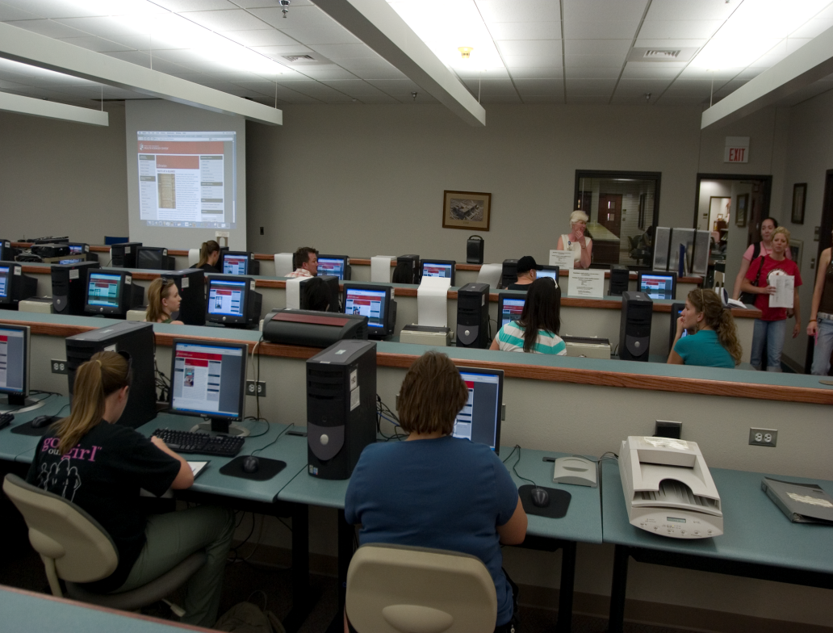
Learning Resource Center
Located on the 2nd floor of the library
Requires a library card
Check out computer stations, anatomical models, and more!
Notes:
The Learning Resource Center is located on the 2nd floor of the Lubbock library. Here, you can check out the library’s audiovisual materials, anatomical models, and computer stations. These materials, including the computer stations, require a library card in order to be checked out. Drinks only are allowed in the Learning Resource Center.

Slide 8
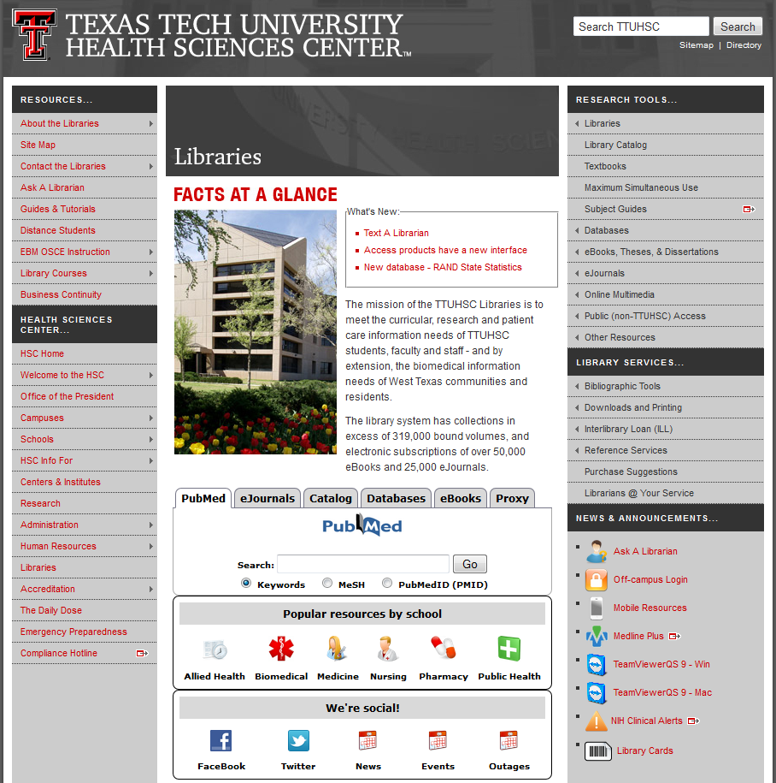
TTUHSC Libraries’ Website
www.ttuhsc.edu/libraries
Notes:
This is the library website, along with the URL address. I recommend bookmarking this page to help you access our resources quickly and easily. Because our resources require you to log in from off campus, it’s best to bookmark the main page rather than any specific resource.

Slide 9
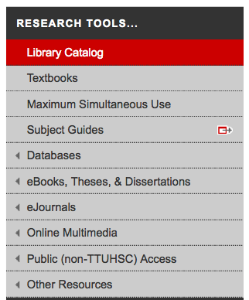
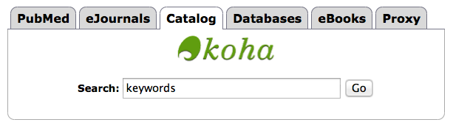
Library Catalog
Two points of access
Notes:
From the library website, there are two points of entry to the catalog. You can select “Catalog” from the toolbar on the right side of the page, or you can choose “Catalog” from the tabs in the middle of the page and either click on the green “Koha” logo or begin a keyword search from the box provided.

Slide 10
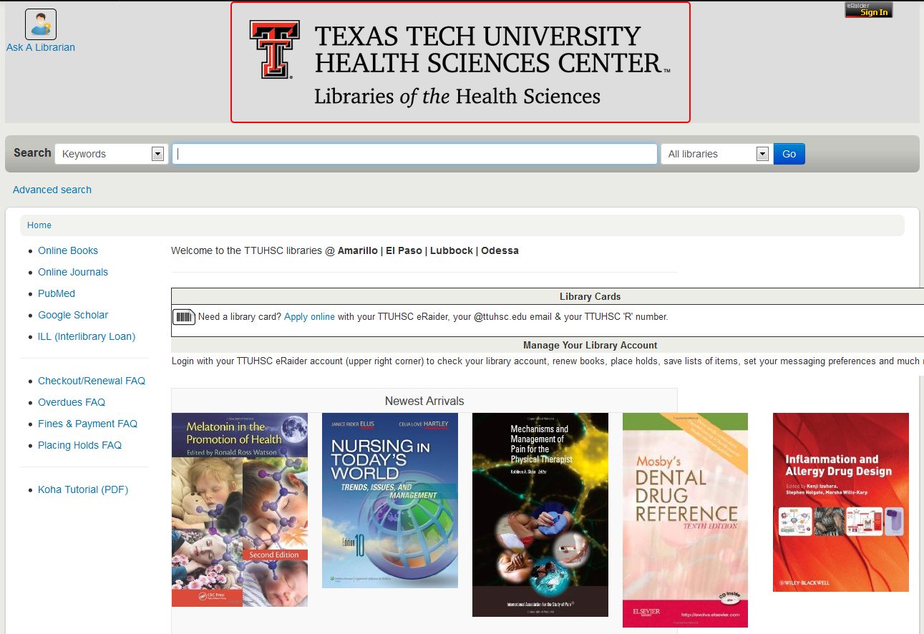


Sign in for your account information
Notes:
The is the main catalog page. From here, you can search the libraries at all our branches for the book that you need. We are also in the process of adding e-books to the catalog in the hopes of making the catalog the main searching tool for all books. In the upper right of the screen is an eRaider sign in button. Click and sign in with your eRaider username and password to access your library account. You can see when your materials are due, if you have any fines, and even renew the materials you have checked out.

Slide 11
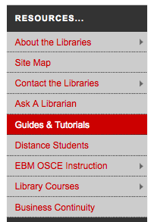
Guides and Tutorials
Online
step-by-step
guides
Notes:
Another place I’d like to point out is our “Guides and Tutorials” page. It’s located in the upper left corner of the library website in the section labeled “Resources”.

Slide 12
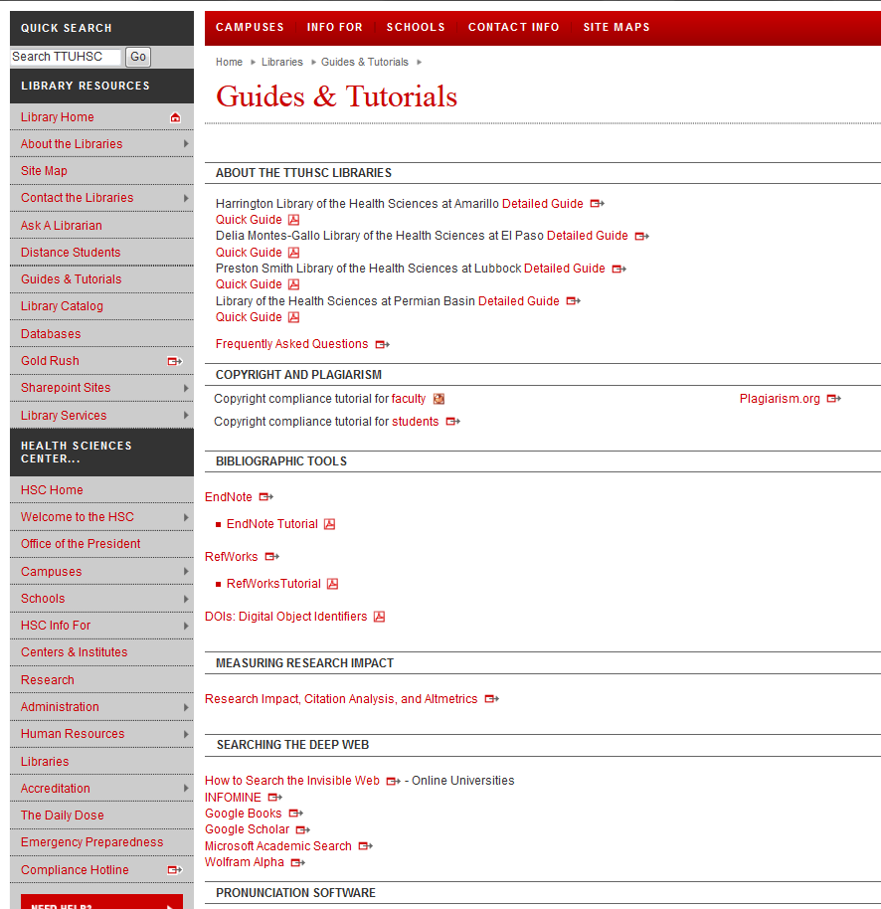
Scroll down to see additional tutorials
Notes:
Here is the “Guides and Tutorials” page. You’ll notice we have guides to all the branch libraries. If you plan to visit any of our branch libraries, this would be a good place to look up the library’s hours and policies before you go. Scrolling down the page will take you to helpful tutorials on our more popular databases and online resources.

Slide 13
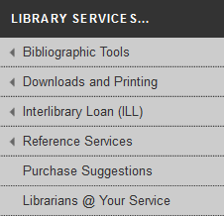

APA Help
Notes:
Are you writing a paper and need help with APA format? We can’t tell you exactly how to cite your paper, but we do have a compilation of tools and websites to help you. In the middle of the left column of the library website, mouse over “Bibliographic Tools”, then click on “More”.

Slide 14
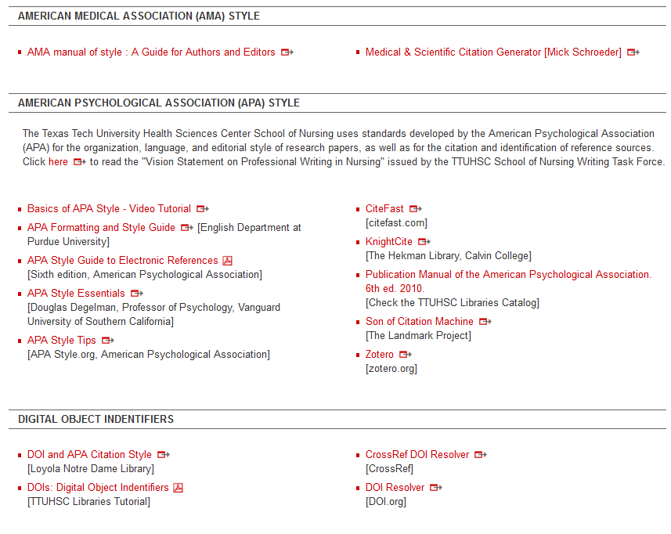
Notes:
Towards the middle of the “Bibliographic Tools” page is this information regarding APA. Here, we have online style manuals, various guides and tutorials, and a few online citation generator tools to help you format your citations.

Slide 15
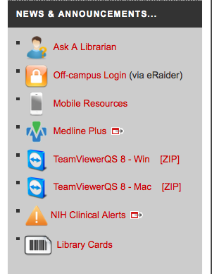
Ask A Librarian
Notes:
If you have a question or need assistance, please don’t hesitate to contact us through our “Ask A Librarian” service. The best way to access this is through the link on the lower right side of the library website.

Slide 16
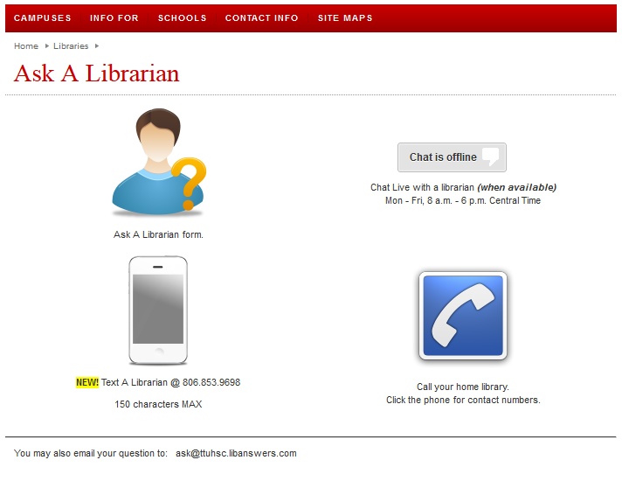

Notes:
From here, there are several ways to contact us. You can submit your question through our Ask A Librarian e-mail form, call the library nearest you, or chat online with a librarian. You now also have the option of texting your question and receiving a text in response. Both the e-mails and texts received are sent to each librarian in all branches of the Health Sciences Center, so you can be assured that your question will be answered in a timely manner.

Slide 17
Team Viewer
Notes:
Another option for receiving additional help from the library is through Team Viewer. Team Viewer is a program that allows the librarian to view your computer desktop remotely in order to help you with your research and other questions in real time. This program is located on the lower right side of the library website. Download options are available for both Windows and Mac systems.

Slide 18
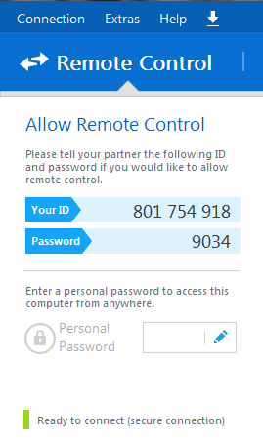
Give your ID and password to a librarian on the phone
We will be able to remotely control your desktop—we will see what you see as well as move your mouse, etc.
Please make an appointment in order to ensure plenty of time to work on your problem!
Notes:
Once you’ve downloaded Team Viewer, an I.D. and password is shown. Give these to a librarian over the phone to allow remote control of your desktop. We will be able to see anything on your screen as well as move your computer’s mouse and click on links. It’s the next best thing to having a librarian at your side! In order to get the most from this service, please call and schedule an appointment in advance. This ensures that there is plenty of time to address your questions.

Slide 19
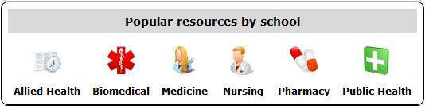
Resources just for you!
Notes:
The library has resources just for you! Starting at the library website, find the tab in the middle of the page labeled “Popular resources by school”. From there, click on the icon labeled “Nursing”.

Slide 20
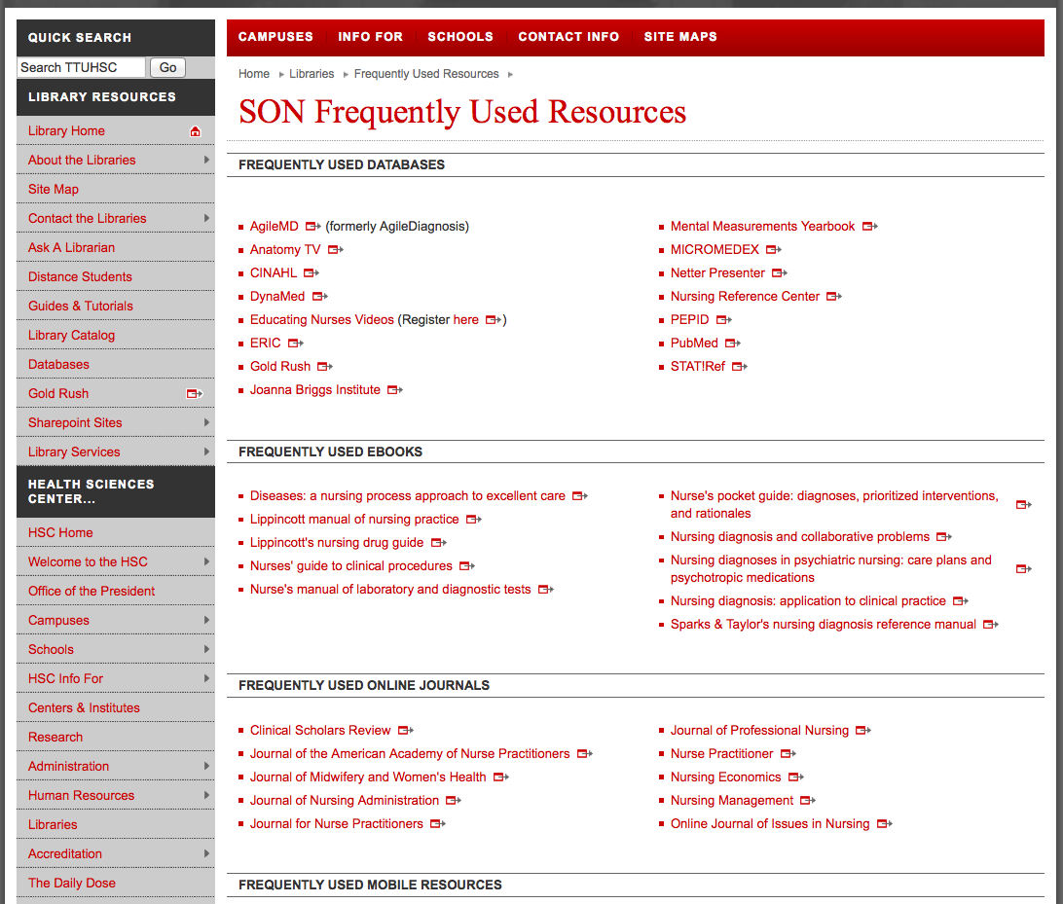
Notes:
This is a list of resources that the School of Nursing faculty has deemed the most important and helpful to their students, although it is by no means a comprehensive list of the resources available to you. It is a great place to start when conducting research for an assignment.

Slide 21
Database Searching 101
Get the Results You Want!
Notes:
In this section, I will be going through helpful tips on searching some of the databases that I will show you later in this presentation. While these databases are extremely useful and will be a great help in your studies, they are not as simple as Google, and searching them successfully requires a good search strategy.

Slide 22
Terms from a Question
Entering a whole question into a database doesn’t work
Use 2-3 words rather than a whole or partial sentence
How do I prevent medication errors in the hospital?
medication errors
hospital
Notes:
Let’s start with extracting search terms from a question. When searching online databases, you might find that entering a question into the search box verbatim doesn’t work. The reason for this is that when you enter a group of words into the search box, the database will search for every single word separately – even the words “and” and “the”! The best way to enter your research question into a database is to examine the question you want to ask and determine two or three words or phrases that best encompass your research topic. For example, if your research question is “how do I prevent medication errors in the hospital?”, you might just want to search “medication errors” and “hospital”.

Slide 23
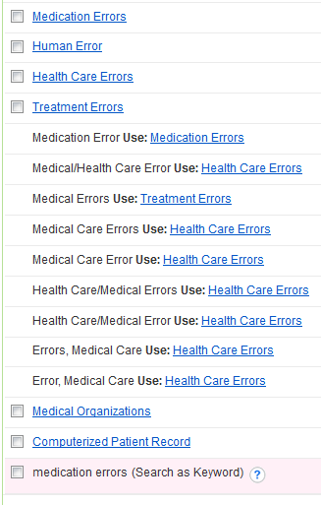
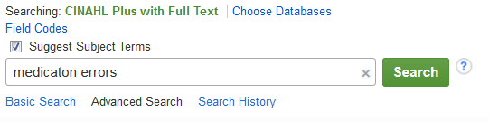
Subject Headings
Notes:
Once you’ve determined which specific words you would like to use to conduct your search, you’re ready to enter them into the database. But wait! Some databases, like CINAHL, have something called subject headings. When you search using your chosen words, the database will give you a list of other terms to choose from. What are these subject headings? Should you use them? How are these different from just searching with the words you chose earlier?

Slide 24
Subject Headings
Subject Headings act as a thesaurus for the database—it’s how the articles are indexed.
Helps clear up any issue with synonyms, making sure you find articles related to a concept, not just a term.
Search the database using terms it is programmed to understand.
Notes:
Subject Headings act like a thesaurus for the database. When articles are added to the database’s collection, they are indexed according to this list of terms. These subject headings also encompass known synonyms, for example, “Heart Attack” will also search for articles that use “Myocardial Infarction” instead. Using these subject headings allows you to search the database with terms it is programmed to understand. Think of it as “speaking the database’s language” in order to get the results you want.

Slide 25

Keywords
Keyword search will look for your word everywhere
Only the entered term is searched; synonyms are excluded
Notes:
As I’ve mentioned previously, searching for a term in the search box, without using any subject headings (also known as a keyword search), will search for that word; however, it will search for that word anywhere it’s found within the citations stored in the database. This means that the search results you find may have your word in the article title, journal title, anywhere in the abstract, even as part of an author’s name. Another point to consider is that keyword searches will only look for the specific word you entered, often leaving out any synonyms. Bottom line: if they’re available within the database, subject headings are best.

Slide 26
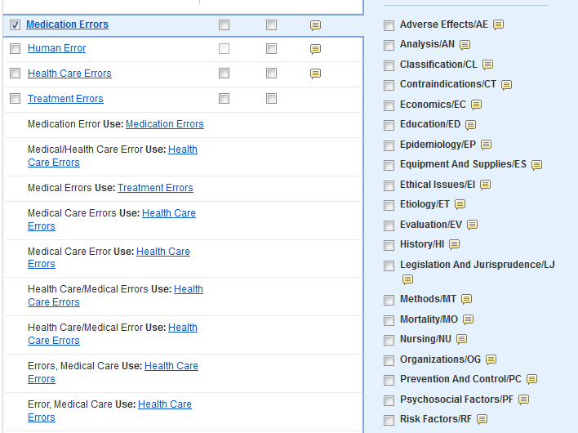

Subheadings
Subheadings act as a facet of subject headings
Narrow a broad subject heading to get more specific results
Notes:
In databases with subject headings, selecting a subject heading will allow you to choose a subheading associated with the term. What does that mean? Think of subheadings as different facets of the subject heading you’ve chosen. For example, one of the terms from our sample question is “medication errors”, but we want to know how to prevent them. Notice there is a subheading called “prevention and control”. This is a great way to narrow a broad topic and achieve more relevant search results.

Slide 27

Boolean Operators
NOT excludes a term from the search
AND searches both terms together
OR searches both terms separately
Notes:
Once you’ve chosen your subject headings and any subheadings you want, many databases will give you the opportunity to search using “AND”, “OR”, or “NOT”. These are called Boolean operators. The operator “NOT” excludes a term or concept from a search. In contrast, “AND” searches both terms together, while “OR” searches both terms separately. What exactly does that mean?

Slide 28
AND vs. OR
hospitals
medication
errors
AND
OR
Notes:
Here is a visual aid that might best illustrate the distinction between the Boolean operators “AND” and “OR”. Think of our two search terms as part of a Venn Diagram. Combining the two with “AND” will only produce those results where both terms are indexed. Combining the two with “OR” will produce the same results as “AND”. However, since it is searching for each term separately, it will also produce results dealing exclusively with one term or the other.

Slide 29
General Searching Tips
Start with a broad search, then narrow it as needed
  This ensures that you don’t miss potentially relevant results
Search each term separately, then combine them later
  This allows you to alter your strategy if your initial search doesn’t work
Notes:
Now that we’ve gone over specific concepts to help improve your search strategy, here are a few general searching tips to help you with your research: First, it’s always best to start with a broad search, then narrow it down further if you get too many results. This is helpful especially if you’re not sure how much information can be found on your topic. If you start with a search strategy that’s too narrow, you might miss some information that might be useful to you. Another tip is to search for each of your terms separately, then combine them in either the advanced search or search history section of the database. While it might seem like extra work, this is helpful in case your initial search strategy is unsuccessful. If your first combination of terms yields results that are unsatisfying (or produces no results at all), searching terms separately will make it easier to go back and combine some of your old terms with new ones. You only have to slightly tweak the work you did the first time, not do it all over again.

Slide 30

More General Tips
Don’t be afraid to hunt for the subject heading you need
  Try looking for it under a different name/synonym
  The more you search, the easier it will be!
Have fun!
Notes:
Don’t be afraid to play around with the terms or subject headings available to find the one that best suits your needs. Another thing to remember is that sometimes the subject heading used by the database might be different that the term you use in everyday life. If you can’t find a subject heading to match what you’re looking for, try looking for your term or concept under a different name, if it has one. And lastly, try to have fun! Once you understand how database searching works, the whole process becomes much easier and less overwhelming. If you work with the database, it will work with you! This concludes this presentation. Please continue to the next presentation, called “Databases”. Thank you!

Slide 31
Useful Databases
Finding Evidence-Based Information
Notes:
Here are some useful databases that will help you with this assignment in particular and your studies in general. I’ll be going through three databases: CINAHL, Nursing Reference Center Plus, and PubMed Clinical Queries. In addition, I’ll also go over the basics of using Gold Rush to find articles in the library’s holdings with its citation information and briefly discuss our Interlibrary Loan service.

Slide 32
CINAHL
Cumulative Index to Nursing and Allied Health Literature
4+ million records
Subject coverage: Nursing and 14 Allied Health specialties
Evidence-based Care Sheets and Research Instruments available
Coverage back to 1937
Notes:
The first and most important database we’ll visit is called CINAHL. The name stands for “Cumulative Index to Nursing and Allied Health Literature”. It has over 4 million records on nursing and 14 different allied health disciplines, with coverage going back as far as 1937.

Slide 33
Notes:
The best way to access it is through the “Nursing” Popular Resources page, found in the middle of the library website.

Slide 34
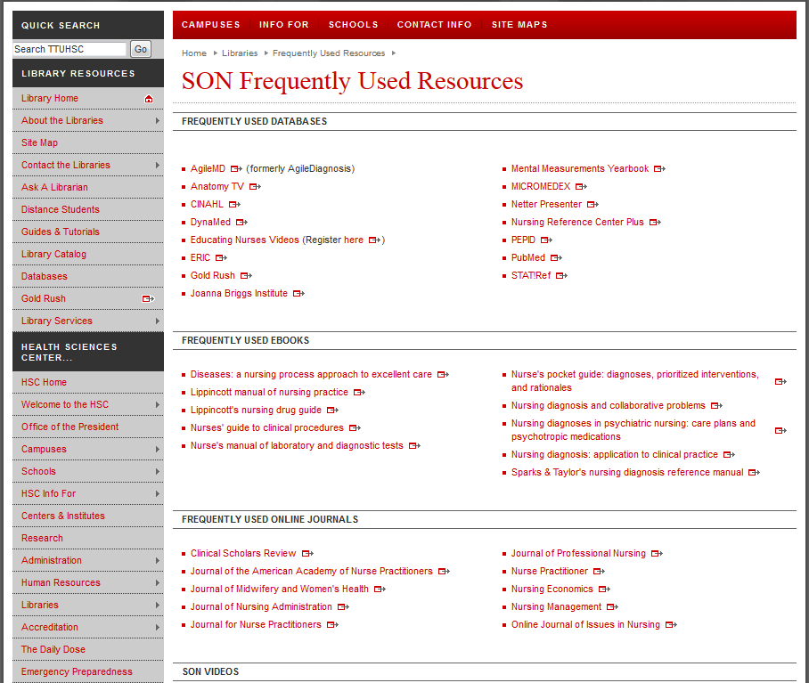
Notes:
CINAHL will be under “Frequently Used Databases”.

Slide 35
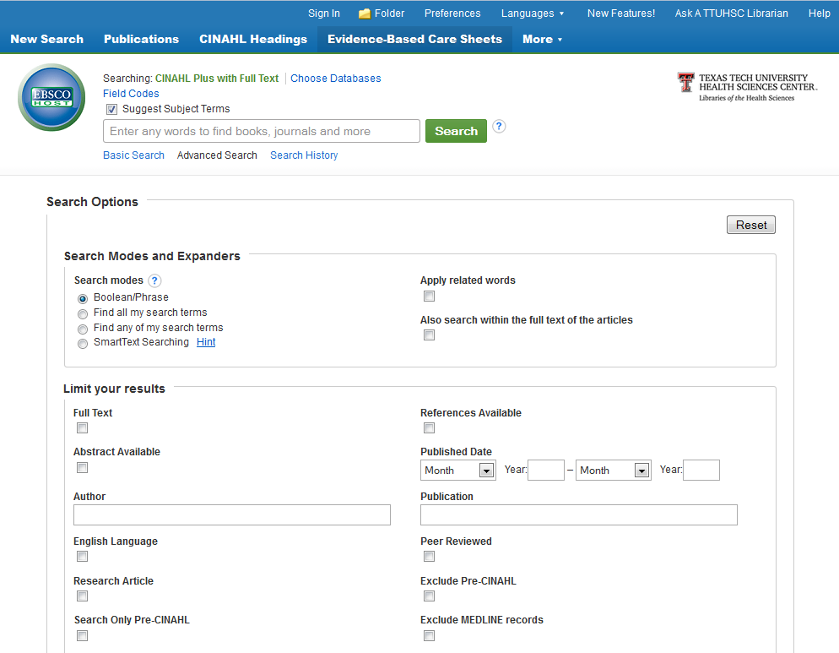
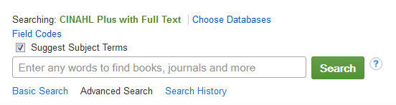
heart attack
Notes:
This is the CINAHL start page. The search box is located at the top of the page. You’ll notice that there is an option called “Suggest Subject Terms” that’s automatically checked. This will search CINAHL’s Subject Headings, a concept we discussed earlier. As an example, let’s search for articles about aspirin and heart attacks. We’ll start with the first part of the search, “heart attack”.

Slide 36
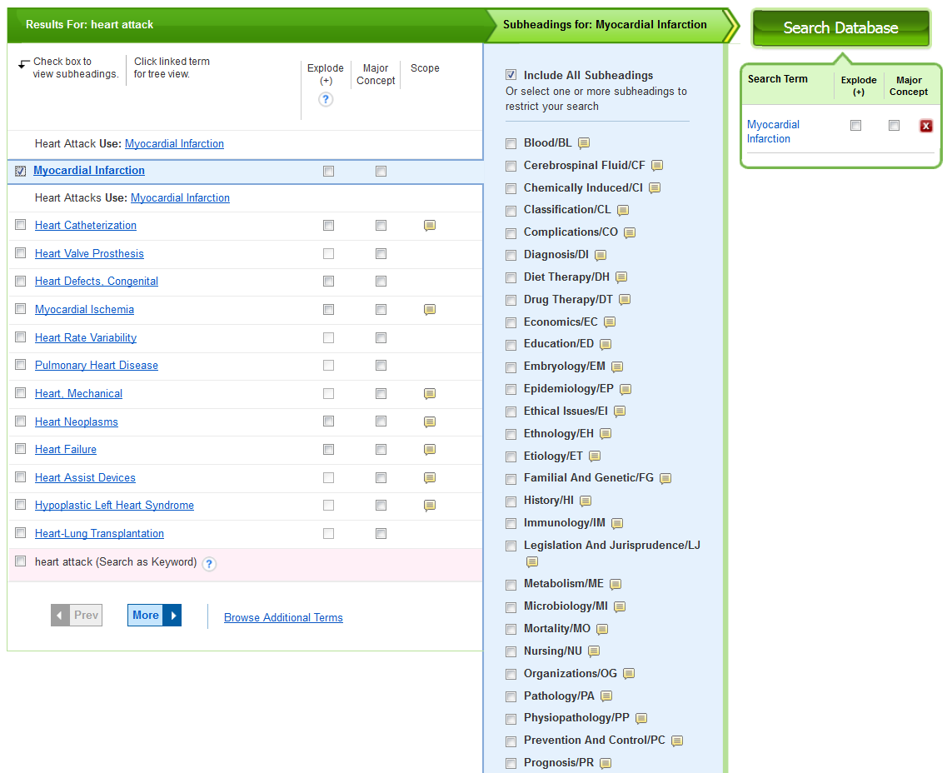
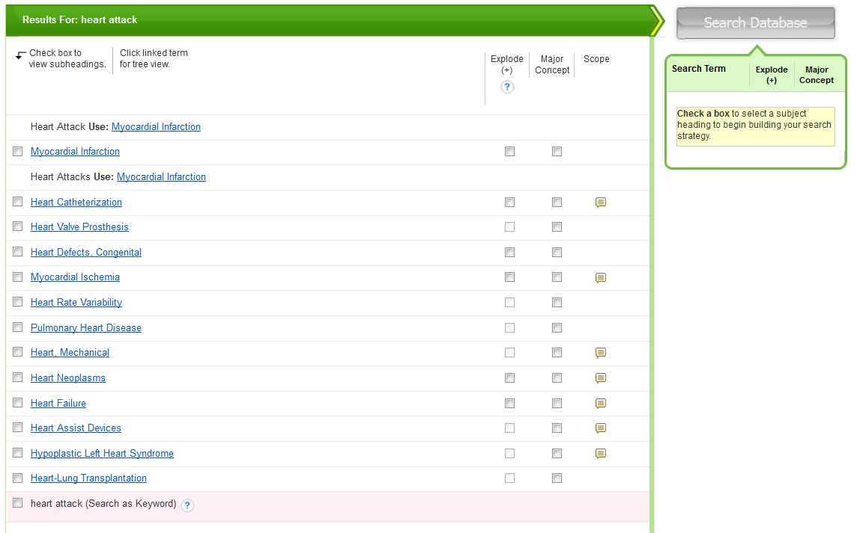
Notes:
CINAHL will give you a list of possible subject headings based on the words you searched. Notice that it corrected me and told me to use “Myocardial Infarction” instead of “Heart Attack”. This is a great example of how subject headings encompass synonyms and search for a whole concept, rather than just the words you enter. Check the box next to the term that best matches what you’re looking for, and a list of subheadings will appear. You can check the boxes next to the ones you want, or not choose any at all. Not choosing any by default will tell the database to search for all of them. This helps you collect all the information that exists in the database about your specific topic. When you’re finished making your selections, click the green button that says “Search Database”.

Slide 37
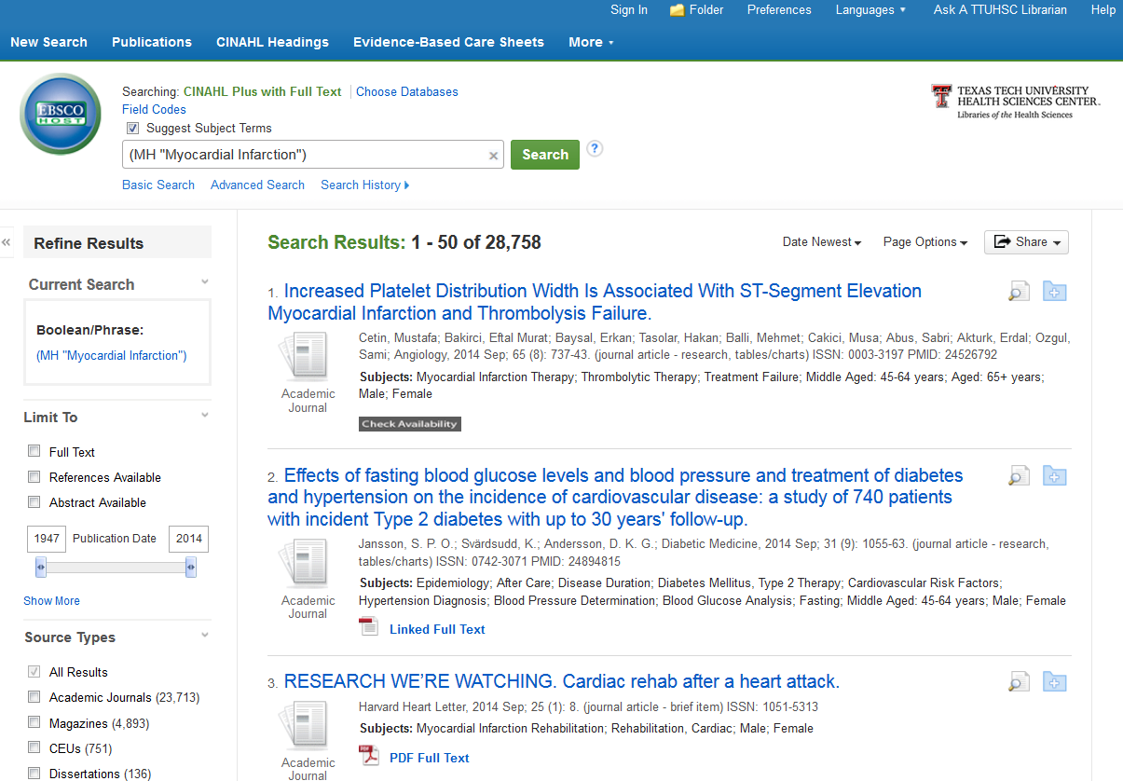
aspirin
Notes:
These results are for “heart attack” only. We still need to search for the second part of our topic, then combine them. Clear the search bar and put in “aspirin”.

Slide 38
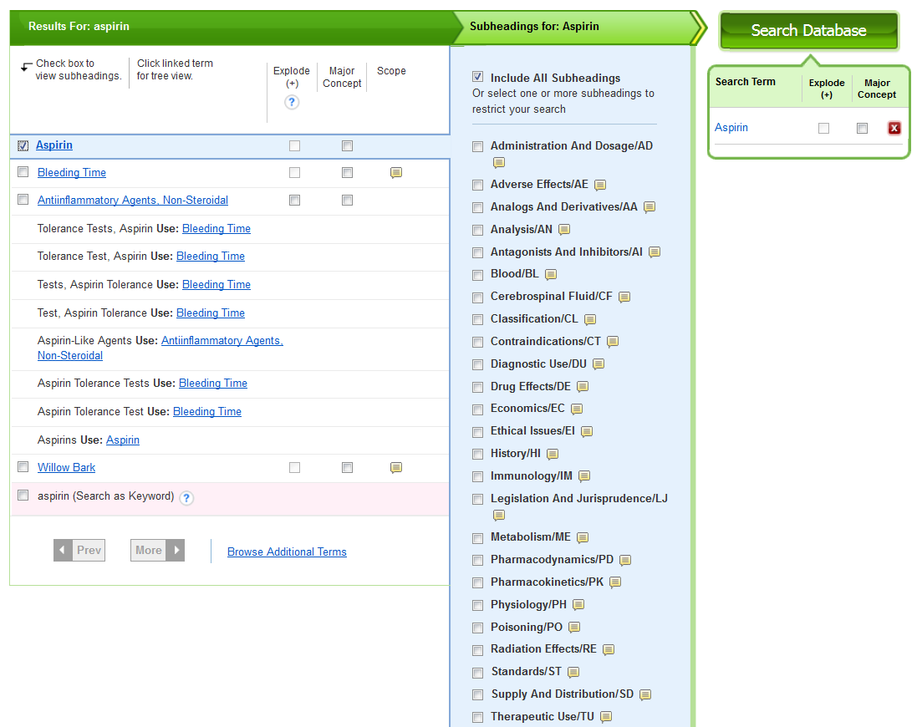
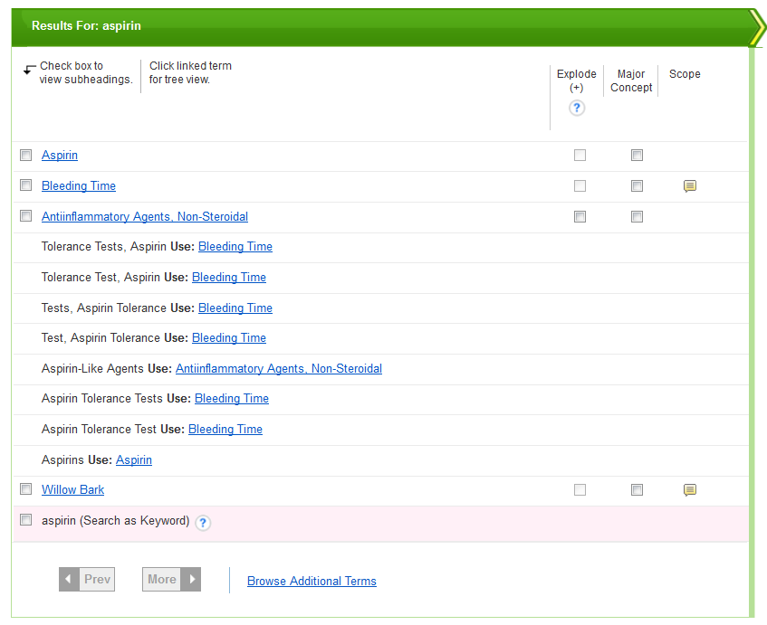
Notes:
Again, follow the same steps as before. Select the subject heading you want, any subheadings, then click “Search Database”.

Slide 39
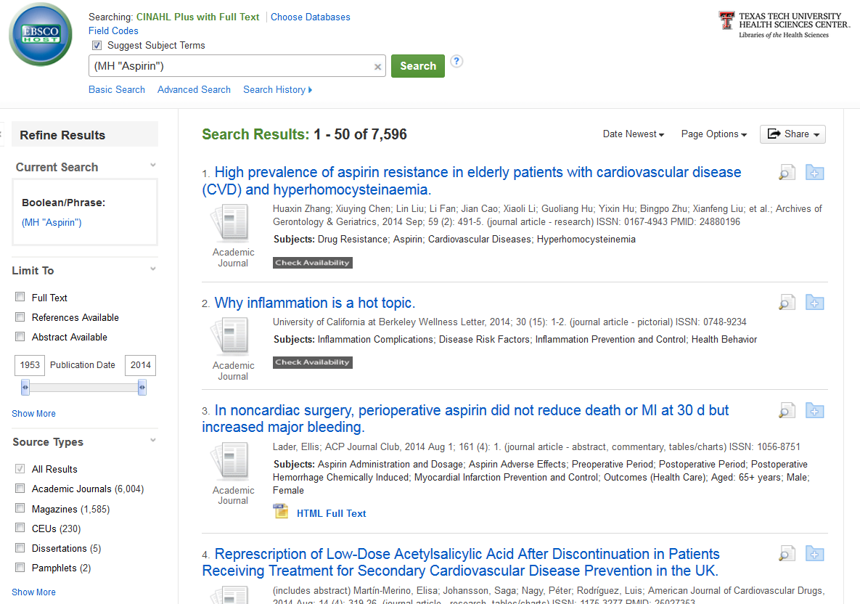
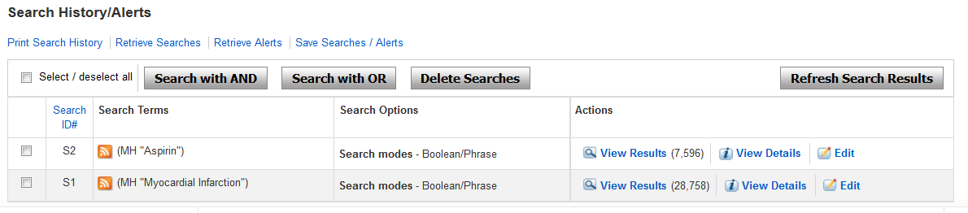
Notes:
These results now are only for “aspirin”. To combine them, clear the search box again, and this time, click “Search History”. You’ll see the two searches you just performed. Check the boxes next to the searches, then choose “Search with AND”. Notice that CINAHL gives you the option of searching with the Boolean operators “AND” or “OR” that we discussed earlier.

Slide 40

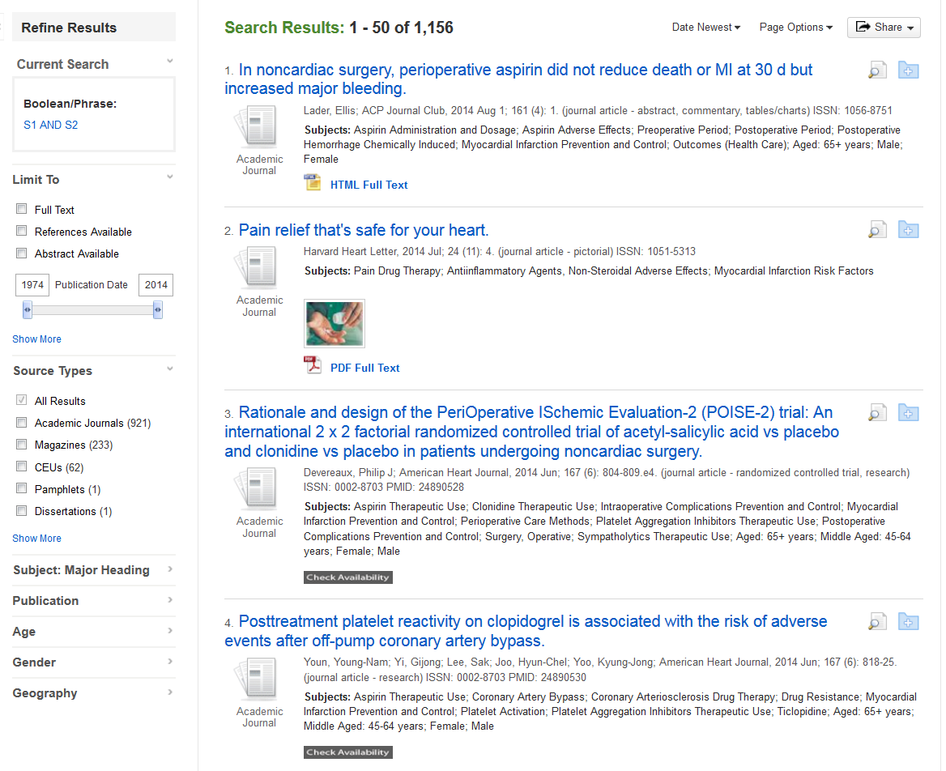
Notes:
Here now are your combined results. To the left is the filter sidebar, where you can limit the results to Year, Age, Geography (if you only want results pertaining to the U.S.), and more. Beneath each article title is the full text availability option. The gray “Check Availability” button will search the TTUHSC library holdings for your article, either online or in print. Seeing that button doesn’t automatically mean that your article isn’t available, it just might be available elsewhere. To the right of the title are two icons. The magnifying glass allows you to view the abstract of the article, and the folder allows you to add the article citation to a folder in CINAHL. From there, you can e-mail or export the information you’ve found.

Slide 41
Notes:
The next database we’ll look at is Nursing Reference Center Plus. It is located on the same page as CINAHL.

Slide 42
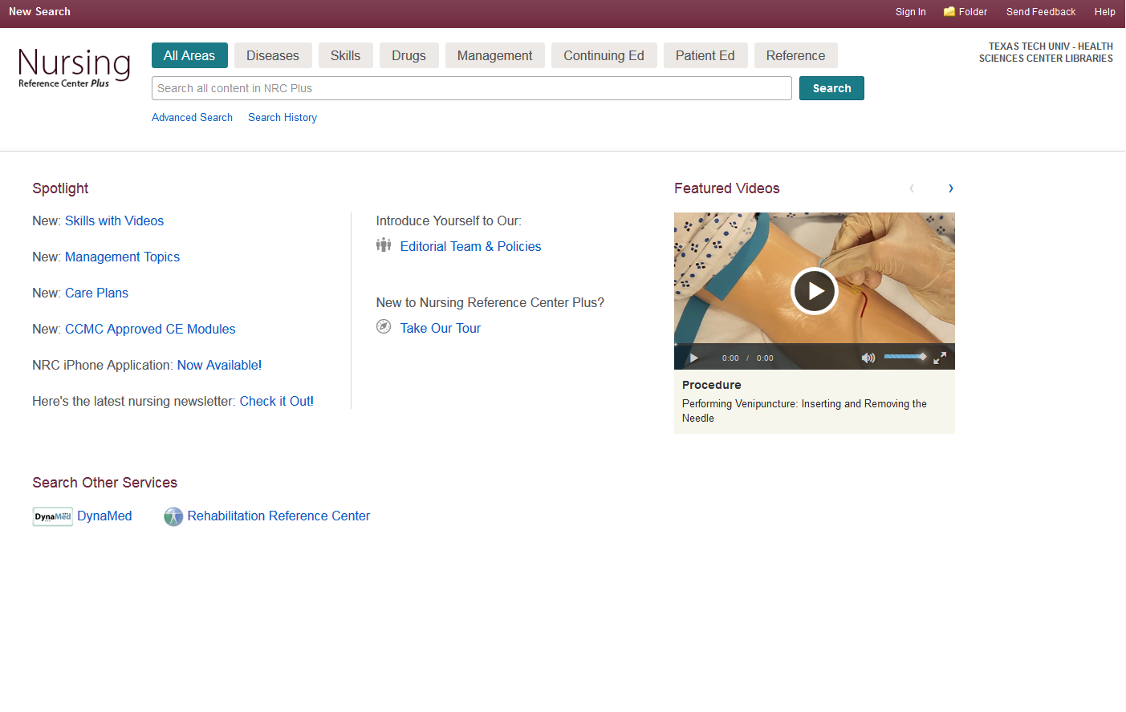
heart attack
Notes:
This is the Nursing Reference Center Plus start page. At the top, you’ll notice that in addition to a basic and advanced search option, there are tabs for Diseases, Skills, which features guides and videos of different procedures, Drugs, Continuing Education, Patient Education, and Reference. You’ll notice also that the start page has featured educational videos, as well as links to other resources like DynaMed and Rehabilitation Reference Center. Let’s continue with our previous search and look up “heart attack”, without clicking on any of the tabs at the top of the page.

Slide 43
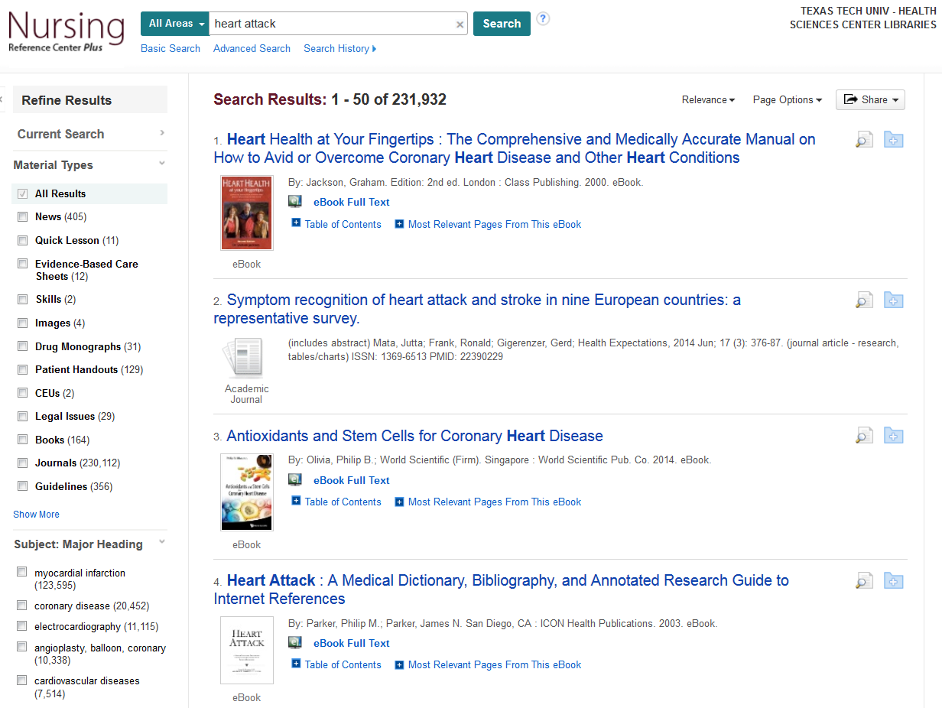
Notes:
This is the result page for everything Nursing Reference Center Plus has on “heart attack”, and it’s a lot! But, to the left of the results, you have the option of limiting the results to only the specific material types that interest you, such as guidelines, patient handouts, journals, etc. One material type unique to Nursing Reference Center Plus that I’d like to highlight is “Evidence-Based Care Sheet”. Check the box next to it to see them all.

Slide 44
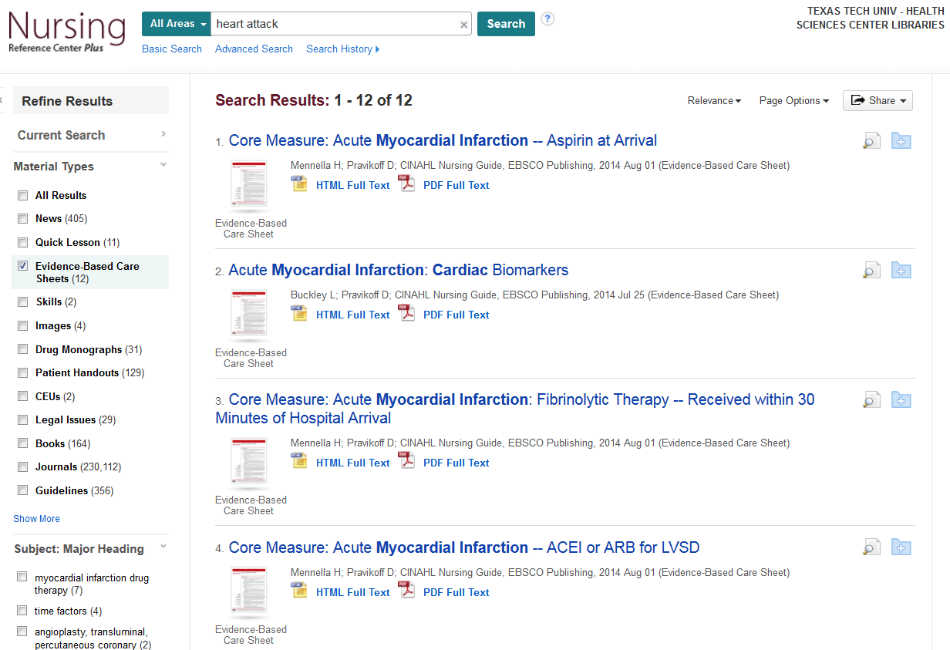
Notes:
These are the Evidence-Based Care sheets available that deal with “heart attack”. To see an example of what one looks like, click on the title of the first result.

Slide 45
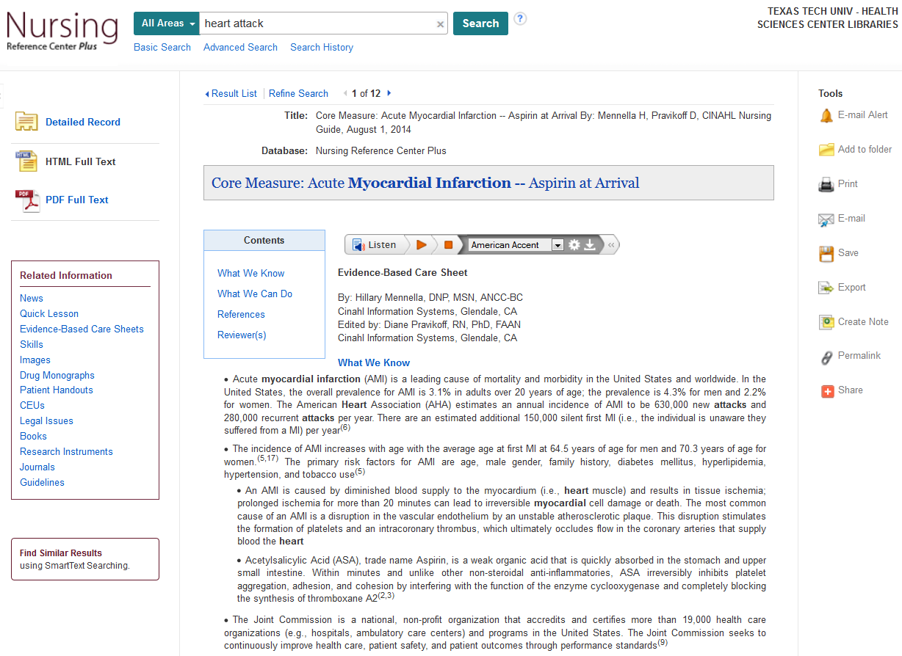
Notes:
This is what an Evidence-Based Care Sheet looks like in Nursing Reference Center Plus. To the left of the information, there is an option to go directly to the section of the care sheet that you want, and links to related information beyond that. To the right are links that will allow you to print, save, e-mail, or export this sheet. Above the grey title box is the Care Sheet’s citation information, and below it is the option to listen to the information, even in a variety of accents. One special aspect of these Care Sheets that I’d like to point out is in the References section. Click on the link in the blue “Contents” box.

Slide 46

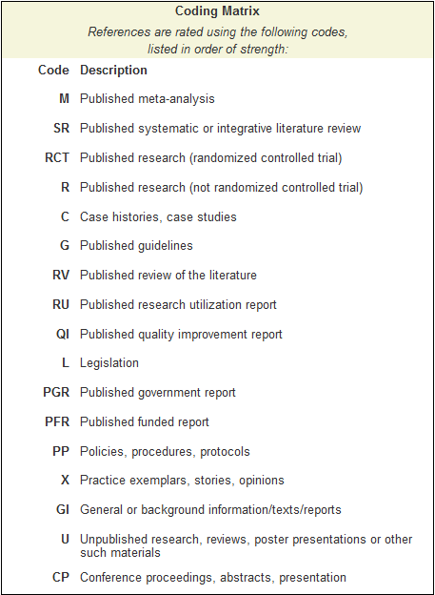
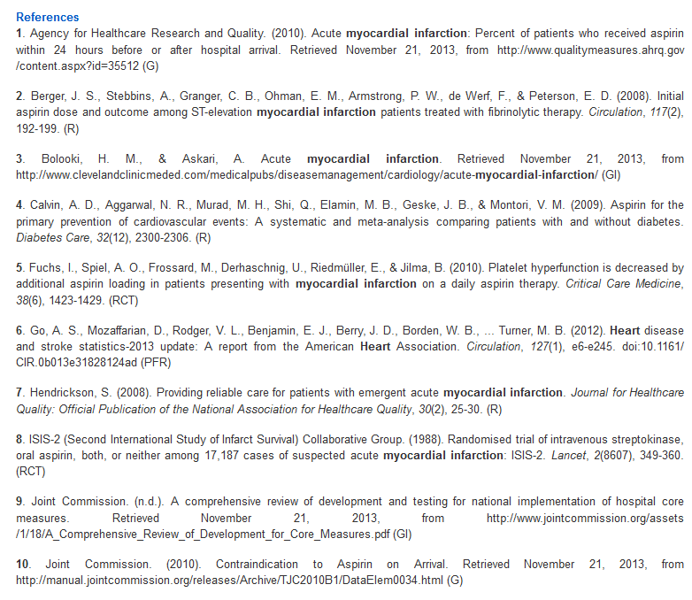
Notes:
This is the list of references for this care sheet. Notice that the references have letters in parentheses next to them. Some have a “G”, “R”, “RCT”, etc. What are these, and what do they mean? Below the references is a “Coding Matrix” with a key to the letters, as well as their ranking in the levels of evidence. For example, reference #5 is labeled “RCT”. According to the matrix, that stands for “Randomized Controlled Trial”, and since it’s the third from the top of the matrix, it means the level of evidence is strong. This would be a good place to find a few evidence-based references as a jumping-off point for research assignments. Now, scroll back up to the top of the page and click on the “Nursing Reference Center Plus” icon. From the main starting page, click on “Diseases”.

Slide 47
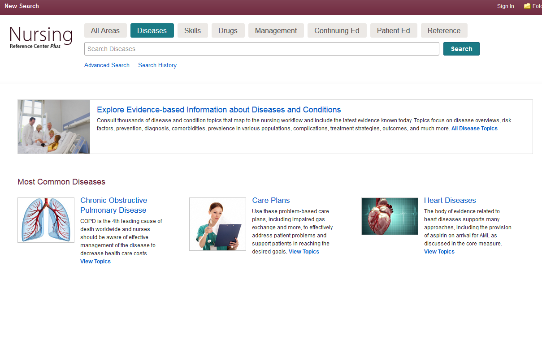
parkinson‘s disease
Notes:
This is the main page for diseases. Here, you have the option to “Explore Evidence-based Information about Diseases and Conditions”, but Nursing Reference Center Plus works better if you search for something specific, rather than browse. So, as an example, let’s search the Diseases section for “Parkinson’s Disease”.

Slide 48
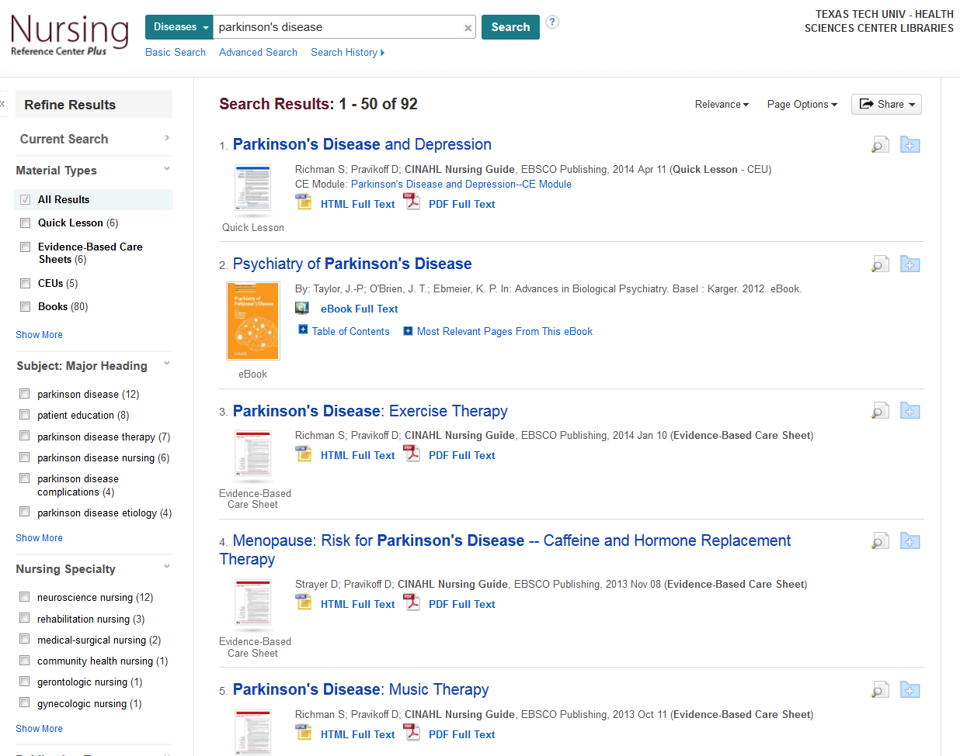
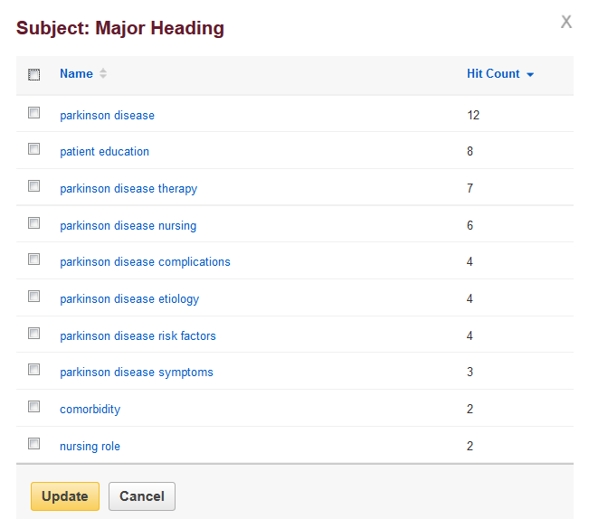
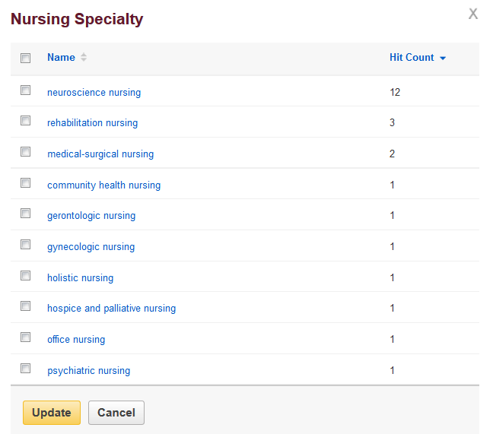
Notes:
This is the information available on “Parkinson’s Disease”. Notice that on the left, along with the material types filter we discussed earlier, you also have the option of filtering according to “Major Heading” or “Nursing Specialty”. “Major Heading” allows you to filter these results down to focus on complications, risk factors, therapy, etc. “Nursing Specialty” allows you to filter the results to only the ones concerning neuroscience nursing, hospice and palliative nursing, etc.

Slide 49
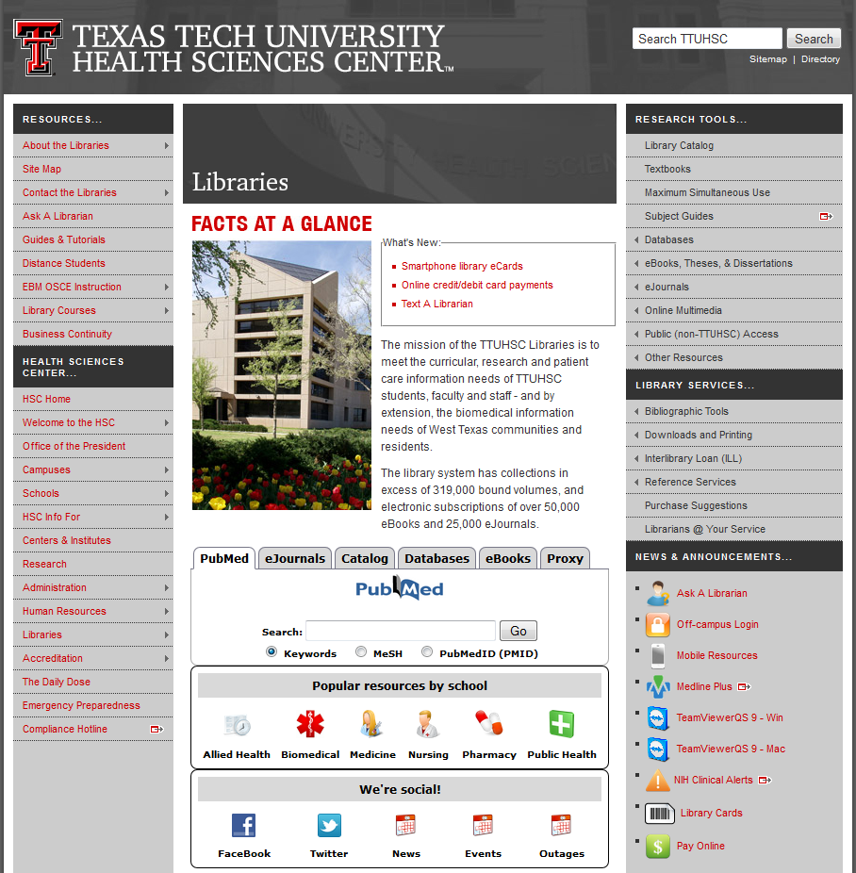
Notes:
The last database tool we’ll be looking at is PubMed Clinical Queries. The easiest way to access this is through the library website. In the middle of the page, under “Facts at a Glance”, there are a series of tabs, the first one being labeled “PubMed”. From there, click on the “PubMed” logo.

Slide 50
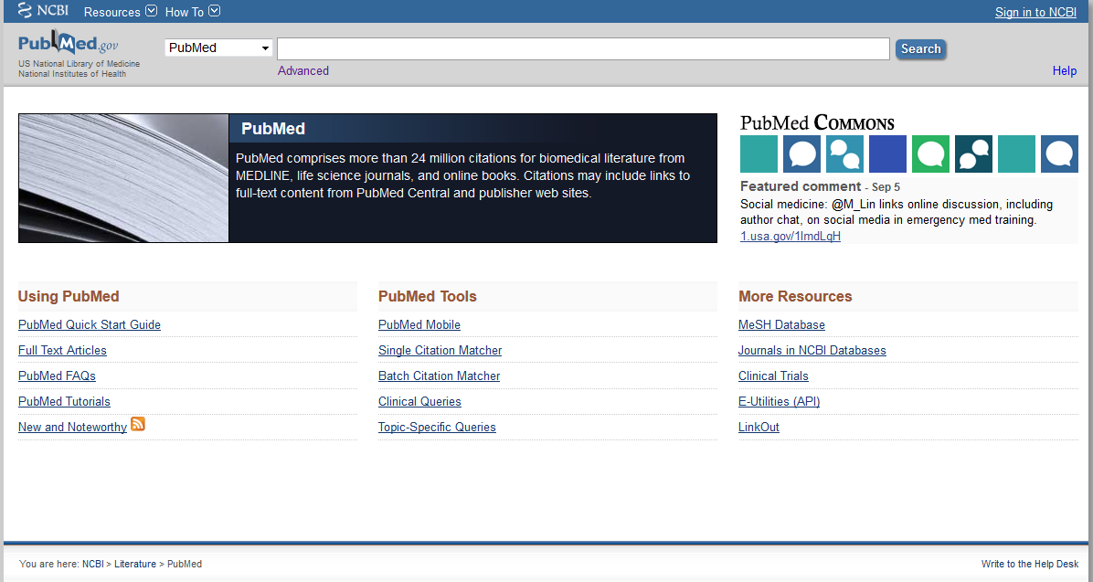
Notes:
This is the PubMed website. From here, “Clinical Queries” is located in the bottom middle of the page, under “PubMed Tools”

Slide 51
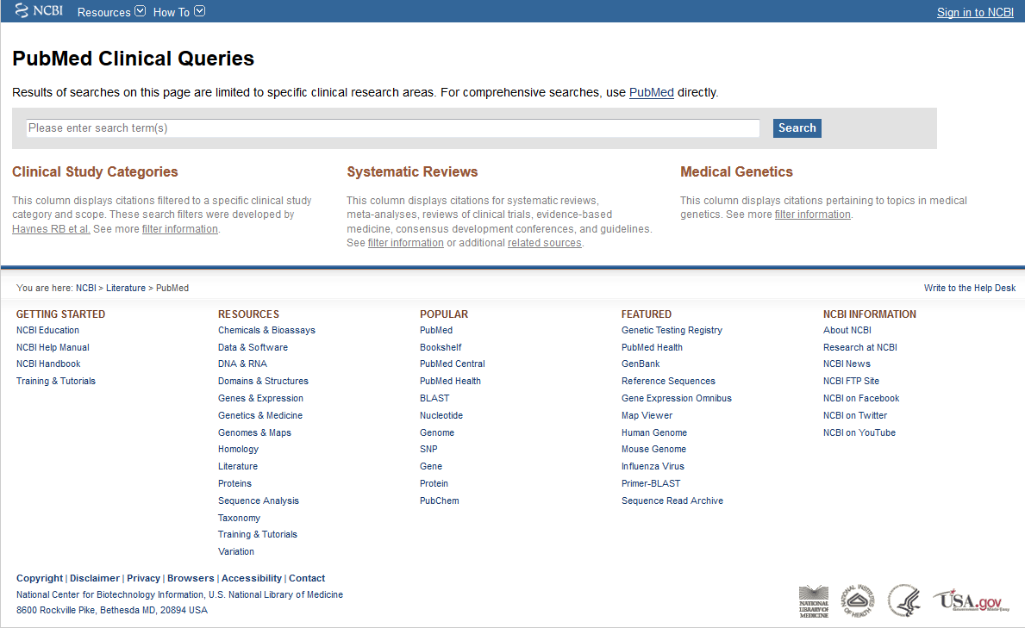
heart attack and aspirin
Notes:
Clinical Queries is a great place to go if you are looking for quality information about a topic, but perhaps don’t have the time to do a lengthy search in CINAHL. Here, you don’t need to search terms separately and combine them, just enter in the basics of what you’re looking for. To use the example running throughout this presentation, let’s search for “heart attack and aspirin”.

Slide 52
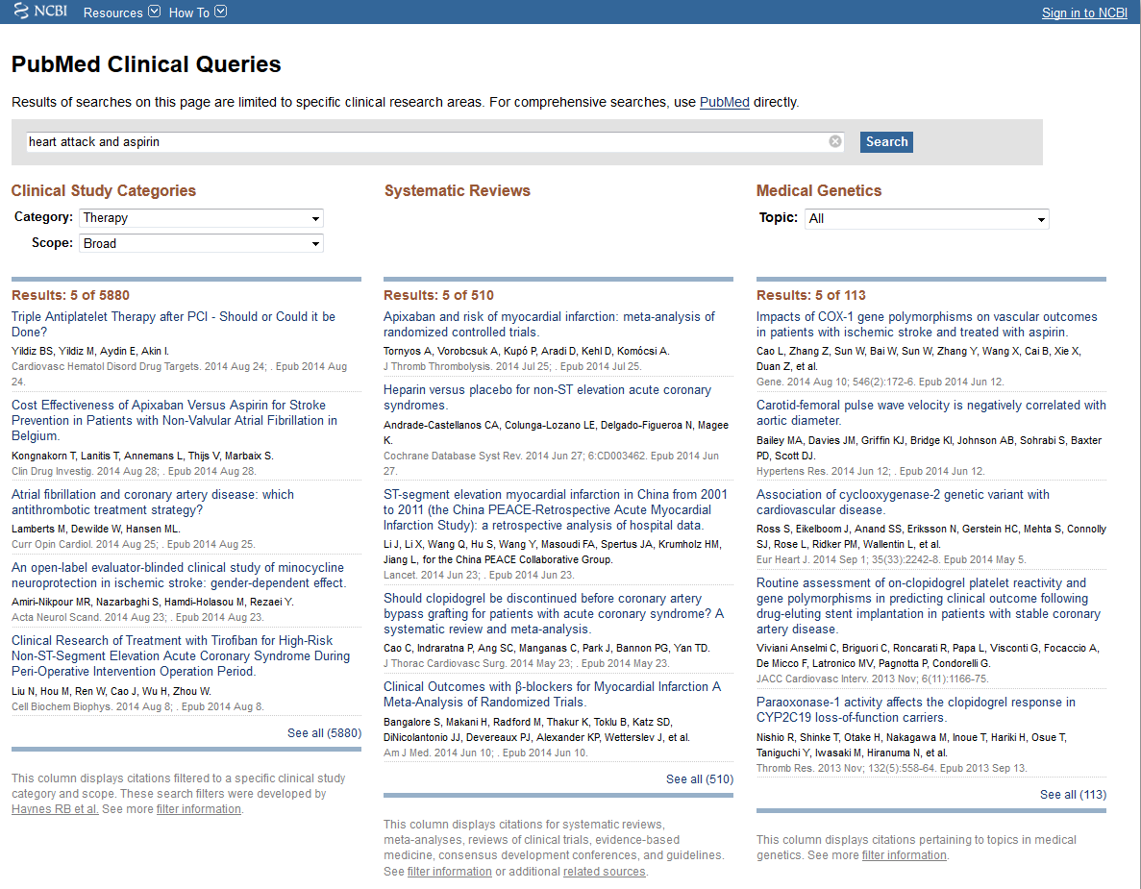



Notes:
These are the results for “heart attack and aspirin”. Notice that the results are separated into three different categories: Clinical Study Categories, Systematic Reviews, and Medical Genetics. Within the Clinical Study Categories, you have the option of changing the category from Therapy to Diagnosis, Etiology, etc. You also have the option of choosing a broad or narrow scope. Notice the difference between Therapy in a broad scope versus a Narrow scope. In the middle section of the results, PubMed has taken your topic and found all of the Systematic Reviews for you. To see all of them, click “See All” at the bottom of the list.

Slide 53
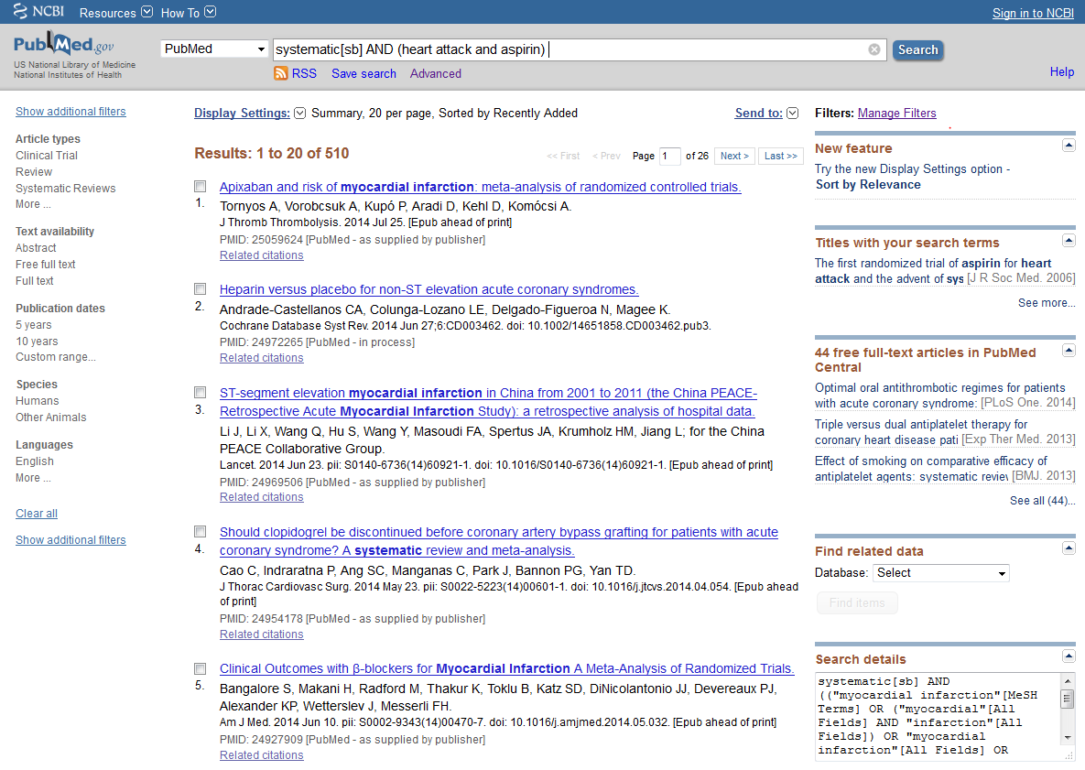
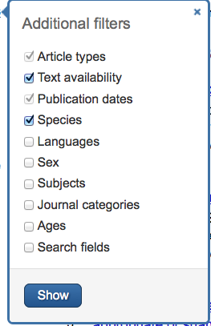
Notes:
Here is the list of all the systematic reviews on our topic. To the left of the results are the filter options. In general, I advise limiting your results in PubMed to “English” and “Humans”, but there are also more filter options found by clicking on “Show additional filters”. Here, you can limit by age and gender as well, if those are relevant to your research subject. When you have chosen the filter options you want, click the blue “Show” button. Please note that clicking the “Show” button doesn’t automatically limit according to what you’ve chosen. It only shows what you’ve chosen in the options on the left of the screen. You have to find the option you’ve chosen and click on it again in order to filter your search results.

Slide 54
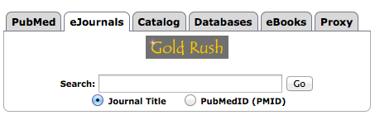
Gold Rush
Notes:
If you have a citation for a journal article and need to see if it’s in the library’s collection (perhaps you found an article with a full text link that didn’t work properly or didn’t have a link at all, and you would like to double check to see if we have it), Gold Rush is the place to go. The fastest way to access it is by selecting “eJournals” from the tabs in the middle of the library website. From here, you can search for the journal title, and now you can search for the article according to its PubMed I.D. number, if your article has one.

Slide 55
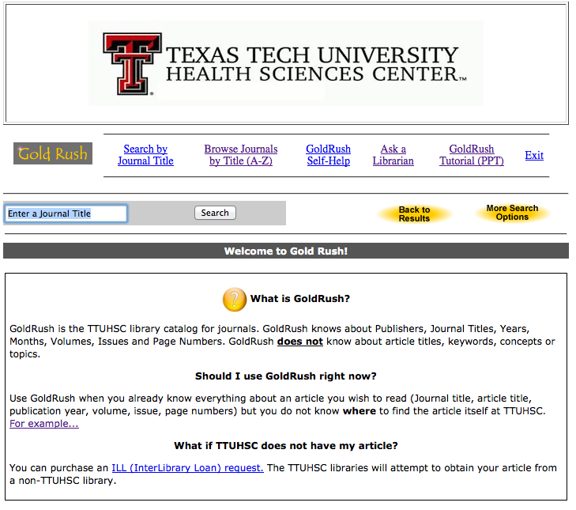
nursing education
Notes:
This is the main Gold Rush page. It includes some additional information about this tool as well as links to tutorials and other helpful resources, including an “Ask A Librarian” link if you need help. To give you an idea of what searching for a journal looks like in Gold Rush, let’s do a search for a journal. You can enter the full title, or just the words you remember. As an example, search for “nursing education”.

Slide 56

Notes:
This is the list of all the journals we have that have the words “nursing education” in them. From the list, choose the exact title you want.

Slide 57

Notes:
The site will then direct you to a page that has some information about the journal, a link to search for it in our print collection, and links to the full text online (when applicable). Notice that this journal has two online options. Some journals have only one and some you encounter might have six or more. How then do you choose which online option to click? The best way is to look at the “Dates Available” information to the right of the online links. Look at the year in which your article was published, then look at the dates available and find one that has the year you need. When you click on an online link, you will then need to find the year, volume, and issue of the journal, then scroll until you find your article. There should be a full text option from there.

Slide 58

Interlibrary Loan (ILL)
Read all about it here!
Notes:
If you need a book or article that is not available at the library, you have the option of ordering it through our Interlibrary Loan system. It’s found on the library website under “Library Services”.

Slide 59
Basic ILL Information
Online ordering form makes submitting requests quick and easy
Response time for requests is anywhere from 2 – 10 business days, depending on location of the item
Books from any TTUHSC branch library are free, all others are $4.00
Journal articles are charged per page, but fees will not exceed $4.00
There is a rush option available, but at a higher fee rate
Notes:
Here is some basic information about our Interlibrary Loan system that will be useful for you to know. For distance students, it is important to note that if you need a book from any TTUHSC branch library, we will ship it to you for free. There is also an online ordering form grouped with the other Interlibrary Loan information on the library website for your convenience.

