Slide 1
Welcome
NURS5326: Research for Advanced Nursing Practice
Module 1 Assignment
TTUHSC - Preston Smith Library
Lubbock, Texas 79430
Sept 2017

Slide 2


When searching library applications, use
Mozilla Firefox, Safari, or Internet Explorer often do not work with library applications.
Plus, Chrome is TTUHSC IT’s supported browser!

Slide 3
If you need help downloading
Go to
http: /ttuhsc.libguides.com/downloading_google_chrome
for instructions!

Slide 4
Definitions of
Primary Research
and
Secondary Sources

Slide 5
Primary sources:
First-hand reports of facts or findings; in research, the original
report prepared by the investigator who conducted the study.
Secondary sources:
Secondhand accounts of events or facts; in research, a description of a study prepared by someone other than the original researcher.
FROM: From:
Polit, D. F., & Beck, C. T. (2008). Glossary. In Nursing research: generating and assessing evidence for nursing practice (8th ed., p. 762, 766). Philadelphia, PA: Lippincott Williams & Wilkins.

Slide 6
Primary sources:
Primary sources present original information by the person or people responsible for creating them. Paintings, speeches, diary entries, autobiographies, and interviews are common examples. In the world of research, however, primary sources are the journal articles, book chapters, dissertations, or conference proceedings written by the people involved in the original research. Primary sources always provide full references to others’ work cited within the paper.
From:
Schmidt, N. A., & Brown, J. M. (2009). Finding sources of evidence. In Evidence-based practice for nurses (p. 79). Sudbury, MA: Jones and Bartlett Publishers.

Slide 7
Secondary sources:
Secondary sources are the resulting commentaries, summaries, reviews, or interpretations of primary sources. Always written after primary sources are presented, and often written by those not involved in the original work, secondary sources can provide new insights or historical perspectives not previously available. Some common secondary sources are textbooks, systematic reviews, biographies, and general magazines. Secondary sources often do not cite the work of others.
From:
Schmidt, N. A., & Brown, J. M. (2009). Finding sources of evidence. In Evidence-based practice for nurses (p. 79). Sudbury, MA: Jones and Bartlett Publishers.

Slide 8
Definitions of
Qualitative
and
Quantitative Studies

Slide 9
Qualitative Studies
Qualitative research is a systematic, subjective approach used to describe life experiences in situations and to give them meaning.
Quantitative Studies
Quantitative research is a formal, objective, systematic process in which numerical data are used to obtain information about the world.
From:
Burns, N., & Grove, S. K. (2007). Discovering nursing research. In Understanding nursing research: building an evidence-based practice (4th ed., pp. 17-18). St. Louis, MI: Saunders.

Slide 10
Create a Search Strategy Plan
Identify the question and key concepts:
Spinal cord injuries and urinary catheters
Concept 1
Concept 2

Slide 11
Searching Scopus

Slide 12
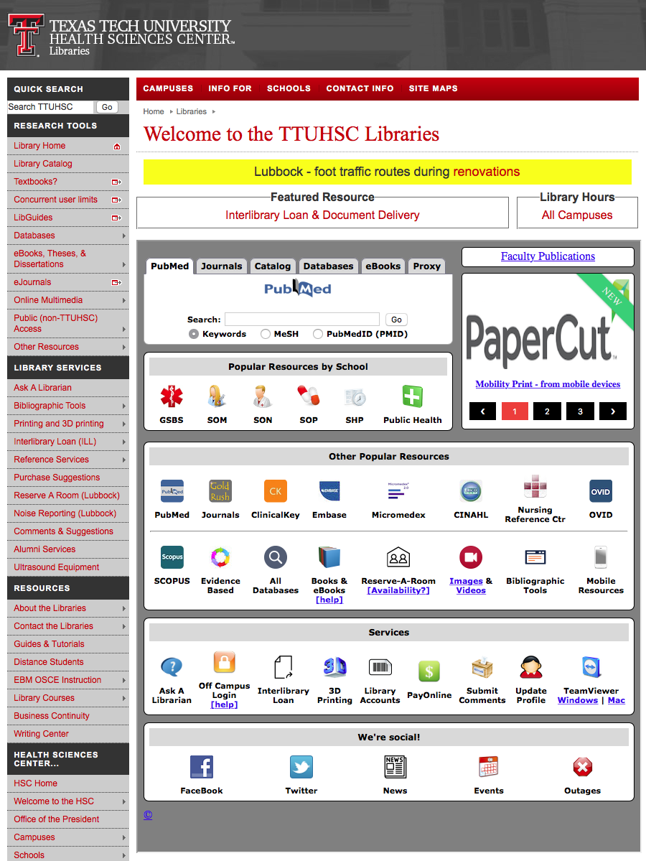

www.ttuhsc.edu/libraries
Click

Slide 13
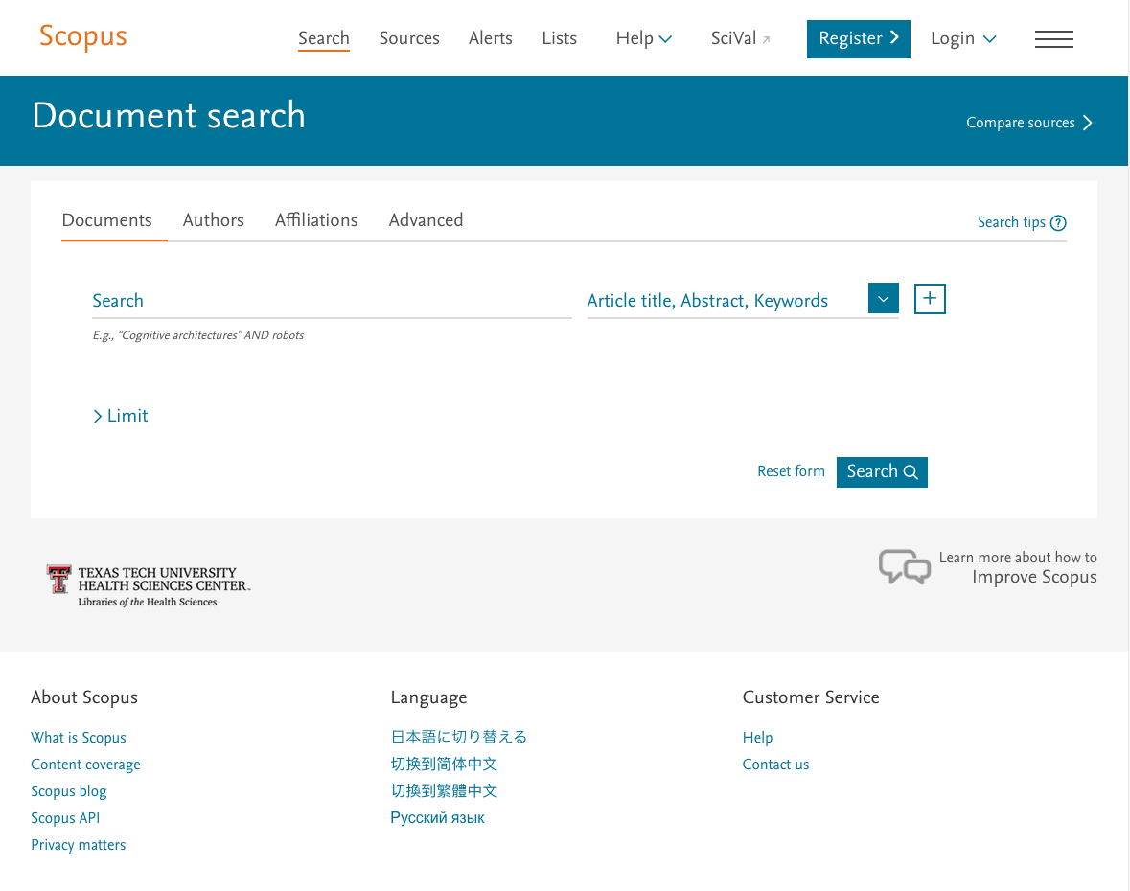
Scopus Home Page

Slide 14
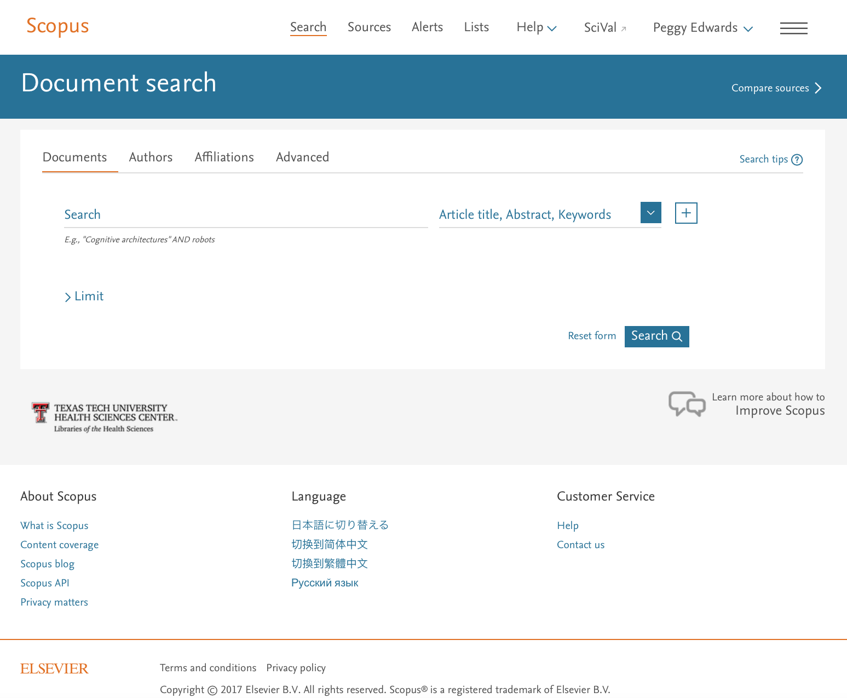
Your name
Click
Search tips

Slide 15
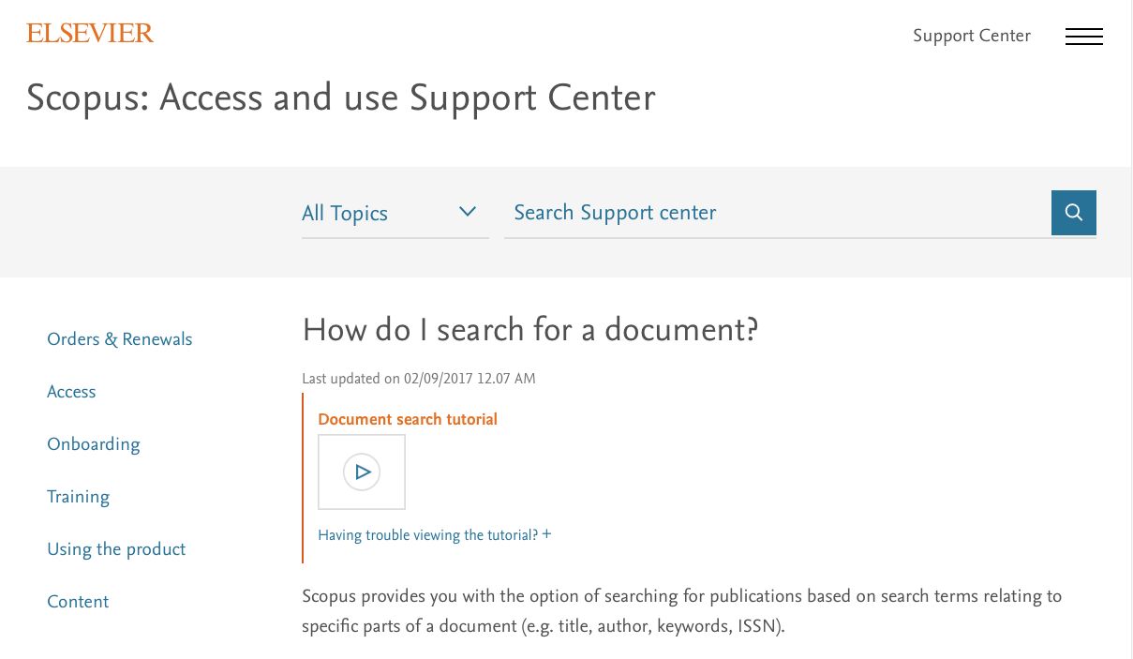
Document search tutorial

Slide 16
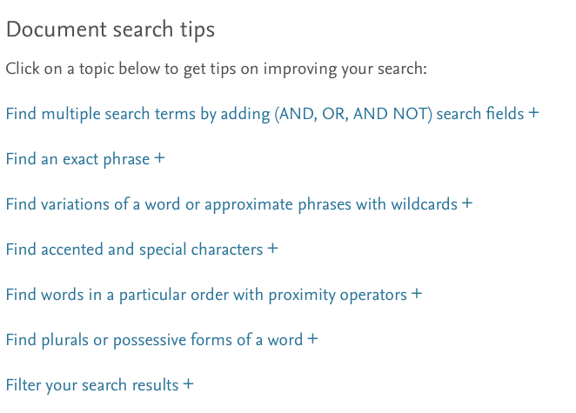
Document search tips

Slide 17
Click
Register >

Slide 18
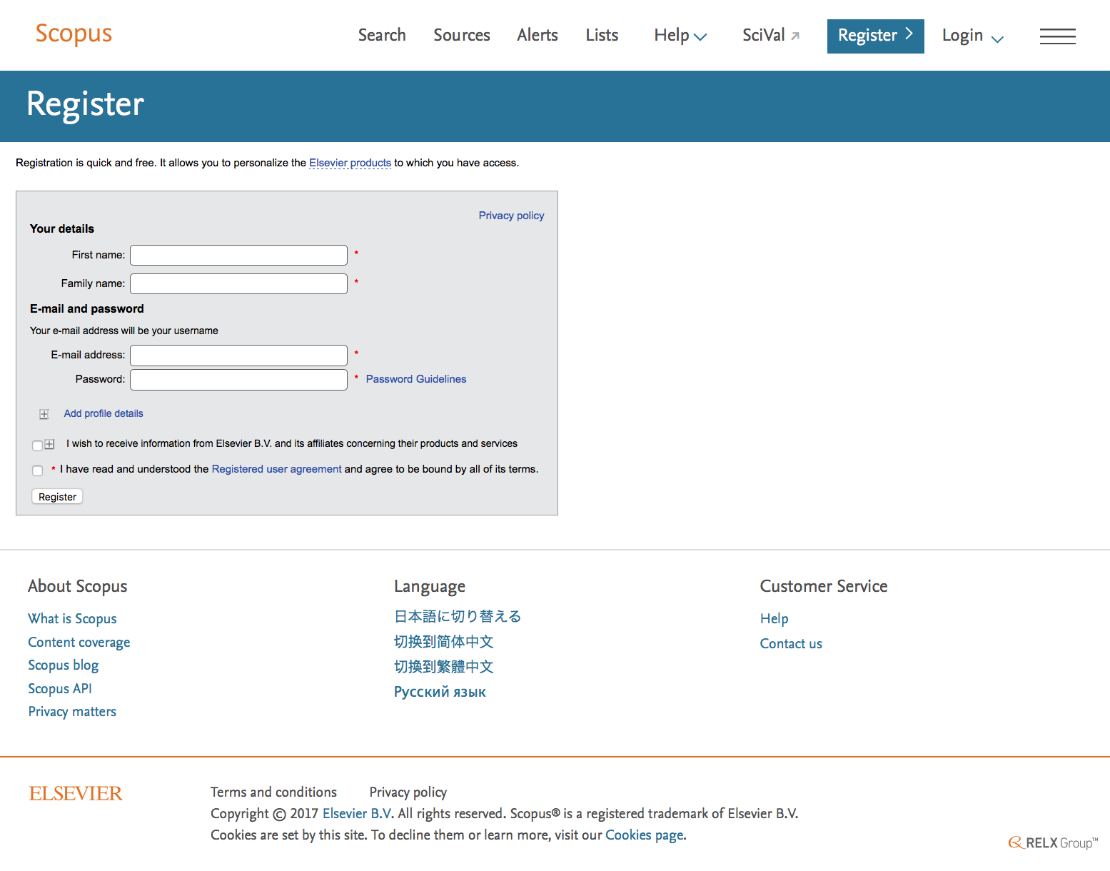
Complete Registration

Slide 19
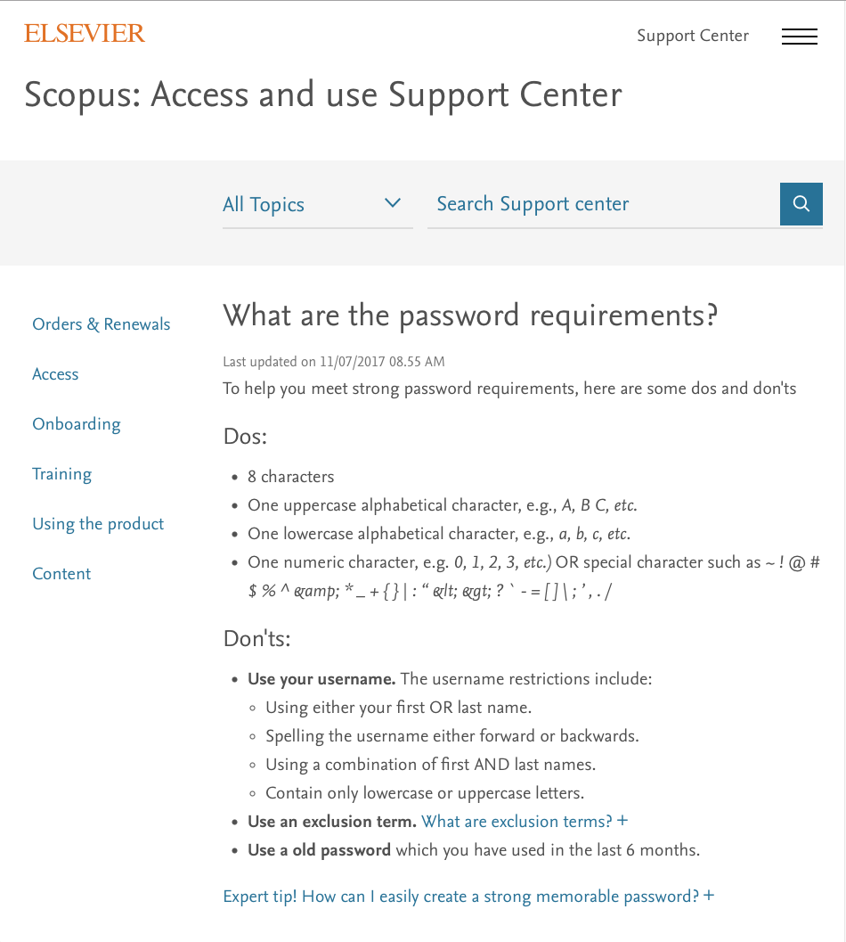

Slide 20
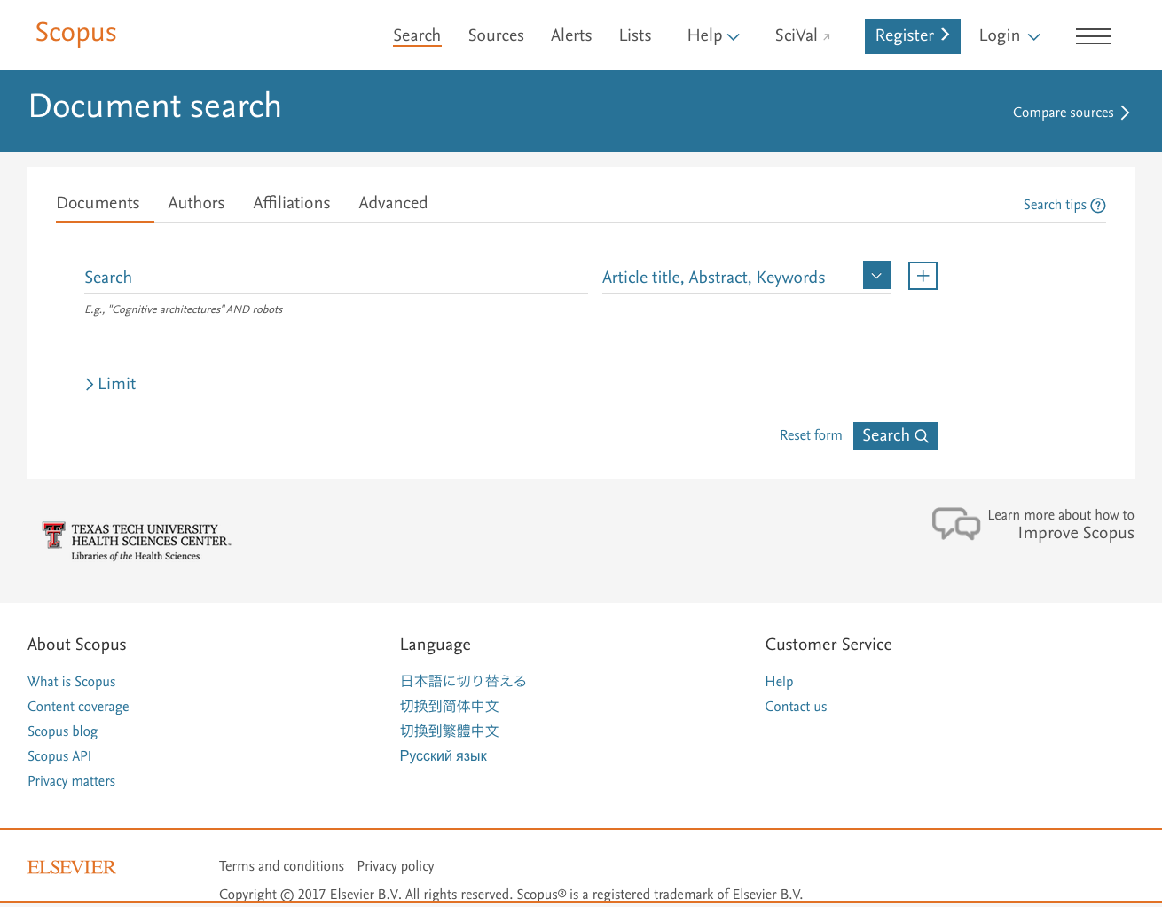
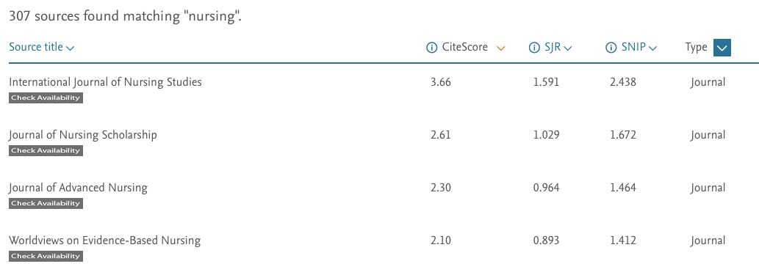
0
Scopus indexes 22,794
peer-reviewed journals
307 journals have the word nursing in the title
0
0

Slide 21
Your name
Click Search to enter first term

Slide 22
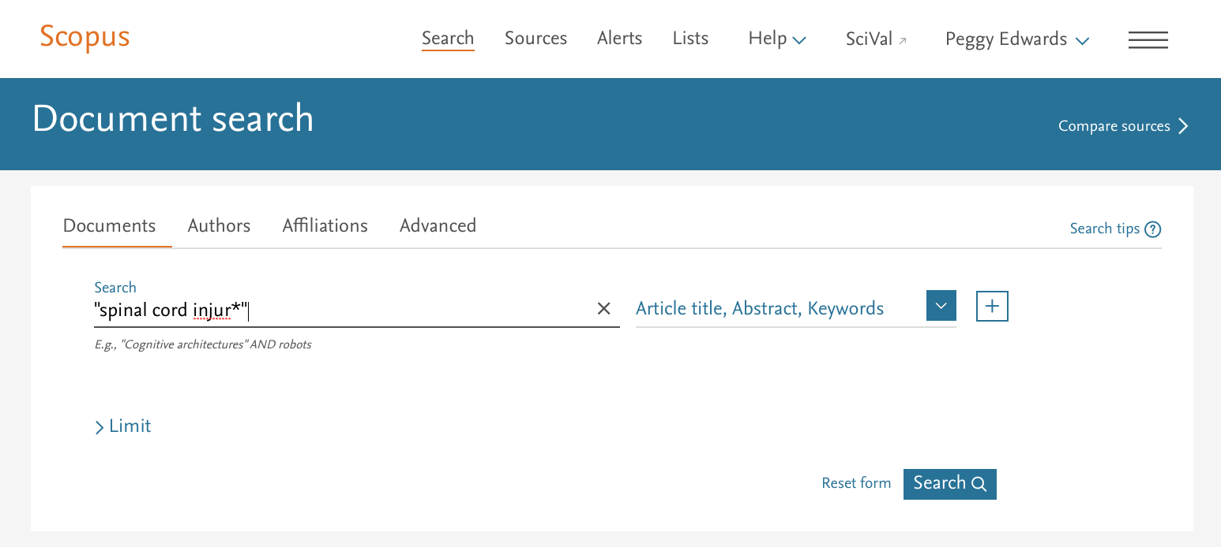
Your name
Then click
+
Enter “spinal cord injur*”
NOTE: 1) Enter phrases in quotes
2) Enter an asterisk (*) after injur* to search for all suffixes

Slide 23
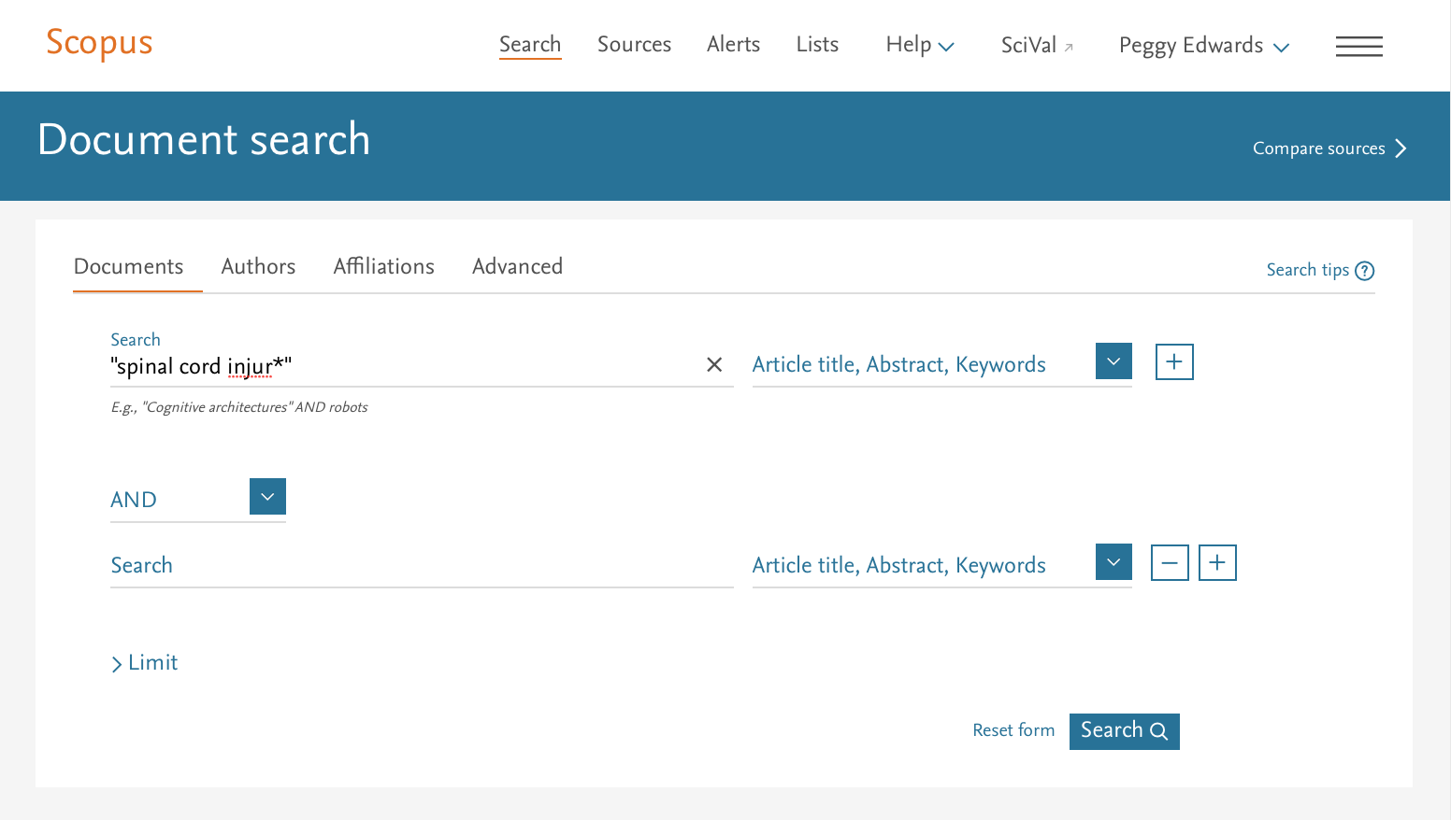
Your name
Enter “urinary catheter*”

Slide 24
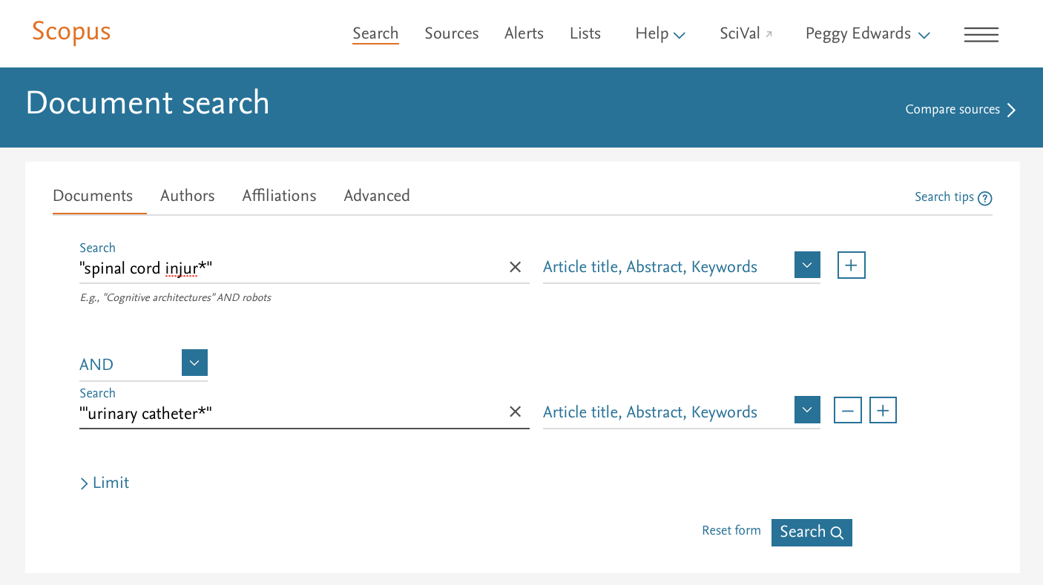
Your name
Click
Search

Slide 25
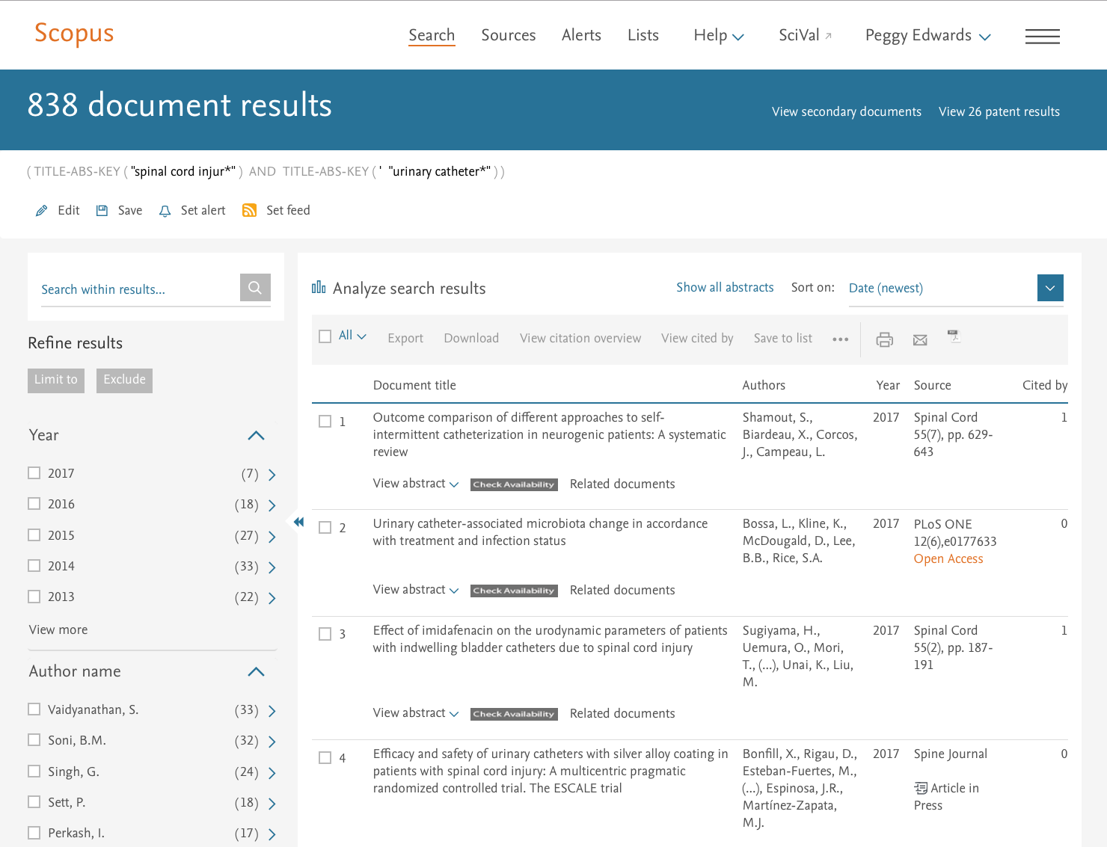
Your name
Click View more

Slide 26
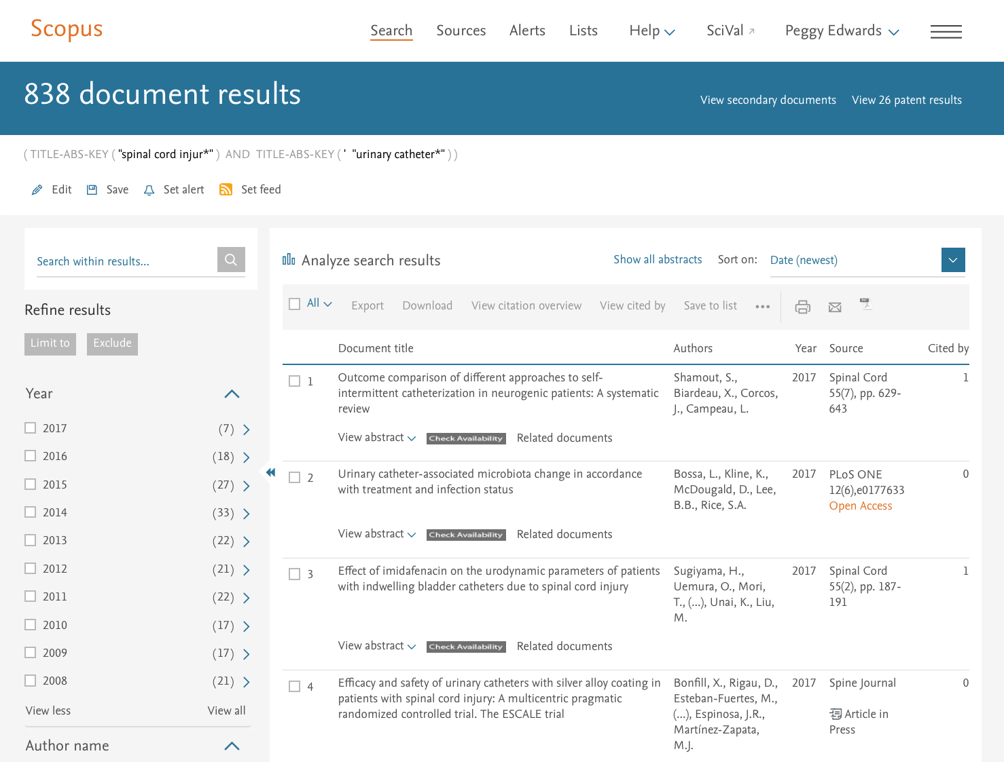
Your name
Click View all

Slide 27
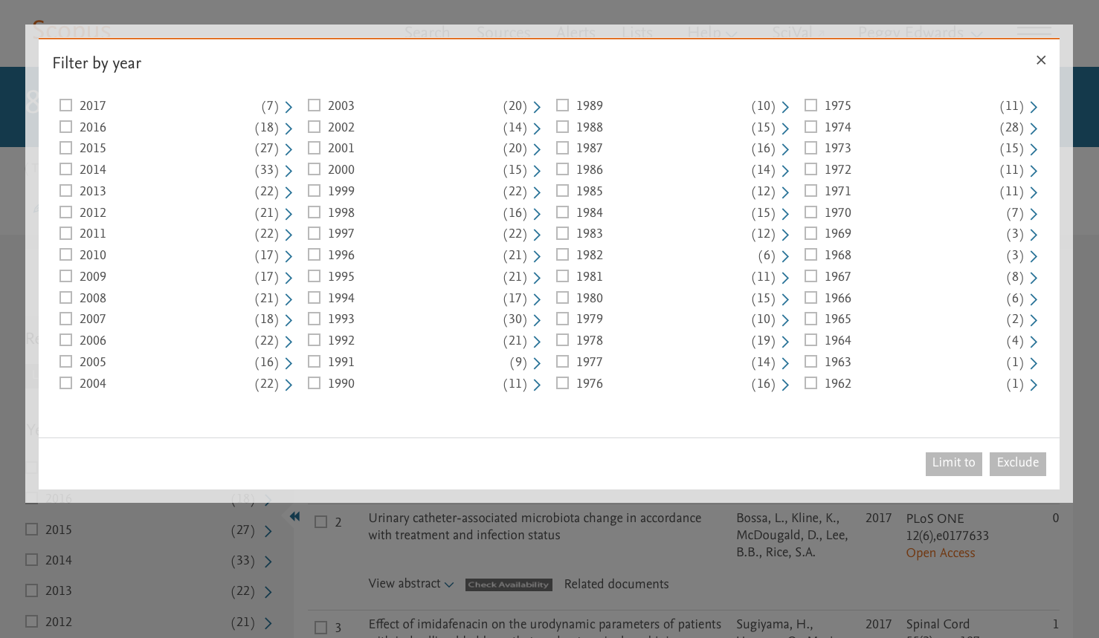
Select 2003-2017. Click
Limit to

Slide 28
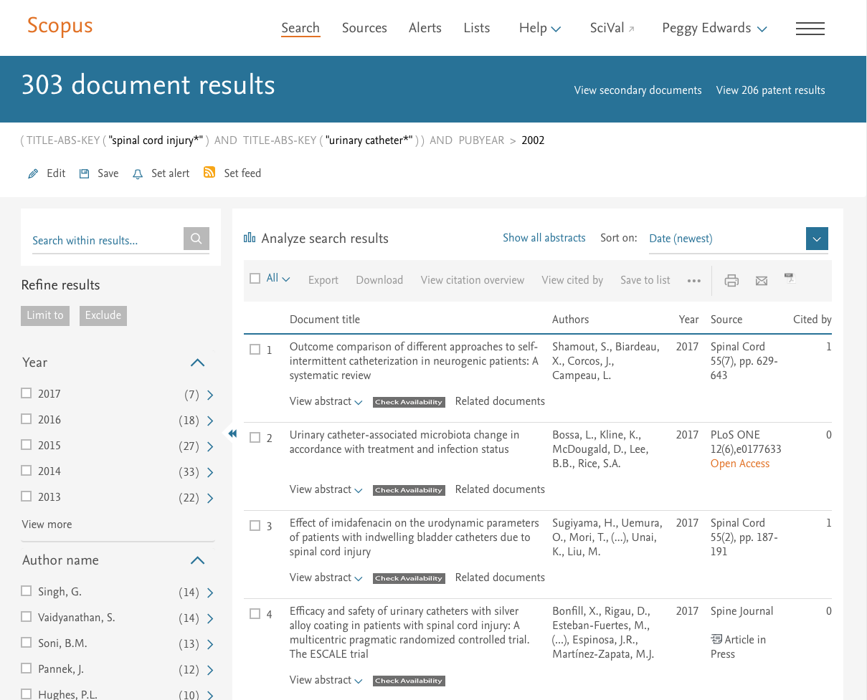
Results = 303 articles
Your name
Scroll

Slide 29
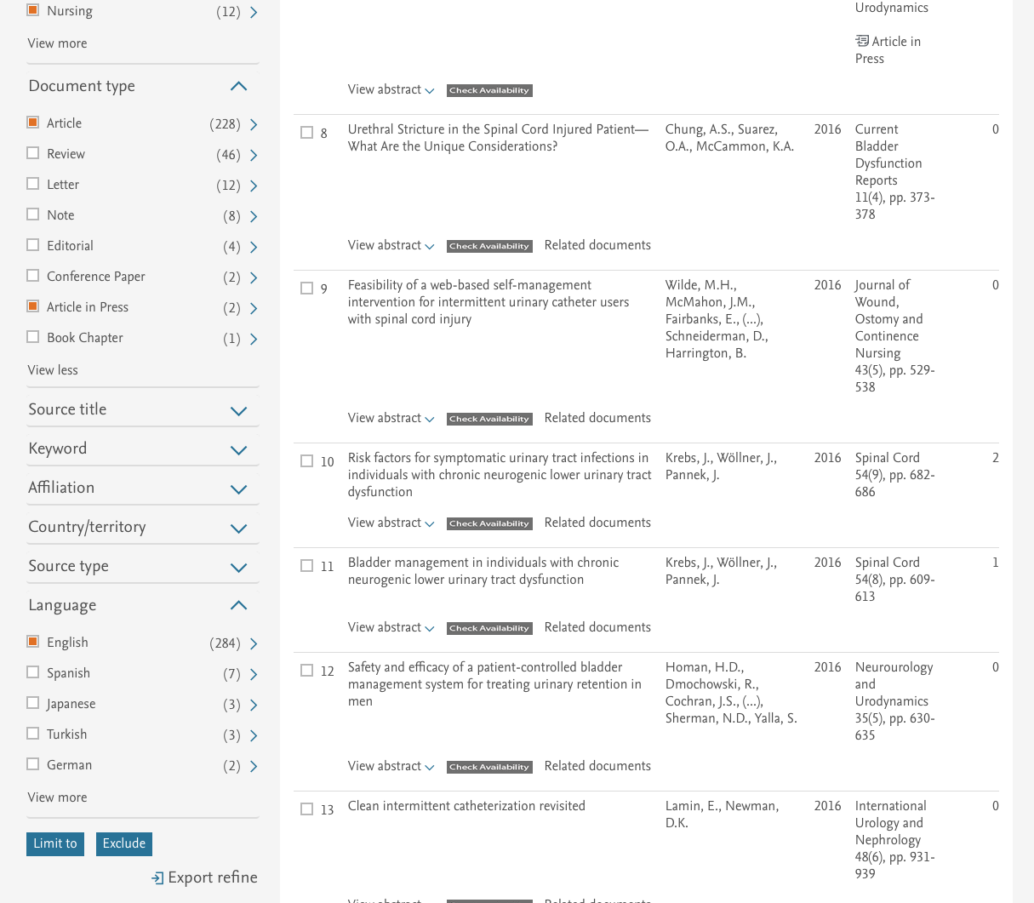
Click Nursing
Click Article
Click Article in Press
Click English
Click
Limit to

Slide 30
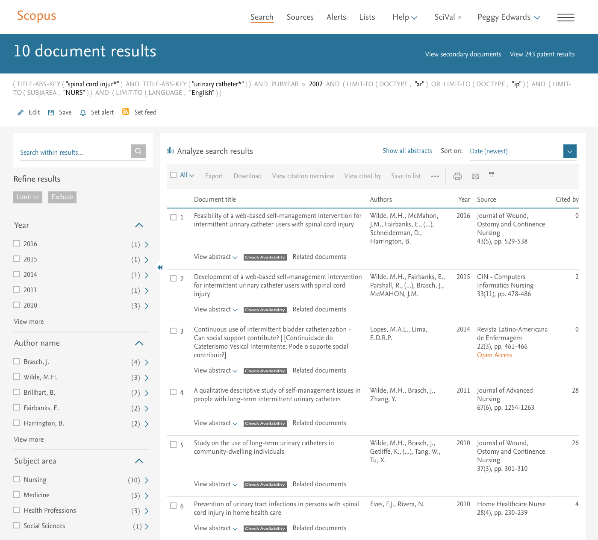
Your name
Results are reduced from 303 to 10 documents

Slide 31
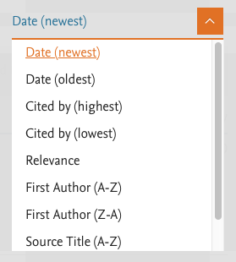
Your name
Click and select Cited by (highest)
>

Slide 32
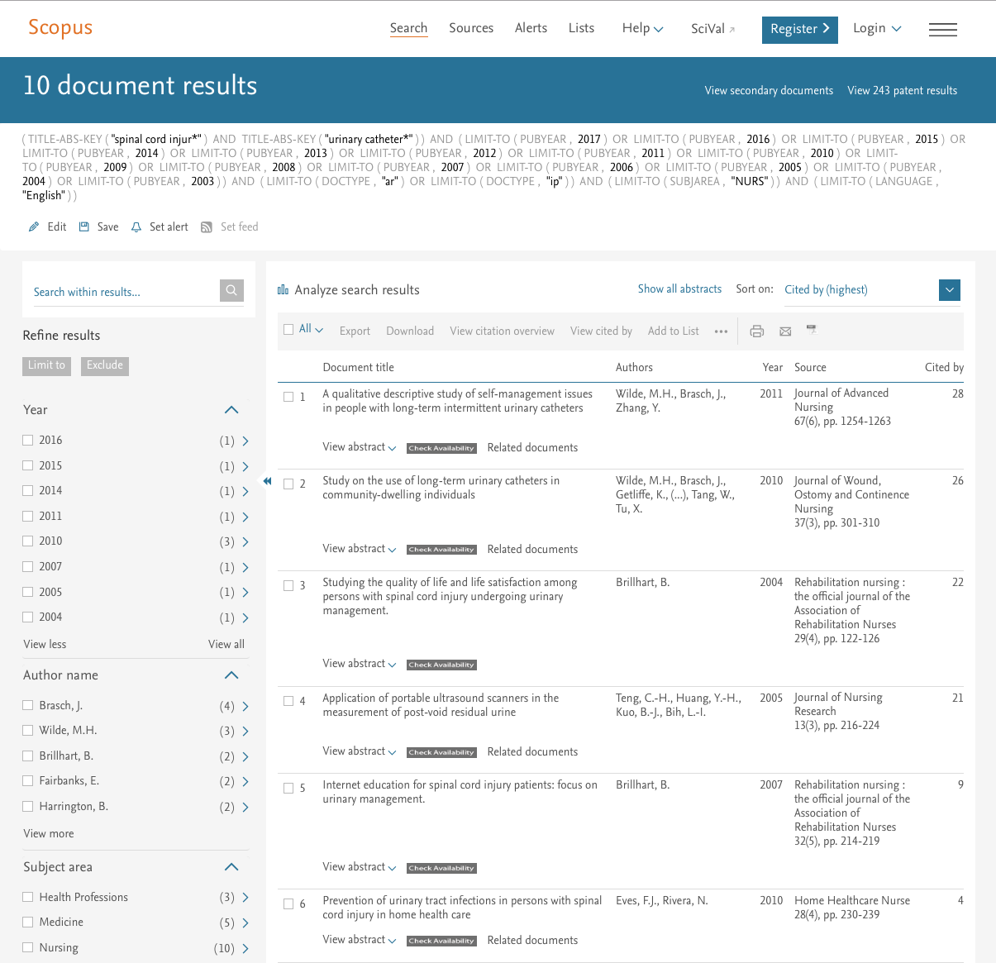
Documents are sorted by number of cites

Slide 33
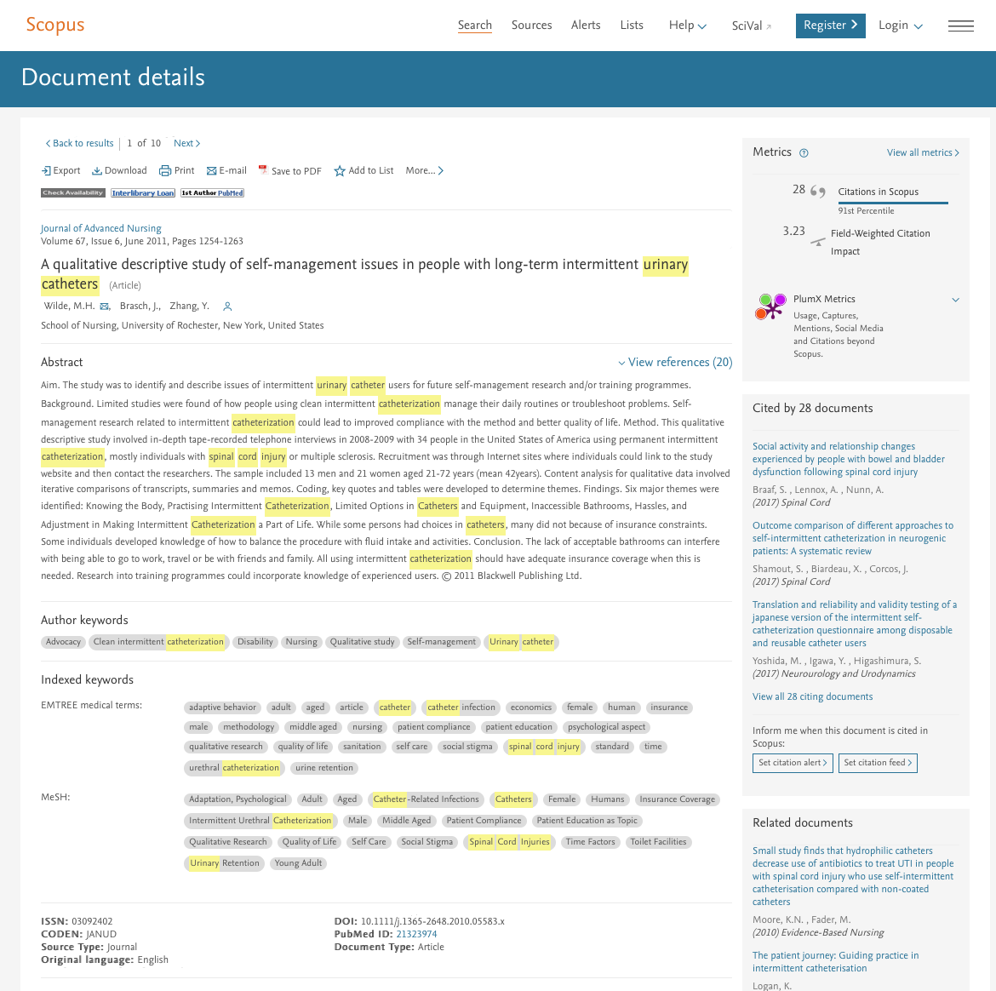
Documents with highest number of cites
MeSH terms

Slide 34
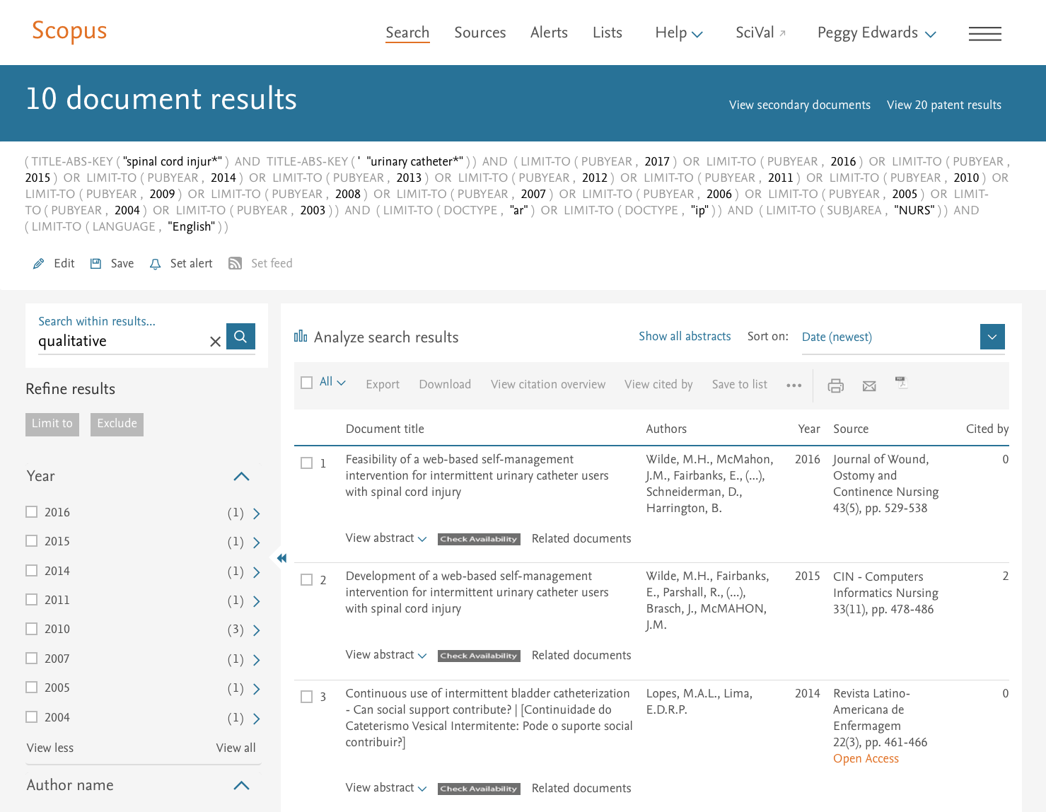
NOTE: You can search within your results for qualitative (or quantitative) studies

Slide 35
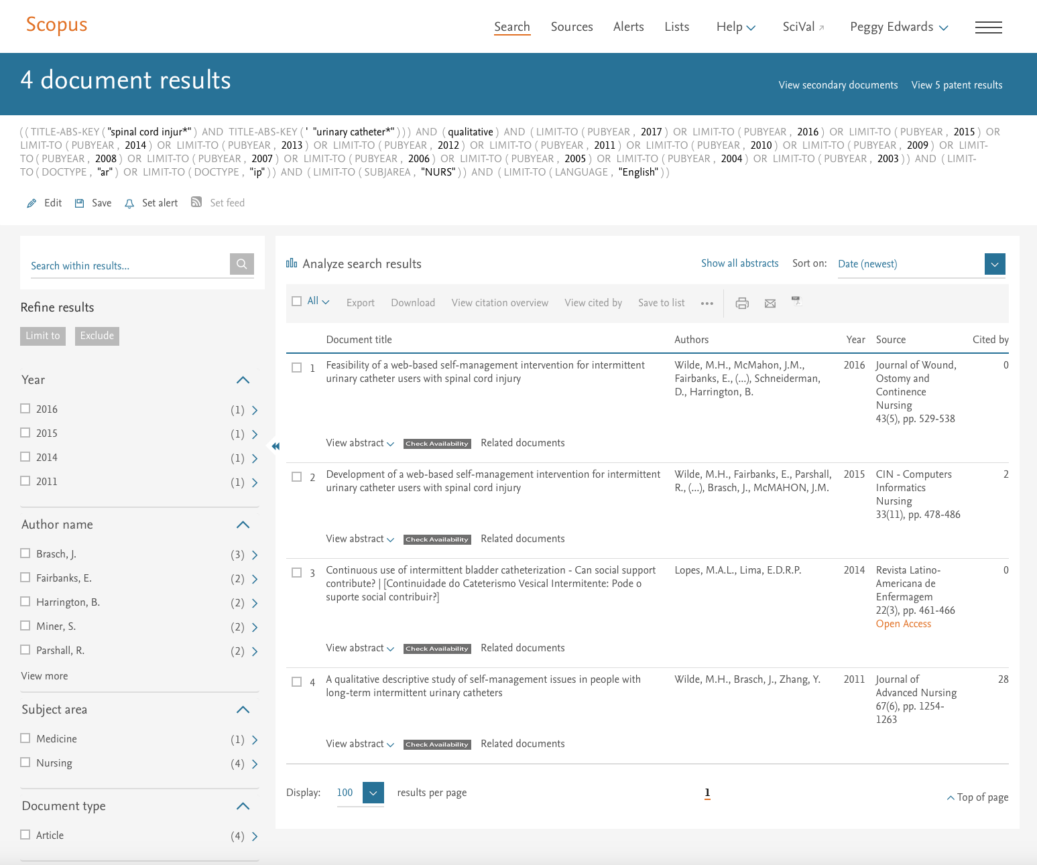
Results for qualitative studies = 4 documents
If you do not find a study, try applying the search example on the following screens to your topic:

Slide 36
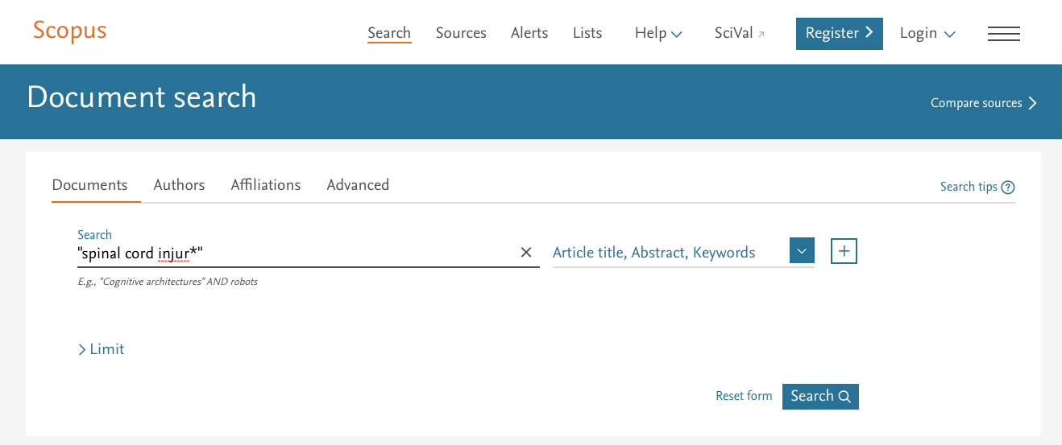
Repeat the search for the first term of your topic
Enter “spinal cord injur*” and click
Search

Slide 37
Your name
Click View more

Slide 38
Your name
Click View all

Slide 39
Select 2003-2017. Click
Limit to

Slide 40
Click Nursing
Click Article
Click Article in Press
Click English
Click
Limit to

Slide 41
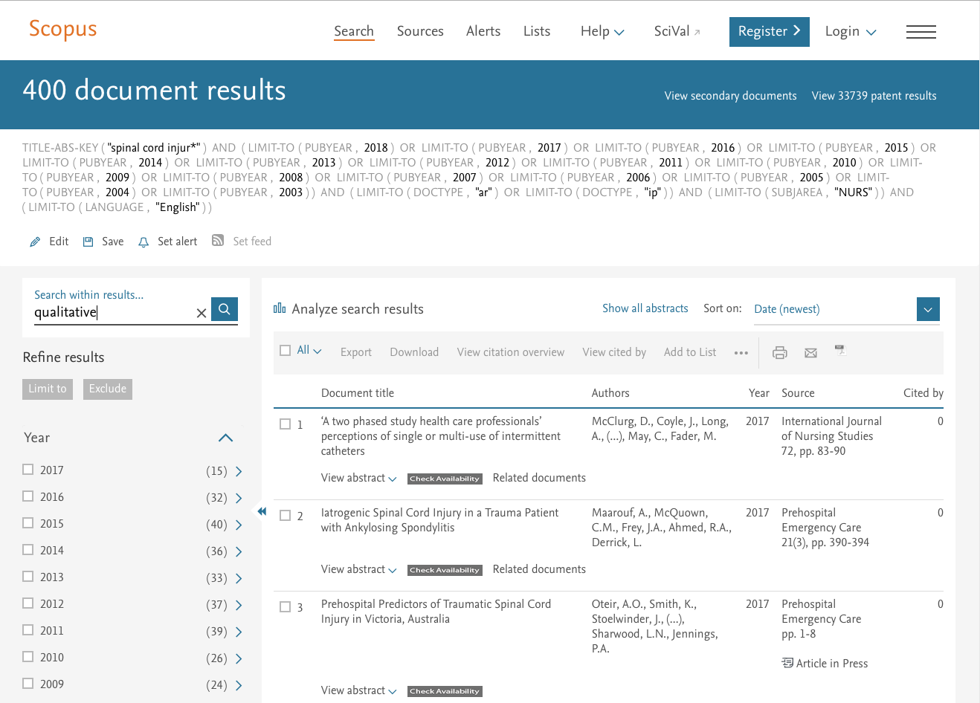
Search within results for qualitative

Slide 42
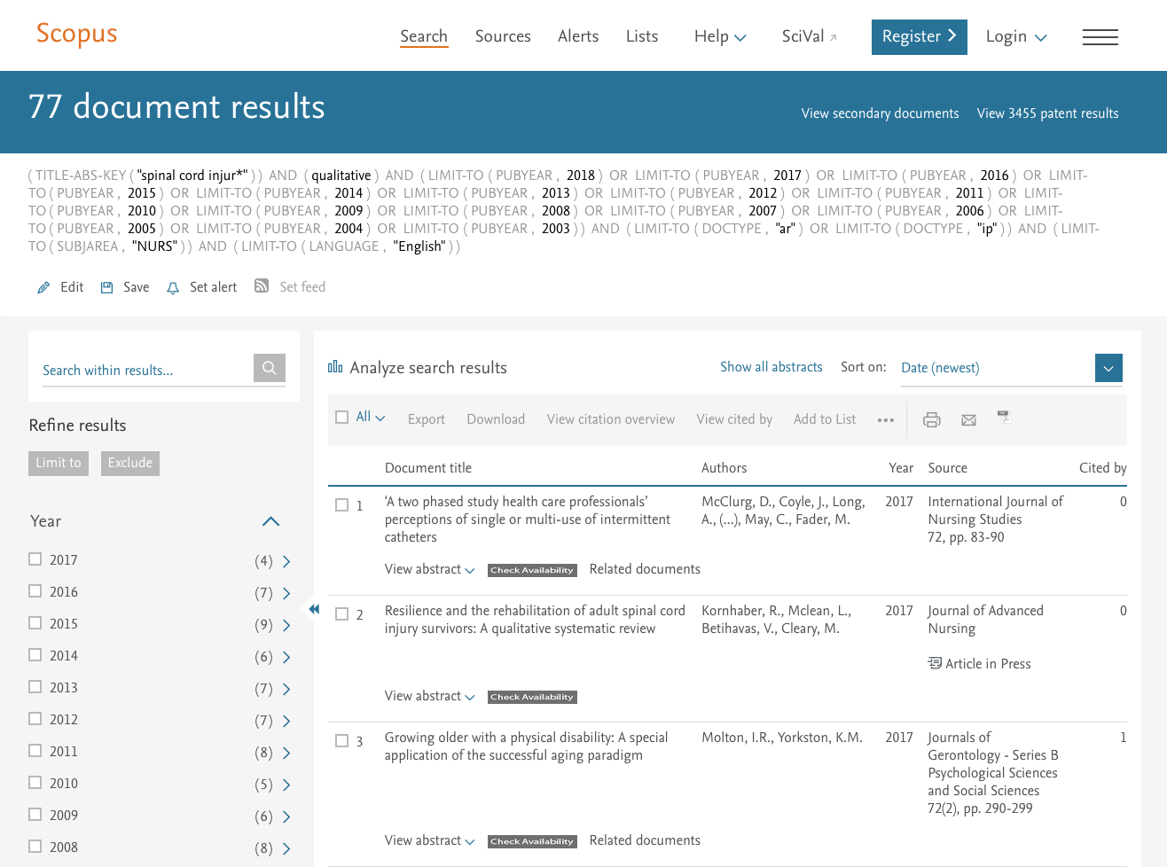
Results = 77 documents this time!

Slide 43
Click and select Cited by (highest)
>

Slide 44
Receiving Automatic Emails of
New Articles

Slide 45

Your name
To receive emails of new articles as they are published, click

Slide 46
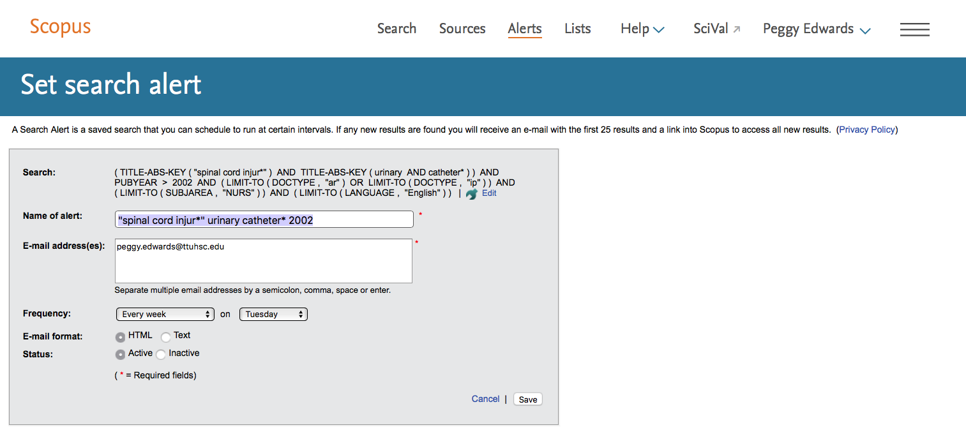
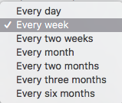
Your name
Your email
Click the drop-down menu and select the frequency you prefer.

Slide 47

Your name
Your email
If you selected week, click the drop-down menu and choose the day you prefer.

Slide 48
Your name
Make sure HTML and Active are selected.
Your email
Click
Save

Slide 49
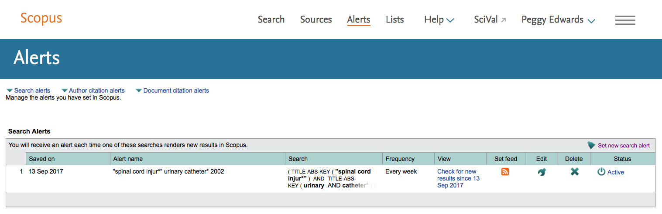

Your search has been saved.
Your name
When you no longer need
automatic search updates, click

Slide 50
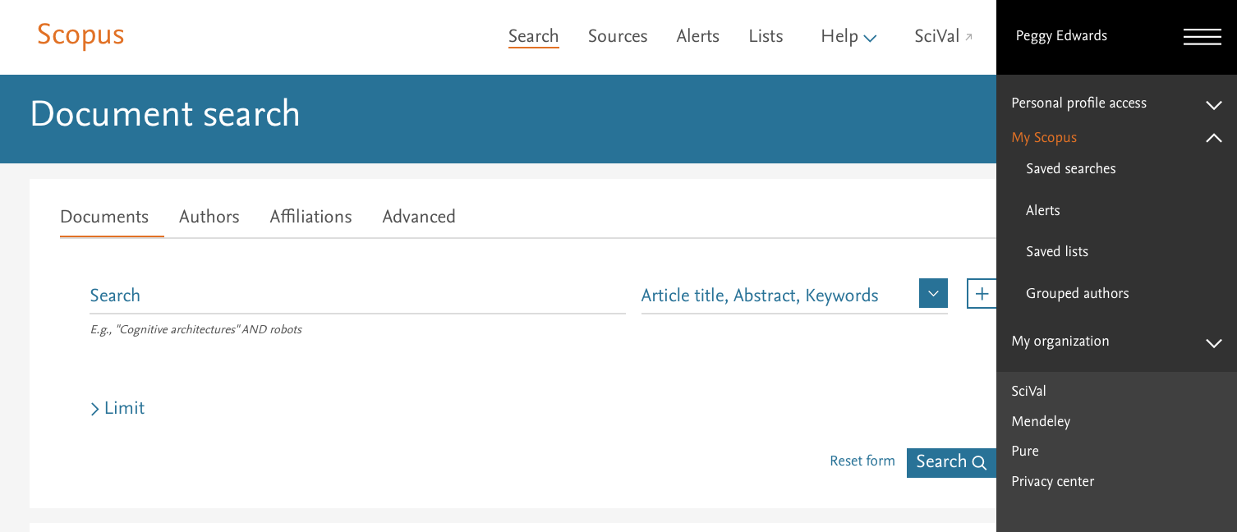
Click to list saved searches.
Your name

Slide 51
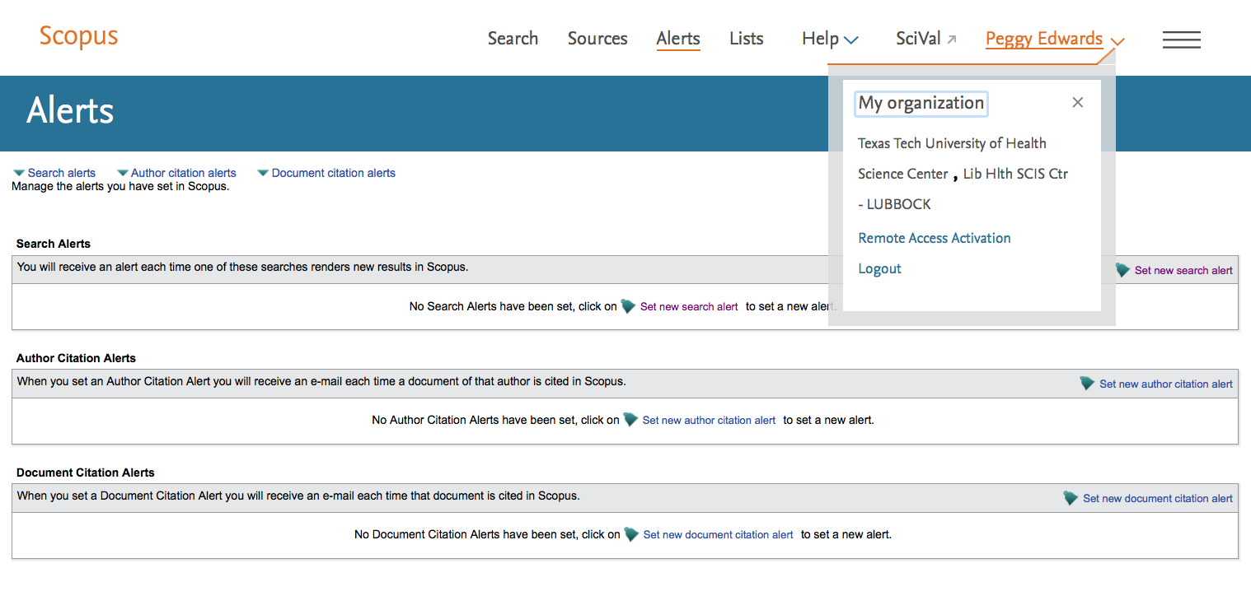
Click to Logout.
Your name

Slide 52
Searching PubMed

Slide 53
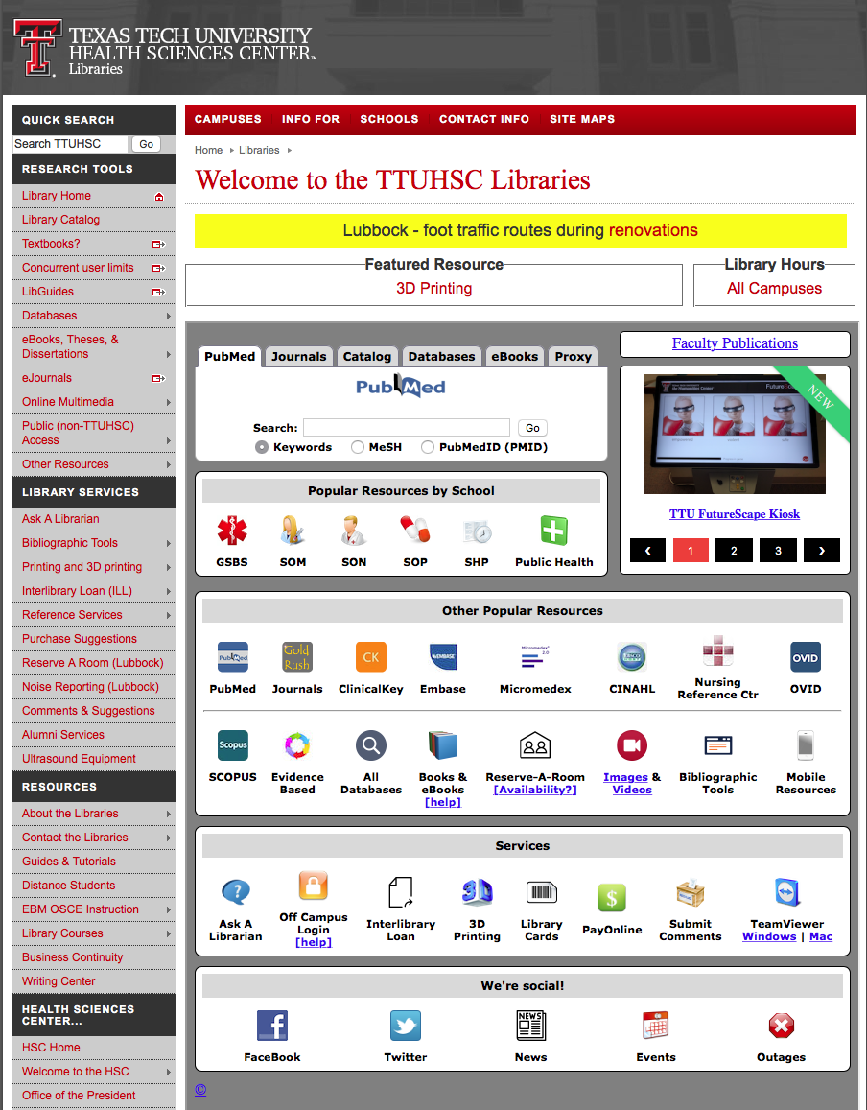

www.ttuhsc.edu/libraries
Click

Slide 54
Creating a
My NCBI Account

Slide 55
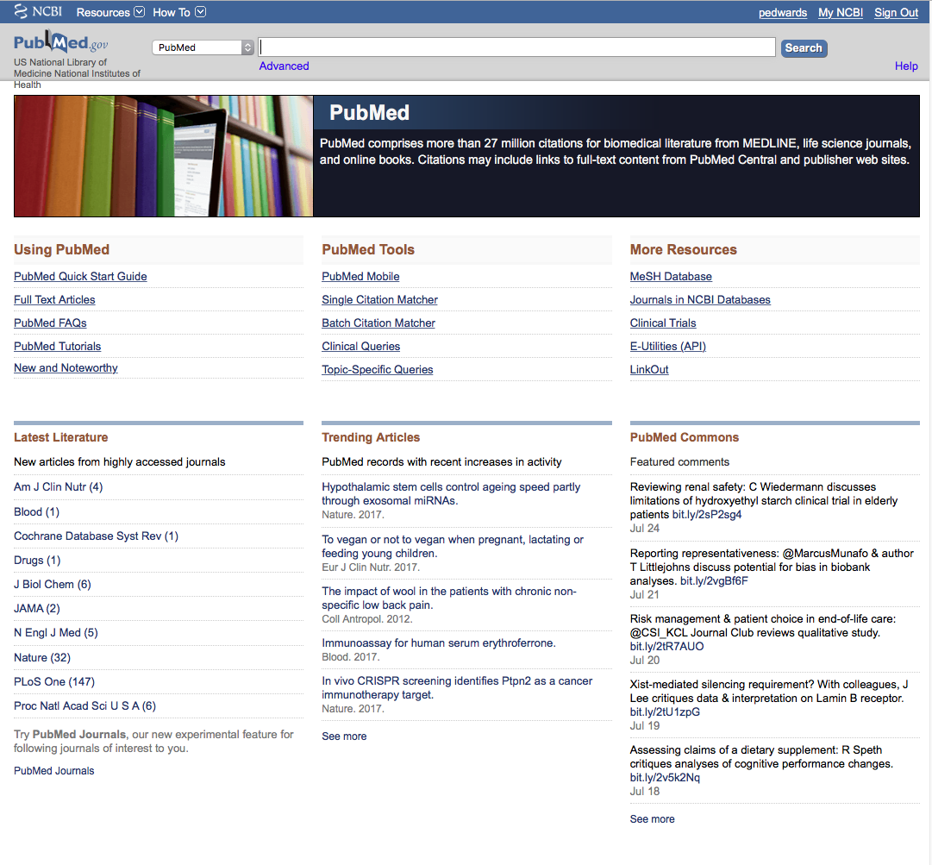
Your user name
Click
Click My NCBI
PubMed Home Page

Slide 56
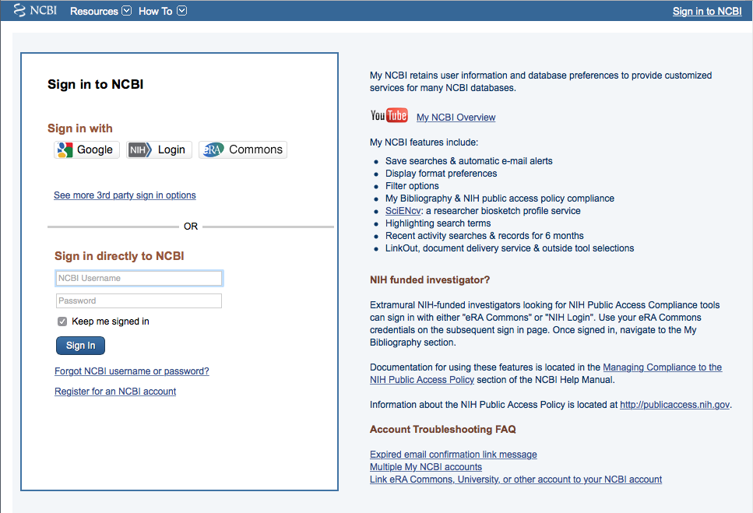
Click
Register for an NCBI account

Slide 57
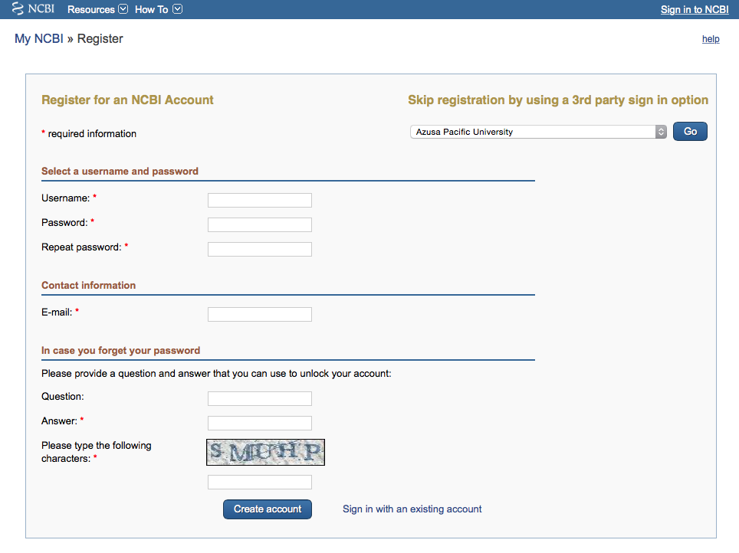
Fill out form
and click
Create account

Slide 58
Verifying your MY NCBI Account
Open the email you used in the account:
1) Locate the link from NCBI
2) Click the link
3) Tells NCBI you are a real user requesting the account
(not computer generated)
4) Your user name will now appear on the top right-hand side

Slide 59
Your username
Your user name

Slide 60
When searching PubMed use
MeSH Database!

Slide 61
Benefits of using MeSH Database
MeSH stands for Medical Subject Heading
Using MeSH makes searching
more effective, accurate, and efficient!
MeSH brings similar topics together under one term!

Slide 62
Benefits of using MeSH Database
When searching Scopus, the computer looks for words appearing in the titles and abstracts of articles.
The searcher must enter all synonyms, and any word variants of the topic.

Slide 63
Example of benefits of using MeSH
In Scopus, if a searcher is looking for articles on AIDS, in order to locate all the articles they must enter:
  AIDS
  acquired immunodeficiency syndrome (3 words)
  acquired immune deficiency syndrome (4 words)
In PubMed, the searcher only needs to click MeSH database and use the MeSH term: acquired immunodeficiency syndrome because the computer searches the MeSH terms Index for the MeSH term.

Slide 64
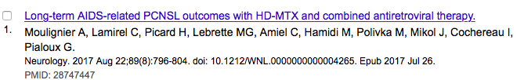
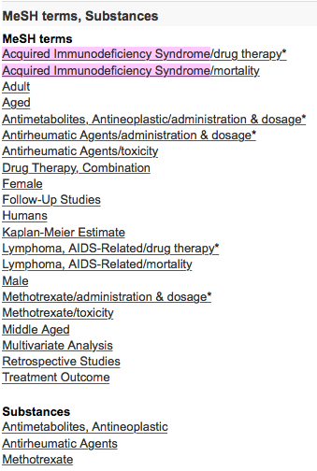
Example of a MeSH Terms Index
PubMed located the MeSH term: Acquired Immunodeficiency Syndrome in the MeSH Terms Index assigned to the above article.

Slide 65
Your user name
PubMed indexes 5,500 journals.
As of 2014, 188 were nursing journals

Slide 66
Your user name
Click
MeSH Database
PubMed Home Page

Slide 67
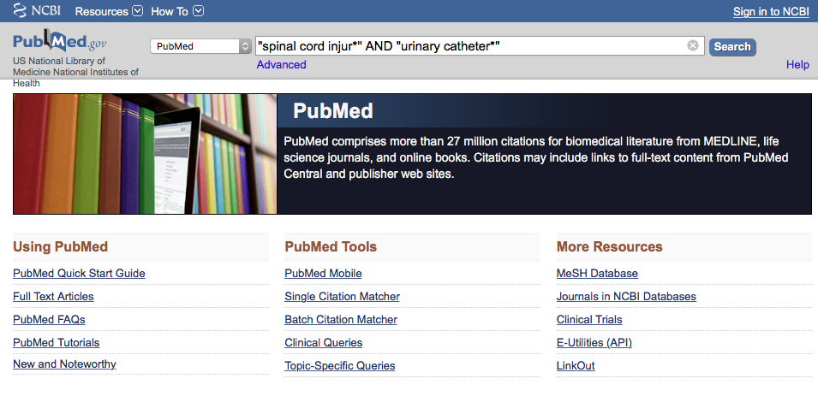
a
Enter
“spinal cord injur*”
AND
“urinary catheter*”
and click
Search

Slide 68
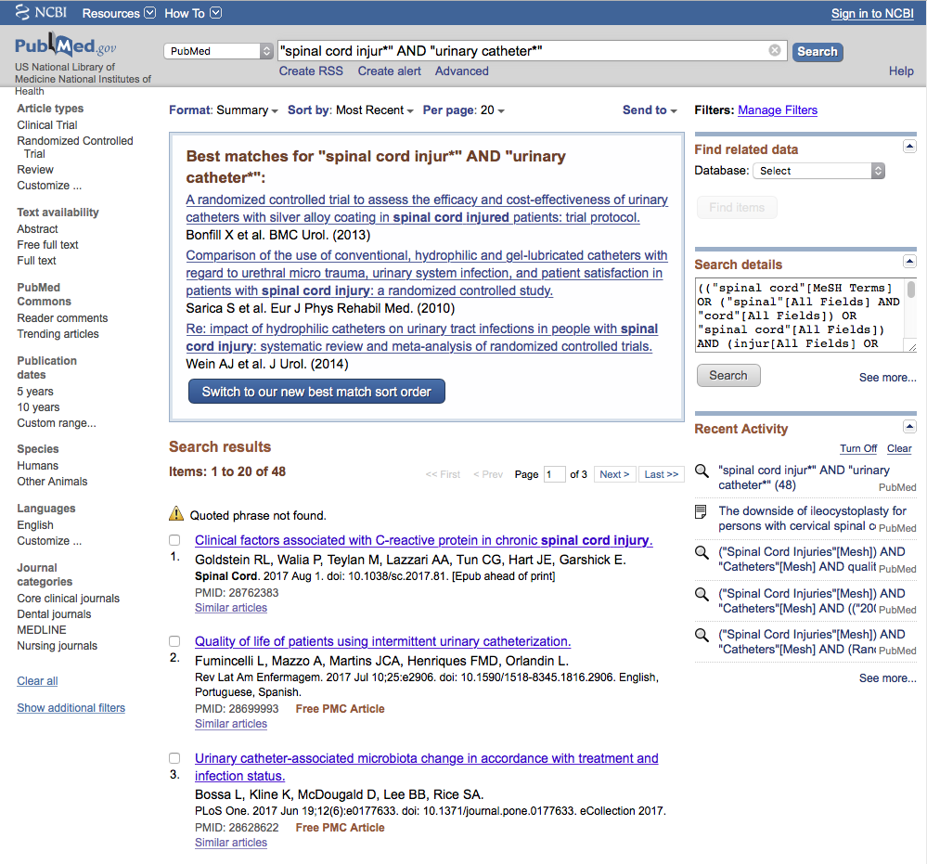
PubMed identifies
48 articles

Slide 69

a
Enter
spinal cord injur*
AND
urinary catheter*
and click
Search

Slide 70
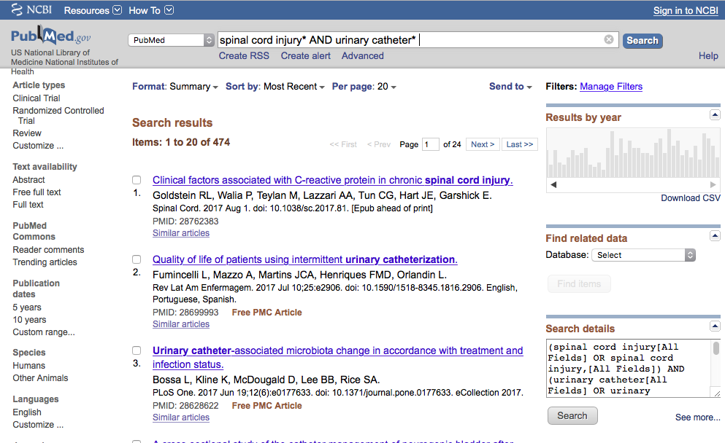
PubMed identifies
474 articles

Slide 71
Click Advanced

Slide 72
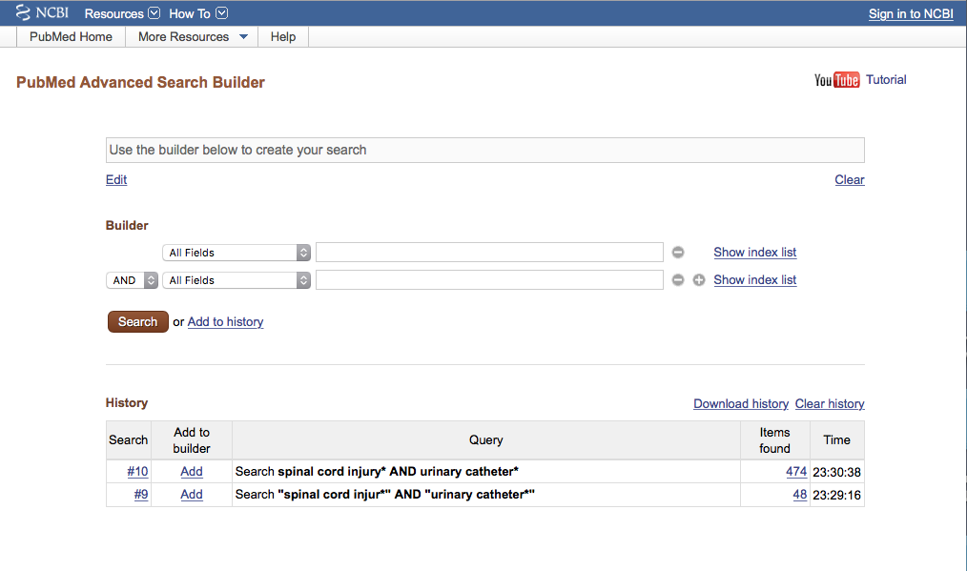

Slide 73
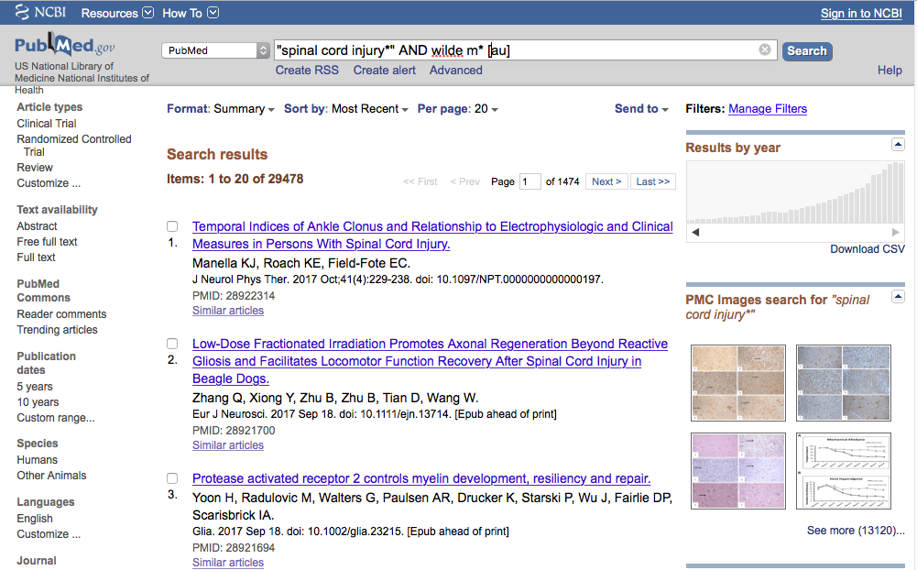
A better way to approach step C, third instruction is to enter the author’s name followed by [au]; i.e. wilde m* [au]

Slide 74
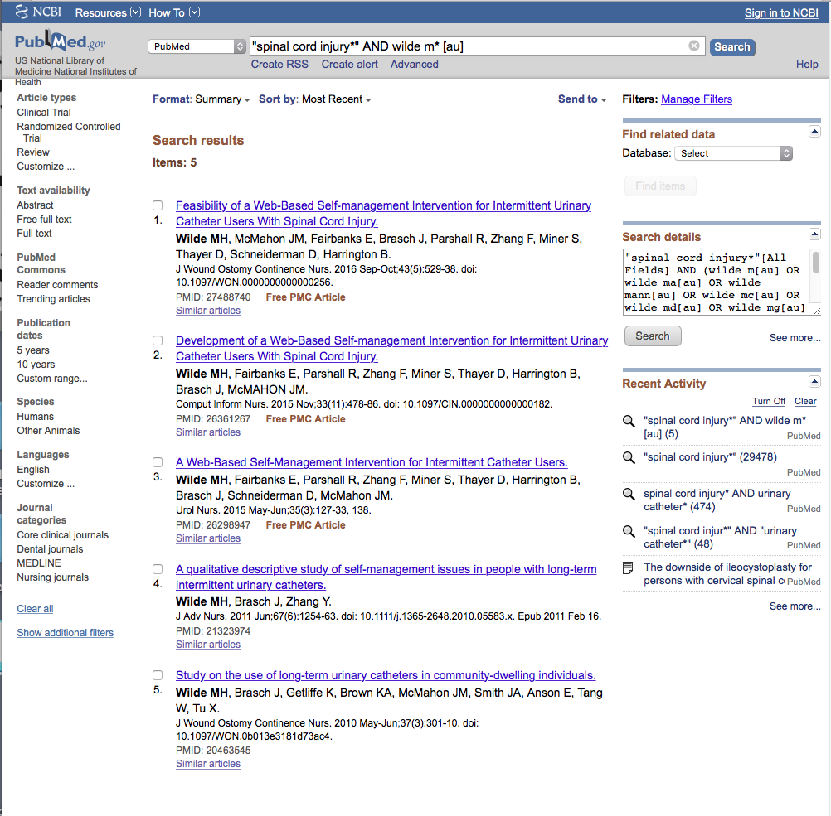
PubMed identifies 5 articles

Slide 75
Article 5 is a qualitative study
Click title

Slide 76
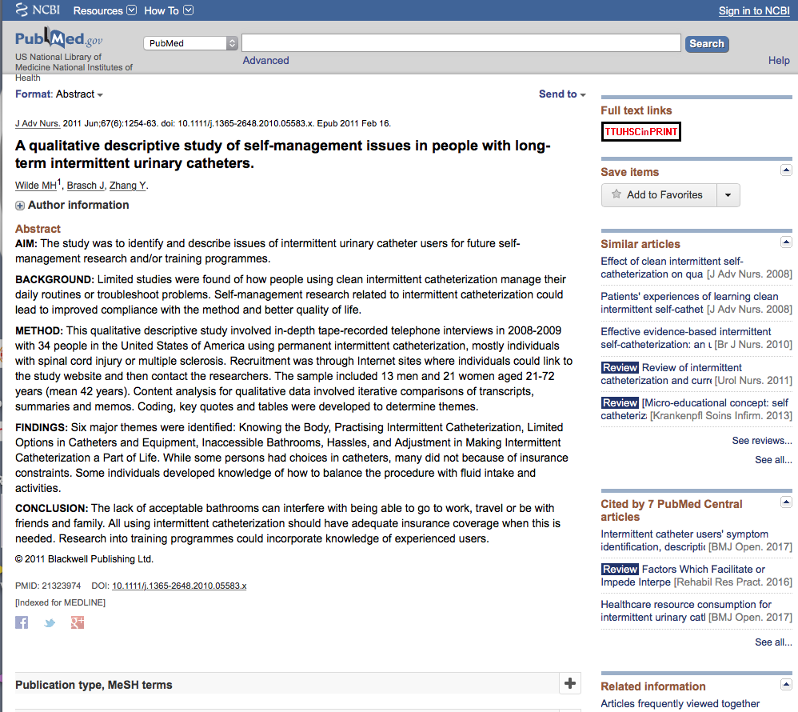
Click MeSH terms

Slide 77
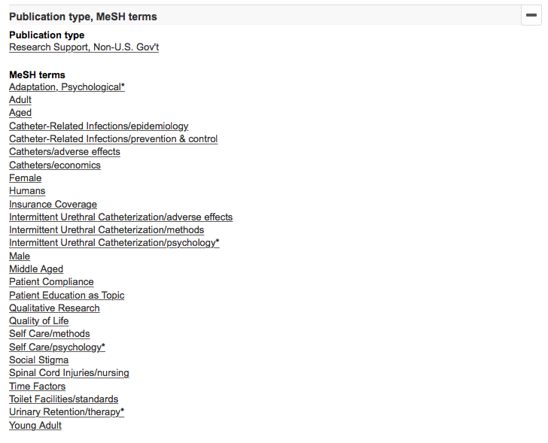
MeSH terms

Slide 78
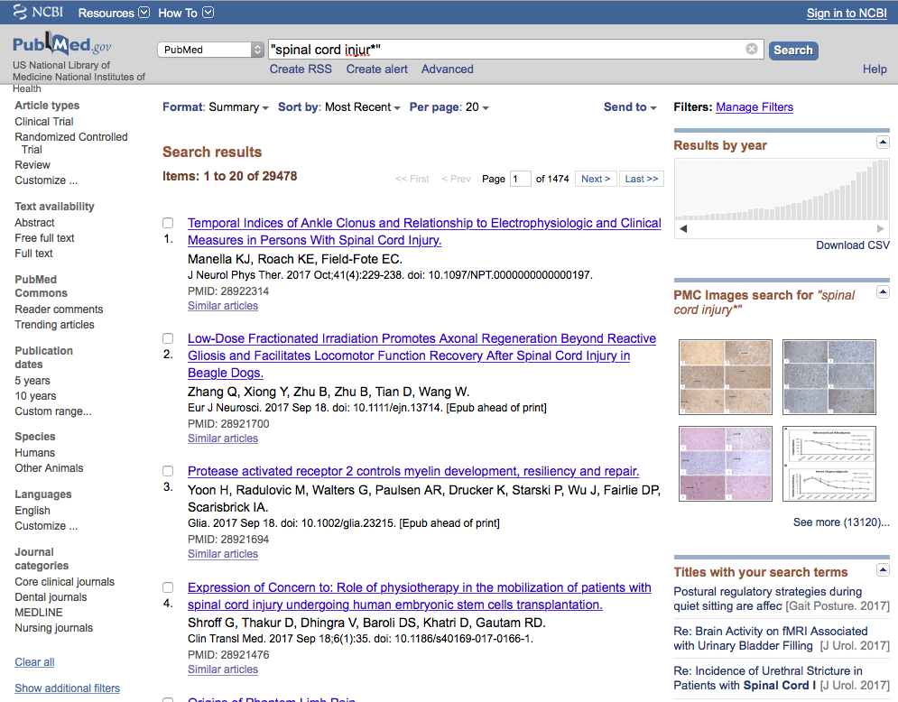
To get the answers you need when sorting, follow these instructions. Enter the first term; if it is a phrase, enter it in quotation marks “word1 word2”

Slide 79
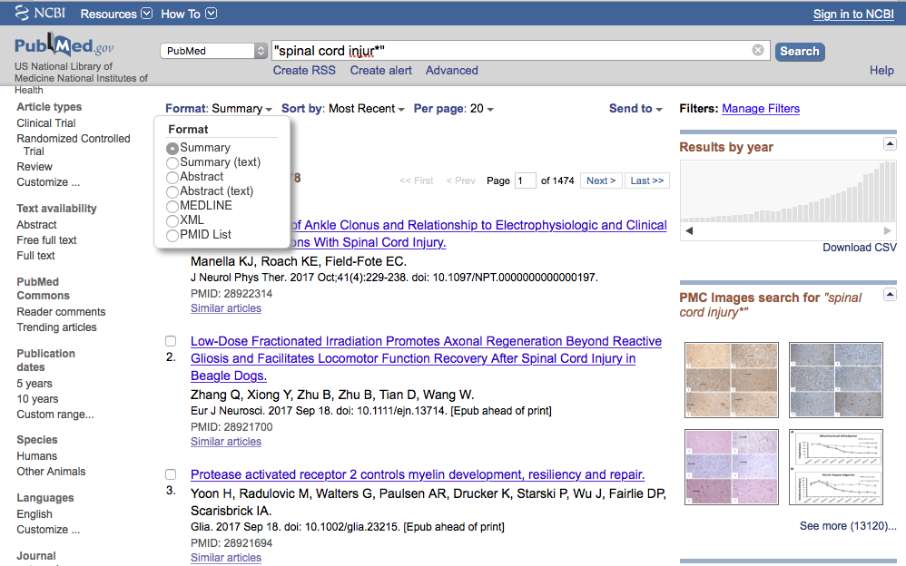
Due to updates in the software, the correct way to complete the steps in PubMed, part c, third instruction, click Summary and select Abstract. Let the computer process.

Slide 80
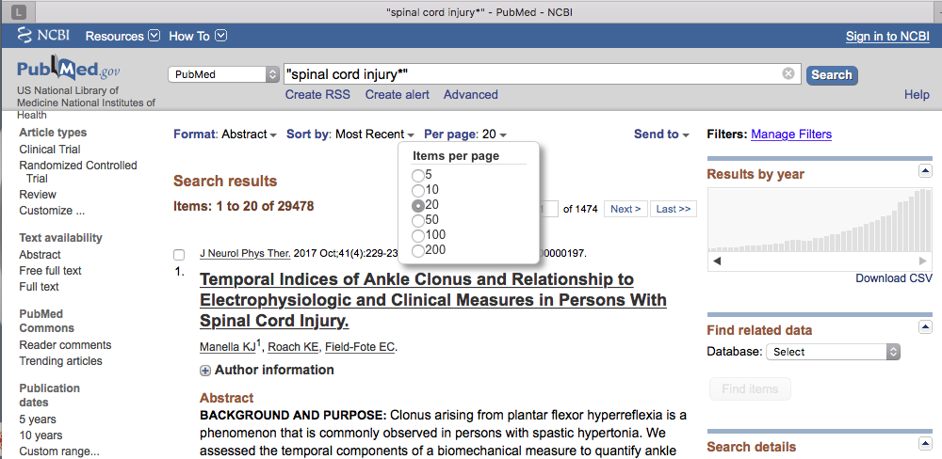
Due to updates in the software, the correct way to complete the steps in PubMed, part c, third instruction, click Per page and select 200. Let the computer process.

Slide 81
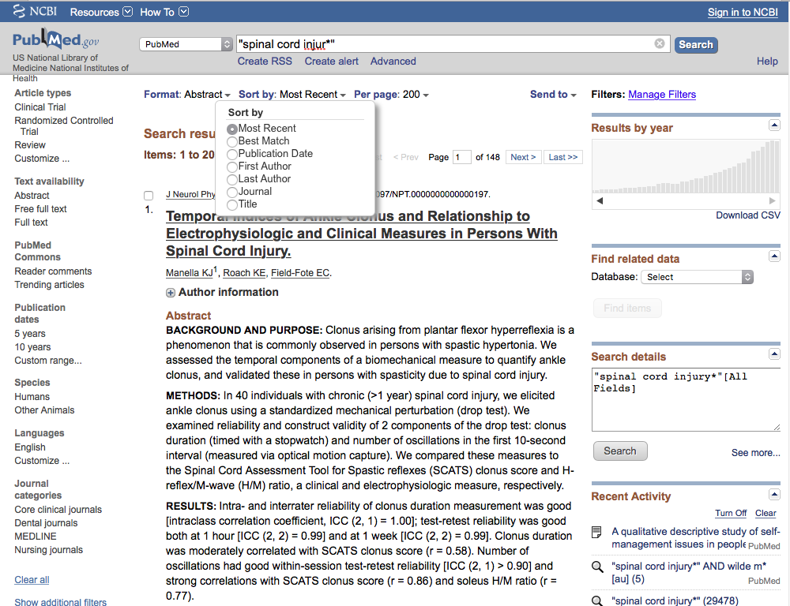
Due to updates in the software, the correct way to complete the steps in PubMed, part c, third instruction, click Sort by and select First Author. Let the computer process.

Slide 82
Your User Name
Click MeSH Database

Slide 83
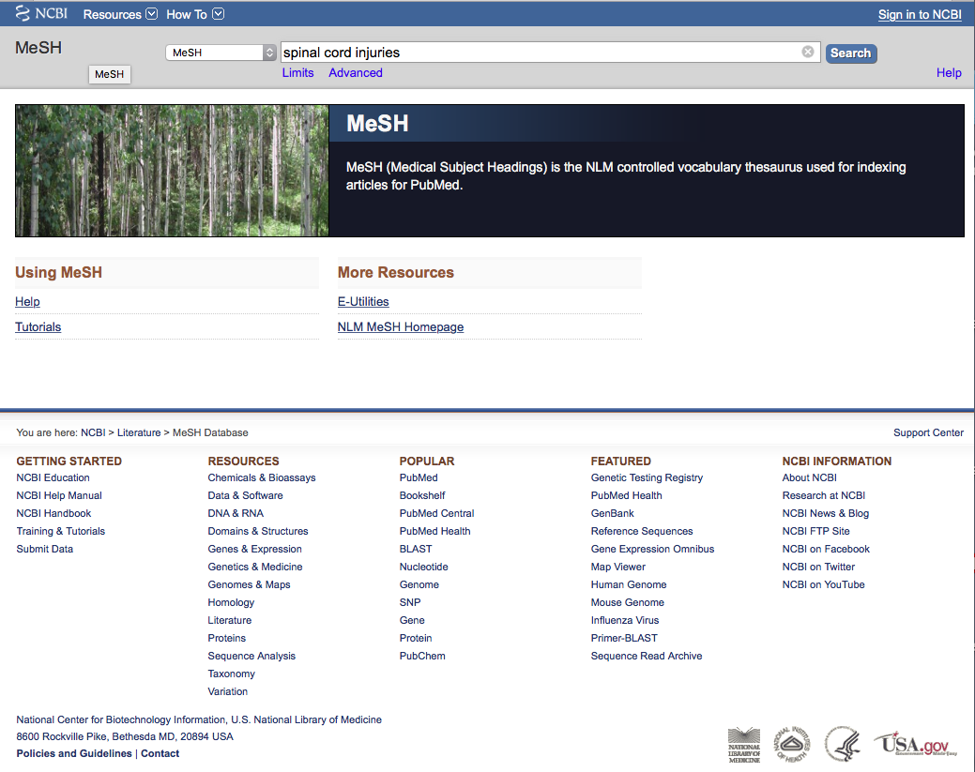
a
Enter
Spinal cord injuries
and click
Search

Slide 84

Term Definition

Slide 85
Then click
Add to search builder

Slide 86

MeSH
The first term
is in the search program “box”

Slide 87

a
Enter urinary catheters and click
Search

Slide 88

Scroll to the
Tree Structures

Slide 89
NOTE: Catheters is a broader term than Urinary Catheters.
Click Catheters to select and broaden the results of the search.

Slide 90

Note:
PubMed automatically
OR’s indented terms
under a broader term…

Slide 91

Click
Search PubMed
Click
Add to search builder

Slide 92
Boolean Logic - AND
Spinal cord
injuries
catheters
and

Slide 93
Search Results

Slide 94

PubMed identifies
193 articles

Slide 95

Click Custom range

Slide 96
Limit to articles written from
2003-2017 by entering
2003 and 2017 in the yyyy boxes.

Slide 97

Click
Show additional filters

Slide 98


Select
Languages
and click
✔
Show

Slide 99
Click English to activate filter

Slide 100
Click
Show additional filters

Slide 101
Select
Journal
Categories
and click
✔
Show

Slide 102
Click Nursing Journals

Slide 103

By applying filters,
results are reduced
From 193 to 7

Slide 104

a
Enter AND qualitative and click
Search

Slide 105

Documents are qualitative studies

Slide 106
Click
Customize…

Slide 107

Scroll
and select
Randomized
Controlled Trial
(quantitative studies)
Show
Click

Slide 108
The End

