Slide 1
Welcome
Information Resources
for P3
Peggy Edwards, AMLS
TTUHSC - Preston Smith Library
Lubbock, Texas 79430
August, 2016

Slide 2
P3/DOCS 1
Provides a framework to learn the fundamental skills of:
* physician-patient interactions,
* obtaining a complete history from a patient
* performing appropriate physical exam techniques
during patient assessments
* professionalism
*communications skills
* health literacy and
* ethical challenges to medical practice

Slide 3
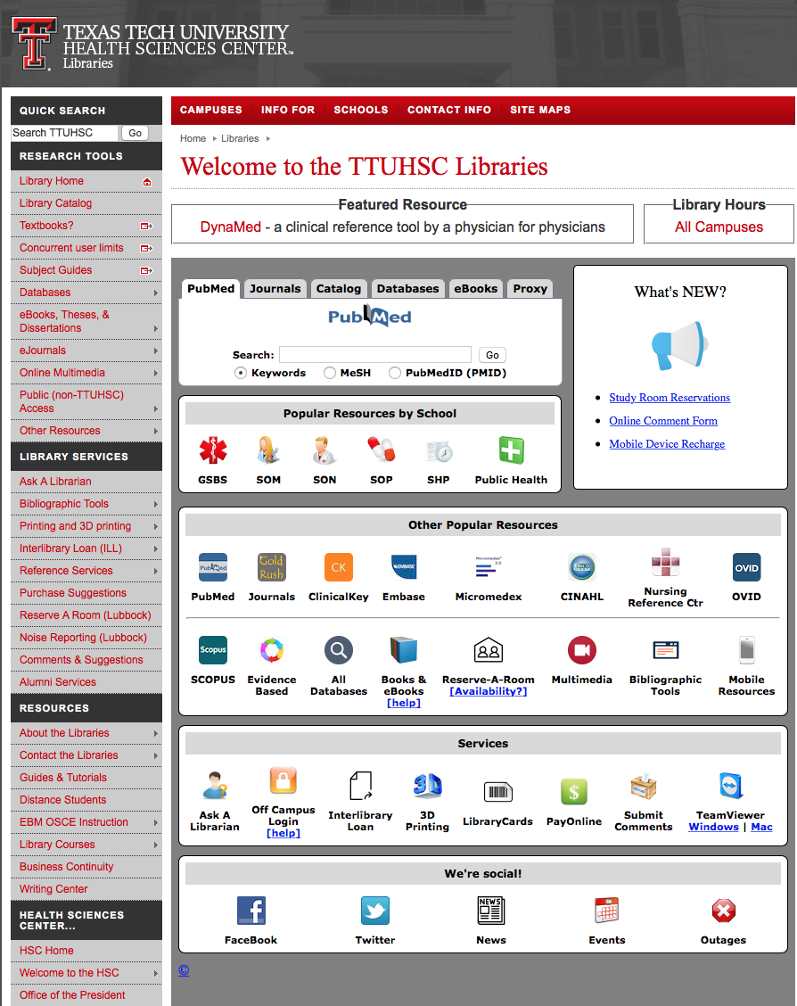
www.ttuhsc.edu/libraries

Slide 4
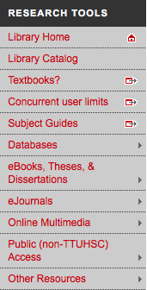
www.ttuhsc.edu/libraries
Select
Subject Guides

Slide 5
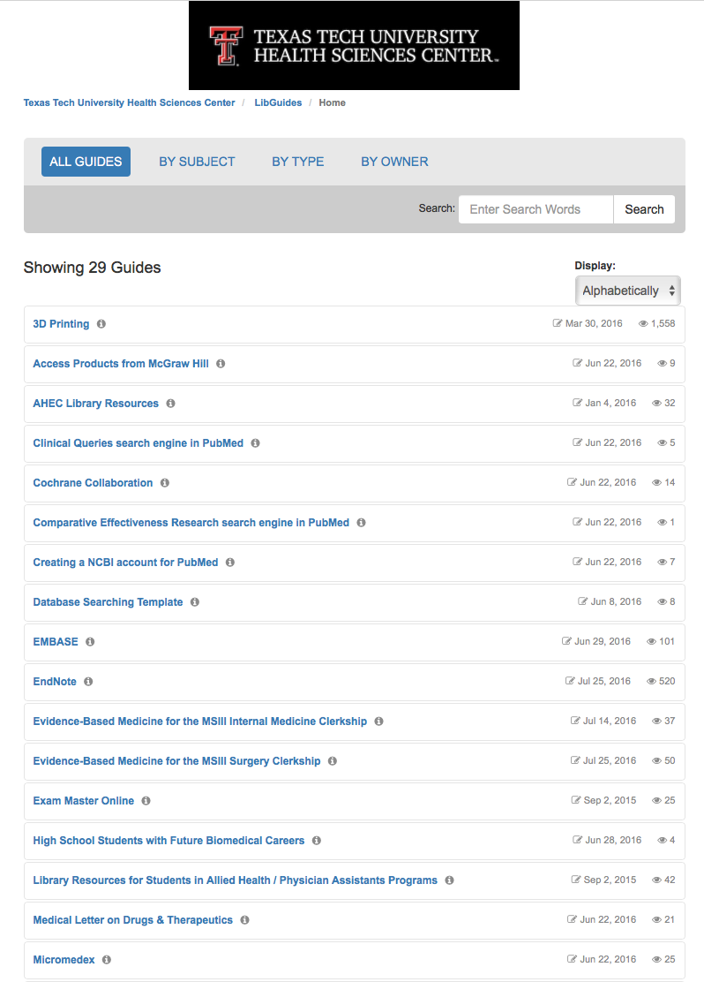
Tutorials

Slide 6
Physician-Patient
Interactions
&
Communication

Slide 7
www.ttuhsc.edu/libraries
Click Clinical Key

Slide 8
Clinical Key
* content from books, journals, and videos
First Consult
*point of care decision support tool within Clinical Key
* main source of information is from the
evidence based organization:
The Cochrane Collaboration where possible

Slide 9
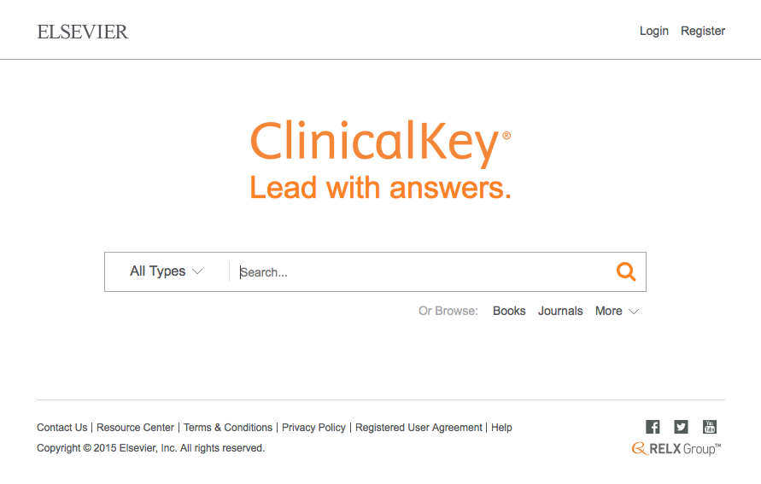
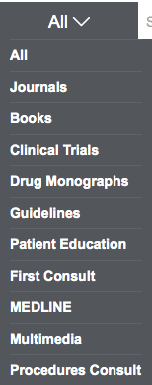
Click All
Select First Consult

Slide 10
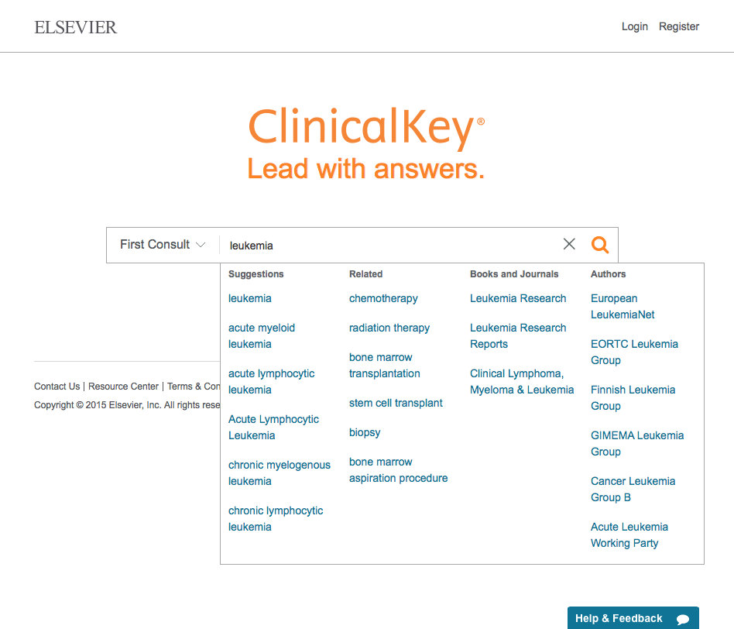
Enter leukemia
Select topic

Slide 11
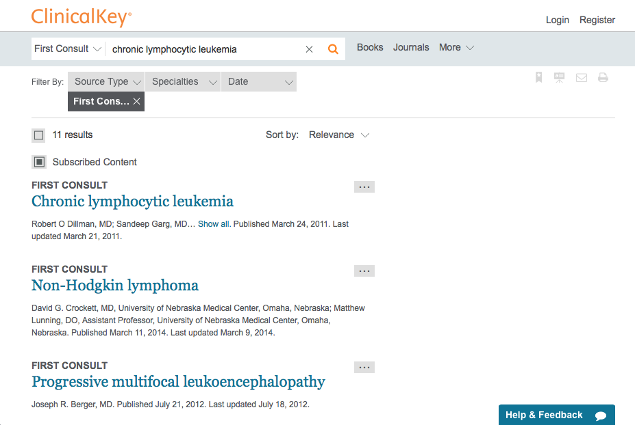
Click Chronic lymphocytic leukemia

Slide 12
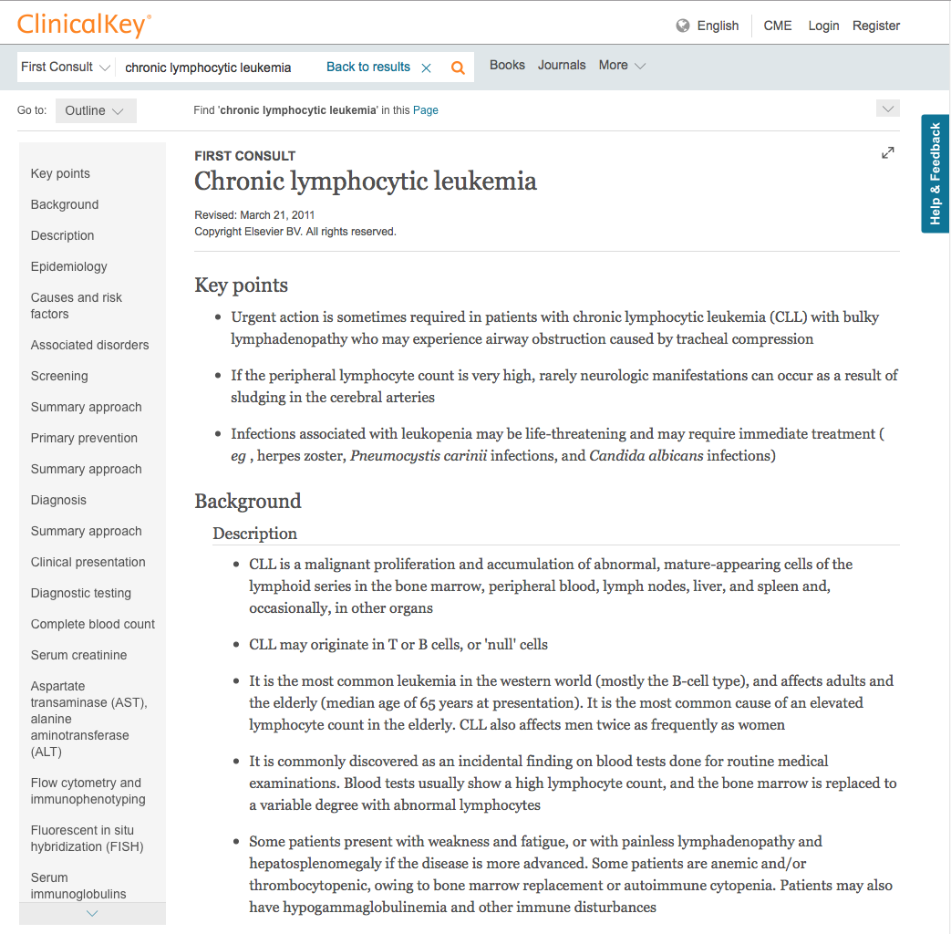
Click Clinical presentation

Slide 13
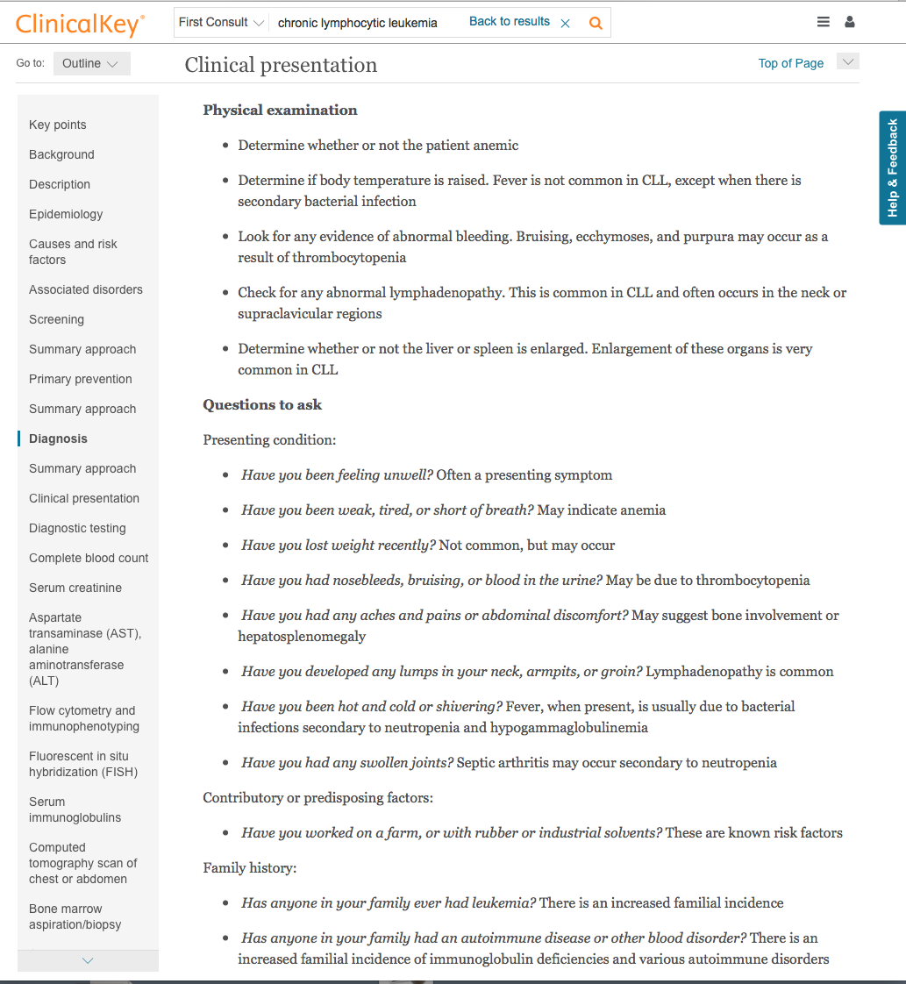
Physical examination
Questions to ask

Slide 14
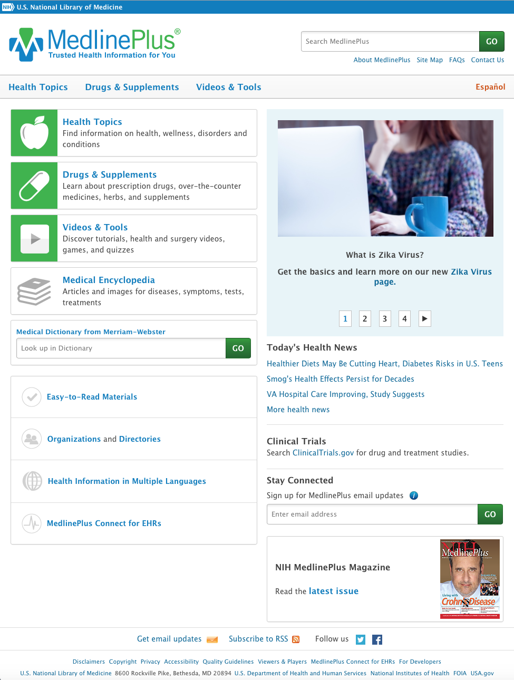
www.medlineplus.gov
Authoritative
Reliable
Easily understood

Slide 15
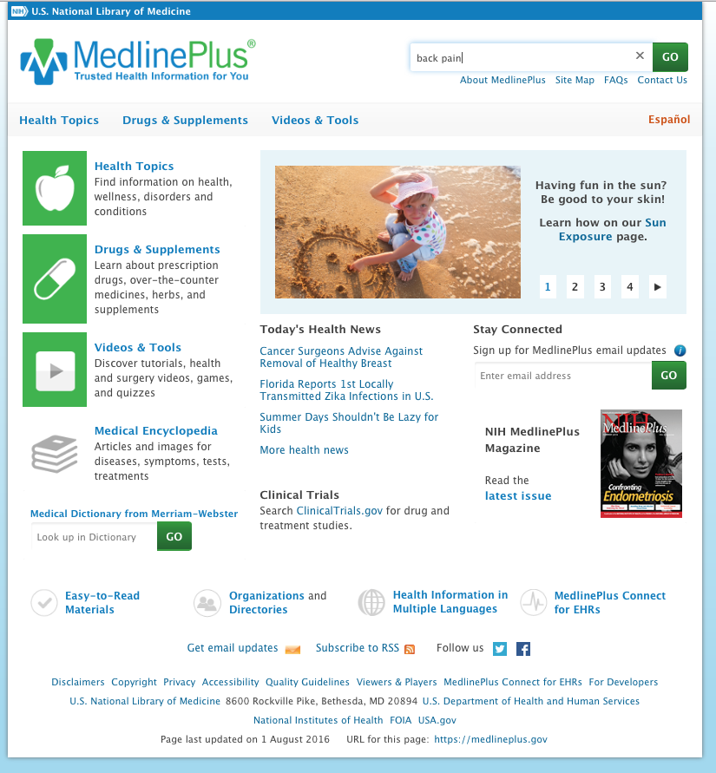
Search back pain

Slide 16
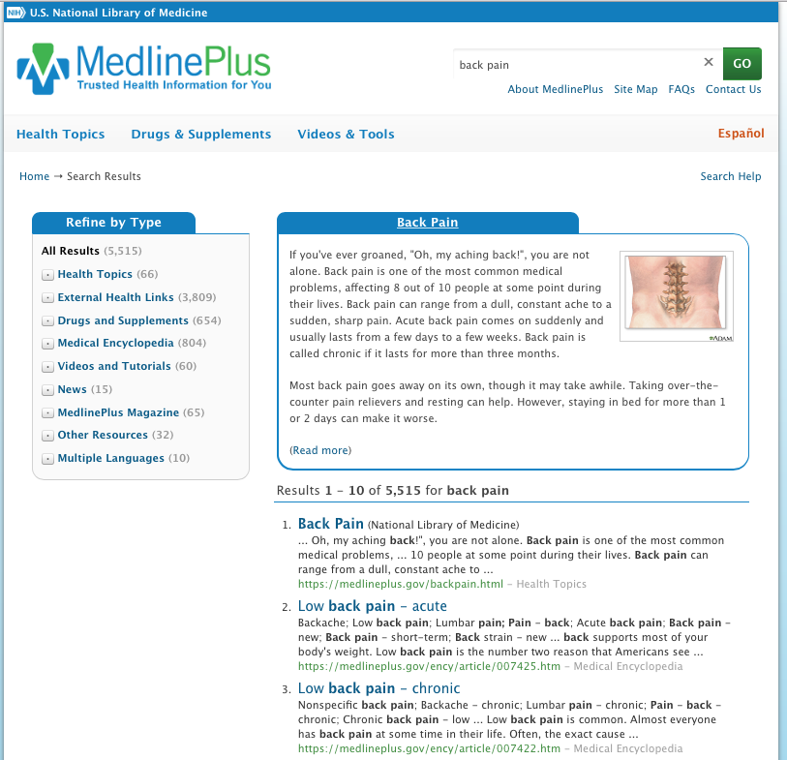
Click back pain

Slide 17

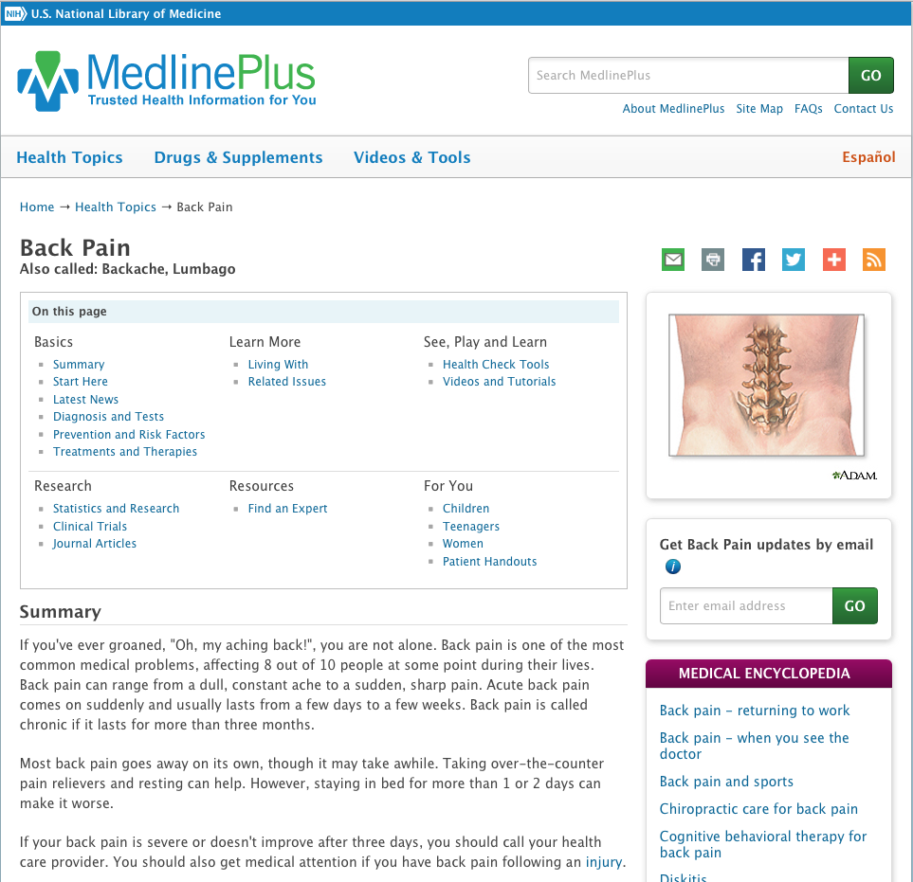
Illustration
links
Medical Encyclopedia

Slide 18
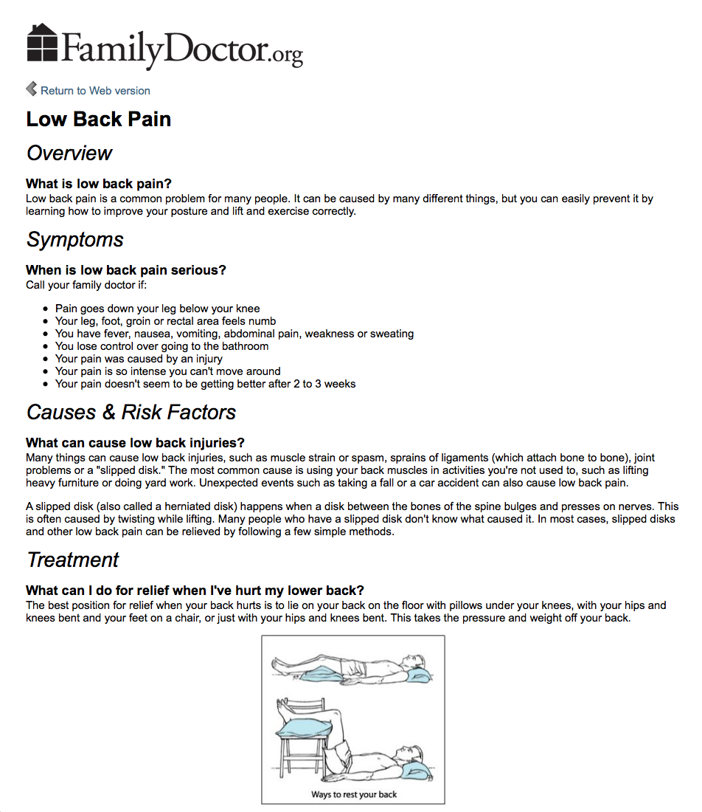
Handout

Slide 19
Click Espanol
~

Slide 20
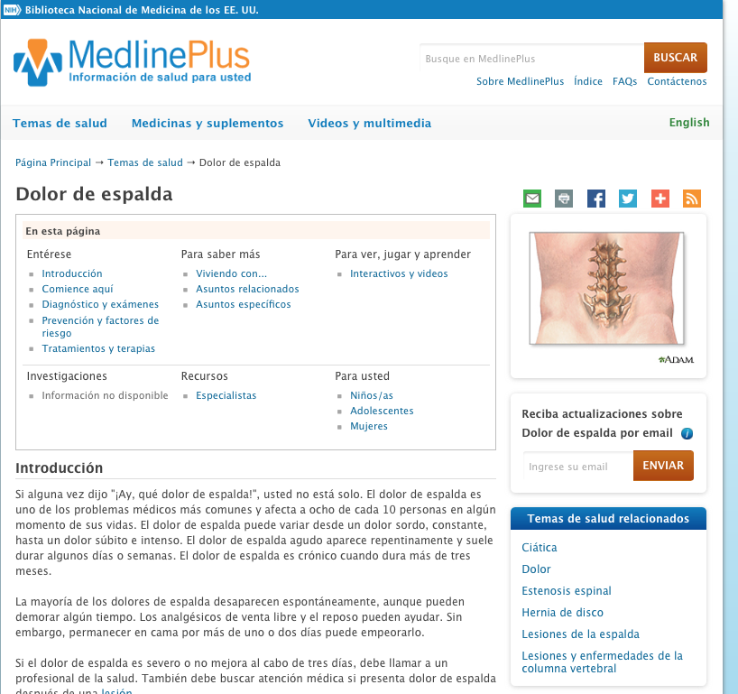
Click MedlinePlus icon
Click English

Slide 21
Multiple
Languages

Slide 22
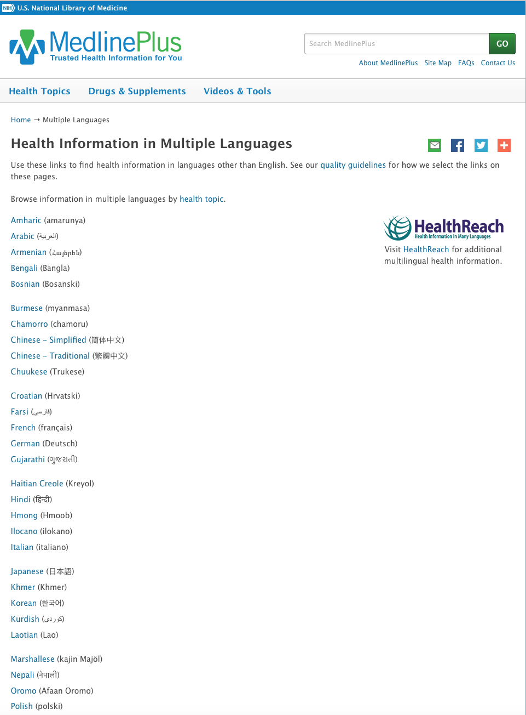
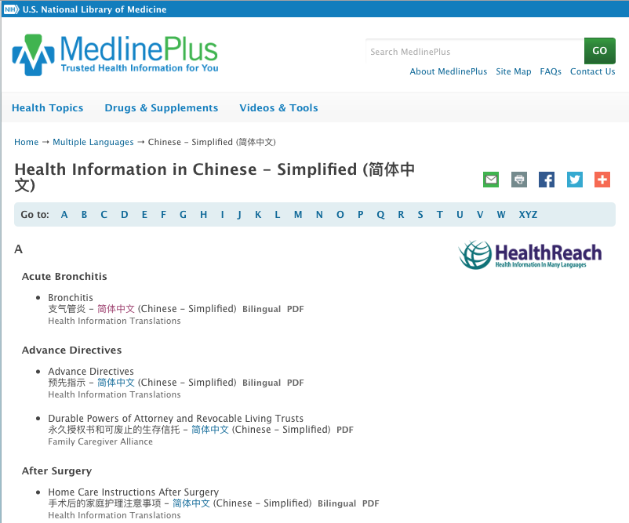
Select a language
Select a topic and click links

Slide 23
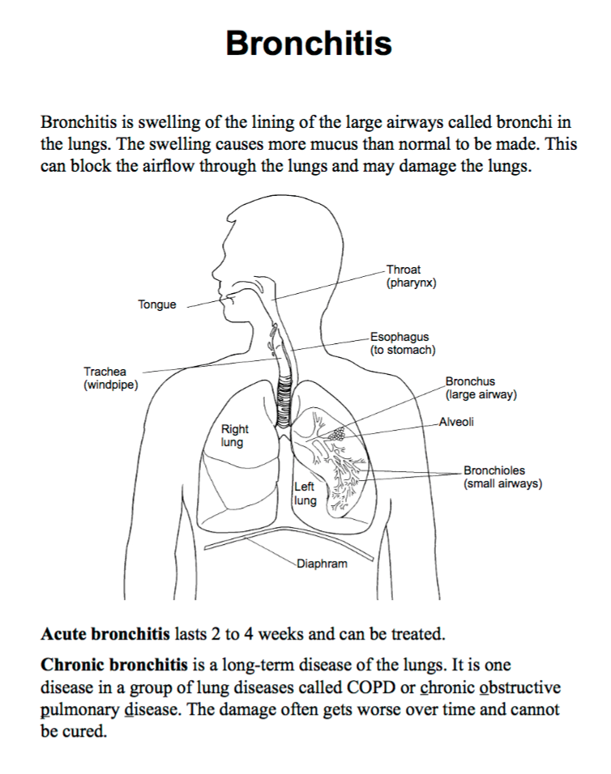
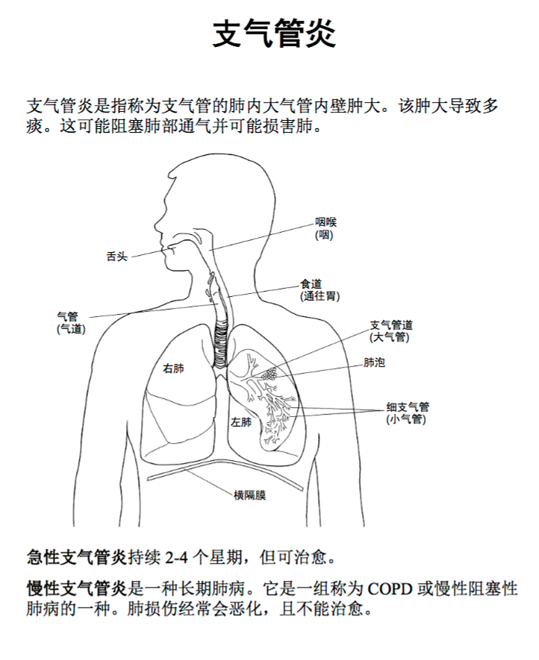
Documents

Slide 24
Click Drugs & Supplements

Slide 25
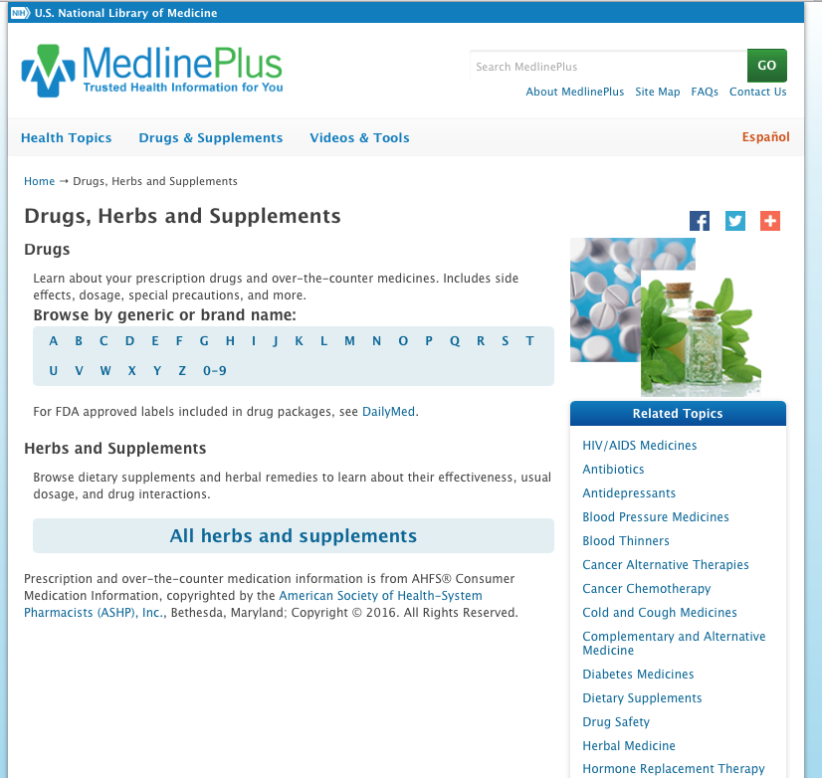
Select a Letter

Slide 26
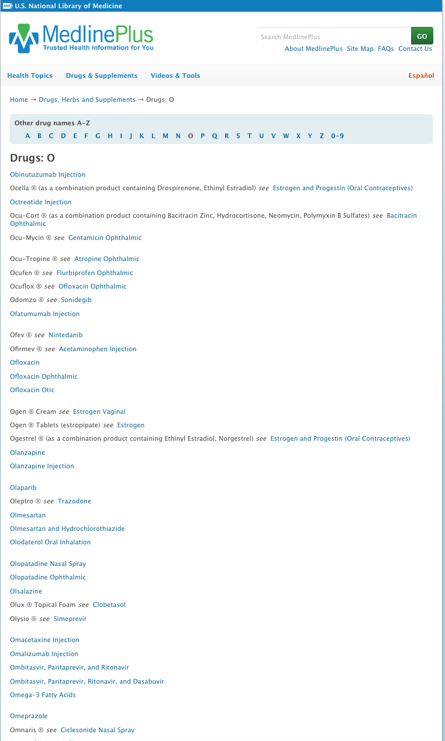
Select Omeprazole

Slide 27

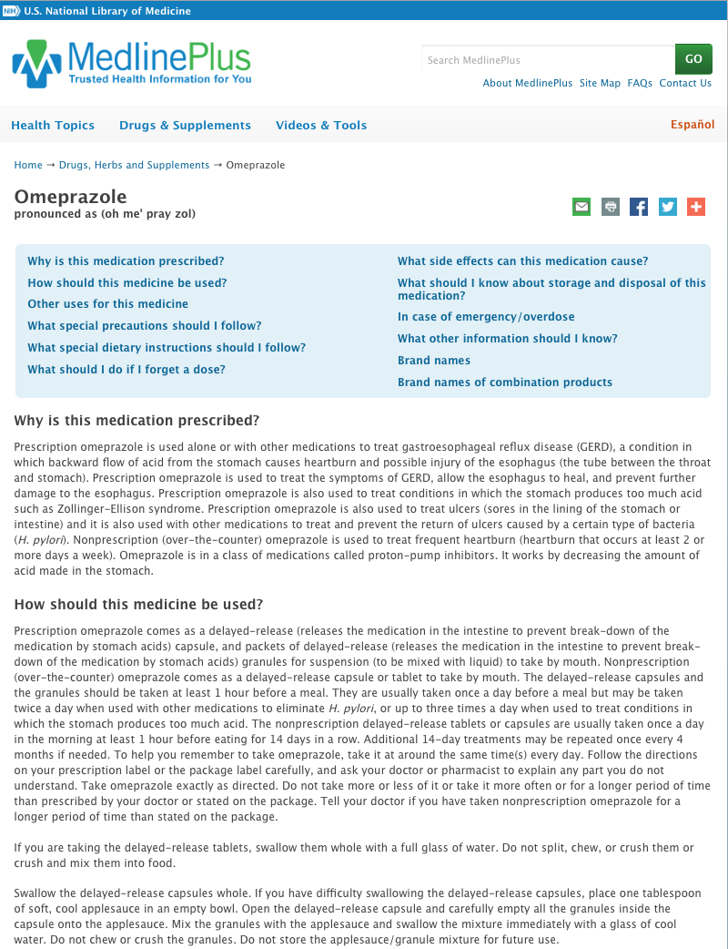
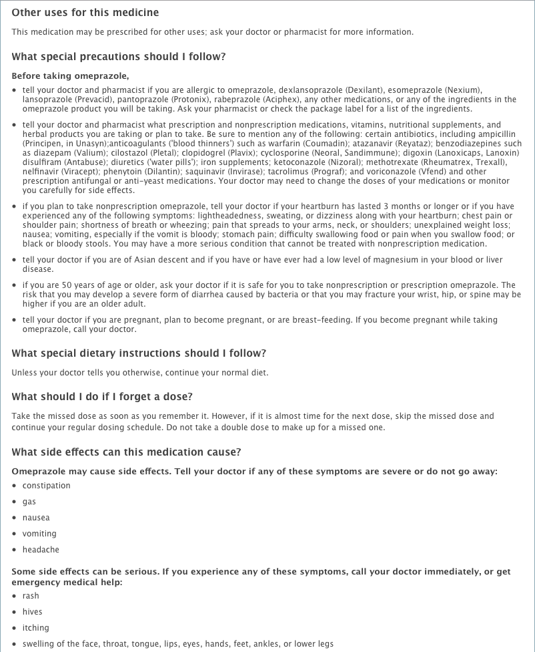
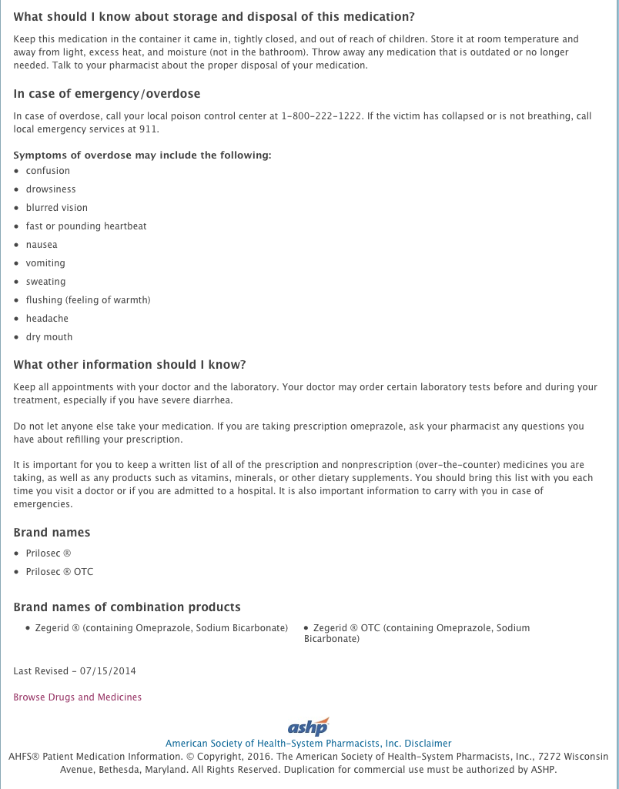

Slide 28
Select Videos & Tools

Slide 29

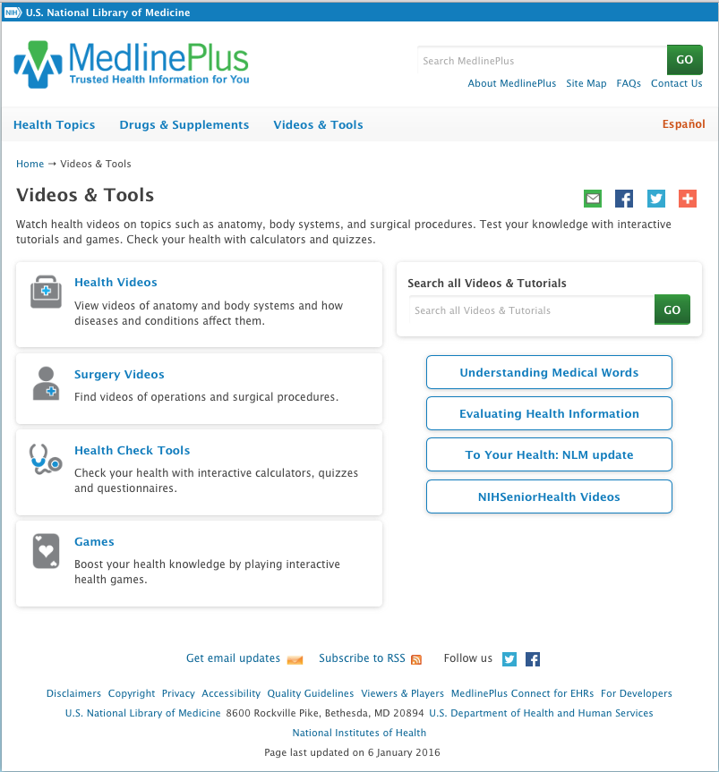
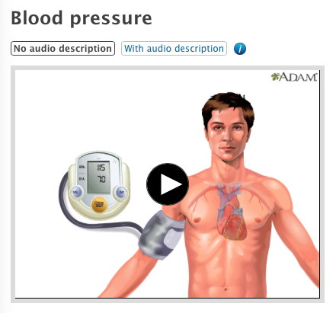

Slide 30
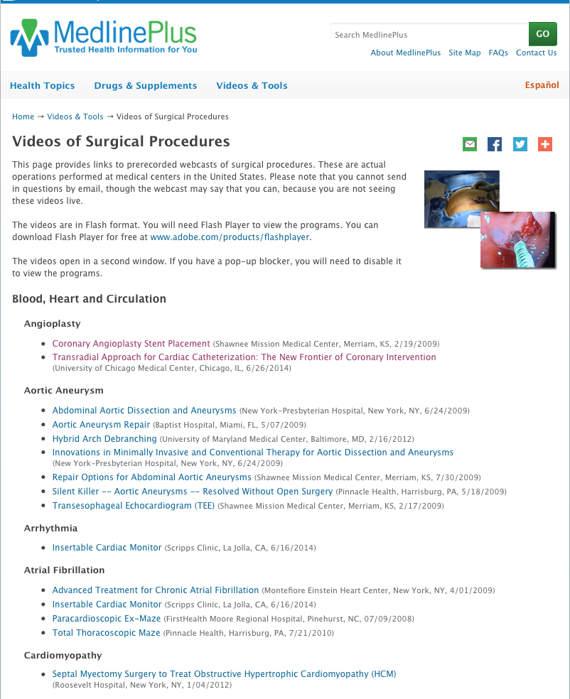

Slide 31
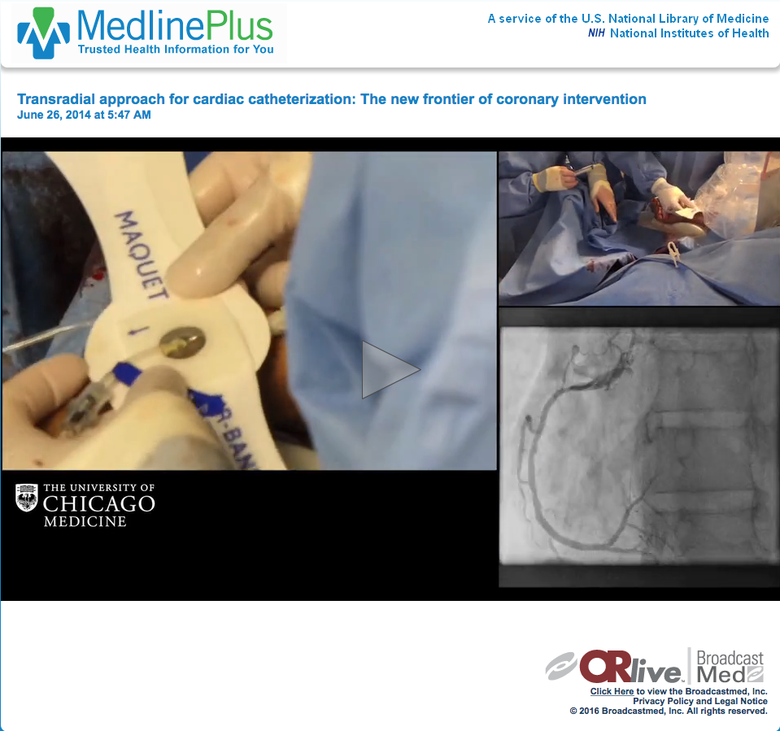

Slide 32
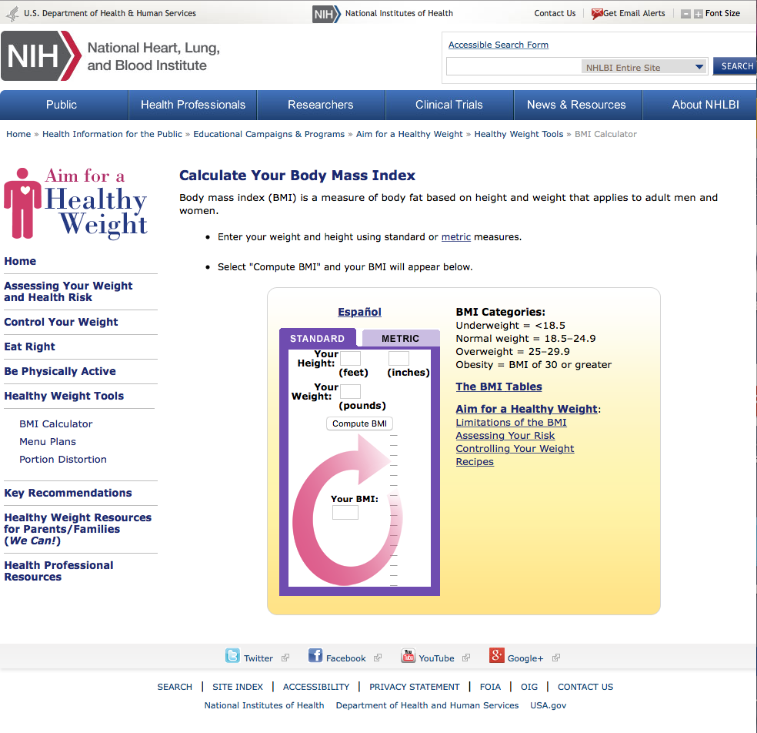

Slide 33
Health Literacy

Slide 34
Health literacy is “the degree to which individuals have the capacity to make appropriate health decisions.”
  Low literacy skills indicate problems with reading, writing, listening, speaking, and math.
  Health care professionals must be aware of their patients’ health literacy levels to maximize the effectiveness of their interactions.
  One way to help patients with low literacy skills is to use visual cues to enhance health education messages.
  (Nielsen-Bohlman, L., 2004)

Slide 35
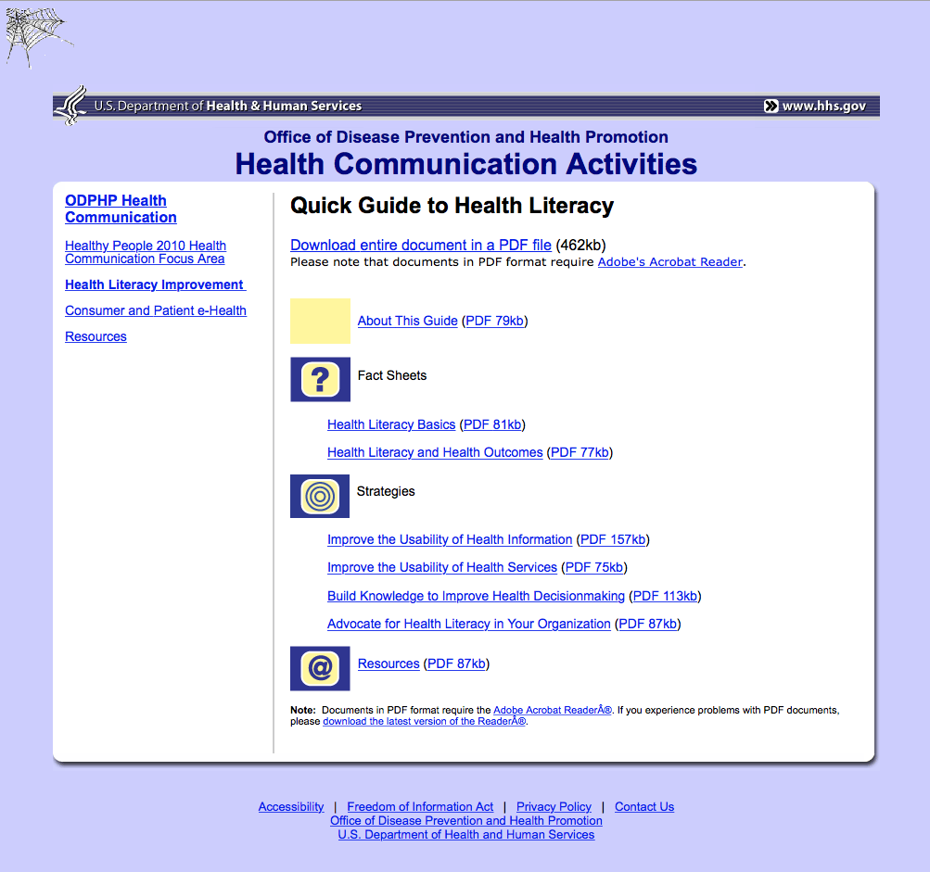
https://health.gov/communication/literacy/quickguide/

Slide 36
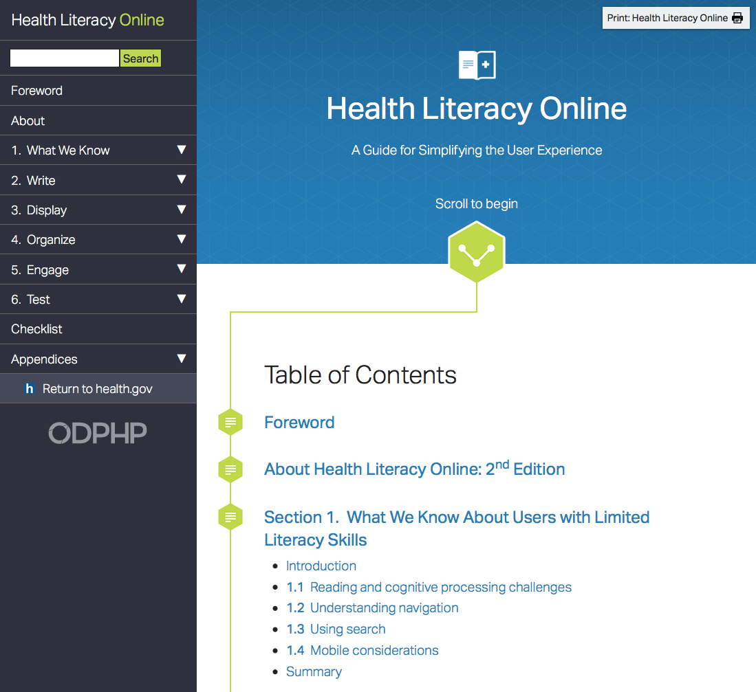
https://health.gov/communication/literacy/quickguide/

Slide 37
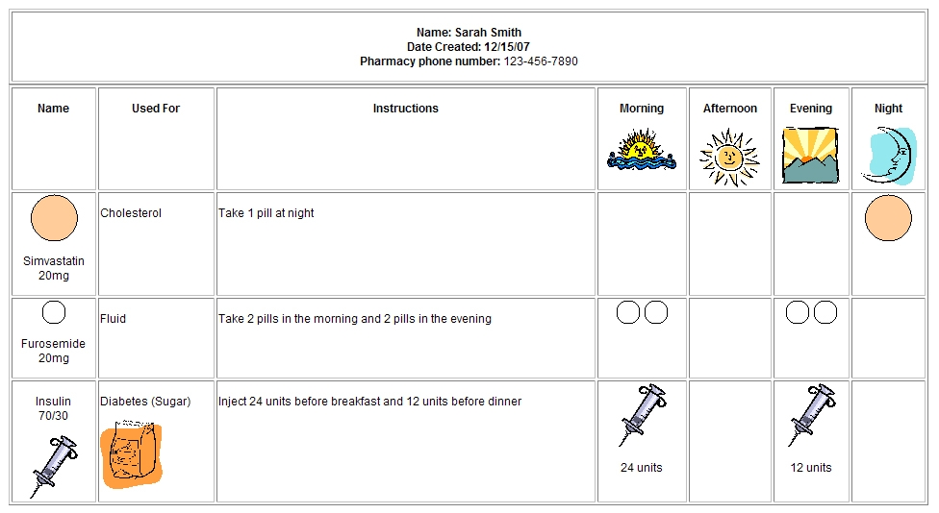
Example of a patient handout that uses visual cues to help the patient understand how to take medications correctly.
U.S. Department of Health and Human Services, The Pharmacy Intervention for Limited Literacy (PILL) Study Research Team, Jacobson, M.P.H., C.H.E.S., K. L., Kripalani, M.D., M.Sc., S., Gazmararian, Ph.D., M.P.H., J. A., & McMorris, B.A., K. J. (2008).
How to create a pill card (08-M016).
Retrieved 8-1-2016 from Agency for Healthcare Research and Quality website:
http://www.ahrq.gov/sites/default/files/wysiwyg/patients-consumers/diagnosis-treatment/treatments/pillcard/pillcard.pdf

Slide 38
Patient History

Slide 39
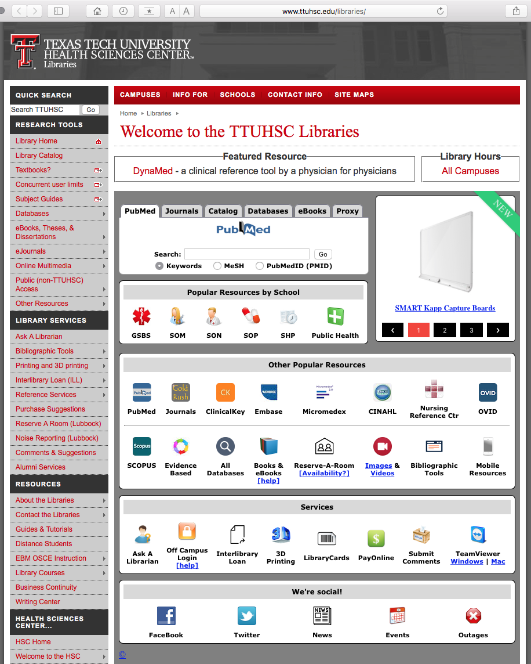

www.ttuhsc.edu/libraries
Under Popular Resources by School
click

Slide 40
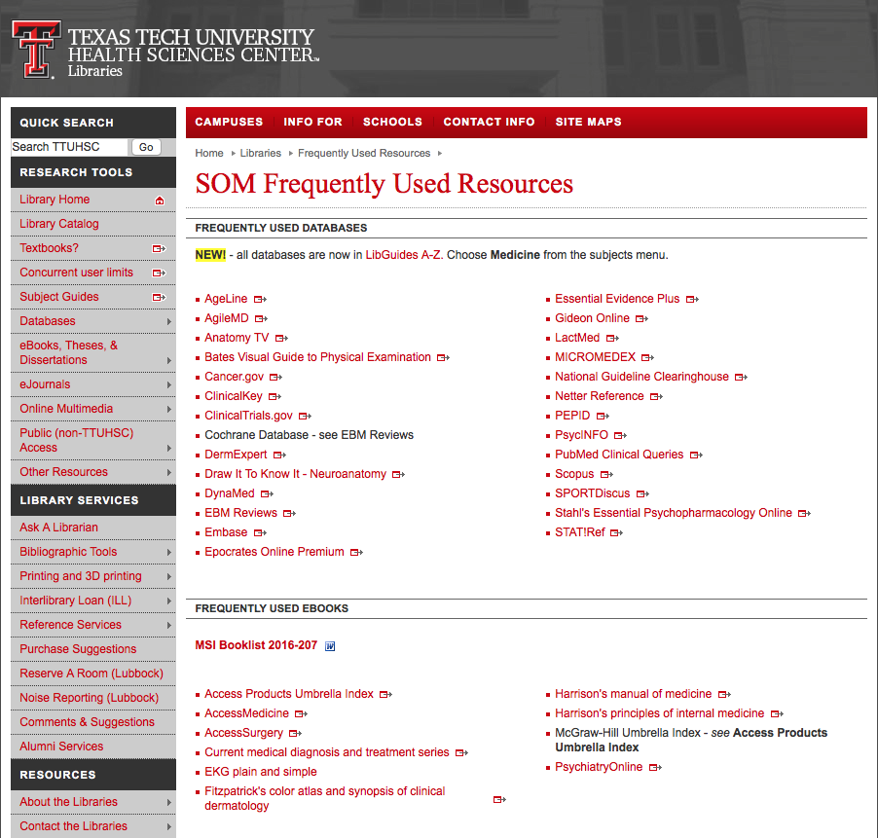
Click Access Medicine

Slide 41
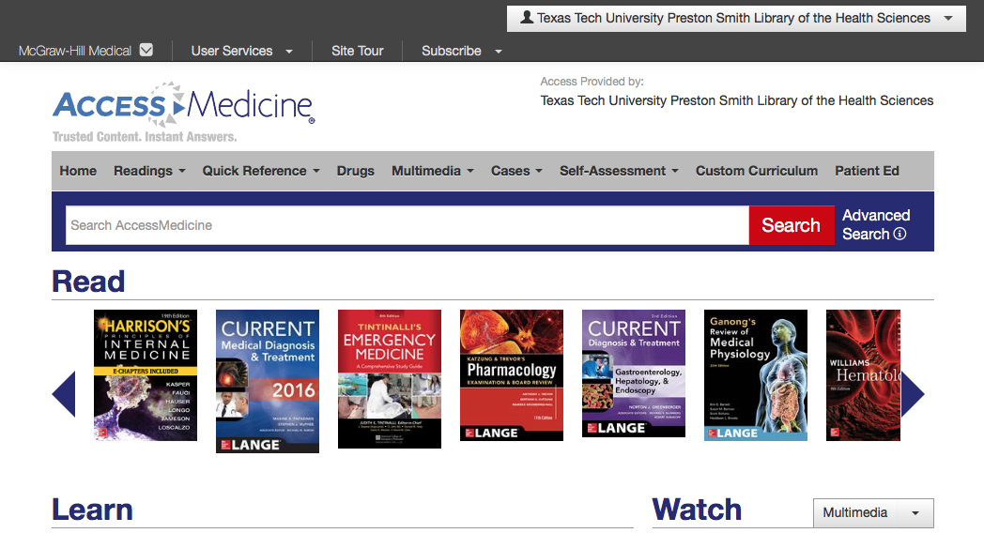
Click the drop down menu

Slide 42
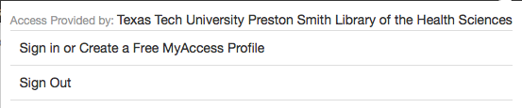
Click Create a Free MyAccess Profile

Slide 43
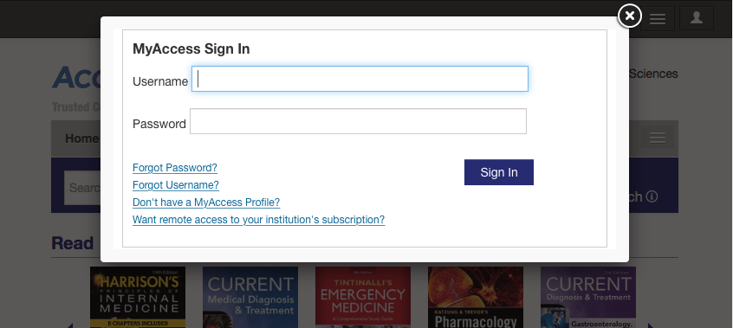
Click Don’t have a MyAccess Profile?

Slide 44
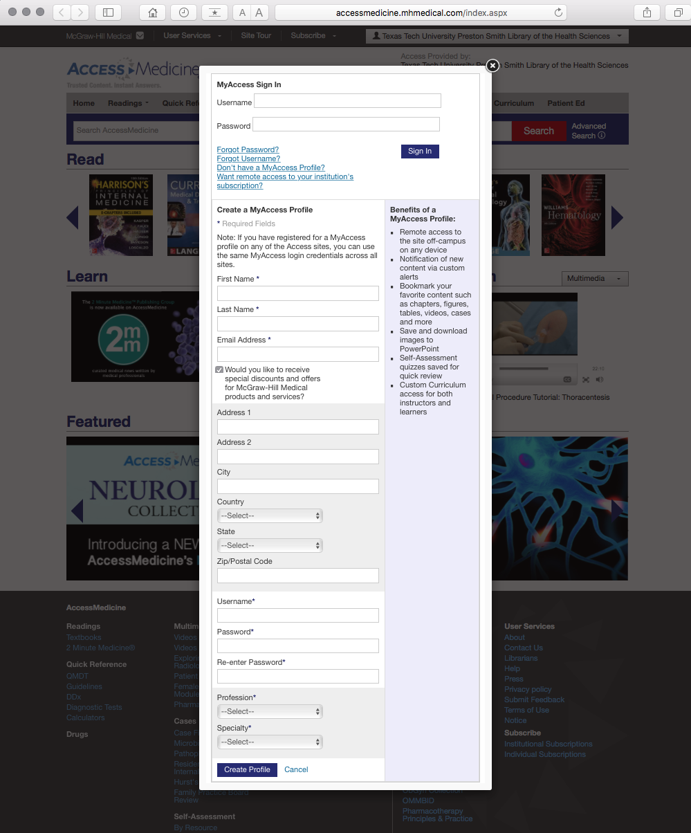
Complete the form

Slide 45
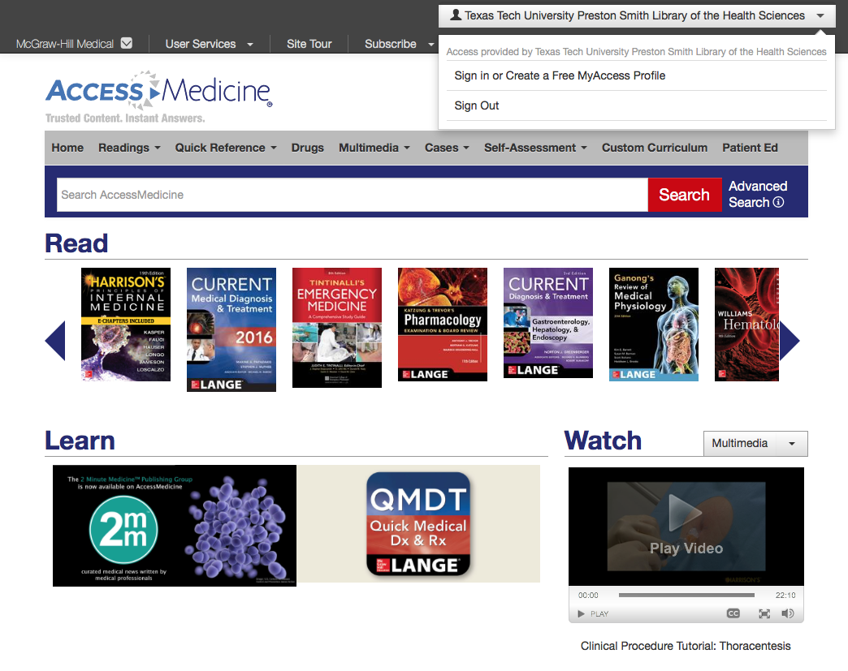
Login to your personal account
For free online textbooks, access from a tablet, laptop, or desktop.

Slide 46
Click arrow to the book:
“The Patient History”

Slide 47

http://accessmedicine.mhmedical.com/book.aspx?bookID=500

Slide 48
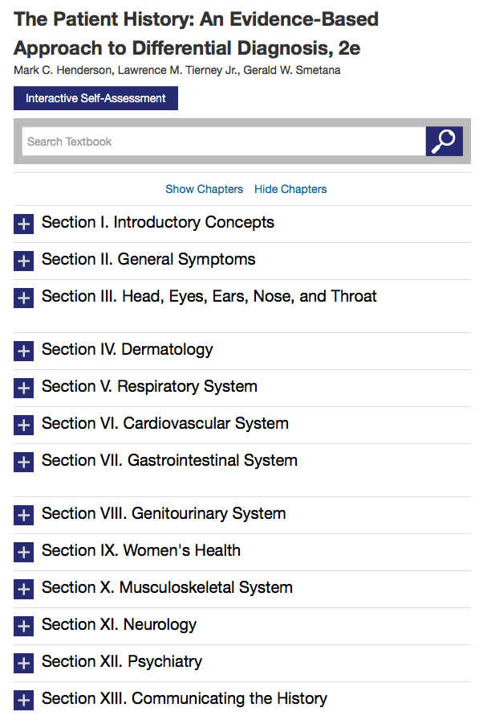
Select
Interactive
Self-Assessment

Slide 49
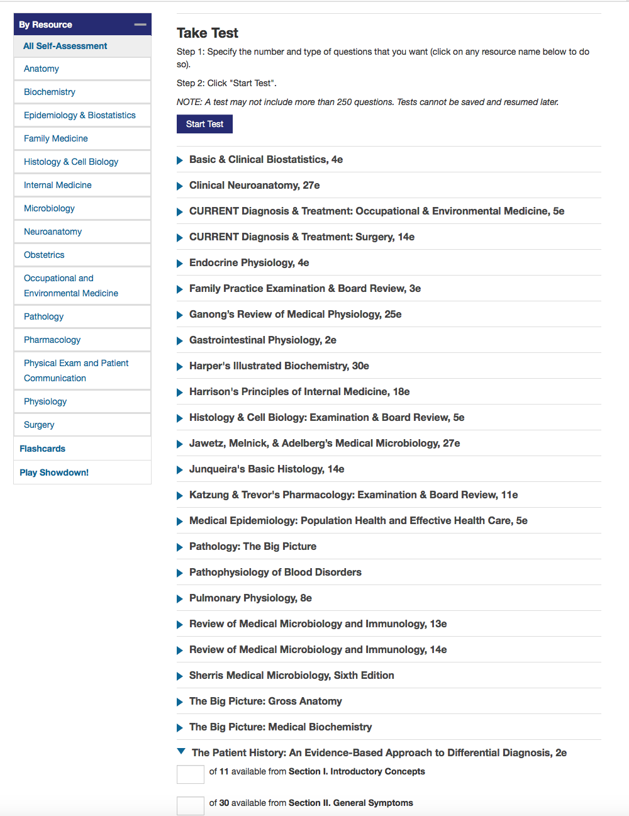
Scroll to
The Patient History

Slide 50
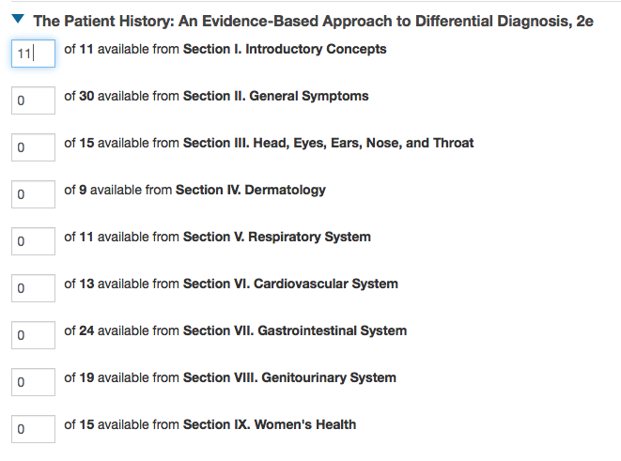
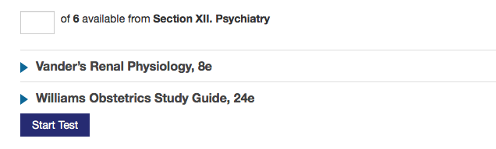
Select the number of questions
Click
Start Test

Slide 51
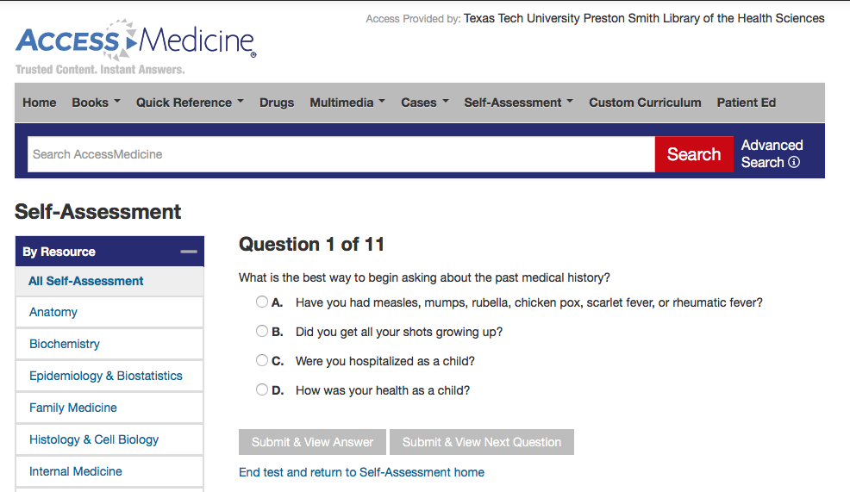
Submit & View Answer
or
Submit & View Next Question

Slide 52
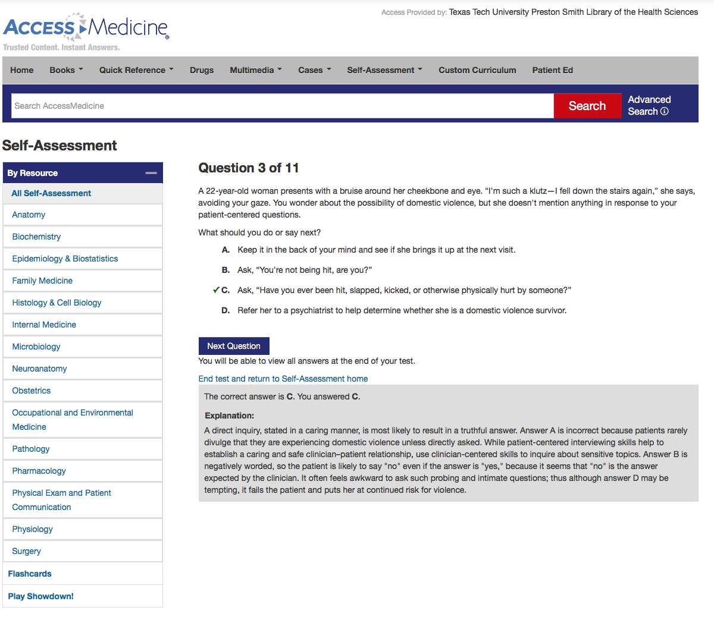
Explanation

Slide 53
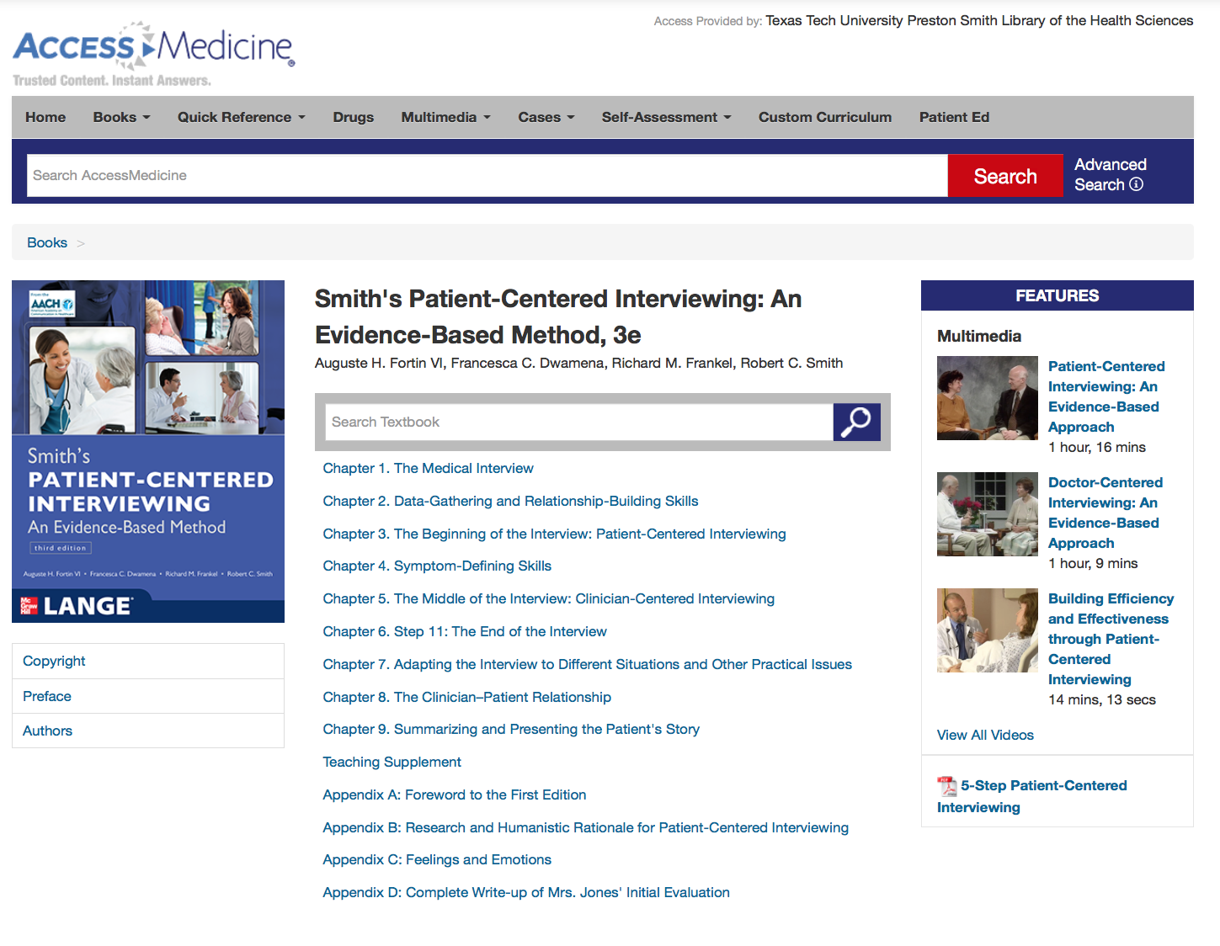
Patient-Centered Interviewing
NOTE!

Slide 54
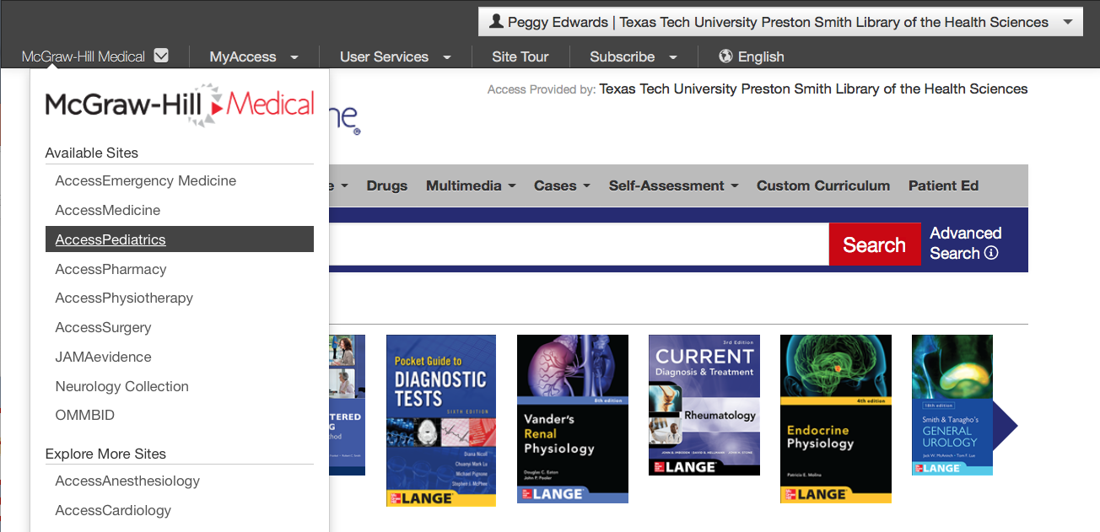
Click McGraw-Hill Medical
Select Access Pediatrics

Slide 55
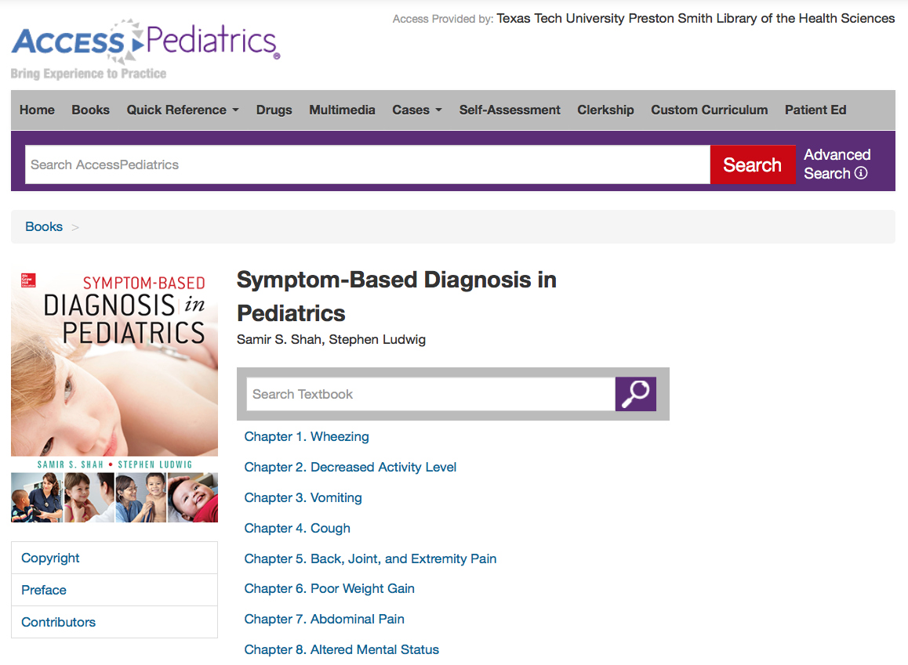

Slide 56
Physical Exam

Slide 57
www.ttuhsc.edu/libraries
Under Popular Resources by School
click

Slide 58
Click Bates Visual Guide to Physical Examination

Slide 59
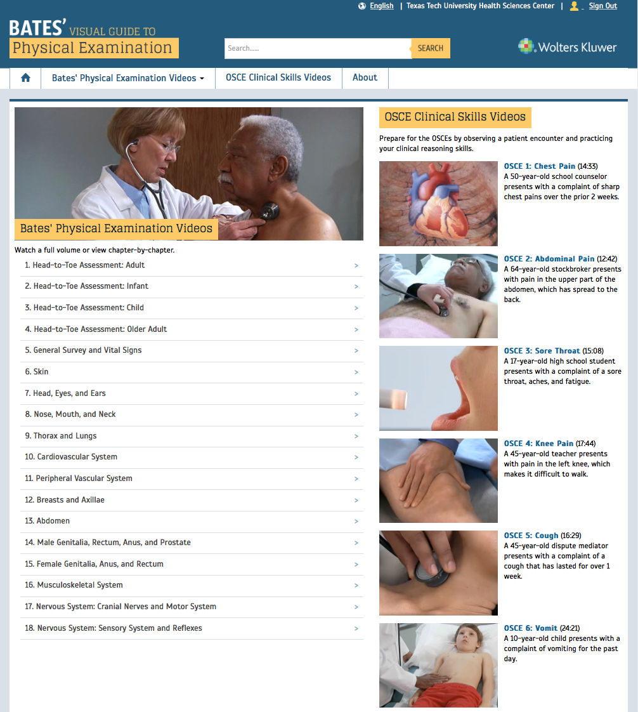
OSCE Clinical Skills Videos
Videos

Slide 60
Take a moment to explore Bates

Slide 61
2 Ethics Journals

Slide 62

www.ttuhsc.edu/libraries
Select Gold Rush

Slide 63
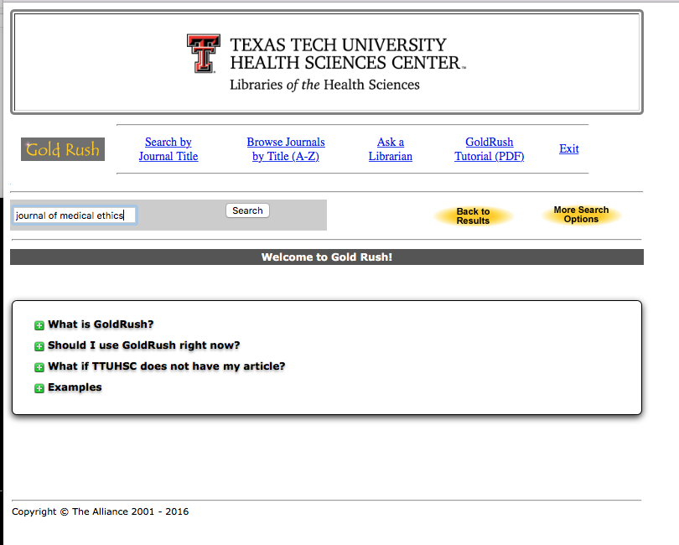
Enter
Journal of Medical Ethics

Slide 64

Select
Journal of Medical Ethics

Slide 65

Note dates, select a
publisher
Click
HighWire Press Journals in this example

Slide 66

Select Current Issue or Archive, navigate to appropriate year, month, and page for your article

Slide 67


Slide 68
Search Engine for
Comparative Effectiveness Research

Slide 69
Federal Coordinating Council for
Comparative Effectiveness Research
Comparative Effectiveness:
conduct and synthesize research
compares benefits and harms of different interventions/strategies
prevent, diagnose, treat and monitor
health conditions in ‘real world’
Purpose:
improve health outcomes
develop and disseminate evidence-based information
Determine:
which interventions are most effective
for which patients under specific circumstances

Slide 70

www.ttuhsc.edu/libraries
Click PubMed

Slide 71

Click Topic-Specific Queries

Slide 72

Click

Slide 73

Search PubMed for articles on:
clinical comparisons of treatments
OR
reports of treatment outcomes

Slide 74
Select Research Category:
clinical studies
randomized controlled trials
observational studies
systematic reviews
simulations

Slide 75
Select Topics:
Health Disparities
Costs and Cost Analysis
Comparative Effectiveness Research
as Subject
or

Slide 76

Enter: genetic testing
Select: Health Disparities

Slide 77

Results
Click article title

Slide 78

Article on:
economic modeling of
molecular diagnostic tests
for antibiotic resistance in
tuberculosis

Slide 79
Evidence-Based Medicine
and the
Quality of Care

Slide 80
EBP Literature from
PubMed’s Clinical Queries

Slide 81



PubMed Database
Biomedical & life sciences journal literature - @6,000 journals
International scope
Developed and maintained by the:
National Center for Biotechnology Information
    at the U.S. National Library of Medicine
    at the National Institutes of Health

Slide 82



Accessing PubMed
Freely available over the Internet
@ www.pubmed.gov
Also through library’s home page

Slide 83




Clinical Queries Searchable by:
Diagnosis
Therapy
Prognosis (prediction of probable outcome)
Etiology (cause)

Slide 84
Clinical Queries Searchable by:
Diagnosis
Therapy
Prognosis (prediction of probable outcome)
Etiology (cause)

Slide 85

PubMed’s Clinical Queries
uses pre-formulated search strategies with a keyword search

Slide 86
To begin…

Slide 87
www.ttuhsc.edu/libraries
Click PubMed

Slide 88

Home Page

Slide 89
Click Clinical Queries

Slide 90

Enter asthma
Click
Search

Slide 91

Results for Therapy and
Broad Scope

Slide 92

Click the
drop-down menus

Slide 93
Change to Diagnosis

Slide 94

Change to Narrow Scope

Slide 95

Results for Diagnosis
and
Narrow Scope
Click See all (1977)

Slide 96

Select filters to narrow

Slide 97

Click 5 years to limit
Click humans
Selections will turn blue: ✓ 5 Years

Slide 98
Click Show additional filters

Slide 99

Select
Languages
✔
Click Show

Slide 100

Click English

Slide 101

Click Review

Slide 102

Results have narrowed to 57 articles
Click on the title of the article you wish to read

Slide 103


Click for Free Full Text

Slide 104

TTUHSC Libraries - Proxy Server
When Searching from Off Campus:
Enter the
Eraider username and password
assigned to you
by Information Services.
Problems with eRaider call: 806-743-1234
a

Slide 105


Click

Slide 106

Full Text

Slide 107

Some articles will have the
icon which is also Free Full Text.
TTUHSC ONLINE

Slide 108
Have Questions
or
Need Help?

Slide 109


www.ttuhsc.edu/libraries
Click

Slide 110
The End

