Slide 1
30 Min. to
PubMed Search Tips pt. 2
Margaret Vugrin, MSLS, AHIP
Preston Smith Library

Slide 2
This Time
Locating full-text
Searching by author
Searching by journal

Slide 3
Refresher
Does vigorous physical activity increase the risk of bleeding in children with hemophilia?

Slide 4
Sometimes you have to use synonyms or translate your terms to database terms
Does vigorous physical activity increase the risk of bleeding in children with hemophilia?
http://www.ncbi.nlm.nih.gov/pubmed?holding=ttuhsclib

Slide 5
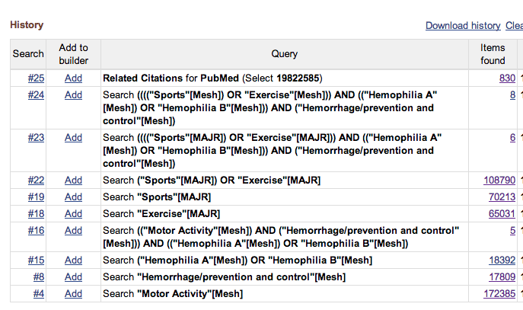

Slide 6
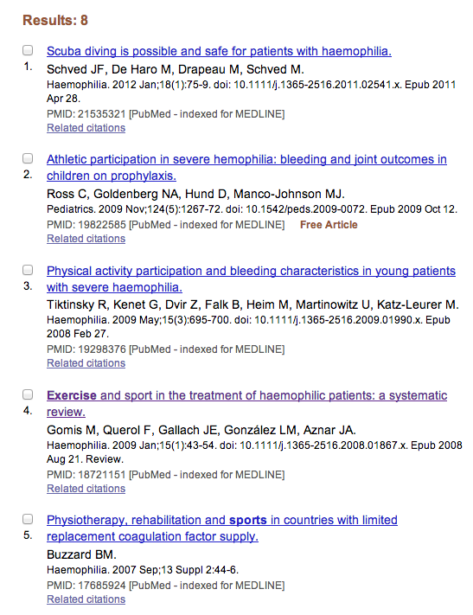

Slide 7
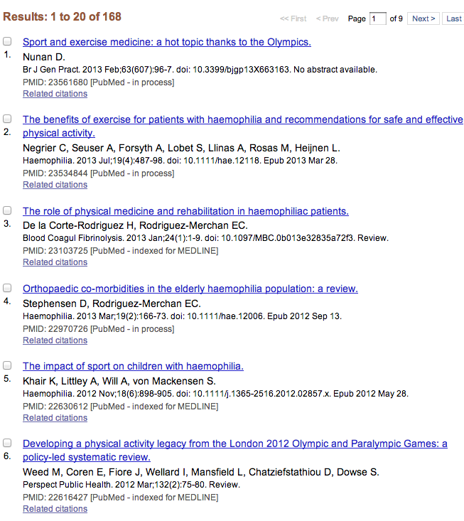

Slide 8
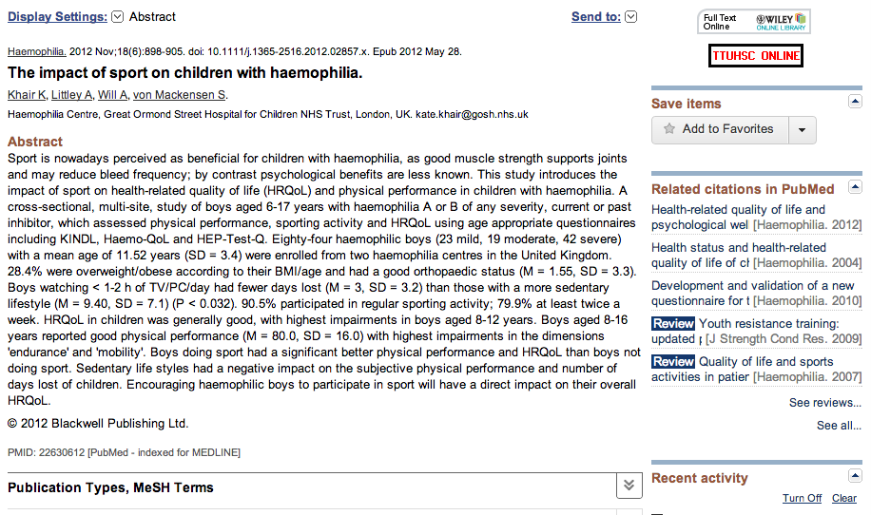
http://www.ttuhsc.edu/libraries

Slide 9
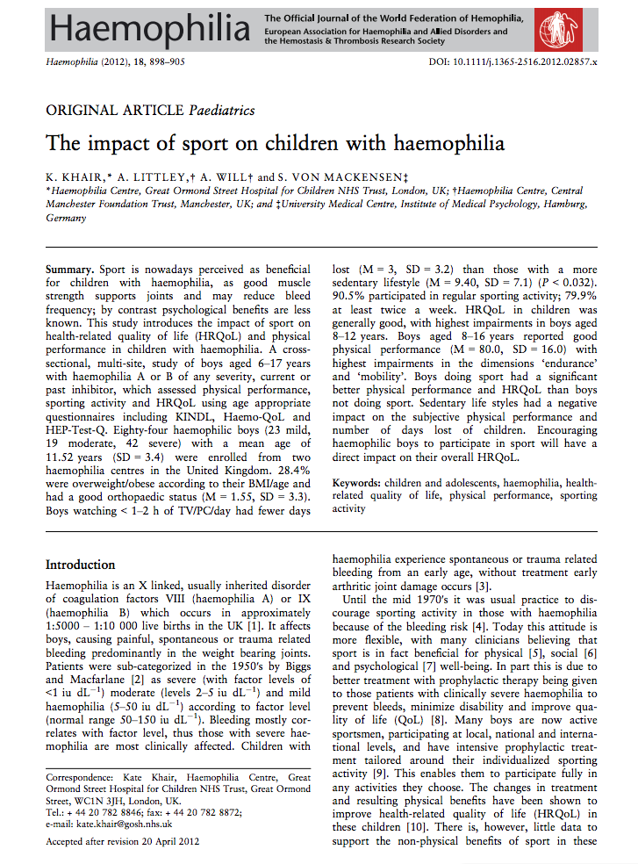
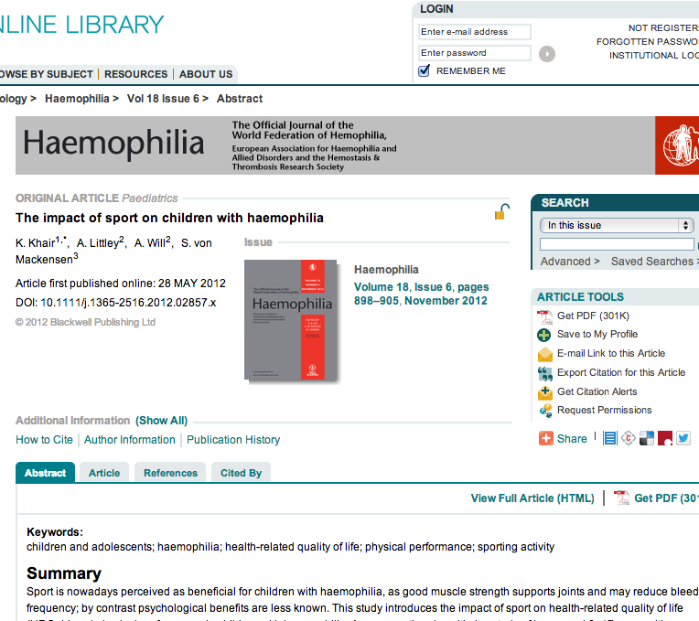

Slide 10
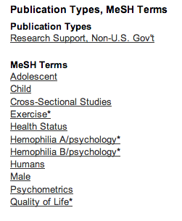
http://www.ttuhsc.edu/libraries

Slide 11
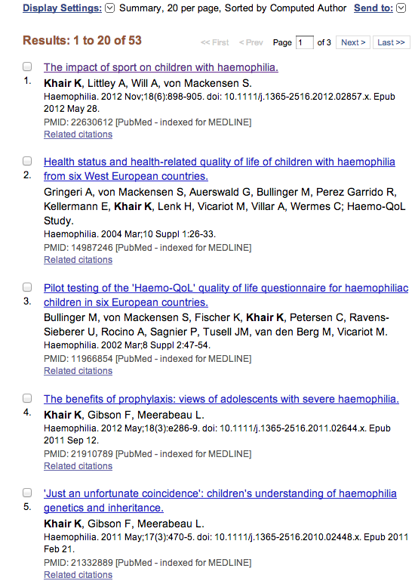
Author searching

Slide 12
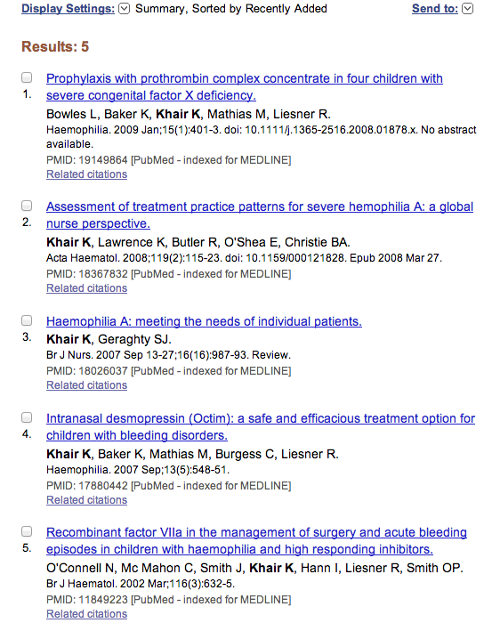
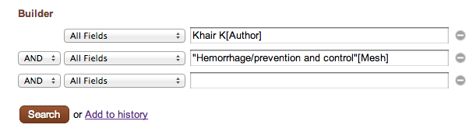
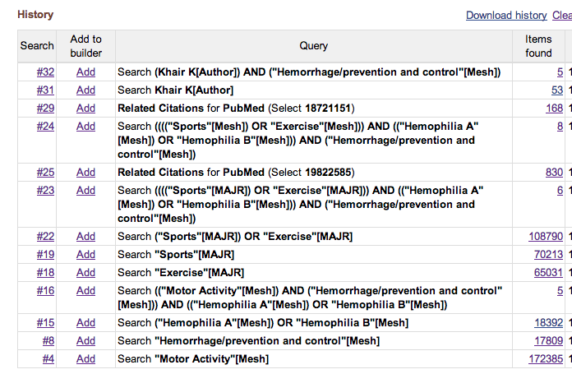
Add
Add

Slide 13
Questions???

Slide 14
Searching within a Journal
I heard during rounds that there’s a recent meta-analysis on treatment of cns tumors in childhood acute lymphoblastic leukemia (ALL).
Oh yes, I remember that it’s in:
Pediatric Blood & Cancer.
I need to present on this article tomorrow!
http://www.ncbi.nlm.nih.gov/pubmed?holding=ttuhsclib

Slide 15
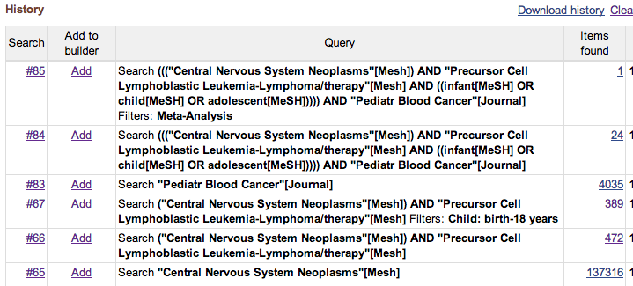

Slide 16
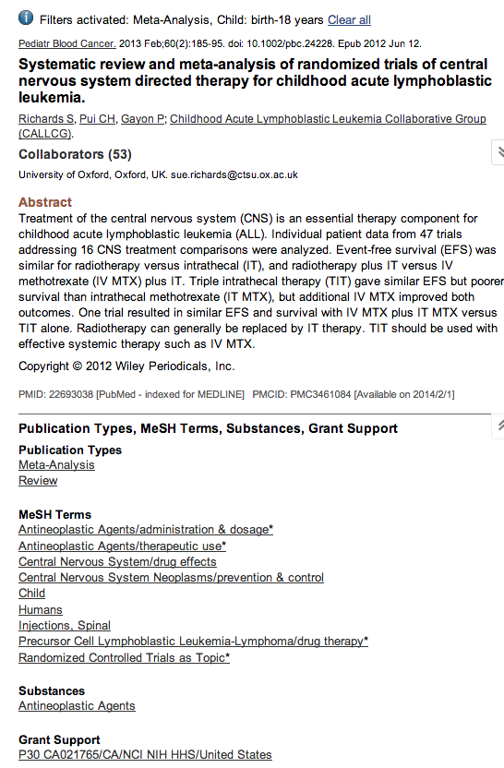

Slide 17
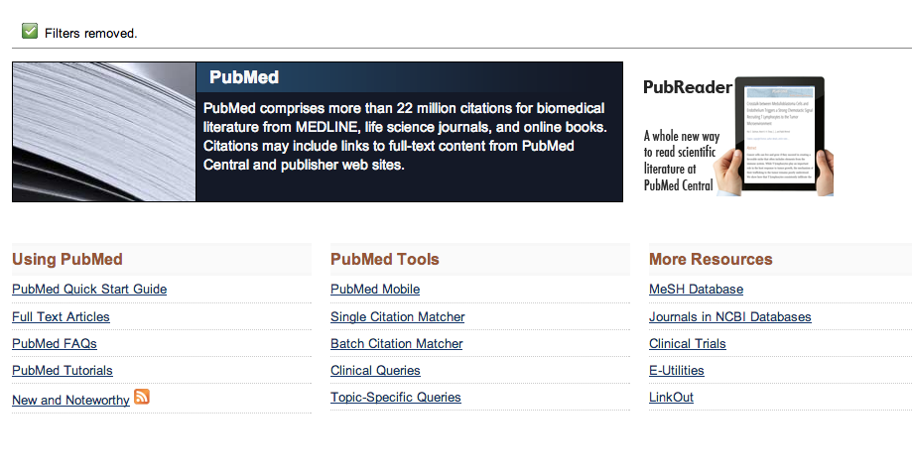

Slide 18
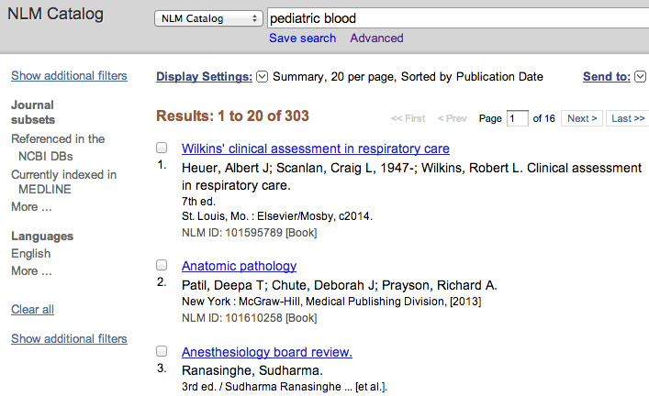
Pediatric blood

Slide 19
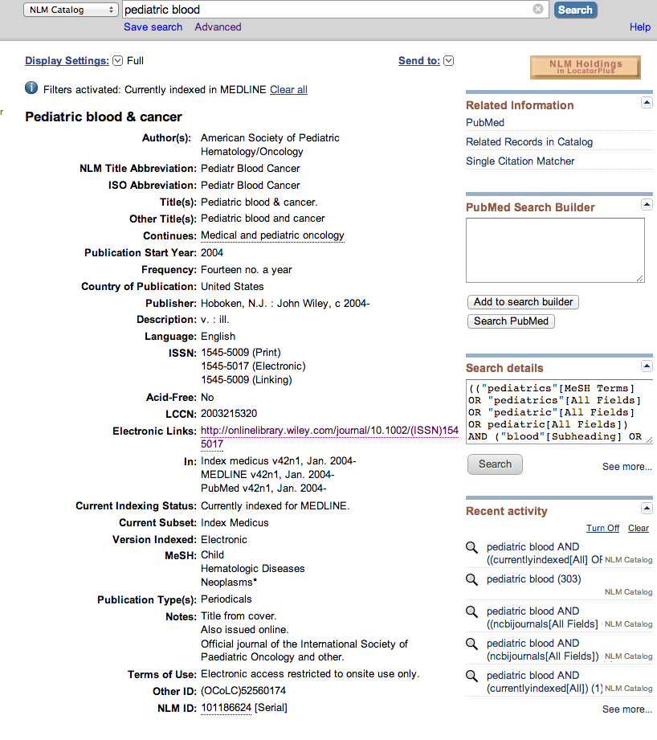


Slide 20
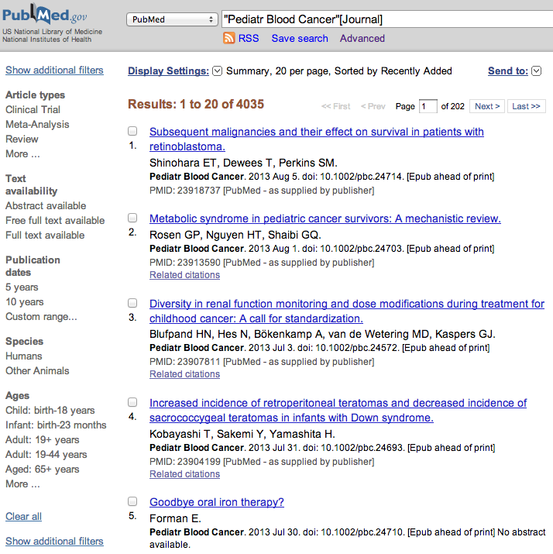

Slide 23
Questions
Can I locate author’s email address within PubMed?
How far back do the journals go that make up PubMed?
Approximately how many titles are indexed to create the PubMed database?

Slide 24
Next Time
Quick steps to locate citations
Gold Rush
Exporting to RefWorks
  Embedding citations in paper
  Creating bibliography of references

Slide 25
Thank you!
margaret.vugrin@ttuhsc.edu
806 –743–2241
http://www.ttuhsc.edu/libraries

