Slide 1
30 Min. to
PubMed Basic Searching
Margaret Vugrin, MSLS, AHIP
Preston Smith Library

Slide 2
Pre–Presentation
I avoid searching in PubMed…
  True or False
I find searching in PubMed…
  Easy, OK, Hard, Never use it
MeSh headings are…________________.
I have a hard time narrowing my results.
  True or False
  I would rather search in…_____________________.

Slide 3
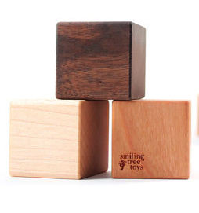
Structure…
PubMed Building Blocks

Slide 4
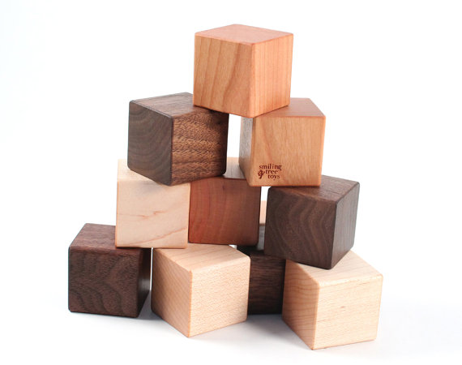
MeSH
Sub-Headings
Key
Words
And
OR
Not

Slide 5
Filters
Language
Major Topic
Age
Gender
Article Type
Date

Slide 6
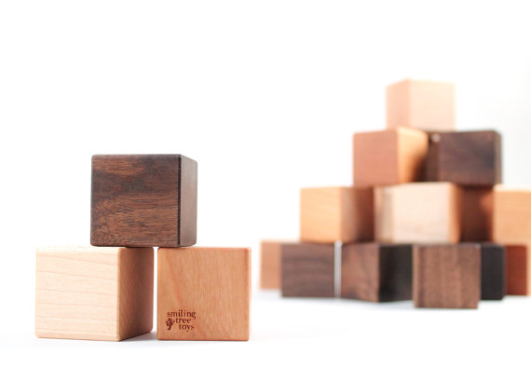
Journal
Title
Author

Slide 7

Child’s play…
Simple
Sophisticated

Slide 8

How you organize your blocks…
will make the difference.

Slide 9
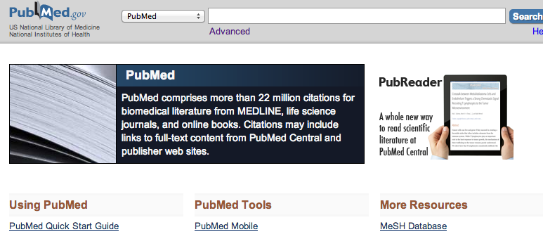
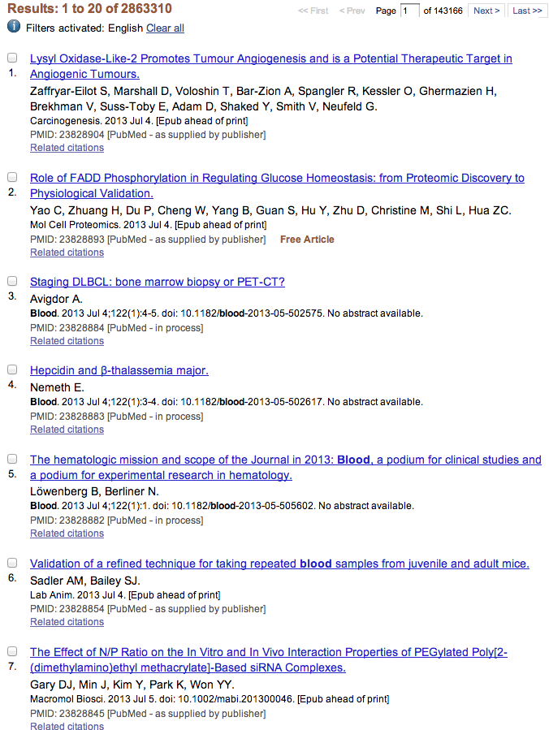
keyword
blood
Combination of letters
blood

Slide 10
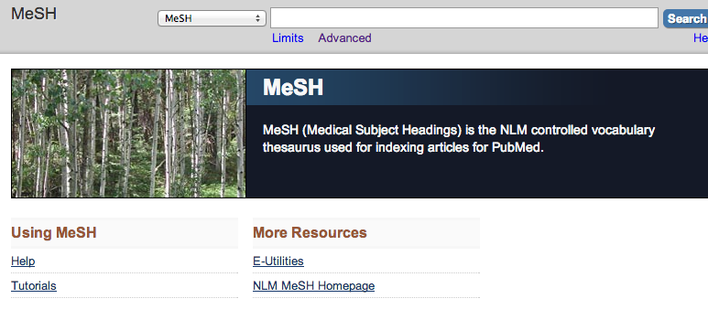
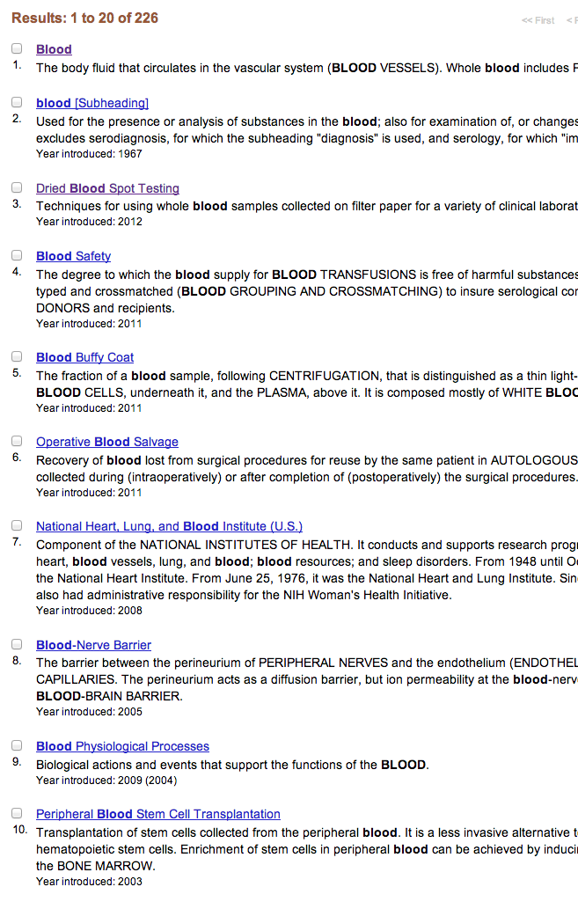
blood

Slide 11
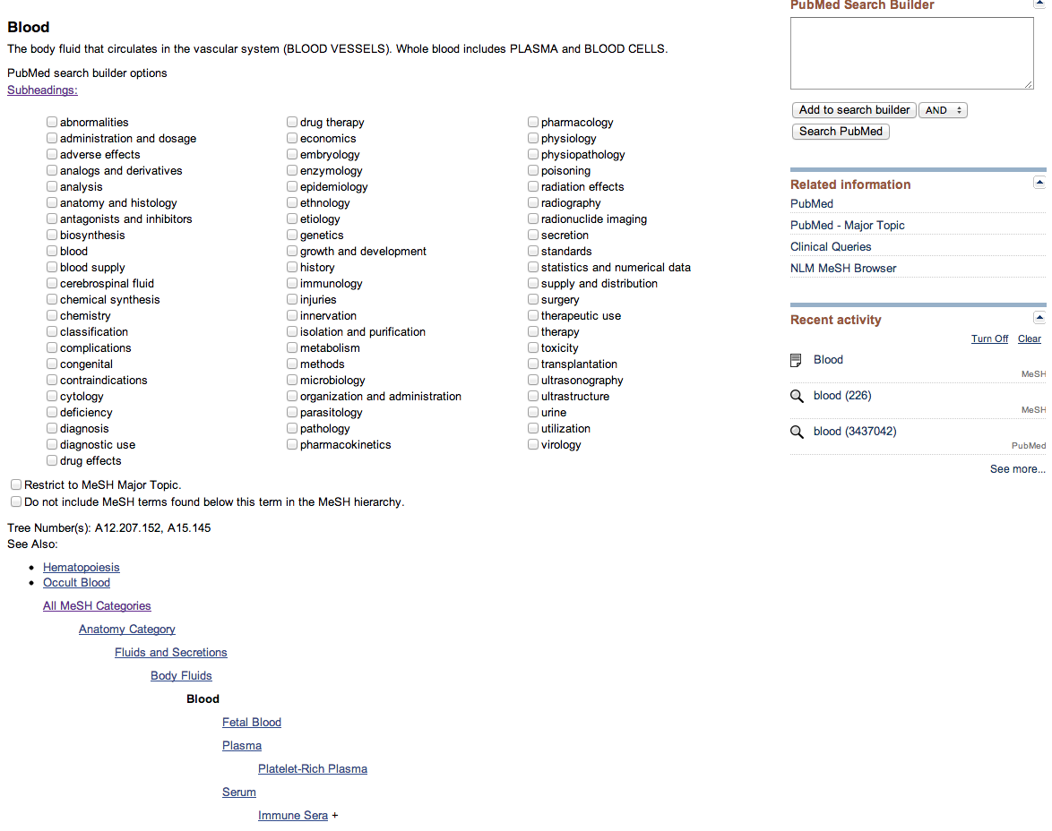

MeSH
Sub-Headings
Major Topic

Slide 12
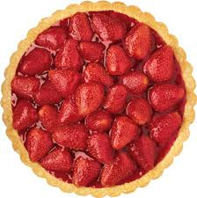
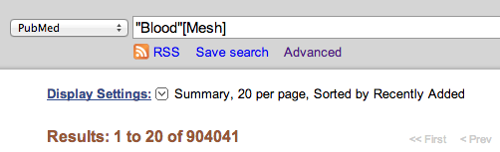
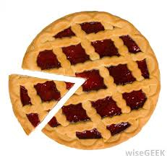
Add to Search Builder
Search PubMed

Slide 13
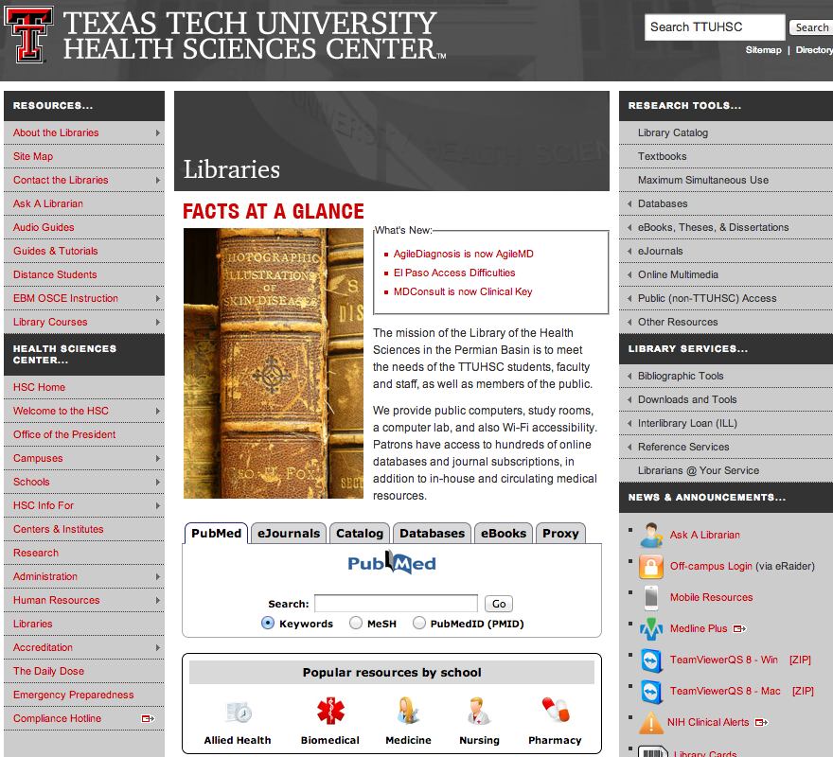

Slide 14
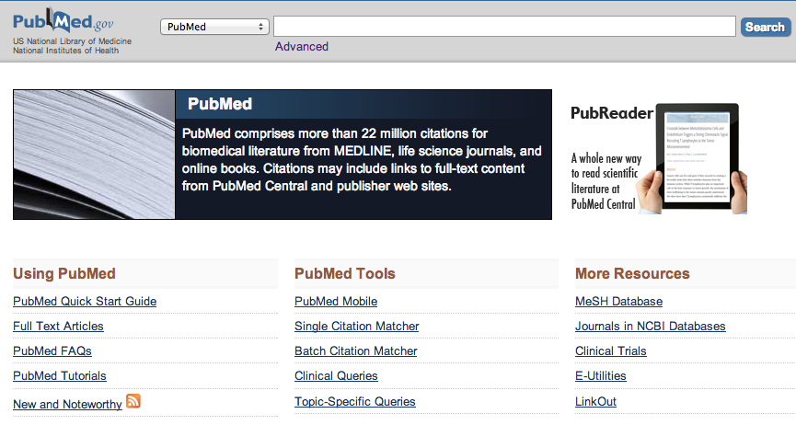
Breastfeeding
MeSH

Slide 15
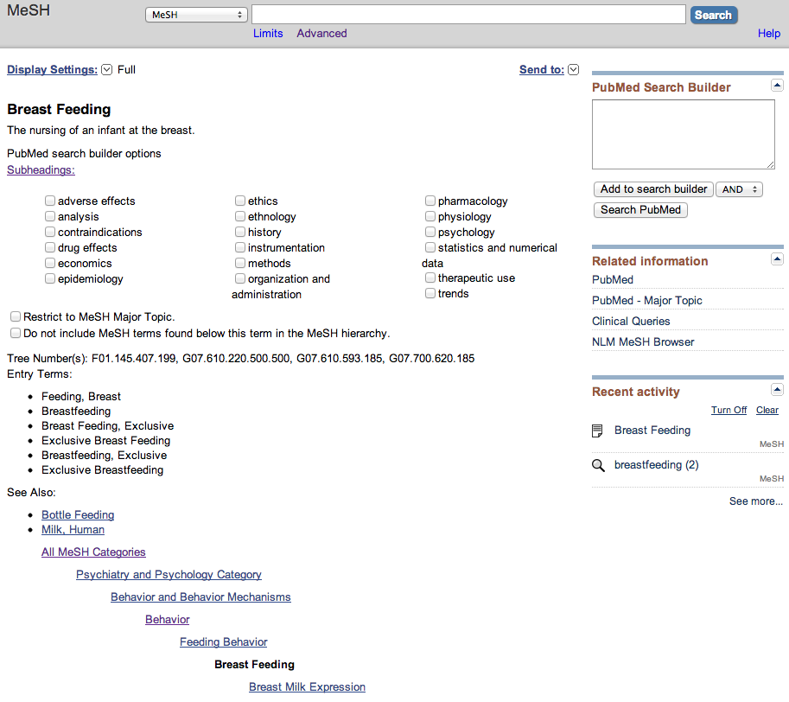
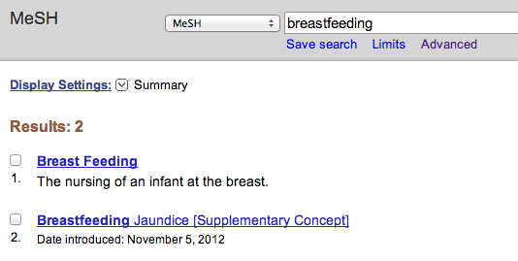

Search PubMed
What’s Different?

Slide 16
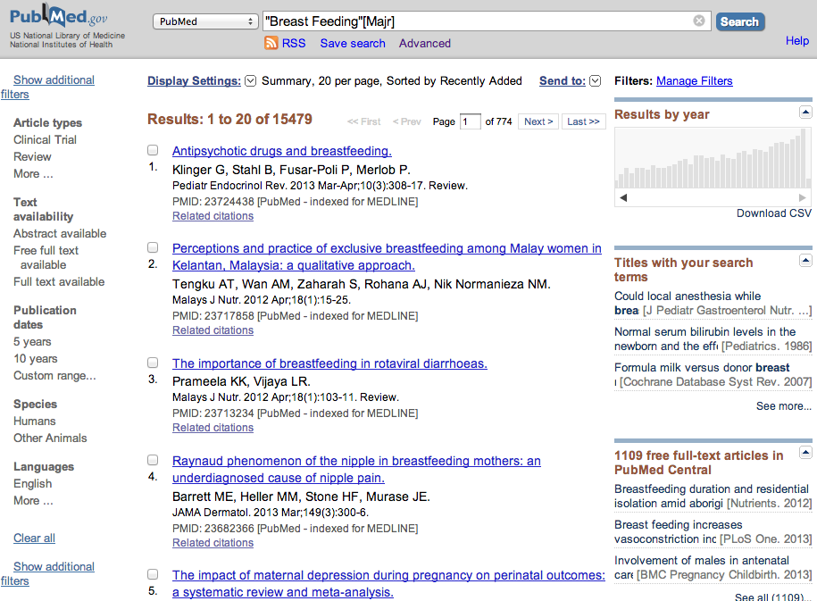

Slide 17
Clinical Question
Does breastfeeding of healthy newborns decrease childhood obesity?
Does breastfeeding decrease childhood obesity?

Slide 18
Obesity
MeSH

Slide 19
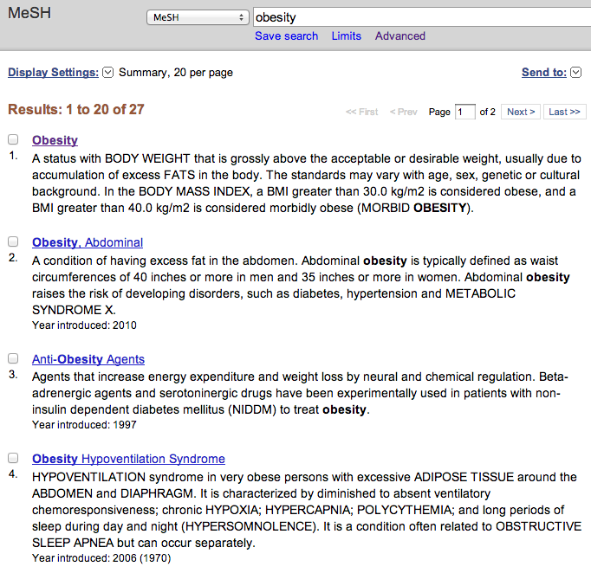

Slide 20
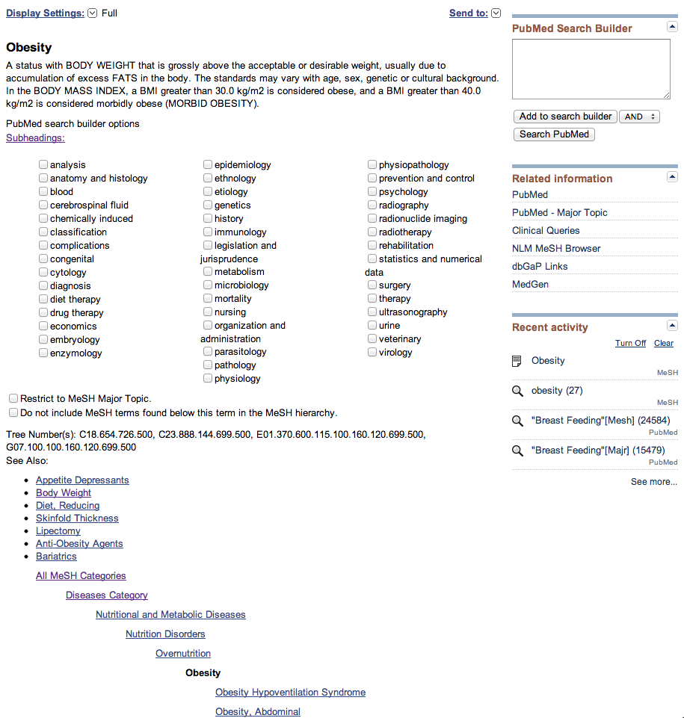

…decrease childhood obesity?
Prevention and control

Slide 21
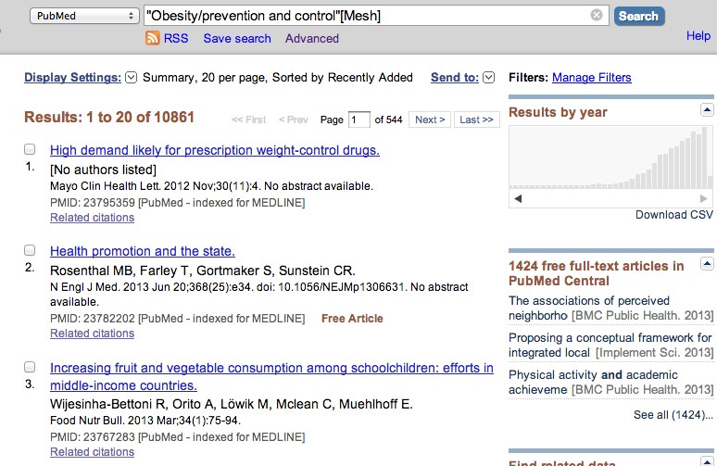
Advanced
10,861

Slide 22
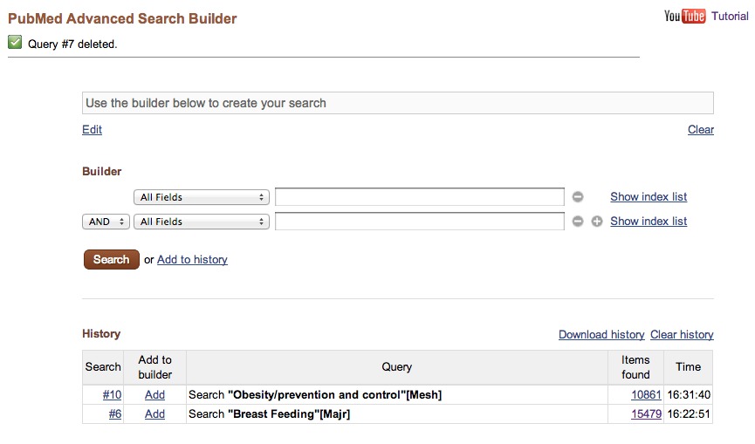
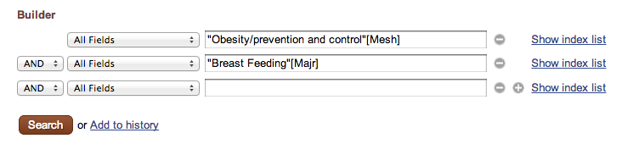
Search
Add
Add

Slide 23
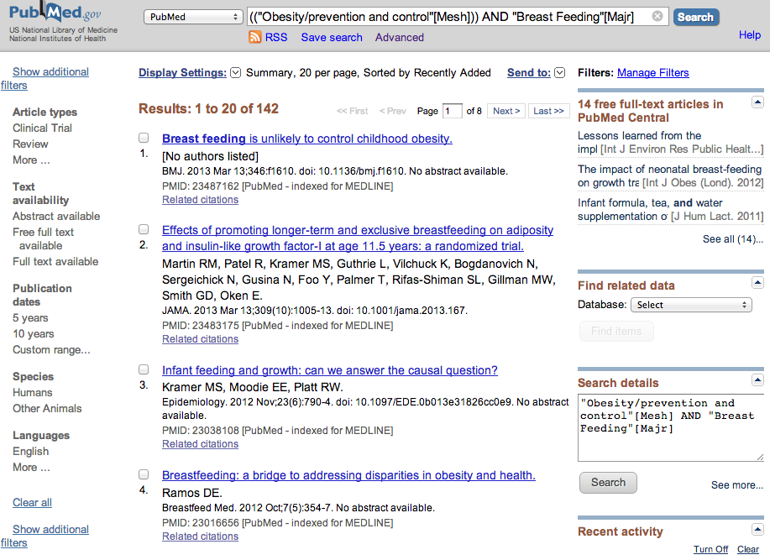
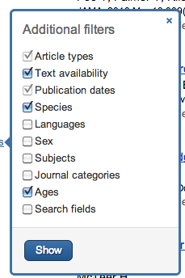

Slide 24
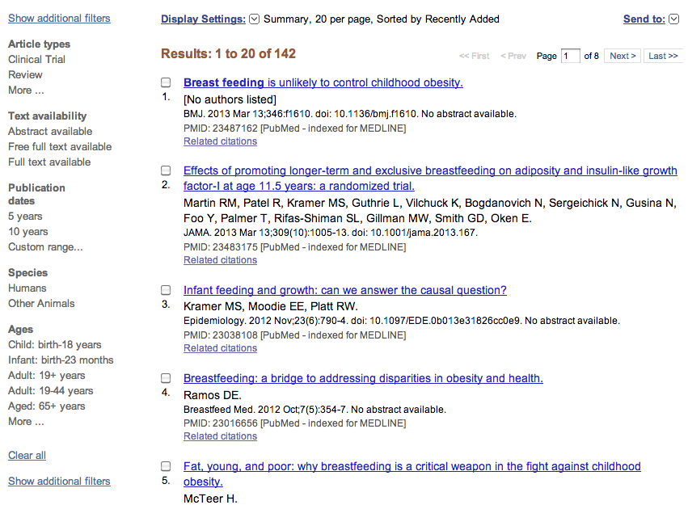
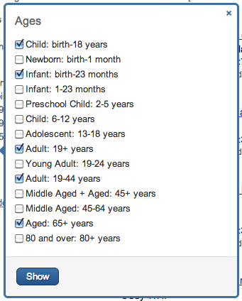
MORE
Show

Slide 25
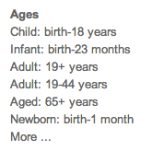

Slide 26
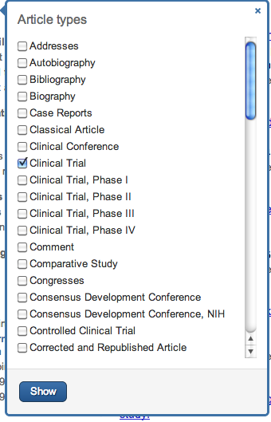
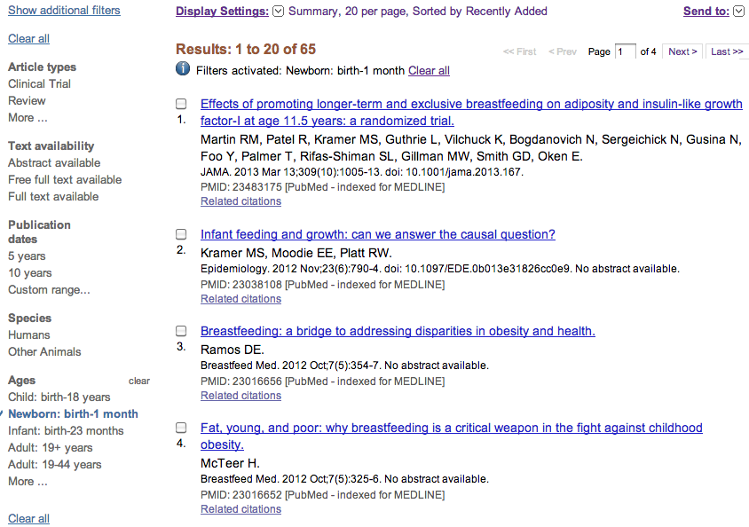
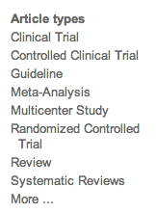
MORE

Slide 27
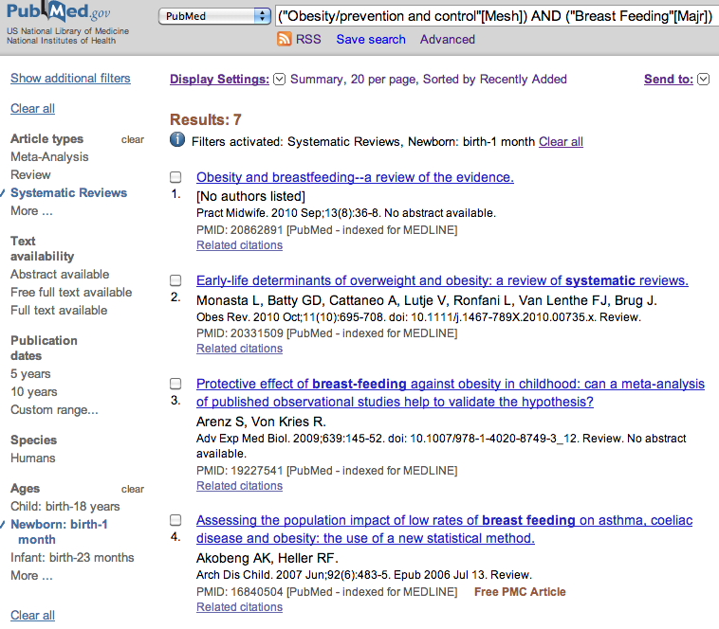

Slide 28
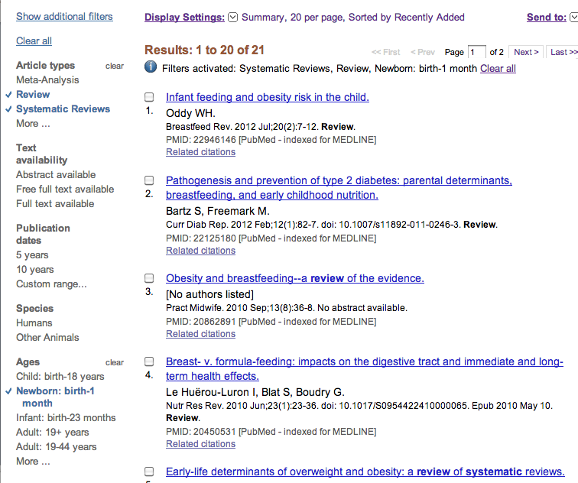
MeSH
Sub-Headings

Slide 29
MeSH
Sub-Headings
And
MeSH
Major Topic

Slide 30
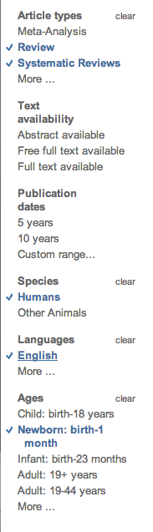
Filters
Article Type
Age
Species
Language

Slide 31
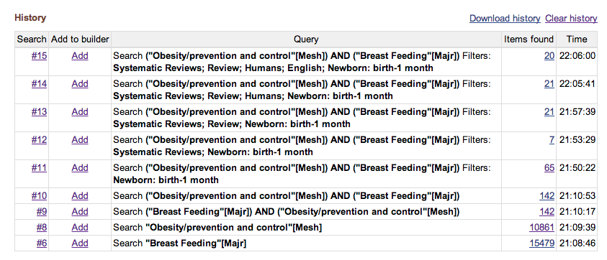
Read from Bottom up

Slide 32
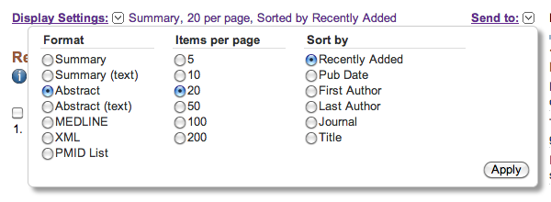
Apply

Slide 33
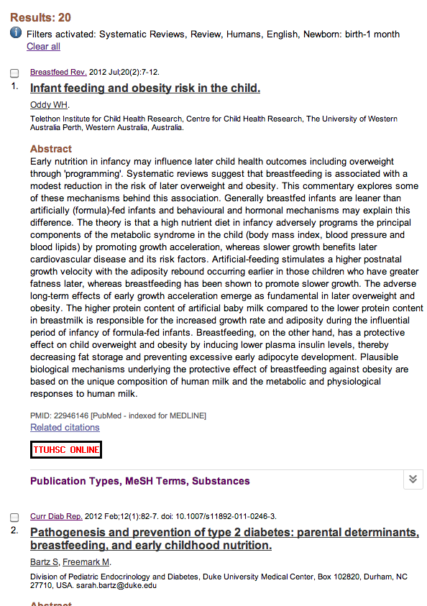

Slide 34
Questions???
Biggest benefit of using MeSH?
Sub–headings broaden or narrow my topic?
Name three filters…

Slide 35
Next Time
Locating full-text
Searching by author
Searching by journal
Quick steps to locate citations
Gold Rush
Exporting

Slide 36
Does vigorous physical activity increase the risk of bleeding in children with hemophilia?
Please send me screen capture of your strategy.

Slide 37
Thank you!
margaret.vugrin@ttuhsc.edu
806 –743–2241
http://www.ttuhsc.edu/libraries

