Slide 1
How to find a peer-reviewed article in CINAHL.
A Preston Smith Library
mini-PowerPoint
Margaret Vugrin MSLS. AHIP
Jan 2017

Slide 2
Peer-Reviewed articles
Have been reviewed by peers
Who are subject experts

Slide 3
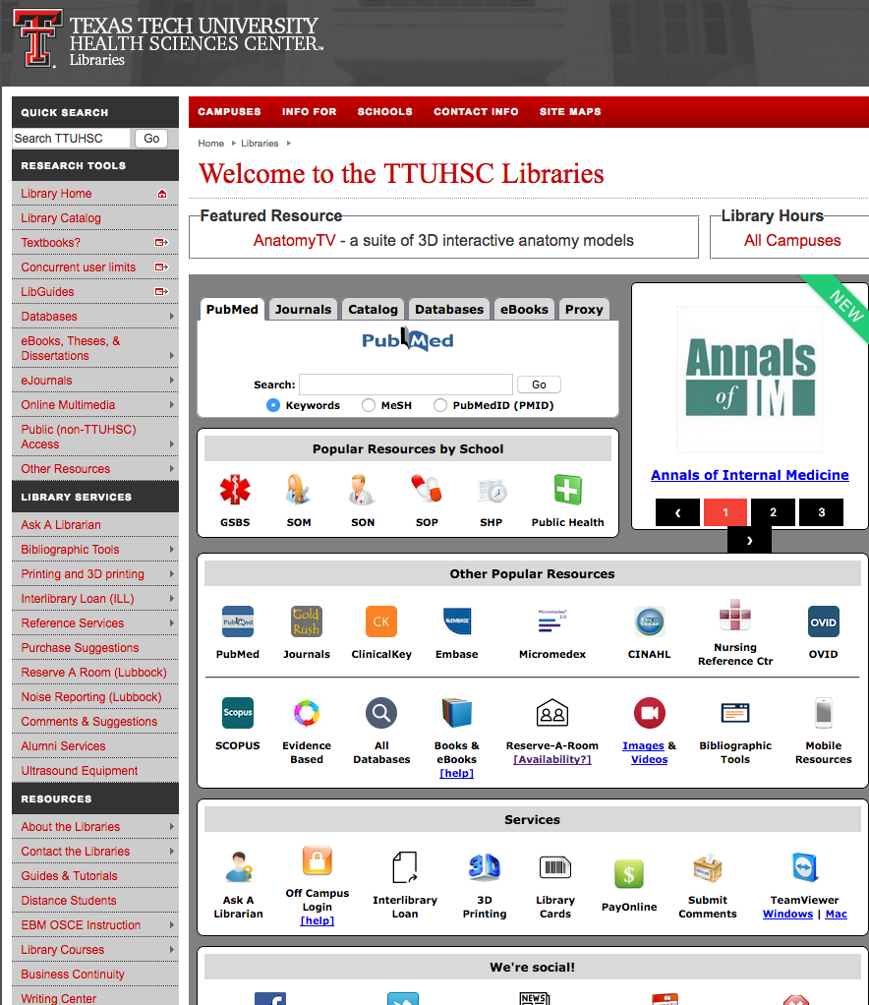
Start here!
Select CINAHL

Slide 4
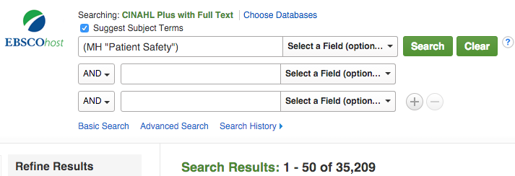
Enter term into first box, since the default is “Subject terms” CINAHL
will search for all articles that have been tagged with concept.
Results Before
OR: If the term doesn’t locate a subject heading try synonyms
OR: You can also remove the in the small blue box.
Now it will search for the term(s) you entered.
THEN: Click on “Advanced Search”
✔

Slide 5
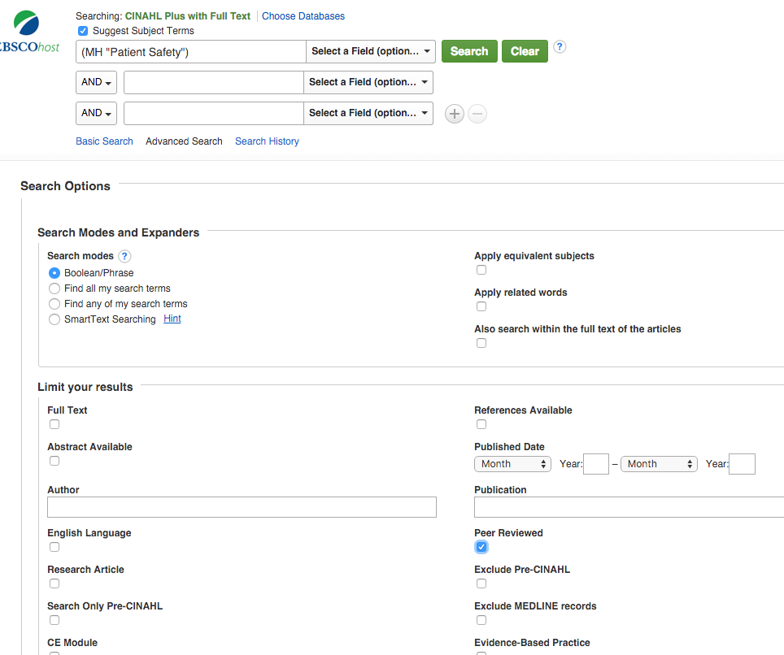
Clicking on “Advanced Search” brings you to this page
Choose as many search options as you like.
Typically the more filters - the Narrower results.
Choose

Slide 6
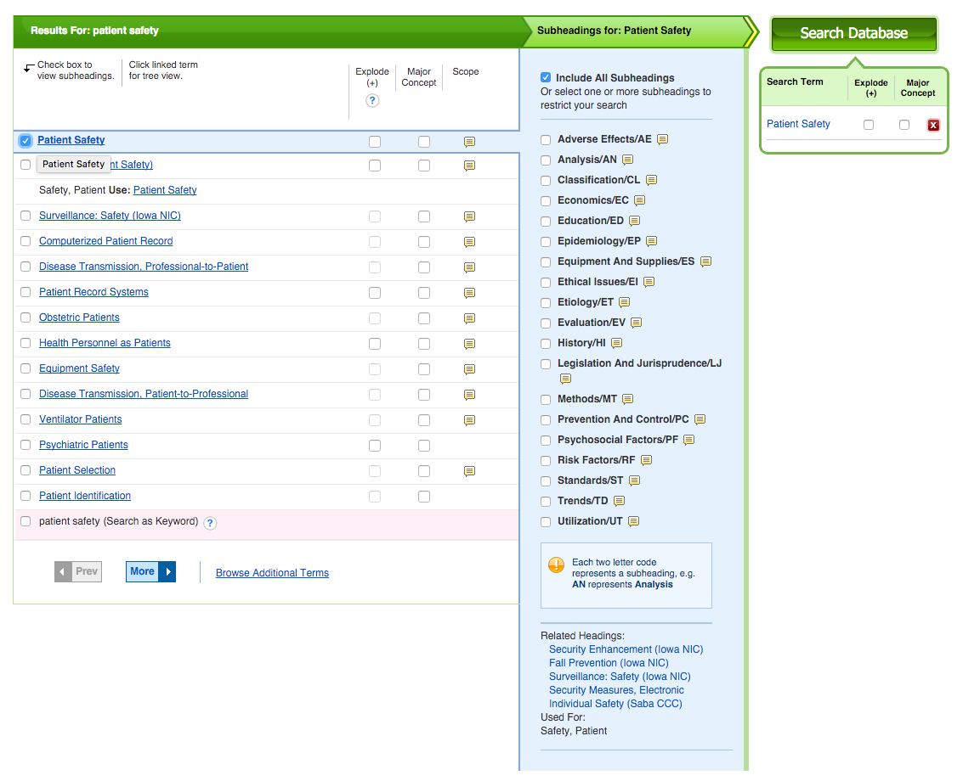
After you make selections or not
“Search Database”
Run your search.
This is a very simple example.

Slide 7
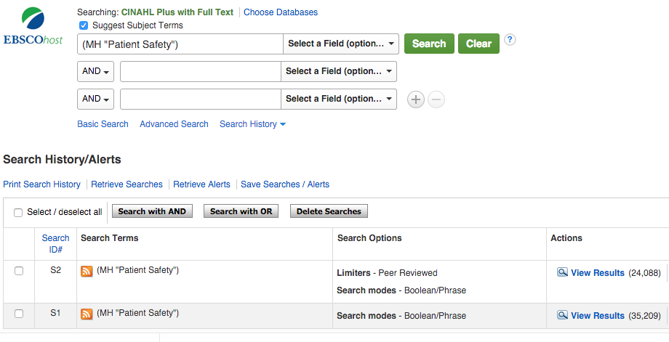
Click on “Search History”
Results After
This “Search History” shows the results of your current searching.
S1 under “Search Options” just shows Boolean Phrase.
S2 shows that you have also used a Limiter – Peer Reviewed.
Notice the differences in the numbers located by “View results”

Slide 8
This example shows how to filter for peer-reviewed articles.
It does not go into detail how to reduce the number of articles.
For this example you would probably want to combine with another
Subject heading or term.
The sequence does not matter.
You can combine 2 or more concepts or terms first and then click on
“ADVANCED SEARCH” or you can progress as was shown in the
example presented in this mini-PowerPoint
For additional information contact your Library

