Slide 1
PEPID
6/2/2015

Slide 2

When searching library applications,
use Mozilla Firefox!

Slide 3
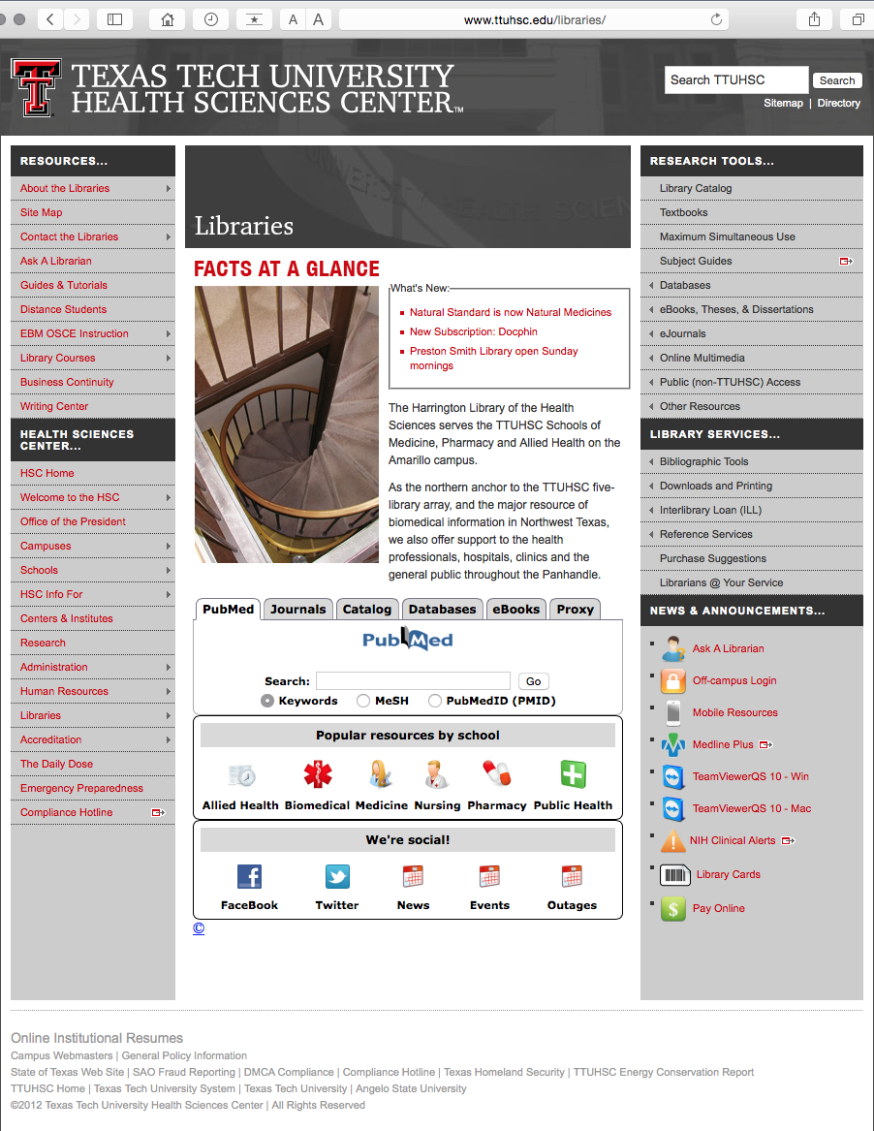
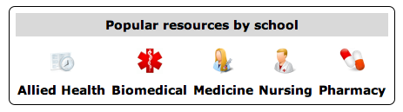
www.ttuhsc.edu/libraries
Click Nursing

Slide 4
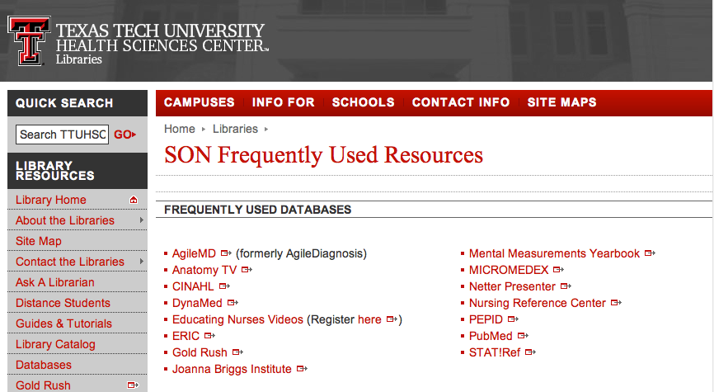
Click PEPID

Slide 5

Click RN Student Clinical Companion

Slide 6
Comprehensive point-of care resource
Formatted for smart phones and tablets

Slide 7
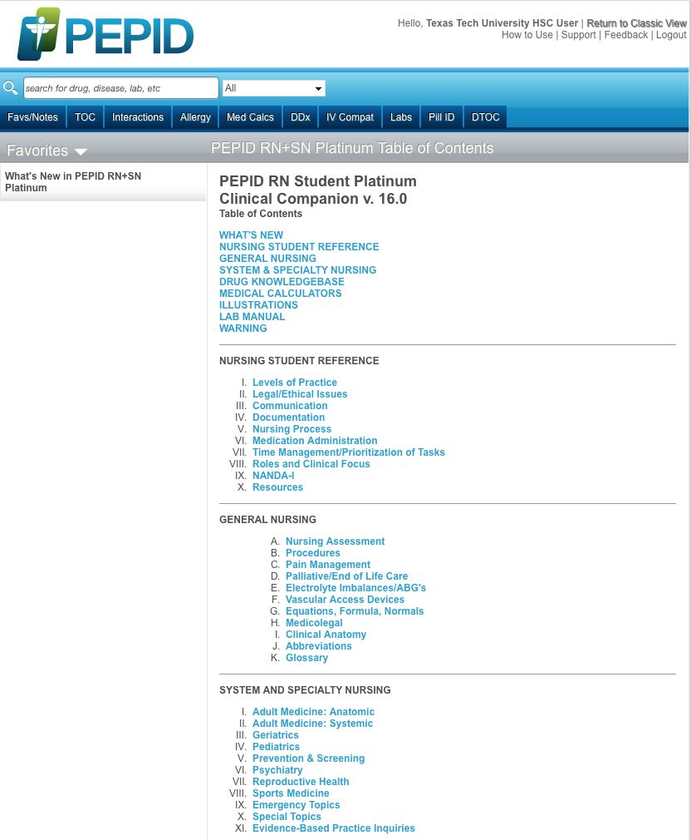
Home Page
Table of Contents

Slide 8
PEPID includes:
Information for different nursing specialties

Slide 9
Scroll Screen
Click
IV. Pediatrics

Slide 10
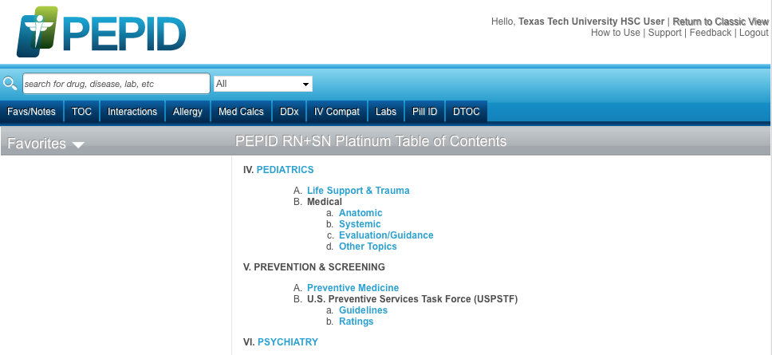
Click
Life Support & Trauma

Slide 11
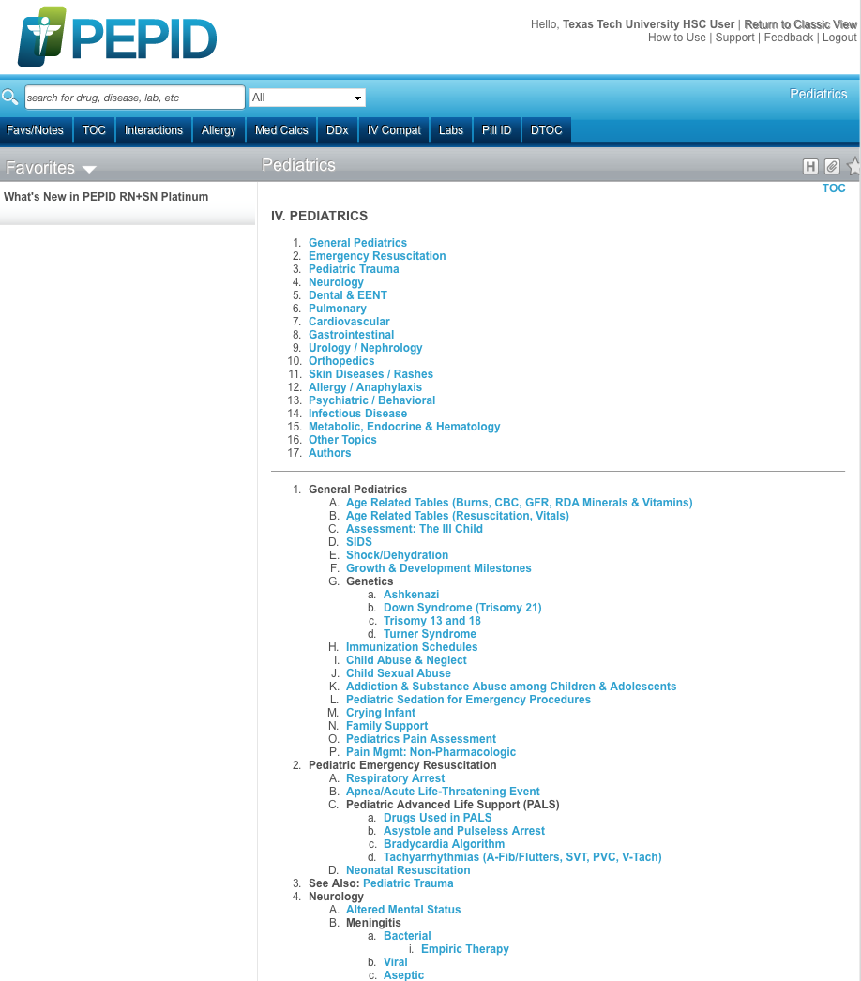
Click
Respiratory Arrest

Slide 12
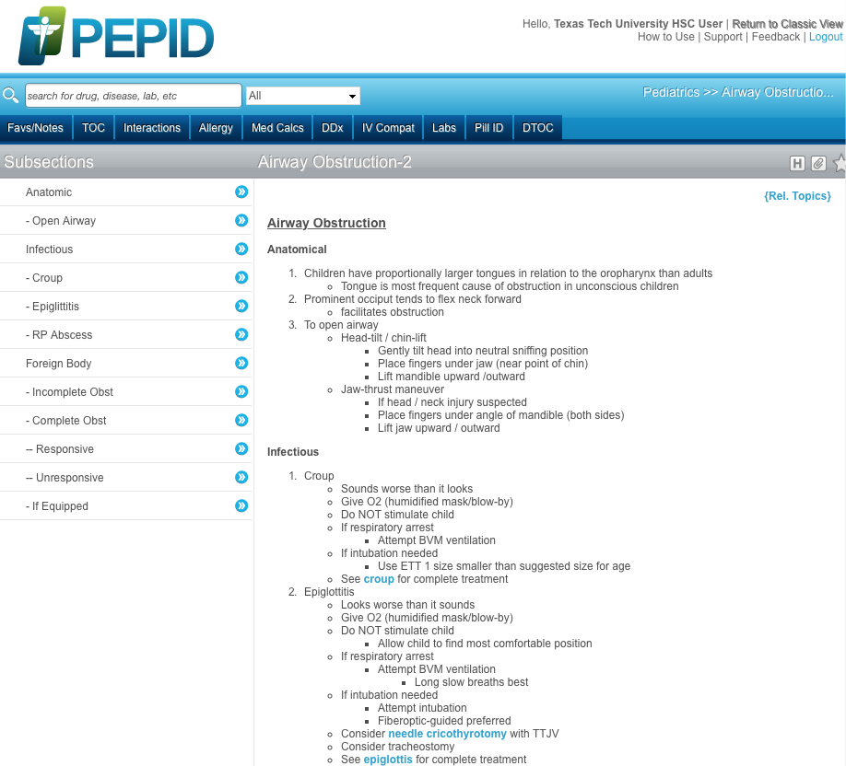
Example

Slide 13
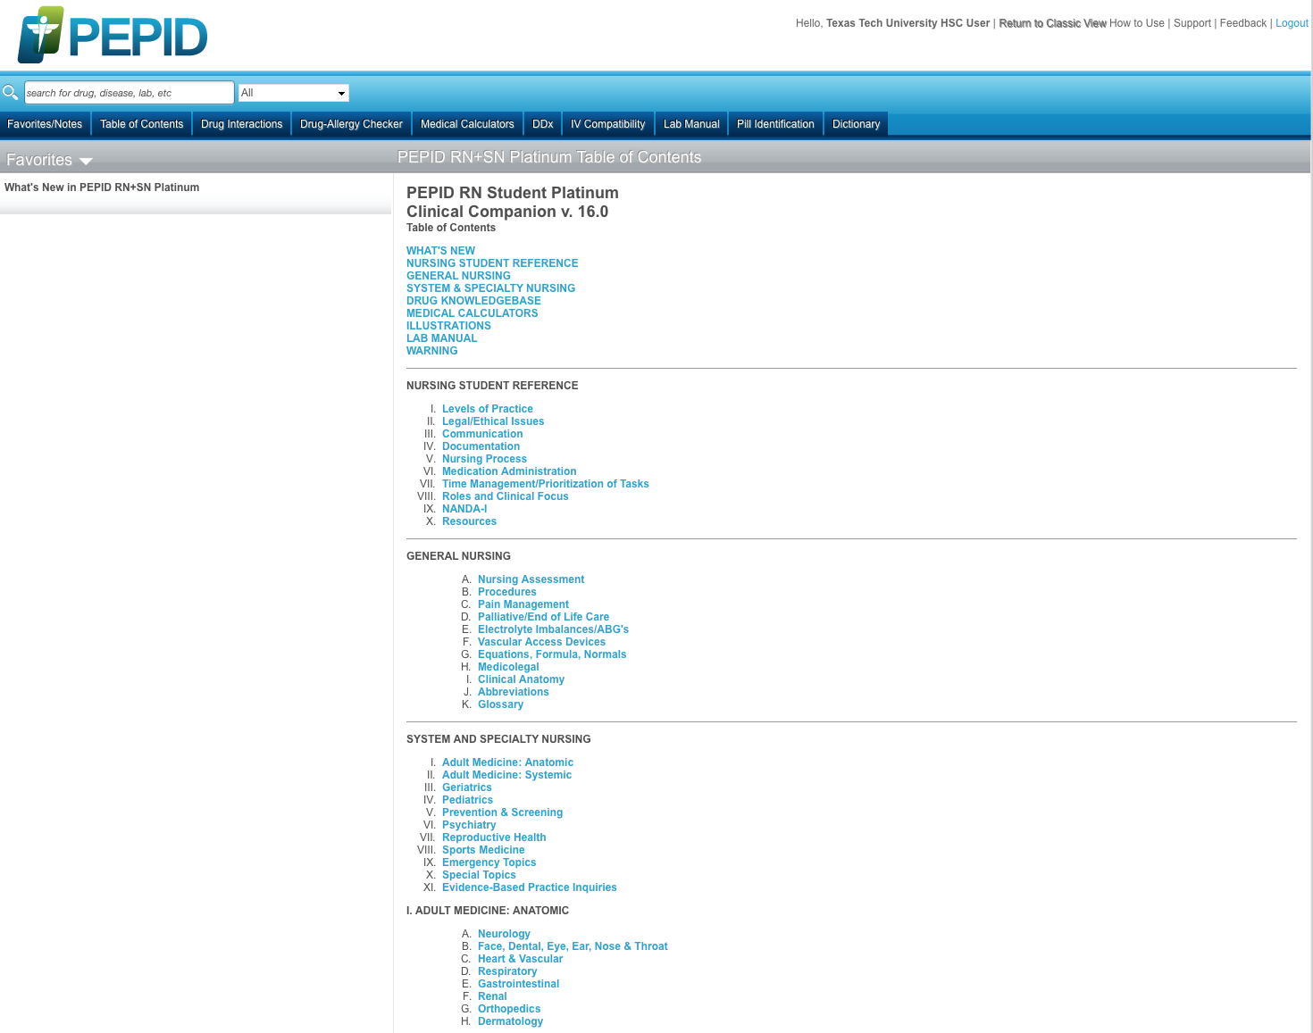
Other Information Topics Include:
General Nursing
Adult Medicine
Geriatrics
Pediatrics
Prevention & Screening
Psychiatry
Reproductive Health
Sports Medicine
Emergency Nursing
Evidence Based Practice Inquiries
*
*
*
*
*
*
*
*
*
*

Slide 14
Click Table of Contents

Slide 15
PEPID includes:
Click
a Drug Knowledgebase

Slide 16
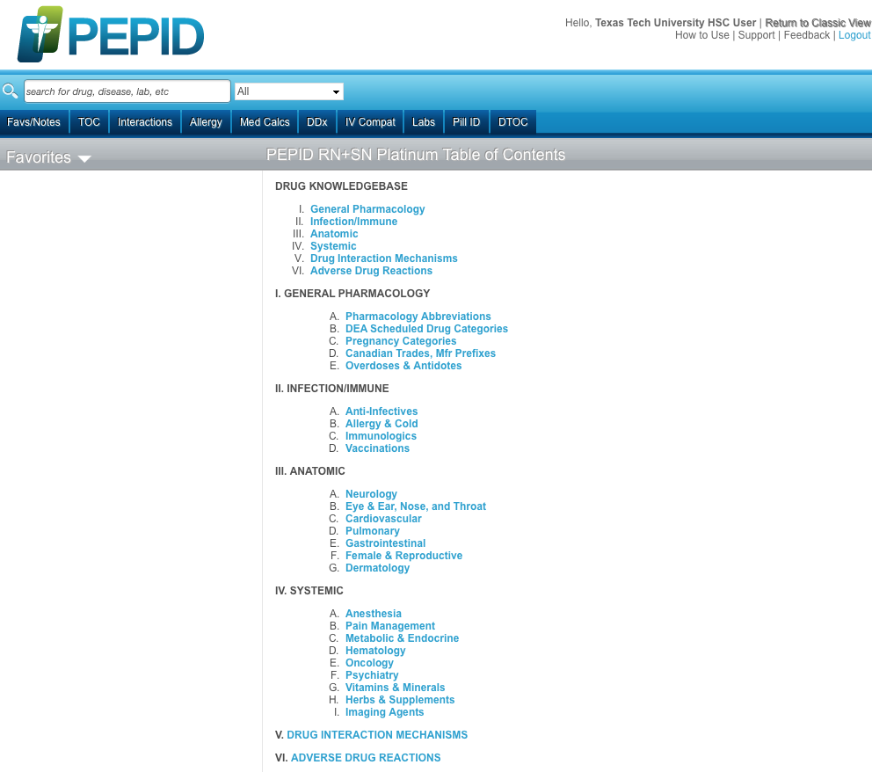
Click
II. Infection/Immune
A. Anti-Infectives

Slide 17
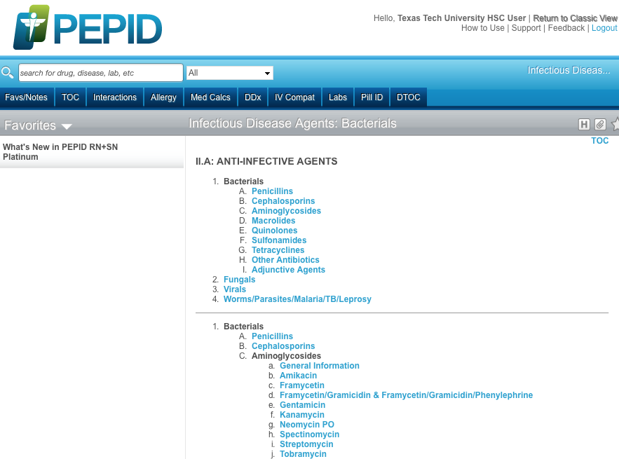
Click
II. A: Anti-infective Agents
1. Bacterials
A. Penicillins

Slide 18
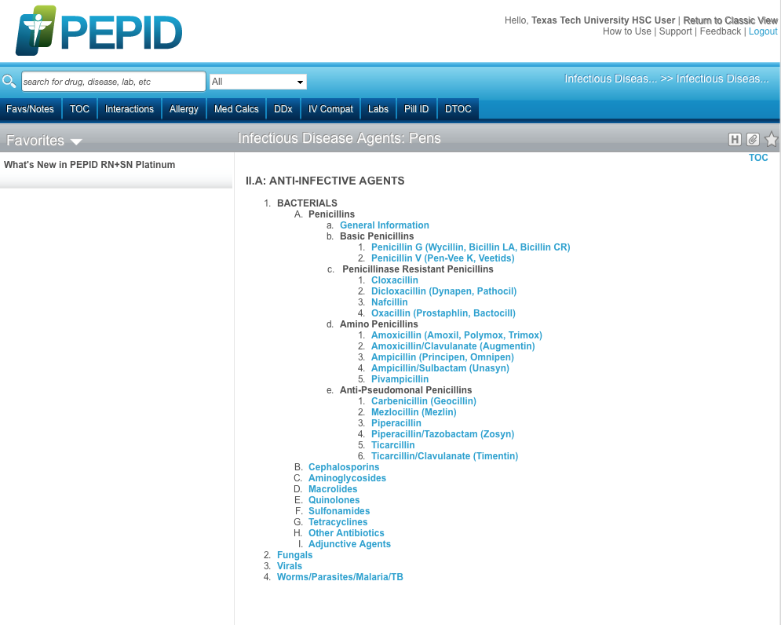
Click
d. Amino Penicillins
1. Amoxicillin(Amoxil, Polymox, Trimox)

Slide 19
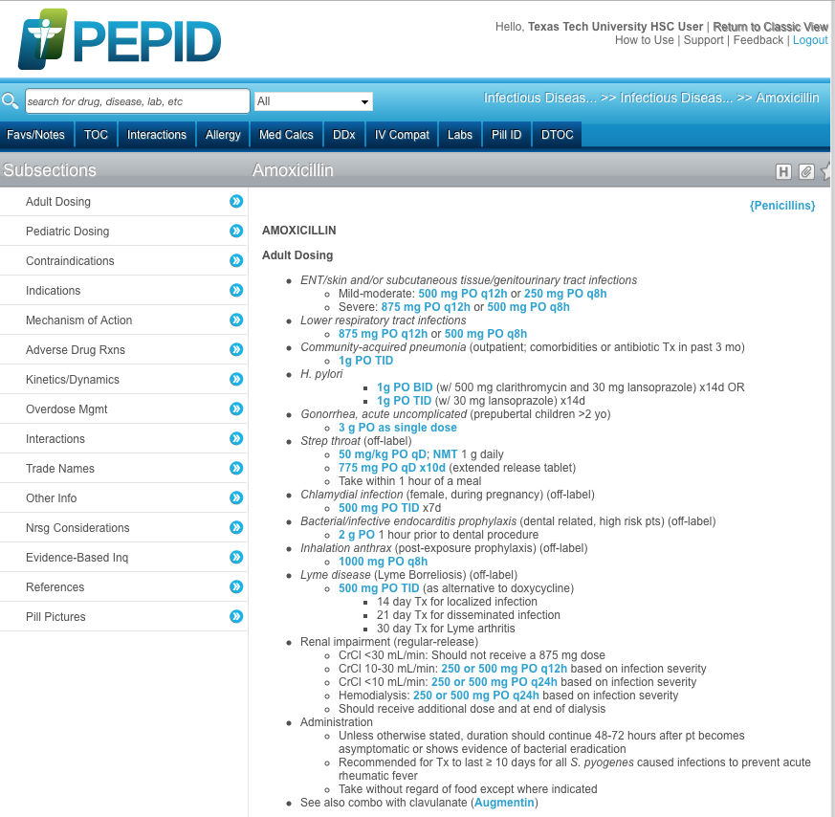
Clickable links
Example

Slide 21
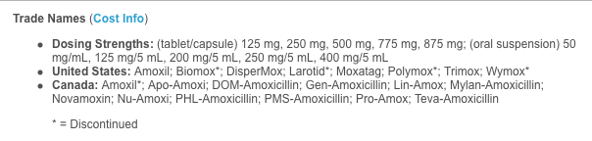
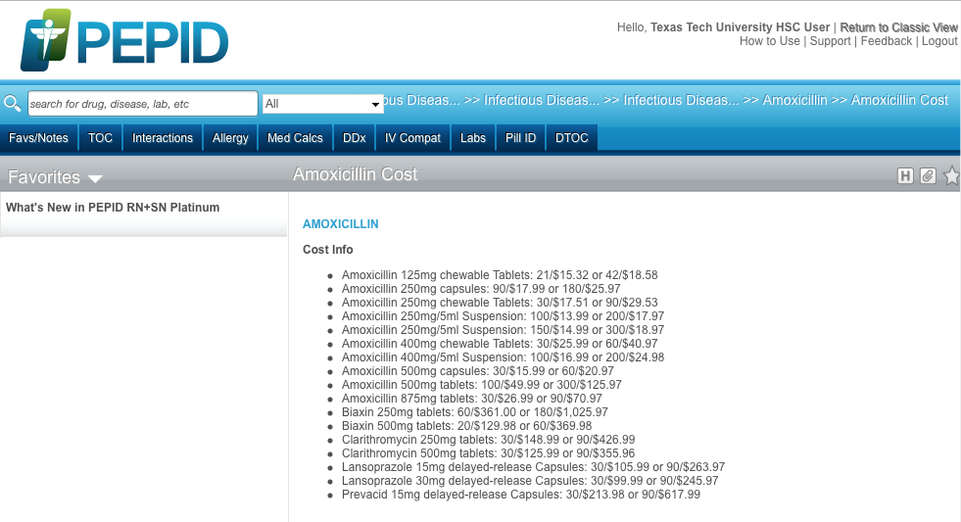
Click
Amoxicillin

Slide 22
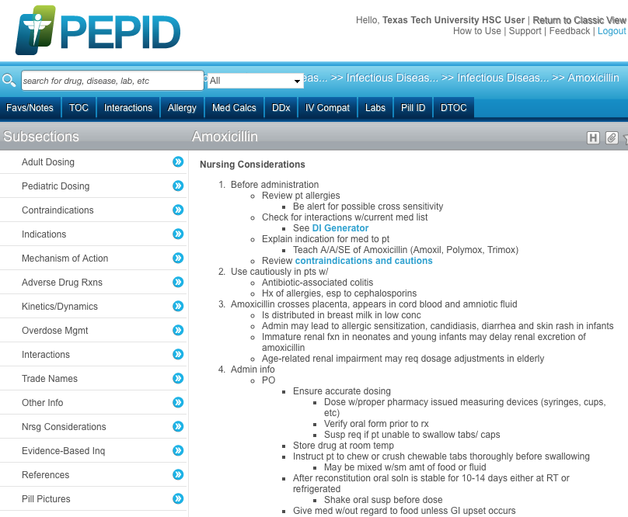

Slide 24
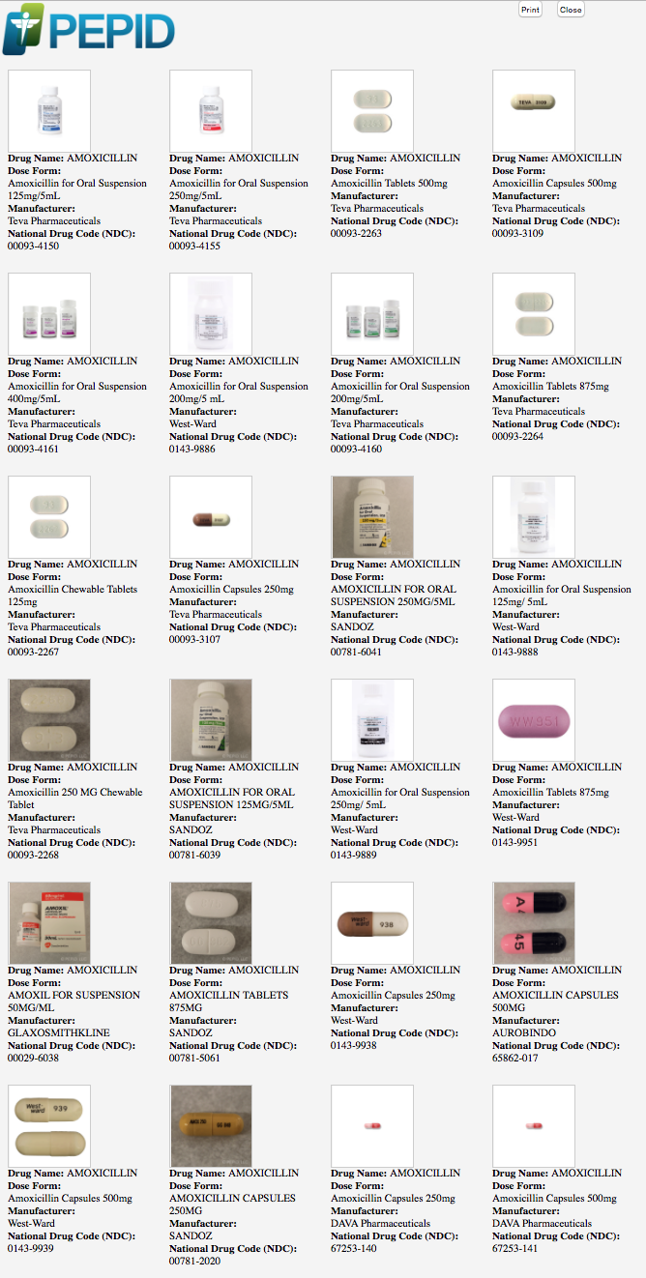
Close
Screen

Slide 25
Click Table of Contents

Slide 26
PEPID includes:
Click
Medical Calculators

Slide 27
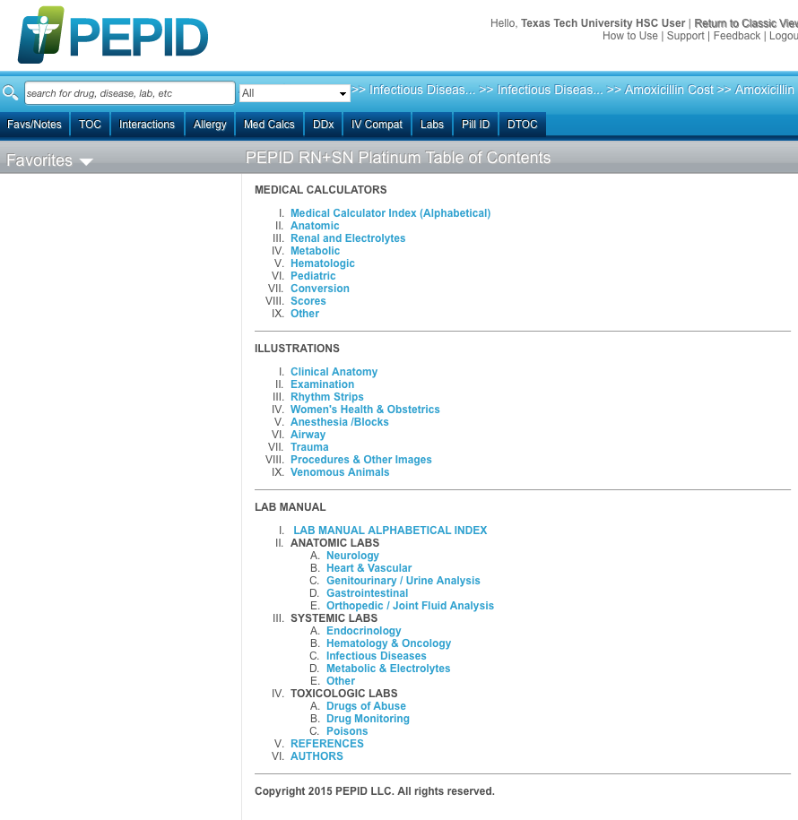
Click
Medical Calculators Index

Slide 28
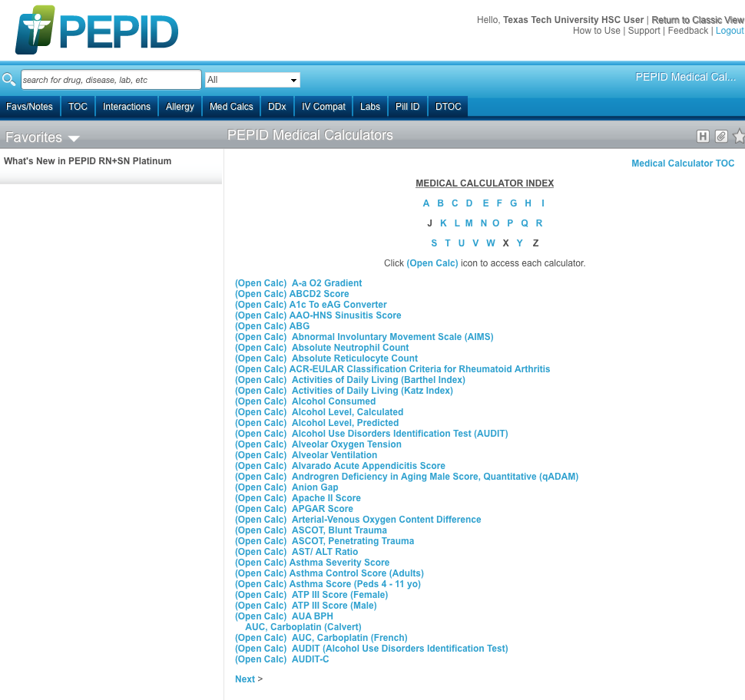

Slide 29
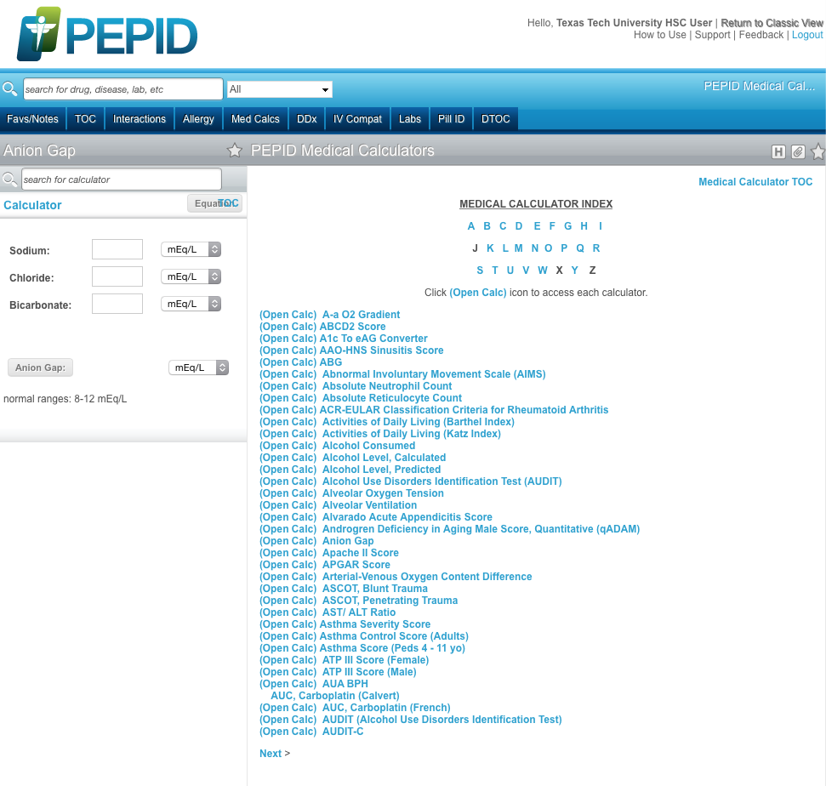

Slide 30
Click Table of Contents

Slide 31
PEPID includes:
Click
Illustrations

Slide 32
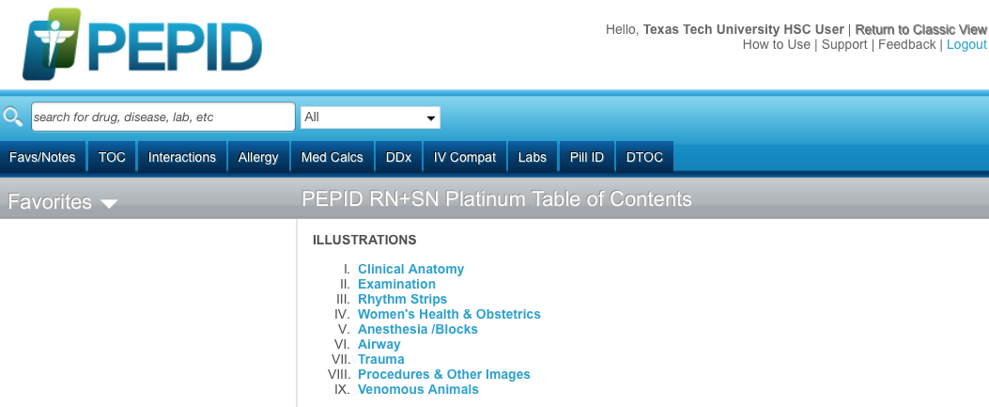

Slide 33
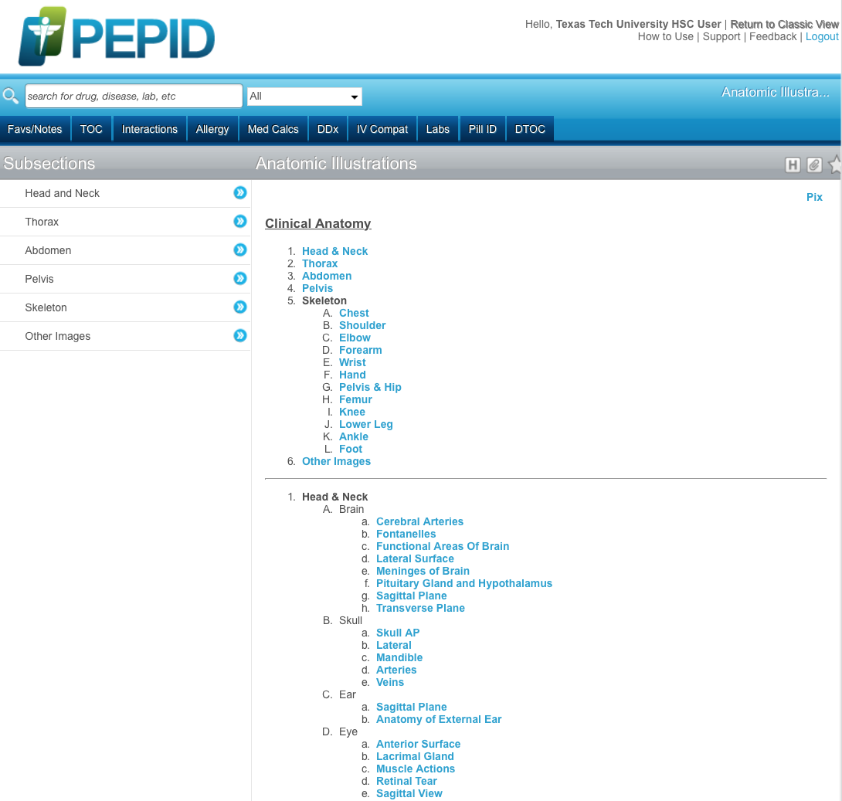

Slide 34
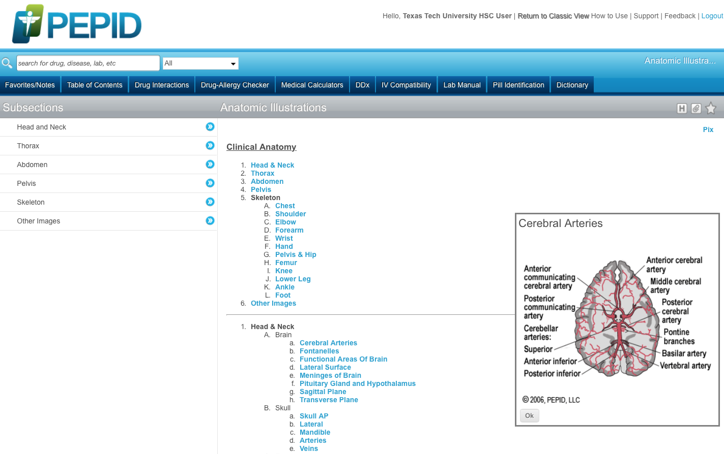
Click OK

Slide 35
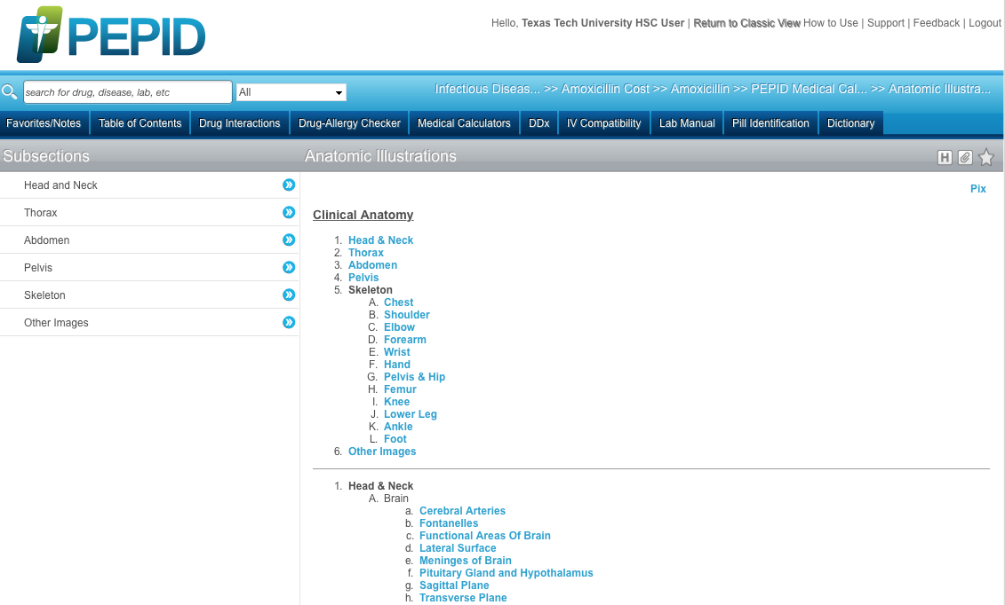
Click Table of Contents

Slide 36
PEPID includes:
Click
Lab Manual

Slide 37
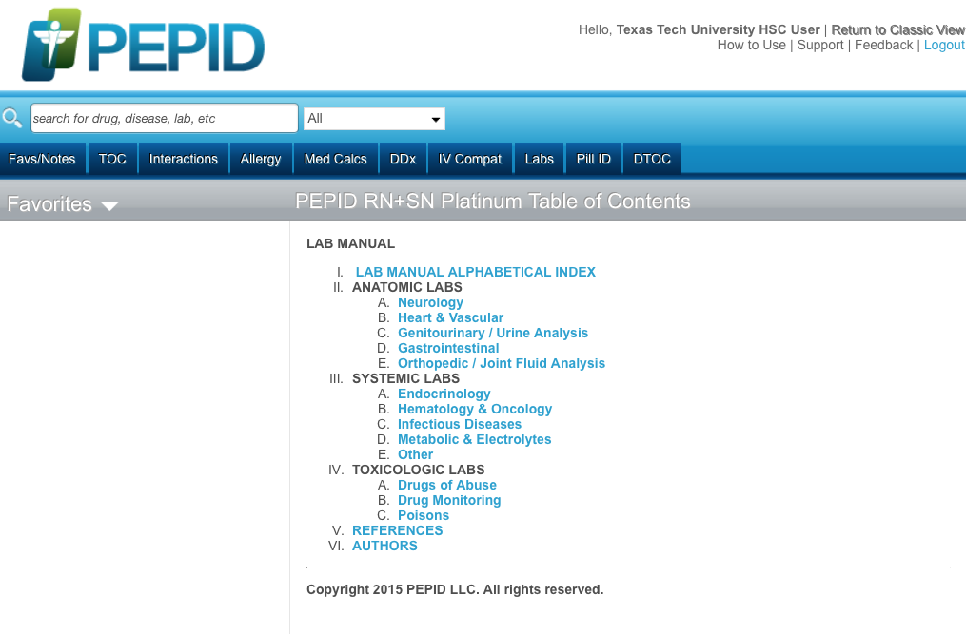

Slide 38
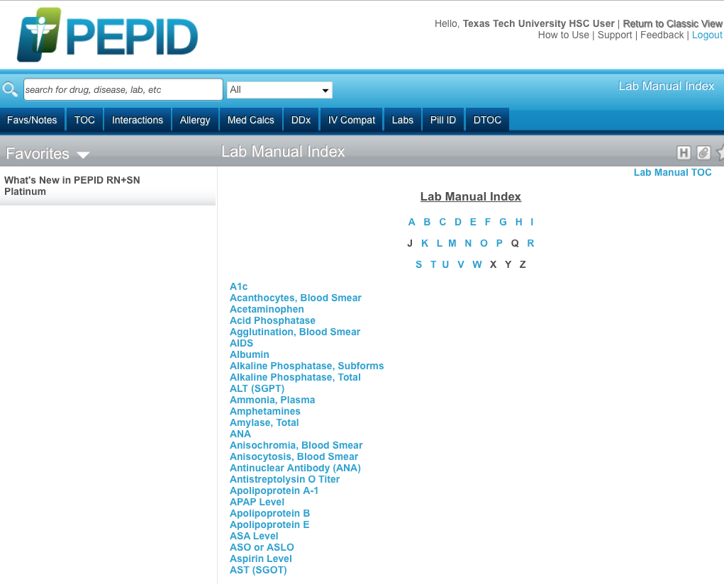

Slide 39
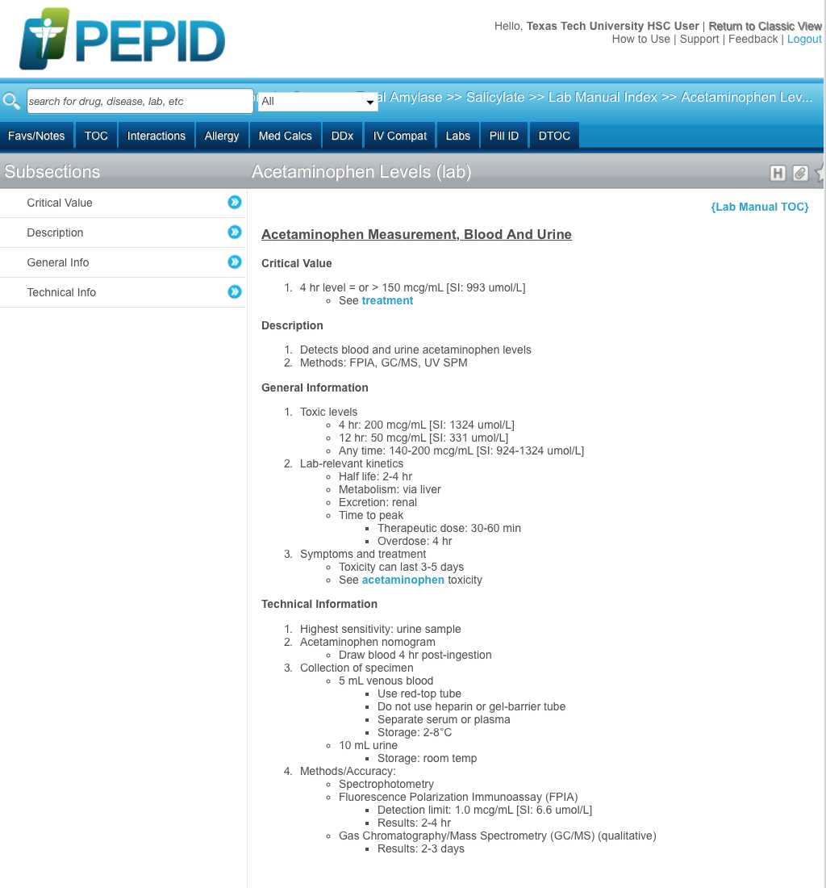

Slide 40
The End

