Slide 1
Welcome
Information Resources for Pharmacy
Peggy Edwards, AMLS
TTUHSC - Preston Smith Library
Lubbock, Texas 79430
August 2015

Slide 2

When searching library applications,
use Mozilla Firefox!

Slide 3
EBP Literature from
PubMed’s Clinical Queries

Slide 4



PubMed Database
Biomedical and life sciences journal literature
International scope
Developed and maintained by the:
National Center for Biotechnology Information
    at the U.S. National Library of Medicine
    at the National Institutes of Health

Slide 5

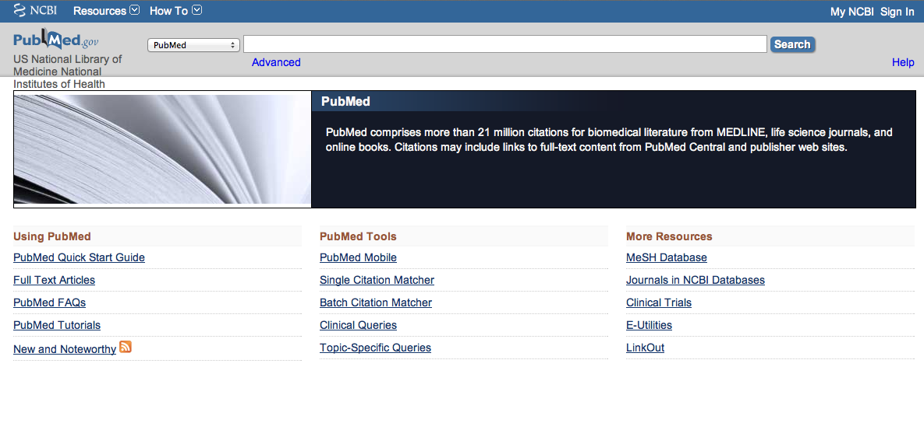
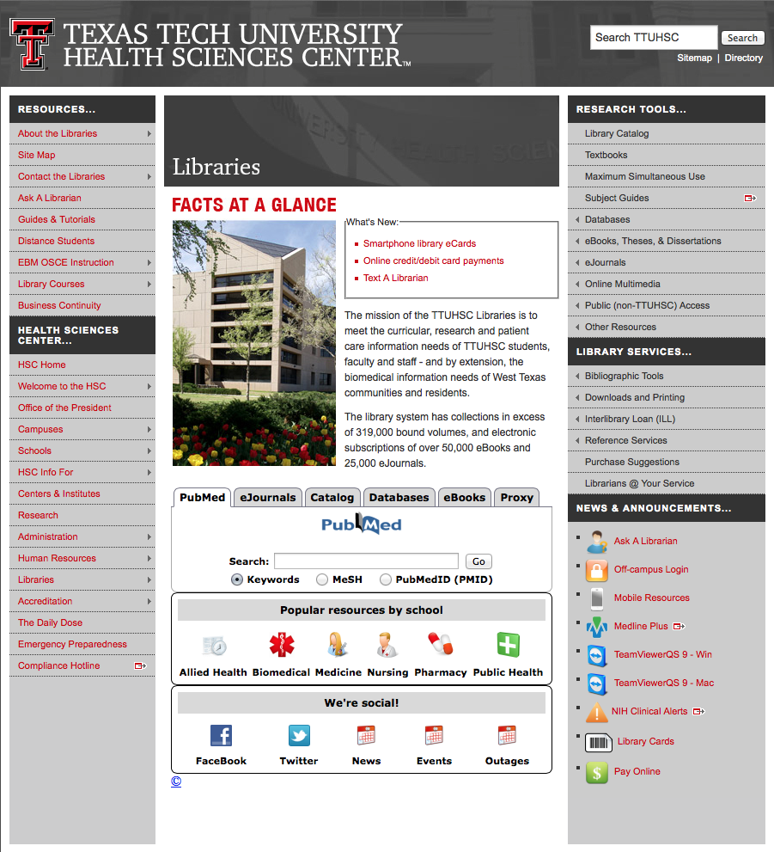
Accessing PubMed
Freely available over the Internet
@ www.pubmed.gov
Also through library’s home page

Slide 6


Evidence-Based Practice is guided by thoughtful integration
of the best available scientific knowledge with clinical expertise.

Slide 7
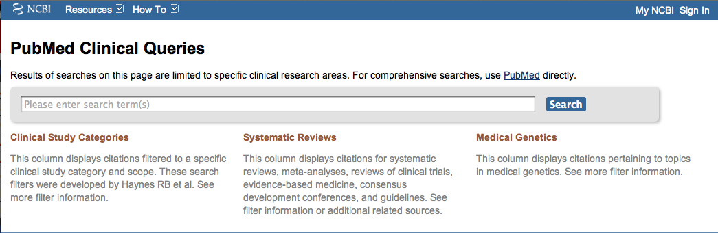
PubMed’s Clinical Queries
tool that searches for evidence-based literature

Slide 8

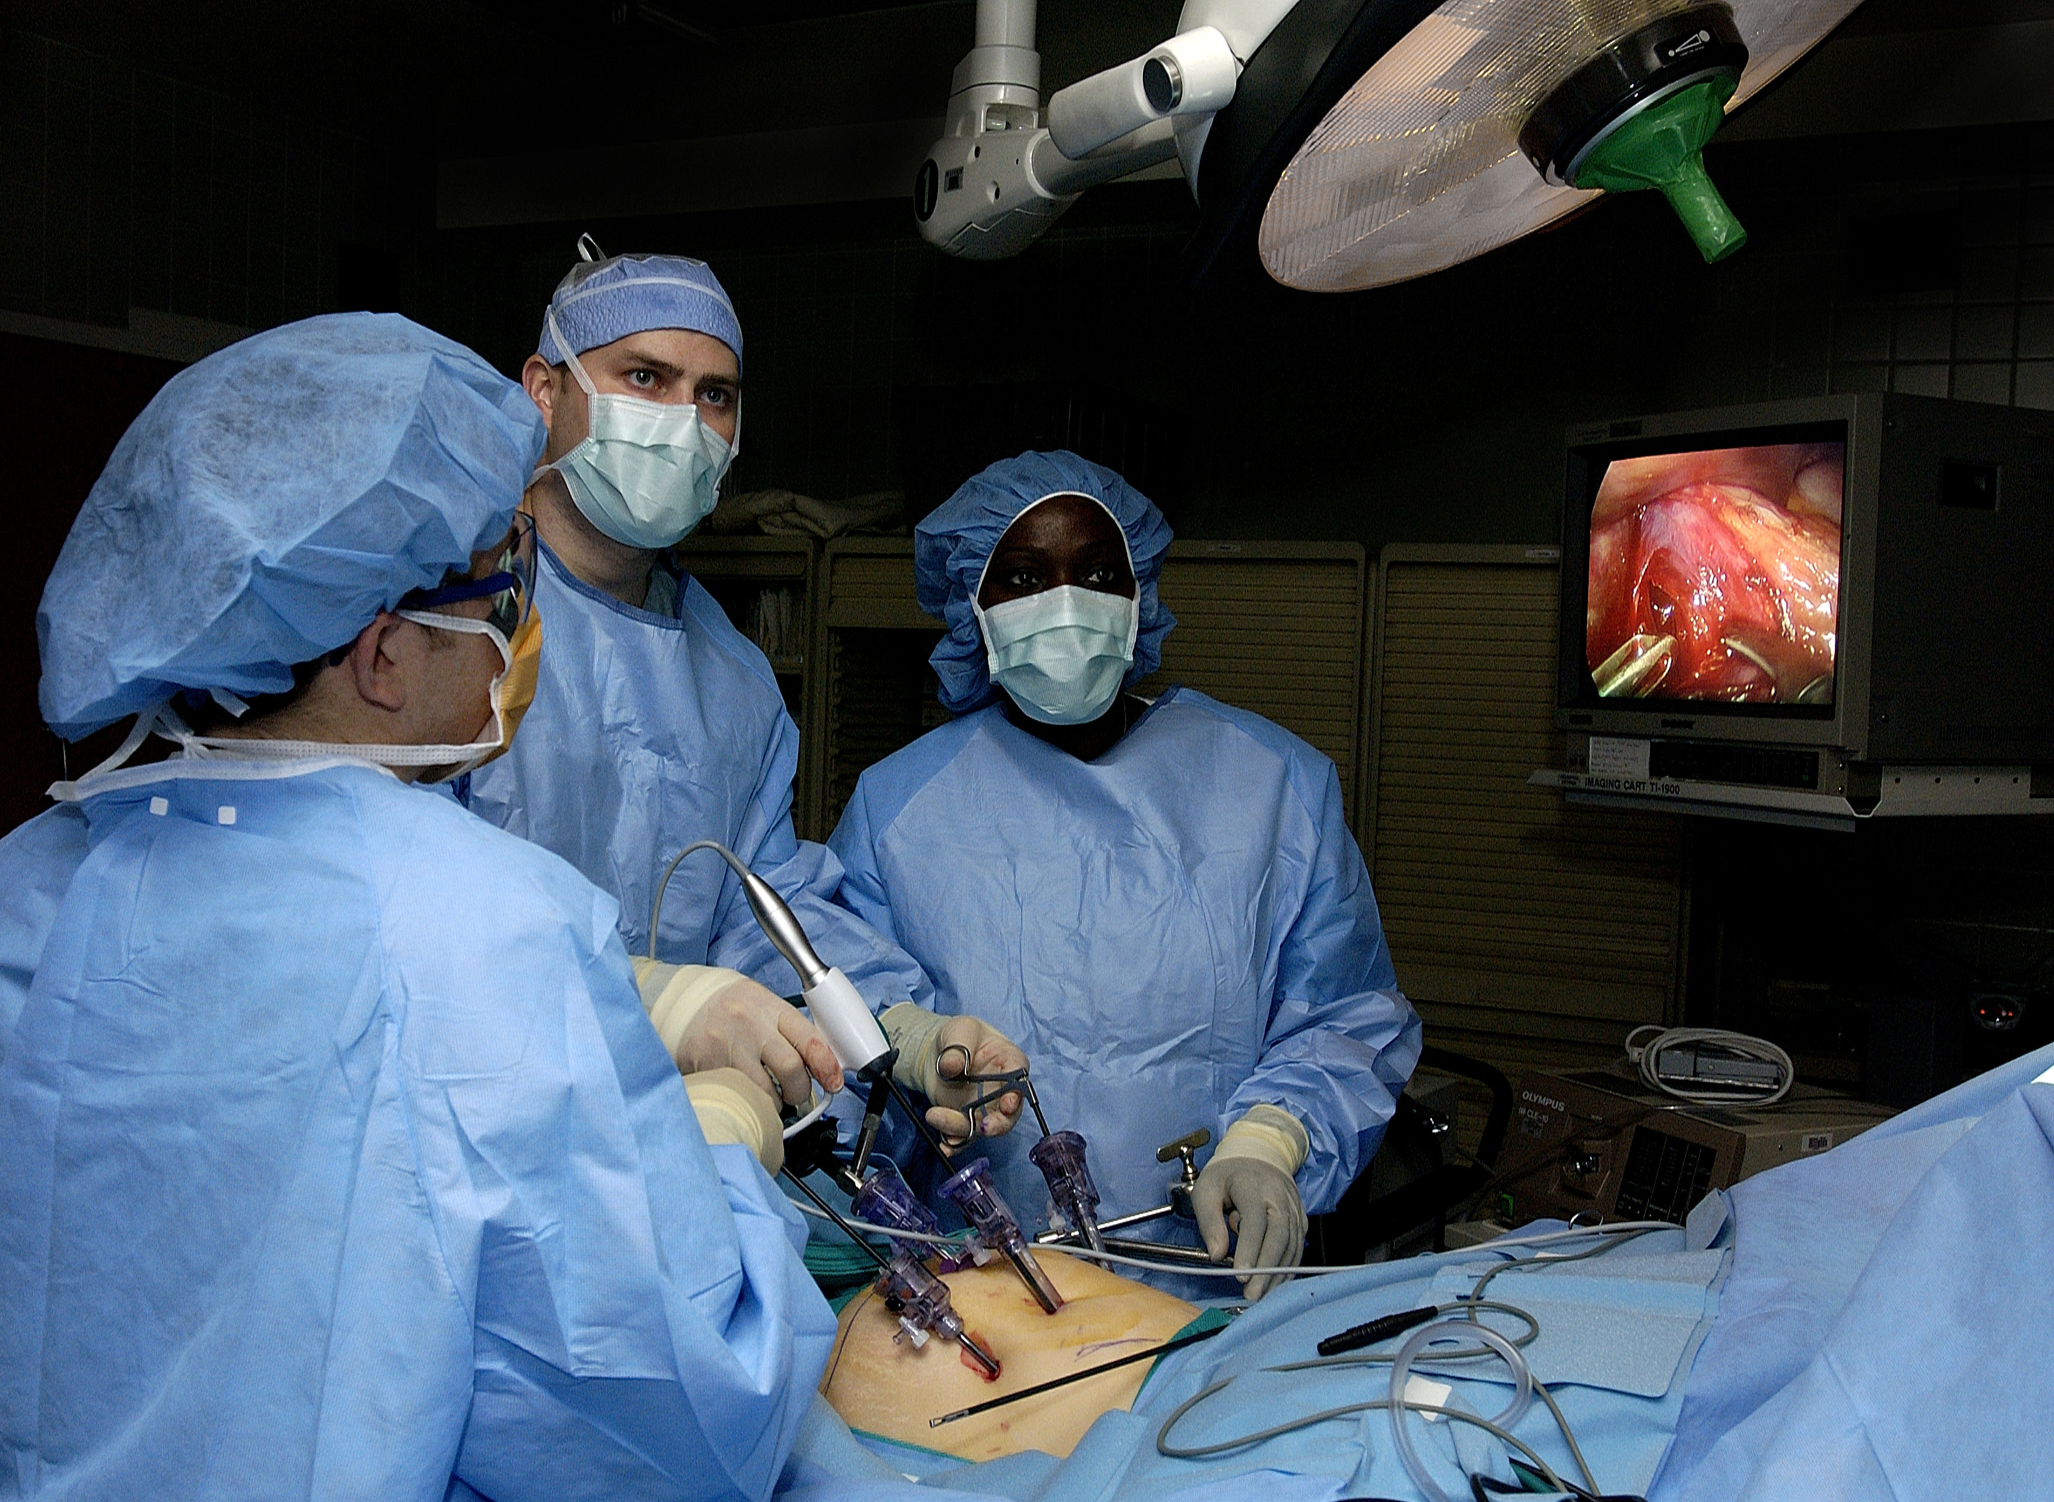
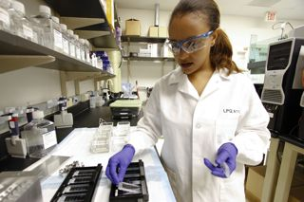
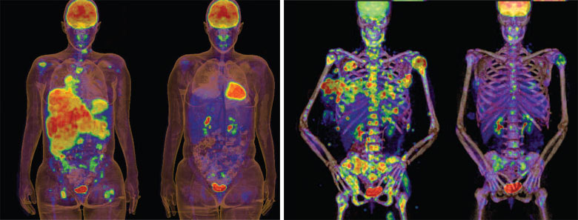
Clinical Queries Searchable by:
Diagnosis
Therapy
Prognosis (prediction of probable outcome)
Etiology (cause)

Slide 9
Clinical Queries Searchable by:
Diagnosis
Therapy
Prognosis (prediction of probable outcome)
Etiology (cause)

Slide 10
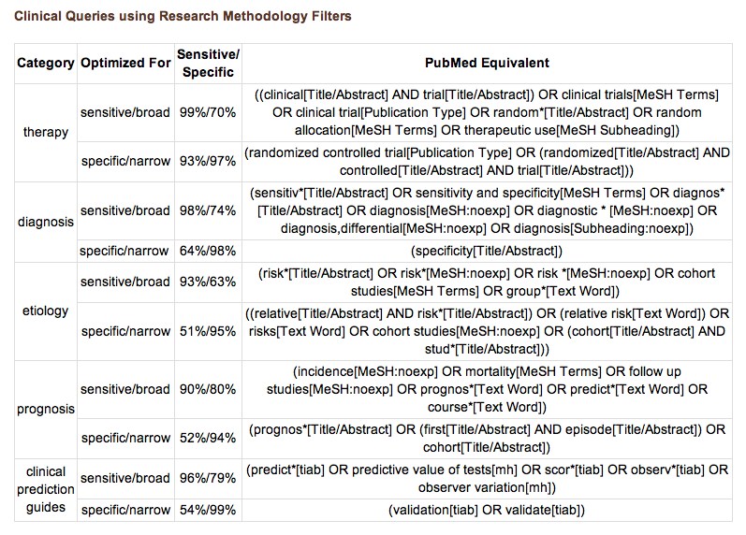
PubMed’s Clinical Queries
uses pre-formulated search strategies with a keyword search

Slide 11
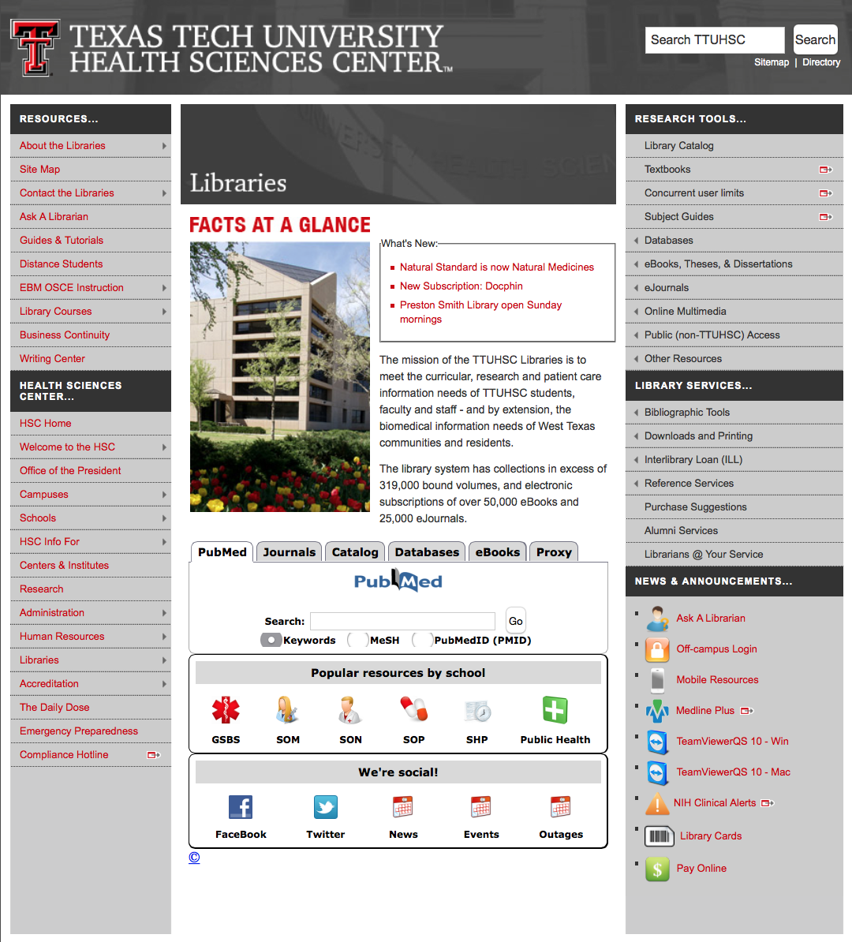
www.ttuhsc.edu/libraries
Click PubMed

Slide 12
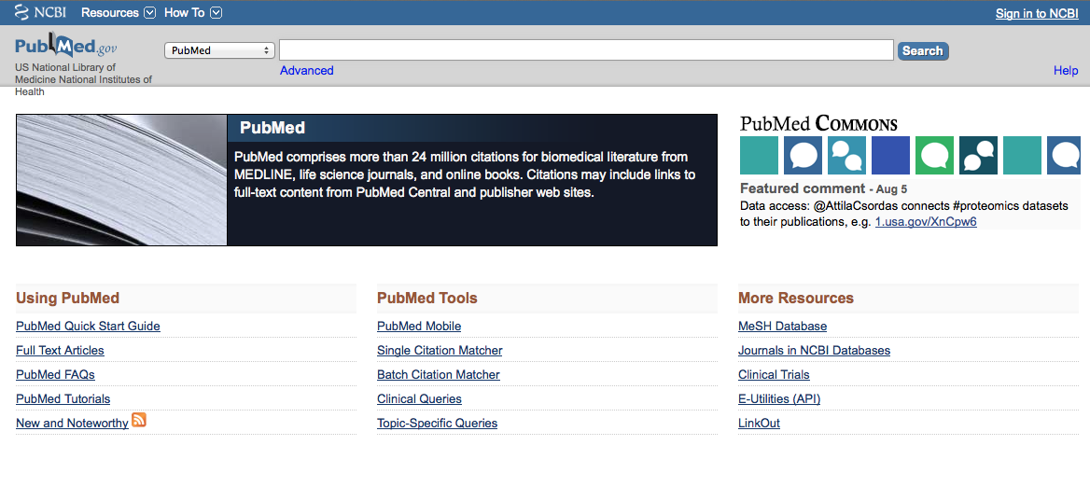
Click Clinical Queries

Slide 13
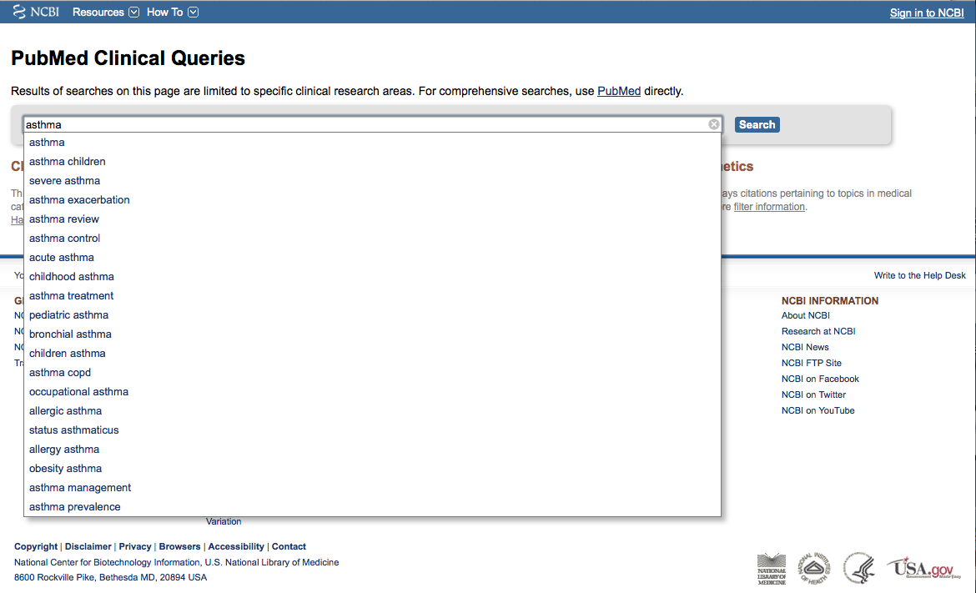
Enter asthma
Click
Search

Slide 14
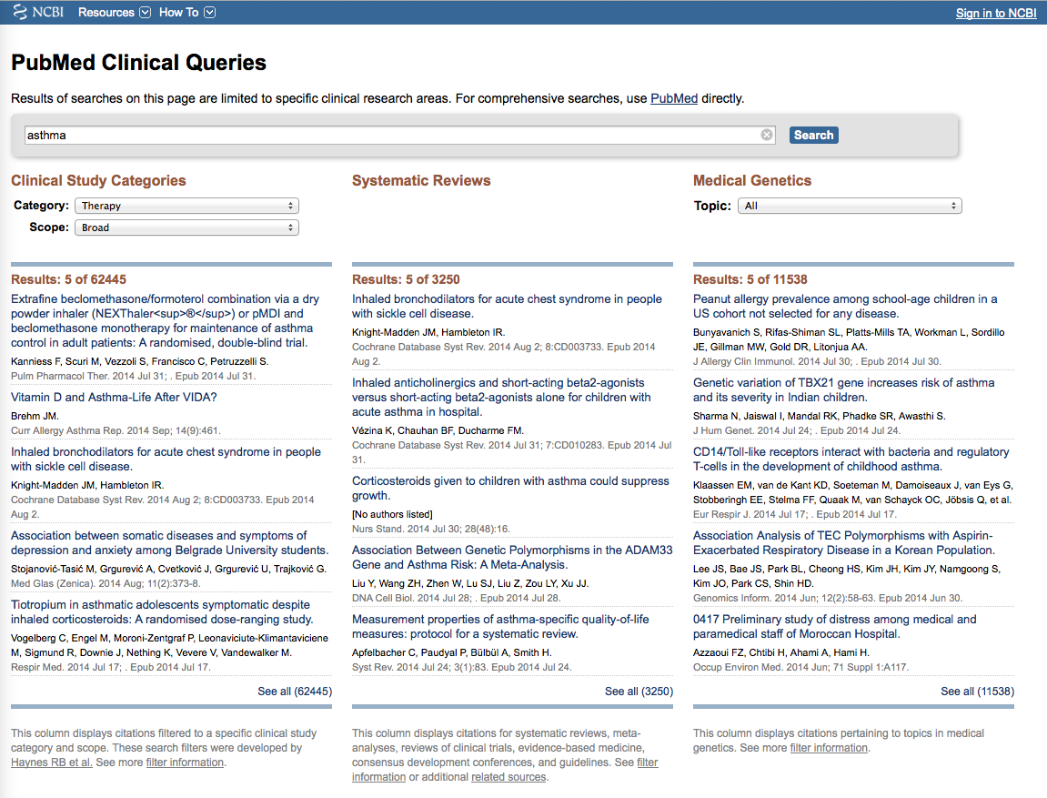
Results for Therapy and
Broad Scope

Slide 15
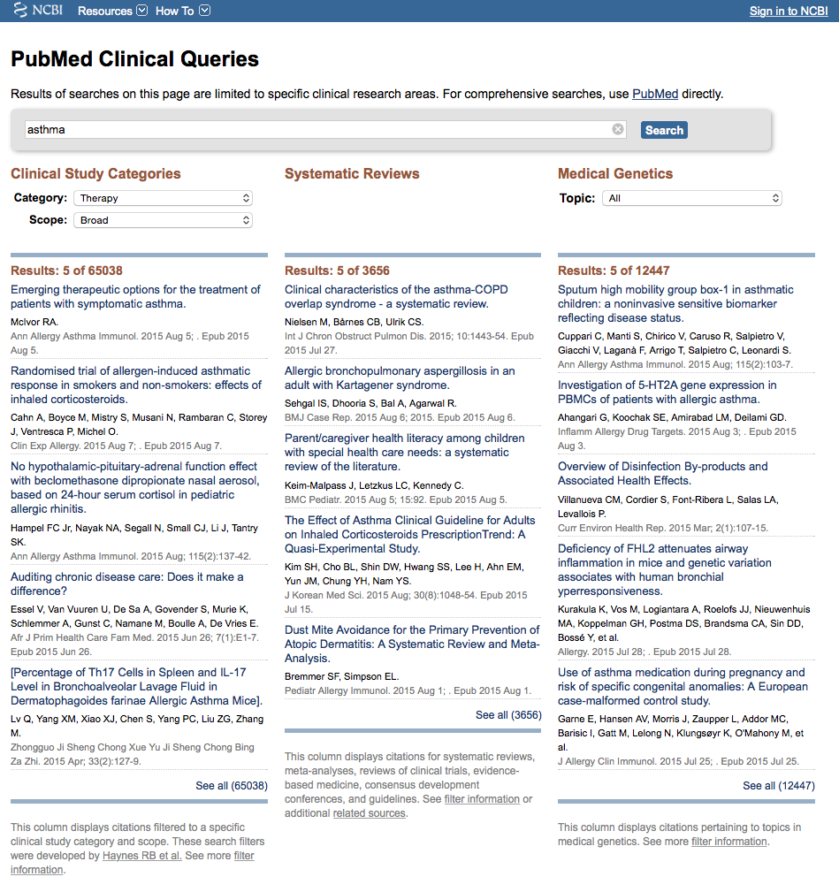

Click on the Therapy drop-down menu

Slide 16
Change to Narrow Scope

Slide 17
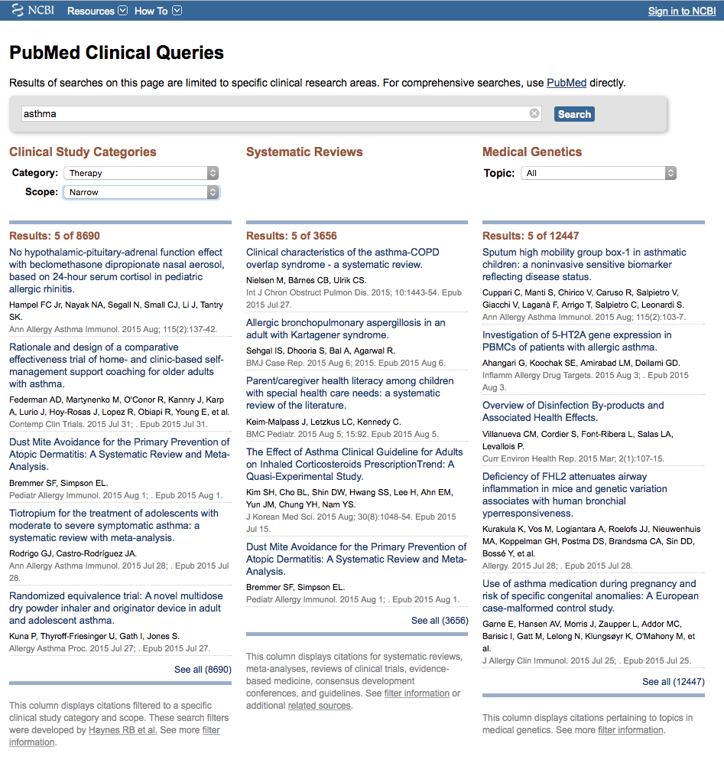
Results for Therapy and
Narrow Scope
Click See all (8690)

Slide 18
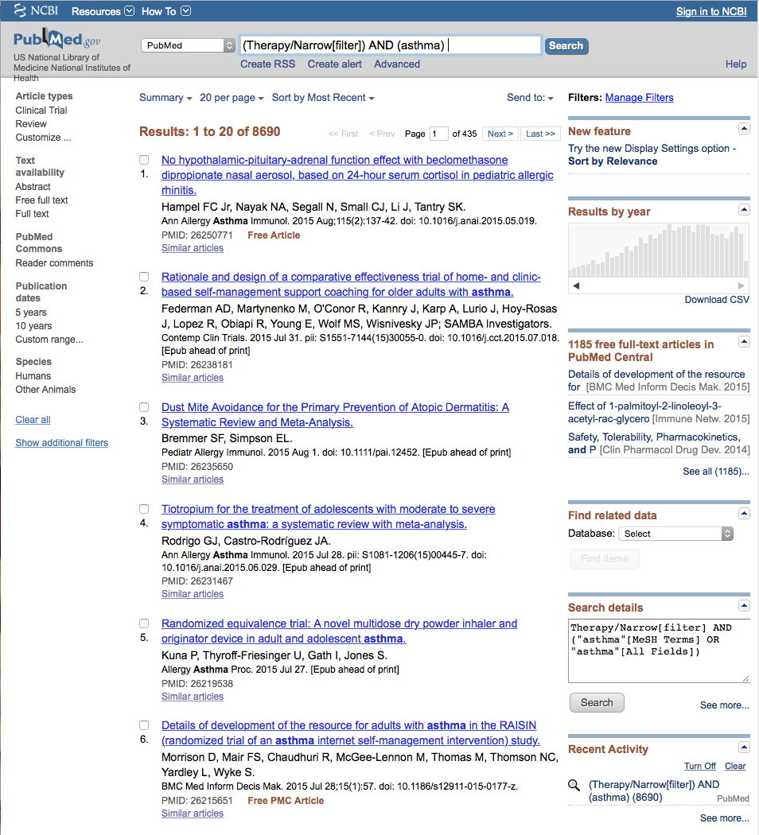
Click Limits

Slide 19
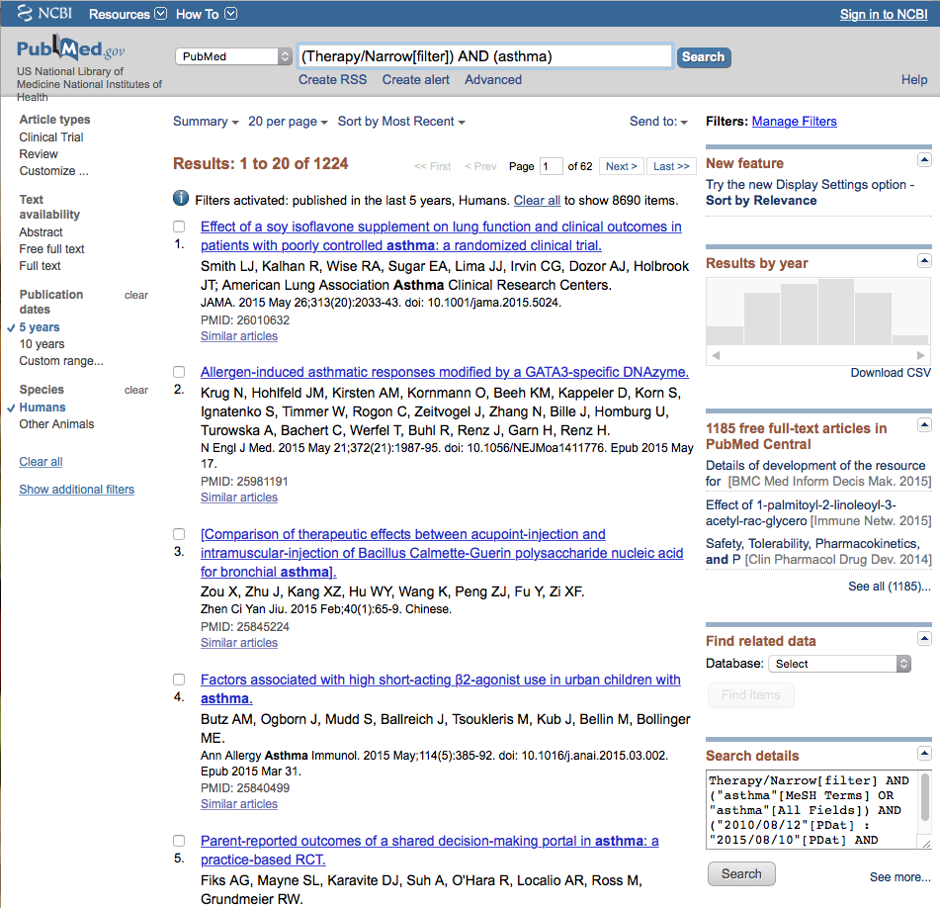
Results and activated filters.
Click Show additional filters

Slide 20
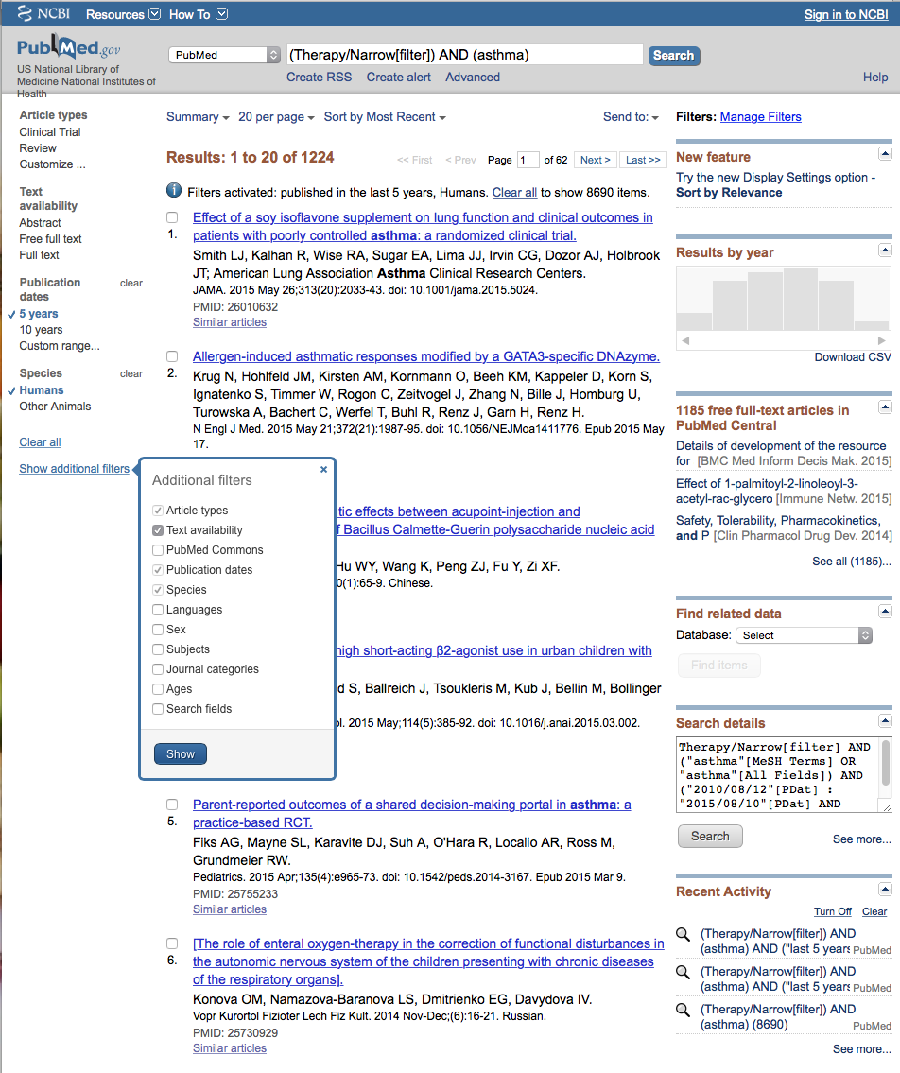
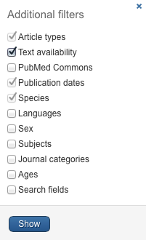
Select
Languages
✔
Click Show

Slide 21
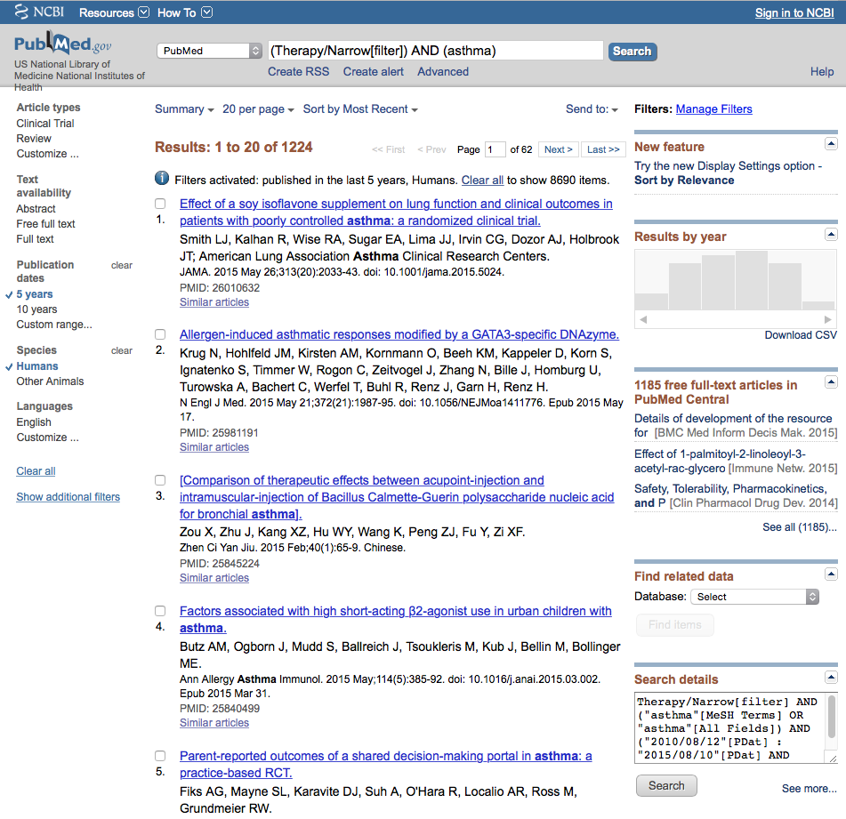
Click English

Slide 22
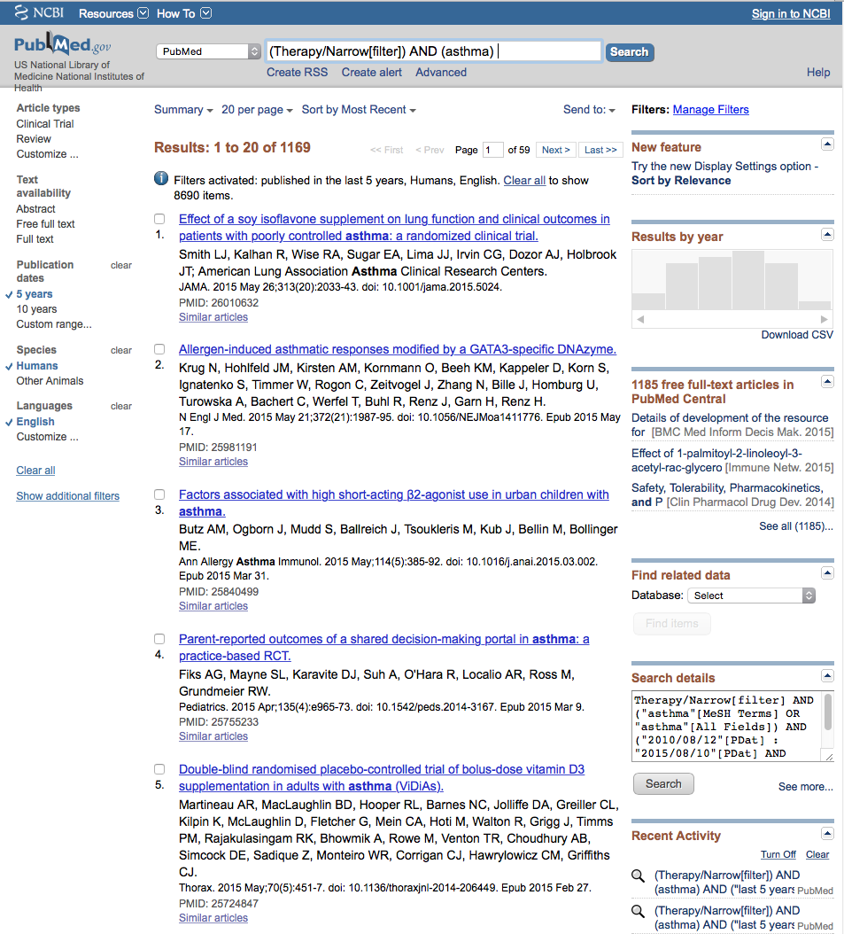
Narrowed Results

Slide 23
Click Customize…

Slide 24
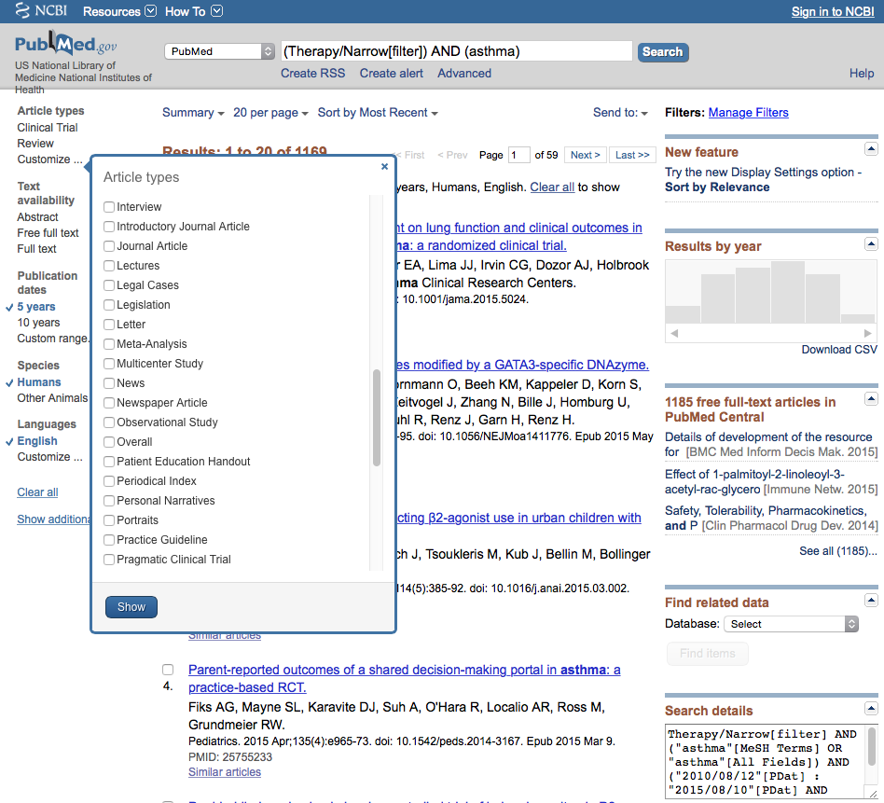
Select
Meta-Analysis
✔

Slide 25
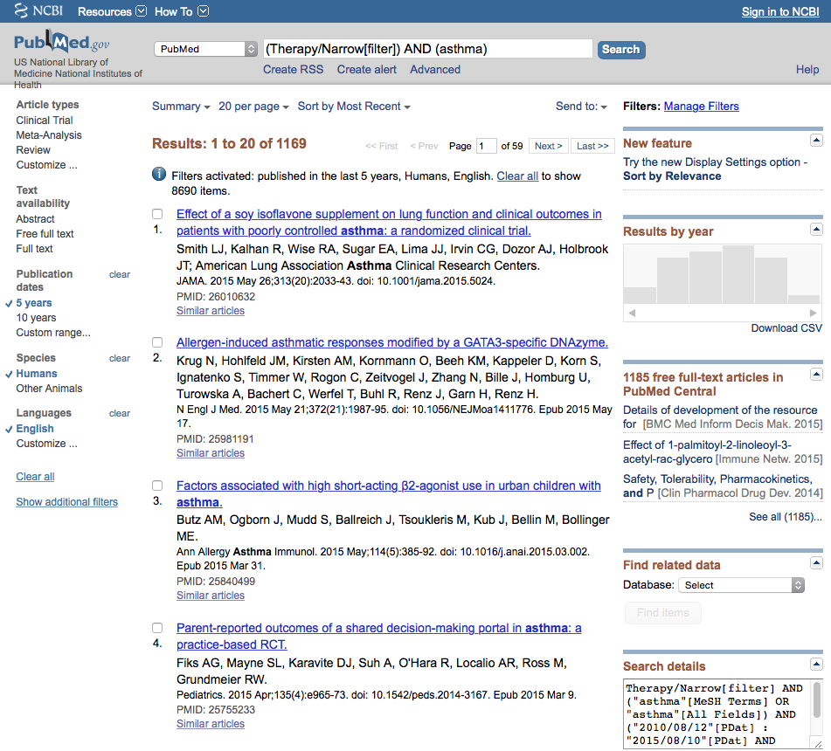
Click Meta-Analysis
to activate filter

Slide 26
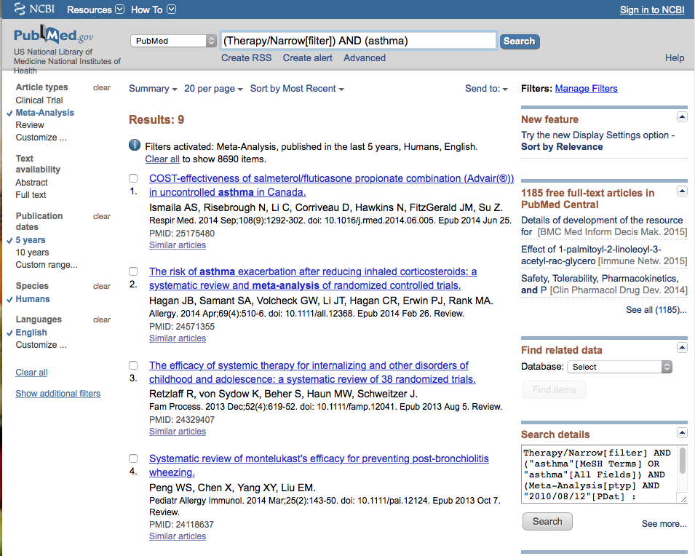
Results have narrowed to 9 articles

Slide 27
Click on the article title you wish to read

Slide 28
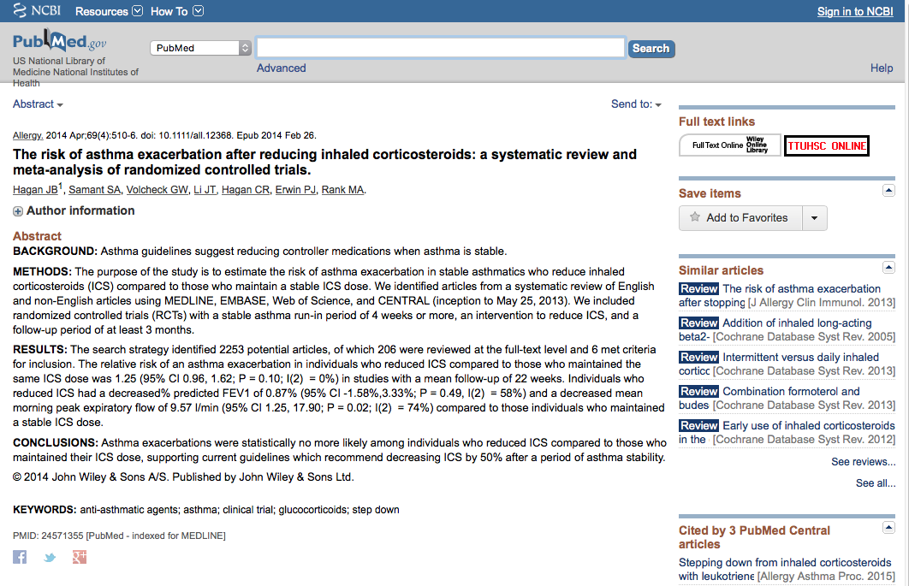
Click for Free Full Text
TTUHSC ONLINE

Slide 29
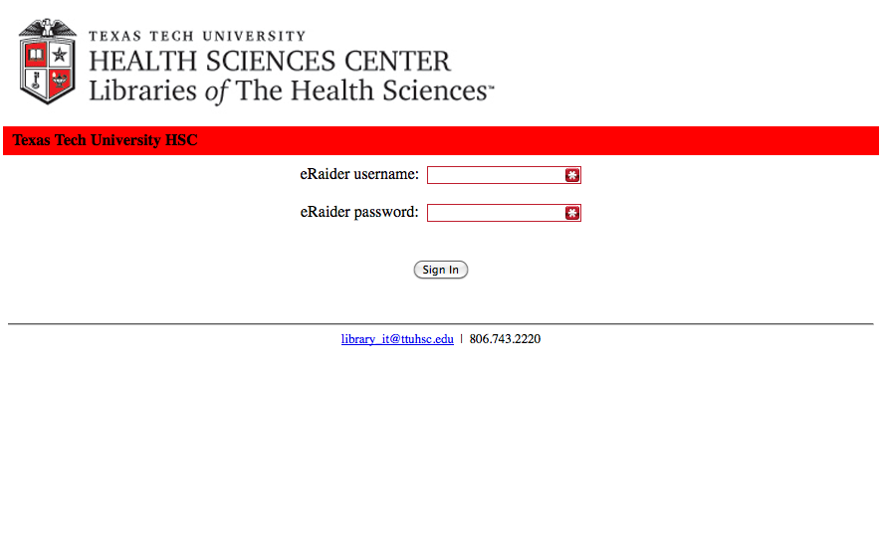
TTUHSC Libraries - Proxy Server
When Searching from Off Campus:
Enter the
Eraider username and password
assigned to you
by Information Services.
A
Problems with eRaider call: 806-743-1234a

Slide 30
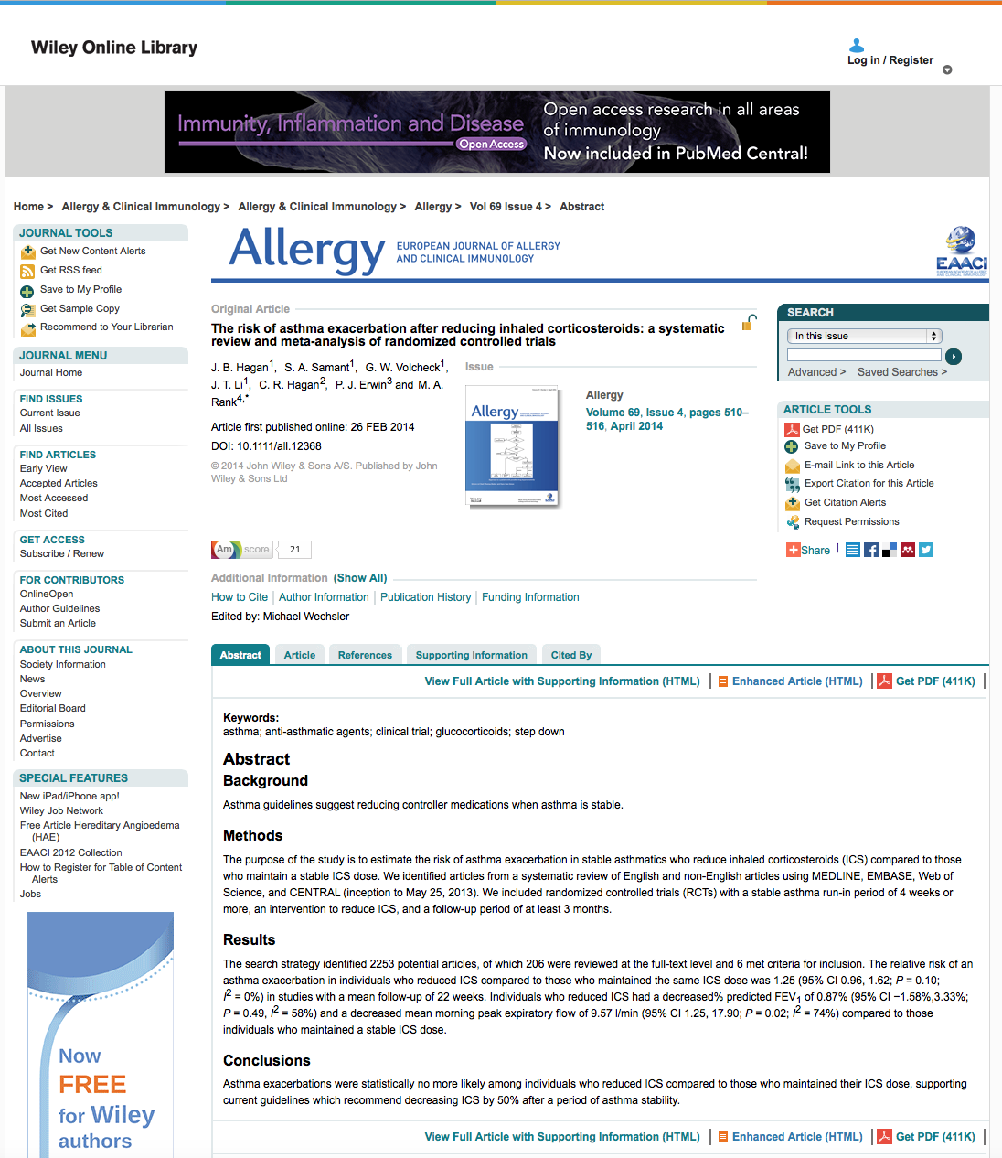

Click

Slide 31
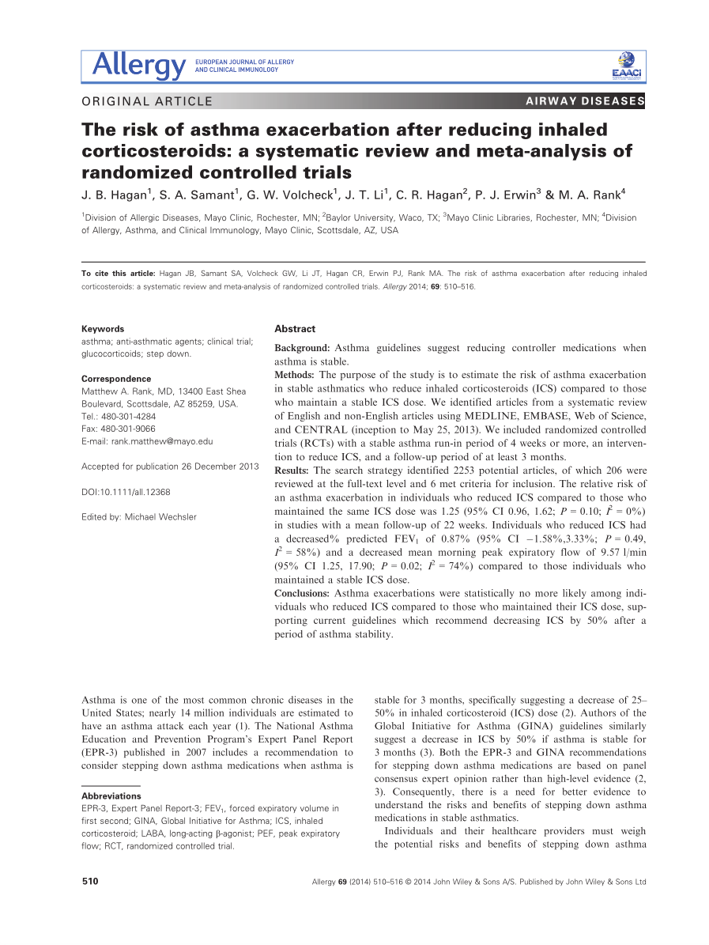
Full Text
Close article

Slide 32

Click

Slide 33
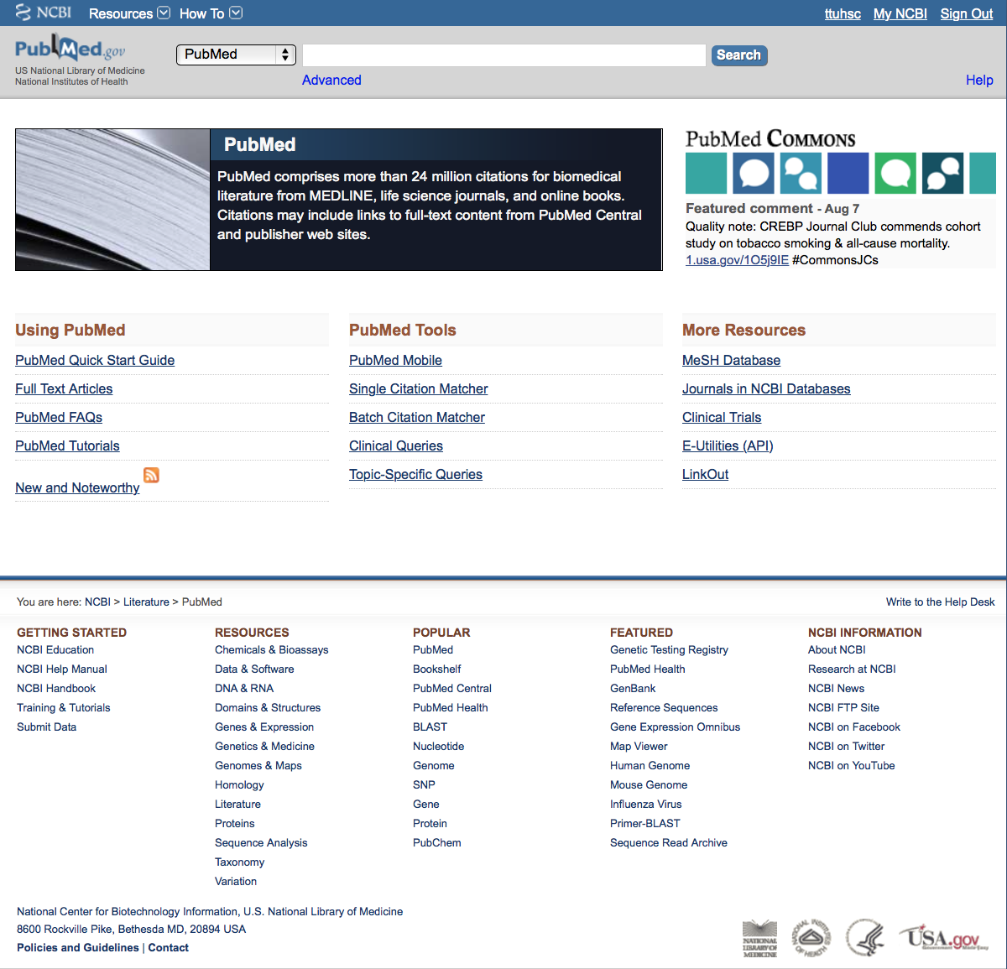
Click PubChem

Slide 34
PubChem

Slide 35
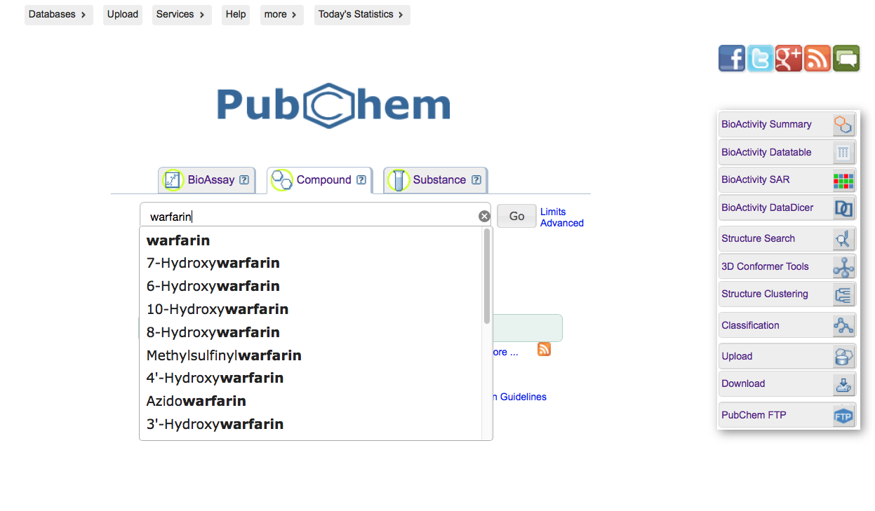
Click one to select
Enter compound, click
Go

Slide 36
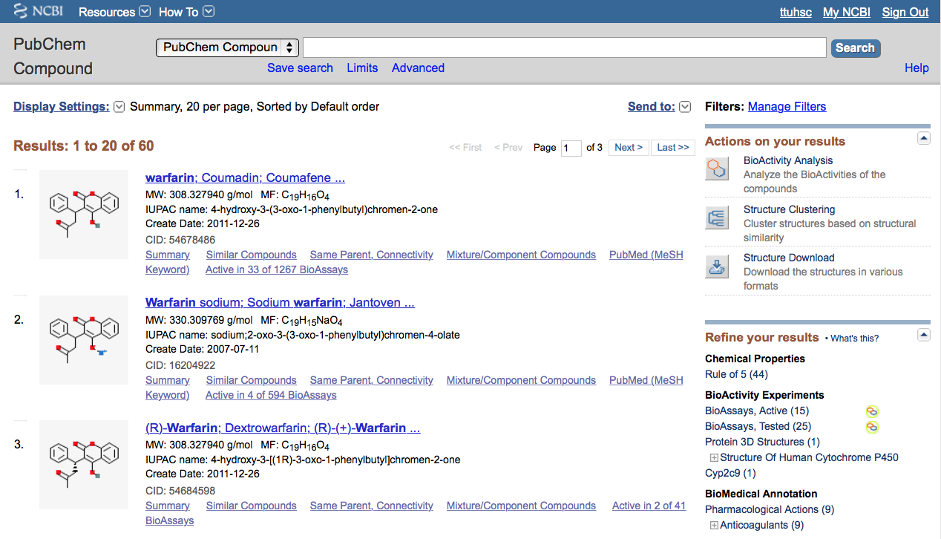
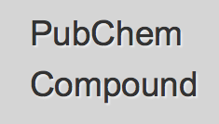
Results
Click

Slide 37
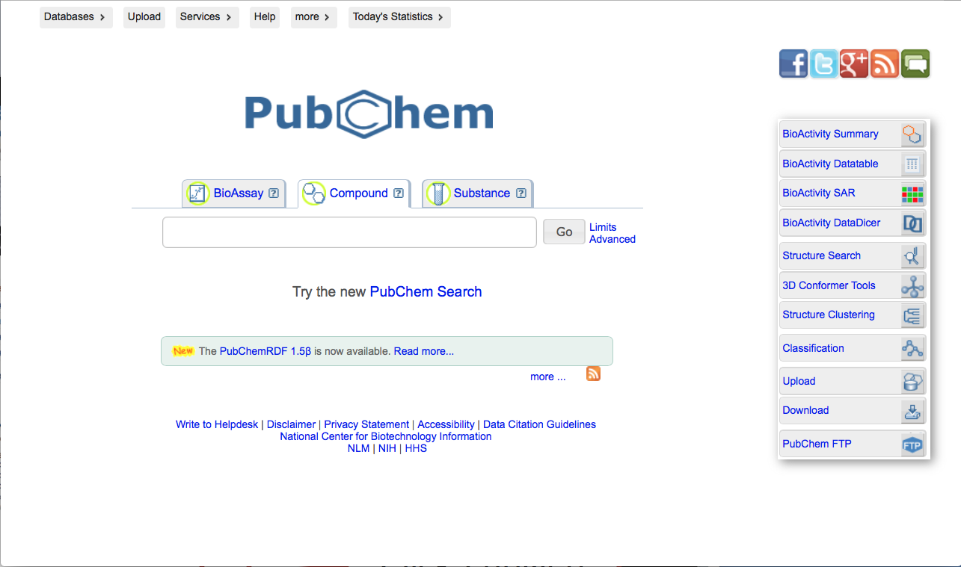
Click Bioactivity Summary

Slide 38
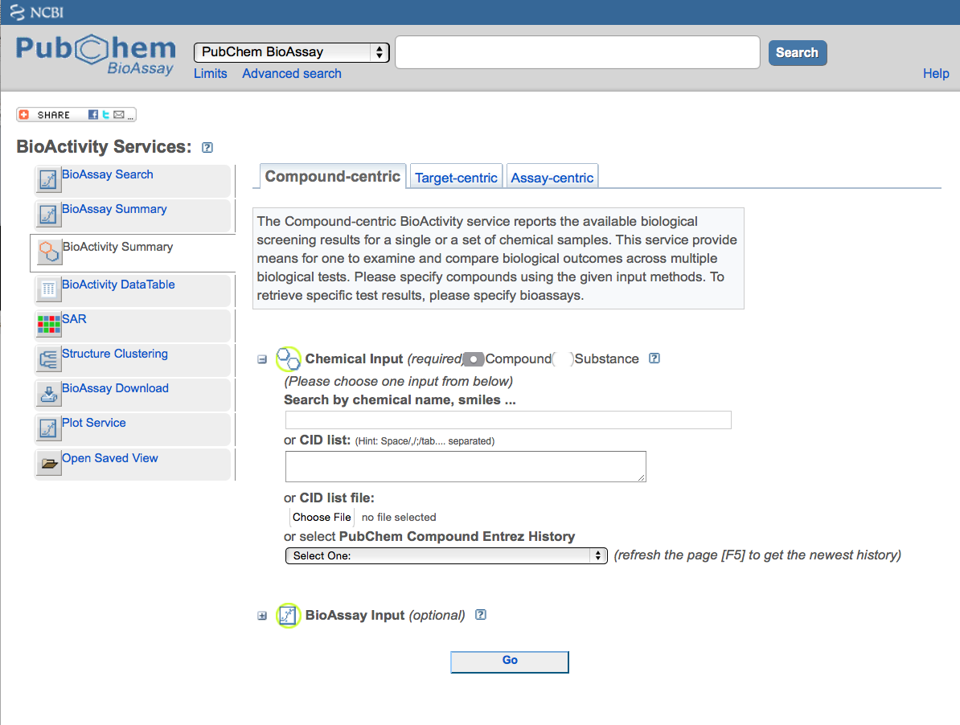
Search Menu

Slide 39
Take some time to explore PubChem

Slide 40
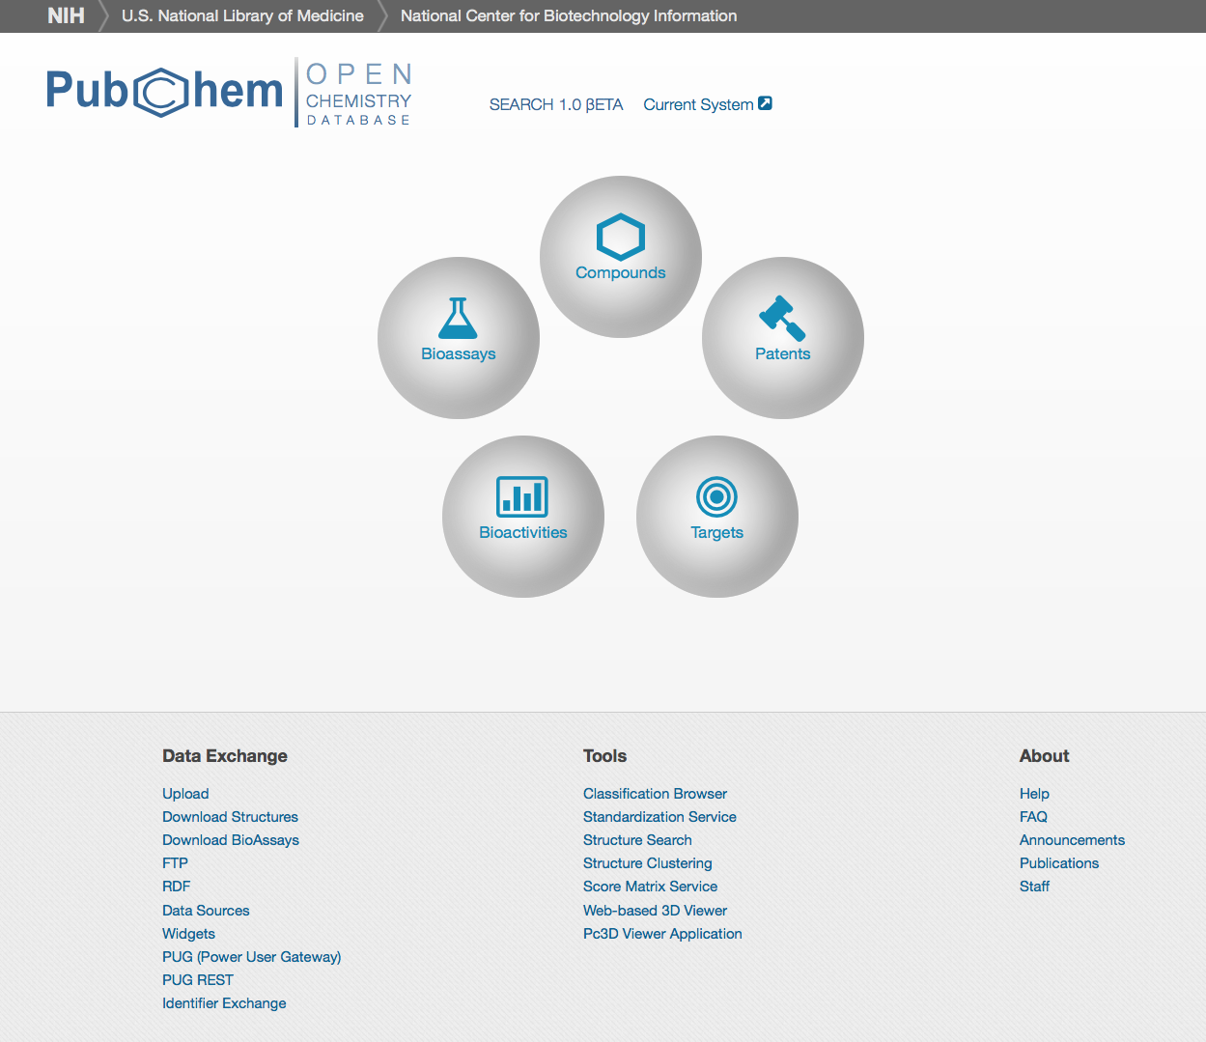
Note: Beta Test Site for new PubChem

Slide 41
Other NLM Databases

Slide 42
www.ttuhsc.edu/libraries
Click PubMed

Slide 43
US National Library of Medicine
Click

Slide 44
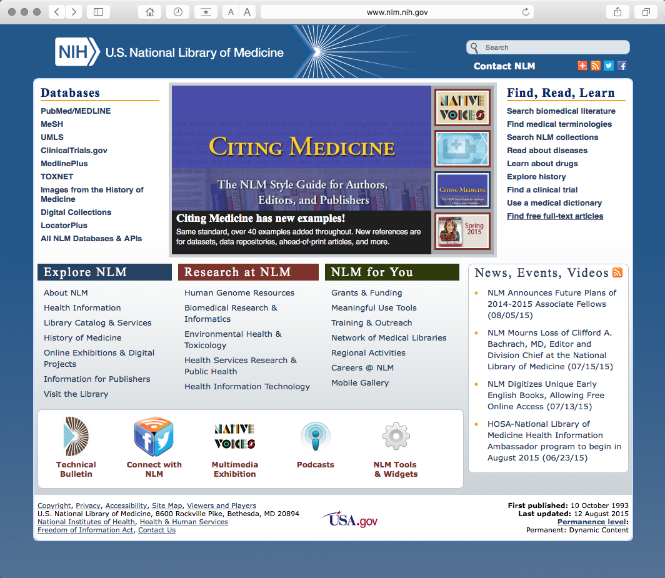
Click All NLM Databases & API’s

Slide 45
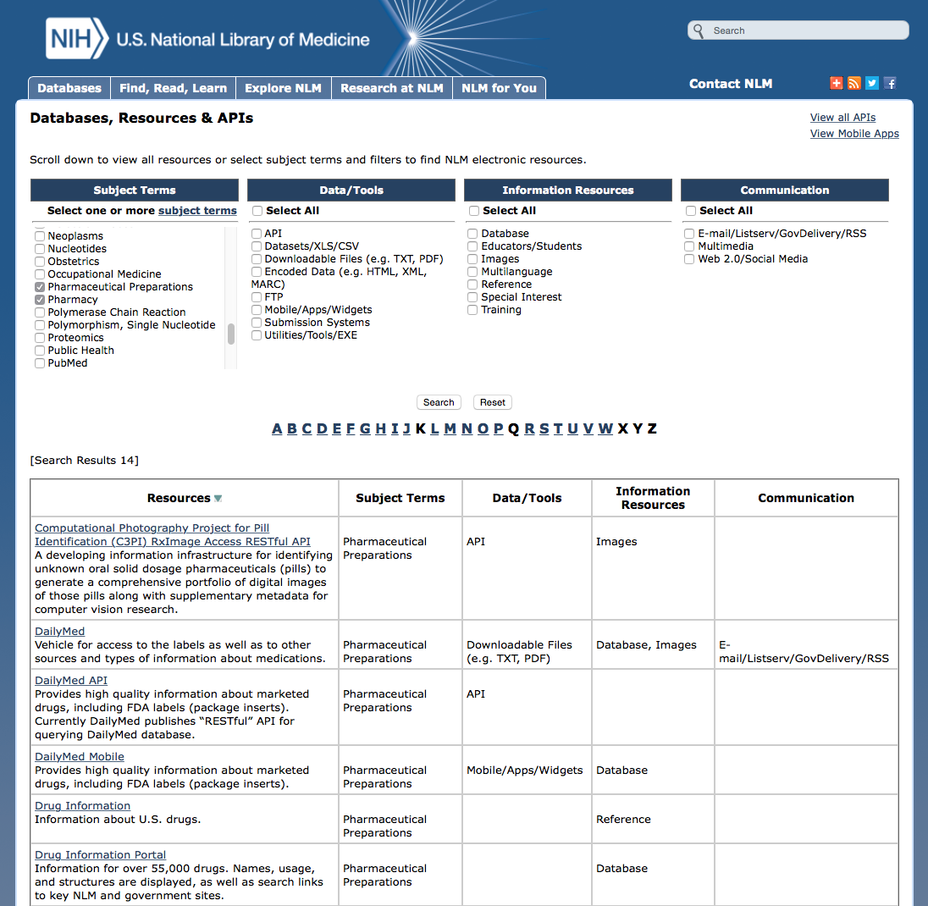
Select Pharmaceutical Preparations and Pharmacy
✔

Slide 46
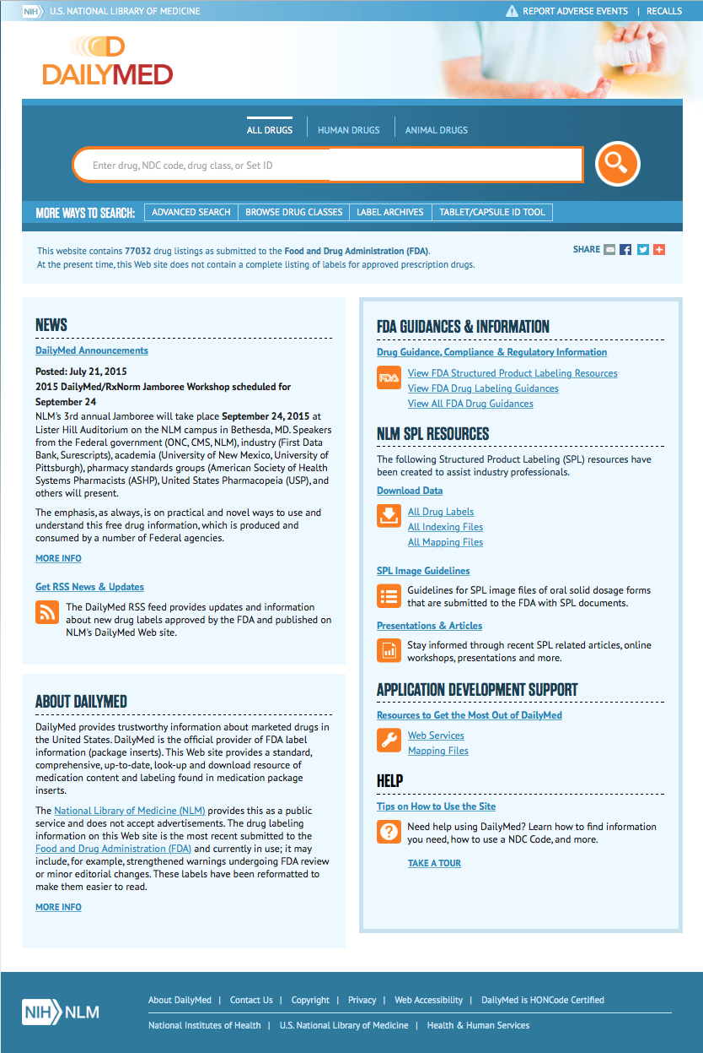
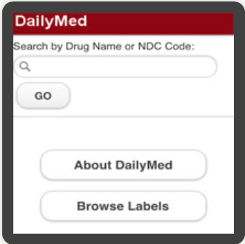

Slide 47
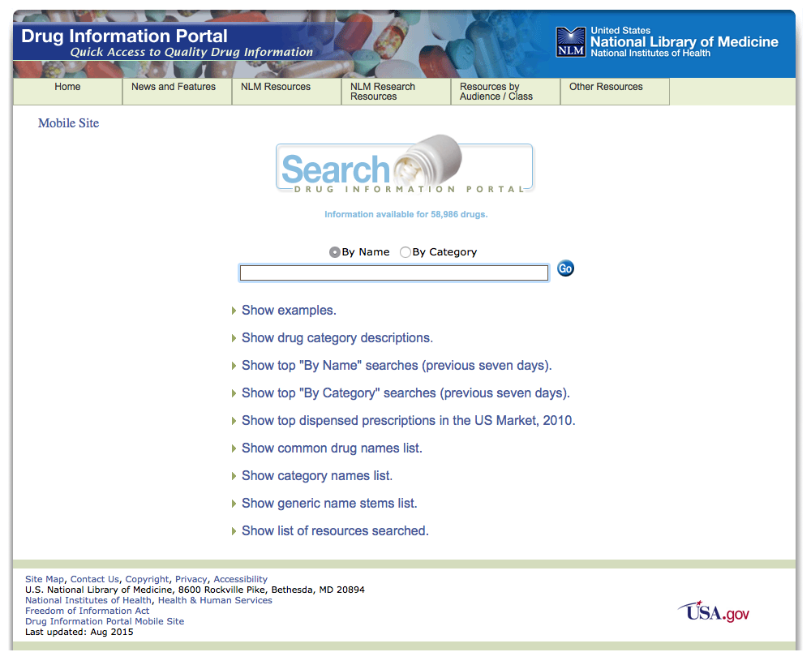

Slide 48
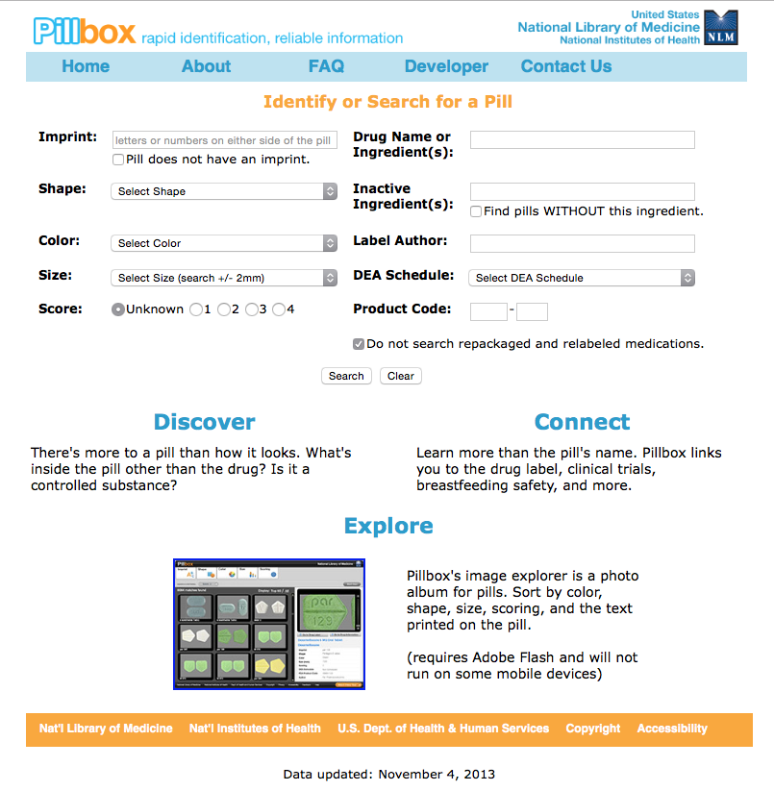

Slide 49
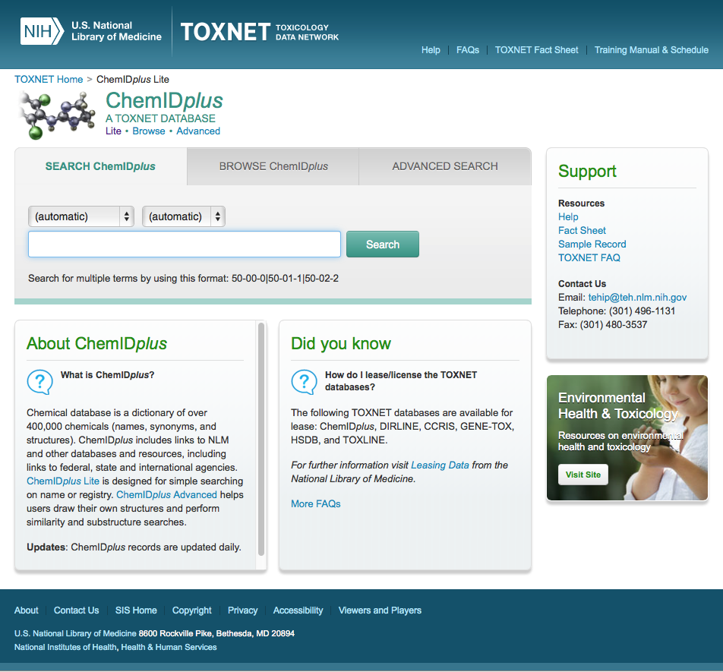

Slide 50
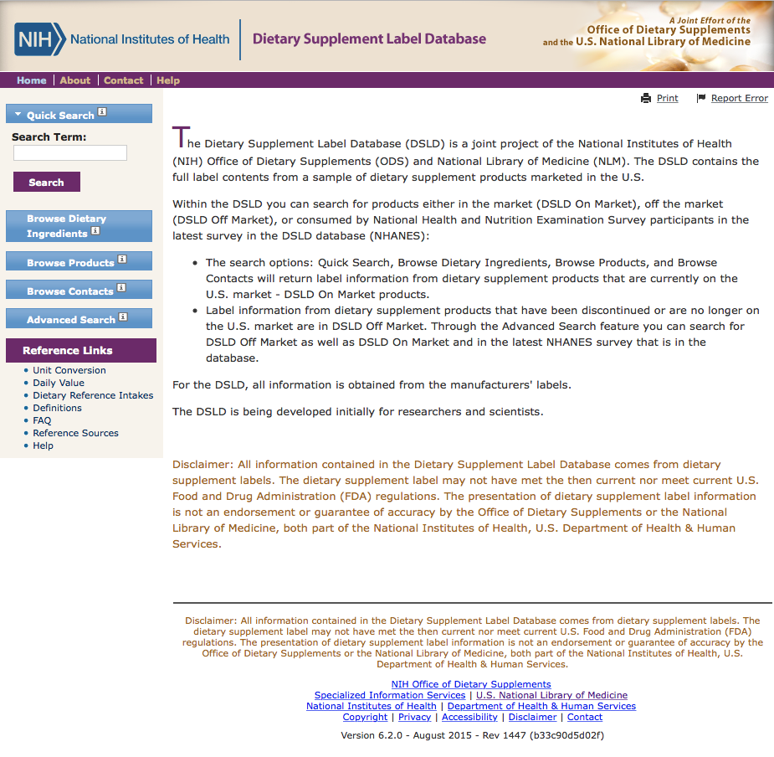

Slide 51
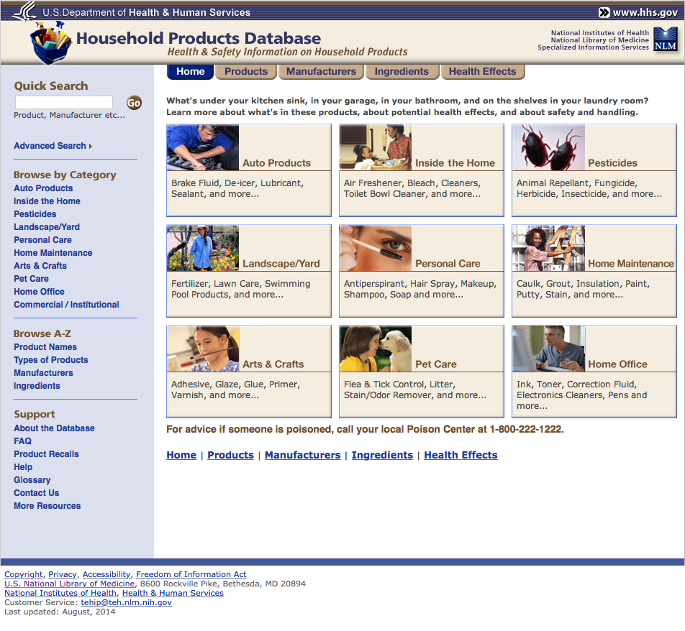

Slide 52
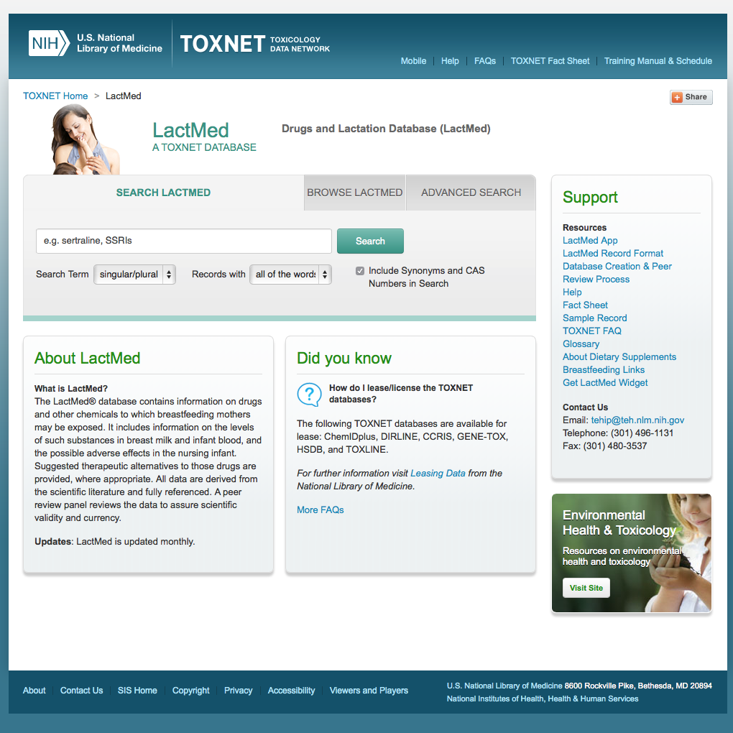


Slide 53
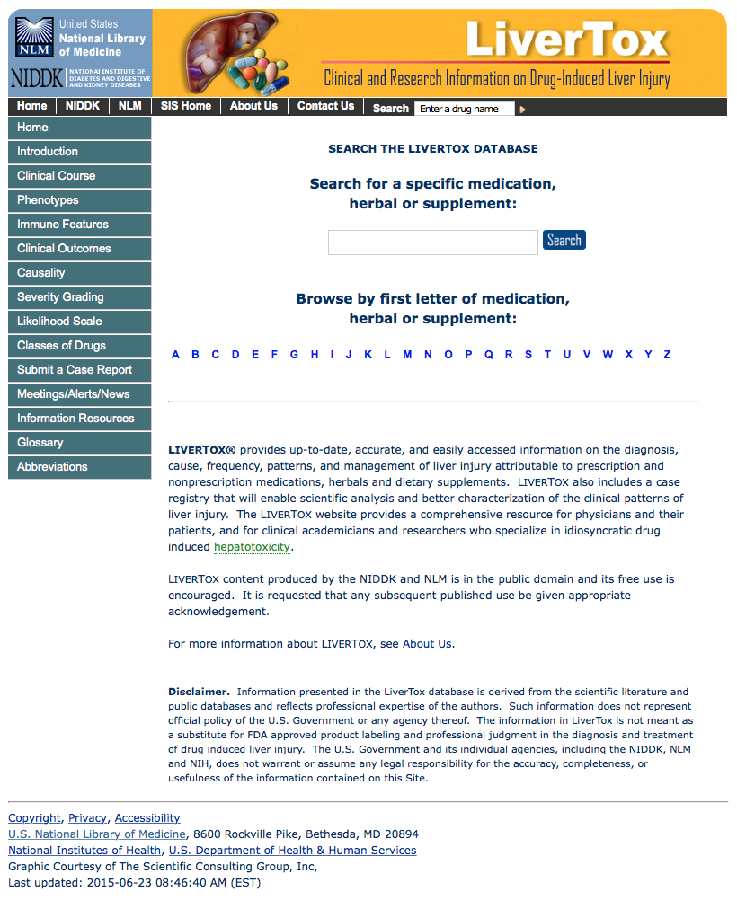

Slide 54

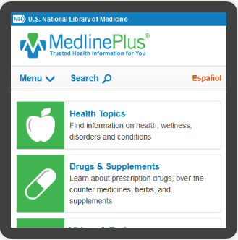

Slide 55
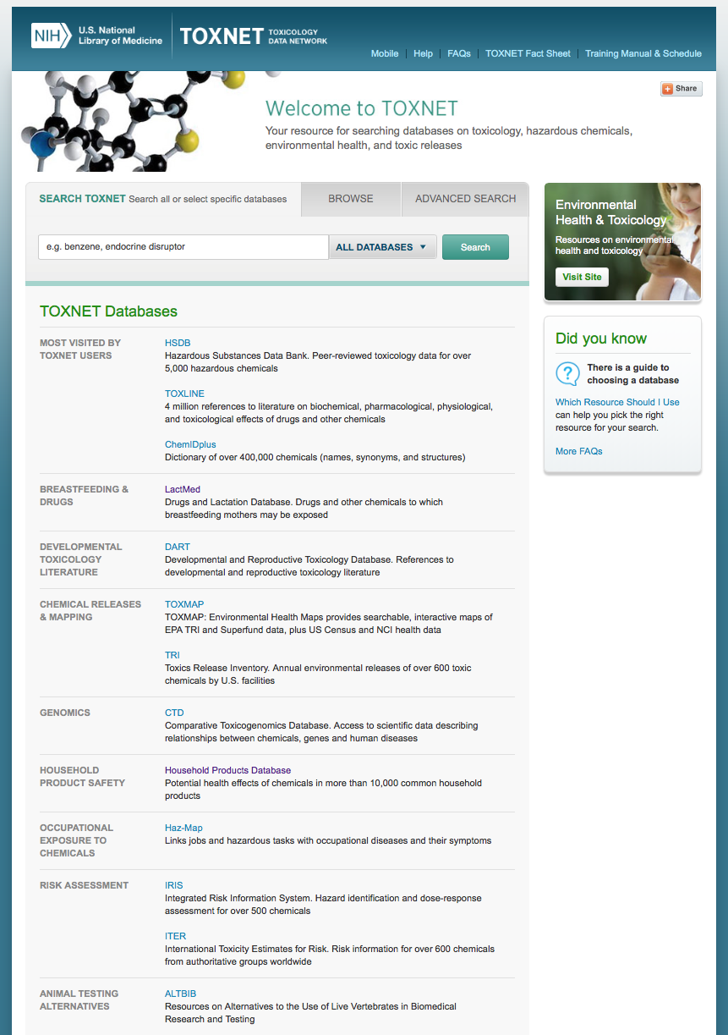
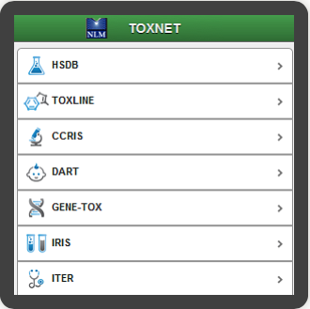

Slide 56
NCBI

Slide 57

Click

Slide 58
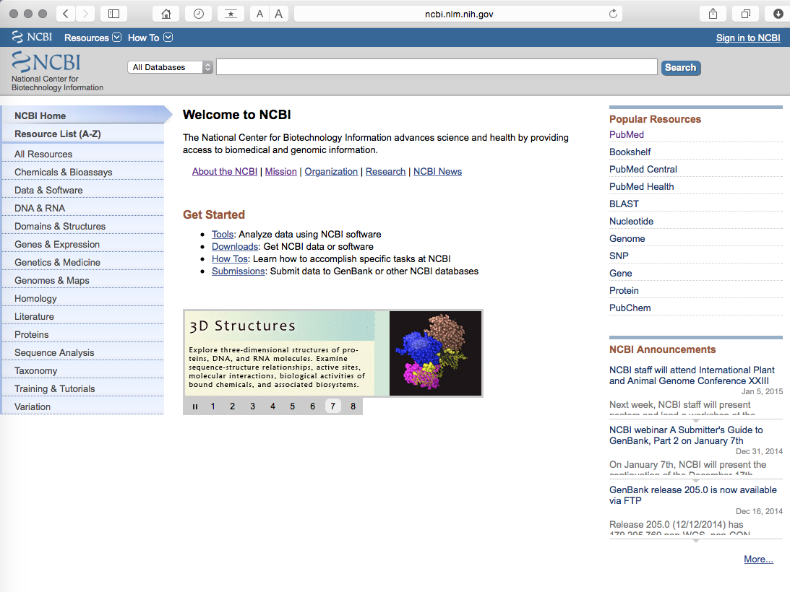
www.ncbi.nlm.nih.gov

Slide 59
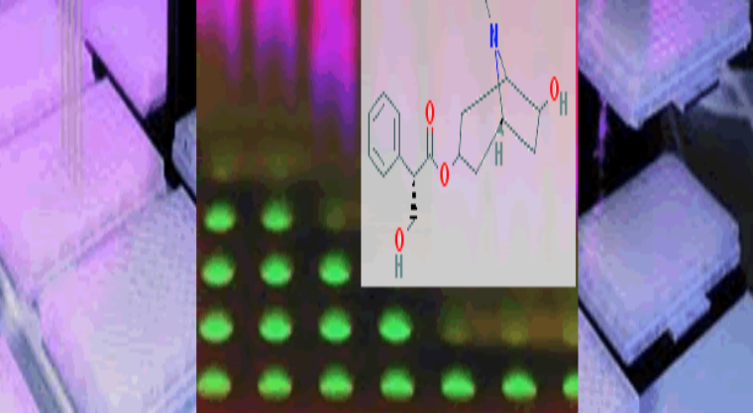

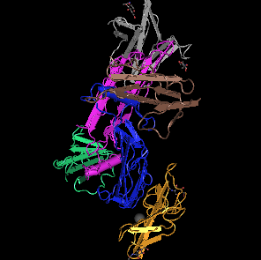






Chemical and Bioassays
DNA and RNA
Domains and Structures
Genes and Expression
Genomes and Maps
Proteins
Sequence Analysis
Variation
Taxonomy

Slide 60
www.ncbi.nlm.nih.gov

Slide 61
Have Questions?

Slide 62

www.ttuhsc.edu/libraries
email us

Slide 63

Today’s Powerpoints

Slide 64
Thank You!

