Slide 1
3rd year Pharmacy Library Orientation, Pt. II
August 14, 2015
Micah Walsleben, MLS

Slide 2
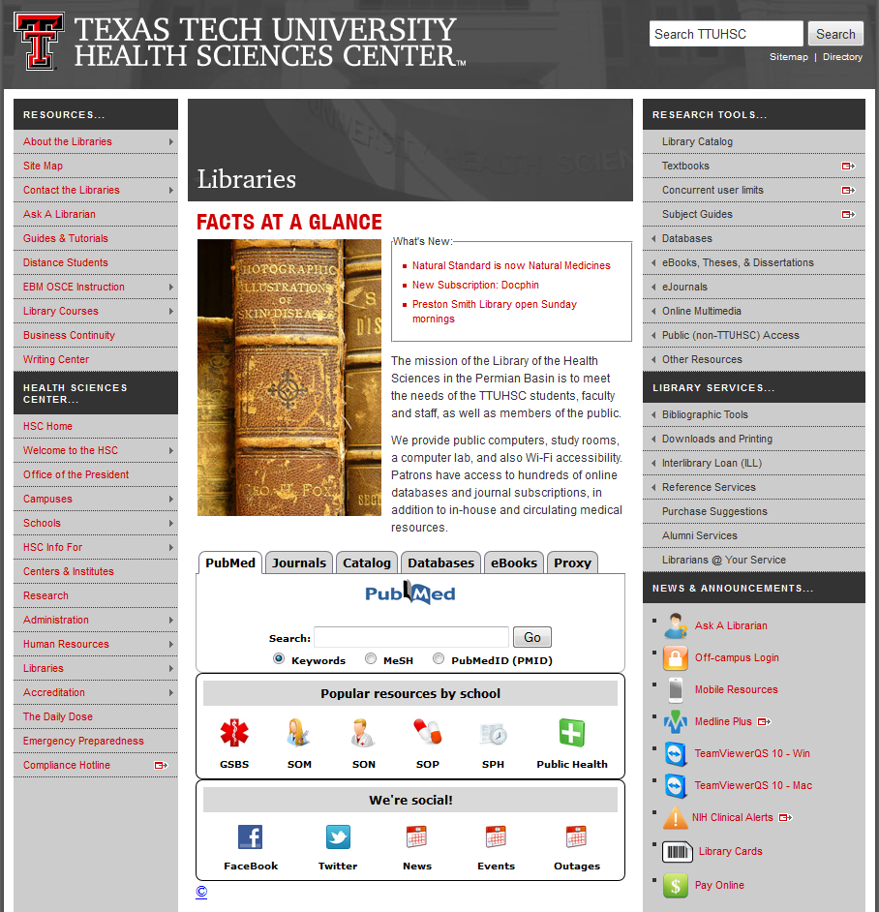
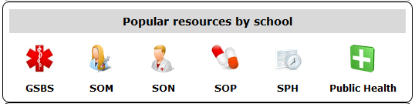
Notes:
The first database I’ll be exploring with you is Pepid. It’s found on the SOP Frequently Used Resources page from the library web site.

Slide 3
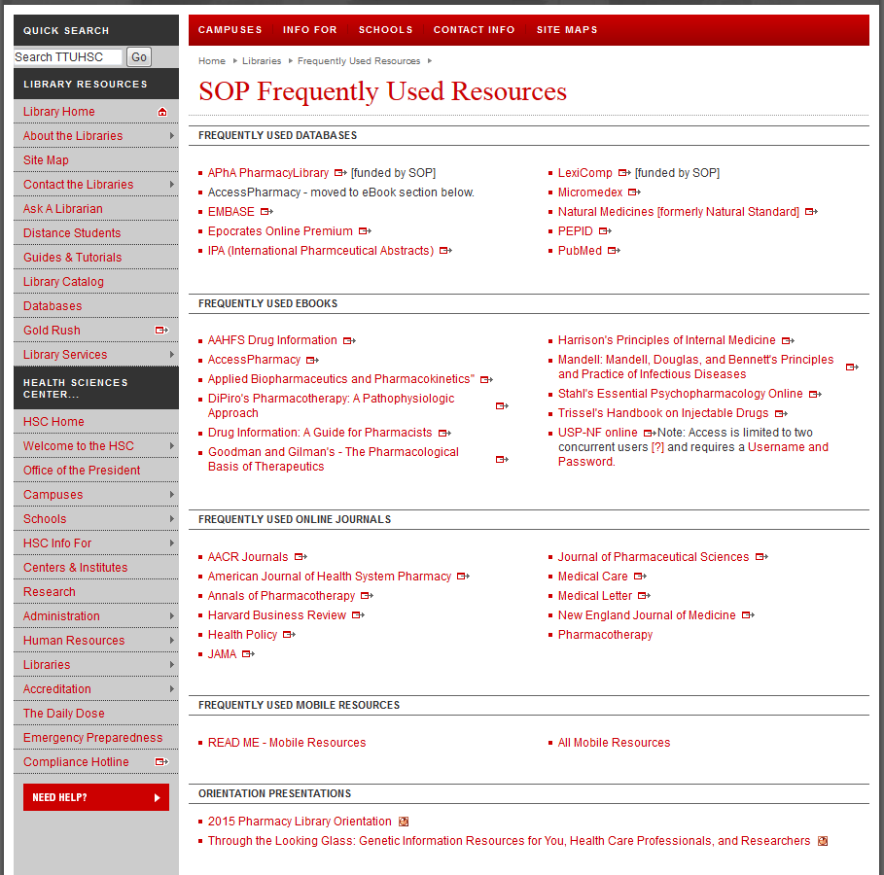
Notes:
Pepid will be under “Frequently Used Databases”.

Slide 4
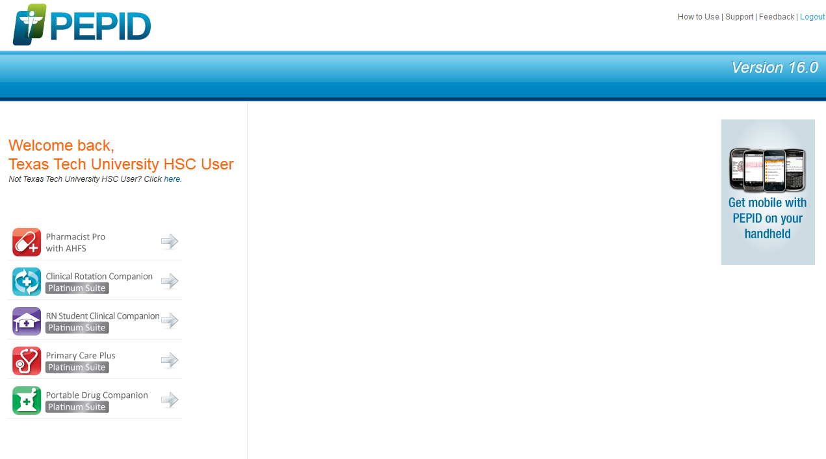
Notes:
When you arrive at Pepid, select “Pharmacist Pro with AHFS”.

Slide 5
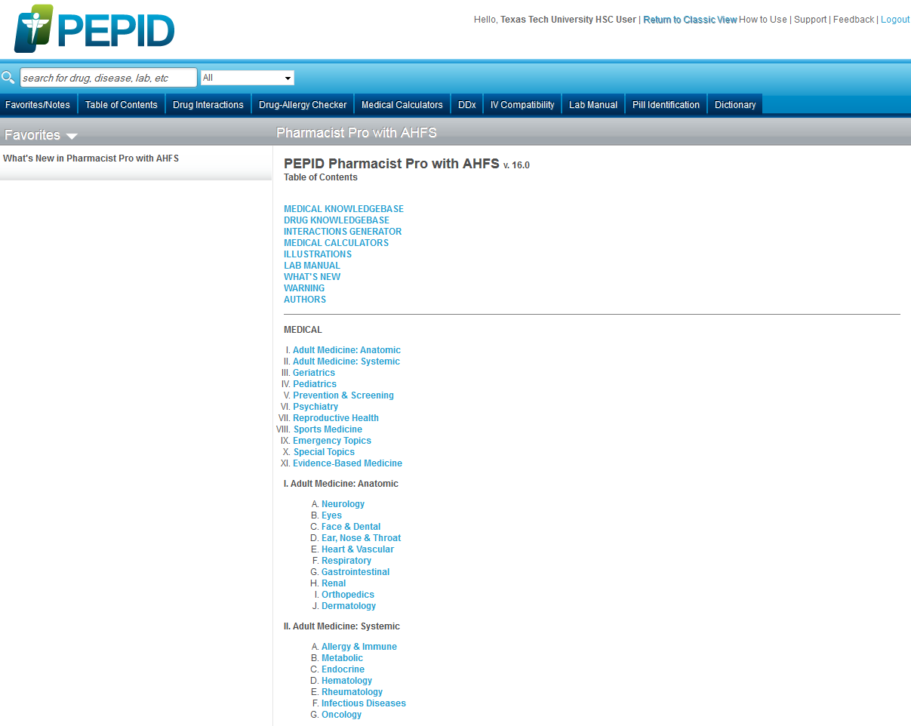
warfarin
Notes:
Here is Pepid Pharmacist Pro with AHFS, automatically defaulted to start at the “Table of Contents” page. Above it are a series of tabs to help you navigate the features of Pepid (Drug Interactions, IV Compatibility, Drug-Allergy Checker, Pill Identification, etc.). You can either browse through the strata of the table of contents, or enter a specific term in the search bar at the top of the page. As an example, let’s do a search on “warfarin”.

Slide 6
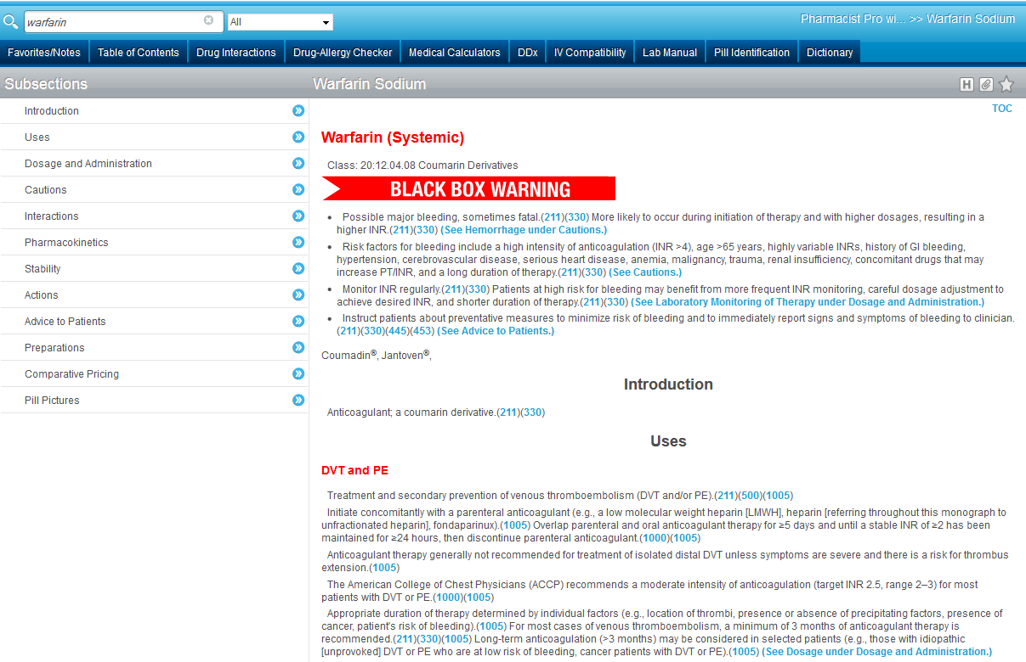
Notes:
When searching for a specific drug in Pepid, it takes you directly to the drug’s information page. To the left is an outline that will let you navigate to a specific section of this page. If you’re following along on your computer, click the table of contents tab to return to the page where we started.

Slide 7
Notes:
I’m going to find information by browsing through the table of contents to give you an idea of what that process looks like. I’ll begin by clicking on “Drug Knowledgebase” at the top of the list.

Slide 8
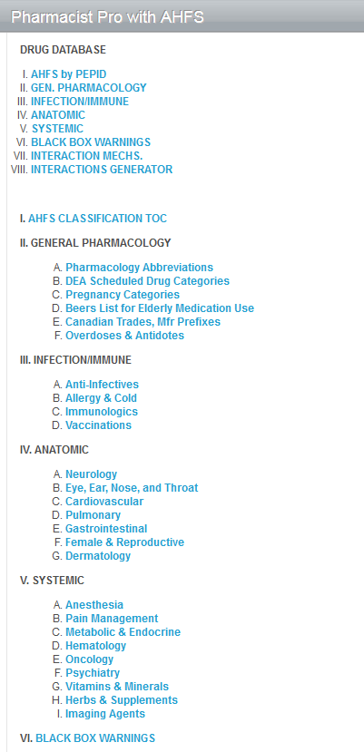
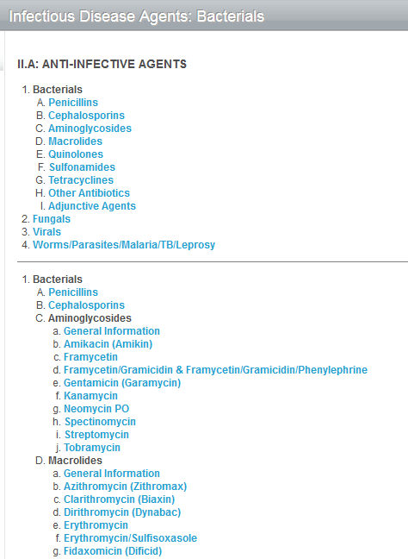
Notes:
From there, I’ll click on III a: “Anti-Infectives”, then on 1 A in the resulting list: “Penicillins”.

Slide 9
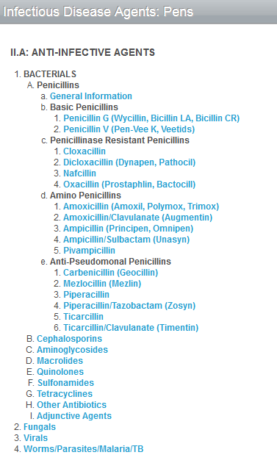
Notes:
Finally, at the last step, I’ll choose d 1 “Amoxicillin (Amoxil, Polymox, Trimox)”.

Slide 10
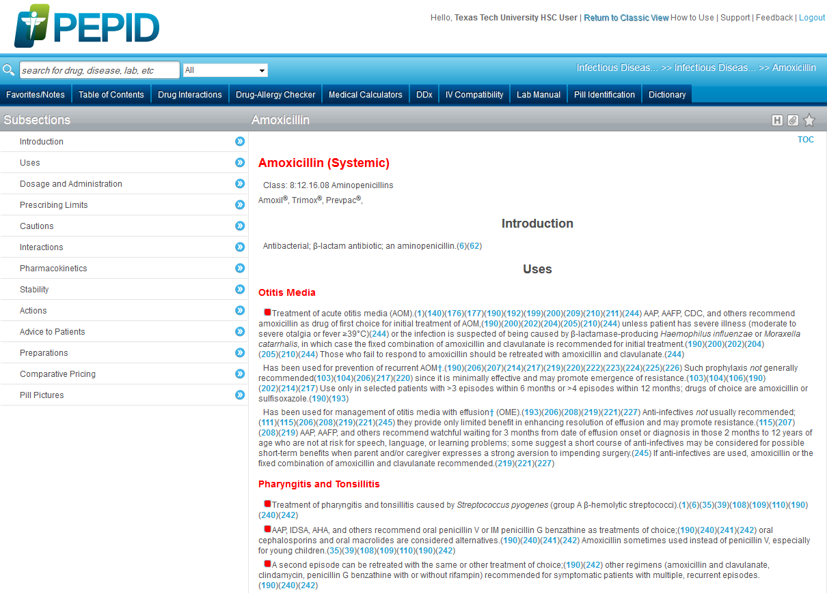
Notes:
Here is the drug information page that comes up. Notice it’s much like the page we saw on warfarin.
To see another feature in Pepid, click on “Table of Contents” once more.

Slide 11
Notes:
Click on “Medical Calculators” at the top of the list. Here, I’ll show you one of the many calculators available to you through Pepid.

Slide 12
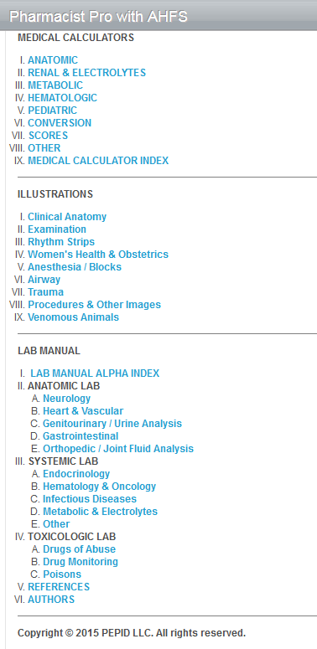
Notes:
As an example, I’ll click on IV: Hematologic.

Slide 13
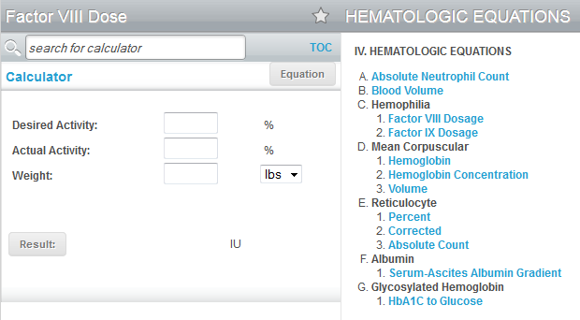
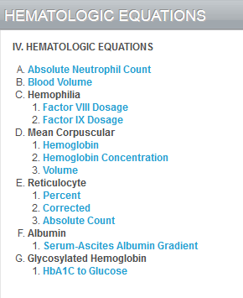
Notes:
Within that list, I’ll click on C 1 “Factor VIII Dosage”. The calculator will automatically appear to the left of the table of content list. Simply enter the information you have to get the result!

Slide 14
Notes:
The second resource I’ll show you today is Natural Medicines (it used to be called Natural Standard). It’s also found on the library’s School of Pharmacy Frequently Used Resources page.

Slide 15
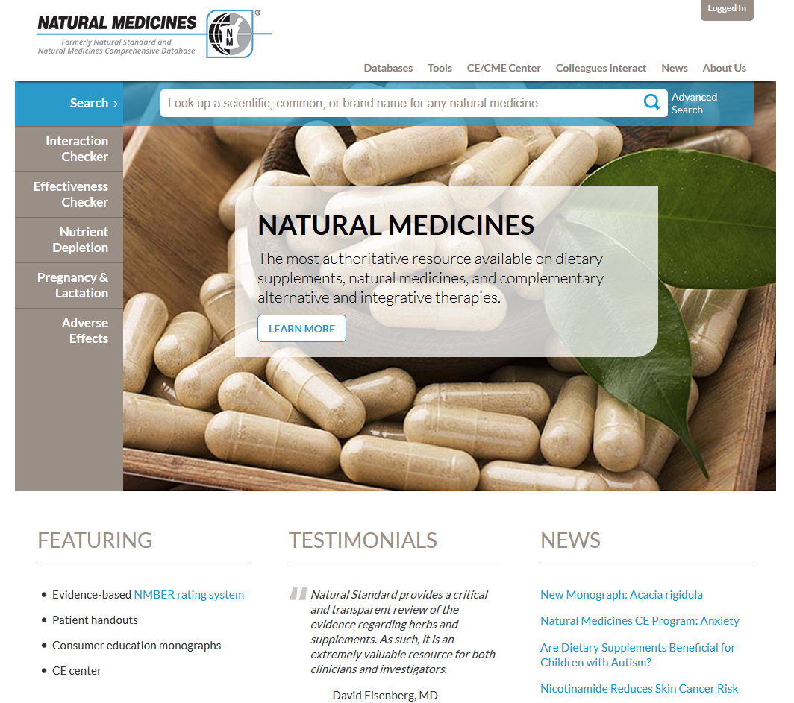
fish oil
Notes:
This is Natural Medicines. It is a database that houses evidence-based information on “natural” medicines, i.e. supplements, CAM therapies, etc. To the left of the page are quick links to helpful tools such as Interaction Checker, Pregnancy & Lactation checker, and more. At the top of the page are sections for all the databases and tools, as well as a search box. If you already know a specific medicine or therapy you want to look up, simply type it into the box. As an example, I searched for “fish oil”.

Slide 16
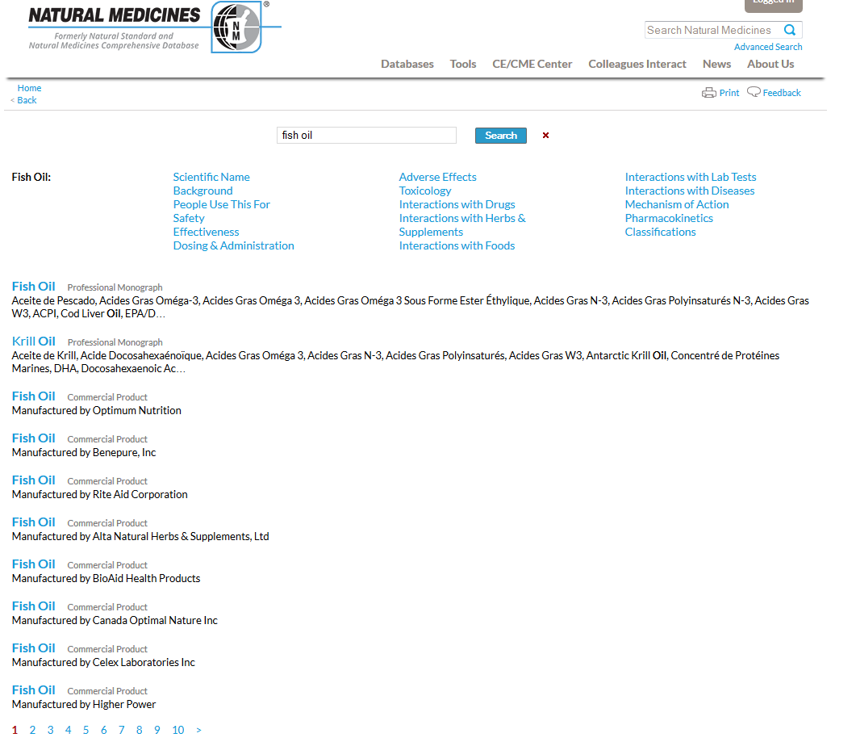
Notes:
Here are the results for “fish oil” in Natural Medicines. Notice above the list of results, there are quick links to information about fish oil, allowing you to access what you need quickly. The professional monograph for “fish oil” is the first result of the list. Notice also that further down the list, most of the results are for various commercial products. I’m going to go ahead and click on the link for the first professional monograph in the list.

Slide 17
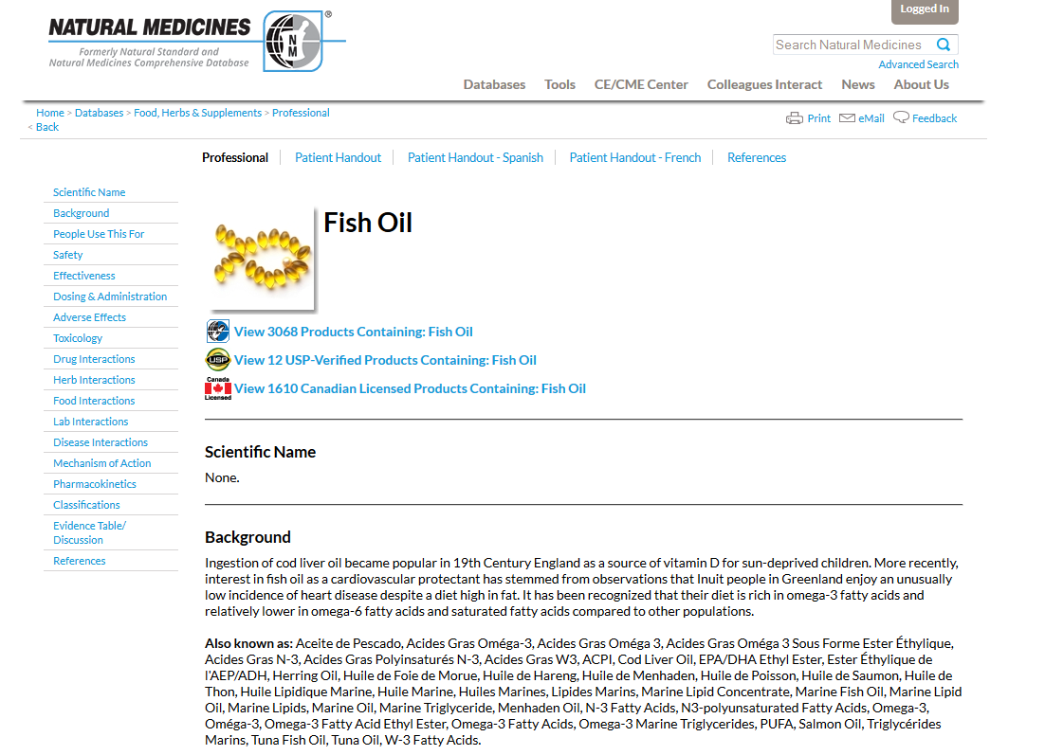
Notes:
Here is Natural Medicines’ information on fish oil. To the left is a table of contents identical to the links we saw in the search results that will allow you to navigate this page. If you’re following along on your own computer, click on the “Natural Medicines” logo to return to the home page.

Slide 18
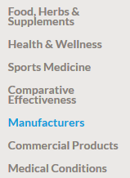
Notes:
This time, mouse over “Databases”, then select “Manufacturers”.

Slide 19
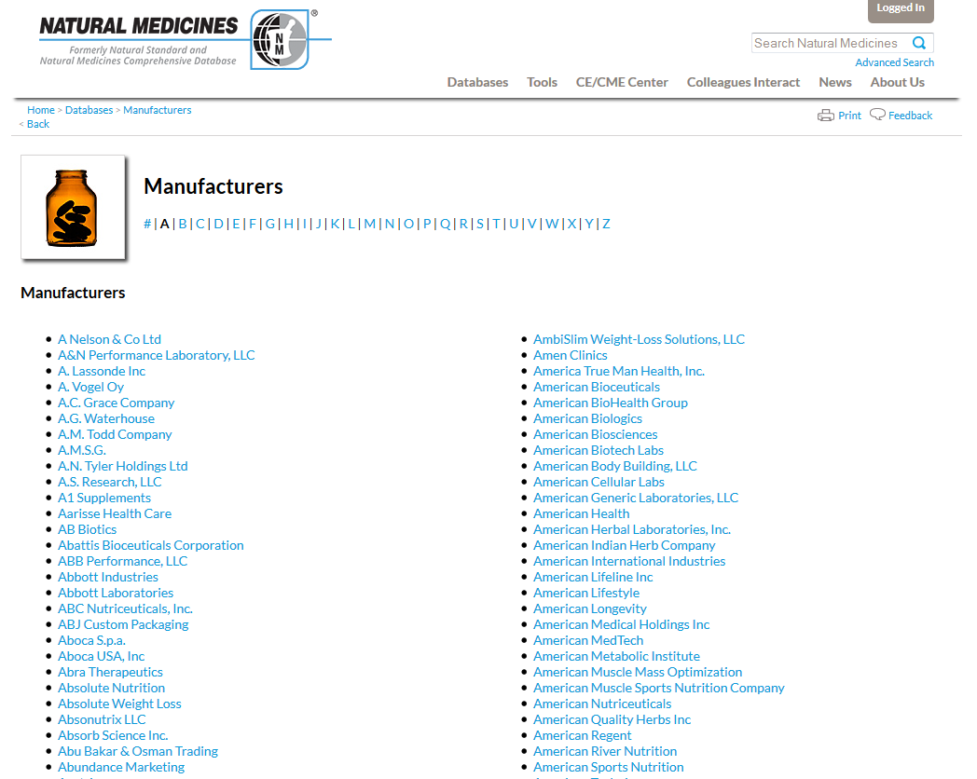
Notes:
You will be directed to a page with an A – Z list at the top of the page. As an example, click “S”.

Slide 20
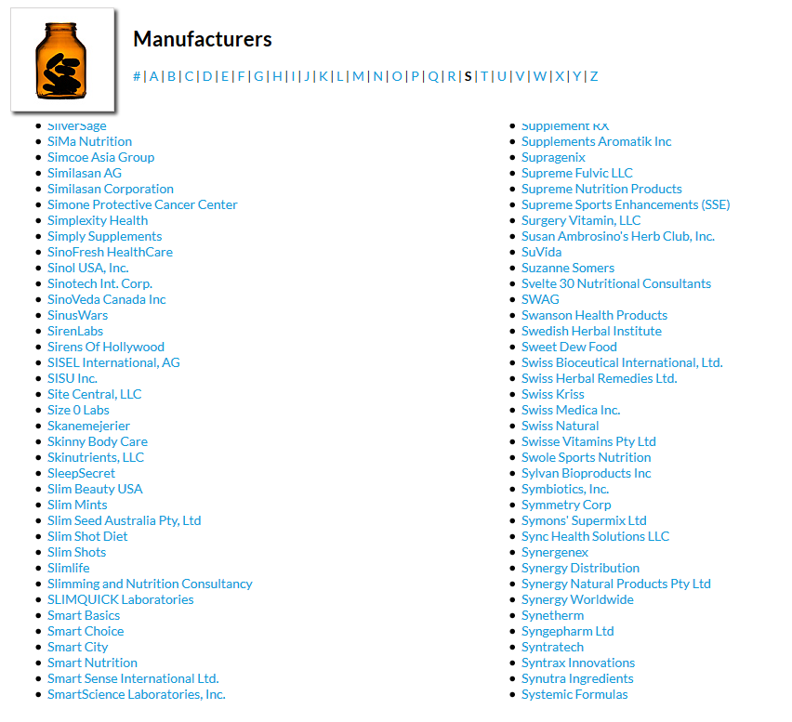
Notes:
Then, scroll down until you see “Swanson Health Products”. Click on it.

Slide 21
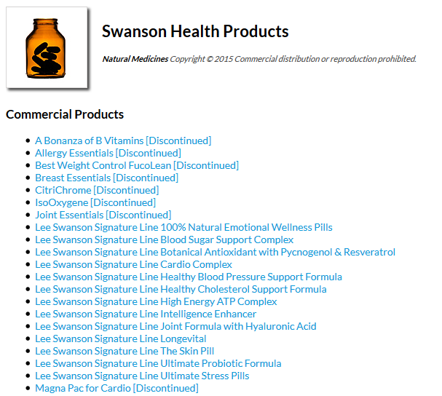
Notes:
A list of Swanson Health Products will appear. Notice that some of the items are listed as “discontinued”. From the list, select “Lee Swanson Signature Line Healthy Blood Pressure Support Formula”.

Slide 22
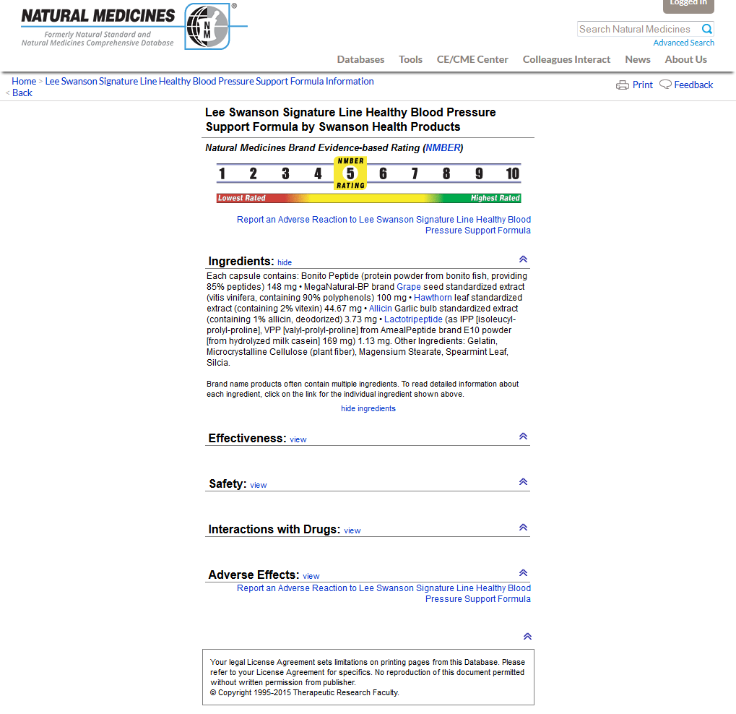
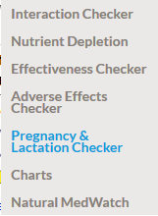
Notes:
Here is Natural Medicines’ information on this particular product. Notice at the top of the page, the database has assigned a level of evidence rating, with a guide to help determine if it is lower or higher. The link in parentheses above the scale provides information on the rating system. Below the scale is more detailed information about the product.
To see a different tool in Natural Medicines, mouse over “Tools” at the top of the page, then select “Pregnancy & Lactation Checker”.

Slide 23
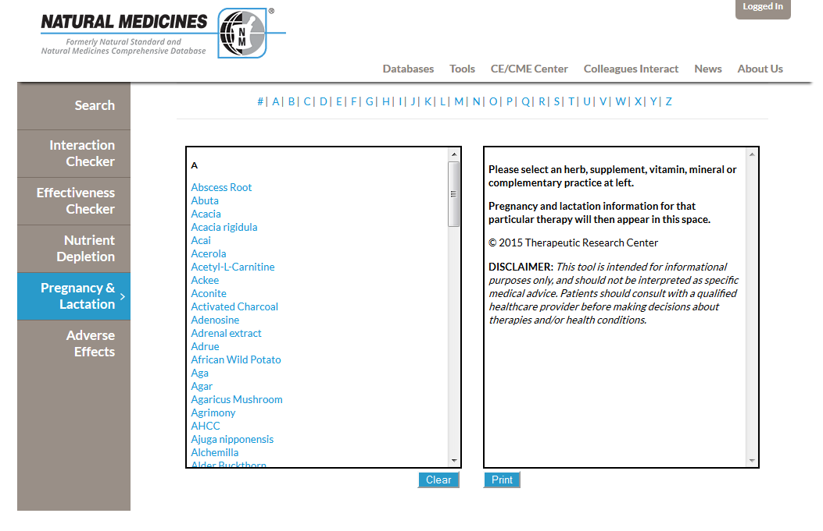
Notes:
Once again, there is an A – Z list at the top of the page. To see an example, select “S”.

Slide 24
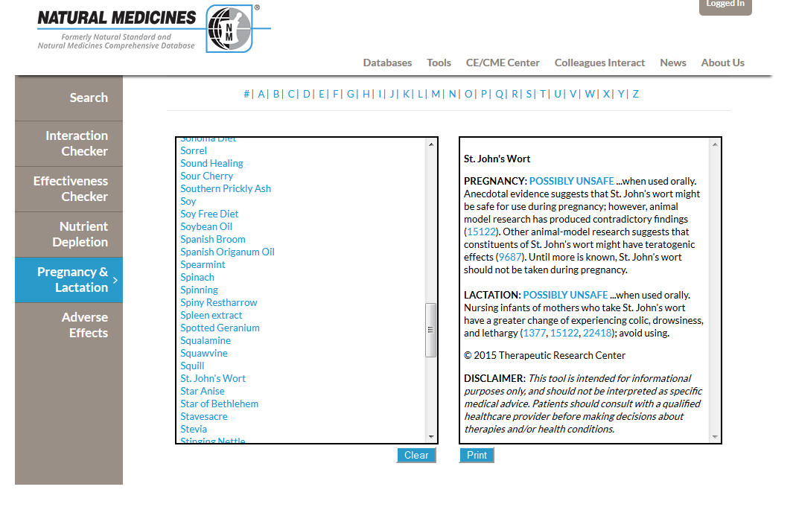
Notes:
Scroll down the list until you get to “St. John’s Wort”, then click it. In the box to the right, information about this product, specifically it’s safety for pregnant and lactating women, will appear.

Slide 25
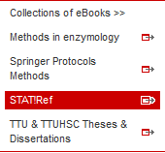
Notes:
The third resource I’ll show you is Stat!Ref. From the library web site, mouse over “eBooks, Theses, & Dissertations”, then choose “Stat!Ref” from the list that appears.

Slide 26
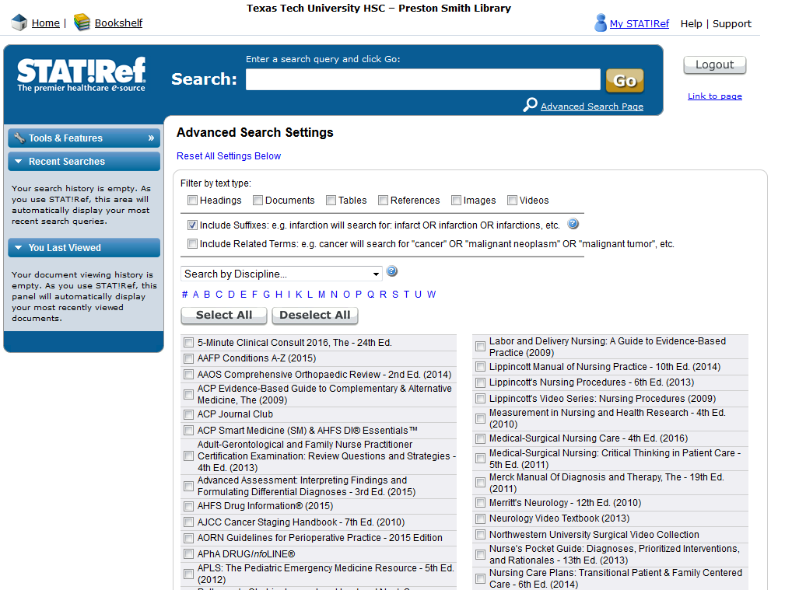
Notes:
Stat!Ref is a collection of e-books. You can search for a broad topic in the search box or search according to a specific book (by checking the boxes in gray under the search box and advanced search settings). If you’d rather browse the books available, then click on the “Bookshelf” link, located to the left of the page and above the blue search box.

Slide 27
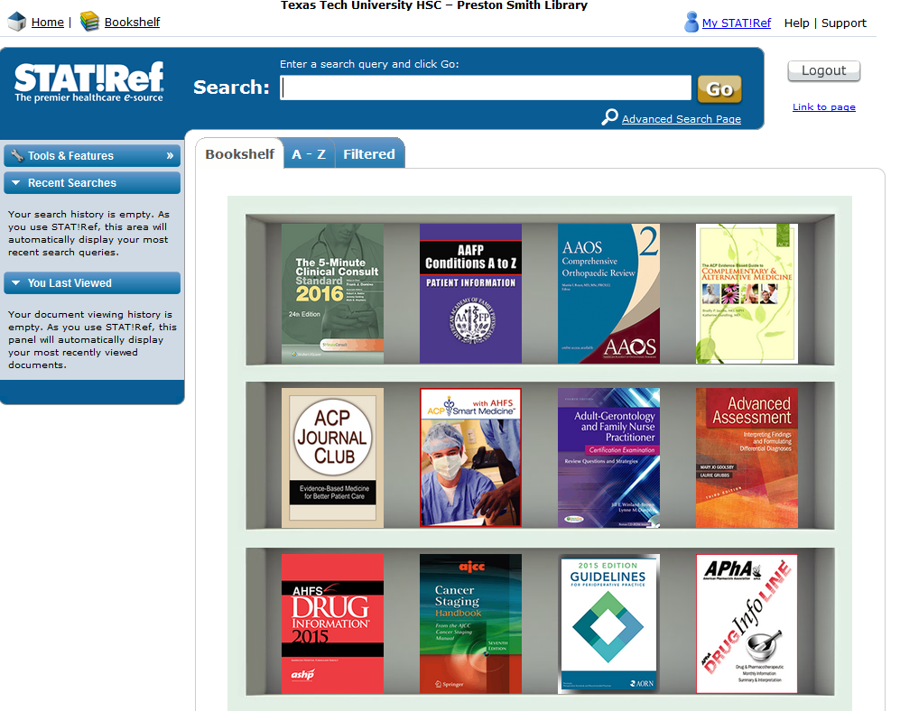
Notes:
You’ll come to a page with the book images displayed as if on a shelf. Above this shelf, select “Filtered”.

Slide 28
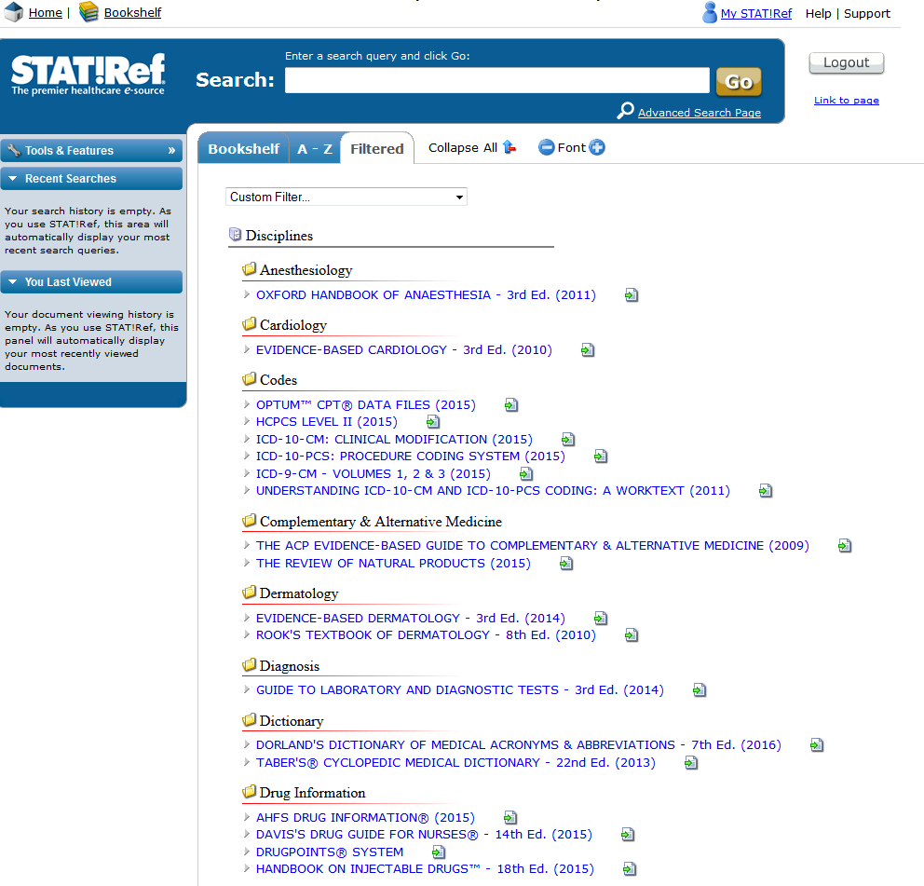
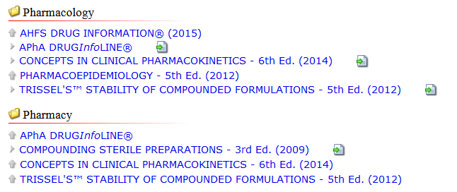
Notes:
Here, the books available are sorted according to subject/field/specialty. If you scroll down the list, you’ll come to books grouped under “Pharmacology” and “Pharmacy”. The titles you see are available in their entirety to you online!

