Slide 1
Welcome
Internal Medicine Orientation
Point of Care Tools
Peggy Edwards, AMLS
TTUHSC - Preston Smith Library
Lubbock, Texas 79430
Aug, 2017

Slide 2
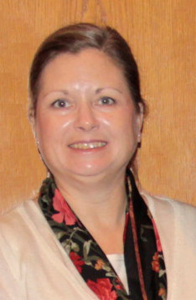

Reference Librarians
Offices on 2nd floor of library, across from the Learning Resource Center and public computers
8am–5pm
Monday–Friday
Peggy Edwards
Micah Walsleben
Margaret Vugrin

Slide 3
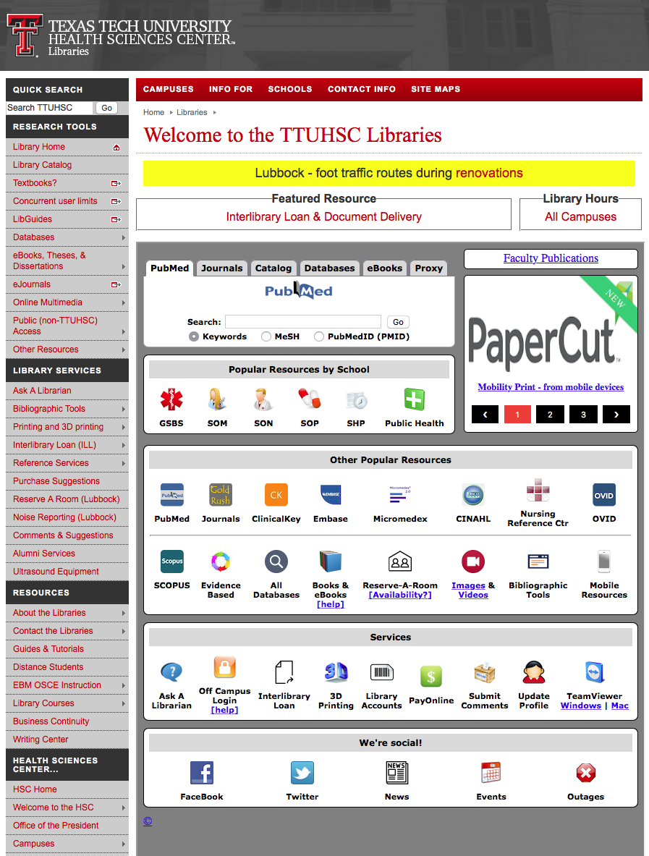
www.ttuhsc.edu/libraries
Click LibGuides

Slide 4
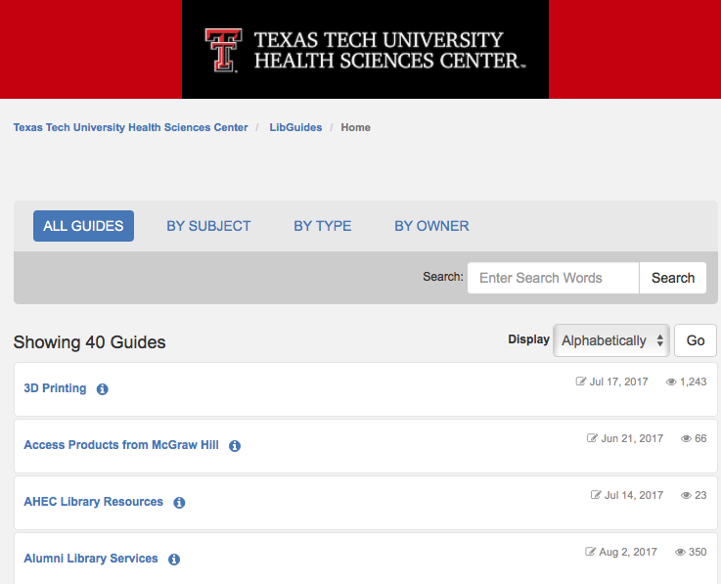
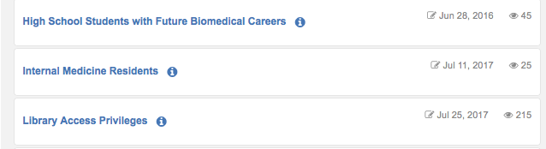
Internal Medicine Residents

Slide 5
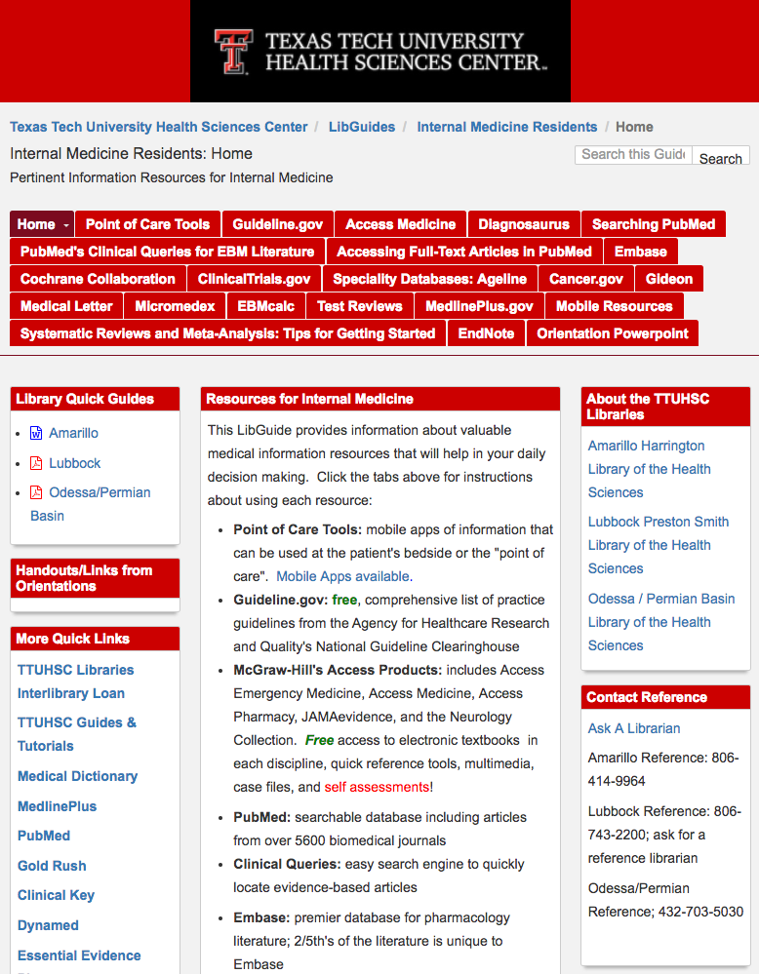
Select Red Tabs

Slide 6
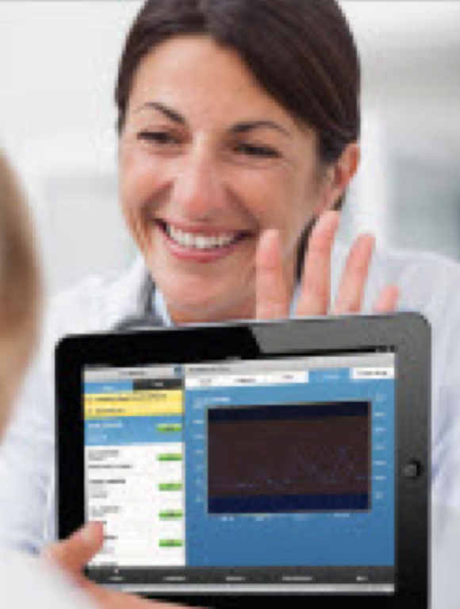
EBM Point of Care Tools
decision support information accessible at the patient’s bedside or the “point of care”

Slide 7
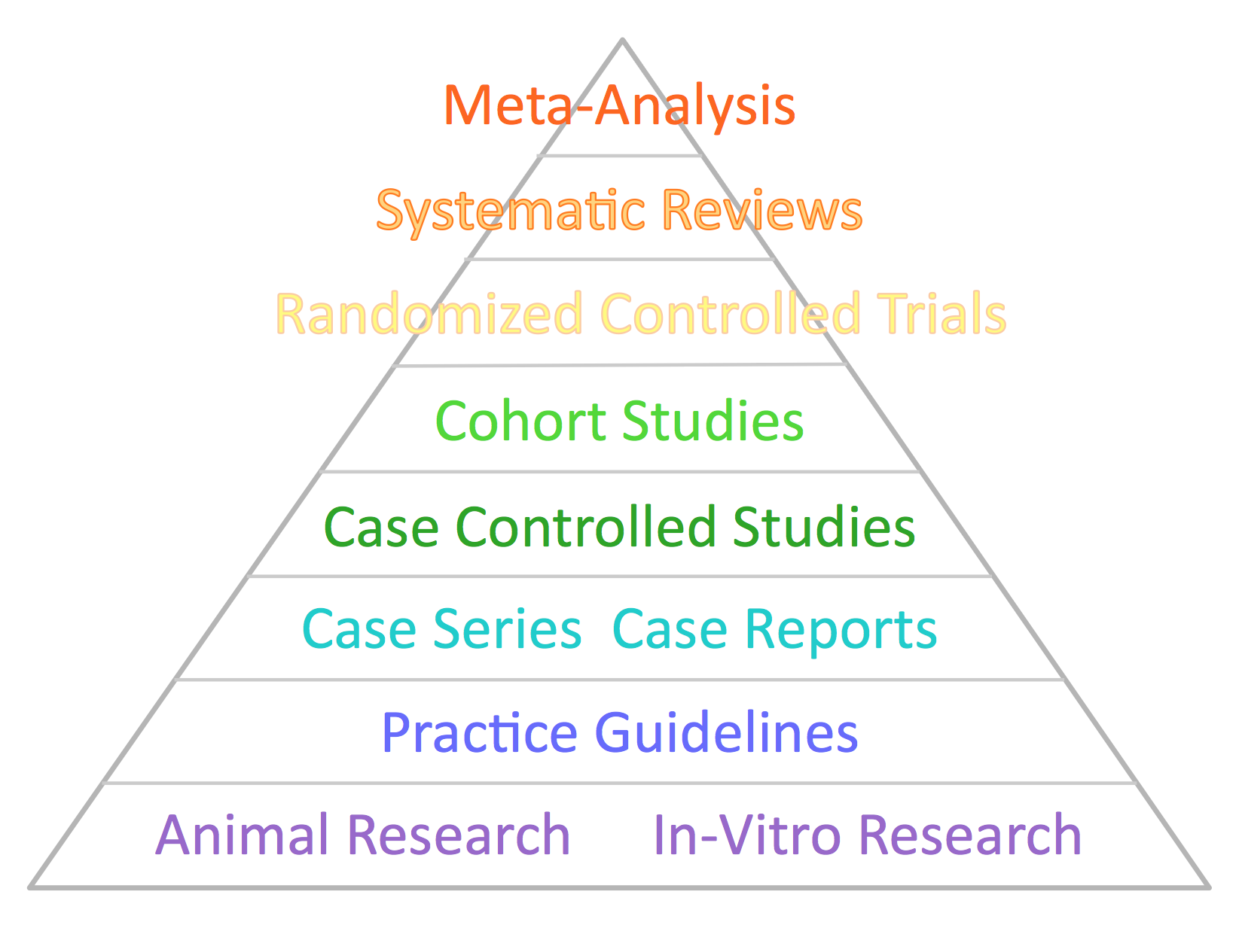
EBM Point of Care Tools
data that is evaluated and rated with levels of evidence

Slide 8

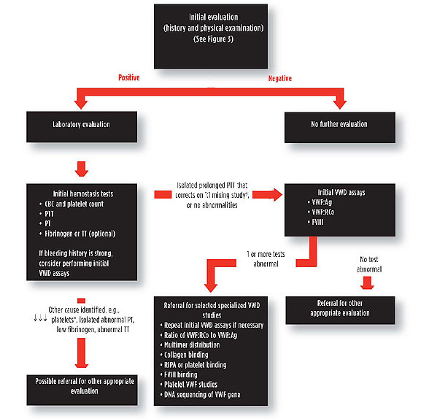

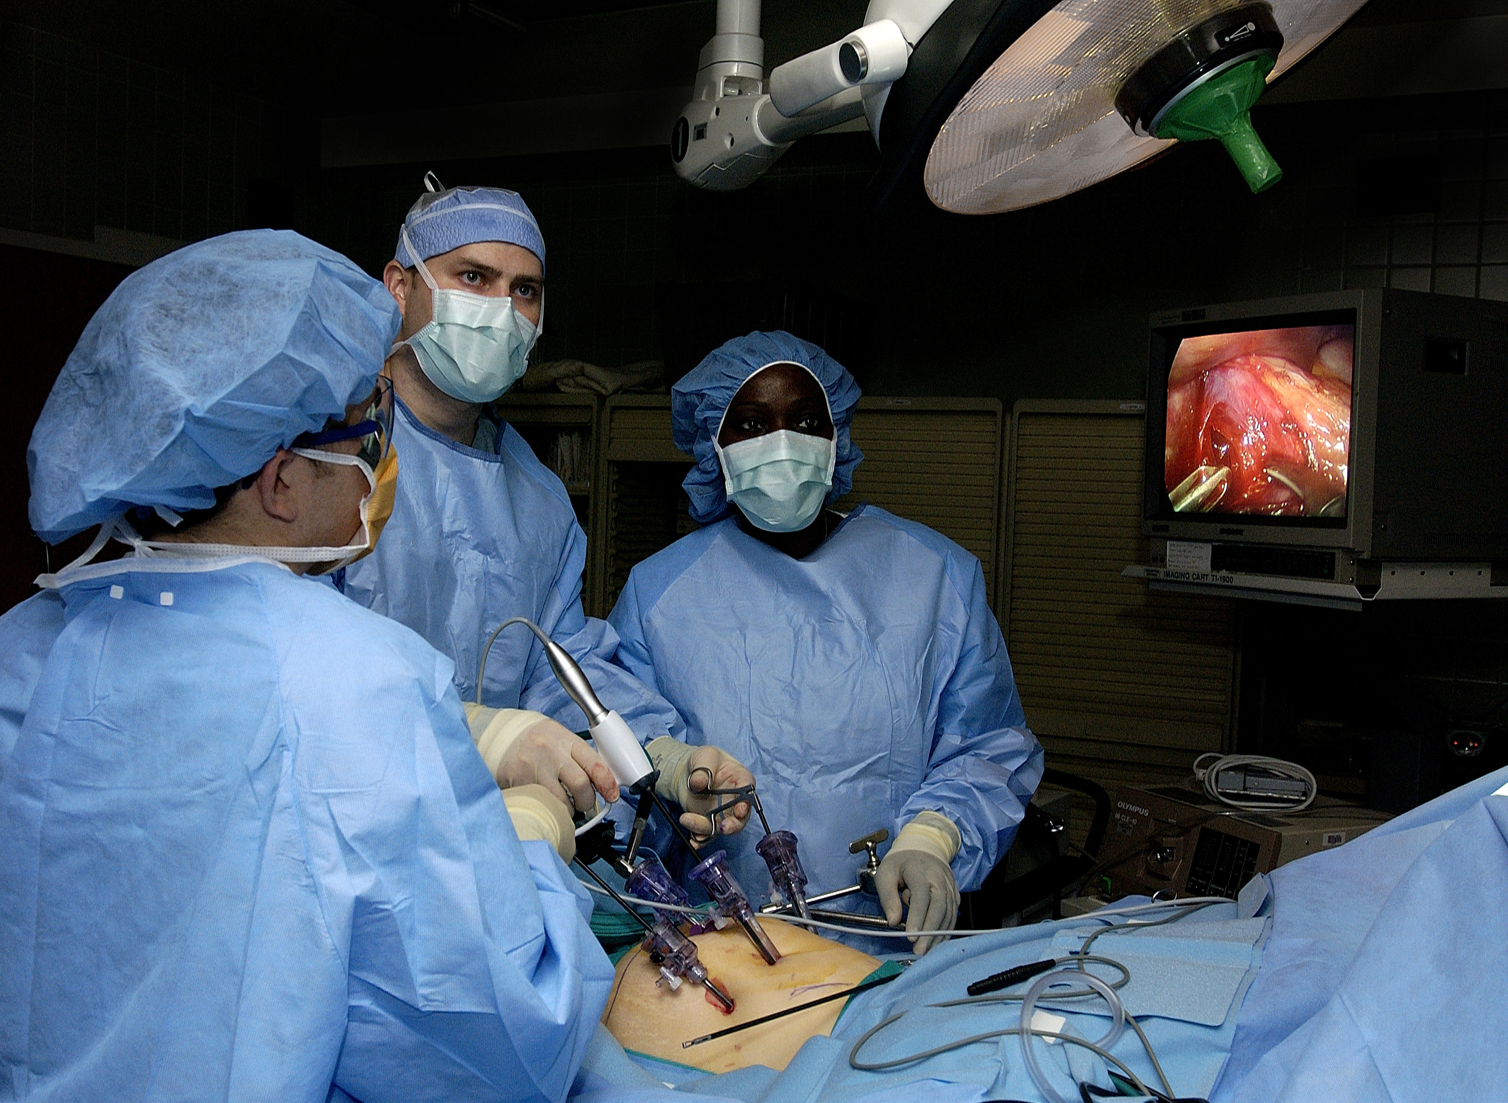
EBM Point of Care Tools – Disease Overview
Signs & Symptoms
Differential Dx
H&P, Diagnosis, Questions to Ask Patient
Therapy

Slide 9

EBM Point of Care Tools – Disease Overview
Follow-up

Slide 10
Background Questions
Background Questions are general:
What is a disorder?
What causes It?
How does it present?
What are some treatment options?
Resources that answer background questions:
Textbooks
Narratives that give a general overview such as the
point of care tools
from SUNY Downstate Medical Center, Medical Research Library of Brooklyn

Slide 11
Foreground Questions
Foreground Questions answer:
specific questions
about a specific patient
Resources that answer foreground questions:
Primary sources – original research articles: PubMed
Secondary sources – systematic reviews, synopses, and reviews of individual studies
from SUNY Downstate Medical Center, Medical Research Library of Brooklyn

Slide 12
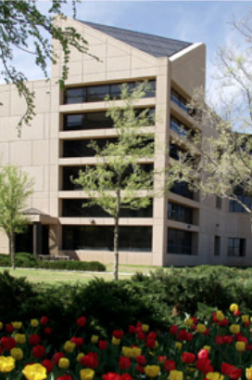
Point of Care Tools
available from
TTUHSC Libraries

Slide 13

DynaMed
First Consult

Slide 14
Point of Care Tools

Slide 15

Clinical Key
* content from books, journals, and videos
* available as a mobile app
First Consult/Clinical Overviews
*point of care decision support tool within Clinical Key
* main source of information is from the
Cochrane Collaboration where possible

Slide 16
Click Clinical Key

Slide 17
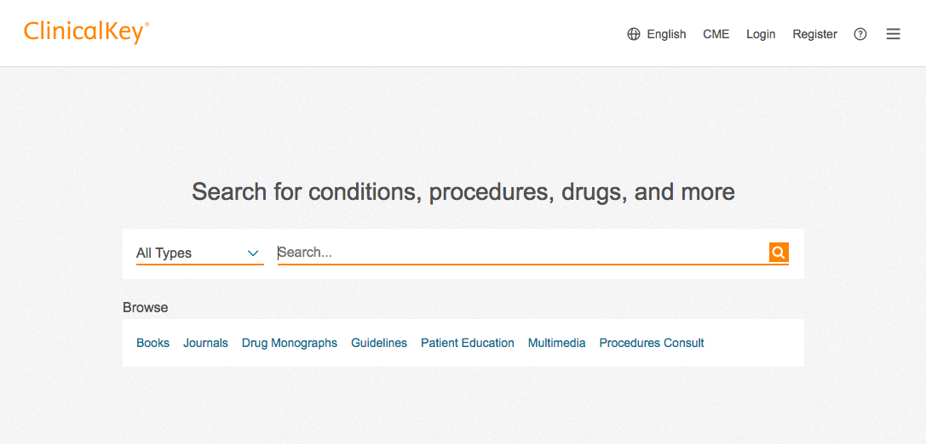
To create your personal account on a laptop or desktop …
Click register

Slide 18
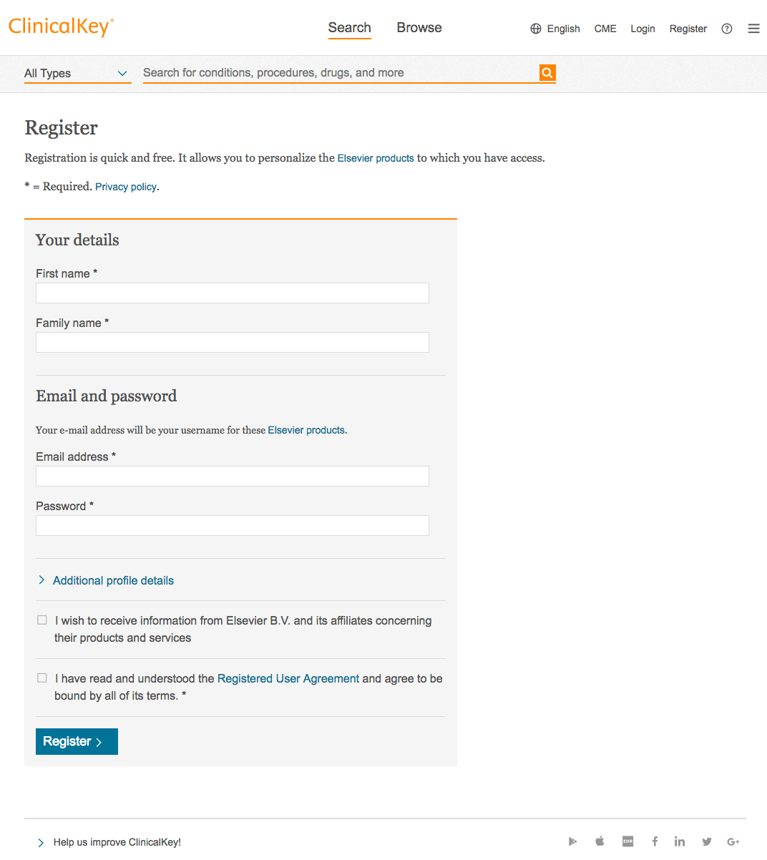
Use your TTUHSC email!

Slide 19
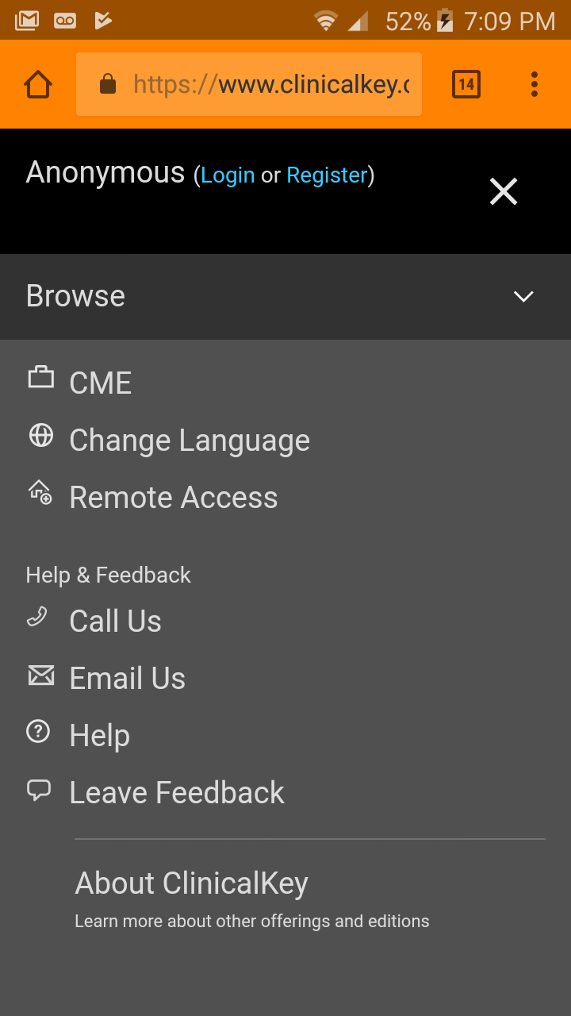
Click to Login

Slide 20
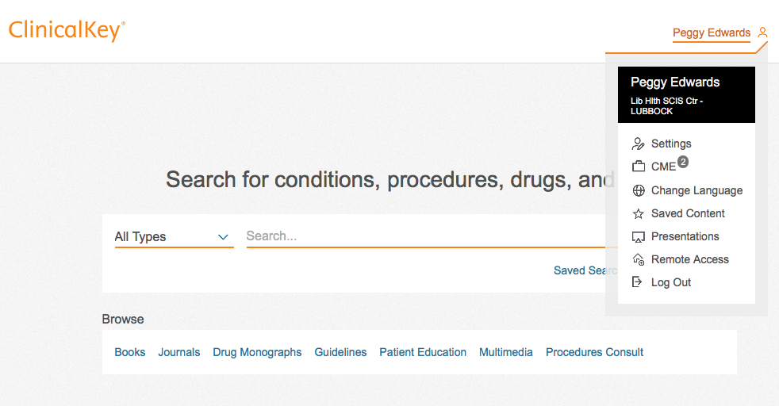
Name
Name
Click Remote Access

Slide 21

Enter your ttuhsc email and click Continue.
You will receive an email with an activation link that expires in 1 hour.
Install the ClinicalKey mobile app from your app store.
Login to the app with your new personal ClinicalKey account.

Slide 22

On your device, click the Clinical Key App icon. Login to your personal account.

Slide 23
Or on a laptop or desktop click Clinical Key

Slide 24
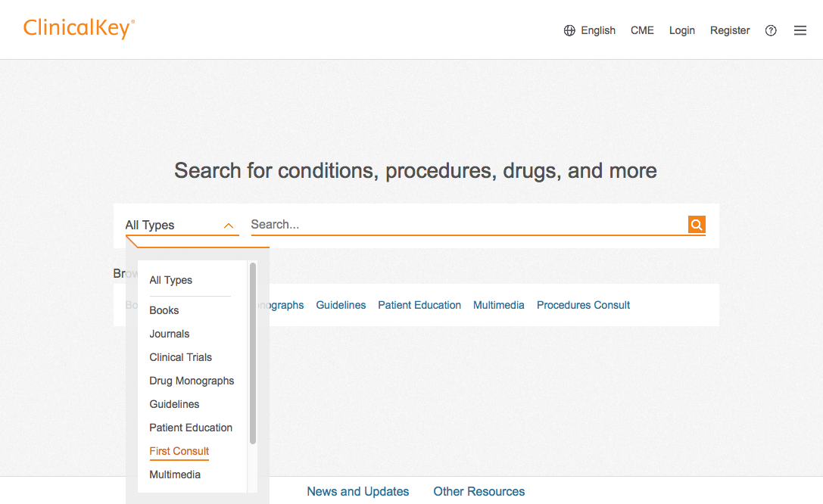
On a laptop or desktop
Select First Consult

Slide 25
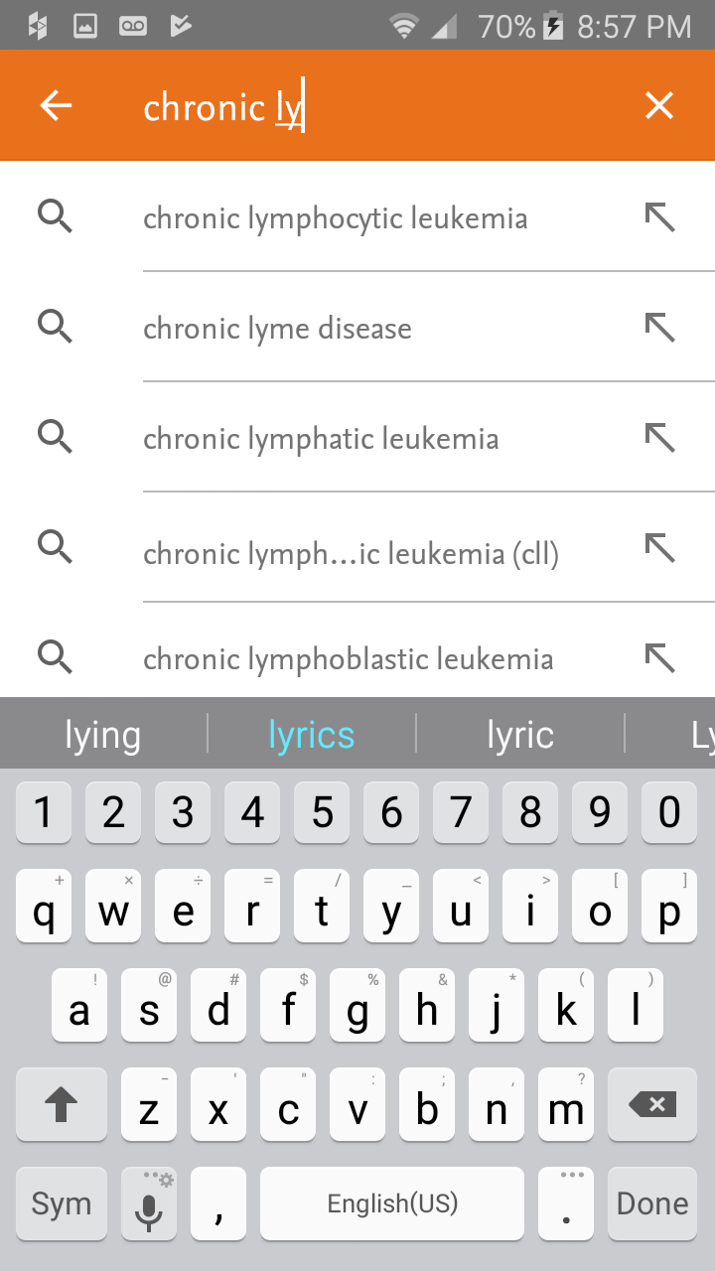
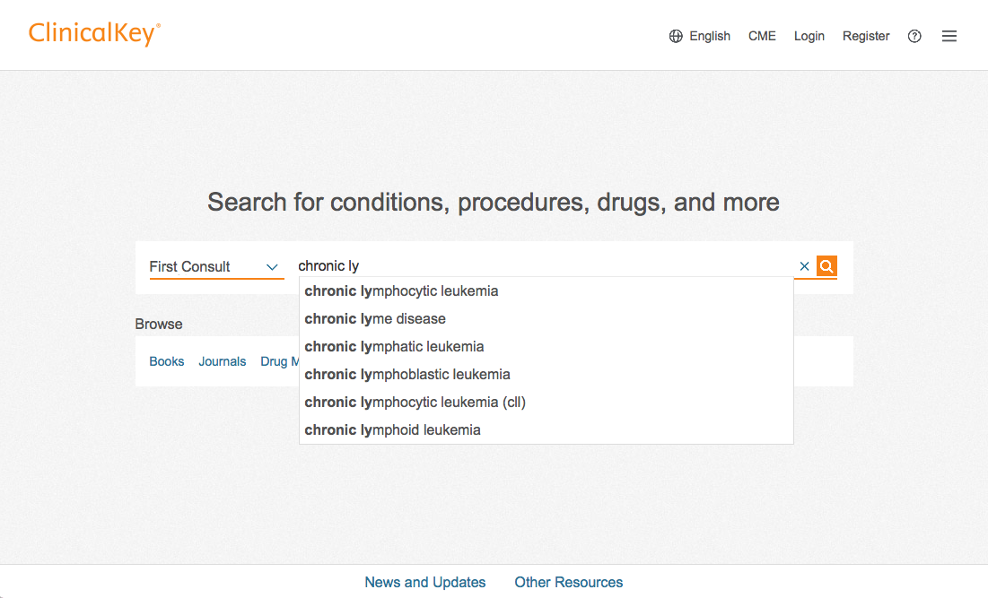
Search for Chronic lymphocytic leukemia

Slide 26
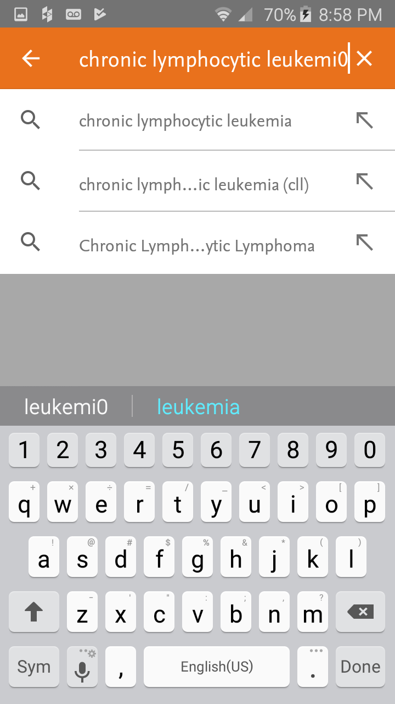
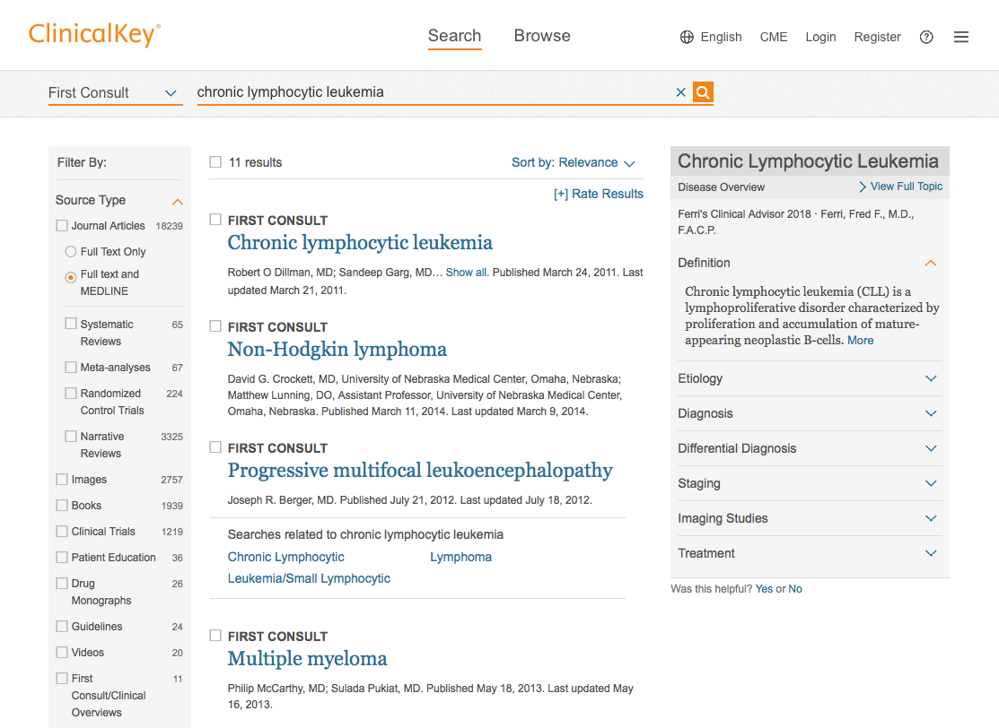
Click/Tap Chronic lymphocytic leukemia

Slide 27
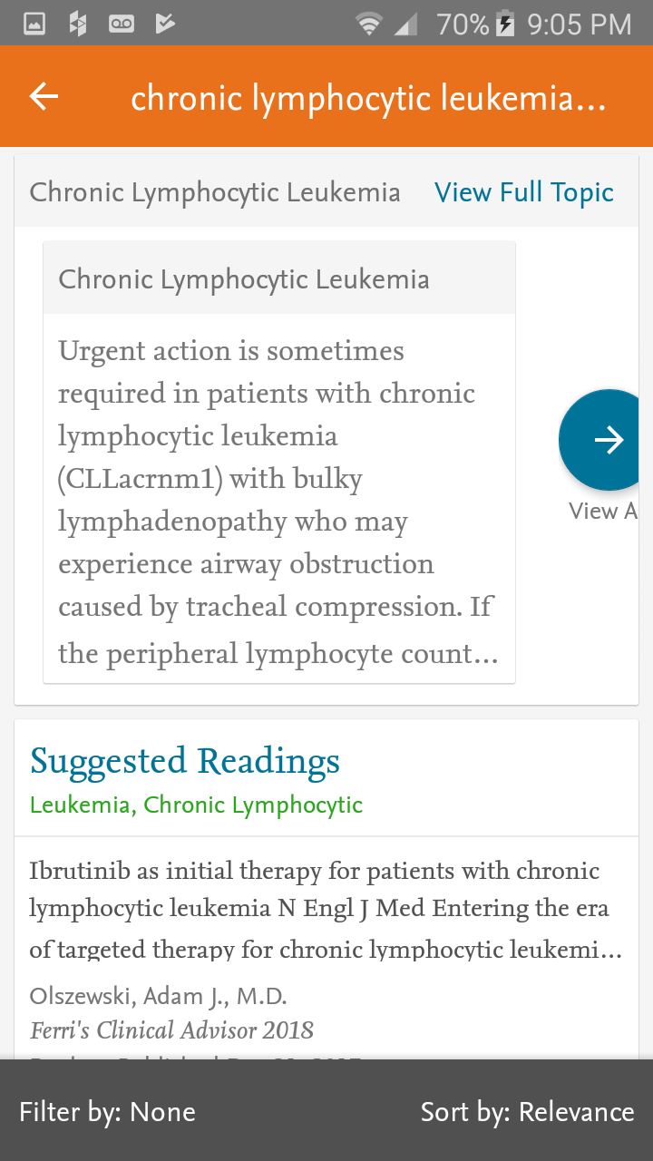
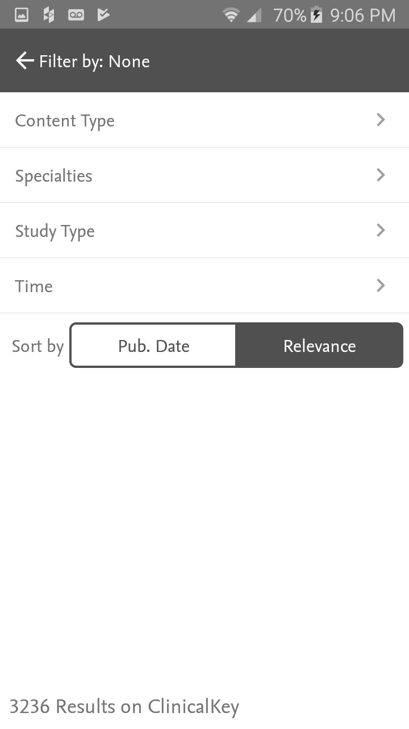
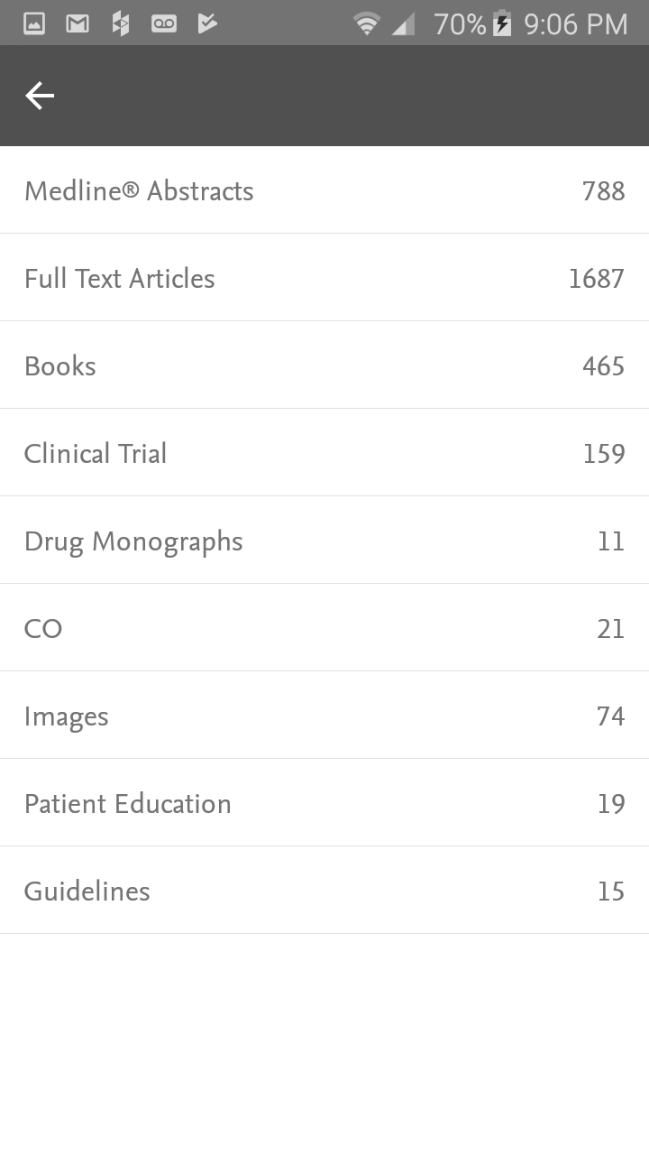
Tap Content Type.
Tap to set a filter.
Tap CO for First Consult/ClinicalOverviews.

Slide 28
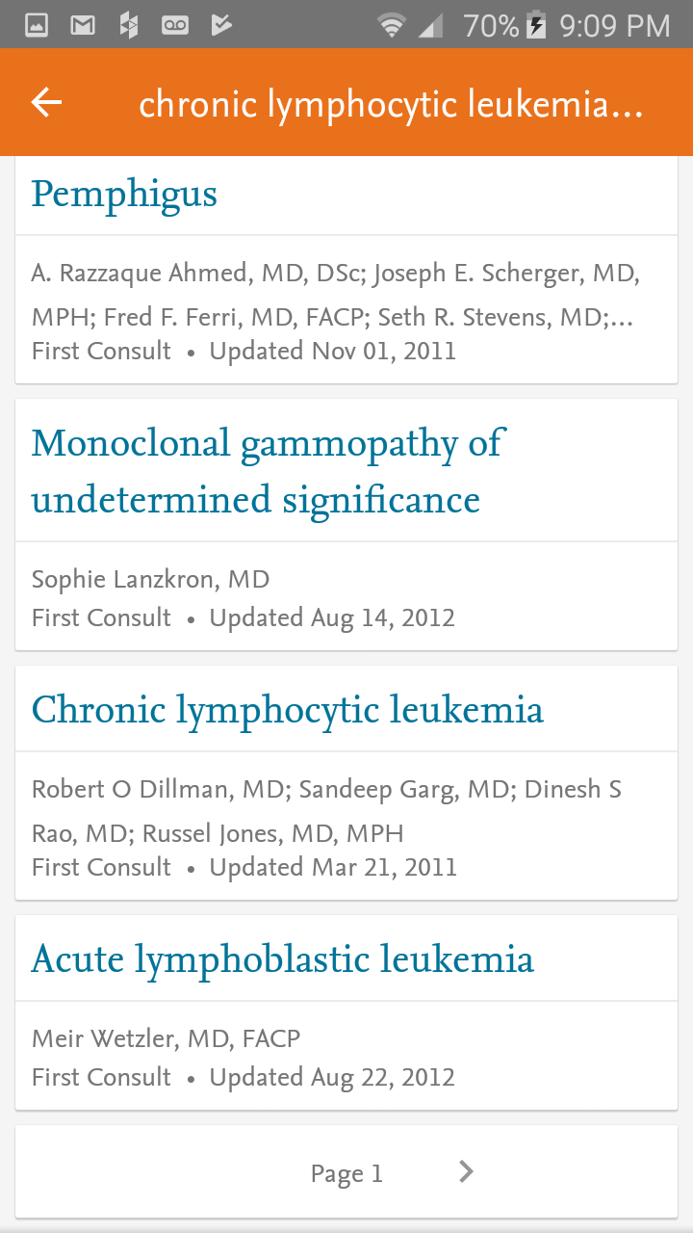
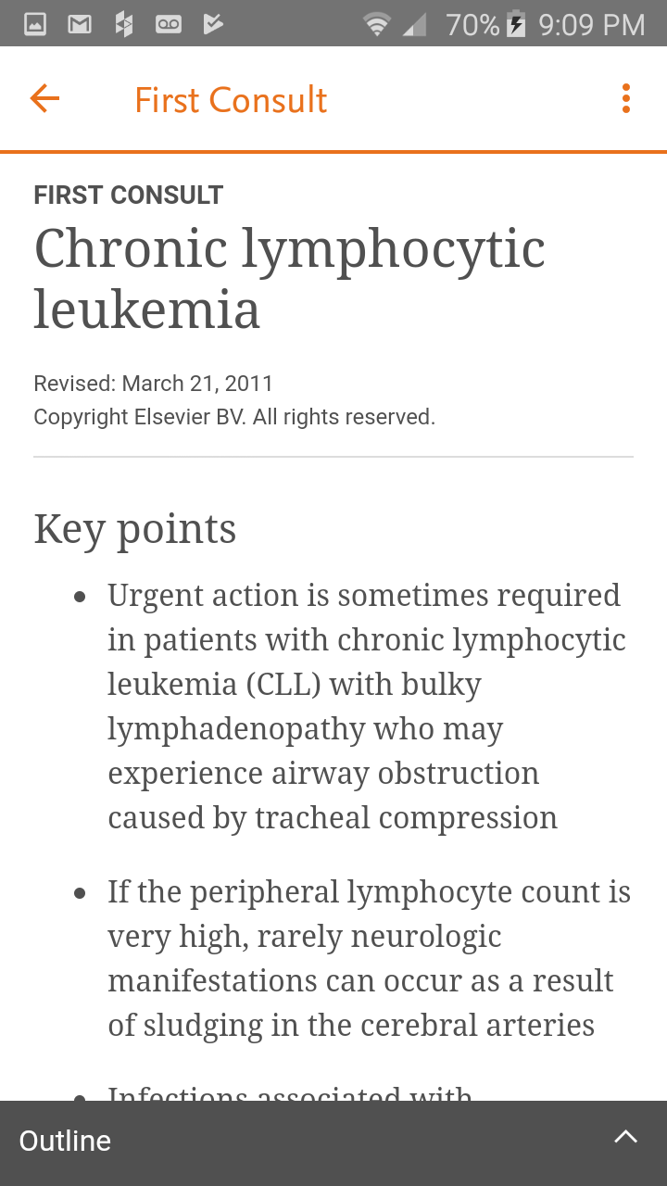
Scroll to and Tap.
Tap Outline

Slide 29
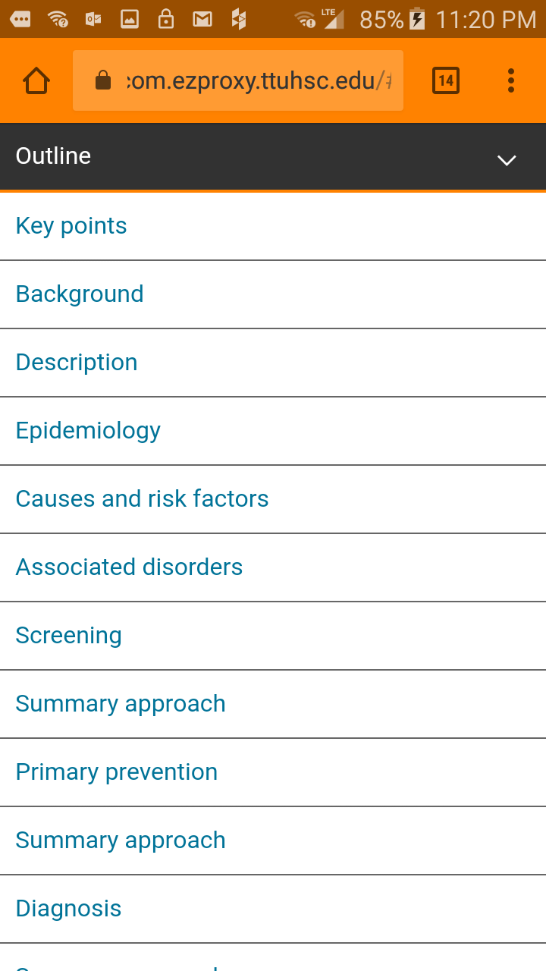
Information Module Outline

Slide 30
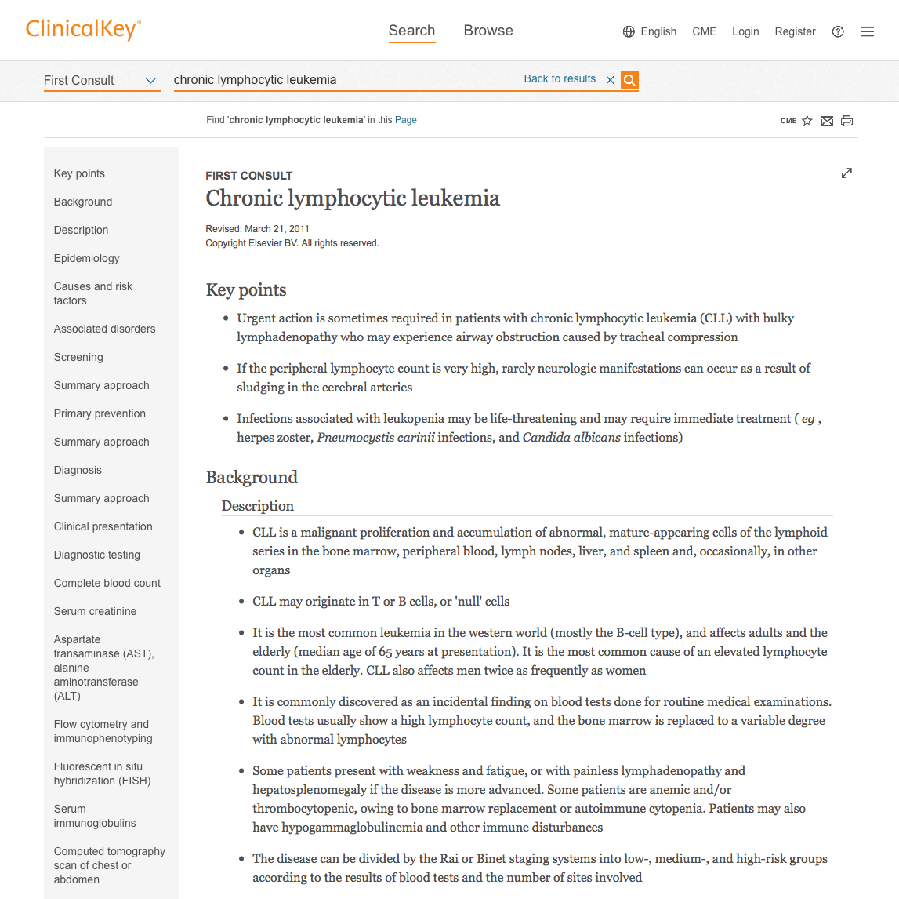
View of Information Module on Desktop/Laptop

Slide 31
DynaMed
Updated daily
Monitors the content of over 500 medical journals
New evidence is integrated with existing content
Overall conclusions represent a synthesis of the
best available evidence.
Available as a mobile app

Slide 32
www.ttuhsc.edu/libraries
Click Evidence Based

Slide 33
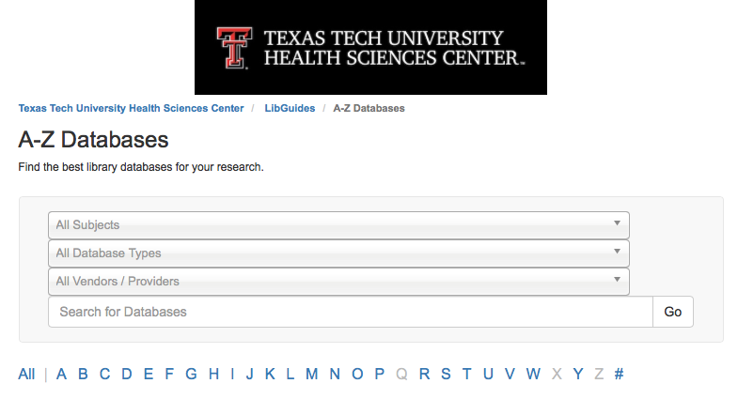
Click “D”

Slide 34
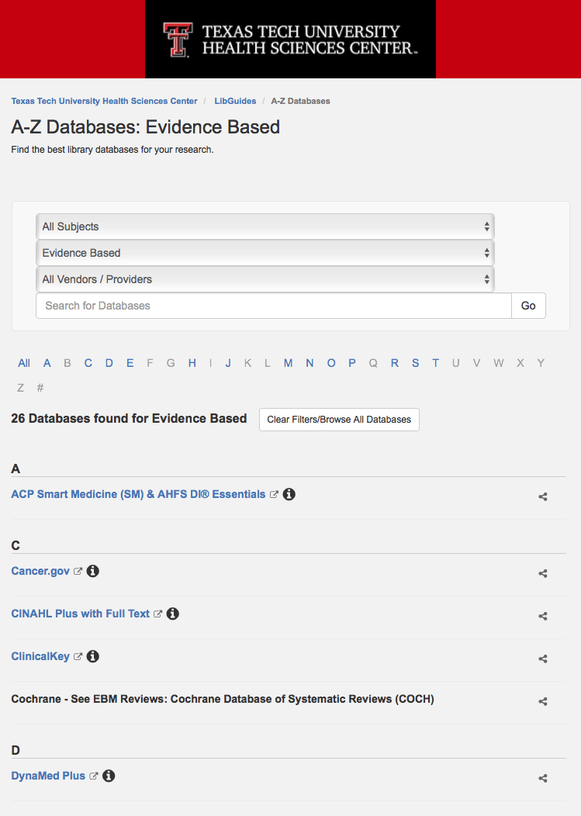
Select Dynamed Plus

Slide 35

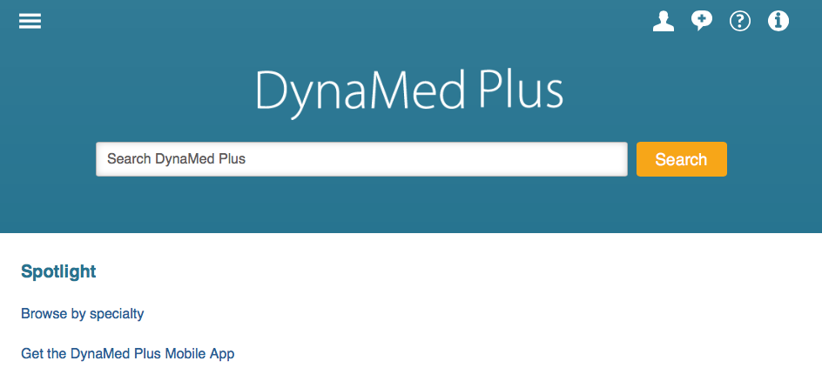
Click to Create Account
Sign In/Create Account

Slide 36
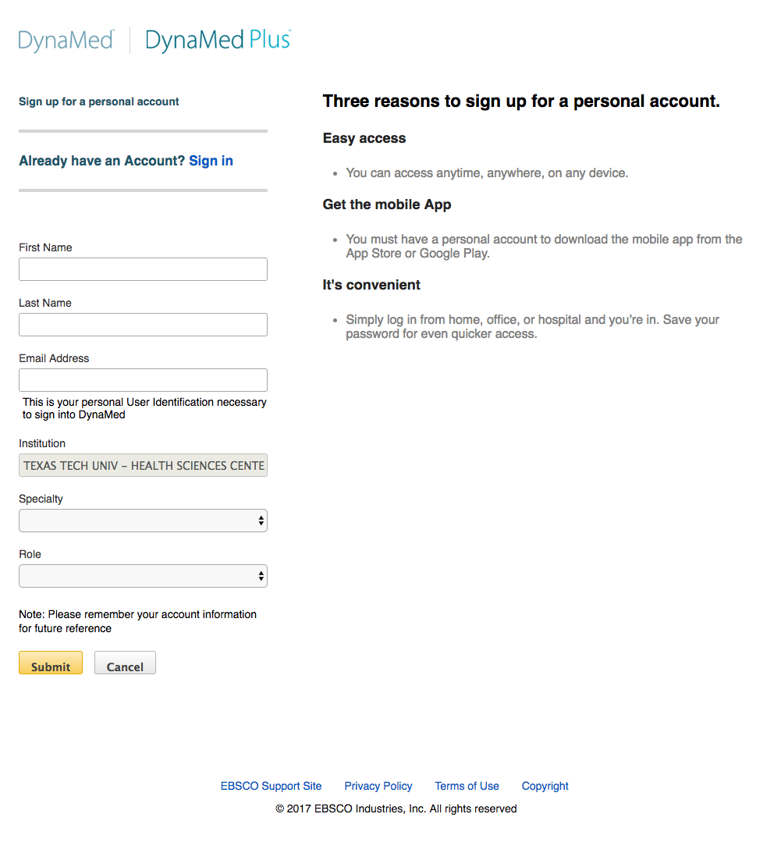
Complete the application

Slide 37
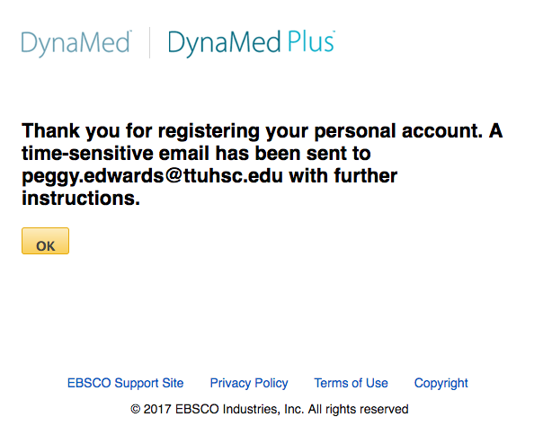
your.name
Check your email

Slide 38
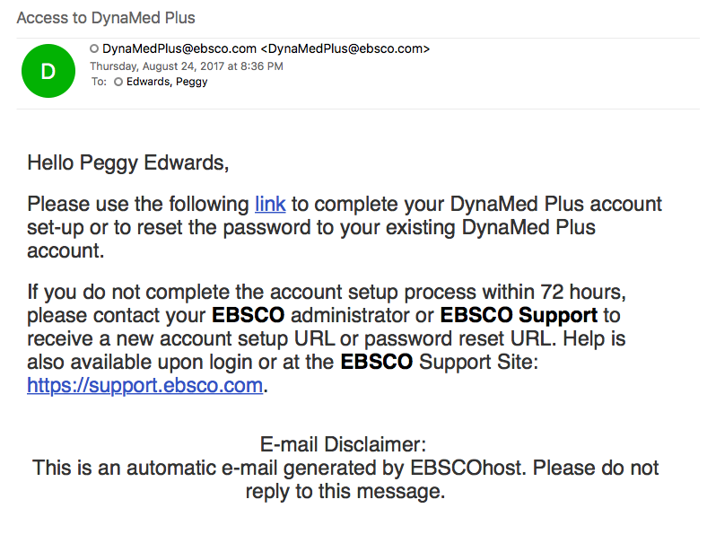
Your Name,

Slide 39
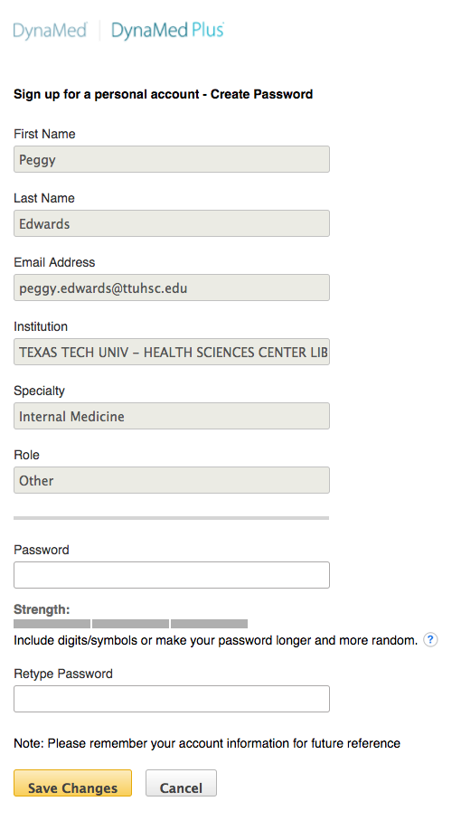
first name
last name
your email
Enter your password
Save Changes

Slide 40
Click to Sign In
Sign In/Create Account

Slide 41
Click Sign In

Slide 42
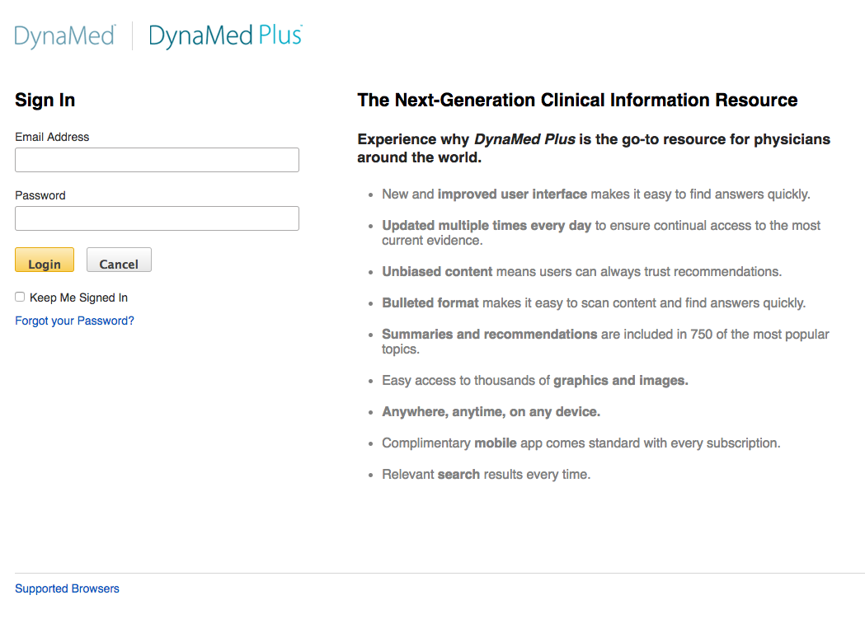
Sign In
Login

Slide 43
Mobile Dynamed

Slide 44
Click Get the DynaMed Plus Mobile App

Slide 45
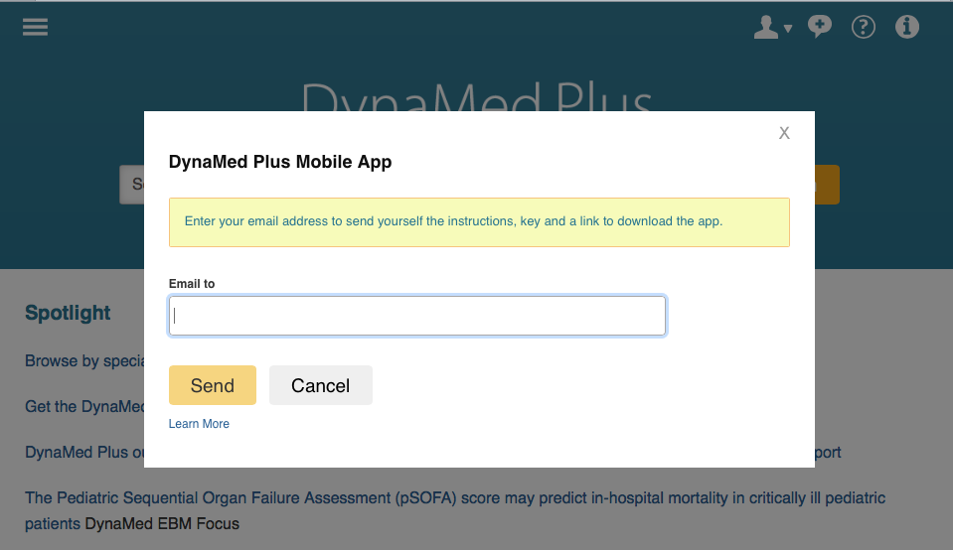
Enter your email address to send yourself the instructions, key and a link to download the app.

Slide 46
Searching Dynamed

Slide 47
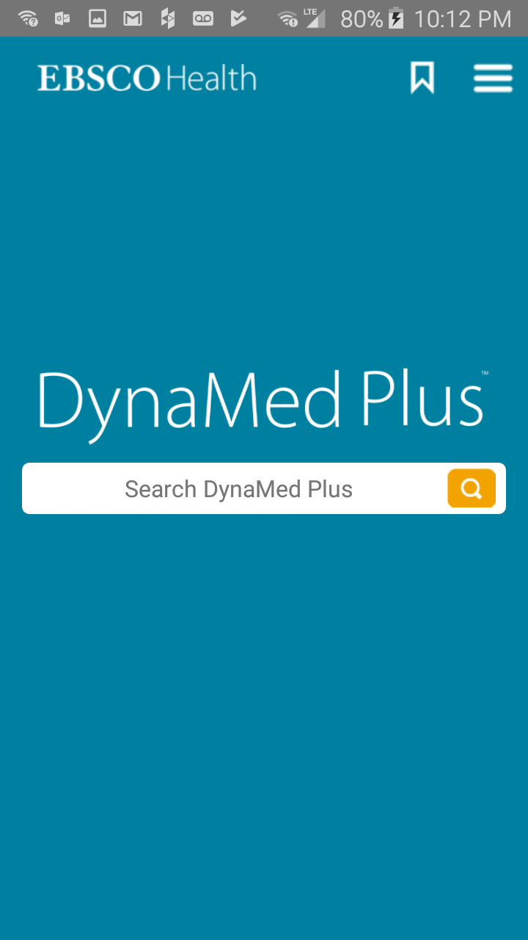
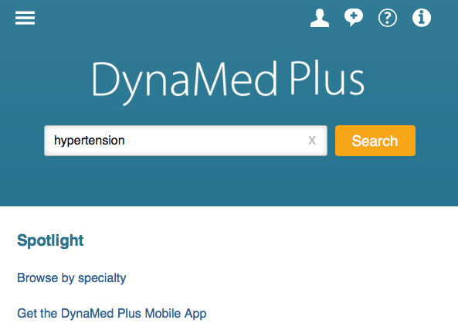
Home Page

Slide 48
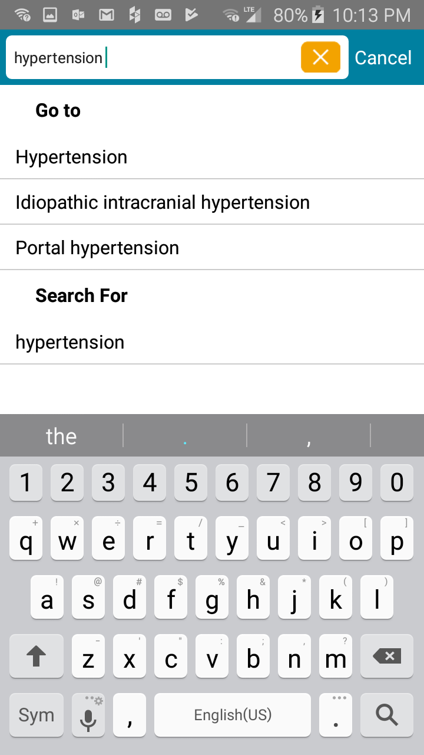
Enter hypertension

Slide 49
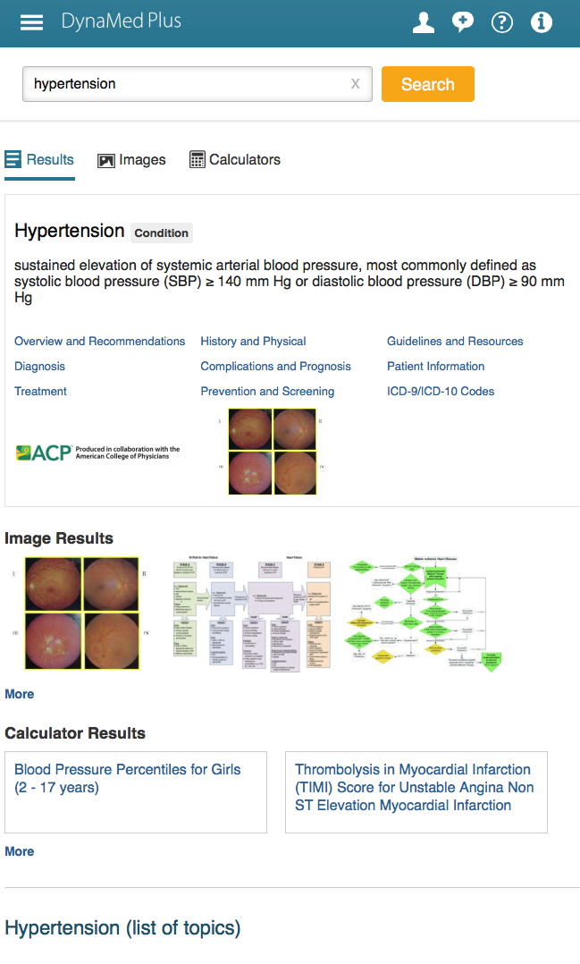
Information
Module

Slide 50
Select Treatment

Slide 51

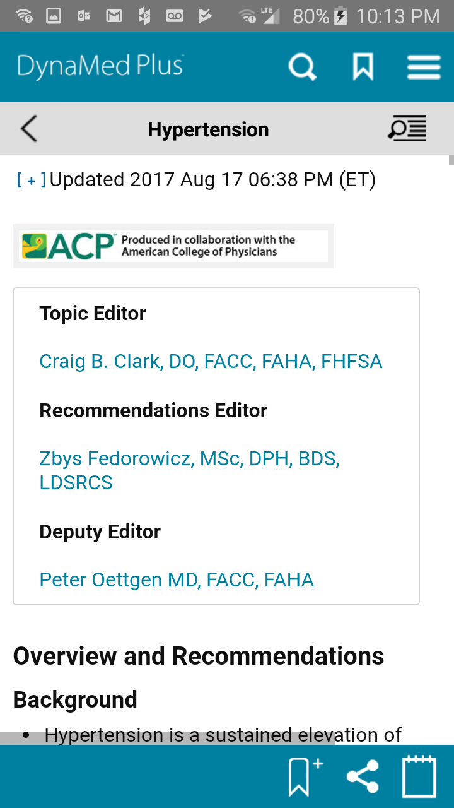
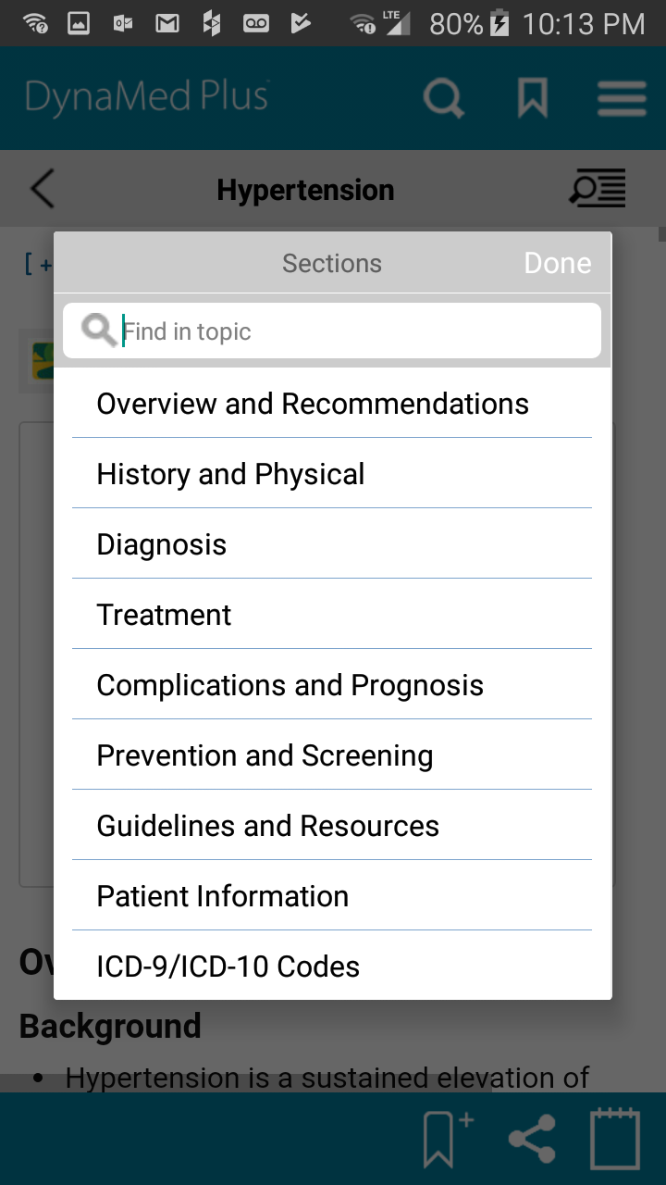
Tap for topics.
Select Treatment

Slide 52
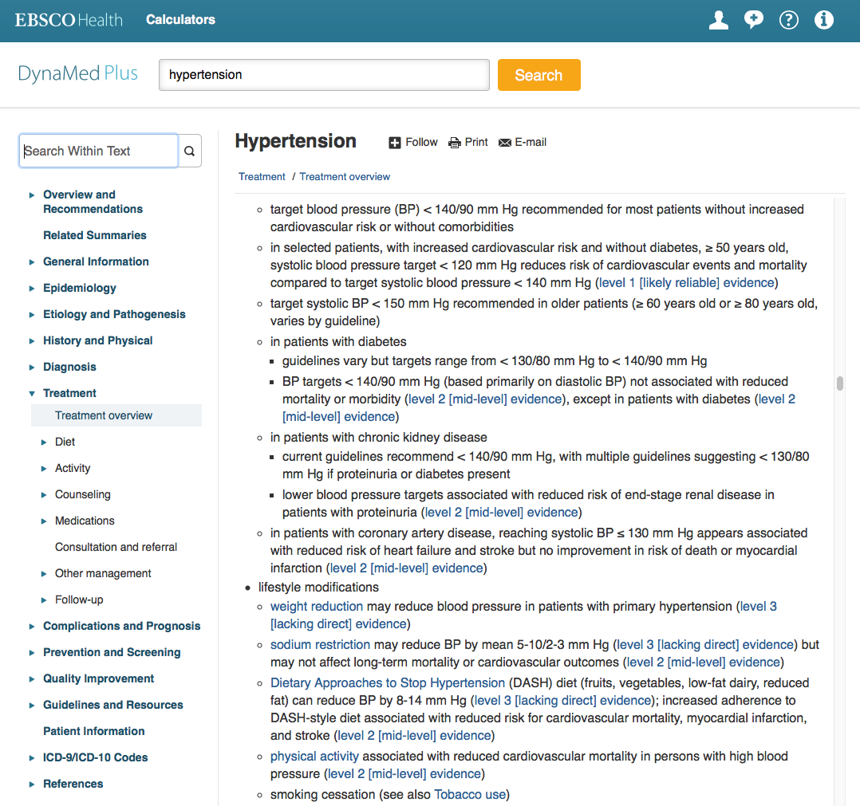
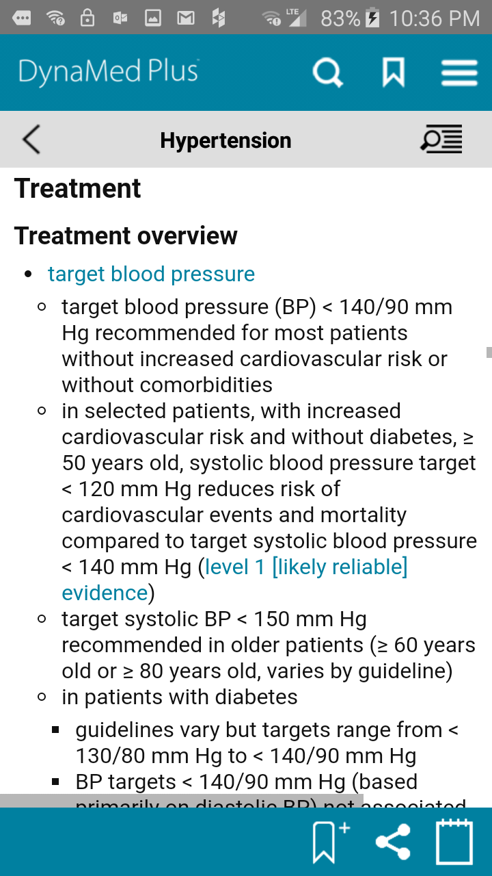
Levels of Evidence
Notice!

Slide 53
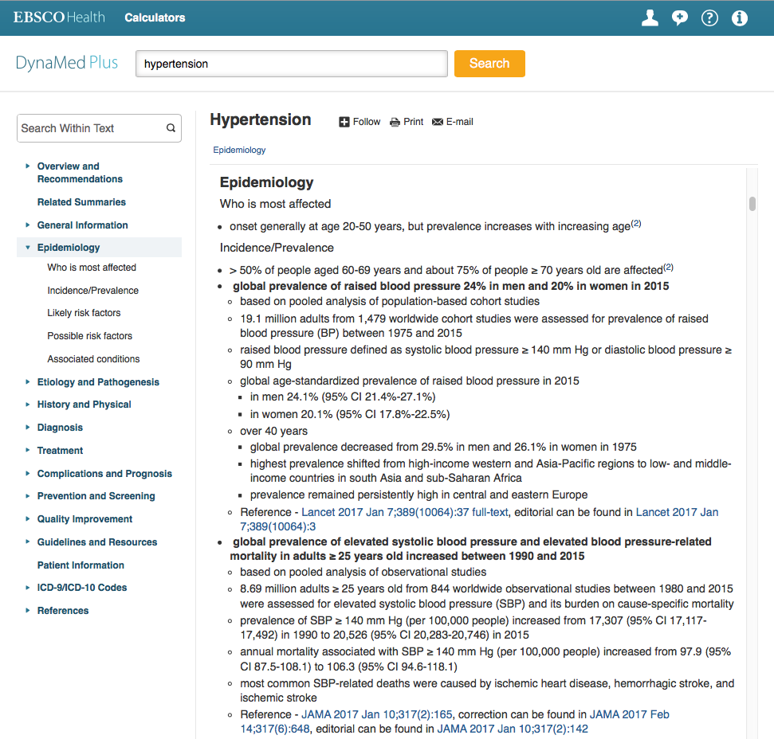
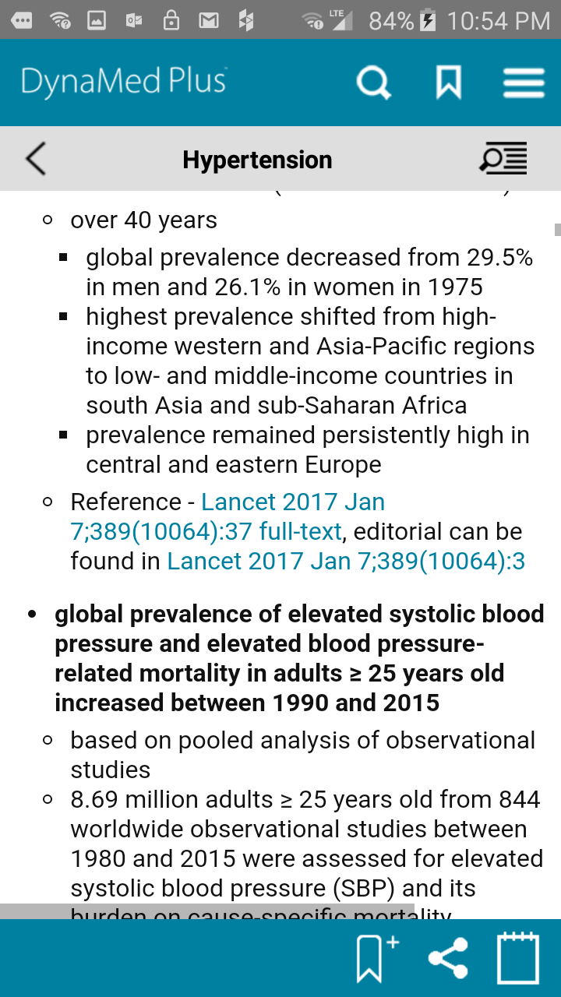
Article Links

Slide 54
ESSENTIAL EVIDENCE PLUS
  Over 13,000 topics
  Systematic Reviews from Cochrane Collaboration
  Daily POEMS – email update alerts
  Calculators
  Derm Expert Image Viewer
  Optimized for mobile devices

Slide 55
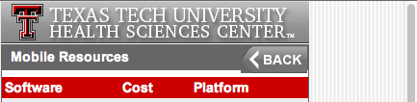
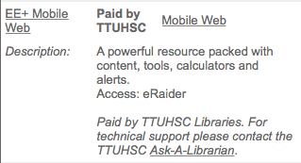
Mobile Instructions
www.ttuhsc.edu/libraries
Scroll to EE+ Mobile Web
Click Mobile Resources
Click Mobile Web

Slide 56


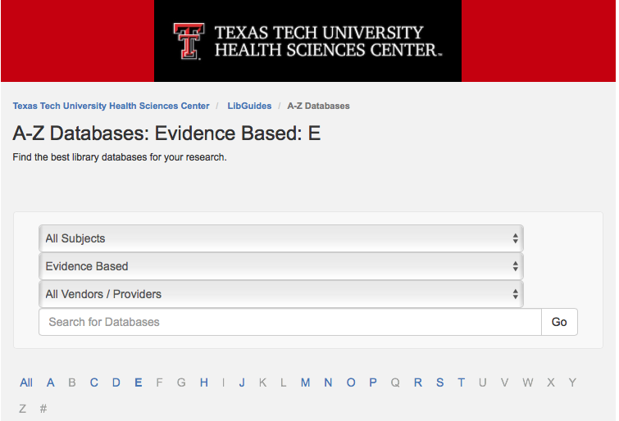
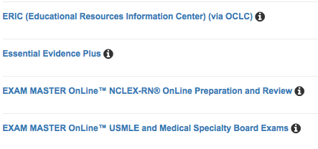
Larger Screen Instructions
www.ttuhsc.edu/libraries
Click “E”
Click Evidence Based
Select Essential Evidence Plus

Slide 57
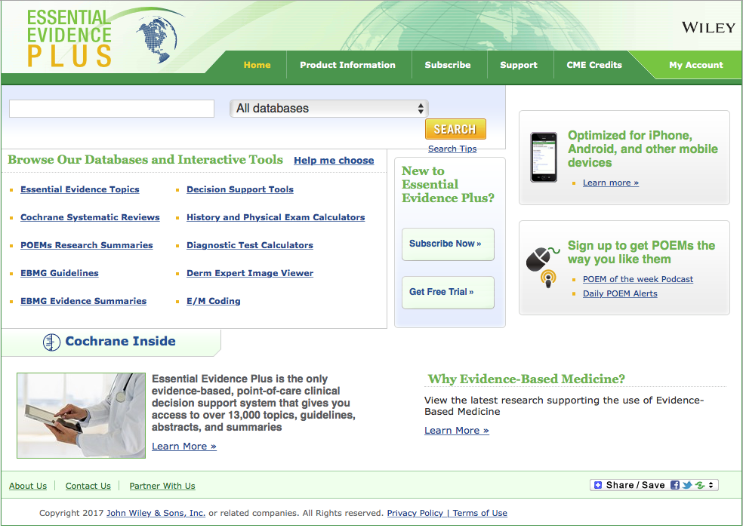
Home Page

Slide 58


Enter heart failure and
Click/tap SEARCH

Slide 59


To access the disease information overview module, always select from Essential Evidence Topics
Click/tap link

Slide 60


Overall Bottom Line
Information Index

Slide 61
Click/tap to return to home page

Slide 62
Calculators & Tools

Slide 63

Search aaa (abdominal aortic aneurysm) suspected
aaa suspected
aaa suspected

Slide 64


Select AAA suspected Diagnostic Test Calculators

Slide 65



Slide 66
Click/tap to return to home page

Slide 67
Select Derm Expert Image Viewer

Slide 68




Select Nodules
Select Cysts
Select All and
Submit
Click

Slide 69



Slide 70
Access Medicine
a collection of information resources and tools

Slide 71

www.ttuhsc.edu/libraries
Under Popular Resources by School
Click

Slide 72

Click Access Products Umbrella Index

Slide 73


1) Click arrow for drop-down menu
You may need to expand your screen to see the drop-down
2) Then click Sign in or
Create a Free MyAccess Profile

Slide 74

Click Create a Free MyAccess Profile

Slide 75

Complete the form

Slide 76
Click to Sign in

Slide 77

Login to your personal account

Slide 78

Click Access Medicine

Slide 79

Major Medical Electronic Textbooks – free!

Slide 80
Click Review Questions

Slide 81

Click Internal Medicine

Slide 82

Board Review Questions

Slide 83

You may need to expand your screen to see the menu bar

Slide 84

Click Quick Reference, select QMDT

Slide 85

Quick Medical Diagnosis & Treatment
Select Abdominal Aortic Aneurysm

Slide 86

Quick Medical Diagnosis & Treatment
Information Module

Slide 87
Click Quick Reference, select Guidelines

Slide 88

Click a topic

Slide 89

Guideline Links

Slide 90
Click Quick Reference, select DDx

Slide 91

Click a topic

Slide 92

Differential Diagnoses
Click a diagnosis

Slide 93

Results from various formats
Results from textbooks
Narrow by Textbook
Narrow by Topic

Slide 94
Click Quick Reference, select Diagnostic Tests

Slide 95


Decision
Making

Slide 96


POC Tests/Microscopy

Slide 97

Lab Tests

Slide 98


Drugs

Slide 99


Microbiology

Slide 100


Dx Imaging

Slide 101


ECG/Echo

Slide 102


DDx

Slide 103


Algorithms

Slide 104


Nomograms

Slide 105
Click Quick Reference, 2 Minute Medicine®

Slide 106


Click Topics

Slide 107

Get Alerts

Slide 108
Click Quick Reference, select Calculators

Slide 109


Slide 110

Click Multimedia
Select
z
z

Slide 111

By Category

Slide 112

By System

Slide 113

Exploring Essential Radiology

Slide 114

Click Cases
z
Select

Slide 115


Slide 116

Click Study Tools
Select

Slide 117

CURRENT Medical Diagnosis & Treatment Flashcards

Slide 118

Click Study Tools
Like Jeopardy!

Slide 119
Mobile App
Access Medicine

Slide 120
www.ttuhsc.edu/libraries
Under Popular Resources by School
Click

Slide 121
Click Access Products Umbrella Index

Slide 122

Click Access Medicine App to download

Slide 123

On your device, click the Access Medicine App icon. Login to your personal account.

Slide 124


Sign In
Click Sign In

Slide 125

Tools available as a “true app” downloaded on your device

Slide 126


MICROMEDEX
Entire US National Formulary
Authoritative drug information
Available as a mobile app

Slide 127
www.ttuhsc.edu/libraries
Click Micromedex

Slide 128

Click Download Mobile Apps

Slide 129

Download instructions
Locate current password

Slide 130

Scroll

Slide 131
Enter a drug name.

Slide 132

Drug Monograph

Slide 133




MICROMEDEX – drug identification

Slide 134




MICROMEDEX: also includes
Diseases & Acute Care
Toxicology & Product Info
Alternative Medicines
Patient Education

Slide 135

Interactions table

Slide 136
www.ttuhsc.edu/libraries
Ask-A-Librarian

Slide 137
Thank-You!
Aug 2017

