Slide 1
Post Master Nursing library orientation:
The Tools You Need to Succeed—
PubMed and Gold Rush
June 3, 2015
Margaret Vugrin, MSLS, AHIP

Slide 2
How databases are constructed
Subject Headings
Thesaurus
Text words
Key words
In PUBMED: MeSH (Medical Subject Headings)
Key word

Slide 3

Subject=sleep

Slide 4

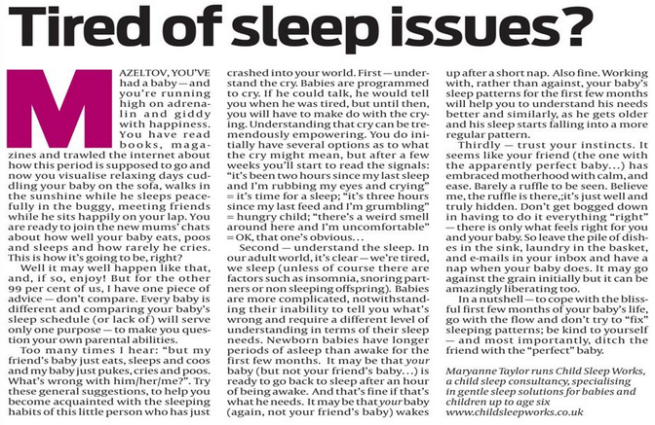
Sleep

Slide 5


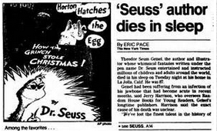
Sleep

Slide 6
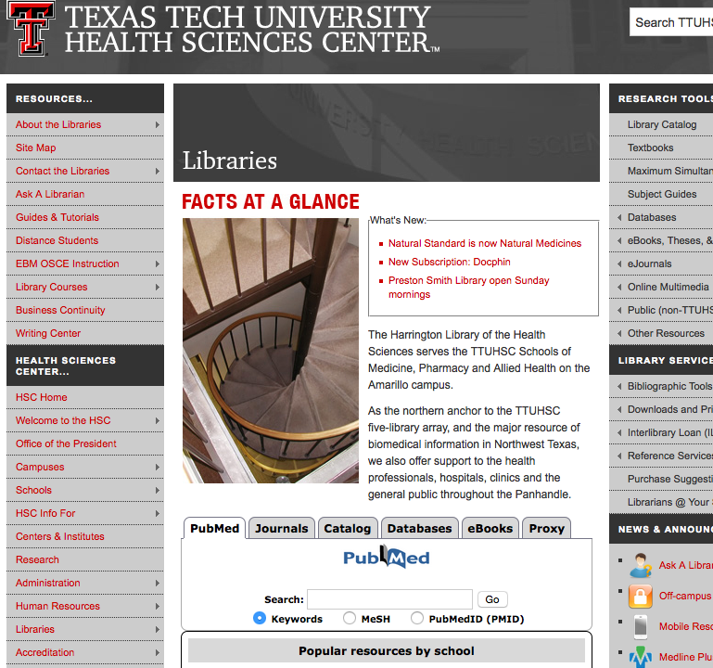

PubMed
Click
PUBMED
ICON

Slide 7
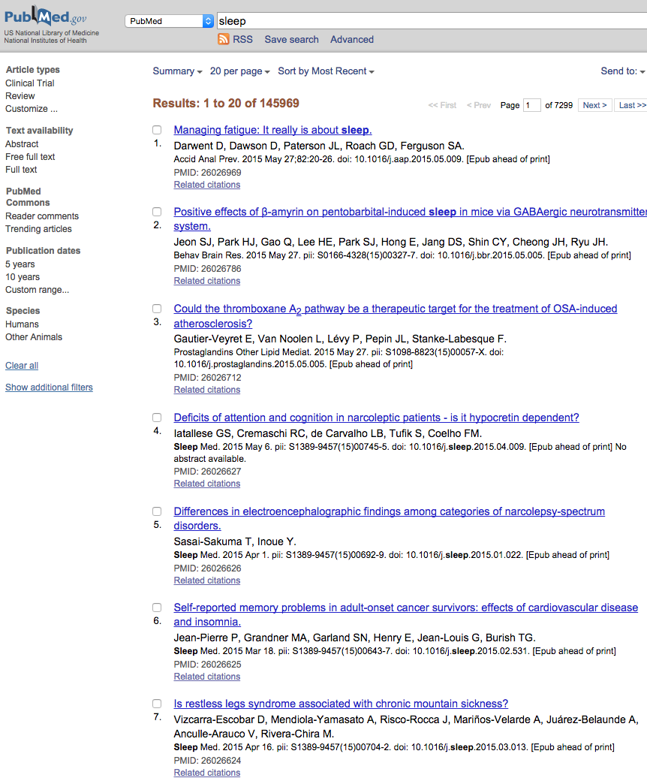

PUBMED
sleep

Slide 8
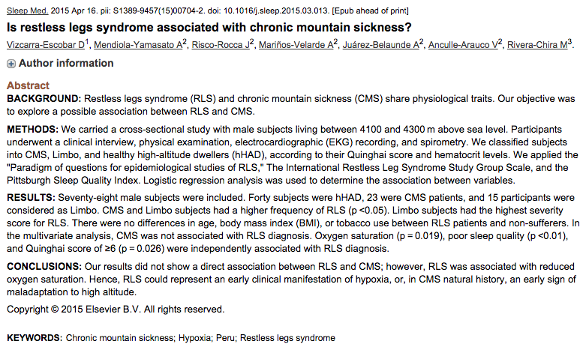
WHY?

Slide 9
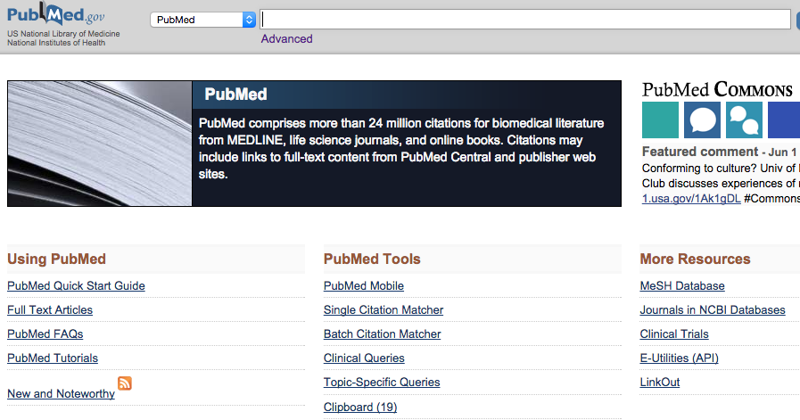
Click
MeSH

Slide 10
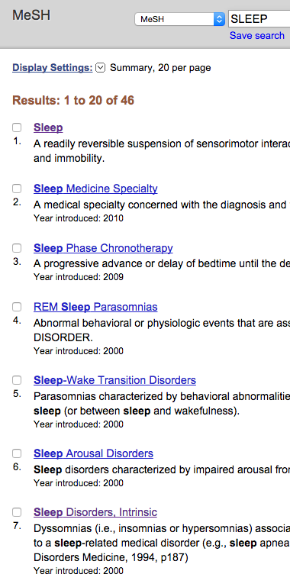
MESH
Click
SLEEP

Slide 11
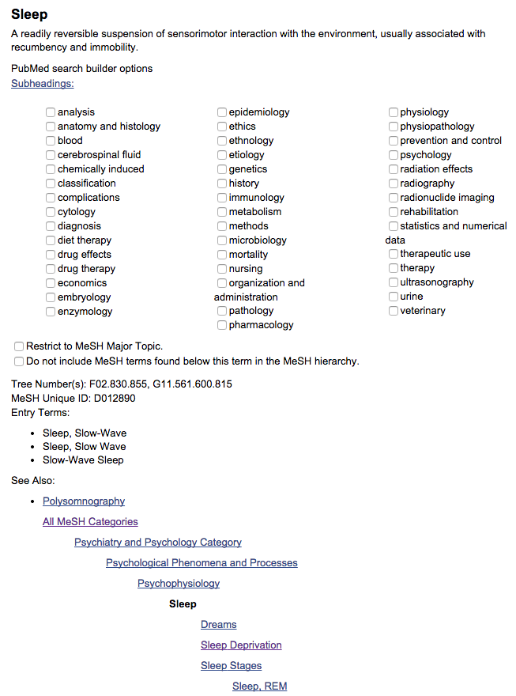
X
X
X
X

Slide 12
Sleep deprivation & post partum depression?

Slide 13
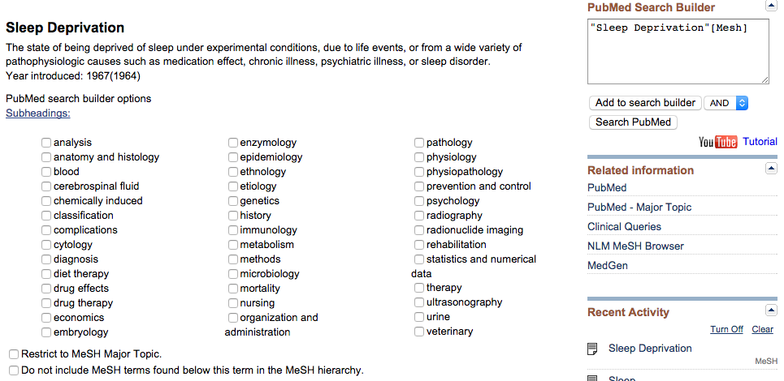
Repeat cycle using new term
Click
Add to
Search Builder

Slide 14
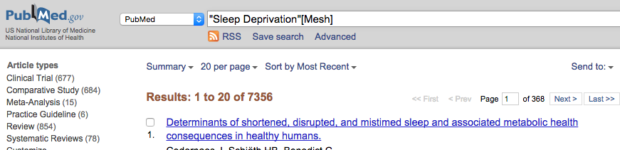
Click
PubMed icon

Slide 15
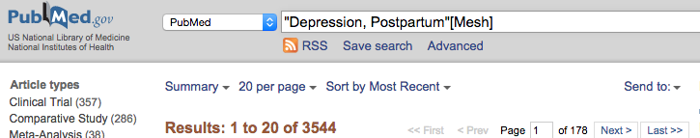

Repeat cycle
using new term

Slide 16
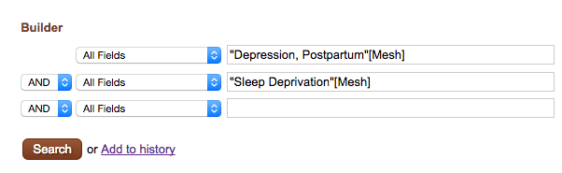


Slide 17
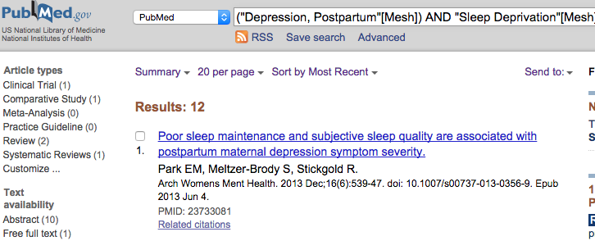

Slide 18
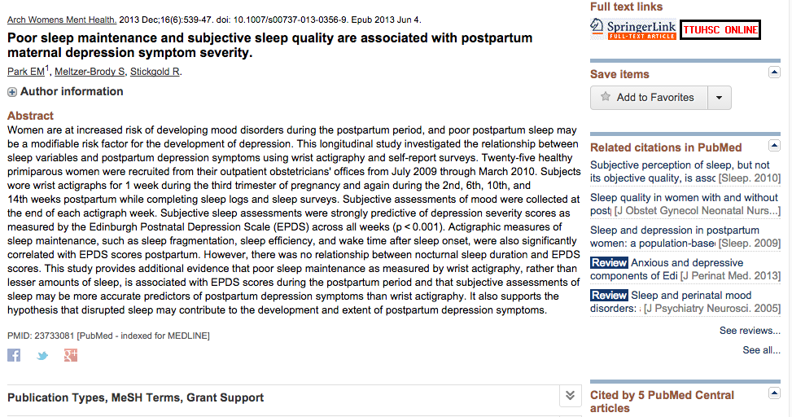

Slide 19
Journal title
Year/Month
16 = Volume
(6) = issue
539–47 = pages
Doi = digital object identifier

Slide 21
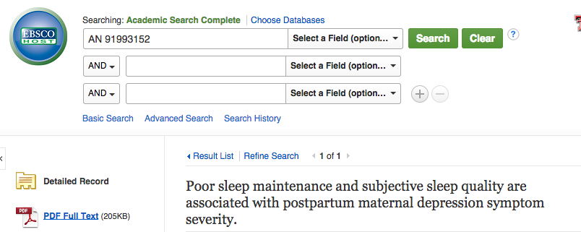

Slide 22
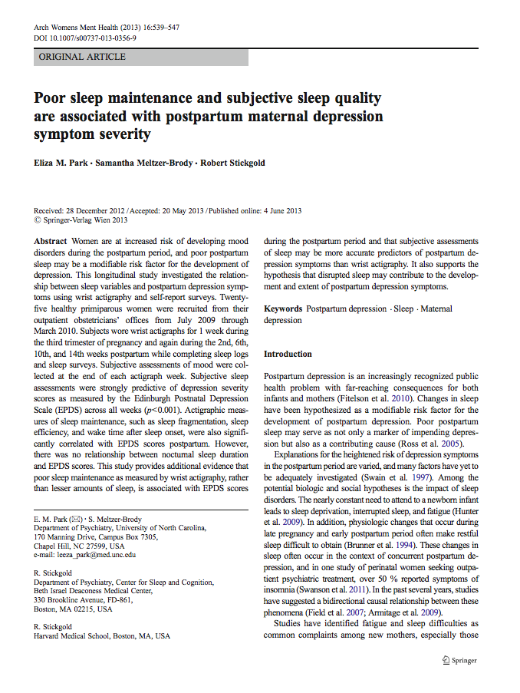

Slide 23
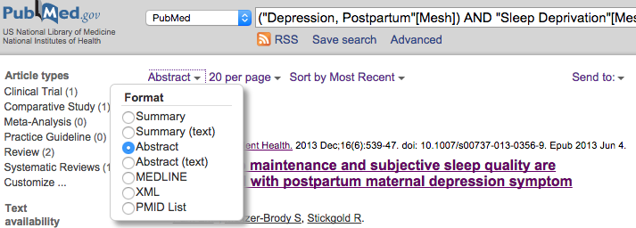
To see all abstracts or selected ones:
You can only view if we have full-text in abstract format

Slide 24
Locating journal article
Click
Journals tab

Slide 25
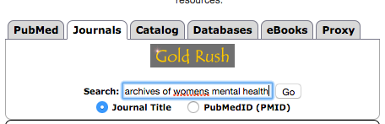
Journal title
Year/Month
16 = Volume
(6) = issue
539–47 = pages
Doi = digital object identifier

Slide 26
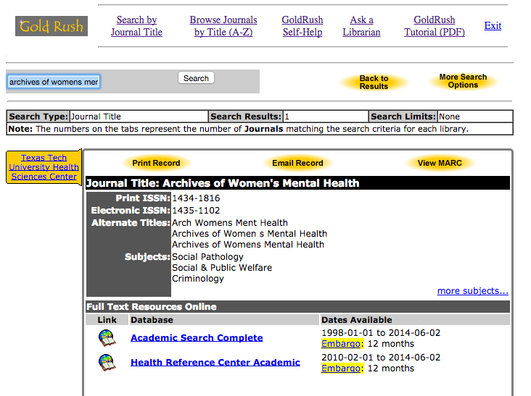

Slide 27
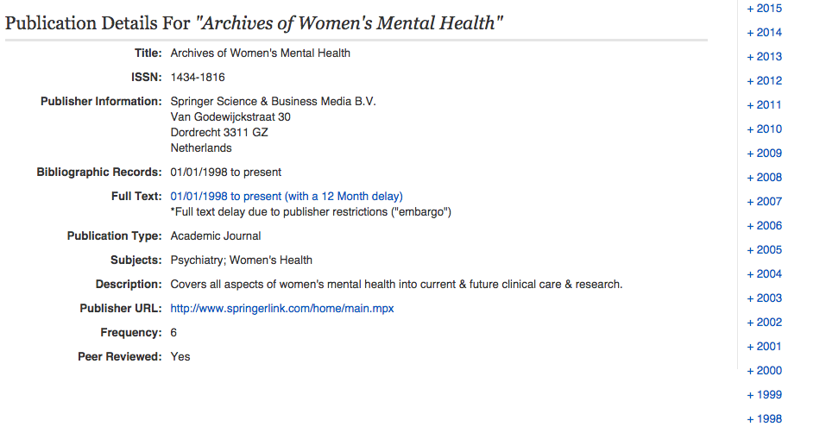
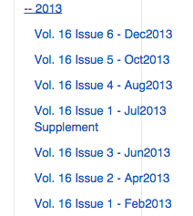

Slide 28
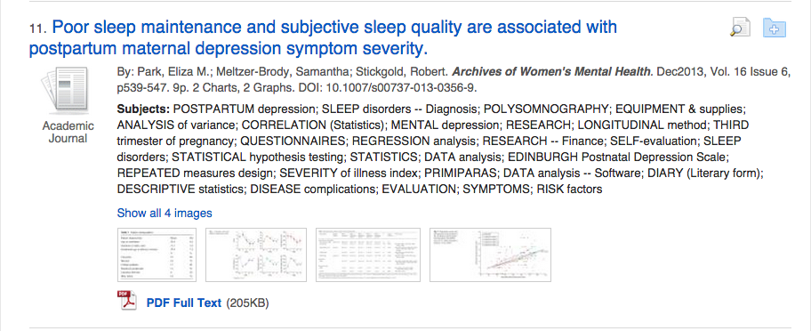

Slide 29
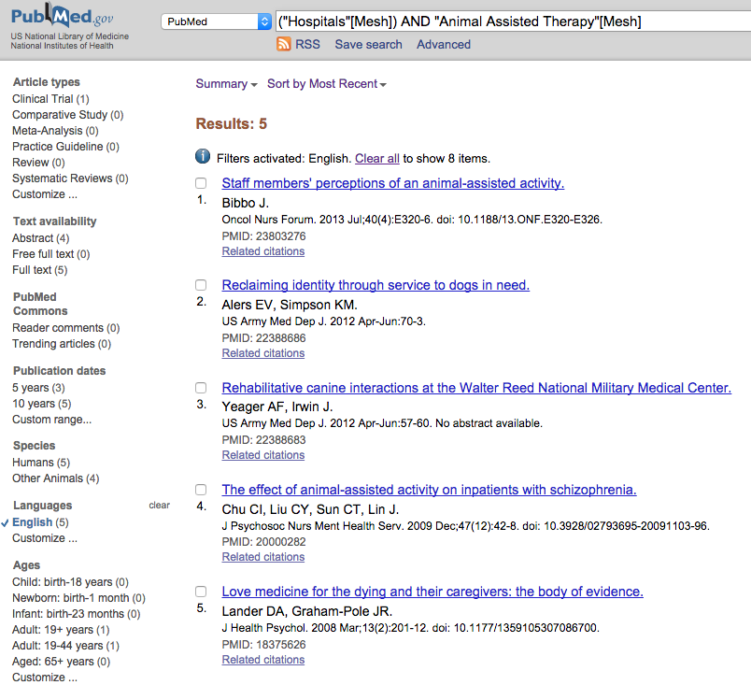
Locate:
Articles on using pets in hospitals.

Slide 30

Puzzled???

Slide 31
Thank you!
You can always contact us at mylibrary@ttuhsc.edu
OR
Call us at 806-743-2200 and ask for a reference librarian!
http://www.ttuhsc.edu/libraries

